Slide 1
Global Cavity Database and Yield Evaluation
Camille M. Ginsburg
Fermilab
Tesla Technology Collaboration Meeting
Fermilab, April 2010
ILC Cavity Database Group:
S. Aderhold (DESY)
Z. Conway (Cornell)
R. Geng (JLab, S0 Group Leader)
C.M. Ginsburg (FNAL)
Y. Yamamoto (KEK)
DESY Database Group:
D. Gall (DESY)
V. Gubarev (DESY)
S. Yasar (DESY)

Slide 2
Global Cavity Database - Motivation
Task established in May 2009 by Akira Yamamoto to accumulate global 9-cell cavity data
Included as part of ILC-S0 (cavity) effort led by Rongli Geng
Supported by all the participating Labs
Facilitates creation and simplifies understanding of cavity yield plots
Common data sample – a common denominator in yield calculations
Data cuts can be easily specified, and anyone could reproduce your results
Use for production modeling and costing exercises
Can also be used to compare yields of different preparation recipes, different vendors, etc.

Slide 3
Global Cavity Database – Data Entry
Data entry rules for reliable and reproducible results
All RF tests from the last couple of years are included; may be flagged for exclusion
Uniform criteria for data entry: only allowed values for as many as possible items
Define everything which might vary or have underlying subtleties, e.g., “LABX#1" might be a final surface treatment referenced as a well-defined recipe anyone can look up
No private/sensitive vendor data
Anything referred to in a comment field must be for information only, and not data selection purposes
Minimize effort required for compliance
Provide regular updates at predetermined times

Slide 4
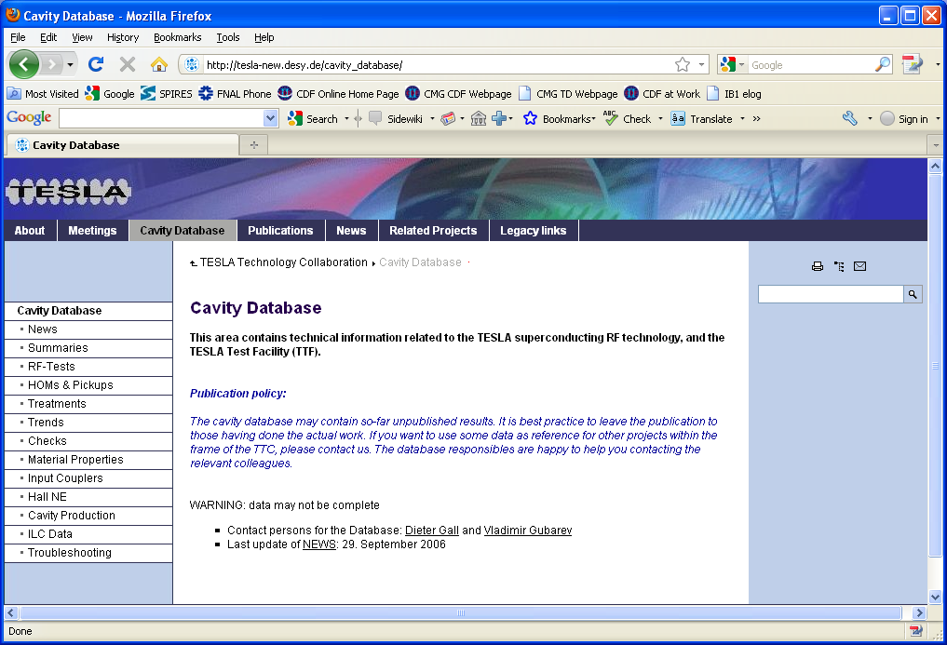
ILC Database tool now fully functional
ILC Database tool was created by the DESY database group
DESY kindly agreed to provide limited support for inclusion of global data into their database
All the participating labs have put their data into the ILC Database
ILC Database is now fully functional
http://tesla-new.desy.de/cavity_database/
Click on “ILC Data”
Two choices: read-only (public) & edit (requires login)

Slide 5
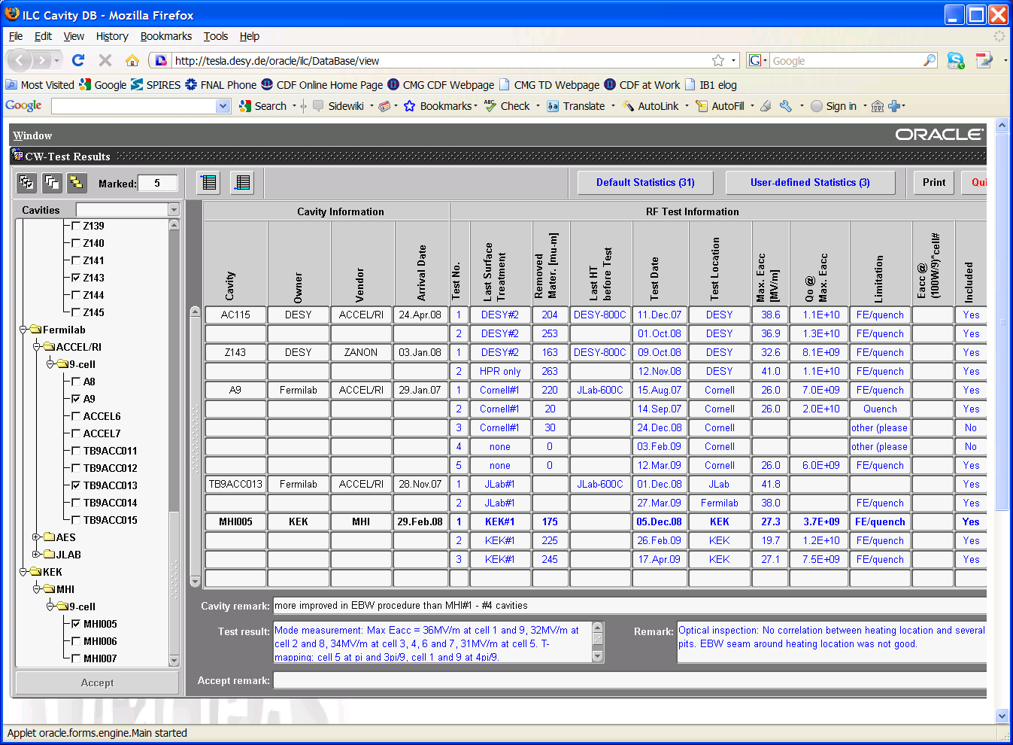
ILC Database Screenshot
For those who have used the DESY database, this will look and feel very familiar

Slide 6
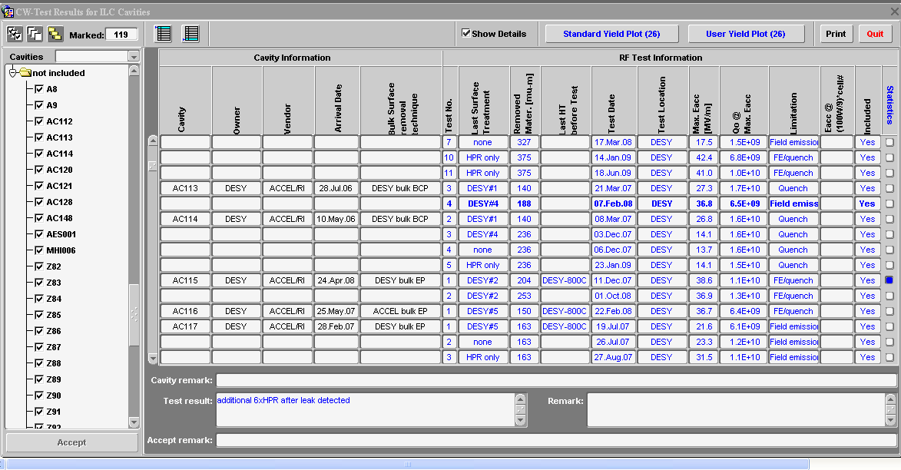
ILC Database: Selected Features (1)
Order and select cavities by features
Extract data in ASCII format and use your private spreadsheet
Make the standard first-pass yield plot defined by ILC DB group,
or make a plot using your own selection

Slide 7
ILC Database: Selected Features (2)
Click on an item to bring up a dialog box explaining definition

Slide 8
ILC Database Status/Plans
All baseline requirements have been implemented by the DESY DB group
A few fine-tuning items are still under discussion, to be implemented as time is available, e.g.,
How best to incorporate inevitable changes to the logic for standard plots
Implement more standard plots, etc.
All cavity yield plots in the rest of this talk use data extracted from the ILC Database

Slide 9
“LCWS2010” Cavity Yield Dataset
ILC Database currently contains data from all three regions, from the last few years [92 cavities]
KEK [5 cavities]: [MHI005:MHI009]
JLab, Cornell, Fermilab [22 cavities]: [A5: A9], [TB9ACC010:TB9ACC017], [AES001:AES004], [TB9AES005:TB9AES010], JLAB-2
DESY [65 cavities]: [Z82:Z110], [AC112:AC129], [Z130:Z135,Z137:Z145], [AC147,AC149,AC150]
(Production 4,5,6,7)

Slide 10
“Qualified-Vendor” Production Yield Plot (First Pass) Definition
ILC Database 26.Mar.2010 aka “LCWS2010”
Cuts
Cavity from experienced vendor= ACCEL or ZANON or (AES SN>=5)
Fine-grain cavity
Use the first successful (= no system problem/limitation) test
Standard EP processing: no BCP, no experimental processes
Defined as JLab#1, DESY#2 (weld tank before test), DESY #4 (weld tank after test)
Ethanol rinse and 120C bake required for DESY cavities
(Ignore test limitation)
Also known as “first-pass”
Include binomial errors
NB: No explicit Q0 cut, but all ILC Eacc-qualified cavities pass Q0>8E9

Slide 11
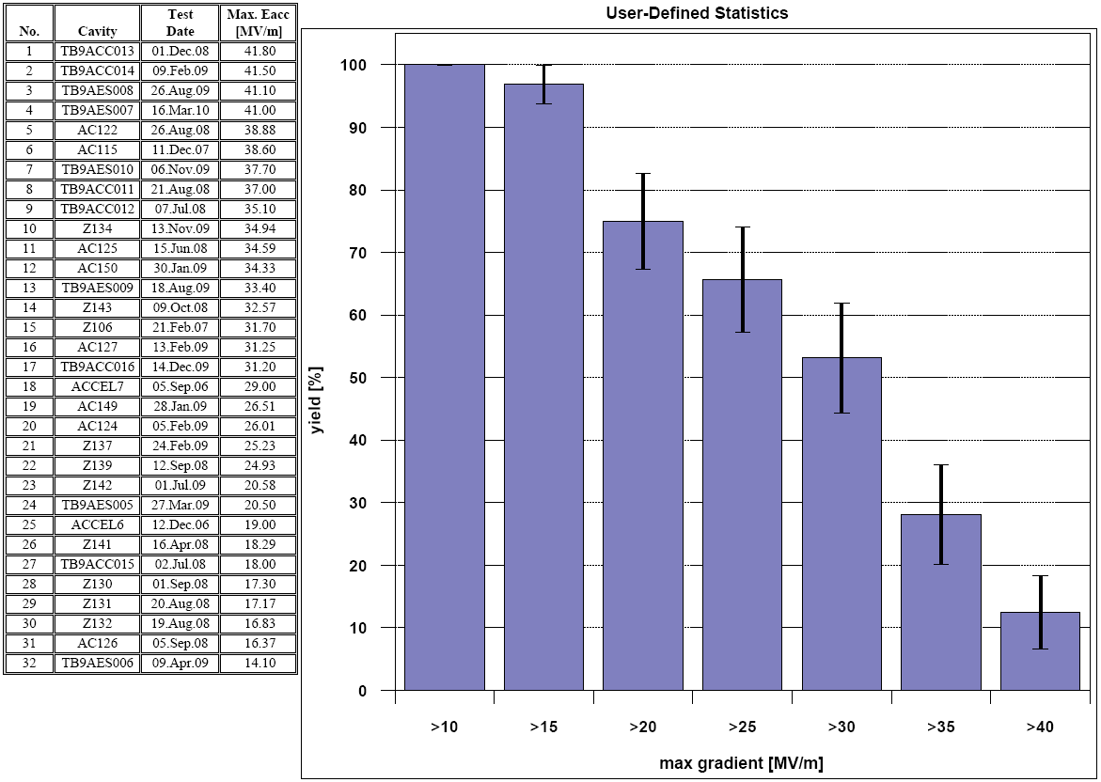
“Experienced-Vendor” Production Yield Plot (First Pass)
LCWS2010
First-pass cavity yield at >25 MV/m is (66 +- 8) %
>35 MV/m is (28 +- 8) %

Slide 12
“Qualified-Vendor” Production Yield Plot (Up-to-2nd-Pass)
Definition
ILC Database 26.Mar.2010 aka “LCWS2010”
Cuts
First pass
Second pass
if (Eacc(1st successful test)<35 MV/m) then
if (2nd successful test exists) then
plot 2nd test gradient
else
plot nothing [assume 2nd test didn’t happen yet]
endif
else
plot 1st successful test gradient
endif
Include binomial errors
NB:
No explicit Q0 cut, but all ILC Eacc-qualified cavities pass Q0>8E9
HPR-only is a valid 2nd pass process

Slide 13
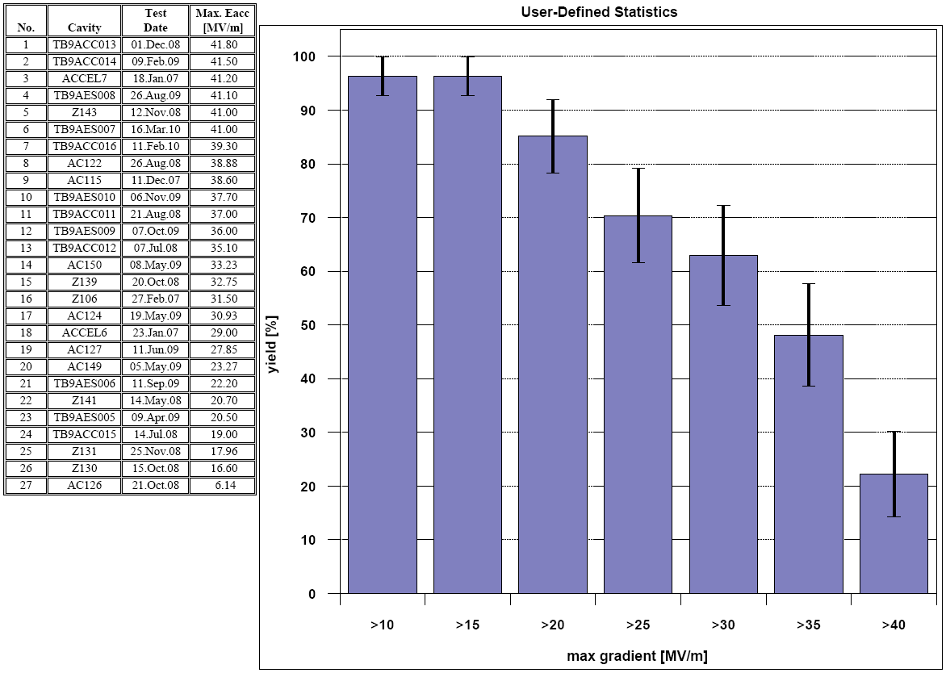
“Experienced vendor” Up-to-Second Pass Yield
LCWS2010
Up-to-second-pass cavity yield at >25 MV/m is (70 +- 9) %
>35 MV/m is (48 +- 10) %

Slide 14
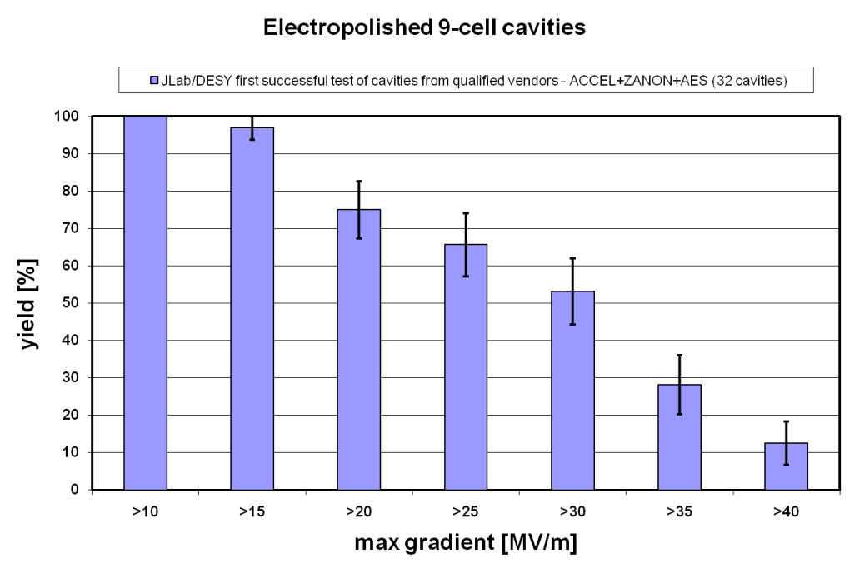
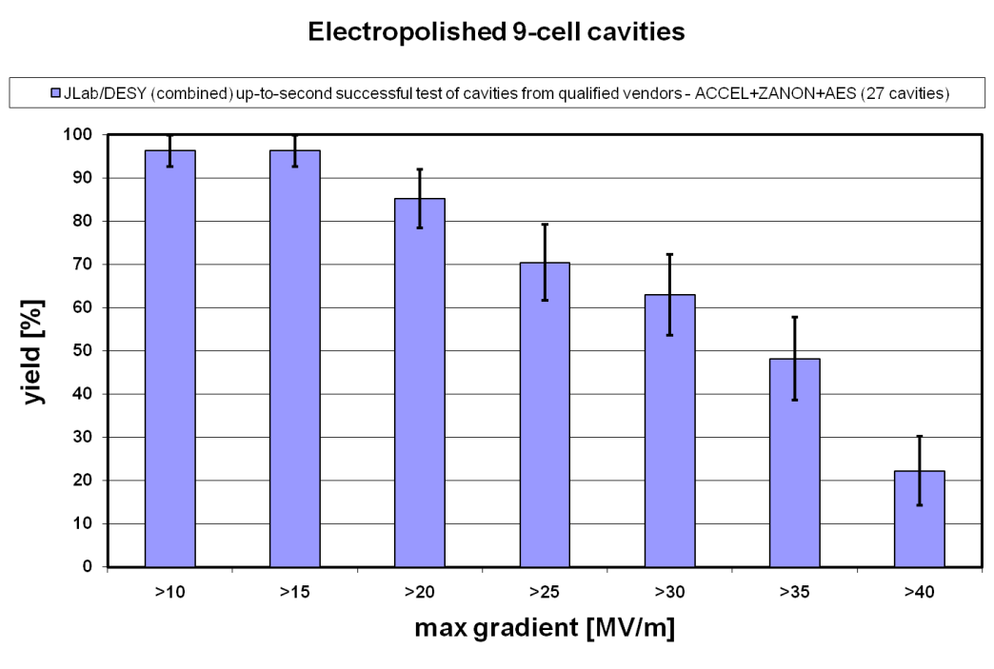
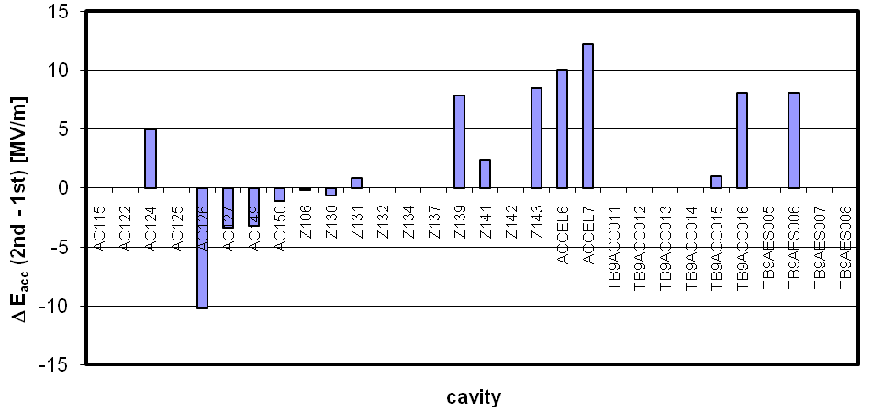
Compare 1st and 2nd pass yields
LCWS2010
LCWS2010
improvement
degradation

Slide 15
Yield as a Function of Time (one way of looking at it…)
[%]
 | yield for
 | >25 MV/m |  | >35 MV/m
 | 1st pass | 2nd pass | 1st pass | 2nd pass
ALCPG-Albuquerque 1.Oct.2009 | 63+-10 | 67+-10 | 23+-9 | 33+-10
AAP-Oxford 6.Jan.2010 | 63+-9 | 64+-10 | 27+-8 | 44+-10
LCWS-Beijing 28.Mar.2010 | 66+-8 | 70+-9 | 28+-8 | 48+-10
NB: errors are very strongly correlated
Within the very limited additional statistics accumulated over the last six months
2nd-pass yield shows slight improvement; largest factor is addition of AES cavities (JLab)

Slide 16
Global cavity statistics: current status and plans
Tens of cavities in Asia next couple of years
Tens of cavities in Europe until XFEL production starts (800)

Slide 17
Americas 9-cell Cavity Inventory
ordered | received
4 | 4 | ACCEL (1st batch)
4 | 4 | Advanced Energy Systems (1st batch)
8 | 8 | ACCEL (2nd batch)
6 | 6 | Advanced Energy Systems (2nd batch)
4 | 4 | JLab
12 | 12 | Research Instruments
6 | 2 | Niowave-Roark
6 | 0 | Advanced Energy Systems (3rd batch)
50 | 40 | TOTAL
Mostly tested
Through ARRA (stimulus funding) ordering 40 additional cavities from US vendors: 20 just ordered from AES, remaining 20 TBD
Currently highest priority is construction of five cryomodules in next several years (CM2-6). Other high priority:
S0 production yield data accumulation - compatible so far only with JLab effort
New facility qualification
New vendor development

Slide 18
Summary
ILC Database now fully functional and available for use
Updated yield plots using the database were shown
We will continue to update the ILC database as we have more cavity tests, and systematically update the cavity yield data
Expect that Americas 9-cell cavity activity this fiscal year (until ~Oct. 2010) provides 8 new cavities will have been processed and vertically tested, of which 4 can be added to the S0 yield statistics
We will be very busy processing and testing cavities for the next couple of years

