Slide 1
Preliminary Experience with Barrel Polishing
P. Kneisel
TTC Meeting at FNAL , April 19-22, 2010

Slide 2
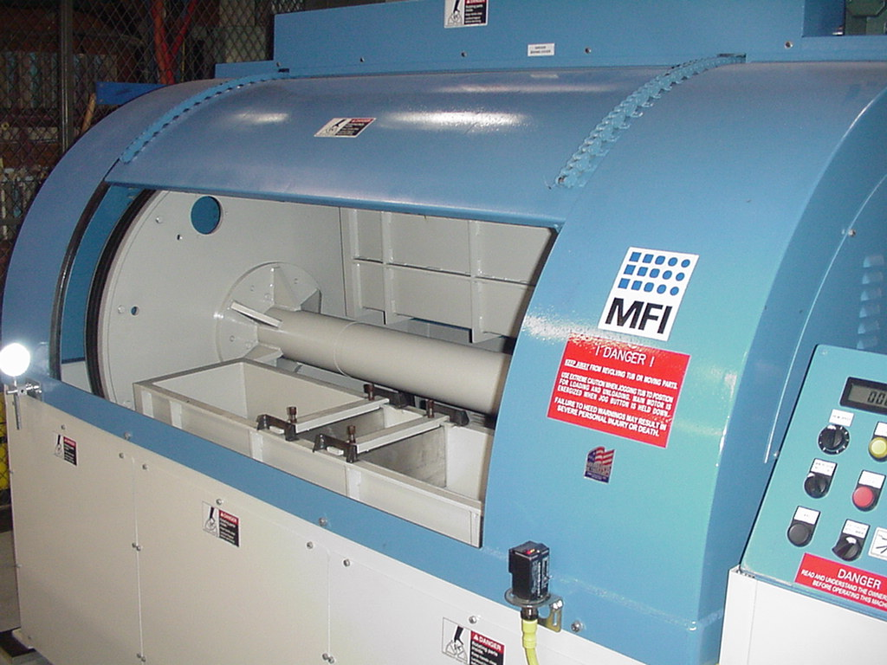
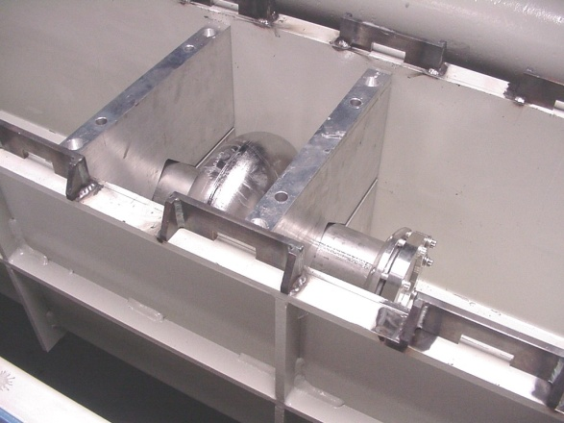
Polishing machine
Machine purchased from Mass Finishing – no centrifugal BP
Initial media removed material very slowly: 200 hrs,~ 30 micron
New media recommended by Mass Finishing: app. 3-4 micron/hr
developed on “Canary” ( large grain cavity)
Method used on 4 single cell cavities from CBMM material ( 3 single crystal, 1 large grain) and a 5-cell high current cavity

Slide 3
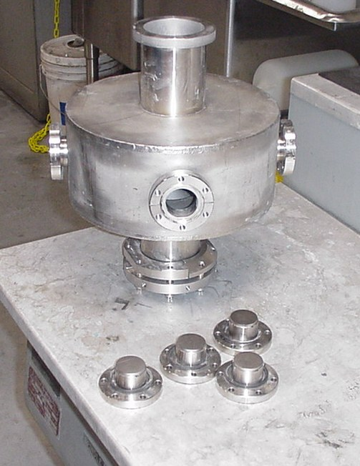
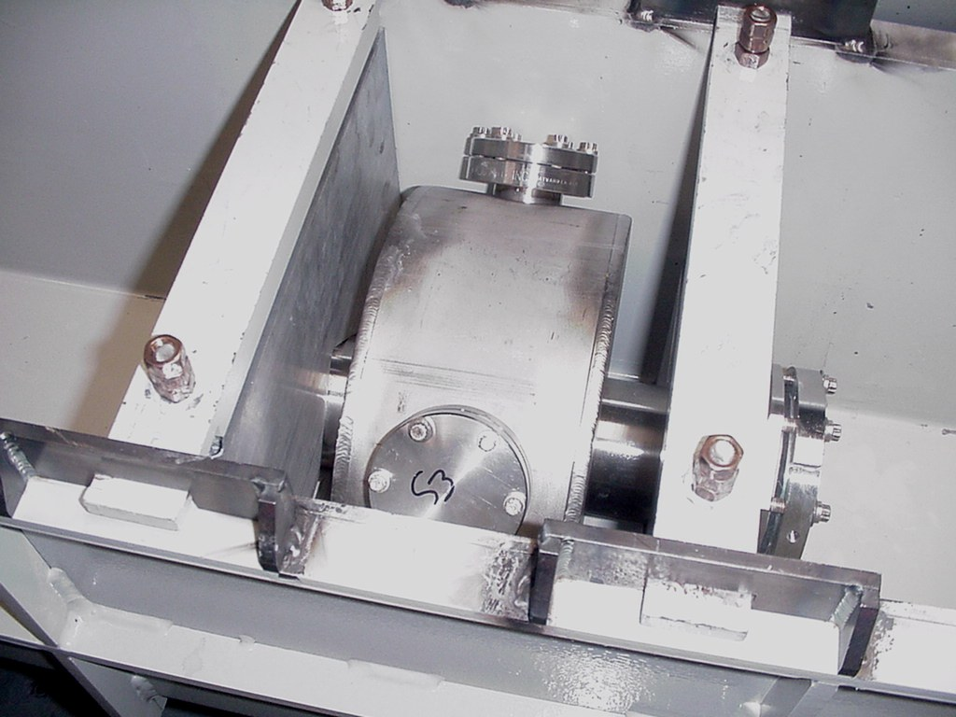
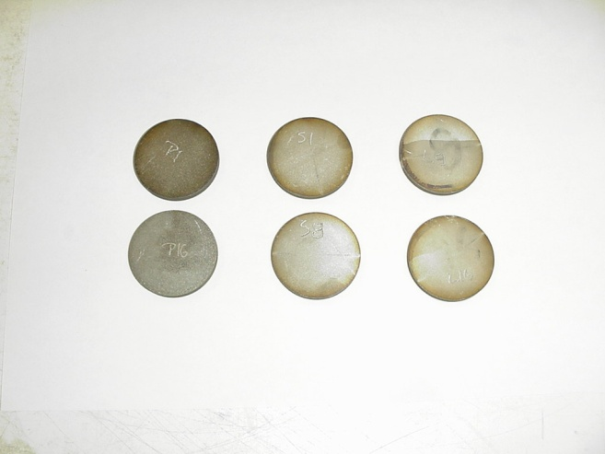
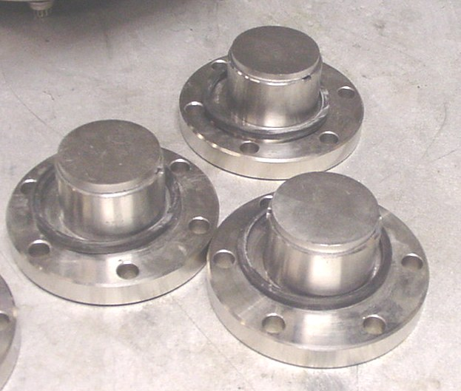
Sample BP

Slide 4
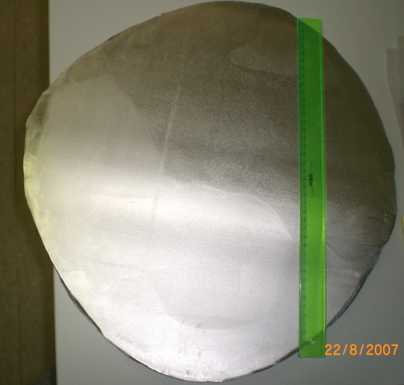
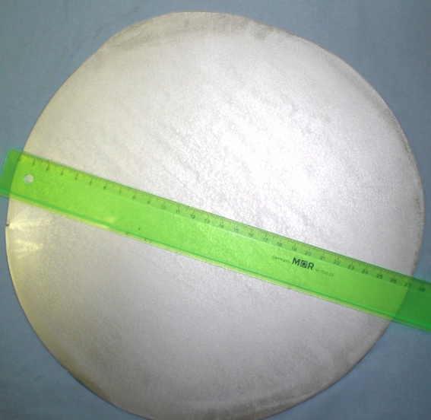
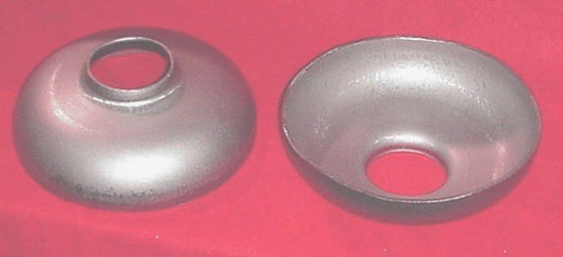
Cavities CBMM”A1”,”A2” and “A3”
Cavities fabricated from CBMM ingot “A” ( RRR ~ 280, Ta:800 ppm), which had several large grains
A large grain was enlarged at DESY by Xenia Singer/Plansee to a sheet size, which was big enough for deep drawing TESLA-type half cells
The cavity fabrication followed our standard procedure:
deep drawing of half cells, 25 micron bcp, annealing of half cells at 600C for 10 hrs, re-drawing, machining for but welds
Subsequent treatment: 100 micron bcp, hydrogen degassing at 600C for 10 hrs, add. bcp (1:1:1 at RT) and HPR for ~ 1 hr, drying in class 10 for several hrs

Slide 5
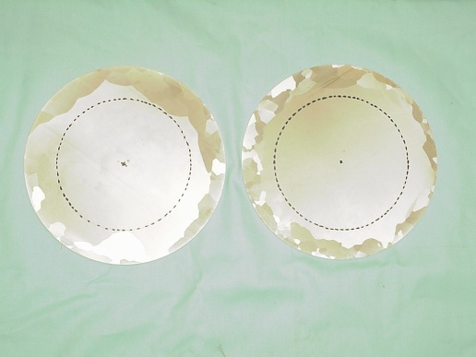
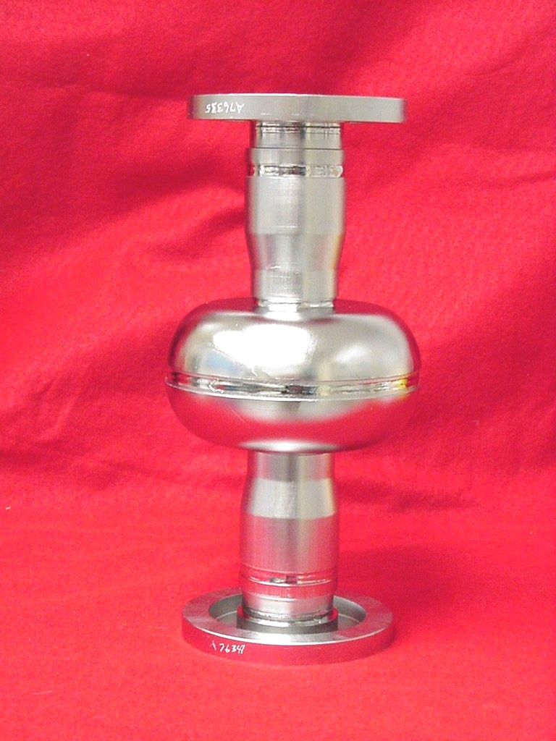
Ingot “A” - CBMM
Nb Discs
LL cavity 2.3GHz
E_{peak}/E_{acc} = 2.072
H_{peak}/E_{acc} = 3.56 mT/MV/m
H_{peak} ~160 mT

Slide 6
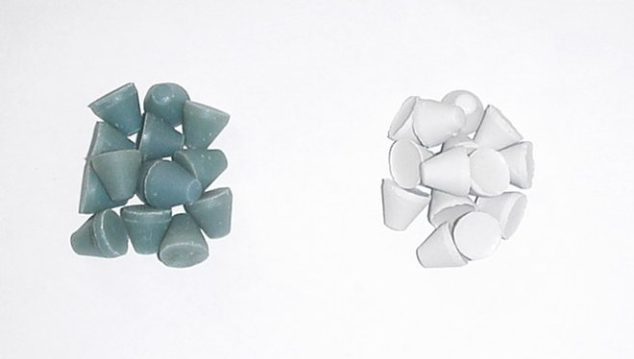
BP with “Slow” media
Coarse
Fine

Slide 7
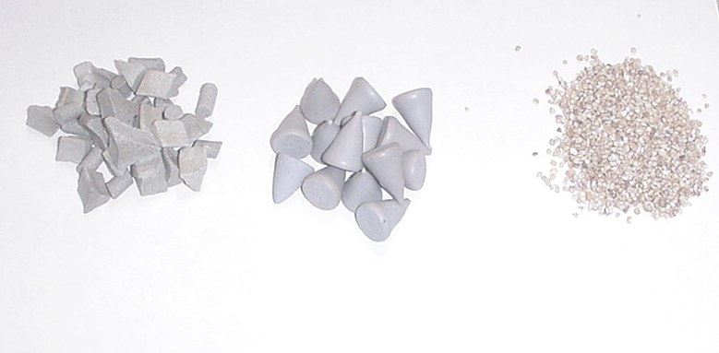
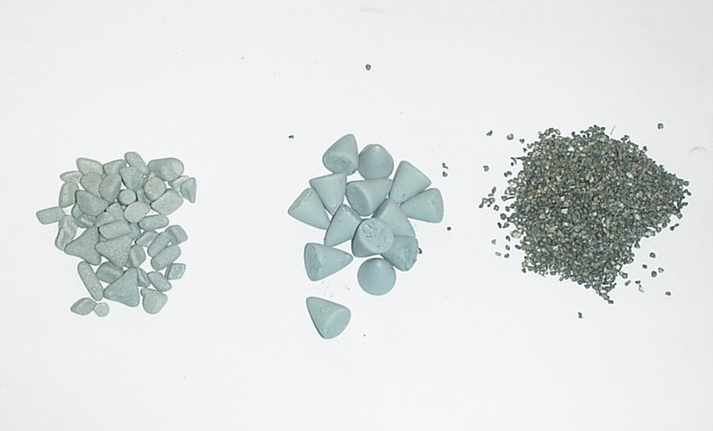
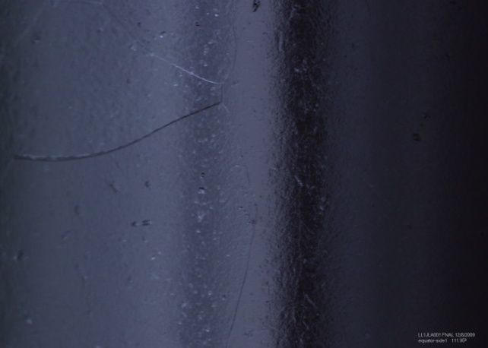
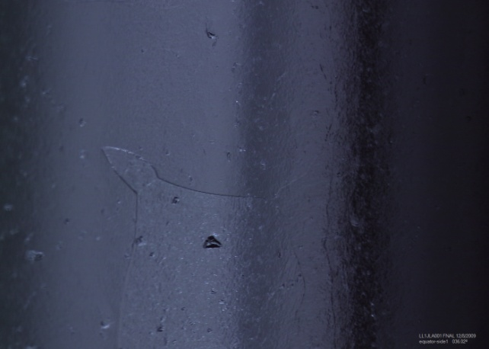
“Fast” Polishing Media
Recommended by Mass finishing (M.Mathisen)
  coarse: ceramic cut mix, part # 5500-71000 (wet)
  Meduim: ½ inch plastic cone, part # 5500-50010 ( wet)
  Fine: medium corn cob, part # 5501-30002 ( dry)
  Polishing rate: ~ 3 – 4 micron/hr
  NEW USED
NEW
USED
Coarse
Medium
Fine
Replica pictures taken by Genfa and Mingqi
Equator

Slide 8
2.nd round of Barrel Polishing: “A2” and “A3”
Purpose: to “streamline” procedure, in particular minimize the amount of material removal after BP- before hydrogen degassing and after furnace treatment
40 micron BP, ~ 12 micron bcp ( 3 min)
600C for 10 hrs
Test series with
no material removal, only HPR
~ 4 micron bcp ( from delta f)
~ add. 4 micron
~ add. 4 micron
Always measure R(T), Q vs E_{acc} to explore the depth of the contaminated surface layer from the furnace treatment

Slide 9
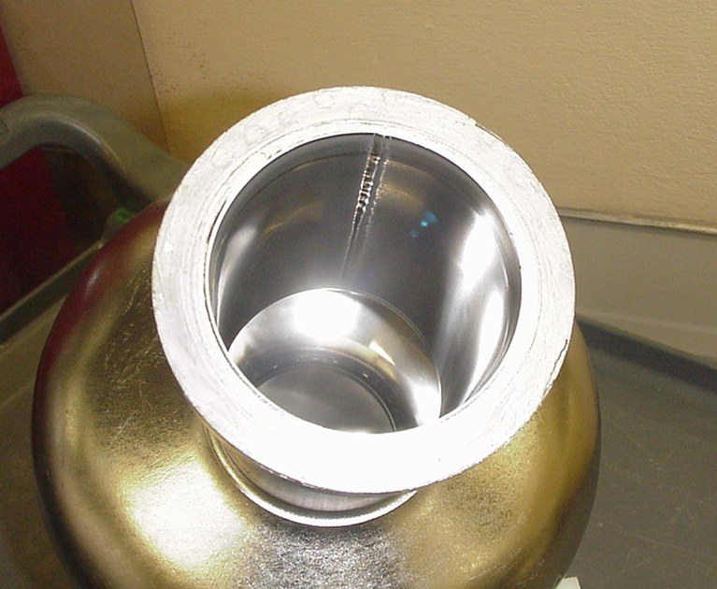
Barrel Polishing of CBMM “A1” and CBMM”B1”
From frequency measurements:
Step 1: 12 hrs coarse stones
Δ d ~ 34 micron
Step 2: 12 hrs coarse stones
Δ d ~ 50 micron
Step 3: 12 hrs medium
Δ d ~ 20 micron
Step 4: 12 hrs corn cob
Δ d ~ 0 micron
Total removal:
Δ d ~ 105 micron

Slide 10
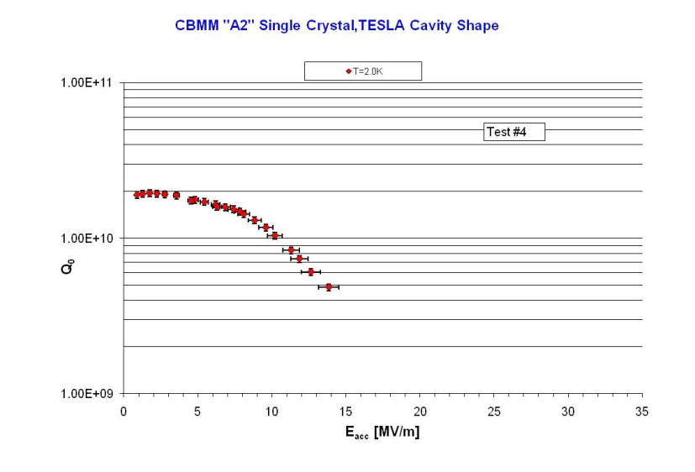
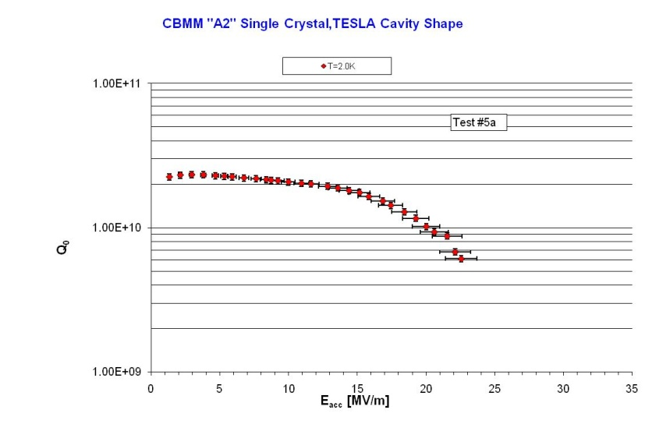
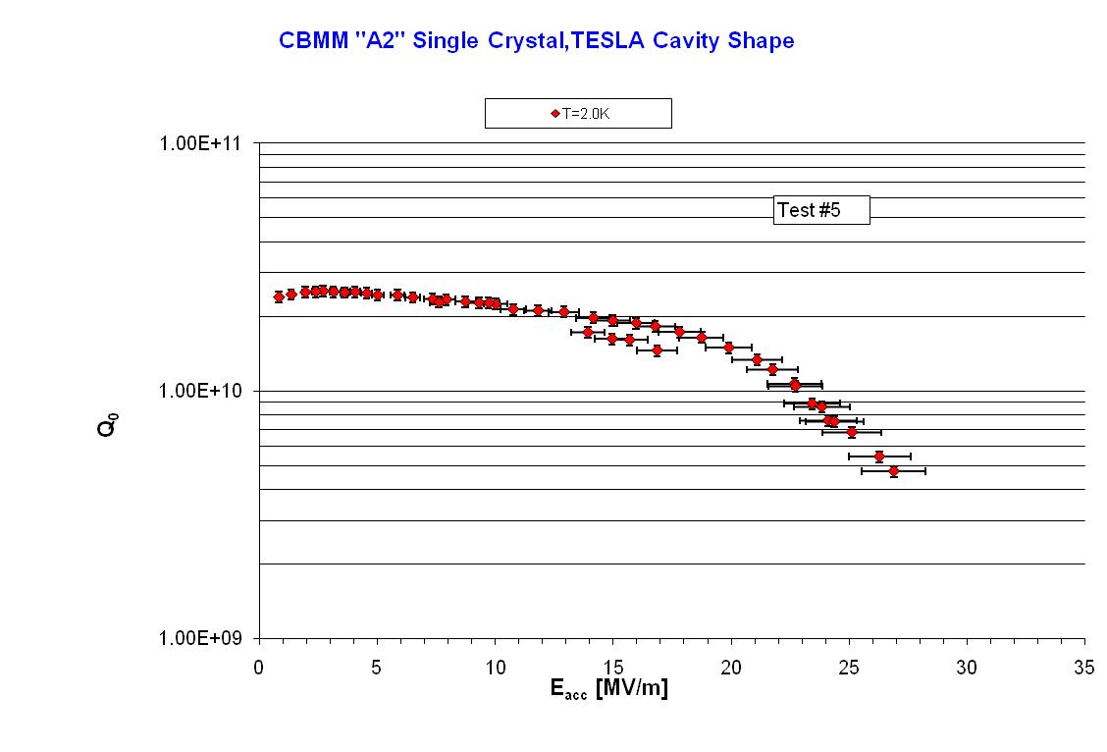
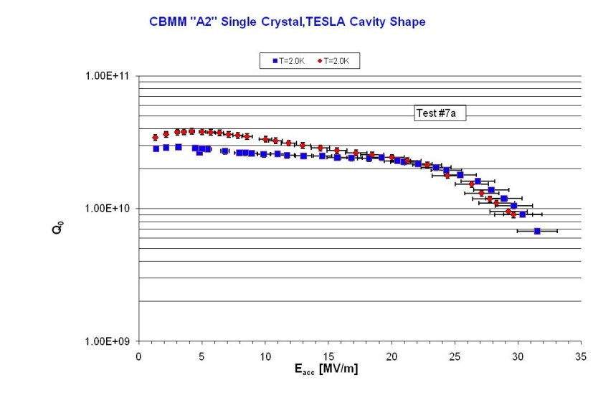
CBMM “A2”
Rinsing only 4 micron bcp
Add. 4 micron( 8 micron) add.4 micron ( 12 micron)/baking

Slide 11
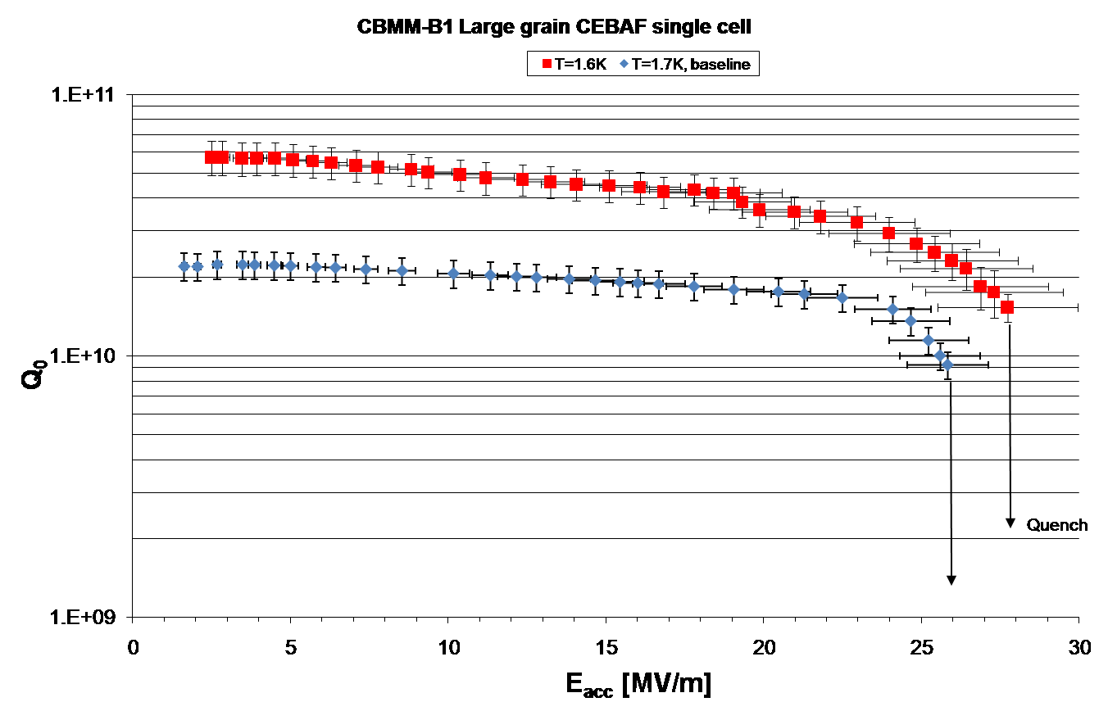
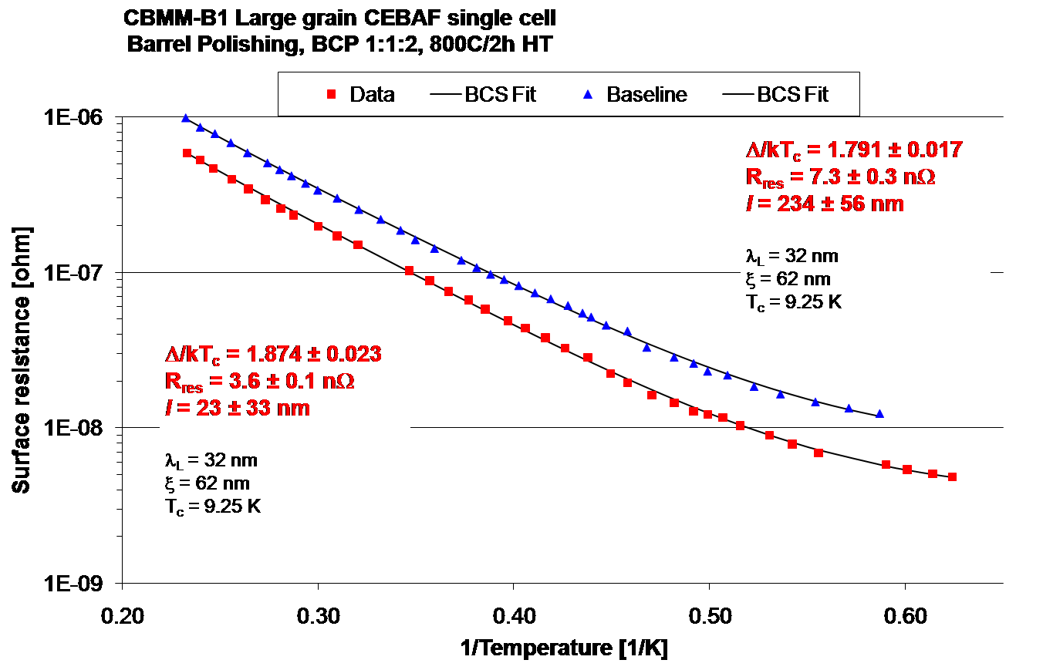
800C, 2hrs (G.Ciovati):Large grain CBMM”B1”

Slide 12
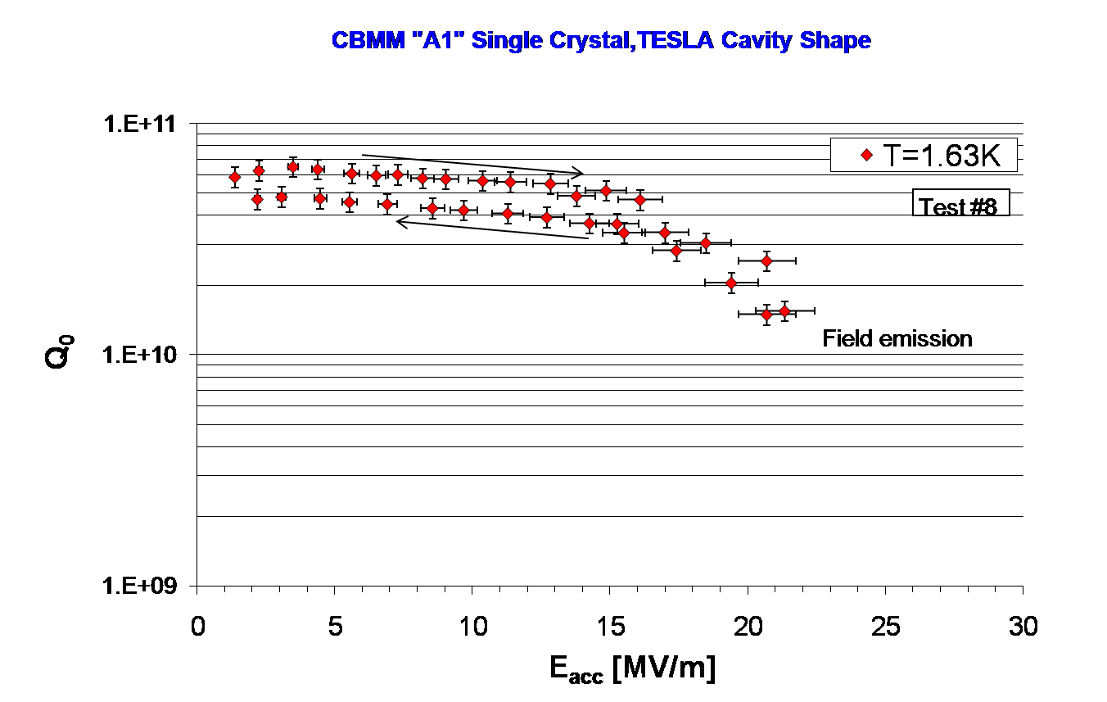
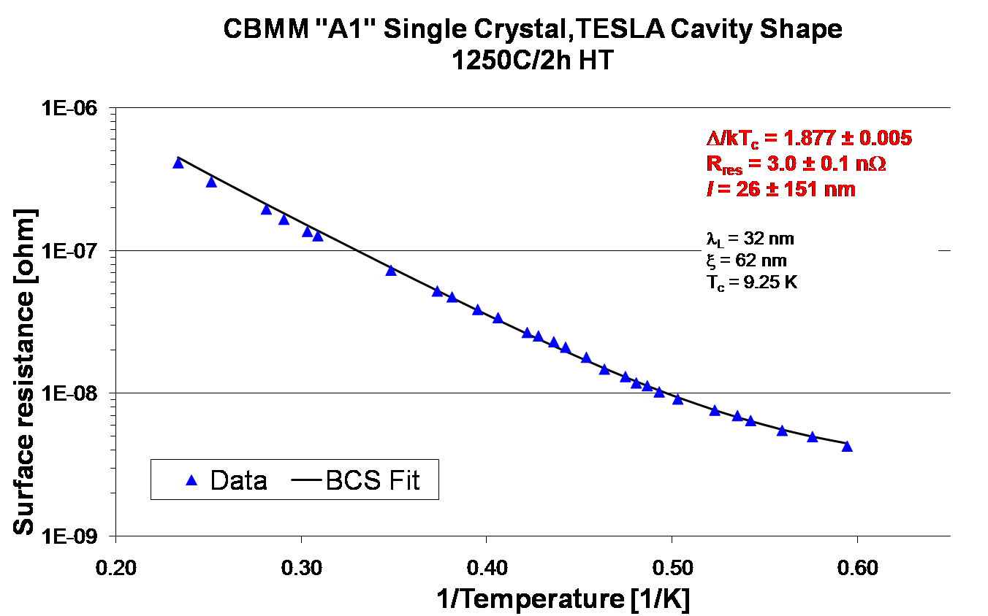
1250C,3 hrs (PK):CBMM”A1”

Slide 13
Barrel Polished Cavities
Cavity | Barrel Pol | Furnace | Δ/kT_{C} | Rr_{res} [nΩ] | E_{acc} [MV/m]
CBMM”A1” SC | ~ 100 μ | 1250C, 3 hrs | 1.88 +0.01 | 3.0 + 0.1 | 21.5 (FE)
CBMM”A2” SC | ~ 40 μ | 800C,2hrs | 1.83 +0.02 | 4.5 + 0.2 | 26.5
CBMM”A3” SC | ~ 40 μ | 800C,2hrs | 1.83 +0.01 | 3.0 + 0.1 | 29
CBMM “B1” LG | ~ 100 μ | 800C,2hrs | 1.87 +0.02 | 3.6 + 0.1 | 27.7

Slide 14
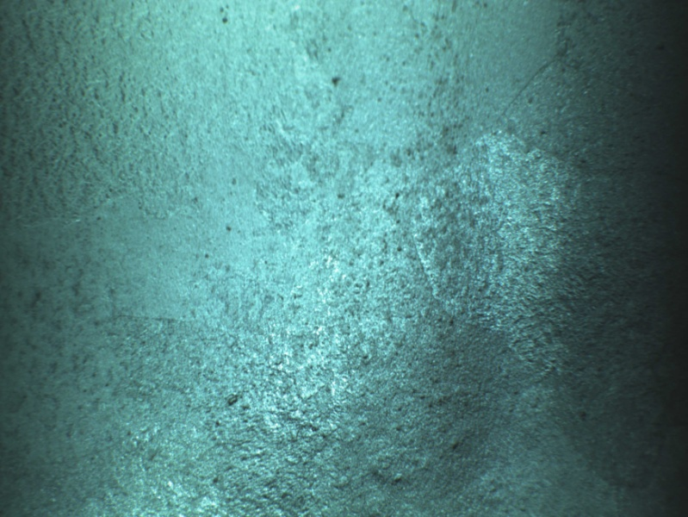
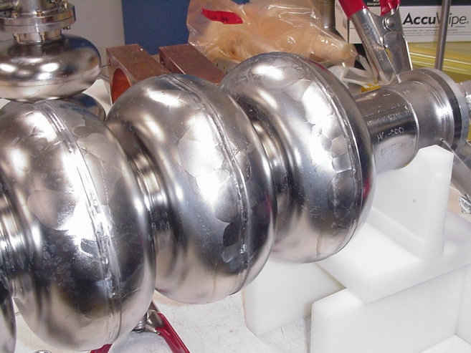
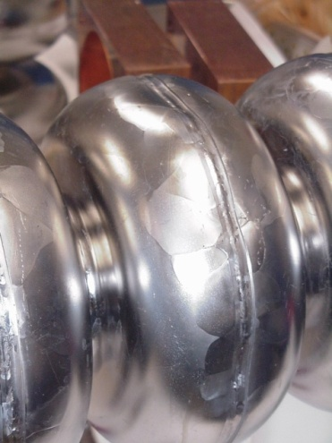
5-cell Large grain High Current Cavity
Problems with fixturing – cell was deformed, but after retuning of this cell the cavity was measured after 40 micron of material removal

Slide 15
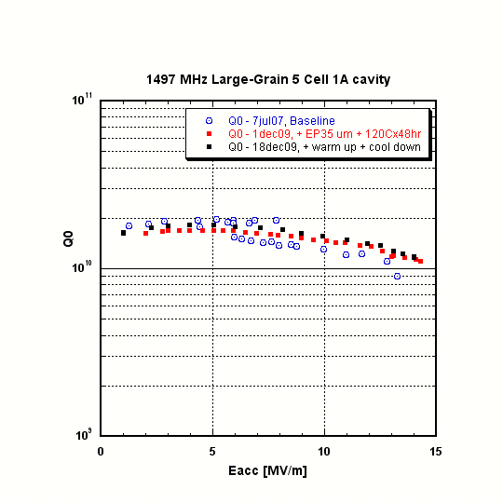
5-cell, cont’d
Prior to barrel polishing the cavity was ep’d with poor performance
After the barrel polishing the performance improved somewhat

Slide 16
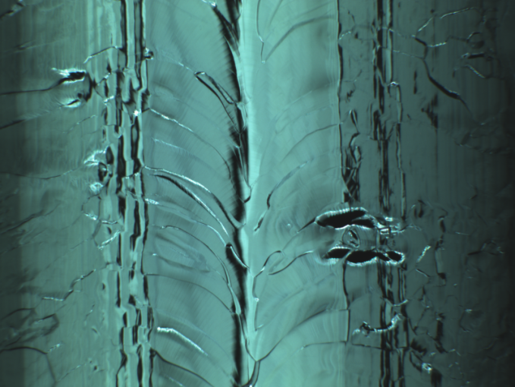
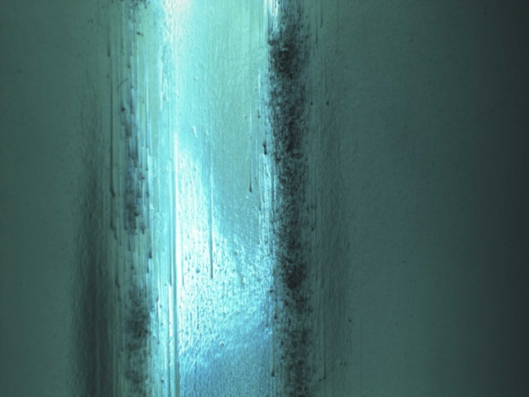
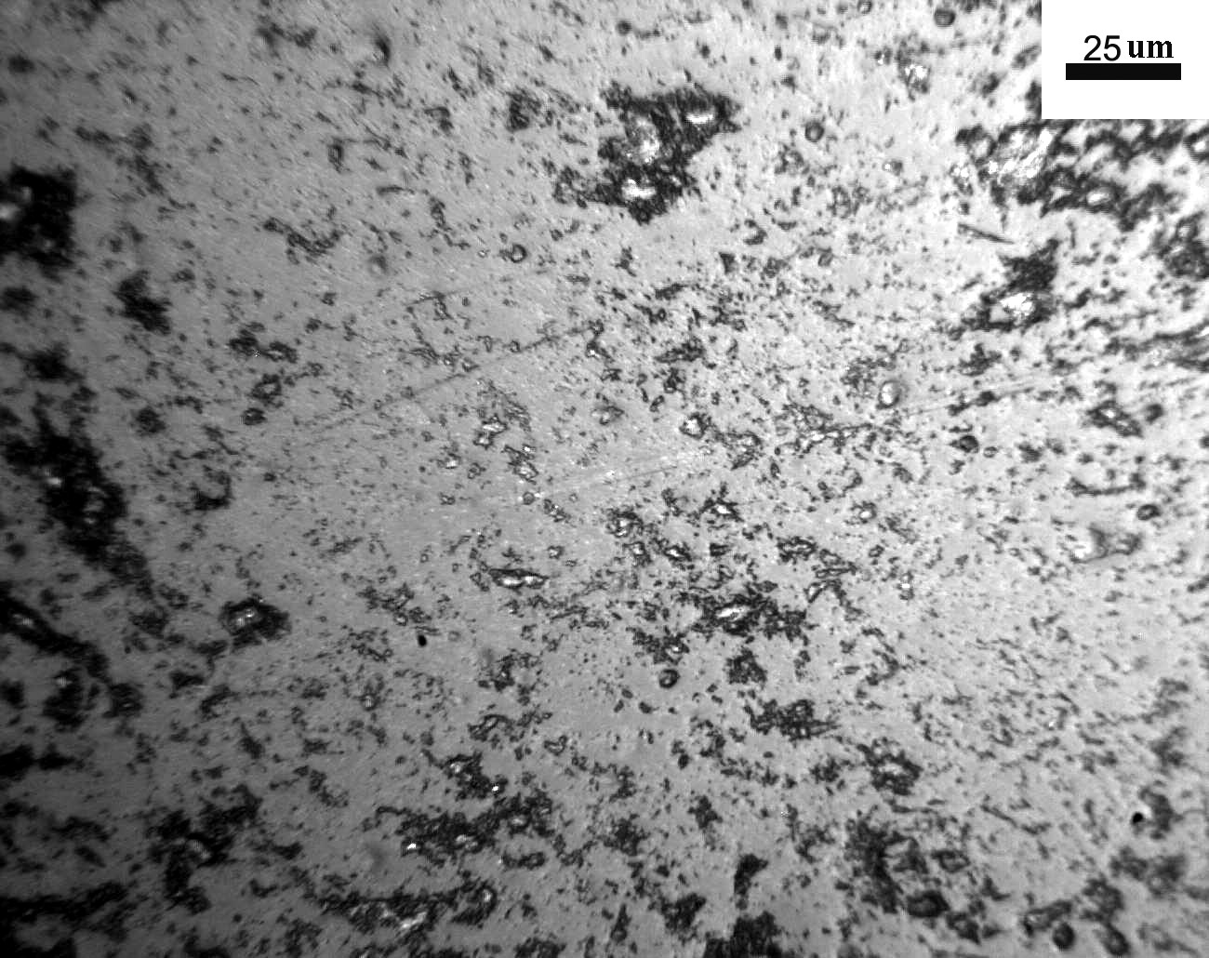
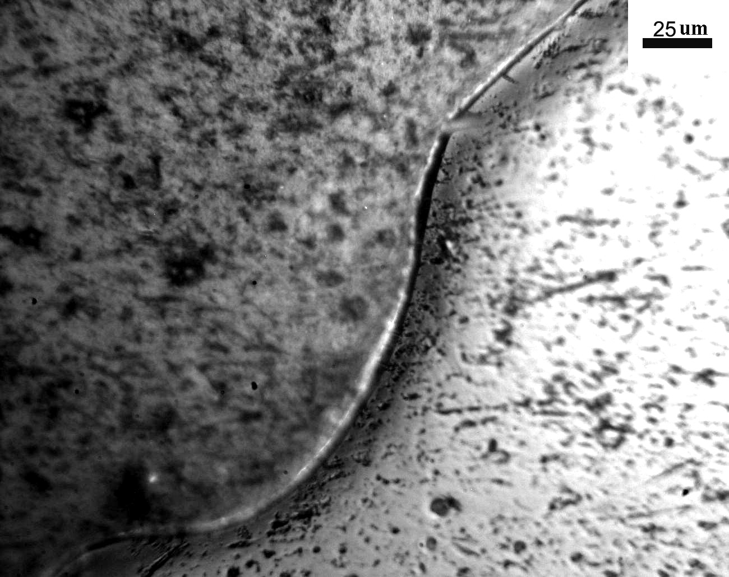
Surface Finish
PKU 9-Cell after bcp CBMM”A1” after 100 μ BP
Kyoto Camera System (T.Goodman)
Replica ( A. Wu): 5-cell high current, ~ 40 μ m
Within large grain, beam pipe
Grain boundary, beam pipe

Slide 17
Summary/what to conclude?
With the right combination of media, removal rates of 3-4 micron/hr can be achieved. This is comparable with centrifugal barrel polishing at KEK
At least 30 micron have to be removed from the surface prior to heat treatment
Until now, no or only marginal improvements in cavity gradients have been achieved;
However, after 800C,2 hrs and subsequent HPR high Q-values ( small residual resistances ) and high gradients with Q-drop were measured.
Similar behaviour found after 1250C, 3 hrs heat treatment

Slide 18
Summary/what to conclude?(2)
In both cases is the cavity behaviour “ in-situ-bake” like:
increase in Δ/kT_{c} , surface resistance lowered by ~60%, low R_{res}
but still Q-drop
SC cavity as fabricated from enlarged crystal do not react to baking ( like poly-cryst.) – Q – drop remains
Is this due to insufficient removal of dislocations? Which act as “traps” for magnetic flux lines or Nb-H complexes?
  Grain boundaries not cause of Q-drop ?
  Dislocations (A.Romanenko): aren’t they annealed out?
  and therefore less flux trapping ( see high Q )
  Hydrogen(G.Ciovati,SRF2009): significantly reduced, but still Q-drop
  Different surface oxides? Ruled out by A.Romananko

Slide 19
Can we “streamline” the surface treatment??
Present
  ~ 100 micron bcp/ep
  Elaborate rinsing
  600C(10 hrs)/800C(2hrs)
  ~ 30 micron ep/bcp
  Elaborate rinsing (S) + HPR
  Pre-assembly
  2.nd rinse cycle ( 6 hrs)
  Assembly after drying
  Baking for 48 hrs
  test
Proposed
  ~ 100 micron barrel polishing
  ~ 30 micron bcp
  Rinsing
  800 C , 2 hrs
  Then baking in furnace at 140C , 3 hrs with argon (B.Visentin)
  Pre-assembly
  HPR ( short)
  Test

