Slide 1
Centrifugal Barrel Polishing (Tumbling) at Fermilab
Tumbling is a mechanical polishing process in which the inside of the cavity is filled with abrasive material and then rotated at high speeds.
Tumbling materials include man made materials like plastics and ceramics and natural materials like corn cob or walnut shells.
Main Shaft up to 115 RPM
Individual Barrels 115 RPM in opposite direction to main shaft

Slide 2
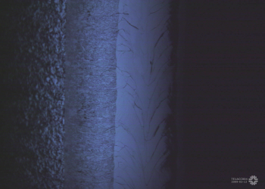
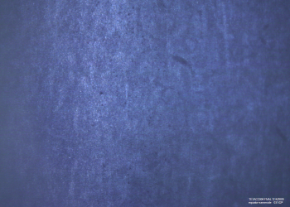
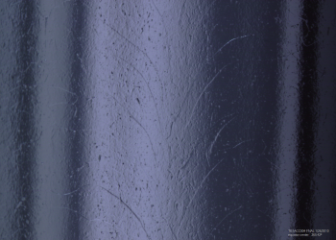
Why do tumbling?
Unprocessed
Remove weld bead at equator cavity created from E-beam welding.
Yields surface finishes(Ra) on the order of 10s of nanometers. Best by EP alone is 200 nanometers.
Relatively fast process.
Environmentally friendly.
Tumbled
10 mm Scale Bars
Electropolished
TE1ACC004

Slide 3
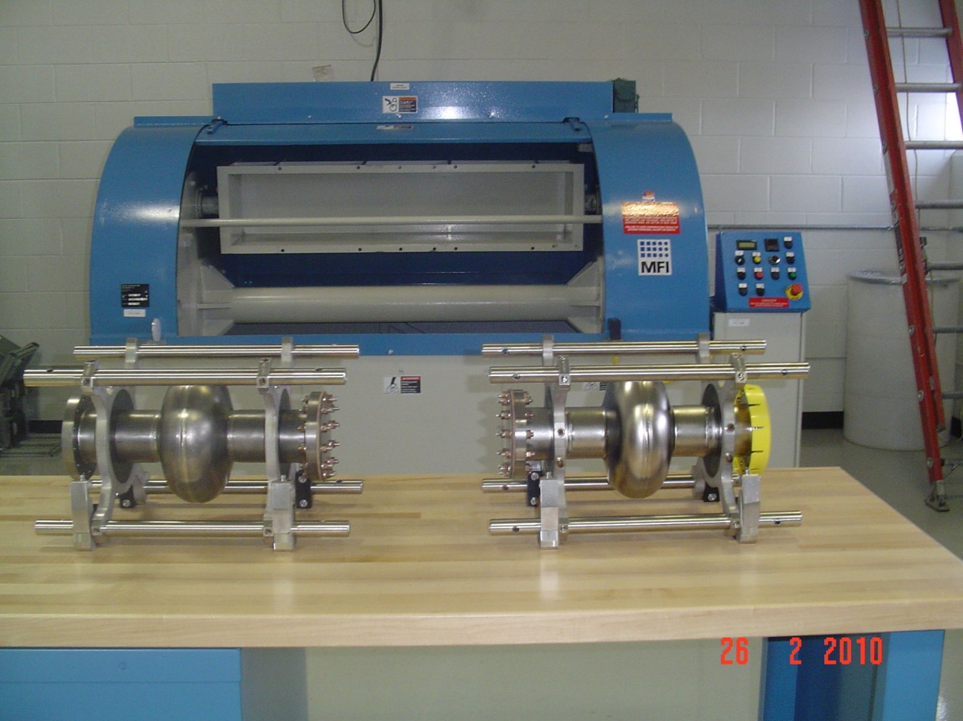
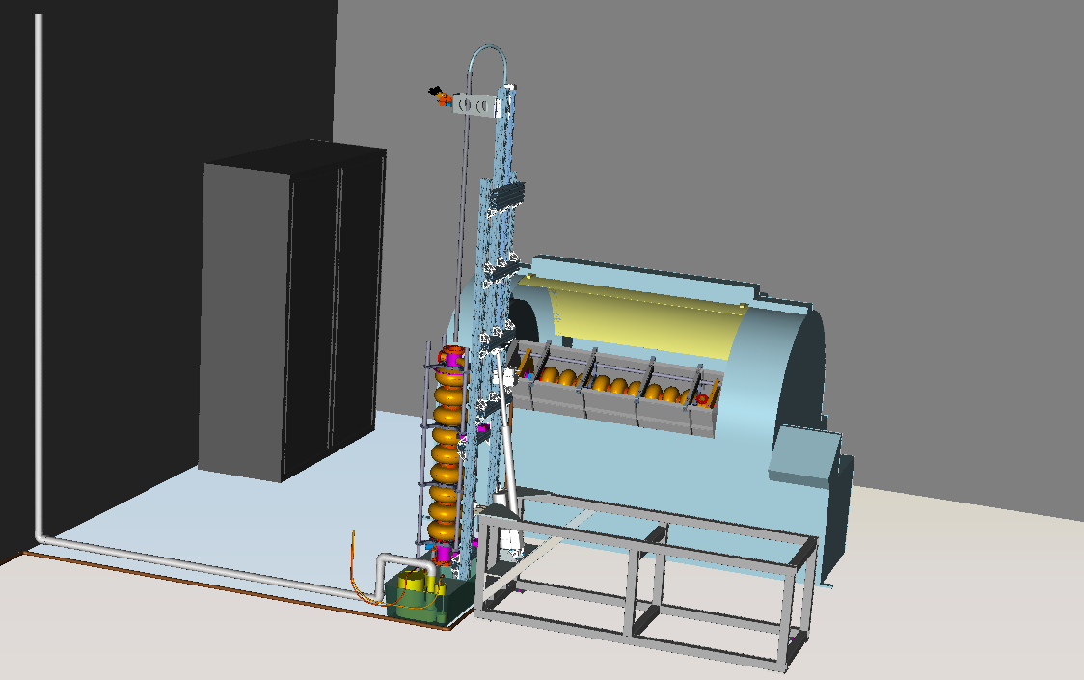
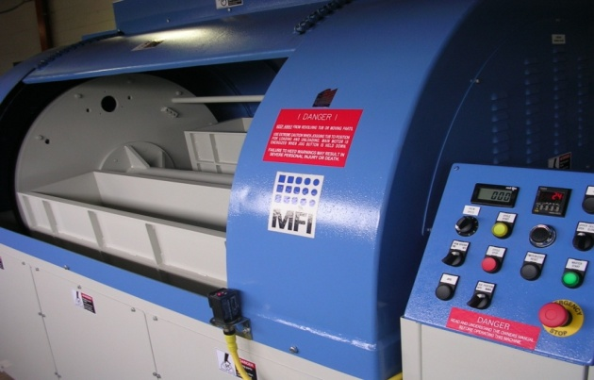
Tumbling Area

Slide 4
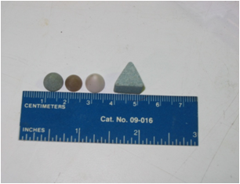
Status of Tumbling
Tumbled Single Cell 1.3 GHz
  TE1ACC004 – Baseline Machine – KEK Cutting Media Removed 70 iris/90 equator in 24 hours (.06 micron/min)
  NR6 – Baseline New Gear Ratio – KEK Cutting Media Removed 60 iris/130 equator in 10 hours (.22 micron/min)
  RRCAT1 – Try t0 Remove Weld Bead
  RRCAT2 – Try to Improve Performance- New Cutting Media Removed 20 iris/80 equator in 6 hours (.22 micron/min)
Tumbling 2, 3.9 GHz Single Cell Cavities
Next Tumble 9 Cell 1.3 GHz Cavity to Improve Performance (By End of May)

Slide 5
TE1ACC004 Process History
Tumbled at Fermi with KEK Media removing 70/120 microns.
40 Micron Light EP at Argonne
US Rinse at Argonne
3 hr 800 C Bake at JLab
20 Micron Light EP at Argonne
HPR & Assembly at Argonne
Cold Test in IB1 at Fermi

Slide 6
TE1ACC004 Q vs. E Result
Hard Quench with No Field Emission at a Residual Resistance of 4.5 nΩ

Slide 7
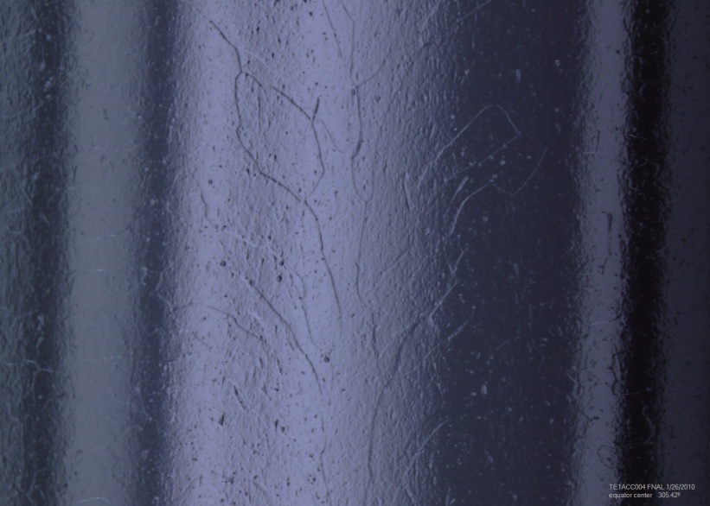
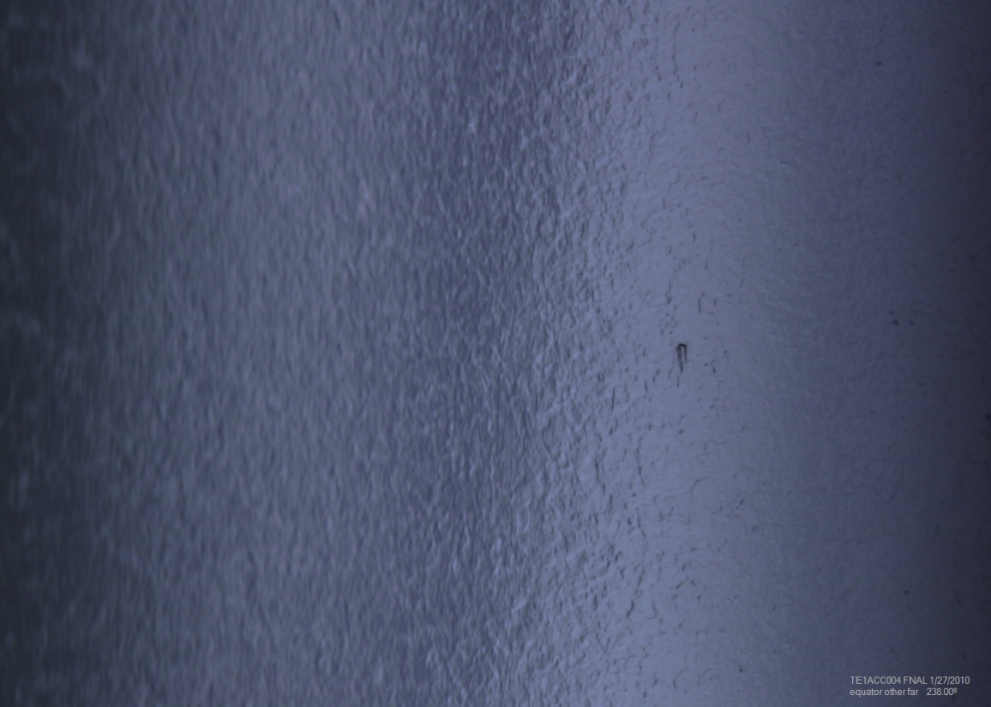
Optical Inspection

Slide 8
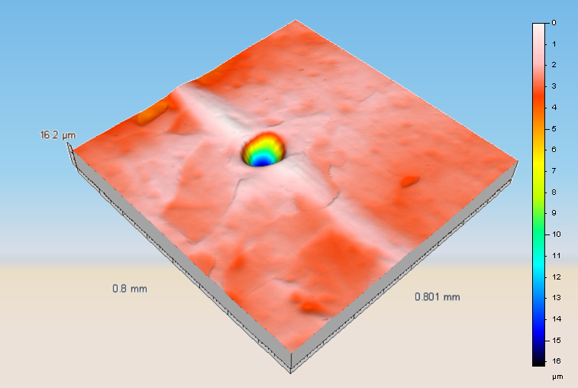
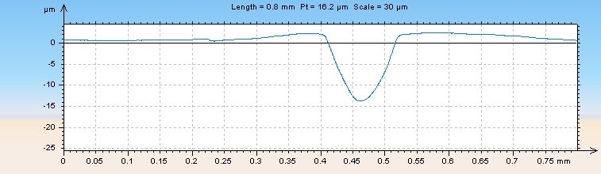
40 MV/m?

Slide 9
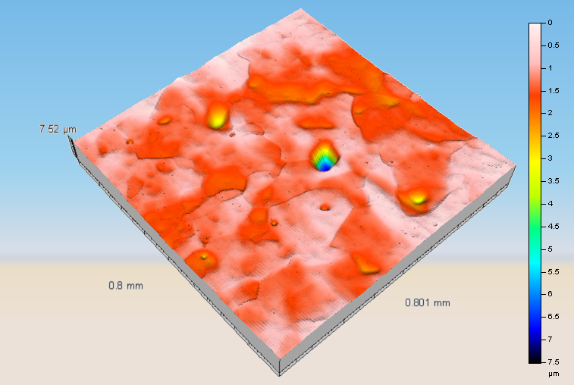
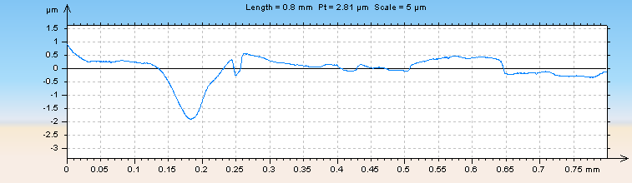

Slide 10
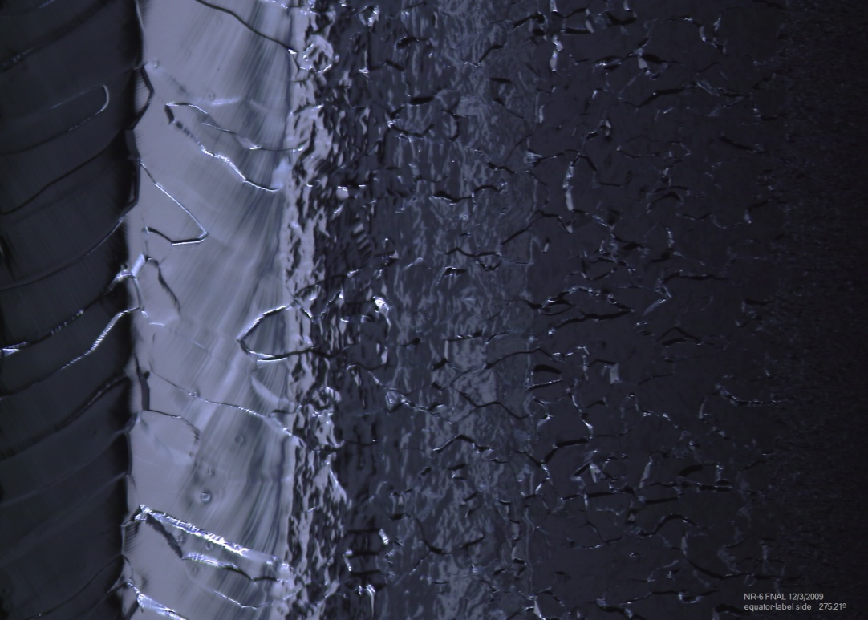
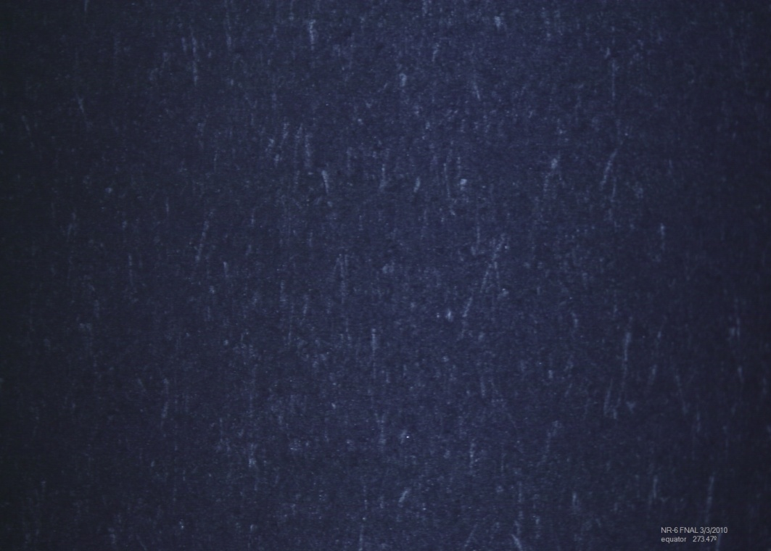
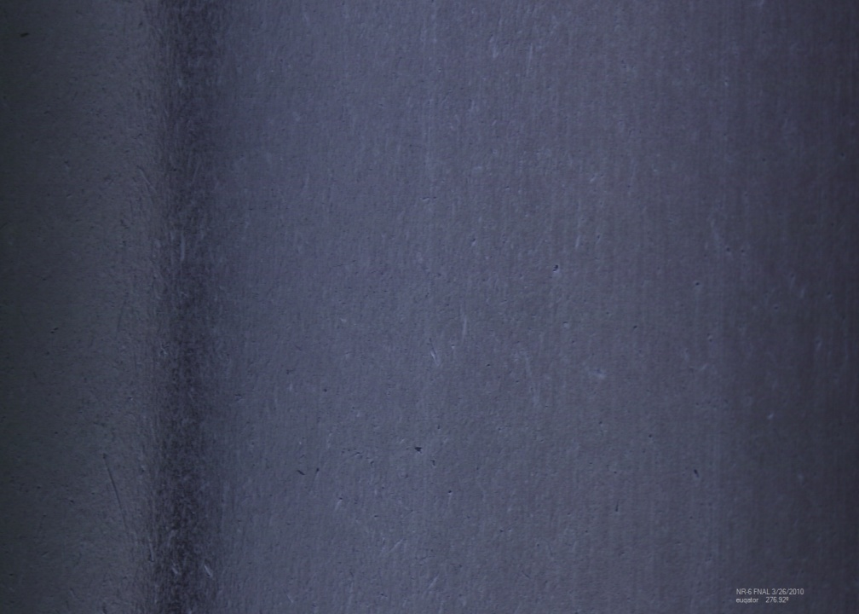
NR6

Slide 11
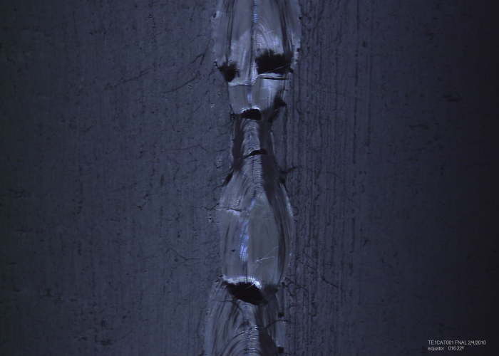
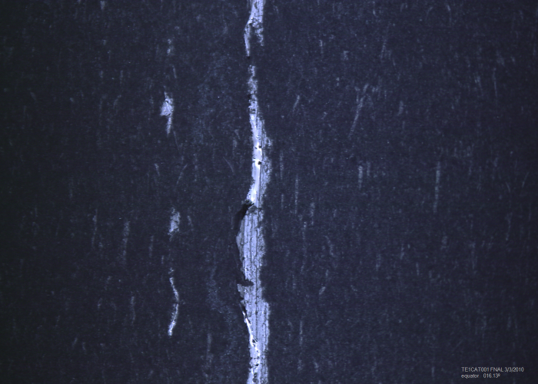
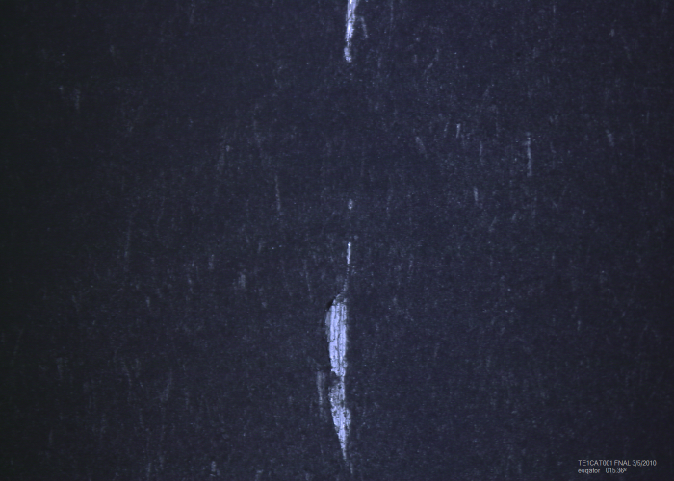
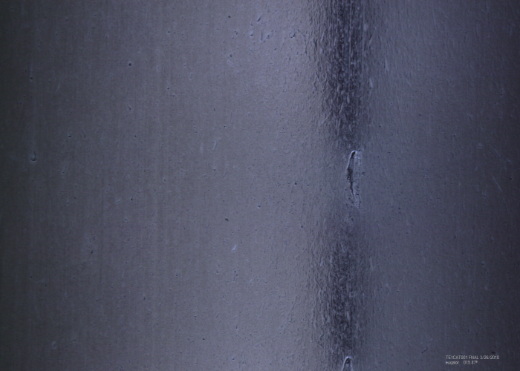
TE1CAT001 – RRCAT1

Slide 12
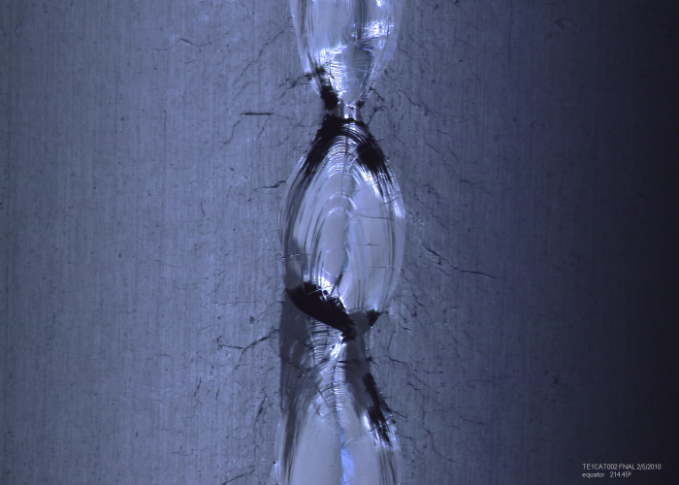
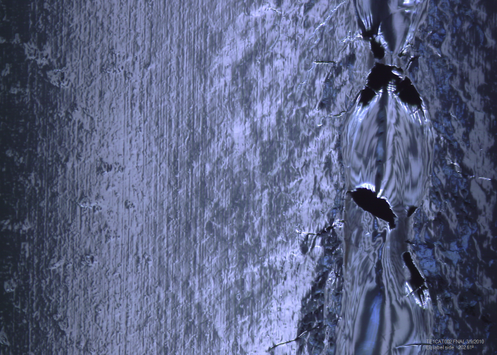
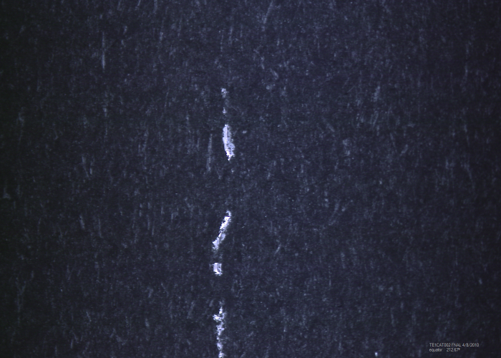
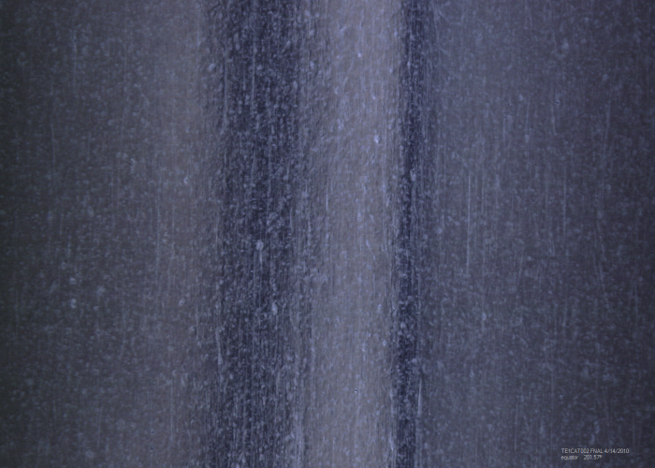
TE1CAT002 – RRCAT2

Slide 13
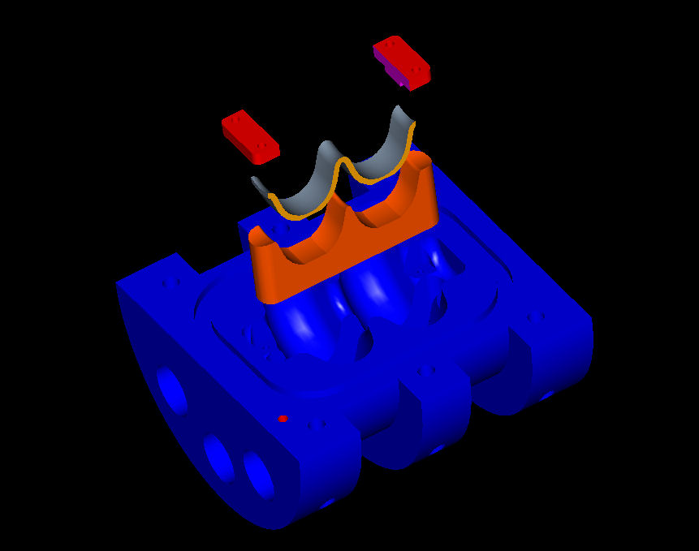
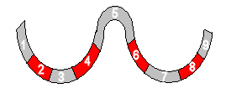
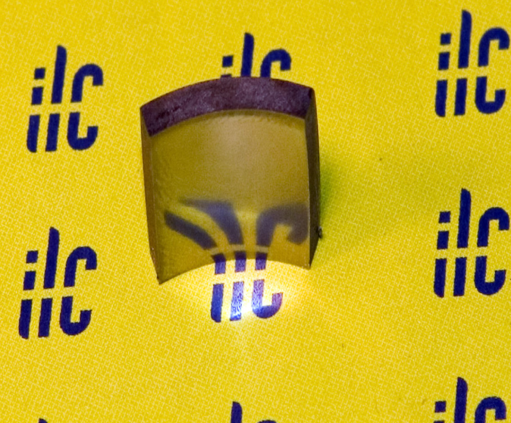
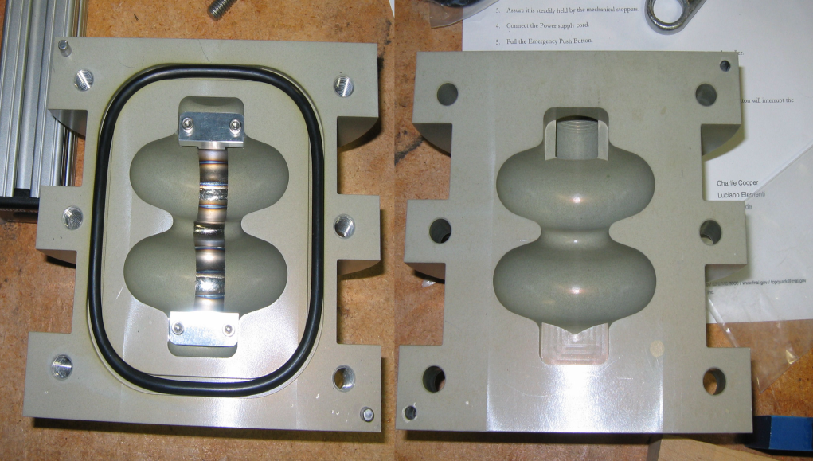
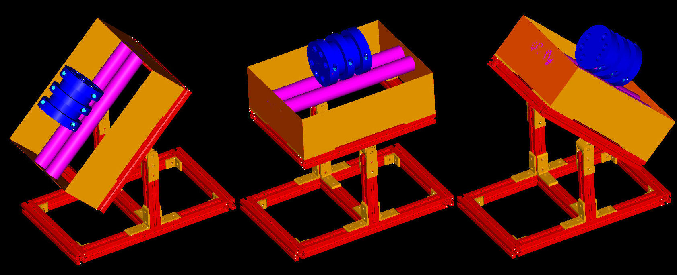
Coupon Tumbling 3.9 GHz Geometry
Photograph by Tom Nicol
Rotation at +/- 20 degrees from horizontal

Slide 14
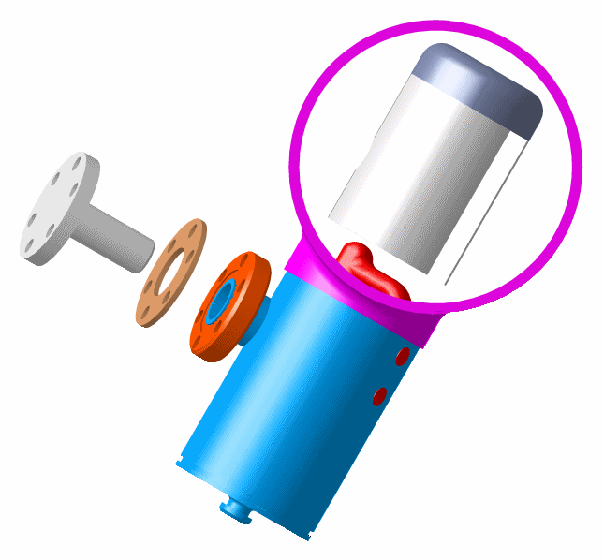
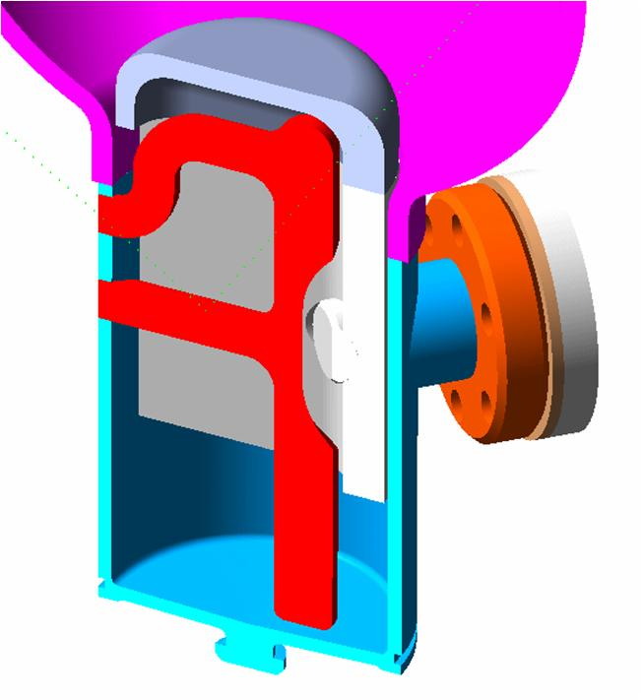
9 Cell Cavity Tumbling
HOM Can Must Be Protected or the Antenna Would be Destroyed.
Caps are Made From Niobium to Avoid Contamination.

