Slide 1
SRF Infrastructure at Fermilab
(and more)
Rich Stanek
Engineer’s Week
February 15, 2010

Slide 2
Introduction
SRF ≠ ILC (although we talk about them in the same context)
SRF is an enabling technology envisioned for use in many new applications of interest to the Office of Science
  Project X
  International Linear Collider
  Muon Collider
  Light Sources, ERL, ADS etc
In many ways SRF is analogous to the superconductor technology Fermilab pioneered for SC Tevatron magnets
  Future payoff (in terms of new applications) could be substantial, but…
  Issues of understanding material properties, fabrication and handling techniques, industrialization of the processes… are all present
  Labs will drive the initial use cases but then industry might develop

Slide 3
History
SRF R&D at FNAL began in the 1990’s via the TESLA Collaboration
  Design/construction of A0/FNPL (collaboration with DESY)
  FNAL effort was small (U.S. was pushing warm technology for NLC)
FY06: The picture changed dramatically
  Cold technology choice for ILC in Aug 05
  FNAL developed plans for SRF based Proton Linac (Proton Driver)
  Requested funds to build SRF infrastructure (SMTF Proposal)
FY 07:
  ILC R&D spending ramped up dramatically: SRF goals established
  FNAL directed $ 24.7 M of core R&D funds towards construction of 1.3 GHz SRF infrastructure for ILC and/or Proton Driver
NOTE: SRF also refers to the B&R code used by the DOE/OHEP to fund a specific type of work at FNAL

Slide 4
History (cont’d)
FY08:
  Plan was for ILC to ramp up further
    Feb 08: ILC cost estimate released (shock to system!)
  Dec 08: Omnibus Bill (& FY09 CR)
    ILC and SRF R&D activities effectively stopped ~ 1 yr
FY 09:
  SRF funding restored to $ 19 M still focused on 1.3 GHz pulsed
SRF ARRA: $ 52.7 M of funds approved
  Huge boost towards recovery from FY08
    Advances schedule of planned FNAL infrastructure
    Allows purchase and construction of previously unfunded infrastructure as well as industrial cavity procurement, etc.
FY10
  Relatively stable & the future looks good !

Slide 5
ILC + SRF Funding and Labor
SRF is a Program ➔ Not a “construction project”
  Specifically ➔ an infrastructure/technology development program
  Must respond to evolving project goals & technology changes
  Scope of work, goals and conditions have changed several times
FY10 Funding
ILC = $11,321K
SRF = $20,500K
(plus still obligating ARRA funds)
Current ILC + SRF Staff (Jan 2010)

Slide 6
SRF Funding Mission & Goals
Mission:
Develop SRF infrastructure at FNAL and perform R&D to master the technology for future accelerator projects (e.g. Project X or ILC)
Goals:
Master fabrication and processing of cavities & cryomodules
Build SRF infrastructure that is difficult for industry to provide
  Large cryogenic & RF systems, cavity & cryomodule testing systems,
Transfer SRF technology to U.S. industry
Participate in national & international collaborative SRF R&D

Slide 7
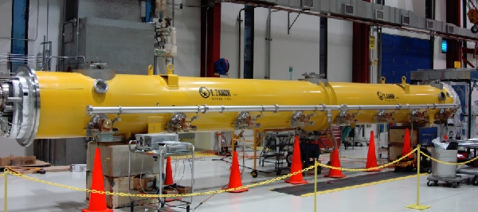
The Process
Fail!
Cavity Fabrication
Surface Processing
Vertical Testing
Fail!
Pass!
Horizontal Testing
HPR or reprocess
He Vessel, couplers, tuner
Cold String Assembly

Slide 8
Integrated SRF Plan (Cryomodules)

Slide 9
Integrated SRF Plan (Infrastructure)

Slide 10
Current Status
Steady progress on SRF infrastructure at FNAL
  Several new SRF facilities now in full operation
Vertical Test Stand; tests bare cavities
  Works! 60 tests so far, 40 in FY09 (achieved design test rate of 5/month)
  Civil construction complete for 2 more VTS systems (325 and 650 MHz capability)
Cryomodule Assembly Facility
  Works! 2 CM assembled in MP9 & ICB (CM1= 1.3 GHz CM + 3.9 GHz CM)
  Completed cavity dressing infrastructure ➔ dressed 7 cavities so far
Horizontal Test Stand; tests dressed cavities (unique in U.S.)
  Works ! Five 3.9 GHz tests + Five 1.3 GHz cavities tested so far (faster than DESY!)
  Two high gradient (> 30 MV/m) dressed “S1-global” cavities shipped to Japan
ANL/FNAL Joint EP Processing; commissioning
  ~Works ! Excellent results with single and nine cells (two ~ 35 MV/m)
  6 nine cell EP cycles, 38 High Pressure rinse and assembly cycles!
Excellent progress on RF unit test facility at New Muon Lab

Slide 11
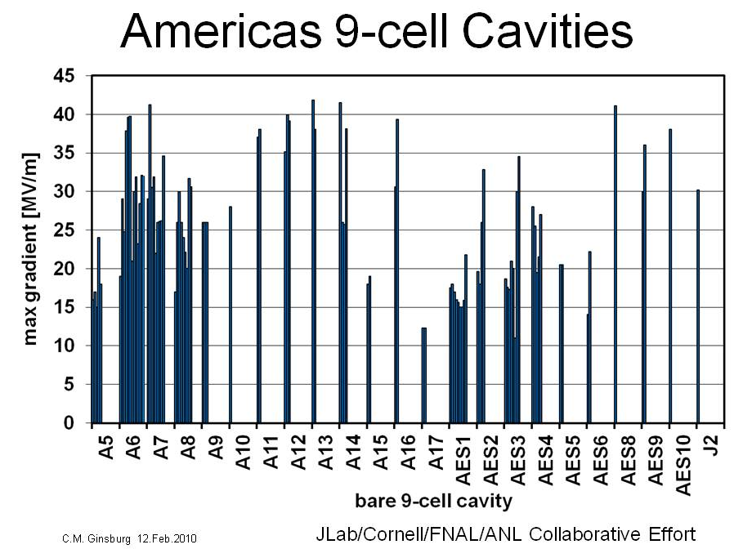
ILC Cavity Gradient
KEK pit repair
+ ANL!
ANL!
ILC goal

Slide 12
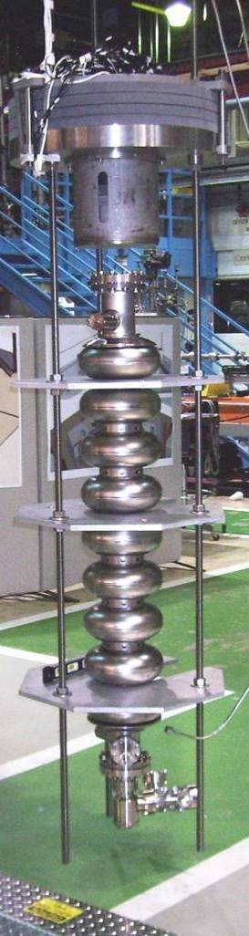
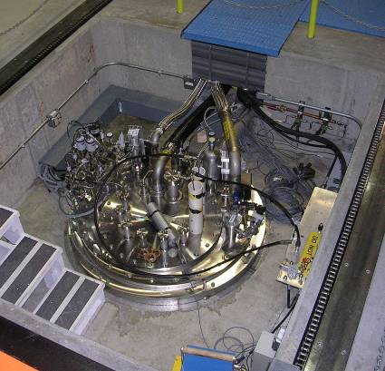
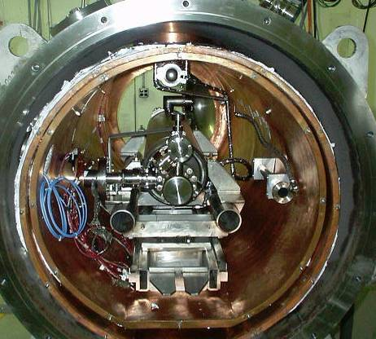
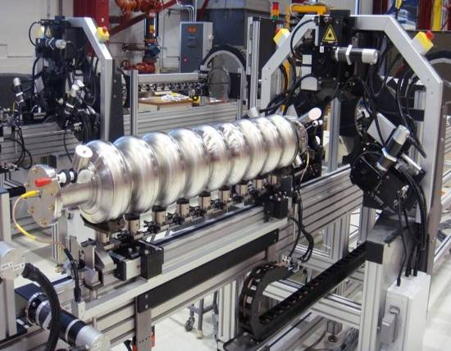
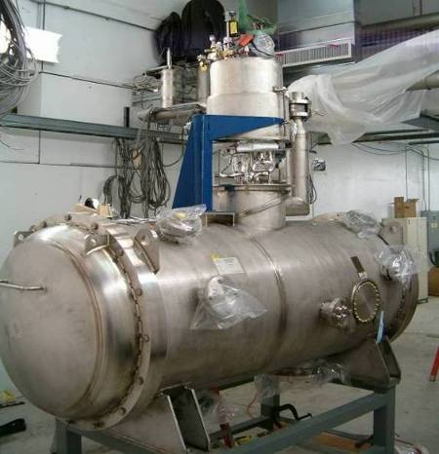
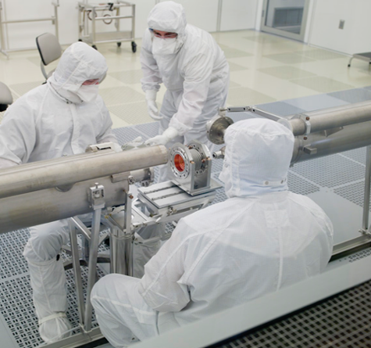
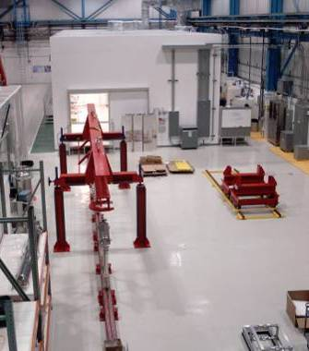
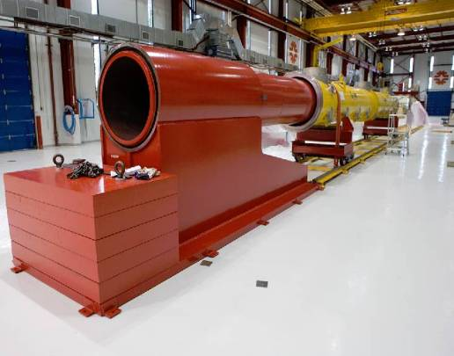
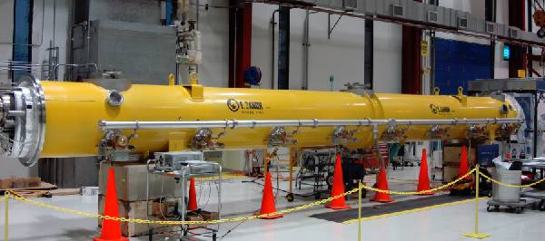
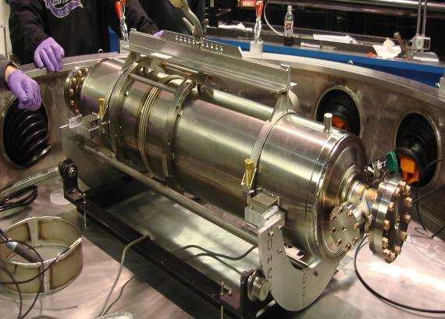
1st Dressed Cavity
New FNAL SRF infrastructure
Cavity tuning machine
VTS
HTS
VTS
String Assembly
MP9 Clean Room
Final Assembly
1st U.S. built ILC/PX Cryomodule

Slide 13
RF Unit Test Facility at NML
Existing Building
72 M
~ 22 M
New ILC like tunnel
Gun
3rd har
Diagnostics
ILC RF unit
2nd ILC RF unit
CC I,II
Bunch Compressor
Laser
Test Area
New Enclosure
RF Equipment
Test Areas
Overall Plan: Test RF units: Px, ILC S1 & S2 goals
  ILC: 3 CM, Klystron, Modulator, LLRF
  Move A0 Injector to provide ILC like beam
New Tunnel Extension: design to allow 2nd RF unit, diagnostic beam lines, AARD facility
New Building: Cryoplant, Cryomodule Test Stands

Slide 14
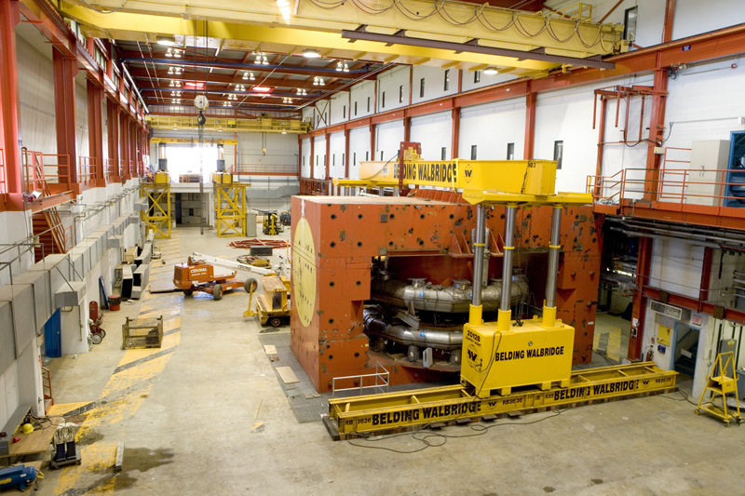
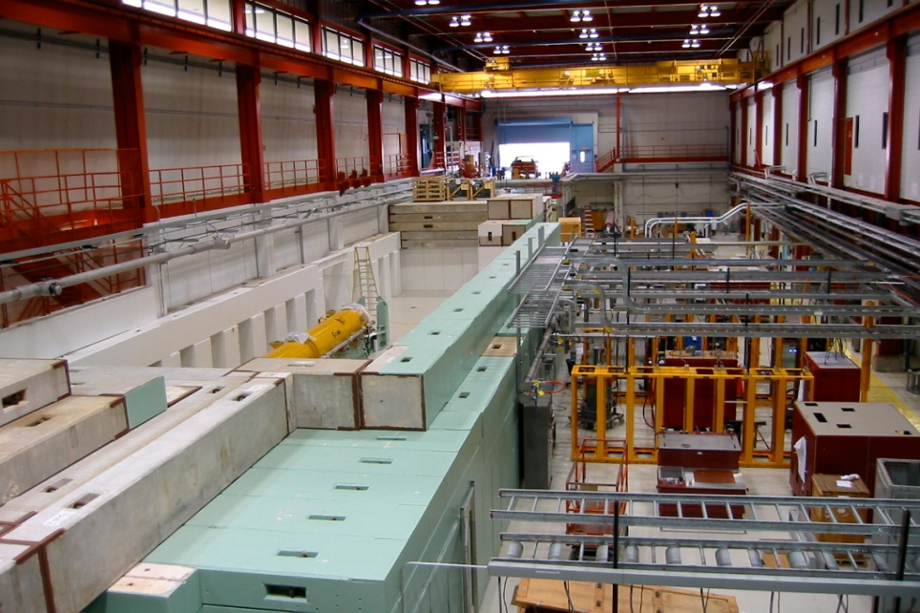
NML Before/After (End of CY09)
NML “back in the days”
  E665 ➔ CVM, CCM, cryo system
  Mechanical assembly
    NuMI/MINOS
New incarnation
  RF Unit Test/Beam Test Facility
Lots of progress since this picture was taken
  CC2 cold & being commissioned
  2nd rrefrigerator installed ➔ checkout
  CM test planned May 2010

Slide 15
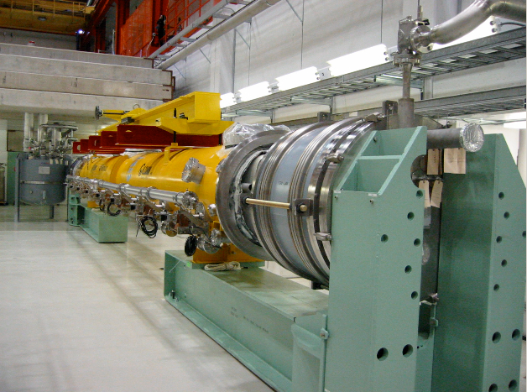
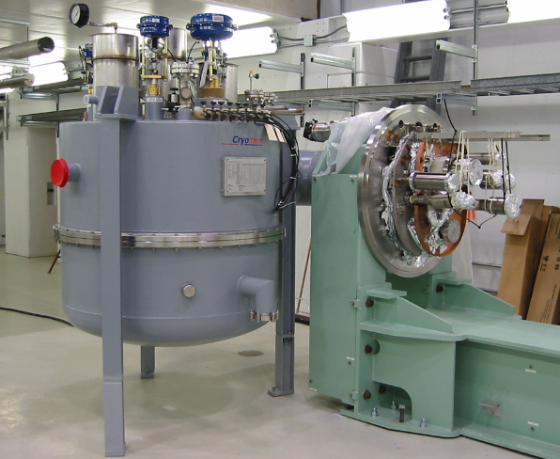
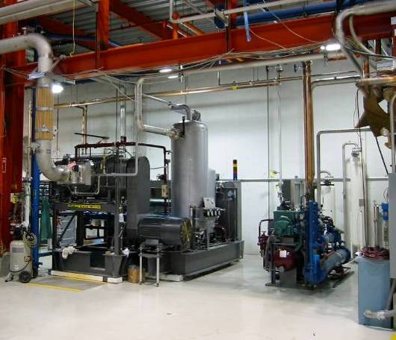
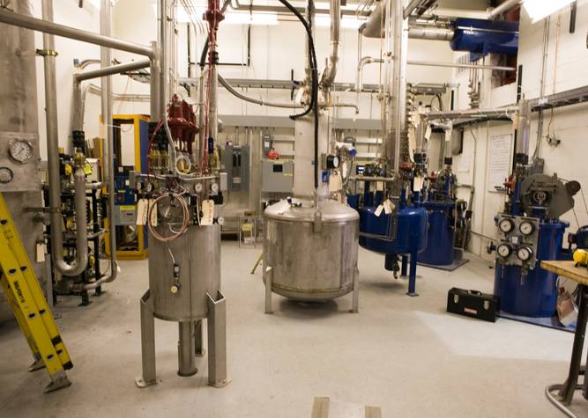
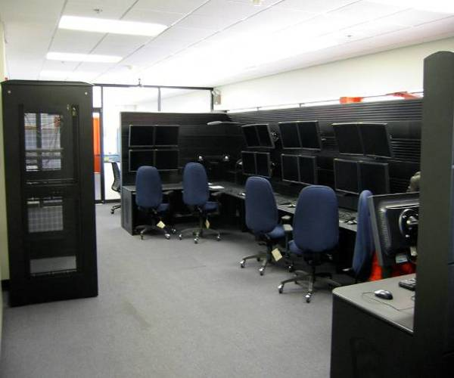
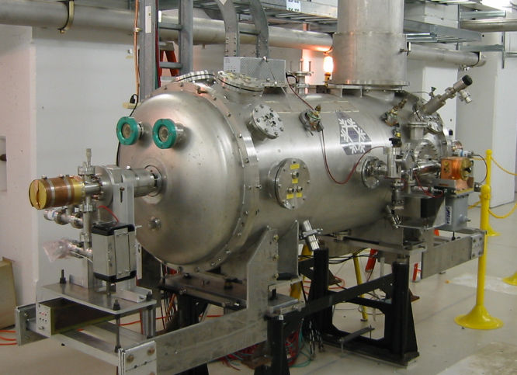
Progress at NML
1st Cryomodule installed
CM Feed Can
Large Vacuum Pump
Control Room
Capture Cavity II @ NML
Operating at 2K
He Refrigerator

Slide 16
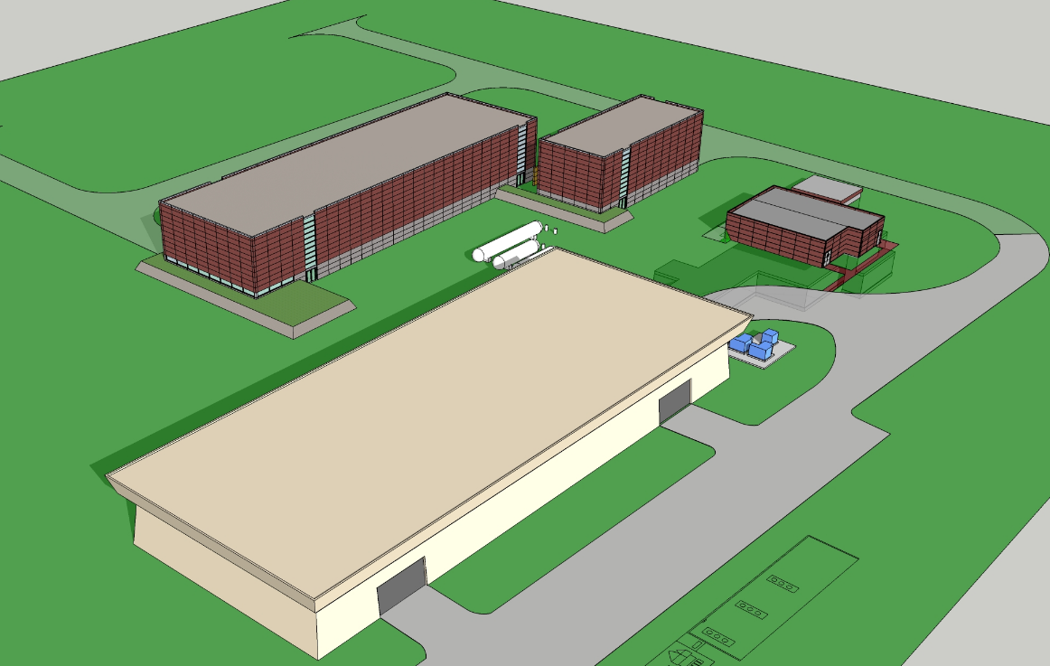
NML in the Future

Slide 17
Collaborations (18 MOU’s)
ANL: EP development and cavity processing
Cornell: Cavity processing & test, materials R&D
DESY: 3.9 GHz, cryomodule kit, FLASH
KEK: Cavity R&D, ATF II
MSU: Cavity cost reduction, hydro-form, TIG
TJNL: EP cavity processing and test
INFN: tuners, HTS, NML gun cathodes
TRIUMF: Vendor development (PAVAC)
SLAC: RF power, klystrons, couplers
CERN, DESY, KEK, INFN, etc: Type IV CM design
India: CM design, cavities, infrastructure, etc
China: Peking U, IHEP, cavity development
UC,NW,NHMFL, Cornell, DESY, KEK…: Materials
Slide 17
Notes:
17

Slide 18
Summary
SRF effort at FNAL started 4 yrs ago at “square 1”
Rapidly becoming a world class SRF lab
  Build & operate some of the best SRF infrastructure in the world
  Developing world class SRF scientific and engineering staff
  Established strong collaborative connections
Considerable technical progress and excellent reviews
Extensive SRF Infrastructure constructed and in operation
  Supports GDE SRF goals for ILC
  Supports revised Project X baseline
  Supports U.S. Industrialization of SRF technology
Additional infrastructure under construction

Slide 19
(and more)

Slide 20
Final Thoughts on Engineer’s Week I
Lab has changed over the last 20 to 30 years
  No longer the “world’s highest energy accelerator”
  Being driven to a more “corporate” structure
  Have had our share of struggles with budgets, project cancellations, delays and technical mishaps…
  More emphasis on
    Reviewing/Reporting/Tracking (EVMS)
    ES&H and QA
  Common sentiment , “Things are not how they were in the past”
    Change can be a good thing
      particularly when it is properly motivated
“If you live in the past, you die in the past” Mike Ditka

Slide 21
Final Thoughts on Engineer’s Week II
Personally, I see things heading in the right direction
  Initiative to define the future in terms of the Energy, Intensity and Cosmic frontiers ➔ very positive
  Delicate balance between trying to do everything vs. all eggs in one basket
  Top Leadership (Pier & Young Kee) has understood and accepted the arguments for adding additional engineers
    SEPC Report ➔ 17 permanent eng. openings (various stages) plus 7 contract eng. positions
  Still a great place to work
    See it in the eyes of the young engineers we interview

Slide 22
Final Thoughts on Engineer’s Week III
To make the most of our situation, we need to
  Work together in as efficient a manner as possible
    Think in terms of “big picture” ➔ work together for common good
“The needs of the many outweigh the needs of the few or the one” Mr. Spock
    Share information and avoid duplication of effort ➔ EDMS
  Adopt more formalized engineering process ➔ Eng Policy Manual
    Avoid misfires and mistakes
  Continue to build our technical staff and keep it strong
    Keep our current engineering staff challenged and motivated
      Make sure we continue to offer training, career development…
    Provide the right tools to do the job ➔ Eng related software
    Add staff where appropriate, use contract employees effectively…

Slide 23
Final Thoughts on Engineer’s Week IV
Lab is developing expertise in many new technologies
  SRF, high-purity LAr, silicon detectors, ASIC, high power targets, computing…
  Each one of these drives intellectual advancement and $ in new infrastructure
For our Engineering Community this is an exhilarating and stimulating time
  As we wind down from one era, we evolve into the next one
  The challenges remain high
    These challenges, that we face together, are what motivates us and keeps us going strong
Very interesting talks (this week) on some exciting and technically challenging projects
  Hopefully you’ll get the chance to participate

