Slide 1
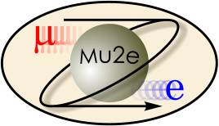
The Mu2e Experiment
Physics Goals and Why it’s important to Fermilab and HEP
How the Experiment Works
Engineering Challenges (emphasis on the magnets)
Conclusion
Engineer’s Week
February 18, 2010
Michael Lamm
for the Mu2e Collaboration
and TD/Magnet Systems Dept.

Slide 2
What is Mu2e and why do it?
Measure the Rare Process: μ- + N ➔ e- + N relative to garden variety μ- + N ➔ nuclear capture
It will be world class experiment in the “Intensity Frontier”
  Single particle sensitivity goal of 10⁻¹⁷ : 4 orders of magnitude improvement
  Judged by P5 Committee to be a high priority for Fermilab and US HEP
…either with or without a signal….
  WITH: Indicate new physics beyond the “standard model”
  WITHOUT: Put severe limits on theories beyond the standard model
  It will compliment LHC Direct Observation Experiments
Timing is right to do it….(Experiment will run ~2016)
  After the Tevatron is shut off….before Project X
  Right about the time the LHC will hit full stride
  Required accelerator resources compliment NOνA
  It has a future: Knowledge learned will go into Project X era experiment
Technically Challenging but very do-able
  Very interesting project for scientists and engineers

Slide 3
Direct vs. Indirect Measurement
DIRECT Measurement
  Reconstruct the Particle Mass, usually from decays from collisions
    Z, W, Top Quark, B Quark, maybe the Higgs Boson someday….
    CDF, D0, LHC experiments…
Indirect Measurement
  Infer mass or existence of a particle by measuring reactions
  For example, the ratio of the W/Z mass can be inferred by measuring the relative rate ν+N➔μ+X vs. ν+N➔ν+X because the former involves a virtual W with the other by a virtual Z
Mu2e is an “indirect measurement” experiment
  The reaction μ- + N ➔ e- + N violates lepton flavor
    Not forbidden in the standard model (i.e. virtual W, Z, γ…) but very very rare is ~ O(10⁻⁵⁰).
    But if “non standard model” particles exist, this reaction could have much more frequently .. Maybe ~ O(10⁻¹⁴).
    This is what we want to find out!
    Complimentary to direct measurement at LHC

Slide 4
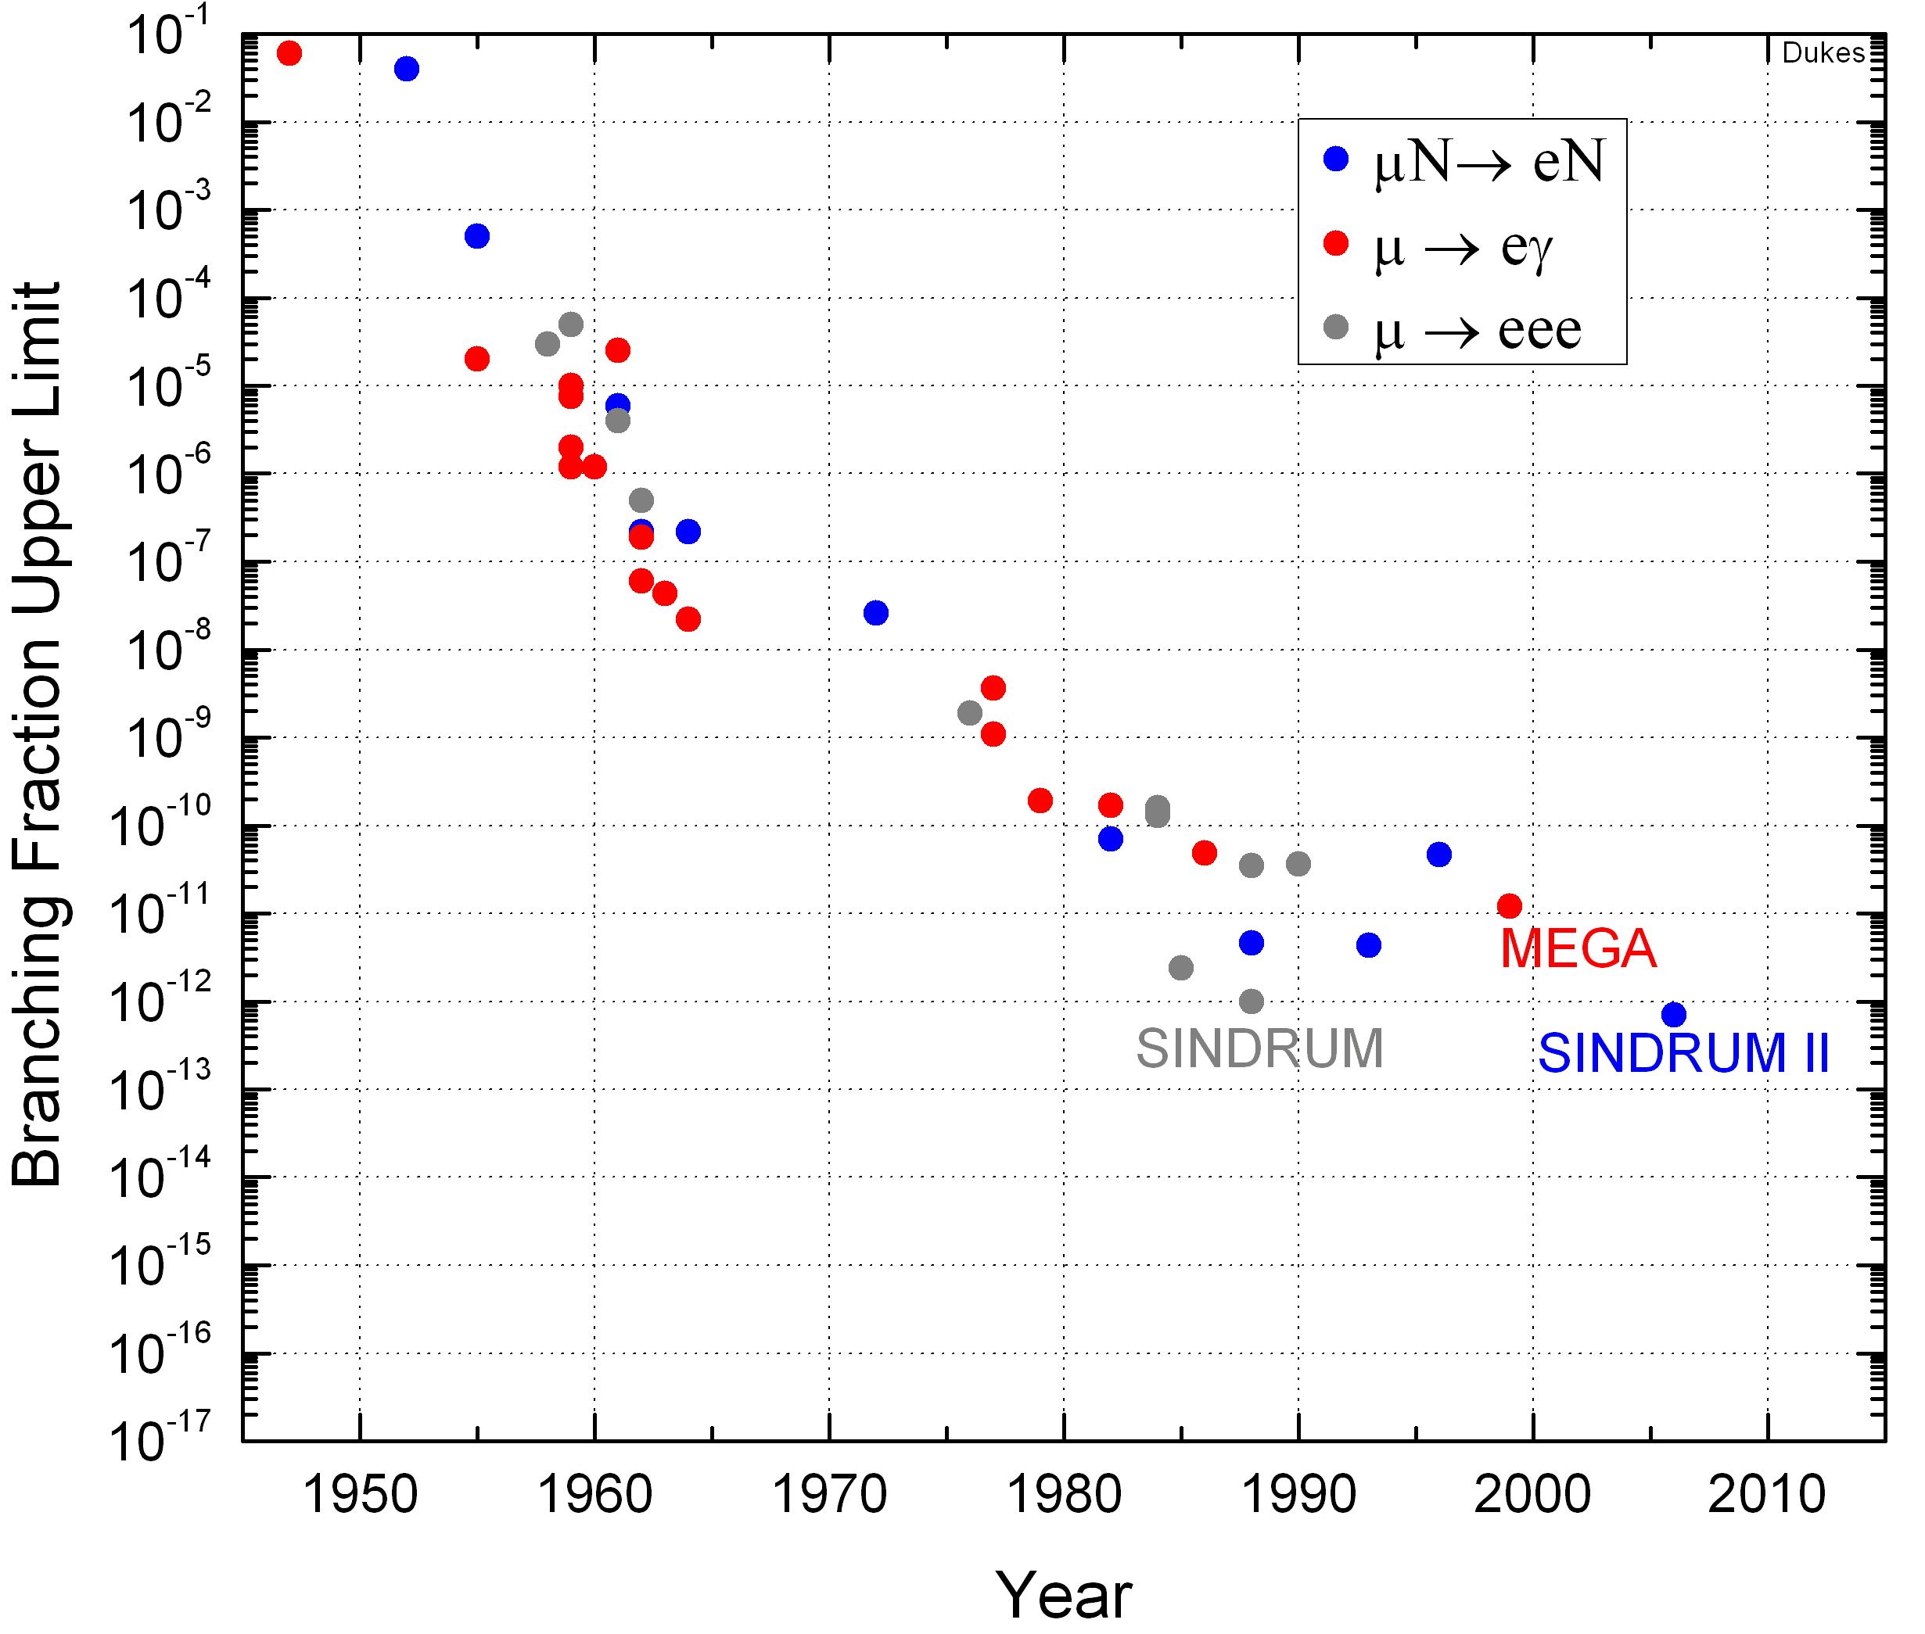
Lepton Flavor Violating Experiments
Goal:4 orders of magnitude more sensitivity than best present experiment
Mu2e
2016

Slide 5
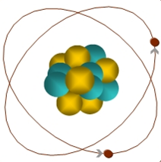
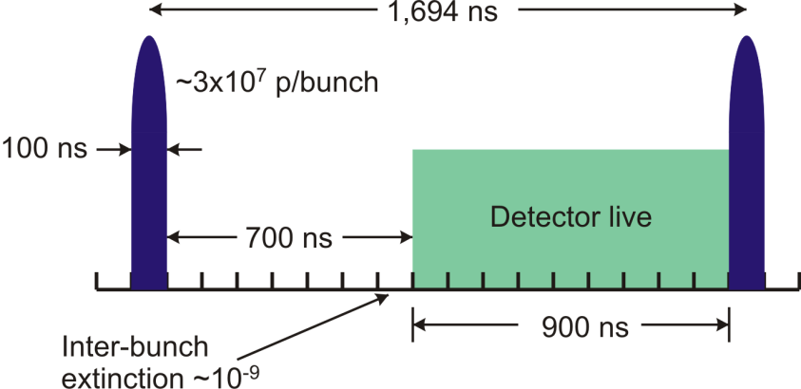
Mu2e Strategy
  Start with high intensity, 100ns wide pulse of 8 GeV protons
Create a beam of high intensity, low momentum “in time” muons
  Beam is full of “ in time” junk (pions, muons and electrons….)
Stop muons in aluminum target: form muonic atom
  μ- can be captured in a nucleus just like an electron
Take advantage of muon life in atom to reduce background
  Turn off the experiment to allow other particles in the muon beam (including a lot of background electrons…) to blow past detector
  Turn experiment on, detect the electrons from target
μ
Note: experiment cannot tolerate out of time particles
Protons in between bunches
Muons that get lost in the transport
105 MeV e⁻

Slide 6
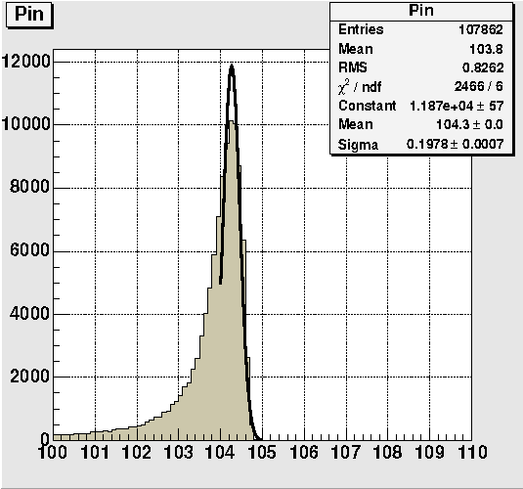
Mu2e Strategy (II)
Once muon is captured in nucleus…most of the time either decays in orbit or normal muon capture
Our reaction μ- + N ➔ e- + N is kinematically constrained to produce mono-energetic electrons of ~105 MeV (distinct signal from backgrounds)
Computer Simulation in Detector

Slide 7
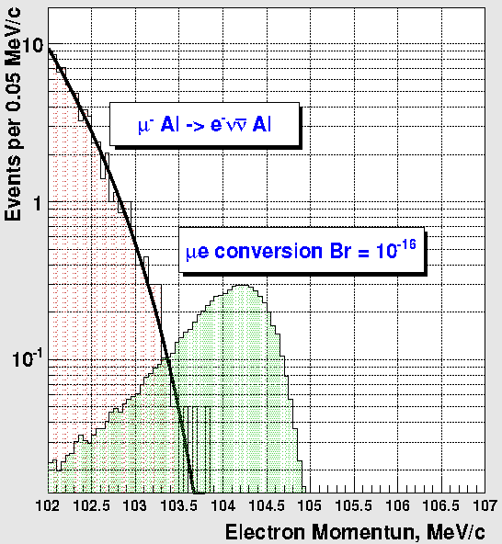
Dominant Signal Background
Decay in orbit followed by nuclear recoil
Background X20
N
Rate approaches conversion (endpoint) energy as
(E_{s}-E)⁵
If detector meets resolution specs, we should be able to see a signal at the 10⁻¹⁶ level

Slide 8
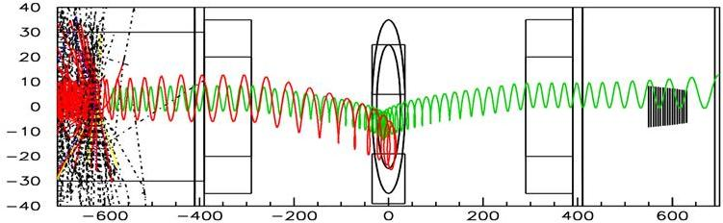
Solenoid System
Transport Solenoid
8 GeV P
  Sign/momentum Selection
  Negative Axial Gradient in S.S. to suppress trapped particles ~0.2 T/m
PT
Production Solenoid
  Graded field to collect conv. e⁻ (2T➔1T)
    Uniform field for e⁻ Spectrometer (1T)
CC
  8 GeV P hit target. Reflect and focus π/μ’s into muon transport
  Strong Axial Gradient Solenoid Field 5T➔2.5T
ST
e⁻ Spectrometer
Detector Solenoid

Slide 9
Engineering Challenges
PS/TS/DS: three separate magnet designs but…..
Coupled together magnetically
  Really ONE Big Magnet
Significant Forces (~100 Tons on end of DS from TS)
Tight physical tolerances
  Cold vs. Warm , with field excitation
  Particularly with odd shaped TS
Integration issues
  It is our job to makes sure magnets built from different vendors, fit together, produce the required magnetic field

Slide 10
Solenoid Work at Fermilab
For the next 12-18 months… taking project to CD1…
Conceptual Design
  Separate working groups for PS, TS and DS
  Technical Specifications
  Preliminary Cost Estimate
Several engineers working on this
  Tom Page Solenoid Project Engineer
  Nikolai Andreev, Vadim Kashikhin, Vladimir Kashikhin, Igor Novitski, Rodger Bossert, Tom Peterson, Roger Rabehl, Bob Wands, Tom Nicol, Daniel Evbota, Sasha Makarov
Working on various aspects of the magnet design
  Magnetic, Mechanical, thermal/cryogenic, quench……

Slide 11
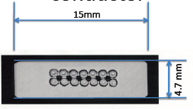
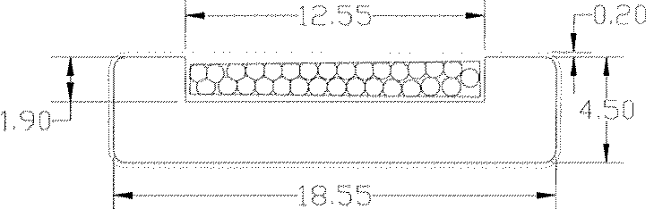
MECO (BNL) vs. Mu2e Magnet Concept
SSC cable
Copper Bar

Slide 12
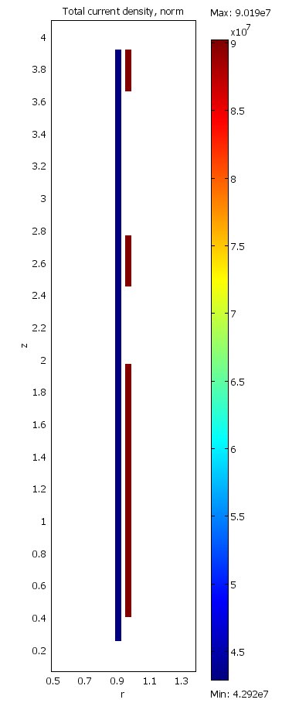
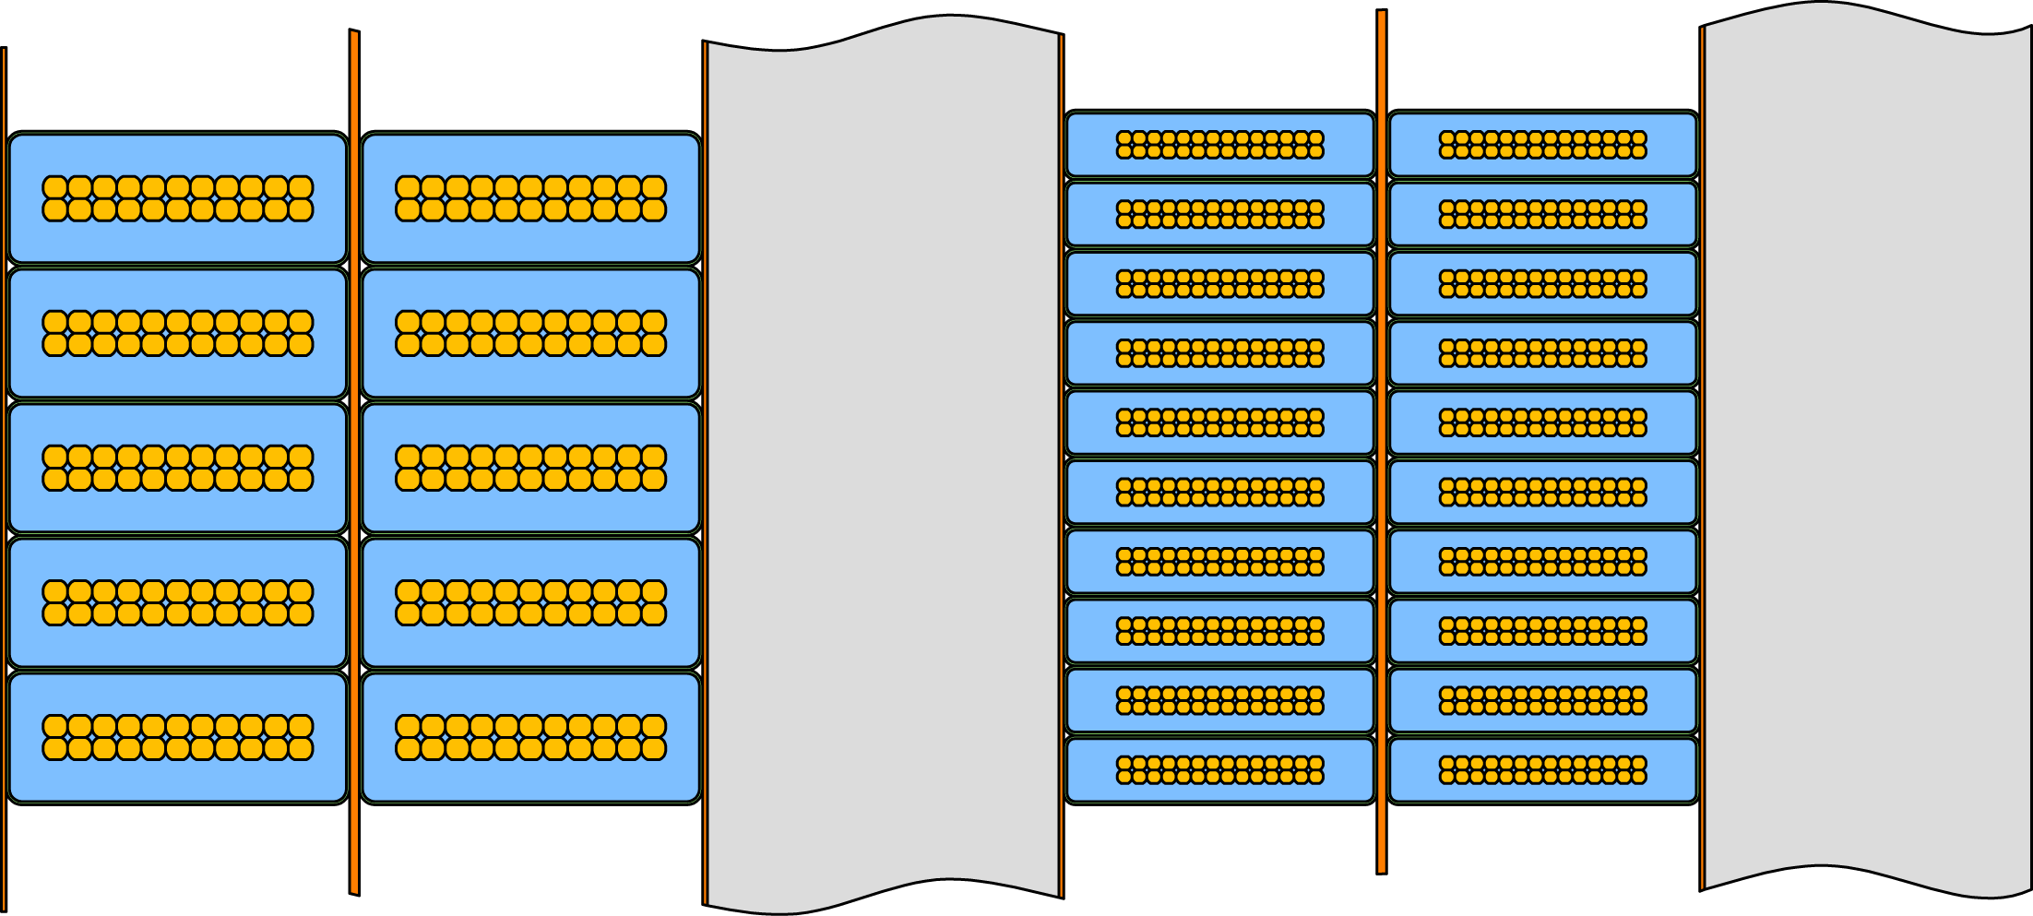
PS Working Design
Vadim Kashikhin
Long continuous inner coils with several short outer “tunable” coils for gradient field and to “match into” transport
Benefits relative to Meco
  Reduce inductance by x5 (Increased operating current)
  Reduce nuclear heating >x2 (Aluminum Stabilizer)
Coil cross section

Slide 13
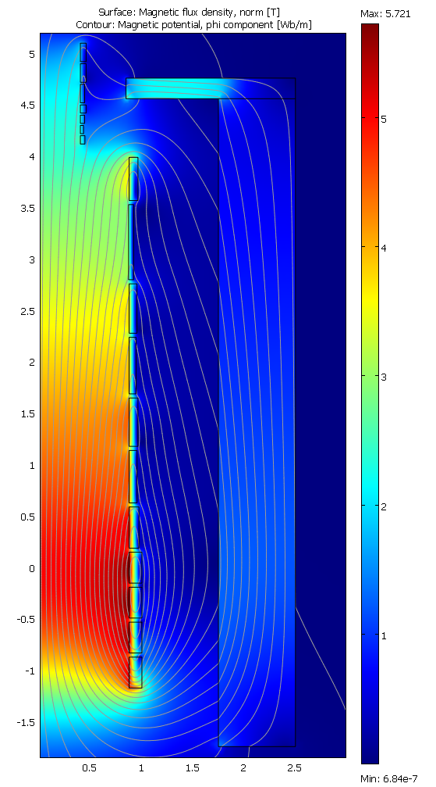
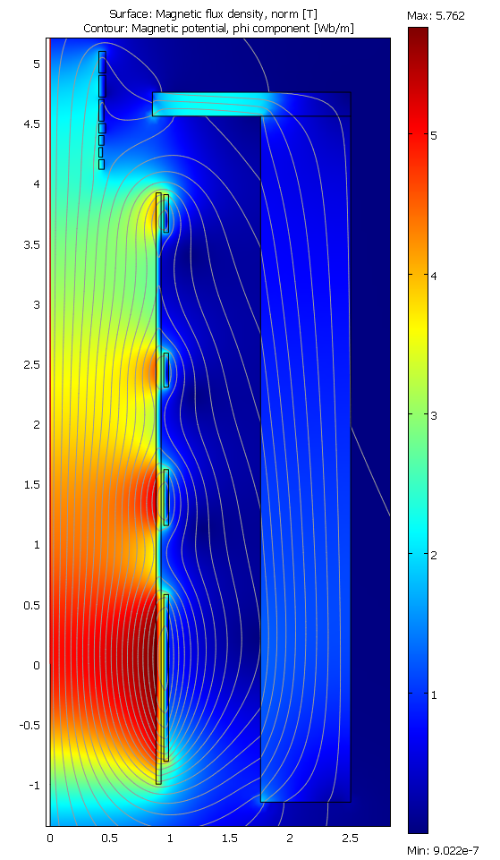
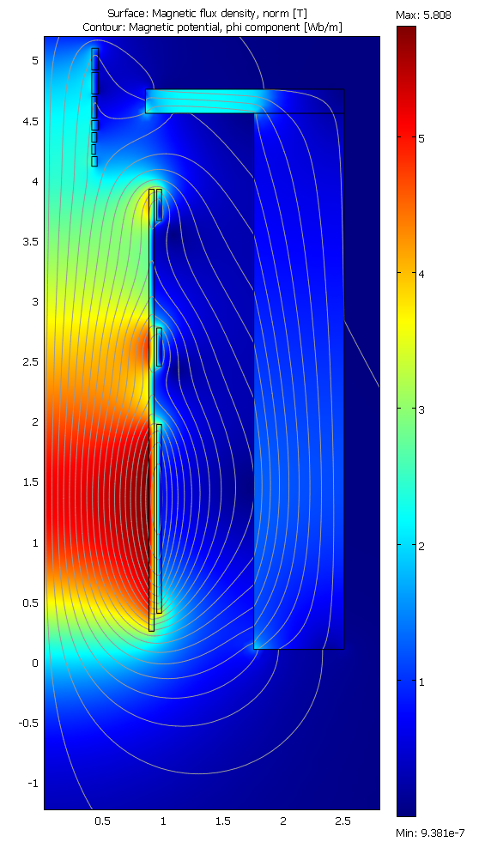
PS Magnetic Design
Vadim Kashikhin
Meco
Two layer Continuous Wind
Shorter Version

Slide 14
Temperature and Current Margins are Acceptable
4.5 K SSL
Current Margin
6.17 K SSL
Current Margin
Temperature margin > 1.5 K
Current Margin I/Ic = 65 percent

Slide 15
Quench Protection: Aluminum Stabilized + High Current Mu2e PS
Aluminum is an effective stabilizer
RRR = 600
RRR = 1100
Coil Peak Temp (Kelvin)
Excitation Current (A)
Compare to copper stabilizer: peak temperature ~85Kelvin
G. Ambrosio

Slide 16
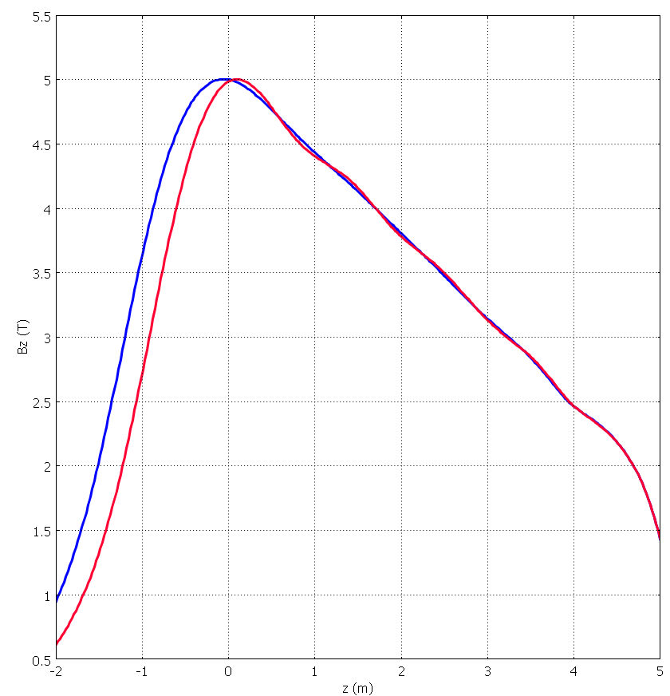
Production Solenoid Challenges
Large Volume : Aperture (1.8 m), Length ~5 m
High field (5.6 T on NbTi)
Large Amount of Stored energy (100 MJ)
Longitudinal Graded field means asymmetric forces on ends (unlike HEP detector solenoids)
8 GeV Target in aperture produces 50 kW of power.
  Absorbers will intercept most beam energy however
  Could be 100 W energy distributed into coils
  Challenge for cooling
  Possibility of radiation damage to insulation and conductor
Solenoid field fn of position

Slide 17
DS Design (model after Atlas)
R. Yamada
2 Tesla
2.5 m Aperture
5 meters long
Atlas Solenoid
2 T 1 T gap 1T 1 T
2➔ 1 Tesla
1.8 m Aperture
2.5 meters long
1 Tesla
1.8 m Aperture
7 meters long
0m | 0.93m | 2.4m |  | 4.17m 10.9m | 11.9m
240 | 162 | 117 |  | 90 turn/m at 9 kA | 127

Slide 18
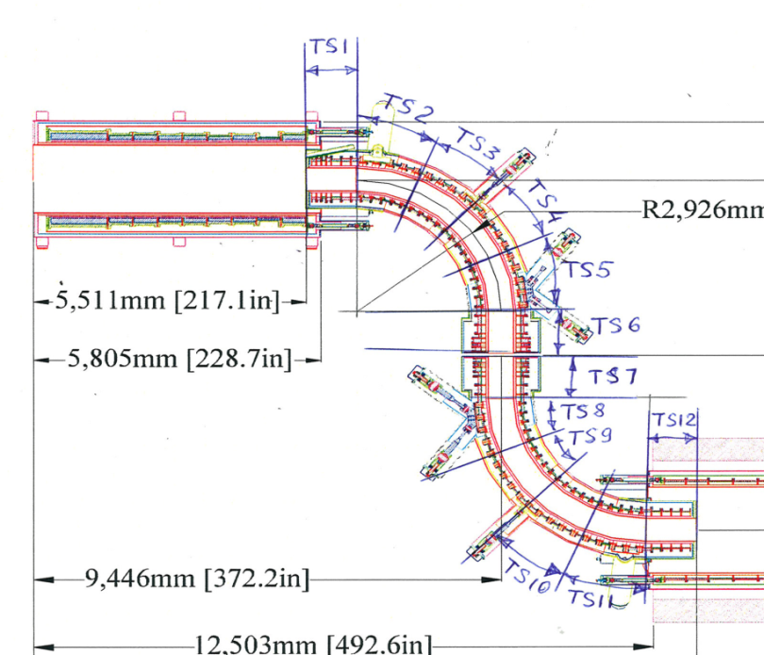
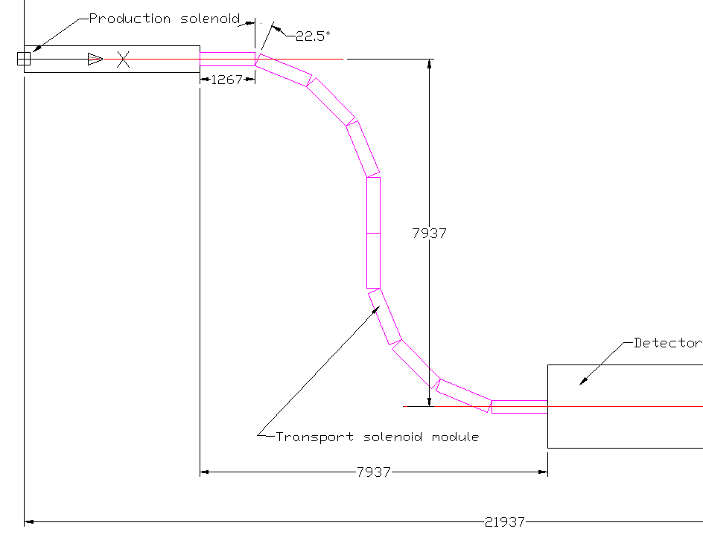
TS Design
Meco Design has 60 solenoid rings, each with different set of amp-turns to get desired field
We are working with Mu2e physicist to understand field specs, in the hope of reducing the number of coils and type of coils….
“S” shape + magnetic coupling to PS and TS is a significant design challenge

Slide 19
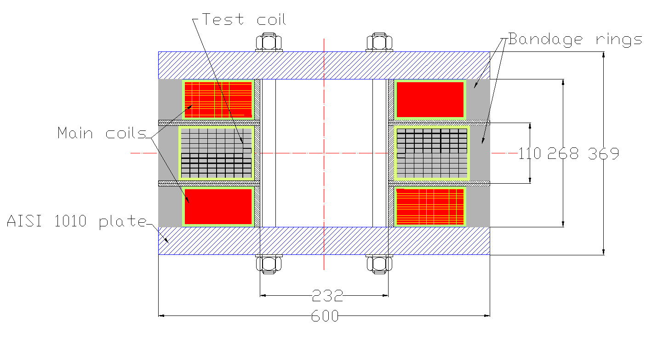
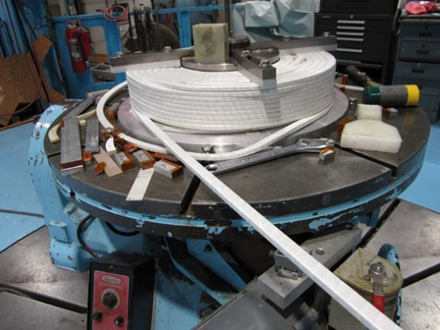
Collaboration with Japan
Vl. Kashikhin
N. Andreev
A. Makarov
Conceptual Design
Magnet Construction ongoing:
Test in spring 2010
Technology Magnet to Study Aluminum Stabilized conductor
Hitachi
Aluminum Stabilized Conductor

Slide 20
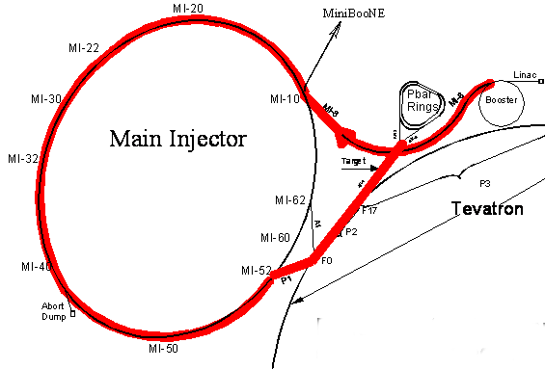
Mu2e Accelerator Project
A major development effort in getting a high intensity 8 GeV beam to the mu2e experiment
  3.6x10²⁰ protons/yr in 100 ns bunches ~10⁷/bunch
  Reuse parts of existing complex to: extract, stack, bunch and delivery to mu2e
  Complementary to NOνA
mu2e
Long list of physicists and a growing list of engineers
Engineering support from AD
  Mechanical Support
  Electrical/ Electronic
  Instrumentation
  RF

Slide 21
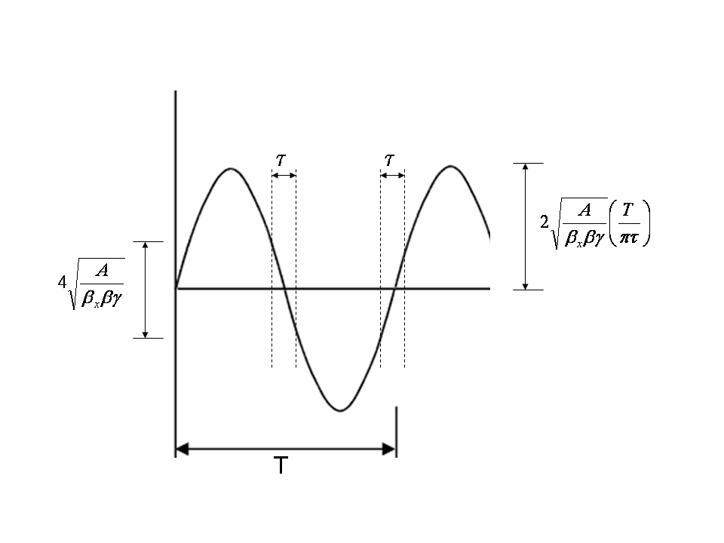
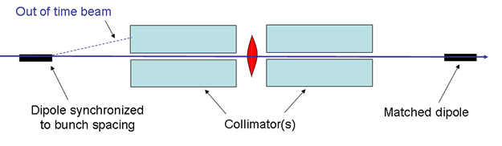
Accelerator Task: Extinction
Beam in between bunches must be suppressed by 9 orders of magnitude:
How to do this? Use AC dipole to sweep in between pulses
Requirements: 300 kHz 0.6 T peak field : VERY Challenging!
Design issues: AC and Magnetization losses at high frequencies
τ corresponds to bunch width

Slide 22
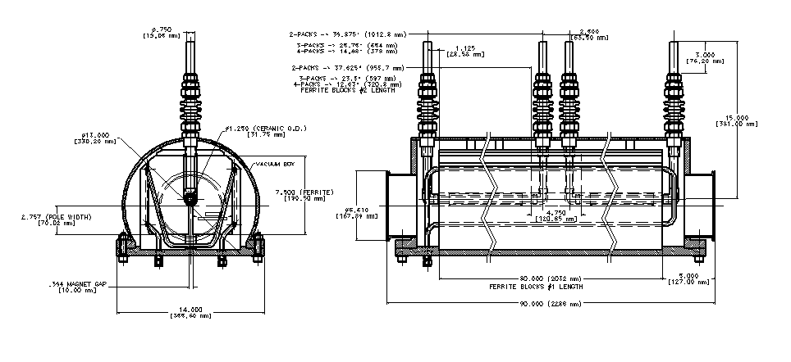
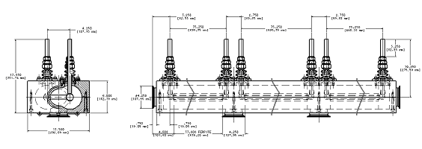
Preliminary magnet design
Two design are under investigation – with C and H shapes of the ferrites
C shape has several disadvantages, the major one is the poor heat dissipation in the ferrite around the conductor hole
A new design of an H type magnet is considered. The design eases the heat extraction and new low heating NiZn ferrites are considered.
2 section C-type magnet
Power leads
3 Section H-type magnet
A.Makarov

Slide 23
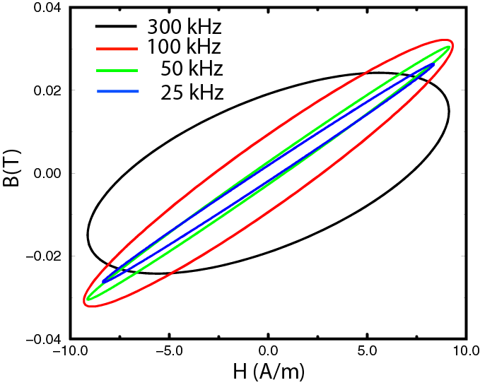
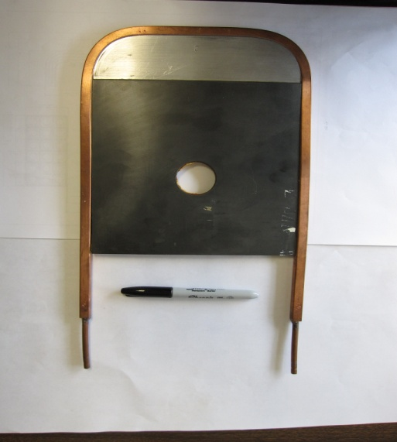
Ferrite measurements
MnZn ferrite was selected due to low magnetization losses
A setup for measuring of the AC loss and ferrite temperature was build in TD
A large eddy current loss is observed, making impossible to control the ferrite temperature at high fields
New type of ferrites are under investigation – NiZn with resistively of 10⁶ Ohm
G.Velev

Slide 24
Conclusion
Mu2e is an important “Intensity Frontier” experiment for this decade at Fermilab
  Fits well into lab program
  Complements LHC program
Substantial progress on conceptual design but still much work to do….
  Short term goal is to complete CD by mid 2011
  Fabrication, installation, commissioning for physics ~2016
Significant technical challenges in magnet, accelerator and detector….
  Will require engineering support from ALL divisions and sections
  We need your help!
  Contact Ron Ray (Project Manager), Kurt Krempetz (Project Engineer) or me….

