Slide 1
Superconducting RF Cavity Processing
Engineering Week
Monday February 15th

Slide 2
Outline
What is the goal of SRF cavity processing?
What steps are involved in processing and what are some of the pitfalls?
Design of the Integrated Cavity Processing Apparatus at Fermilab.
Some Fermilab Processing Results.

Slide 3
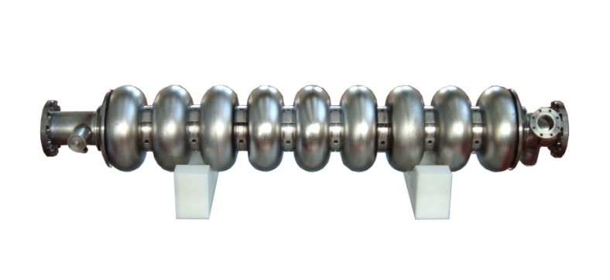
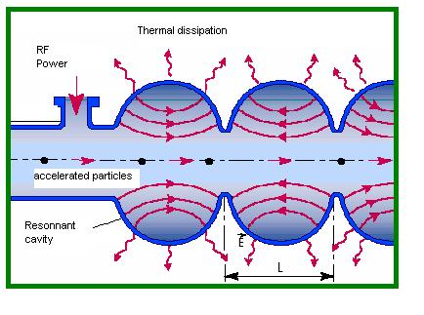
A basic SRF cavity…
SRF cavities are used to accelerate charged particles to high speeds. The electric field inside the cavity kicks a charged particle passing through it. A large speed is attained after the particle travels through many cavities.
Quality coefficient
Q₀ ∝ G / R_{s}
G = geometry factor
i.e. E_{acc} depends on the shape
Surface resistance - R_{S} .
R_{S} depends on surface roughness and chemical purity
Region of highest
magnetic field
Region of highest
electric field
Graphic from L. Cooley / C. Antoine

Slide 4
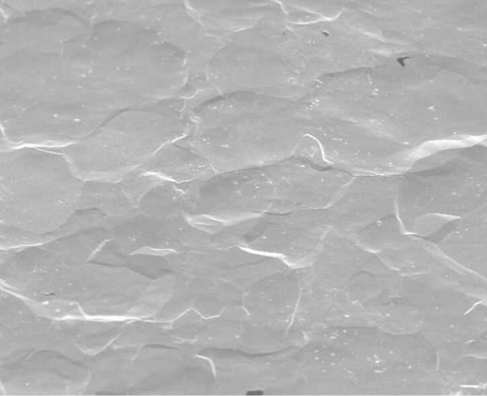

Objective of Cavity Processing
SEM Picture of 1 Micron Ra BCPed Niobium
SEM Picture of 0.1 Micron Ra EPed Niobium

Slide 5
What must be done during cavity processing to get high quality factors and accelerating gradients?
Start with High Purity Niobium Sheet
End with High Purity Niobium
End with a “Smooth” Homogeneous Surface
End with a Clean Surface
Fermilab Niobium Specification
Element | PPM (Weight) | Element | PPM (Weight)
W | 70 | Ni | 30
Ti | 40 | O | 10
Fe | 30 | N | 10
Si | 30 | C | 10
Mo | 50 | H | 2

Slide 6
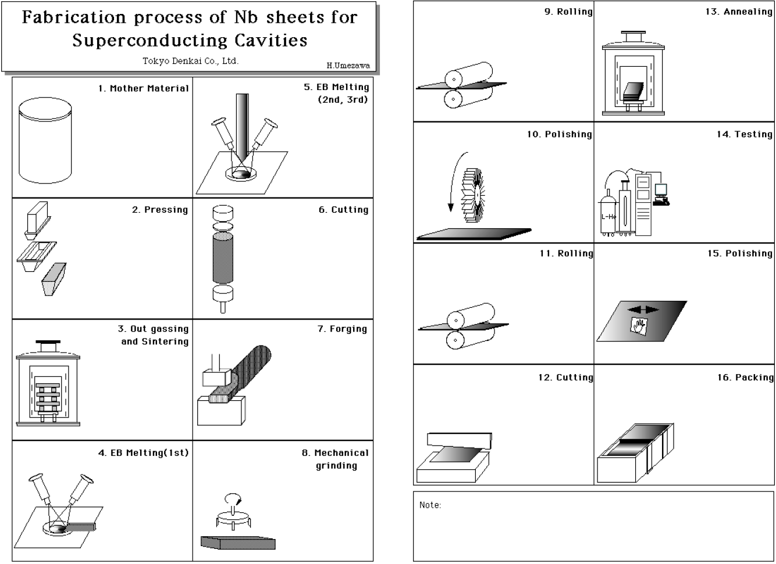
How are Niobium Sheets Made?

Slide 7
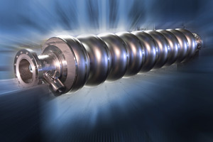
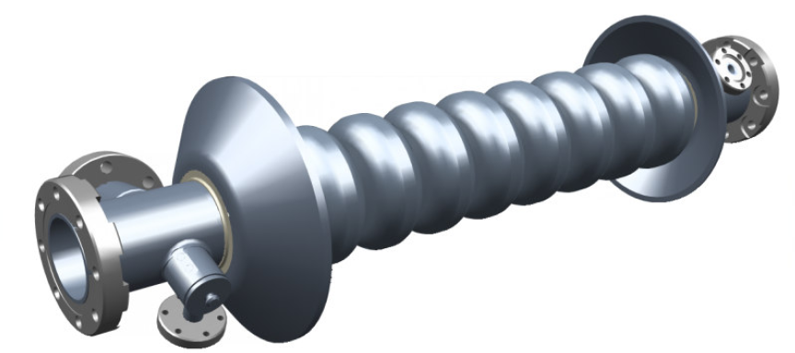
How Cavities Are Made from these Sheets?
Sheets Formed Into Half Cells
Half Cells Undergo Cleaning/Pre-weld Etching
Cells E-Beam Welded Together Along with Beam Tubes and End Groups.

Slide 8
How Cavities Are Processed
Bulk Material Removal
High Temperature Bake
Light Material Removal
(Alcohol Rinse)
High Pressure Rinse
Assembly
(Low Temperature Bake)
RF Test
Rinse
120-150 Micron Electropolishing
120-150 Micron Tumbled
Light EP
Rinse
800 C for 2-3 hours , 600 C for 10 hours
20 Micron EP
For Sulfur Precipitate Removal
1200 psi, Ultrapure Water
Class 10 Clean-room
48 Hour, 100 C

Slide 9
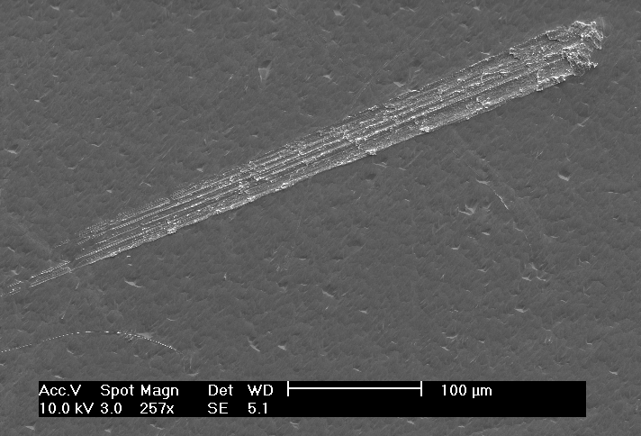
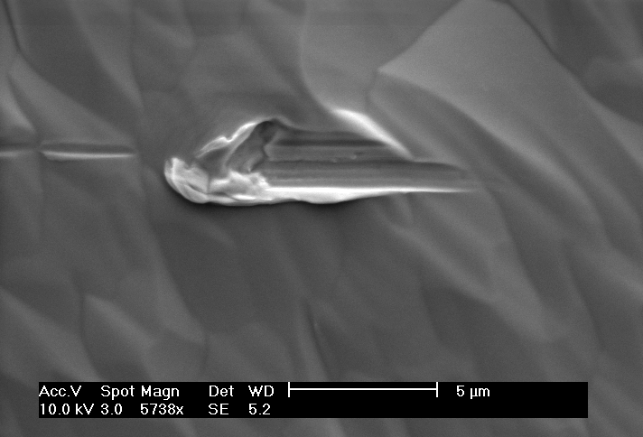
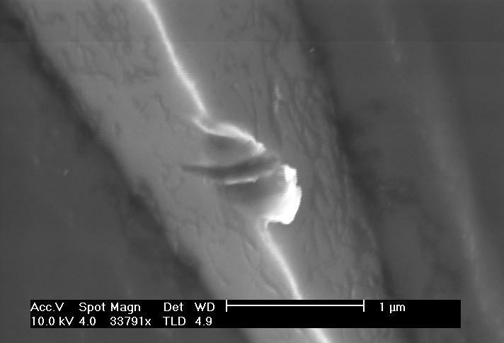
(Not So) Smooth Surface
100 μm
5 μm
1 μm

Slide 10
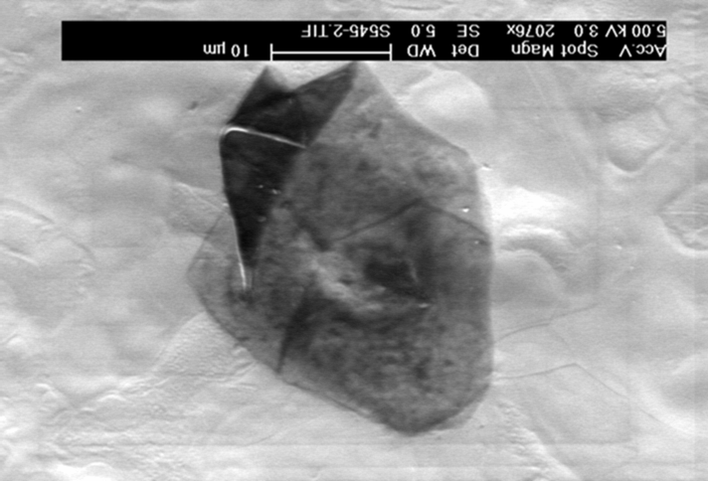
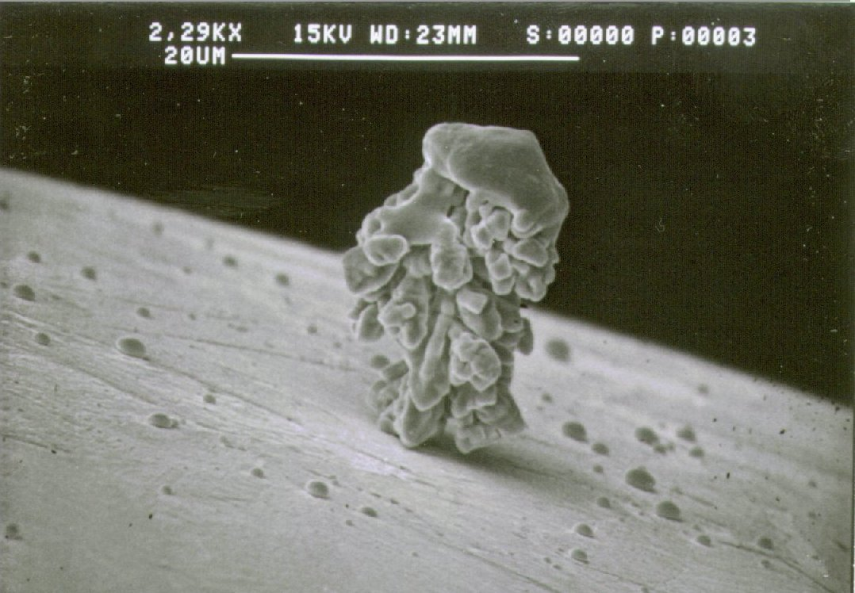
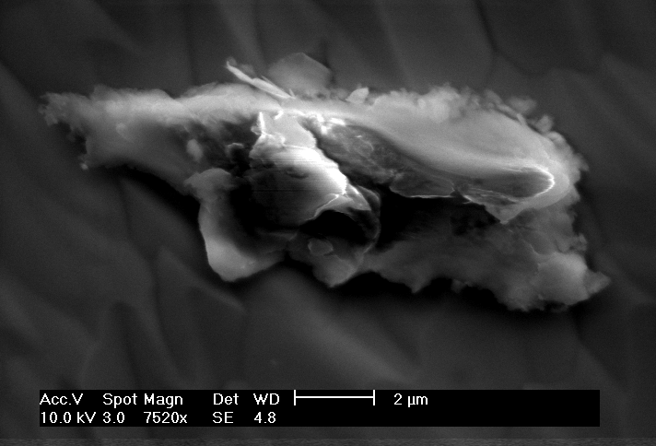
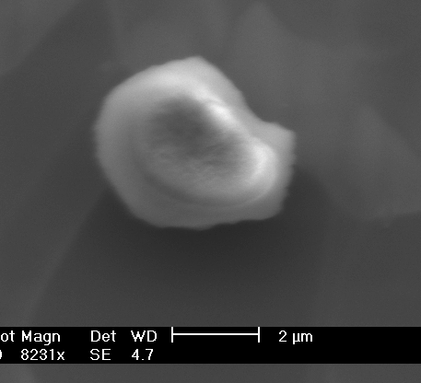
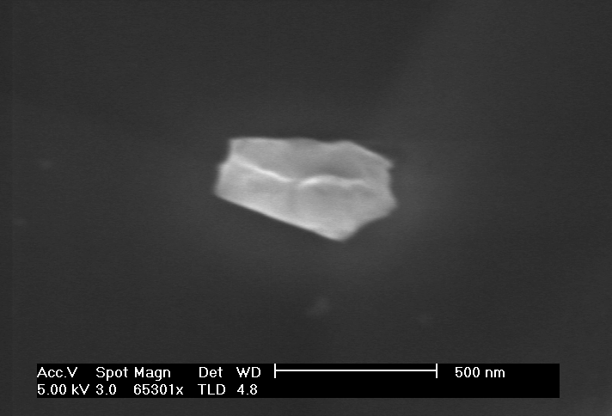
(Not So) Clean Surface
2 µm
2 µm
500 nm
Images from C. Reece/G. Müller

Slide 11
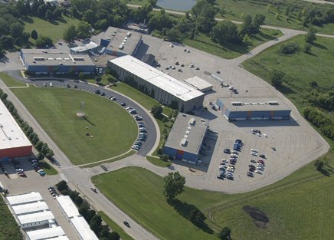
Integrated Cavity Processing Apparatus (ICPA) at Fermilab in IB4
Industrial Center Building
Industrial Building
#4
CDF
ICPA will be used to quickly process single cell cavities and sample coupons to conduct processing and materials research and development.

Slide 12
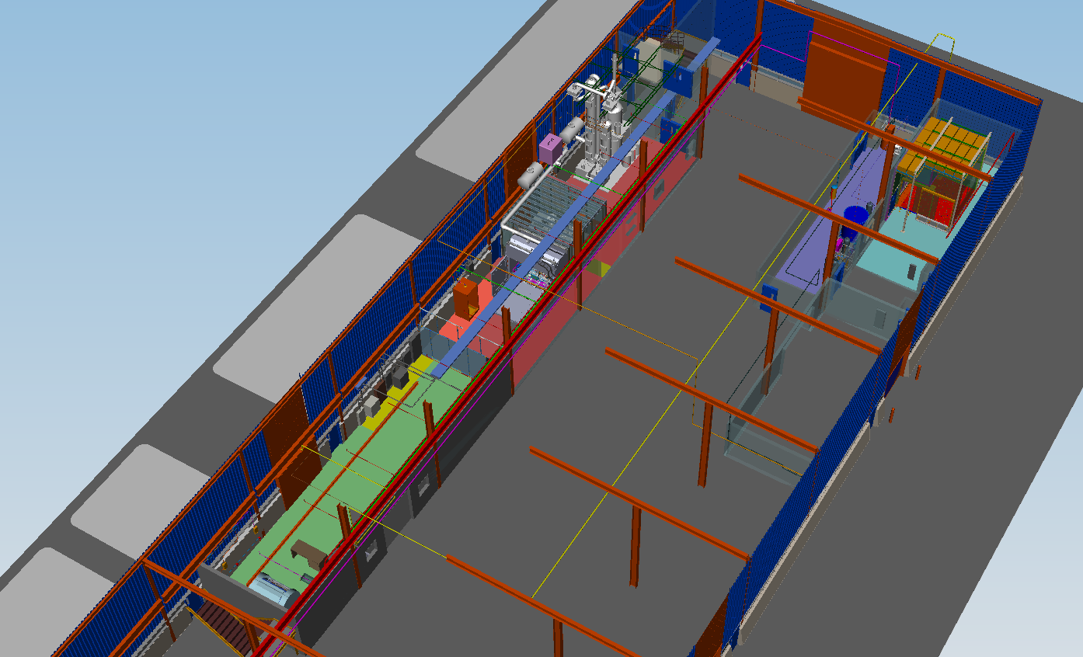
General Layout of IB4 & Path of Cavity
Utilities Area
Chemical
Work Area
General Work Area
High Pressure Rinse & Clean Assembly Area
N

Slide 13
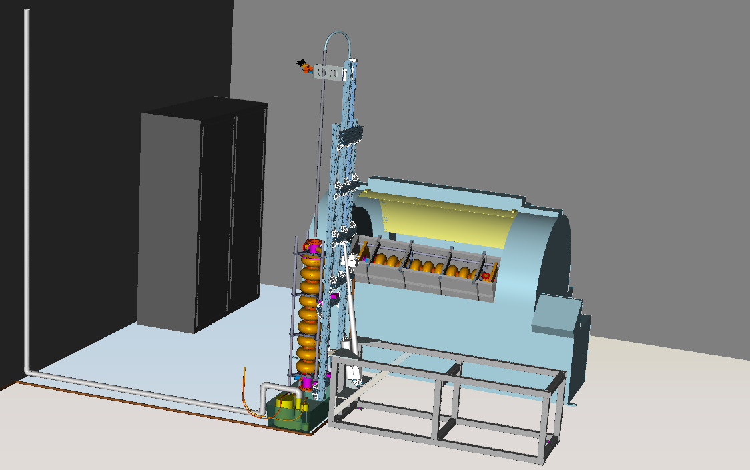
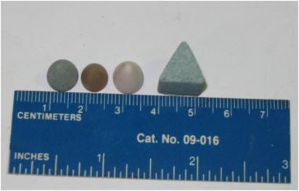
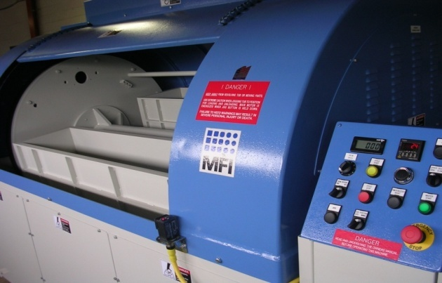
Tumbling Area

Slide 14
What is tumbling?
Tumbling is a mechanical polishing process in which the inside of the cavity is filled with abrasive material and then rotated at high speeds.
Tumbling materials include man made materials like plastics and ceramics and natural materials like corn cob or walnut shells.
Main Shaft up to 115 RPM
Individual Barrels 115 RPM in opposite direction to main shaft

Slide 15
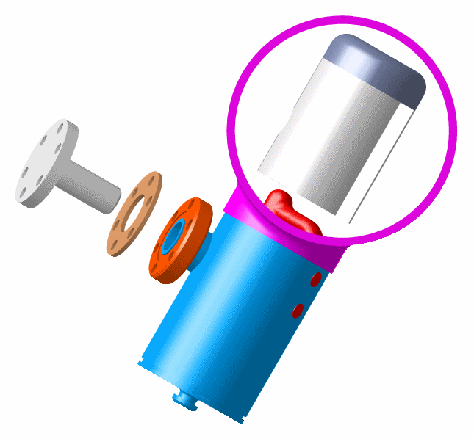
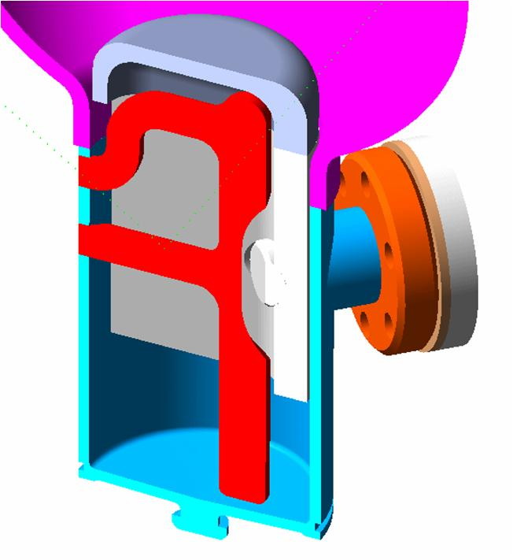
9 Cell Cavity Tumbling
HOM Can Must Be Protected or the Antenna Would be Destroyed.
Caps are Made From Niobium to Avoid Contamination.

Slide 16
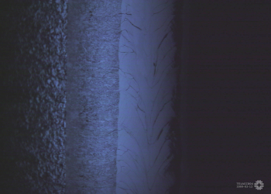
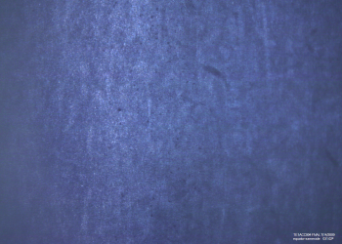
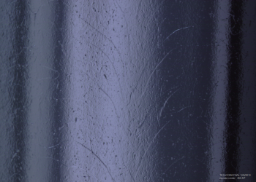

Why do tumbling?
Unprocessed
Remove weld bead at equator cavity created from E-beam welding.
Yields surface finishes(Ra) on the order of 10s of nanometers. Best by EP alone is 200 nanometers.
Relatively fast process.
Environmentally friendly.
Tumbled
10 mm Scale Bars
Electropolished
Why not do tumbling?
Dirty!
Dirty!

Slide 17
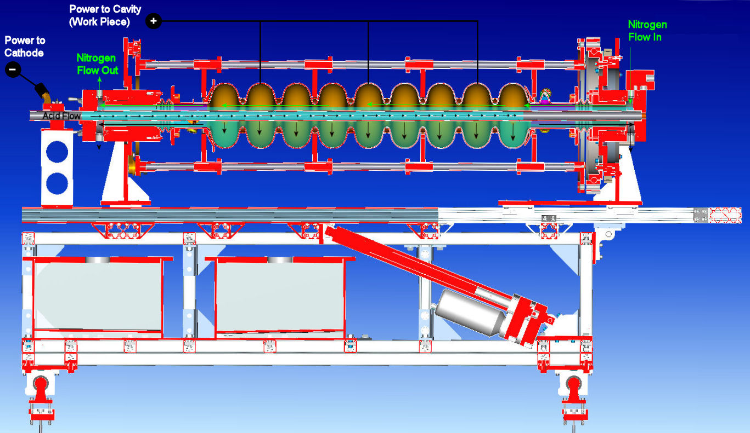
Electropolishing – Central Processing Step
e⁻
9 Parts by Volume 98% Concentrated H₂SO4
1 Parts by Volume 49% HF
14-18 Volts, 50 ma/cm²
25-30 C
Nb → Nb⁵⁺ + 5 e- → Nb₂O₅
Nb₂O₅ + 10 HF ⇔ 2 NbF₅ + 5 H₂O
e⁻
Nb⁵⁺
Nb⁰
NbF₅
2H⁺ + 2e⁻
H₂
MUST CONTROL VISCOUS BOUNDARY LAYER
Rate determining step diffusion of niobium salt to bulk
Acid flows through the cavity from the cathode
Cooling provided by externally cooling acid – want to change
Nitrogen purge because of hydrogen evolved
Cavity rotates at about 1 RPM
Cavity horizontal during process and vertical during rinse

Slide 18
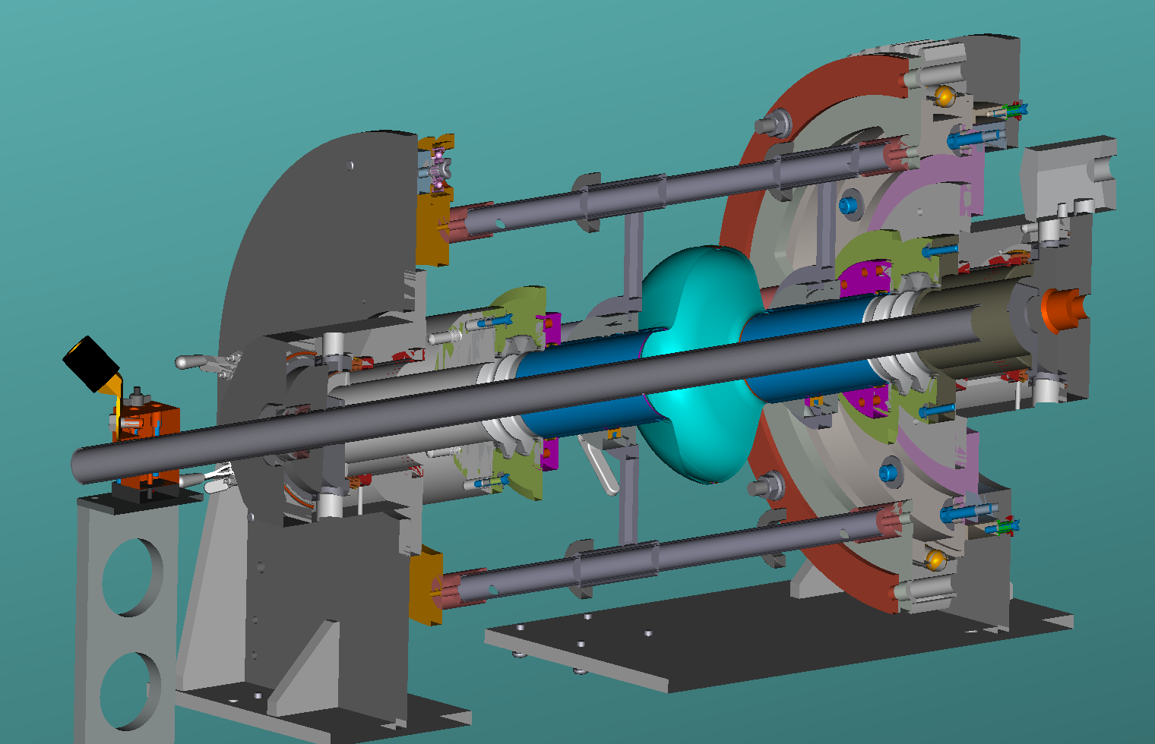
Single Cell Tool

Slide 19
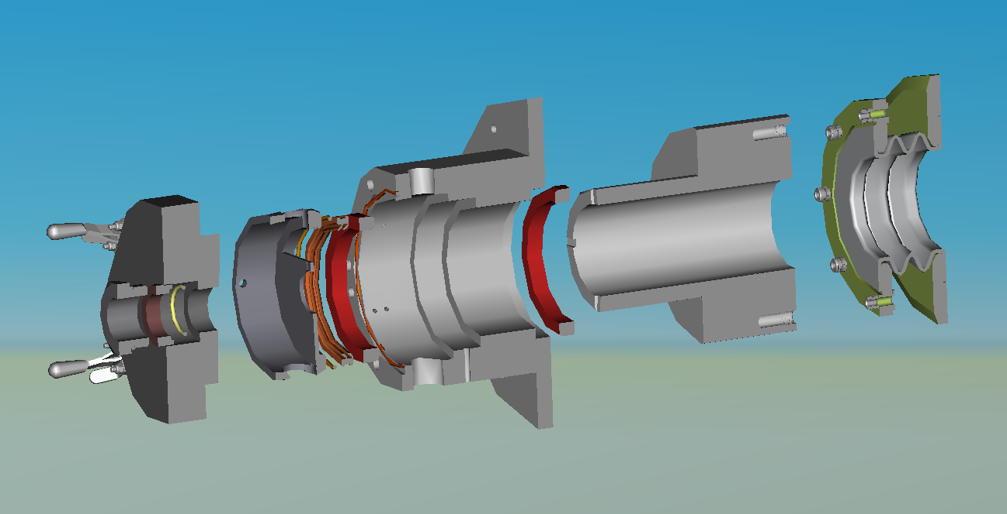
Cathode Side End Group
Resistoflex Teflon Bellows with SS Flanges
Teflon Dam
Stationary Teflon Block
Rotating Teflon Block
Tamshell Rotating Seal
Polycarbonate End Cap
Teflon Bearing Housing
Polycarbonate Nut – Fine Thread
FEP Encapsulated Viton O-ring
Teflon O-ring Backer

Slide 20
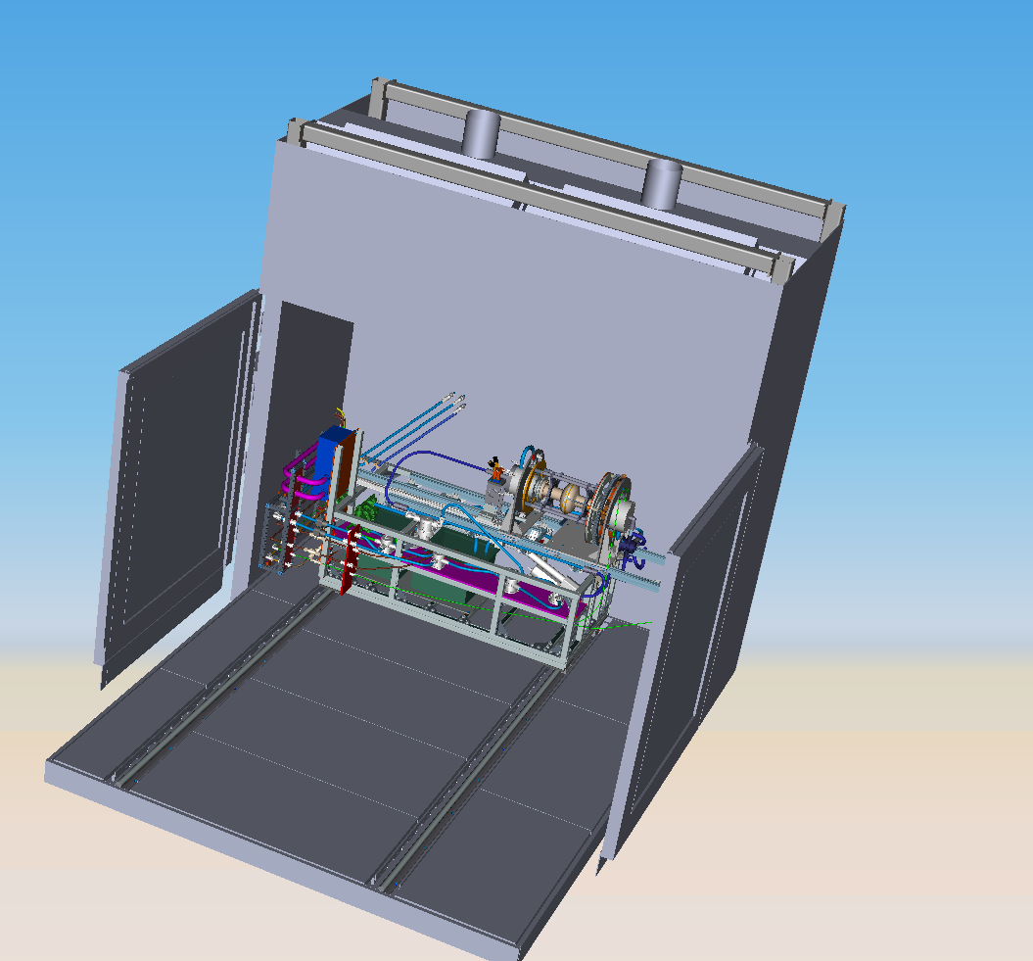
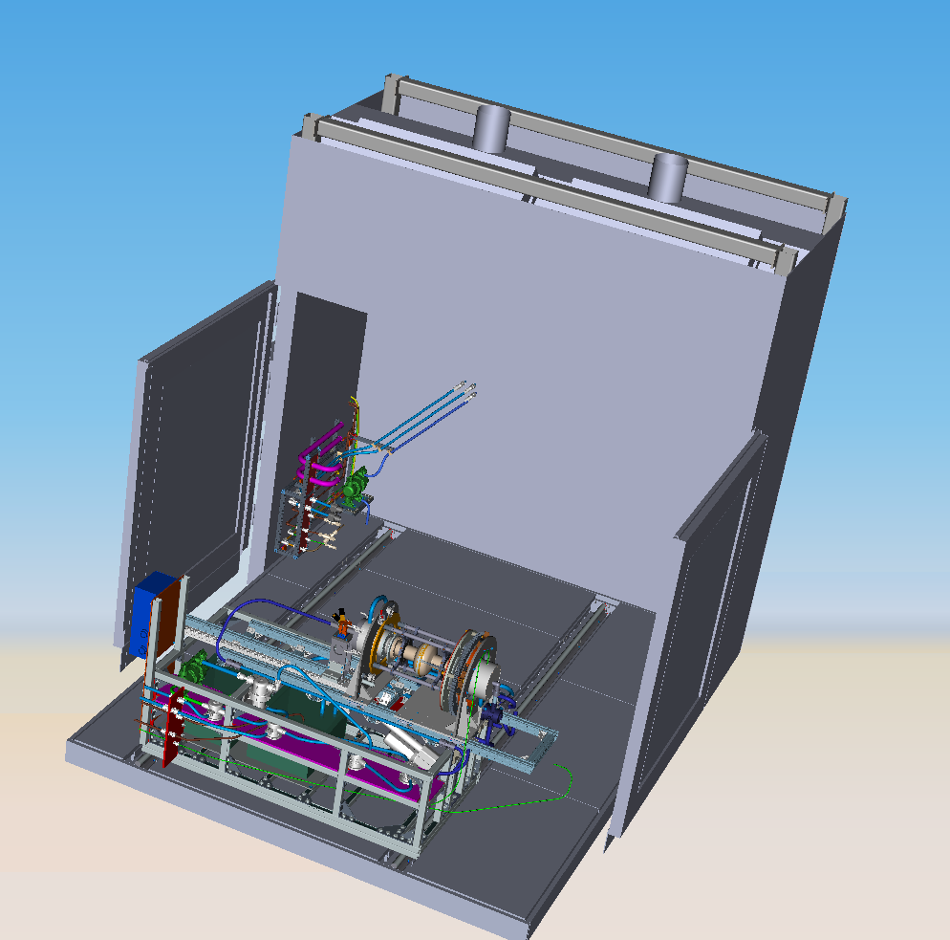
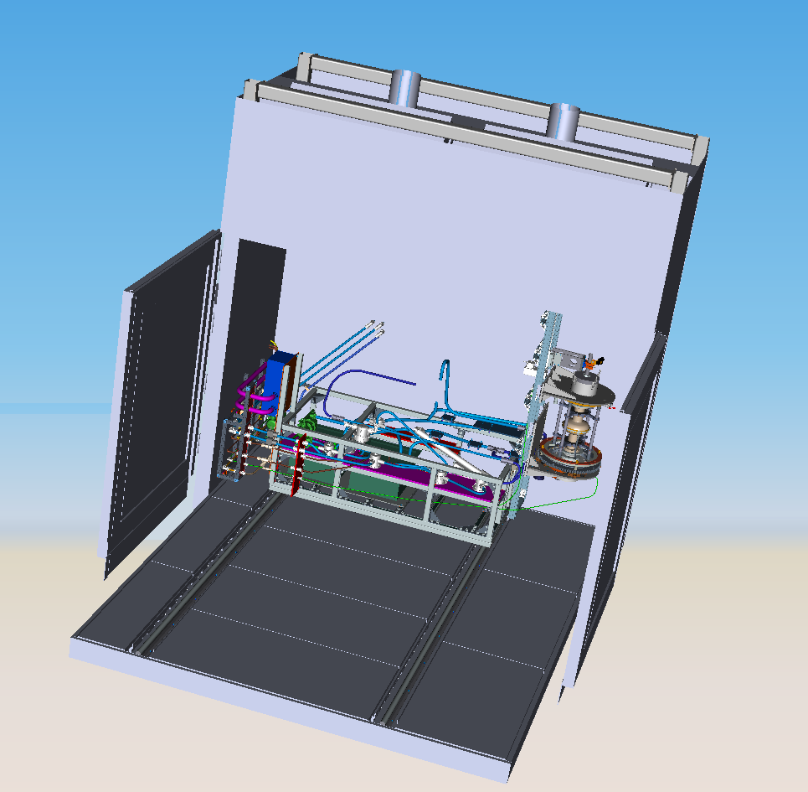
Electropolishing Tool
Operated in a cabinet to mediate any potential gas or vapor risks
Process as “hands-free” as practical
All wetted parts should be made out of PVDF, PFA, or PTFE
Sled comes in and out of cabinet for ease of assembly/dissassembly
Heavy integration of safety components in operation

Slide 21
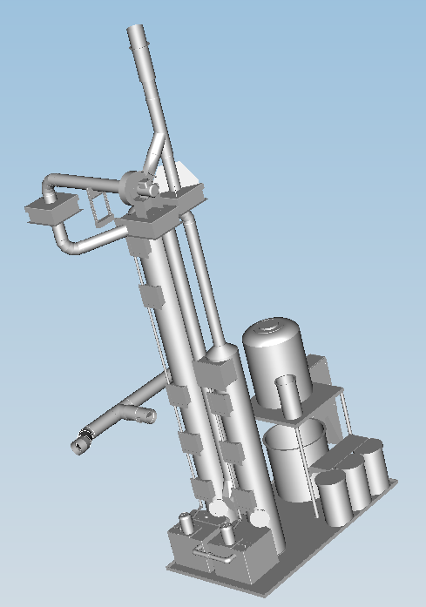
Chemistry Area - Safety
Safety was and is the number one consideration in the design of the ICPA.
1000 CFM Scrubber to clean process air.
Neutralization system to pH adjust process effluent.
All areas with concentrated chemicals have 2 to 3 layers of containment. Potential spills automatically trigger a pump which contains the spill in a drum.
Several Monitoring Systems
Safety Showers/Eye Wash Stations

Slide 22
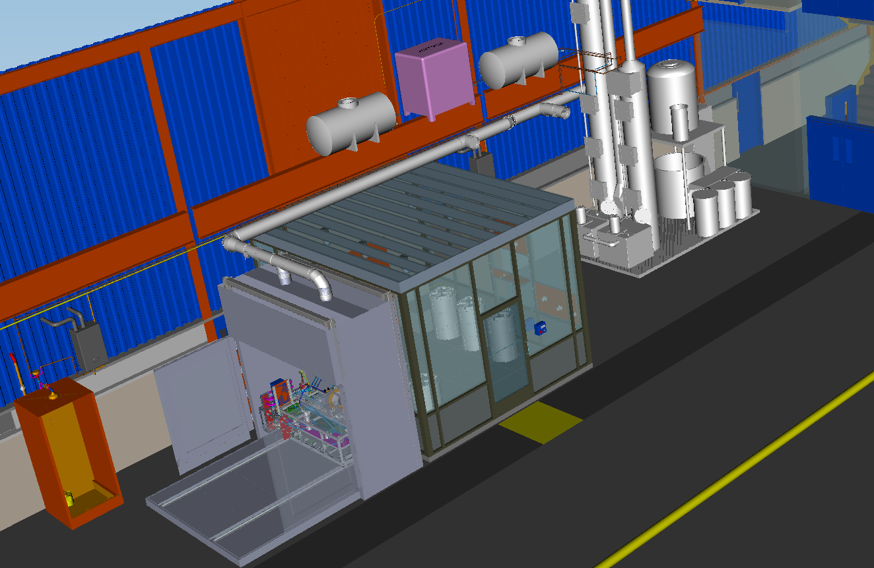
Chemistry Area
Safety Shower with 20 GPM Tepid Water
1000 CFM Scrubber & Dilute Acid Neutralizer
Chemical Storage Room
Electropolishing Tool and Cabinet
Secondary Spill Containment Floors

Slide 23
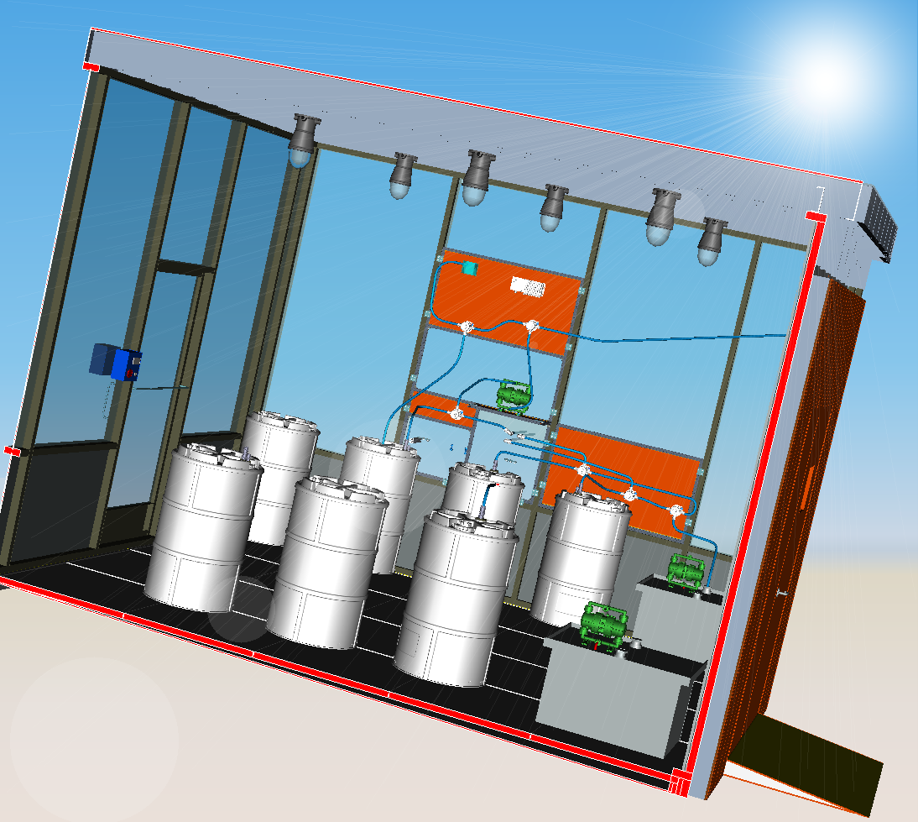
Chemical Storage Room - Safety
30 Gal.Drum in 55 Gal. Over-pack
Secondary Containment Floor
Delivery Door

Slide 24
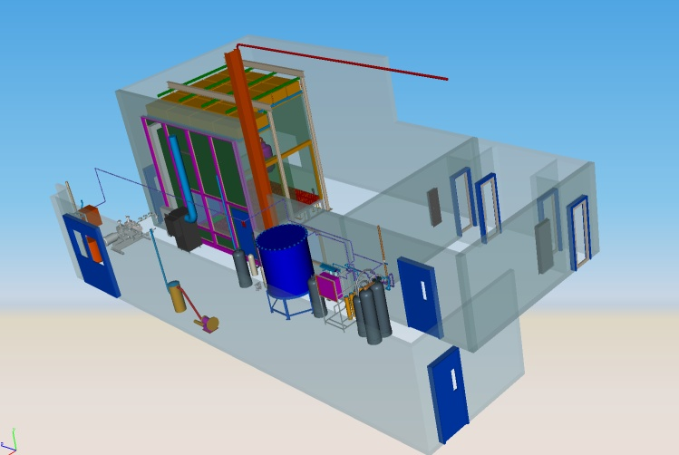
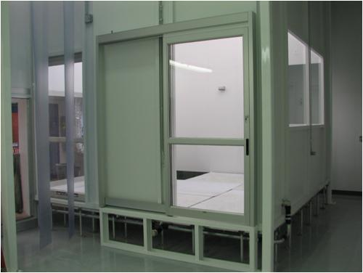
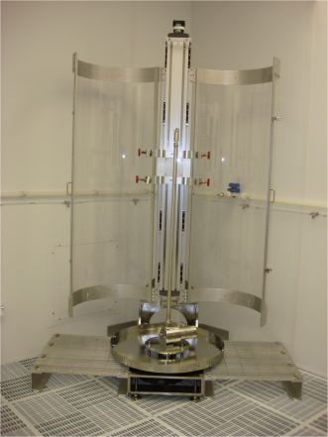
High Pressure Rinse – Clean Room Assembly Area

Slide 25
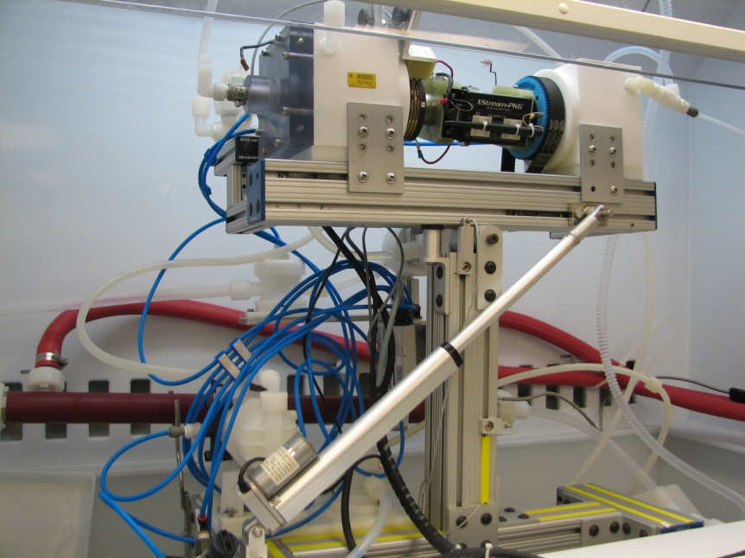
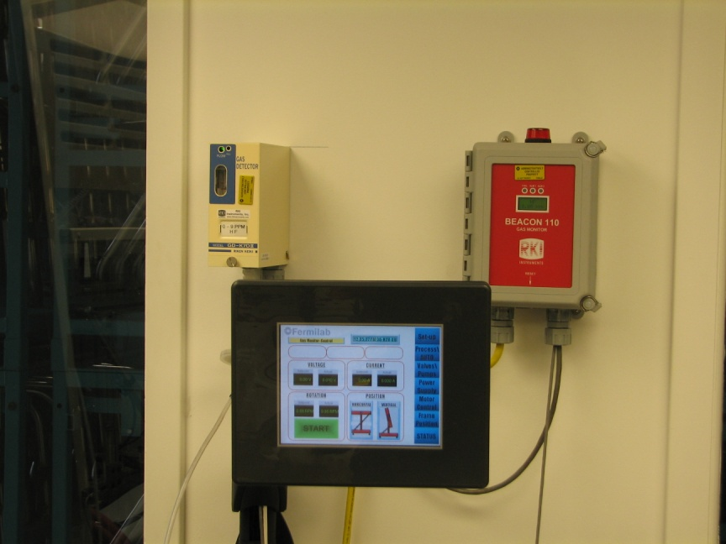
Preliminary Results – 3.9 EP
150 Micron EP at Able Using Fermilab Tool
US Rinse at A0
High Temperature Bake in the Village
Light Ep at Able
HPR at A0
Cold Test at A0

Slide 26
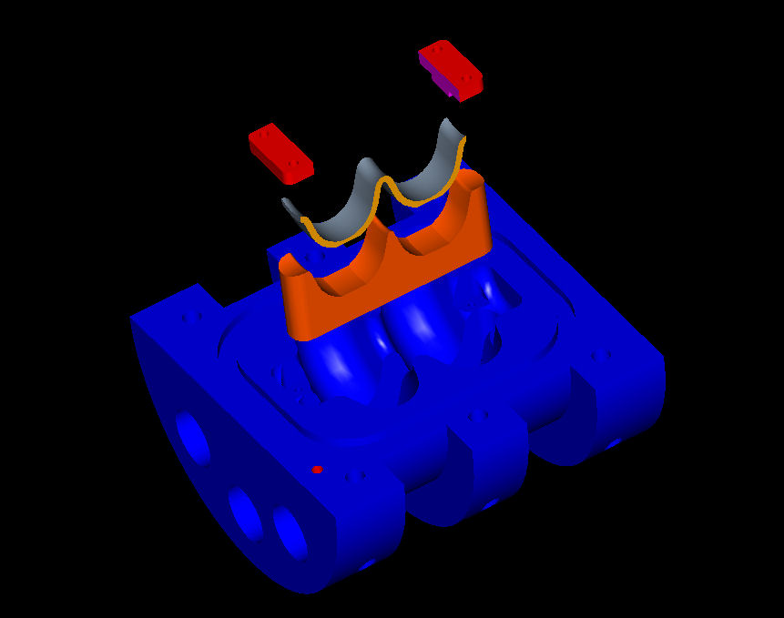
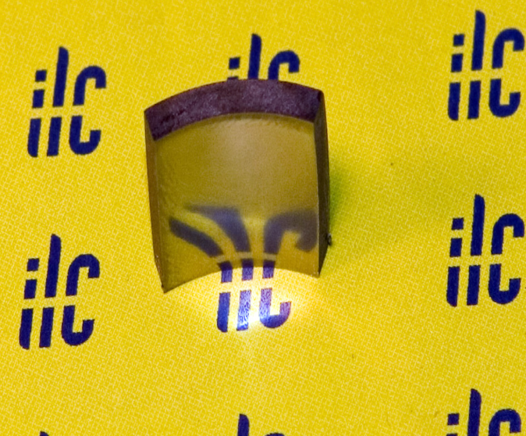
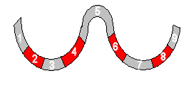
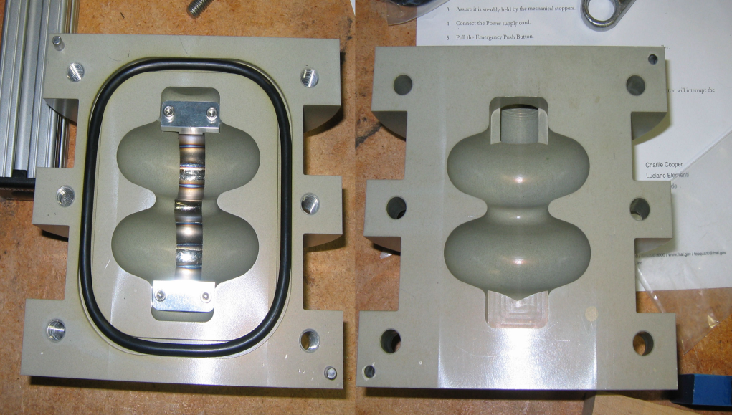
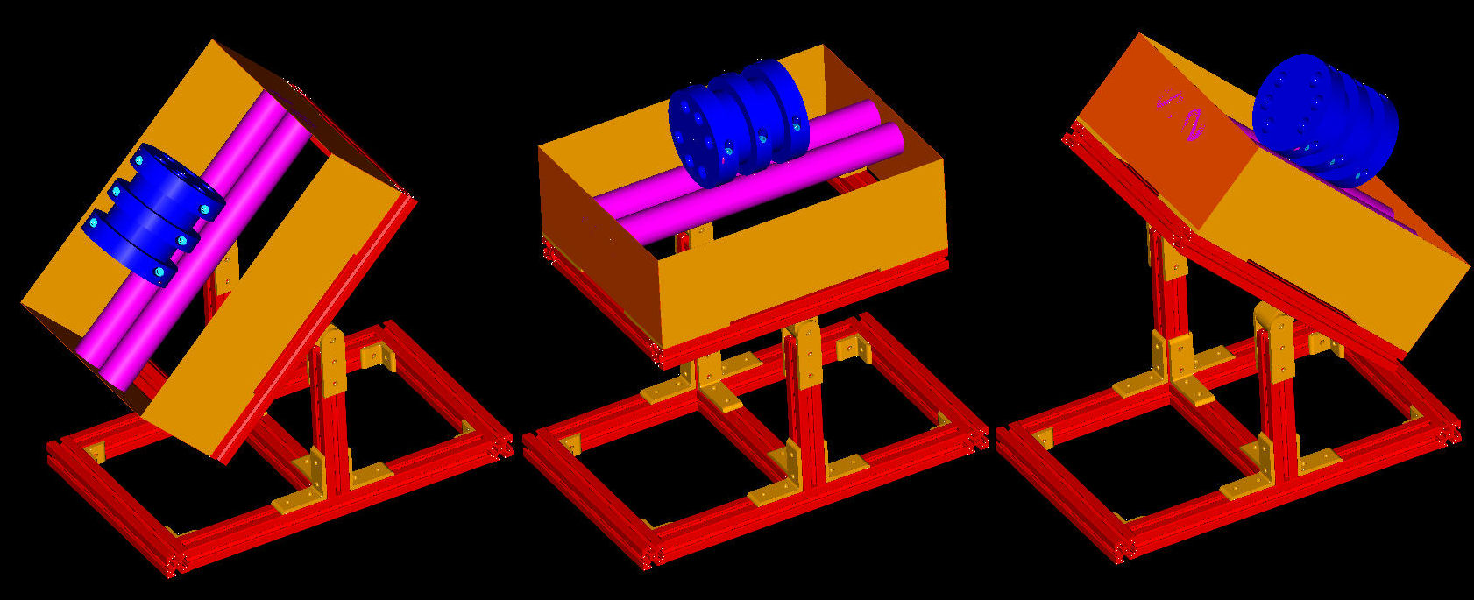
Coupon Tumbling 3.9 GHz Geometry
Photograph by Tom Nicol
Rotation at +/- 20 degrees from horizontal

Slide 27
40 MV/m!
Unprocessed
Tumbled
Electropolished
ACCELL manufactured single cell 1.3 GHz Cavity
100/120 micron tumbling
40 micron EP at Argonne
3 hour 800 C bake at JLab
20 micron EP at Argonne
HPR at Argonne

Slide 28
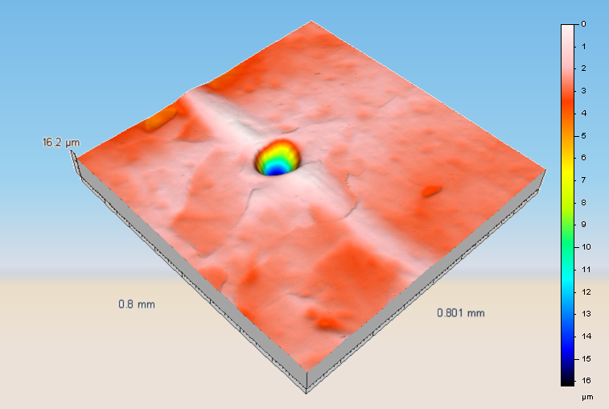
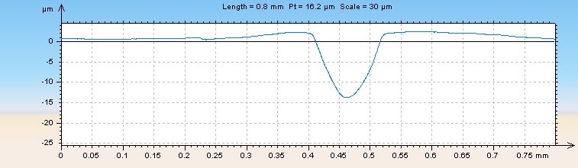
40 MV/m?

Slide 29
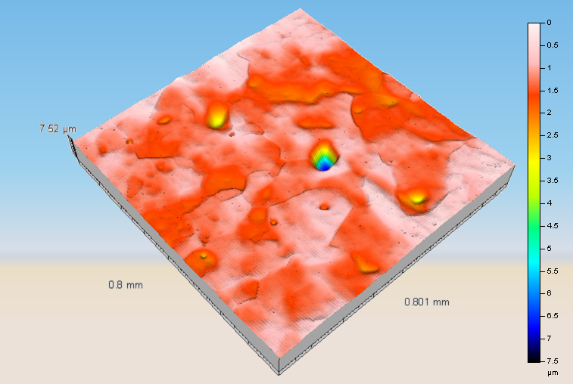
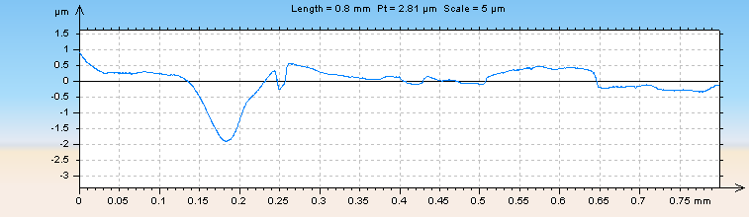

Slide 30
Work to Come
Finish Integrated Cavity Processing Apparatus
Tumbling
Nine Cell Tumbling
Perfect Medias Used for Smooth Finish and Minimal Contamination
Chemical – Mechanical Tumbling
Electropolishing
Decouple Acid Flow From Acid Cooling
Real Time Fluorine Monitoring
Eliminate Sulfur Precipitation

Slide 31
