Slide 1
CERN Strategy for Crab Cavities
E. Ciapala, E. Jensen, J. Tuckmantel.
CERN
US-LARP CM14
Fermilab, April 26-28, 2010.

Slide 2
CERN Strategy for Crab Cavities
Crab Cavities – Introduction
CC09, Chamonix 2010
IR Upgrade
Compact cavities
Study Issues
Conventional cavities
Milestones
Conclusions

Slide 3
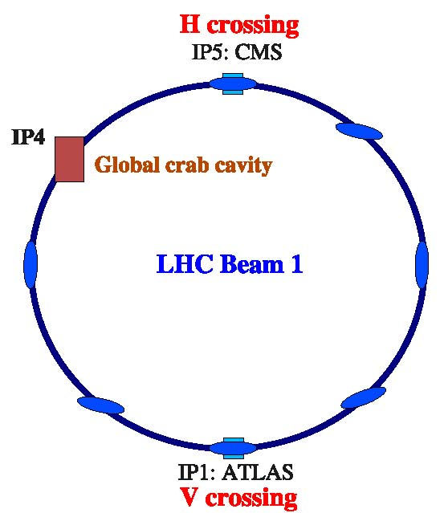
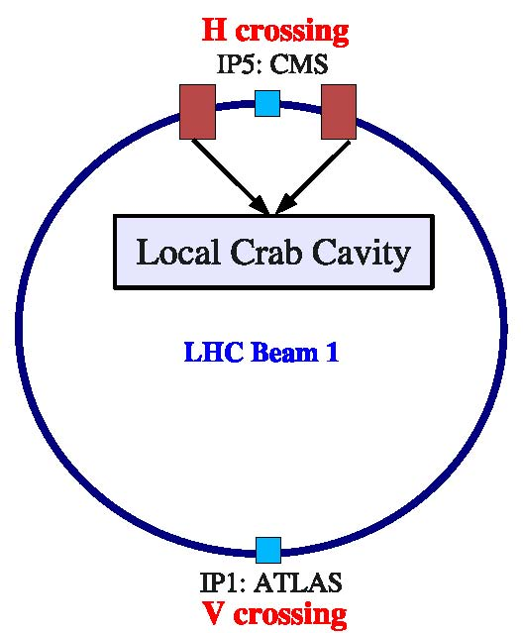
Global and Local Schemes
phase I/II
F. Zimmermann

Slide 4
CC Workshop 2009 & Conclusions
Time scale for 2014/15 shutdown too short, even to install a Global Scheme in IR4
Space reservations in IR4 for ADT upgrade and ACN installation needed to be kept open
Better to longer-term pursue Local Scheme around the experimental IRs, using compact cavities.
‘Down select’ the compact cavity options
CC09 Wind-up meeting
Crab Cavities considered a very attractive option compared to intensity increase, further work strongly encouraged by CERN management.
BUT Do not use LHC as a test bed !
Issues with machine protection to be studied
Test a Crab Cavity first in SPS
Look at possibility of installing the ex-KEK crabs in SPS.

Slide 5
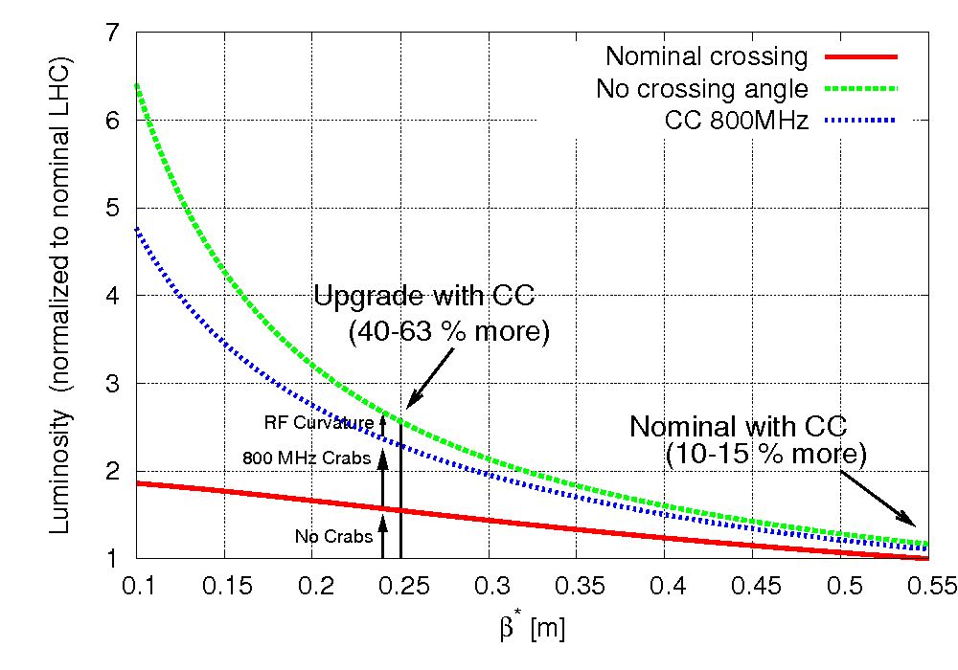
LHC IR upgrade proposal
Nominal luminosity 1.0E34 with 1.1E11 particles/bunch
Ultimate 2.3E34 with 1.7E11/bunch (Needs cryo upgrade in IRs)
Upgrade for 5-6E34, keeping 1.7E11 needs (amongst other things)
New triplets with lowest possible β* (~20 cm), based on high field Nb3Sn (or Nb3Al)
Compensation of geometric effect with crab cavities
Considerable luminosity increase for β* <25 cm

Slide 6
Compact Crab Cavities
Main Goal : Compact Crab Cavities for LHC Local Scheme
Since CC09 down-selection has evolved..
Some candidates fitting in the normal 194 mm beam separation regions:-
HWDR JLAB J. Delayen
HWSR SLAC Z. Li
DR UK,JLAB G. Burt/H. Wang
Kota KEK Kota
Covered in talk by R. Calaga, and
dedicated talks by
J. Delayen and Zenghai Li.

Slide 7
On Compact Crab Cavities for LHC Local Scheme
Comparison based on basic common parameter set, e.g.
Beam separation 194 mm CL to CL
Beam pipe diameter 42 mm
Frequency 400 MHz
Integrated kick identical
On the down selected options:
Do the full design (mech. drawings) – (perhaps also do this for other preferred designs)
Construct copper prototypes (to check construction methods)
Build Niobium versions
Do bare cavity tests
Construct couplers
Design of HOMs, RF components
Design & Build cryostats
Test in SPS ….
A strong R&D program with hardware prototyping needs to continue.

Slide 8
Studies
Fundamental issues:
Machine protection
Collimation
Orbit control, orbit feedback
Impedance, Q external, power requirements
Operational issues :
Tuning,
Ramping,
RF noise
Effects of RF trips
See next talk R. Calaga
Inter related

Slide 9
KEK Crab Cavity in SPS
A working group under E. Metral (CERN) has made a preliminary study (end 2009) with some basic conclusions:- R. Calaga – next talk
=> First tests could only be in 2012
Power system (IOT) needed, LLRF & Controls
Probably need to power test & condition before installing in SPS..
CRAB SPS Studies by Hyung Jin KIM ( Acc Systems B)

Slide 10
Conventional Elliptical Cavities
‘Conventional’ elliptical cavities
Global Scheme discounted due to time scale imposed by IR upgrade in 2014/5
Space availability in IR4 was also a concern
BUT
Time constraints changed due to merging of upgrade phases (new proposal….)
Space reservation in IR4 for ACN now less likely to be needed (SPS RF system upgrade)
Detailed study
by Liling Xiao, Zenghai Li ,CC09
Test of Conventional CC in SPS or LHC IR4…
Mitigation of risk on embarking on long R&D program for compacts
Limited fundamental development needed
Interest in doing a CC test in SPS at a nominal frequency (no bunch pattern restrictions)
Possibility to test the cavity in LHC
Test of Global Scheme in LHC (with some luminosity gain possible)

Slide 11
Timeline
Milestones :
Towards a full local scheme around IRs 1 and 5 in 2018.
First compact cavity with cryostat mid 2014 ?
SPS test of compact cavity 2014/15, use elliptical if this appears unachievable ?
Possible test in IR4 could follow to demonstrate luminosity
Production and test of compacts 2015-2017
Installation 2017/2018

Slide 12
Conclusions
IR upgrade Phases 1 & 2 may now become a single upgrade
Crab cavities offer significant luminosity improvement, without intensity increase, important issue for LHC and the whole injector chain.
“Highly speculative” but needs to be pursued vigorously
Has become an integral & important part of the upgrade study
(L. Rossi Task Force)
Baseline is compact cavities with elliptical as back up for proof of principle & studies in SPS at an early stage
Important beam studies need to be continued.
There are many challenges:
Beam issues, machine protection, SC technology…..
Talks at this meeting
Dedicated meeting on CCs Wednesday p.m.

