Slide 1
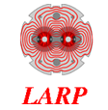
LQS01a Test Results
LARP Collaboration Meeting 14
Fermilab - April 26-28, 2010
Guram Chlachidze

Slide 2
Outline
Introduction
Quench History
Quench Locations
Ramp Rate and Temperature Dependence Study
Magnetic Measurements
  Summary
  Active Ground Fault Monitoring System
  LQS01b Test Plan

Slide 3
Introduction
The first long Nb₃Sn quadrupole with a shell-based structure - LQS01a - was tested at Fermilab (Nov. – Dec. 2009) and 200 T/m field gradient was reached
Magnet training was interrupted to avoid coil damage at high currents
Most of the test was performed at 4.5 and 3 K (2 quenches at 1.9 K)
Various system upgrades were implemented at the Fermilab’s Vertical Magnet Test Facility (VMTF) in preparation to LQS01a test
  Quench detection system with current dependent thresholds
  Magnet protection and Strain gauge readout system
  Active Ground Fault Detection System to be implemented at VMTF before LQS01b test
  Upgrade details were presented at LARP CM12 at LBNL, April 2009
LQS01a test readiness review at Fermilab - October 2009

Slide 4
LQS01a coil instrumentation
LQ coils were made of 27-strand Rutherford cable with 0.7-mm Nb₃Sn RRP strand of 54/61 design
Voltage tap system covers the inner and outer coil layers (20 segments per coil in total)
Protection heaters were installed on both the outer and inner coil layers
Details on coil instrumentation and protection heaters will be presented by Helene Felice

Slide 5
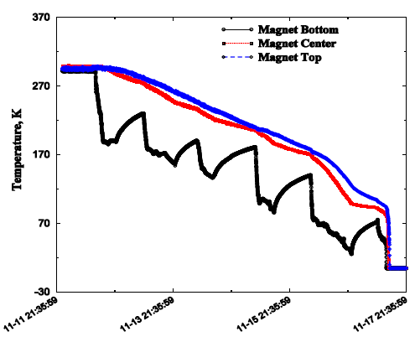
Cool down and first quenches
Helium only cool down - no pre-cool with Nitrogen gas
5 calendar days of cool down from 300 to 4.5 K with 150 K constrain on temperature gradient along the magnet length. 6-7 days required for warm-up back to room temperature
Large voltage spikes at low currents
  Consistent with other coils made of
  RRP 54/61 strand
  Spikes up to 4 V at currents 1.5-2 kA
  Quench detection thresholds adjusted
Less and smaller voltage spikes are
observed at high ramp rates
Few high ramp rate quenches at the
  beginning until the optimal ramp rate
  settings were found
  200 A/s to 3 kA,
  50 A/s to 5 kA,
  20 A/s to 9 kA and
  10 A/s to quench

Slide 6
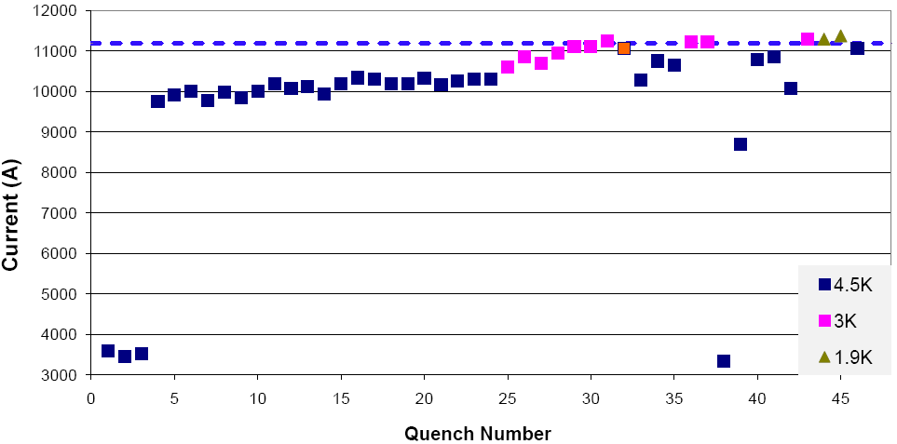
LQS01a Quench History
Target field gradient was reached
200 T/m
Slow start of training at 4.5 K
More training at 3 K
Ramp rate of 200 A/s

Slide 7
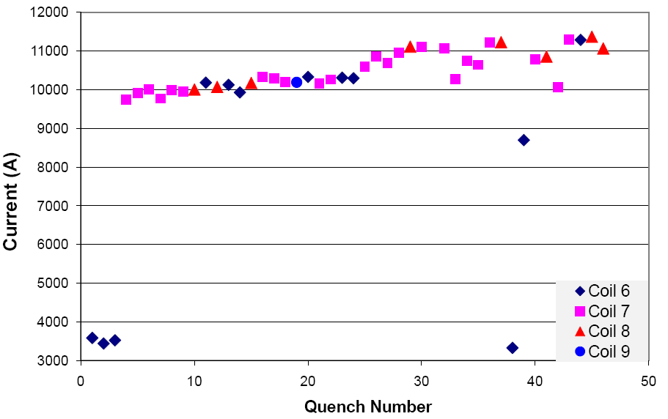
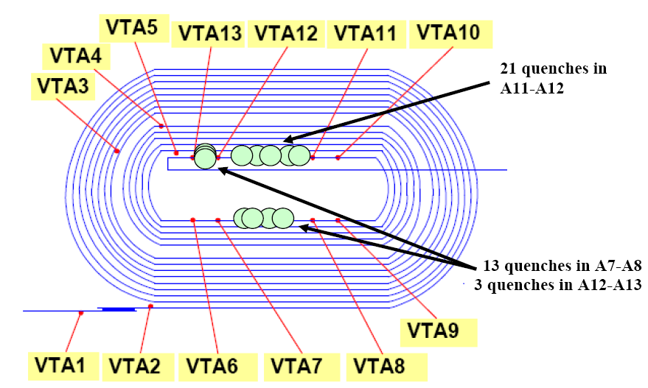
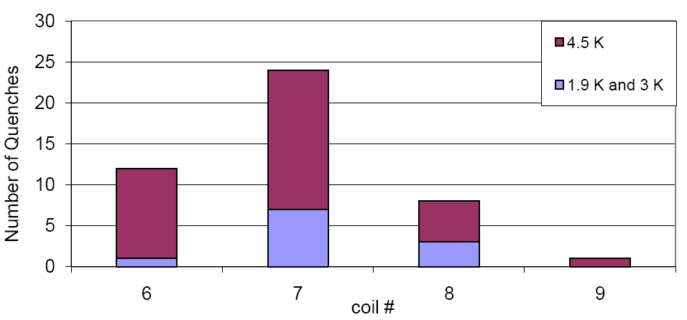
LQS01a Quench Locations
All training quenches
developed in pole turns
No preferred longitudinal
location was observed
High ramp rate quenches
developed in mid-plane
segments
All coils were quenching

Slide 8
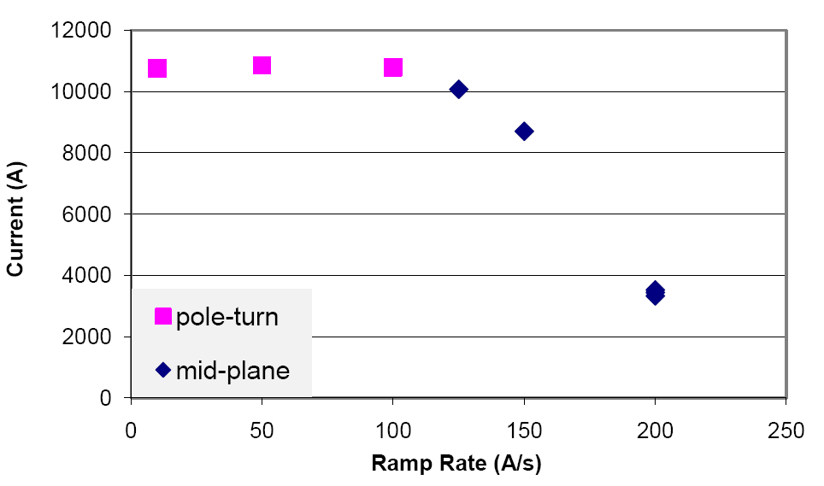
LQS01a Ramp Rate Dependence
Ramp rate study was performed at 4.5 K after the short training at 3 K

Slide 9
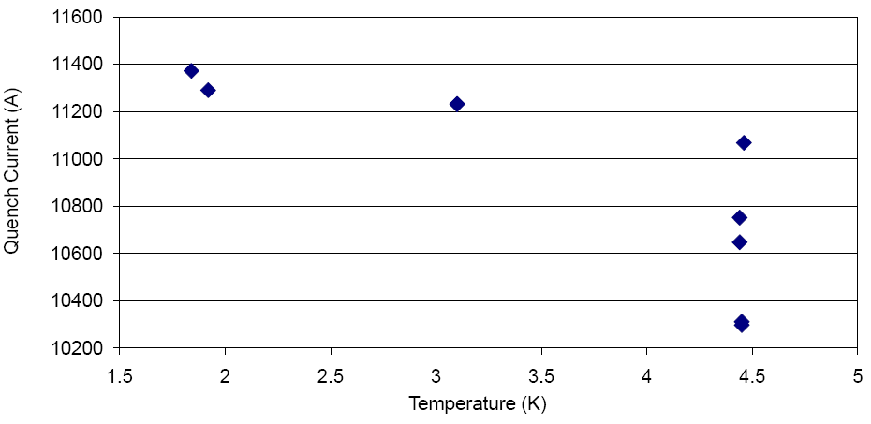
LQS01a Temperature Dependence
Ramp rate of 10 A/s used for the temperature dependence study
Quenches at 4.5 K are shown after the initial training, after the training at
3 K and at the end of test
200 T/m
At the end of test
After the training at 3 K
After the initial training at 4.5 K

Slide 10
Magnetic Field Measurements
Magnetic measurements were made at VMTF using a vertical drive rotating coil system with 82-cm long &1.95-cm radius tangential probe. Warm bore was only ~2/3 of the magnet length
Warm (300 K) measurements before and after the cold test were consistent
Cold measurements included
  Pre-quench z-scan at 6.5 kA
  Z-scans at 12.3 Tm/m (LHC injection, ~ 655 A), 100 Tm/m (5.3 kA) and at 10 kA
  Eddy current loops with the ramp rates 20 A/s, 40 A/s, 80 A/s
  Measurement of dynamic effects
  Stair step measurements from 1.5 kA to 9 kA
Reference radius at 2.25 cm
Unallowed harmonics up to 8 units were
observed at all currents
Iron saturation observed for currents above
~6 kA
No decay or “snapback” was observed in the
dodecapole (b6)
Ramp rate dependence shows little or no
eddy current contribution to the b6 hysteresis
loop
# | Injection ( 0.66 kA) | 100 T/m (5.3 kA) | 10 kA
b_3 | 3.34 | 2.29 | 2.61
b_4 | 7.72 | 6.73 | 6.93
b_5 | 0.06 | 0.17 | -0.08
b_6 | -33.31 | 9.89 | 7.47
b_7 | 0.05 | -0.06 | -0.11
b_8 | -0.28 | -0.98 | -0.38
b_9 | 0.08 | 0.19 | 0.13
b_10 | 0.56 | 0.35 | -0.47
a_3 | 2.03 | 2.28 | 2.28
a_4 | 6.28 | 1.94 | 2.11
a_5 | -0.50 | -0.51 | -0.65
a_6 | -1.14 | -0.12 | -0.29
a_7 | 0.17 | 0.29 | 0.14
a_8 | 0.12 | 0.08 | 0.06
a_9 | -0.29 | -1.09 | -0.16
a_10 | 0.05 | 0.37 | 0.12

Slide 11
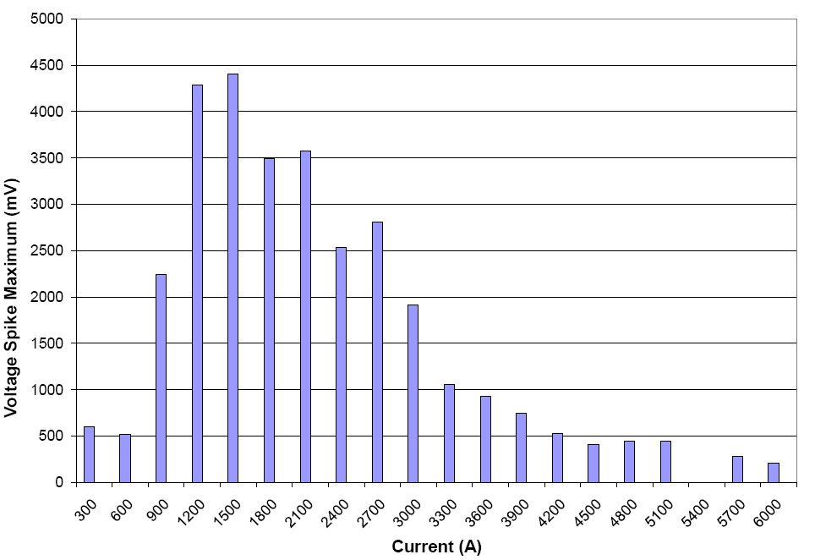
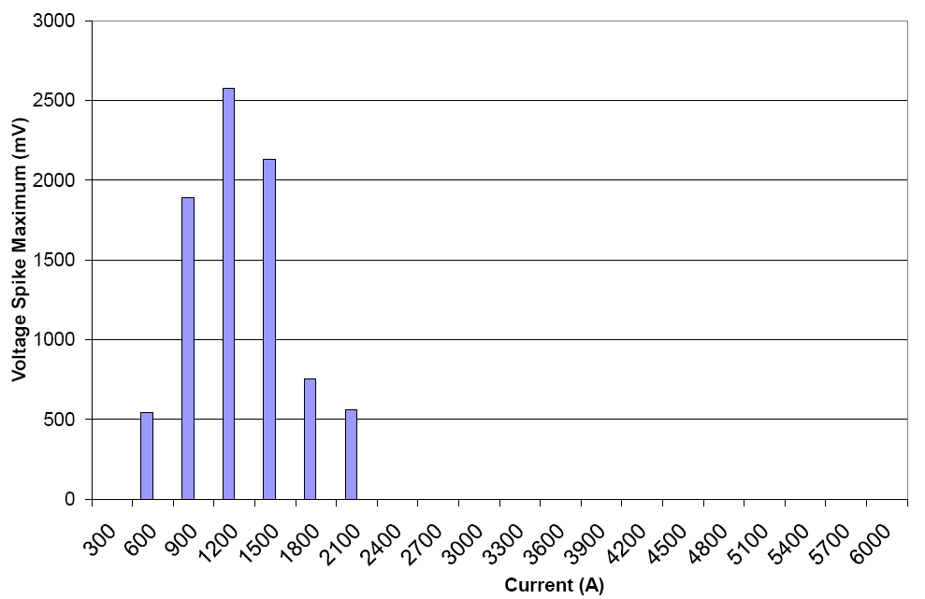
Voltage Spikes
50 A/s
The voltage spike detection system captures
half-coil signals at 100 kHz sampling rate
Different ramp rates result in the different
Voltage spike distribution
Quench Detection system with a current
dependent threshold allowed to avoid low
current trips due to voltage spikes and
keep MIITs low during quench training
- 0.6-0.8 V threshold at quench
Current dependent thresholds were derived
from the spike data analysis
150 A/s
Voltage spike maximum amplitude vs. current
at 4.5 K

Slide 12
Summary
The First LARP Nb₃Sn Long Quadrupole - LQS01a - was successfully
tested at Fermilab
The magnet reached target field gradient of 200 T/m several times at both
3 K and 1.9 K temperatures
Magnet training was interrupted to avoid coil degradation due to possibly non-optimal pre-stress distribution in the magnet
The maximum quench current reached in the test was 11372 A (~202 T/m)
at 1.9 K. At 4.5 K magnet reached ~11100 A (~197 T/m) or ~ 80% of the predicted short sample limit
Ramp rate dependence study confirmed that quench training was not completed and there is margin for improving the magnet performance
Measured RRR for most of segments was above 250, and for the half-coil segments - 290-295

Slide 13
Active Ground Fault Monitoring System
Active ground fault monitoring system at VMTF was proposed in order to increase sensitivity to the detection of ground faults which would not depend on the location of the fault or the magnet inductance
An active ground fault detection circuit includes an isolated 5V voltage source connected in series with the ground resistor
Voltage drop will develop across the 100-Ohm ground resistor in case of coil-to-ground short
  System is “always armed”
Internal review and Failure Modes Analysis completed
First bench testing was successful, currently implementing the system for testing with a magnet (TQM04)

Slide 14
LQS01b Test Plan
Test Cycle I
Room Temperature preparation and cool down
  Magnetic measurements (z-scan) at VMTF
At 4.5 K Operation:
  Cold Electrical Checkout
  Quench Detection Checkout
  Start quench Training, only 2-3 quenches (install Quench Antenna)
Comments:
  LQS01a cold test showed fast quench training at 3 K while start of the training at 4.5 K was rather slow. Since LHe consumption during the 3 K training was less than at 4.5 K (with comparable recovery time between quenches) most of the quench training will be done at 3 K.
At 3.0 K
  Quench Training
  Quench Temperature Dependence

Slide 15
LQS01b Test Plan
At 4.5 K Operation:
  Check quench plateau at 20A/s ramp rate
  Magnetic measurements (6500A)
  Quench Ramp Rate Dependence
  Heater study (low current tests)
At 1.9 K
  Quench Training
Comments:
To avoid possible damage after first few quenches we will do heater to coil hipot to verify proper operation of heaters
  Heater to coil hipot (after first few quenches)
  Quench Ramp Rate Dependence
  Magnetic measurements (90% of max. quench current at 1.9K)
  Outer Coil Conductor Stability Heater test (if required)
  Temperature Dependence Study
At 4.5 K
  Check quench plateau at 20 A/s ramp rate
  Heater study

Slide 16
LQS01b Test Plan
Warm up to 300K
  RRR Measurement
Test Cycle II
Not finalized, depending on results of the Test Cycle I.
Fermilab/VMTF is ready for LQS01b test

Slide 17
Backup Slides

Slide 18
RRR Measurements
In average RRR for most of segments is above 250, and for
half-coil segments varies from 290 to 295

Slide 19
Symmetric Coil Grounding
The 30kA DC power system used for testing magnets in VMTF is grounded at one point on the negative current bus via a 25 Ohm current limiting resistor.
This "asymmetric" grounding configuration will be changed to a “symmetric” grounding scheme in which both the positive and negative bus will be grounded via two100 Ohm resistors to a center tap, which will be connected to ground through another 100 Ohm current limiting resistor.
With symmetric grounding the
maximum coil to ground voltage
will be 500 V (the power system
is designed for a max. of 1000 V)
Symmetric grounding was tested
several times and will be implemented on a permanent base in April.

Slide 20
Modified Strain Gauge Readout System
In order to boost the strain gauge signals in LQS01 magnet we plan to use 4 current sources.
  2 Keithley current sources were used for 36 strain gauges in LQSD magnet providing a maximum current of 1.25 mA.
We plan to increase data saving rate by splitting the SG and RTD (temperature) scans
Reference bridge was built at Fermilab for the calibration and monitoring of the strain gauge readout systems. Measurements with the LBNL portable and Fermilab SG readout systems showed very good agreement with the reference numbers.
  LQSD SG data were read out with the LBNL portable system before and after the test. During the test we used the Fermilab SG readout system. We will continue the same practice for LQS01 test.
Modified SG readout system will be tested in June.

Slide 21
Quench Detection System with Adaptive Thresholds
Proposed solution is to use the FPGA based quench management (QM) system already developed and used to test HINS solenoids at Fermilab.
New FPGA based will work in parallel to the existing
VxWorks based QM system.
Interfacing an FPGA based
quench management system
to VMTF has already been
tested.
First full scale test will be done in
2nd half of April – at the end of
TQM02 test.

