Slide 1
Measurement of Nb₃Sn strand behavior during heat treatment
D. Bocian
I would like to thank people who have share their data and helped during the course of this work:
G. Ambrosio, E. Barzi, D. Dietrich, F. Nobrega, Ch. Scheuerlein, D. Turroni, M. Wake and M. Whitson
LARP CM14, April 27, 2010

Slide 2
OUTLINE
Motivation
Available data
Strand measurements at FNAL
Observations
Future plans

Slide 3
MOTIVATION
During the reaction process of a Long Nb₃Sn coil (part of the LARP Long Quadrupole R&D) some issues were found:
  the inner layer had ~1200 lbs (~5337 N) of longitudinal tension.
  the total length of the outer and inner layers pole parts changed
  by different amounts
Experimental data required in order to understand and model this problem
Modeling of reaction process
  requires experimental data of all coil components
    strand dimension changes during/after treatment
    cable dimension changes during/after treatment
    coil dimension changes during/after treatment
Optimize reaction process, tooling and select the best material for pole

Slide 4
Available data
Strand type | T [°C] | HT duration | Before HT [mm] |  | After HT [mm] |  | ΔL/L [%] | ΔD/D [%] | Ref.
 |  |  | Length | Diameter | Length | Diameter
IGC | 680 | 680C/10’ | 5.08 |  |  |  | - 0.5 |  | 1
OST RRP | 695 | 695C/17h | 304.2 | 0.803 | 304.0 | 0.823 | - 0.07 | 2.5 | 2
PIT | 200 | 200C/6h | 250.47 |  | 25.05 |  | - 0.17 |  | 3
PIT | 695 |  | 300.69 |  | 300.24 |  | - 0.15 |  | 3
PIT | 695 |  | 300.78 |  | 300.50 |  | - 0.09 |  | 3
DT | 680 | 220C/14h+680C/36h |  |  |  |  | 0.1 |  | 4
D. R. Dietderich et al., “Dimensional changes of Nb 3Sn. Nb3Al. and Bi2Sr2CaCu2O8 conductors during heat treatment and their implication for coil design.” Adv. Cryo. Eng., vol. 44b, pp. 1013–1020,
Ch. Scheuerlein et al., „Phase Transformations During the Reaction Heat Treatment of Internal Tin Nb3Sn Strands With High Sn Content”, IEEE TRANS ON APPL. SUPERCOND., VOL.18, NO. 4, 2008,
Ch. Scheuerlein, Private communication,
M. Wake, Private communication,
Cable type | T [°C] | HT duration | Before HT [mm] | After HT [mm] | ΔL/L [%] | Ref.
LARP HQ | 640 | 210C/72h+400C/48h+665C/72h | 1346.0 | 1344.7 | -0.10 | 1
LARP HQ | 640 | 210C/72h+400C/48h+665C/72h | 1345.0 | 1342.9 | -0.16 | 1
LARP LQ09 | 400 | 210C/48h+400C/36h | 1207.0 | 1202.35 | -0.385 | 2
LARP LQ09 | 665 | cont. (+1.2%) 400C/12h+665C/58h | 1207.0 | 1203.55 | -0.265 | 2
LARP LQ06 | 640 | 210C/48h+400C/48h+640C/48h | 1210.0 | 1208.8 | -0.1 | 2
D. R. Dietderich, Private communication,
A. Ghosh, Private communication.

Slide 5
FNAL measurements
Strand reactions:
G. Ambrosio (samples reacted together with LQ coil #10) July 2009
D. Bocian (samples reacted together with LQ coil #12) October 2009
D. Bocian (small oven at FNAL - East oven) February 2010
D. Bocian (small oven at FNAL - West oven ) March 2010
Measurement goals:
Length and diameter changes
  Strand sample length: 50, 100, 200, 300 and 560 mm
  Strand types: RRP 54/61 and RRP 108/127
Strand „untwist” during heat treatment
  Twist change homogeneity
Influence of sample preparation process
  Different sample ends preparation: crimped, fused, opened

Slide 6
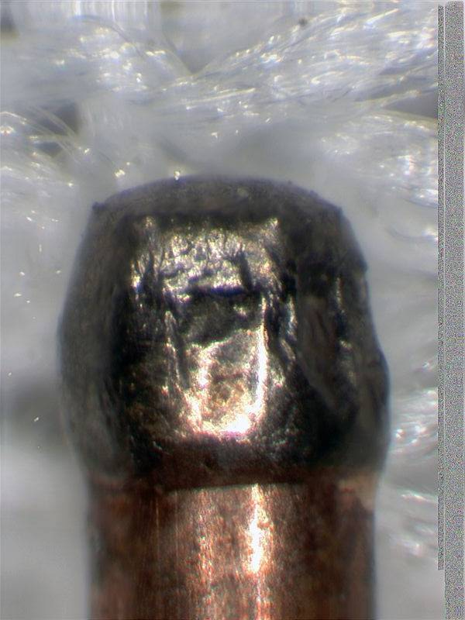
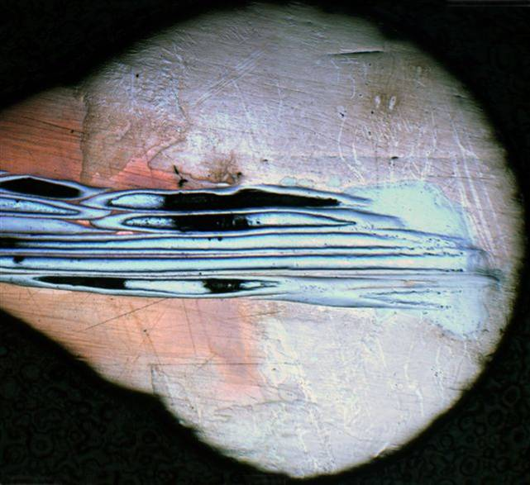
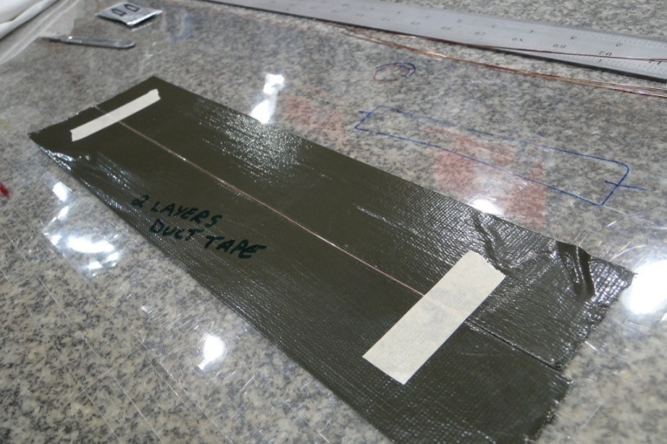
Sample preparation
SAMPLES - reaction 1
(54/61 - billet #8648-10):
2 x ~300 mm crimped
1 x ~560 mm crimped
Samples were inserted inside 1 mm
inner diameter quartz tube.
In reaction 4 also sample in tube
made from mica were reacted to
check possible environment influence
SAMPLES - reaction 4
(54/61 - billet #9532
108/127 – billet #10400):
For billet #9532:
4 x ~48 mm fused
4 x ~48 mm non-fused
2 x ~100 mm fused
2 x ~100 mm non-fused
2 x ~200 mm fused
2 x ~200 mm non-fused
4 x ~300 mm fused
6 x ~300 mm non-fused
For billet #10400
2x ~300 mm non-fused
Samples painted with temperature resistant marker to check „untwist”
SAMPLES - reaction 2
(54/61 billet #9532):
3 x ~48 mm fused and filed
fused strand end
SAMPLES - reaction 3
(54/61 - billet #9532
108/127 – billet #10400):
For each billet:
1 x ~48 mm fused and filed
1 x ~48 mm non-fused
1 x ~300 mm fused and filed
1 x ~300 mm non-fused
Samples painted with temperature resistant marker to check „untwist”
SAMPLES painting

Slide 7
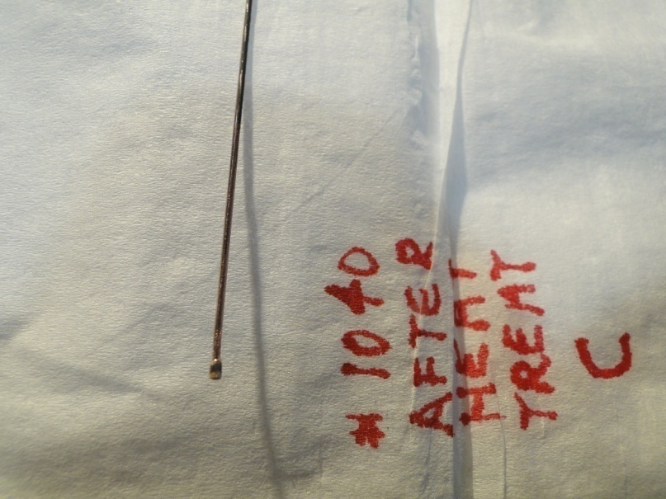
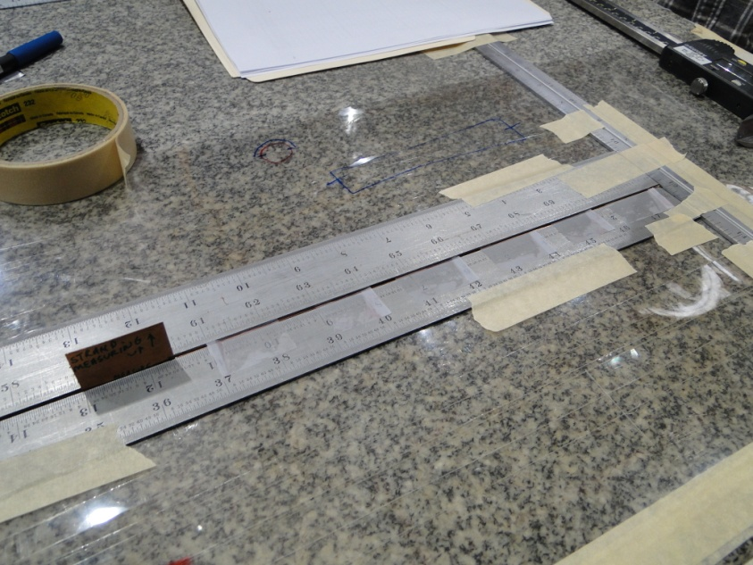
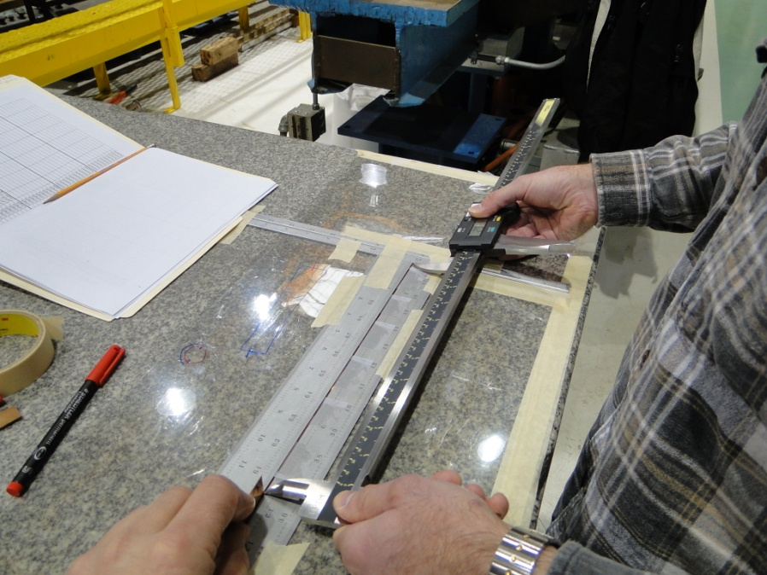
Samples Measurement
The length changes are order of tenth percent → precise measurement of long samples was required.
The error on the diameter was ±0.00025, length ± 0.003 inches.
Each sample was measured 10 times.
A written strand measurement procedure is available (M. Whitson)

Slide 8
Strand measurements at FNAL
Diameter increase show conformance with:
N. Andreev, E. Barzi, D.R. Chichili, S. Mattafirri, and A.V. Zlobin,
Volume expansion of Nb-Sn strands and cables during heat treatment
What is the origin of sample elongation dependence on sample length?
C – crimp, F – fused, NF – not fused (as cut)

Slide 9
Observations from recent measurements
LARP strands type 54/61:
demonstrate elongation for LQ-type heat treatment
    short samples elongate more than long samples
demonstrate radial increase for LQ-type heat treatment
demonstrate twist change
    „Untwist” is a small fraction (4%) to nominal twist (13 mm)
    Twist change is homogenous over sample length
  Remarks:
„Weak” correlation ΔL/L and twist change.
No impact from strand sample preparation procedure

Slide 10
Future plans
Discuss current results with experts (partialy done)
  understand sample behavior,
  what are the initial stresses in virgin strand sample?
Check experimentally dependence sample length vs. elongation for:
  different sample lengths (50 mm – 2000 mm),
  strands 54/61 and 108/127,
  different Heat Treatment duration (relate to non-FNAL measurements)
  fused and non fused strand samples,
Prepare input data for 3D FEM model
  which initial values should be use for simulation?

Slide 11
EXTRAS

Slide 12
Post presentation actions
Prepare and optimize new measurement campaign
  How many samples?
  Which sample lengths (from the range 50 – 2000 mm)?
  Which strands (54/61 and 108/127?)? Fused or non fused?
  Which sample holder? Quartz tubes or/and mica envelope?
  Different heat treatment duration (relate to non-FNAL measurements)
  Different target temperature (stop at 210C, 400 C)?
  React cable samples with the same heat treatment run as for strands?
Decide which initial values use for 3D FEM model?
  Initial stress in strand/cable?
  E-modulus, density, CTE of all intermetallic phases during reaction?

Slide 13
Preliminary analysis diagram for strand
Plastic deformation
due to the stress release
and phase transition?
Plastic deformation
due to phase transition?
Plastic deformation
due to phase transition?
T [°C]
II
III
IV
V
VI
VII
48 h
VIII
640
50°C/h
48 h
400
25°C/h
~48 h
72 h
210
25°C/h
20
Cu₆Sn₅
Cu₃Sn
Nb₃Sn
Distributed tin strand
Courtesy M. Wake

Slide 14
Simulation plan
Temperature 210 → 400°C
Continuation of Sn diffusion to Cu
(Sn melts at 238°C)
Temperature 400 → 640°C
Nb₃Sn formation start
(Sn diffusion into Nb)
Need Nb₃Sn properties
→ tuning of the model
Temperature 20 → 210°C
Linear/non-linear elongation
Temperature 640 → 20°C
→ strand/cable shrinksl
I
T [°C]
II
III
IV
V
VI
VII
VIII
48 h
Preload on Nb (z-axis)
(Nb under tension,
Cu under compression)
640
50°C/h
48 h
400
25°C/h
72 h
~48 h
Strand/cable annealing
( 2 h at 200 °C)
Linear elongation,
Plastic deformation.
210
25°C/h
Cu₆Sn₅
Cu₃Sn
Nb₃Sn
20
7h36’
79h36’
87h12’
135h12’
140h
188h
Ch. Scheuerlein et al.,
IEEE Trans. Appl. Supercond.
VOL.18, NO. 4, 2008,
Temperature=210°C
Sn diffusion to Cu
→ Cu₆Sn₅ formation
Strand/cable shrinkage
Need Cu₆Sn₅ properties
→ tuning of the model
Temperature=400°C
Further Sn diffusion to Cu
→ Cu₃Sn formation,
→ strand/cable shrinks,
→ all Sn reacted
Need Cu₃Sn properties
→ tuning of the model
Temperature = 640°C
→ Strand/cable expand,
→ Plastic deformation?
→ Larger strand cross-section?

Slide 19
400 °C

