Slide 1
Commissioning the LHC Synchrotron-Light Monitors
Alan Fisher
SLAC
LARP CM14
Fermilab
2010-04-26

Slide 2
CERN Collaborators
Stéphane Bart-Pedersen
Andrea Boccardi
Enrico Bravin
Stéphane Burger
Gérard Burtin
Ana Guerrero
Adam Jeff
Thibaut Lefevre
Malika Meddahi
Aurélie Rabiller
Federico Roncarolo

Slide 3
Synchrotron-Light Monitors
Two applications:
BSRT: Imaging telescope, for transverse beam profiles
BSRA: Abort-gap monitor, to verify that the gap is empty
When the kicker fires, particles in the gap get a partial kick and might cause a quench.
Two particle types:
Protons and lead ions
Three light sources:
Undulator radiation at injection (0.45 to 1.2 TeV)
Dipole edge radiation at intermediate energy (1.2 to 3 TeV)
Central dipole radiation at collision energy (3 to 7 TeV)
Spectrum and focus change during ramp

Slide 4
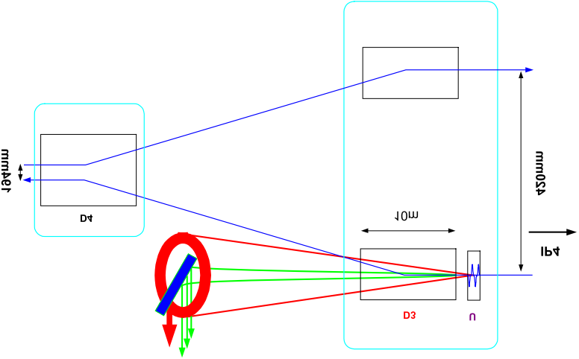
Layout: Emission and Extraction
Cryostat
70 m
194 mm
To RF cavities and IP4
To arc
1.6 mrad
420 mm
D4
10 m
Extracted light sent to an optical table below the beamline
D3
U
560 mm
26 m
937 mm

Slide 5
Calculated Beam Size and Resolution
Beam Energy |  | Beam Size at Source Point |  | Calculated Size on the Camera |  | Increase over Magnified Size (M = 0.3)
(TeV) |  | (μm RMS) |  | (μm RMS) |  | (μm RMS)
 |  | x | y | x | y | x | y
Protons | 0.45 | 1302 | 1244 | 391 | 373 | 1.002 | 0.999
 | 3.5 | 473 | 447 | 146 | 139 | 1.030 | 1.035
 | 7 | 334 | 315 | 98.5 | 111 | 0.983 | 1.179
Ions | 0.45 | 1304 | 1246 | 392 | 375 | 1.003 | 1.004
 | 3.5 | 473 | 447 | 144 | 135 | 1.013 | 1.006
 | 7 | 335 | 315 | 104 | 98.8 | 1.033 | 1.044
Calculation includes geometric optics, depth of field, and diffraction.
400-nm wavelength is used, except at injection, where the undulator spectrum is shifted to the red and infrared.

Slide 6
Optical Table
Extraction mirror
Beam
Table
Shielding
Alignment laser
Calibration light and target
PMT and 15% splitter for abort gap
F1 = 4 m
F2 = 0.75 m
Intermediate image
Cameras
Focus trombone
Slit
Table Coordinates [mm]

Slide 7
Photoelectrons per Particle at Camera
Protons
Lead Ions
Dipole center
Combined
Dipole center
Combined
Undulator
Dipole edge
Undulator
Dipole edge
In the crossover region between undulator and dipole radiation:
Weak signal
Two comparable sources: poor focus over a narrow energy range
Focus moves with energy: from undulator, to dipole edge, and then to dipole center.
Dipole egde radiation is distinct from central radiation only for ω >> ω_{c}

Slide 8
Particles per Bunch and per Fill
 | Protons | Lead Ions
Particles in a pilot bunch | 5×10⁹ | 7×10⁷
Particles in a nominal bunch | 1.15×10¹¹ | 7×10⁷
Bunches in early fills | 1 to 43 | 1 to 62
Bunches in a full ring | 2808 | 592

Slide 9
Photoelectrons in the Peak Pixel
Protons
Lead Ions
Pilot bunch Single nominal bunch Full ring
In one turn In 20 ms
The emission increases with energy while the beam size shrinks, giving a strong variation of the signal on the peak pixel.

Slide 10
Commissioning: 450-GeV Pilot Bunch
Undulators set to 400 A, not 450 (full field)
Some tweaking of the new quench-protection system was needed to keep them from tripping.
79% of nominal emitted power
No problems finding the first image (other than getting the undulators on and some confusion with software)
Only modest intensifier gain needed
No neutral-density or color filters

Slide 11
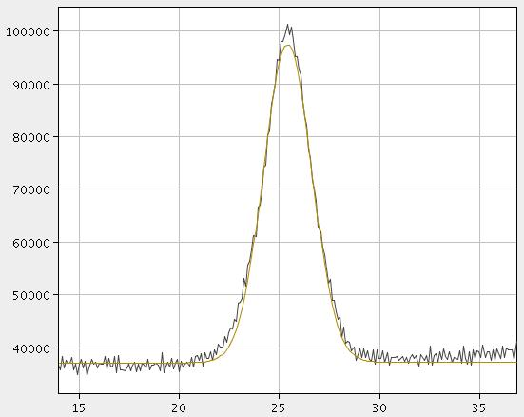
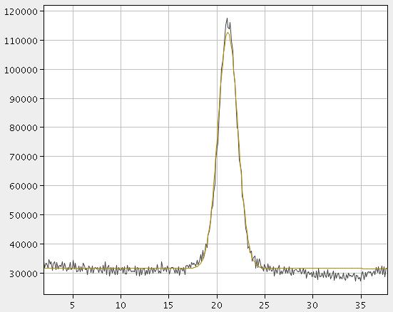
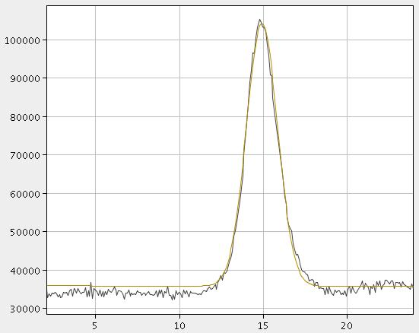
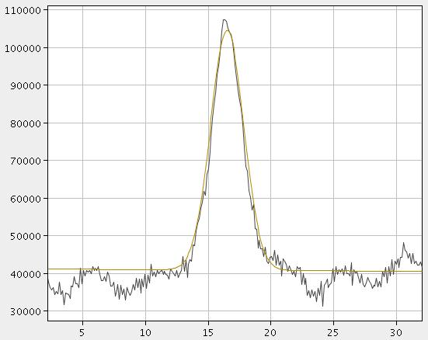
LHC Beams at Injection (450 GeV)
Beam 1
Beam 2
Horizontal
1.3 mm 1.2 mm
Vertical
0.9 mm 1.7 mm
Light from undulator.
No filters. Open slit.

Slide 12
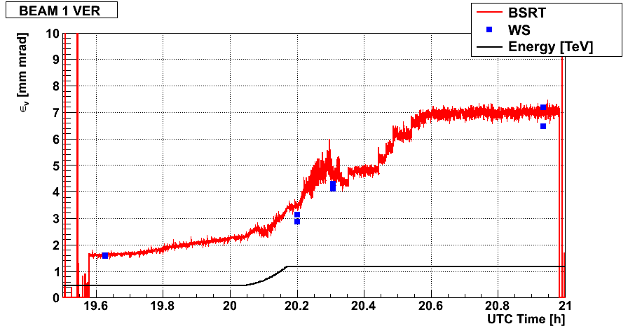
Beam 1 at 1.18 TeV
Vertical Emittance
Synchrotron Light
Wire Scanner
Proton Energy
1.18 TeV has the weakest emission in the camera’s band.
Undulator’s peak has moved from red to the ultraviolet
Dipole’s critical energy is still in the infrared
Nevertheless, there is enough light for an adequate image.
Some blurring from two comparable sources at different distances
Vertical emittance growth before and after ramp

Slide 13
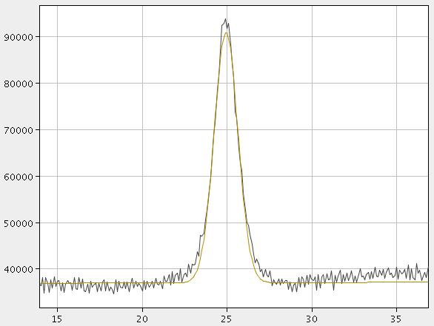
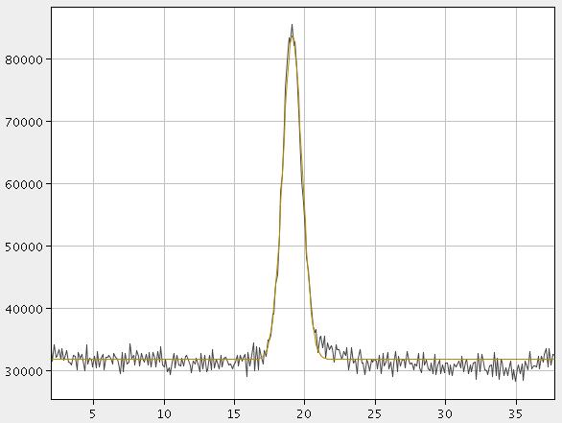
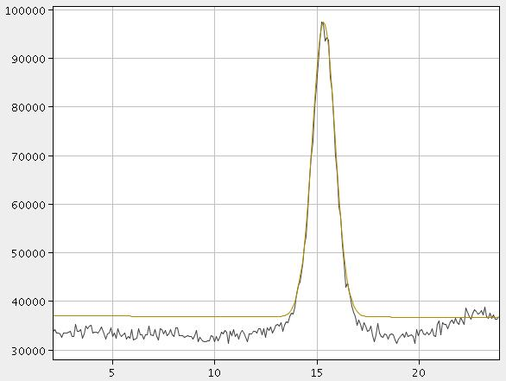
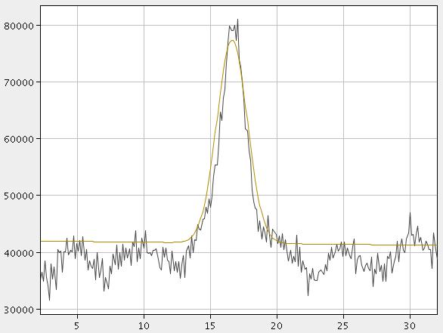
LHC Beams at 3.5 TeV
Beam 1
Beam 2
Horizontal
0.68 mm 0.70 mm
Vertical
0.56 mm 1.05 mm
Light from D3 dipole.
Blue filter. Narrow slit.

Slide 14
Calibration Techniques
Target
Incoherently illuminated target (and alignment laser) on the optical table
Folded calibration path on table matches optical path of entering light
Wire scanners
But adjust sizes for different β_{x,y}
Beam bump
Compare changes in image centroid and BPMs
5 mm

Slide 15
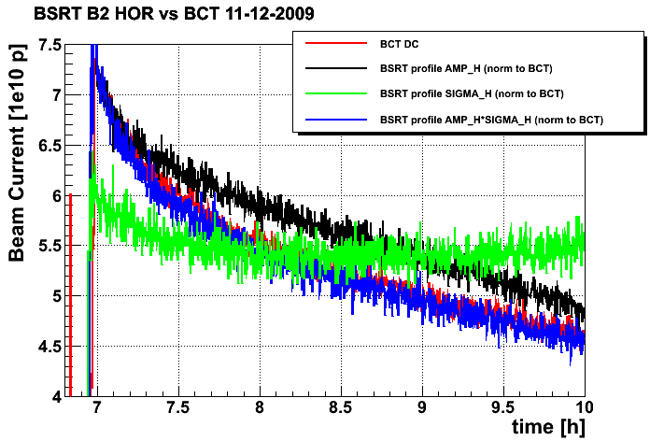
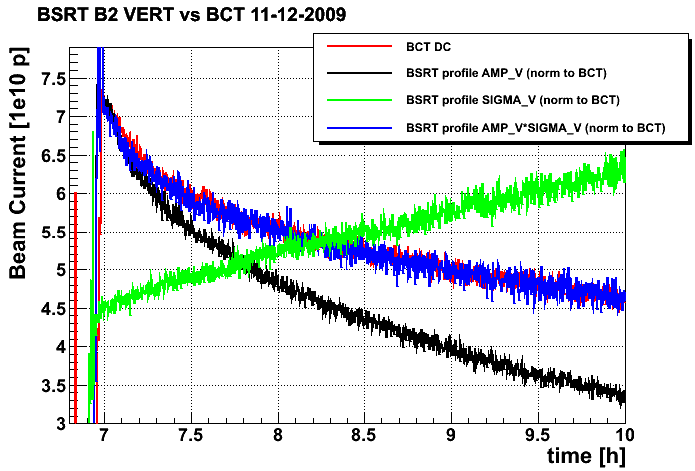
Growth with Time of Beam 2 Vertical Size
In December, Beam 2 was slowly growing vertically, but not horizontally, during fills at 450 GeV.
No data then for Beam 1: Undulator wasn’t available until February.
Perhaps related to the spectral “hump” that was reducing the lifetime?

Slide 16
Vertical Emittance of Beam 1 during Ramp
First ramp to 3.5 TeV, showing emittance growth
Synchrotron light versus wire scanner
Vertical agreement is excellent up to ~2.5 TeV
Adjustments to BSRT settings needed for higher energies

Slide 17
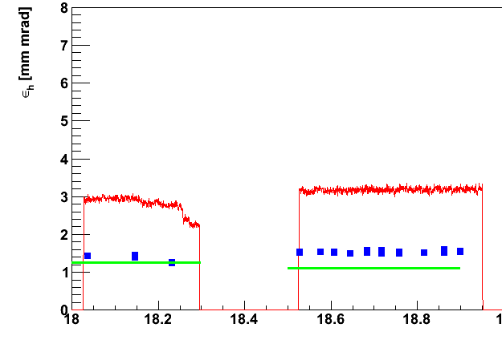
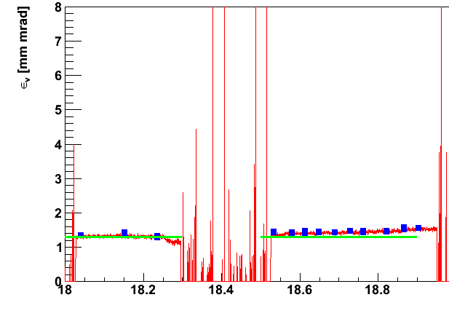
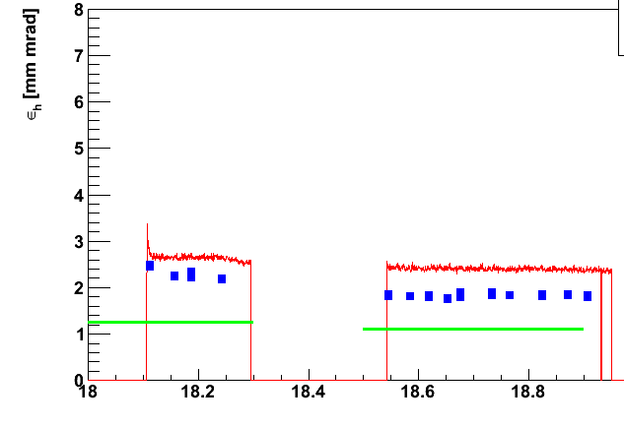
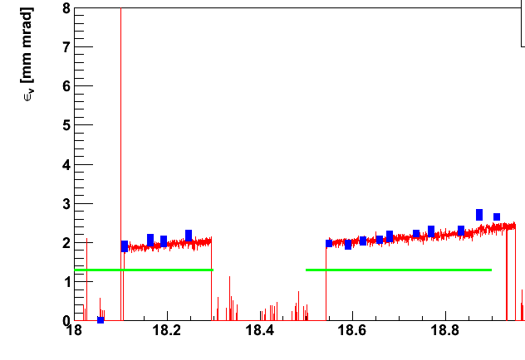
Emittance Comparisons at 450 GeV
Beam 1 Horizontal
Beam 1 Vertical
LHC Synchrotron Light
LHC Wire Scanner
From SPS
Nominal ε
Beam 2 Horizontal
Beam 2 Vertical
Time [h]
Time [h]

Slide 18
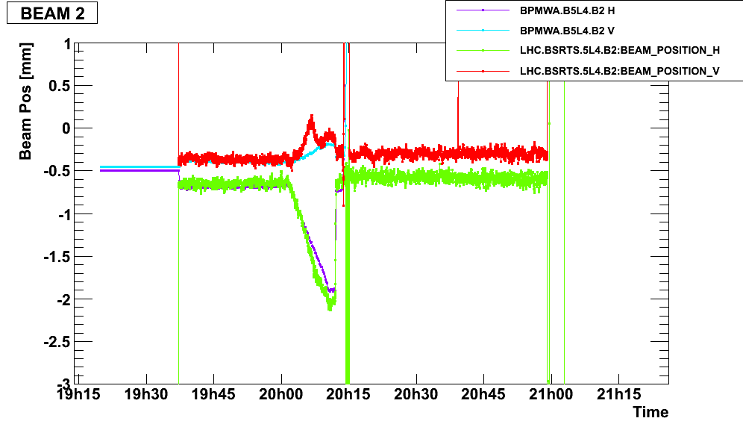
Synchrotron-Light Centroid vs. BPMs
Adjusting filter and gain
Synchrotron Light V
BPM V
Synchrotron Light H
BPM H
Why do slopes during beam bump match in x, but not in y?
Why do filter and gain changes affect x, but not y?

Slide 19
Disagreement with Wire Scanners
The horizontal size—but not the vertical—measured with synchrotron light is larger than the size from the wire scanners.
Beam 1: Factor of 2 in x emittance (√2 in beam size)
Beam 2: Factor of 1.3 in x emittance
β beat isn’t large enough to explain this.
But image of calibration target doesn’t appear distorted in x.
As I was leaving CERN in March, Thibaut, Federico and Aurélie went down to the tunnel to investigate.
Looked at image of calibration target formed by F1, and at final image.
Saw no distortion.
But recent improvements seen after new slit installed (original didn’t fit new layout), and then adjusting slit and focus
I’ve considered other ideas too...

Slide 20
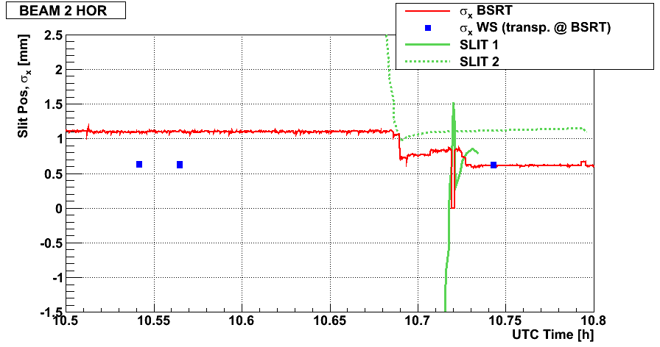
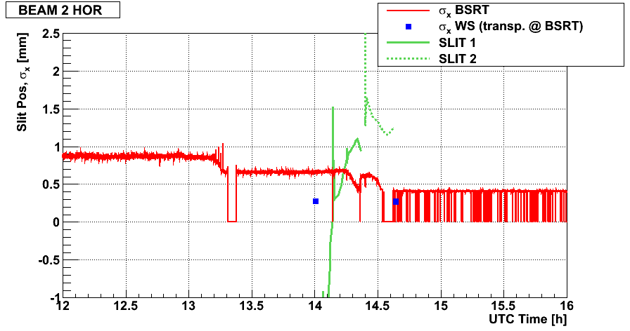
Adjusting Beam-2 Optics at 450 GeV
Synchrotron Light
Adjusting Slit Jaws
Wire Scanner
Adjusting Focus Trombone

Slide 21
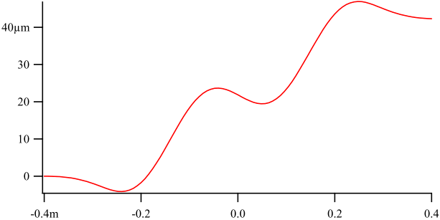
x Oscillation in the Undulator
B_{y} [T] along Undulator Axis
-0.4 0 0.4
Position [m]
Position [m]
The proton beam oscillates in x, spreading out the source.
The magnet has full-strength poles at the end, causing the beam to drift to one side.
But the motion is too small, less than 60 µm, to explain the large x measurements.

Slide 22
Off-Normal Incidence in x?
The rays in the LHC design are incident at 1° to the normal in the horizontal plane.
Zemax (optics code) shows:
Increasing aberration with angle
Stretched more in x than in y
But not enough to explain the factor of 1.4 in size, even at larger angles like 1.5°

Slide 23
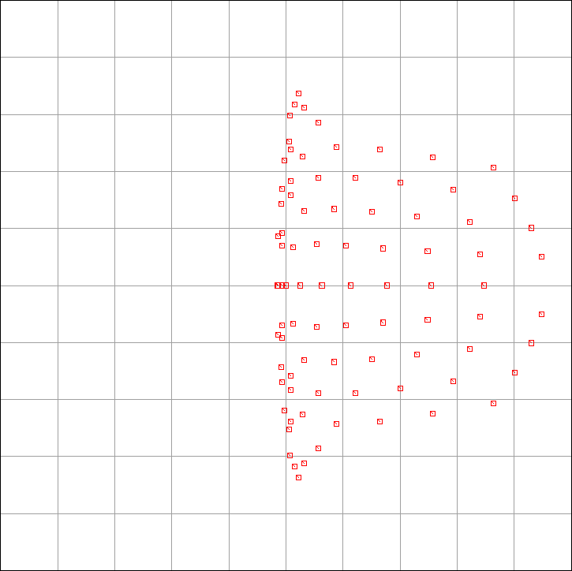
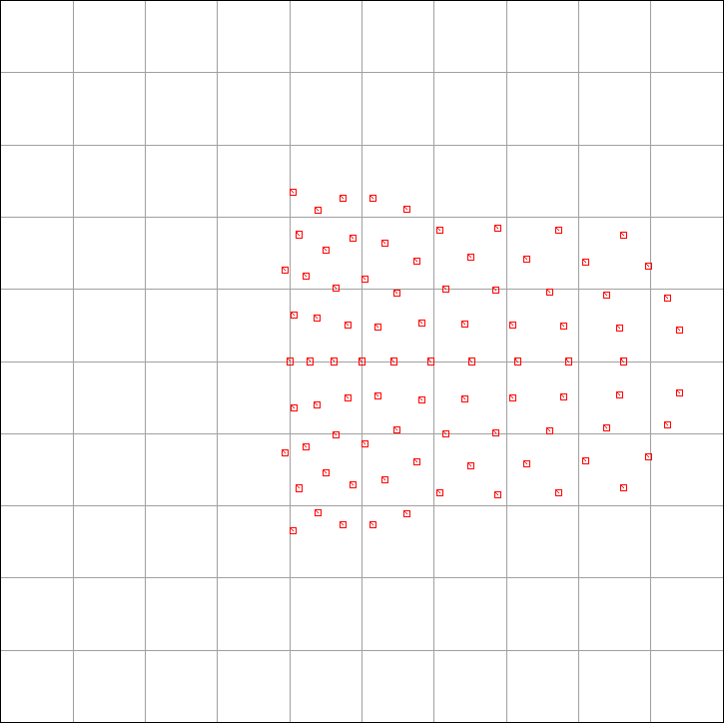
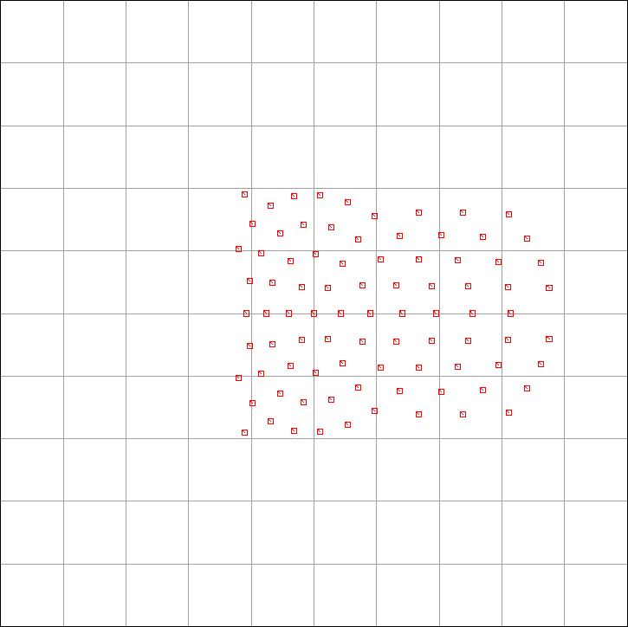
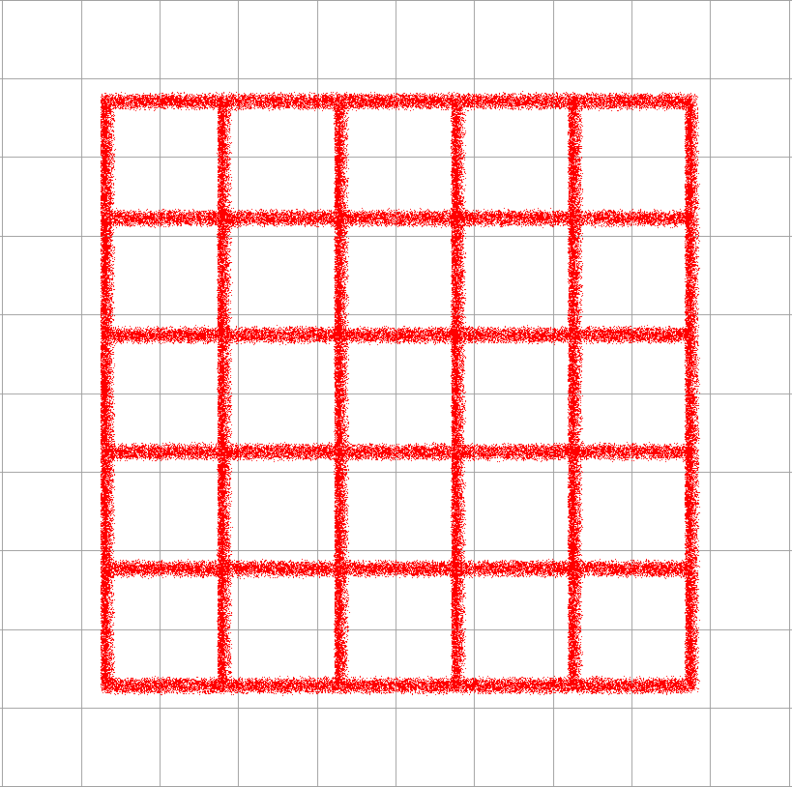
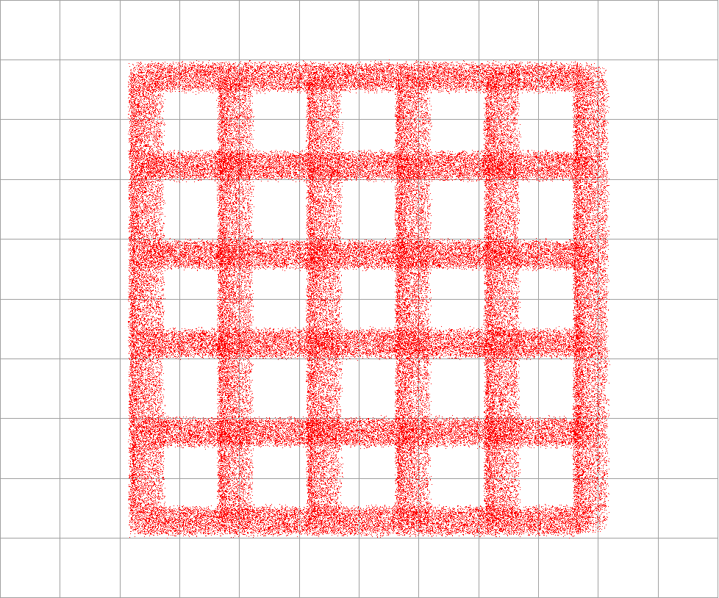
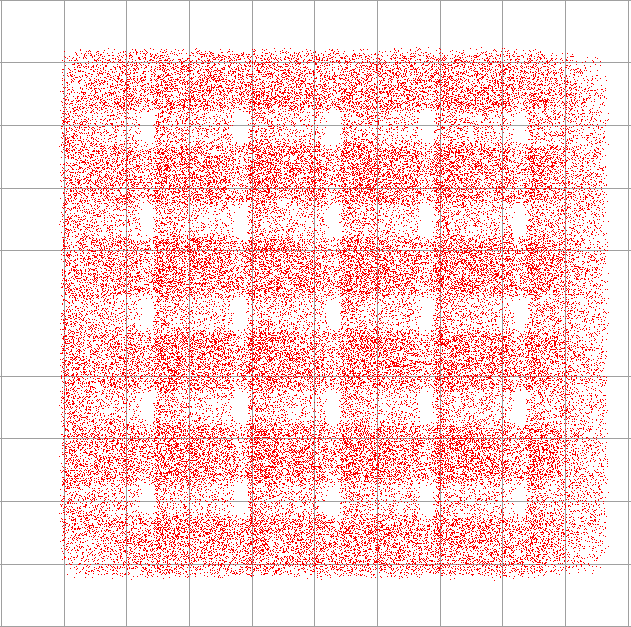
Zemax: Off-Normal Incidence in x
Rays Imaged from a Point Source
0.5°
1.0°
1.5°
10 µm
40 µm
100 µm
Radius (µm):
RMS 2.5
Geometric 4.5
Radius (µm):
RMS 9.5
Geometric 17.7
Radius (µm):
RMS 20.6
Geometric 37.8
Image of a 1-mm-Wide Grid (magnification = 0.3)
0.5°
1.0°
1.5°
400 µm
400 µm
400 µm

Slide 24
Off-Center Extraction Mirror?
Extraction mirror is off-center in x
Shift keeps edge away from proton beam
Mirror is 40 mm wide
Central ray from undulator hits mirror 7 mm off center
Does clipping on one side introduce asymmetry?
Undulator light is wide, but the problem persists with the narrower emission at 3.5 TeV
Clipping near the focusing optic should have little effect on the image
Similar to closing the iris in a camera lens, which doesn’t change the image.
Zemax confirms that the effect is small.

Slide 25
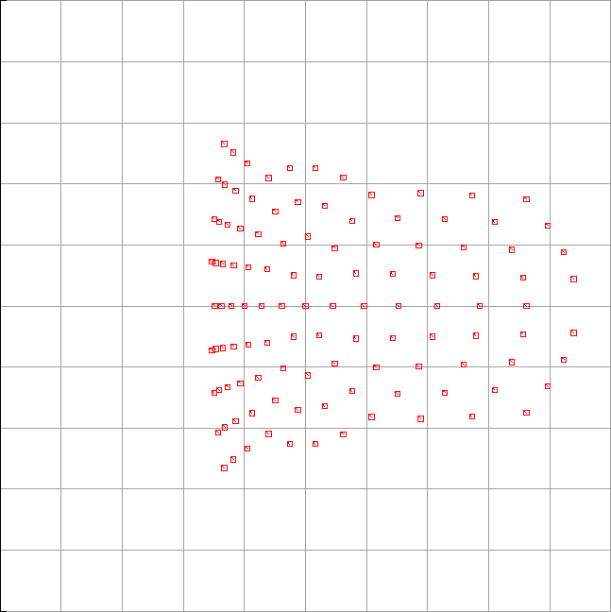
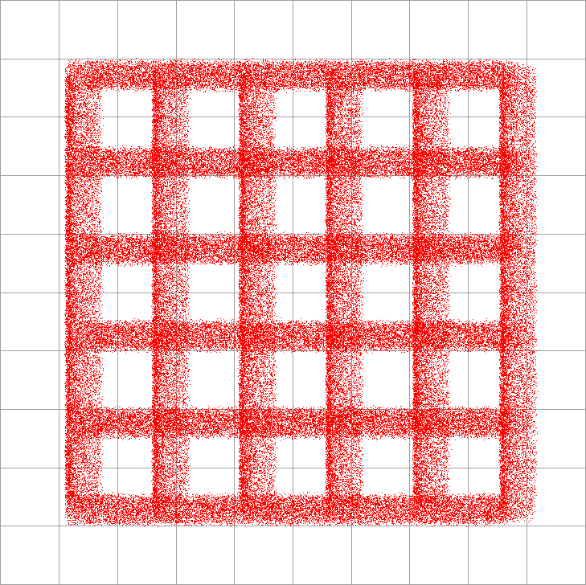
Zemax: Off-Center Extraction Mirror
Actual extraction mirror:
40 mm wide, 7 mm off center in x
Larger mirror:
60 mm wide, on center
1.0°
1.0°
40 µm
40 µm
Radius (µm):
RMS 9.5
Geometric 17.7
Radius (µm):
RMS 9.2
Geometric 17.7
1.0°
1.0°
400 µm
400 µm

Slide 26
Problem with First Focusing Mirror?
I tested the whole optical system on a bench last June.
Found that first focusing mirrors (F1) for both beams were deformed
Mirrors hastily replaced in summer, with no time for testing
During setup in the tunnel, the focal lengths of the two new F1 mirrors were found to be out of spec (~5%) and not equal.
No time to replace mirrors again
F1 had to be repositioned to maintain image location
Increased the angle of incidence, but remained < 1.25°
But F1 should also distort the image of the calibration target.
Main target holes may be too big, while small ones are hard to see.
Consider a new design with holes and slits comparable to beam size.
New mirrors ordered and expected in late May
Consider keeping a third telescope in the lab for testing.
Only enough parts for the two setups in the tunnel (for Beams 1 and 2)

Slide 27
BSRA: Abort-Gap Monitor
Gated photomultiplier gets ~15% of collected light.
PMT is gated off except during the 3-μs abort gap:
High gain needed during gap.
No saturation when filled bunches pass by.
Pick off before all slits or filters for maximum light.
Digitize the gap signal in 30 100-ns bins.
Sum over 100 ms and 1 s.
Requirement: Every 100 ms, detect whether any bin has a population over 10% of the quench threshold.
Longer integration, 1 s, is needed where PMT signal is weak (protons near 1.2 TeV and ions at injection).
Worst case signal-to-noise is 10 for 1-s integration with a population of 10% of quench threshold.

Slide 28
Protons/100ns at Quench Threshold
Protons in a pilot bunch
Original specification
Model for BSRA (Q4 quench) (M. Sapinski)
General quench model (B. Dehning)
Original threshold specification (given only at 0.45 and 7 TeV) was too generous. Must detect levels well below a pilot bunch.
BLM group provided improved models. We use Sapinski’s calculation.
Ion threshold is scaled from proton threshold:
Ions fragment on beam screen, deposit equivalent to Z protons at same point in ramp.

Slide 29
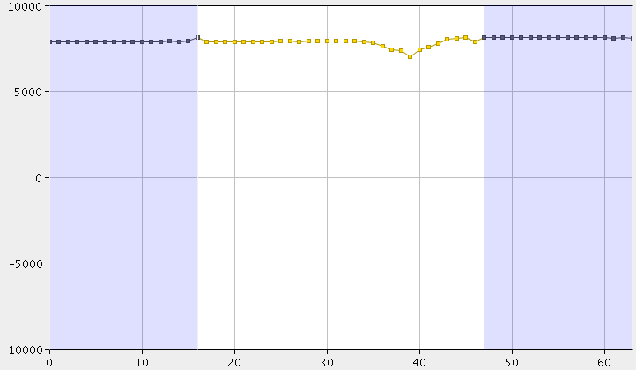
Calibration of BSRA
Inject a “pilot” bunch
Charge measured by bunch-charge and DC-current electronics
Attenuate light by ratio ≈ bunch charge / quench threshold
Move BSRA gate to include the pilot bunch
Find PMT counts per proton (adjusted for attenuation) as a function of PMT voltage and beam energy
Turn RF off (coast) for 5 minutes to observe a small, nearly uniform fill of the gap
Useful to test gap cleaning…
Last bunch in fill
First bunch in fill
Pilot bunch
Abort gap
After coasting briefly, bunch spreads out
Time [100-ns bins]

Slide 30
Test of Abort-Gap Cleaning
December 16: Injected 4 bunches into Beam 2
Poor lifetime, but not important for this experiment
Turned off RF, and coasted for 5 minutes
Abort-gap monitor detected charge drifting into the abort gap
Excited 1 µs of the 3-µs gap at a transverse tune for 5 minutes
How well did this work? Look inside the gap...
RF off
Gap cleaning
Beam dumped
RF on (poor lifetime)
Beam charge
(injection)
Total PMT signal (negative going) in all 30 bins
0
25 minutes

Slide 31
Charge in Abort Gap
Abort gap (3 µs)
Beam dumped
Excitation had ringing on the trailing edge (improved in January)
Time (s)
Cleaning started in 1-µs region: Immediate effect
Charge drifting from first bunch after gap
RF off: coasting beam
Position in fill pattern (100-ns bins)

Slide 32
Commissioning Automatic Operation
Automatic (software) control of optics, depending on:
Particle type (protons or ions)
Beam charge: Adjust during fill
Beam energy: Adjust during ramp
Peak image intensity
Adjustments being implemented:
Motorized mirrors (to steer the entering light)
Focus “trombone”
Motorized slit, one focal length from the F1 mirror
Color and neutral-density filters
Camera settings:
Intensified camera: Gain and integration frames
Turn-by-turn camera: Framing speed (upcoming: MCP gate)
BSRA settings:
PMT high voltage

Slide 33
BSRT for Beam 1
Door to RF cavities
Undulator and dipole
Beam 1
Beam 2
B1 Extraction mirror (covered to hunt for light leak)
Optical Table

Slide 34
Table Enclosure under Extraction Mirror
Beam 1
Beam 2

Slide 35
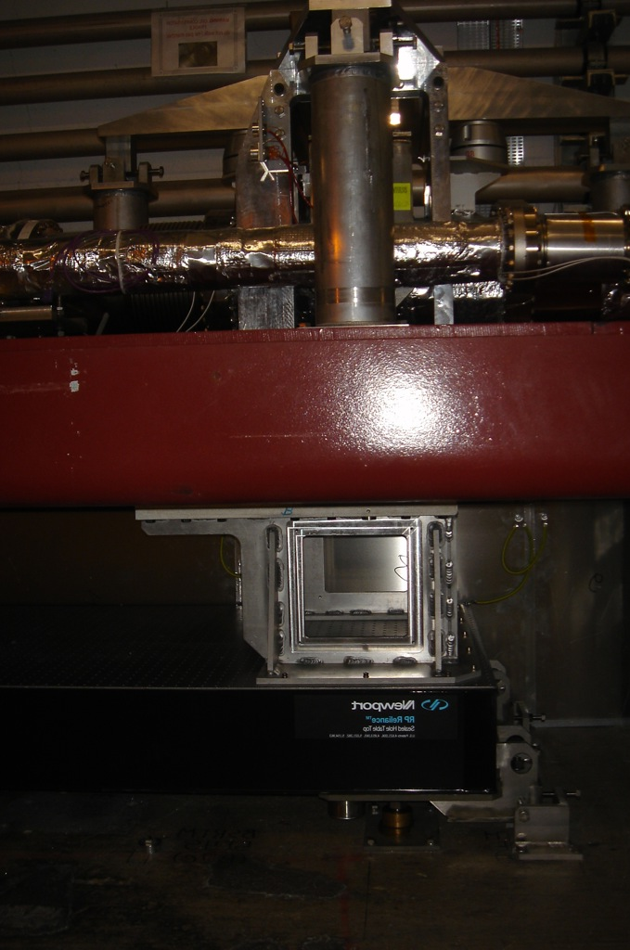
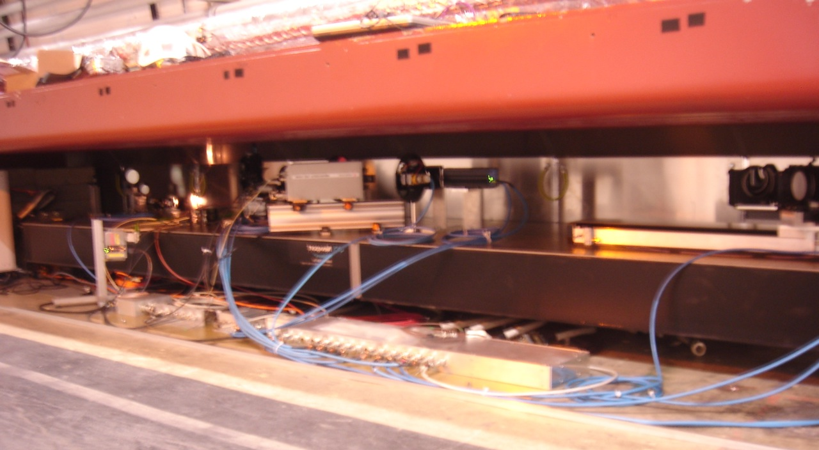
Optical Table

Slide 36
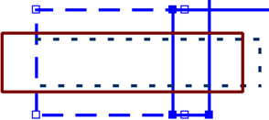
4-Pass Focus Trombone
600-mm translation stage
Outer trombone: 2 passes gives a 1200-mm range.
Inserting 2 mirrors converts trombone to 4 passes.
With a fixed extra path, the 4-pass mode spans 600 to 3000 mm.

Slide 37
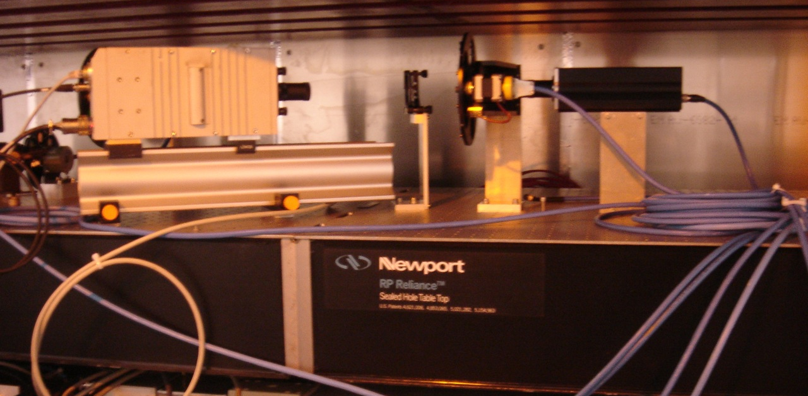
Intensified and Gated Cameras
Neutral-density filters
Gated camera (turn by turn)
40% beamsplitter
Intensified camera

Slide 38
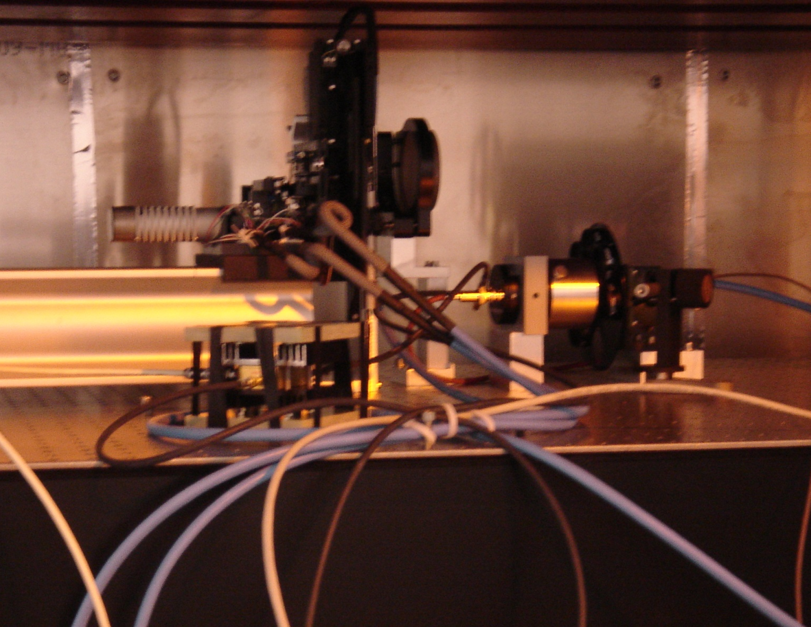
Abort-Gap Monitor
Motorized slit
PMT
Pulsed LED
Amplifier
Neutral-density filters

