Slide 1
Detector Research at Fermilab
Erik Ramberg
Users Meeting
2 June, 2010

Slide 2
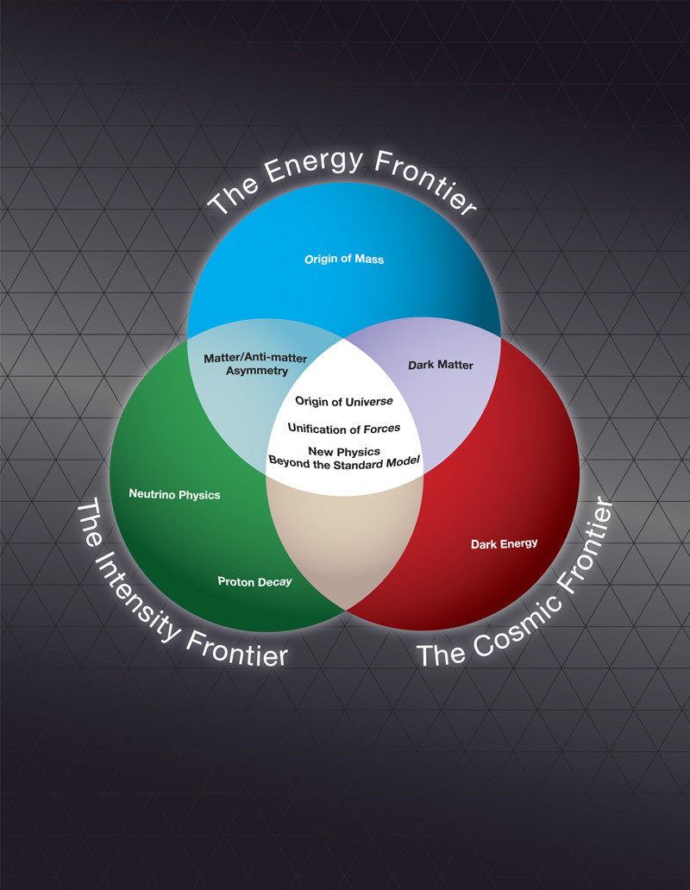
The Frontiers of the Field
The ‘3 frontiers’ outline the major thrusts of high energy physics:
  ‘Energy’: includes lepton and hadron collider detectors
  ‘Intensity’: neutrino and rare decay experiments
  ‘Cosmic’: dark matter and dark energy
In each area, the physics is advancing rapidly. It is crucial that the detector technology keep pace.
Fermilab is making major contributions in each of these frontier areas.

Slide 3
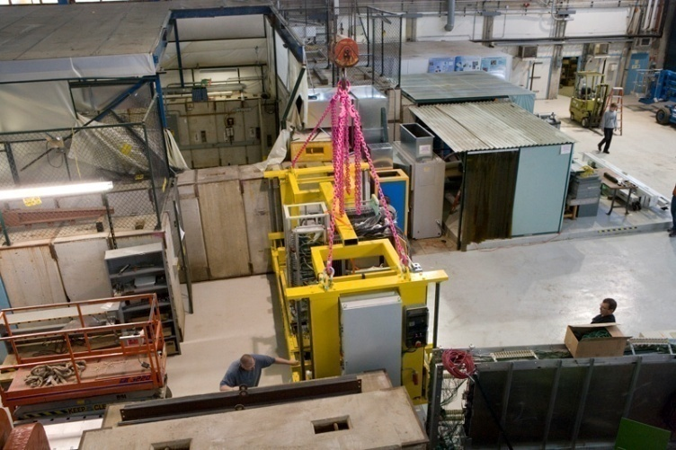
Why Fermilab?
Detector R&D at Fermilab should be geared towards our strengths as a national lab. Typically this means that the lab’s institutional capabilities come into play. These can be
  Presence of unique facilities
  Experienced, well established engineering groups
  Managing projects that are too large for an individual university
  Projects that require a large initial investment
In almost all cases there is a high degree of collaboration with the university community or other (inter)national labs.
CALICE at the test beam

Slide 4
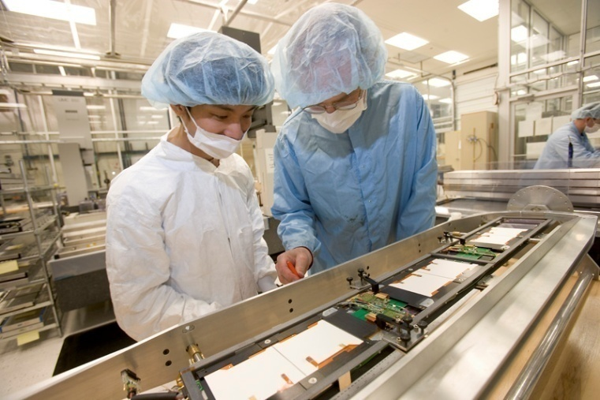
Why Fermilab?
Detector R&D at Fermilab should be geared towards our strengths as a national lab. Typically this means that the lab’s institutional capabilities come into play. These can be
  Presence of unique facilities
  Experienced, well established engineering groups
  Managing projects that are too large for an individual university
  Projects that require a large initial investment
In almost all cases there is a high degree of collaboration with the university community or other (inter)national labs.
Inspection at SiDet

Slide 5
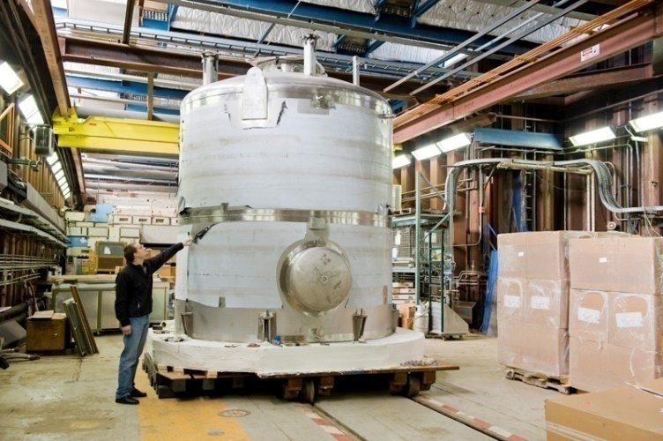
Why Fermilab?
Detector R&D at Fermilab should be geared towards our strengths as a national lab. Typically this means that the lab’s institutional capabilities come into play. These can be
  Presence of unique facilities
  Experienced, well established engineering groups
  Managing projects that are too large for an individual university
  Projects that require a large initial investment
In almost all cases there is a high degree of collaboration with the university community or other (inter)national labs.
Liquid Argon purity Demonstrator

Slide 6
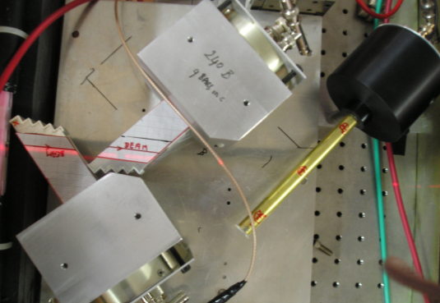
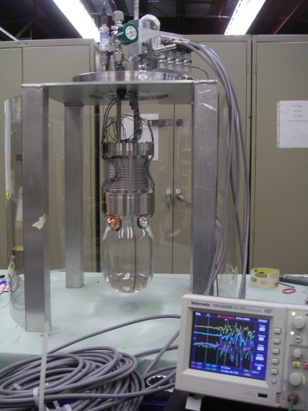
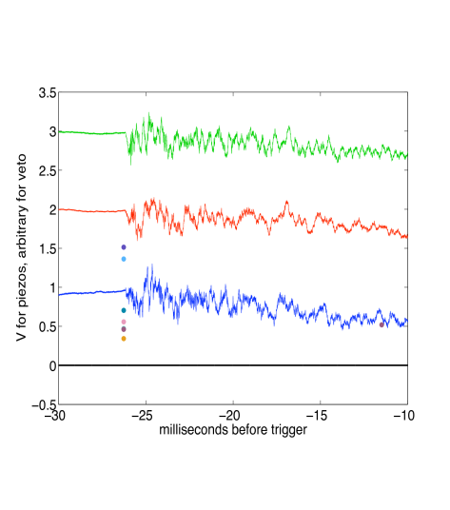
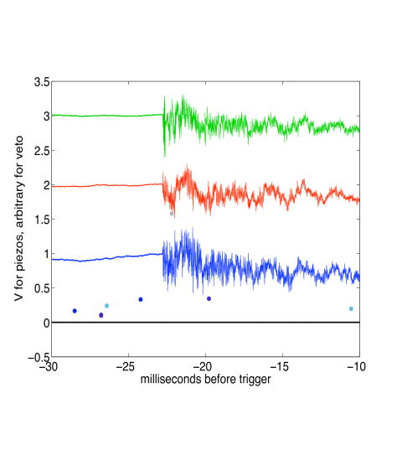
As examples of detector R&D questions,
Why don’t we….?
Make silicon sensors in 3 dimensions instead of 2
Read out detectors with light instead of cables
Make hadronic calorimeters out of crystals
Smash the 100 psec barrier in time-of-flight
Fill liquid Argon tanks without evacuating them
Freeze Xenon into a solid crystal, instead of using liquid
Perform particle identification…
(15 psec resolution quartz TOF devices)
With sound waves?
COUPP
4 kg Test
Chamber
Neutron interaction
α Decay

Slide 7
I. 3-Dimensional Silicon
The development of 3D integrated circuits has recently received much attention in trade journals, special sessions have been arranged at various IEEE meetings, and dedicated meetings such as 3D Architectures for Semiconductor Integration and Packaging have taken place.
All of this attention is generated by industry seeking to perpetuate Moore’s Law. In particular, industry is focusing on several 3D IC applications:
  stacked memory chips
  pixel arrays for imaging
  logic and memory stacking on microprocessors and FPGAs.
The 3D technology is being driven entirely by industry. However, the time has come when HEP can begin to benefit from work in progress.
Fermilab began exploring 3D technology for HEP several years ago and submitted the first 3D IC (VIP1) for HEP to MIT Lincoln Labs in October 2006.

Slide 8
3D = Vertical Integration
Vertical integration of thinned and bonded silicon tiers with vertical interconnects between the IC layers
Conventional MAPS
3-D Pixel
Diode
pixel
Detector
3T
pixel
Addressing
ROIC
Processor
Addressing
A/D, CDS, …

Slide 9
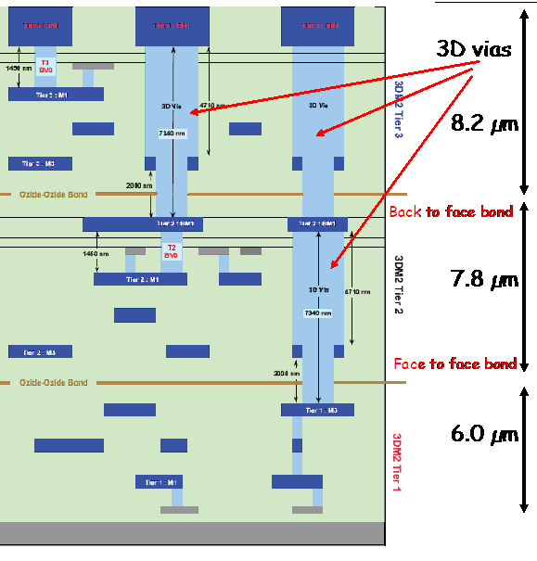
Milestones Achieved in First HEP 3D Circuit called VIP1
Demonstrated increased circuit density by integrating 3 circuit tiers
Showed that extreme circuit thinning (7um) was possible
Showed that small vias (~1.5 um) were possible thus allowing for small pixel sizes.
Showed that 3D vias and bonding were reliable
MIT LL 3 Tier Assembly

Slide 10
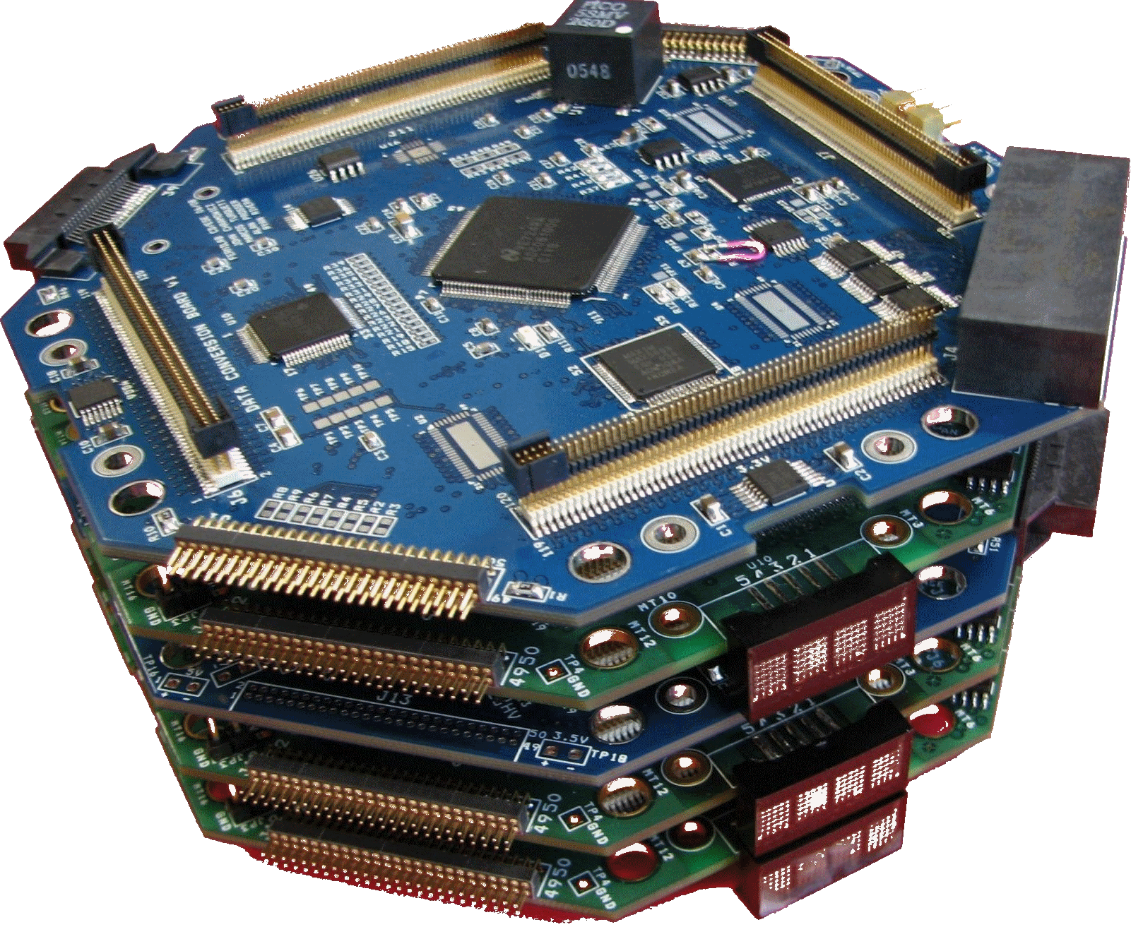
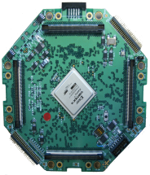
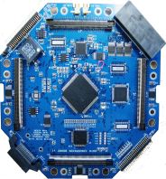
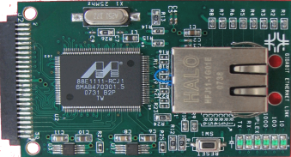
II. The CAPTAN DAQ system
The CAPTAN DAQ system has been developed by the DIG (Detector Instrumentation Group) of CD/ESE. There are 3 basic concepts behind the system:
1)Vertical standard bus
2)A set of core boards:
NPCB – Node Processing
and Control Board
DCB – Data
Conversion Board
3)Horizontal connectivity
Gigabit Ethernet Link
Interface Boards
Level Translator
USB
The software is a multithreaded application running on windows

Slide 11
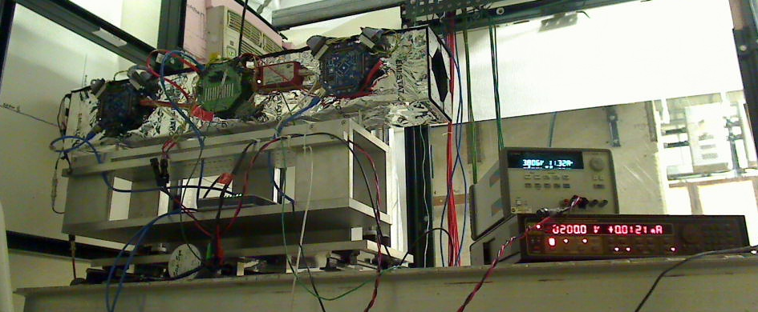
Test Beam Pixel Telescope Overview
TELESCOPE BOX
CAPTAN STACK
POWER SUPPLY
DUT SENSOR BIAS
SCINTILLATOR
ROUTER
A great example of the synergy between detector development, Fermilab’s unique facilities (test beam, in this case) and the User community, which now benefits from this added capability.

Slide 12
III. Free-Space Optical Interconnects for Cable-less Readout in Particle Physics Detectors
The Problem: Future particle physics experiments at the high energy frontier will all require large arrays of silicon detectors making data transmission cumbersome.
The Solution: Vega Wave Systems proposes to design and develop a free-space optical link for trigger and data extraction.
The novelty and feasibility of this system is based upon the fact that the silicon detectors are transparent to the infrared wavelengths (1.4 micron) of the optical data link.
Two Phase 1 SBIR proposals submitted with Fermilab as partner
Rather than waiting for the outcome, since February, we have been working with Vegawave on a demo test-stand.
10Gb/s Optical Reveivers
10 Gb/s Optical Transmitters at different wavelengths
Silicon Detectors
~100-150 cm
~50-100 cm
~10- 50cm
Beam Line Center
A conceptual sketch of a free-space optical link for data extraction and trigger functions in a vertex detector.

Slide 13
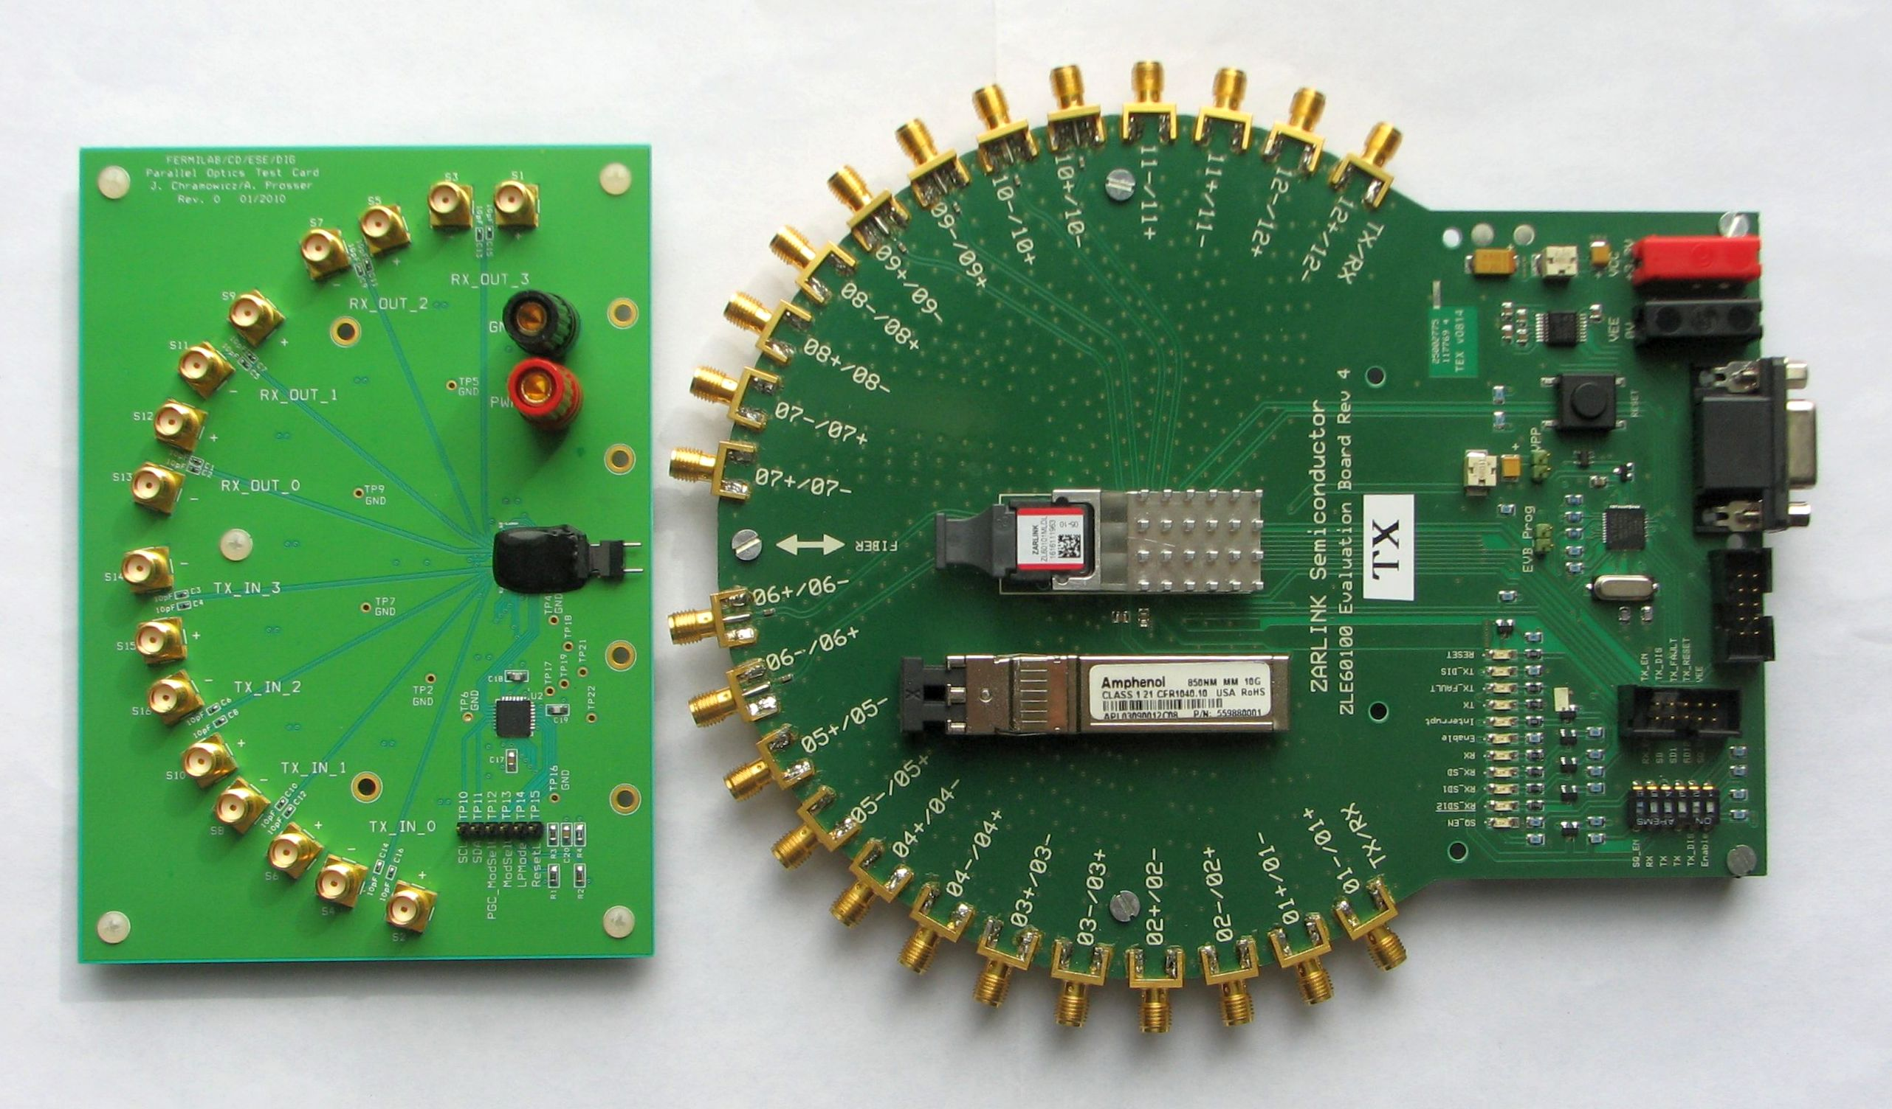
SNAP12 Tx (2.7 Gbps/channel)
SFP+ Single Channel TRx (10 Gbps)
4x4 Optical Engine Transceiver (6.25 Gbps/channel)
Notes:
This slide illustrates the three optical technologies evaluated so far by the FNAL group.
Single channel SFP+ transceivers capable of operating at 10 Gbps were obtained and tested to characterize transmitter and receiver performance. Single mode and multimode versions of these devices (1310 nm and 850 nm respectively) were tested and reference components have been selected.
To exploit the density advantages offered by parallel optical components, FNAL recently obtained a SNAP 12 evaluation board from Zarlink and tested their SNAP Tx and Rx modules at rates up to 5 Gbps. This evaluation board will also be used to test a prototype of a 12 channel single mode receiver (also from Zarlink) for possible use in phase 1 upgrades at the LHC.
Driven by the advent of 100Gbps standards in the telecommunications market, novel optical engine technologies are now arriving as early product offerings. The list of providers of this technology is growing. FNAL has evaluated one example of this technology with a custom board designed by Fermilab engineers. Currently, these same engineers are designing a demonstration board to serve as an evaluation platform for other engines This board will operate as a stand alone bench top test stand or in a uTCA platform.

Slide 14
IV. Technical Issues for Liquid Argon TPC-based detector being addressed at Fermilab
Chemical purity of Argon to allow electron drift (neutrino and DM)
Chemical purity of Argon to allow light propagation (DM)
HV feedthroughs (>100 kV) in Argon gas (neutrino and DM)
TPC design (neutrino and DM)
Wire readout (neutrino)
Light Detection (neutrino and DM)
Data Acquisition (neutrino and DM)
Cryogenics (and associated safety issues) (neutrino and DM)
Detector Materials Qualification (neutrino and DM)
Shielding from environment radiation (DM)
Radio-purity of detector materials (DM)

Slide 15
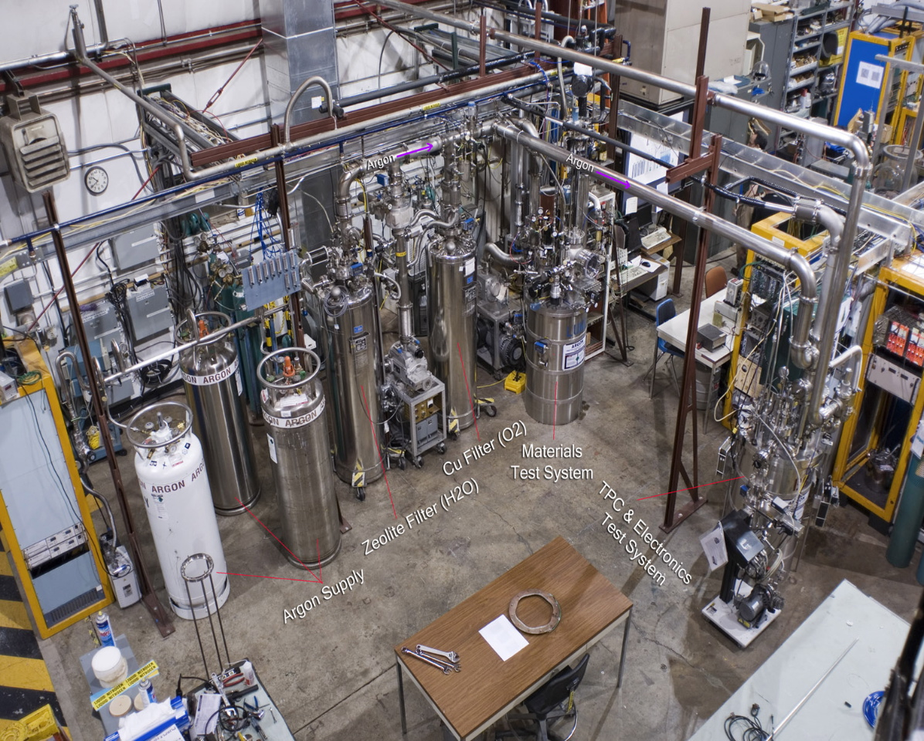
Liquid Argon Setup for Materials Testing and TPC Readout
copper on aluminum filter
molecular sieve
Argon test cryostat
(Luke)
my brief case
TPC test cryostat
(Bo)
Notes:
15

Slide 16
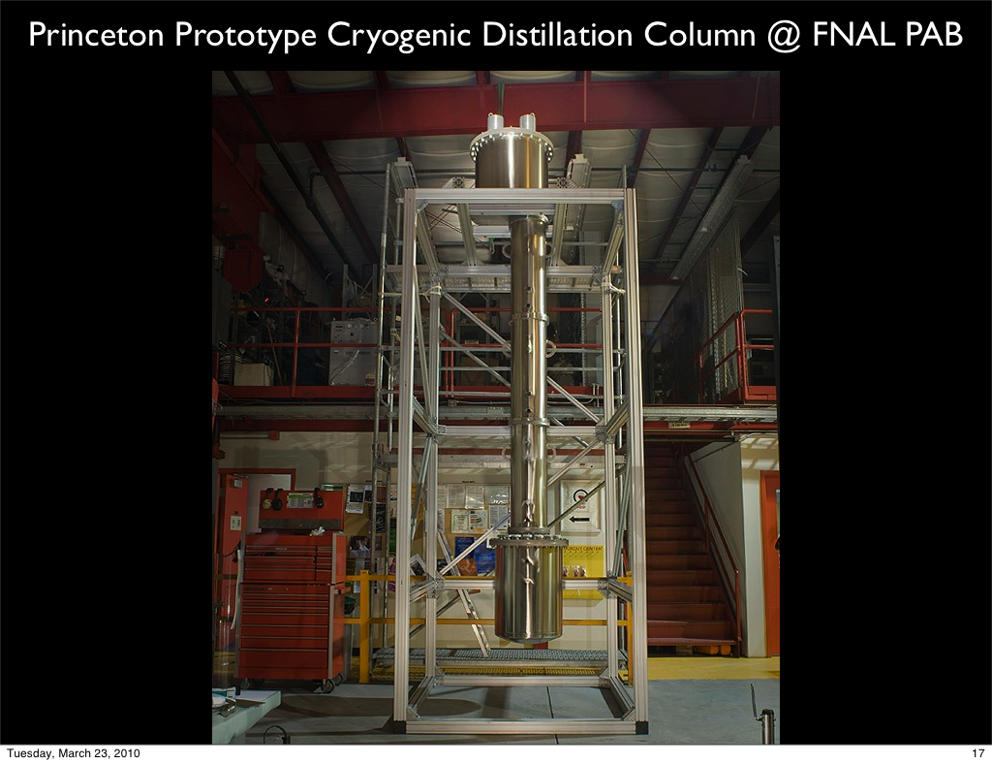
Atmospheric Argon has activity of 1 Bq/kg from ³⁹Ar, which is a source of background and pile-up in multi-ton Argon based Dark Matter detectors. Underground Argon has been shown to be depleted in ³⁹Ar by at least a factor of 25.
Distillation Column at the PAB was designed at Princeton and assembled at Fermilab, for the separation of underground Argon from the accompanying Nitrogen and Helium.

Slide 17
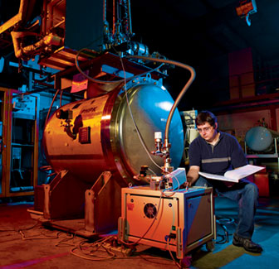
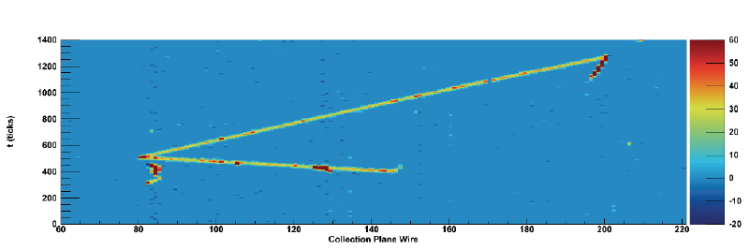
ArgoNeut succeeds in capturing and analyzing the first low energy neutrinos (<10 GeV) seen in a liquid Argon TPC.
Can this be scaled up so that it competes with water Cerenkov detectors for long baseline neutrino detectors?

Slide 18
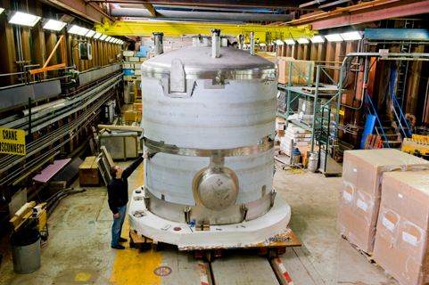
“LAPD” = Liquid Argon Purity Demonstrator
• Primary goal is to show that required electron lifetimes can be
achieved without evacuation in an empty vessel - Phase I
• Will also monitor temperature gradients, concentrations of water,
O2, and N2
• Phase II will place materials that would be used in a TPC into the
volume and show that the lifetime can still be achieved
• Possible Phase III upgrade could place an actual TPC in the volume to
provide a test bed for electronics, light collection, etc

Slide 19
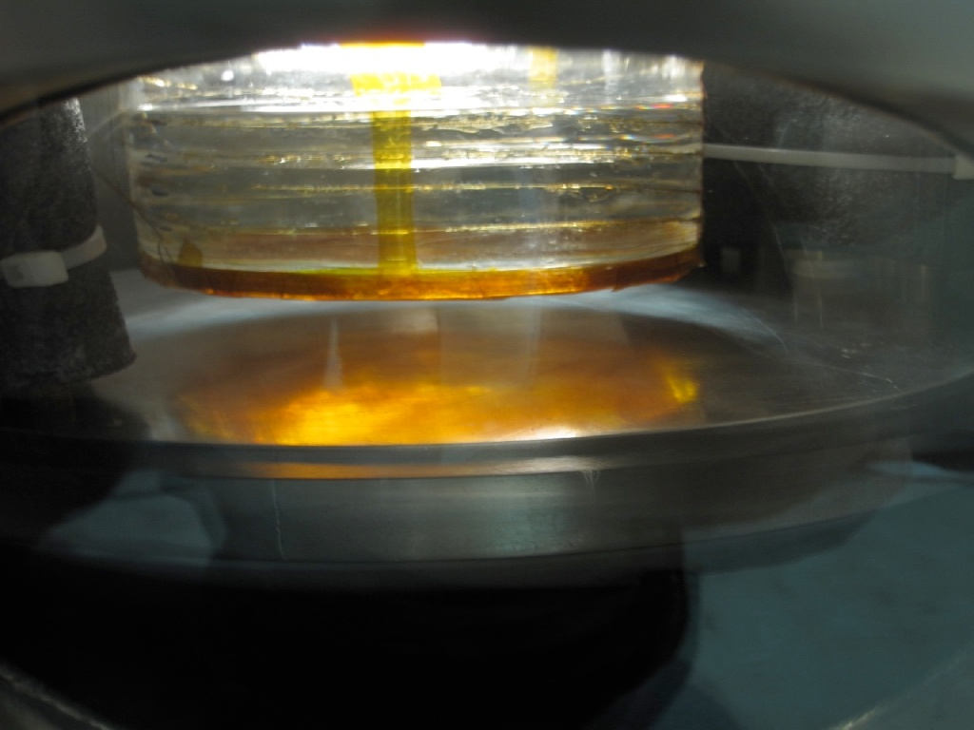
VII. Solid Xenon Detector R&D Project
Low Background Science
● Solar axion search
● Dark matter search
● Neutrinoless double beta decay
Why Xenon?
● No long-lived Xe radio isotope
● High yield of scintillation light
● Easy purification (distillation, etc)
● Self shielding : Z=54
Liquid Xenon
Why Solid Xenon?
● Bragg scattering
● Simple crystal structure : fcc
● More scintillation light (solid > liquid)
● Drifting electrons faster
● No further background contamination
through circulation loop
R&D Phase-1 Completed
● Collaboration with U.Florida and TAMU
● Build optically transparent solid xenon
● Detailed recipes ready
Solid Xenon (~850g)

Slide 20
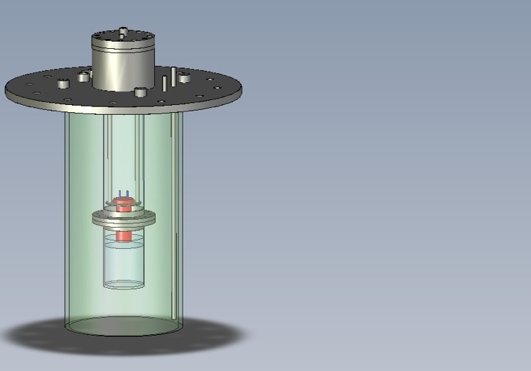
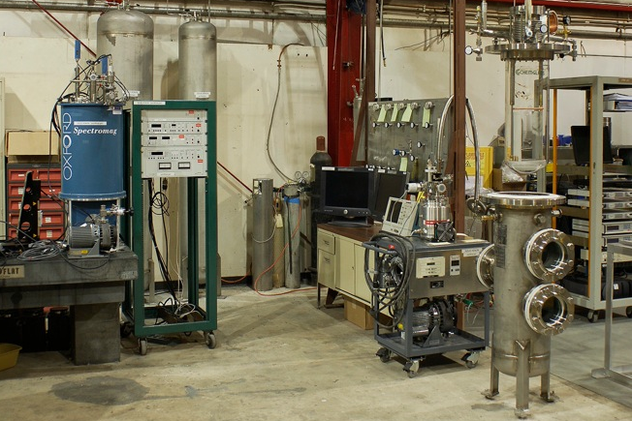
R&D Phase-2: Scintillation Light Readout (Now)
Automatic controller setup for crystal growth
Xenon purification system and mass spectroscopy
Scintillation light measurement from solid xenon
Fermilab/PAB
R&D Phase-3: Ionization Readout (Plan)
Ionization readout
Solid Xenon property measurement
- Transparency, absorption, index of refraction …
- Low temperature characteristics (~4K)
Large solid xenon crystal growth (>10kg)

Slide 21
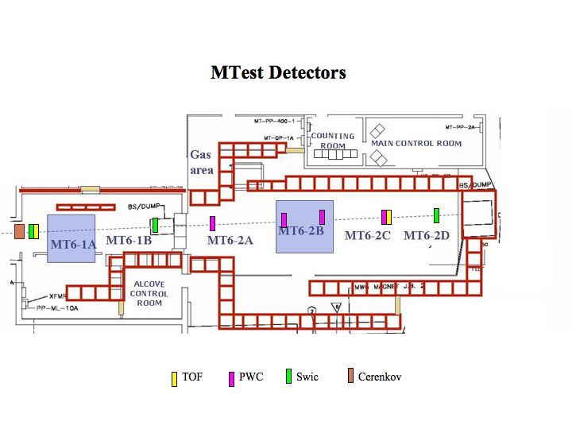
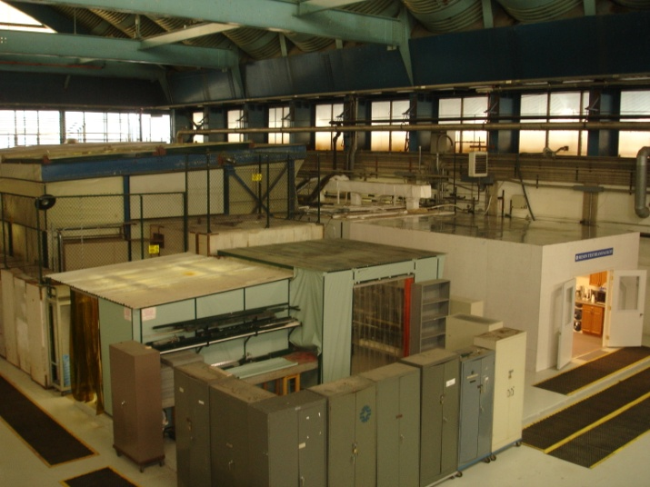
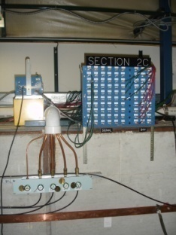
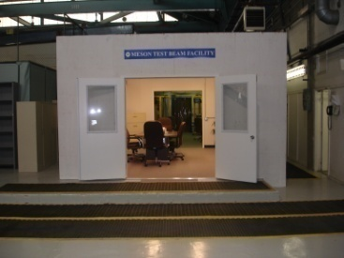
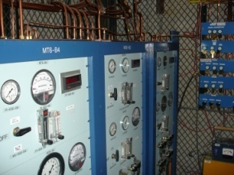
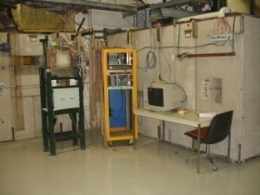
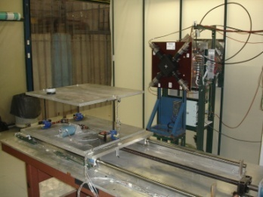
VIII. Fermilab’s Test Beam Facility
Spacious control room
Signal and HV cables
Gas delivery to 6 locations
4 station MWPC spectrometer
Two motion tables

Slide 22
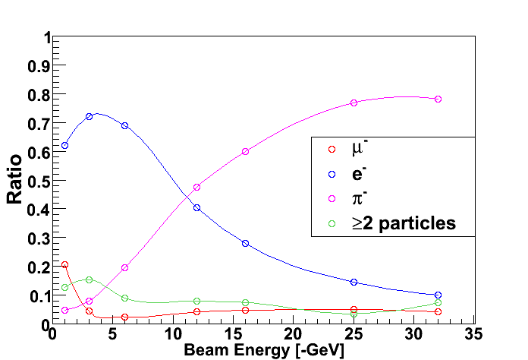
Beam Rates and Electron Content
Measured rates (normalized to 1E11 at MW1SEM)
Beam Energy (GeV) | Rate at Entrance to Facility (per spill) | Rate at Exit of Facility (per spill) | %Pions, Muons** | % Electrons**
16 | 132,000 | 95,000 | 87% | 13%
8 | 89,000 | 65,000 | 55% | 45%
4 | 56,000 | 31,000 | 31% | 67%
2 | 68,000 | 28,000 | <30% | >70%
1 | 69,000 | 21,000 | <30% | >60%

Slide 23
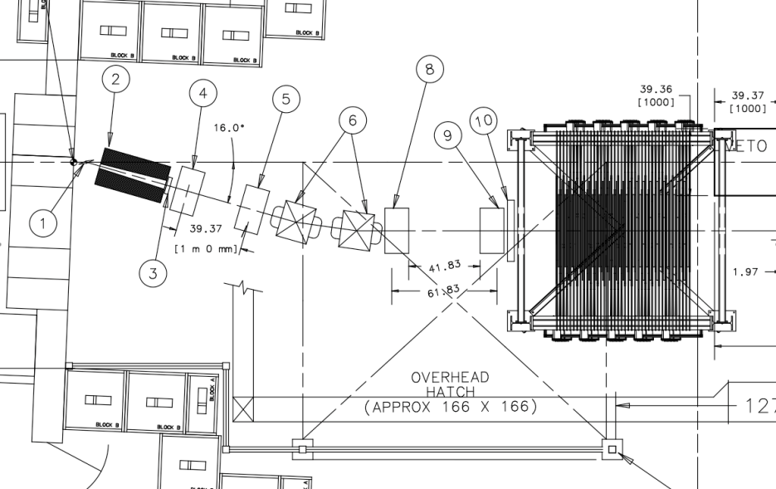
Tertiary 300 MeV/c Beamline for MINERVA
The MINERVA experiment requested space to create a new tertiary beamline that could deliver particles down to 300 MeV/c momentum.
The Particle Physics Division and Accelerator Division have agreed to help and are proceeding on installation.
Full tracking and TOF will allow for momentum measurement and particle i.d.

Slide 24
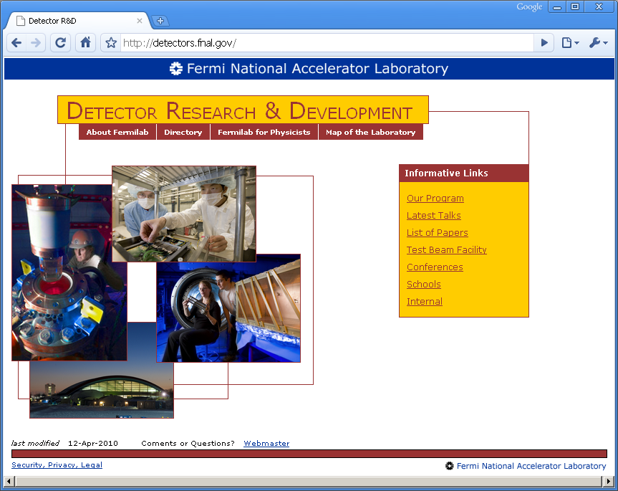
Apologies, for a lack of time, to:
High Finesse Holographic Interferometry
CMB B-field polarization
Argo-Neut Liquid Argon TPC
Dual readout calorimetry
CCD low recoil energy dark matter detector
21-cm Baryon Acoustic Oscillation Experiment
Silicon Photomultiplier characterization
…
Our Web Site: http://detectors.fnal.gov
- a work in progress!

Slide 25
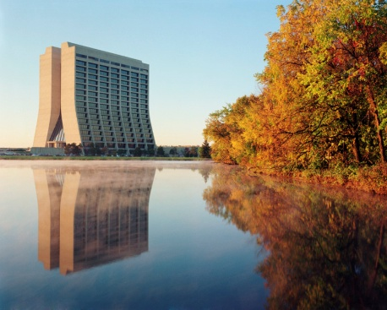
Are we doing our job?
In the Energy frontier, we are:
  Advancing silicon detector construction into a new 3D realm.
  Beginning work on understanding how to build a dual readout calorimeter
  Developing low cost, high performance DAQ systems for the R&D community
  Investigating optical data transmission for detectors
In the Intensity frontier:
  Operating Liquid Argon test stands to test for the effect of materials on charge drift and purity.
  Built and ran the first U.S. Liquid Argon TPC to operate in a neutrino beam
  Established the world’s fastest beamline time-of-flight system
In the Cosmic frontier:
  Learning about acoustic response to various backgrounds in a bubble chamber, for dark matter detection
  Growing solid Xenon crystals for axion and rare neutrino interactions.
  Utilizing CCD’s for low mass dark matter searches.
Backed up by our facilities:
  ASIC design
  Silicon detector fabrication
  Cryogenic engineering
  Particle test beam
We invite the R&D community to work with Fermilab to develop strategic partnerships in detector research !

