Slide 1




Long-Baseline Neutrino Experiment - Status
ν
ν
ν
1300 km
ν
ν
ν
Robert J. Wilson
for the LBNE Collaboration
3 June 2010
FNAL Users Meeting

Slide 2
Overview
Physics Objectives
Status
  DOE
  LBNE DUSEL
  LBNE Project
  LBNE Science Collaboration
  Beams & Detectors Configurations
Sensitivity
Summary

Slide 3
Physics Objectives
  CP Violation in neutrino sector
    How: ν_{μ} → ν_{e} à la MINOS, T2K & NOνA (see R. Zwaska, S. Budd talks) - but longer baseline and wide band low energy beam
…and other missing pieces of the neutrino puzzle
  Resolve the neutrino mass hierarchy
  Precision measurements of oscillation parameters (mixing angles, mass differences)
  Precision neutrino interactions studies (near detector)
… and other fundamental physics enabled by massive detectors
  Proton decay measurement
  Astrophysics
    Solar neutrinos – direct MSW effect measurement (day/night)
    Supernova ν burst flux & relic neutrinos from past supernovae
    Ultra High Energy neutrinos
    Neutrinos from dark matter…

Slide 4
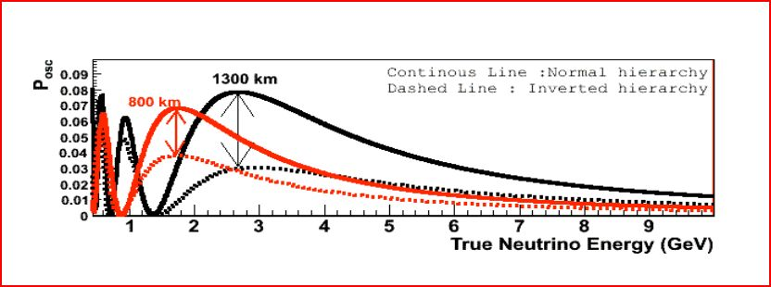
Long(er) Baseline
NOνA
Fermilab – Homestake (South Dakota) = 1300 km
Wide Band Low Energy Beam – information from both 1st & 2nd maxima
All neutrino parameters measured in the same detector complex

Slide 5
Status

Slide 6
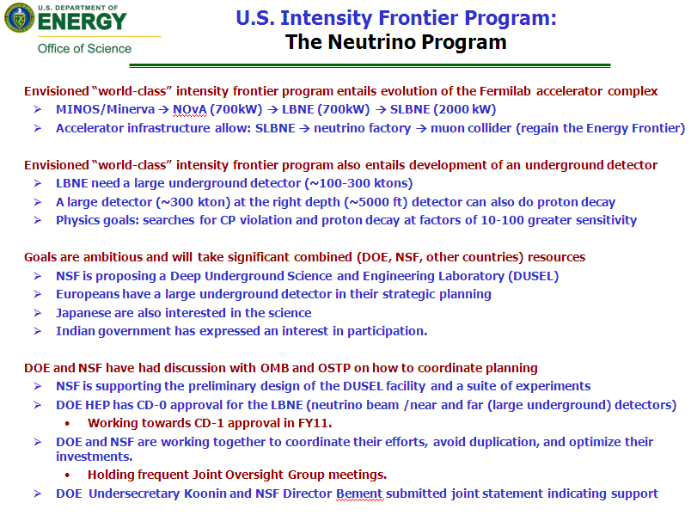
Strong support at DOE
D. Kovar, Fermilab Users Meeting, June 2010

Slide 7
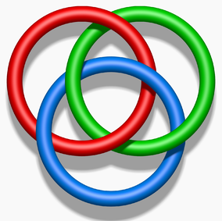
Science
Project ↔ Collaboration ↔ DUSEL
Borromean Rings: Removing any one leaves two unlinked rings
LBNE Project - DOE Project initiated by CD-0 (Jan. 2010)
  DOE will “steward” LBNE
  Project Manager=Jim Strait (FNAL) + Project Scientist=Gina Rameika (FNAL)
DUSEL LBNE – Part of the NSF laboratory
  NSF will “steward” the Homestake DUSEL facility & contribute to LBNE
  DUSEL LBNE Lead Scientist=Richard Kadel (LBNL)
LBNE Science Collaboration – scientists to use the facility
  Advise on the configuration to achieve the best science
  Executive Committee & Institution Board established
  Co-spokesmen elected late 2009=Bob Svoboda (UC-Davis) + Milind Diwan (BNL)
http://en.wikipedia.org/wiki/File:Borromean_Rings_Illusion.png

Slide 8
Project Timeline
(Jim Strait)
Currently early in the project planning phase.
Received DOE CD-0 (Approve “Mission Need”) Jan. 2010
Working towards CD-1 Review (Conceptual design,
preliminary cost and schedule range) Dec. 2010
CD-1 (assuming successful CD-1 review) Apr. 2011
Schedule for CD-2 (Project baseline) depending on funding... Winter 2012/3 ~ Summer 2013
CD-3 (start construction) depending on funding… 2014 ~ 2015
Schedule for construction is in the process of being developed
guess that project will be complete >~ 2020

Slide 9
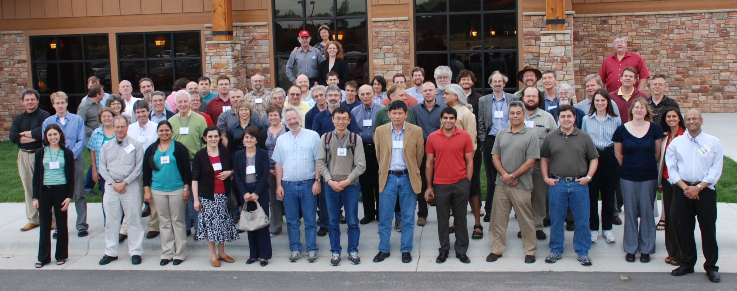
Science Collaboration
~250 members, 54 institutions (3 international)
Co-spokespersons Bob Svoboda (UC-Davis) & Milind Diwan (BNL)
Speakers Board – THANKS!
Argonne
Alabama
Boston University
Brookhaven
Caltech
Cambridge
Catania
Columbia
Chicago
Colorado
Colorado State
Columbia
Crookston
Davis
Drexel
Duke
Duluth
Fermilab
Hawaii
Indian Group
Indiana
Iowa State
IPMU-Tokyo
Irvine
Kansas State
Lawrence Berkeley National Lab
Livermore
London UCL
Los Alamos
Louisiana State
Maryland
Michigan State
Minnesota
MIT
NGA
New Mexico
Notre Dame
Oxford
Pennsylvania
Pittsburgh
Princeton
Rensselaer
Rochester
South Carolina
South Dakota State
SDSMT
Southern Methodist
Texas
Tufts
UCLA
Virginia Tech
Washington
Wisconsin
Yale
Long-Baseline Neutrino Experiment Collaboration
Deadwood, SD 25-28 May 2010

Slide 10
Physics Working Group
Topical Group Conveners:
Long-Baseline Mary Bishai & Sam Zeller Mass Hierarchy and CP violation θ₁₃ measurement Precision Oscillation parameters New Phenomena | Short-Baseline Physics Roberto Petti Required for LB physics Other opportunities
Proton decay Ed Kearns | Atmospheric Neutrinos Hugh Gallagher
Galactic SN Burst Flux Kate Scholberg | Geoneutrinos and Reactor neutrinos Nikolai Tolich
Diffuse SN Flux Mark Vagins | UHE Neutrinos Erik Blaufuss
Solar Neutrinos Michael Smy | PWG Coordinator Bob Wilson
Formed in just the last few months
Contribute to the project CDR, esp. Vol. I (G. Rameika)
Major task : PWG Physics Report building on much past work – late summer
Primary input to the collaboration’s detector configuration recommendation

Slide 11
Beam & Detector Groups
Great progress in the beam and detector groups
NSF DUSEL S4 + DOE funds
Performance and cost and schedule range needed for CD-1
Selection of a “reference” beam/detector designs for CD-1 review
Performance/cost/risk will inform trade-offs between components of the project

Slide 12
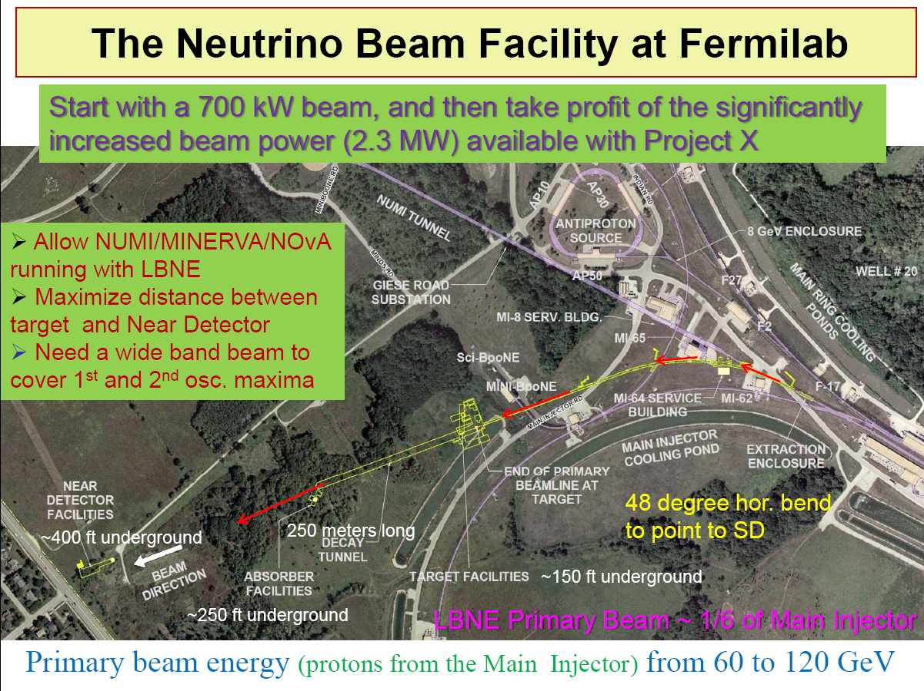

Beam
V. Papadimitriou, May 2010

Slide 13
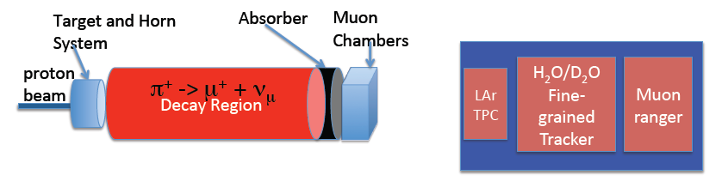
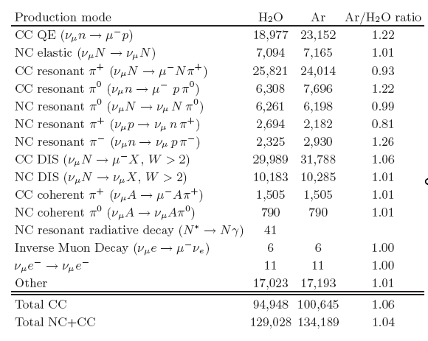
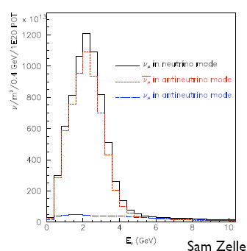
Near Detector Complex
?? tbd
Events per ton per 10²⁰ pot
Chris Mauger
Similar to NuMI LE flux
r

Slide 14
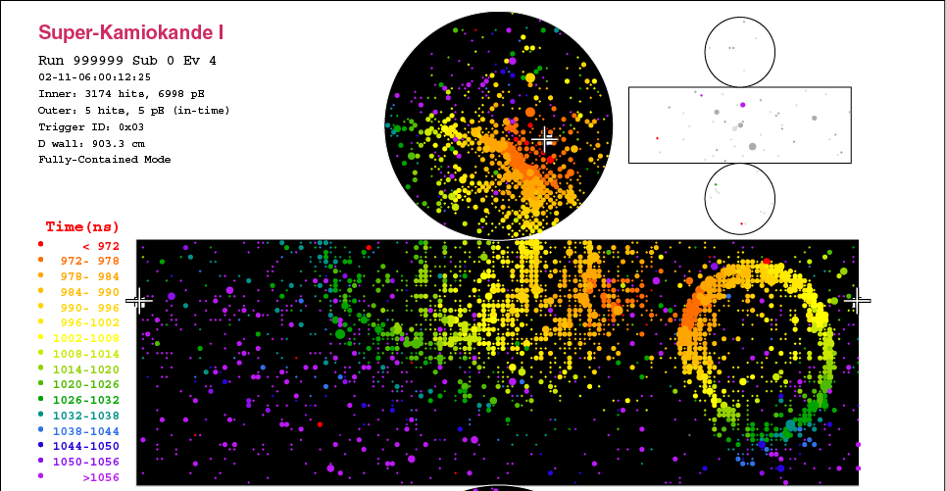
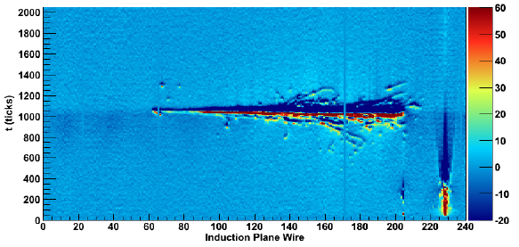
Two Far Detector Technologies
Water Cherenkov
  Tried-and-true technology and physics productivity: 50,000 ton Super-Kamiokande/T2K
  Low cost sensitive medium; photosensor “off-the-shelf”
  Free protons for nucleon decay and inverse beta-decay ν interactions
  Could be supplemented with gadolinium for low energy ν physics
Liquid Argon TPC
  Bubble chamber-like imaging; detailed event topology with few mm resolution
  Very high efficiency and background rejection ⇒ ~6x lower mass than WC
  600 ton ICARUS now operating at Gran Sasso
  No free protons for nucleon decay or inverse beta-decay studies; excellent for kaon ID

Slide 15
Far Detector Depth Requirements
Fermilab-TM-2424-E, BNL-81896-2008-IR
Physics | Water Cherenkov (mwe*) | Liquid Argon (mwe*)
Long Baseline Accelerator | 1000 | 0-1000
p→K⁺ν | >3000 | >3000(veto?)
Day/Night ⁸B Solar ν | ~4300 | ~4300
Supernova Burst | 3500 | 3500
Diffuse ν from Supernova | 4300 | >2500
Atmospheric ν | 2400 | 2400
*1 mwe (meters-water-equivalent) ~ 1.15’ of rock density=2.9 gm/cc
No physics needs greater than Homestake 4850’ level (4200 mwe)

Slide 16
Water Cherenkov Detector
100 kT fiducial
Project Manager:
Jim Stewart (BNL)
83m

Slide 17
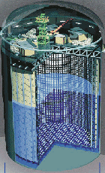
Water Cherenkov Detector
100 kT fiducial
Project Manager:
Jim Stewart (BNL)
83m
Super Kamiokande
41.4m
39.3^{φ}m
39.3m

Slide 18
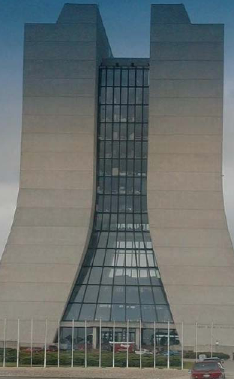
Water Cherenkov Detector
100 kT fiducial
Project Manager:
Jim Stewart (BNL)
73m
83m
39.3m
Wilson Hall 238’ = 72.5 m
LBNE WC

Slide 19
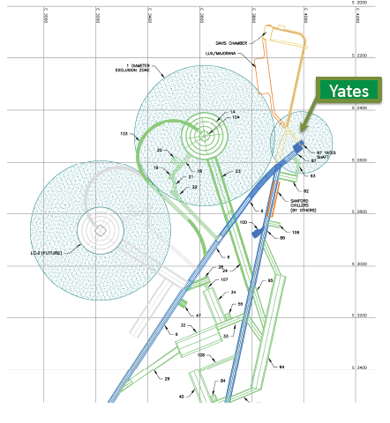
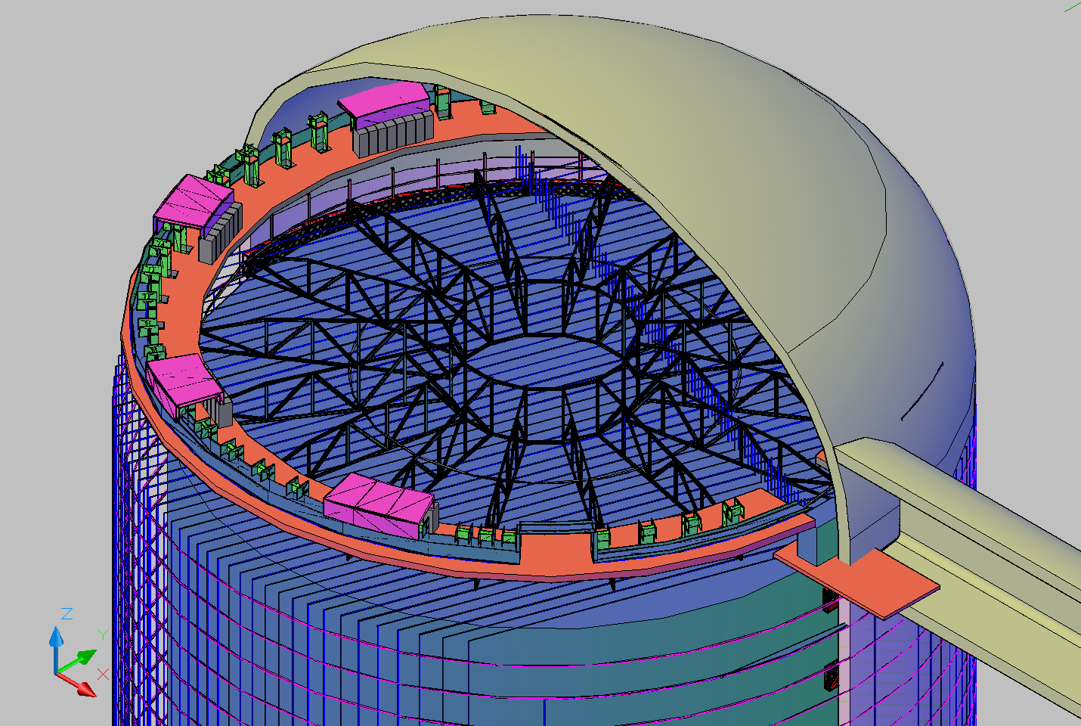
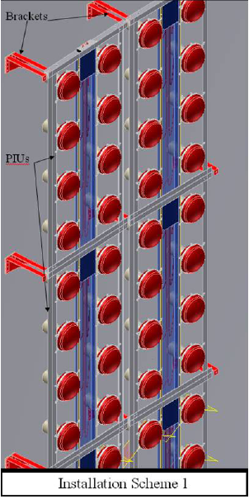
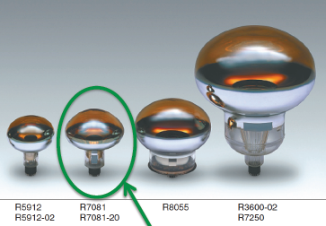
Water Cherenkov Detector

Slide 20
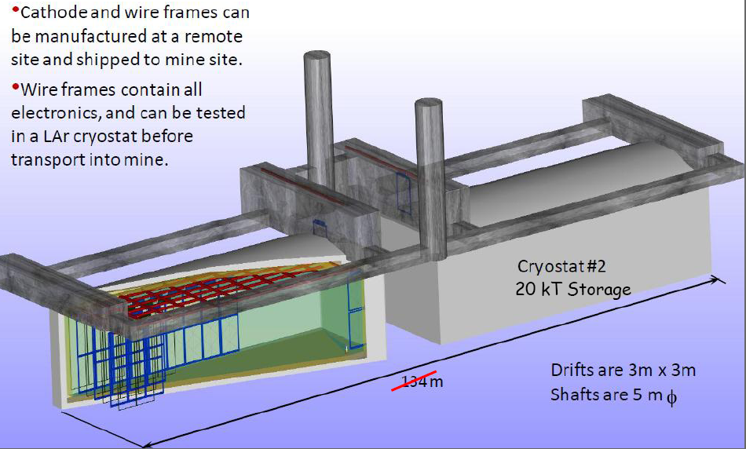

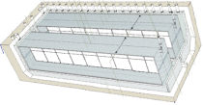
Liquid Argon TPC - Ref. Design 3a
Liquid Argon TPC
Project Manager:
Bruce Baller (FNAL)
Volume: 16m x 19m x 70m
Fiducial Mass: 16.8kT
Total Mass: 25 kT
NOνA 15.6mx15.6mx68m
ICARUS T600
3.6m x 3.9m x 19.6m

Slide 21
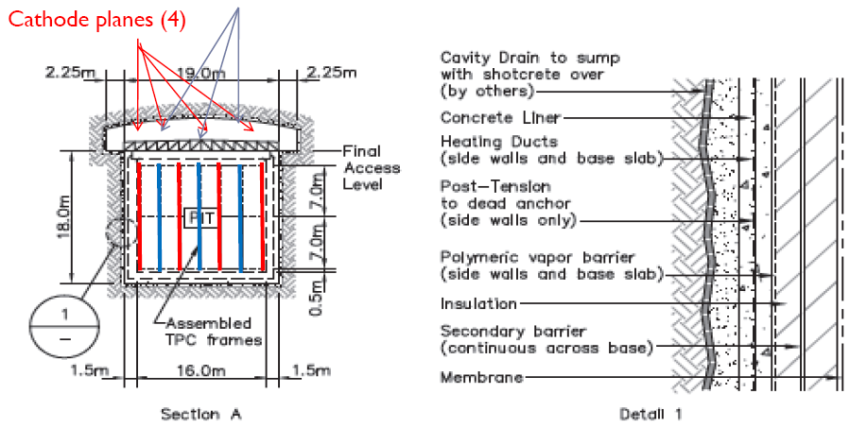
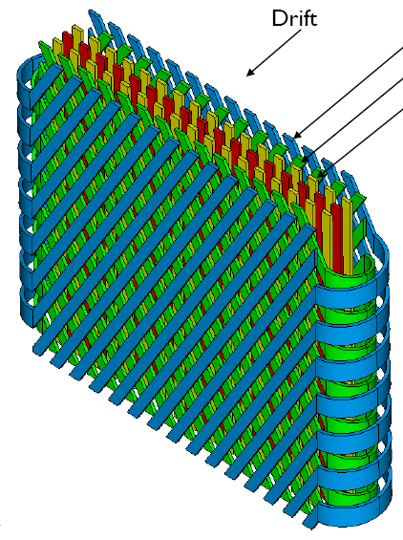
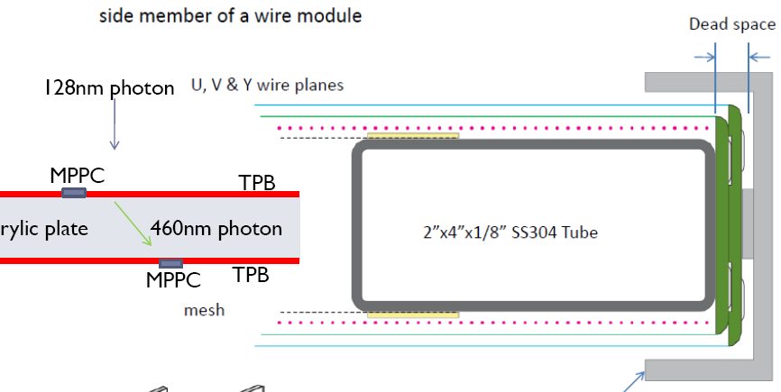
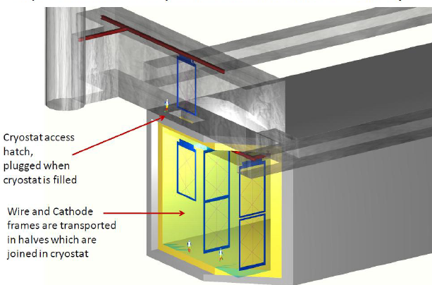
Liquid Argon TPC

Slide 22
Physics Report FD Configurations
Technology | Depth | Detail
Three x 100 kton* WC | 4850’ | 15% pmt† coverage
 |  | 30% pmt† coverage
 |  | 30% pmt† coverage + Gd
Three x 17 kton* LAr TPC | 4850’ | Scintillation photon trigger
 | 300’/800’ | No photon trigger
Two x 100 kton* WC AND One x 17 kton* LAr TPC | 4850’ 300’/800’ | 15% pmt† coverage
 |  | 30% pmt† coverage
 |  | 30% pmt† coverage + Gd
One x 100 kton* WC AND Two x 17 FV kton* LAr TPC | 4850’ 300’/800’ | 30% pmt† coverage + Gd No photon trigger
* fiducial volume † 10 inch High-QE PMT’s

Slide 23
Project Far Detector Configurations
 | WCD @ 4850 | LAr @ 4850 | LAr @ 300/800
a) | 2 x 100 kT
b) |  | 2 x 20 kT
c) |  |  | 2 x 20 kT
d) | 1 x 100 kT | 1 x 20 kT
e) | 1 x 100 kT |  | 1 x 20 kT

Slide 24
Physics Sensitivity

Slide 25
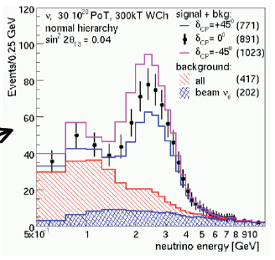
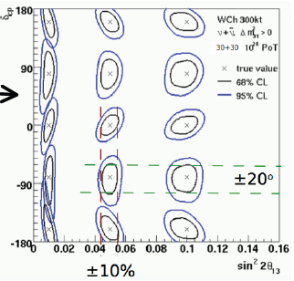
CP Signal & Sensitivity
300 kT Water Cherenkov (~50kT LAr TPC) 700 kW – 4yrs ν + 4 yrs ν

Slide 26
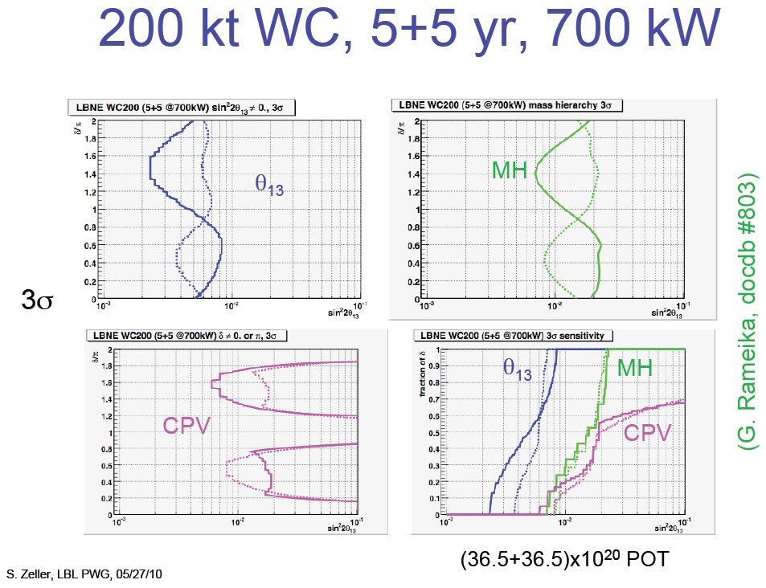

Slide 27
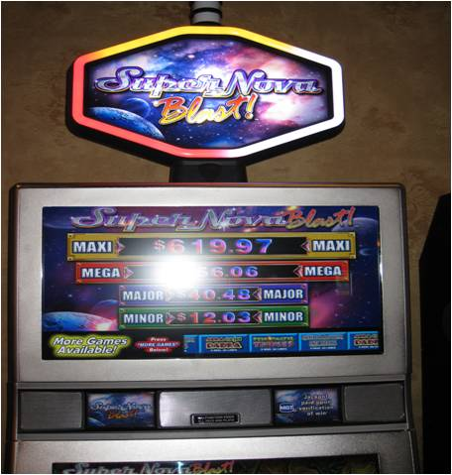
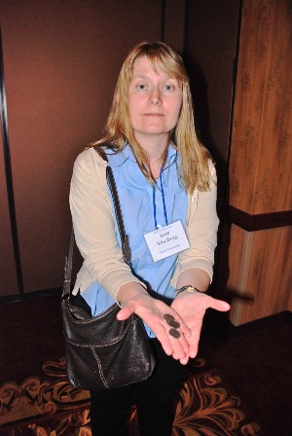
Put Your Money on Supernovae
LBNE Collaboration meeting - Deadwood, SD 25-28 May 2010

Slide 28
Summary
CD-0 has put FNAL firmly into the drivers seat and LBNE is accelerating up the on-ramp
LBNE project is preparing a CDR for December CD-1 review
LBNE science collaboration is preparing a “physics report” to guide a preferred detector configuration recommendation for this fall
Project X : 700 kW → >2 MW – all the better!

Slide 29
Supplementary Slides

Slide 30
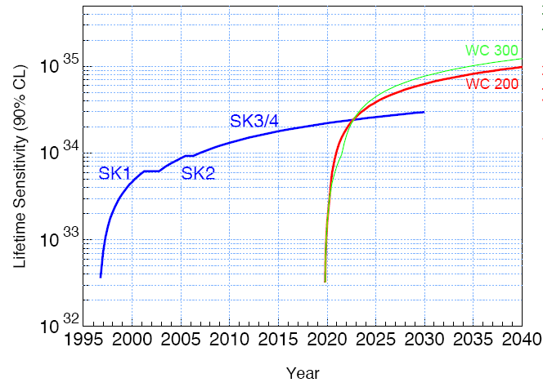
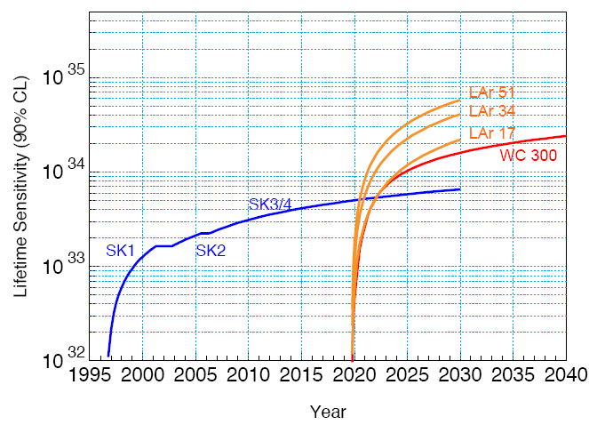


Proton Decay
Ed Kearns (BU)
Super-Kamiokande will have >20 years operation before LBNE turn-on
Liquid Argon TPC significantly better for kaon modes

Slide 31
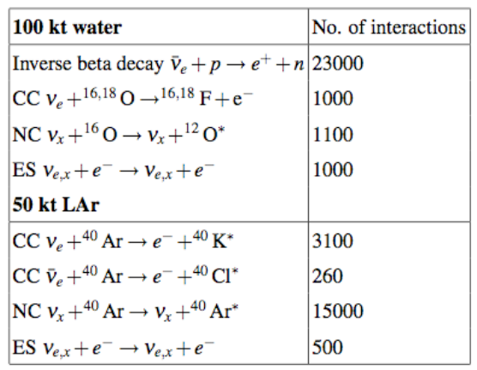
Supernova
When a star's core collapses, ~99% of the gravitational binding energy of the proto-nstar goes into ν's of all flavors with ~MeV energies
SN at galactic core (10 kpc) ⇒ tens of thousands of interactions in 100 kT WCD in tens of seconds
Larger detector mass -> extragalactic reach
Too bad they are so rare… 1-3 @90% c.l. in 25 yrs (Diehl et al, 2006)

Slide 32
SN Neutrino Events vs SN Distance
H₂O: 300 kT, 7 MeV threshold
Betelgeuse
H₂O
Mean Galactic
Distance
LAr
LMC
Andromeda
S.D. Reitzner, May 2010
Larger detector mass -> extragalactic reach

Slide 33
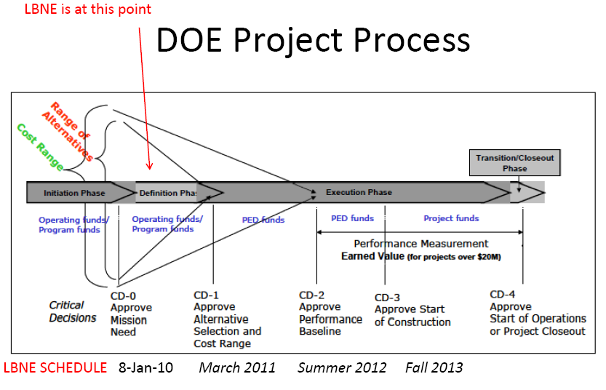

Slide 34
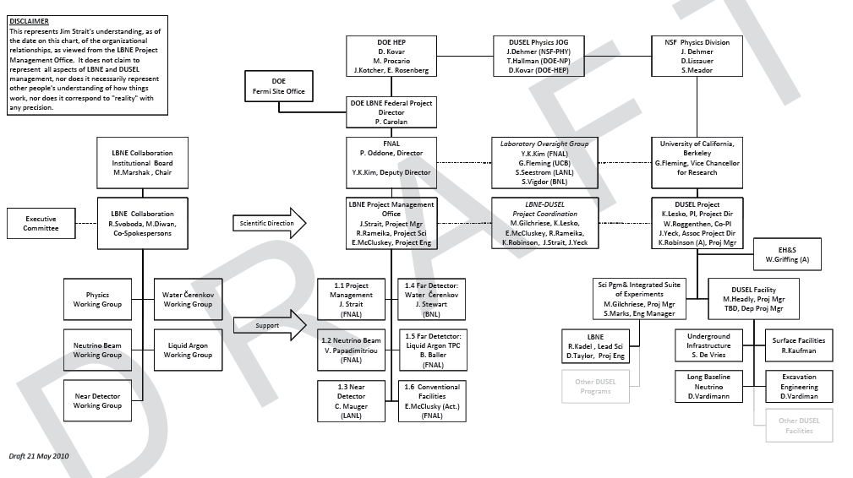
LBNE Project
WBS 1.2 - New neutrino beam at Fermilab:
  Initial proton beam power = 0.7 MW, but facility to be capable of being upgraded to ≥2 MW
WBS 1.3 - Near detector
  To measure un-oscillated beam spectrum and neutrino cross sections needed to make the oscillation measurements
A far detector complex of ≥ 200 kT Water Cerenkov equivalent
  WBS 1.4 – Water Cerenkov Detector (WCD) 100 kT “modules” placed at 4850 feet
  WBS 1.5 – Liquid Argon TPC Detector (LAr) ~20 kT “modules” placed at 300/800 feet or 4850 feet

Slide 35
LBNE Project

Slide 36
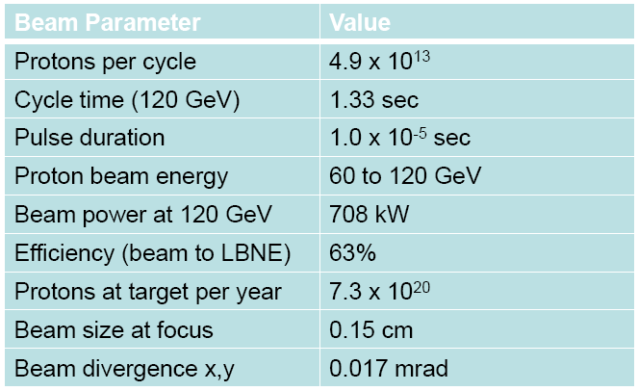
Reference Beam Design

Slide 37
Long-Baseline Neutrino Experiment Collaboration
Alabama: J. Goon, I Stancu
Argonne: M. D’Agostino, G. Drake. Z. Djurcic, M. Goodman, V. Guarino, J. Paley, R. Talaga, M. Wetstein
Boston: E. Hazen, E. Kearns, J. Raaf, J. Stone
Brookhaven: M. Bishai, R. Brown, H. Chen, M. Diwan, J. Dolph, G. Geronimo, R. Gill, R. Hackenberg, R. Hahn, S. Hans, D. Jaffe, S. Junnarkar, J.S. Kettell, F. Lanni, L. Littenberg, D. Makowiecki, W. Marciano, W. Morse, Z. Parsa, C. Pearson, V. Radeka, S. Rescia, T. Russo, N. Samios,R. Sharma, N. Simos, J. Sondericker, J. Stewart, H. Tanaka, C. Thorn, B. Viren, Z. Wang, S. White, L. Whitehead, M. Yeh, B. Yu
Caltech: R. McKeown
Cambridge: A. Blake, M. Thomson
Catania/INFN: V. Bellini, G. Garilli, R. Potenza, M. Trovato
Chicago: E. Blucher
Colorado: A. Marino, M. Tzanov, E. Zimmerman
Colorado State: B. Berger, J. Harton, W. Toki, R. Wilson
Columbia: L. Camillieri, C.Y. Chi, C. Mariani, M. Shaevitz, W. Sippach, W. Willis
Crookston: D. Demuth
Dakota State: B. Szcerbinska
Davis: R. Breedon, T. Classen, J. Felde, M. Tripanthi, R. Svoboda
Drexel: C. Lane, J. Maricic, R. Milincic, K. Zbiri
Duke: J. Fowler, K. Scholberg, C. Walter
Duluth: R. Gran, A. Habig
Fermilab: D. Allspach, B. Baller, D. Boehnlein, S. Childress, T. Dykhuis, A. Hahn, P. Huhr, J. Hylen, M. Johnson, T. Junk, B. Kayser, G. Koizumi, T. Lackowski, C. Laughton, P. Lucas, B. Lundberg, P. Mantsch, J. Morfin, V. Papadimitriou, R. Plunkett, C. Polly, S. Pordes, G. Rameika, B. Rebel, D. Reitzner, K. Riesselmann, R. Schmidt, D. Schmitz, P. Shanahan, J. Strait, K. Vaziri, G. Velev, G. Zeller, R. Zwaska
Hawaii: S. Dye, J. Kumar, J. Learned, S. Matsuno, S. Pakvasa, M. Rosen, G. Varner
Indian Universities: V. Bhatnagar, B. Bhuyan, B. Choudhary, P. Gupta, A. Kumar, S. Mandal, S. Sahijpal, V. Singh
Indiana: C. Bower, W. Fox, M. Messier, J. Musser, R. Tayloe, J. Urheim
Iowa State: M. Sanchez
IPMU/Tokyo: M. Vagins
Irvine: W. Kropp, M. Smy, H. Sobel
Kansas State: T. Bolton, G. Horton-Smith
LBL: R. Kadel, B. Fujikawa, D. Taylor
Livermore: A. Bernstein, R. Bionta, S. Dazeley, S. Ouedraogo
London-UCL: J. Thomas
Los Alamos: S. Elliot, V. Gehman, G. Garvey, T. Haines, D. Lee, W. Louis, C. Mauger, G. Mills, Z. Pavlovic, G. Sinnis, R. Van de Water, H. White
Louisiana State: N. Buchanan, T. Kutter, W. Metcalf, J. Nowak
Maryland: E. Blaufuss, T. Straszheim, G. Sullivan
Michigan State: E. Arrieta-Diaz, C. Bromberg, D. Edmunds, J. Huston, B. Page
Minnesota: M. Marshak, W. Miller
MIT: W. Barletta, J. Conrad, R. Lanza, P. Fisher
NGA: S. Malys, S. Usman
New Mexico: B. Becker, J. Mathews
Notre Dame: J. Losecco
Oxford: G. Barr, J. DeJong, A. Weber
Pennsylvania: J. Klein, K. Lande, A. Mann, M. Newcomer, R. vanBerg
Pittsburgh: D. Naples, V. Paolone
Princeton: Q. He, K. McDonald
Rensselaer: D. Kaminski, J. Napolitano, S. Salon, P. Stoler
Rochester: R. Bradford, K. McFarland
SDMST: X. Bai, R. Corey
SMU: J. Ye
South Carolina: S. Mishra, R. Petti, C. Rosenfeld
South Dakota State: K. McTaggert
Texas: S. Kopp, K. Lang, R. Mehdiyev
Tufts: H. Gallagher, T. Kafka, W. Mann, J. Schnepps
UCLA: K. Arisaka, D. Cline, K. Lee, Y. Meng, F. Sergiampietri, H. Wang
Virginia Tech: J. Link
Washington: S. Enomoto, J. Kaspar, N. Tolich, H.K. Tseung
Wisconsin: B. Balantekin, F. Feyzi, K. Heeger, A. Karle, R. Maruyama, C. Wendt
Yale: B. Fleming, M. Soderberg, J. Spitz
17 May 2010

