Slide 1
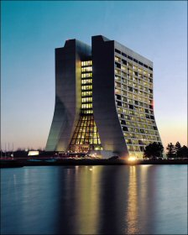
J/ψ production in p-A collisions at 158 and 400 GeV: results from the NA60 experiment
Introduction
Data analysis
Differential distributions (y, p_{T})‏
Polarization
Nuclear effects
Conclusions
P. Cortese (Università del Piemonte Orientale – Alessandria
and INFN Torino, Italy)‏
for the NA60 Collaboration
1
Notes:
1

Slide 2
Motivation
NA50 and NA60 studied J/Ψ suppression in Pb-Pb and In-In collisions at 158 GeV at the CERN SPS
Observation of J/Ψ suppression beyond CNM expectation can be a signal of deconfinement
Careful estimation of CNM effects is a basic prerequisite for any claim of an “anomalous suppression” in A-A
This fact motivated p-A data taking at 158 GeV by NA60 in order to obtain a reference sample taken in the same conditions of In-In (NA60) and Pb-Pb (NA50) data
Data at 400 GeV (also collected by NA60) extremely useful as a cross-check (same energy/kinematic domain of a large statistics data sample collected by NA50)
2
Notes:
2

Slide 3
pA at 158/400 GeV: analysis
Muon trigger
and tracking
2.5 T dipole magnet
NA10/38/50 muon spectrometer
beam tracker
vertex tracker
magnetic field
Iron wall
targets
hadron absorber
Matching in coordinate and momentum space
Muon
Other
2 analysis approaches possible
Dimuons detected in the NA50 MS
Higher acceptance and detection efficiency
No target identification
Matched dimuons
Unambigous target identification thanks to VT resolution
Improved mass resolution and background rejection
mixed A-order to limit
possible z-dependent
systematics
9 subtargets: Al-U-W-Cu-In-Be1-Be2-Be3-Pb
3
Notes:
3

Slide 4
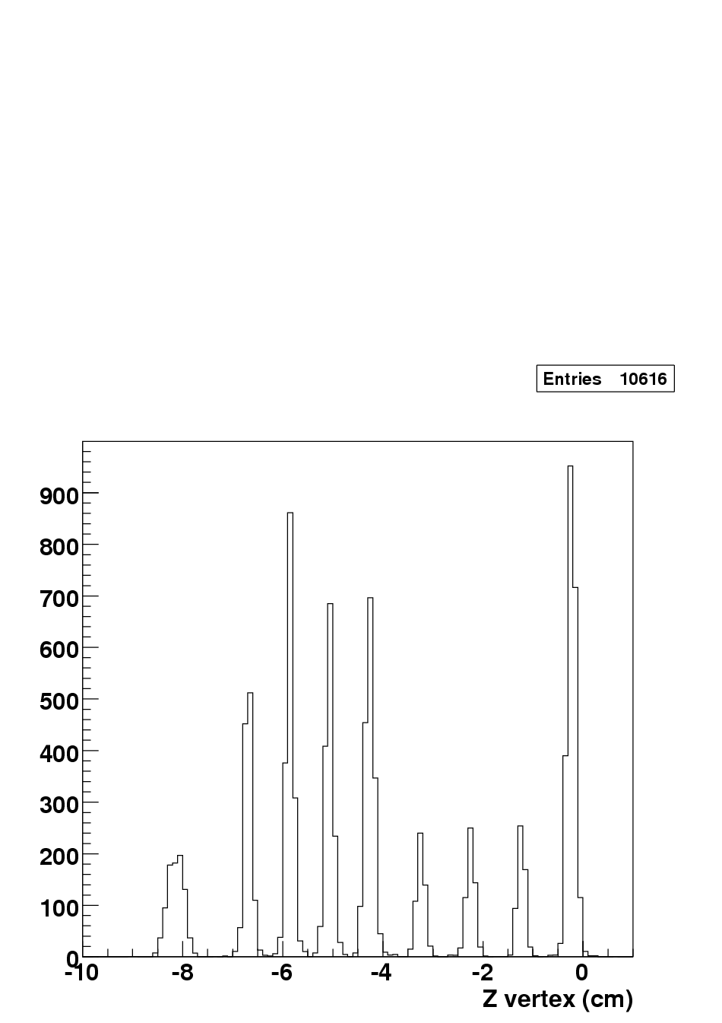
Cross section ratios
W
Pb
Cu
In
U
Be
Al
The beam luminosity factors N_{A}^{inc} cancel out
(apart from a small beam attenuation factor),
since all the targets were simultaneously exposed to the beam
→ no systematic errors
The acceptance and reconstruction efficiencies do not cancel out
completely because each target sees the vertex spectrometer under
a (slightly) different angle
Need to compute these quantities, and their time evolution for
each target separately
Restrict the kinematic window to reduce systematics

Slide 5
Efficiency corrections
Reconstruction efficiency does not cancel in the ratio
Estimation based on a Monte-Carlo approach
Inject realistic VT efficiencies (follow their time evolution)‏
Finest granularity (8 pixels ~0.8*0.8 mm² where statistics is enough)‏
Use “matching efficiency” and its time evolution as a check of
the goodness of the procedure
Matching rate data
Matching rate MC
Efficiency map
(4th plane, sensor 0)‏
5
Matching efficiency
Notes:
5

Slide 6
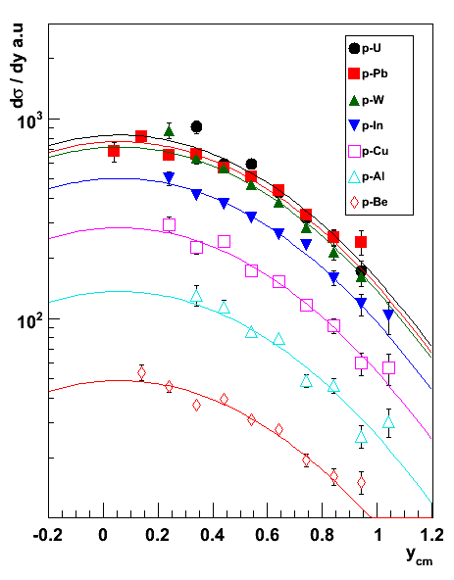
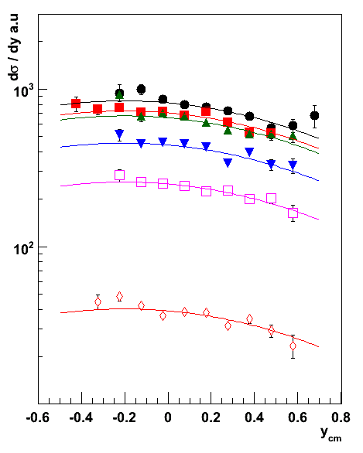
Differential distributions: dσ/dy
158 GeV
400 GeV
Gaussian fit at 158 GeV gives μ_{y}=0.05±0.05, σ_{y}=0.51±0.02 (in agreement with NA3)
y-distribution wider at 400 GeV, as expected
Peak position not well constrained at 400 GeV
Imposing μ_{y}=-0.2 (NA50 at 400 GeV) σ_{y}=0.81±0.03 (NA50 got 0.85)‏
6
Notes:
6

Slide 7
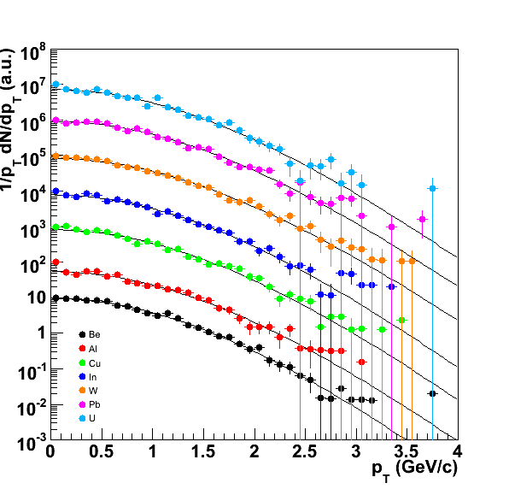
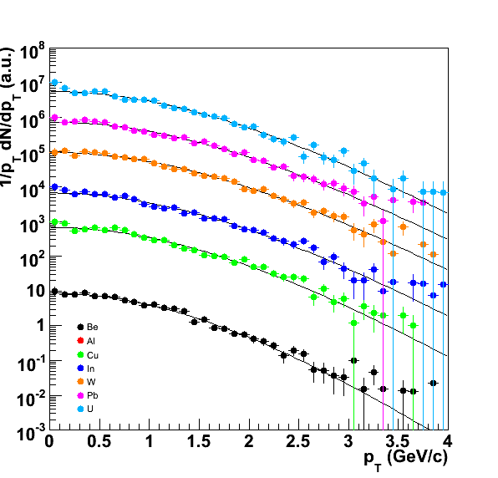
Differential distributions: dσ/dp_{T}
158 GeV
400 GeV
p_{T} broadening (Cronin effect) observed at both 158 and 400 GeV
7
Notes:
7

Slide 8
Comparison with previous experiments
<p_{T}²>= <p_{T}²>_{pp}+ α_{gN} × L
Fit ⟨p_{T}²⟩ for various nuclei as
<p_{T}²>= <p_{T}²>_{pp}+ ρ(A^{1/3}-1)
Agreement NA60 vs NA50 at 400 GeV
<p_{T}²>_{pp} shows an increase vs s
Does ρ increase with √s ?
8
Notes:
8

Slide 9
Polarization
Interesting variable to investigate the production models
and their ingredients
Theory still evolving (NLO, contribution of color octet states)‏
Significant amount of studies at collider energy (CDF)‏
Not much guidance at fixed target
y
x
Reference frames studied
Collins-Soper
z axis parallel to the bisector of the
angle between beam and target directions
in the quarkonium rest frame
Helicity
z axis coincides with the J/ψ direction in
the target-projectile center of mass frame
decay plane
μ⁺
ϕ
ϑ
z axis
p_{projectile}
p_{target}
Viewed from dimuon rest frae
reaction plane
Study the full angular distribution
9
Notes:
9

Slide 10
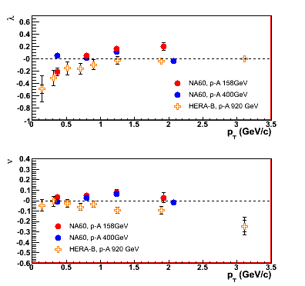
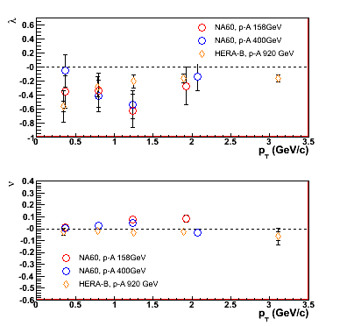
Preliminary pA results and comparisons
Helicity
Collins-Soper
NA60 systematic error (preliminary): ~± 0.10 (increasing with p_{T})‏
Large errors for λ in the CS frame (acceptance large only at small |cosθ_{CS}|)‏
μ compatible with zero everywhere
No large differences between NA60 and HERA-B
10
Notes:
10

Slide 11
Relative cross sections vs A
3.2 < y_{lab} < 3.7
A-dependence fitted using the Glauber model
Shadowing neglected, as usual (but not correct!) at fixed target
400 GeV
158 GeV
σ_{abs} ^{J/ψ} (158 GeV) = 7.6 ± 0.7(stat) ± 0.6(syst) mb
σ_{abs} ^{J/ψ} (400 GeV) = 4.3 ± 0.8(stat) ± 0.6(syst) mb
We get
(158 GeV) = 0.882 ± 0.009 ± 0.008
α(400 GeV) = 0.927 ± 0.013 ± 0.009
Using
11
Notes:
11
6.4±0.5 mb at 158 GeV (exp vs L)

Slide 12
Relative cross sections: systematic errors
We only quote the fraction of the total systematic error which is
not common to all the points (i.e. the one which affects the
evaluation of σ_{abs} ^{J/ψ})‏
The investigated sources of systematic errors are connected with:
Uncertainty on target thicknesses (≤ 1.5%)‏
Uncertainty on the J/ψ y distribution (≤ 1.5%)‏
Uncertainty in the reconstruction efficiency calculation (≤ 3%)‏
12
Notes:
12

Slide 13
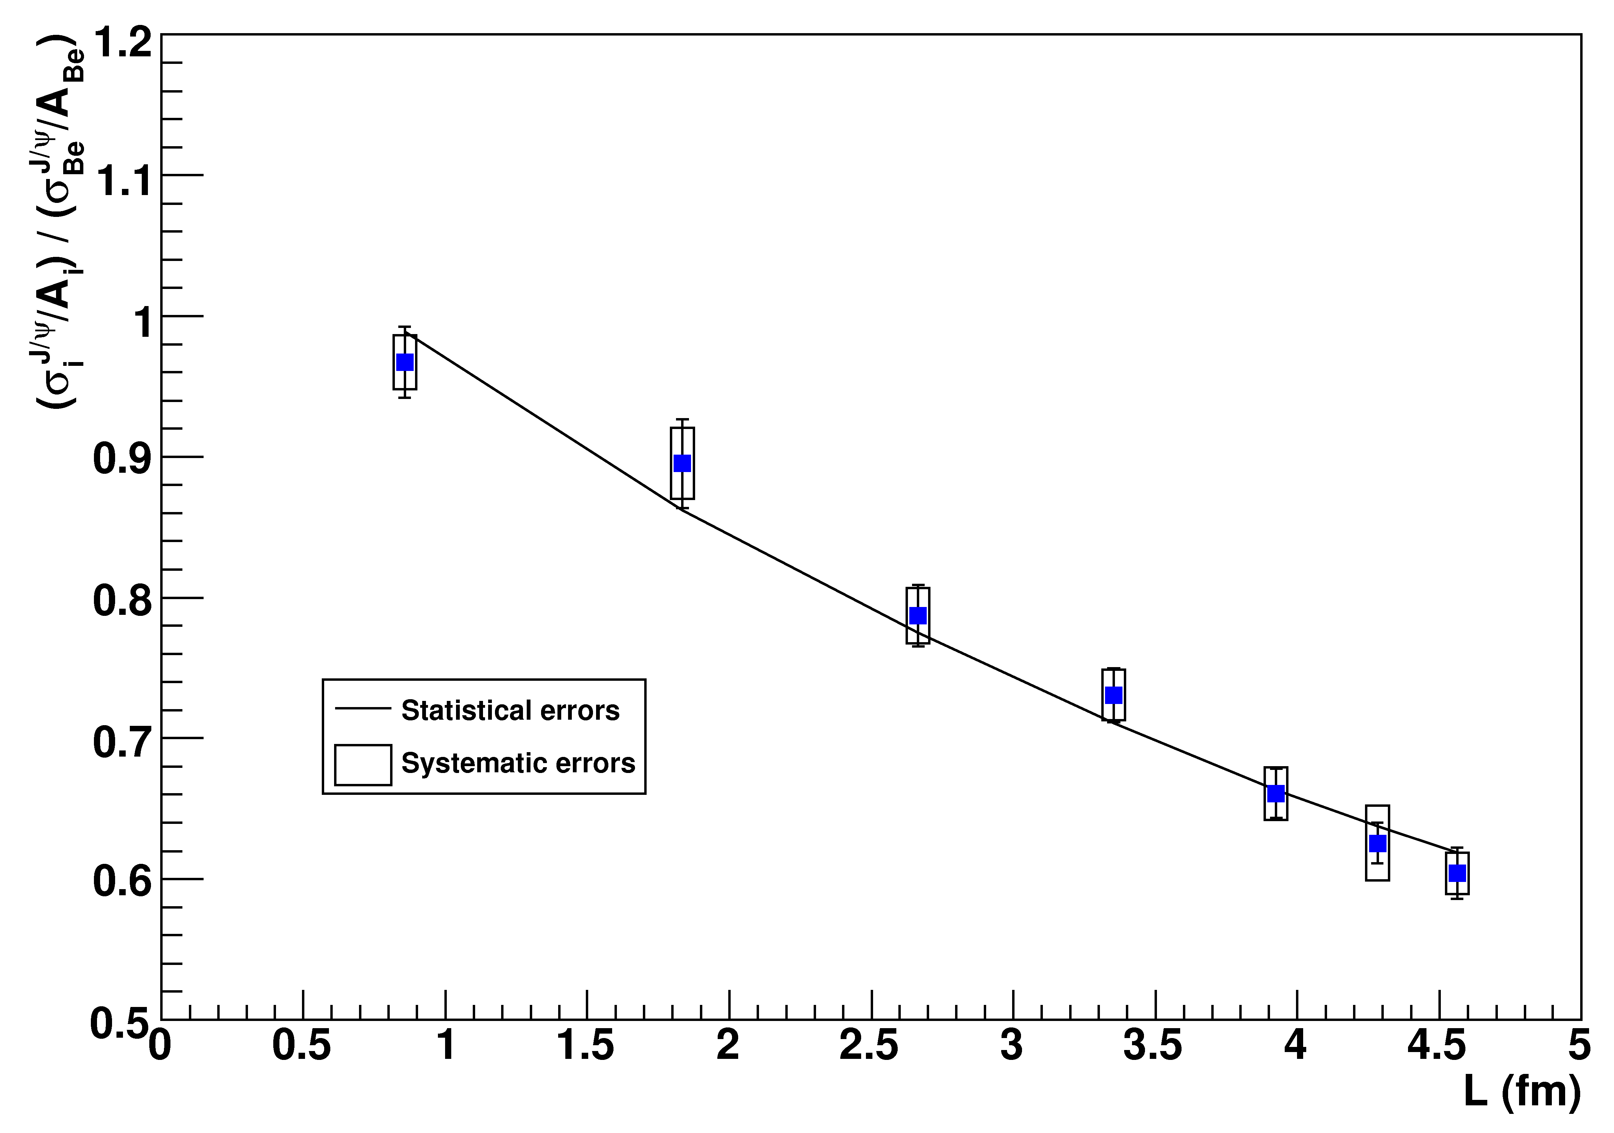
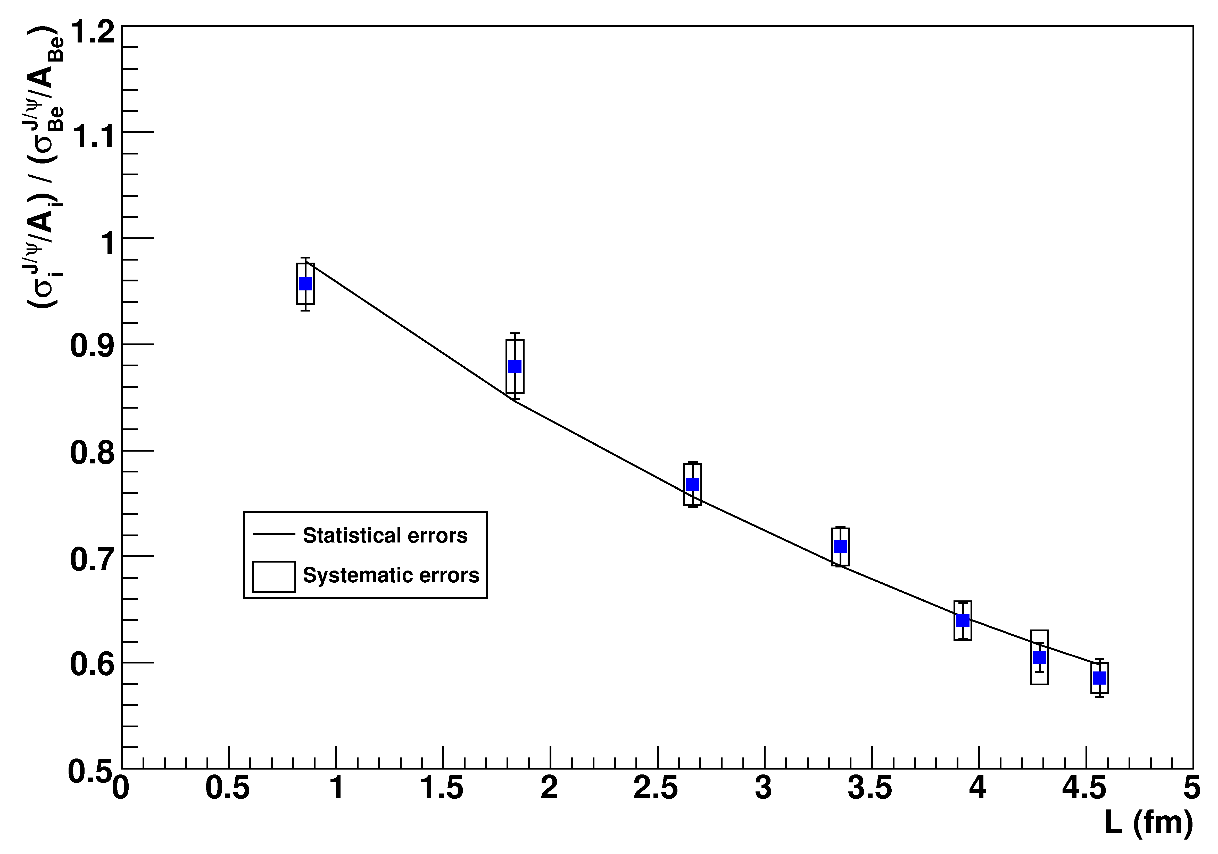
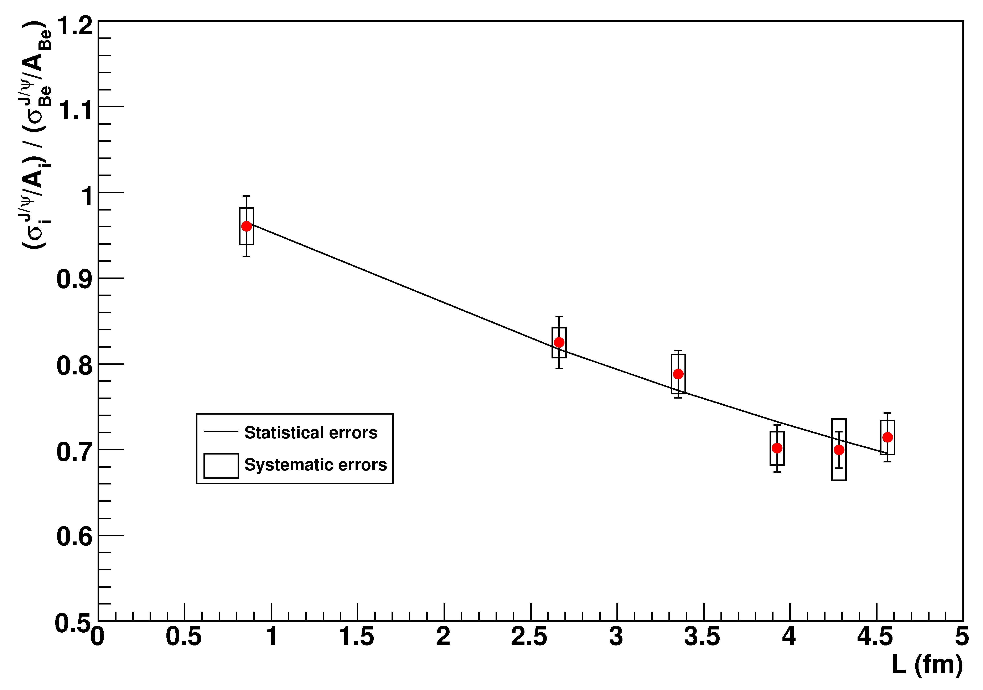
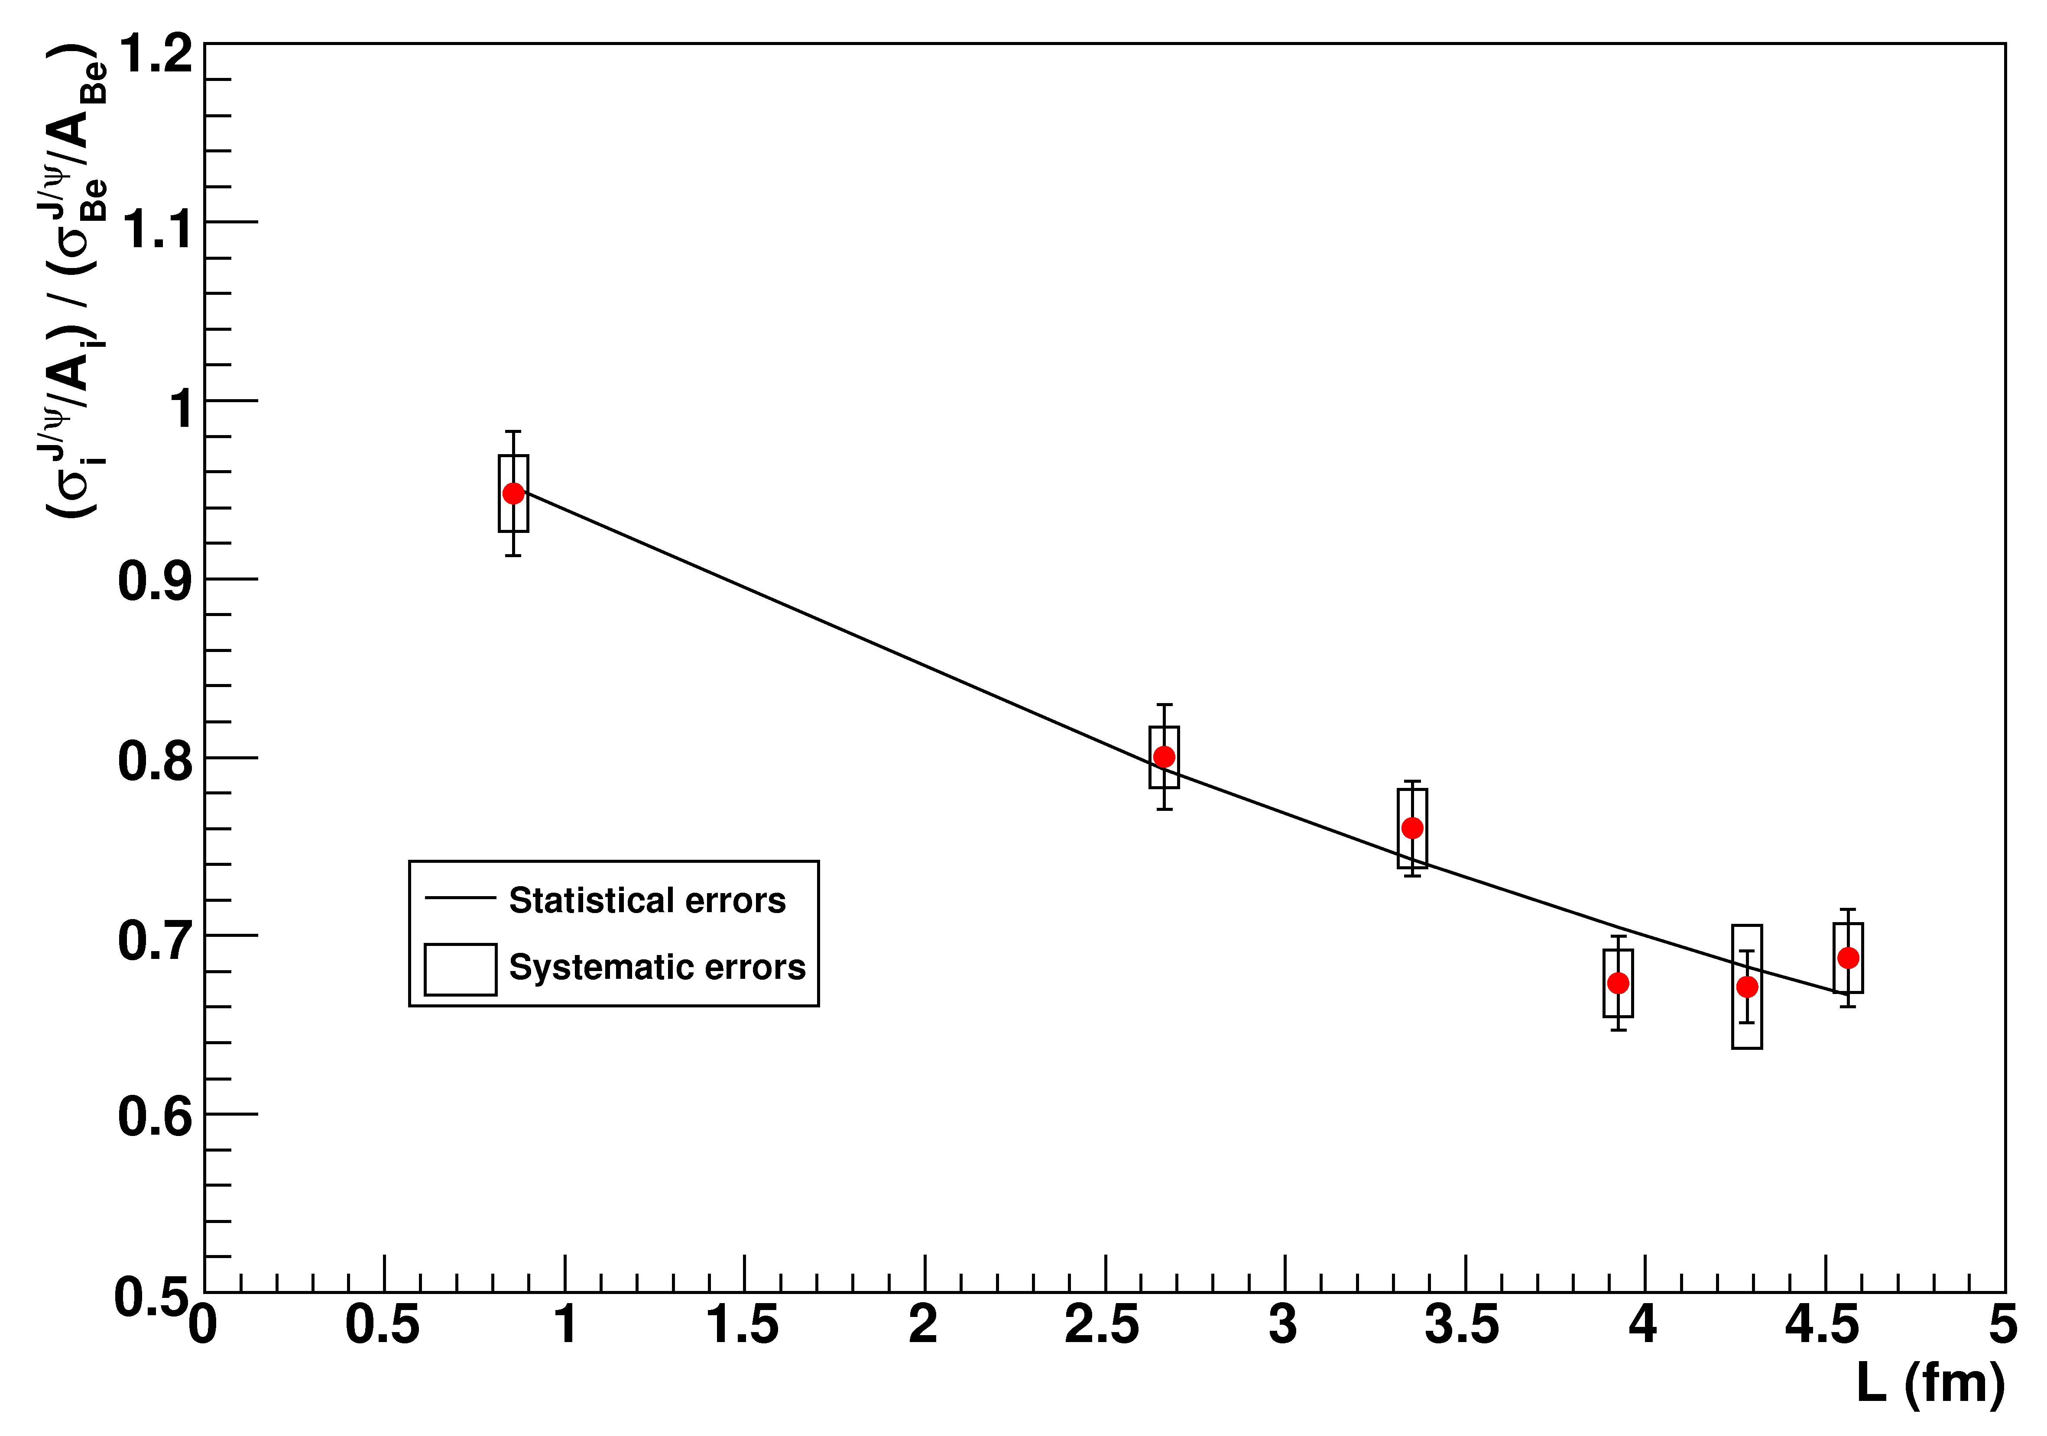
Shadowing at 400/158 GeV
We have evaluated (and corrected for) the (anti)shadowing effect
expected for our data points, within the EKS98 and EPS08 scheme
158 GeV,
EKS98
158 GeV,
EPS08
400 GeV,
EKS98
400 GeV,
EPS08
σ_{abs} ^{J/ψ,EKS} (158 GeV)=9.3±0.7±0.7 mb
σ_{abs} ^{J/ψ,EKS} (400 GeV)=6.0±0.9±0.7 mb
σ_{abs} ^{J/ψ,EPS} (158 GeV)=9.8±0.8±0.7 mb
σ_{abs} ^{J/ψ,EPS} (400 GeV)=6.6±1.0±0.7 mb
The Glauber fit now gives
Significantly higher than the “effective” values
13
Notes:
13
EPS as an upper limit for shadowing effects

Slide 14
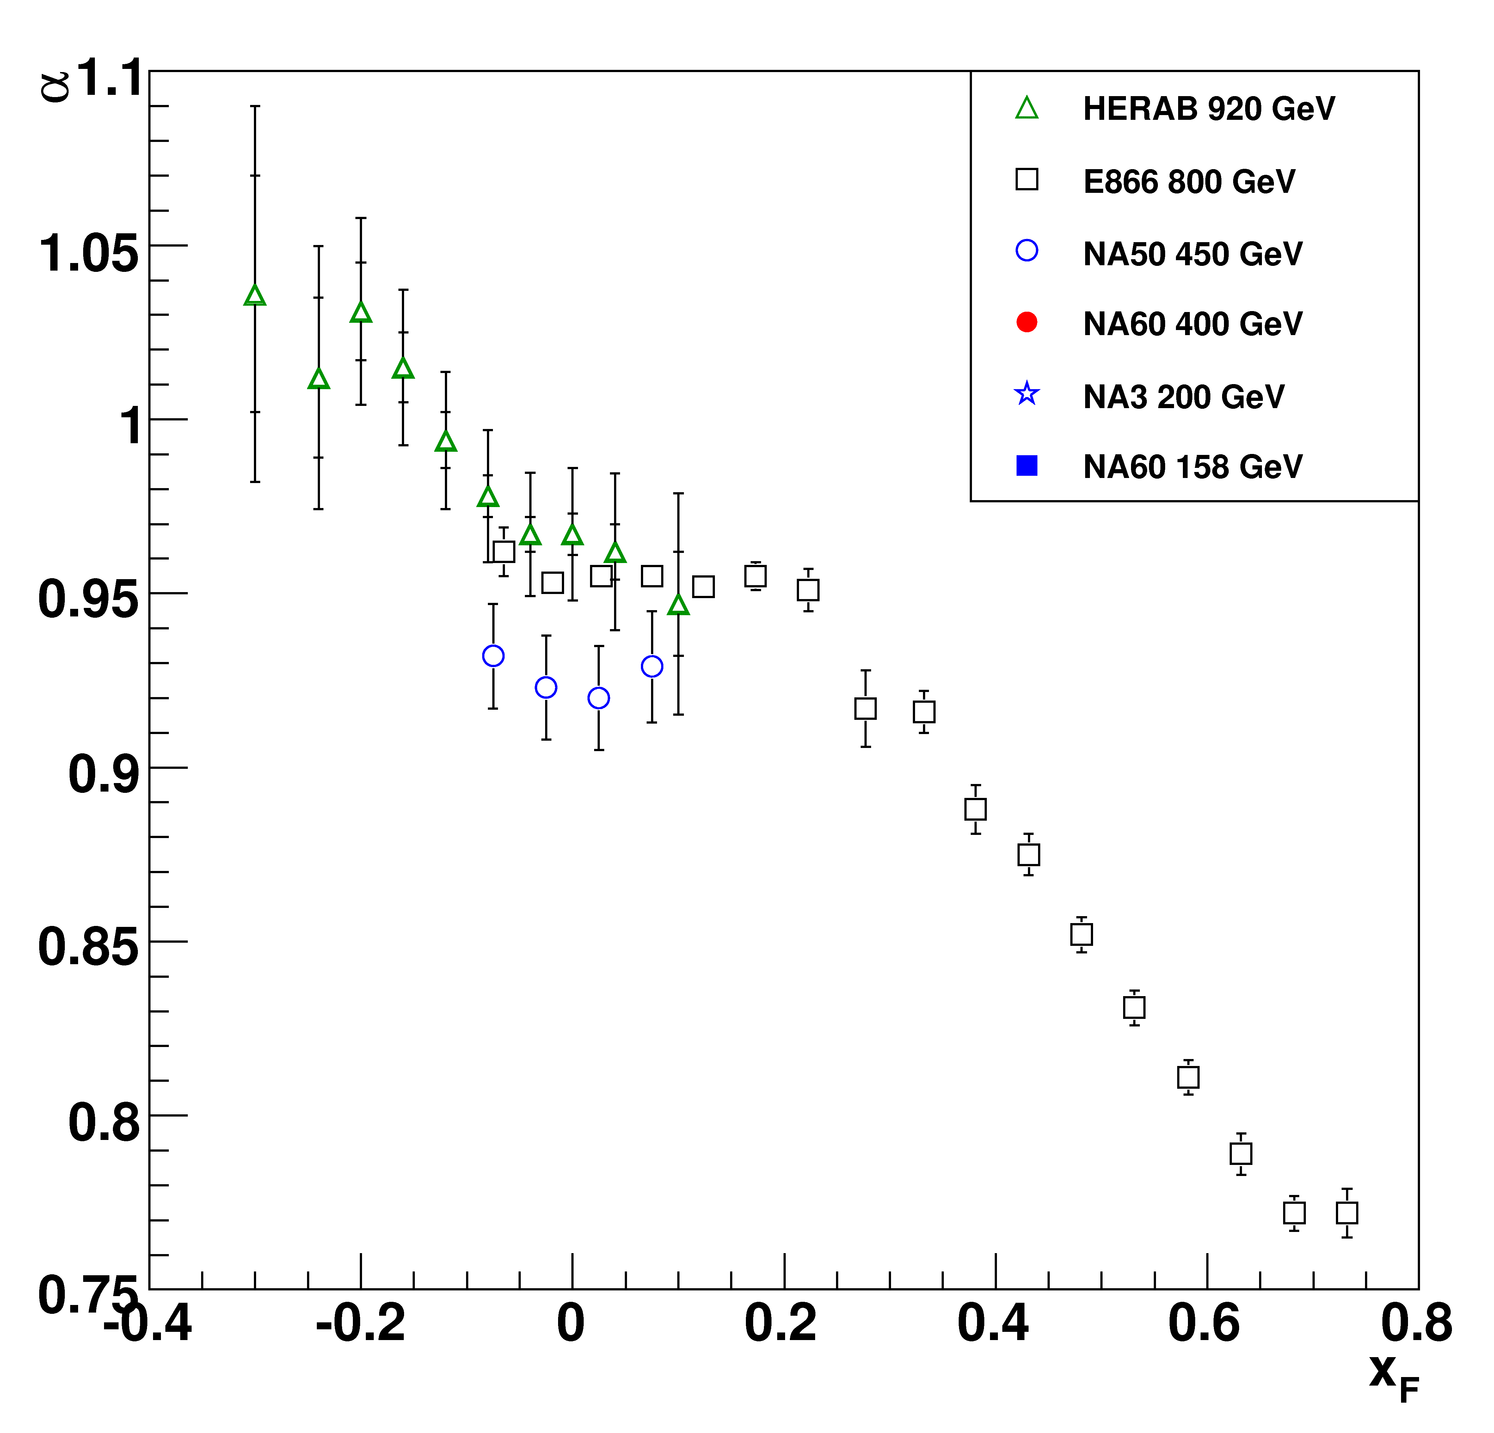
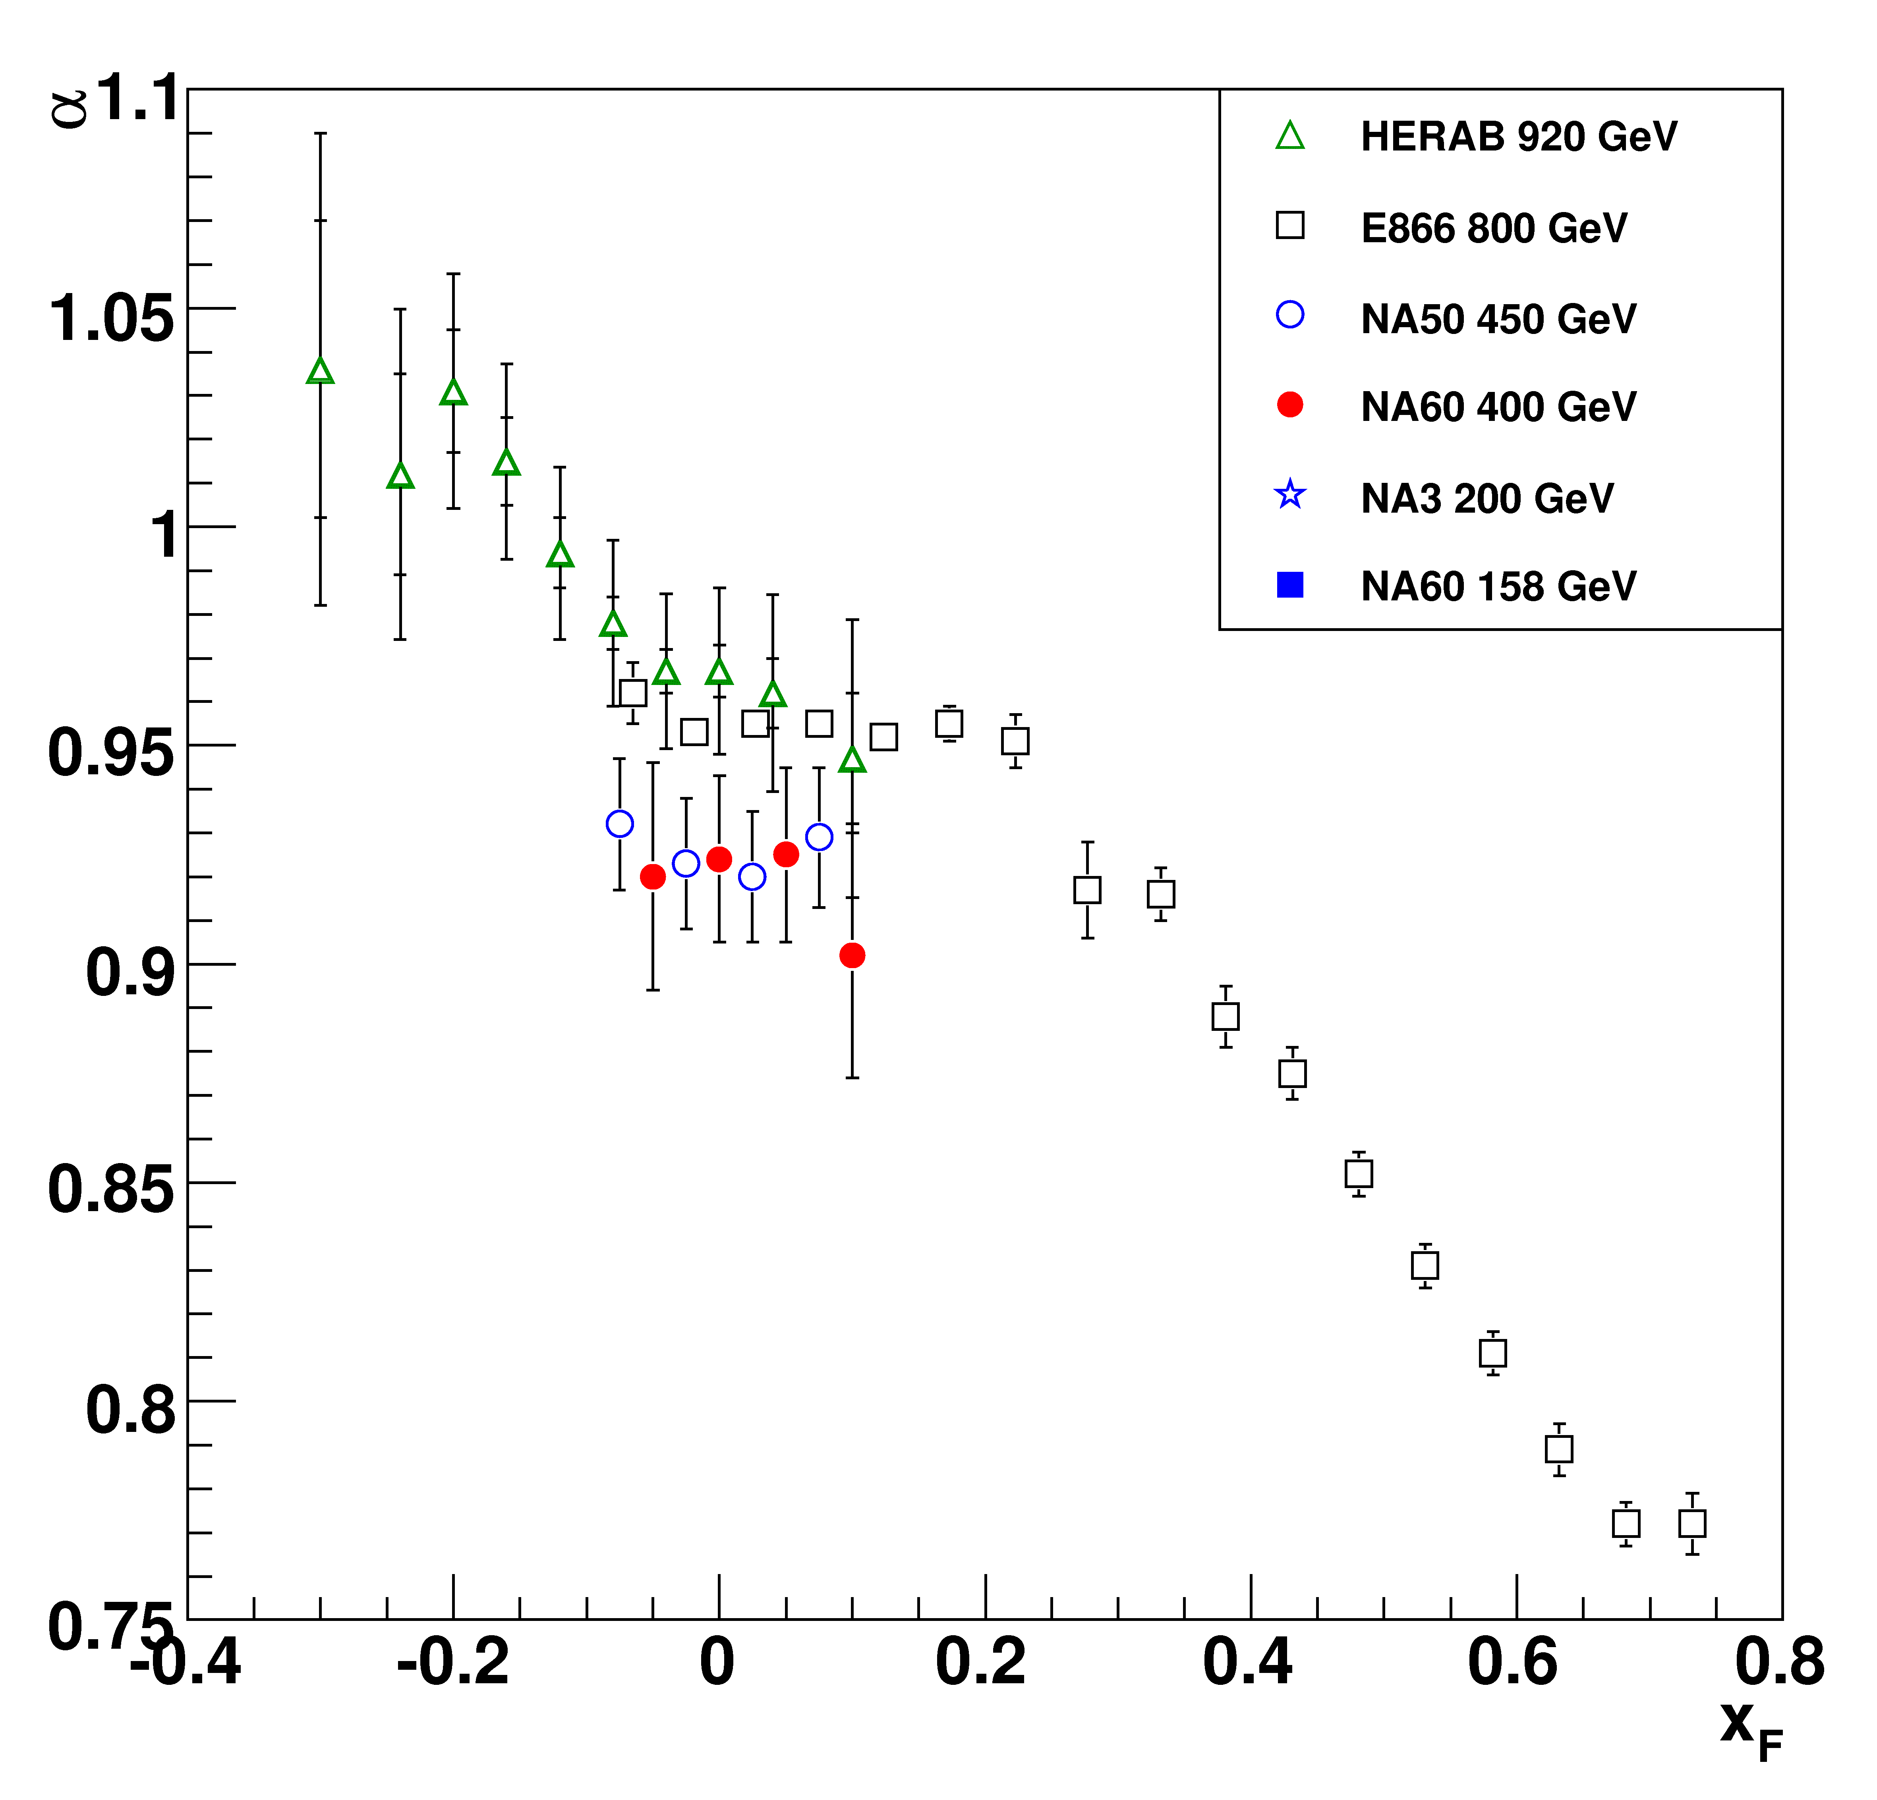
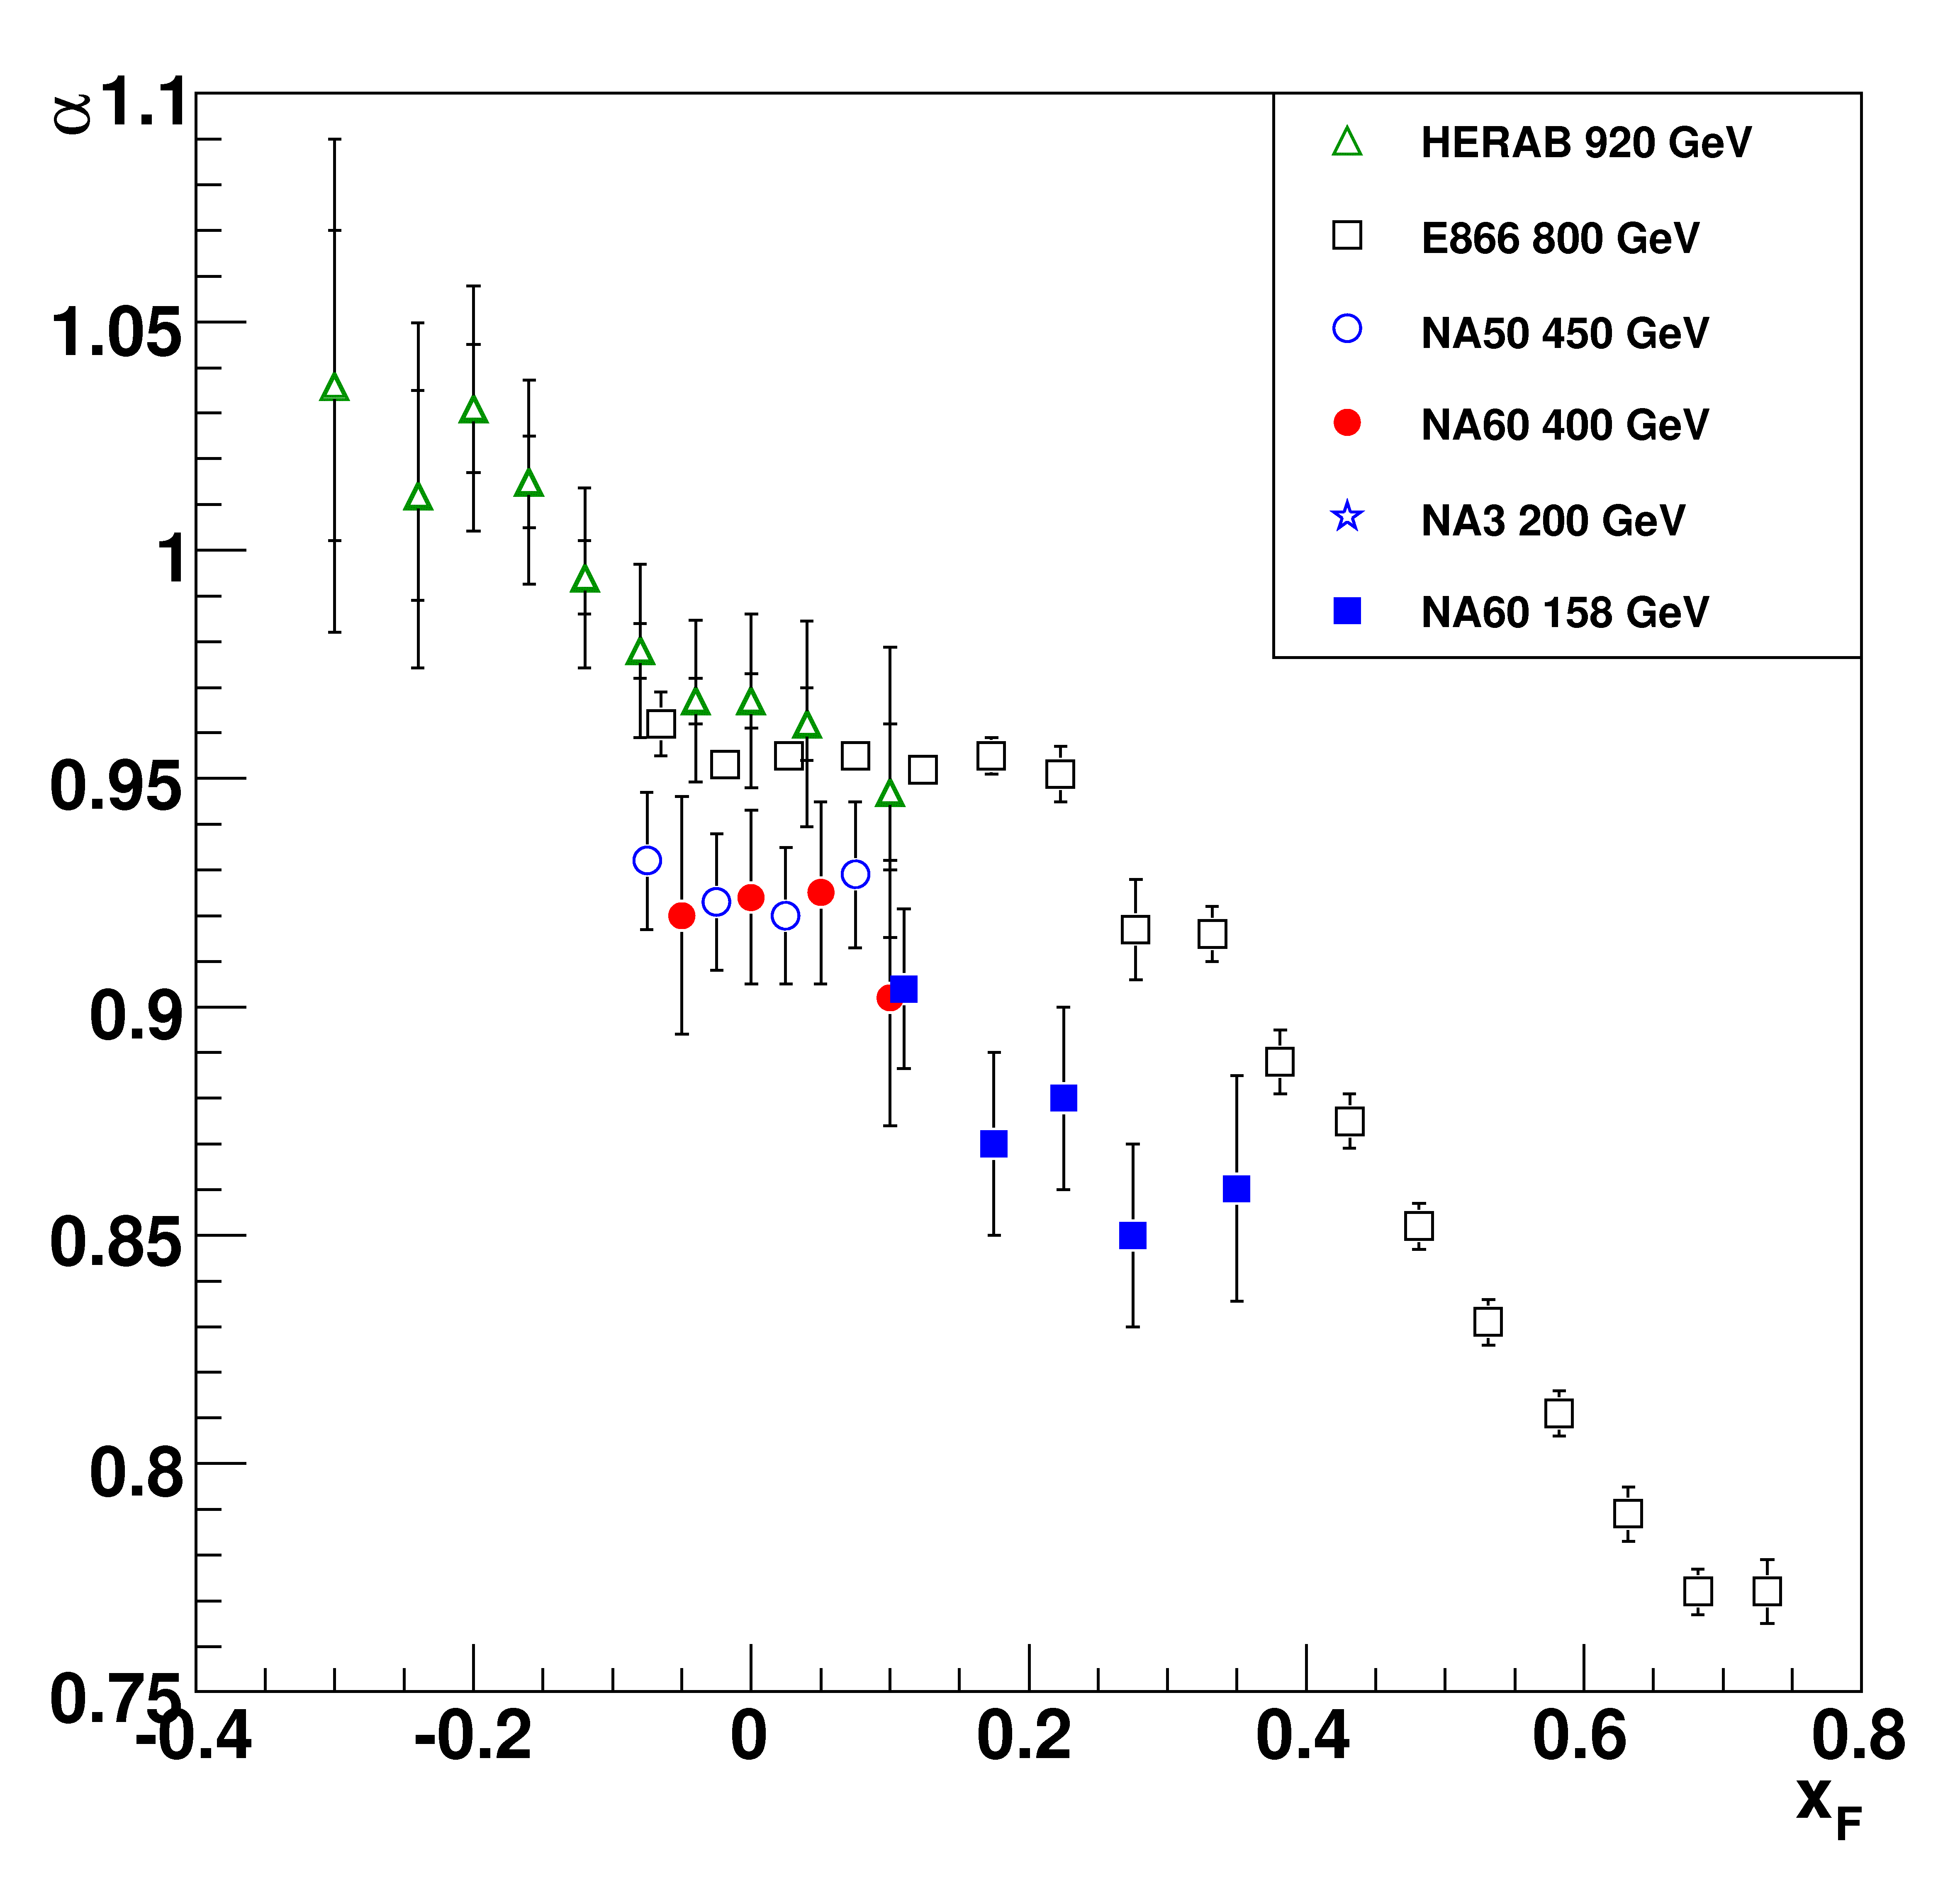
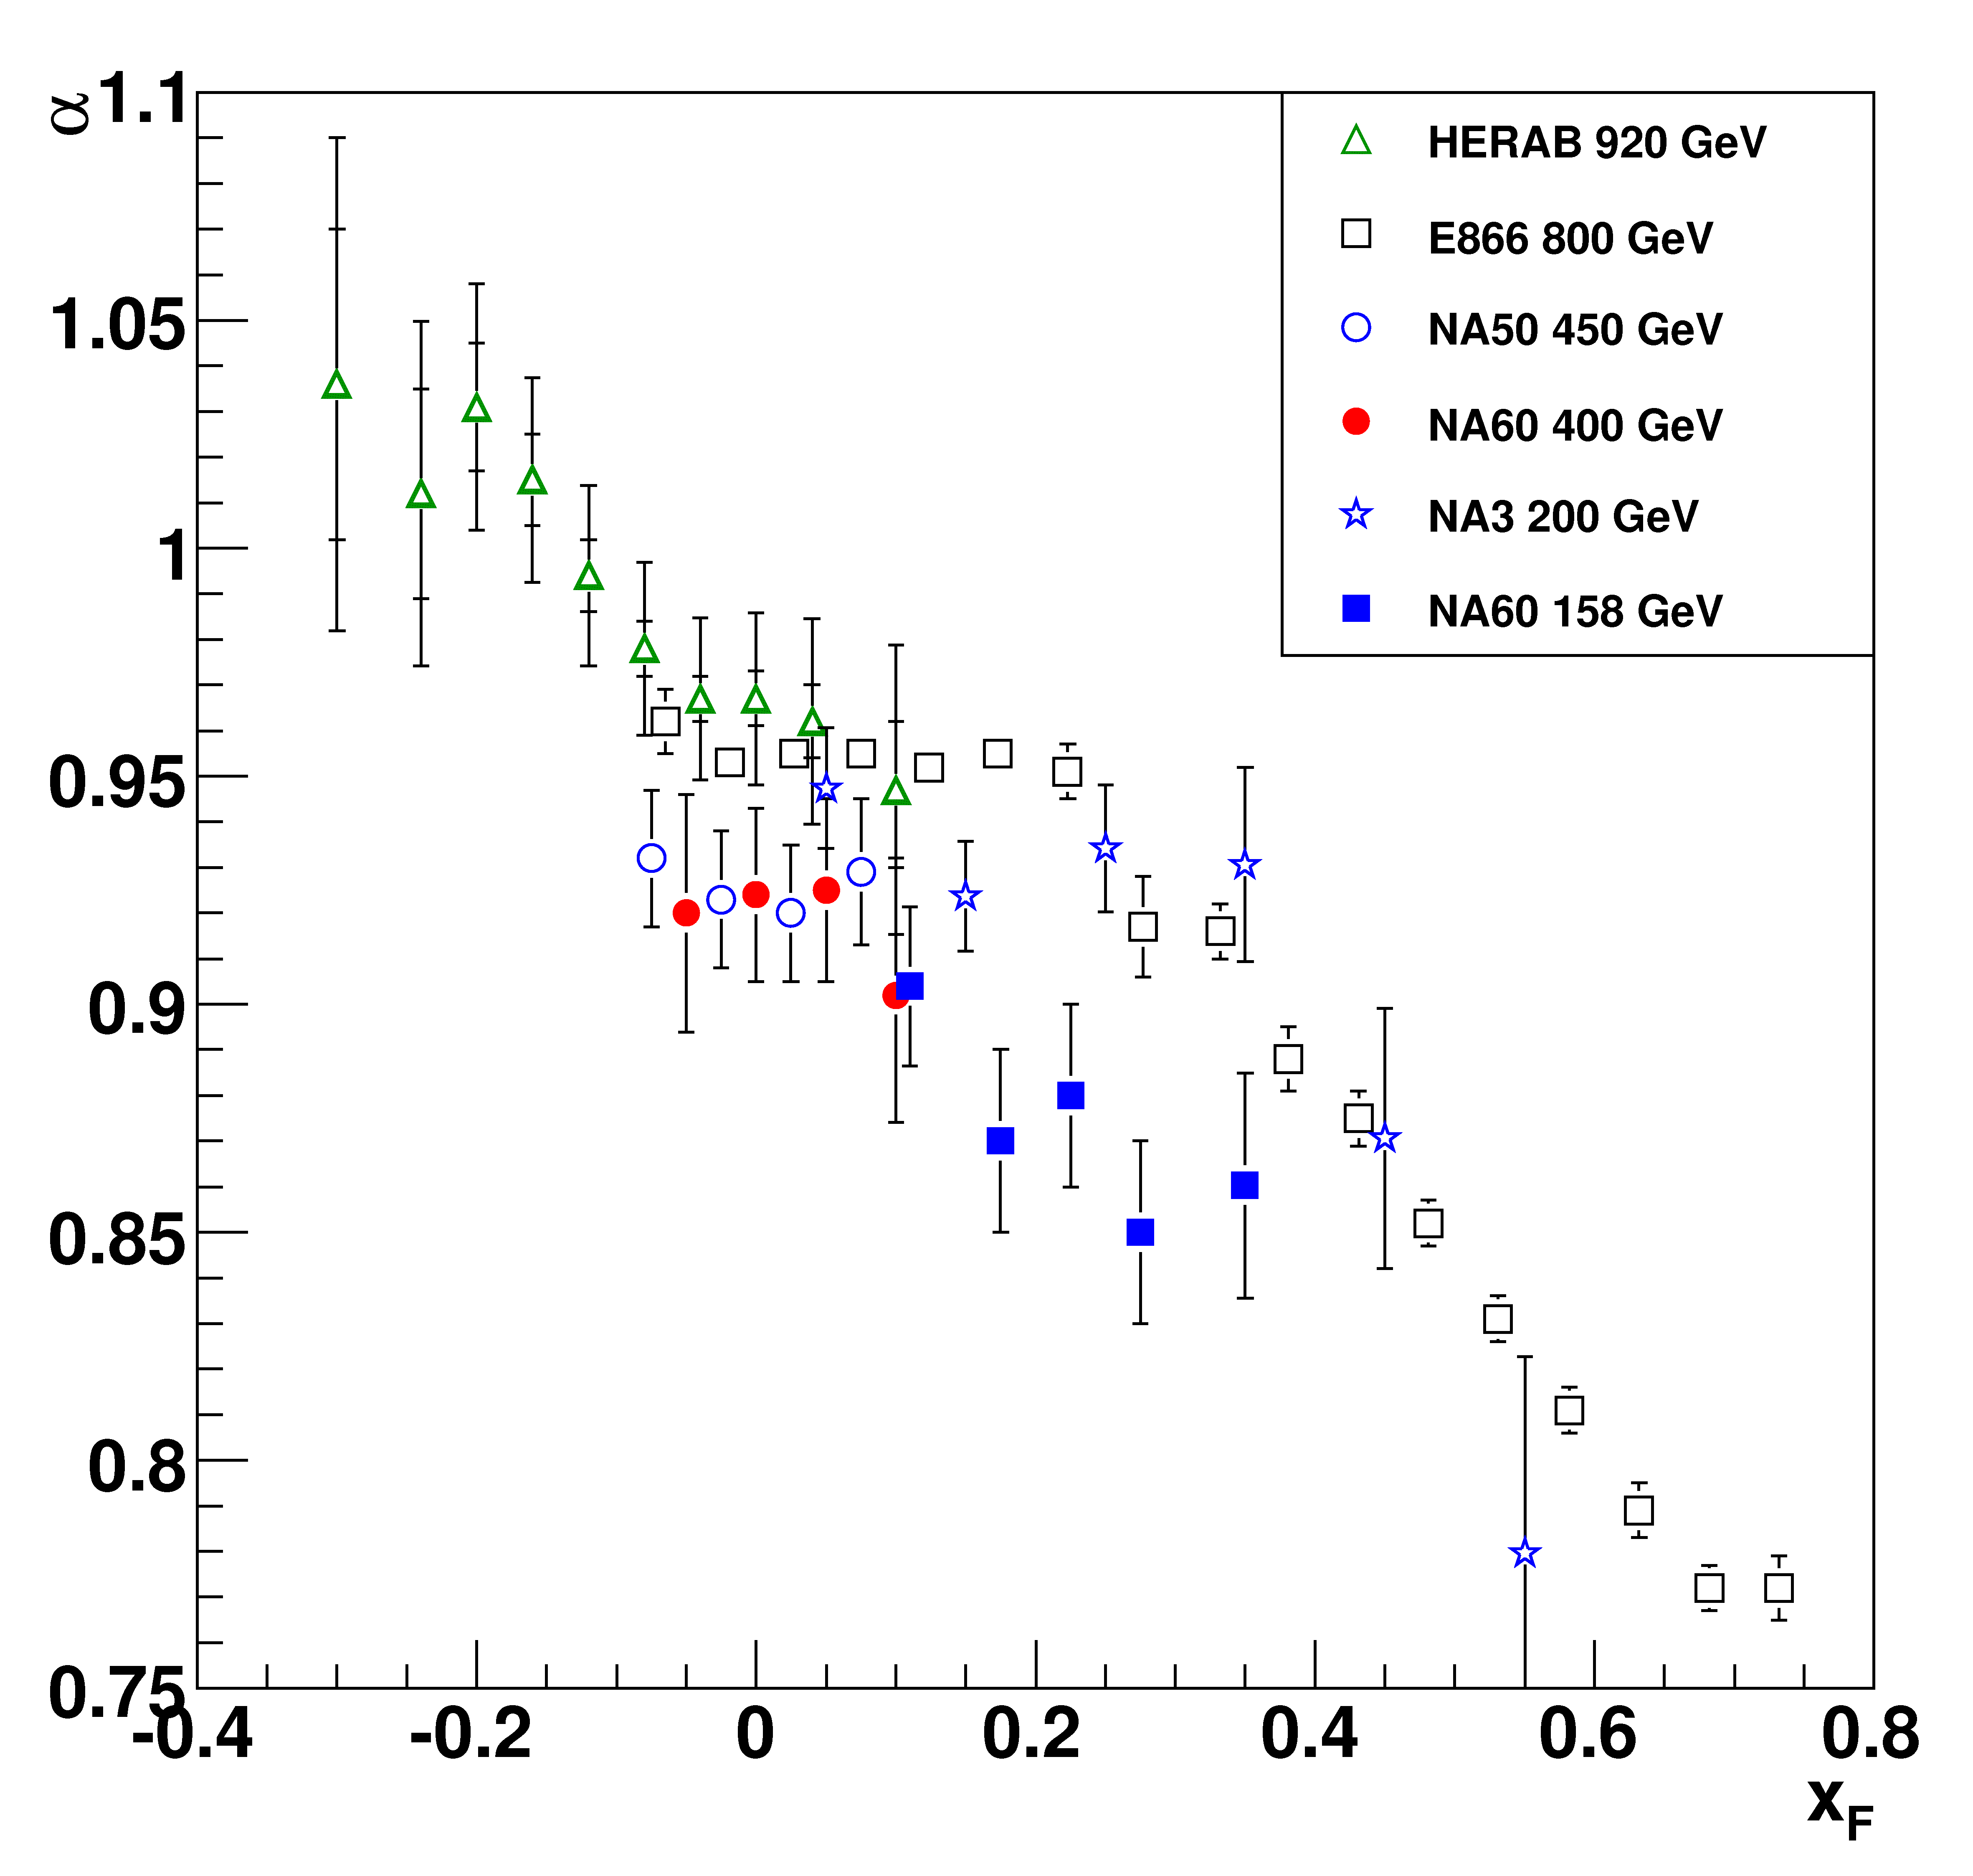
Comparison with other experiments: x_{F}‏
Recent results on α vs x_{F} from HERA-B, together with other data
from NA50, E866, NA3 (removed α bias from use of p-p)
In the region close to x_{F}=0,
increase of α with √s
NA60
400 GeV: very good
agreement with NA50
158 GeV: smaller α,
hints of a decrease towards
high x_{F} ?
Disagreement with NA3
14
Systematic error on α for NA60 points ~0.01
Notes:
14

Slide 15
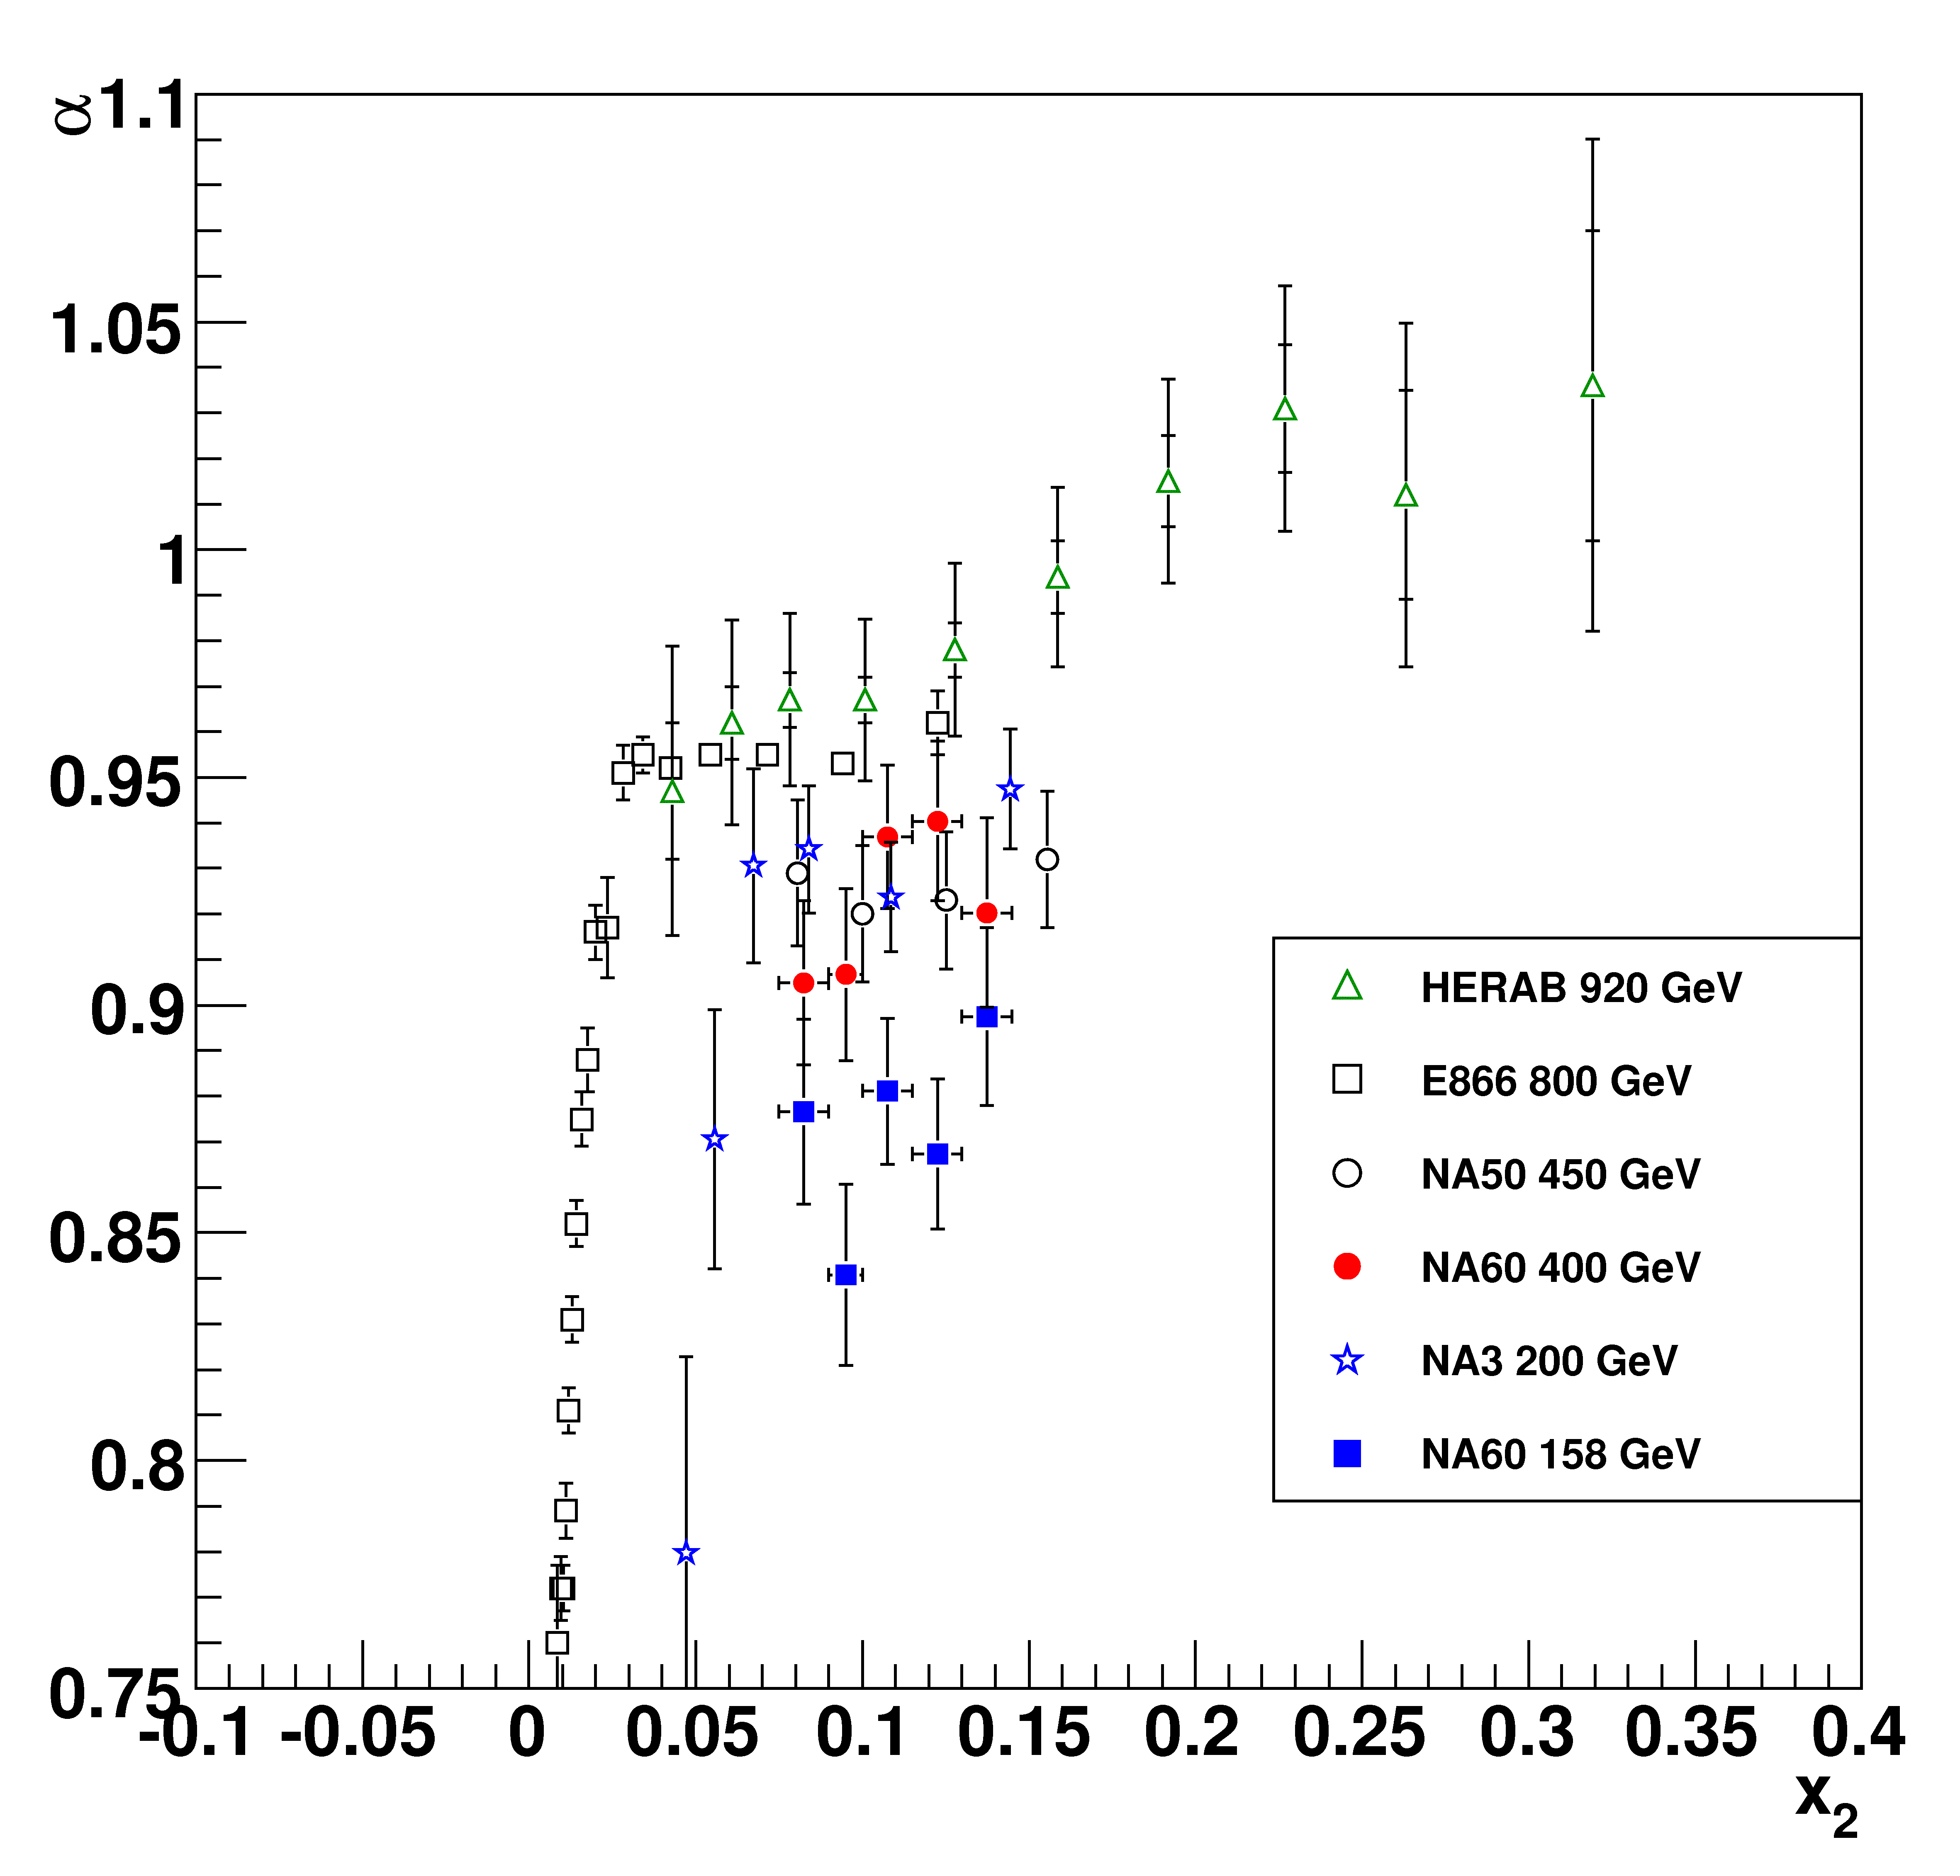
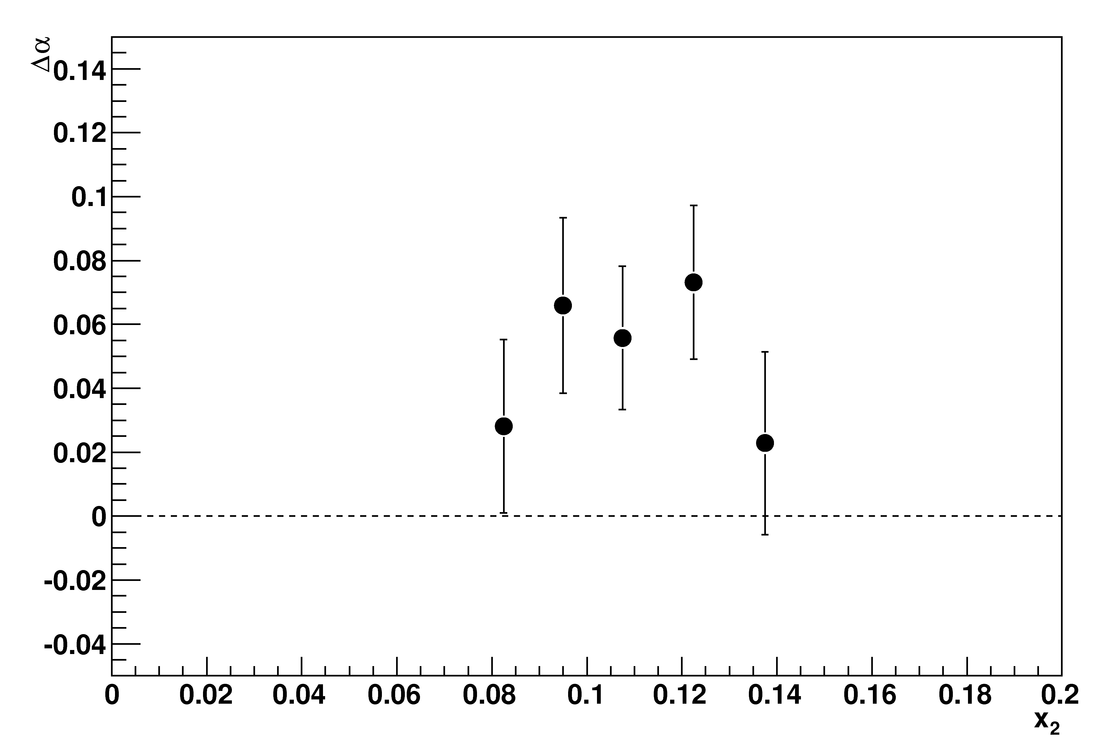
Comparison with other experiments: x₂
In the 2→1 approach shadowing effects and final state absorption scale with x₂
NA60 Δα(400-158)
NA60: two energies in the same experimental conditions
small syst. error on Δα
α does not scale with x₂ clearly other effects are present
15
Notes:
15

Slide 16
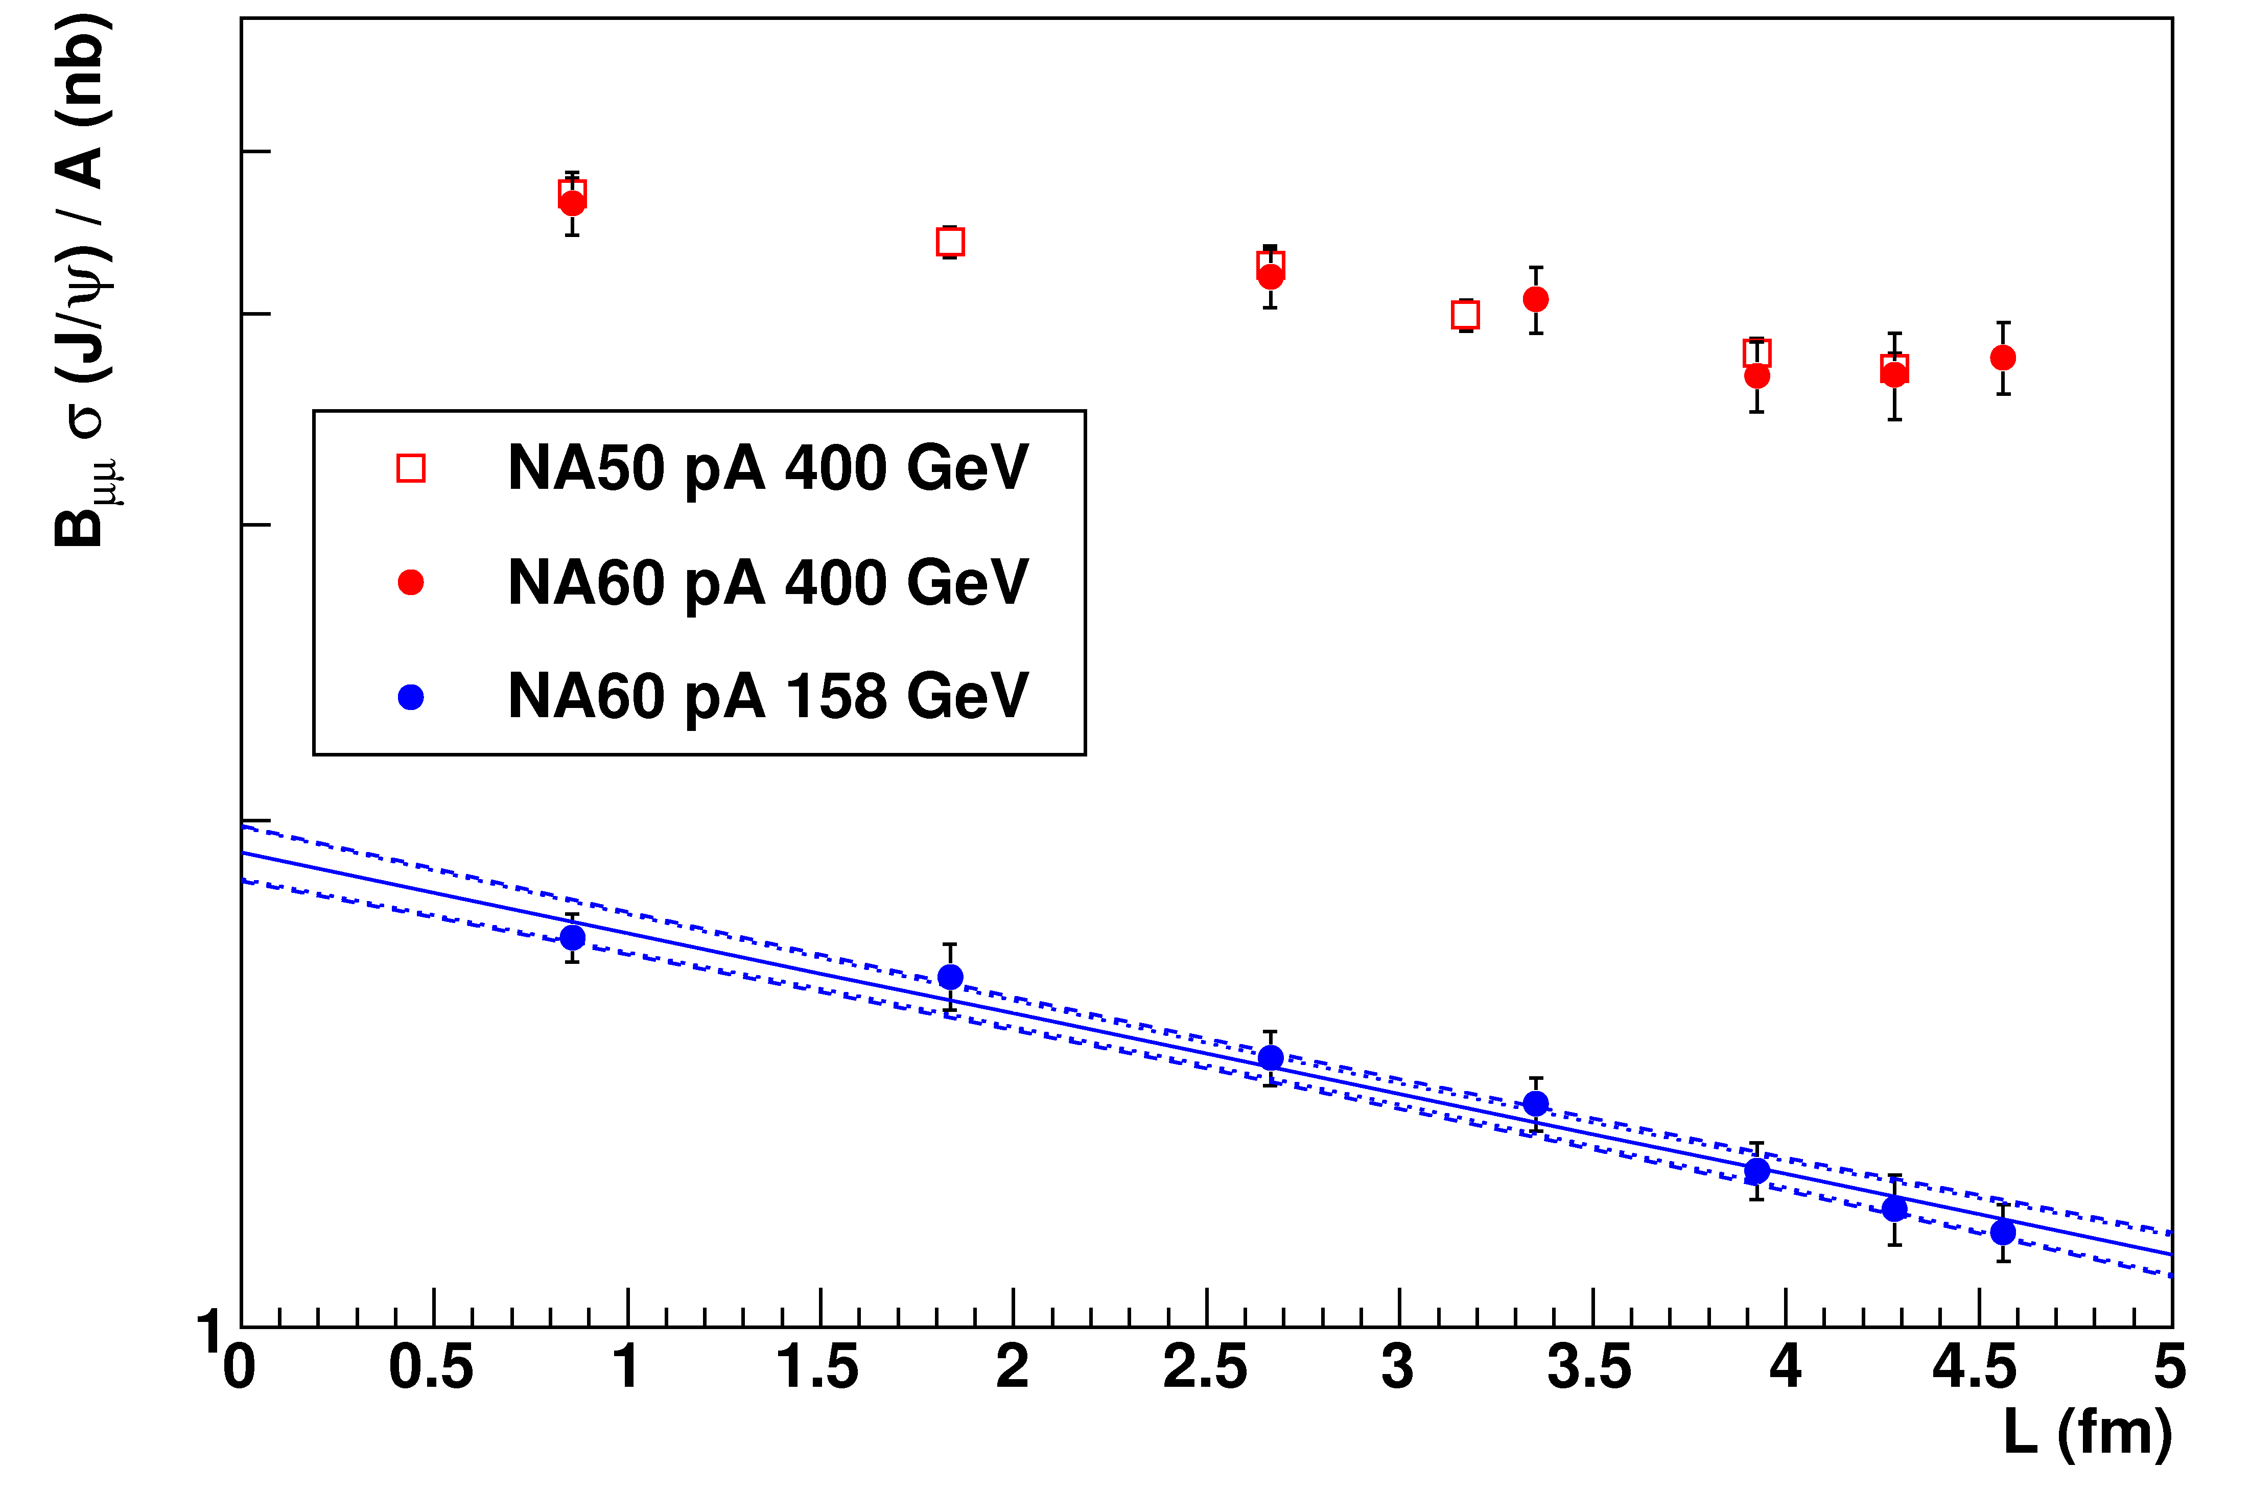
Recent results: J/Ψ cross sections at 158 GeV
Preliminary
• Systematic error on (absolute) luminosity estimation quite high
• Relative luminosity estimation between 158 and 400 GeV much better known (~2-3% systematic error)
Normalize NA60 400 GeV cross section ratios to NA50 results
• 158 GeV cross sections constrained by the relative normalization
16
Notes:
16

Slide 17
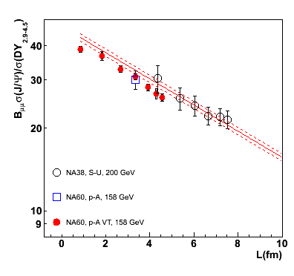
Current CNM reference for AA results
The reference for AA is based on
the slope determined only from pA @ 158 GeV
σ_{abs} ^{J/ψ} (158 GeV) = 7.6 ± 0.7(stat) ± 0.6(syst) mb
the normalization to σ_{J/ψ}^{pp} determined from pA @ 158 GeV and (to reduce the overall error) SU @ 200GeV
SU points might show additional (hot nuclear matter) effects but were
included in the fit since they exhibit a similar slope with respect to pA points at 158 GeV
advantage: small error on normalization
drawback: hypothesis that SU is “normal”‏
17
Notes:
17

Slide 18
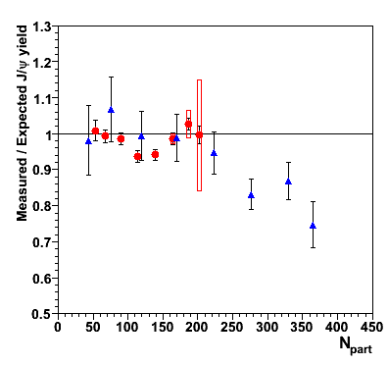
Current estimate of anomalous suppression
After correction for EKS98 shadowing
Pb-Pb anomalous suppression in central collisions (N_{part}>200)
In-In almost no anomalous suppression?

Slide 19
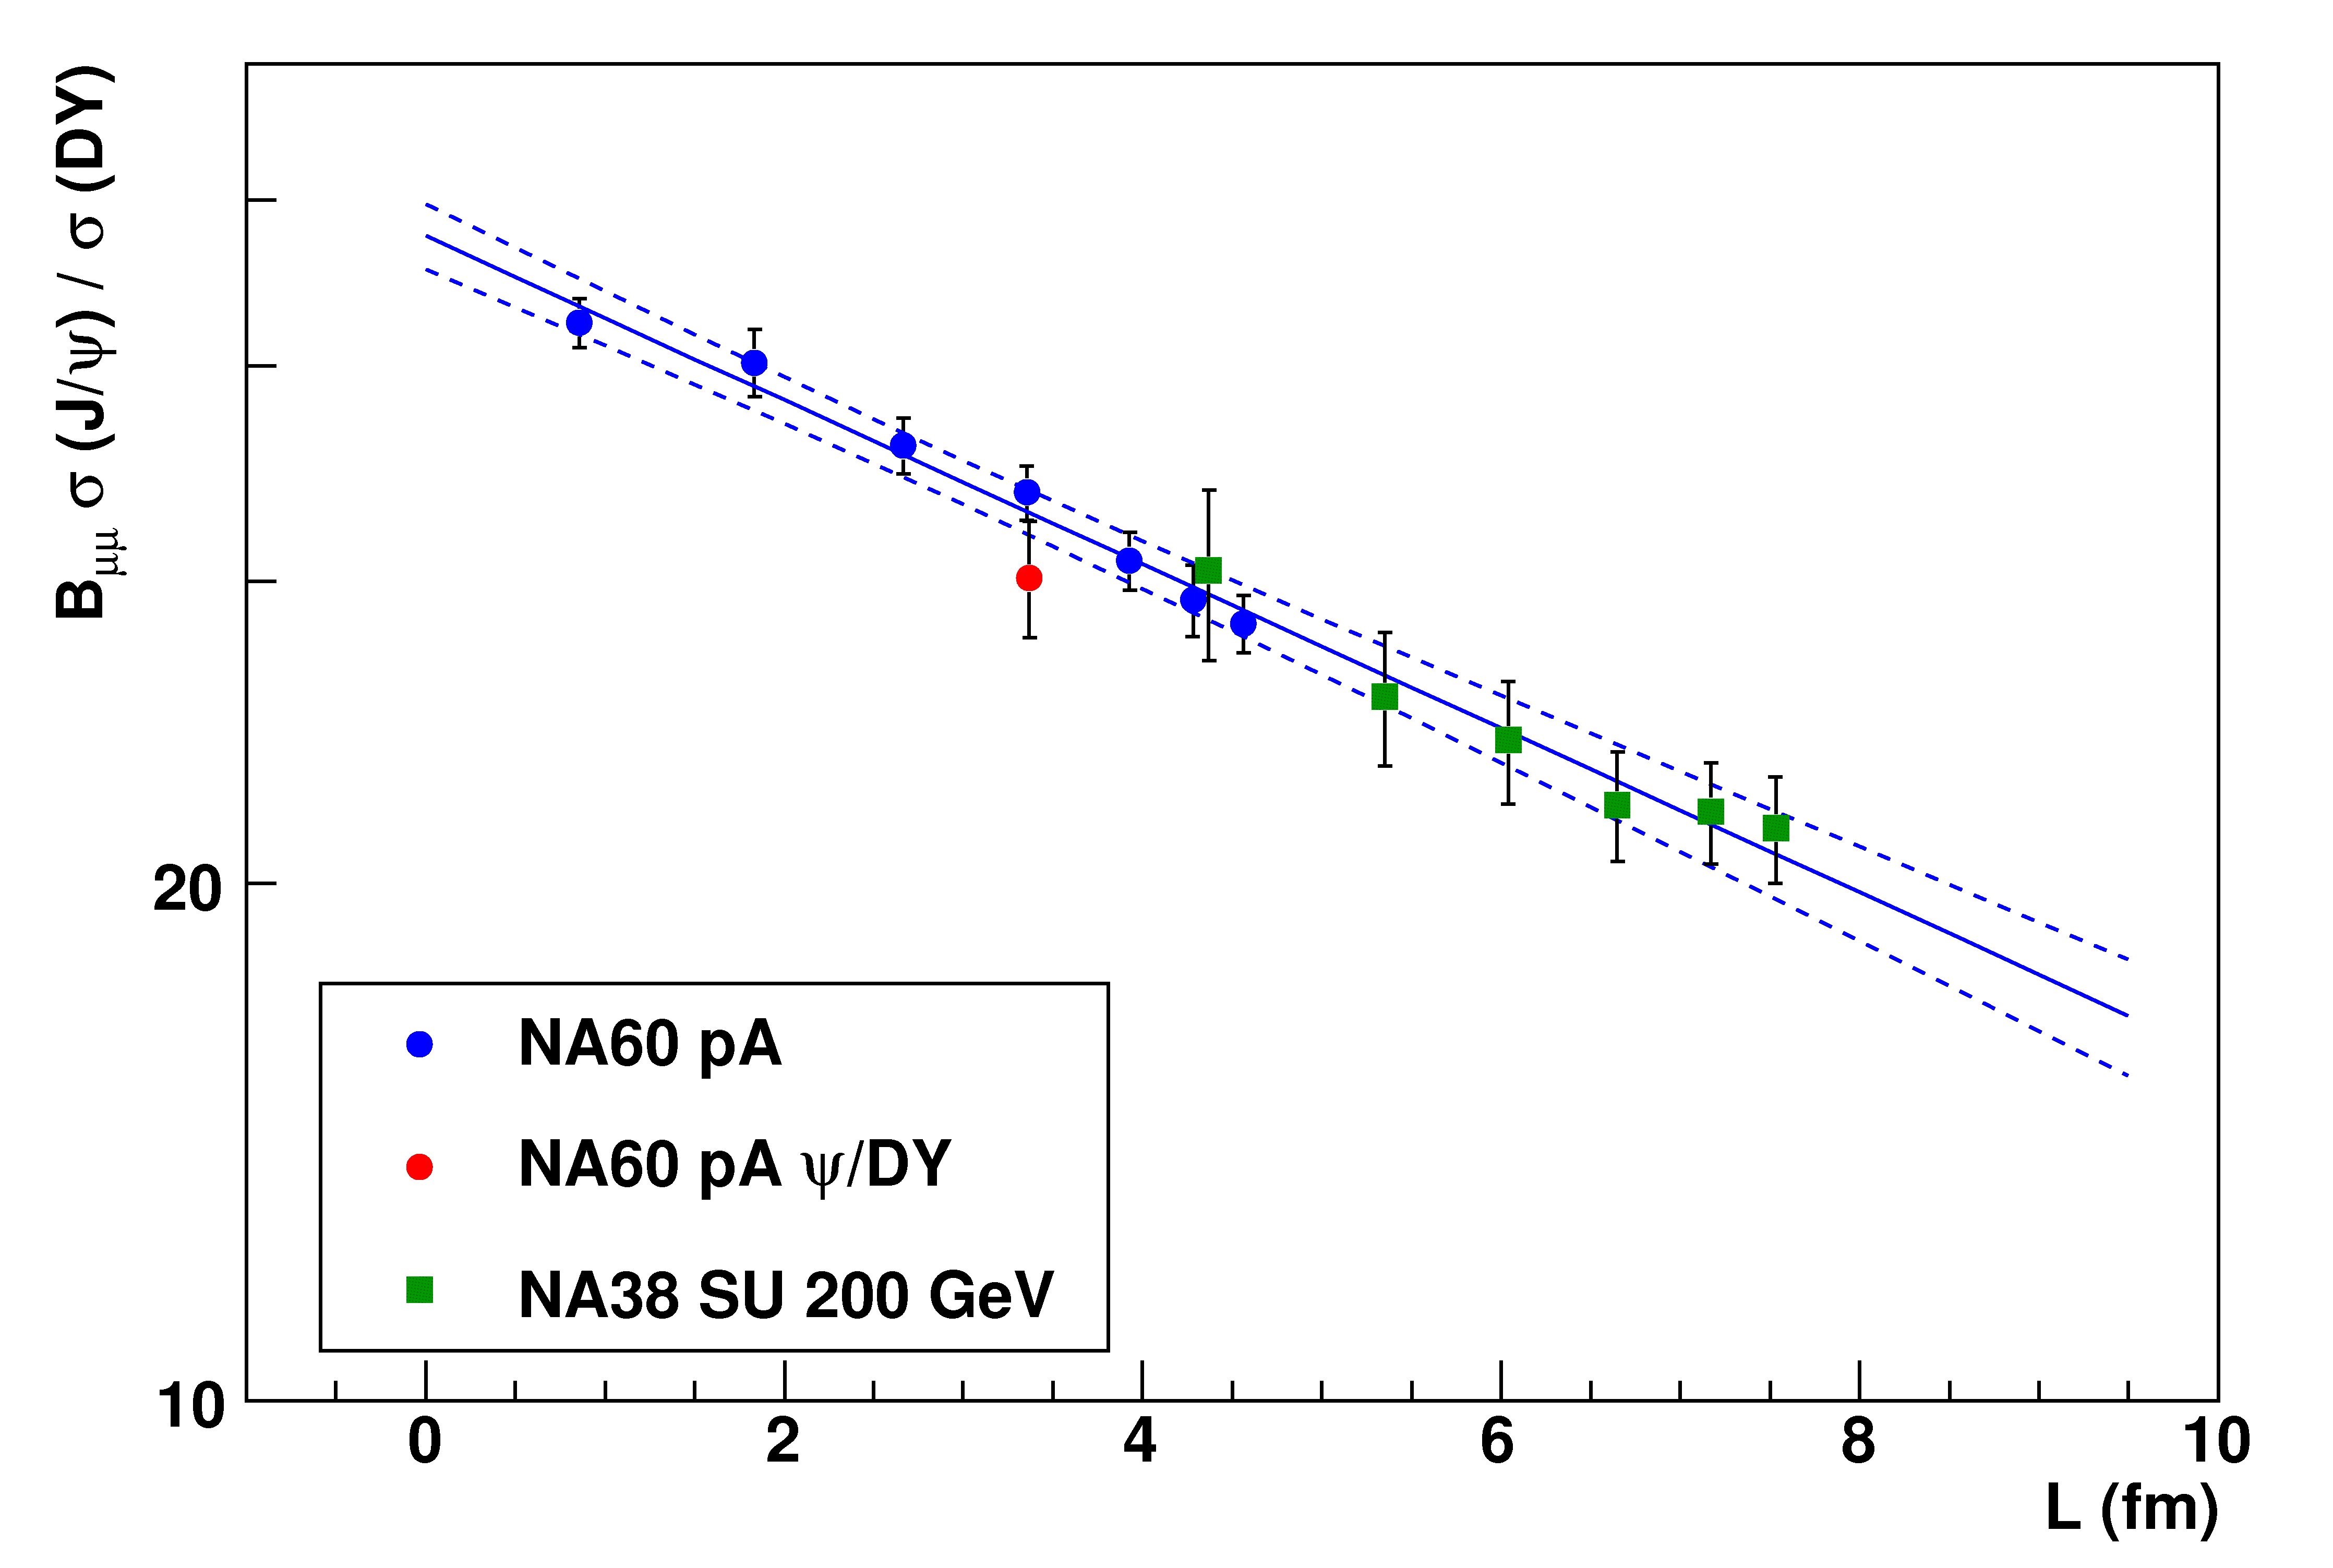
New reference using J/ψ cross sections at 158 GeV
Main advantage:
SU not used anymore in the fit
Difference with old CNM reference ~1% well within errors
Preliminary
No practical consequence on anomalous J/Ψ suppression
DY cross section obtained by rescaling 450 GeV NA50 results (not enough statistics at 158 GeV)
This procedure introduces some systematics: PDF choice

Slide 20
Conclusions
Results from NA60 for p-A collisions at 158 and 400 GeV
400 GeV
Energy/kinematic domain already investigated (with higher
statistics) by NA50 → good agreement on differential spectra
and nuclear effects
158 GeV
Same kinematic domain of NA50/NA60 A-A collisions
Nuclear effects more important wrt 400 GeV
Overall picture of cold nuclear effects on p-A still not clear
No scaling of α vs. x_{F} or x₂
New CNM reference for A-A based on p-A data only
Previous results of anomalous suppression confirmed
20
Notes:
20

Slide 21
The NA60 collaboration
http://cern.ch/na60
CERN
Heidelberg
~ 60 people
13 institutes 8 countries
Palaiseau
Bern
BNL
Riken
Stony Brook
Yerevan
Lisbon
Torino
Clermont
Cagliari
Lyon
R. Arnaldi, R. Averbeck, K. Banicz, K. Borer, J. Buytaert, J. Castor, B. Chaurand, W. Chen, B. Cheynis, C. Cicalò, A. Colla, P. Cortese, S. Damjanović, A. David, A. de Falco, N. de Marco, A. Devaux, A. Drees, L. Ducroux, H. En’yo, A. Ferretti, M. Floris, P. Force, A.A. Grigoryan, J.Y. Grossiord, N. Guettet, A. Guichard, H. Gulkanyan, J. Heuser, M. Keil, L. Kluberg, Z. Li, C. Lourenço, J. Lozano, F. Manso, P. Martins, A. Masoni,
A. Neves, H. Ohnishi, C. Oppedisano, P. Parracho, P. Pillot, T. Poghosyan, G. Puddu, E. Radermacher,
P. Ramalhete, P. Rosinsky, E. Scomparin, J. Seixas, S. Serci, R. Shahoyan,P. Sonderegger, H.J. Specht,
R. Tieulent, E. Tveiten, G. Usai, H. Vardanyan, R. Veenhof and H. Wöhri
21
Notes:
21

