Slide 1
Trigger & DAQ R&D for high rate experiments
Wesley H. Smith
U. Wisconsin – Madison
CMS Trigger Coordinator & Upgrade R&D Peer Review Chair
Workshop on Detector R&D
Fermilab
October 8, 2010
Outline:
Tools for High Rate Experiments: μTCA, FPGAs, Transceivers
Mu2e Trigger & DAQ
ATLAS & CMS Trigger & DAQ
LHC evolution & challenges
Upgrades for ATLAS & CMS Trigger & DAQ

Slide 2
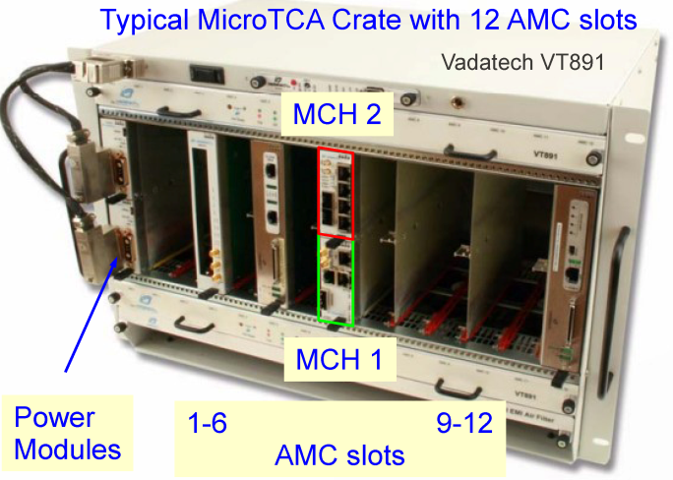
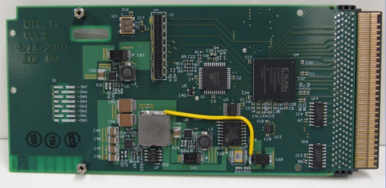
HEP tools for high rate experiments: μTCA
Advanced Telecommunications Computing Architecture ATCA
μTCA Derived from AMC std.
Advanced Mezzanine Card
Up to 12 AMC slots
Processing modules
1 or 2 MCH slots
Controller Modules
6 standard 10Gb/s point-to -point links from each slot to hub slots (more available)
Redundant power, controls, clocks
Each AMC can have in principle (20) 10 Gb/sec ports
Backplane customization is routine & inexpensive
Single Module (shown): 75 x 180 mm
Double Module: 150 x 180mm

Slide 3
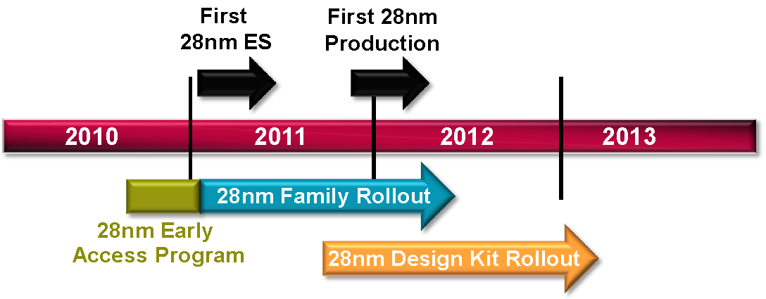
FPGAs: Logic Cells
Next generation 28 nm:

Slide 4
FPGAs: Transceivers

Slide 5
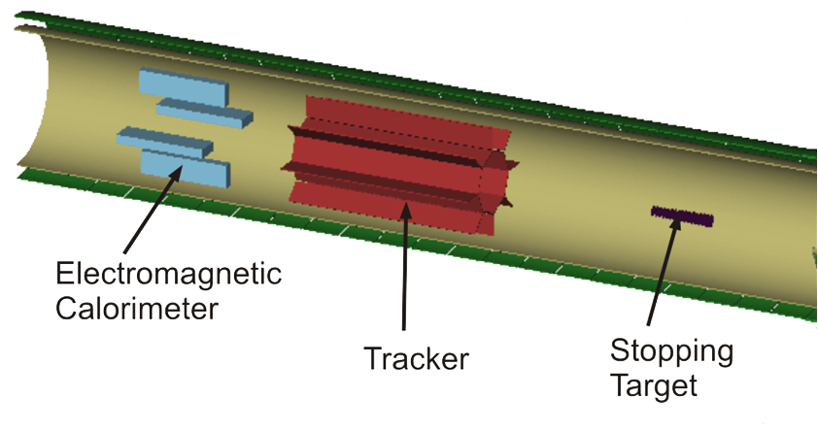
Mu2e Detector
Graded Field for Magnetic Mirror Effect
1.0T
μ beam
1.0 T Solenoidal Field
1.2k PbWO₄ crystals
3 GBytes/sec
2.0T
2.8k 3m long straws & 17k cathode pads
83 GBytes/sec
17 Al. foils each 200 μm thick spaced 5 cm apart
Mu2e physics data set includes selected detector events that contain a candidate high momentum electron (> 70 MeV/c)
Calibration data sets include min-bias, in situ high-pt positrons, standalone tests, etc.

Slide 6
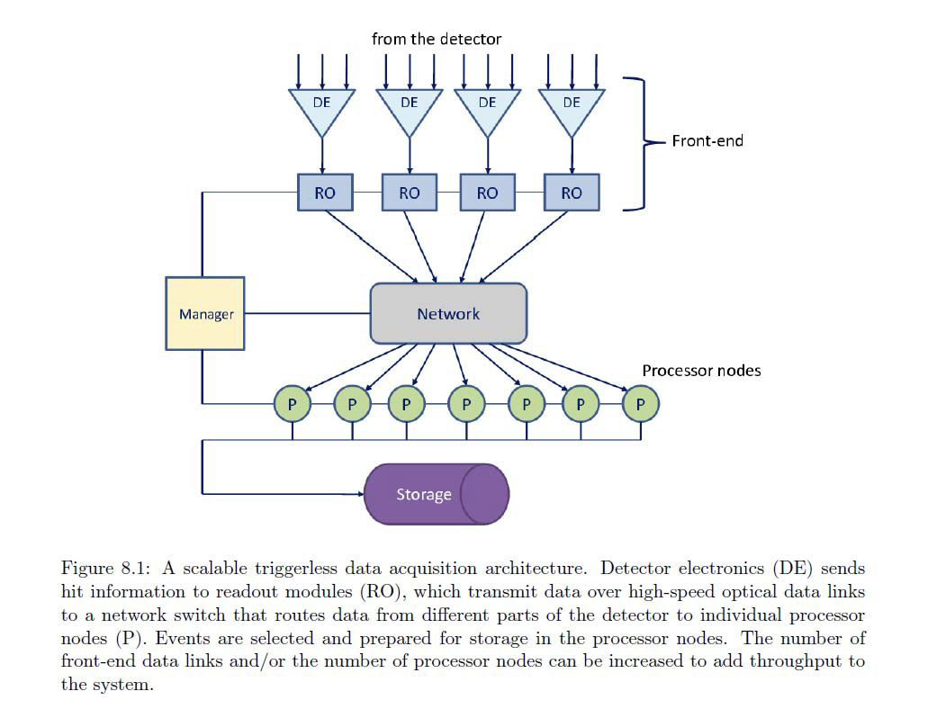
Mu2e proposal: Streaming DAQ
Network Fabric:
Ethernet: 2011: 100-GBit
InfiniBand: 2012: 100-GBit (low- latency)

Slide 7
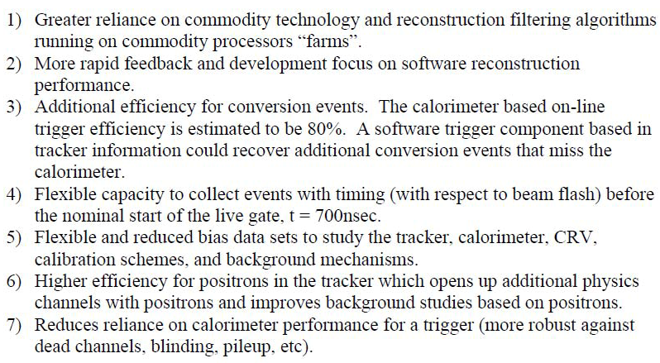
Mu2e DAQ Architecture
Motivations for Streaming Architecture:

Slide 8
ATLAS & CMS Trigger & Readout Structure
Detectors
Detectors
Lvl-1
Front end pipelines
Lvl-1
Front end pipelines
Lvl-2
Readout buffers
Readout buffers
Switching network
Switching network
Lvl-3
Processor farms
HLT
Processor farms
ATLAS: 3 physical levels
CMS: 2 physical levels

Slide 9
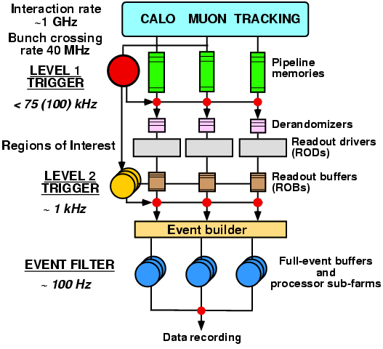
ATLAS Three Level Trigger Architecture
LVL1 decision made with calorimeter data with coarse granularity and muon trigger chamber data.
Buffering on detector
LVL2 uses Region of Interest data (ca. 2%) with full granularity and combines information from all detectors; performs fast rejection.
Buffering in ROBs
EventFilter refines the selection, can perform event reconstruction at full granularity using latest alignment and calibration data.
Buffering in EB & EF
2.5 μs
~10 ms
~ sec.

Slide 10
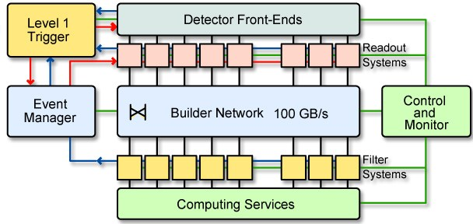
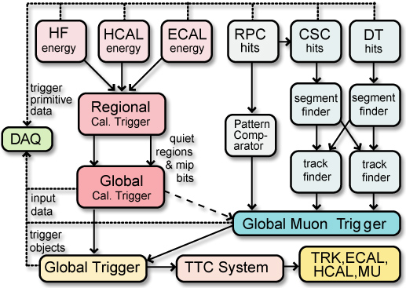
CMS Trigger & DAQ
Overall Trigger & DAQ Architecture: 2 Levels:
Level-1 Trigger:
25 ns input
3.2 μs latency
UXC→
Calorimeters:
Muon Systems:
←USC
Interaction rate: 1 GHz
Bunch Crossing rate: 40 MHz
Level 1 Output: 100 kHz (50 initial)
Output to Storage: 100 Hz
Average Event Size: 1 MB
Data production 1 TB/day

Slide 11
LHC Luminosity Forecast
shutdown
shutdown
Phase 0➔Phase 1➔Phase 2 (high L) ➔
shutdown

Slide 12
Requirements for the phases of the upgrades: ~2010-2020
Phase 1:
This decade will see the initial operation of the LHC and the increase of energy and luminosity towards the design luminosities.
Goal of extended running in the second half of the decade to collect ~100s/fb
80% of this luminosity in the last three years of this decade
About half the luminosity would be delivered at luminosities above the original LHC design luminosity
Trigger & DAQ systems should be able to operate with a peak luminosity of up to 2 x 10³⁴

Slide 13
2020-2030 – High Lumi LHC
Phase 2:
Continued operation of the LHC beyond a few 100/fb will require substantial modification of detector elements
The goal is to achieve 3000/fb in phase 2
Need to be able to integrate ~300/fb-yr
Will require new tracking detectors for ATLAS & CMS
Trigger & DAQ systems should be able to operate with a peak luminosity of up to 5 x 10³⁴, possibly 10³⁵

Slide 14
CMS Upgrade Trigger Strategy
Constraints
Output rate at 100 kHz
Input rate increases x2/x10 (Phase 1/Phase 2) over LHC design (10³⁴)
Same x2 if crossing freq/2, e.g. 25 ns spacing → 50 ns at 10³⁴
Number of interactions in a crossing (Pileup) goes up by x4/x20
Thresholds remain ~ same as physics interest does
Example: strategy for Phase 1 Calorimeter Trigger (operating 2016):
Present L1 algorithms inadequate above 10³⁴ or 10³⁴ w/ 50 ns spacing
Pileup degrades object isolation
More sophisticated clustering & isolation deal w/more busy events
Process with full granularity of calorimeter trigger information
Should suffice for x2 reduction in rate as shown with initial L1 Trigger studies & CMS HLT studies with L2 algorithms
Potential new handles at L1 needed for x10 (Phase 2: 2020)
Tracking to eliminate fakes, use track isolation.
Vertexing to ensure that the multiple trigger objects come from the same interaction
Requires finer position resolution for calorimeter trigger objects for matching (provided by use of full granularity cal. trig. info.)

Slide 15
Phase 1 Upgrade Cal. Trigger Algorithm Development
Particle Cluster Finder
Applies tower thresholds to Calorimeter
Creates overlapped 2x2 clusters
Cluster Overlap Filter
Removes overlap between clusters
Identifies local maxima
Prunes low energy clusters
Cluster Isolation and Particle ID
Applied to local maxima
Calculates isolation deposits around 2x2,2x3 clusters
Identifies particles
Jet reconstruction
Applied on filtered clusters
Groups clusters to jets
Particle Sorter
Sorts particles & outputs the most energetic ones
MET,HT,MHT Calculation
Calculates Et Sums, Missing Et from clusters
HCAL
Δη x Δφ=0.087x0.087
η
ECAL
φ
e/γ
η
HCAL
ECAL
φ
τ
η
HCAL
ECAL
φ
jet

Slide 16
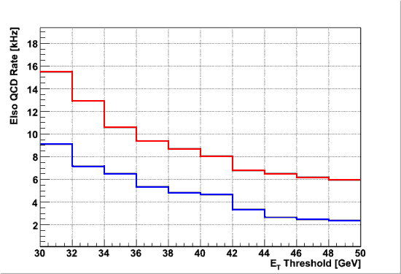
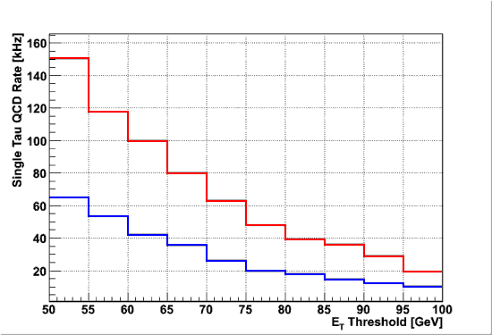
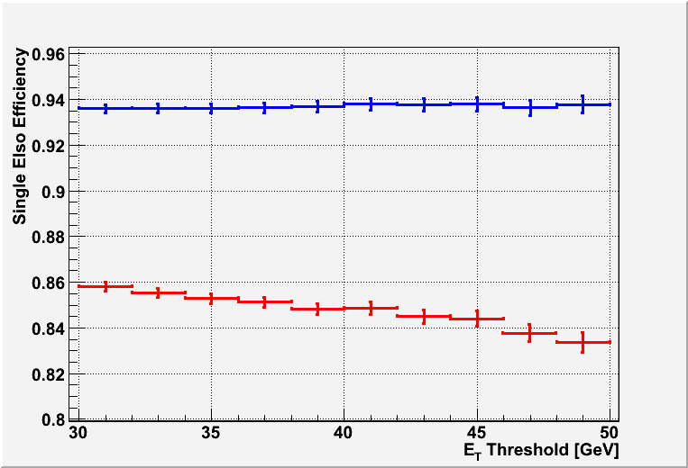
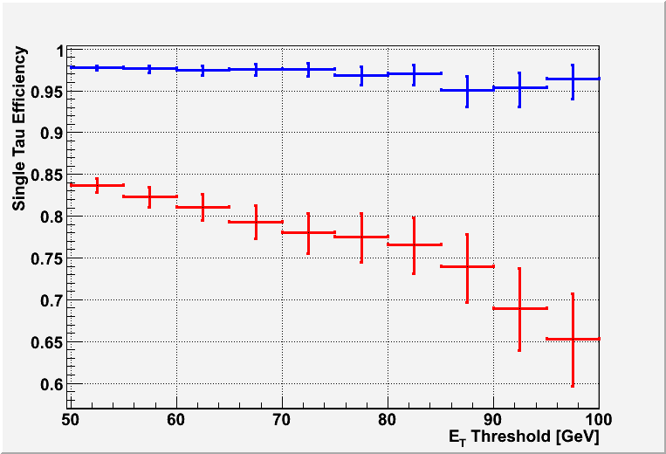
Upgrade Algorithm Performance: Factor of 2 for Phase I
Present
Algorithm
Present
Algorithm
Isolated electrons
Taus
QCD Rate (kHz)
QCD Rate (kHz)
Phase 1 Algorithm
Phase 1 Algorithm
Factor of 2 rate reduction
Phase 1 Algorithm
Phase 1 Algorithm
Isolated electrons
Taus
Efficiency
Efficiency
Present
Algorithm
Present
Algorithm
Higher Efficiency

Slide 17
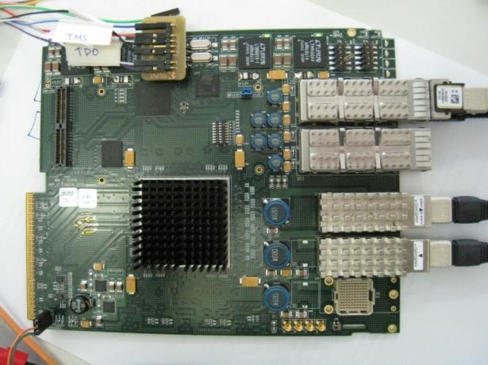
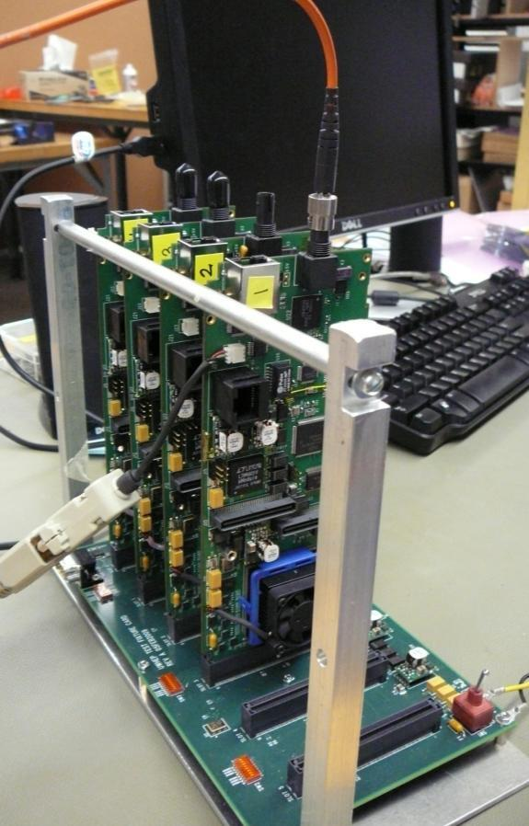
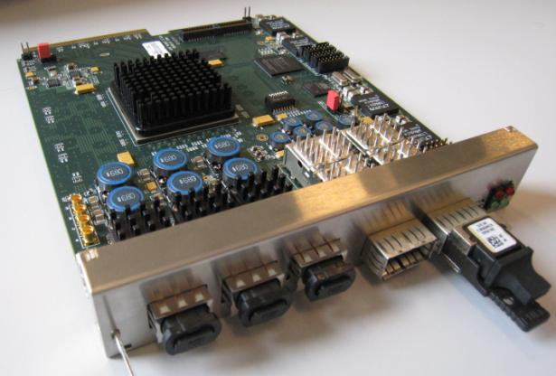
uTCA Calorimeter Trigger Demonstrators
⬅processing cards with 160 Gb/s input & 100 Gb/s output using 5 Gb/s optical links.
four trigger prototype cards integrated in a backplane fabric to demonstrate running & data exchange of calorimeter trigger algorithms ➔

Slide 18
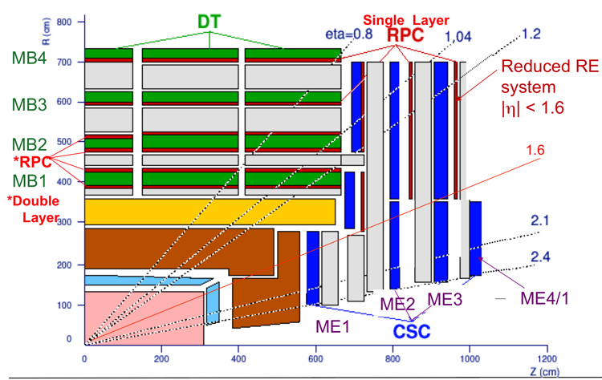
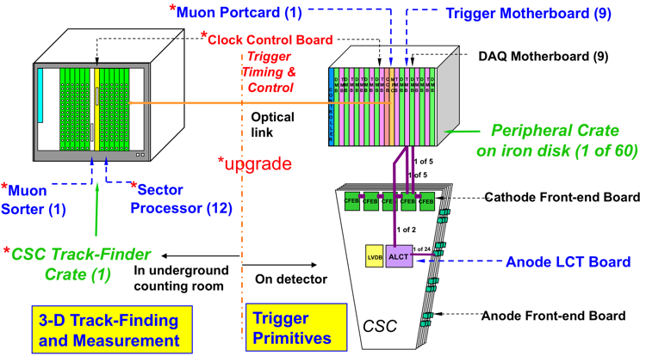
CMS CSC Trigger Upgrades
Improve redundancy
Add station ME-4/2 covering η=1.1-1.8
Critical for momentum resolution
Upgrade electronics to sustain higher rates
New Front End boards for station ME-1/1
Forces upgrade of downstream EMU electronics
Particularly Trigger & DAQ Mother Boards
Upgrade Muon Port Card and CSC Track Finder to handle higher stub rate
Extend CSC Efficiency into η=2.1-2.4 region
Robust operation requires TMB upgrade, unganging strips in ME-1a, new FEBs, upgrade CSCTF+MPC
ME4/2

Slide 19
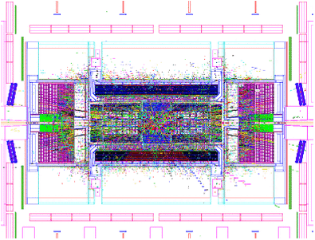
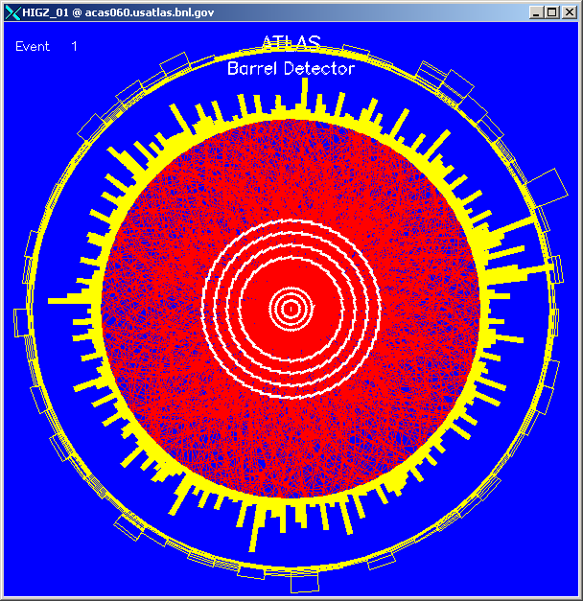
Expected Pile-up at High Lumi LHC in ATLAS at 10³⁵
230 min.bias collisions per 25 ns. crossing
~ 10000 particles in |η| ≤ 3.2
mostly low p_{T} tracks
requires upgrades to detectors
N_{ch}(|y|≤0.5)

Slide 20
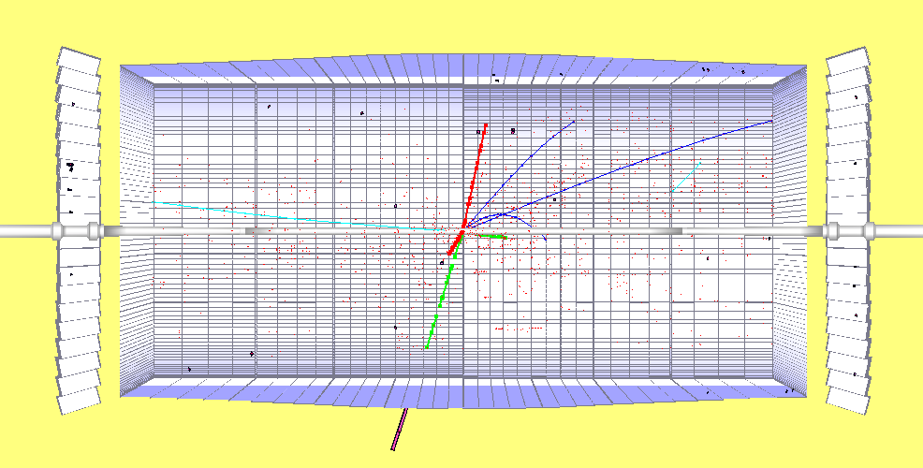
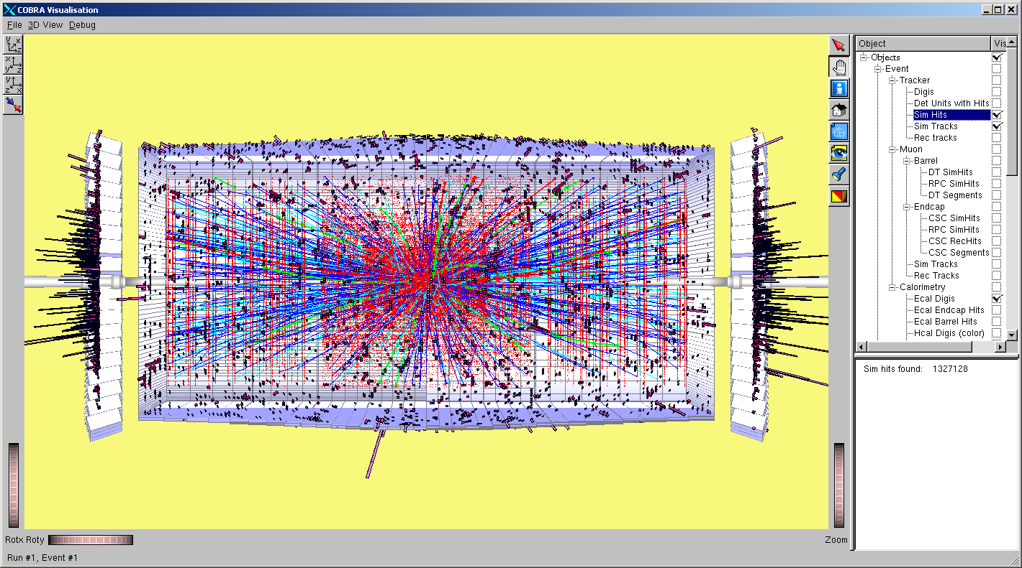
Detector Luminosity Effects
H→ZZ → μμee, M_{H}= 300 GeV for different luminosities in CMS
10³² cm⁻²s⁻¹
10³³ cm⁻²s⁻¹
10³⁴ cm⁻²s⁻¹
10³⁵ cm⁻²s⁻¹

Slide 21
CMS Level-1 Trigger ➔10³⁵
Occupancy
Degraded performance of algorithms
Electrons: reduced rejection at fixed efficiency from isolation
Muons: increased background rates from accidental coincidences
Larger event size to be read out
New Tracker: higher channel count & occupancy → large factor
Reduces the max level-1 rate for fixed bandwidth readout.
Trigger Rates
Try to hold max L1 rate at 100 kHz by increasing readout bandwidth
Avoid rebuilding front end electronics/readouts where possible
Limits: ⟨readout time⟩ (< 10 µs) and data size (total now 1 MB)
Use buffers for increased latency for processing, not post-L1A
May need to increase L1 rate even with all improvements
Greater burden on DAQ
Implies raising E_{T} thresholds on electrons, photons, muons, jets and use of multi-object triggers, unless we have new information ⇒Tracker at L1
Need to compensate for larger interaction rate & degradation in algorithm performance due to occupancy

Slide 22
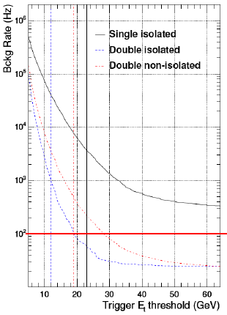
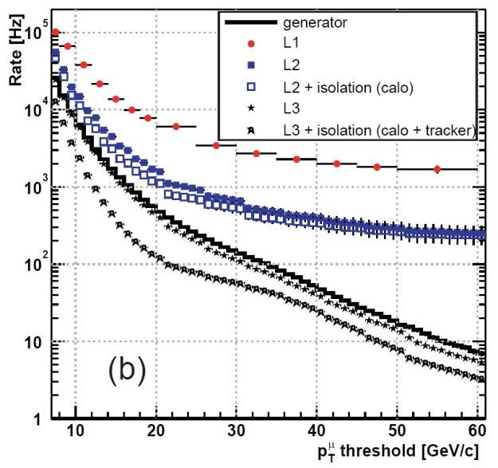
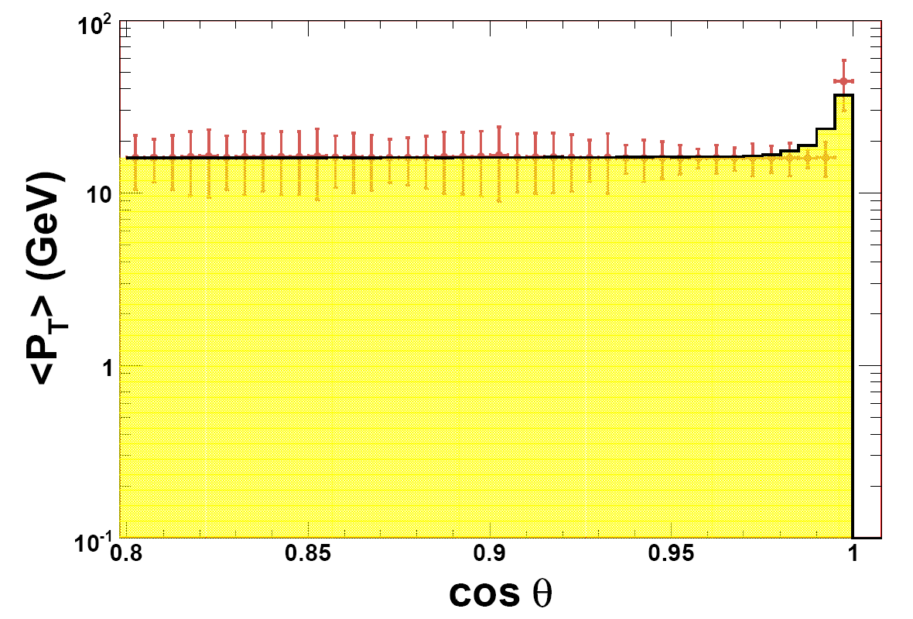
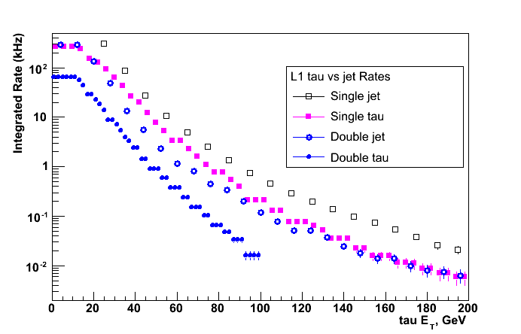
Tracking needed for L1 trigger
Single electron trigger rate
Isolation criteria are insufficient to reduce rate at L = 10³⁵ cm⁻².s⁻¹
L = 10³⁴
Muon L1 trigger rate
L = 2x10³³
5kHz @ 10³⁵
Standalone Muon trigger resolution insufficient
Cone 10º-30º
τ
We need to get another x200 (x20) reduction for single (double) tau rate!
~dE_{T}/dcosθ
Amount of energy carried by tracks around tau/jet direction (PU=100)
MHz

Slide 23
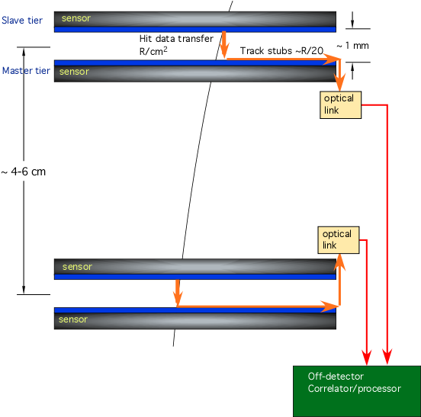
The Track Trigger Problem
Need to gather information from 10⁸ pixels in 200m² of silicon at 40 MHz
Power & bandwidth to send all data off-detector is prohibitive
Local filtering necessary
Smart pixels needed to locally correlate hit P_{t} information
Studying the use of 3D electronics to provide ability to locally correlate hits between two closely spaced layers

Slide 24
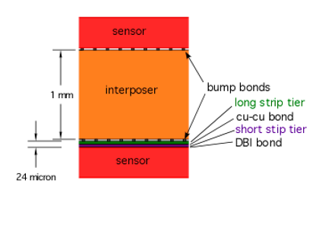
3D Interconnection
Key to design is ability of a single IC to connect to both top & bottom sensor
Enabled by “vertical interconnected” (3D) technology
A single chip on bottom tier can connect to both top and bottom sensors – locally correlate information
Analog information from top sensor is passed to ROIC (readout IC) through interposer
One layer of chips
No “horizontal” data transfer necessary – lower noise and power
Fine Z information is not necessary on top sensor – long (~1 cm vs ~1-2 mm) strips can be used to minimize via density in interposer

Slide 25
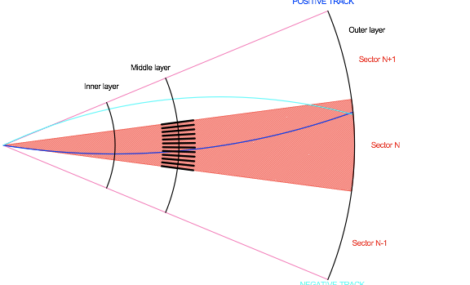
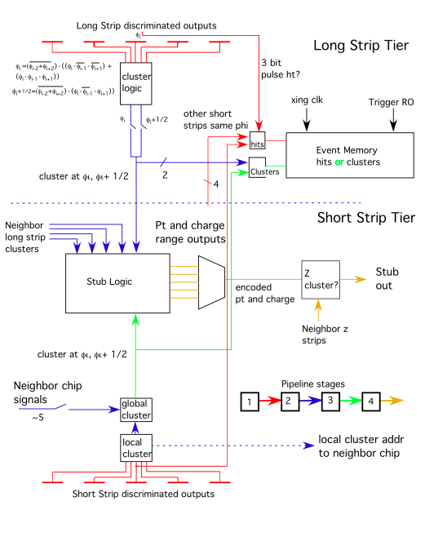
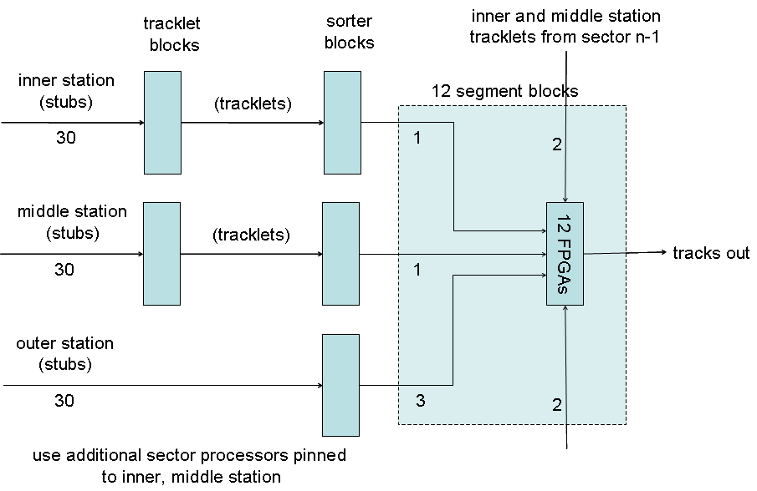
Track Trigger Architecture
Readout designed to send all hits with P_{t}>~2 GeV to trigger processor
High throughput – micropipeline architecture
Readout mixes trigger and event data
Tracker organized into phi segments
Limited FPGA interconnections
Robust against loss of single layer hits
Boundaries depend on p_{t} cuts & tracker geometry

Slide 26
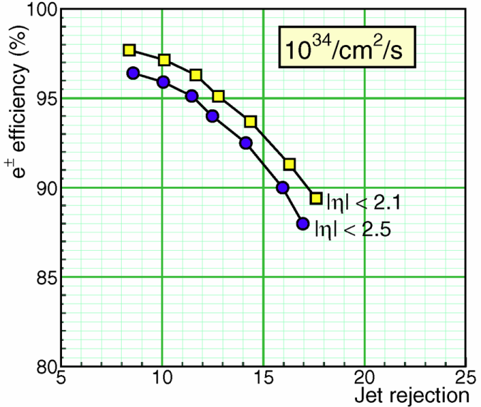
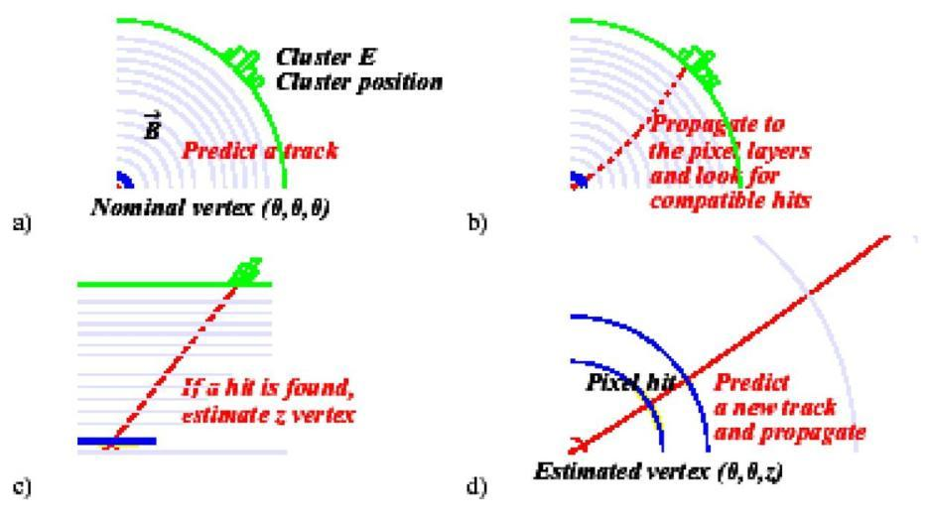
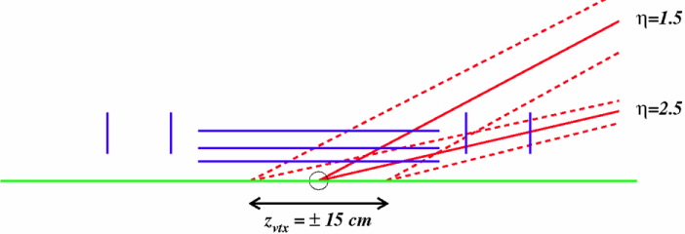
Tracking for electron trigger
- C. Foudas & C. Seez
Present CMS electron HLT
Factor of 10 rate reduction
γ: only tracker handle: isolation
Need knowledge of vertex location to avoid loss of efficiency

Slide 27
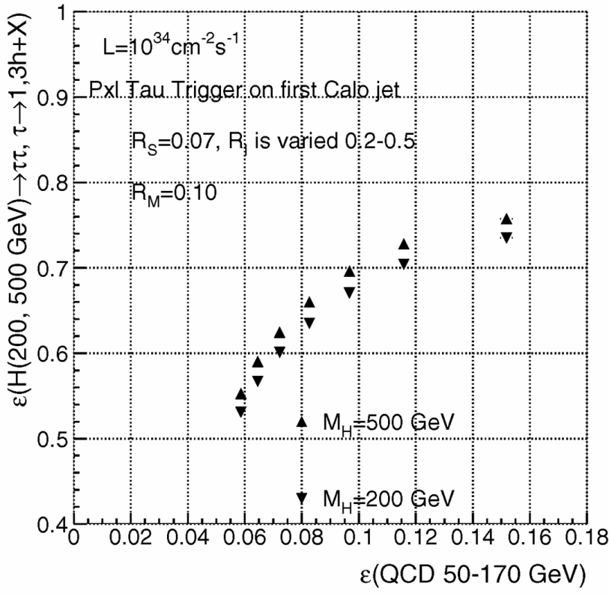
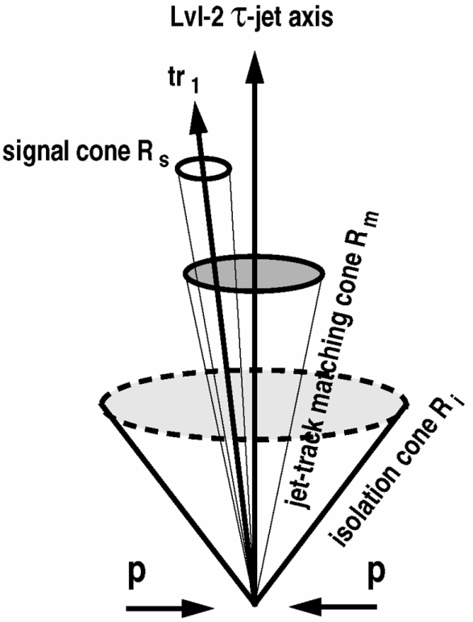
Tracking for τ-jet isolation
τ-lepton trigger: isolation from pixel tracks outside signal cone & inside isolation cone
Factor of 10 reduction

Slide 28
CMS L1 Track Trigger for Muons
Combine with L1 μ trigger as is now done at HLT:
Attach tracker hits to improve P_{T} assignment precision from 15% standalone muon measurement to 1.5% with the tracker
Improves sign determination & provides vertex constraints
Find pixel tracks within cone around muon track and compute sum P_{T} as an isolation criterion
Less sensitive to pile-up than calorimetric information if primary vertex of hard-scattering can be determined (~100 vertices total at SLHC!)
To do this requires η−φ information on muons finer than the current 0.05−2.5°
No problem, since both are already available at 0.0125 and 0.015°

Slide 29
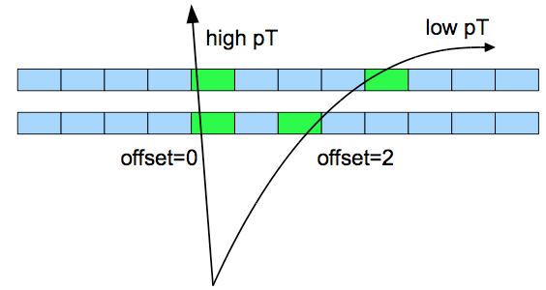
ATLAS Trigger Upgrades
Various projects being pursued:
Track trigger
Fast Track Finder (FTK), hardware track finder for ATLAS (at L1.5)
ROI based track trigger at L1
Self seeded track trigger at L1
Combining trigger objects at L1 & topological "analysis"
Full granularity readout of calorimeter
requires new electronics
Changes in muon systems (small wheels), studies of an MDT based trigger & changes in electronics
Upgrades of HLT farms
Some of the changes are linked to possibilities that open when electronics changes are made (increased granularity, improved resolution & increased latency)

Slide 30
ATLAS Cal. Trigger upgrade
Phase I: upgrade current L1Calo
FPGA-based MCM replacement for PreProcessor (?)
Augment EM/Had and Jet/Energy processors with CMM++ to add topological algorithm capabilities
Replacement for present trigger data Common Merger Module
Phase II: Replace L1Calo with 2-level system
Full digital readout of LAr, Tile data to Readout Drivers (RODs) in underground counting room (USA15)
"Level 0": Synchronous, fixed latency, Topological algorithms with calorimeters + muon ROIs
Uses trigger towers (0.1✕0.1) w/finer η✕ϕ, depth segmentation.
"Level 1": Asynchronous, longer latency, access to full resolution calorimeter data, Topological algorithms with calo, muon and ID ROIs
Improved ID of isolated electrons, hadrons identified by L0
Aim for similar performance to present L2

Slide 31
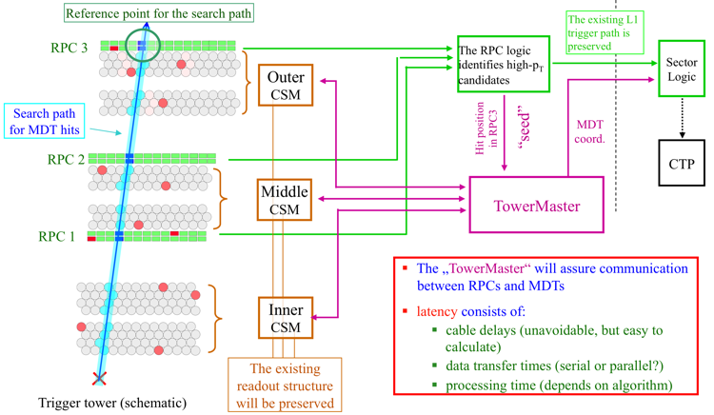
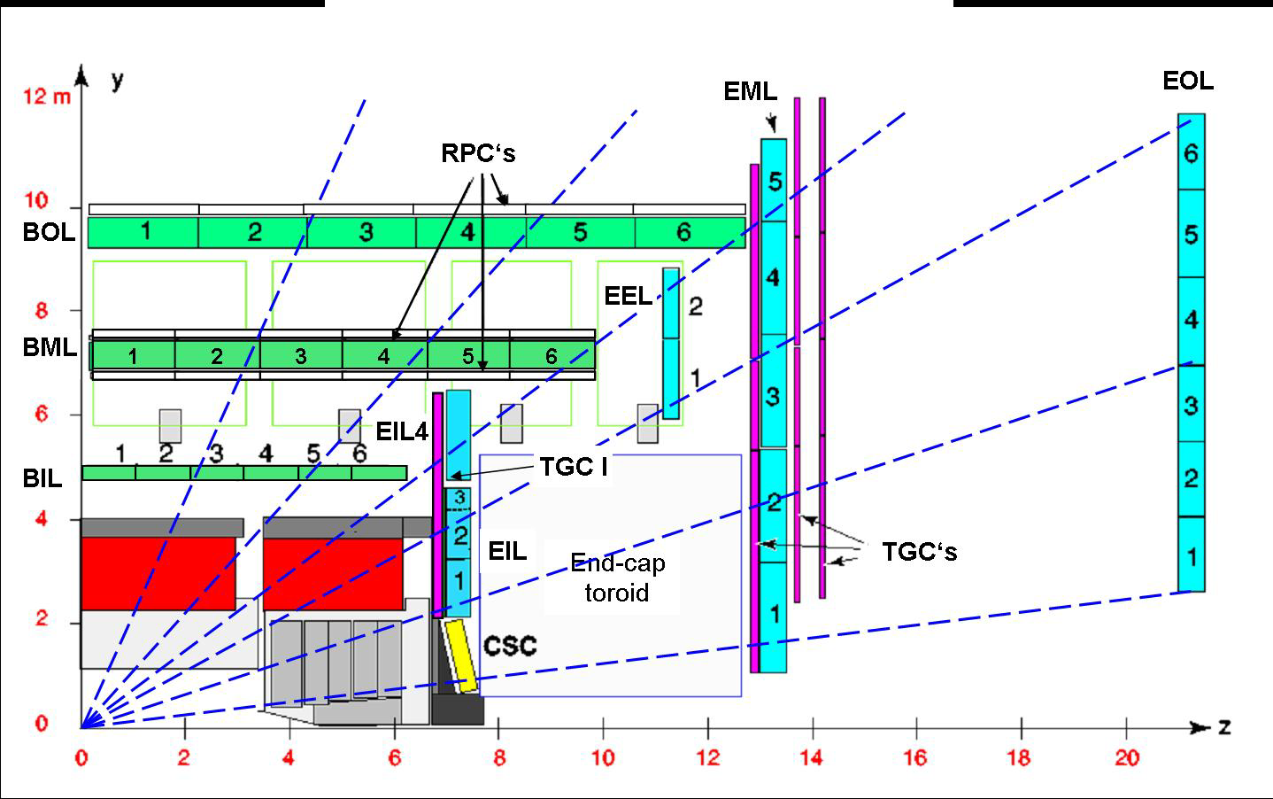
ATLAS Muon Trigger Upgrade
MDT precision can be used for L1 sharpening
Present ATLAS muon trigger based on RPCs only.
Use RPC L1 trigger as “seed”. MDTs only verify p_{T} on request from RPC
No stand-alone trigger of Monitored Drift Tubes
Use RPC hits to define a search road for corresponding MDT hits
Need extra latency of ~ 2 μs (Phase 2)
Benefits:
No additional trigger chambers required in Barrel
No interference with normal readout
Hardware consequences: concept needs
rebuilding of MDT electronics
modification of parts of RPC electronics (PADs, Sector Logic).
Requires new chips & boards:
New front end board (mezzanine)
New Chamber Service Module
New architecture of RPC/TowerMaster
interface to RPC readout
Notes:
31

Slide 32
ATLAS FastTracKer (FTK)
For Phase 1:
Dedicated hardware processor completes GLOBAL track reconstruction by beginning of level-2 processing.
Allows very rapid rejection of most background, which dominates the level-1 trigger rate.
Frees up level-2 farm to carry out needed sophisticated event selection algorithms.
Addresses two time-consuming stages in tracking
Pattern recognition – find track candidates with enough Si hits
10⁹ prestored patterns simultaneously see each silicon hit leaving the detector at full speed.
Track fitting – precise helix parameter & χ² determination
Equations linear in local hit coordinates give near offline resolution

Slide 33
ATLAS FTK Approach
Design: FTK completes global tracking in 25 μsec at 3×10³⁴.
Current level-2 takes 25 msec per jet or lepton at 3×10³⁴.

Slide 34
ATLAS L1 Track Trigger Design Options for Phase 2
Region Of Interest based Track Trigger at L1
uses ROIs from L1Calo & L1Muon to seed track finding
has a large impact on the Trigger architecture
requires significantly lengthened L1 pipelines and fast access to L1Calo and L1Muon ROI information
could also consider seeding this with an early ("Level-0”) trigger, or sending a late ("Level-1.5") track trigger
smaller impact on Silicon readout electronics
Self-Seeded Track Trigger at L1
independent of other trigger information
has a large impact on Silicon readout electronics
requires fast access to Silicon detector data at 40 MHz
smaller impact on the Trigger architecture

Slide 35
ATLAS RoI Tracking Trigger
L0 similar to current L1-Calo & L1-Muon defines regions of interest (RoIs)
There is no inner detector (tracking) information in the RoI definition
RoI defines an eta-phi region for strips & pixel information to be extracted
L1 uses inner detector information from RoIs that were defined in L0
Can also do a detailed correlation with outer detector
Example of
RoI: Contains
≈ 1% of
tracker
modules

Slide 36
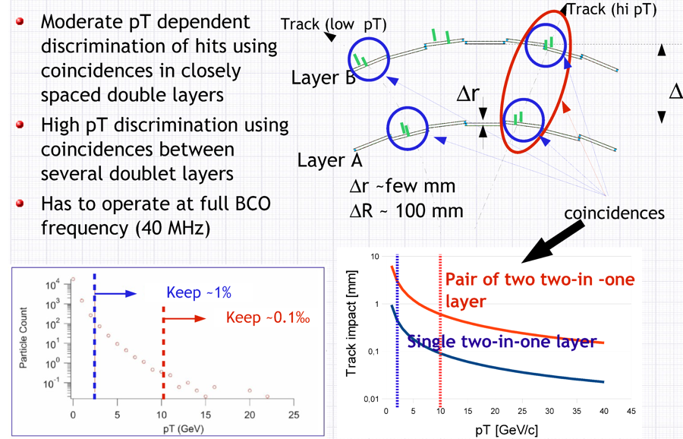
ATLAS Self-Seeded L1 Track Trigger with Doublet Layers

Slide 37
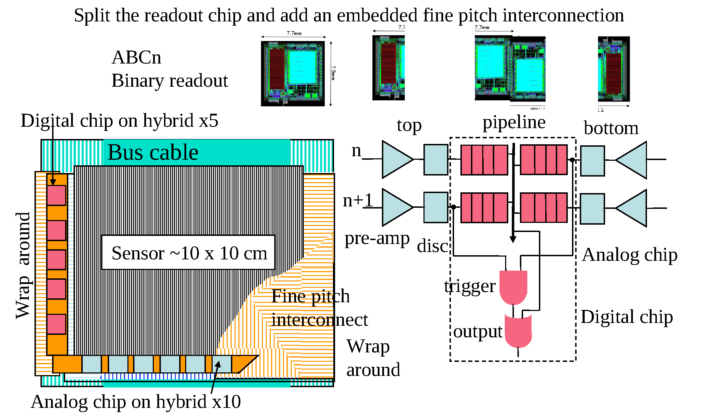
ATLAS Self-Seeded L1 Track Trigger: One possible solution

Slide 38
Upgrade DAQ
Phase 2 Network bandwidth at least 5-10 times LHC
Assuming L1 trigger rate same as LHC
Increased Occupancy
Decreased channel granularity (esp. tracker)
CMS DAQ Component upgrades
Readout Links: replace existing SLINK (400 MB/s) with 10 Gbit/s
Present custom Front End Detecto Builder & Readout Unit Builder replaced with modern network technology & mult-gigabit link network switch
Higher Level Trigger CPU Filter Farm estimates:
2010 Farm = 720 Dual Quad Core Xeon 5430 (2.66 GHz)
2012 Farm = 3✕ present farm
2016 Farm = 3✕ 2012 farm
Requires upgrades to network infrastructure

Slide 39
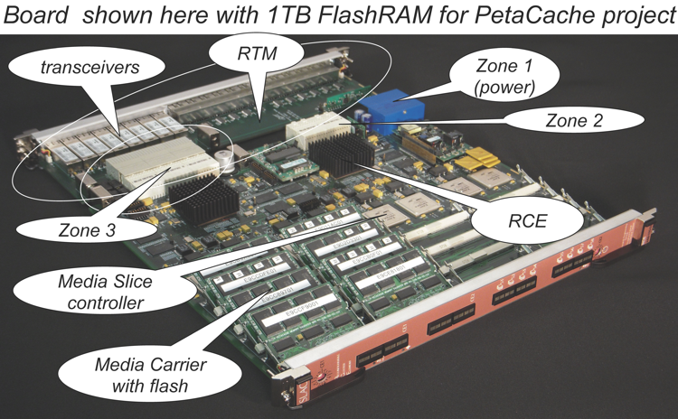
ATLAS Upgrade DAQ
One project explores full capabilities of large modern FPGAs for versatile generic DAQ with its core effort named as Reconfigurable Cluster Element (RCEs), implemented on ATCA platform.
First generation boards in use on SLAC LCLS experiments, LSST DAQ, PetaCache proj.
Studying possible use for ATLAS pixel upgrade

Slide 40
High Rate Experiment R&D
Very significant challenges to operate trigger & DAQ systems for high rate experiments, particularly examples shown for ATLAS & CMS
Very substantial assets to bring to bear on these challenges from commercial world: μTCA, FPGAs, high speed links (transceivers).
Exploiting these assets enables physics input to drive much more precise selection of events and processing of a much higher volume of data.
e.g. a level-1 tracking trigger
There is considerable technical difficulty involved in successfully exploiting these advances in technology and implementing them in running experiments in a controlled and adiabatic manner.

Slide 41
Acknowledgements
Thanks to the following for slides and information:
Darin Acosta, Bob Bernstein, Sridhara Dasu, Su Dong, Hal Evans, Costas Foudas, Tom Gorski, Reiner Hauser, Eric Hazen, Greg Iles, Andy Lankford, Jim Linneman, Eliot Lipeles, Ron Lipton, Jordan Nash, Abe Seiden, Mel Shochet, Sam Silverstein, Bob Tschirhart

