Slide 1
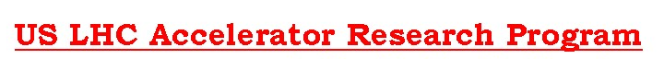
Long Quadrupole
Giorgio Ambrosio
Fermilab
Long Quadrupole Task Leaders:
Fred Nobrega (FNAL) – Coils
Jesse Schmalzle (BNL) – Coils
Paolo Ferracin (LBNL) – Structure
Helene Felice (LBNL) – Instrumentation and QP
Guram Chlachidize (FNAL) – Test preparation and test
Notes:
1

Slide 2
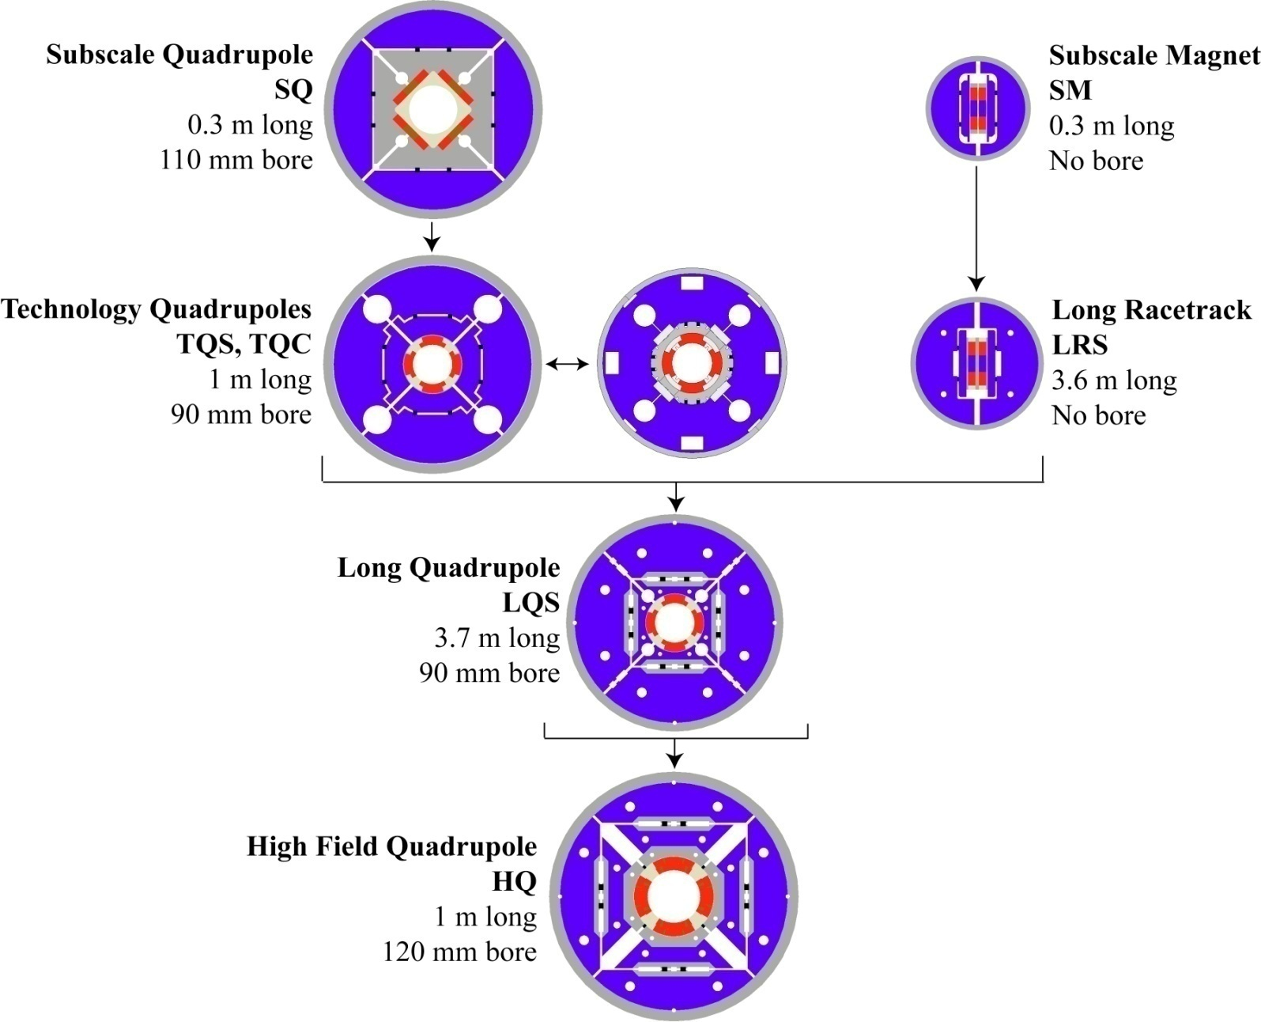
LARP R&D plan†
“C”: Collar-based support structure
Completed
“S”: Shell-based support structure
In progress
Length
1st test
5/2010
† P.Wanderer, et al., "Overview of LARP Magnet R&D," Applied Superconductivity, IEEE Trans. on , vol.19, no.3, pp.1208-1211, June 2009

Slide 3
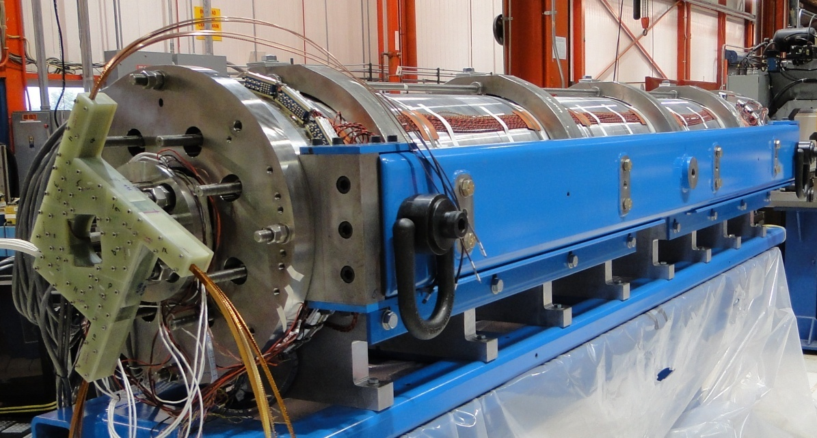
Long Quadrupole†
Main Features:
Aperture: 90 mm
magnet length: 3.7 m
Target:
Gradient: 200+ T/m
Goal:
Demonstrate Nb₃Sn magnet scale up:
  Long shell-type coils
  Long shell-based structure (bladder & keys)
  LQS01 was tested in Nov-Dec 2009
  LQS01b test in progress
LQS01 SSL | 4.3 K
Current | 13.9 kA
Gradient | 242 T/m
Peak Field | 12.4 T
Stored Energy | 473 kJ/m
† LQ Design Report available online at:
https://plone4.fnal.gov/P1/USLARP/MagnetRD/longquad/LQ_DR.pdf

Slide 4
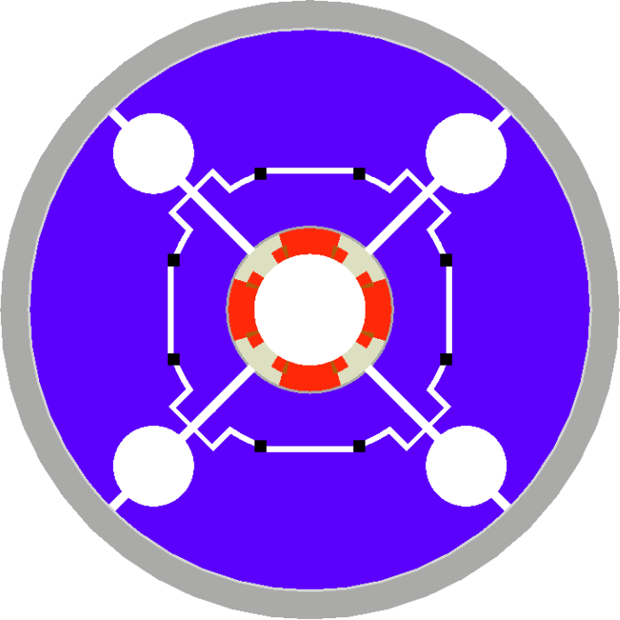
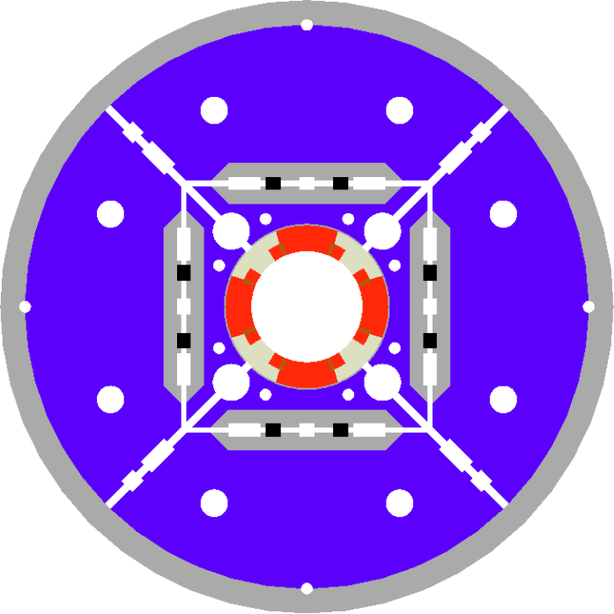
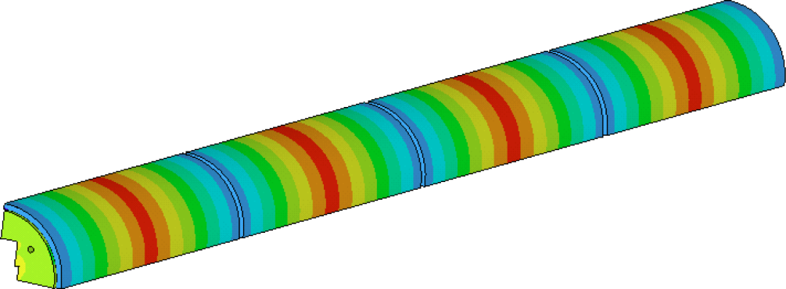
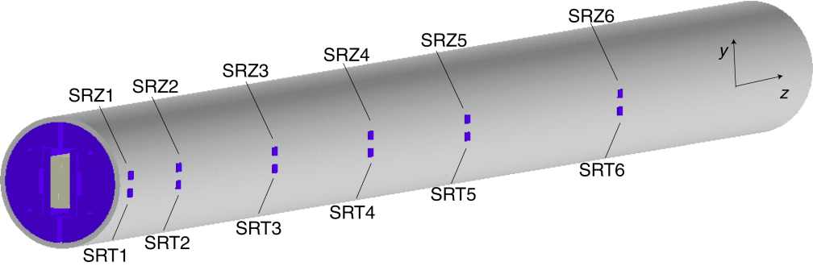
LQ Structure†
LQS is based on TQS (1m model)
and LRS (4m racetrack)
TQS Modifications:
  Added masters
  Added tie-rods for yoke & pad laminations
  Added alignment features for the structure
  Rods closer to coils
  Rods made of SS
Aluminum shell
TQS
LQS
  Segmented shell (4)
† P. Ferracin et al. “Assembly and Loading of LQS01, a Shell-Based 3.7 m Long Quadrupole Magnet for LARP” to be published in IEEE Trans. on Applied Superconductivity.

Slide 5
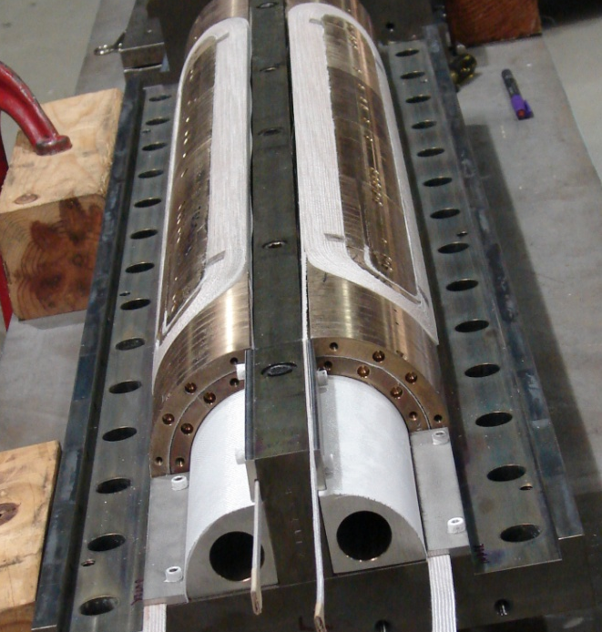
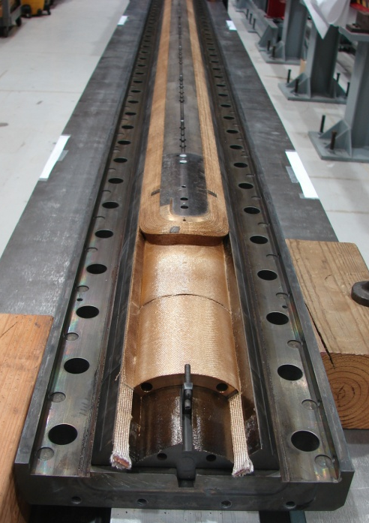
LQ Coils†
Coil design:
  LQ coils = long TQ02 coils with gaps to accommodate different CTE during HT
Fabrication technology:
  From 2-in-1 (TQ coils) to single coil fixtures (LQ)
  Mica during heat treatment
  Bridge between lead-end saddle and pole
Cross-section of TQ/LQ coil
LQ Coil Fabrication:
5 practice coils (Cu and Nb₃Sn)
coils #6-#9 ➔ LQS01
coils #10-#13 ➔ LQS02
Note: coils #6-#9 had 3 severe discrepancies
† G. Ambrosio et al. “Final Development and Test Preparation of the First 3.7 m Long Nb3Sn Quadrupole by LARP” to be published in IEEE Trans. on Applied Superconductivity.

Slide 6
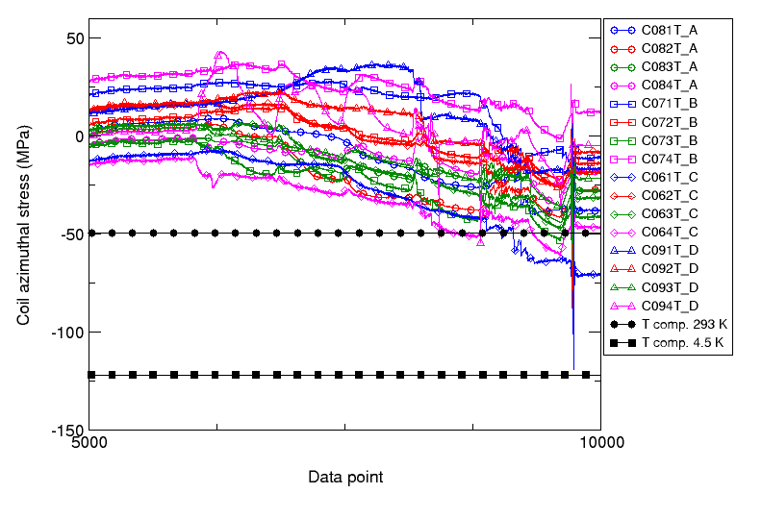
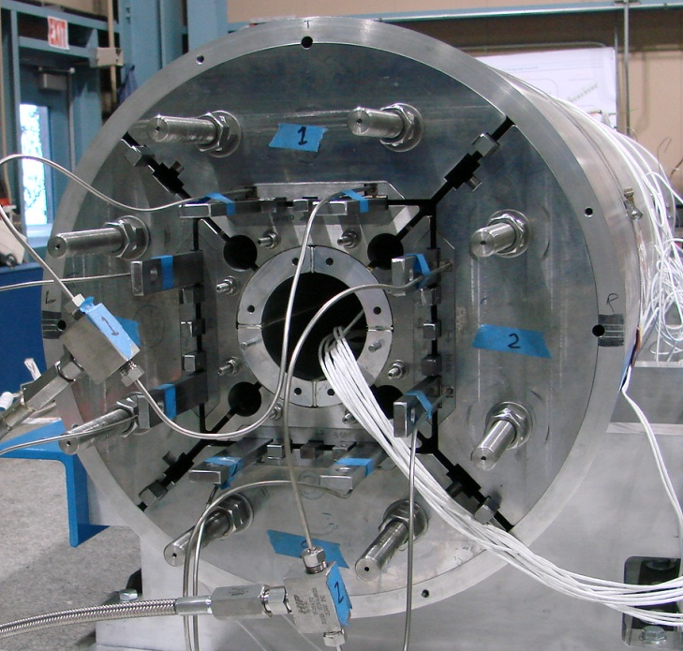
LQS01 Load & Cooldown
Pre-load
  Target stress on shell
  Target stress on roads
  Lower stress on coils ID
Cooldown
  Shell: close to target stress
  Rods: close to target stress
  Coil ID: ~ ½ target stress
Azimuthal stress (MPa) in the coil poles during cool-down:
values measured (colored markers)
and computed (black markers) from a 3D finite element model

Slide 7
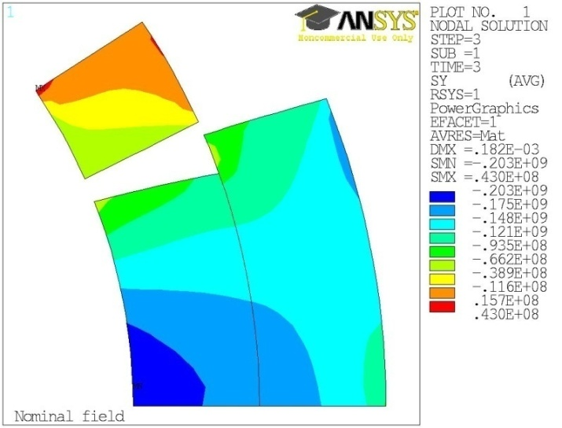
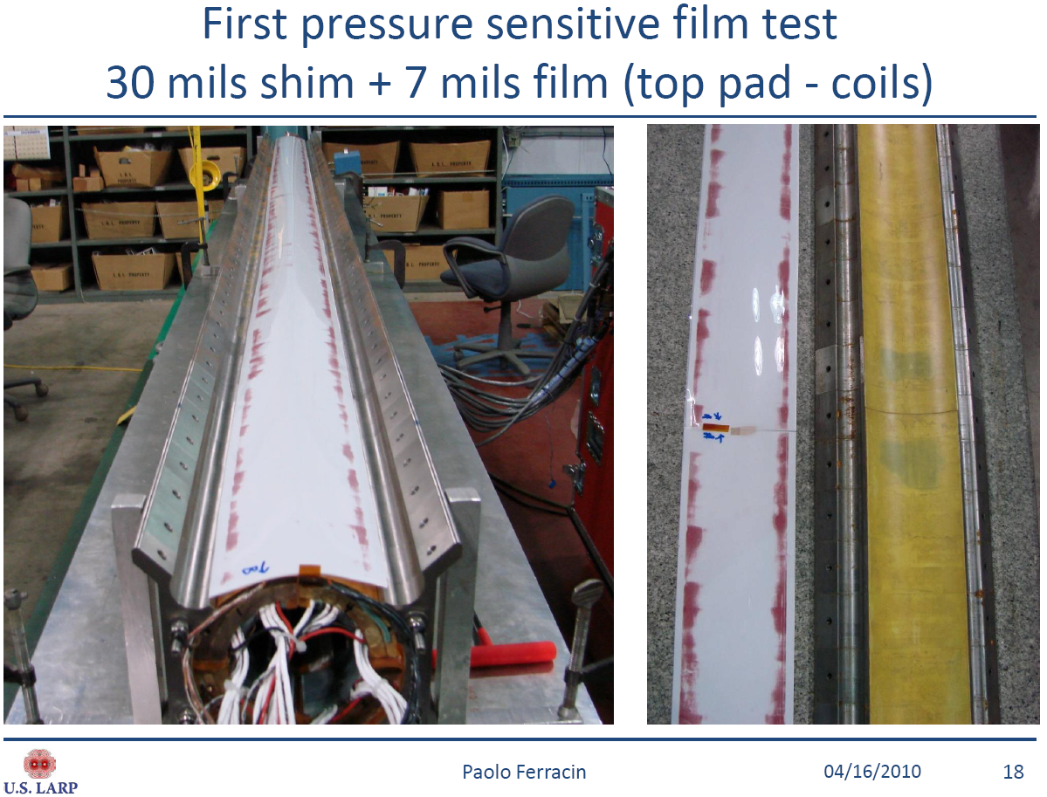
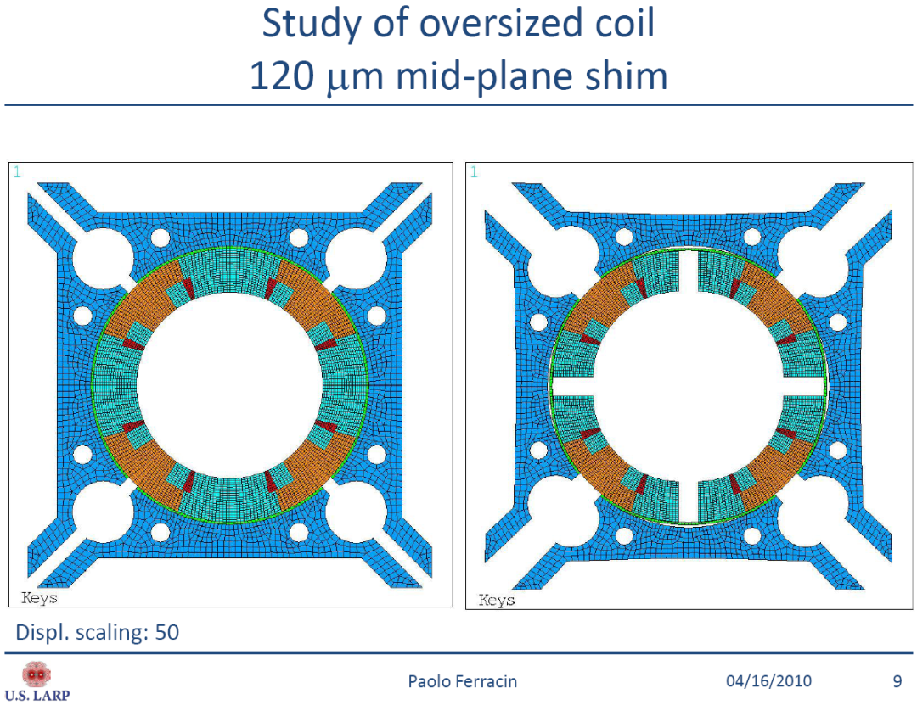
Coil-Pad Mismatch
FEM model with azimuthally oversized coils (120 μm)
  bending due to coil-pad mismatch
  Lower stress in the pole
    Consistent w measurement
  Higher stress on midplane
    Risk of damage above 200 T/m
Verified during disassembly
  Tested with pressure sensitive paper
Contact points
Contact points

Slide 8
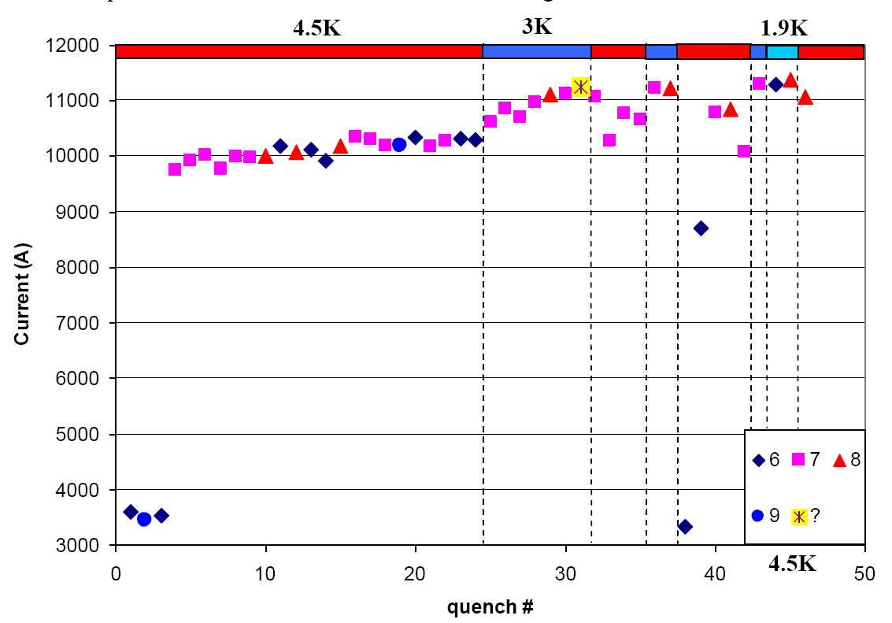
LQS01 Quench History
Slow start
  First quenches at high ramp rate (200 A/s)
    Trying to avoid QPS trips due to voltage spikes
  Slow training at 4.5K
    Due to low pre-load on pole turns
Faster training at 3 K
  Reached 200 T/m
Stopped training
  to avoid coil damage before reassembly
200 T/m
200 T/m
At the end of test
After the training
at 3.0 K
200 A/s
After the initial
training at 4.5 K
Test report available online at:
https://plone4.fnal.gov/P1/USLARP/MagnetRD/longquad/report/TD-10-001_LQS01_test_summary.pdf

Slide 9
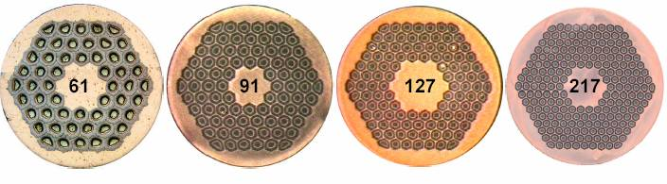
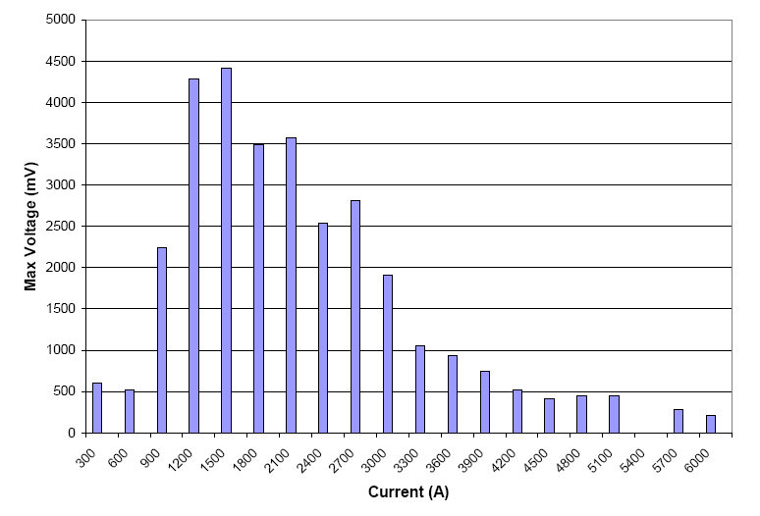
Voltage Spikes
Large voltage spikes
  Due to flux jumps
    Seen in TQ magnets using RRP 54/61
  Larger than in TQs
  ➔Variable quench detection threshold
  ➔Variable ramp-rate during training
    200 A/s ➔ 3 kA
    50 A/s ➔ 5 kA
    20 A/s ➔ 9 kA
    10 A/s ➔ quench
RRP 54/61
by OST
RRP 108/127
by OST
Will be eliminated or significantly reduced by using RRP 108/127
Maximum Voltage Spike amplitude at 4.5 K with 50 A/s ramp rate

Slide 10
Magnetic Measurement
Magnetic measurement at 4.5K:
  Harmonics:
    Some are a few units different w.r.t. computed
    Similar to short models (TQ) †
    A few harmonics, slightly worse, may have been affected by assembly
  Dynamic effects
    No decay and snapback
In progress on LQS01b
# | 100 T/m (5.3 kA) |  | 179 T/m (10 kA)
 | Computed | Measured | Computed | Measured
b_3 |  | 2.29 |  | 2.61
b_4 |  | 6.73 |  | 6.93
b_5 |  | 0.17 |  | -0.08
b_6 | 9.8 | 9.89 | 6.1 | 7.47
b_7 |  | -0.06 |  | -0.11
b_8 |  | -0.98 |  | -0.38
b_9 |  | 0.19 |  | 0.13
b_10 | -0.04 | 0.35 | -0.02 | -0.47
a_3 |  | 2.28 |  | 2.28
a_4 |  | 1.94 |  | 2.11
a_5 |  | -0.51 |  | -0.65
a_6 |  | -0.12 |  | -0.29
a_7 |  | 0.29 |  | 0.14
a_8 |  | 0.08 |  | 0.06
a_9 |  | -1.09 |  | -0.16
a_10 |  | 0.37 |  | 0.12
Geometrical harmonics at 100 and 179 T/m field gradient.
Results are presented at 22.5 mm reference radius, which corresponds to the official radius adopted for LHC (17 mm) corrected for the increase in the magnet aperture from 70 to 90 mm.
An 81.8 cm long tangential probe was used.
† G. Velev, et al., “Field Quality Measurements and Analysis of the LARP Technology Quafrupole Models”, IEEE Trans. On Applied Supercond. , vol.18, no.2, pp.184-187, June 2008

Slide 11
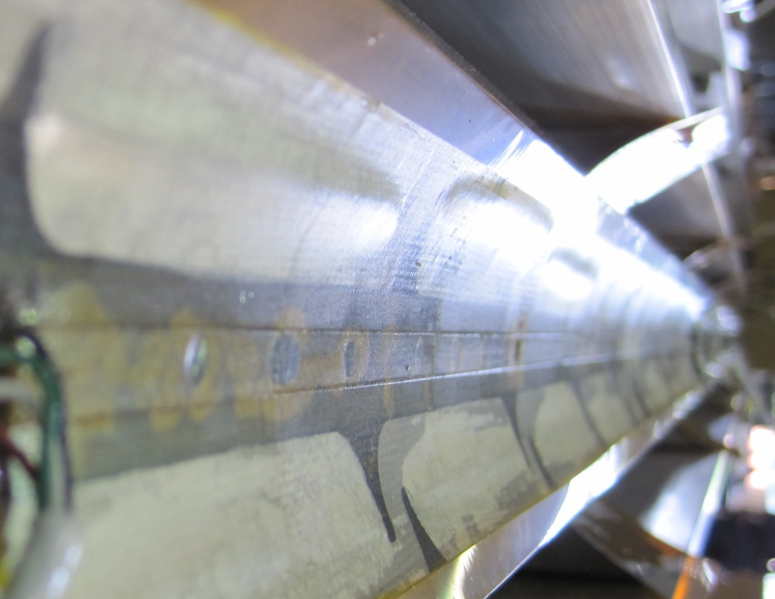
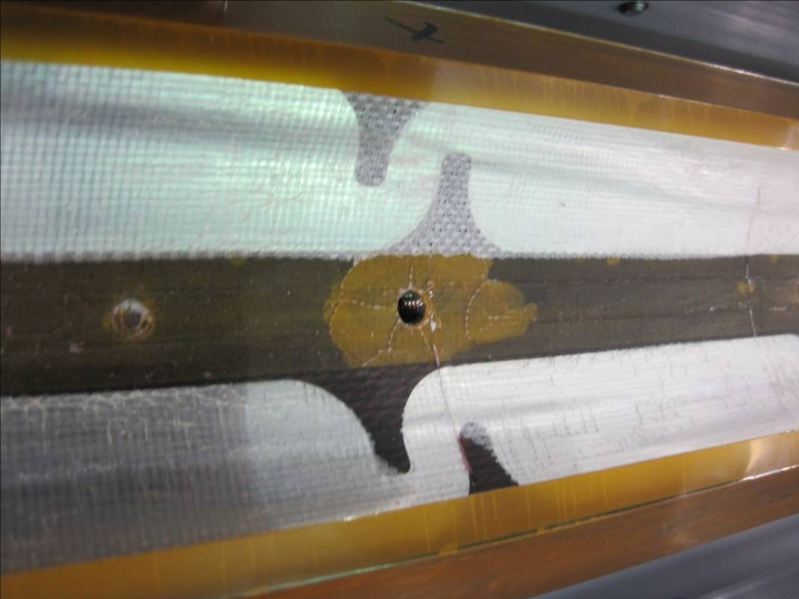
Coils after Test
Some “bubbles” on coils inner layer
  Coil-insulation separation
Possible causes:
  Superfluid helium and heat during quench
    Seen in TQ coils
  Heat from heaters on inner layer
    Only in LQ coils
Plans:
  Strengthen insulation or
  Change heater location

Slide 12
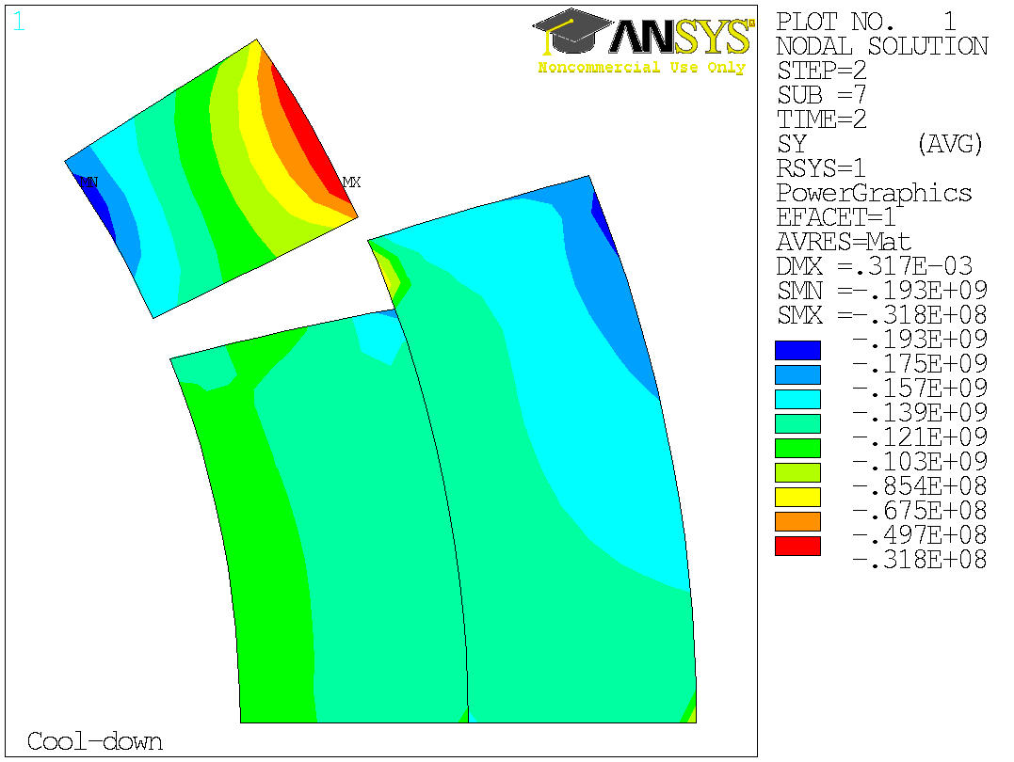
LQS01b Loading
New shims give correct ratio between strain in the shell and strain in the coils (same coils of LQS01)
  ➔ More uniform prestress
Higher preload based on short models (TQS03 a/b/c)
  ➔ Peak load: 190 MPa +/- 30
LQS01b
12

Slide 13
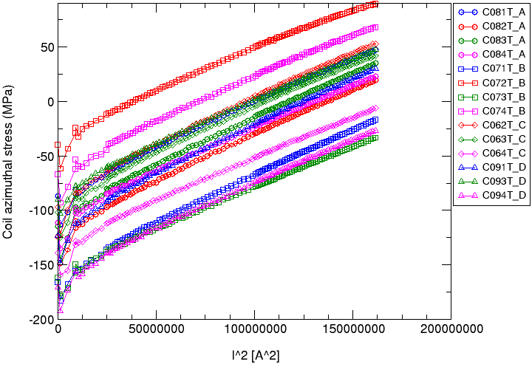
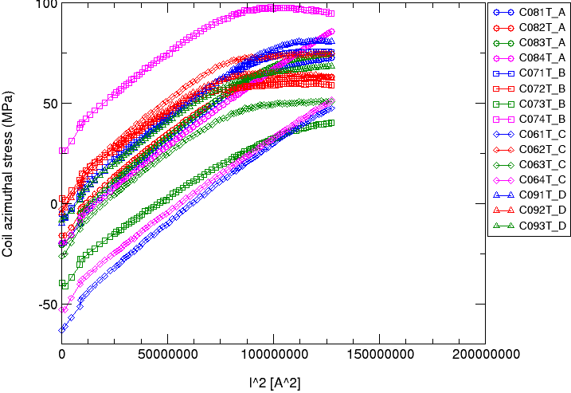
Strain Gauges: LQS01b vs. LQS01a
LQS01a: Most gauges unloading at 11.2 kA
LQS01b: No unloading at 12.8 kA

Slide 14
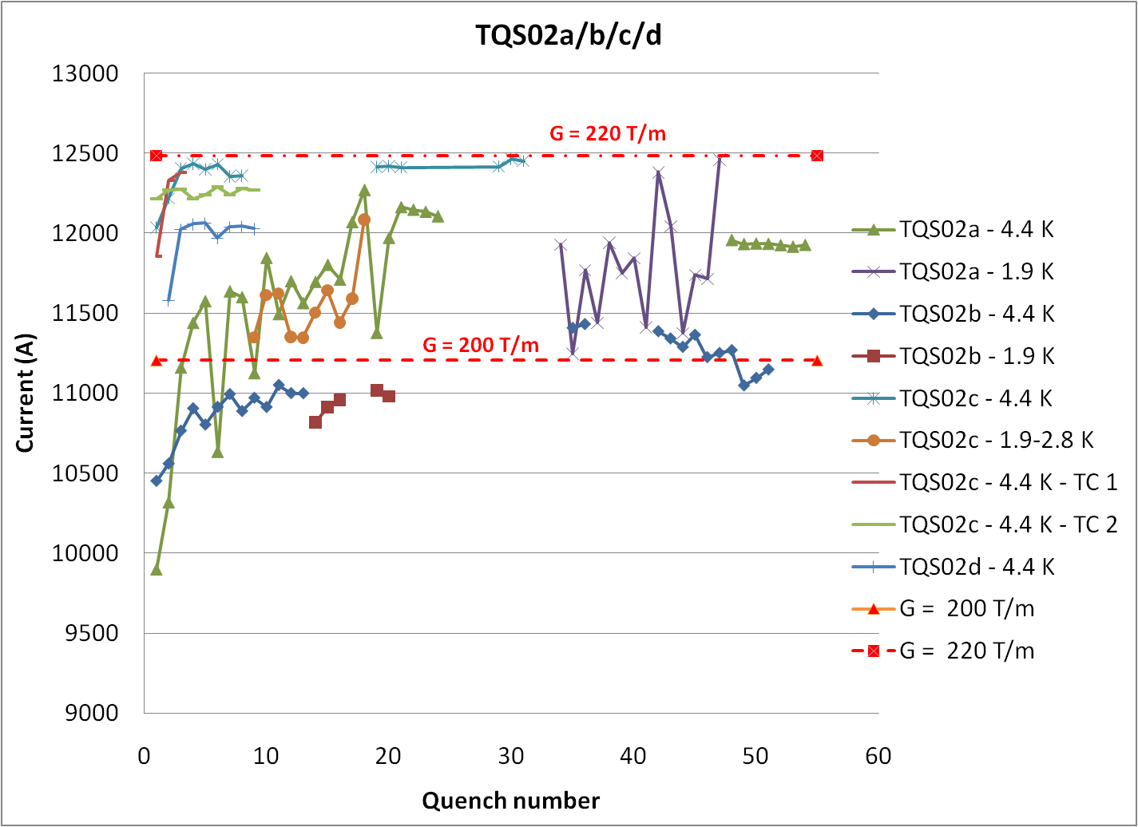
G = 220 T/m
G = 200 T/m

Slide 15
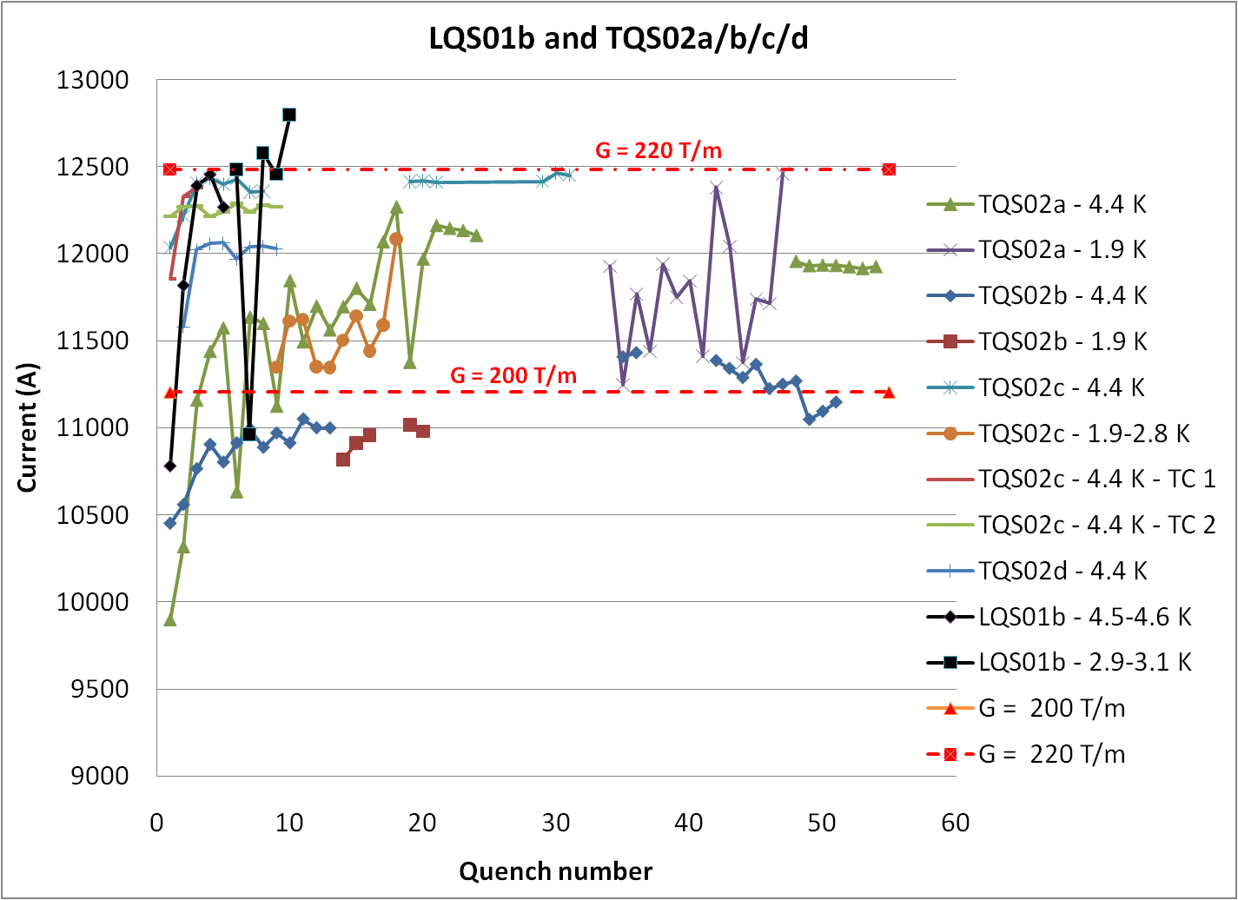
LQS01b: 220 T/m
in 4 quenches

Slide 16
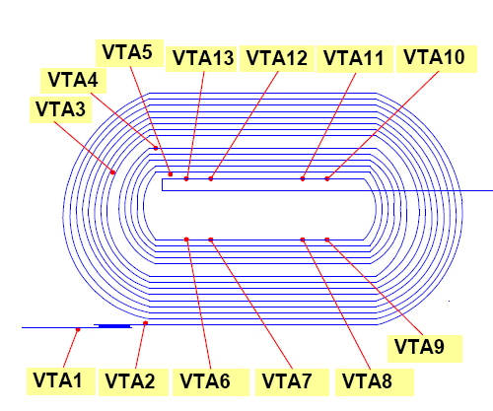
LQS01b Quench Location
Most quenches are in Inner Layer pole turn, with a few exceptions
The location keeps changing
➔ Still training
Quench # 3:
Coil8_B2_B3
Quench # 9:
Coil 6_B2_B3
6
9
7
8

Slide 17
LQS01b Preliminary Observ.
LQS01b reached the best performance of all TQS02 series (made with same conductor)!!!
  With the first four LQ-production coils; three of which had “severe” discrepancies
  ➔ We know how to make and fix long Nb₃Sn coils
  Al-shell-based structure is providing support (up to 225 T/m and 91% of ssl) with no signs of limitation
  ➔ Segmented shell structure can be used for long Nb₃Sn magnets with shell-type coils
  Quench protection keeps hot-spot temperature below 260 K
  ➔ We have tools (computation & instrumentation) for protecting long Nb₃Sn magnets above 2.2K

Slide 18
Insulation Development
The cable insulation in LQS01 and LQS02 coils is an S2-glass sleeve
    Same insulation used in TQ and LR coils
    The application to long coils requires days of labor and is not suited for a production
Development of new insulation for Long Nb₃Sn Coils and test in LQS03 coils:
  Plan A: E-glass tape (tested in TQ coils)
    Qualification in progress
  Plan B: S2-glass braided on the cable (NEWT)
    Qualification in progress
  Plan C: S2-glass braided on the cable (other vendors)
  Plan D: use the sleeve for LQS03 coils and continue develop.

Slide 19
LQ GOALS
Next LQ models goals:
  Reproduce short-model performances (gradient and training):
    LQS01b/LQS02 ➔ TQS02 gradient at 4.5K (~220 T/m)
    LQS03 ➔ TQS03 gradient at 1.9K (~240 T/m)
  Demonstrate reproducibility & memory; 4m keys & bladders; uncontrolled cooldown:
    LQS02 , LQS02b
  Demonstrate conductor with reduced voltage-spikes &
  cable insulation suited for production:
    LQS03, LQS03b
Need still some R&D:
  Reliable solution for protection heaters on inner layer at 1.9K

Slide 20
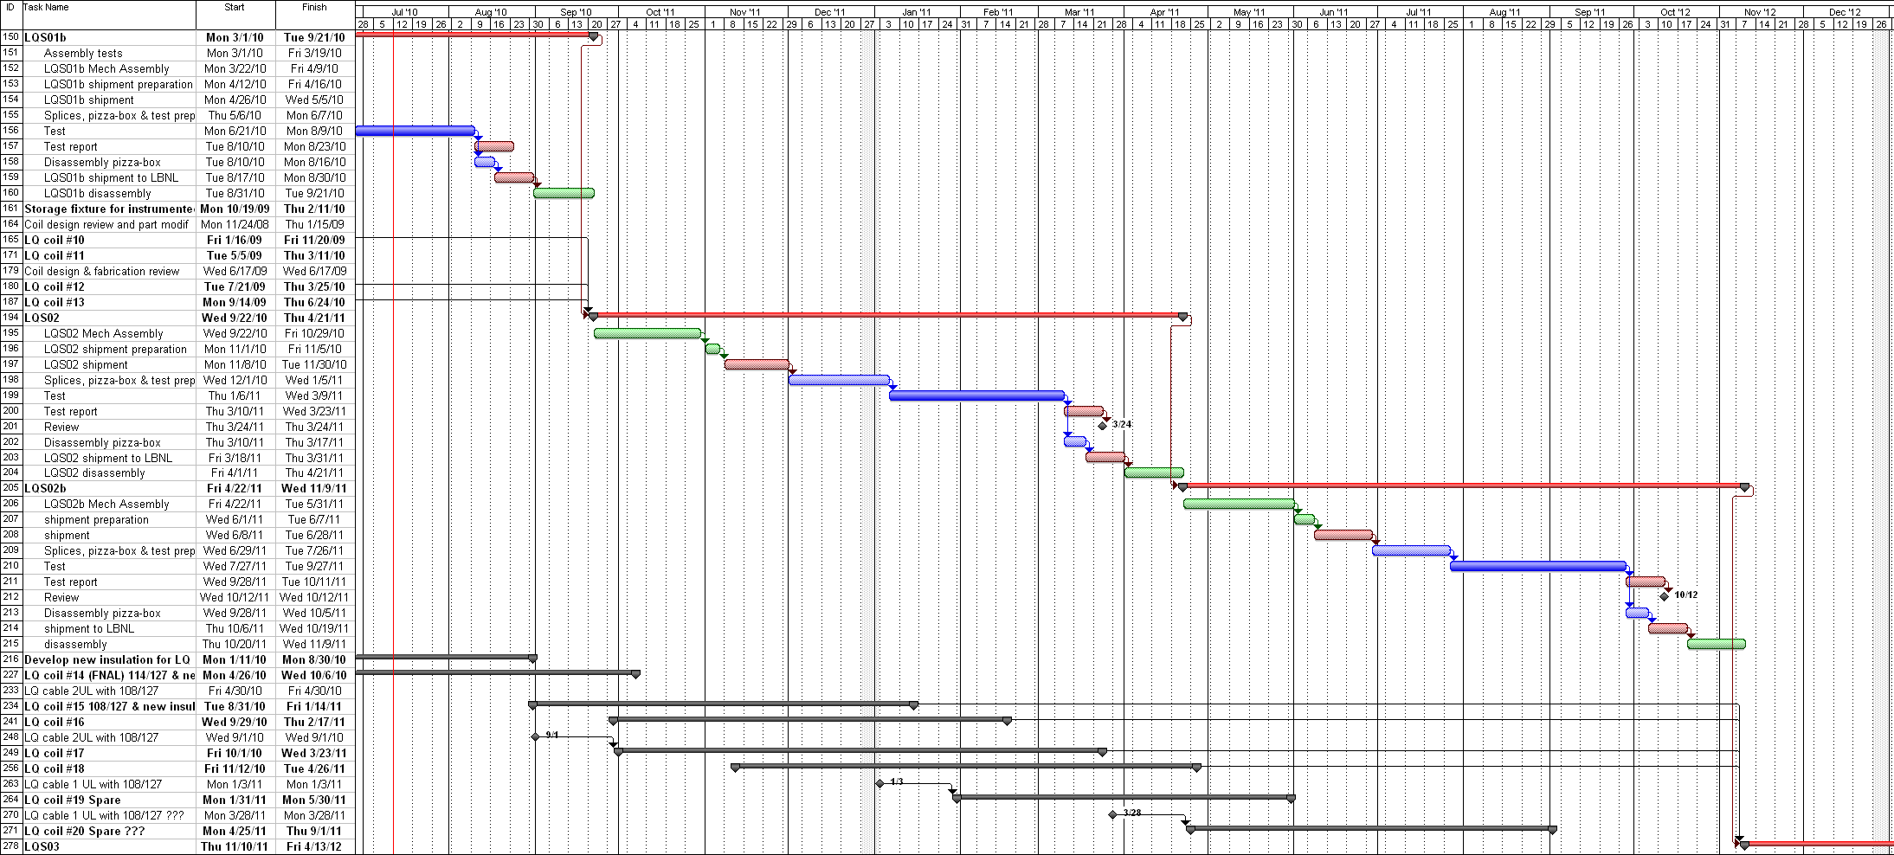
LQ Schedule
LQS01b test
LQS02a test
LQS02b test
108/127 coils
LQ test turn around time: ~ 7 months
LQ test time: 2 months

Slide 21
Extra

Slide 22
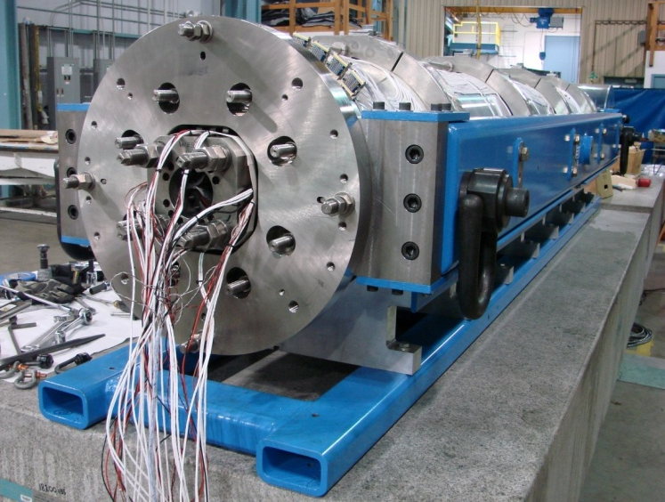
LQS01 Assembly
LQS01 assembled and pre-loaded
Strain gauge readings:
on the structure (shell & rods) are on target
on the coils are lower than expected with large scattering
  Seen also in TQS models; possibly caused by coil/pads mismatch
293 K | σ_{y} (MPa) | σ_{z} (MPa)
Shell measured | +33 ±8 | +3 ±7
Shell target | +34 | +6
Pole measured | -12 ±11 | +14 ±17
Pole target | -49 | -14
Rod measured | n/a | +60 ± 3
Rod target | n/a | +63
Comparison of measurements and targets
LARP CM14 - FNAL, Apr. 26-28, 2010
G. Ambrosio - Long Quadrupole

Slide 23
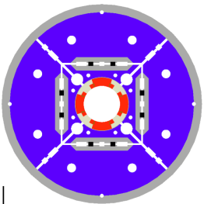
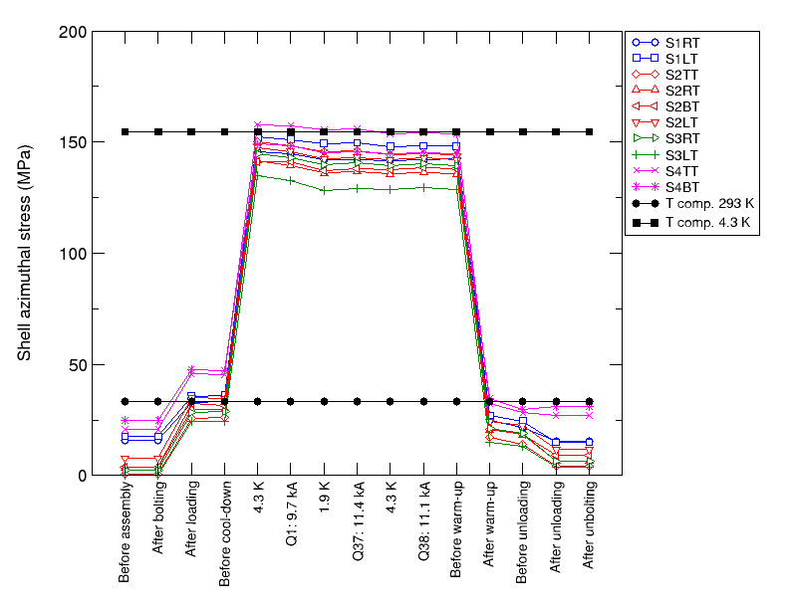
LQS01 Cooldown
Delta stress on the pole lower than expected
Stress on the shell close to expected value
  Stress distribution in the coil different from the computed one
Azimuthal stress (MPa) in the coil poles during cool-down:
values measured (colored markers)
and computed (black markers) from a 3D finite element model
Azimuthal stress (MPa) in the coil shell:
values measured (colored markers)
and computed (black markers) from a 3D finite element model

Slide 24

FEM Analysis
FEM model with azimuthally oversized coils
  bending due to coil-pad mismatch
  Lower stress in the pole
    Consistent w measurement
  Higher stress on midplane
    Risk of damage above 200 T/m
Less stress
More stress

Slide 25
LQS01 Disassembly
Test with pressure-sensitive paper confirmed coil-pads mismatch
Contact points
Contact points

Slide 26
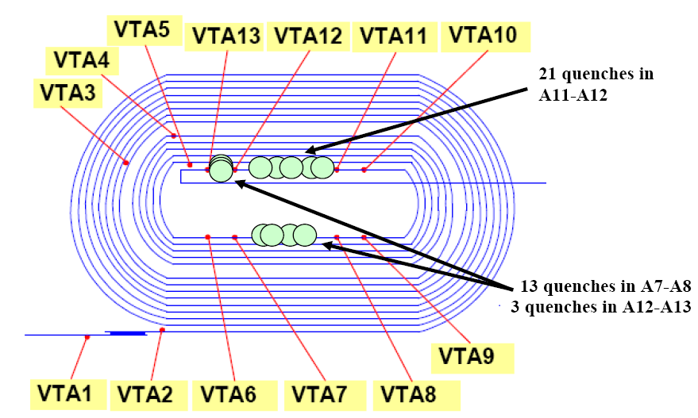
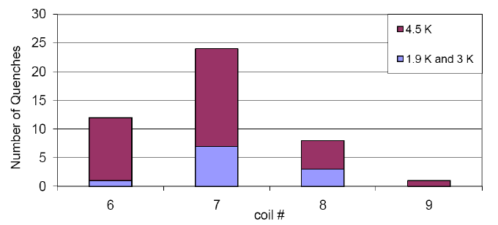
Quench Location
All quenches in pole turns
  Except high ramp-rate quenches
  No preferred location
All coils participating
  Largest number in coil 07
    Smallest I_{c} margin

Slide 27
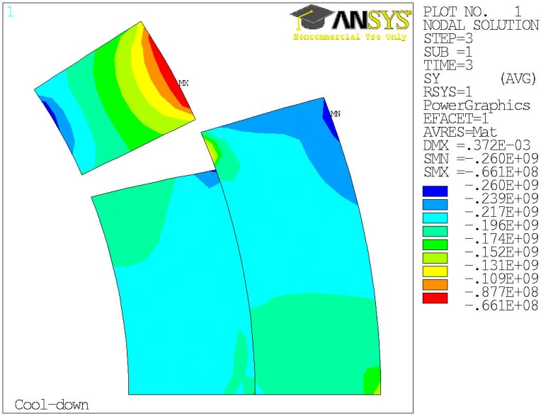
LQS01b Pre-load
LQS01b
Target pre-load at cold:
  Pole: 160 ± 30 MPa
    Same as TQS03b
  Inner layer: 193 ± 30 MPa
    Lower than TQS03c
  Outer layer: 186 ± 30 MPa
    Lower than TQS03c
Delta based on sensitivity analysis
  Coil mid-plane variation: ± 50 μm
  Shell inner-radius variation: ± 65 μm
TQS03c

