Slide 1
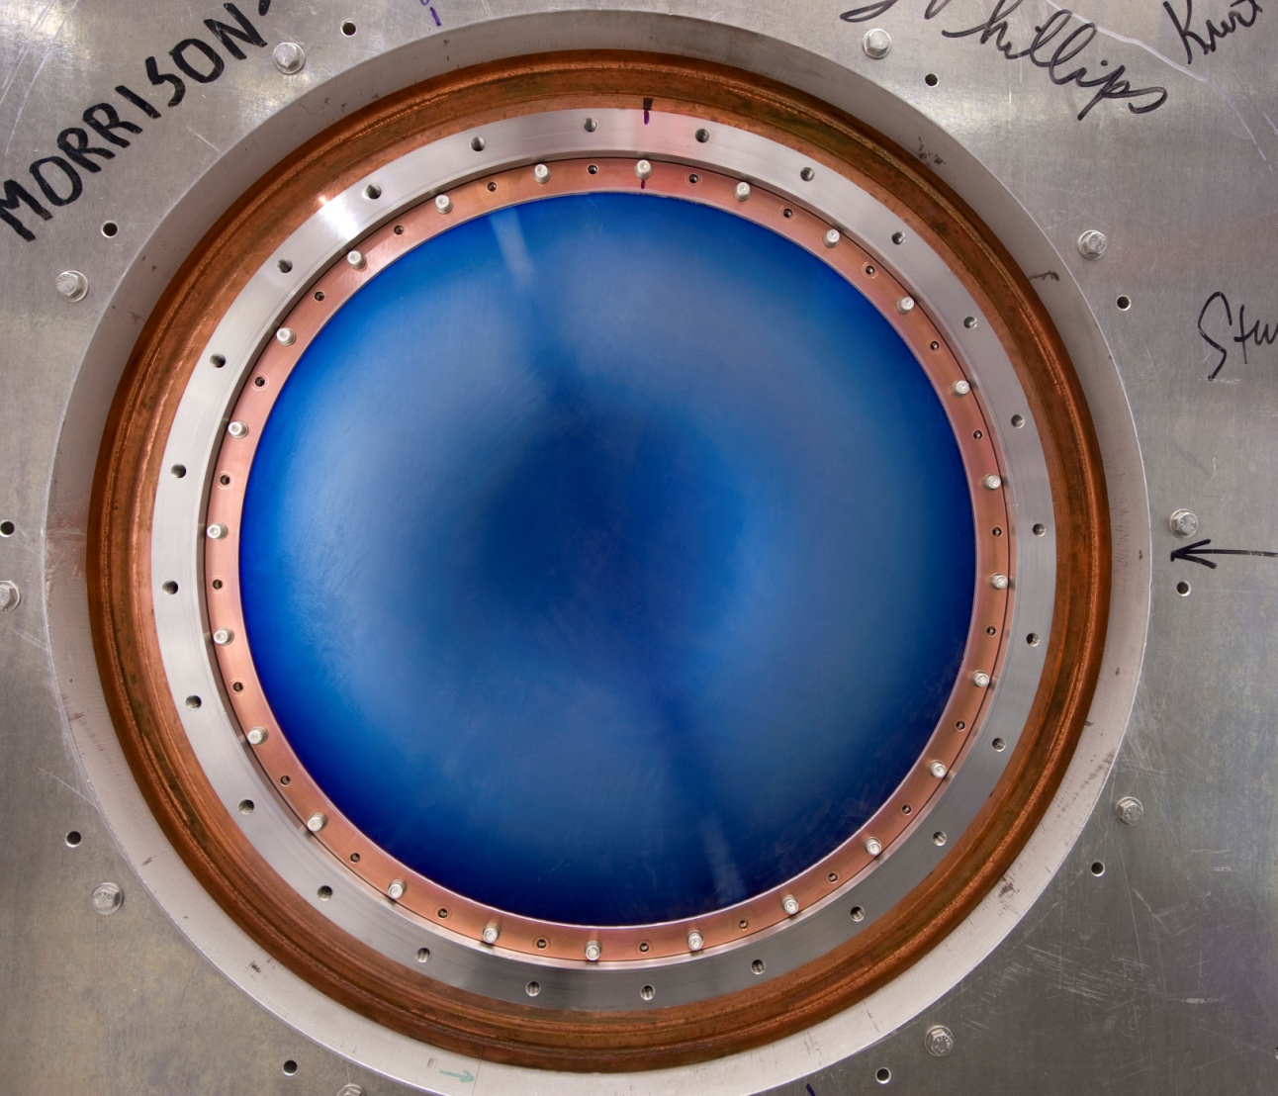
RF Strategy & the MuCool Test Area
Meeting the RF in Magnetic Field Challenge

Slide 2
Outline
  The “RF Challenge”
  Science of RF Breakdowns
  Current Program (Where we are)
    Derun Li’s talk (next) will discuss where we are going
  The MuCool Test Area
  Summary

Slide 3
Goals of This Talk
We have a well defined and measured experimental program
There are extensive scientific underpinnings for the program
The experimental effort is supported by detailed simulation work which is predictive

Slide 4
Just to Review
Remember, from Long Ago – (Yesterday)

Slide 5
Normal Conducting RF
R&D Issues and Present Status
Muon bunching, phase rotation and cooling requires Normal Conducting RF (NCRF) that can operate at high gradient within a magnetic field strength of up to approximately 6T
  Required gradients (15-18MV/m) easily obtainable in absence of magnetic field
But

Slide 6
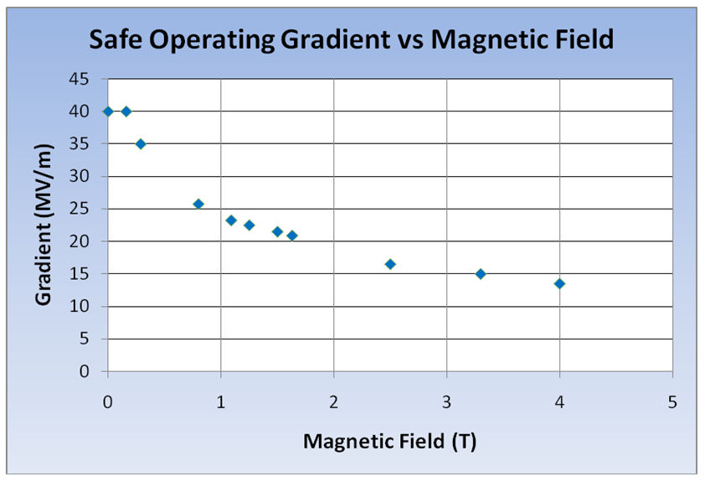
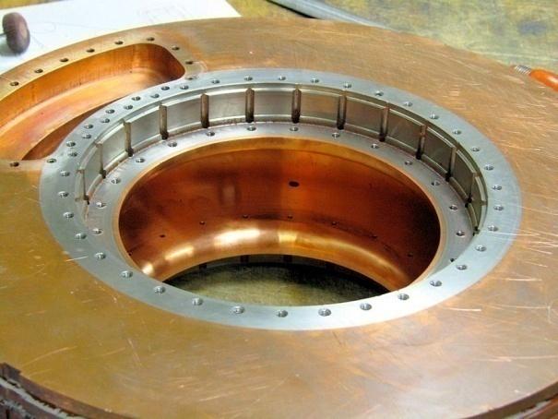
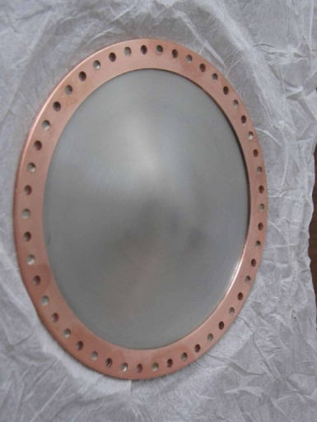
The RF Challenge
Significant degradation in maximum stable operating gradient with applied B field
805 MHz RF Pillbox data
  Curved Be windows
  E parallel B
  Electron current/arcs focused by B
Degradation also observed with 201 MHz cavity
  Qualitatively, quite different

Slide 7
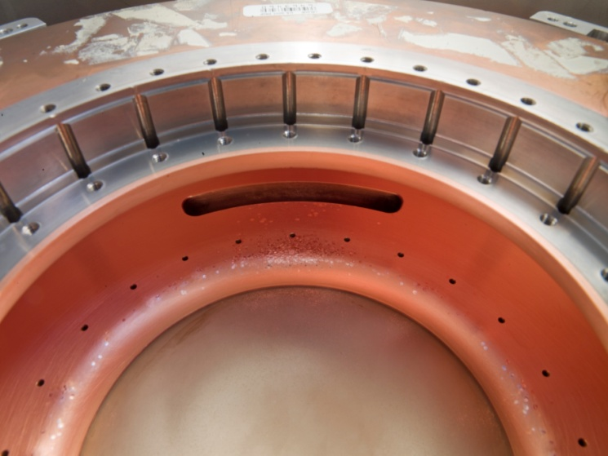
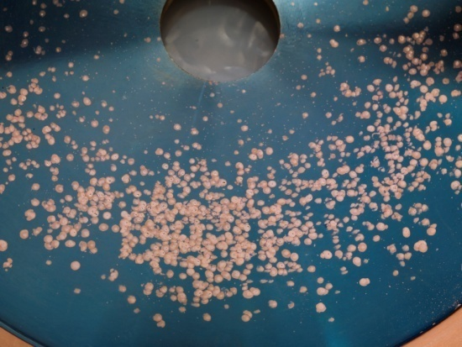
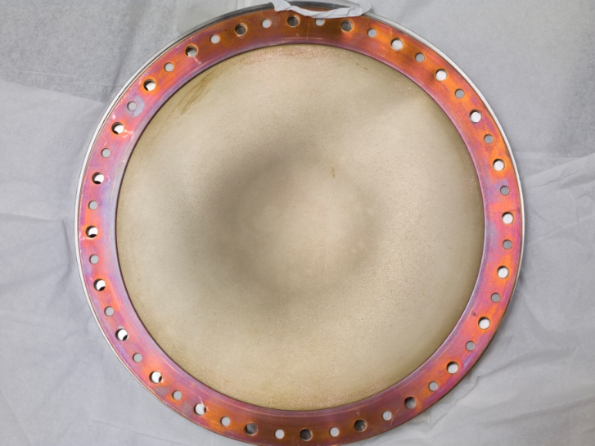
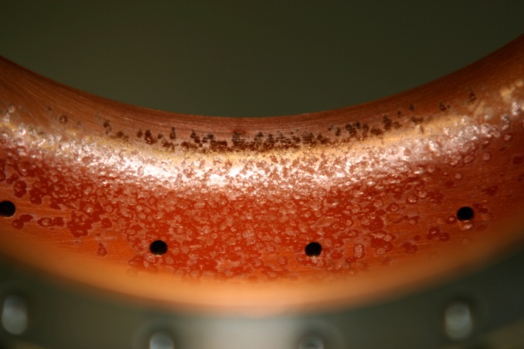
805 Pillbox
Post-Mortem
Significant damage observed
  Iris
  RF coupler
  Button holder
However
  No damage to Be window

Slide 8
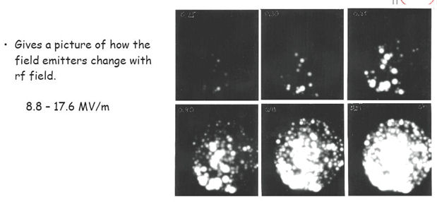

805 MHz Imaging
Hot Spot Arc forms
Cavity Energy
W=1/2 CV²
≈ 1-5 joule
All goes into melting Cu
B
Surface Field Enhancement
Initiates the event & B focuses the e⁻ current
which causes damage
8

Slide 9
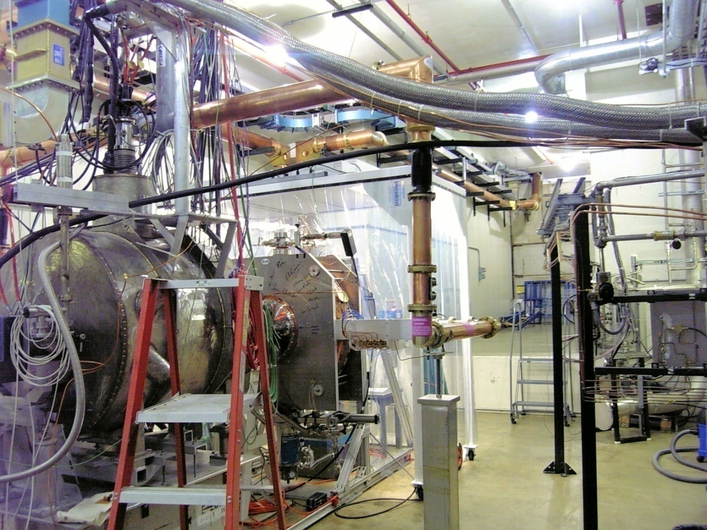
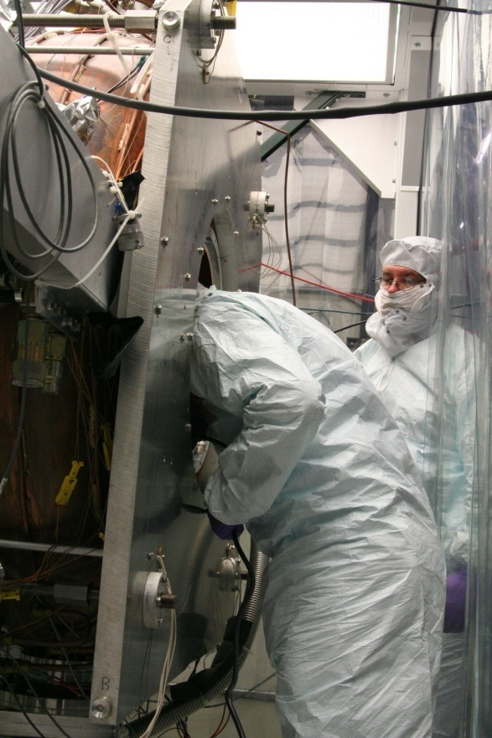
201 MHz Cavity Test
Treating NCRF cavities with SCRF processes
The 201 MHz Cavity – Achieved 21 MV/m
  Design gradient – 16MV/m
  At 0.75T reached 10-12 MV/m
However, No observed damage!

Slide 10
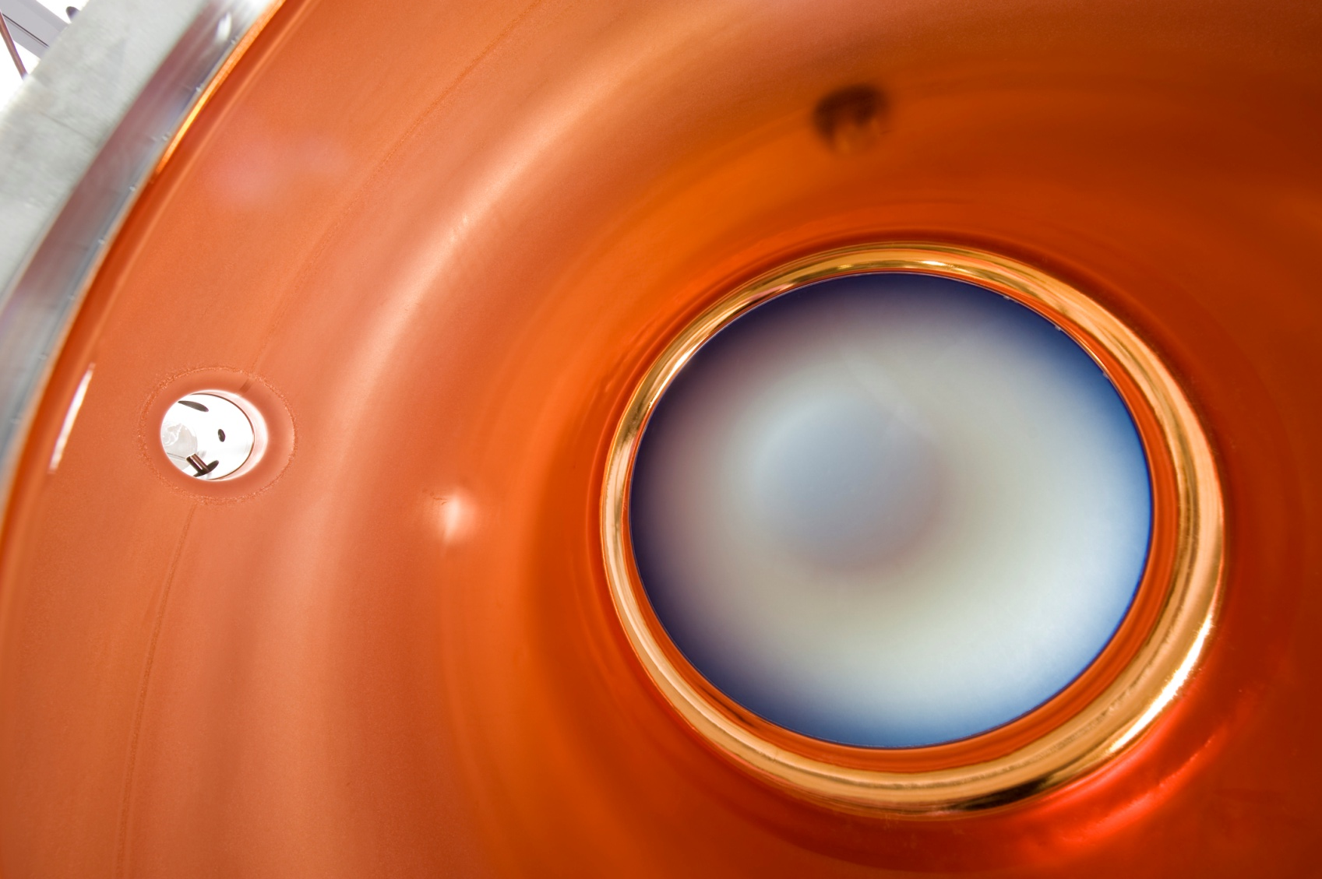
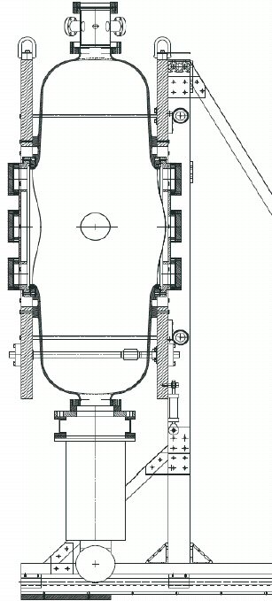
201 MHz Prototype

Slide 11
RF Breakdowns
Are not all equal
  NCRF conditioning (B=0), process allows for higher gradient operation (“conditioning”)
  NCRF (B ≠ 0), process can cause damage and require re-conditioning at lower gradient in order to reach the same gradient attainable before breakdown

Slide 12
The Science of RF Breakdown
Vacuum
In recent years, we have learned a great deal about the Science of RF Breakdown
  Vacuum Arcs
    An explanation of the formation of high β asperities
      Surface Field Enhancements
    Predictions of very high surface fields in arcs, consistent with measurements.
    An explanation of the microstructure in arc pits
    Preliminary results of arcs in static B fields.
    Comparison with studies of unipolar arcs.
    Calculations of sputtering and erosion rates.
  Effects due to magnetically focused Field Emission

Slide 13
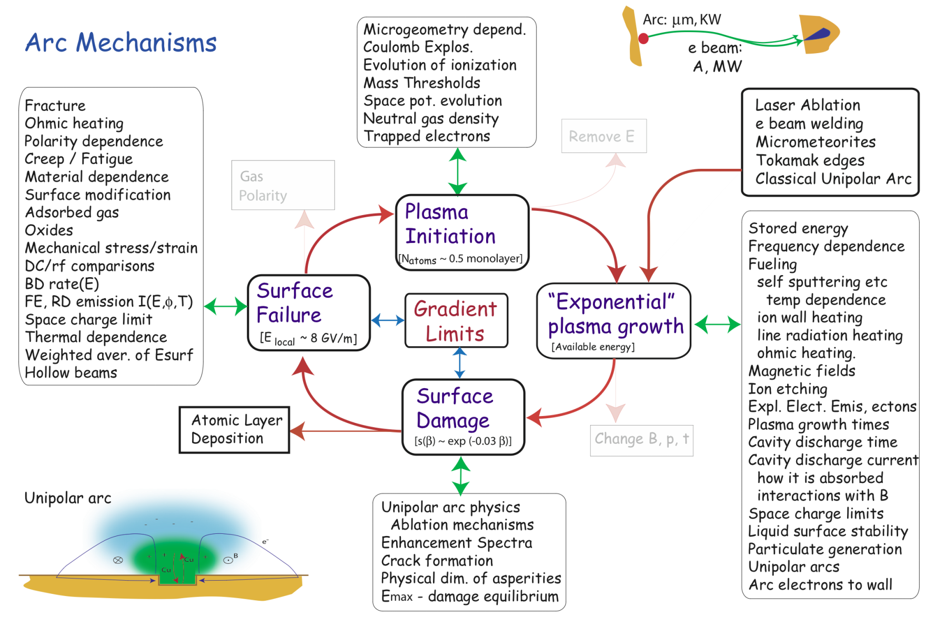
The Science of RF Breakdown II
Vacuum
Norem et al., 2001-2010
Workshop on Uni-polar Arcs, ANL, Jan. 2010
Breakdown Physics Workshop, CERN May 2010

Slide 14
The Science of RF Breakdown III
Vacuum
Advanced Simulation Code
  OOPIC & VORPAL: Kevin Paul, Tech-X
This is where all the interesting physics for RF breakdown takes place!!!
New particles
added (lost
removed)
{x_{α}, v_{α}}
Particles
accelerated
by the fields
{v'_{α}}
Particles
moved based on
new velocity
{x'_{α}}
Collisions and
interactions
computed
One Time Step
New fields
computed from
old fields
{E'_{i}, B'_{i}}
Currents
“deposited”
on the grid
{J_{i}}

Slide 15
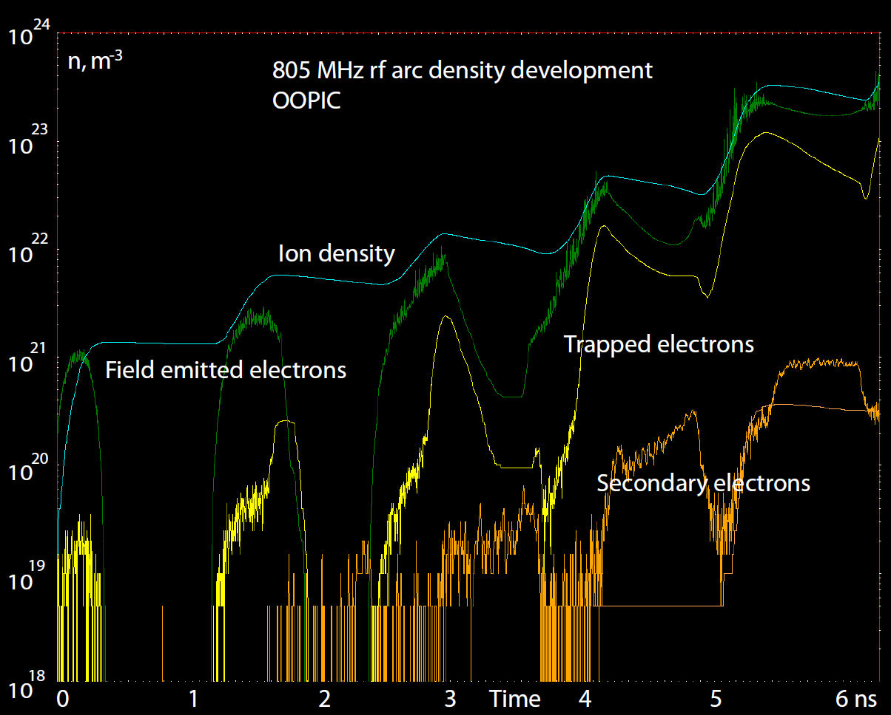
The Science of RF Breakdown IV
Vacuum

Slide 16
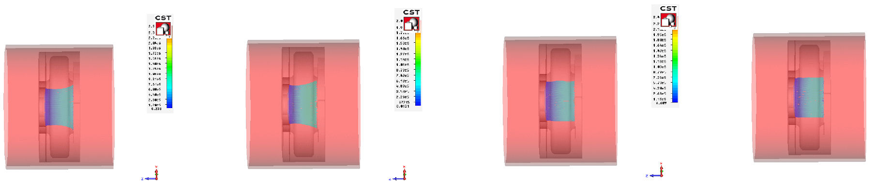
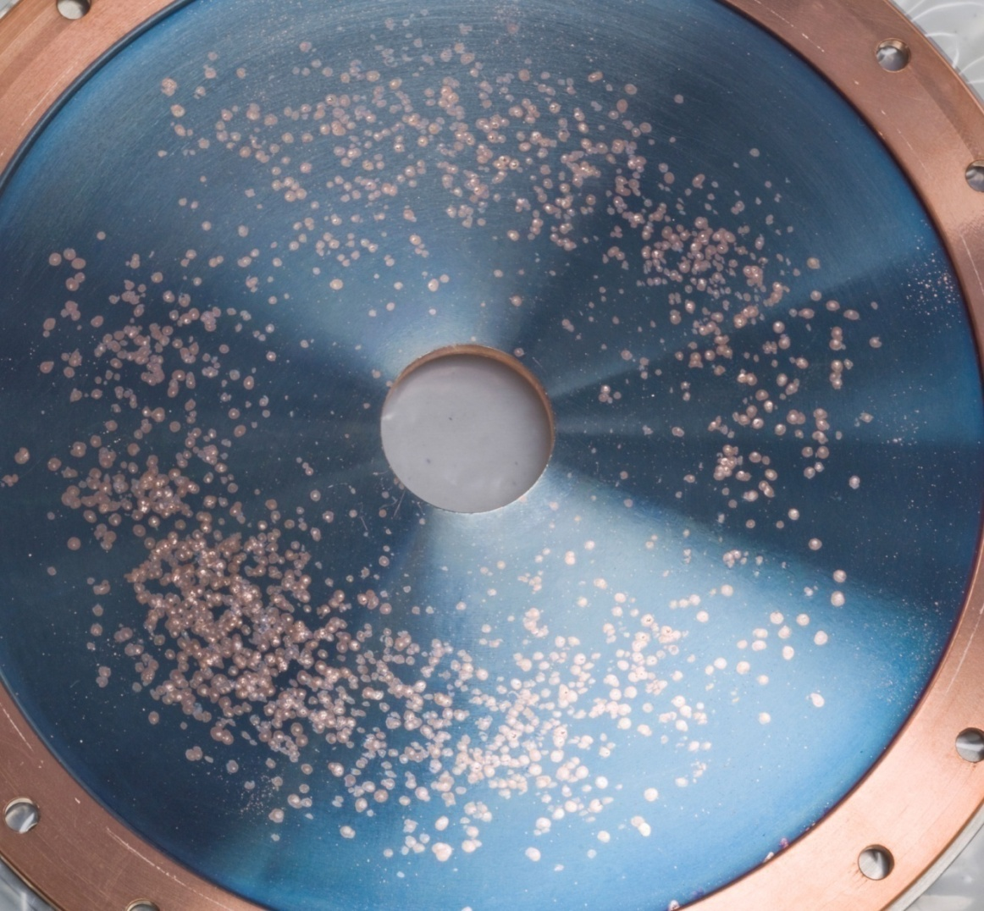
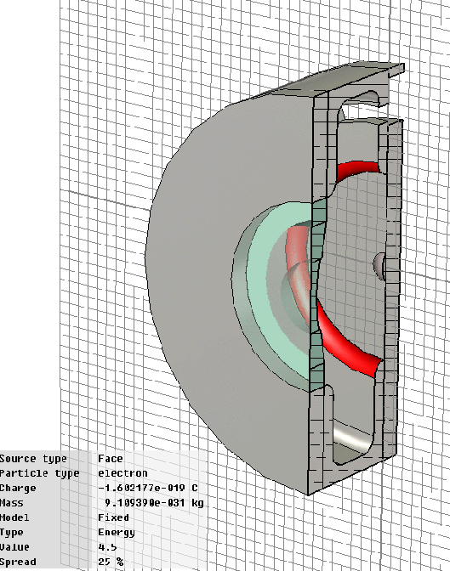
The Science of RF Breakdown V
Vacuum
0 0.1 T 0.25 T 0.5 T
Dazhang Huang (IIT), Particle Studio Simulation

Slide 17
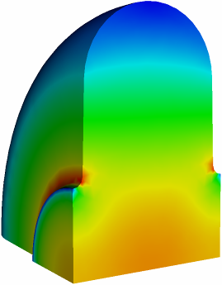
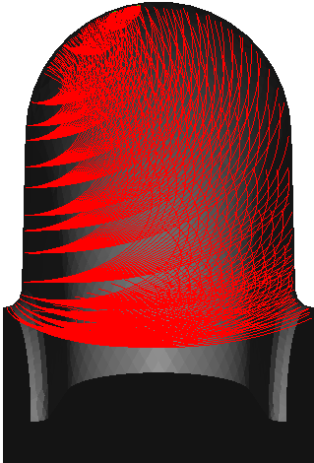
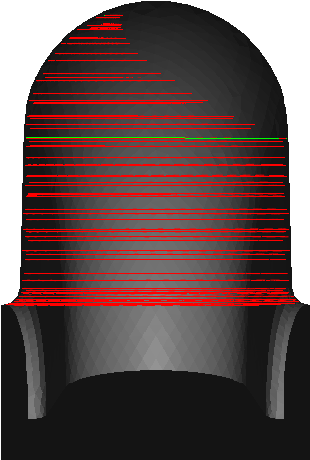
The Science of RF Breakdown VI
Vacuum
Numerical studies at BNL and SLAC (in collaboration) using Omega-3P and Track-3P codes,
  Cavity with flat windows: 5 MV/m on axis; 2-T uniform external magnetic field; scan of a few points from one cavity side
Trajectories without external B field
Trajectories with external B = 2-T field
E field contour

Slide 18
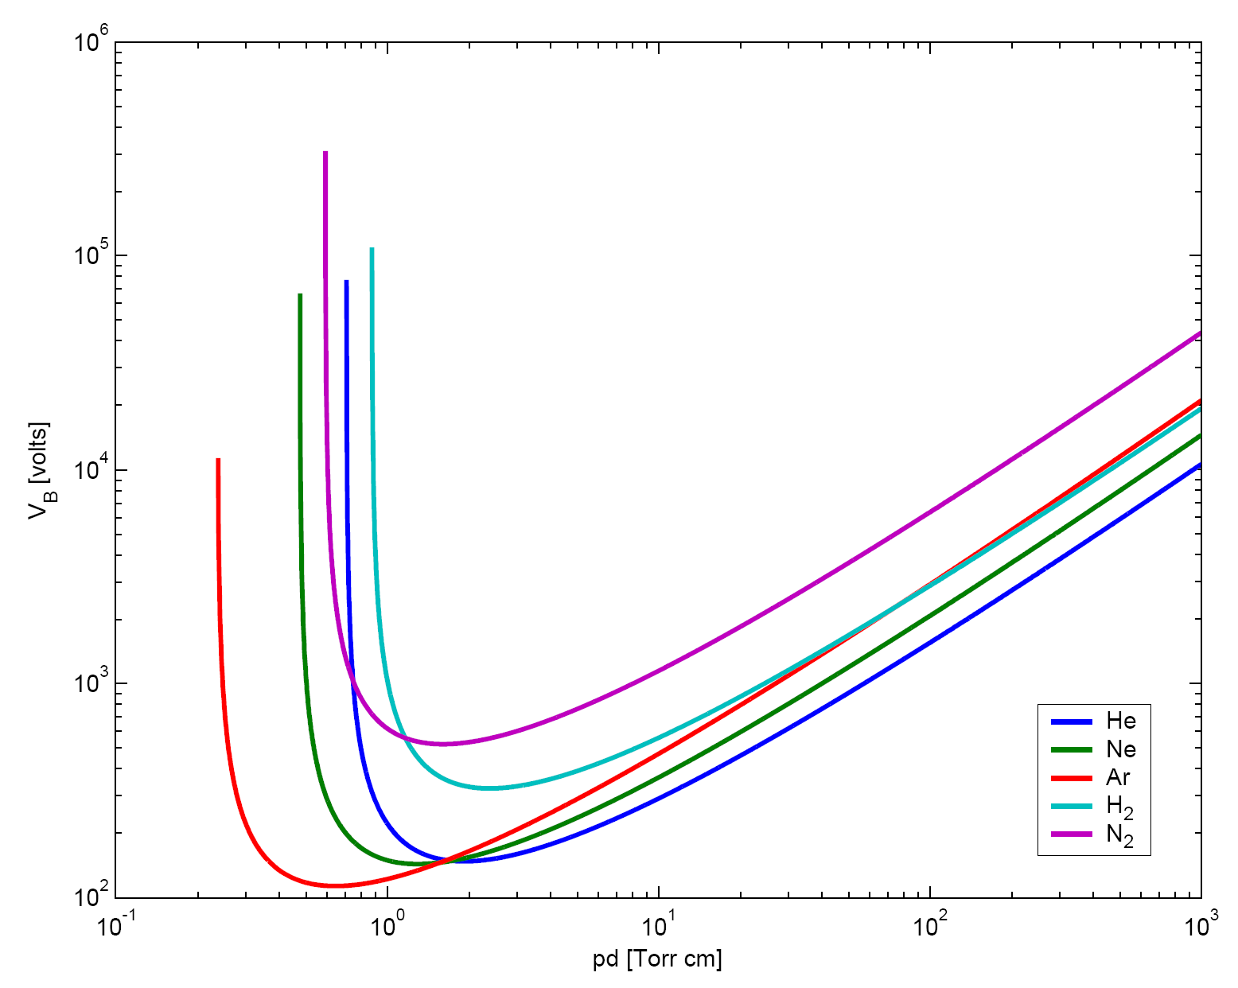
The Science of RF Breakdown
Gas
RF cavities filled with High-Pressure H₂
  Paschen’s Law
Rolland Johnson
Shelter Island 2002

Slide 19
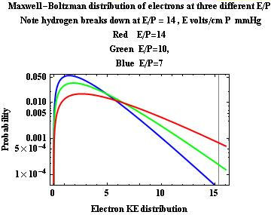
The Science of RF Breakdown II
Gas
Gas Filled Cavities
No focusing of electron avalanche
V_{rf} = V_{o} Sin[ωt]
+
H₂
H₂
H₂
H₂
H₂
H₂
H₂
H₂
H₂
H₂
Electron Avalanche
H₂
H₂
H₂
Note: 40MV/m & 100 Atm
E/p ≈ 5
Cavity Energy
W=1/2 C V²
≈ 1 joule → Heats gas
Collision frequency >> cyclotron frequency
B has no effect !
Done?

Slide 20
The Science of RF Breakdown III
Gas
However we want to operate with up to 10¹³ muons/pulse
  Beam-impact ionization + Ionization by secondary e⁻
μ + H₂ → μ + H₂⁺ + e⁻
e⁻ + H₂ → H₂⁺ + 2e⁻
Most electrons (>90%) are quickly thermalized inside the cavity by elastic and inelastic collisions, and drift with RF until annihilated by recombination or attachment

Slide 21
The Science of RF Breakdown IV
Gas
see K. Yonehara’s talk
1. Rapid decay of pickup
signal according to the
ionization rate
2. Saturation level and
recovery rate determined
by the recombination rate
Gray line: normal signal
without beam
Solution:?
Electron “getter”
Electro-neg. Gas

Slide 22
NCRF Program
R&D Strategy
Technology Assessment (continuation of existing multi-pronged program)
  Surface Processing
    Reduce (eliminate?) surface field enhancements, dark current
      SCRF processing techniques
        Electro-polishing (smooth by removing) + HP H₂O rinse
      More advanced techniques (Atomic-Layer-Deposition (ALD))
        Smooth by adding to surface (conformal coating @ molecular level)
  Materials studies: Use base materials that are more robust to the focusing effects of the magnetic field
    Cavity bodies made from Be or possibly Mo
  Magnetic Insulation
    Inhibit focusing due to applied B
  High-Pressure Gas-filled (H₂) cavities
Vacuum

Slide 23
201 MHz Cavity Test
Treating NCRF cavities with SCRF processes
21 MV/m Gradient Achieved (Design – 16MV/m)
  Limited by available RF power (4.5 MW)

Slide 24
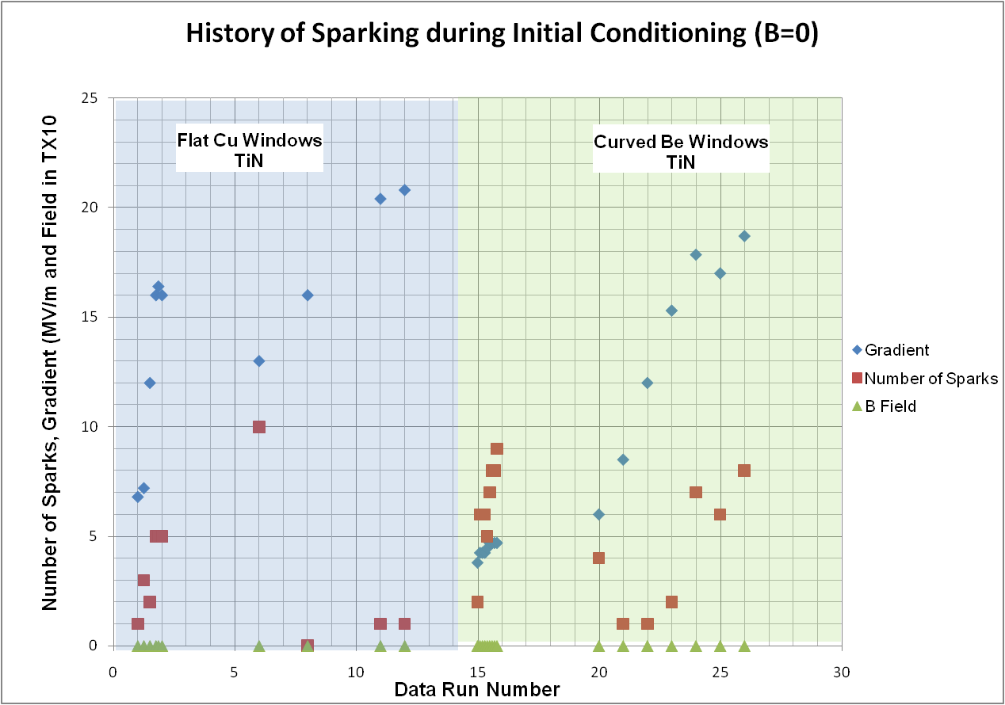
201 MHz Cavity Running
Summary I (B=0)
Limited by RF
Power
Design Gradient

Slide 25
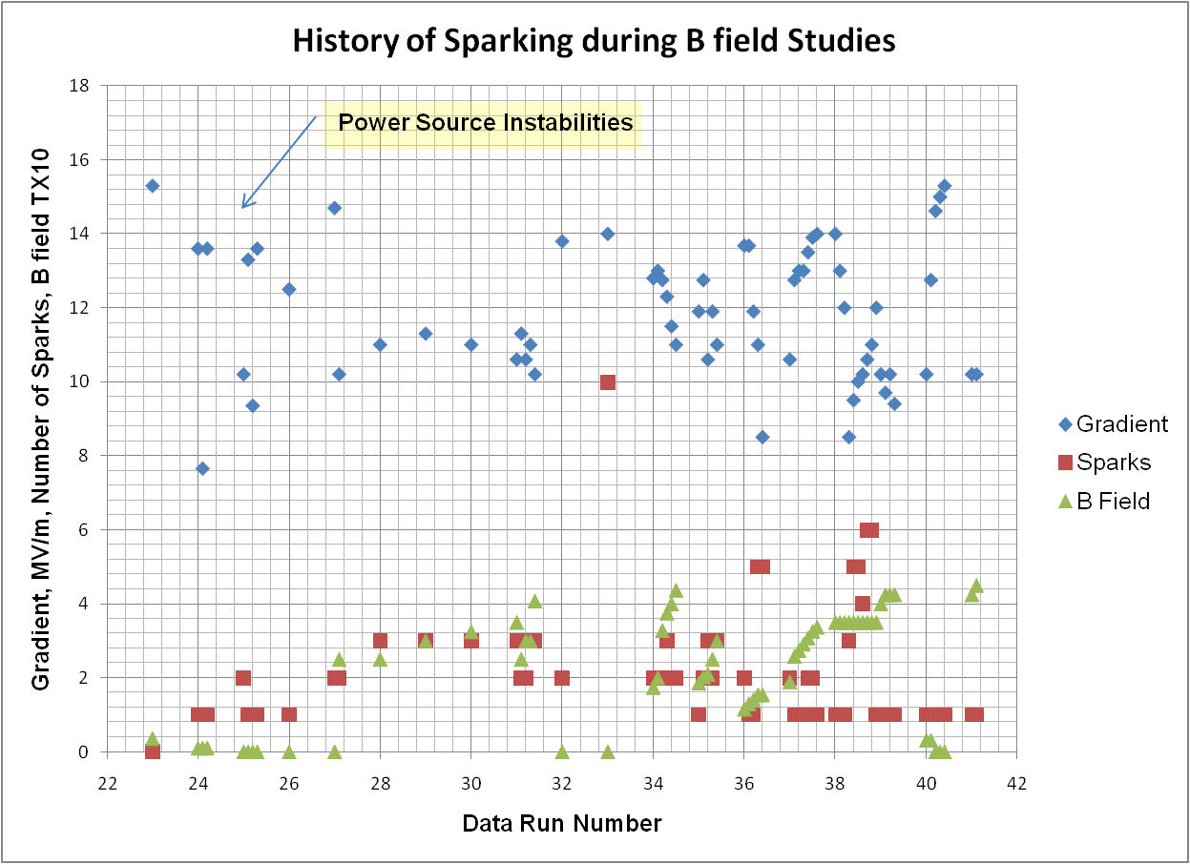
201 MHz Cavity Running
Summary II (B>0)

Slide 26
201 MHz Cavity B Field Tests
Summary
Sparking @ B=0 did condition the 201 cavity
Sparking @ B ≠ 0 causes damage (B relatively low)
Although we “broke” the 201, it did re-condition @ B=0.
But upon inspection of the cavity
  No observed damage
    SCRF processing techniques help

Slide 27
Advanced Processing Concept
Atomic Layer Deposition (ALD)
Field enhancements in RF cavities root cause of surface breakdown
  Due to high local electric fields that exist at surface asperities (field enhancements)
  Cover asperities with a conformal coatings applied with Atomic Layer Deposition (ALD)
  Has been applied to SCFR
1 example of
ALD processing of
1.3GHz SCRF cell

Slide 28
NCRF R&D Program
Potential paths towards a solution: Phase I: Technology Assessment (continuation of existing program) Multi-pronged approach:
  Surface Processing
    Reduce (eliminate?) surface field enhancements, dark current
      SCRF processing techniques
        Electro-polishing (smooth by removing) + HP H₂O rinse
      More advanced techniques (Atomic-Layer-Deposition (ALD))
        Smooth by adding to surface (conformal coating @ molecular level)
  Materials studies: Use base materials that are more robust to the focusing effects of the magnetic field
    Cavity bodies made from Be or possibly Mo
  Magnetic Insulation
  High-Pressure Gas-filled (H₂) cavities
Vacuum

Slide 29
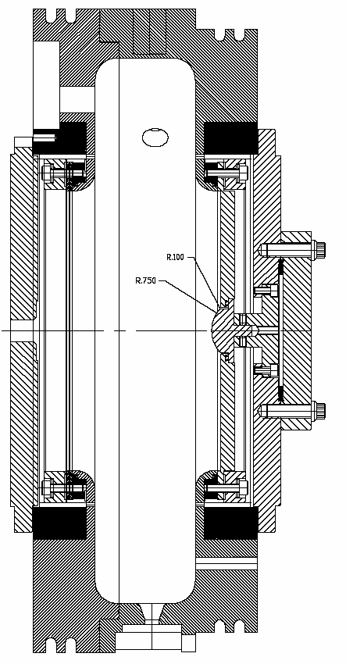
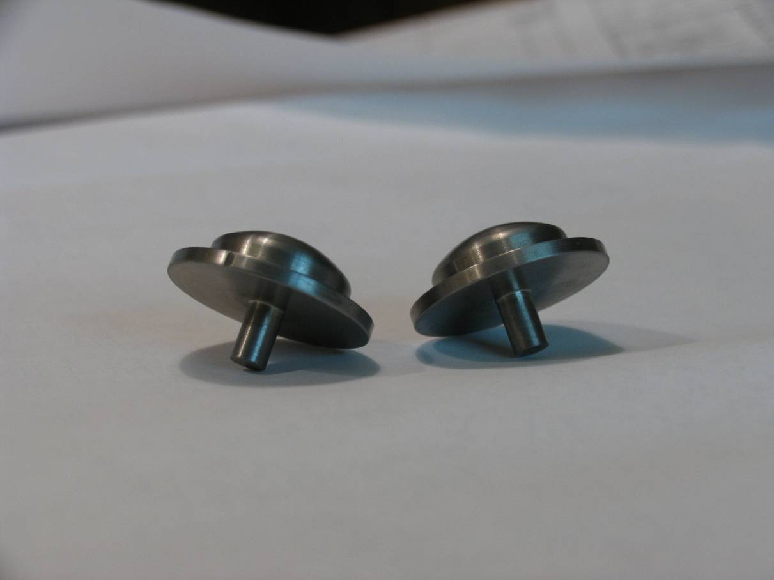
Material Studies
“Button” system in pillbox cavity designed for easy replacement of test materials
  Tested so far: TiN-coated Cu & Mo, bare Mo and W
  Results to date indicate that Mo can improve performance at a given B field by somewhat more than 50%
  16.5MV/m → 26MV/m
(1.7x field enhancement factor on button surface)
Molybdenum buttons

Slide 30
Button RF Cell Data
Summary

Slide 31
NCRF R&D Program
Potential paths towards a solution: Phase I: Technology Assessment (continuation of existing program) Multi-pronged approach:
  Materials studies: Use base materials that are more robust to the focusing effects of the magnetic field
    Cavity bodies made from Be or possibly Mo
  Surface Processing
    Reduce (eliminate?) surface field enhancements, dark current
      SCRF processing techniques
        Electro-polishing (smooth by removing) + HP H₂O rinse
      More advanced techniques (Atomic-Layer-Deposition (ALD))
        Smooth by adding to surface (conformal coating @ molecular level)
  Magnetic Insulation
  High-Pressure Gas-filled (H₂) cavities
Vacuum

Slide 32
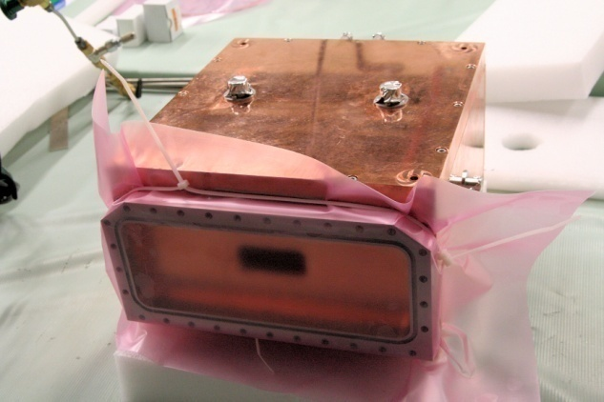
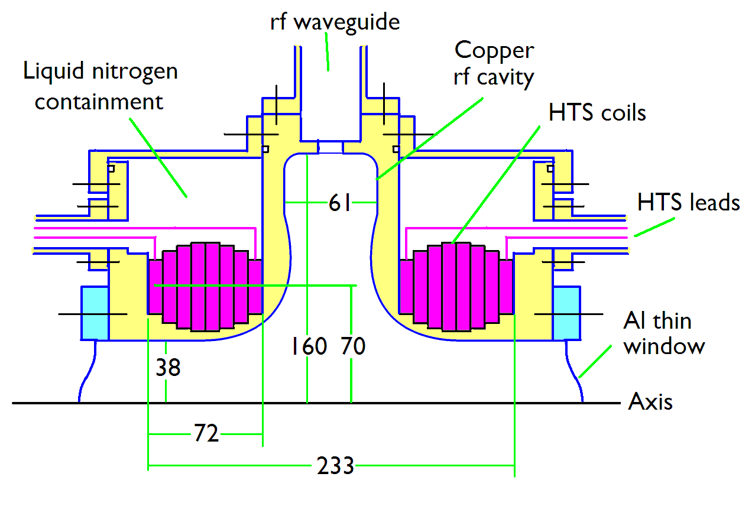
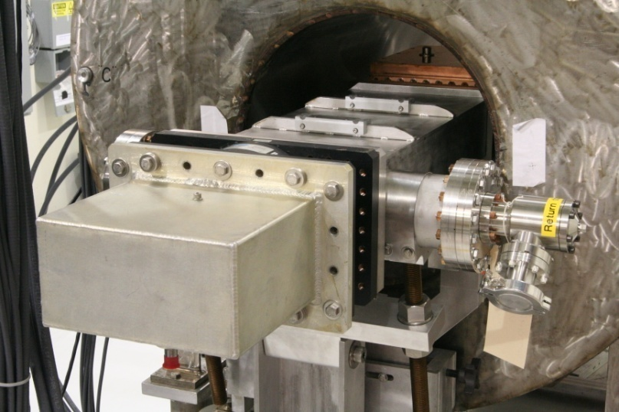
Magnetic Insulation
Conceptual Design
Although lattices that employ magnetic insulation have drawbacks with respect to the required RF power, we are studying the concept using a newly completed 805 MHz box cavity

Slide 33
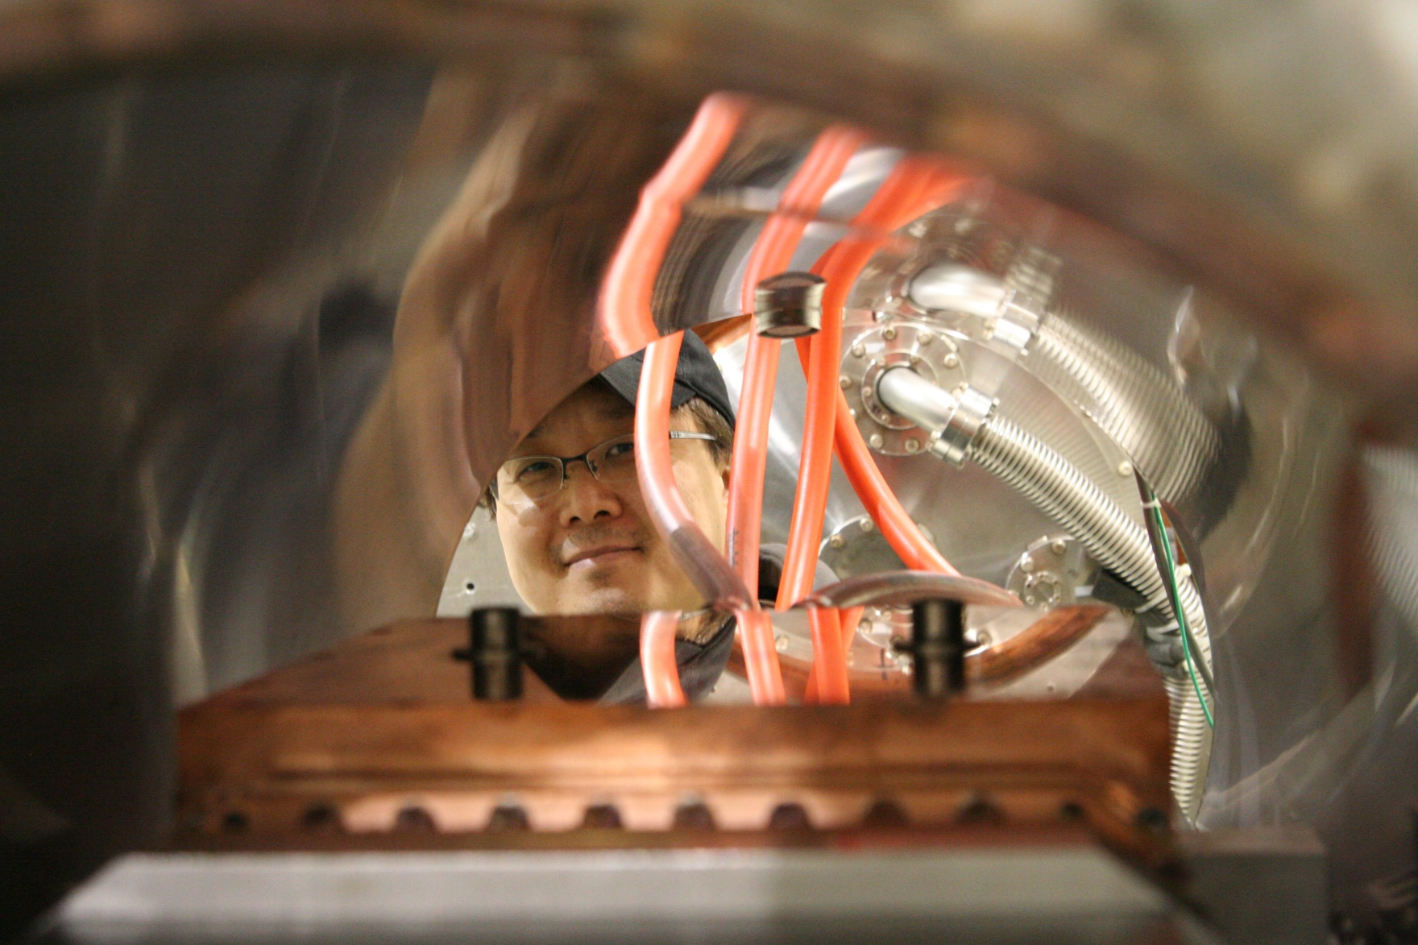

Slide 34
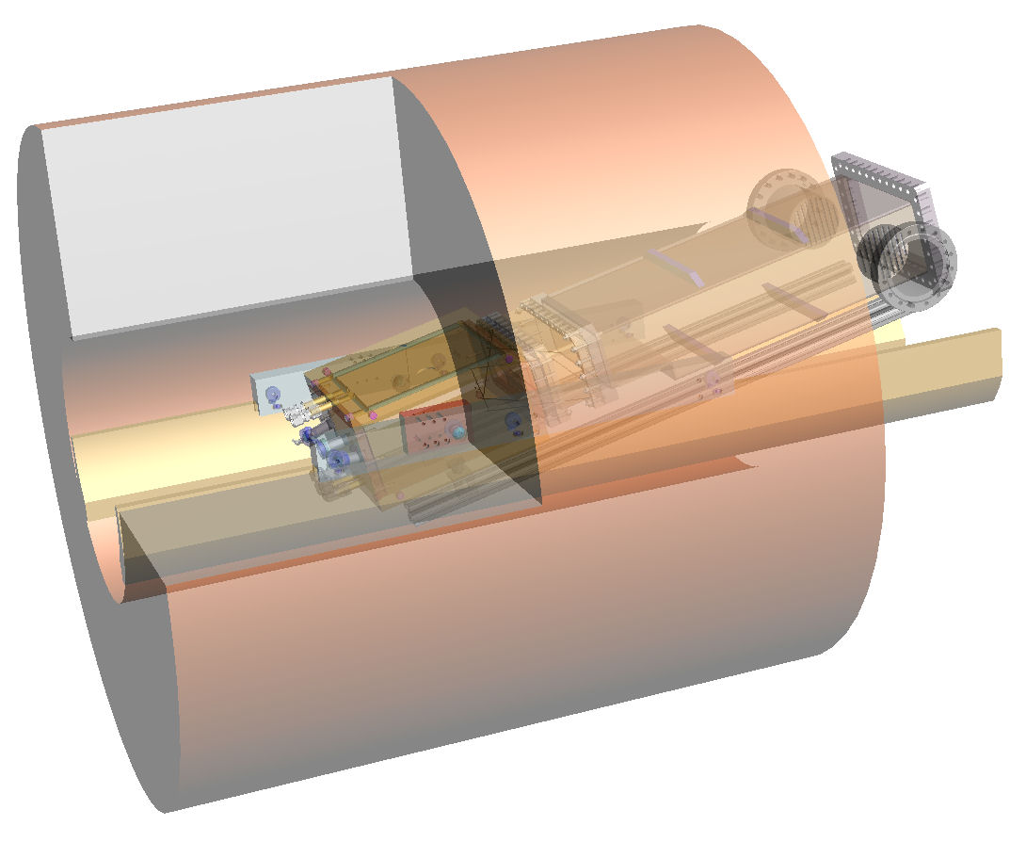
Box Cavity in Solenoid
Max angle w/r to horizontal ≈ 12⁰
  E at 78º w/r to B
Max Gradient (B=0)
  40MV/m

Slide 35
NCRF R&D Program
Potential paths towards a solution: Phase I: Technology Assessment (continuation of existing program) Multi-pronged approach:
  Materials studies: Use base materials that are more robust to the focusing effects of the magnetic field
    Cavity bodies made from Be or possibly Mo
  Surface Processing
    Reduce (eliminate?) surface field enhancements, dark current
      SCRF processing techniques
        Electro-polishing (smooth by removing) + HP H₂O rinse
      More advanced techniques (Atomic-Layer-Deposition (ALD))
        Smooth by adding to surface (conformal coating @ molecular level)
  Magnetic Insulation
  High-Pressure Gas-filled (H₂) cavities
Vacuum

Slide 36
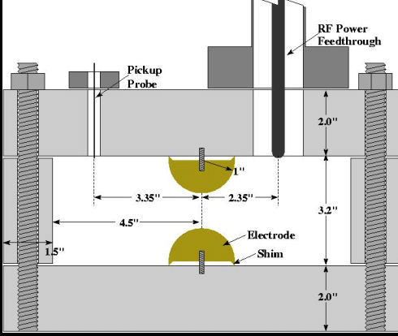
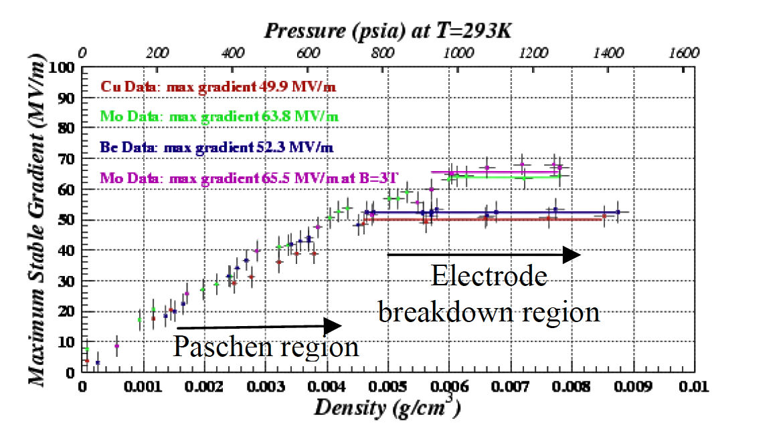
High Pressure H₂ Filled Cavity Work with Muons Inc.
High Pressure Test Cell
Study breakdown properties of materials in H₂ gas
Operation in B field
  No degradation in M.S.O.G. up to ≈ 3.5T
Next Test – Repeat with beam
No Difference
B=0 & B=3T
Well beyond gradient requirement for HCC

Slide 37
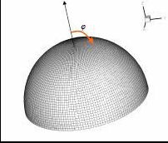
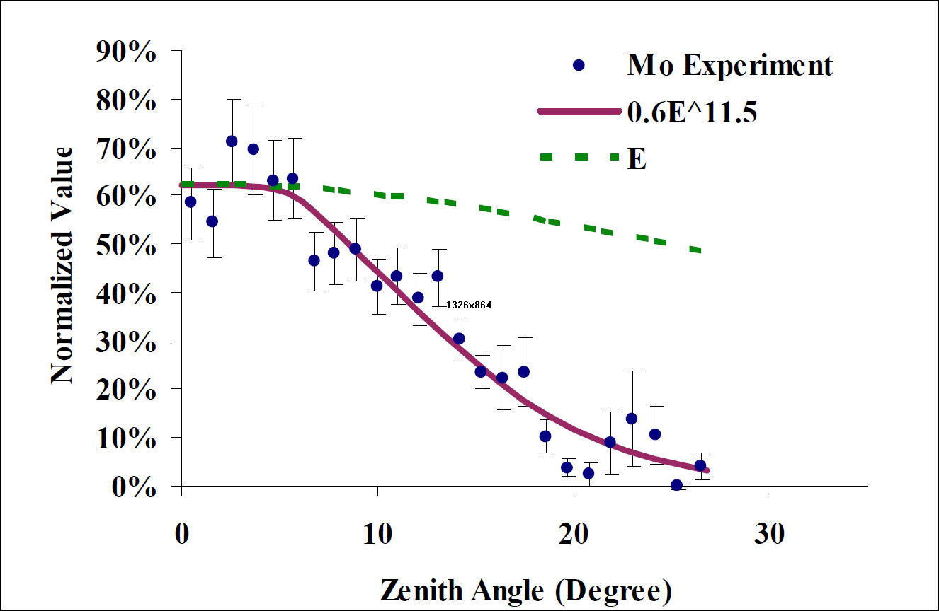
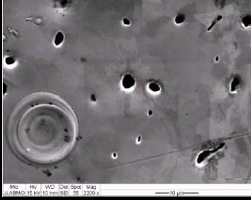
High Pressure H₂ Filled Cavity Results
In Surface Breakdown Regime
Pit distribution fit to E_{max} (ANSYS)
≈ Fowler-Nordheim

Slide 38
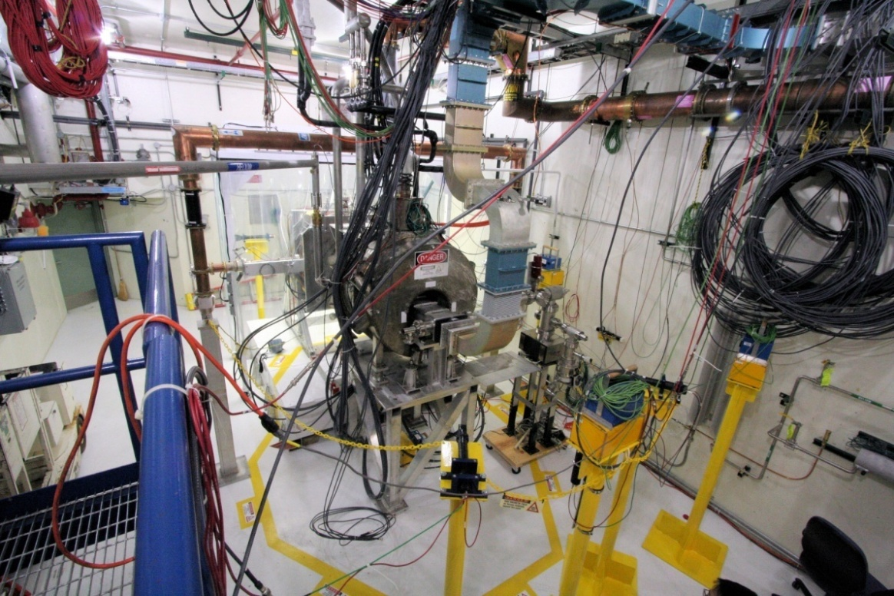
RF Test Facility
MuCool Test Area (MTA)
  RF power
    201 MHz (5MW)
    805 MHz (12 MW)
  Class 100 clean room
  4T SC solenoid
    250W LHe cryo-plant
  Instrumentation
    Ion counters, scintillation counters, optical signal, spectrophotometer
  400 MeV p beam line

Slide 39
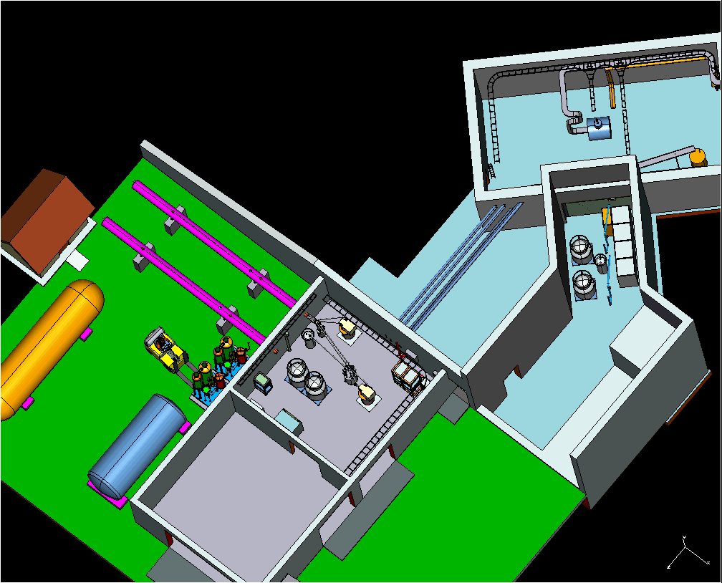
MTA Layout

Slide 40
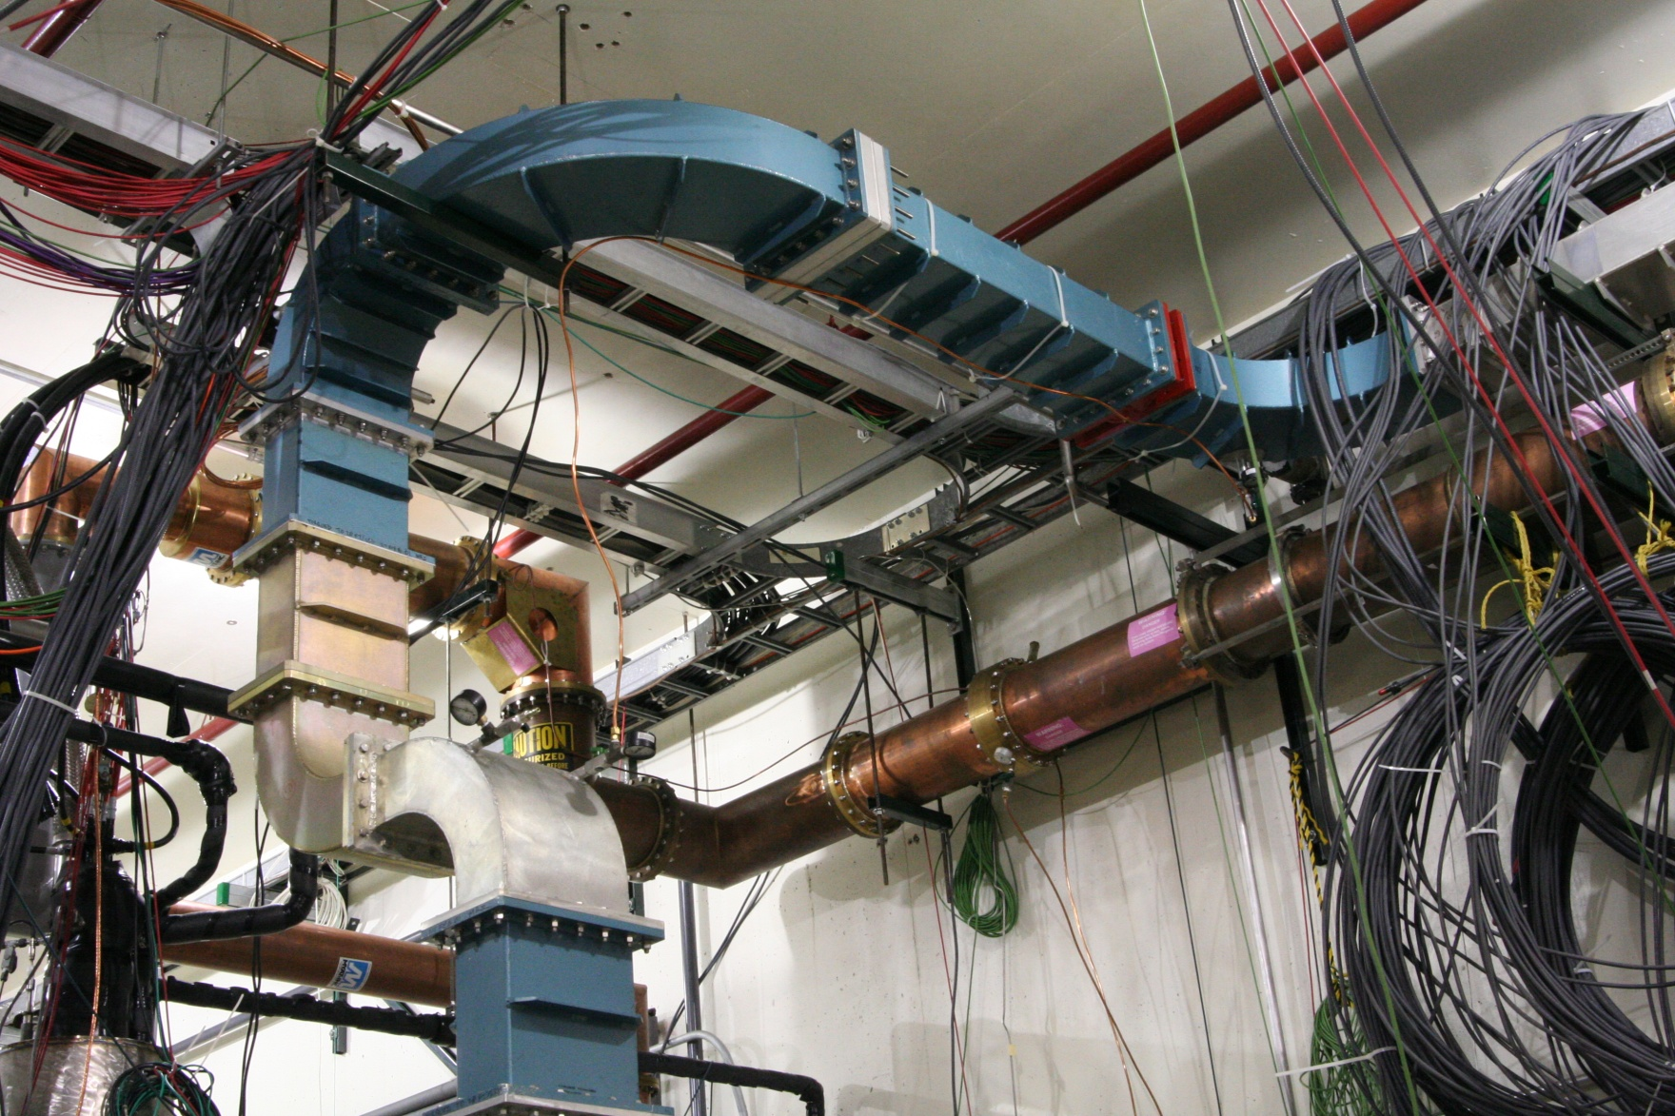
MTA RF

Slide 41
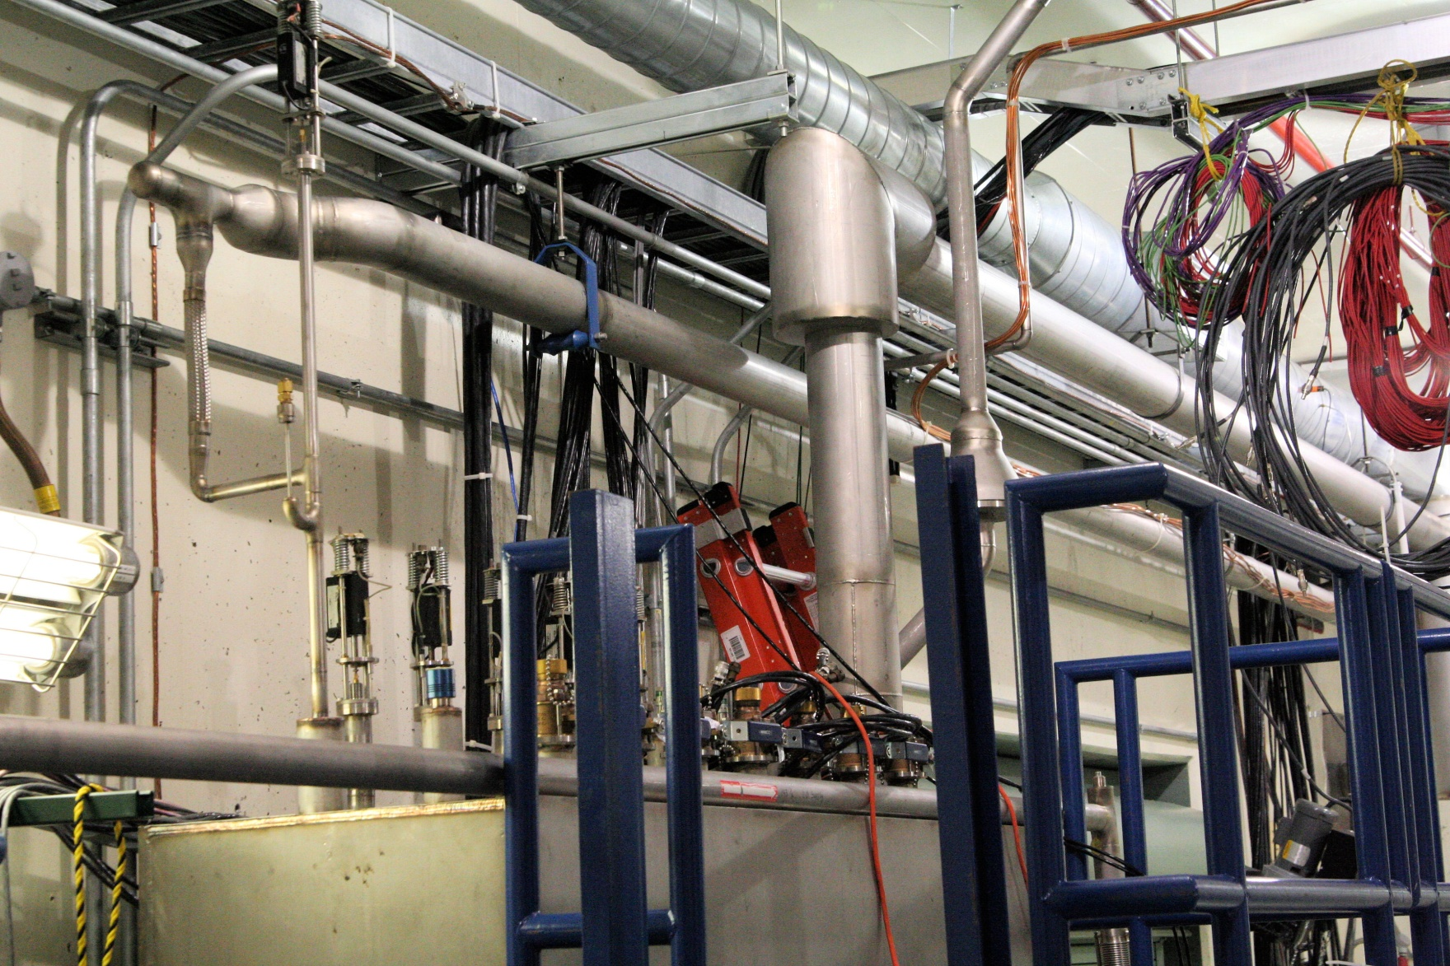
MTA Cryo
Valve Box & Transfer Line

Slide 42
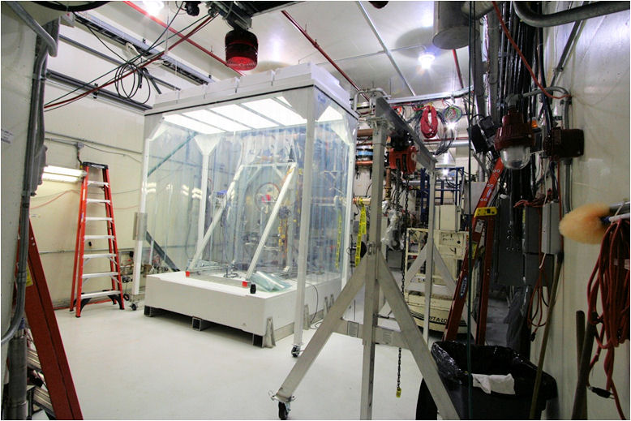
MTA Hall – Clean Room

Slide 43
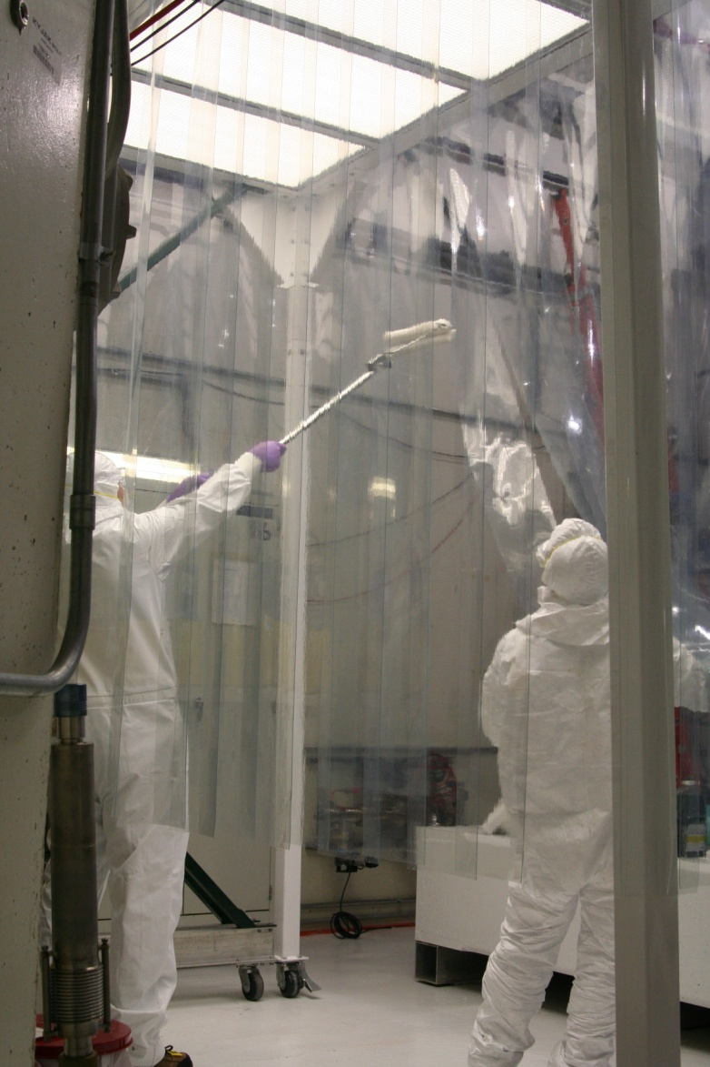
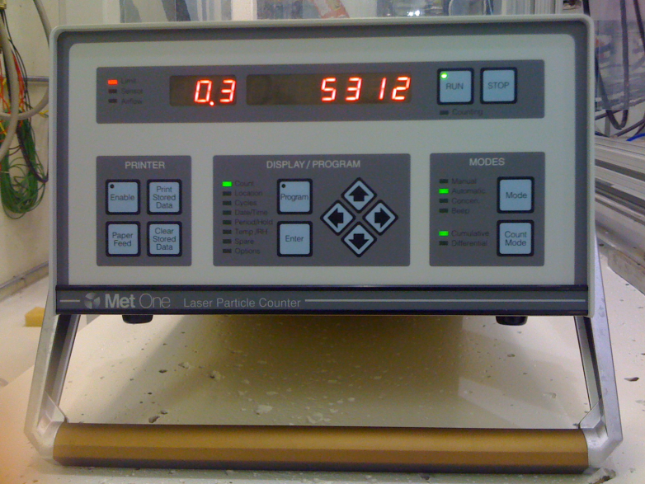
MTA Hall – Clean Room II
Goal for Clean room : Class 100
  Achieved better than Class 10
    Even with 3 people inside: Class 40
Goal for Hall: Class 1000
  Achieved Class 500

Slide 44
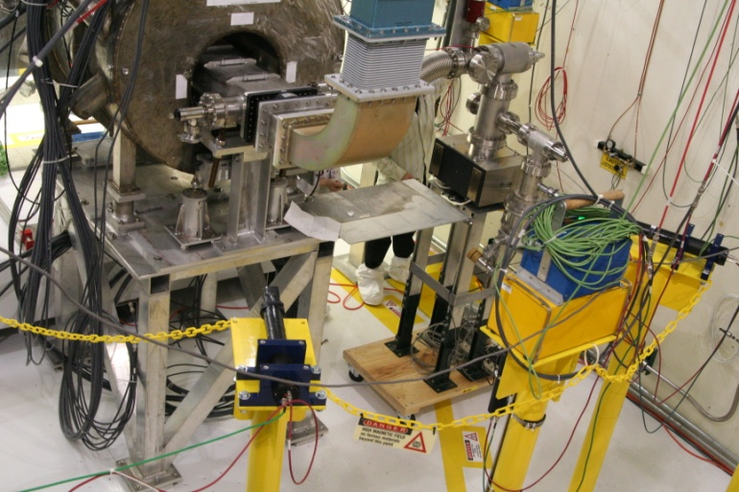
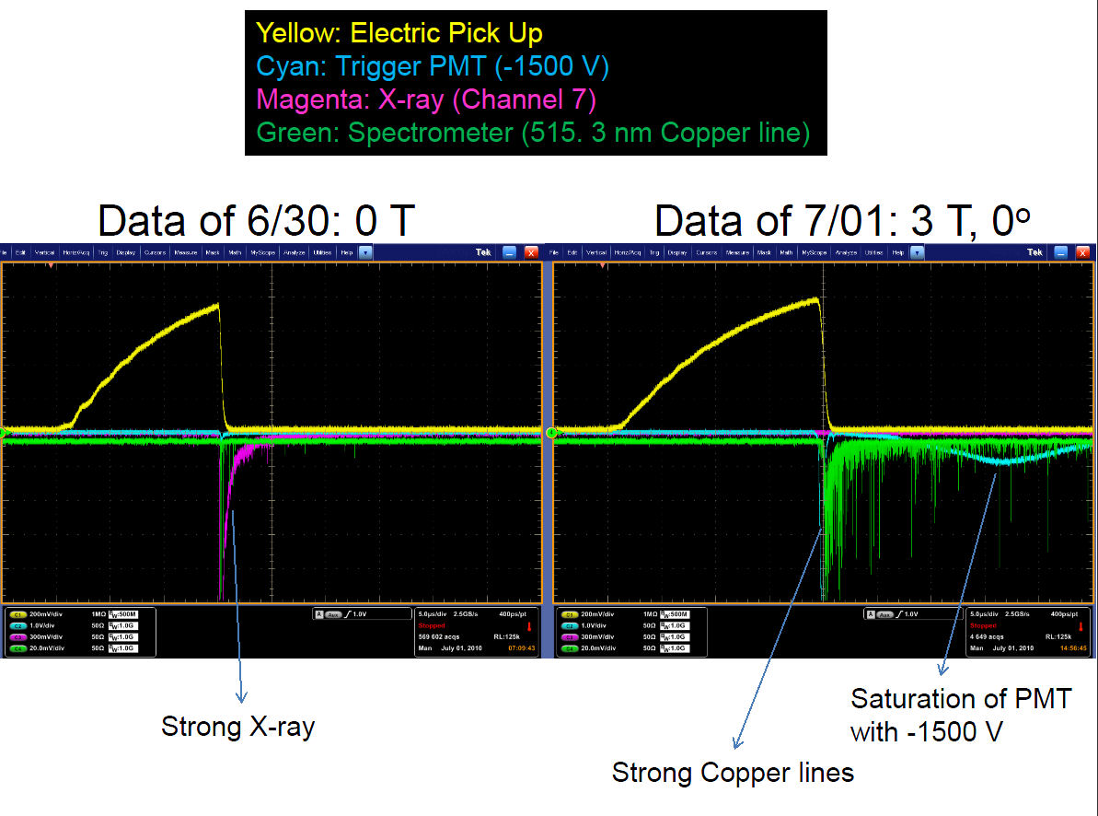
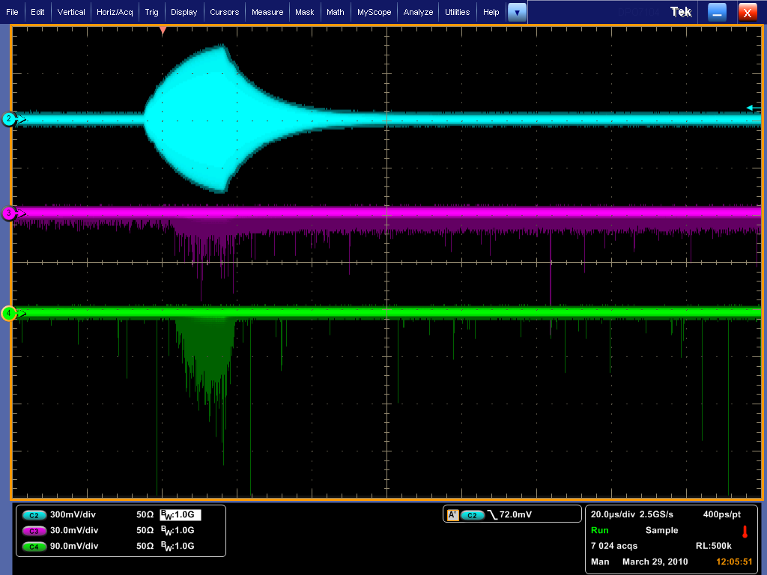
MTA Instrumentation
Counters
Optical Diagnostics
RF Pickup
X-ray
Optical
DAQ

Slide 45
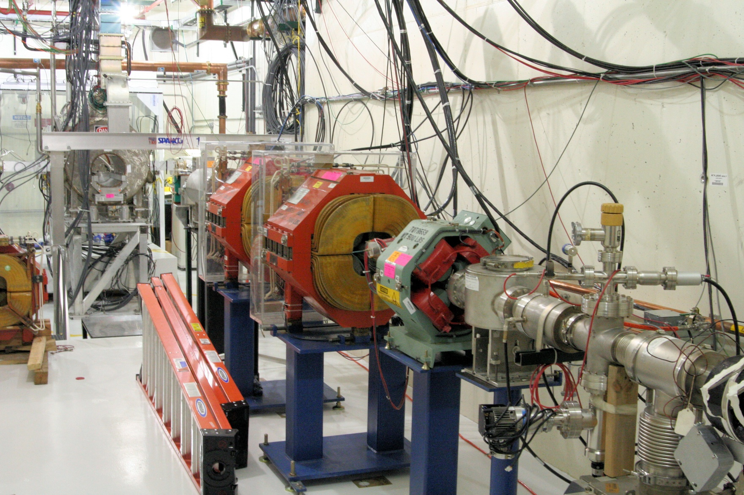
Current MTA Beam Line

Slide 46
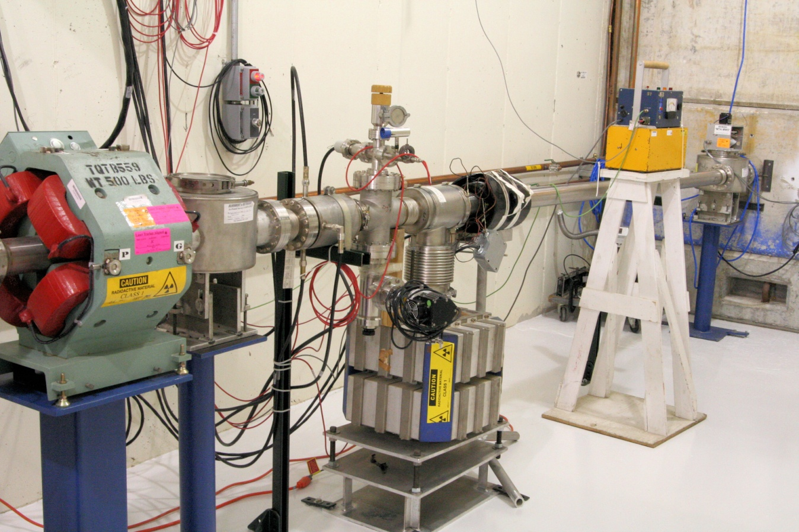
MTA Beam Line Status
Beam Line Installation
  Complete
Beam Line commissioning to first beam stop.
  Complete
First pass @ Radiation assessment review
  Complete
First beam experiments by the end of the year
The MTA is a World-Class Facility (& Unique):
High-Power RF; High-Intensity Beam; H₂ handling, SC Magnet

Slide 47
Phase I RF Program (2 year)
D. Li, Next Talk
Complete tests on Magnetic Insulation
  Second box test series with E ⊥ B
  Box with orientation E || B
Be materials tests
  Button cavity test
  Be wall cavity
ALD coated button test
  And with purpose RF cavity
Beam tests of high pressure H₂ filled cavity
201 MHz tests in higher B field
  Need new SC magnet - FY2012

Slide 48
RF Strategy
Down Selecting
Down selection of RF cavities will be based on the outcome of the experimental studies. The successful cavity technology must work at an acceptable RF gradient (requirements are, of course, dependent on the position along the channel, i.e., phase rotation, bunching, initial cooling, final cooling, etc.) in a multi-tesla magnetic field. Engineering, fabrication, integration, and cost of the cavity and RF power must also be considered

Slide 49
Summary
We have a comprehensive program aimed at developing a solution to the “RF Challenge”
The experimental program is robust and scope-appropriate, is coupled with mature simulation efforts and is backed by a good understanding of the physics of breakdown/arcs in RF structures
This multi-pronged approach gives us confidence that we can meet this challenge and minimize the risk to a future Muon Collider

Slide 50
  END

Slide 51
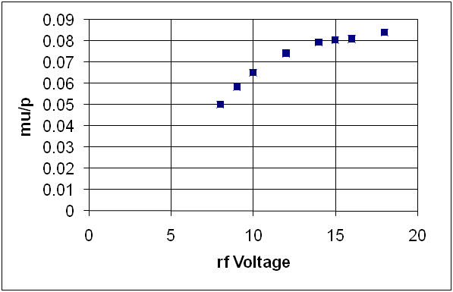
But it is not a Cliff
μ/p after initial (4D cooling)

