Slide 1
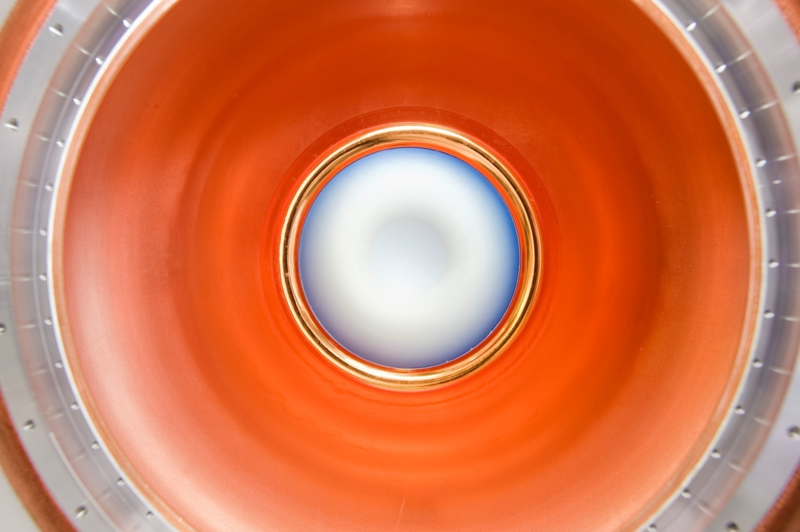
Technology Development
Overview and Resources

Slide 2
Outline
  Organization
  Goals
  Program Overview
    Where we are & where we are headed
  Milestones
  Planning and Resources

Slide 3
Technology Development
L2 Organization
Normal Conducting RF
  Derun Li, LBNL, RF scientist for the MuCool program
Superconducting RF
  Don Hartill, Professor Cornell University
Magnets
  Mike Lamm, Department Head Fermilab (TD) Magnet Systems
Targets and Absorbers
  Kirk McDonald, Princeton University & co-spokesperson of the MERIT experiment
MuCool Test Area Coordinator
  Yagmur Torun, Professor Illinois Institute of Technology & deputy MuCool spokesperson

Slide 4
Primary Goals
Establish the viability of the concepts and components that will be used in the design reports
  Neutrino Factory Reference Design Report (NF-RDR)
  Muon Collider Design Feasibility Study Report (MC-DFSR)
Establish the engineering performance parameters to be assumed in the design studies
Provide a good basis for cost estimates.

Slide 5
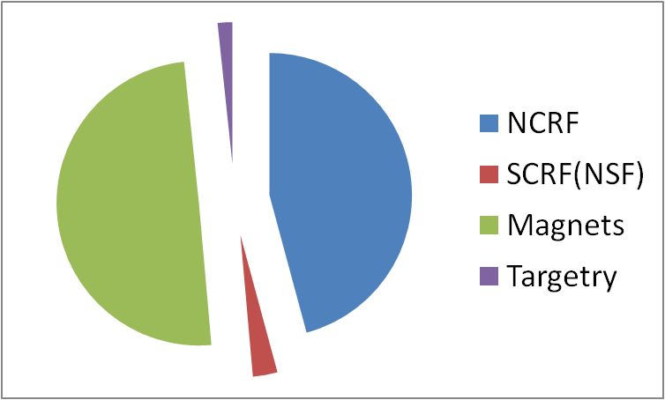
TechDev – Total Effort Snapshot
M&S + Manpower
TOTAL = $35M + $1M

Slide 6
Normal Conducting RF
R&D Issues and Present Status
Muon bunching, phase rotation and cooling requires Normal Conducting RF (NCRF) that can operate at high gradient within an approximately 3 to 6T magnetic field
  Required gradient easily obtainable in absence of magnetic field
But

Slide 7
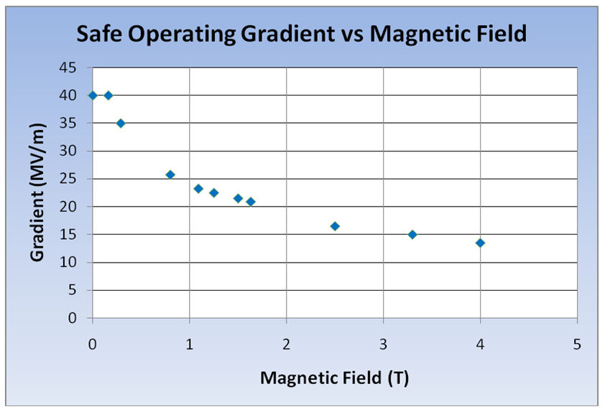
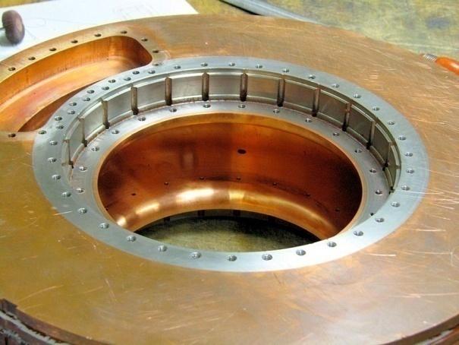
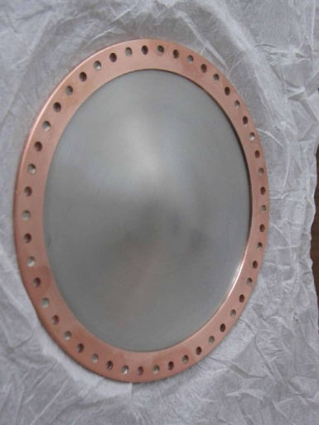
The RF Challenge
Significant degradation in maximum stable operating gradient with applied B field
805 MHz RF Pillbox data
  Curved Be windows
  E parallel B
  Electron current/arcs focused by B
Degradation also observed with 201 MHz cavity
  Qualitatively, quite different
Details will be presented in RF parallel

Slide 8
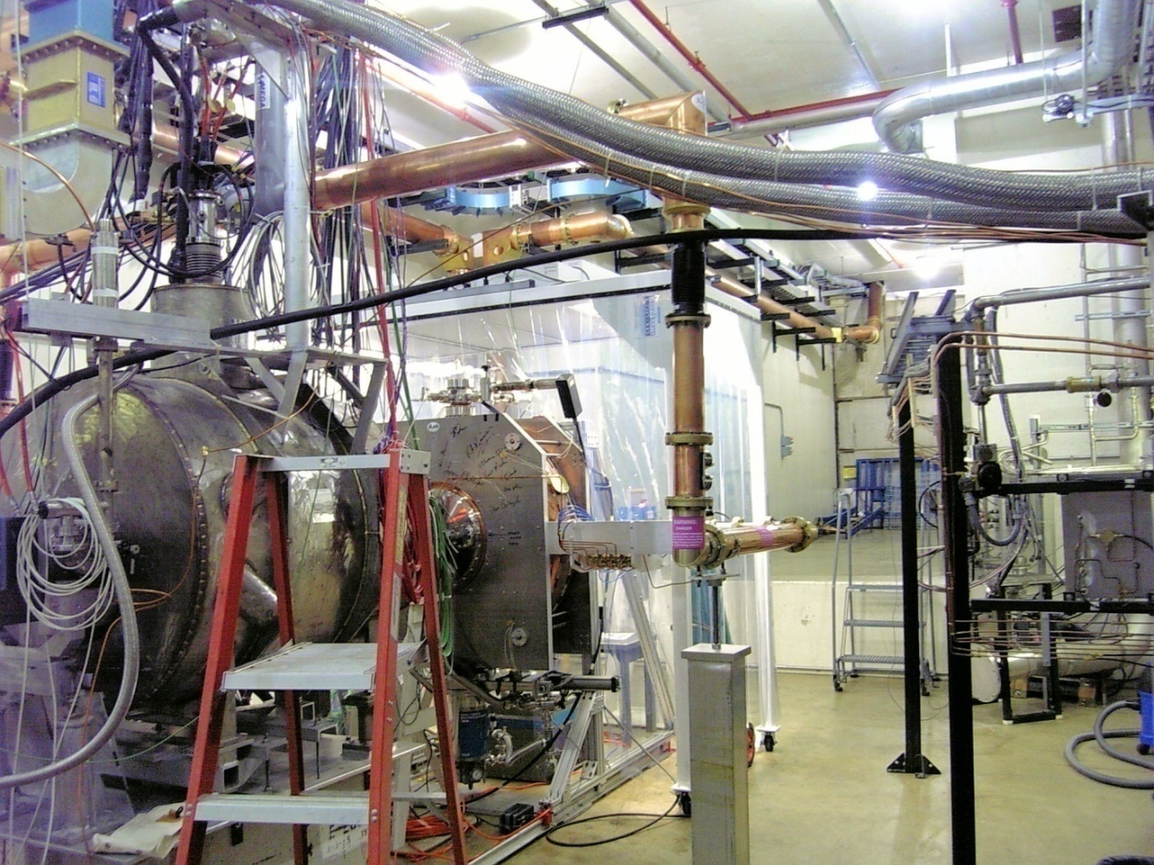
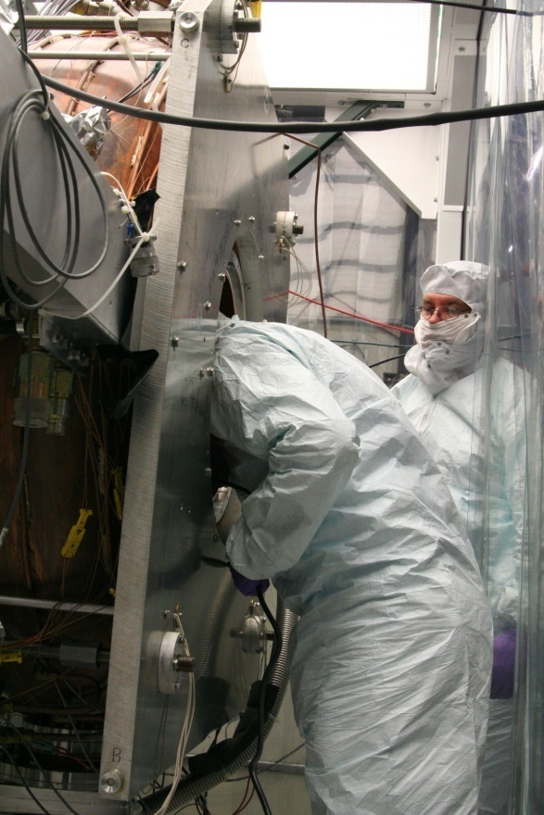
201 MHz Cavity Test
Treating NCRF cavities with SCRF processes
The 201 MHz Cavity –Achieved 21MV/m
  Design – 16MV/m
  At 0.75T reached 10-12 MV/m
However, No observed damage!

Slide 9
NCRF R&D Program
Potential paths towards a solution: Phase I: Technology Assessment (continuation of existing multi-pronged approach)
  Materials studies: Use base materials that are more robust to the focusing effects of the magnetic field
    Cavity bodies made from Be or possibly Mo
  Surface Processing
    Reduce (eliminate?) surface field enhancements, field emission
      SCRF processing techniques
        Electro-polishing (smooth by removing) + HP H₂O rinse
      More advanced techniques (Atomic-Layer-Deposition (ALD))
        Smooth by adding to surface (conformal coating @ molecular level)
  High-Pressure Gas-filled (H₂) cavities show promise
    Paschen’s Law (V_{bd} ∝ p) → p inhibits breakdown
    Operation with beam critical next test
  Magnetic Insulation
    Eliminate focusing of electrons
Details in RF Strategy Talk
Tomorrow

Slide 10
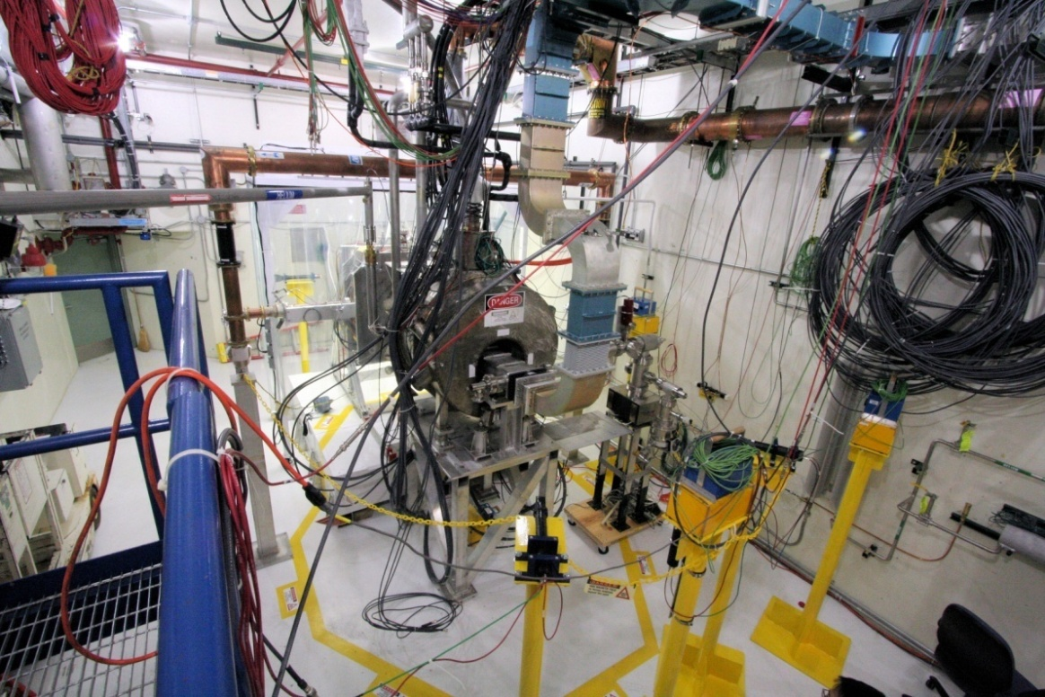
RF Test Facility
MuCool Test Area
  RF Power
    201 MHz (5MW)
    805 MHz (12 MW)
  Class 100 clean room
  Instrumentation
    Ion counters, scintillation counters, optical signal, spectrophotometer
  4T SC Solenoid
    250W LHe cryo-plant
  400 MeV p beam line
You all will have an opportunity to
tour the MTA tomorrow

Slide 11
Phase I RF Program (2 year)
Complete first round of tests on Magnetic Insulation
  Second round with identical cavity, but with orientation E || B
Materials tests: Be
  Button cavity test
  Be wall cavity
ALD coated button test
  In addition with recently awarded DOE supplemental funds, we believe we may be able to do an ALD test on a full cavity in Phase I
Beam tests of high pressure H₂ filled cavity
201 MHz tests in higher B field
  Need new SC magnet - FY2012

Slide 12
RF Down Selecting
Down selection of RF cavities will be based on the outcome of these experimental studies. The cavity must work at an acceptable RF gradient (requirements are, of course, dependent on the position along the channel, ie, phase rotation, bunching, initial cooling, final cooling, etc.) in a multi-tesla magnetic field. Engineering, fabrication, integration and cost of the cavity and RF power must also be considered

Slide 13
Phase II RF Program
Design, build and bench test a short cooling channel section to demonstrate cavity performance in a realistic magnetic channel, and ensure that all of the engineering and safety details that affect cavity operation are well understood.
There is, of course, uncertainty regarding what will be done in this phase
  Guggenheim
  Helical Cooling Channel
  Helical FOFO Snake
And impacts magnet program

Slide 14
Magnet R&D - Overview
Neutrino Factory and Muon Collider accelerator complexes require magnets with quite challenging parameters
  Target Capture Solenoid
    What is the most effective scheme to protect the target solenoid from the radiation environment near to the target?
  HTS solenoid R&D to assess the parameters that are likely to be achieved
    What is the highest practical achievable solenoid field & what is the R&D required before these solenoids can be built?
  HCC magnet R&D to assess the feasibility of this type of cooling channel and
    Eventually build a demonstration magnet for a HCC test section (dependent on success of HP RF tests)
  Magnet design R&D for collider ring and IR magnets that have to deal with the expected high level of energy deposition from μ decay electrons
    What is the optimal design for the collider ring magnets that will enable them to operate in the presence of the decay electrons? Paper studies only (with D&S group)
  Fast Ramping Magnets utilized in rapid-cycling synchrotron for final acceleration for the MC
Collider Ring/Acceleration
Cooling
Targetry

Slide 15
Magnet R&D – Overview II
HTS Solenoid
  Develop functional specifications for the high field solenoid
  Evaluate/compile a data base on state-of-the-art of conductors
    Propose R&D to fill in gaps from existing data from Industry, DOE lab core programs and the VHFSMC through additional conductor tests
      Note: The VHFSMC is working with industry to develop conductor
  Build HTS and hybrid inserts to prove technology.
  Perform conceptual designs for highest field practical magnet
  Present plan for building magnets in years 1-3 post plan
HCC
  Continue work on HCC magnet development (first 2 years)

Slide 16
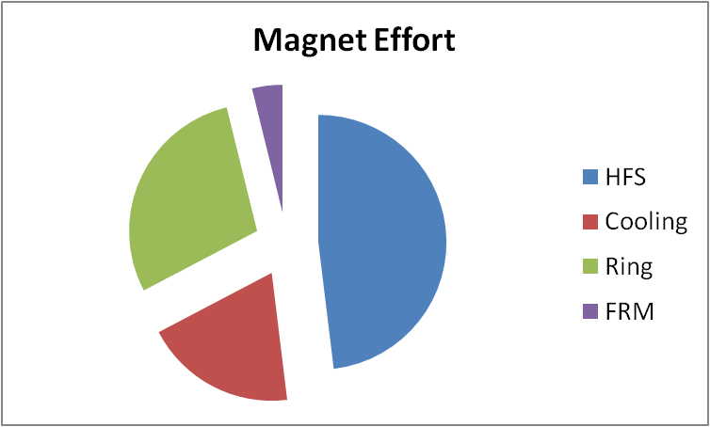
Magnet R&D – Overview III
Collider Ring Magnets
  Produce effective conceptual designs for
    IR quads & dipoles
    Collider ring dipoles and quads
Fast Ramping Magnets (400 Hz)
  Build two 6mm gap prototype dipoles
    First - 30 cm long
    Second – 6.3 m long
$17M

Slide 17
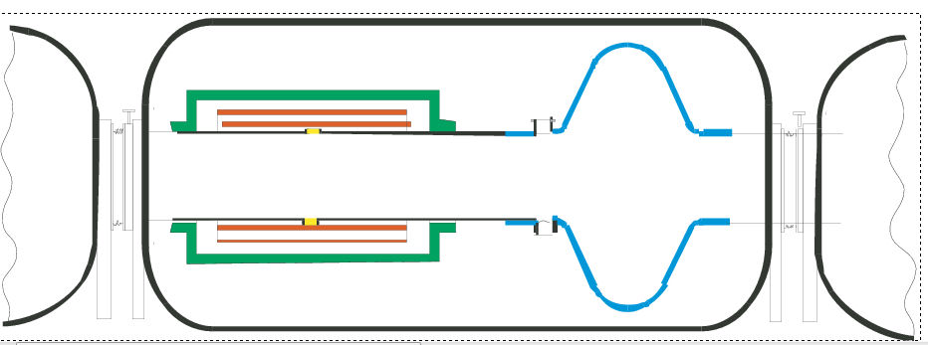
Superconducting RF R&D
Develop high accelerating gradient superconducting RF cavities to provide rapid acceleration of low energy muons
Develop a single cell superconducting cavity operating at 200 MHz with an accelerating gradient of at least 15 MV/m
SCRF R&D is supported through NSF

Slide 18
Targetry
Within Technology Development, targetry R&D is limited to
  Support for completion of analysis of MERIT data
  Some M&S for target hardware development

Slide 19
TechDev Milestones
FY10 Complete engineering design for Be-wall rf cavity TD10.1 DR, MR
Complete initial HPRF cavity beam test TD10.2 DR, MR
Test magnetically insulated “box” cavity TD10.3 DR, MR
FY11 Fabricate Be-wall rf cavity TD11.1 DR
FY12 Test new HPRF cavity TD12.1 DR
Complete Be-wall rf cavity tests TD12.2 FR
Test 201-MHz cavity with coupling coil in MTA TD12.3 DR
FY13 Fabricate small HTS test magnet TD13.1 DR
Begin conceptual design of collider magnet TD13.2 DR
FY14 Prepare rf test cavity with ALD coating TD14.1 DR
Begin conceptual design of >30-T solenoid TD14.2 DR
Complete component designs for 6D cooling bench test TD14.3 FR
FY15 Fabricate components for 6D cooling bench test TD15.1 MR
FY16 Complete components for 6D cooling bench test TD16.1 DR
Assemble components for 6D cooling bench test TD16.2 MR
Complete conceptual design of >30-T solenoid TD16.3 DR,ER
Finish technology section of Final MC DFS report TD16.4 FR
RF Down Select

Slide 20
Goals at End of 7th Year
Spec Concept D Engin. D Proto
High field HTS solenoid X X X
HCC magnets X X {X X}¹
Fast-ramping magnets X X X X
Collider ring magnets X X
Target design X X X
¹ If the HCC option is chosen

Slide 21
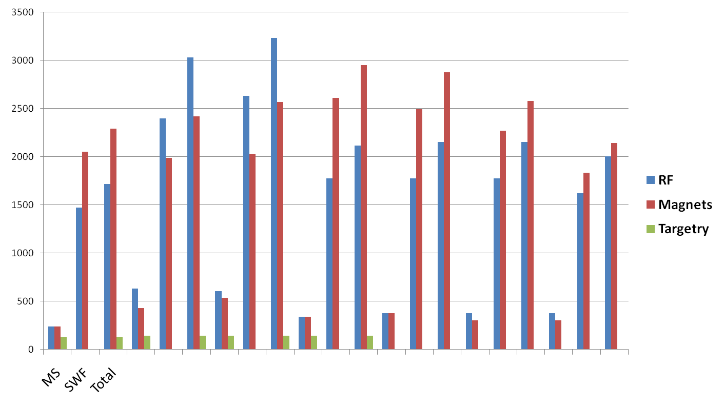
TechDev - Resources
Y3
FY10
Y2
Y4
Y5
Y1
Y6
Y7
K$

Slide 22
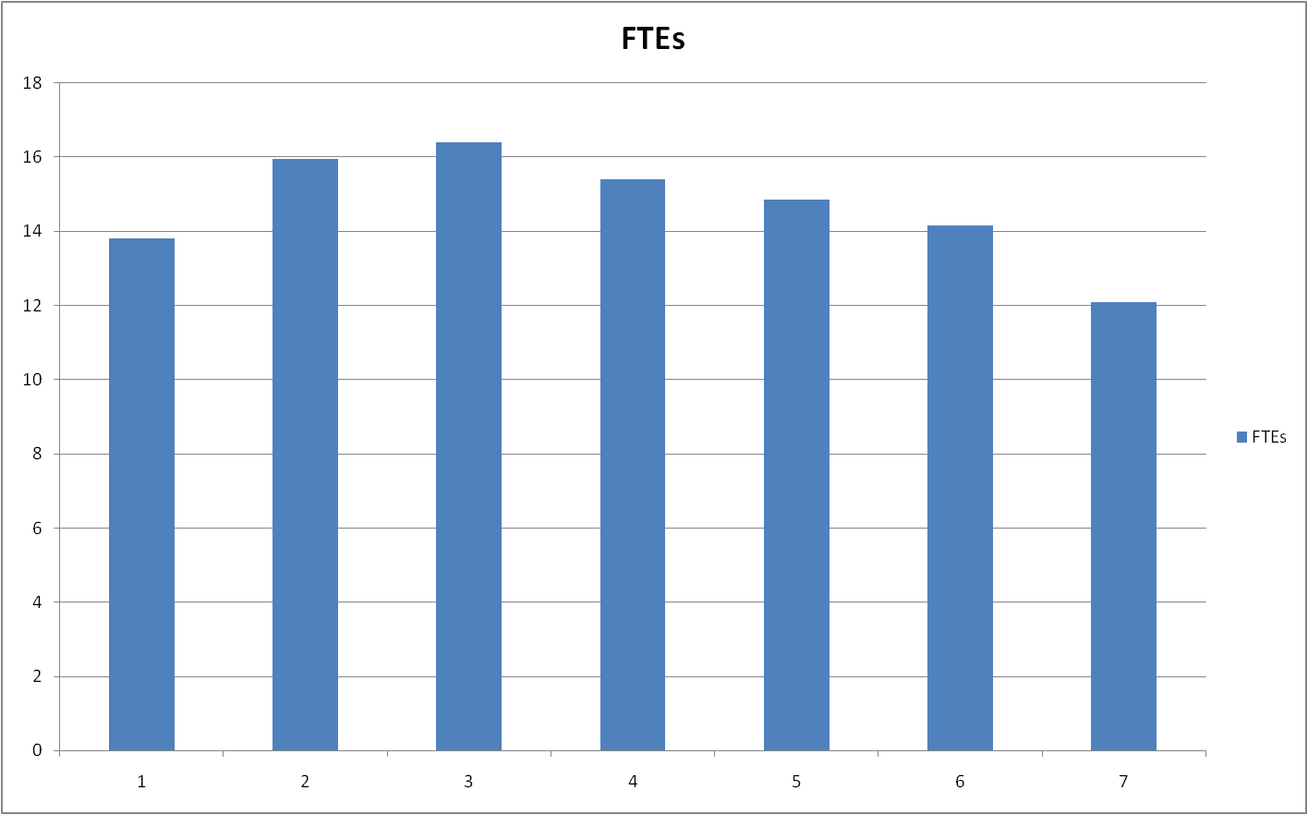
TechDev - Manpower
FY10
Year

Slide 23
TechDev - Manpower

Slide 24
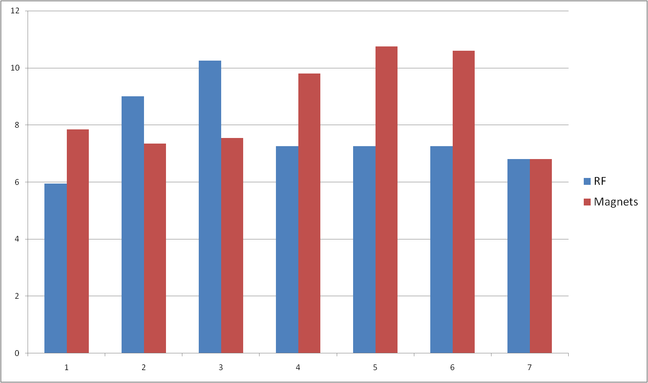
TechDev – Manpower II
FTEs
FY10
Year

Slide 25
Summary
The MAP effort in Technology Development (& Assessment) focuses on cooling (as it should)
  Important for the Neutrino Factory performance optimization
  Crucial for a multi-TeV, high-L MC
The RF program is taking a multi-pronged attack on the technology
  The MTA is now a smoothly running facility that is unique in the world
    Multi-frequency RF
    SC magnet(s) & cryogenics infrastructure
    Extensive RF diagnostic instrumentation
    Clean room for RF cavity work
    H₂ handling infrastructure
    p beam line

Slide 26
Summary II
Ongoing RF Program
Technology Assessment
  Magnetic Insulation
  Materials studies
    SCRF processing
    ALD
    Cavity materials (Be)
  High-pressure H₂ filled RF exposed to p beam
  Continuing 201 MHz program
    Future studies @ higher B field

Slide 27
Summary III
Magnet program primarily addresses cooling issues
  Final cooling via very-high-field HTS solenoids
  HCC solenoids as potential option
But also addresses the other critical magnet issues for the MC complex
  Ring magnets
    Open-plane dipoles, quads, etc
  Acceleration
    Fast-ramping magnets

Slide 28
Summary IV
Much of this program pushes the state-of-the-art and might better be characterized as technology invention rather than development
With this there is, of course, risk. However, at this early stage of this endeavor, our approach is needed in order to minimize the technical risk of a future Muon Collider

Slide 29
  END

