Slide 1
Fermilab WAN Performance Analysis Methodology
Wenji Wu, Phil DeMar
Summer 2010 ESCC/Internet2 Joint Techs
Columbus, Ohio
Notes:
My topic is “Fermilab WAN Performance Analysis Methodology”,

Slide 2
Factors Affecting Network Performance
On the host system:
  Application software
  Operating system
  Hardware
In the network path:
  Local network infrastructures
  Wide area network domains (potentially many…)
Its an end-to-end issue
Notes:
Usually, when the performance problems arise, system administrator or network operators point fingers to each other.
Actually, they might be both right.
Many factors affecting network performance,
On the host system:
Application software
Operating system
Hardware
In the network path:
Local network infrastructures
Wide area network domains (potentially many…)
Its an end-to-end issue

Slide 3
Find the performance problem area(s)
Notes:
Users often don’t know about:
(1) Common OS tuning issues for WAN data movement
(2) Wide-area network path, its characteristics, available tools

Slide 4
Performance Analysis Methodology
Structured approach to performance analysis
  Even with wizards, ad hoc analysis seems to be the norm
  Seems likeliest path to automated analysis
Model the process like medical diagnosis
  Collect the physical characteristics
  Run diagnostic tests
  Record everything; develop a history of the analysis
Strategic approach:
  Sub-divide problem space:
    Application-related problems
    Host diagnosis and tuning
    Network path analysis
  Then divide and conquer
Notes:
We began the performance analysis methodology in 2006, and now this methodology is used in our normal operation
Our structured analysis methodology seeks to put some of the wizardry into structured process
Divide the overall problem into three sub-problems.
Application-related problems (This is case by case, an application could be developed very inefficiently)
Host diagnosis and tuning
Network path analysis

Slide 5
Tools…
Host diagnosis
  Script that pulls system configuration
  Network Diagnostic Tool (NDT)
    Faulty network connections, malfunctioning NICs, duplex mismatch
Network path diagnosis
  OWAMP to collect and diagnose one-way network path statistics.
    Packet loss, latency, jitter
  Other tools such as ping, traceroute, as needed
Packet trace analysis
  Port mirror on border router(s)
  Tcpdump to collect packet traces
  Tcptrace to analyze packet traces
  Xplot for visual examination.
Notes:
Here are the tools we are using for the performance analysis.
For Host diagnosis
We develop Script that pulls system configuration
We sue Network Diagnostic Tool (NDT) to diagnose Faulty network connections, malfunctioning NICs, duplex mismatch
For Network path diagnosis
OWAMP to collect and diagnose one-way network path statistics.
Packet loss, latency, jitter
Of course, Other tools such as ping, traceroute, as needed
If host diagnosis and network path diagnosis can not solve the problems, we apply the packet packet trace analysis,
We collect packet trace with
Port mirror on border routers
Tcpdump to collect packet traces
Run tcptrace to analyze packet traces
Xplot for visual examination.

Slide 6
Focus on:
Host Diagnosis
Packet Trace Diagnosis
Notes:
Today I will focus on host diagnosis and packet trace diagnosis.

Slide 7
Host information collected

Slide 8
CASE STUDY 1: FNAL -> UERJ
A walk-thru of the methodology to diagnose the network performance between FNAL and UERJ:
UERJ contacts US-CMS Tier-1 about poor performance
UERJ host configurations collected with script
Host configuration settings analyzed
  (see following pages…)

Slide 9
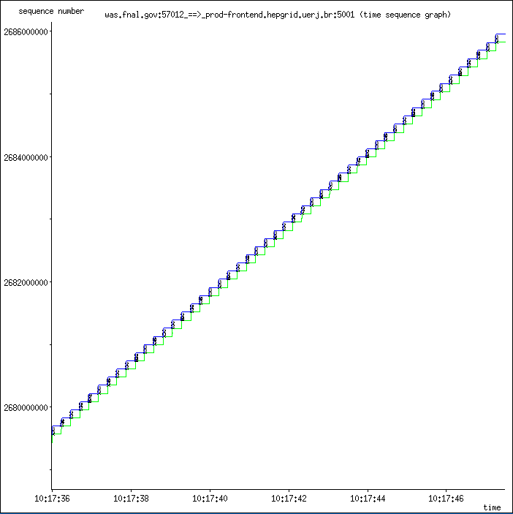
Host Tuning & Diagnosis:
UERJ TCP send buffer & receive buffers too small.
  The maximum send/receive buffer size was 131071 bytes
  RTT is 250ms
Sequence number
Receive window
Acks
Maximum throughput per stream that could be achieved would be 4.2 Mbps (131071*8/0.25) !
Segment sent
Time sequence diagram
with small buffer size (cubic)
Time

Slide 10
Host Tuning – A second problem
TCP congestion control algorithm is Reno/NewReno
  Ineffective for RTT of 250ms
Re-test with more aggressive congestion control algorithm(s)
Iperf througput per stream with various congestion control algorithms

Slide 11
Time sequence diagram (packet trace analysis)
Sequence number
Receive window
FNAL -> UERJ
Acks
Time sequence diagram
with large buffer size (cubic)
Segment sent
Time

Slide 12
Network path performance analysis:
Discovered route flapping in FNAL to UERJ direction
  Might cause transient loss of connectivity and packet drops
Disclosed path between FNAL & UERJ not symmetric
  Large discrepancy in one-way delay in opposite directions
Path problem resolution:
  Route-flapping problem identified & corrected
  Path asymmetry remains a product of routing policies
Bottom line improvement:
  ~50Mb/s sustained throughput initially
  ~500Mb/s when completed

Slide 13
Path diagnosis
FNAL -> UERJ
OWAMP indicates
route flapping
OWAMP indicates
markedly differing
latencies

Slide 14
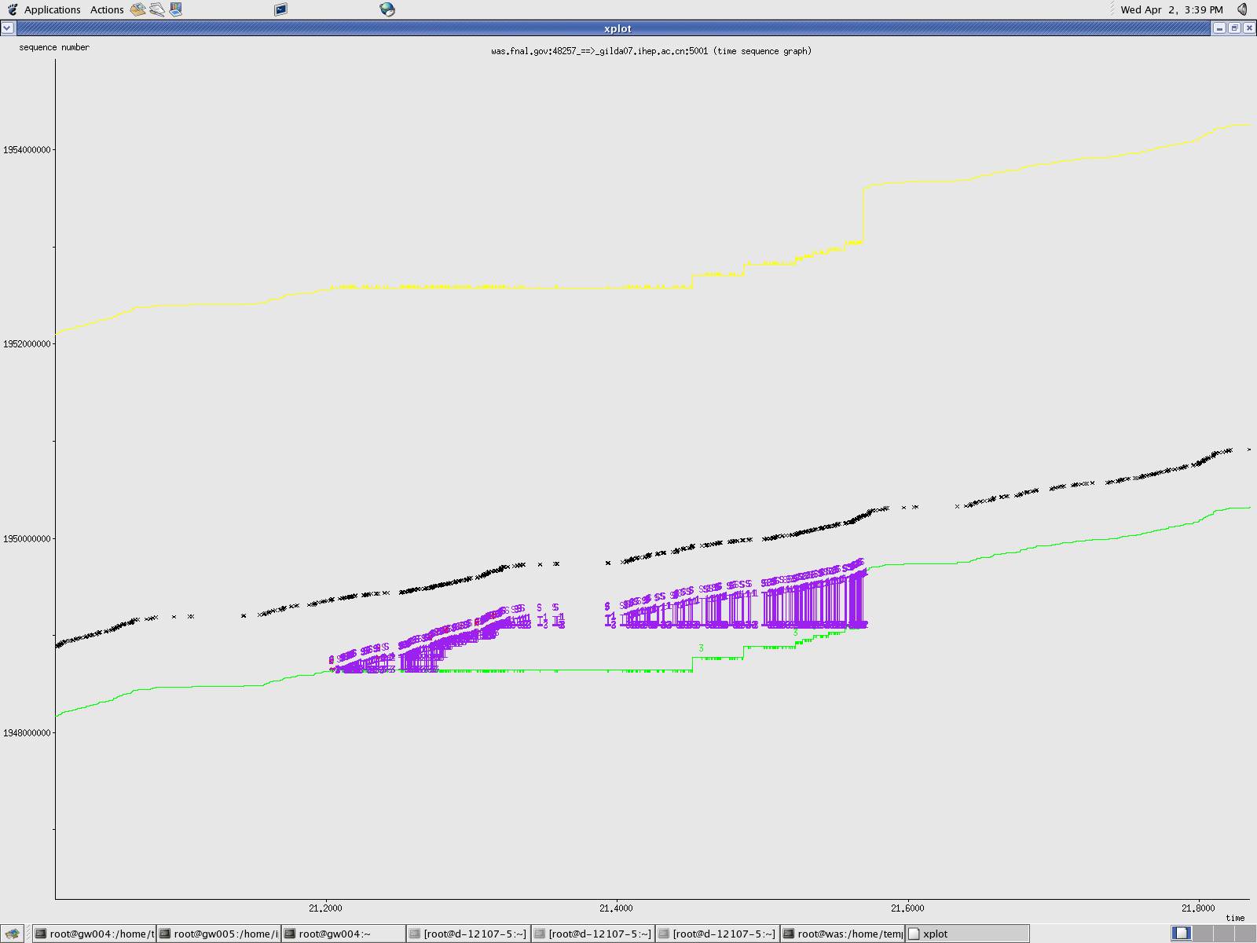
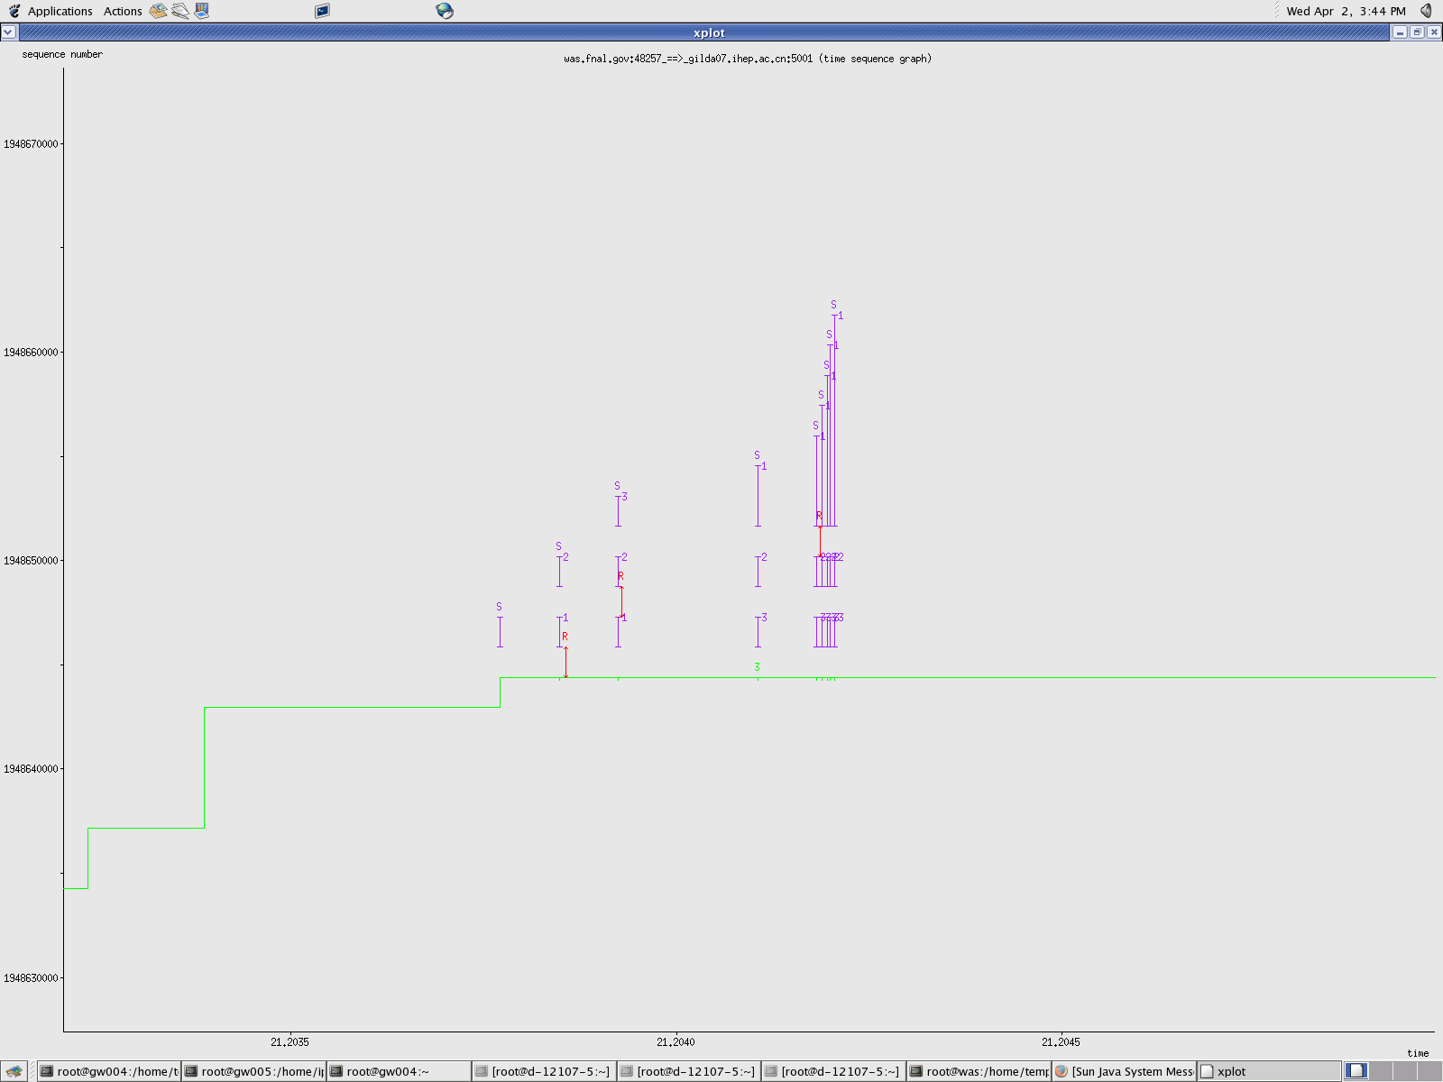
Evaluation of packet trace patterns:
If host tuning & path analysis aren’t enough, detailed packet trace is attempted
  TCPdump & Xplot graphs
Sequence
number
Receive window
Acks
Sack
Segment sent
Time
Sack
Wizard’s are still useful…
Retransmit
Acks

Slide 15
CASE STUDY 2: FNAL -> UFL
UFL contacts FNAL WAN about poor performance
  The maximum bandwidth between FNAL and UFL is 10Gbps; however, the overall achievable throughput is less than 1Gbps (between two powerful hosts residing in FNAL and UFL respectively, both with 10G NICs).
We follow our methodology to diagnose the network performance between FNAL and UFL
  UFL host configurations collected with script
  Host configuration settings analyzed
  Network path performance analysis
Notes:
The bandwidth is 10Gbps, achievable throughput is less than 1G

Slide 16
Surprisingly, We did not find any apparent problems!!!
No problem with Host configuration settings
  The host is the latest powerful hardware in the market
  The host system parameters have been correctly configured for bulk data transmission in the WAN context.
No problem with Network path
  RTT: 40ms
  No apparent packet drops detected
  No apparent packet reordering detected
  No apparent path changes detected
  Low link utilization, no apparent traffic congestion detected.

Slide 17
Evaluation of packet trace patterns
Experiment system features
Run bulk data transmission from FNAL to UFL with IPERF,
In the sender, iperf is run as “iperf –c hostname –t 100 –w 5M”
In the receiver, iperf is run as “iperf –s –w 5M”
We vary the number of TCP streams; overall throughput is always <1Gbps
Since RTT is 40ms, theoretically the throughput is 10Mbyte/40ms= 2Gbps/stream if the throughput is not limited by the network

Slide 18
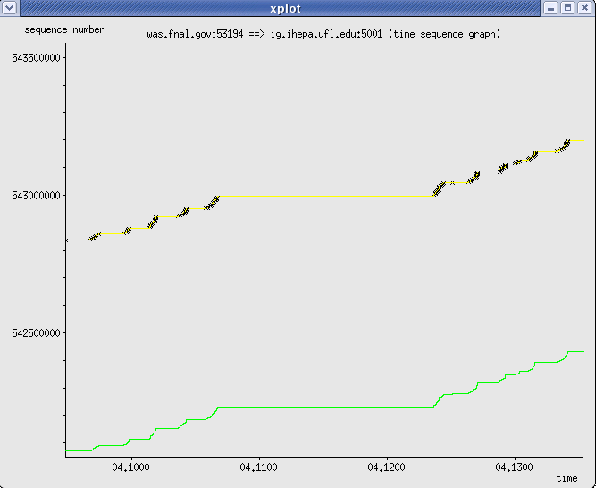
Evaluation of packet trace patterns (I)
What is wrong?!!!
Packet trace analysis shows:
No packet drops
No packet reordering
The performance is limited
by the receiver!!!
Sequence
number
Receive window
Limiting receiver window size!!!
Segment sent
But TCP/IP parameters have
been optimized for WAN!!!
Maximum receive window size
could go as high as 10MBytes
Time
Acks

Slide 19
Evaluation of packet trace patterns (II)
Packet trace analysis does not lie!
Host has been correctly configured! Doubled checked!
What is wrong?
Called network engineer in UFL:
  their systems are doing TCP-offloading…
TCP-offloading is performed in the NIC:
  NIC does not have as much memory as host
  For high BDP context, TCP needs lots of memory for good performance.
    TCP-offloading might not be suitable for WAN.

Slide 20
Solution
TCP-offloading disabled
Per stream TCP throughput ~2Gbps
  close to theoretical analysis.
Increased the number of streams to 10 and 20:
  overall throughput reach around 4Gbps.
    An in-path Cisco router did unintended rate liming
  Router is updated, overall throughput increases to 6-7 Gbps.

