Slide 1
ESnet Update
Summer 2010 ESCC Meeting
Columbus, OH
Steve Cotter, ESnet Dept Head
Lawrence Berkeley National Lab

Slide 2
Agenda
  Administrative Updates
  Network Updates
  OSCARS Update and Case Studies
  Advanced Networking Initiative
  ECS Upgrade
  New Initiatives

Slide 3
Administrative
Organizational Changes

Slide 4
Changes @ ESnet
New additions:
  Greg Bell – Chief Information Strategist
    Formerly Chief Technology Architect in office of CIO at LBNL
  Sowmya Balasubramanian – Software Engineer
    Developed ESnet’s weathermap as a student intern
  S. J. Ben Yoo – Computational Faculty Appt. Sci/Eng
    Research at UCDavis includes future Internet architectures, high-performance optical switching systems, optically-interconnected computing systems
Role Changes:
  Greg Bell – Area Lead, Infrastructure & Support
  Inder Monga – Area Lead, Research & Services

Slide 5
Dept. Head
Steve Cotter
ESnet Senior Advisor
William Johnston
General Manager
Joe Burrescia
Project Manager
Hing Chow
Program Administrator
Gizella Kapus
Security and Disaster
Recovery Officer
Dan Peterson
Kathy Day
Area Lead – Infrastructure & Support & Chief Information Strategist
Greg Bell
Area Lead
Research & Services
Inder Monga
Audio, Video,
Data Collaboration
Stan Kluz
Federated Trust
Mike Helm
Infrastructure
Greg Bell
Operations and
Deployment
Jim Gagliardi
Network
Engineering
Mike Collins
Advanced Network
Technologies
Brian Tierney
Turn Key Operations
Dhiva Muruganantham
Doug Oslon*
Josef Grosch
Deb Heller
Roberto Morelli
Ken Pon
Marcy Santana
John Webster
Chris Cavallo
John Christman
Scott Mason
John P. Jones
Mark Redman
Clint Wadsworth
Vangelis Chaniotakis
Eli Dart
Jon Dugan
Chin Guok
Yvonne Hines
Joe Metzger
Kevin Oberman
Mike O’Connor
David Robinson*
Mary Thompson*
Chris Tracy
Open
Andy Lake
Eric Pouyoul
Sowmya Balasubramanian
S. J. Ben Yoo
* Part time ESnet
Notes:
5

Slide 6
Network Updates
Installs, Upgrades, Futures

Slide 7
Backbone Updates
Current Hub Count: 20
  32 AofA (NYSERnet), NEWY, WASH, ATLA, NASH, CLEV, BOST, CHIC, STAR (Starlight), KANS, HOUS, ELPA, DENV, ALBU, BOIS, PNWG, SUNN, SNV (Qwest), SDSC, LASV (SwitchNap)
  Future / proposed: ALBU (new location), SAND (San Diego to support General Atomic)
Current Backbone Wave Count:
  Internet2/Level3 10G waves:
    IP: total of 25
    SDN: total of 30
  NLR 10G waves:
    Total of 5

Slide 8
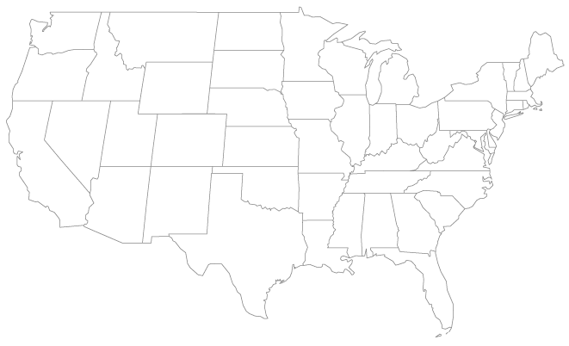
Current ESnet4 Topology
Router node
10G link

Slide 9
Circuit & Site Updates
Peering upgrades:
  EQX‐ASH: installed MX480 on Nov 30th
  EQX‐CHI: installed MX480 on Feb 18th
Site and hub router upgrades:
  FORR 7206: replaced by M7i on Dec 22nd – in production Apr 20th
  AMESLAB M10: replaced by M10i on Jan 13th
  DOE‐GTN 7206: replaced by M10i Feb 18th
  GA M7i: replaced by MX480 Mar 25th
  DOE-NNSA was upgraded to an M7i on June 16th
  Added 4x10GE DCP to MX’s at SUNN‐SDN2, CHIC‐SDN2, KANS‐SDN1 and DENV‐SDN1 in preparation for additional SDN wave
  PPPL M120: to be replaced by MX480 TBD

Slide 10
Circuit & Site Updates
Circuit installs
  10G EQX-ASH (DC2) & 10G EQX-SJ (SJ1) fabric upgraded in Jan
  OC12 between DENV‐HUB and Pantex Jan 28th
  DS3 between WASH‐HUB and SNL‐DC Feb 2nd
  10G peering with GPN @ KANS‐HUB Feb 10th
  10G EQX‐CHI fabric upgraded Feb 19th
  OC3c for NSO to LASV‐HUB Mar 8th
  Three 1GE links in D.C. Area (DC-MAN)
    The three new 1GE circuits between DOE-GTN, IN-FORR and WASH-HUB went into production on Apr 20th
  Moved the JLAB and NRL-STAR-WASH circuits to new Level3 cross-connects Apr 28th
  10G MERIT wave was added to the 1GE between Equinix Chicago (CH2) on May 7th
  10G Level3 wave replacing 1GE between Equinix SJ (SJ1) in acceptance testing

Slide 11
Circuit & Site Updates
Future circuit installs:
  10G peering with MERIT @ Starlight (pending acceptance)
  10G wave between WASH‐HUB and EQX‐ASH (on order)
  1G private peering at EQX-ASH with Level3 (pending final configurations)
  1G private peering being planned with TATA Communications at all 3 Equinex (move from fabric)
  1GE wave in BOIS to INL via IRON (TBD)
  Future site ordered 1GE wave from KCP to KANS-HUB (TBD)
Future backbone installs:
  Planning additional waves between SUNN - DENV - KANS - CHIC – CLEV – WASH by Oct (based on traffic demand)

Slide 12
Long Island MAN
Southern route:
  AoA to BNL: 79 miles
  Last 5 miles into BNL is aerial fiber but scheduled to migrate to buried fibers when go production in November. The rest of the route will be buried fiber.
  Scheduled to install Infineras in Oct
Northern route
  111 8th to BNL: 95 miles
  Scheduled for delivery 2 months after Southern route – to reduce hardware installation costs.
  Fibers from AoA to 111 8th are in place and are buried

Slide 13
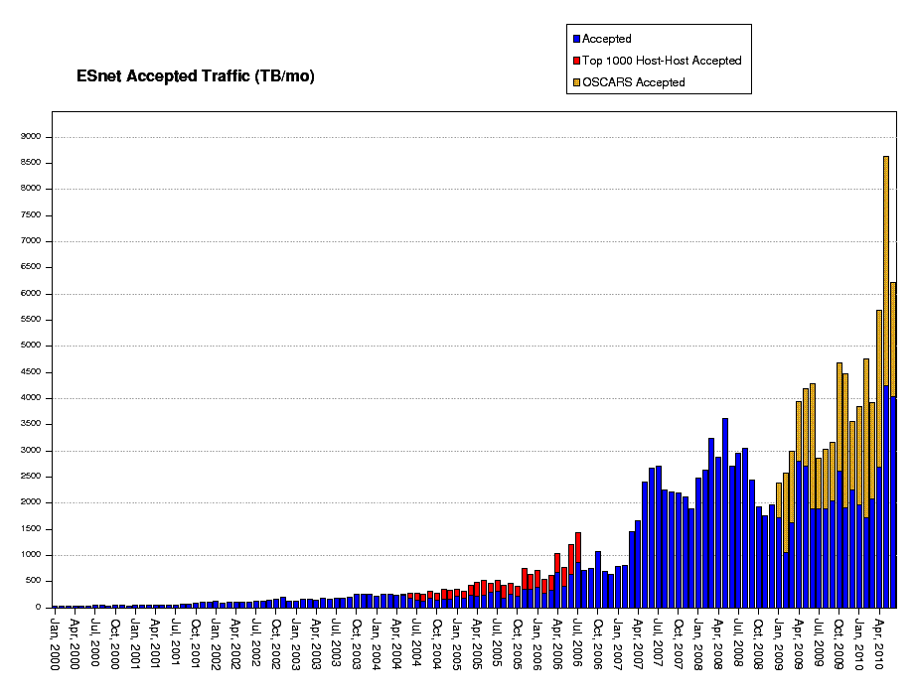
ESnet Traffic
June 2010 Summary
Total Bytes Accepted: 6.28 PB
Total Bytes OSCARS circuits: 2.13 PB
Percentage of OSCARS traffic: 33.9%
May 2010 Summary
Total Bytes Accepted: 8.66 PB
Total Bytes OSCARS circuits: 4.41 PB
Percentage of OSCARS traffic: 50.9%
Nearly 300% increase in traffic June09-May10

Slide 14
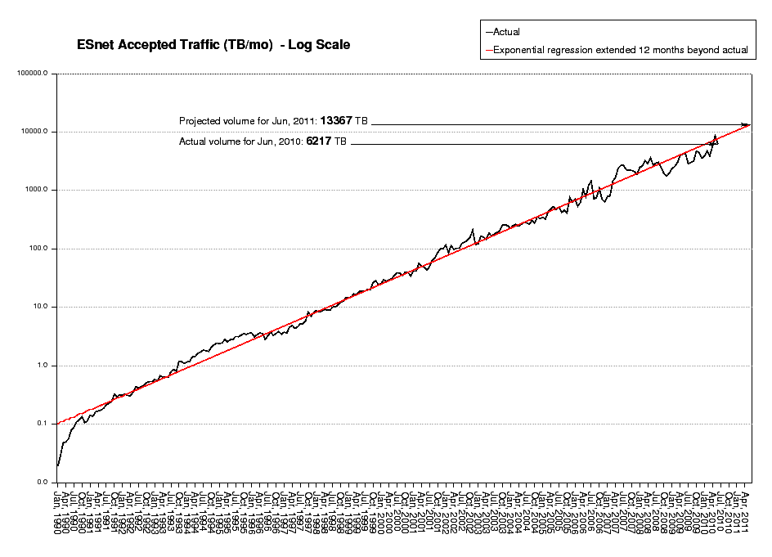
ESnet Traffic
May’s jump in traffic put us back above the long-term trend line
Traffic over last 5 years have become more volatile – indicative of the influence large scientific instruments have on network traffic
One year projection is 13.4 PB/month

Slide 15
Highly Reliable Infrastructure
Annual Network Availability – All Sites
99.954%
99.969%
99.985%
Feb07-Jan08
Feb08-Jan09
Feb09-Jan10

Slide 16
OSCARS Update

Slide 17
OSCARS Service Goals
Allow users to request guaranteed bandwidth between specific end points for specific period of time
  User request is via Web Services or a Web browser interface
  The assigned end-to-end path through the network is called a virtual circuit (VC)
  Provide traffic isolation
Support the inherently multi-domain environment of large-scale science by interoperating with similar services in other network domains in order to set up cross-domain, end-to-end virtual circuits
Goals that have arisen through user experience with OSCARS include:
  Flexible service semantics: e.g. allow a user to exceed the requested bandwidth, if the path has idle capacity – even if that capacity is committed
  Rich service semantics: e.g. provide for several variants of requesting a circuit with a backup, the most stringent of which is a guaranteed backup circuit on a physically diverse path

Slide 18
OSCARS Is a Production Service
Each month ~50% of all ESnet production traffic is now carried across OSCARS VCs
Operational Virtual Circuit (VC) support
  As of 6/2010, there are 31 (up from 26 in 10/2009) long-term production VCs instantiated
    25 VCs supporting HEP: LHC T0-T1 (Primary and Backup) and LHC T1-T2
    3 VCs supporting Climate: GFD and ESG
    2 VCs supporting Computational Astrophysics: OptiPortal
    1 VC supporting Biological and Environmental Research: Genomics
  Short-term dynamic VCs
    Between 1/2008 and 6/2010, there were roughly 5000 successful VC reservations initiated by TeraPaths (BNL), LambdaStation (FNAL), and Phoebus

Slide 19
OSCARS Federated IDC Interoperability
The following organizations have implemented/deployed systems which are compatible with the DICE IDCP:
Internet2 ION (based on OSCARS/ION)
ESnet SDN (based on OSCARS/ION)
GÉANT AutoBAHN System (pan-European backbone R&E network)
Nortel DRAC (based on OSCARS)
Surfnet (NREN – European national network) (based on Nortel DRAC)
LHCnet (based on OSCARS/DCN + Dragon (Ciena CoreDirector manager)
NYSERnet (New York Regional Optical Network) (OSCARS/DCN)
LEARN (Texas RON) (OSCARS/DCN)
LONI (Louisiana RON) (OSCARS/DCN)
Northrop Grumman (OSCARS/DCN)
University of Amsterdam (OSCARS/DCN)
MAX (OSCARS/DCN)
The following “higher level service applications” have adapted their existing systems to communicate using the DICE IDCP:
LambdaStation (manages and aggregate site traffic) (FNAL)
TeraPaths (manages and aggregate site traffic) (BNL)
Phoebus (University of Delaware) (TCP connection reconditioner for WAN latency hiding)

Slide 20
The OSCARS Software is Evolving
The code base is undergoing its third rewrite (OSCARS v0.6)
  As the service semantics get more complex (in response to user requirements) attention is now given to how users request complex, compound services
    Are defining “atomic” service functions and building mechanisms for users to compose these building blocks into custom services
The latest rewrite is to affect a restructuring to increase the modularity and expose internal interfaces so that the community can start standardizing IDC components
  For example there are already several different path setup modules that correspond to different hardware configurations in different networks
  Several capabilities are being added to facilitate research collaborations

Slide 21
OSCARS v0.6 Progress
Code Development
  10/11 modules completed for intra-domain provisioning, undergoing testing
  Packaging of PCE-SDK underway
Collaborations
  2-day developers meeting with SURFnet on OSCARS/OpenDRAC collaboration
  Supports GLIF GNI-API Fenius protocol Version 2
    Fenius is a short term effort to help create a critical mass of providers of dynamic circuit services to exchange reservation messages
  Contributing to OGF NSI and NML working groups to help standardize inter-domain network services messaging
    OSCARS will adopt the NSI protocol once it has been ratified by OGF

Slide 22
General ESnet R&D
Line-rate classification of large IP flows and their re-routing to OSCARS circuits to relieve congestion on the general IP network
Vertical integration of OSCARS from the optical layer up through layer 3. (Some of this is in-progress.)
Real-time analysis of network "soft-failures" (degraded elements that still work, but with losses – a significant factor in limiting very high-speed data transfers) and the predictive re-routing and repair.
Real-time analysis of network traffic trends for predictive provisioning and re-configuration.
Bro at 10G and 100G providing a real-time "global" view of network attacks that individual Labs would not see (e.g. coordinated, low level attacks).

Slide 23
OSCARS Case Study 1: JGI / NERSC
OSCARS provides the mechanism to easily extend the LAN to make remote resources appear local (barring network latencies)
Background
  JGI had a sudden need for increased computing resources
  NERSC had a compute cluster that could accommodate request
Network Solution
  OSCARS was used to dynamically provision a 9 Gbps guaranteed Layer 2 circuit over SDN between JGI and NERSC, virtually extending JGI’s LAN into the NERSC compute cluster

Slide 24
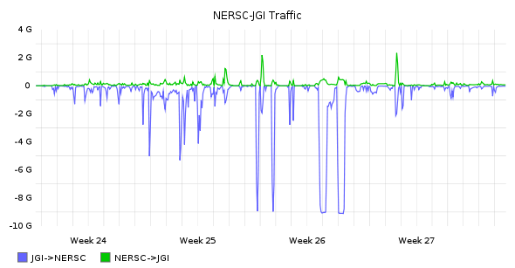
Case Study 1:
JGI / NERSC
Impact:
  WAN portion (OSCARS circuit) was provisioned within minutes and worked seamlessly
  Compute cluster environment had to be adapted to new hardware (at NERSC), but once completed, all local tools (at JGI) worked
More importantly: the compute model did not change
JGI / NERSC Virtual LAN Traffic

Slide 25
OSCARS Case Study 2: LBNL / Google
OSCARS provides the agility to quickly traffic engineer around bottlenecks in the network
Background
  ESnet peers with Google at the Equinix exchanges
    Equinix Ashburn @ 1 Gbps (upgrade to 10 Gbps mid-Aug 2010)
    Equinix Chicago @ 10 Gbps
    Equinix San Jose @ 1 Gbps (upgraded 7/12 to 10 Gbps)
  Default routing from LBNL to Google Cloud uses Equinix San Jose (closest exit) @ 1Gbps, but higher bandwidth was required
  LBNL application required 4 Gbps layer 3 traffic directed to Google Cloud

Slide 26
OSCARS Case Study 2: LBNL / Google
Network Solution
  OSCARS was used to dynamically provision a 4 Gbps guaranteed Layer 3 circuit over SDN between LBNL and Equinix Chicago
Impact
  The selected traffic to Google Cloud experienced a higher latency (+50ms), but was not restricted to the physical 1Gbps connection at Equinix San Jose
  As a result of the request, OSCARS is adding the feature to allow multi-source/destination network filters for Layer 3 circuits

Slide 27
OSCARS Case Study 3: LHC Circuit Redundancy
FNAL Capacity Model for LHC OPN Traffic to CERN
Use | Requirements estimate | Normal b/w (23G available) | path | Usage when 1 path degraded (10G available) | path | Usage when 2 paths degraded (3G available) | path
FNAL primary LHC OPN | 8.5G | 8.5G | 3500 | 8.5G |  | 0G
FNAL primary LHC OPN | 8.5G | 8.5G | 3506 | 0G |  | 0G
FNAL backup LHC OPN | 3G | 0G | 3501 | 0G |  | 3G
Estimated time in effect: |  | ≈363 days/yr |  | 1-2 days/ year |  | 6 hours/yr

Slide 28
OSCARS Case Study 3: LHC Circuit Redundancy
CERN
US LHCnet
US LHCnet
ESnet SDN-AoA
ESnet SDN-Ch1
US LHCnet
ESnet SDN-St1
CERN
US LHCnet
US LHCnet
primary-1 8.5G
Normal operating state
primary-2 8.5G
BGP
backup-1 3G
FNAL1
ESnet SDN-F1
FNAL2
ESnet SDN-F2

Slide 29
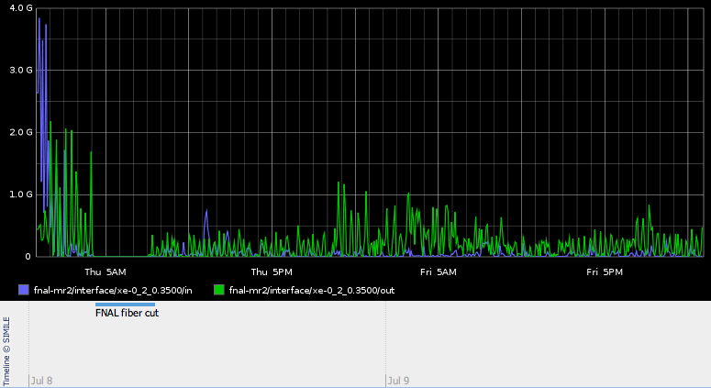
OSCARS Case Study 3: LHC Circuit Redundancy
FIBER CUT
VL3500 – Primary-1

Slide 30
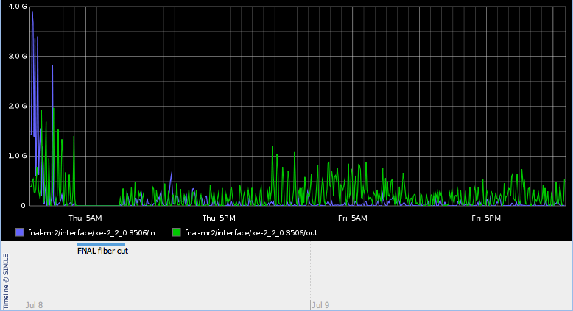
OSCARS Case Study 3: LHC Circuit Redundancy
FIBER CUT
VL3506 – Primary-2

Slide 31
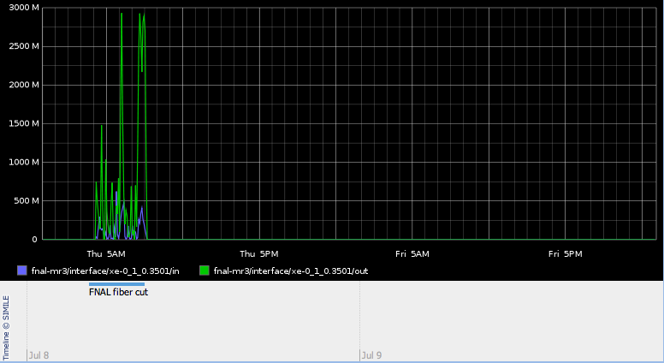
OSCARS Case Study 3: LHC Circuit Redundancy
FIBER CUT
VL3501 – Backup

Slide 32
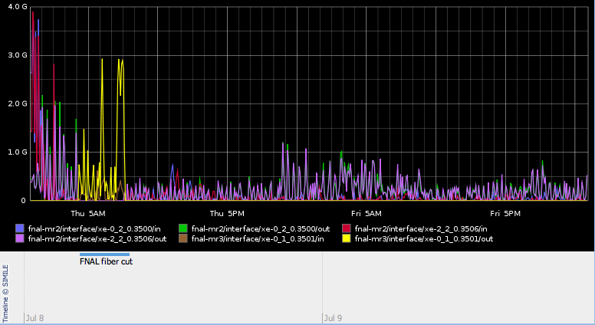
OSCARS Case Study 3: LHC Circuit Redundancy
FIBER CUT
FERMI Cut - All

Slide 33
PerfSONAR
Looking for trouble in all the right places
Listen to Joe Metzger’s talk tomorrow morning

Slide 34
Advanced Networking Initiative
RFP Status, Technology Evaluation, Testbed Update

Slide 35
ARRA Advanced Networking Initiative (ANI)
Advanced Networking Initiative goals:
  Build an end-to-end 100 Gbps prototype network
    Handle proliferating data needs between the three DOE supercomputing facilities and NYC international exchange point
  Build a network testbed facility for researchers and industry
RFP for 100 Gbps transport and dark fiber released last month (June)
RFP for 100 Gbps routers/switches due out in Aug

Slide 36
ANI 100G Technology Evaluation
Most devices are not designed with any consideration of the nature of R&E traffic – therefore, we must ensure that appropriate features are present and devices have necessary capabilities
Goals (besides testing basic functionality):
  Test unusual/corner-case circumstances to find weaknesses
  Stress key aspects of device capabilities important for ESnet services
Many tests conducted on multiple vendor alpha-version routers, examples:
  Protocols (BGP, OSPF, ISIS, etc)
  ACL behavior/performance
  QoS behavior
  Raw throughput
  Counters, statistics, etc

Slide 37
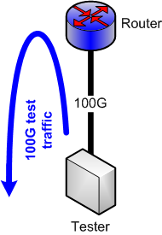
Example:
Basic Throughput Test
Test of hardware capabilities
Test of fabric
Multiple traffic flow profiles
Multiple packet sizes

Slide 38
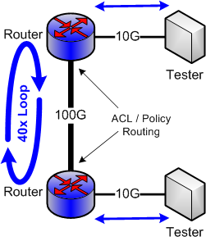
Example:
Policy Routing and ACL Test
Traffic flows between testers
ACLs implement routing policy
Policy routing amplifies traffic
Multiple packet sizes
Multiple data rates
Multiple flow profiles
Test SNMP statistics collection
Test ACL performance
Test packet counters

Slide 39
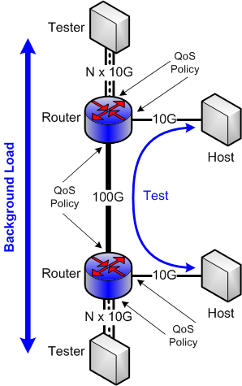
Example:
QoS / Queuing Test
Testers provide background load on 100G link
Traffic between test hosts is given different QoS profile than background
Multiple traffic priorities
Test queuing behavior
Test shaper behavior
Test traffic differentiation capabilities
Test flow export
Test SNMP statistics collection

Slide 40
Testbed Overview
A rapidly reconfigurable high-performance network research environment that will enable researchers to accelerate the development and deployment of 100 Gbps networking through prototyping, testing, and validation of advanced networking concepts.
An experimental network environment for vendors, ISPs, and carriers to carry out interoperability tests necessary to implement end-to-end heterogeneous networking components (currently at layer-2/3 only).
Support for prototyping middleware and software stacks to enable the development and testing of 100 Gbps science applications.
A network test environment where reproducible tests can be run.
An experimental network environment that eliminates the need for network researchers to obtain funding to build their own network.

Slide 41
Testbed Status
Progression
  Operating as a tabletop testbed since June
  Move to Long Island MAN as dark fiber network is built out
  Extend to WAN when 100 Gbps available
Capabilities
  Ability to support end-to-end networking, middleware and application experiments, including interoperability testing of multi-vendor 100 Gbps network components
  Researchers get “root” access to all devices
  Use Virtual Machine technology to support custom environments
  Detailed monitoring so researchers will have access to all possible monitoring data

Slide 42



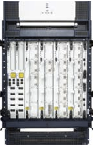
Tabletop: A layered view
10G Tester
FS/BS/
App host
Monitoring
Host
10G Tester
Applications
Layer 3
Openflow
Switch
Layer 2/Openflow
WDM/
Optical
WDM Link
10GE Link
1GE Link
Layer 0/1

Slide 43

LIMAN ANI Testbed
Configuration
(40G aggregate)
MX80 Router
100G Prototype Network
Prod.
Mon host
ssh gateway
App Host
AofA
File Server
Infinera
4x10GE
8x1GE
Testbed
IO Tester
To Internet
MX80 Router
NEC Openflow
Mon host
App Host
NEC Openflow
File Server
Infinera
4x10GE
Prod.
Testbed
Testbed
IO Tester
Infinera
4x10GE
IO Tester
NEC Openflow
IO Tester
Testbed
Infinera
2x10GE
Prod.
Prod.
WDM Link
2 x 10 G Infinera
10 GE Link
1 GE Link
NEWY
BNL

Slide 44
ECS Upgrade

Slide 45
ESnet Collaboration Services
Audio and data conferencing
  WebEx style desktop sharing and remote viewing of content with ~300 users
  On average, there are ~850 meetings and ~2400 port hours of audio
  Cisco MeetingPlace equipment nearing end of life
Video conferencing
  Reaches 1800 DOE researchers and collaborators worldwide at 270 institutions
  On average, there are ~2200 meetings and 3800 port hours per month
  Reliability and feature/capacity upgrades an issue

Slide 46
ECS Survey Review
Rated ECS as important service
  Registration process and service capacity rated lowest
ECS enhancement requests
  Reliability, High Def most important, followed by more capacity
Long-term needs
  Support for emerging collaborative technologies
  Federation with other collaboration services
  Enhanced operational support and troubleshooting

Slide 47
Voice / Data Conferencing Comparison
MeetingPlace (old)
ReadyTalk (new)
Redundancy: None
Maximum # ports: 144
Ports available per conference: 50
Toll free access US & Canada: No
Toll free access international: No
Reservations: Required
Service support: 8am-5pm PT Mon-Fri
Redundancy: 7 data centers
Maximum # ports: 60,000
Ports available per conference: 96
Toll free access US & Canada: Yes
Toll free access international: ~100 countries
Reservations: Not required
Service support: 24x7

Slide 48
ReadyTalk Transition Timeline
July 19 – Memo sent to ecs-status@es.net informing users about the transition from MeetingPlace to ReadyTalk
  A short version of the memo to be placed on ESnet web sites
July 19 – List of current MeetingPlace users submitted to ReadyTalk for account creation
  Additional names will be added to the list as required between now and July 30th
  It will take about 1 to 2 weeks for ReadyTalk to process ~300 accounts – users will receive email with new account information and instructions
July 26 – Testing new registration web page
July 30 12pm PST – Go live with https://www-west.ecs.es.net/

Slide 49
Video Conferencing Comparison
Current System
New System
3 MCUs at one location
  40 SD ports each
IP/ISDN gateway with 2 PRIs
2 gatekeepers at one location
2 chassis, geographically dispersed
  80 SD, 20 HD ports each
  Expansion slots for growth
IP/ISDN gateway with 2 PRIs each
2 gatekeeper at each location
Telepresence capable

Slide 50
Videoconferencing Upgrade Timeline
Procurement: Process started
  August: Orders placed
  Sept/Oct: Arrival of equipment
Installation / Test & Acceptance
  Nov/Dec: First system put into production
  Feb/Mar: Second system put into production

Slide 51
New ECS Appropriate Use Policy
Proposed terms and conditions to go into effect July 30th
“ESnet provides collaboration services (including audio, video, and data conferencing) in support of the mission of the DOE Office of Science. These services are intended to foster and encourage collaboration across organizations and virtual organizations funded by the office of Science.
By registering for this service, users agree to abide by the following policies:
  ECS services are provided for the purpose of enabling collaboration within organizations and projects funded by the DOE Office of Science.
  ECS services must not be used for other purposes.
ESnet reserves the right to audit use of ECS services to assure conformance with the policies described above. Specifically, ESnet may contact users (either randomly or based on usage patterns) to verify eligibility and appropriate use. Violations of appropriate use policies may result in termination of services.”

Slide 52
Trust Federation
Science Identity Federation, DOEGrids

Slide 53

Science Identity Federation
ESnet is taking the lead to develop an interoperable identity for DOE labs
  Based on the well-known Shibboleth authentication & authorization software from Internet2
  Labs can federate with InCommon and other federations as needed
US Higher Education Shibboleth Federation: see www.InCommonfederation.org

Slide 54





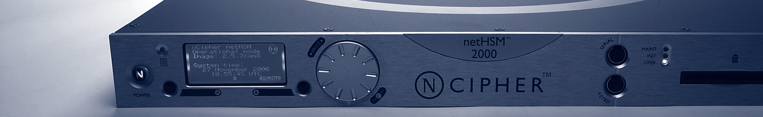



DOEGrids CA with High Availability
DOEGrids CA master
DOEGrids CA clone
LDAP
LDAP
P
. . .
1 to n
. . .
1 to n
P
CRL delivery
P
netHSM
netHSM
. . .
. . .
P
West coast
East coast
Mid West ?
PAvailable
Remote Operator
Remote Operator

Slide 55
DOEGrids Certificates & ESnet PKI
How does the newly-announced InCommon certificate service (a partnership with Comodo) impact DOE and the DOEGrids project?
  This service is a good opportunity for campuses to save money on SSL certs
  DOE Labs are not part of the deal, but may be able to participate eventually
  If so, we envision a model of complementary services in the short term
  - right now, only ~40% of DOEGrids users have access to the InCommon/Comodo service
  - many virtual organizations don't have identity infrastructures, aren't InCommon members, and rely on DOEGrid's project-oriented vetting process for certificates
  In the medium term, the user community may move in the direction of the InCommon service
  Important to note that Comodo is not currently issuing IGTF-profile certs, which DOEGrids customers need
OSG Includes (ATLAS, ALICE, BNL, CDF, CIGI,CMS, CompBioGrid, DES, DOSAR, DZero, Engage, Fermilab, geant4, GLOW, GlueX, GROW, GPN, GRASE, HCC, i2u2, IceCube, ILC, JDEM, JLAB, LIGO, mariachi, MIS, nanoHUB, NEBioGrid, NWICG, NYSGrid, OSG, OSGEDU, SBGrid, SLAC & STAR )

Slide 56
New Initiatives
Site Outreach, Communications

Slide 57
Outreach Program Goals
Enable productive and effective use of ESnet and other networks by scientists
  By definition, this requires collaboration with sites
  Assist sites in designing/deploying infrastructure optimized for WAN usage
  Assist with adoption of ESnet services, e.g. SDN
Better understand issues facing sites so that ESnet can better serve its customers
Discover users with specific needs/issues and address them
Build expertise within ESnet’s user community so that effective use of the network is not specialized knowledge

Slide 58
Outreach Program Explicit Non-Goals
Assistance with LAN-only services such as 802.1x, VOIP, etc
  It is unlikely that a bunch of WAN engineers can teach site networking staff very much about VOIP
  If there is a need for services to traverse the WAN, we are of course happy to help
Security policy outsourcing
  ESnet does not and cannot understand site security policy
  ESnet is staying out of the site security business
  We will help with design/architecture of perimeter security as it pertains to network performance, but we won’t configure your firewall for you
RFP or procurement assistance

Slide 59
Outreach Program Progress
Initial progress has been slow
  Distracted by ANI
  Near-term needs of science programs have taken cycles that might otherwise have been focused on sites
Process is still evolving
  Different sites / user communities have different needs & expertise
  It is possible that we will end up with multiple solutions / processes for different types of sites
However, still believe this effort is extremely important and remain committed to its success
  Many scientists cannot use networks effectively
  Need for effective network use is increasing in most disciplines
  We must collaborate with our sites to succeed

Slide 60
Improved Communications
New blog to communicate more frequently about ESnet activities
www.esnetupdates.wordpress.com
New Twitter feed for shorter, more timely updates
www.twitter.com/esnetupdates
  Eventually provide automated network status updates

Slide 61
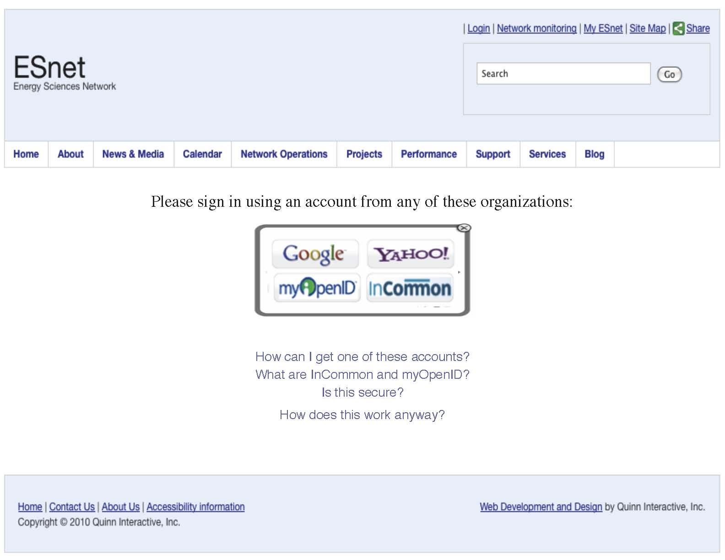
ESnet Website
Current plan is to have a "beta" site ready by August and to start loading in our content at that time.
Working with the SilverStripe CMS core developers on Shib/SAML authentication
An OpenID module is in SilverStripe and is being cleaned up and updated
Integration with the Sphinx full text search engine is underway
Users can share an interesting page via social networking services like Twitter, Facebook, Google and Yahoo Bookmarks, Del.icio.us, etc...

Slide 62
My ESnet Portal
Users will be able to select the Graphite graphs that they want to see regularly have the it stored in their profiles so that they come up automatically.
Widgets can be enabled and positioned by the content authors, and users have the option of expanding or collapsing a particular widget
  A widget that displays Twitter and RSS feeds
  A Google calendar widget. ESnet will be publishing events through Google Calendar.
  A gallery widget that allows users to select and view videos and images from a scrolling thumbnail selection

Slide 63
ESnet Diagnostic Tool: 10 Gbps IO Tester
16 disk raid array:
  Capable of > 10 Gbps host to host, disk to disk
  Runs anonymous read-only GridFTP
Accessible to anyone on any R&E network worldwide
  1 deployed now (West Coast, US)
  2 more (Midwest and East Coast) by end of summer
Will soon be registered in perfSONAR gLS
http://fasterdata.es.net/disk_pt.html
Performance Tester already being used to solve multiple problems from as far away as Australia!

Slide 64
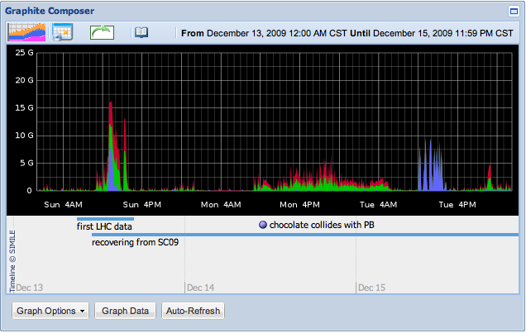
Graphite Visualization with Net Almanac Annotation

Slide 65
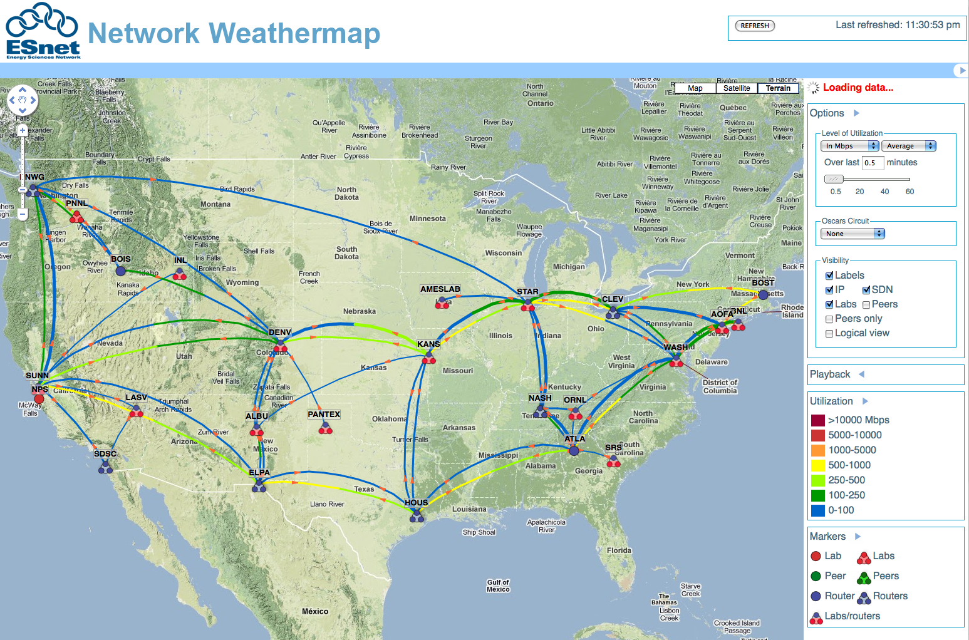
Network Weathermap

Slide 66
Questions?
Email: steve@es.net
Follow us: http://esnetupdates.wordpress.com, http://www.twitter.com/esnetupdates
ANI Testbed: https://sites.google.com/a/lbl.gov/ani-testbed/

