Slide 1
Network Service Performance Metrics Discussion
Phil DeMar
Summer 2010 JointTechs meeting
July 14, 2010

Slide 2
What are we trying to measure here?
Network service performance measurements:
applies to your network service
not to user’s network performance
Used to assess the quality of your network service
Measure whether network service SLA’s/OLA’s are being met

Slide 3
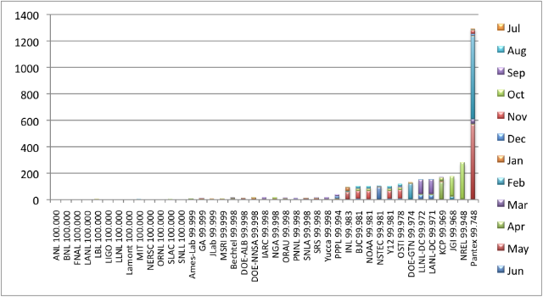
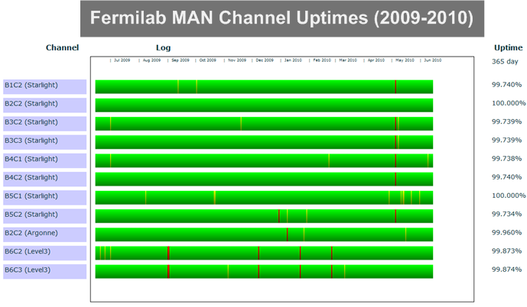
A couple of examples
ESnet site availability
ChiMAN channel availability

Slide 4
Survey Says…
Most responding sites said that they were measuring their own network service performance
But only ~50% of the sites responded to this survey
A few fairly common metrics measured:
Device uptime
B/W utilization (presumably versus b/w capacity)
Some of the more ‘exotic’ metrics:
# of connections; packet size characterization; top b/w users
Device CPU, memory, buffer utilization
Error counters
Measured off-site stream performance

Slide 5
Questions:
What’s useful in measuring quality of site WAN service?
Is ESnet’s measured site availability data sufficient?
If not, what is?
Something in terms of capacity versus utilization?
Do PerfSONAR active measurements come into play here?
What’s useful in measuring quality of site LAN service?
What are reasonable standards to measure against?
Is there a recommendation role for ESCC to play here?

