Slide 1
Program Management
Michael S. Zisman
Center for Beam Physics
Accelerator & Fusion Research Division
Lawrence Berkeley National Laboratory
Muon Accelerator Program Review-Fermilab
August 24, 2010
August 24-26, 2010
1

Slide 2
Outline
Introduction
Organization
Organizing principles
Organization charts
Ingredients
Responsibilities
Oversight
Approach to down-selection
Summary
August 24-26, 2010
2

Slide 3
Introduction
DOE requested Fermilab to set up merged NFMCC+MCTF organization in October 2009
MAP is the result of that process
Goal is to execute multi-year R&D program to
complete Design Feasibility Report for MC
participate in IDS-NF effort toward NF RDR
carry out supporting technology R&D
participate in system tests of 4D and 6D cooling
MICE and 6D “bench test” (no beam)
Written Program Management Plan available for sign-off by appropriate managers
August 24-26, 2010
3

Slide 4
Organizing Principles
Create organization that delivers
a coherent, national R&D program
a multi-institutional program (Labs, Universities)
a streamlined structure with clear reporting lines
Key principles
Fermilab provides overall management
collaborative effort integrating NFMCC and MCTF
maintains existing NFMCC commitments
led by Program Director who controls funding
adequate oversight (MCOG, MUTAC, PMG, DOE)
MAP Program Manager at DOE will be selected
August 24-26, 2010
4

Slide 5
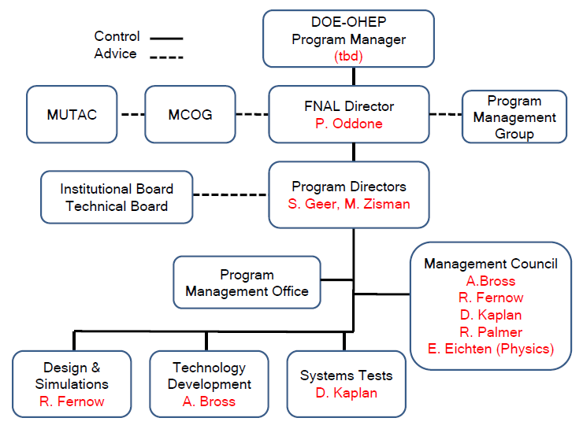
MAP Upper Level Organization
Organization in place and functioning
Level 0 and Level 1 names interim appointments
Level 0
Level 1
August 24-26, 2010
5

Slide 6
MAP Level 2 Organization
Level 2 organization in place and functioning
L2 leaders chosen by L1 leaders
approved by Program Co-Directors
Level 1
Level 2
August 24-26, 2010
6

Slide 7
Organization Ingredients
Co-Directors (L0) appointed by Pier Oddone
Level 1 organization comprises three groups:
design & simulations (R. Fernow, BNL)
technology development (A. Bross, FNAL)
system tests (D. Kaplan, IIT)
Institutional Board (IB)
chaired by D. Hartill (Cornell)
Technical Board
chaired by Program Co-Directors
Management Council
chaired by Program Co-Directors
August 24-26, 2010
7

Slide 8
Organizational Responsibilities (1)
Program Director
responsible for technical, policy, funding decisions
controls allocation of funds to participating institutions
maintains and updates multi-year R&D plan
defines goals and objectives, required resources, and program responsibilities
leads organization to carry it out
makes final decisions on technology choices (“down-selection”)
provides periodic reports to Fermilab Director and OHEP
serves as MAP “Complaint Department” ☺
August 24-26, 2010
8

Slide 9
Organizational Responsibilities (2)
Level 1 leaders
coordinate tasks in each technical area
D&S produces work for MC-DFS and IDS-NF RDR
includes MDI responsibility and support for 6D cooling test
TD demonstrates feasibility and cost range of components for MC and NF designs
ST coordinates system tests to demonstrate feasibility and cost of MC and NF cooling systems
develop organization to carry out tasks
try to reflect MAP population in making assignments
develop and maintain plan to carry out tasks
including milestones and deliverables
participate in preparations for MAP reviews
August 24-26, 2010
9

Slide 10
Organizational Responsibilities (3)
Technical Board
comprises Level 1 leaders plus other members designated by Program Director
interim TB taken over from existing NFMCC TB
assists Program Director in assessing technical plans and budgets
reviews and assesses proposals from new institutions requesting MAP funding
such requests will compete for available “reserve” funds
gives advice on
required support, choice of technical options, changes of direction of R&D efforts
meets as requested by Program Director
August 24-26, 2010
10

Slide 11
Organizational Responsibilities (4)
Management Council
comprises Level 1 leaders + other MAP members designated by Program Director
includes representative from Physics and Detector study
advises Program Director on operational issues
progress toward milestones, priorities and resource allocations, issues that cross Level 1 boundaries, weekly meeting agendas, items for attention of TB or IB
maintains parameter sets and advises on need for updates

Slide 12
Organizational Responsibilities (5)
Program Management Office
comprises Fermilab staff to provide support for MAP administrative and organizational tasks
budget monitoring and planning (across institutions)
web site development
development and maintenance of documents database
collects and maintains MAP financial records from all participating institutions
also progress toward milestones
helps prepare progress reports as required by Fermilab Director and/or DOE-OHEP

Slide 13
Organizational Responsibilities (6)
Institutional Board
comprises members designated by each institution as policy representative
chair chosen by IB membership, in consultation with Program Director
members serve (individually) as institutional contact
responsible for negotiating milestones and deliverables
advises Map Director on policy matters
defines MAP membership guidelines and presentation and publication policies; raises policy matters to MAP Director; maintains publication information; considers outreach aspects

Slide 14
Oversight (1)
Oversight comes from
Fermilab Director
MCOG, with assistance from MUTAC
Program Management Group (PMG)
DOE Program Manager
Muon Collider Oversight Group (MCOG)
members at directorate level (S. Vigdor)
expanded membership cf. NFMCC version
advised by MUTAC (international)
currently chaired by D. Rubin (Cornell)
meets annually to assess program
August 24-26, 2010
14

Slide 15
Oversight (2)
Program Management Group
comprises resource managers from primary MAP institutions
will resolve resource issues as they arise
resource-loaded schedule and WBS are primary tools to assess ongoing needs and impact of program changes
fosters inter-institutional communication
monitors progress of program
definition of goals and strategic approach (evolutionary)
progress against plan (technical and resource utilization)
resource and schedule implications of configuration change actions
major procurements (ensure timely execution)
cost accounting

Slide 16
MAP Board Memberships
Institutional Board
ANL: Harry Weerts
BNL: Ilan Ben-Zvi
FNAL: Vladimir Shiltsev
Jlab: Andrew Hutton
LBNL: Steve Gourlay
ORNL: Van Graves
SLAC: Tor Raubenheimer
Cornell: Don Hartill (Chair)
IIT: Dan Kaplan (Secretary)
Princeton: Kirk McDonald
UCB: Jonathan Wurtele
UCLA: David Cline
UCR: Gail Hanson
U-Miss: Don Summers
Technical Board
A. Bross, NFMCC Co-Spokesperson
R. Fernow
S. Geer, Co-Chair
M. Green
D. Hartill
D. Kaplan
H. Kirk, NFMCC Co-Spokesperson
K. McDonald
J. Norem
R. Rimmer
M. Zisman, Co-Chair
August 24-26, 2010
16

Slide 17
Oversight Board Memberships
MCOG
S. Vigdor, BNL
S. Holmes*, Fermilab
J. Siegrist, LBNL
D. MacFarlane, SLAC
tbd, University member
*to be replaced by
S. Henderson
MUTAC
John Byrd, LBNL
David Finley, FNAL
Vladimir Litvinenko, BNL
Peter McIntosh, Daresbury Lab
Lia Merminga, TRIUMF
David Rubin (Chair), Cornell
Michael Shaevitz, Columbia
tbd, SLAC
Thomas Roser, BNL
Susan Smith, Daresbury Lab
Mike Syphers, Fermilab
Frank Zimmermann, CERN
August 24-26, 2010
17

Slide 18
Down-selection Process (1)
Choosing among technical alternatives not easy
MAP approach: specify “initial design configuration”
recognize that ideas will change
provide formal mechanism for this to happen
in a few cases, initial design configuration not yet specified
e.g., RF technology or 6D cooling
we have specified procedure to make decision on initial design configuration (or change it later)
responsibility for down-selection rests with MAP Director
aided by Level 1 leaders

Slide 19
Down-selection Process (2)
Procedural steps
in consultation with Mgmt Council, Level 1 leader defines set of technical criteria to judge against
after MAP Director’s approval, criteria made available to proponents and all MAP members
MAP Director will appoint review group to evaluate alternatives and make recommendation
MAP Director makes final decision on choice
decision communicated formally to MCOG
MCOG can request external review, e.g. MUTAC, if desired

Slide 20
Summary
MAP organization is in place and functioning
a natural evolution of our NFMCC+MCTF heritage
multi-institutional to reflect MAP population
NSF has involvement via IB and MUTAC
Responsibilities defined for upper-level leaders
clear reporting lines defined
procedure for down-selection specified
Strong oversight mechanisms in place
involvement of resource managers at MAP institutions will be a key to our success
August 24-26, 2010
20

Slide 21
Backups

Slide 22
Management Tools (1)
Budget planning and scheduling will be managed primarily at Level 2
lower levels used where needed to collect institutional information
Primary tool is Primavera
a DOE-vetted tool for this purpose
Excel used as input-output interface for collecting information from individual institutions
option exists to use MS Project for dealing with schedule and resource information transfer

Slide 23
Management Tools (2)
Capabilities exist to create
WBS dictionary
milestone schedule
milestone dictionary
resource-loaded schedule and funding profile

Slide 24
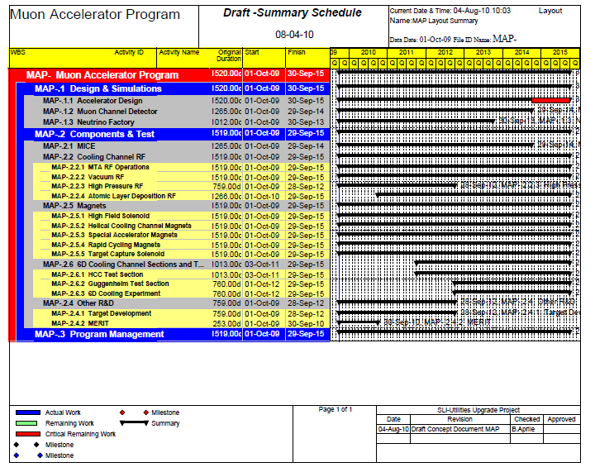
Management Tools (3)
Example output (no information content)

