Slide 1
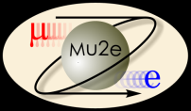


Muon-to-Electron Conversion Experiment (Mu2e) Detector Solenoid Design
August 3, 2010
Bryce Austell
University of Illinois
Fermilab SIST INTERN
Advisor: Ryuji Yamada

Slide 2
Outline
Mu2e Project
  Detector Solenoid
COMSOL Multiphysics
Calculations and Analyses with COMSOL Multiphysics
  Iron Endplates
  Axial Forces with Iron Endplates
  Coil Force Calculation Comparison
  DS and TS Current Manipulation
  Coil Force Calculation Comparison
Future Work
Acknowledgments

Slide 3
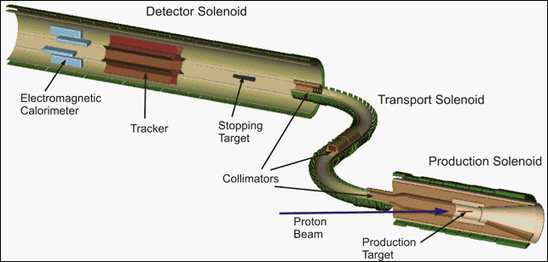
Mu2e Project at Fermilab
Aims to find neutrino-less conversion of muon to an electron in the Coulomb field of a nucleus
May provide further understanding of or remodeling of the Standard Model (SM)

Slide 4
Mu2e Detector Solenoid - Geometry

Slide 5
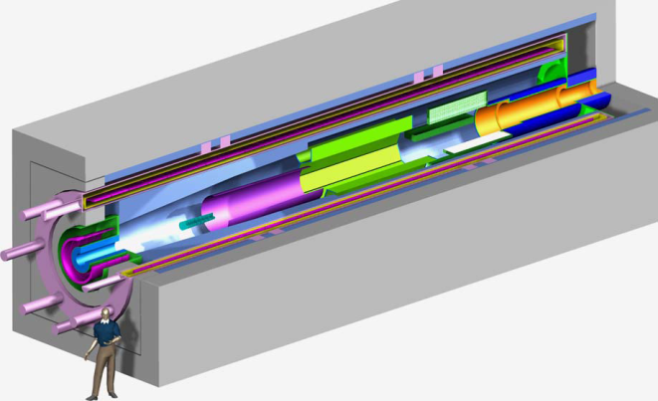
Mu2e Detector Solenoid
1. 2 to 1 Tesla Transition Region
Peak Field Along TS Axis | 2T
Gradient Linearity on axis | 5%
Value of gradient on axis | <0.3 T/m
2. Tracker Region
Field value in spectrometer | 1T +/- 0.02
Goal Field Uniformity in Spectrometer | 0.20%
Req. axial length of uniform field | 3 m
3. Calorimeter Region
Req. radius of uniform field | 0.7 m
Req. uniformity in calorimeter region | 1%
Req. axial length of field | 1.5 m
Muon Beam Stop
Tracker (T tracker will be used)
Calorimeter
Cryostat Inner Diameter | 1.9 m
Coil Length | 11.9 m
Maximum Cryostat outer Diameter | 2.66 m
Outer Dimension of Iron Box | 4.6 m
Thickness of Iron Box | 0.5 m
Focuses muons onto stopping target
Focuses converted electrons to tracker and electron calorimeter
Provides uniform solenoid field for tracker

Slide 6
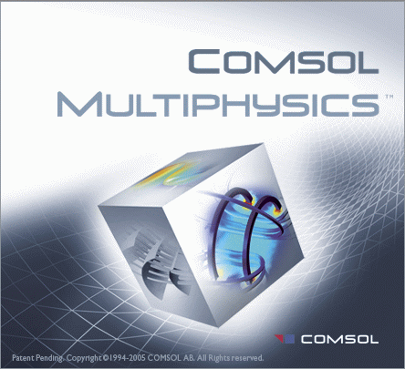
COMSOL Multiphysics
Finite Element Analysis (FEM) program
Gaining popularity: Many Multiphysics capabilities
Emerging Technologies:
  Alternative energy sources
  Biotechnology
  Microelectromechanical systems
  Optoelectronics
  Nanotechnology
Used for analysis of magnetic fields, axial forces, currents, and deformation

Slide 7
Calculations and Analyses with COMSOL
Problems to Investigate and Solve:
  Optimal geometry of Detector Solenoid?
  Magnetic Field Distribution?
  Axial Forces on Detector Solenoid?
  Current Densities in Coils?
  5 Coil, 7 Coil, or other Coil Arrangement?
  Can design meet project specifications?

Slide 8
COMSOL: Iron Endplates
Studies of magnetic flux and axial forces:
  One performed with 30 cm iron endplate
  One performed without 30 cm iron endplate

Slide 9
COMSOL: Iron Endplates
Magnetic field specification goal: 2 Tesla region, 3 m gradient, 1 Tesla region

Slide 10
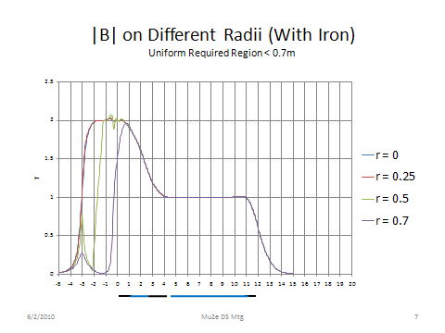
COMSOL: Iron Endplates
Iron Endplate Conclusion:
The magnetic fields in the gradient region and 1 Tesla region have only small differences between the iron endplate and no iron endplate.
Centerfield does not change drastically, but larger radii fields do.

Slide 11
COMSOL: Axial Forces With Iron Endplates
Conclusion:
Axial force greatest for 30 cm iron end plate and least for 5 cm iron endplate.
Trend: thinner endplate equates to a smaller force
Must consider fringing force however.

Slide 12
COMSOL: Coil Force Calculation Comparison
Conclusion:
Large Radius and Small Radius similar in forces
5 cm iron endplate optimal
Accidental reverse and off TS current cause bearable forces
DS and TS forces in opposite directions

Slide 13
COMSOL: DS and TS Current Manipulation
Coil | I Density | Height | Width
Ds 5 | 3.75E+07 | 1 | 0.03
Ds 4 | 2.67E+07 | 6.73 | 0.03
Ds 3 | 2.60E+07 | 1.73 | 0.03
Ds 2 | 4.45E+07 | 1.47 | 0.03
Ds 1 | 6.65E+07 | 0.93 | 0.03
Ts 1 | 1.30E+06 | 0.15 | 0.03
Ts 2 | 4.80E+06 | 0.15 | 0.03
Ts 3 | 7.50E+06 | 0.15 | 0.03
Ts 4 | 1.20E+07 | 0.15 | 0.03
Ts 5 | 2.10E+07 | 0.15 | 0.03
Ts 6 | 3.50E+07 | 0.15 | 0.03
Ts 7 | 2.50E+07 | 0.15 | 0.03
Ts 8 | 5.40E+07 | 0.15 | 0.03
Ts 9 | 6.15E+07 | 0.5 | 0.03
Ts 10 (1) | 6.35E+07 | 0.5 | 0.03
Ts 10 (2) | 6.55E+07 | 0.5 | 0.03
Ts 10 (3) | 6.50E+07 | 1 | 0.03
Conclusion:
The Magnetic flux density can be easily manipulated
Increasing local current increases local magnetic field
Decreasing local current decreases local magnetic field

Slide 14
COMSOL: DS and TS Current Manipulation
Conclusion for +/- 0.2 % Magnetic Field for 1 T Region:
Can be achieved for many specific designs by simple current manipulation.
However, this can be difficult and tedious.

Slide 15
COMSOL: DS and TS Current Manipulation
Practically there are many potential problems:
  Difficult to make conductor +/- 0.2% over several km in length
  Aligning every turn accurately requires much attention
  Potentially needs a correction coil – fixes winding and current

Slide 16
COMSOL: Coil Force Calculation Comparison
7 Coil Graded DS Design
5 initial coils, 1 gap and 2 latter coils
Easier to manipulate magnetic field gradient

Slide 17
COMSOL: Coil Force Calculation Comparison
7 Coil Graded DS Design Conclusion:
Best design in order to meet +/- 5.0 % gradient of magnetic field (2 T to 1 T drop)
Best design to fit detector devices (Tracker and Calorimeter) in +/- 0.2 % magnetic field 1 T region

Slide 18
Future Work
Finalize the conceptual design
  DS physical dimensions
  forces and field from TS
  weight from itself and absorber detector
  expected radiation loads
  technical specification of DS
  the conductor properties
  the coil properties, the cryostat
  iron geometry
  cryogenic system
  mechanical studies
  thermal studies
  radiation studies
  quench protection studies
  magnetic field studies
  alternate design considerations
Selection of Vendors
Construction
Data Collection / Results / Analysis

Slide 19
Acknowledgements
Thank you very much to the following individuals for their advising roles and assistance in research in the Technical Division at Fermilab.
Ryuji Yamada
Dr. Davenport
Cosmore Sylvester
Dianne Engram
Jamieson Olsen
The SIST Committee

Slide 20
Backup Slides
Geometries for the 30 cm Iron Endplate and 0 cm Iron Endplate DS Designs
30 cm Iron Endplate to be used for reduction of Fringing Field by the TS coil
This will be used despite the force on the coil being bigger

