Slide 1
Dark Energy Survey via technique of counts of Galaxy Clusters
Salem Cherent
Senior in Mechanical Engineering
At University of Illinois at Urbana Champaign
Fermi lab SIST Presentation
3 august, 2010
Advisor: Juan Estrada

Slide 2
Outline
Background
Previous works
My project
Results
Recommendation

Slide 3
Dark Energy Survey
is an optical imaging survey project led by Fermi lab to make precision measurements of dark energy using four independent techniques : Counts of Galaxy Clusters, Weak Lensing Shear Tomography, Supernovae redshift, and Baryon Acoustic Oscillations.

Slide 4
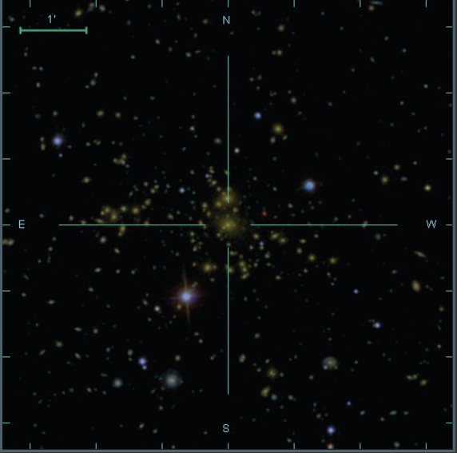
My Involvement
Dark Energy Survey via technique of counts of Galaxy Clusters
Developing GUI for analyzing images from CCD
Notes:
Slide from Juan Estrada

Slide 5
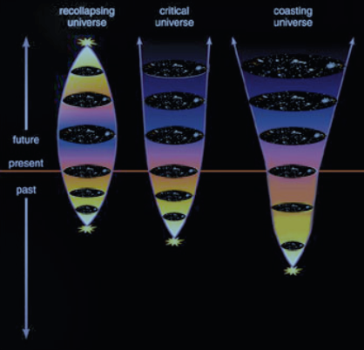
Notes:
Slid from Juan Estrada

Slide 6
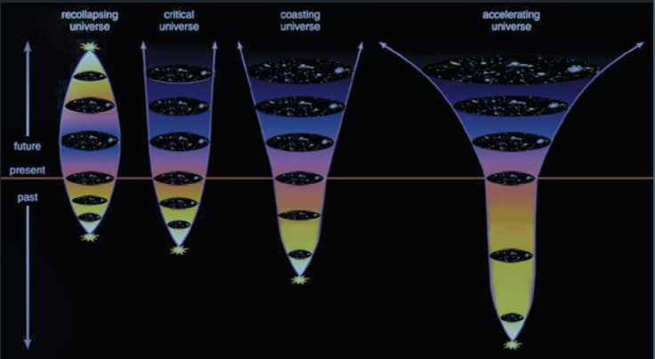
Notes:
Slide from Juan Estrada

Slide 9
Notes:
http://map.gsfc.nasa.gov/media/080998/index.html

Slide 10
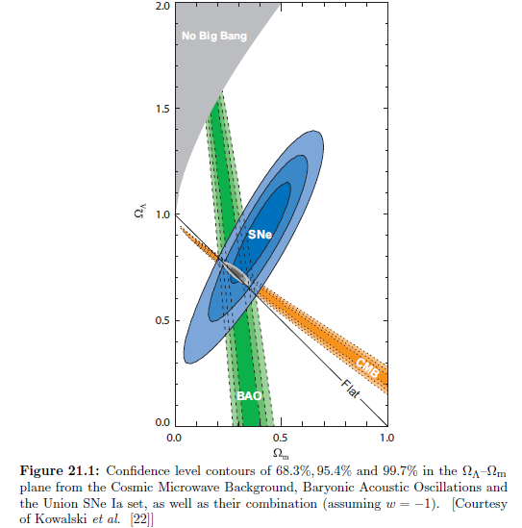
Notes:
] O. Lahav and A.R. Liddle. 2009. “THE COSMOLOGICAL PARAMETERS”

Slide 11
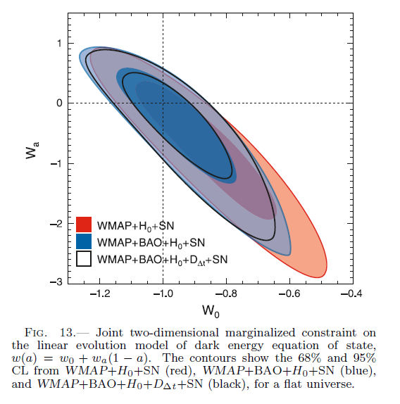
Notes:
Want to calculate w and sigma w that is much smaller than this plot
E. Komatsu, K. M. Smith, J. Dunkley, C. L. Bennett, B. Gold, G. Hinshaw, N. Jarosik, D. Larson, M. R.Nolta8, L. Page7, D. N. Spergel, M. Halpern, R. S. Hill, A. Kogut, M. Limon, S. S. Meyer, N.Odegard, G. S. Tucker, J. L. Weiland, E. Wollack, and E. L. Wright. February 21, 2009. “COSMOLOGICAL CONSTRAINTS FROM THE SDSS MAXBCG CLUSTER CATALOG.” Draft version.

Slide 12
W and σ_{w} Results
For example, Kowalski et al. [22] deduced from SNe Ia combined with CMB and Baryonic Acoustic Oscillations (BAO) data, assuming a flat universe, that w = −0.97 ± +0.06 ± 0.06 (stat, sys) and Ωm = 0.274 ± 0.016 ± 0.012. Similarly Kessler et al. [24] estimated w = −0.96±0.06±0.12 and Ωm = 0.265±0.016±0.025, but they note a sensitivity to the light-curve fitter used.

Slide 13
Definitions
Correlation Function-“…[a function that] determines the probability of finding two objects at separation r in excess of the probability one would expect for independent distribution.” (Grin)
Notes:
In mathematics, the Fourier transform (often abbreviated FT) is an operation that transforms one complex-valued function of a real variable into another.

Slide 14
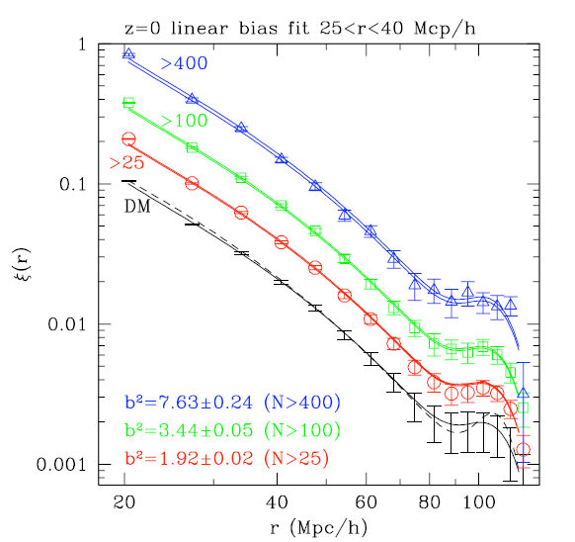
Notes:
Halo Models of Large Scale Structure
Asantha Cooray (Caltech), Ravi Sheth (University of Pittsburgh)

Slide 15
Objective
Get a value for w by comparing a model bias with measured or simulated bias.
Get sigma w, preferably, less than 0.06

Slide 16
Methods
Step 1 – Develop a mathematica based tool to compute the bias, then generate bias values for different masses and redshifts
Step 2- Develop a mathematica based tool to compute the probability – which compares model data to measured/simulated data
$P(b0,w)=\frac{1}{{(2πσ_{b})}^{\frac{Nm}{2}}}e^{−\frac{{\sum_{i=0}^{Nm}{{(bdata}_{i}−b0∗{bmodel}_{i}})}^{2}}{2∗{σ_{b}}^{2}}}$
Where b0=1, Nm – number of data points
And find the max-likelihood

Slide 17
Step 3 – Use the same equation but keep w constant instead and b0 as a variable.
Step 4 – keep both w and b0 as variables then take compute the integral
$$P\left(w\right)=\int{P\left(b0,w\right)db0}$$
To get P(w) then find the Max-likelihood

Slide 18
$$Figure 1:GUI for computing bias$$

Slide 19
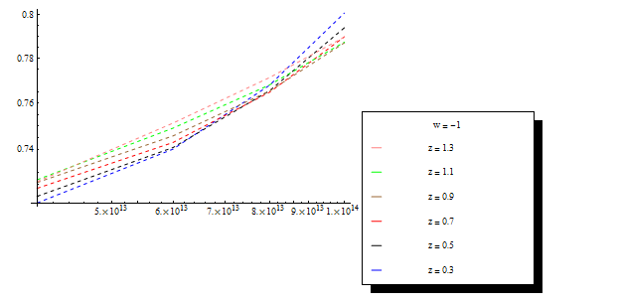
Figure 2: Bias values as a function of mass for different redshift values and w = -1

Slide 20
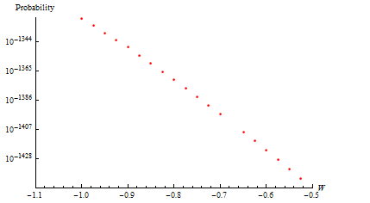
Figure 4: P(b0,w) at b0 = 1

Slide 21
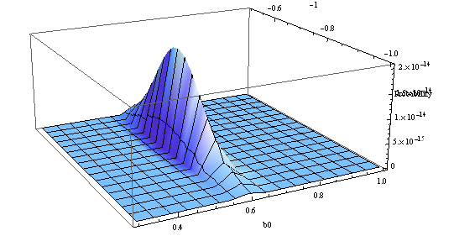
Figure 5: P(b0,w)

Slide 22
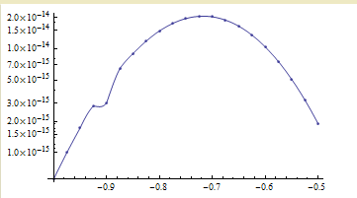
Figure 6: $P\left(w\right)=\int{P\left(b0,w\right)db0}$

Slide 23
Results
 | b0-constant | w constant | P(b0,w) | P(w)
P(w)- max | @ w = -1 | - | @ w = -0.71 & b0 = 0.61 | @ w = -0.716488
σ_{w @} σ_{D}=0.03 | 0.002853 | - | - | 0.098
b0-Max | - | 0.61224 | - | -
The above table results are for measured data from simulation. When a model at w = -0.975 is used as a data we get w = -0.975182 and σ_{w} = 0.0715
Notes:
cosmological parameters as follows:$Ω_{DE}=0.70,$
$$Ω_{m}=0.3, w_{o}=−1,{ w}_{a}=0, z=0, Ω_{b}=0.045, h=0.7, ns=0.95, σ_{8}=0.9$$

Slide 24
Recommendation
When calculating the bias, the first value of a mass threshold was used. Therefore, instead using a constant mass for the bias, using a mass threshold would result in a better final result.
A tool for computing a bias for mass threshold is already made but it is still just a code so creating a GUI for that would be something to consider.

Slide 25
Relevant Equations
$H^{2}={(\frac{\dot{R}}{R})}^{2}=\frac{8πG∗ρ}{3}$ (1)
$H_{0}=2.133∗{10}^{−33}eV/ℏ$ (2)
$H^{2}={H_{0}}^{2}(Ω_{m}{\left(1+z\right)}^{3}+Ω_{DE}{(1+z)}^{3(1+w)})$ (3)
$δ_{sc}=\frac{3}{5}{(\frac{3π}{2})}^{\frac{2}{3}}∗(1+z)$ (4)

Slide 26
$R(m)={(\frac{3m}{4πρ})}^{\frac{1}{3}}$ (5)
${σ(m)}^{2}=\int_{0}^{∞}{\frac{dk}{k}\frac{k^{3}P^{lin}(k)}{2π^{2}}{|W(kR)|}^{2}}$ (6)
$W\left(x\right)=\frac{3}{x^{3}}(Sin\left(x\right)−xCos(x))$ (7)
$ν≡\frac{{δ_{sc}}^{2}}{{D(z)}^{2}∗{σ(m)}^{2}}$ (8)
$E_{1}=\frac{\frac{2∗p}{δ_{sc}}}{1+{(q∗ν)}^{p}}$ (9)
Notes:
Where, G = 6.67*10⁻¹¹m³kg⁻¹s⁻²
$$ℏ=1.055∗{10}^{−34}Js$$
eV = 1.602*10⁻¹⁹J
$$Ω_{DE}−Dark Energy density parameter$$
$$Ω_{m}−mass density parameter$$
Z – red shift, w=p/ρ, δsc(z) is the critical density required for spherical collapse, m-mass,(in Ms)
Ms-mass of sun = 1.989*10³⁰kg, ρ-density in (Ms/Mpc), Mpc - Mega parsec = 3.086*10²⁴ cm
$P^{lin}\left(k\right)−power spectrum (\frac{{Mpc}^{3}}{h^{3}})$ , k (h/Mpc), h, p and q are dimensionless constants, b1- bias, L- likelihood, $σ_{b}−the error in Bias$
$σ_{w}−error in w$, D (z) = Growth factor, Nm-Sample number
b0 –a constant that that multiplies the measured bias data

Slide 27
$ε_{1}=\frac{q∗ν−1}{δ_{sc}}$ (10)
$b_{1}=1+ε_{1}+E_{1}$ (11)
$P(b0,w)=\frac{1}{{(2πσ_{b})}^{\frac{Nm}{2}}}e^{−\frac{{\sum_{i=0}^{Nm}{{(bdata}_{i}−b0∗{bmodel}_{i}})}^{2}}{2∗{σ_{b}}^{2}}}$ (12)
$P\left(w\right)=\int{P\left(b0,w\right)db0}$ (13)
$b\left(mass threshold\right)= \frac{\int{b_{i}∗\frac{ρm}{m}∗f(ν)dν}}{\int{\frac{ρm}{m}∗f(ν)dν}}$ (14)
$f\left(ν\right)=A(p)(1+{\left(qν\right)}^{−p}){(\frac{qν}{2π})}^{1/2}e^{(\frac{qν}{2})}$ (15)
$A\left(p\right)={[1+\frac{2^{−p}Γ(\frac{1}{2}−p)}{\sqrt{π}}]}^{−1}$ (16)

