Slide 1
Picosecond Fiber Pulsed Laser
Courtney Clarke
Fermilab SIST
Supervisors:
Jinhao Ruan & Jamie Santucci
Notes:
no acronyms after the 1st time

Slide 2

Outline
  An Introduction
  The PSL system
    Laser 101,102,102.5
    Ultra-short pulses
  My results
    Plots & Conclusions
Notes:
Here is an outline of my presentation today…

Slide 3

Outline
ME
  Miami University of Ohio
  Sophomore
  Mechanical Engineer Major and Electrical Minor
  The Canadian Soccer player
Notes:
A little bit about me
I’m Courtney a…..

Slide 4
Introduction
My experiment
  Picosecond Pulsed Fiber Laser (PSL)
    Yb-doped Seed laser
    Produces pulses of 5 ps at 1.3 GHz repetition rate and 1054 nm
    Replace A0 seed laser in NML
    Based on new fiber technology
    My Goal is to characterize the laser in terms of:
      Jitter, wavelength, pulse width, repetition rate, power, and beam spot sizes
Notes:
I’ve been working at the A0 on the Picosecond Pulsed Fiber Laser (PSL)
The PSL uses a Yb fiber as a gain media…

Slide 5
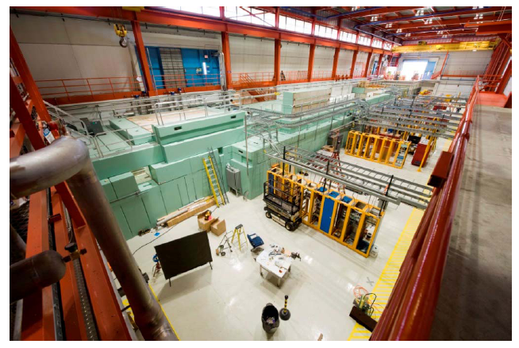
Introduction
A0PI
  Uses the drive laser to make electron bunches
  To be transferred to NML
  Currently housing a diode pumped Nd:YLF seed laser
NML
  SCRF accelerator test facility
  Tests accelerator components
Notes:
Drive laser photon source is the seed laser which is currently a Neodymium Doped:Yttrium Lithium Fluoride laser
Regarding the New Muon Lab Facility:
-It will consist of a drive laser; a photocathode in an RF-electron gun within the Photoinjector; a beam acceleration section of up to 6 SCRF cavities, several downstream beamlines for testing and diagnostic, and a beam dump
-Also for testing RF-equipment and instrumentation, and to development of Low Level RF and control systems (for future SCRF accelerators such as ILC and Project-X linear proton accelerator)

Slide 6
Photoinjector (PI)
RF Electron Gun
Drive Laser Photons
Electron Bunches
U
S
E
R
e-
e-
e-
e-
e-
e-
e-
e-
Photoelectric Effect
Photocathode

Slide 7

Introduction
SIST
  One of many programs that target undergraduates, giving youth experience in science and technology
Fermilab
  A facility open for user research where people from around the world can perform experiments with its cutting edge technology
Office of Science of DOE
  A department of DOE that support universities, U.S. industry, non-profit sector, and national laboratories

Slide 8

Recap
    Me
    +
    My PSL Experiment
    +
    A0PI & NML
    +
    SIST
    +
    Fermilab
    +
    Office of Science, DOE
    =
    Happy Fermilab ☺

Slide 9

PSL
Why PSL?
  “P”= Pulsed
Why Pulsed?
  So the photons are emitted periodically to created synchronized electron clusters
So what?
  For the USERS to RESEARCH!
But what’s so special about the pulses?
  They are ULTRA-SHORT
Meaning?
  They are ps in length, hence “P-S-”L. (10⁻¹²)
How do you do that?
  Well…
Notes:
So if I were to have a conversation with you it would go like this:
I’m not sure about the acronym but “P” is for pulsed…

Slide 10
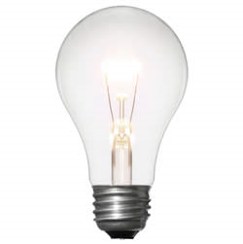
Laser 101
What is light?
  Light is an electromagnetic wave that can propagate through vacuum at about 300,000,000 m/s
  For example: a light bulb has a broad span of wavelengths, and random phases shining in all directions
Why light?
  Light = Photons = ENERGY
  For an electron to be excited it must absorb the energy that corresponds the energy between the ground and that excited state
  So, for an electron to be ejected from an atom is must obtain a specific amount of energy
  So if a light bulb cannot be used to produce a steady flow of electrons because of the random energies what can?
Notes:
So back to the basics…
Why light? Simplest way to say it….

Slide 11

Laser 101
A laser can!
  A laser is unidirectional and has discretely set wavelengths, so you can set the amount of power your atoms gets to release electrons
A laser has 3 parts:
  Excitation mechanism: lasers energy source
  Excitation medium: Media that is excited to produce coherent light
  Optical resonator: A cavity that amplifies the light then emits it through the output coupler
So What?
Notes:
So what? Well hold on…let me explain further

Slide 12
Laser 101
Cavity
Photon
Excitation Media
`
Output
Coupler
Until…
Then…
100% reflective mirror
Notes:
(*********11 CLICKS)
Photons from excitation media (form with stimulated emission **what the initial power source?)
Amplifies at each end until…a high intensity beam
Then…at a specific intensity the outlet coupler(semi-transparent mirror) allow light to pass through as laser light

Slide 13
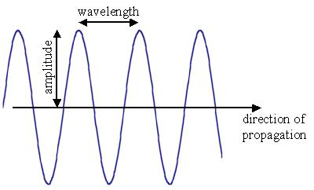
Laser 102
Recap: A light is an electromagnetic wave
  Can be modeled as a standing wave inside the cavity
    What do waves do?
      Waves interfere or superimpose
Mode Locking
  When waves interfere to created ultra-short pulses at a specified pulse repetition rate
  Note:
    First: A laser has a NARROW bandwidth all centered
    around the center wavelength determined by the media
    Second: The cavity length determines the repetition
    rate of the light that survives in the cavity, and the
    repetition rate syncs with an RF-Signal
Notes:
Because the amount of energy needs a specific wavelength of light to be excited, but it is not EXACTLY one wavelength
If only the harmonics of the fundamental frequency survive and superimpose then pulses are made. Since waves superimpose the cavity is made so that all other frequency interfere destructively, and only one frequency survives
For example…

Slide 14
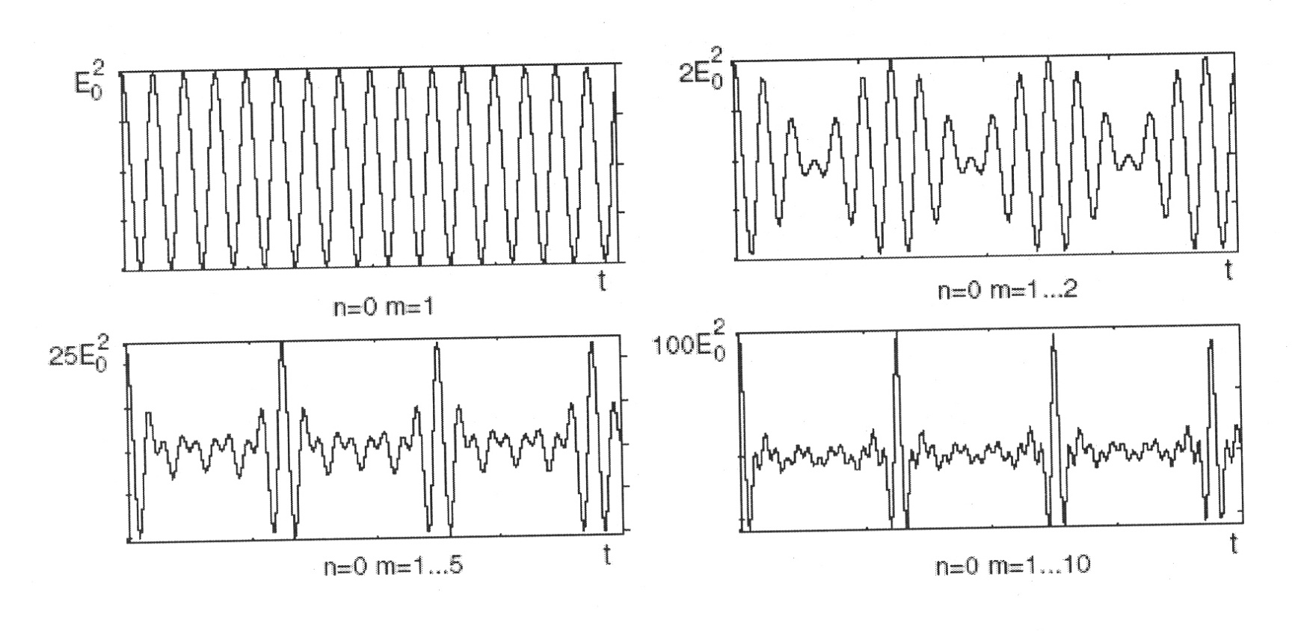
Laser 102
When standing waves of the fundamental frequency superimpose in a certain way you get pulses
n^{th} Longitudinal Modes (m_{n})
Certain way?
Notes:
(***********1 CLICK)
Say longitudinal mode “m” has a certain has a certain wavelength
…… ASK JINHAO!

Slide 15

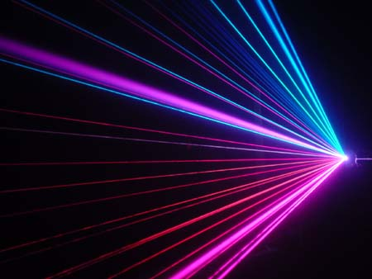
Laser 102
Conditions?
  This condition creates the interference pattern of ultra-short pulses:
  every “standing wave” of different wavelengths must be in PHASE
How?
  Piezoelectric Stage: adjusts length of cavity
  AM modulation: keeps signals phase locked by Modulator controlled via Modulator Bias voltage
  Well lets see…

Slide 16
Laser 102.5
Cavity
Photon
Excitation Media
Voilà! Pulses
1.3 GHz
Outlet
Coupler
Interference until…
100% reflective mirror
Notes:
(************10 CLICKS)
How modulator works:
Pulses are supposed to be evenly spaced at 1.3 GHz
Modulator bias voltage controls the mode-locking ability, so the Modulator work best when the modulator bias voltage is set to produce the best locking. This voltage is said to drift…but I will talk more on this later.

Slide 17
Laser 102.5.5
Excitation Mechanism
Excitation Medium
Optical Cavity
Output
Coupler
Mode-lock
Inputs & Displays
Notes:
(******************7 CLICKS)

Slide 18
Recap
    Laser waves
    +
    Principle of superposition
    +
    Mode-locking
    +
    Modulator
    +
    photocathode
    +
    ME
    =
    Electron Bunches & happy USERS ☺
Notes:
(**************2 CLICKS)
Me…maybe not
But I’m sad…

Slide 19
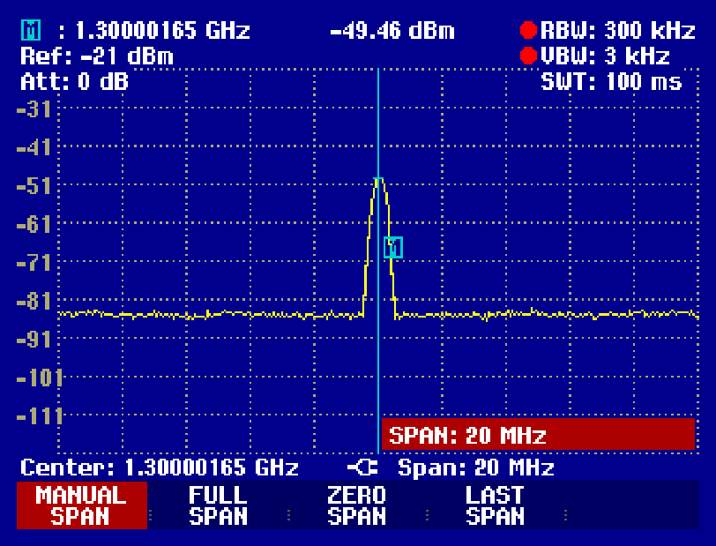
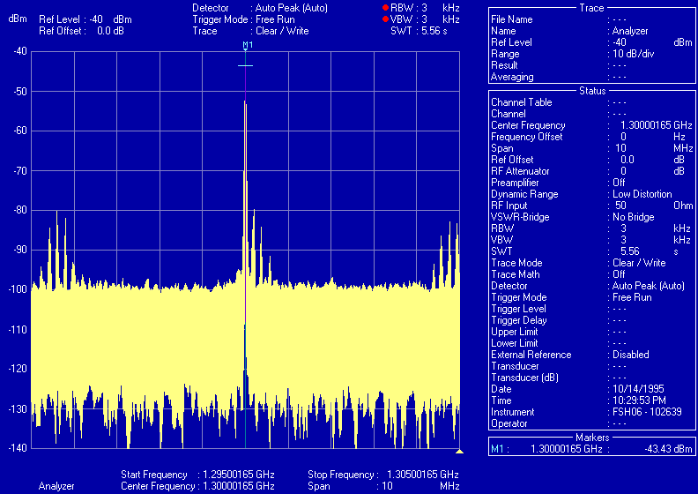
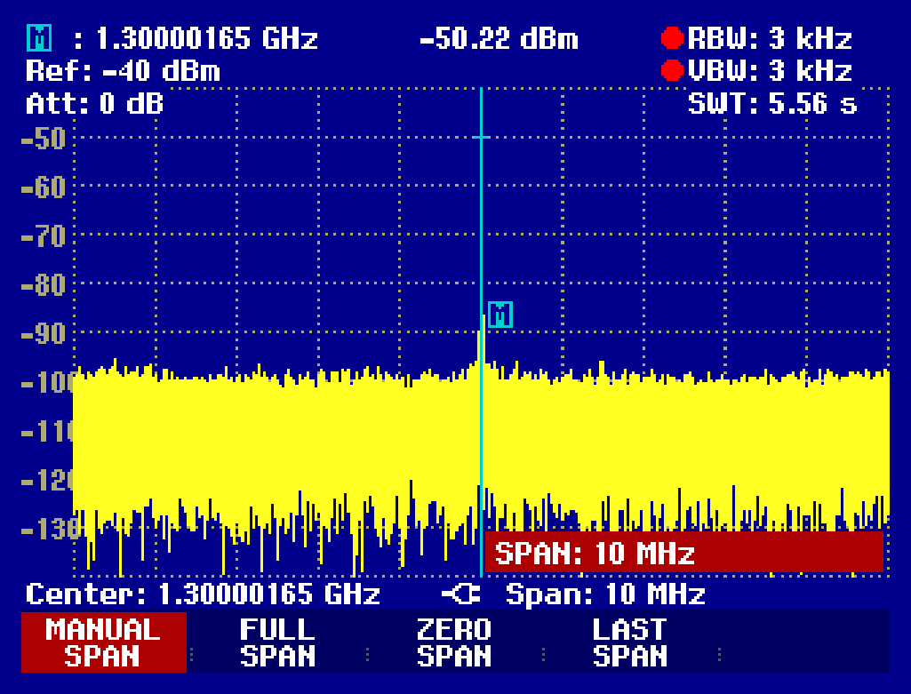
Results
Low Resolution RF-Spectra (300 kHz)
Ugly “Sidebanded” RF-Spectra
at Modulator Voltage -3 V (3 kHz)
However, it is possible to get a clean RF-spectrum and 1.51 V and 52.64 mW (3 kHz)
Why is this important?
Notes:
OSA Traces:
Vertical: Power in dBm
Horizontal: Wavelength where peak is the central wavelength of the media
“Zoomed out” by adjusting the Video band wdith (VBW). Looks good right but actually….
Sidebands can be a sign of back locking to 1.3 GHz
We can get a clean spectrum, but the power is much lower than the proposed power: -50.22 dBm rather than -10 dBm!

Slide 20
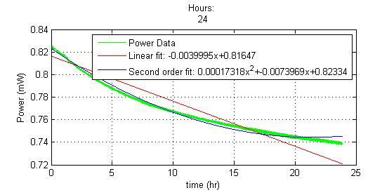
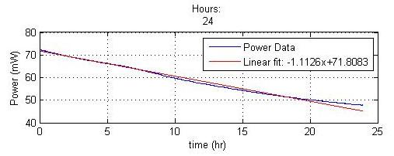
Results
Output B
What then?
Output A
Notes:
(****************5 CLICKS)
Mode-locking is how we get pulses, and if we cannot mode-lock there is no use in testing jitter, or repetition rate….or for the matter keeping the laser at all
Anyways…
After checking the spectra we noticed that the scanning the modulator bias.
Vertical: Power mW
Horzontal: Modulator Bias Voltage
Voltage the power changes differently each day, this means that the modulator bias drifts randomly over time….Which is very bad, because we cannot predict how it will change.
Next we tested the power output at a specific voltage, and we noticed….a downward trend
(******************4 CLICKS)

Slide 21

Solutions & Future Work
The PSL is not meeting specifications so…
  Solution: Feedback circuit
    However, this would be very complicated to do because you have to find the equilibrium of spectra and power
Further testing:
  Pulse duration
  Jitter
  Test A0PI laser
  Find the “magic” modulator bias point!
Lots of work to do!
Notes:
(********1 CLICK)
To find optimal modulator bias for EVERYTHING!
Have to find the point where you can get the optimum power and the cleanest spectra, because these modulator bias points are not the same!
At the moment my supervisor and Calmar Lasers are discuss possible solutions to the power drift. They say that the drift is in inherent property of the Electro-optics modulators and is unavoidable. Therefore the two major possibilities include:
-A new and Better modulator
Or the Feedback circuit

Slide 22
Recap all
    ME
    +
    PSL
    +
    Fermilab
    +
    Stable Power
    +
    Clean spectrum
    =
    Happy Fermilab, Happy Users,
    but especially
    Happy ME ☺
Notes:
Me…maybe not

Slide 23

Acknowledgements
Fermilab SIST staff
The A0PI staff
A0 Drafting Staff
The other summer interns
My family
And God
Notes:
Especially Dianne, Linda, Dr. Davenport, Jamieson my SIST mentor Dave Peterson for this internship opportunity
Especially Jamie and Jinhao the support through the duration of my program
Especially Stewart Mitchell for all the technical support
Especially my housemates
For giving me up for a summer
For making it all possible

Slide 24
Questions?

Slide 25
References
Reference list:
[1] Office of High Energy Physics, Office of Science, U.S. Department of Energy, “Exploring the Quantum Universe,” June 2010, http://www.science.doe.gov/hep/index.shtml.
[2] U.S. Department of Energy, “National Labs,” July 2010, http://www.energy.gov/sciencetech/nationallabs.htm.
[3] Fermilab, “Fermilab Facts,” January 2010, http://www.fnal.gov/pub/presspass/factsheets/pdfs/Fermilab_Overview_2010.pdf.
[4] A0 Photoinjector and SCRF Facilities, Fermi National Accelerator Laboratory, “A0 Photoinjector and SCRF Facilities,” June 2010, http://www-a0.fnal.gov/.
[5] DESY, “Getting There,” July 2010, http://www.desy.de/about_desy/getting_there/index_eng.html.
[6] Antonine Education, “em_spectrum.jpg,” July 2010, http://www.antonine-education.co.uk/physics_gcse/Unit_1/Topic_5/em_spectrum.jpg.
[7] Calmar Lasers, Inc, “Picosecond Pulsed Fiber Laser Instruction Manual,” Manual No.: Man-880690.
[8] Winter, Axel, “Fiber Laser Master Oscillators for Optical Synchronization systems.” PhD diss., University of Hamburg, Germany, 2008.
[9] Porta Optica, “Chormatic Diserpsion,” July 2010, http://pos.lumii.lv/uploads/prezentacijas/piotr-4.pdf.
[10] Yariv, Amnon. “The Propagation of Optical Beams in Homogenous and Lenslike Media” & “Q-Switching and Mode Locking of Lasers”, in Quantum Optics, 2nd ed. New York: John Wiley & Sons: 1975, ch. 6, pp. 99-115, ch. 11, pp. 256-262.
[11] Optoelectronics Business Division, Sumitomo Osaka Cement Co., LTD, “Application Note for LN Modulators”, July 2002, http://www.lambdaphoto.co.uk/pdfs/SumitomoModulatorApplicationNote.pdf.
[12] University of Cambridge, “Population Inversion,” July 2010, http://www.sp.phy.cam.ac.uk/~SiGe/Population%20Inversion.html.
[13] Wikipedia, “Stimulated Emission,” July 2010, http://en.wikipedia.org/wiki/Population_inversion#Stimulated_emission.
[14] Encyclopedia of Laser Technology, “Ytterbium-Doped Gain Media,” July 2010, http://www.rp-photonics.com/ytterbium_doped_gain_media.html.
[15] Calmar Laser, Inc., “Low Dispersion Amplifier Instruction Manual,” Manual No.: Man-880691.
[16] Calmar Laser, Inc., “Electronic Pulse Generator Instruction Manual,” Manual No.: Man-880689.
[17] A. Brun, P. Georges, G. Le Saux, and F. Salin, “Single-Shot Characterization of Ultra-short light pulses,” J. Phys. D: Appl. Phys. 24, U.K.: January 1991, pp. 1226-1233.
[18] Agilent Technologies, “Agilent 86140B Series Optical Spectrum Analyzer User’s Guide,” http://cp.literature.agilent.com/litweb/pdf/86140-90068.pdf.
[19] Thorlabs Instrumentation, “Optical Power Meter System,” 2006, http://www.thorlabs.com/Thorcat/12200/12271-D02.pdf.
[20] Rossi, R. S., Physics Eng., Turin Polytechnic, “Phase comparator” Accelerator Div., Fermilab, Summer 2009.

