Slide 1
Particle Accelerators
Part 2
Eric Prebys
FNAL Accelerator Physics Center

Slide 2
Today’s outline
Some “tricks of the trade”
  Ion injection
  Beam injection/extraction/transfer
  Instrumentation
Special topic
  pBars
Case Study: LHC
  Design Choices
  Superconductivity
  Specifications
  “The Incident”
  Current status
  Future upgrades
Overview of other accelerators
  Past
  Present
  Future

Slide 3
Linac -> synchrotron injection
Most accelerators start with a linear accelerator, which injects into a synchrotron
In order to maximize the intensity in the synchrotron, we can
  Increase the linac current as high as possible and inject over one revolution
    There are limits to linac current
  Inject over multiple (N) revolutions of the synchrotron
    Preferred method
Unfortunately, Liouville’s Theorem says we can’t inject one beam on top of another
  Electrons can be injected off orbit and will “cool” down to the equilibrium orbit via synchrotron radiation.
  Protons can be injected a small, changing angle to “paint” phase space, resulting in increased emittance
Linac emittance
Synchrotron emittance

Slide 4
Ion (or charge exchange) injection
Magnetic chicane pulsed to move beam out during injection
Circulating Beam
Beam at injection
H⁻ beam from LINAC
Stripping foil
Instead of ionizing Hydrogen, and electron is added to create H⁻, which is accelerated in the linac
A pulsed chicane moves the circulating beam out during injection
An injected H⁻ beam is bent in the opposite direction so it lies on top of the circulating beam
The combined beam passes through a foil, which strips the two electrons, leaving a single, more intense proton beam.
Fermilab was converted from proton to H⁻ during the 70’s
CERN still uses proton injection, but is in the process of upgrading.

Slide 5
Injection and extraction
We typically would like to extract (or inject) beam by switching a magnetic field on between two bunches (order ~10-100 ns)
Unfortunately, getting the required field in such a short time would result in prohibitively high inductive voltages, so we usually do it in two steps:
fast, weak “kicker”
slower (or DC) extraction magnet with zero field on beam path.

Slide 6
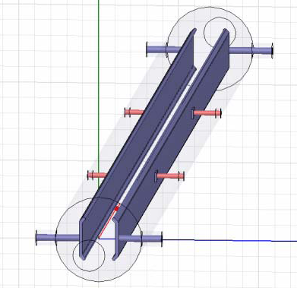
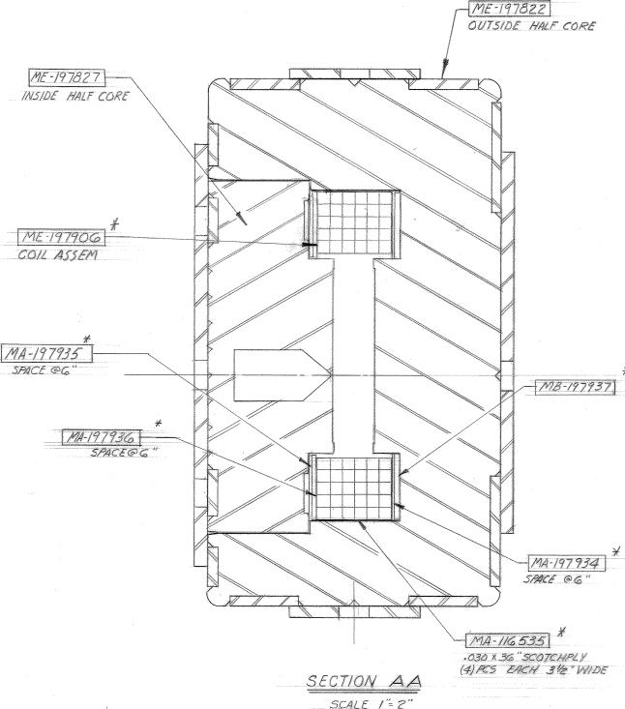
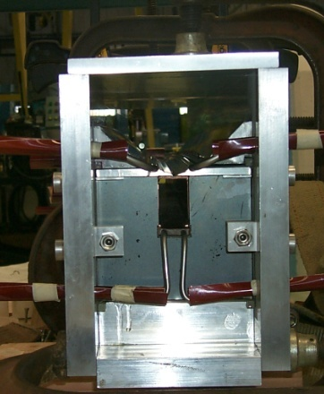
Extraction hardware
“Fast” kicker
usually an impedance matched strip line, with or without ferrites
“Slow” extraction elements
“Lambertson”: usually DC
Septum: pulsed, but slower than the kicker
circulating beam (B=0)
circulating beam (B=0)
B
current “blade”
B
return path

Slide 7
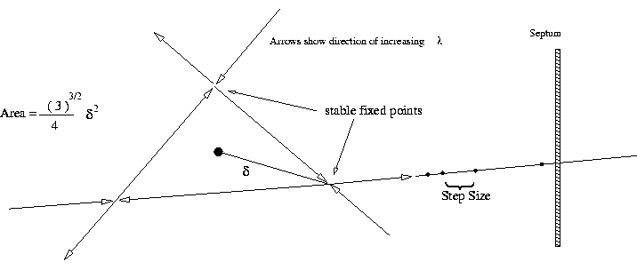
Slow Extraction
A harmonic resonance is generated
  Usually sextupoles are used to create a 3rd order resonant instability
Tune the instability so the escaping beam exactly fills the extraction gap between interceptions (3 times around for 3rd order)
  Minimum inefficiency ~(septum thickness)/(gap size)
  Use electrostatic septum made of a plane of wires. Typical parameters
    Septum thickness: .1 mm
    Gap: 10 mm
    Field: 80 kV
particle flow
E
Particles will flow out of the stable region along lines in phase space into an electrostatic extraction field, which will deflect them into an extraction Lambertson

Slide 8
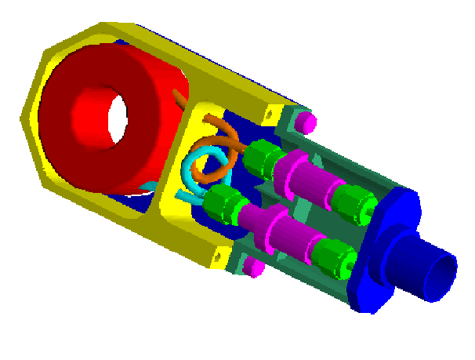
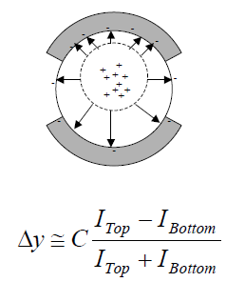
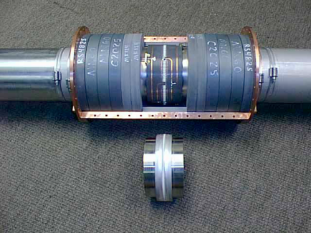
Standard beam instrumentation
Bunch/beam intensity are measured using inductive toriods
Beam position is typically measured with beam position monitors (BPM’s), which measure the induced signal on a opposing pickups
Longitudinal profiles can be measured by introducing a resistor to measure the induced image current on the beam pipe -> Resistive Wall Monitor (RWM)

Slide 9
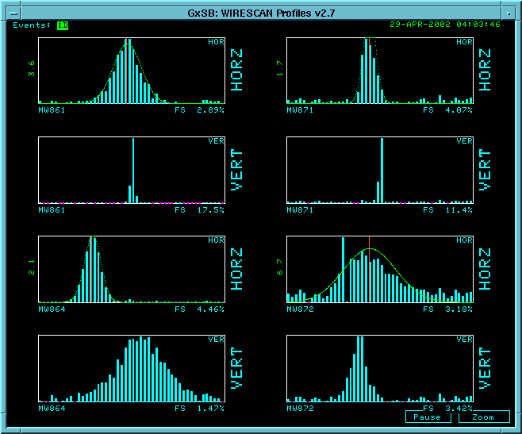
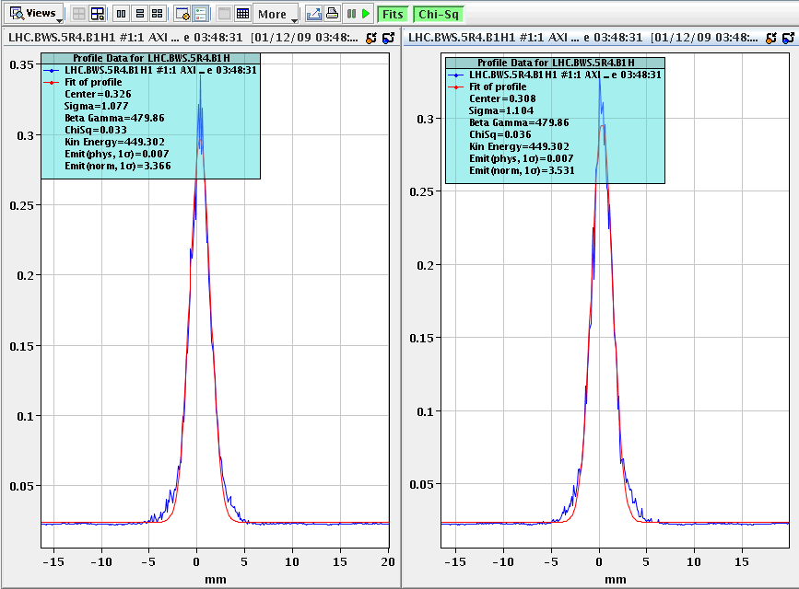
Beam instrumentation (cont’d)
Beam profiles in beam lines can be measured using secondary emission multiwires (MW’s)
Can measure beam profiles in a circulating beam with a “flying wire scanner”, which quickly passes a wire through and measures signal vs time to get profile
Non-desctructive measurements include
  Ionization profile monitor (IPM): drift electrons or ions generated by beam passing through residual gas
  Synchrotron light
    Standard in electron machines
    Also works in LHC
Beam profiles in MiniBooNE beam line
Flying wire signal in LHC

Slide 10
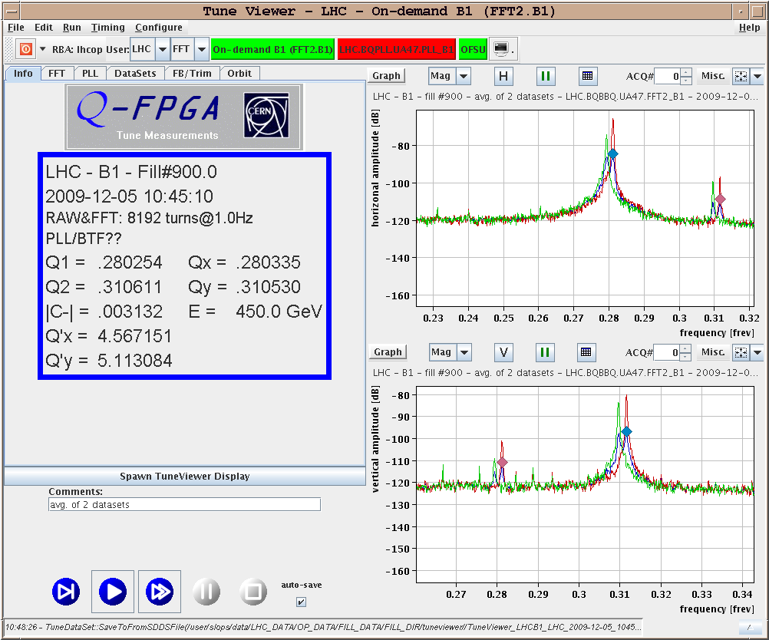
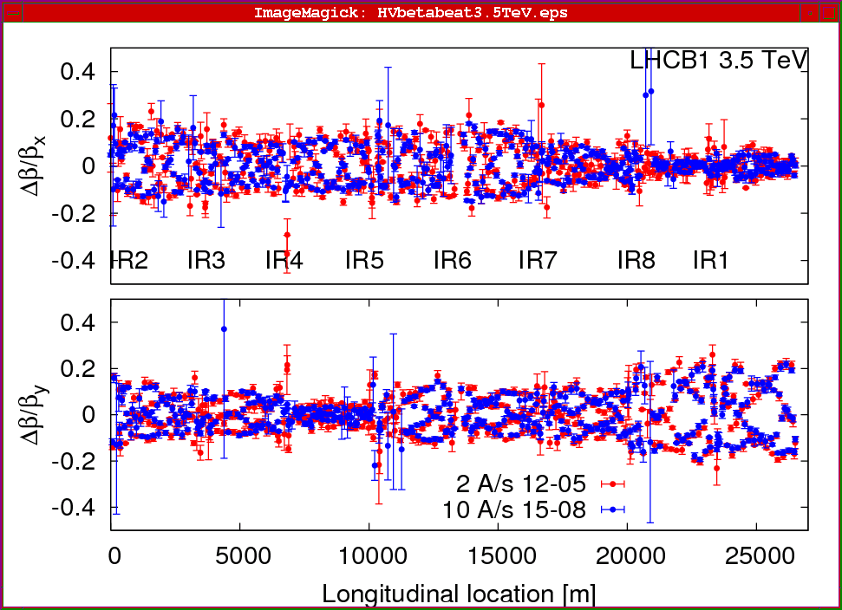
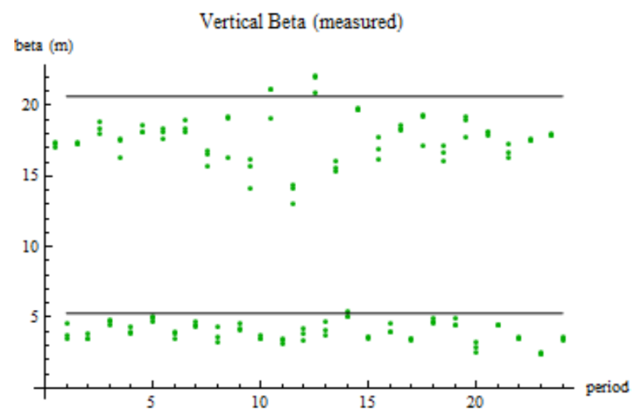
Measuring lattice parameters
The fractional tune is measured by Fourier Transforming signals from the BPM’s
  Sometimes need to excite beam with a kicker
Beta functions can be measured by exciting the beam and looking at distortions
  Can use kicker or resonant (“AC”) dipole
Can also measure the by
functions indirectly by
varying a quad and measuring
the tune shift

Slide 11

A case study: the LHC
How were the choices made?
  Colliding beams vs. fixed target
  Protons vs. electrons
  Proton-proton vs. proton anti-proton
  Superconducting magnets
  Energy and Luminosity
Done
Done

Slide 12
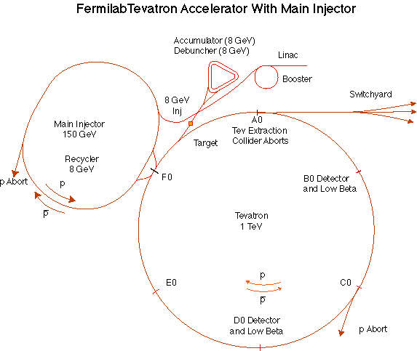
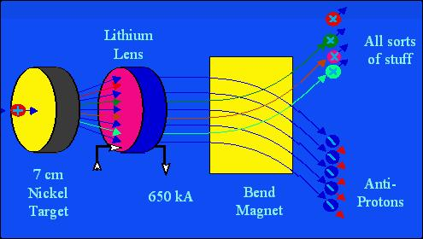
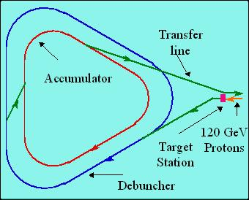
Special Topic: Fermilab Antiproton Source
120 GeV protons strike a target, producing many things, including antiprotons.
a Lithium lens focuses these particles (a bit)
a bend magnet selects the negative particles around 8 GeV. Everything but antiprotons decays away.
The antiproton ring consists of 2 parts – the Debuncher
– the Accumulator.

Slide 13




Antiproton Source – debunching
Particles enter with a narrow time spread and broad energy spread.
High (low) energy pbars take more (less) to go around…
…and the RF is phased so they are decelerated (accelerated),
resulting in a narrow energy spread and broad time spread.
At this point, the pBars are transferred to the accumulator, where they are “stacked”

Slide 14
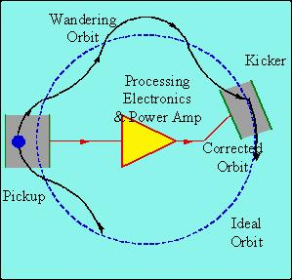
Stochastic cooling of antiprotons
Positrons will naturally “cool” (approach a small equilibrium emittance) via synchrotron radiation.
Antiprotons must rely on active cooling to be useful in colliders.
Principle: consider a single particle
which is off orbit. We can detect
its deviation at one point, and
correct it at another:
But wait! If we apply this technique
to an ensemble of particles, won’t
it just act on the centroid of the
distribution? Yes, but…
Stochastic cooling relies on “mixing”, the fact that particles of different momenta will slip in time and the sampled combinations will change.
Statistically, the mean displacement will be dominated by the high amplitude particles and over time the distribution will cool.

Slide 15
Proton-Proton vs. Proton-antiproton
Beyond a few hundred GeV, most interactions take place between gluons and/or virtual “sea” quarks.
  No real difference between proton-antiproton and proton-proton
Because of the symmetry properties of the magnetic field, a particle going in one direction will behave exactly the same as an antiparticle going in the other direction
  Can put protons and antiprotons in the same ring
    This is how the SppS (CERN) and the Tevatron (Fermilab) have done it.
The problem is that antiprotons are hard to make
  Can get >1 positron for every electron on a production target
  Can only get about 1 antiproton for every 50,000 protons on target!
  Takes a day to make enough antiprotons for a “store” in the Fermilab Tevatron
  Ultimately, the luminosity is limited by the antiproton current.
Thus, the LHC was designed as a proton-proton collider.

Slide 16
Superconducting magnets
For a proton accelerator, we want the most powerful magnets we can get
Conventional electromagnets are limited by the resistivity of the conductor (usually copper)
The field of high duty factor conventional magnets is limited to about 1 Tesla
  An LHC made out of such magnets would be 40 miles in diameter – approximately the size of Rhode Island.
The highest energy accelerators are only possible because of superconducting magnet technology.
Power lost
Square of the field

Slide 17
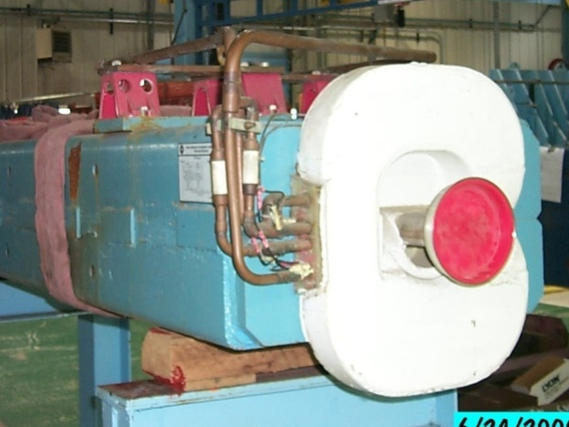
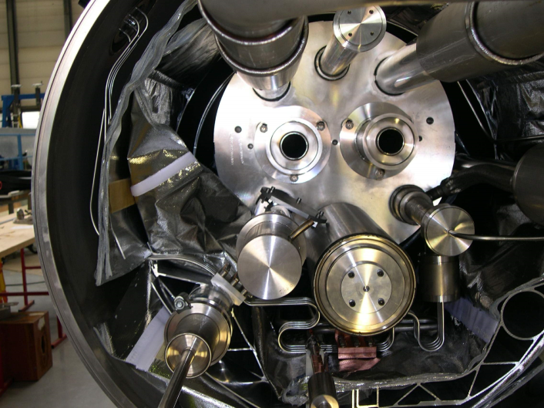
Issues with superconducting magnets
Conventional magnets operate at room temperature. The cooling required to dissipate heat is usually provided by fairly simple low conductivity water (LCW) heat exchange systems.
Superconducting magnets must be immersed in liquid (or superfluid) He, which requires complex infrastructure and cryostats
Any magnet represents stored energy
  In a conventional magnet, this is dissipated
  during operation.
  In a superconducting magnet, you have to worry about where it goes, particularly when something goes wrong.

Slide 18
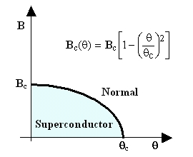
When is a superconductor not a superconductor?
Superconductor can change phase back to normal conductor by crossing the “critical surface”
When this happens, the conductor heats quickly, causing the surrounding conductor to go normal and dumping lots of heat into the liquid Helium
This is known as a “quench”.
Can push the B field (current) too high
Can increase the temp, through heat leaks, deposited energy or mechanical deformation
T_{c}

Slide 19

Quench example: MRI magnet*
*pulled off the web. We recover our Helium.

Slide 20
Magnet “training”
As new superconducting magnets are ramped, electromechanical forces on the conductors can cause small motions.
The resulting frictional heating can result in a quench
Generally, this “seats” the conductor better, and subsequent quenches occur at a higher current.
This process is knows as “training”

Slide 21
Nominal LHC parameters compared to Tevatron
Parameter | Tevatron | “nominal” LHC
Circumference | 6.28 km (2*PI) | 27 km
Beam Energy | 980 GeV | 7 TeV
Number of bunches | 36 | 2808
Protons/bunch | 275x10⁹ | 115x10⁹
pBar/bunch | 80x10⁹ | -
Stored beam energy | 1.6 + .5 MJ | 366+366 MJ*
Initial luminosity | 3.3x10³² (cm⁻²s⁻¹) | 1.0x10³⁴(cm⁻²s⁻¹)
Main Dipoles | 780 | 1232
Bend Field | 4.2 T | 8.3 T
Main Quadrupoles | ~200 | ~600
Operating temperature | 4.2 K (liquid He) | 1.9K (superfluid He)
*2 MJ ~ “stick of dynamite” -> Very scary

Slide 22
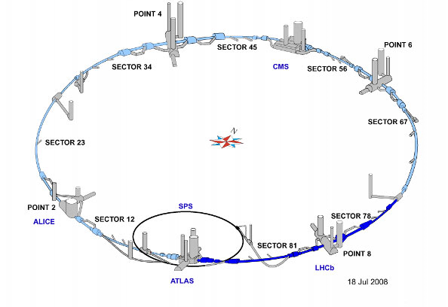
LHC Layout
8 crossing interaction points (IP’s)
Accelerator sectors labeled by which points they go between
  ie, sector 3-4 goes from point 3 to point 4

Slide 23
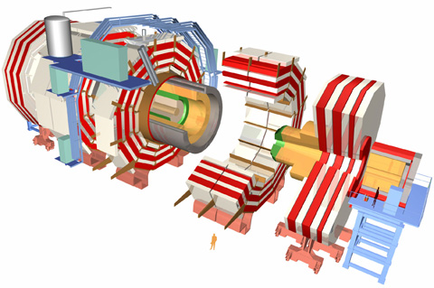
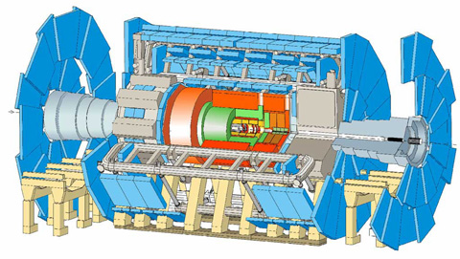

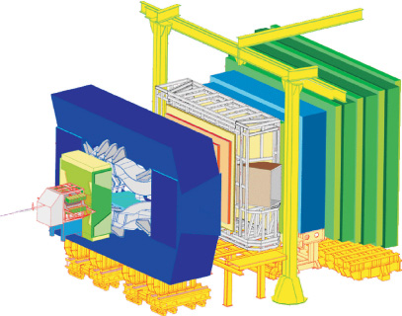
CERN experiments
Damn big, general purpose experiments:
“Medium” special purpose experiments:
Compact Muon Solenoid (CMS)
A Toroidal LHC ApparatuS (ATLAS)
A Large Ion Collider Experiment (ALICE)
B physics at the LHC (LHCb)

Slide 24
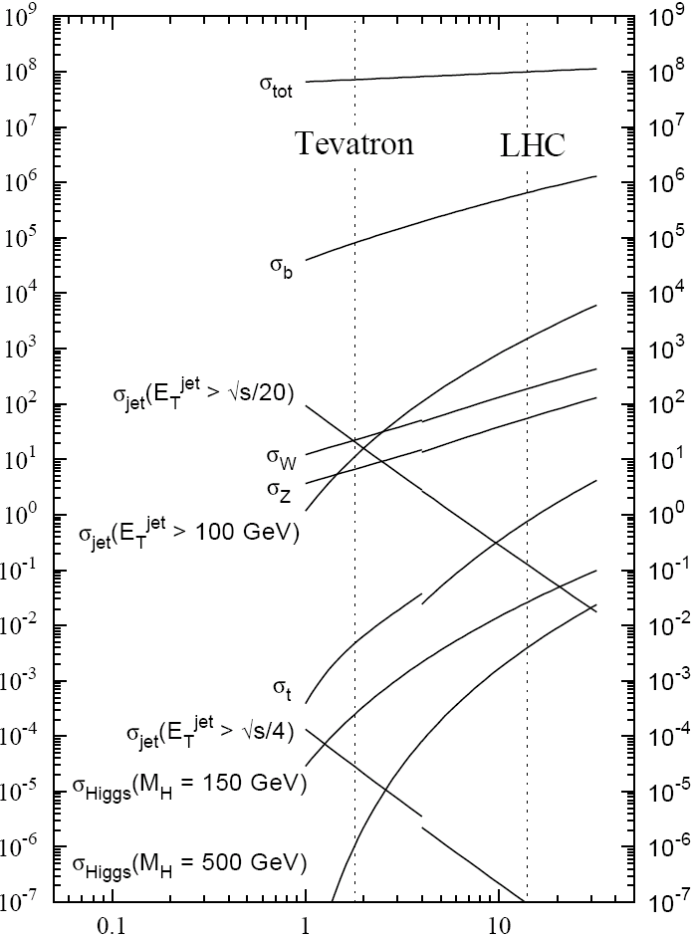

Experimental reach of LHC vs. Tevatron
The rate of physical processes depends strongly on energy
  For some of the most interesting searches, the rate at the LHC will be 10-100 times the rate at the Tevatron.
Nevertheless, still need about 30 times the luminosity of the Tevatron to study the most important physics
σ_{W} (M_{W}=80 GeV)
σ_{Z} (M_{Z}=91 GeV)

Slide 25
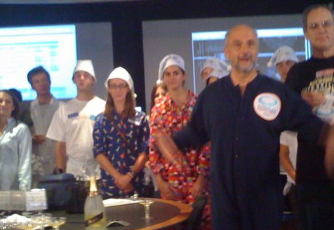
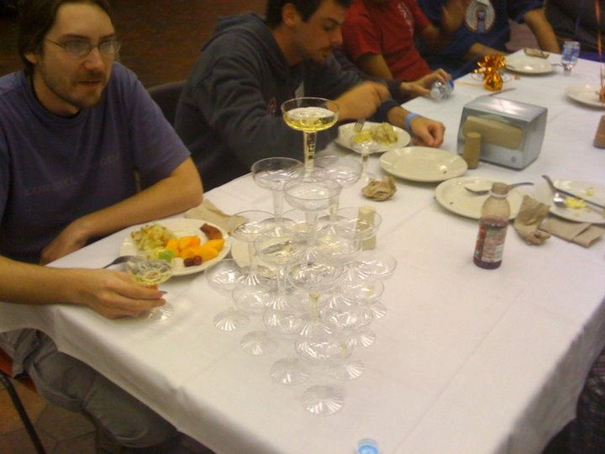
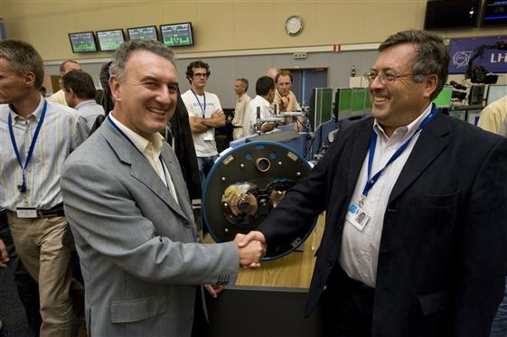
Sept 10, 2008: The (first) big day
9:35 – First beam injected
9:58 – beam past CMS to point 6 dump
10:15 – beam to point 1 (ATLAS)
10:26 – First turn!
…and there was much rejoicing
Commissioning proceeded smoothly and rapidly until September 19th, when something very bad happened

Slide 26

Nature abhors a (news) vacuum…
Italian newspapers were very poetic (at least as translated by “Babel Fish”):
"the black cloud of the bitterness still has not
been dissolved on the small forest in which
they are dipped the candid buildings of the CERN"
“Lyn Evans, head of the plan, support that it
was better to wait for before igniting the
machine and making the verifications of the parts.“*
Or you could Google “What really happened at CERN”:
**
* “Big Bang, il test bloccato fino all primavera 2009”, Corriere dela Sera, Sept. 24, 2008
**http://www.rense.com/general83/IncidentatCERN.pdf

Slide 27
What (really) really happened on September 19^{th*}
Sector 3-4 was being ramped to 9.3 kA, the equivalent of 5.5 TeV
  All other sectors had already been ramped to this level
  Sector 3-4 had previously only been ramped to 7 kA (4.1 TeV)
At 11:18AM, a quench developed in the splice between dipole C24 and quadrupole Q24
  Not initially detected by quench protection circuit
  Power supply tripped at .46 sec
  Discharge switches activated at .86 sec
Within the first second, an arc formed at the site of the quench
  The heat of the arc caused Helium to boil.
  The pressure rose beyond .13 MPa and ruptured into the insulation vacuum.
  Vacuum also degraded in the beam pipe
The pressure at the vacuum barrier reached ~10 bar (design value 1.5 bar). The force was transferred to the magnet stands, which broke.
*Official talk by Philippe LeBrun, Chamonix, Jan. 2009

Slide 28
Pressure forces on SSS vacuum barrier
Vacuum
Pressure
1 bar
1/3 load on cold mass (and support post)
~23 kN
1/3 load on barrier
~46 kN
Total load on 1 jack ~70 kN
V. Parma

Slide 29
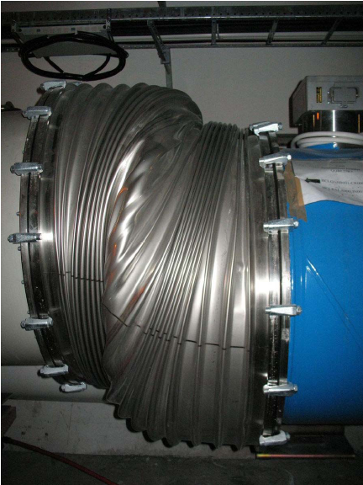

Collateral damage: magnet displacements
QQBI.27R3

Slide 30
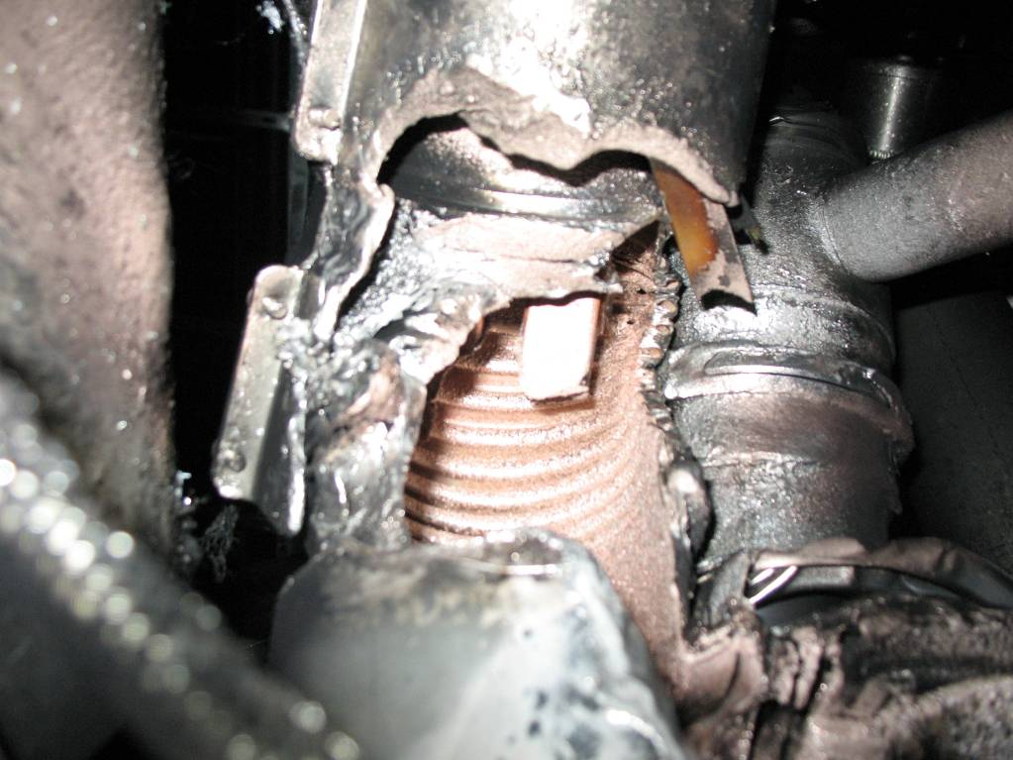
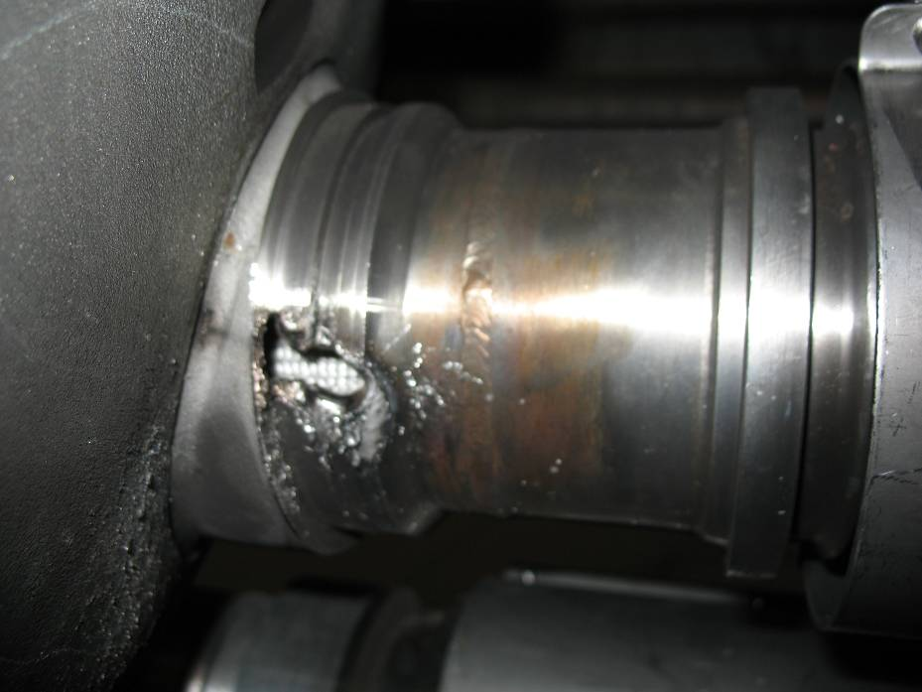
Collateral damage: secondary arcs
QBBI.B31R3 M3 line
QQBI.27R3 M3 line

Slide 31
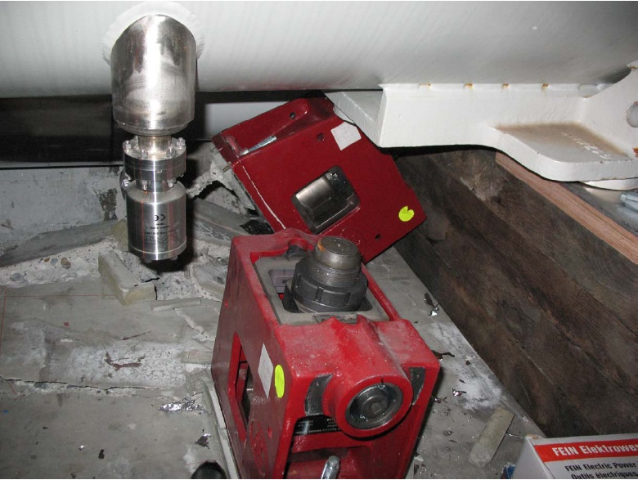
Collateral damage: ground supports

Slide 32
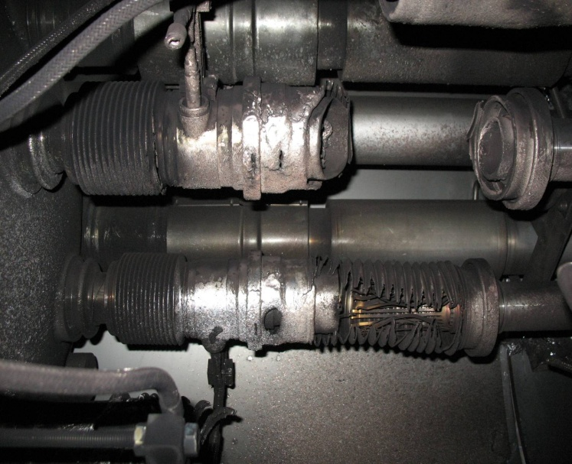
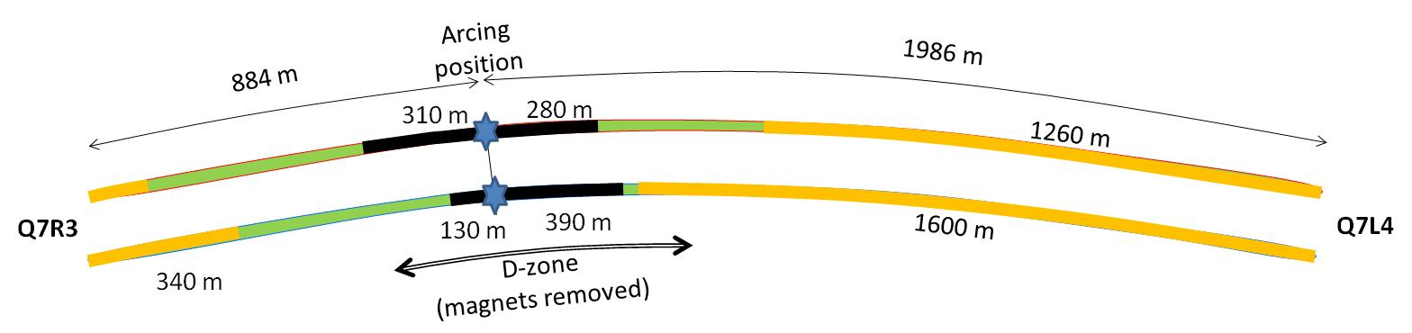

Collateral damage: Beam Vacuum
Arc burned through beam vacuum pipe
clean
MLI
soot
The beam pipes were polluted with thousands of pieces of MLI and soot, from one extremity to the other of the sector
LSS3
LSS4
OK
Debris
MLI
Soot

Slide 33
Important questions about Sept. 19
Why did the joint fail?
  Inherent problems with joint design
    No clamps
    Details of joint design
    Solder used
  Quality control problems
Why wasn’t it detected in time?
  There was indirect (calorimetric) evidence of an ohmic heat loss, but these data were not routinely monitored
  The bus quench protection circuit had a threshold of 1V, a factor of >1000 too high to detect the quench in time.
Why did it do so much damage?
  The pressure relief system was designed around an MCI Helium release of 2 kg/s, a factor of ten below what occurred.

Slide 34
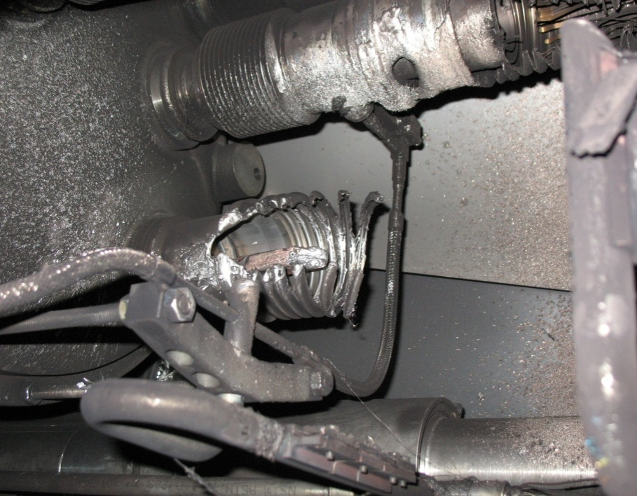
What happened?
Working theory: A resistive joint of about 220 nΩ with bad electrical and thermal contacts with the stabilizer
No electrical contact between wedge and U-profile with the bus on at least 1 side of the joint
No bonding at joint with the U-profile and the wedge
Loss of clamping pressure on the joint, and between joint and stabilizer
Degradation of transverse contact between superconducting cable and stabilizer
Interruption of longitudinal electrical continuity in stabilizer
Problem: this is where the evidence used to be
A. Verweij

Slide 35
Improvements
Bad joints
  Test for high resistance and look for signatures of heat loss in joints
  Warm up to repair any with signs of problems (additional three sectors)
Quench protection
  Old system sensitive to 1V
  New system sensitive to .3 mV
Pressure relief
  Warm sectors (4 out of 8)
    Install 200mm relief flanges
    Enough capacity to handle even the maximum credible incident (MCI)
  Cold sectors
    Reconfigure service flanges as relief flanges
    Reinforce floor mounts
    Enough capacity to handle the incident that occurred, but not quite the MCI

Slide 36
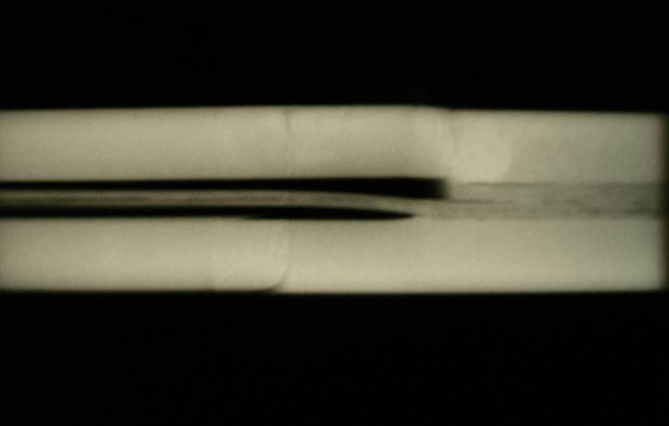
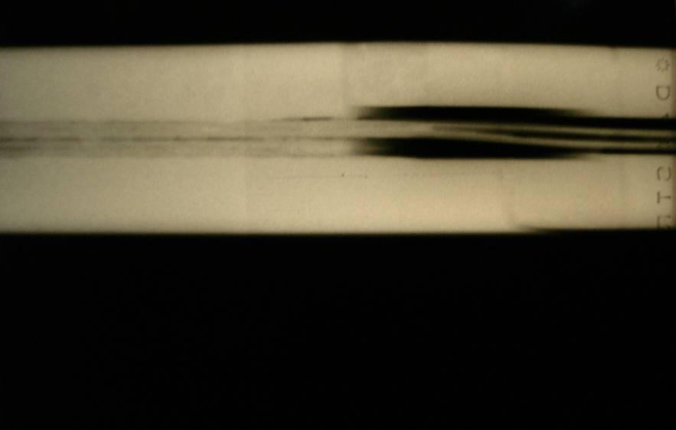
Bad surprise
With new quench protection, it was determined that joints would only fail if they had bad thermal and bad electrical contact, and how likely is that?
  Very, unfortunately ⇒ must verify copper joint
Have to warm up to at least 80K to measure Copper integrity.
Solder used to solder joint had the same melting temperature as solder used to pot cable in stablizer
⇒Solder wicked away from cable

Slide 37
Impact of joint problem
Tests at 80K identified an additional bad joint
  One additional sector was warmed up
  New release flanges were NOT installed
Based on thermal modeling of the joints, it was determined that they might NOT be reliable even at 5 TeV
  3.5 TeV considered the maximum safe operating energy for now

Slide 38
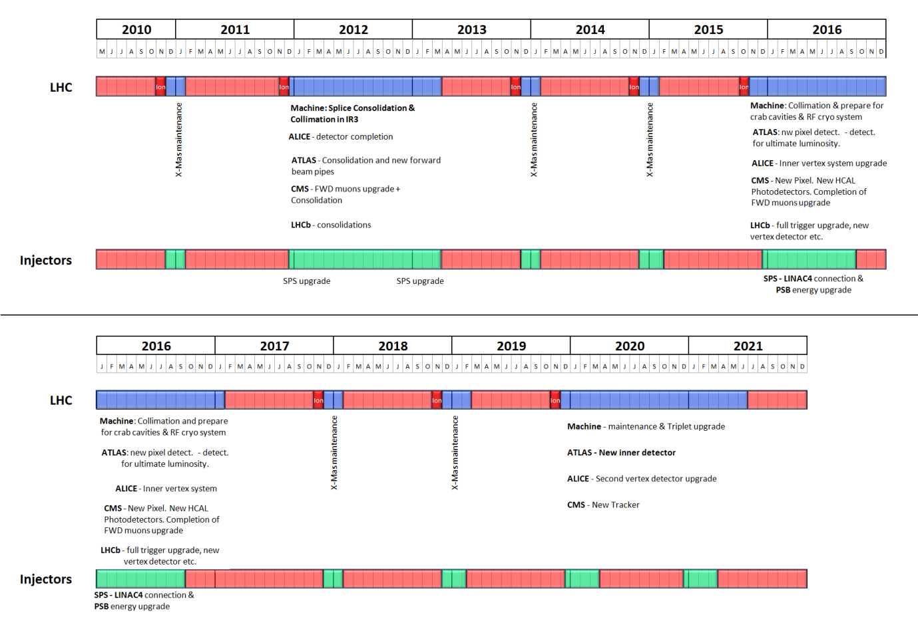
Tentative LHC Plan

Slide 39
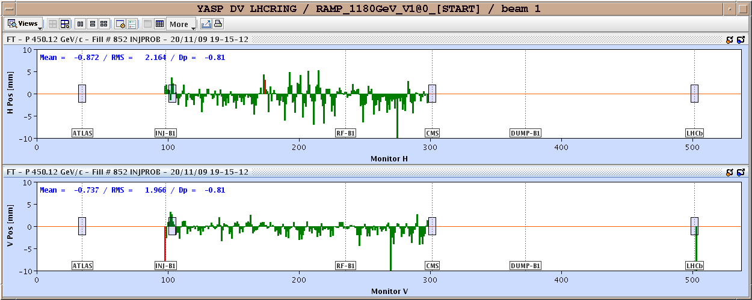
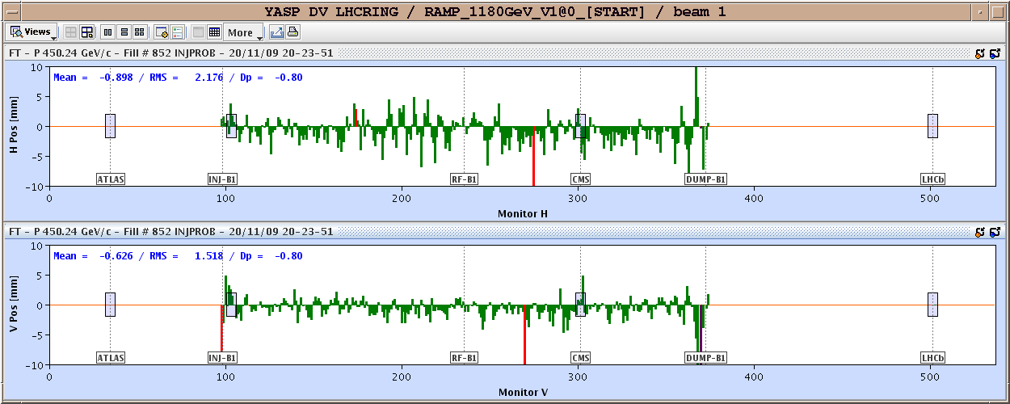
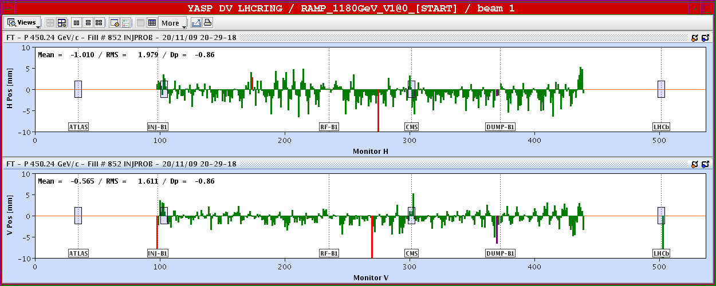
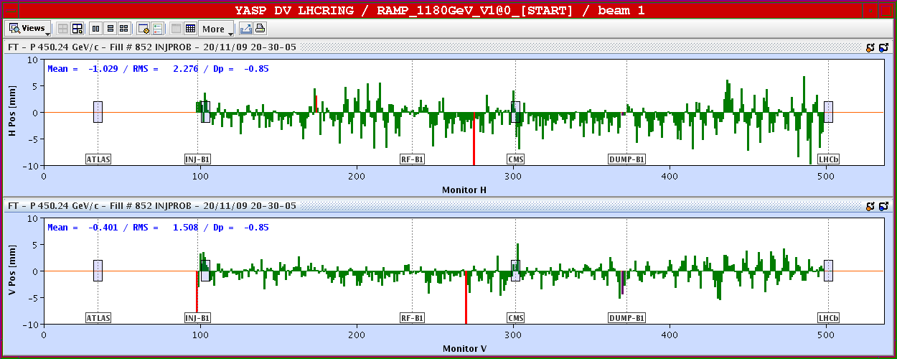
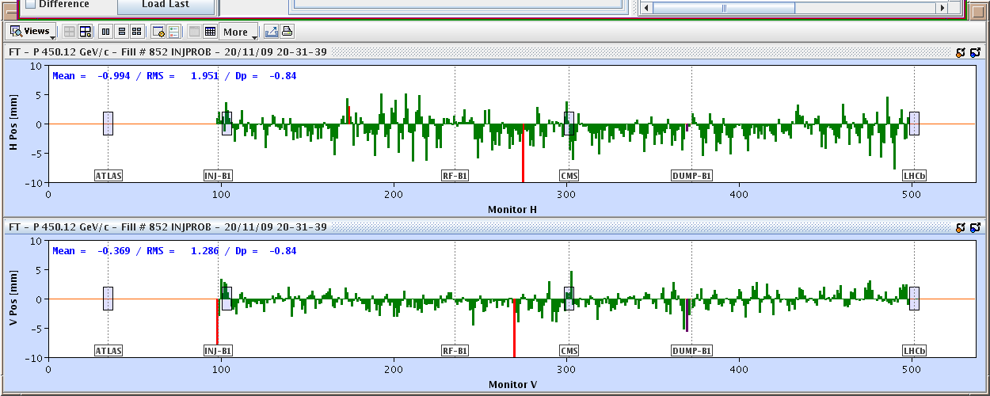
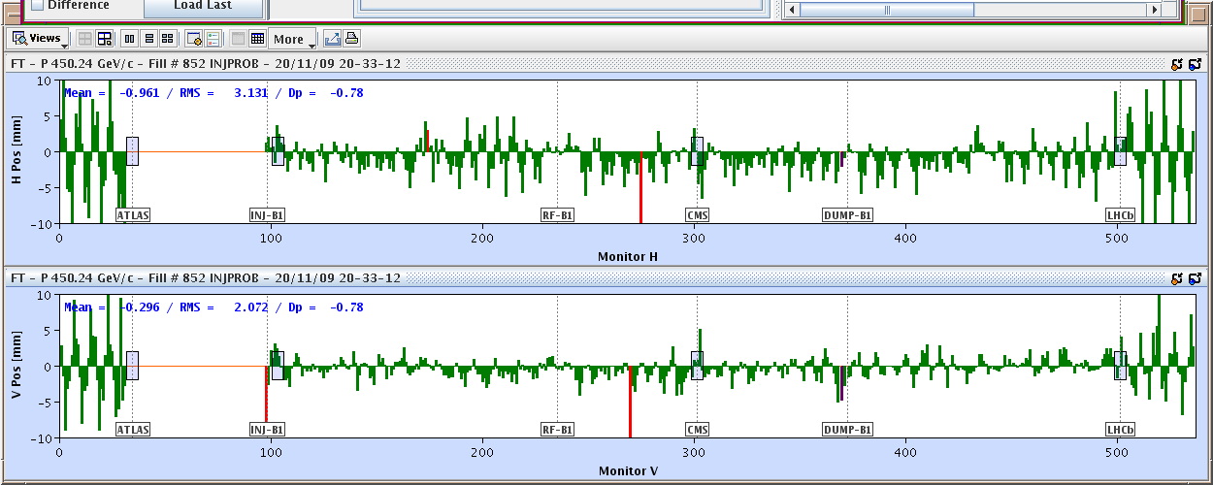
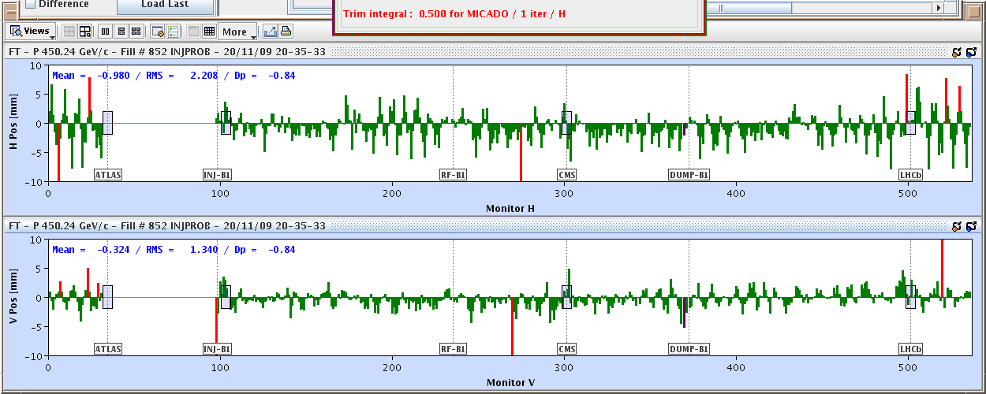
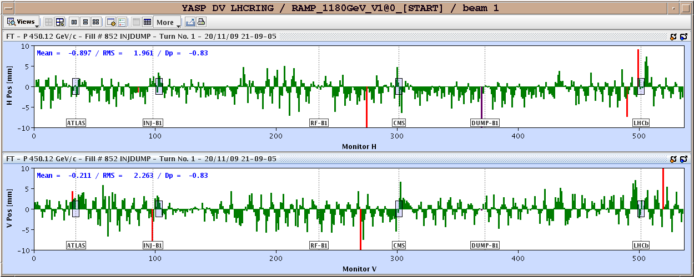
November 20, 2009: Going around…again
Total time: 1:43
Then things began to move with dizzying speed…

Slide 40
Progress since start up
Sunday, November 29th, 2009:
  Both beams accelerated to 1.18 TeV simultaneously
  LHC Highest Energy Accelerator
Monday, December 14th
  Stable 2x2 at 1.18 TeV
  Collisions in all four experiments
  LHC Highest Energy Collider
Tuesday, March 30th, 2010
  Collisions at 3.5+3.5 TeV
  LHC Reaches target energy for 2010/2011

Slide 41
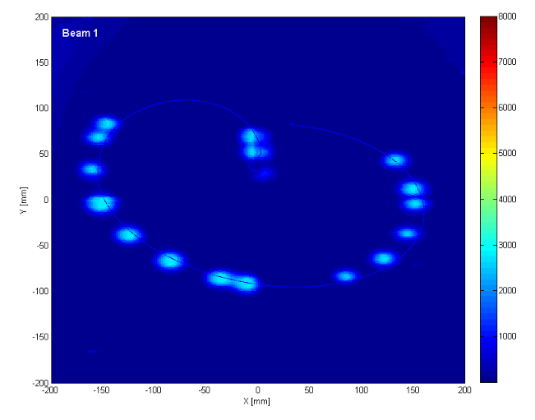
General plan
Push bunch intensity
  Already reached nominal bunch intensity of 1.1x10¹¹
Increase number of bunches
  Up to 156, use symmetrically spaced bunches, then must introduce crossing angle
  Beyond 156, go to 144 bunch trains with 50 ns bunch spacing
At all points, must carefully verify
  Beam collimation
  Beam protection
  Beam abort
Example: beam sweeping over abort

Slide 42
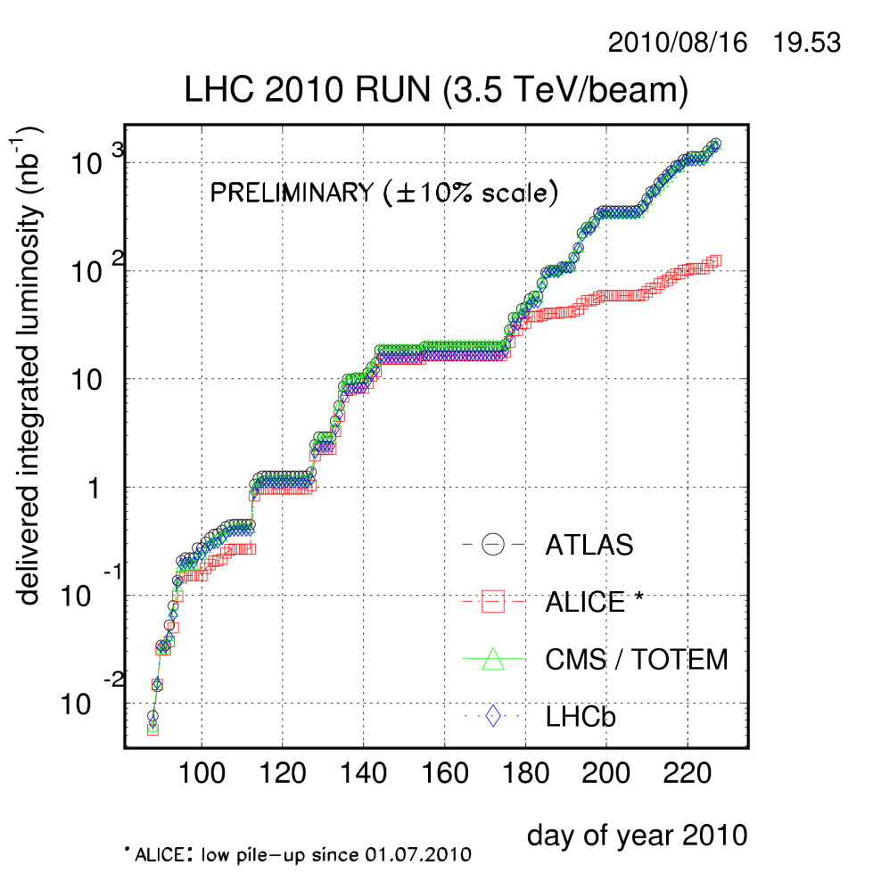
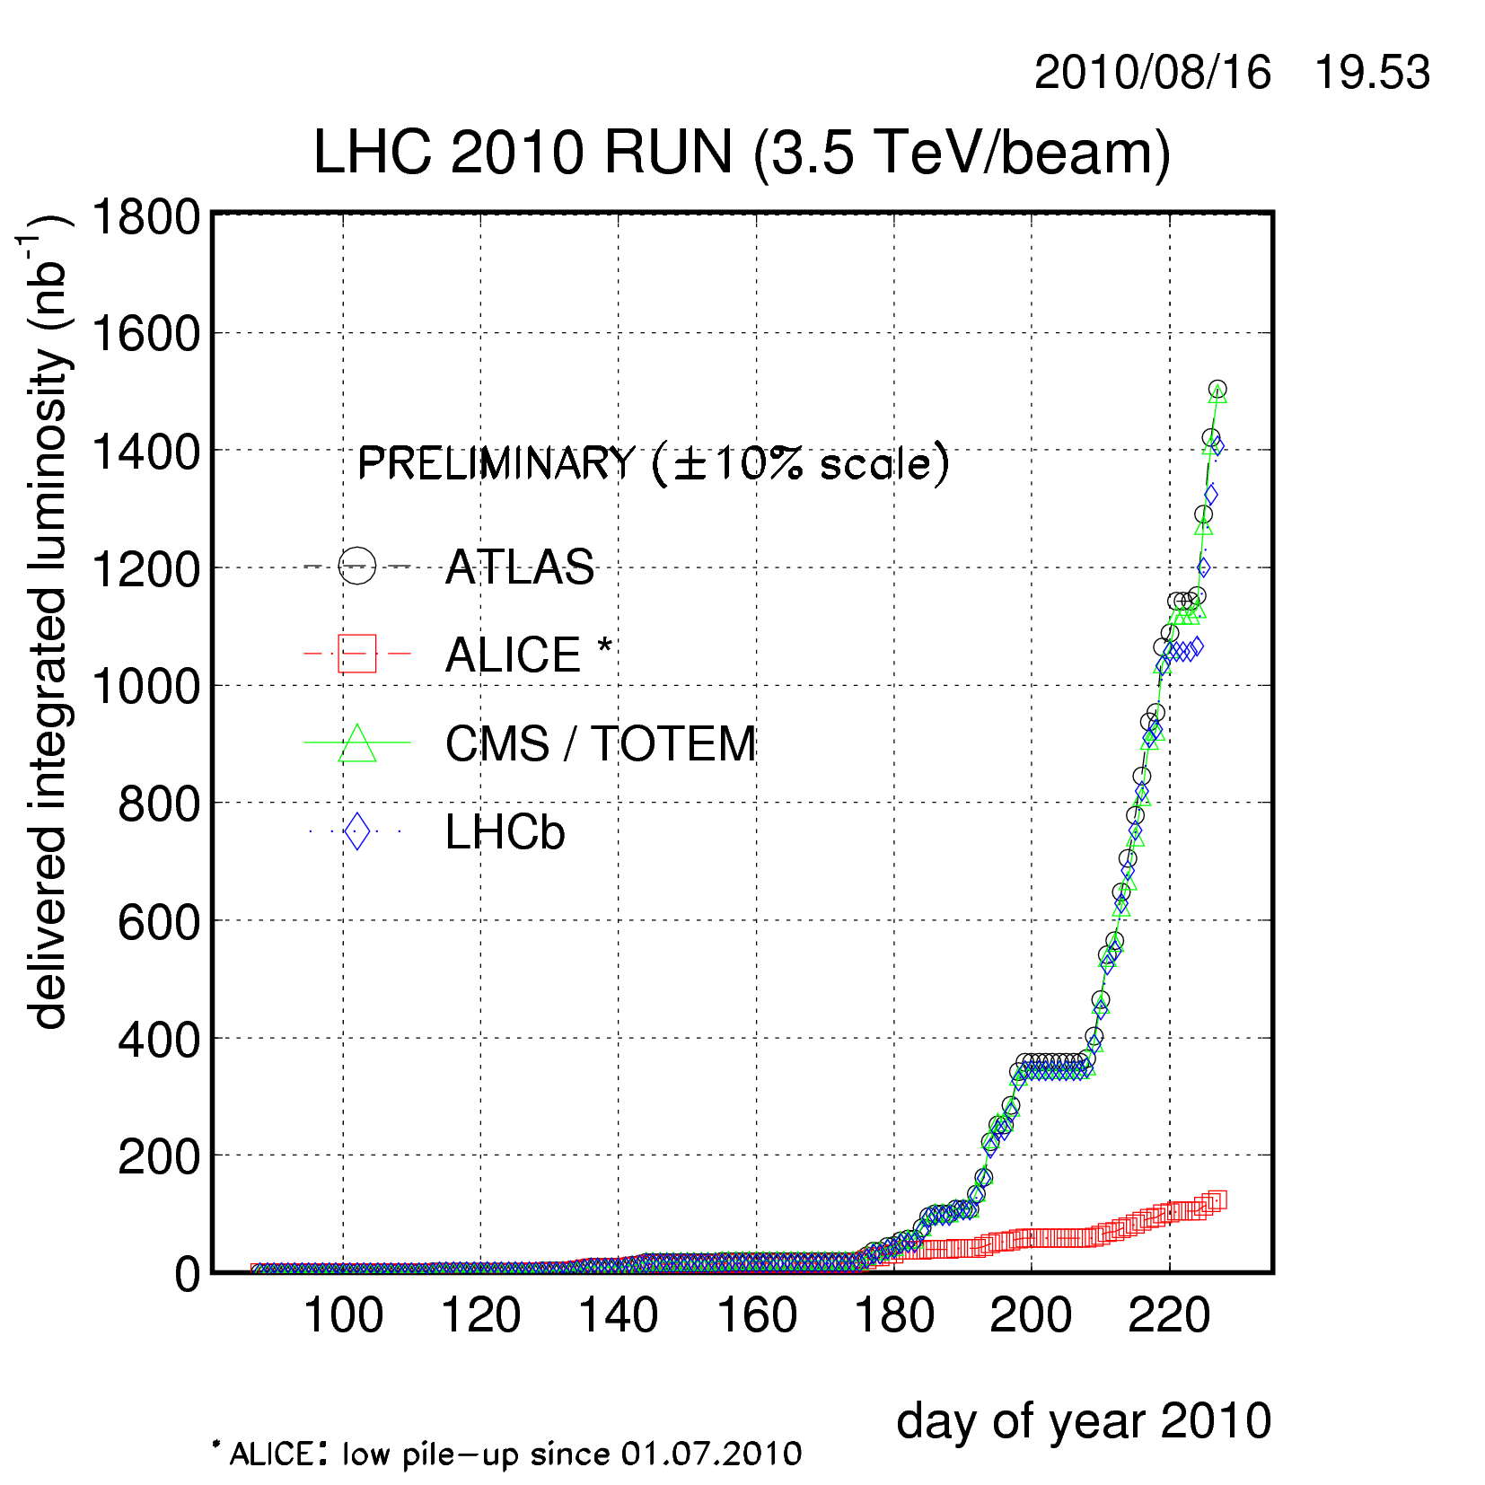
Current Status
Reached 25x25 bunches
  Peak luminosity ~4-5x10³⁰ cm⁻²s⁻¹

Slide 43
Future plans for LHC (as of Chamonix 2010)
Run until end of 2011, or until 1 fb⁻¹ of integrated luminosity
  About .1% of the way there, so far
Shut down for ~15 month to fully repair all ~10000 joints
  Resolder
  Install clamps
  Install pressure relief on all cryostats
Shut down in 2016
  Tie in LINAC4
  Increase Booster energy 1.4->2.0 GeV
  Finalize collimation system
Shut down in 2020
  Full luminosity: 5x10³⁴ leveled
  New inner triplets based on Nb₃Sn
  Crab cavities

Slide 44
Tentative LHC Plan

Slide 45
Understanding LHC Luminosity
Total beam current. Limited by:
  Uncontrolled beam loss!!
  E-cloud and other instabilities
Brightness, limited by
Injector chain
Max tune-shift
If n_{b}>156, must turn on crossing angle
β*, limited by
  magnet technology
  chromatic effects
Geometric factor, related to crossing angle…
*see, eg, F. Zimmermann, “CERN Upgrade Plans”, EPS-HEP 09, Krakow, for a thorough discussion of luminosity factors.

Slide 46
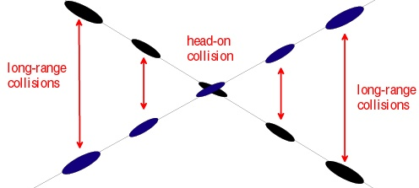
Crossing Angles
Luminosity effects

Slide 47
Crossing Angle Considerations
Crossing angle reduces luminosity
However, crossing angle
also reduces tune-shift
In principle, the two effects should cancel
“Piwinski Angle”
“Large Piwinksi Angle” (LPA) Solution

Slide 48
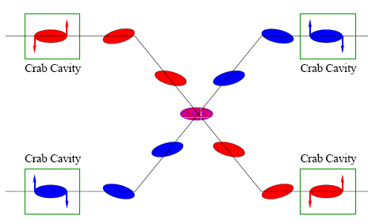

Other Option: Crab Cavities
Possibilities
  2 or 4 cavities in “global” scheme
    Implications for apertures/collimation
  8 for full “local”
Main Technical question
  Space constraints -> 800 MHz elliptical (simple) versus 400 MHz “exotic”.
Currently part of the base line proposal

Slide 49
LHC Upgrade Parameters and Options
(not quite up to date)
Requires magnets close to detectors
Requires PS2
Big pile-up
Parameter | Symbol | Initial | Full Luminosity Upgrade
 |  |  | Early Sep. | Full Crab | Low Emit. | Large Piw. Ang.
transverse emittance | ε [μm] | 3.75 | 3.75 | 3.75 | 1.0 | 3.75
protons per bunch | N_{b} [10¹¹] | 1.15 | 1.7 | 1.7 | 1.7 | 4.9
bunch spacing | Δt [ns] | 25 | 25 | 25 | 25 | 50
beam current | I [A] | 0.58 | 0.86 | 0.86 | 0.86 | 1.22
longitudinal profile |  | Gauss | Gauss | Gauss | Gauss | Flat
rms bunch length | σ_{z} [cm] | 7.55 | 7.55 | 7.55 | 7.55 | 11.8
beta* at IP1&5 | β∗ [m] | 0.55 | 0.08 | 0.08 | 0.1 | 0.25
full crossing angle | θ_{c} [μrad] | 285 | 0 | 0 | 311 | 381
Piwinski parameter | φ=θ_{c}σ_{z}/(2*σ_{x}*) | 0.64 | 0 | 0 | 3.2 | 2.0
peak luminosity | L [10³⁴ cm⁻²s⁻¹] | 1 | 14.0 | 14.0 | 16.3 | 11.9
peak events/crossing |  | 19 | 266 | 266 | 310 | 452
initial lumi lifetime | τ_{L} [h] | 22 | 2.2 | 2.2 | 2.0 | 4.0
Luminous region | σ_{l} [cm] | 4.5 | 5.3 | 5.3 | 1.6 | 4.2
excerpted from F. Zimmermann, “LHC Upgrades”, EPS-HEP 09, Krakow, July 2009

Slide 50

The need for new quadupoles
Recall from yesterday
  Small β*⇒huge β at focusing quad
  Need bigger quads to go to smaller β*
Existing quads
70 mm aperture
200 T/m gradient
Proposed for upgrade
At least 120 mm aperture
200 T/m gradient
Field 70% higher at pole face
⇒ Beyond the limit of NbTi

Slide 51

Motivation for Nb₃Sn
Nb₃Sn can be used to increase aperture/gradient and/or increase heat load margin, relative to NbTi
Limit of NbTi magnets
Very attractive, but no one has ever built accelerator quality magnets out of Nb₃Sn
Whereas NbTi remains pliable in its superconducting state, Nb3Sn must be reacted at high temperature, causing it to become brittle
  Must wind coil on a mandril
  React
  Carefully transfer to yolk
120 mm aperture

Slide 52


LARP Design
120 mm aperture
200 T/m gradient
Unique “shell” preloading structure
Testing first 1m long prototype

Slide 53

The long road to discovery
Even with the higher rates, still need a lot of interactions to reach the discovery potential of the LHC
Z’@6TeV
ADD X-dim@9TeV
SUSY@3TeV
Note: VERY outdated plot. Ignore horizontal scale.
Would probably take until ~2030 to get 3000 fb⁻¹
3000
Compositeness@40TeV
H(120GeV)→γγ
300
Higgs@200GeV
SUSY@1TeV
30
SHUTDOWN
200 fb⁻¹/yr
10-20
fb⁻¹/yr
100 fb⁻¹/yr
1000 fb⁻¹/yr
50 x Tevatron luminosity
500 x Tevatron luminosity (will probably never happen)

Slide 54


Some other important accelerators (past):
LEP (at CERN):
  27 km in circumference
  - e+e-
  - Primarily at 2E=M_{Z} (90 GeV)
  - Pushed to E_{CM}=200GeV
  - L = 2E31
  - Highest energy circular e+e- collider that will ever be built.
  - Tunnel now houses LHC
SLC (at SLAC):
  2 km long LINAC accelerated electrons AND positrons on opposite phases.
  - 2E=M_{Z} (90 GeV)
  - polarized
  - L = 3E30
  - Proof of principle for linear collider

Slide 55


B-Factories
- B-Factories collide e+e- at E_{CM} = M(ϒ(4S)).
-Asymmetric beam energy (moving center of mass) allows for time-dependent measurement of B-decays to study CP violation.
KEKB (Belle Experiment):
- Located at KEK (Japan)
- 8GeV e- x 3.5 GeV e+
- Peak luminosity >1e34
PEP-II (BaBar Experiment)
- Located at SLAC (USA)
- 9GeV e- x 3.1 GeV e+
- Peak luminosity >1e34

Slide 56

Relativistic Heavy Ion Collider (RHIC)
- Located at Brookhaven:
Can collide protons (at 28.1 GeV) and many types of ions up to Gold (at 11 GeV/amu).
Luminosity: 2E26 for Gold
Goal: heavy ion physics, quark-gluon plasma, ??

Slide 57

Continuous Electron Beam Accelerator Facility (CEBAF)
Locate at Jefferson Laboratory, Newport News, VA
6GeV e- at 200 uA continuous current
Nuclear physics, precision spectroscopy, etc

Slide 58

Research machines: just the tip of the iceberg

Slide 59

Example: Spallation Neutron Source
(Oak Ridge, TN)
A 1 GeV Linac will load 1.5E14 protons into a non-accelerating synchrotron ring.
These are fast extracted onto a Mercury target
This happens at 60 Hz -> 1.4 MW
Neutrons are used for biophysics, materials science, industry, etc…

Slide 60


Light sources: too many to count
Put circulating electron beam through an “undulator” to create synchrotron radiation (typically X-ray)
Many applications in biophysics,
materials science, industry.
New proposed machines will use
very short bunches to create coherent
light.

Slide 61

Other uses of accelerators
Radioisotope production
Medical treatment
Electron welding
Food sterilization
Catalyzed polymerization
Even art…
In a “Lichtenberg figure”, a low energy electron linac is used to implant a layer of charge in a sheet of lucite. This charge can remain for weeks until it is discharged by a mechanical disruption.

Slide 62
The future: International Linear Collider (ILC)?
LEP was the limit of circular e⁺e⁻ colliders
  Next step must be linear collider
  Proposed ILC 30 km long, 250 x 250 GeV e⁺e⁻
BUT, we don’t yet know whether that’s high enough energy to be interesting
  Need to wait for LHC results
  What if we need more?

Slide 63

“Compact” (ha ha) Linear Collider (CLIC)?
Use low energy, high current electron beams to drive high energy accelerating structures
Up to 1.5 x 1.5 TeV, but VERY, VERY hard

Slide 64

Muon colliders?
Muons are pointlike, like electrons, but because they’re heavier, synchrotron radiation is much less of a problem.
Unfortunately, muons are unstable, so you have to produce them, cool them, and collide them, before they decay.

Slide 65

Wakefield accelerators?
Many advances have been made in exploiting the huge fields that are produced in plasma oscillations.
Potential for accelerating gradients many orders of magnitude beyond RF cavities.
Still a long way to go for a practical accelerator.

Slide 66
Summary and Conclusion
Still lots of fun ahead.

