Slide 1
Fermilab Colloquium
Recent Physics Results
From the
CMS Experiment
Dan Green
Fermilab

Slide 2
CMS – the Detector
LHC detectors and accelerator are the most complex scientific instruments yet built

Slide 3
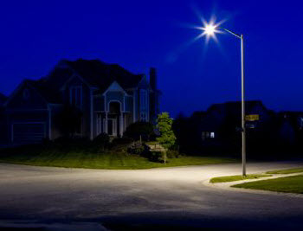
The Standard Model
Commissioning a new accelerator in an unexplored energy regime with a new detector -> “rediscover the SM”. As of today, CMS has, indeed, observed all the particles of the SM (not the H) !.
SM

Slide 4
Rediscovery of the SM
strong
MB, UE
EM
EW
Jets
10⁹
^{In}
⁵
^{months}
b Jets
Ψ - MET, MB > 50 GeV
J+γ
W->e
Z->e,μ
Z->τ
top
BSM ?

Slide 5
Tracking System
CMS all Si tracker – start by understanding the MB and UE. Tuning of the Monte Carlos needed at the new CM energy of 7 TeV – more soft particles than predicted.

Slide 6
Inclusive Cross Section
CMS data taken and published at 0.9, 2.36 and 7 TeV. Tracking commissioned down to ~ 100 MeV = Pt. Rapidity density of 6 charged particles.

Slide 7
Particle ID – dE/dx in Tracker
Use energy deposited in several Si strip layers to measure dE/dx. Useful for particle id. Once commissioned, use in heavy stable particle searches.
-mass measurement using P and dE/dx from tracker
min ion

Slide 8
MB Events – s Quarks
Find s quark decays – secondary vertices for
Λ, Ks, Ξ, Ω. Use the dE/dx to find K, p.
Checks tracker momentum scale and resolution.

Slide 9
Tracker Material
beam pipe, pixels, strips
radius
For a complete understanding of the momentum scale and resolution a detailed understanding of the tracker material throughout the system is needed – use photon conversions for high Z and nuclear interactions for low Z material.

Slide 10
Triggers - Commissioning
At L = 10³² /(cm²sec) MB rate is ~ 10⁷ . Triggers need to be sharp in Pt due to steeply falling spectrum. Start with MB and look at “mark and pass” triggers. Establish the turn on curves , behavior in Pt. As luminosity increases, commission higher rejection triggers - bootstrap.

Slide 11
Jets – u, d, s, g Resolution
Pt1
Jets from q and g – strong production. Use azimuthal symmetry, dijet balance and single particle (isolated) response to calibrate the jet energy scale and measure the jet energy resolution. Resolution ranges from 14 to 5 %.
Pt2

Slide 12
Jet Cross Section
Establish the jet cross section as a function of y and Pt. Monte Carlo agreement is good. Now ready to look at high masses for BSM Physics – more later.

Slide 13
MET “Core” Commissioning
Use calorimetry and tracking to improve the MET resolution. Tracker has better resolution at low E and there are many soft particles in UE and jet fragments. Cleaning of cosmics, beam halo and calorimeter discharges is needed.
Gaussian core of MET resolution is

Slide 14
MET – “Tail” and Noise Filtering
MB events :
The MET noise filtering greatly reduces the tail. An irreducible floor is set by the EW processes, which are ~ 10⁷ times smaller in cross section than the inclusive MB events.
MET commissioned to EW scale – ν_{e}, ν_{μ}, ν_{τ}
10x EW

Slide 15
Tracker Performance – b Quarks
Note error ellipses on primary and secondary vertices

Slide 16
b Cross Section
At the LHC the b cross section is large -> LHCb. The b jet rate is ~ 2 % (Pt dependent) of the inclusive jet rate. Well modeled by PYTHIA Monte Carlo. Use secondary vertex mass, Ptrel templates for u+d+g, c, and b – efficient b tagging with good u+d+g rejection

Slide 17
Photons, Electrons and ECAL
The CMS ECAL has a transverse segmentation ~ 1 Moliere radius. Use that fine granularity for photon ID and for track matching in the case of electrons. ECAL energy resolution is very good for E/p matching of the e track.

Slide 18
ECAL Calibration
Use low mass resonances to study energy scale calibration and energy resolution. Use azimuthal symmetry to check uniformity of response over the full, |y| < 3, detector coverage. Photon + J (Compton) used to check the JES using the better resolution of the ECAL

Slide 19
ECAL Commissioning
ECAL “clusters”. Present calibration to 1 % in the barrel. Timing good to < 0.5 nsec – very useful in “cleaning” and cosmic/halo rejection.
EB
EE

Slide 20
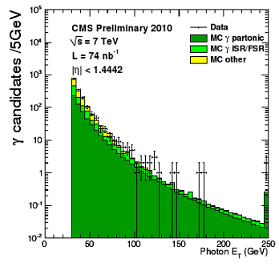
Photon Commissioning
Clean photon + J events. Photon spectrum quite clean for high Pt photons, > 100 GeV. Data /Monte Carlo agreement is good.

Slide 21
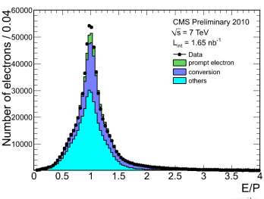
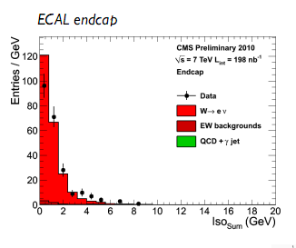
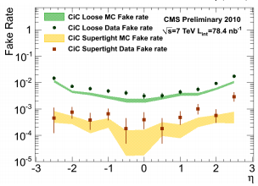
Electrons – Track + ECAL
Understanding material of the CMS tracker is crucial. Bremm in pipe and Si -> collect E in φ Use E/p and isolation
Eiso

Slide 22
Muons
Experience from ~ 10⁹ muons recorded before beam in the LHC. Muons up to 1 TeV in cosmics – gives experience with showering muons (critical energy). LHC “halo” also used for alignment of large |y| muon and tracking detectors - break alignment degeneracies.

Slide 23
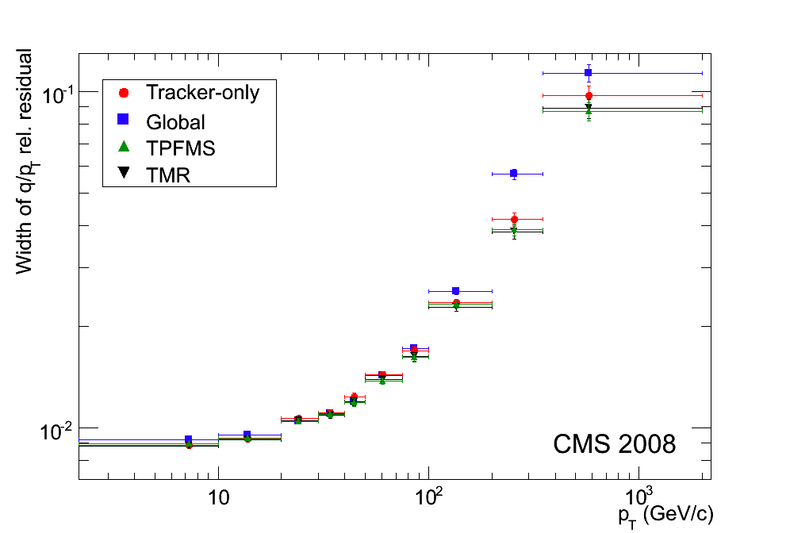
Muon Performance
Isolation uses tracker + ECAL + HCAL. Typical energy cuts, relative to the muon Pt are 0.05 to 0.15 depending on the specific analysis. Muon scale, efficiency and resolution established using tracker/muon system redundancy. Resolution ~ design value of 10% at 1 TeV.

Slide 24
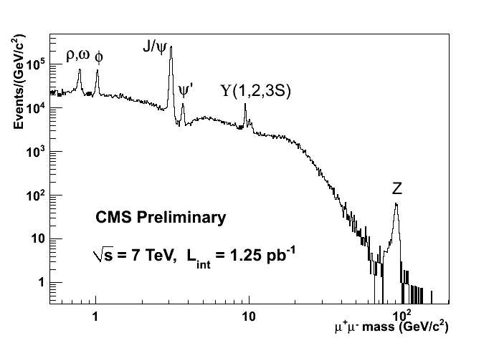
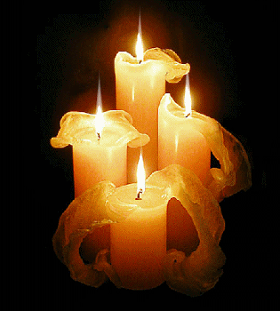
Dilepton “Standard Candles”
Use known resonances for mass scale, mass resolution and trigger/reco efficiency – “tag and probe”

Slide 25
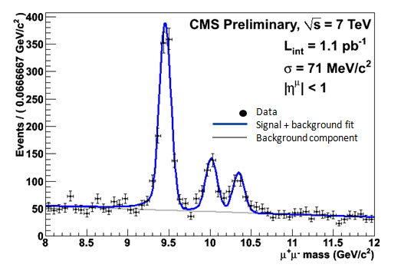
Mass Scale and Resolution
ψ
Υ -
The several “standard candles” will light our way to new discoveries

Slide 26
EW Physics – W and Z, Muons

Slide 27
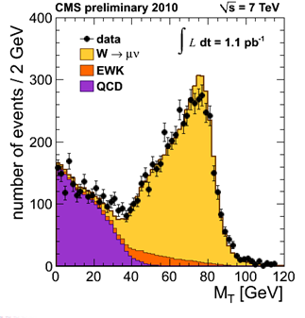
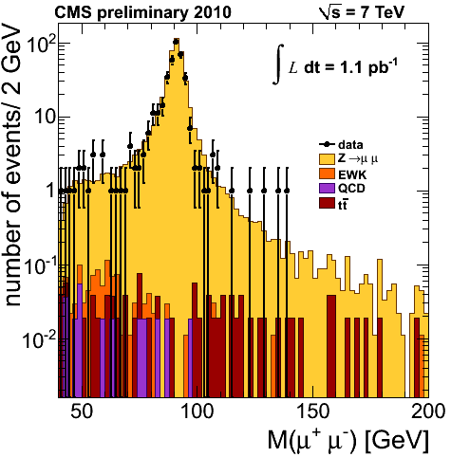
Muon Spectra for M_{T} and M
Jacobean peak

Slide 28
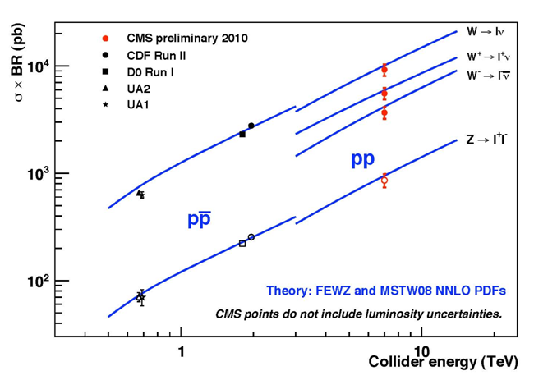
EW Cross Sections
Luminosity error now at 11%. This should drop quickly quite soon – van der Meer methods.

Slide 29
Tau Commissioning in Z Decays
A tau “standard candle” – one tau decays leptonically, one decays hadronically.
Virtual W decays.

Slide 30
W + J
Processes are backgrounds to top. Need to understand the heavy flavor content of W + nJ. Backgrounds to J + MET SUSY signatures. Is the Monte Carlo reliable? Early days…

Slide 31
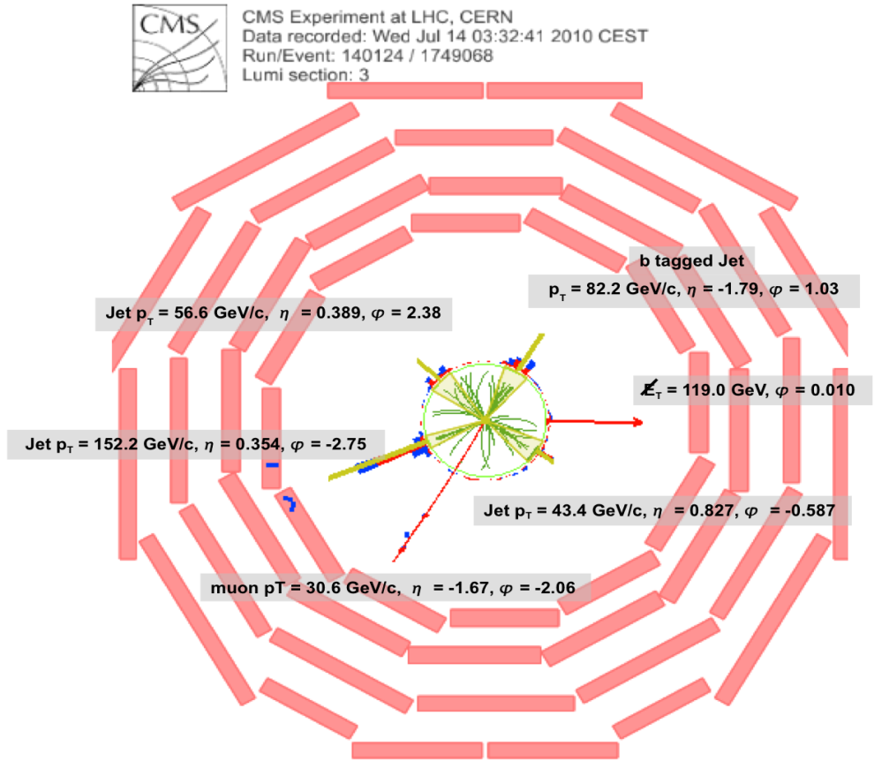
Top Candidate – Muon+4J (b tag) +MET
Look at lepton + MET + 4 Jets
Candidate events with enhanced number of jets with b tags ( all objects commissioned already ). Basically no background – clean top signal due to rapid commissioning of b tagging.

Slide 32
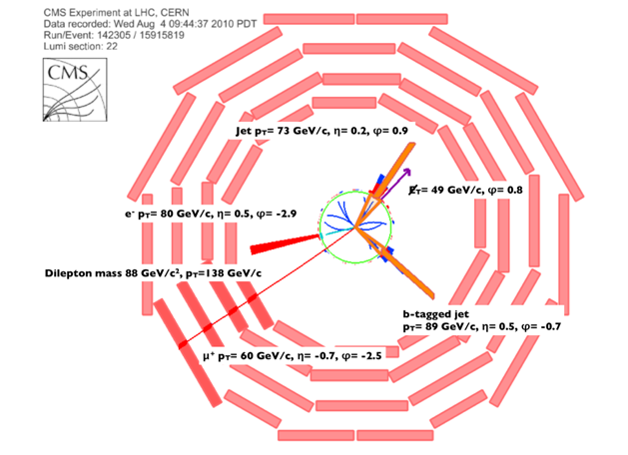
Top Candidate - Dilepton
Dilepton with MET and b tagging is a zero background top sample

Slide 33
Start the BSM Searches

Slide 34
Parton Luminosities
How can 10 pb⁻¹ == 10 fb⁻¹ ? It isn’t the hadron luminosity, it’s the parton luminosity
For M = 1 TeV, ratio is ~ 1000 for 2 to 7 TeV. For 1.5 TeV it is ~ 1,000,000.
Data shown is from ICHEP (1 month ago) with ~ 0.2 pb⁻¹. Now hit L = 10³¹/(cm²sec) and 10x the ICHEP set. Progress in 2010 has been dizzying.

Slide 35
Generic BSM – Contact Interactions

Slide 36
Event Scanning - Dijet
Look for more central, S wave, BSM effects. SM is t channel dominated -> check angular distribution of dijets
SM

Slide 37
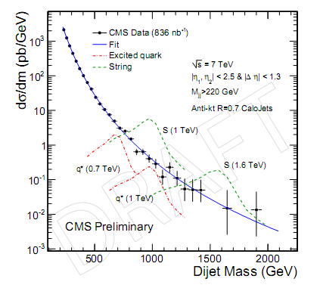
Jet Searches - Present
bump hunting in dijet mass. Limits with 0.8 pb⁻¹ are now at or above Tevatron values – e.g. q* mass > 1.14 TeV.

Slide 38
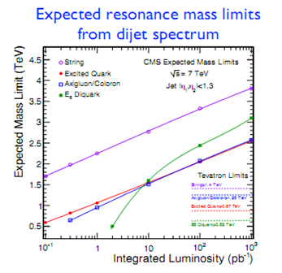
Jet BSM Search Reach with L
L now ~ 1 x 10³¹, aim for 10³² by end of 2010 -> ~ 10 pb⁻¹/week. Have ~ 100 pb⁻¹ by the end of 2010 -> mass limits ~ 2.0 to 3.5 TeV in dijet resonance mass search

Slide 39
Tail of the BW for W
Having established the W, look in the high mass tail for contact interactions (enhanced tail) or new W’ resonances (Jacobean peak).

Slide 40
Tail of the BW for Z, DY Continuum
Having established Z look in BW tail for contact interactions or Z’ resonances. Interference effects of a Z’ or Contact Interaction will also show up in Afb decay asymmetry.

Slide 41
Top Tagging
High mass parent decaying into a top pair will cause a “fat jet” with W and b jets merged. Look at jet mass and other variables to distinguish from QCD J backgrounds.

Slide 42
SUSY Searches – J + MET
Energy is very important. By the end of 2010, substantial new parameter space for SUSY will be opened up.

Slide 43
Higgγ Searches
Higgs takes longer. By the end of 2011 ( ~ 1 fb⁻¹) CMS will exclude a significant mass range for a SM Higgs. Combined CMS + ATLAS excludes ~ (140,200) GeV. This is only for cut based WW+ZZ+γγ. Studying gains due to advanced techniques, e.g. NN and adding other final states, e.g. . May increase exclusion range to LPC limit.

Slide 44
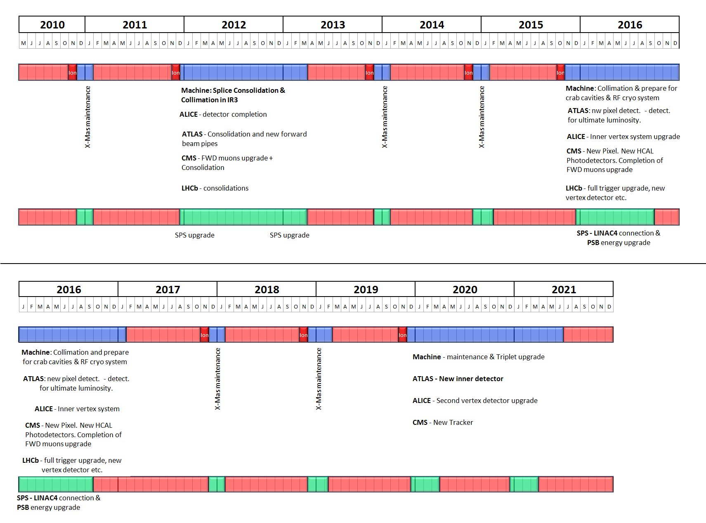
The 10 year Technical Plan
splices
collimators
New tracker for high L
7 TeV,
0.1 fb⁻¹ 1 fb⁻¹
14 TeV
10 fb⁻¹ 40 fb⁻¹
LHC Upgrade beyond design
luminosity

Slide 45
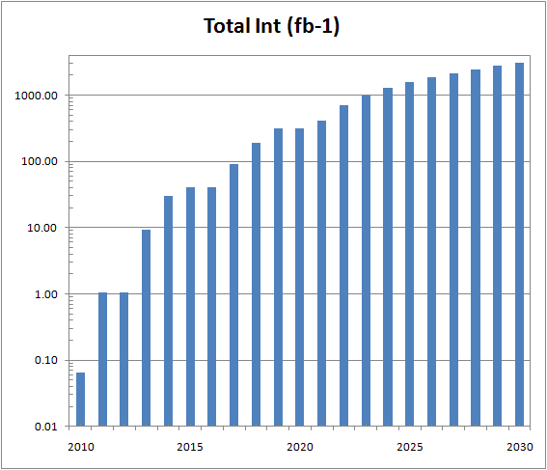
Preliminary Long Term Predictions
2011 plan:
Achieved design for n
10¹¹ p/bunch
Have gone to 2 m for β* (design 0.5 m)
More bunches N (but stored energy)
N = 48 (now) -> 384 in 2010 to achieve 10³²
Efficiency =0.2
Headroom? β* -> 2 m, N -> 936 are possible
To keep pace with the LHC the detectors are starting a long term series of phased Upgrades. Technical proposals this year.

Slide 46
Terascale Incognita
SM
We will soon be arriving in “terascale incognita”, please fasten your seat belts. The exploration of the TeV mass scale has begun.

Slide 47
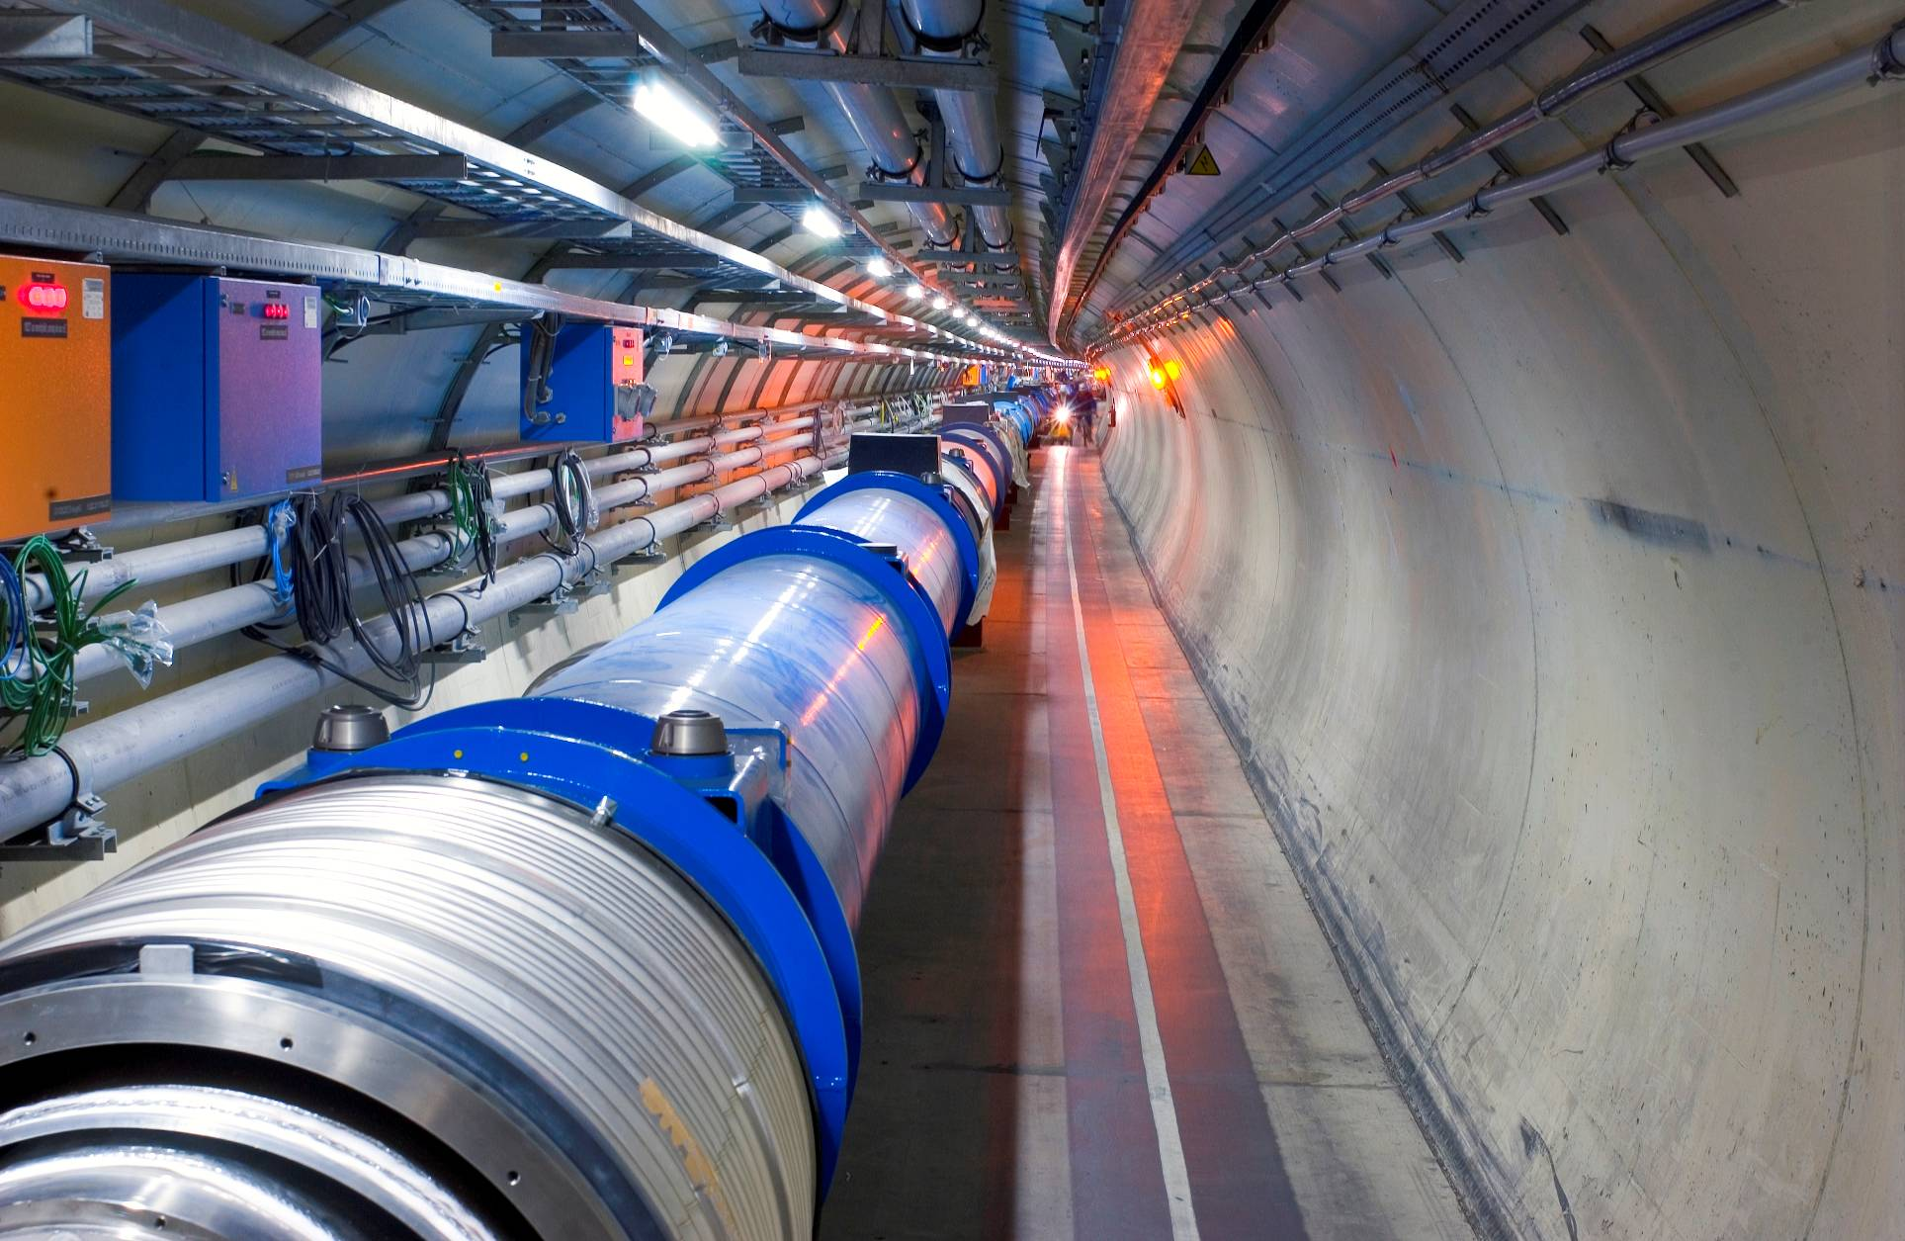
LHC Accelerator - Dipoles
wrt Tevatron (at design)
Energy x 7
luminosity x 20
To reach the required energy in the existing LEP tunnel, the dipoles operate at 8.3 T & 1.9 K in super fluid helium. That makes the LHC colder than the CMB at 2.3 K.
The LHC is the highest energy collider in the world
The LHC has the worlds largest cryogenic plant.
The LHC is designed to have the highest reaction rate of any collider.
The associated experiments are the largest and most complex scientific instruments ever built.
Notes:
The LHC magnets are cooled with pressurized superfluid helium.
Unique engineering properties
low bulk viscosity - allows it to permeate the smallest cracks. Used to advantage in the magnet design by making the coil insulation porous enabling the fluid to be in contact with the strands of the superconductor.
large specific heat - 100,000 times that of the sc per unit mass and 2000 times per unit volume.

Slide 48
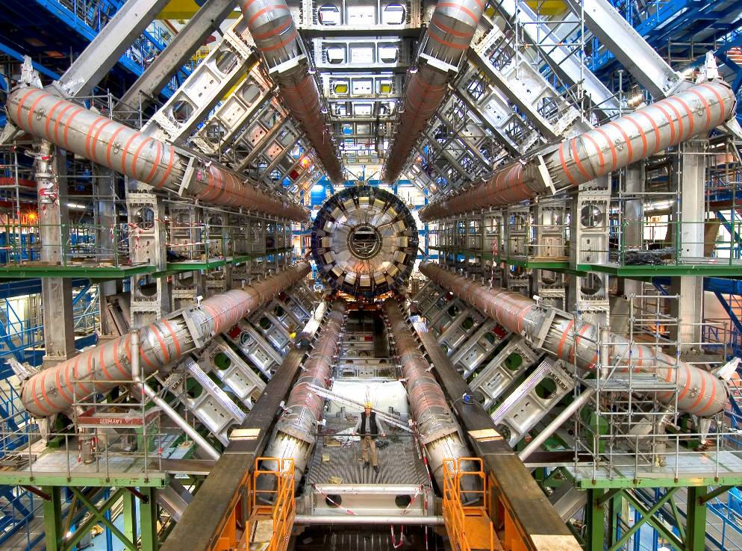
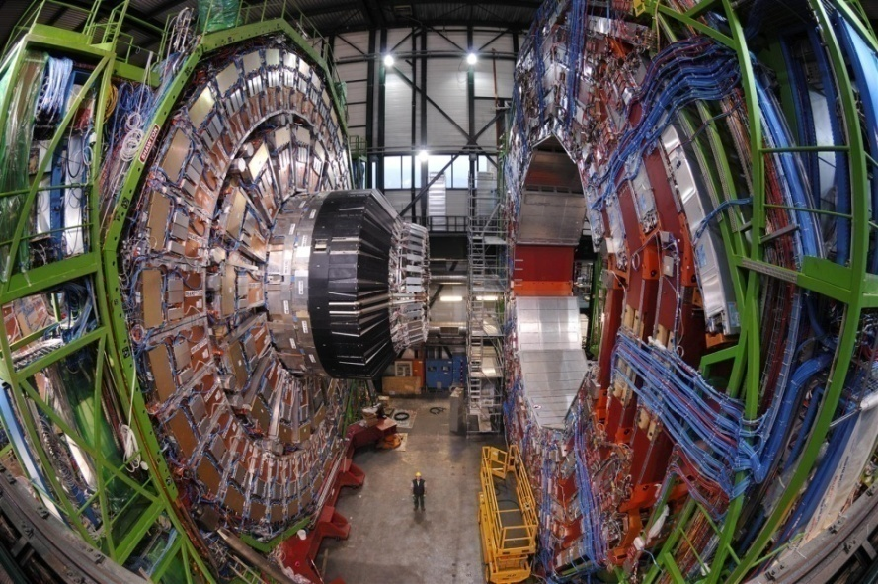
The ATLAS and CMS Experiments – at the Leading Edge
Each detector is like a 100 megapixel camera which takes 40 million pictures per second

Slide 49
Detector Performance

Slide 50
Progress on SM – Factor ~10⁹
Order is that of observability – as the Luminosity increases

Slide 51
Jet Energy Scale
CMS calorimetry uses different technologies in different regions of |y|. Check that JES is well modeled and that CMS has a uniform calibration for jets over the full, |y| < 5 coverage.

Slide 52
Heavy Flavor “Tags” – c Quark
Use tracker secondary vertex finding. Tools are vertex mass, P_{trel} templates for u+d, c and b. Commission for c quark with D decay chains

Slide 53
Jet Angular Distributions
Look for more central, S wave, BSM effects. SM is t channel dominated -> flat chi distribution.
SM

Slide 54
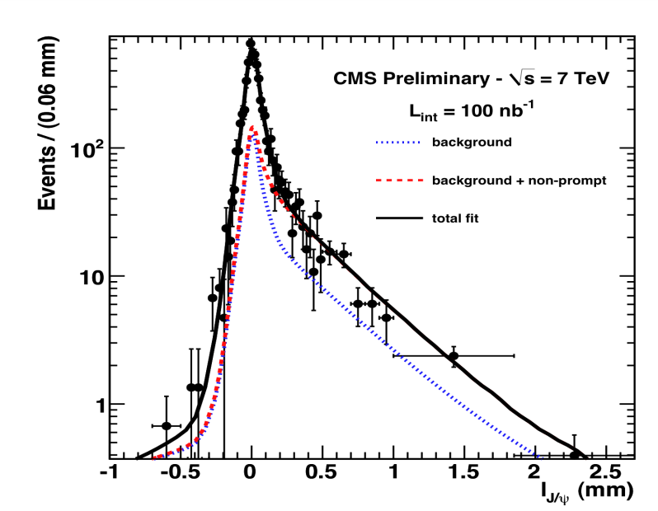
b Tags
Many BSM scenarios, and top decays focus on third quark generation. Commission b tags with templates and vertexing.

Slide 55
EW Physics – W and Z, Electrons

Slide 56
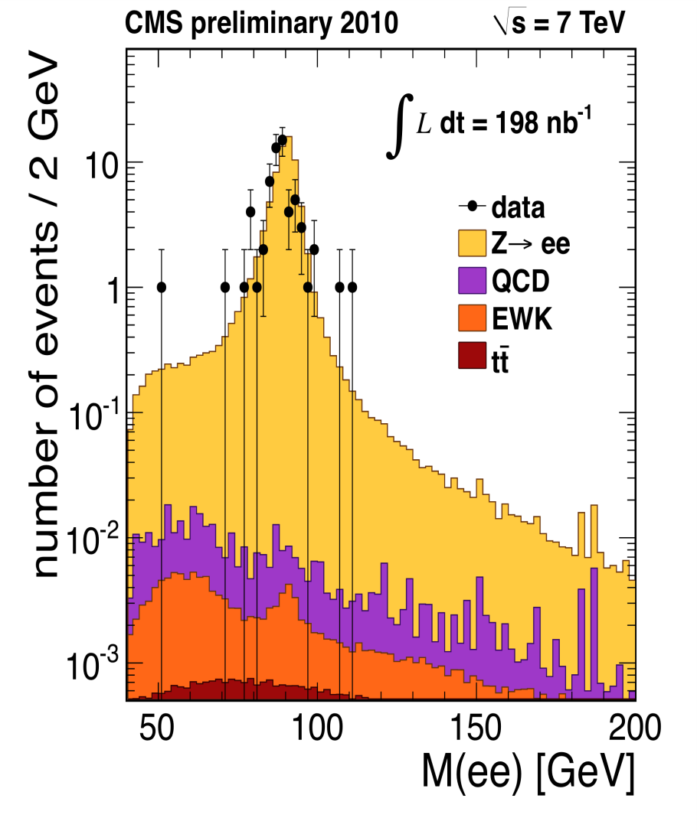
Electron Spectra or M_{T} and M

Slide 57
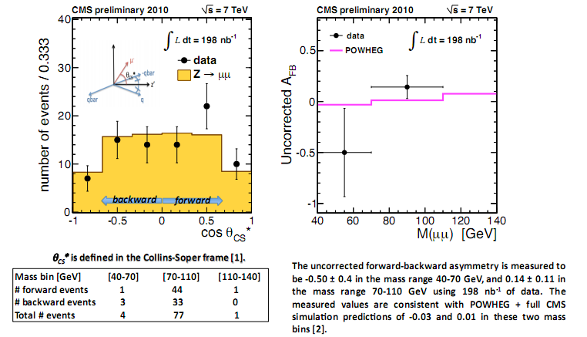
Decay Asymmetries – W and Z

Slide 58
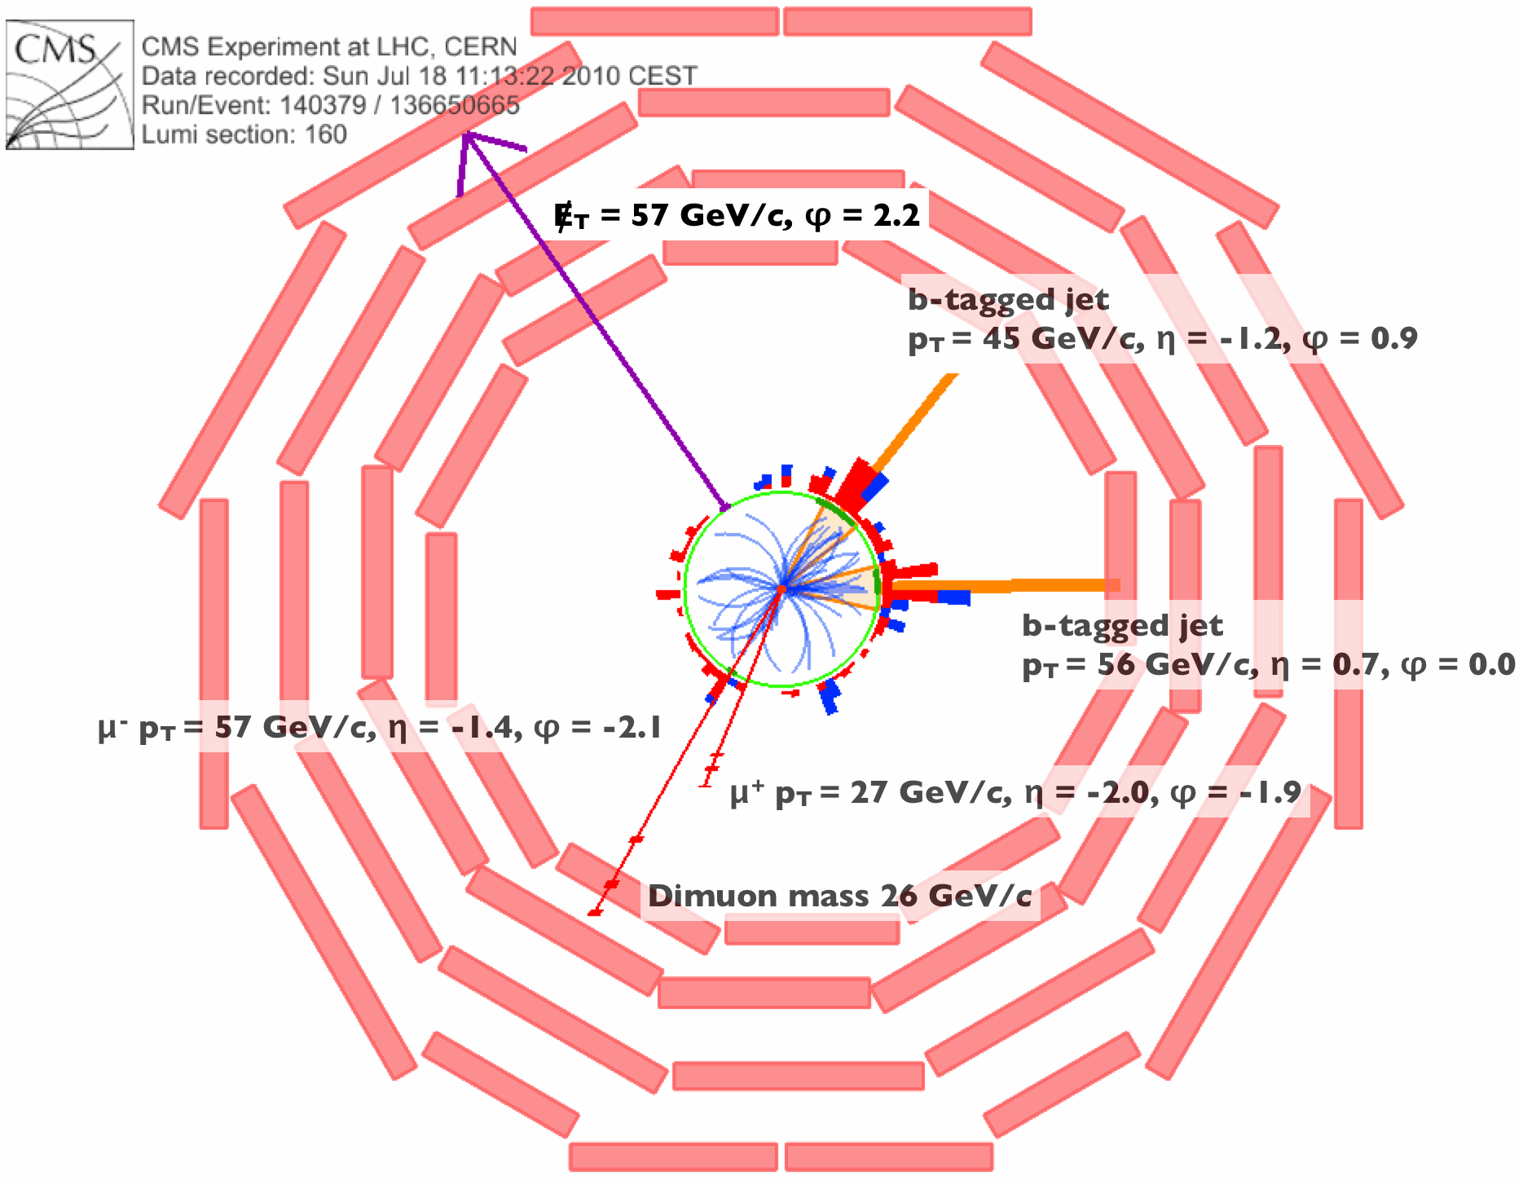
Top Candidate - Electron
Two J tagged as b jets -> top signature

Slide 59
Top Candidates and b Tag
Because of rapid commissioning of b tagging, a clean top signal in lepton + > 2 jets with at least 1 b tag is possible.

Slide 60
Gluino Pair Production

Slide 61
Leptoquarks ?
Quarks and leptons are unified at some high mass scale. Implies “lepto-quarks”. Look at q + l mass – bump hunting.

Slide 62
Heavy Stable Charged Particle
Use tracker timing and dE/dx – and muon system timing. Tracker only here.

Slide 63
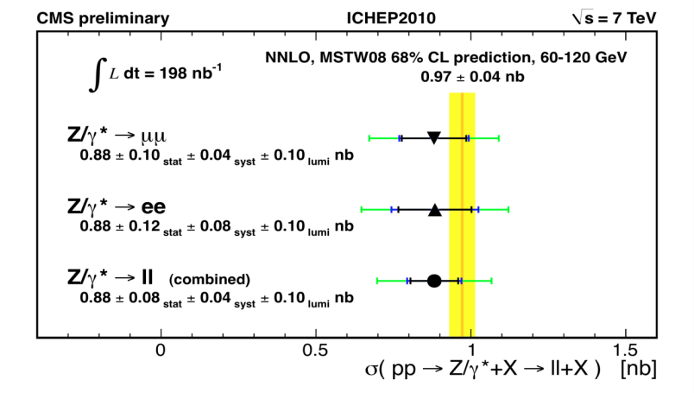
W, Z Cross Sections

Slide 64
SUSY and MET
Prepare for SUSY searches by using data driven methods to predict the MET spectrum at large MET values

Slide 65
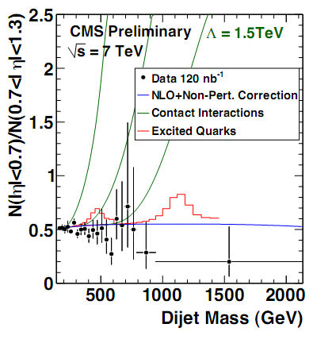
Dijet – Contact Interaction Limits

