Slide 1
WW / WZ / ZZ Diboson Production at the Tevatron
SUSY 2011 Conference - FNAL
Kyle J. Knoepfel
Fermi National Accelerator Laboratory
On behalf of the CDF and D0 Collaborations
August 30, 2011

Slide 2
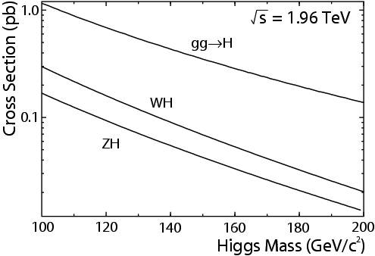
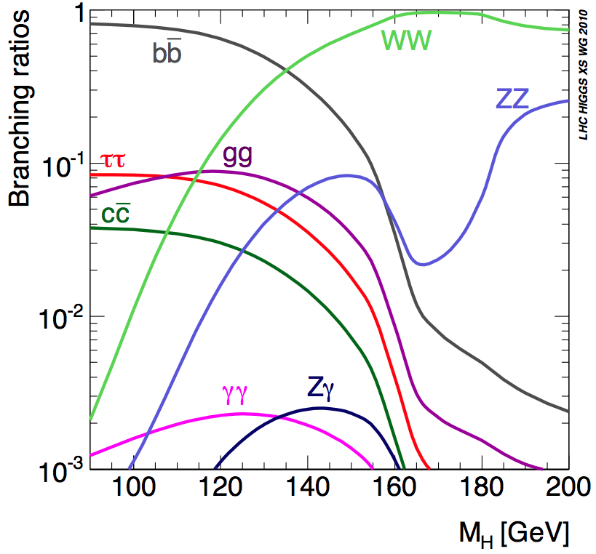
Getting to Higgs Territory
Higgs Production
Higgs production cross-sections are very small
( 0.01 to 1 ) pb
Look in production modes/decay channels with highest statistics
Naïve Search Channels:
Low-mass Higgs
(m_{H} < 135 GeV)
High-mass Higgs
(m_{H} > 135 GeV)
Higgs Decay

Slide 3
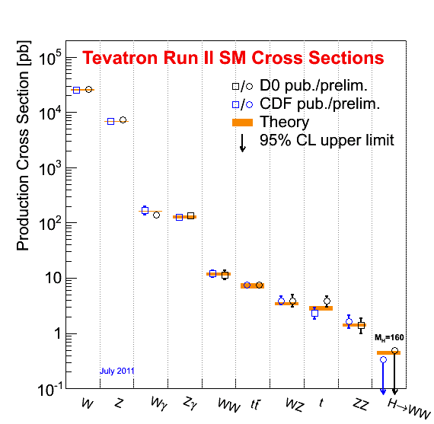
Getting to Higgs Territory
In reality…
Large multijet QCD backgrounds make
searches unfeasible at low Higgs mass
Search for low-mass Higgs with associated production:
Small cross-sections!
To validate Higgs search procedures, search for known SM-processes with “comparably”-small production cross sections:
Diboson Production!

Slide 4
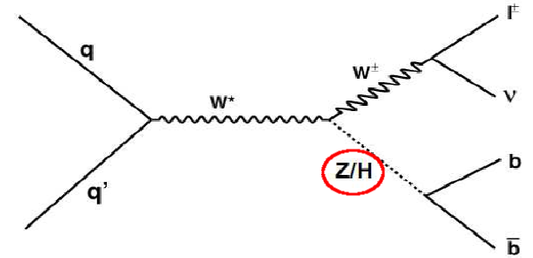
Diboson vs. Higgs Analyses
Feynman diagrams are
topologically equivalent
Same final states, and therefore same analysis strategy, modulo different definitions of signal.
Retraining signal/background discriminants

Slide 5
W-Boson Decays
Z-Boson Decays
Dominant decay modes are to jets, limited energy resolution
Start with leptonic decay modes, benefit from precise energy determinations from trackers and electromagnetic calorimeters

Slide 6
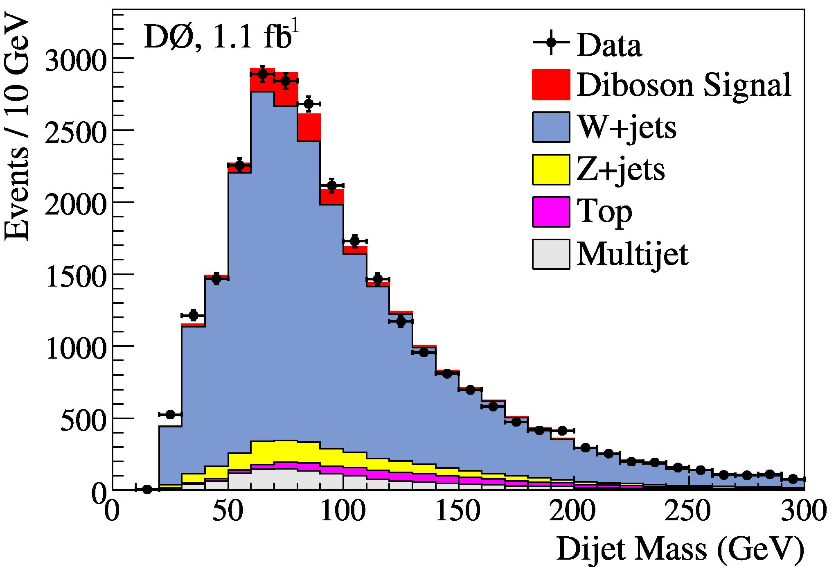
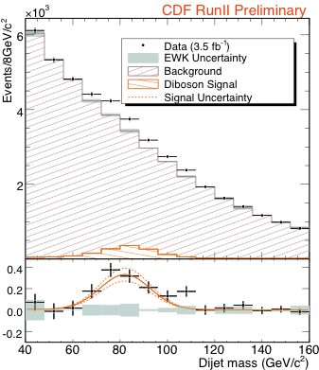
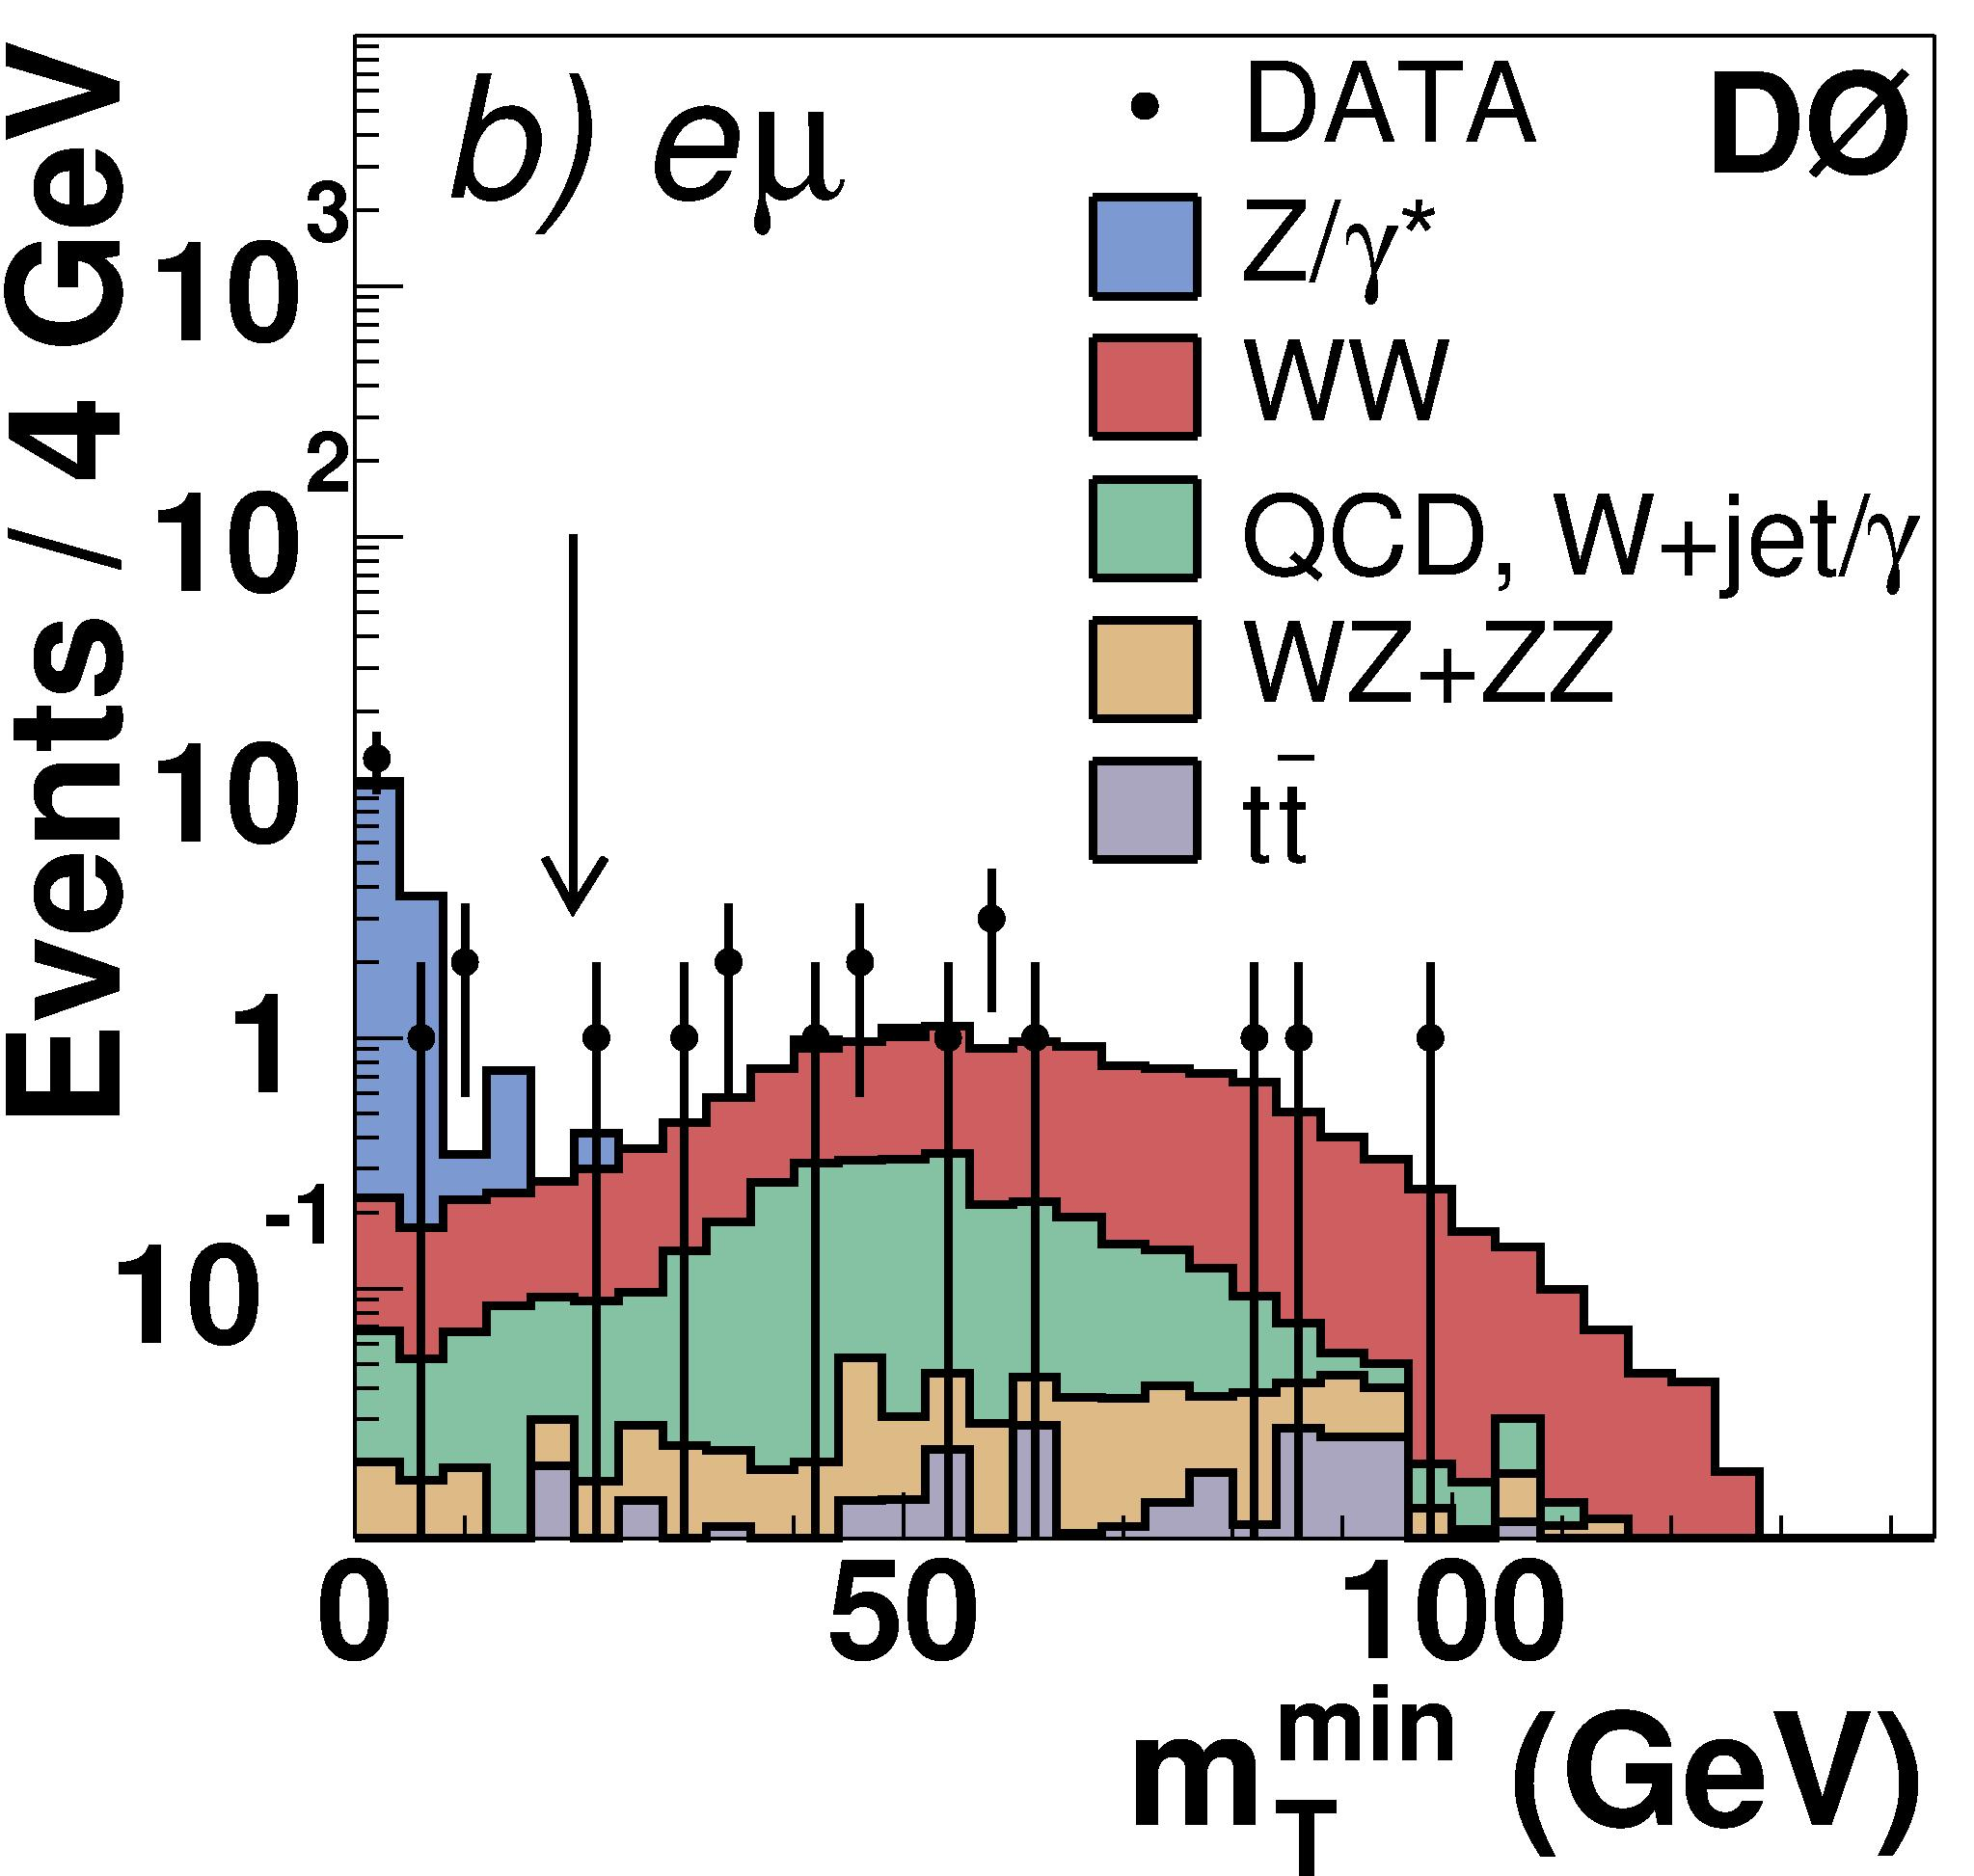
Previous Diboson Searches
First observation of diboson production in lepton channels (2005)
WW production in 2 Leptons plus Missing Energy
D0 Analysis:
1.1 fb⁻¹ (2009)
First evidence of WW/WZ production in 2 jets + 1 lepton:
4.4σ
CDF Analysis:
3.5 fb⁻¹ (2009)
First observation of WW/WZ/ZZ production in 2 jets + MET:
5.3σ
D0: PRL 94 151801 (2005)
CDF: PRL 94 211801 (2005)
D0: PRL 102 161801 (2009)
CDF: PRL 103 091803 (2009)

Slide 7
Getting Closer to the Higgs
Diboson production observed in hadronic final states
Look for diboson production in final states with two heavy-flavor (H.F.) jets
Discussed today—diboson final states with the following reconstructed objects:
H.F. Jets | Leptons | Missing E? | Analogous Higgs Process
2 | 2 | No
2 | 1 | Yes
2 | 0 | Yes

Slide 8
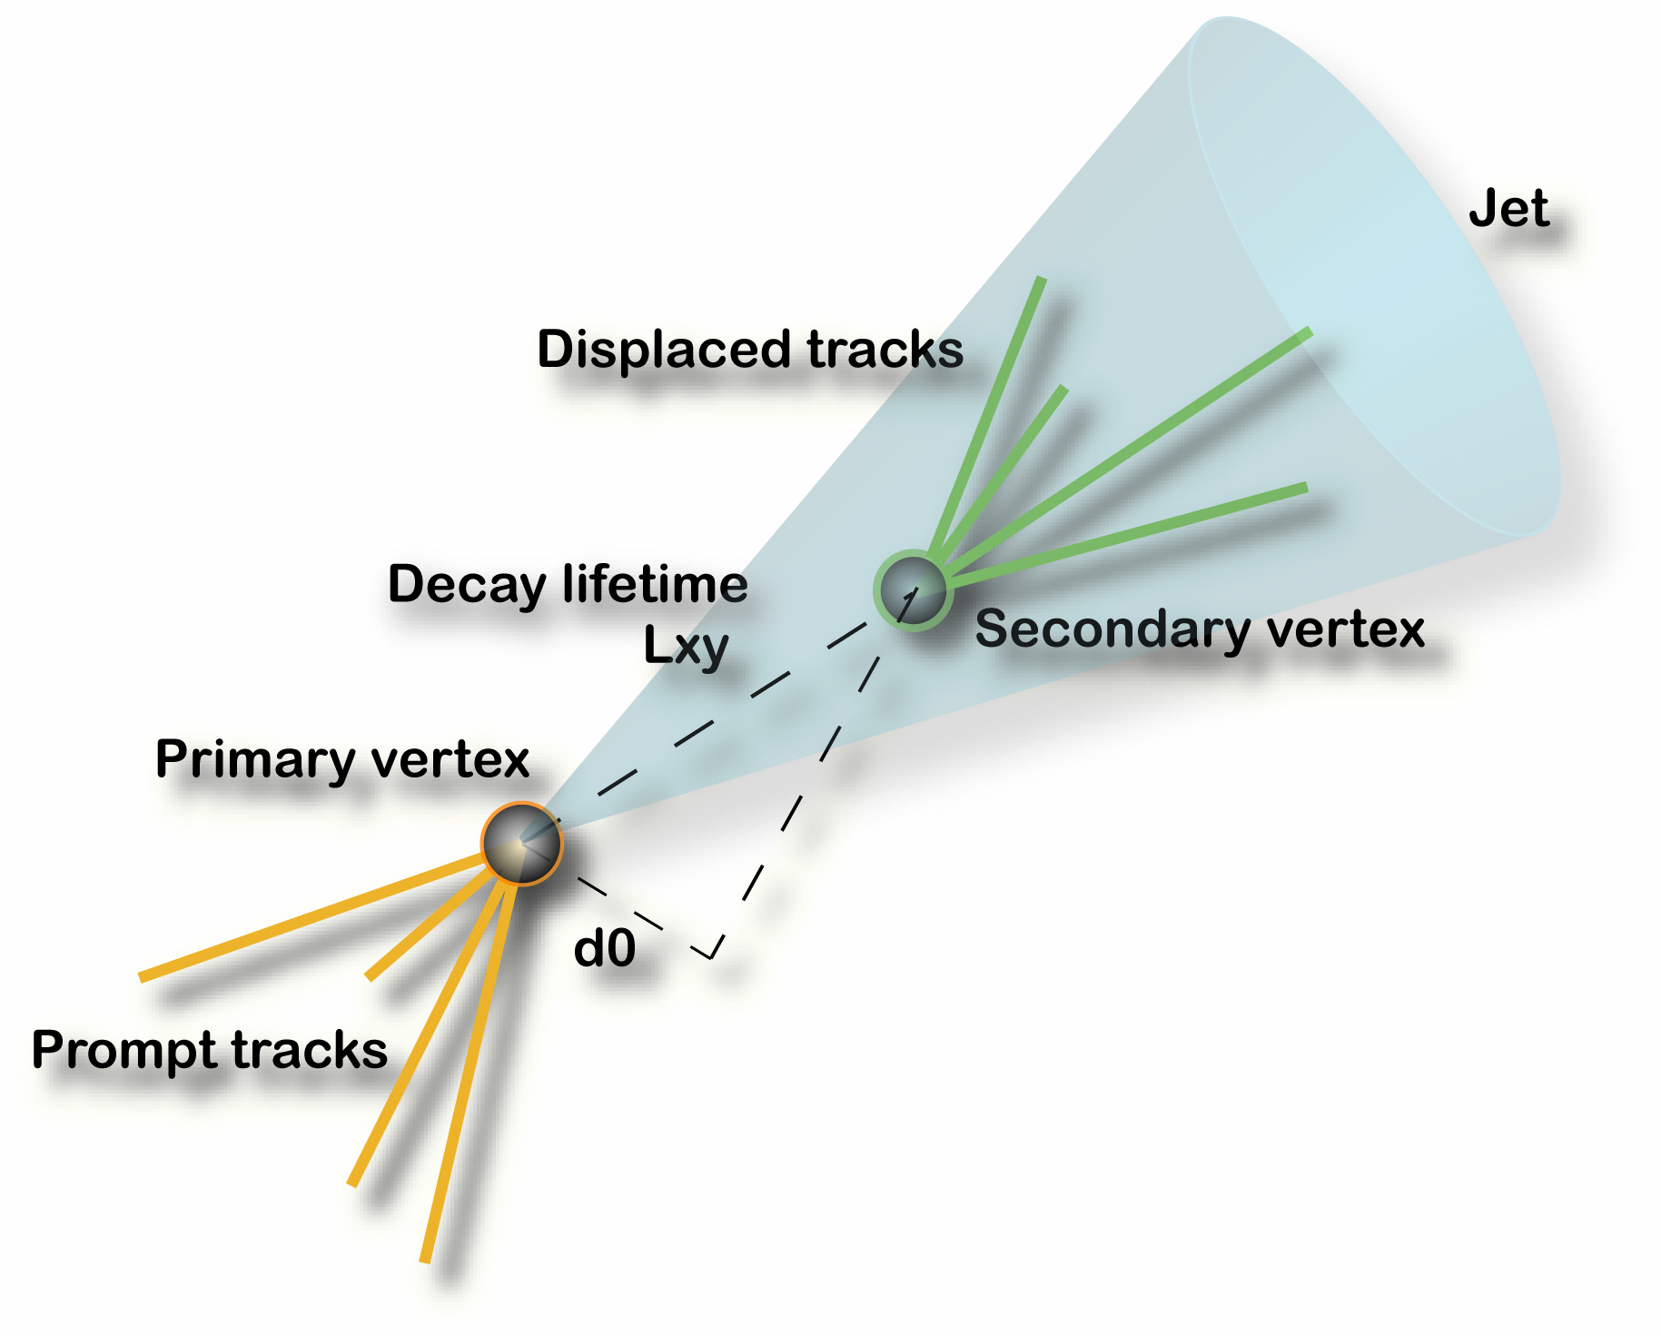
Tagging heavy-flavor jets
Both collaborations use algorithms to identify b(c)-jets.
Neural networks
Decision trees
Use variables which depend on longer lifetimes and heavier masses of B(D)-hadrons
Displaced vertex (L_{xy}, d₀)
Jet lifetime
Jet mass
Distribution of tracks within the jet cone
etc.

Slide 9
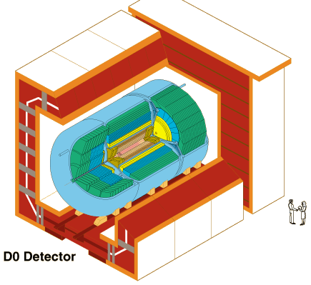
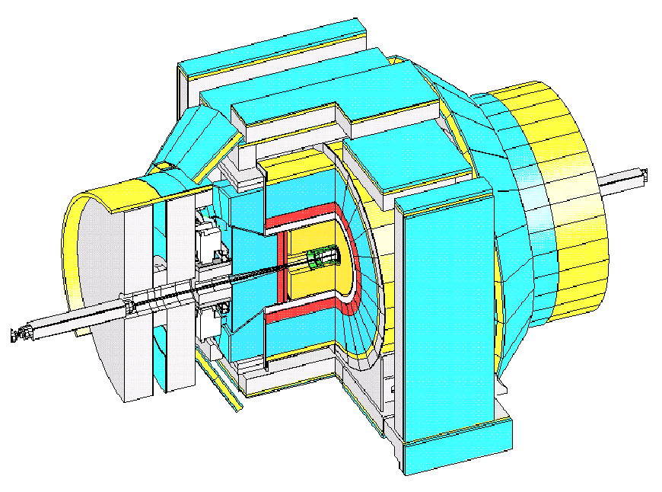
Detectors
Center-of-Mass Energy: 1.96 TeV
11.7 fb⁻¹ delivered to both experiments
CDF II Detector
Collected Lumi: ~9.7 fb⁻¹
Analyzed Lumi: ≤ 7.5 fb⁻¹
D0 Detector
Collected Lumi: ~10.5 fb⁻¹
Analyzed Lumi: ≤ 8.4 fb⁻¹

Slide 10
2 Jets + 2 Leptons + No Missing Energy
Final States:
Benefit: Can completely reconstruct the Z
Downside: Small Z-to-leptons branching ratio (~7%)

Slide 11
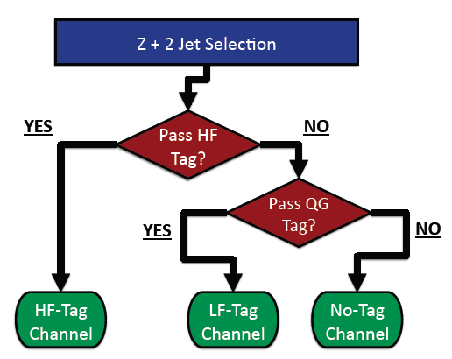
(b-) jets + 2 Leptons (6.6 fb⁻¹)
Selection criteria
Lepton P_{T} > 20 GeV/c
76 < m_{Z} < 106 GeV/c²
2 Jet E_{T} > 20 GeV
Jet |η| < 2.0
Small MET
etc.
Energy Adjustments
Electrons: Z+0 jets
Z-peak matches in MC and data
Jets: Z+1 jets
Gluon- and quark-like jets treated differently in MC
Analysis performed in three channels
HF-Tag channel
LF-Tag channel
No-Tag channel

Slide 12
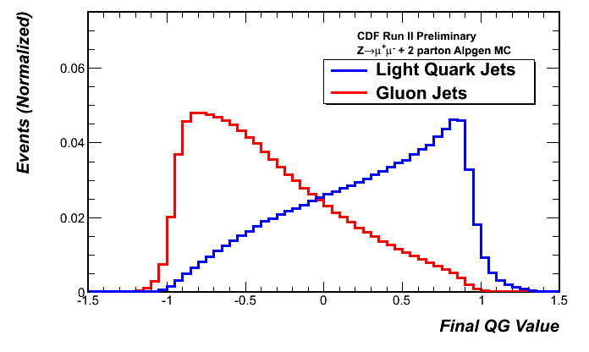
(b-) jets + 2 Leptons (6.6 fb⁻¹)
CDF Run II Preliminary
Z + 2 Jet Selection
HF-tagged event based on bness (NN):
Track p_{T}
Track rapidities
Impact parameters
etc.
(arXiv:1108.4738)
LF-tagged event based on quark-gluon discriminant:
Track/tower distributions
within jet
No. of tracks/towers
Jet η
Jet E_{T}
etc.
No-tagged event fails both of these criteria

Slide 13
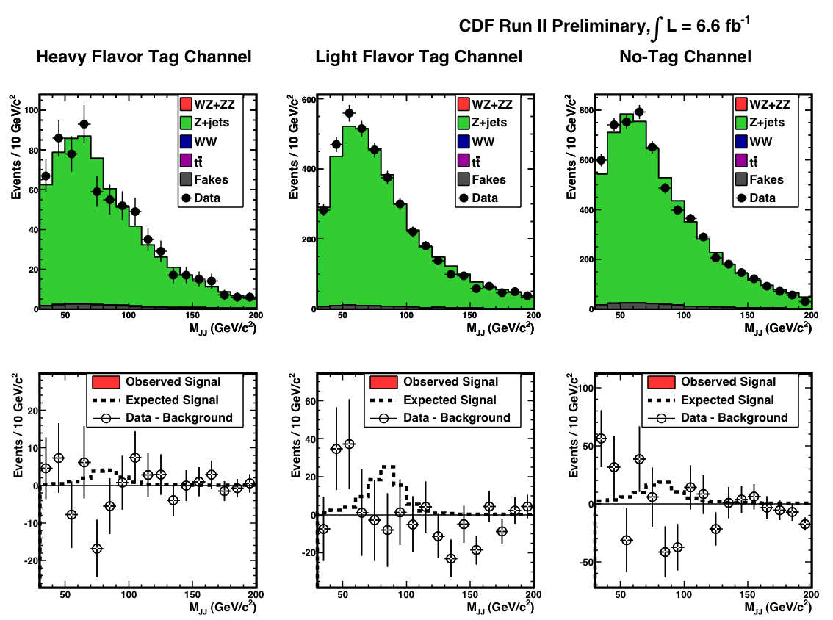
(b-) jets + 2 Leptons (6.6 fb⁻¹)
Combined
Result:
Close to SM diboson production sensitivity in this channel.

Slide 14
2 Jets + 1 Lepton + Missing Energy
Final States:
Benefit: Large branching ratio to hadronic final states
Downside: Backgrounds from multi-jet QCD

Slide 15
b/c-Jets + 1 Lepton + MET (7.5 fb⁻¹)
Selection criteria (e.g.)
Missing E_{T} > 20 GeV
Lepton E/P_{T} > 20 GeV
2 Jet E_{T} > 20 GeV
Results determined from two regions
Only 1 HF-tag
Only 2 HF-tags
Fake-W backgrounds suppressed by support vector machine (SVM) algorithm (e.g.):
Lepton P_{T}
MET
Electron-MET Angle
Jet 2 E_{T}
Significance of MET
Remaining backgrounds
Fake-W
W + non-resonant b-jets
W + Mis-tagged Jets
Electroweak

Slide 16
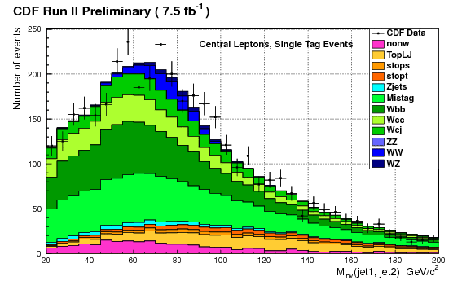
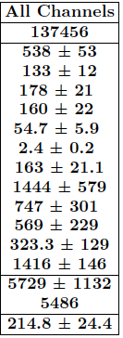
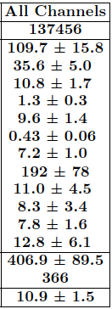
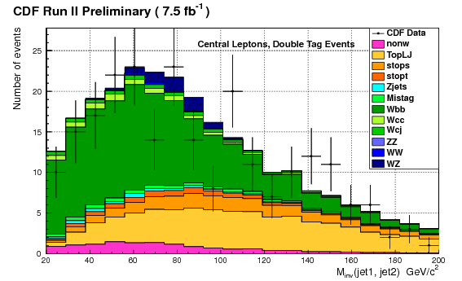
b/c-Jets + 1 Lepton + MET (7.5 fb⁻¹)
Fit Results
1 HF-Tag
2 HF-Tags

Slide 17
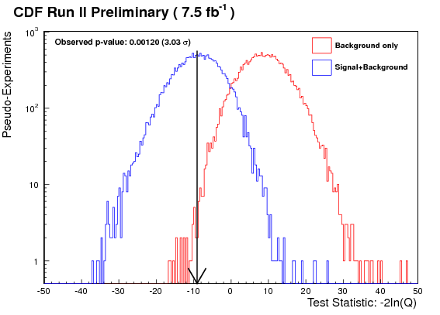
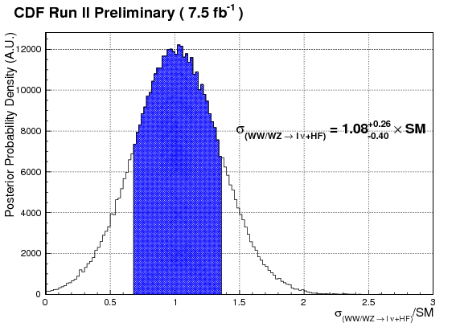
b/c-Jets + 1 Lepton + MET (7.5 fb⁻¹)
Significance of result determined with by log-likelihood ratio (-2 ln Q) test: 3.03σ (obs.) 3.02σ (exp.)

Slide 18
2 Jets + 0 Leptons + Missing Energy
Final States:
Benefits: Large branching ratio to hadronic final states
Large-ish Z-to-neutrinos branching ratio (20%)
Downside: Very large backgrounds from multi-jet QCD

Slide 19
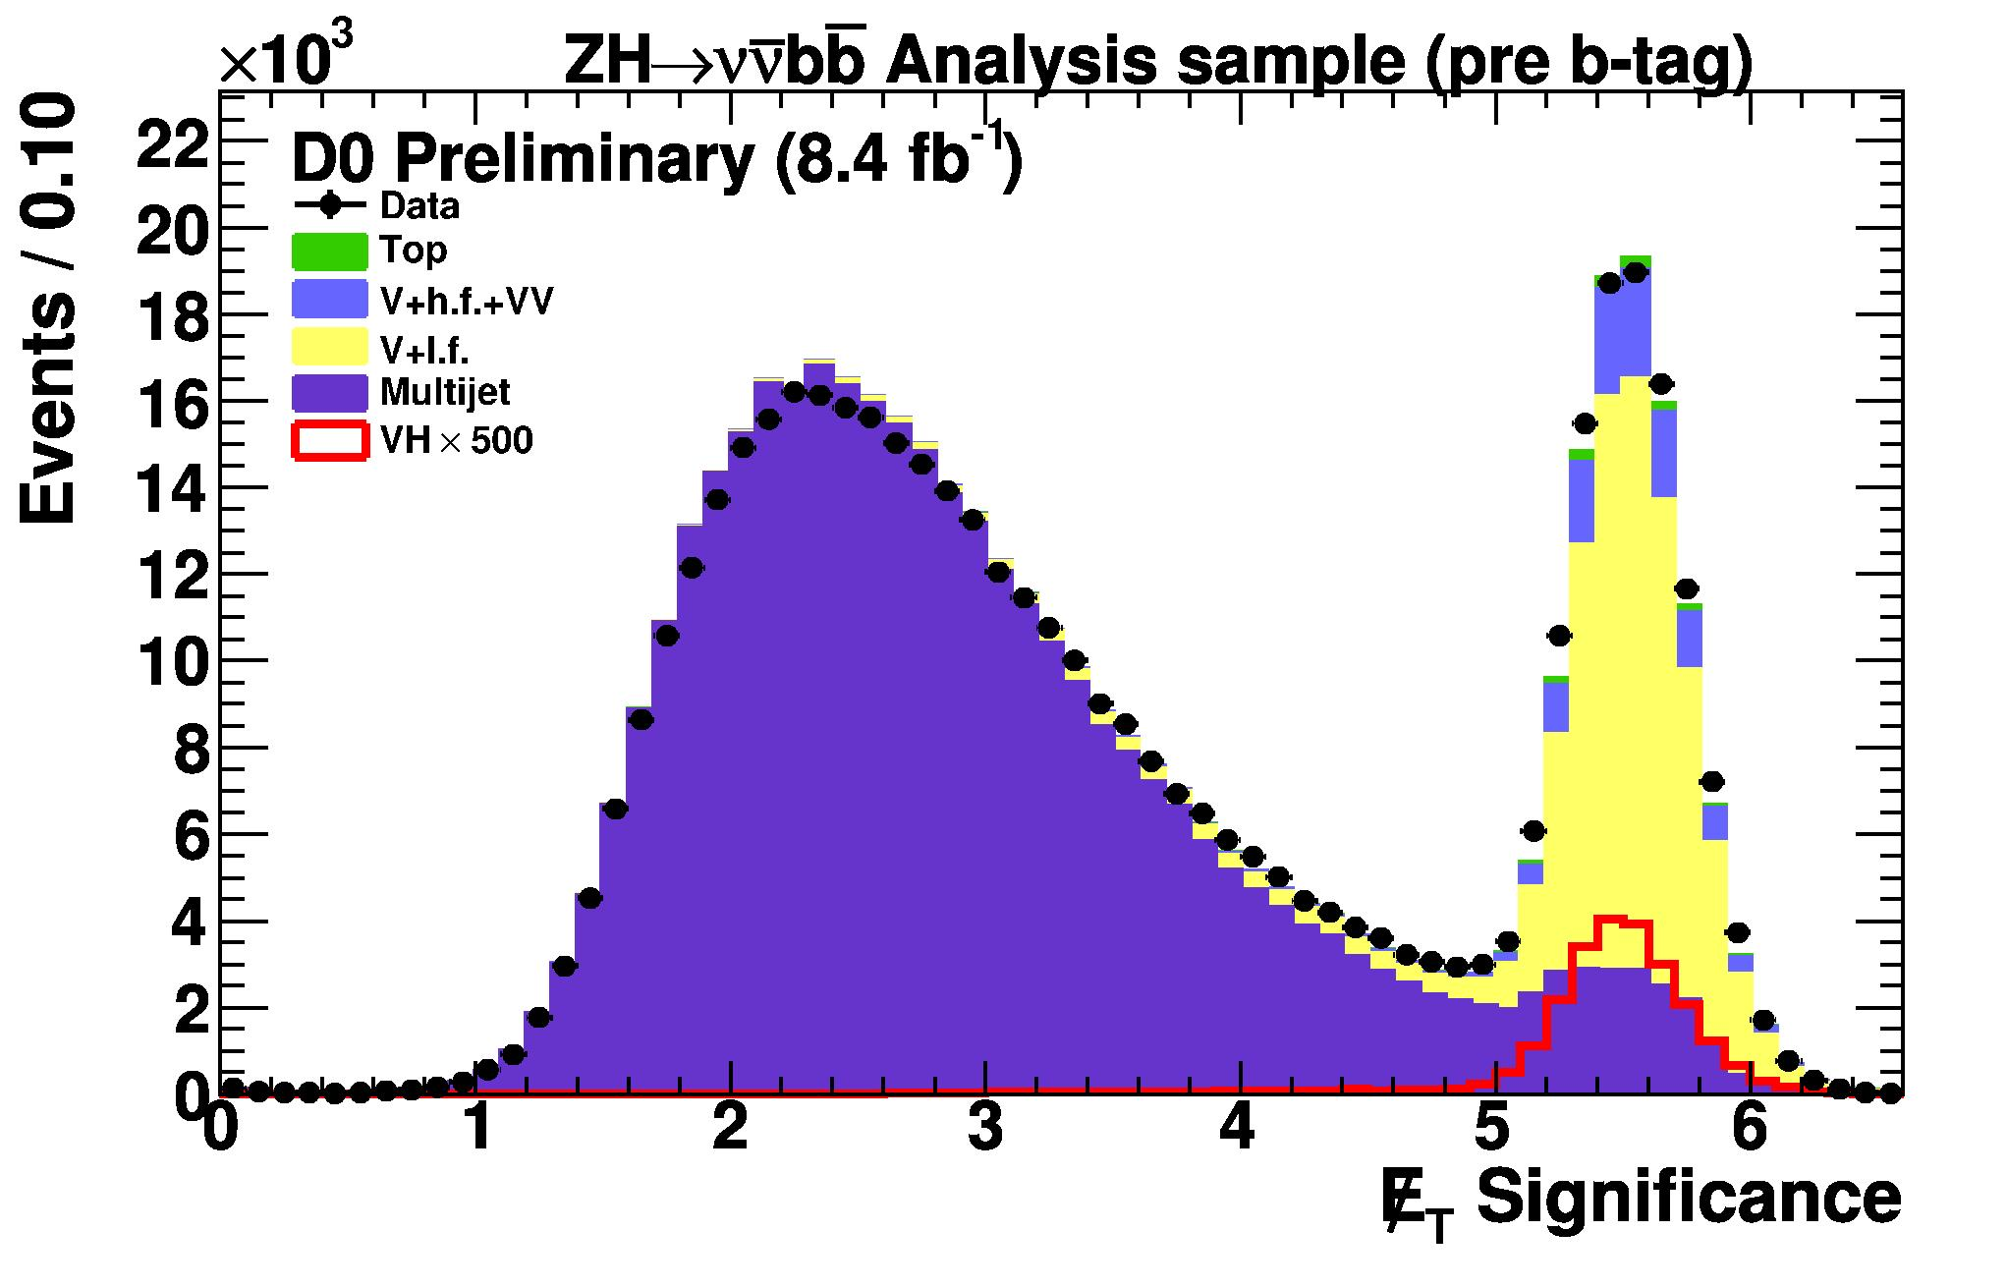
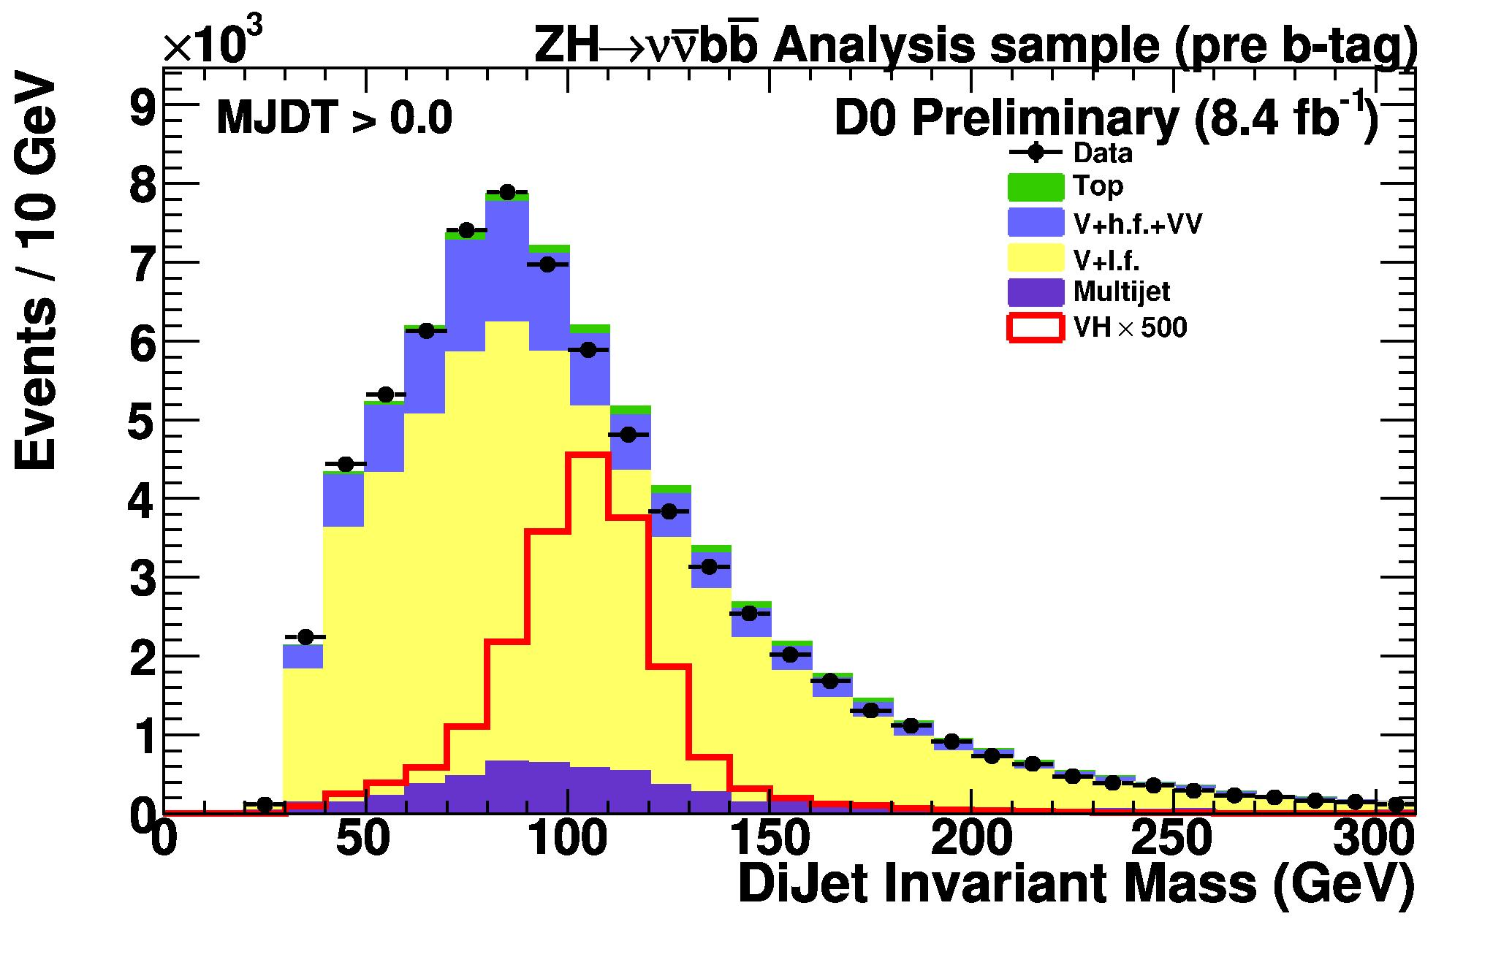
Missing Energy + b-jets (8.4 fb⁻¹)
QCD backgrounds suppressed with selection criteria:
Missing E_{T} > 30 GeV
MET-Jet Angle > 23 degrees
Jet1-Jet2 Angle < 165 degrees
MET significance > 5
Boosted Decision Tree used to identify b-jets
Boosted Decision Trees used to suppress
QCD multi-jet backgrounds (MJDT)
Remaining SM backgrounds
Analysis performed in 1- and 2-b-tagged channels

Slide 20
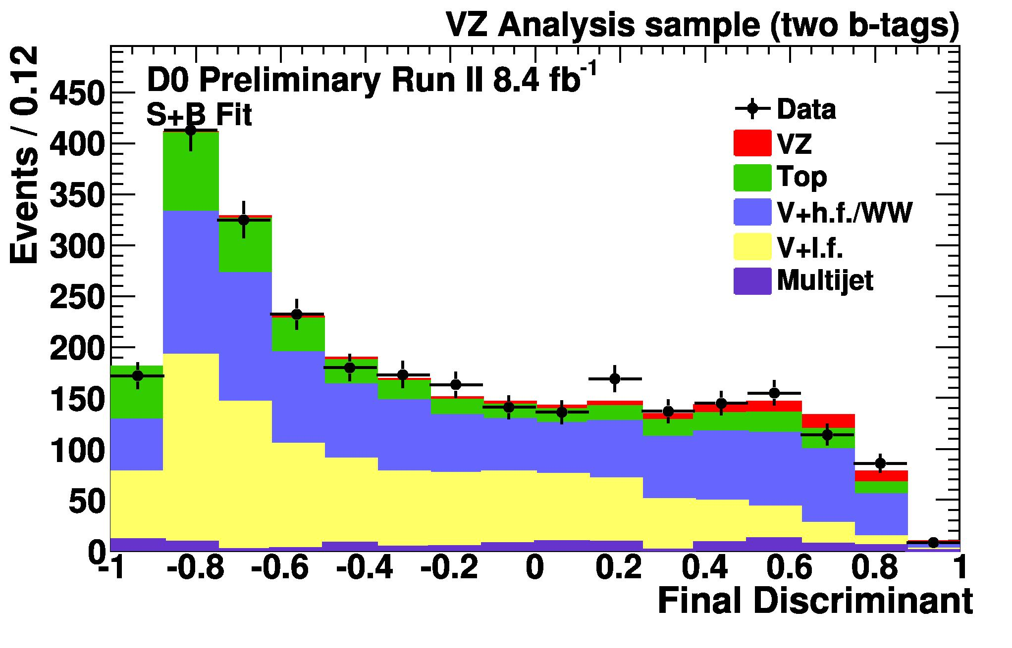
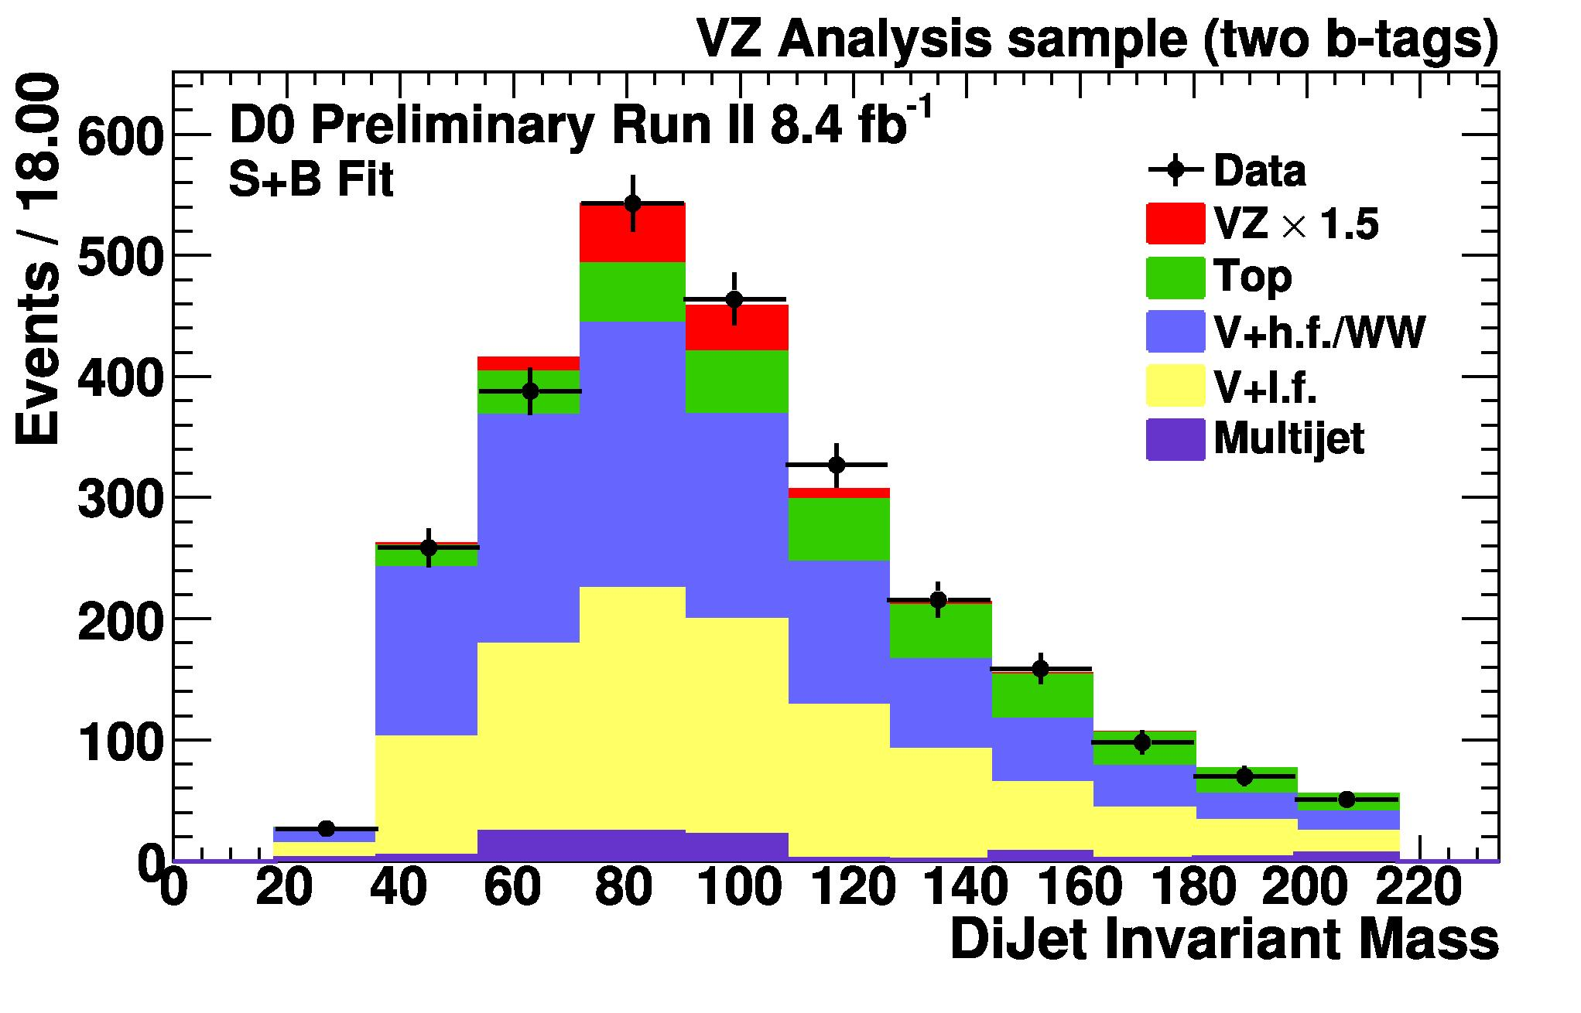
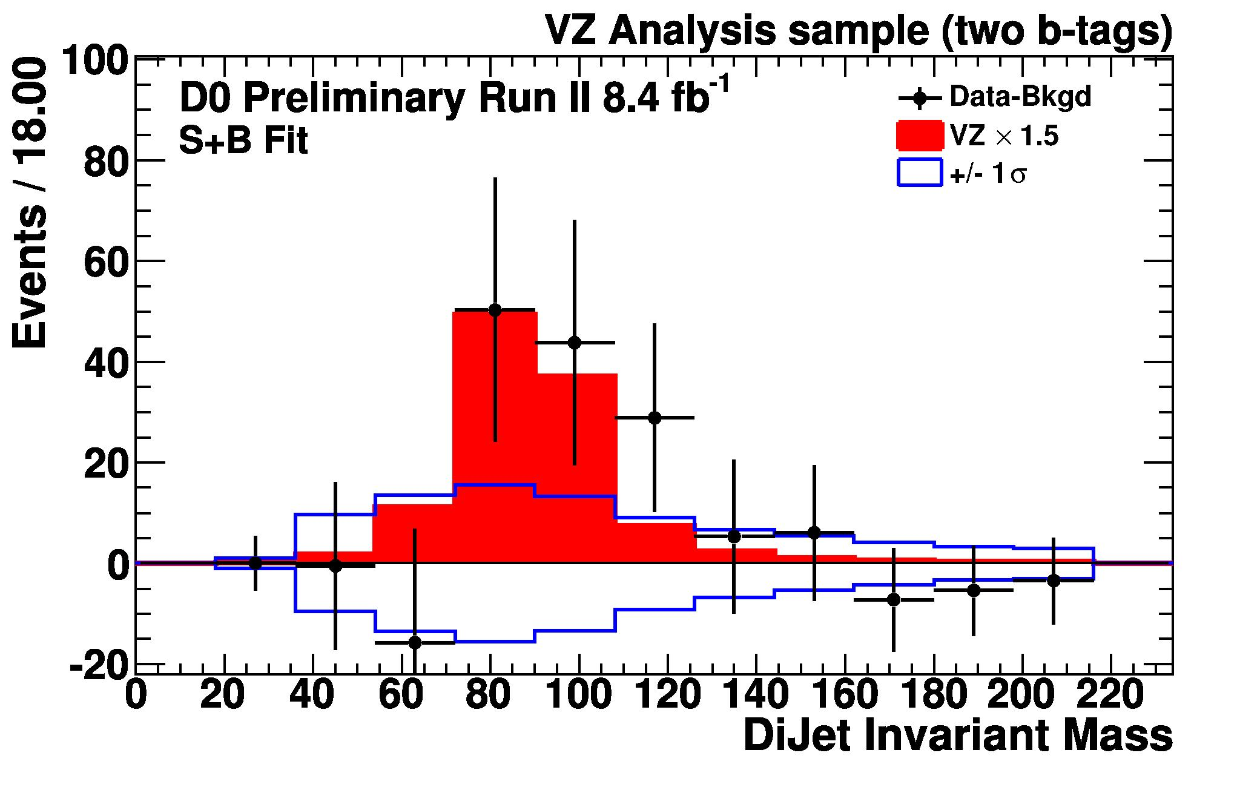
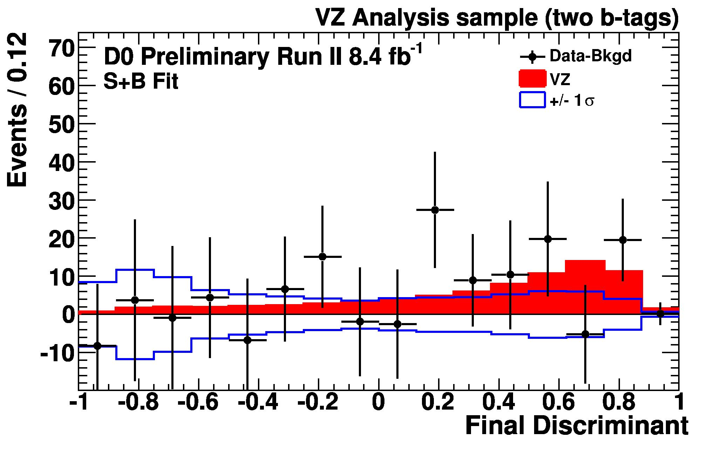
Missing Energy + b-jets (8.4 fb⁻¹)

Slide 21
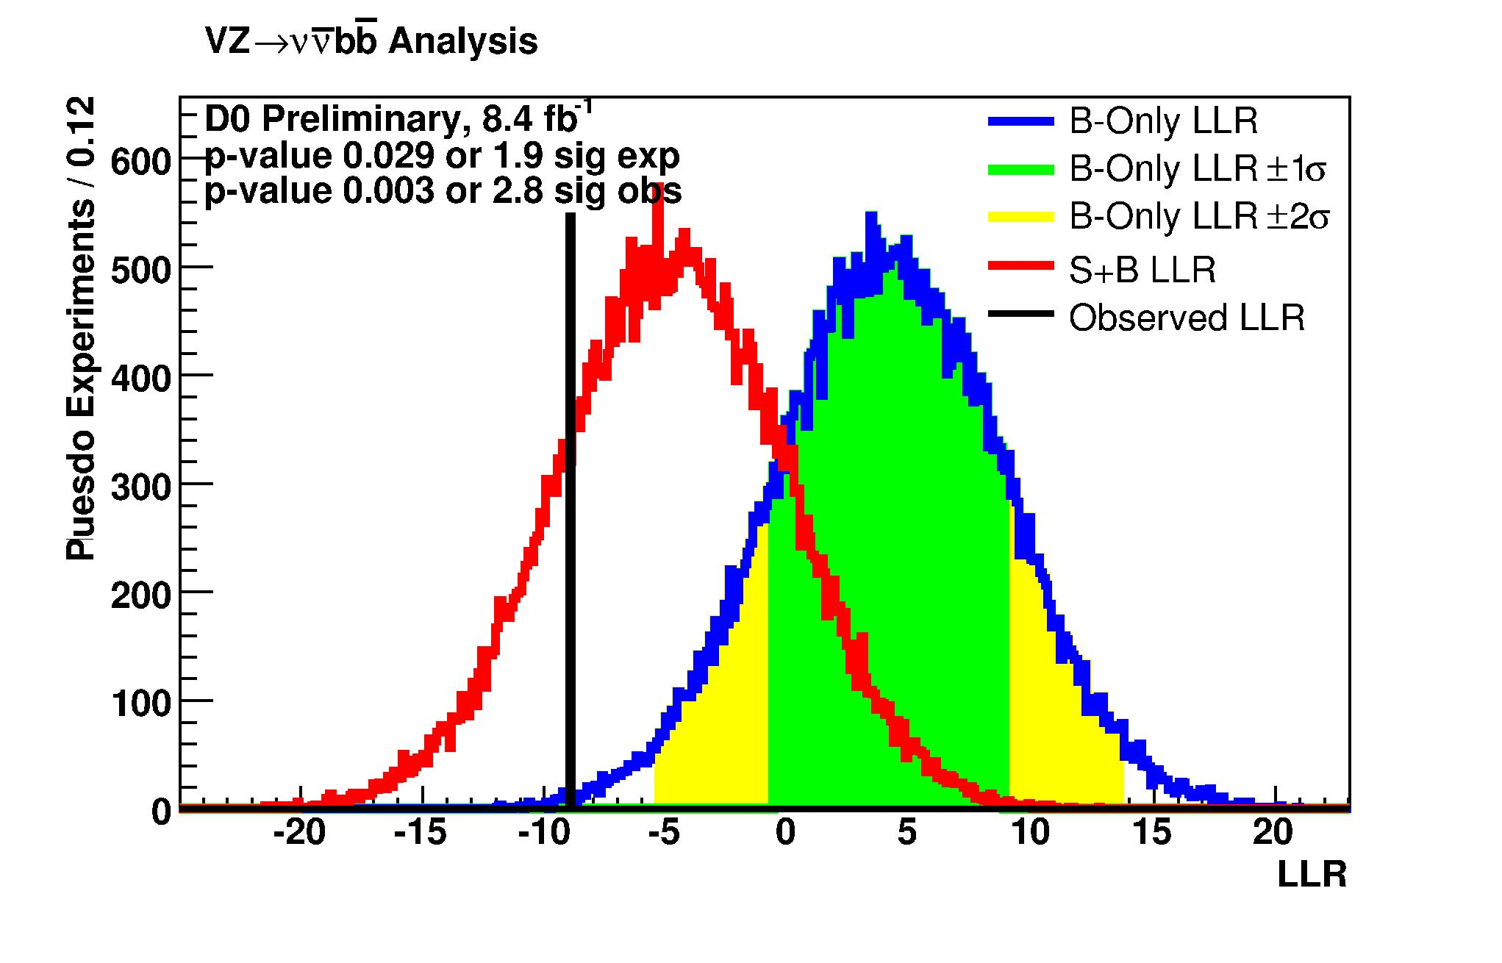
Missing Energy + b-jets (8.4 fb⁻¹)
Significance: 2.8σ (obs.) 1.9σ (exp.)

Slide 22
Missing Energy + (b-) jets (5.5 fb⁻¹)
CDF analysis performed with at most one identified lepton (e or µ)
QCD backgrounds suppressed by:
Missing E_{T} > 50 GeV
MET-Jet Azimuthal Angle > 0.4
(avoids instrumental MET)
b-jets identified with bness variable
Remaining QCD multijet background measured in data control region
Analysis performed in b-tagged and untagged samples
Results determined from simultaneous fit to both samples

Slide 23
Missing Energy + (b-) jets (5.5 fb⁻¹)
Combined Result:

Slide 24
Conclusions
Diboson production is a rare process with cross-sections near the Higgs production level
Increased sensitivity to diboson production with new analyses, and close to evidence in b-tagged jets
WW, WZ production: CDF (HF-jets) 3.0σ
WZ, ZZ production: D0 (b-jets) 2.8σ
Significances will increase with more luminosity, refined analysis techniques
D0 + CDF combination planned for individual WZ and ZZ cross-section measurements with b-jets.
Thank you.

Slide 25
Public Webpages
D0
http://www-d0.fnal.gov/Run2Physics/WWW/results/final/EW/E08H/
CDF
http://www-cdf.fnal.gov/physics/new/hdg/Results_files/results/wzllbb_071911/Diboson_public_6.6fb.html
http://www-cdf.fnal.gov/physics/new/hdg/Results_files/results/wzlnubb_071911/
http://www-cdf.fnal.gov/physics/new/hdg/Results_files/results/wzzz_sep10/METBB_dibosons/Dibosons_METJJ_2.html

Slide 26
Back-up Slides

Slide 27
Some definitions
MET | Missing Transverse Energy
“tagged” | Jet identified as a b-jet
HF | Heavy Flavor
LF | Light Flavor
NN | Neural Network

