Slide 1




SUSY Searches at CMS
Isabell-A. Melzer-Pellmann
for the CMS Collaboration
SUSY 2011
Fermilab/Chicago

Slide 2
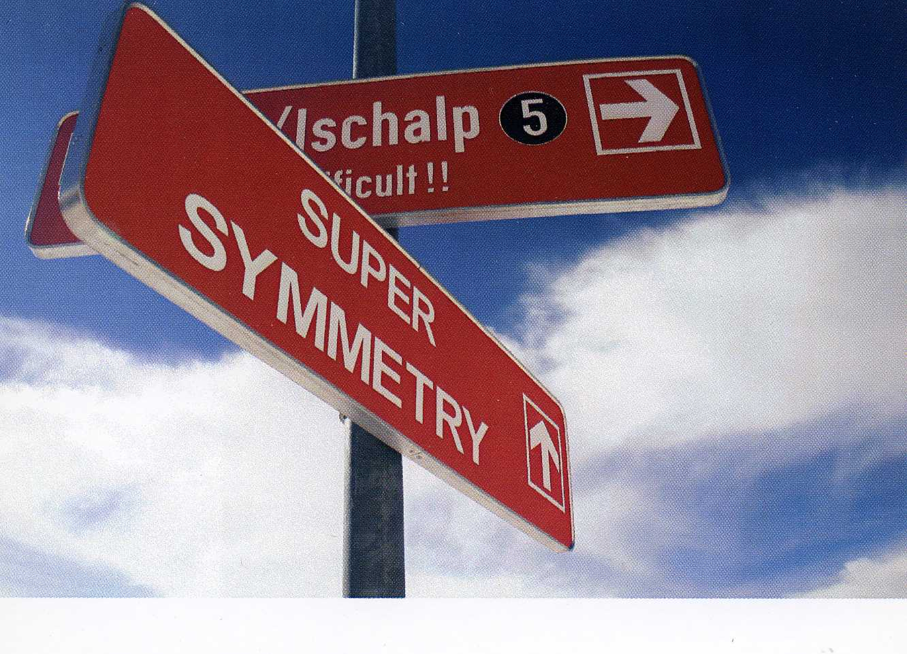
Outline
  The CMS Experiment
  Hadronic searches
  Leptonic searches
  Searches with photons

Slide 3
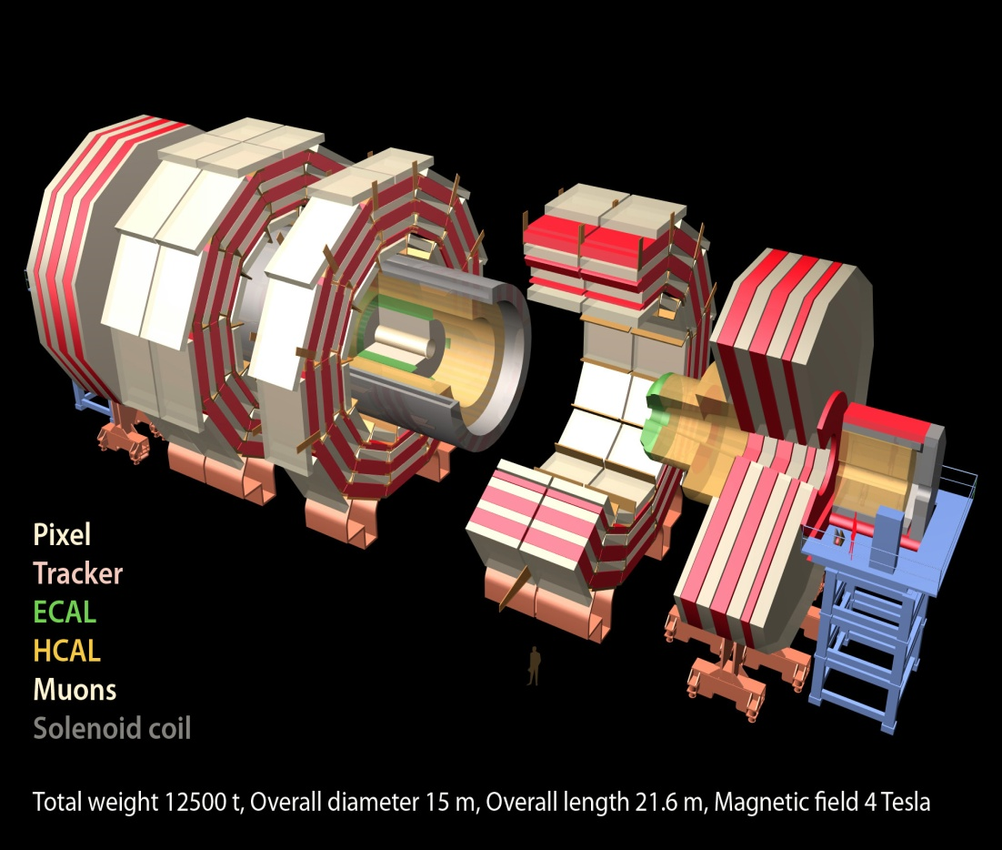
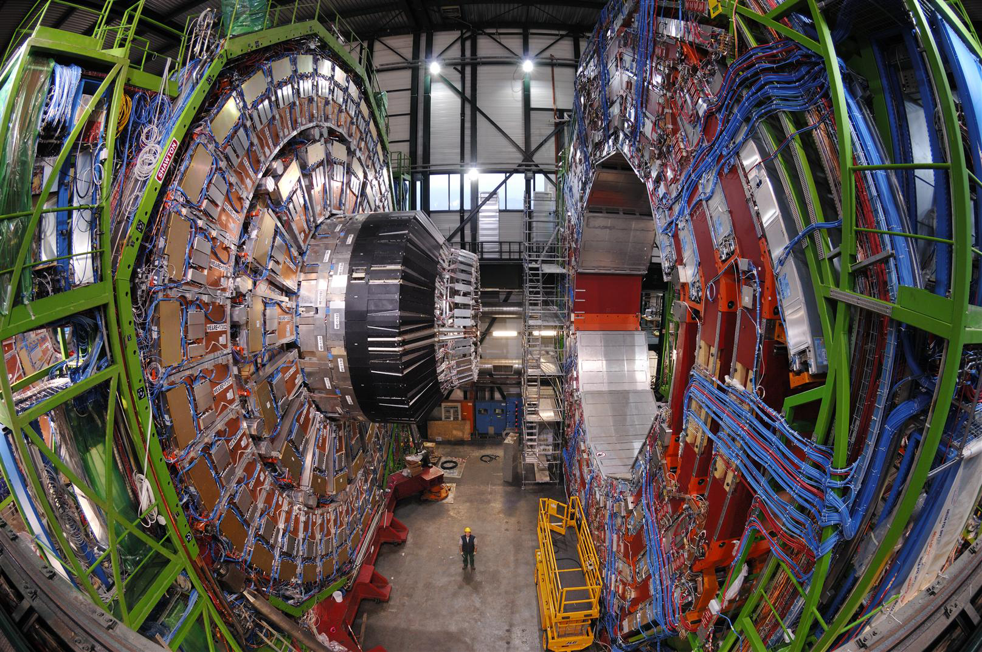
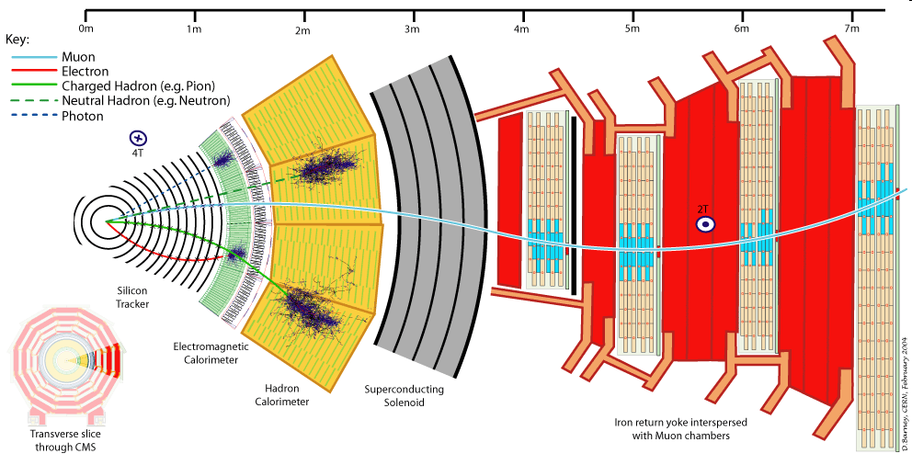
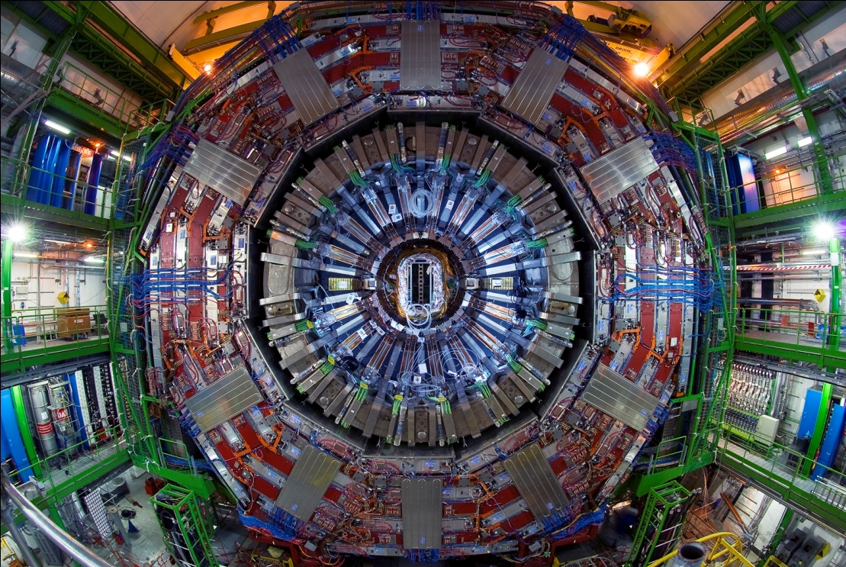
Compact Muon Solenoid (CMS)

Slide 4
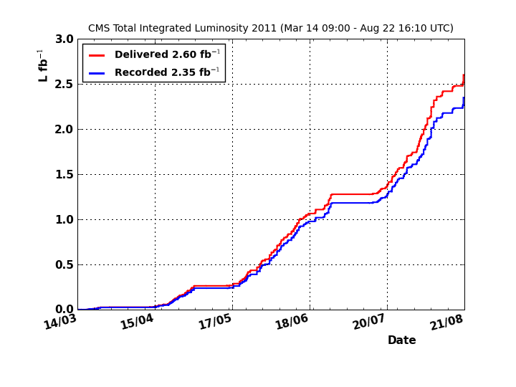
Luminosity accumulated so far
More than 2.5 fb⁻¹ accumulated so far
Most analyses presented here are performed with ~ 1 fb⁻¹

Slide 5
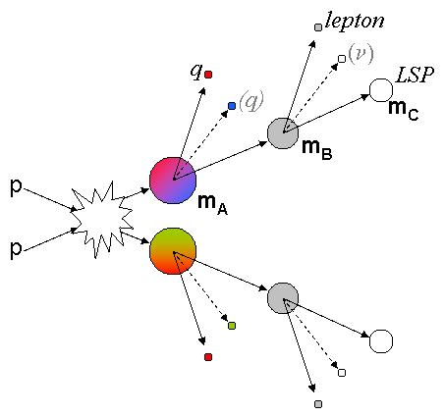
CMS Search Strategy
0 leptons | 1 lepton | OSDL | SSDL | ≥3 lep. | 2 γ | 1 γ+ 1 lep.
Jets + E_{T}^{miss} (+special variables) | Single lepton+ jets+E_{T}^{miss} | Opposite sign di-leptons+ jets+E_{T}^{miss} | Same-sign di-leptons+ jets+E_{T}^{miss} | Multi-leptons | Di-photon+jets+E_{T}^{miss} | Photon+lepton+E_{T}^{miss}
Topology based searches, not optimized for any particular SUSY model
Most searches probe tails of E_{T}^{miss} distribution
Try to cover as much phase space as possible (e.g. as low lepton p_{T} as possible)
Estimate backgrounds from data (data-driven bkg estimate) to minimize reliance on MC (e.g. for detector (mis)reconstruction effects)

Slide 6
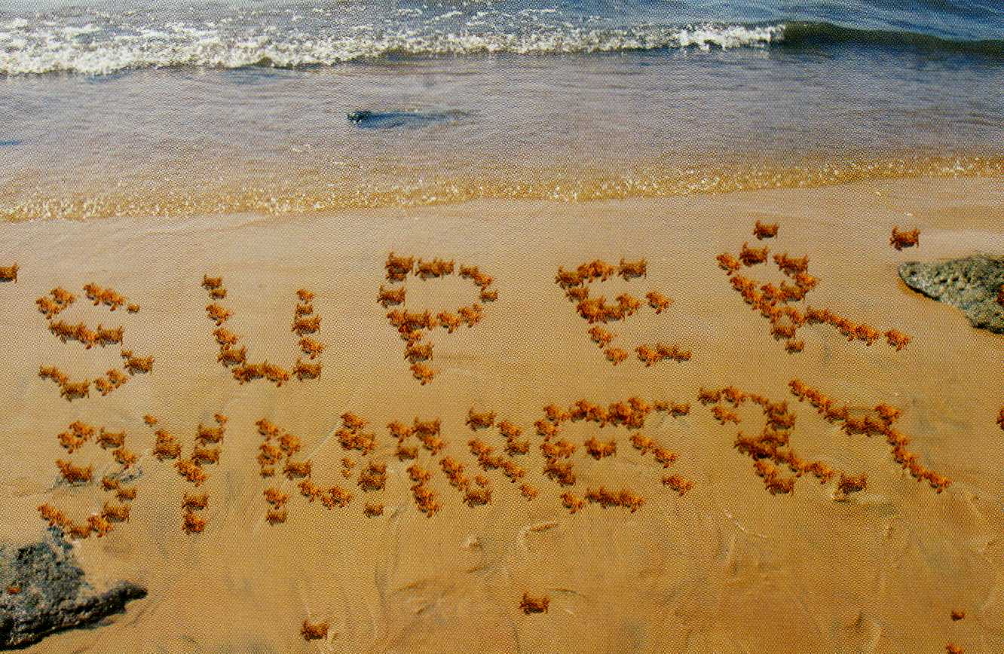
Where we are…
  The CMS Experiment
  Hadronic searches
    Inclusive hadronic analysis
    Inclusive analysis with M_{T2}
  Leptonic searches
  Searches with photons

Slide 7
Inclusive All-Hadronic Search: Introduction
Signature:
Many jets and large missing transverse energy
Least model-dependent analysis
Large backgrounds:
  Z+jets with Z→ νν (irreducible)
  W+jets and ttbar with W → lν and lost lepton or τ → hadrons + ν
  QCD multijet events with large missing transverse momentum due to:
    Leptonic decays of heavy flavor hadrons inside jets
    Jet energy mismeasurement
    Instrumental noise
    Non-functioning detector components
Phys. Lett. B698:196-218 (2011)
CMS PAS SUS-11-004

Slide 8
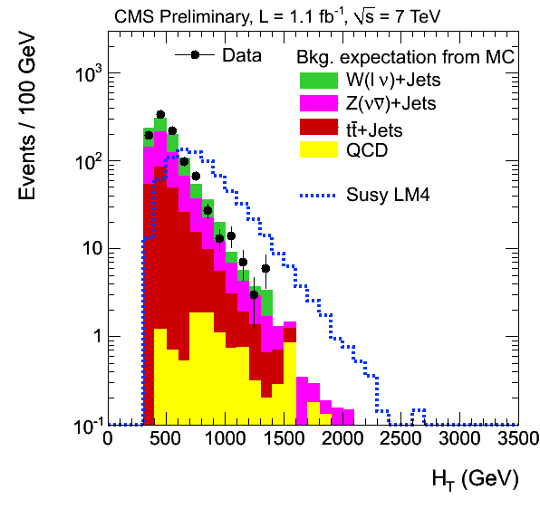
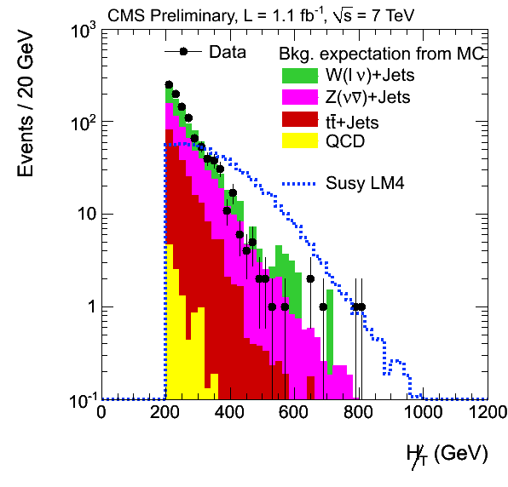
Inclusive All-Hadronic Search:
Event Selection
Baseline selection
  At least 3 jets with p_{T}^{jet} > 50 GeV and |η| < 2.5
  H_{T} > 350 GeV
  H_{T}^{miss} > 200 GeV
  |Δ Φ (J_{1,2}, H_{T}^{miss})| > 0.5 and |Δ Φ (J₃, H_{T}^{miss})| > 0.3 to veto events where H_{T}^{miss} is aligned in transverse plane with one of the 3 leading jets
  Veto on isolated muons and electrons
H_{T} = Σ| p_{T}^{jet}|
H_{T}^{miss} = -Σ p_{T}^{jet}
CMS PAS SUS-11-004

Slide 9
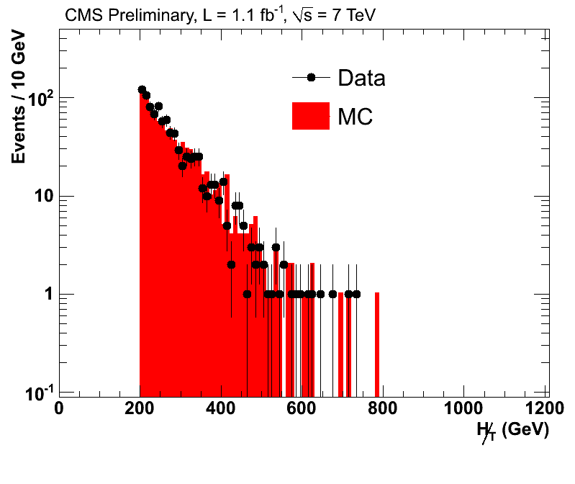
Inclusive All-Hadronic Search: Background Estimation for Z → νν
Background estimation with γ+jets :
Strategy:
  Declare photon invisible to emulate neutrinos
  Then re-calculate E_{T}^{miss} for this event
  Correct for the photon reconstruction efficiency and neutrino branching ratio
γ
ν
ν
x
γ+jets
SUSY signals could bias the
prediction
Crosscheck with Z→μμ+jets:
Drawback: Low statistics in signal region, but comparable result in baseline selection
CMS PAS SUS-11-004

Slide 10
Inclusive All-Hadronic Search:
W and Top Background Estimation
Lost Lepton Background Estimation
  Muon control sample with M_{T} < 100 GeV with M_{T}=√(2p_{T}^{μ} E_{T}^{miss} (1-cos φ)) used to model:
    Non-isolated (but identified) leptons
    Non-identified leptons (ratio id/non-id taken from Monte Carlo)
e/μ/τ
x
ν
τ Background Estimation
  Determined with a muon control sample
  Substitute μ with τ jet using response template to model the fraction of visible momentum
  Recalculate all quantities like H_{T}
CMS PAS SUS-11-004
Notes:
photon + jets only in 2010 to get resolution

Slide 11
Inclusive All-Hadronic Search:
QCD Background Estimation
Most difficult background, derived here by ‘Rebalance & Smear’ method:
  Rebalance all jets to overall p_{T} balance (=kind of ‘generator level jet’, robust against seed jet mismeasurements and non-QCD processes)
  Smear p_{T} of each seed jet by a factor derived from jet resolution distribution (from simulation, and corrected for data/MC differences)
Smearing of the jets results in artificially created E_{T}^{miss} used to estimate the real E_{T}^{miss} distribution
E_{T}^{miss}
CMS PAS SUS-11-004

Slide 12
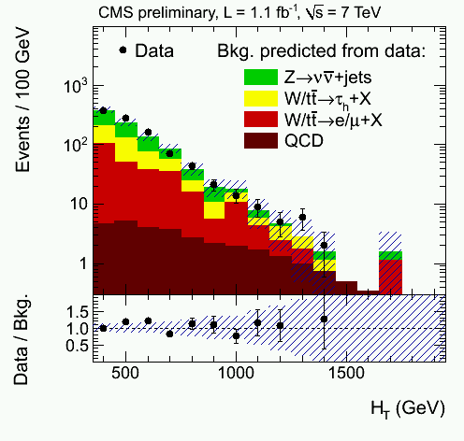
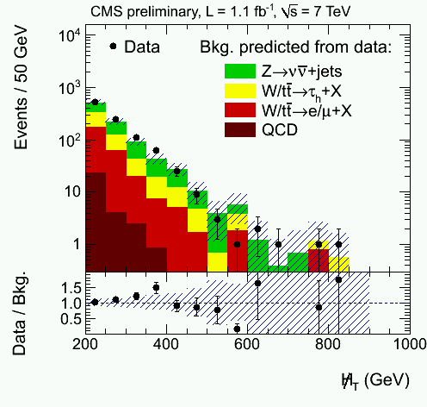
Inclusive All-Hadronic Search:
Results
Method | Baseline H_{T} > 350 GeV and H_{T}^{miss} > 200 GeV | Medium H_{T} > 500 GeV and H_{T}^{miss} > 350 GeV | High H_{T} H_{T} > 800 GeV and H_{T}^{miss} > 200 GeV | High H_{T}^{miss} H_{T} > 800 GeV and H_{T}^{miss} > 500 GeV
Z → νν from γ+jets | 376.3 ± 12.3 ± 79.2 | 42.6 ± 4.4 ± 8.9 | 24.9 ± 3.5 ± 5.2 | 2.4±1.1 ± 0.5
tt/W → e,μ+X | 243.5 ± 19.8^{+30.0} _{-30.9} | 12.7 ± 3.3 ± 1.5 | 22.5 ± 6.7^{+3.0} _{-3.1} | 0.8±0.8 ± 0.1
tt/W → τ_{hadr}+X | 263 ±8 ± 7.4 | 17 ± 2 ± 0.7 | 18 ± 2 ± 0.5 | 0.73 ± 0.73 ± 0.04
QCD | 30.9 ±35.2^{+16.6}_{-6.2} | 1.3 ±1.3^{+0.6}_{-0.4} | 13.5 ±4.1^{+7.3}_{-4.3} | 0.09 ±0.31^{+0.05}_{-0.04}
Total background | 927.5 ±103.1 | 73.9 ±11.9 | 79.4 ±12.2 | 4.6 ±1.5
Observed in data | 986 | 78 | 70 | 3
Here:
Bkg
pred.
from
data
No excess observed!
CMS PAS SUS-11-004

Slide 13
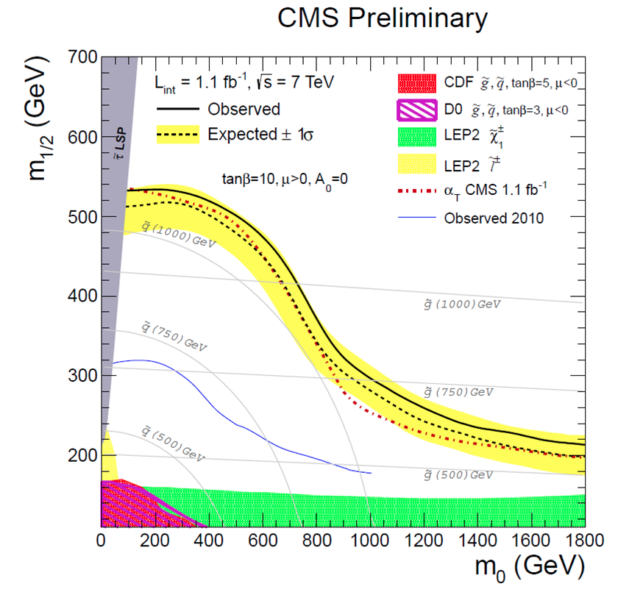
Inclusive All-Hadronic Search:
Exclusion Plot
Observed and expected 95% CL exclusion limit in the CMSSM m₀-m_{1/2} plane using the signal cross sections calculated at NLO
Contours are the combination of the different selections, such that the shown contours are the envelope with respect to best sensitivity
CMS PAS SUS-11-004

Slide 14
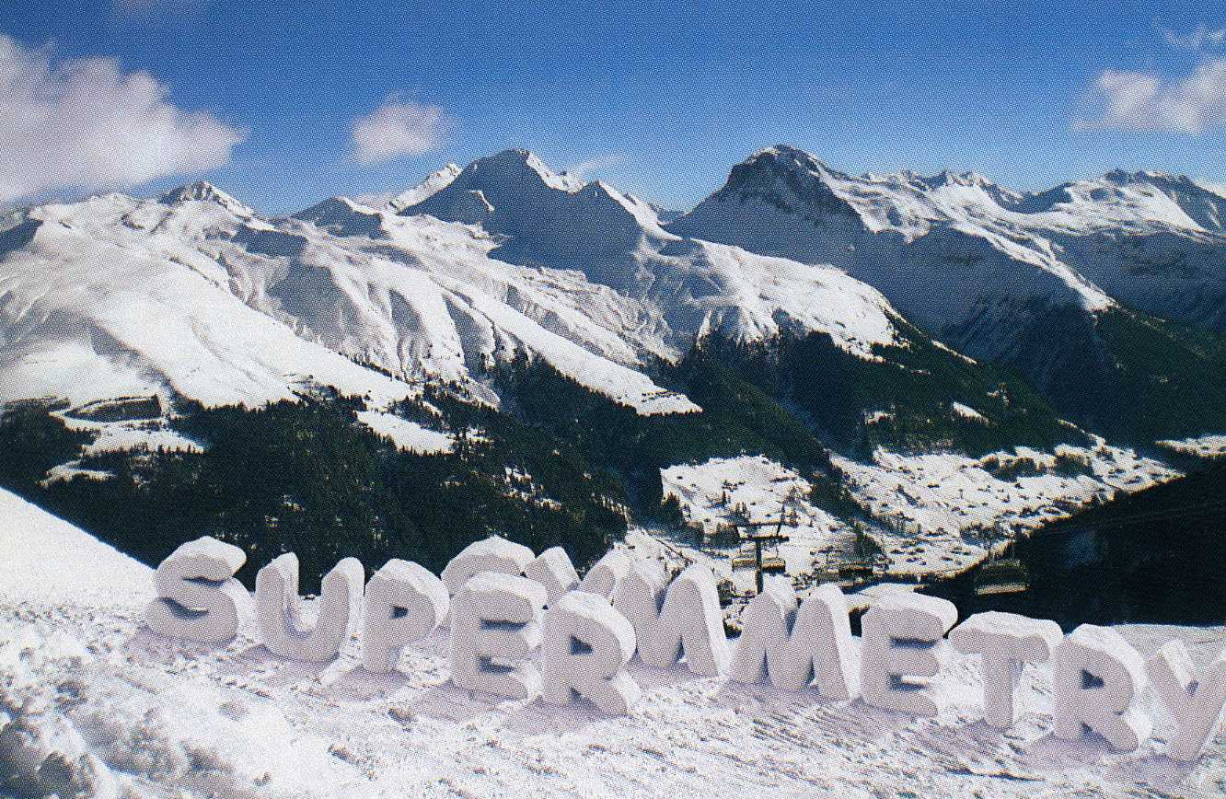
Where we are…
  The CMS Experiment
  Hadronic searches
    Inclusive hadronic analysis
    Inclusive analysis with M_{T2}
  Leptonic searches
  Searches with photons

Slide 15
All-Hadronic Search with M_{T2} Method:
Introduction
M_{T2}: natural extension of M_{T} in case of SUSY with two colored sparticles decaying through cascade of jets (& leptons) to LSPs
M_{T2} reflects masses of produced particles and is much lighter for SM than for most SUSY particles
  Definition of M_{T2}:
  m_{χ} remains free parameter, minimized fulfilling E_{T}^{miss} constraint
  For correct m_{χ}: distributions of m_{T}^{(i)} have an endpoint at value of primary sparticle mass
χ⁰(1)
E_{T}^{miss}
χ⁰(2)
  with m_{T}: transverse mass of sparticle decaying to visible system + LSP
CMS PAS SUS-11-005

Slide 16
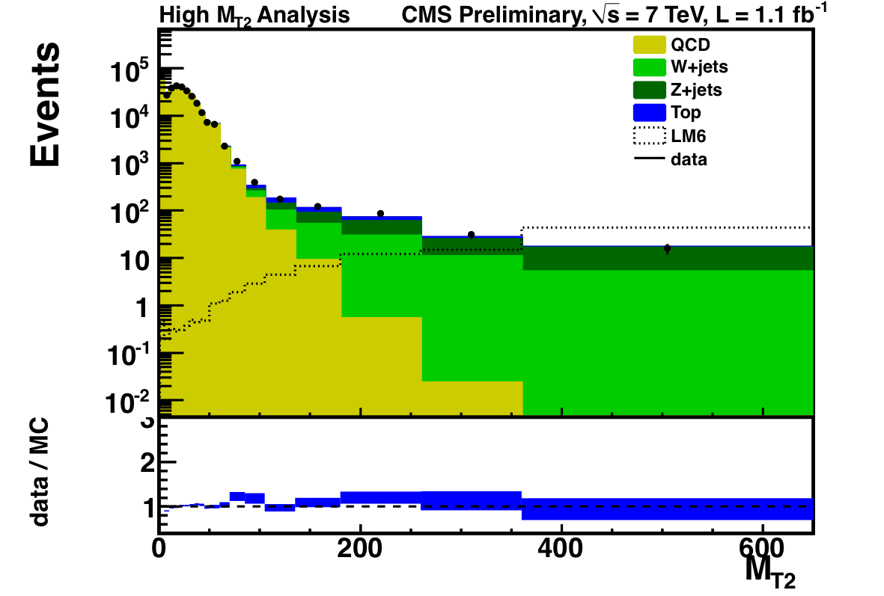
All-Hadronic Search with M_{T2} Method:
Event Selection
Baseline selection
  At least 3 jets with p_{T}^{jet1,jet2} > 100 GeV and |η| < 2.4
  E_{T}^{miss} > 30
  |H_{T}^{miss} – E_{T}^{miss}| < 70 GeV
  |Δ Φ (p_{T}^{jet}, E_{T}^{miss})| > 0.3
  Veto on isolated muons and electrons
Search regions
  High M_{T2} analysis:
    H_{T} > 600 GeV
    M_{T2} > 400 GeV
  Low M_{T2} analysis:
    ≥ 4 jets
    ≥ 1 b-tagged jet
    H_{T} > 650 GeV
    M_{T2} > 150 GeV
CMS PAS SUS-11-005

Slide 17
All-Hadronic Search with M_{T2} Method:
Background Estimation
High M_{T2} analysis:
QCD estimation:
  Factorization (ABCD) method with Δφ_{min} (azimuth angle between E_{T}^{miss} and closest jet) and M_{T2}
  Correlation between Δφ_{min} and M_{T2} is parameterized in control region (50 GeV < M_{T2} < 80 GeV) and extrapolated to higher M_{T2}
Background from W+jets, ttbar
  Leptonic W decay with lost lepton or τ decays
    Similar estimation as in previously described analysis
Background from Z → νν
  Obtained from W → lν + jets, where the lepton is added to E_{T}^{miss}
Low M_{T2} analysis:
Estimated similarly as for high M_{T2} analysis on pre-b-tagged sample to have enough statistics
(Ratio of b-tagged/pre-b-tagged sample constant vs. M_{T2})
CMS PAS SUS-11-005

Slide 18
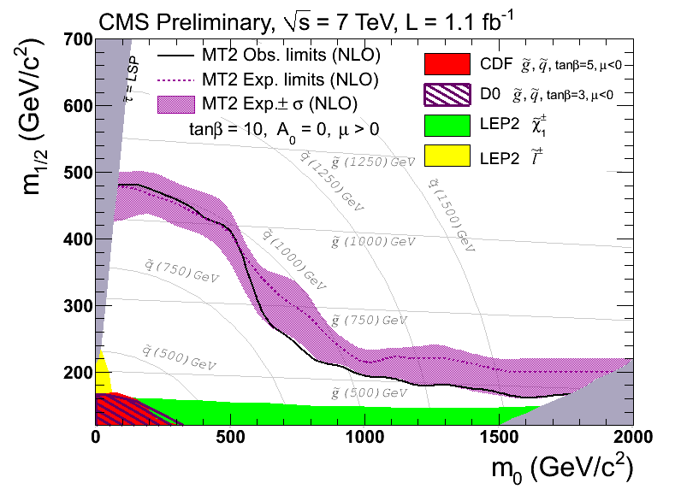
All-Hadronic Search with M_{T2} Method:
Results
Analysis | Predicted BG | Data | σ x BR (pb)
 |  |  | observed limit | expected limit
High M_{T2} | 12.6 ± 1.3 ± 3.5 | 12 | 0.010 | 0.011
Low M_{T2} | 10.6 ± 1.9 ± 4.8 | 19 | 0.020 | 0.014
Background in low M_{T2} mass analysis probably underestimated due to statistical fluctuation in the control region
No excess observed!
CMS PAS SUS-11-005

Slide 19
Other Hadronic Analyses
Kinematic variable α_{T} :
  Robust against QCD background
  Updated 2011 with shape analysis
Razor variables:
  Designed to characterize pair-production of heavy particles
  Combine all particles into two hemispheres, then boost back to rest-frame (update soon!)
Phys. Lett. B698:196-218 (2011)
CMS PAS SUS-10-003
CMS PAS SUS-11-001
CMS PAS SUS-11-003
arxiv:1107.1279
CMS PAS SUS-10-009

Slide 20
Hadronic Analysis:
Interpretation
Simplified models (on-shell effective theory): intermediate step between a complete theory and experimental signature
From data in
CMS PAS SUS-11-003

Slide 21
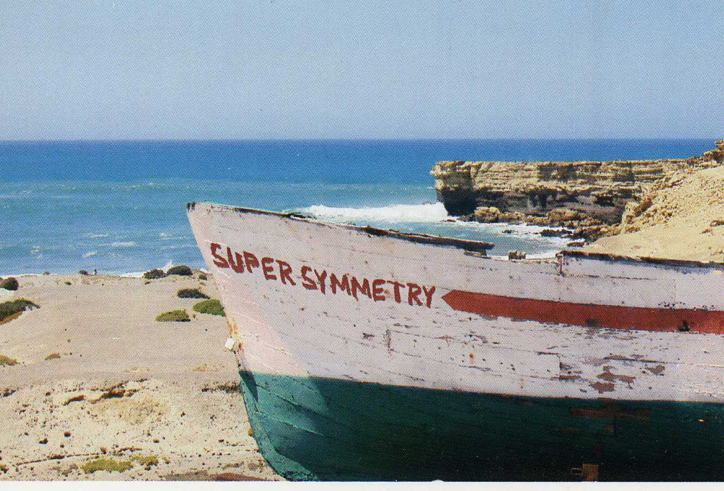
Where we are…
  The CMS Experiment
  Hadronic searches
  Leptonic searches
  → Searches including one lepton
  → Searches with opposite-sign leptons / Z
  Searches with photons

Slide 22
Searches including one Lepton:
Introduction
Signature:
Exactly one lepton, several jets and large missing transverse energy
QCD background reduced by 1 lepton requirement
Two complementary methods to determine the remaining background:
  Lepton spectrum method
    Prediction of E_{T}^{miss} spectrum with the observed lepton spectrum
  Lepton projection method
    Sensitive to the helicity angle of the lepton in the W rest frame
χ±
CMS PAS SUS-11-015
Notes:
Lepton spectrum method
Prediction of E_{T}^{miss} spectrum with the observed lepton spectrum
Sensitive to models in which E_{T}^{miss} is decoupled from the lepton spectrum, e.g. 2 LSPs producing large missing transverse energy
Lepton projection method
Sensitive to the helicity angle of the lepton in the W rest frame
W polarization well understood in ttbar and W+jets background

Slide 23
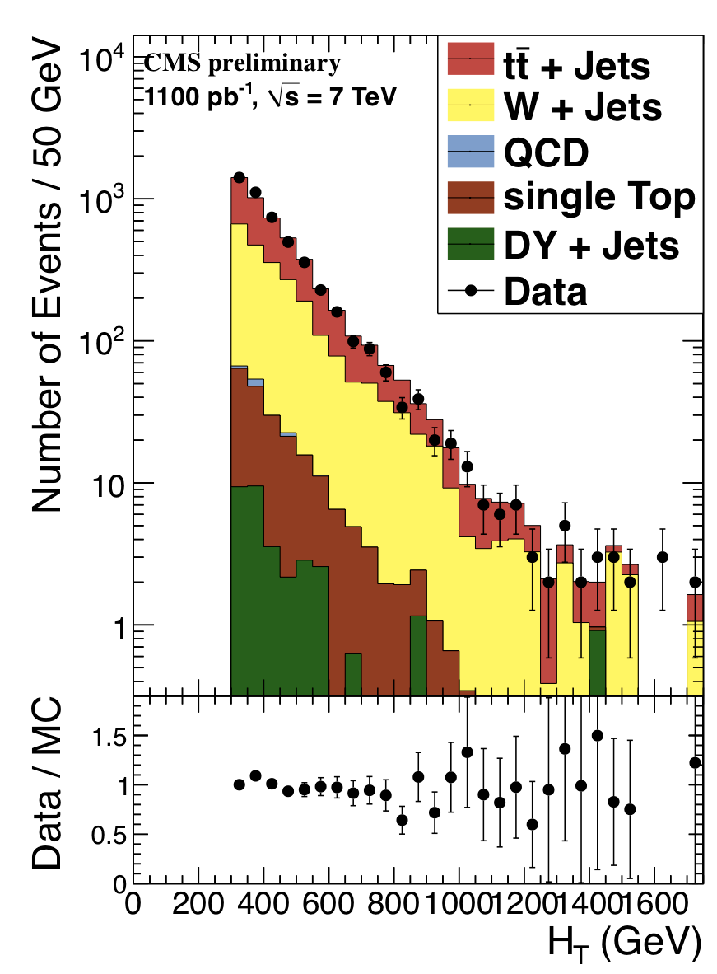
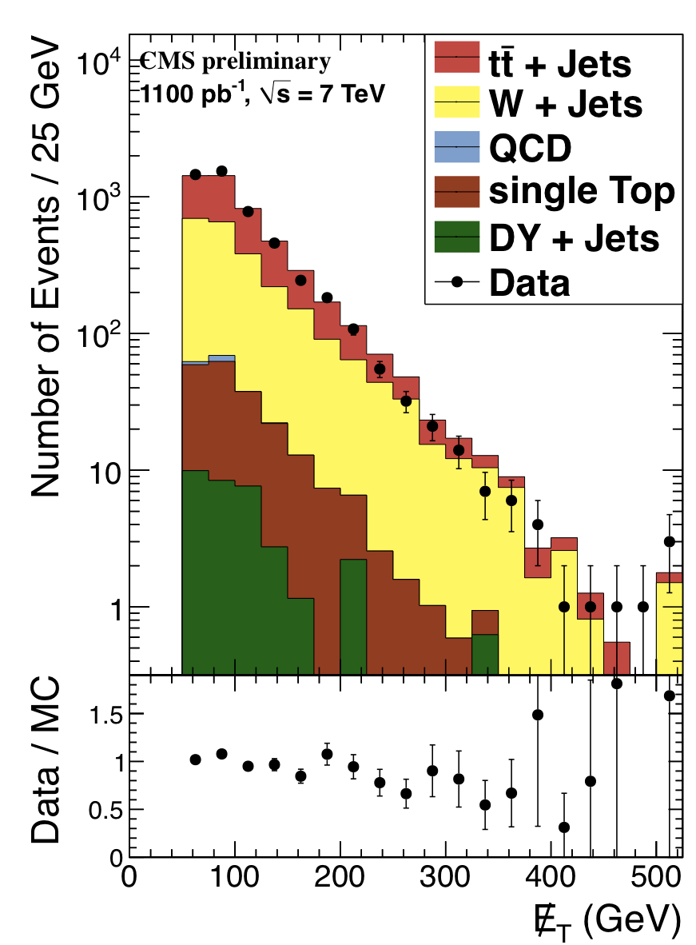
Searches including one Lepton:
Event selection
Baseline selection
  At least 3 (4) jets with p_{T} > 40 GeV and |η| < 2.4
  Exactly 1 isolated muon or electron with
    p_{T}^{μ} > 20 GeV and |η| < 2.1
    p_{T}^{e} > 20 GeV and |η| < 2.4, excluding 1.44 < |η| < 1.57
    Relative isolation: I = Σ(E_{T(Cal.)}+P_{T(Tracker)})/p_{T}^{lep} < 0.1 (μ), I < 0.3 (e)
CMS PAS SUS-11-015

Slide 24
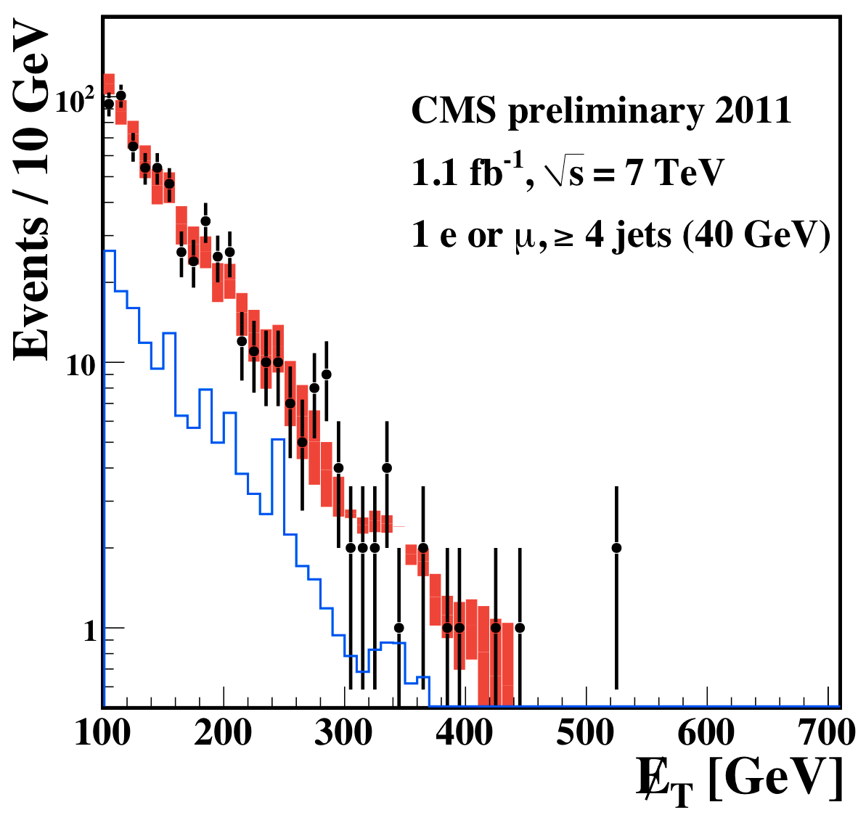
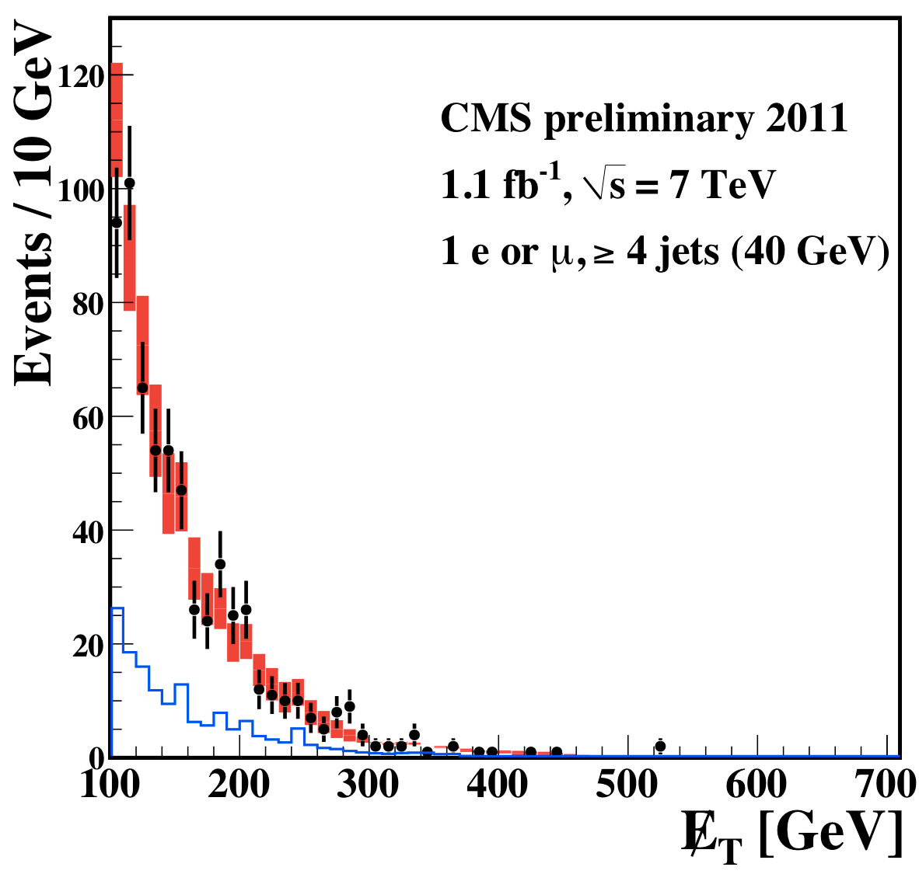
Searches including one Lepton:
BG with Lepton Spectrum Method
Idea: in W decays the charged lepton and neutrino p_{T} spectrum are related
  Take muon p_{T} spectrum
  Correct for acceptance, efficiency and polarization effects
  E_{T}^{miss} resolution worse than e/mu → smear muon p_{T}
  Remaining background:
    Di-leptons
    τ
data
Σ BG prediction
SM dilepton and
τ → l
CMS PAS SUS-11-015

Slide 25
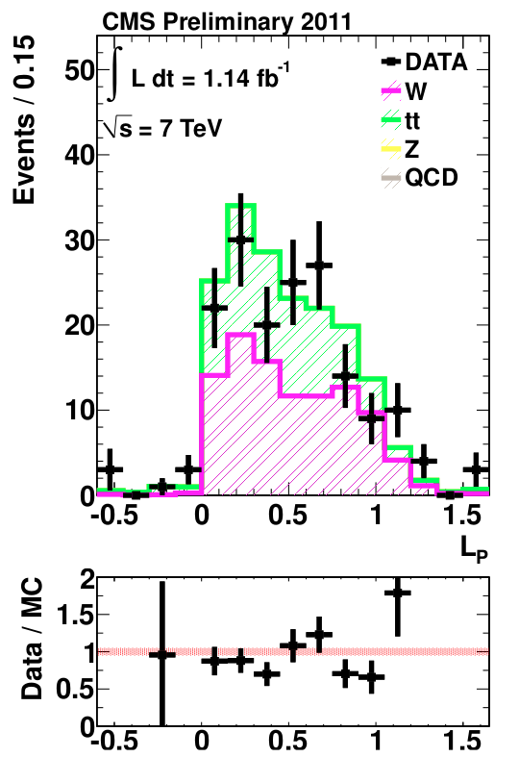
Searches including one Lepton:
BG with Lepton Projection Method
SM background in signal region predicted by
with
In addition: data-driven estimation of QCD
background due to fake electrons
Analysis is performed in several bins of the (leptonic) mass scale:
S_{T}^{lep} = |p_{T}^{lep}| + |E_{T}^{miss}|
signal region
norm. region
CMS PAS SUS-11-015

Slide 26
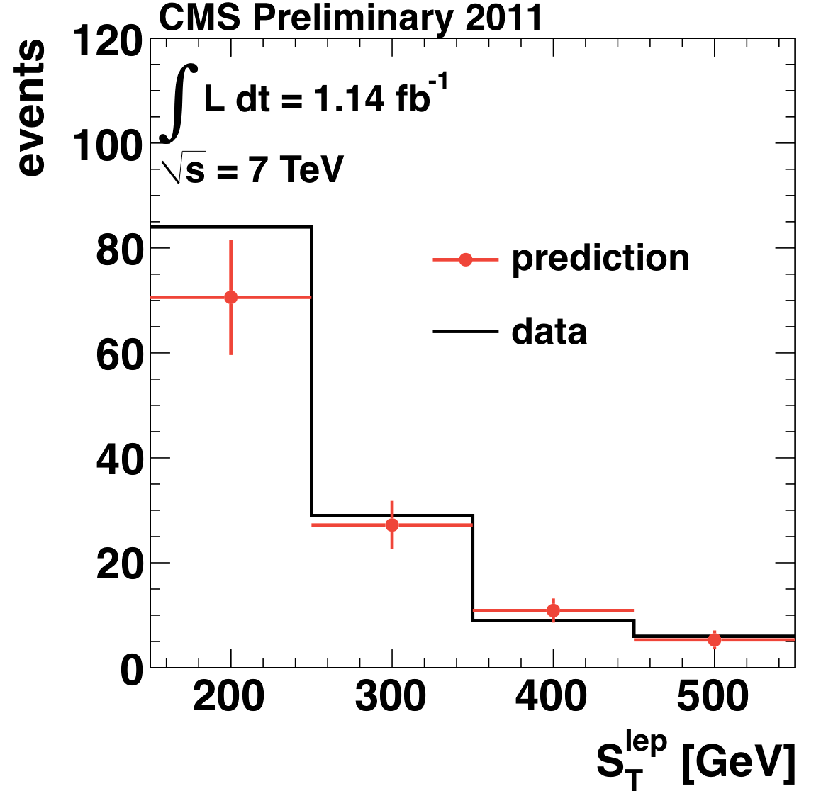
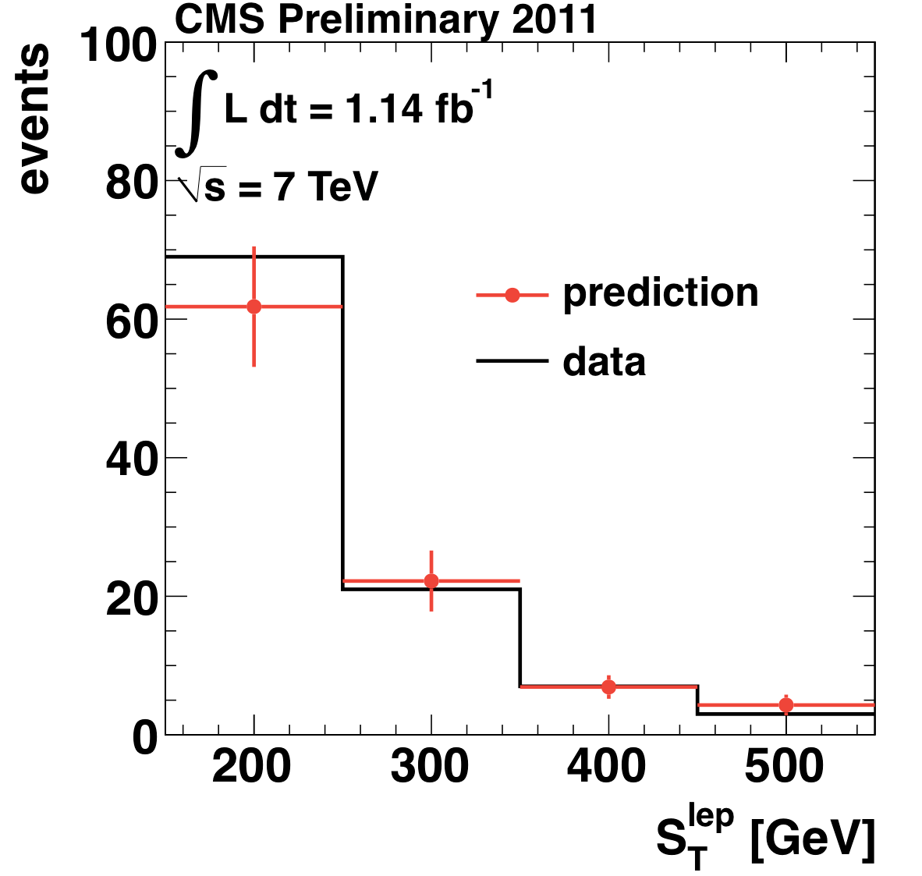
Searches including one Lepton:
Results
Lepton spectrum method:
Lepton projection method:
Sample | Loose selection H_{T} > 500 GeV, E_{T}^{miss} > 250 GeV | Tight selection H_{T} > 500 GeV, E_{T}^{miss} > 350 GeV
Total predicted SM | 49.8 ± 8.8 ± 10.8 | 12.1 ± 4.3 ± 3.6
Data | 52 | 8
S_{T}^{lep} range/GeV | SM estimate μ | Data μ | SM estimate e | Data e
150 − 250 (control sample) | 70.6 ± 11 | 84 | 61.8±8.7 | 69
250 − 350 | 27.2 ± 4.6 | 29 | 22.2±4.4 | 21
350 − 450 | 10.9 ± 2.3 | 9 | 6.9±1.7 | 7
>450 | 5.3 ± 1.8 | 6 | 4.3±1.5 | 3
muon
electron
No excess observed!
CMS PAS SUS-11-015

Slide 27
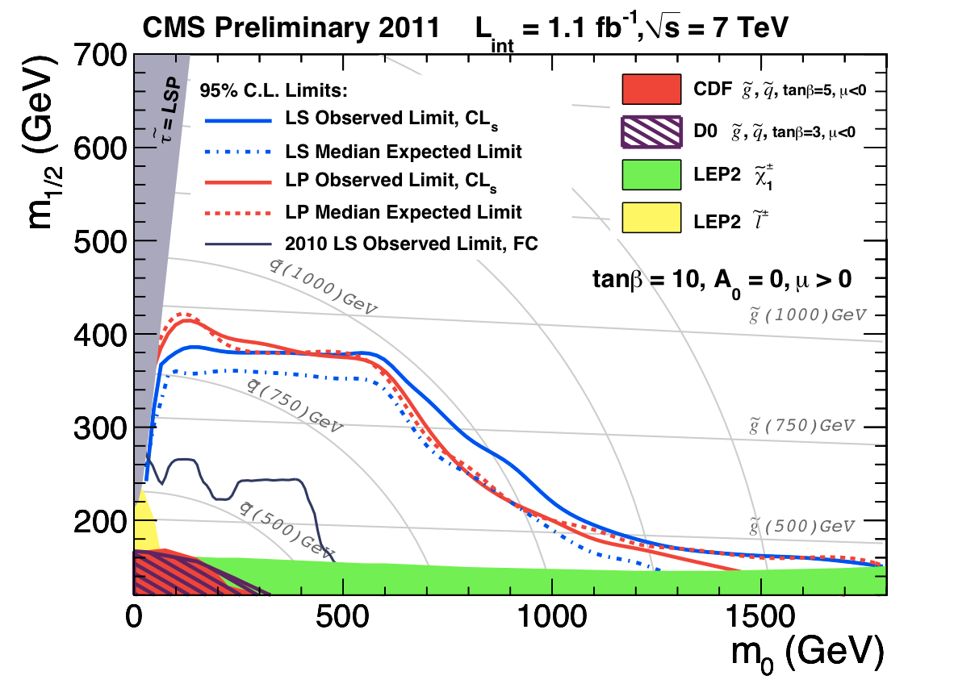
Searches including one Lepton:
Exclusion Limits
CMS PAS SUS-11-015

Slide 28

Where we are…
  The CMS Experiment
  Hadronic searches
  Leptonic searches
  → Searches including one lepton
  → Searches with opposite-sign leptons
  Searches with photons

Slide 29
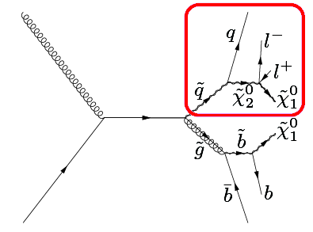
Opposite Sign Di-Leptons:
Introduction
Opposite-sign di-leptons can have two sources:
  Neutralino decays
  Z production
Phys. Rev. Lett. 106, 211802 (2011)
CMS PAS SUS-11-011
CMS PAS SUS-10-010
CMS PAS SUS-11-012
CMS PAS SUS-11-017

Slide 30

Where we are…
  The CMS Experiment
  Hadronic searches
  Leptonic searches
  → Searches including one lepton
  → Searches with opposite-sign leptons outside the Z region
  → Searches with opposite-sign leptons in the Z region
  Searches with photons

Slide 31
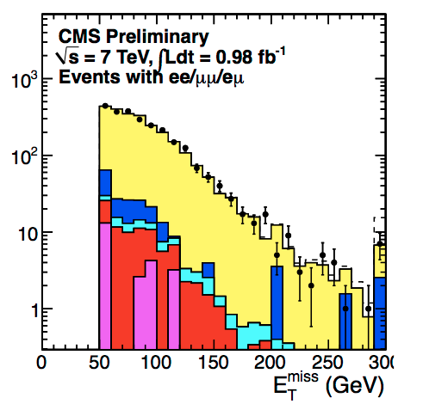
Opposite Sign Di-Leptons:
Event Selection outside Z-region
Baseline selection
  p_{T}^{lep1} > 20 GeV, P_{T}^{lep2} > 10 GeV, |η| < 2.4 (μ) and |η| < 2.5 (e)
  Relative isolation : I = Σ(E_{T(Cal.)}+P_{T(Tracker)})/p_{T}^{lep} < 0.15 for leptons
  At least 2 jets with p_{T} > 30 GeV, |η| < 3 and ΔR=0.4 to leptons
  H_{T} > 100 GeV, E_{T}^{miss} > 50 GeV
Counting experiments:
  Exclude Z and low mass resonances
Kinematic edge measurement:
Use opposite flavor to determine bkg
(signal expected in same flavor sample)
  E_{T}^{miss} > 100 GeV (to remove DY)
CMS PAS SUS-11-011
Notes:
76 GeV > m_{μμ,ee} < 106 GeV and m_{μμ,ee} > 12 GeV

Slide 32
Opposite Sign Di-Leptons:
Counting Experiments
Three independent methods to estimate the background (data-driven)
Factorization method (ABCD’) with H_{T} and y=E_{T}^{miss}/√H_{T}:
  Derive background in signal region D from events in control regions ABC
  Small correlation taken into account including a correction factor
Di-lepton spectrum method:
  Similar to lepton spectrum method in 1-lepton case
Comparison of same-flavor to different-flavor
  Expect excess of same-flavor vs different-flavor events in BSM, while rates should be similar for ttbar (different reconstruction efficiencies for μ and e taken into account)
High E_{T}^{miss}
High H_{T}
No excess observed!
CMS PAS SUS-11-011

Slide 33
Opposite Sign Di-Leptons:
Kinematic Edge Measurement
Dominant background (ttbar, WW, DY → ττ): flavor is uncorrelated
Use different flavor to predict background in same-flavor signal sample
Signal fit (edge model for two subsequent 2-body decays):
Z modeled by Breit-Wigner convoluted with Gaussian (fixed Z mass and width)
Background fit:
Simultaneous, extended, unbinned ML fit in SF and DF events
Same Flavor
Different Flavor
Control
Region
100 < H_{T} < 300 GeV
Signal
Region
H_{T} > 300 GeV
No excess observed!
CMS PAS SUS-11-011

Slide 34
Opposite Sign Di-Leptons:
Results
Counting experiment
95 % CL exclusion contour at NLO in the CMSSM plane with ±1 σ variation
(More tables with results in backup)
Kinematic edge measurement
95 % CL upper limit on cross section times acceptance as function of the endpoint in the mass spectrum assuming triangular shaped signal
CMS PAS SUS-11-011

Slide 35
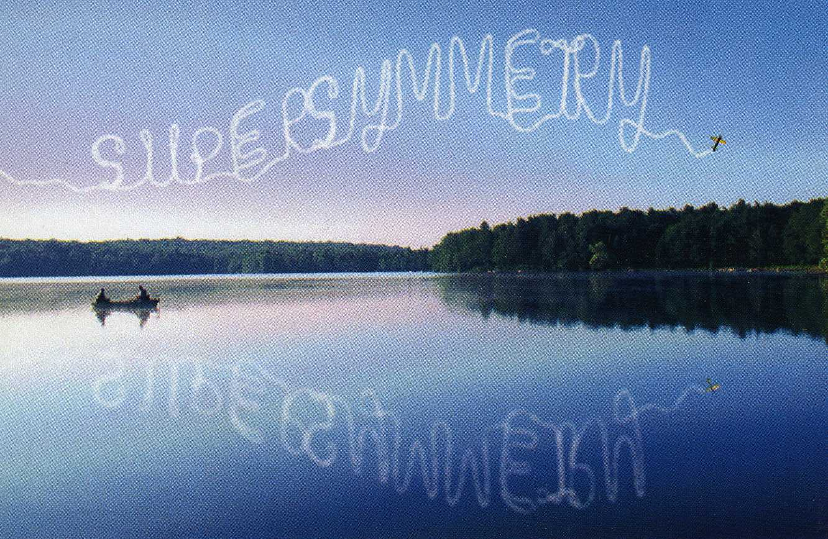
Where we are…
  The CMS Experiment
  Hadronic searches
  Leptonic searches
  → Searches including one lepton
  → Searches with opposite-sign leptons outside the Z region
  → Searches with opposite-sign leptons in the Z region
  Searches with photons

Slide 36
Opposite Sign Di-Leptons:
Event Selection on Z-region
New physics expected to connect to EW sector, e.g. χ₂⁰ → Z χ₁⁰
Baseline selection
  p_{T}^{lep1,lep2} > 20 GeV, |η| < 2.4 (μ) and |η| < 2.5 (e)
  Relative isolation : I = Σ(E_{T(Cal.)}+P_{T(Tracker)})/p_{T}^{lep} < 0.15 for leptons
  At least 2 jets with P_{T} > 30 GeV, |η| < 3 and ΔR=0.4 away from leptons
  81 GeV > m_{lep,lep} < 101 GeV
Two search strategies
  E_{T}^{miss} measurement:
    E_{T}^{miss} > 100 (200) GeV
  Jet-Z balance method:
    At least 3 jets with P_{T} > 30 GeV, |η| < 3 and ΔR=0.4 away from leptons
    Loose selection: JZB = |Σ p_{T}^{jets}| – |p_{T}^{Z}| > 50 GeV
    Tight selection: JZB > 100 GeV
CMS PAS SUS-11-012
CMS PAS SUS-11-017

Slide 37
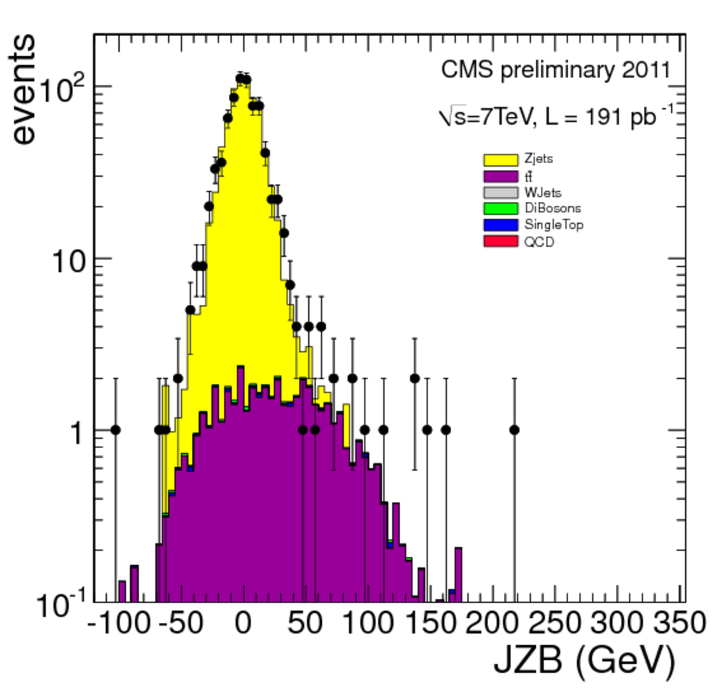
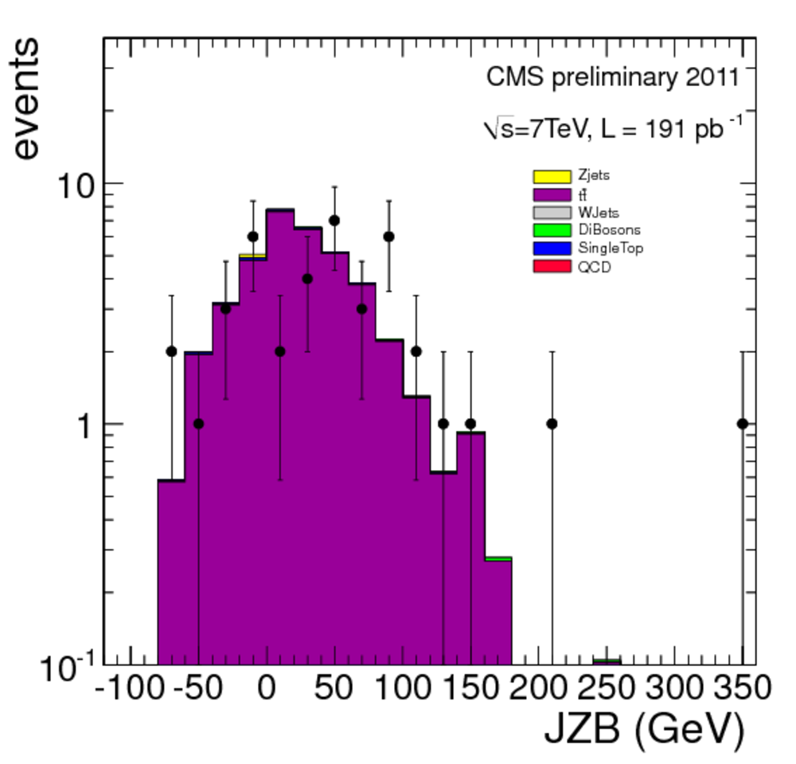
Opposite Sign Di-Leptons:
Background Determination (Z-region)
E_{T}^{miss} measurement:
  Artificial E_{T}^{miss}: use templates from γ+jet or QCD multi-jet events
  ttbar estimation: subtract different-flavor contribution (without Z mass constraint) from same-flavor sample
Jet-Z balance method:
  Total SM background in JZB > 0:
SF
DF
CMS PAS SUS-11-012
CMS PAS SUS-11-017

Slide 38
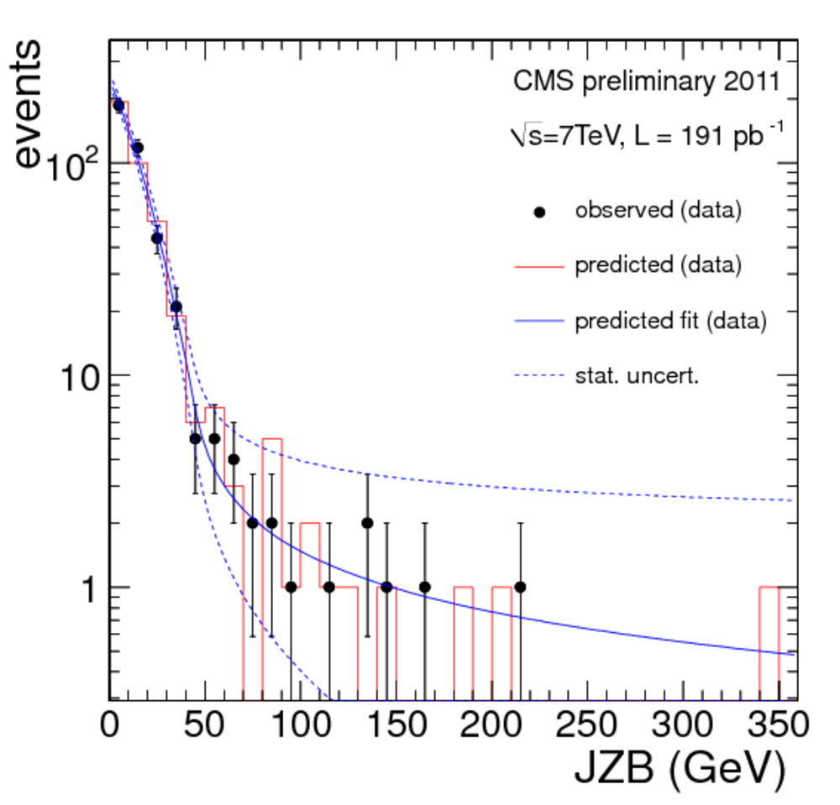
Opposite Sign Di-Leptons:
Results (Z-region)
E_{T}^{miss} measurement:
Jet-Z balance method:
Loose
Tight
Loose
Tight
Sample | Loose selection JZB > 50 GeV | Tight selection JZB > 100 GeV
MC expectation | 16.0 ± 1.2 | 3.6 ± 0.4
Total predicted SM | 24 ± 6_{stat} ± 1.4_{peak} ^{+1.2}_{-2.4 sys} | 8 ± 4_{stat} ± 0.1_{peak} ^{+0.4}_{-0.8 sys}
Data | 20 | 6
No excess observed!
CMS PAS SUS-11-012
CMS PAS SUS-11-017

Slide 39
Opposite Sign Di-Leptons:
Interpretation
Simplified model
From data in
CMS PAS SUS-11-017

Slide 40
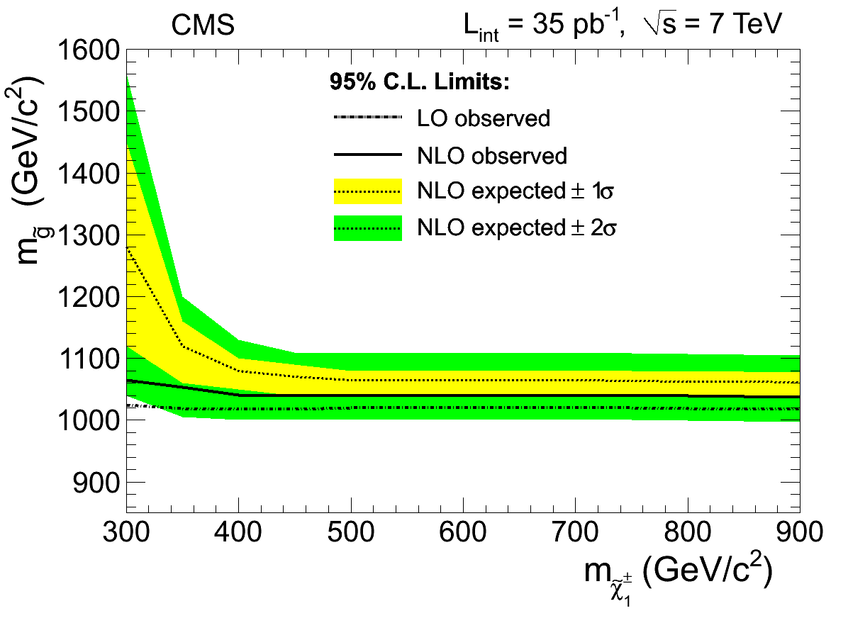
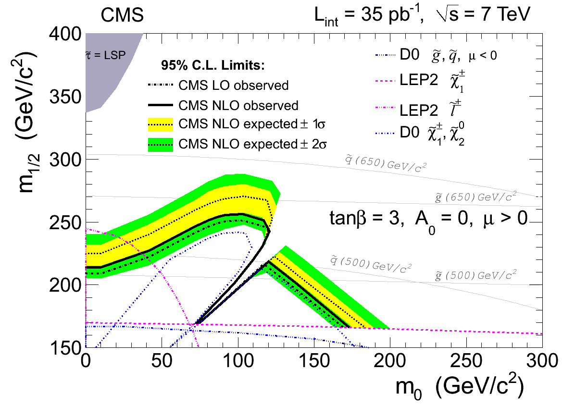
Other Leptonic Analyses
Same-sign di-leptons
  Very small background
Three or more leptons
  Very small background, probes co-NLSP models (GMSM)
arXiv:1104.3168
CMS PAS SUS-11-010
arXiv:1106.0933

Slide 41
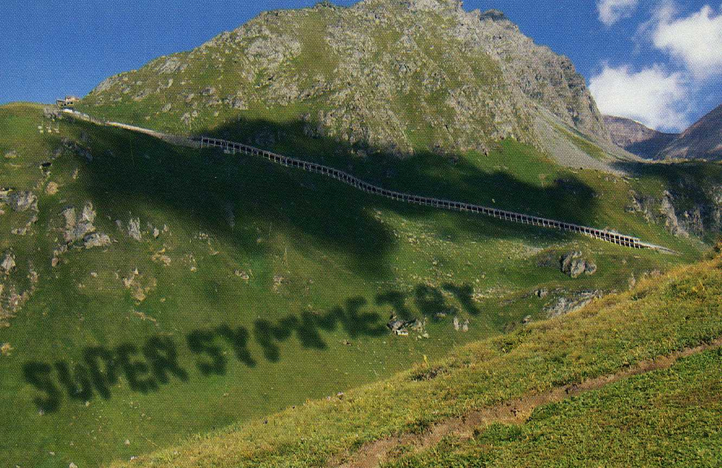
Where we are …
  The CMS Experiment
  Hadronic searches
  Leptonic searches
  Searches with photons
  → Search with di-photon
  → Searches with one photon

Slide 42
Searches with Photons:
Introduction
In General Gauge Mediated SUSY
Gravitino is LSP
Neutralino is NLSP
  Neutralinos: mix of Binos, neutral Winos, and Higgsinos
  In CMS up to now: interpretation via a “Bino-like” neutralino model, with χ₀¹ → γ + G (undetected G ⇒E_{T}^{miss})
  Conserve R parity ⇒ two neutralinos ⇒ di-photon analysis
NEW: Add simplified model where the Wino is less massive than the Bino, resulting in a neutralino-chargino co-NLSP
  Photons not as common as in Bino-like case, but still occuring, most frequently at lower neutralino mass ⇒ single photon analysis
Phys. Rev. Lett. 106,
211802 (2011)
CMS PAS SUS-11-009

Slide 43
Searches with Photons:
Event Selection
Di-photon analysis:
  At least 2 photons in barrel with p_{T}^{γ1} > 45 GeV, p_{T}^{γ2} > 30 GeV
  At least 1 jet with p_{T} > 30 GeV, |η|<2.6
  Loose signal region: E_{T}^{miss} > 50 GeV
  Tight signal region: E_{T}^{miss} > 100 GeV
Single photon analysis:
  Exactly 1 photon in barrel with p_{T}^{γ} > 75 GeV (due to trigger constraint)
  H_{T} > 400 GeV (also from trigger)
  At least 3 jets with p_{T} > 30 GeV, |η|<2.6
  E_{T}^{miss} > 200 GeV
CMS PAS SUS-11-009

Slide 44
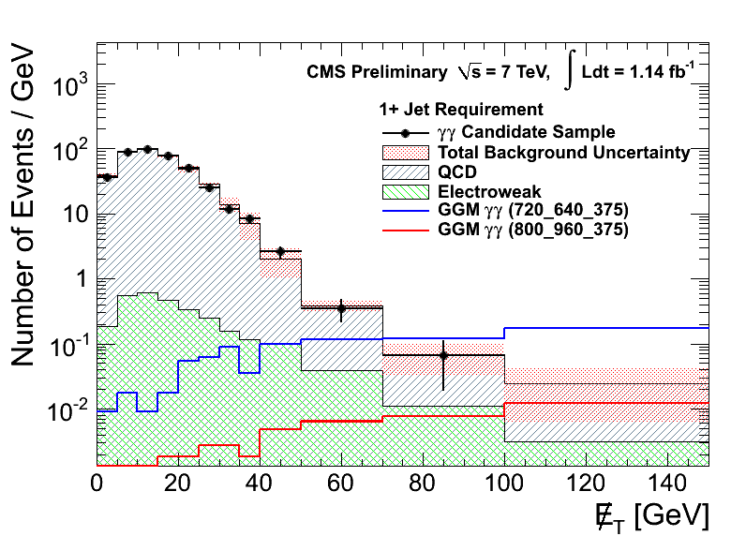
Searches with Di-Photons:
Background Determination
QCD background (no true E_{T}^{miss})
  Mis-measurement of E_{T}^{miss} in QCD processes and/or photon mis-identification:
    Direct di-photon production
    γ+jets and multijets, with jets mimicking photons
  Background determined from samples with 2 fake γ or 2 electrons
Electroweak background with true E_{T}^{miss}
  Background from events with real or fake photon and W → νe (where e is misidentified as γ)
Fake rate determination
  Measure rate of events in Z region in eγ and ee sample:
  f_{e→γ} = 0.014 ± 0.0004 (stat.) ± 0.002 (syst.)
CMS PAS SUS-11-009

Slide 45
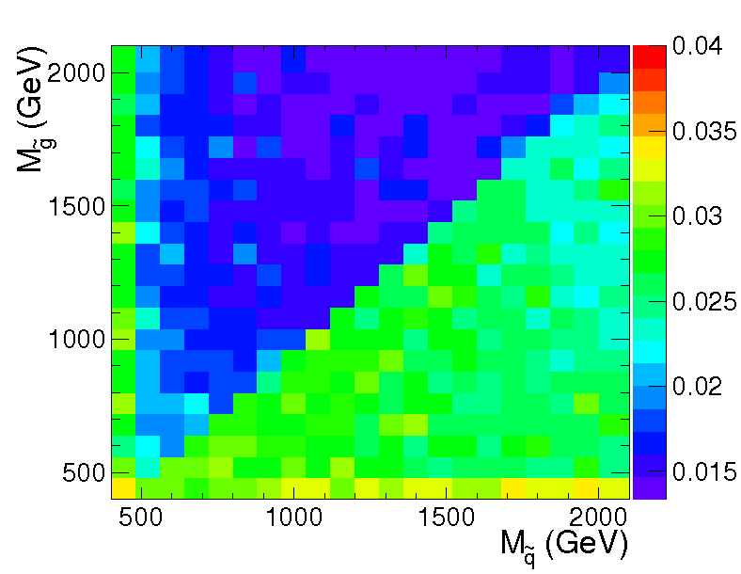
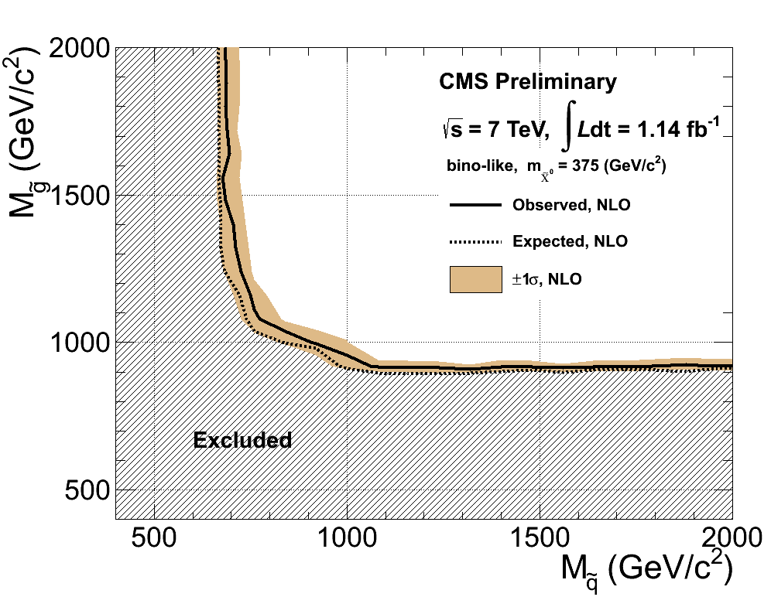
Searches with Di-Photons:
Results
95% CL upper limits on the cross section in gluino-squark mass space for a neutralino mass of 375 GeV
95% CL exclusion contours in gluino-squark mass space for a neutralino mass of 375 GeV
Sample | Loose selection (E_{T}^{miss} > 50 GeV) | Tight selection (E_{T}^{miss} > 100 GeV)
Total predicted SM | 11.3 ± 1.9 ± 0.8 | 1.5 ± 0.8 ± 0.6
Data | 9 | 0
No excess observed!
CMS PAS SUS-11-009

Slide 46
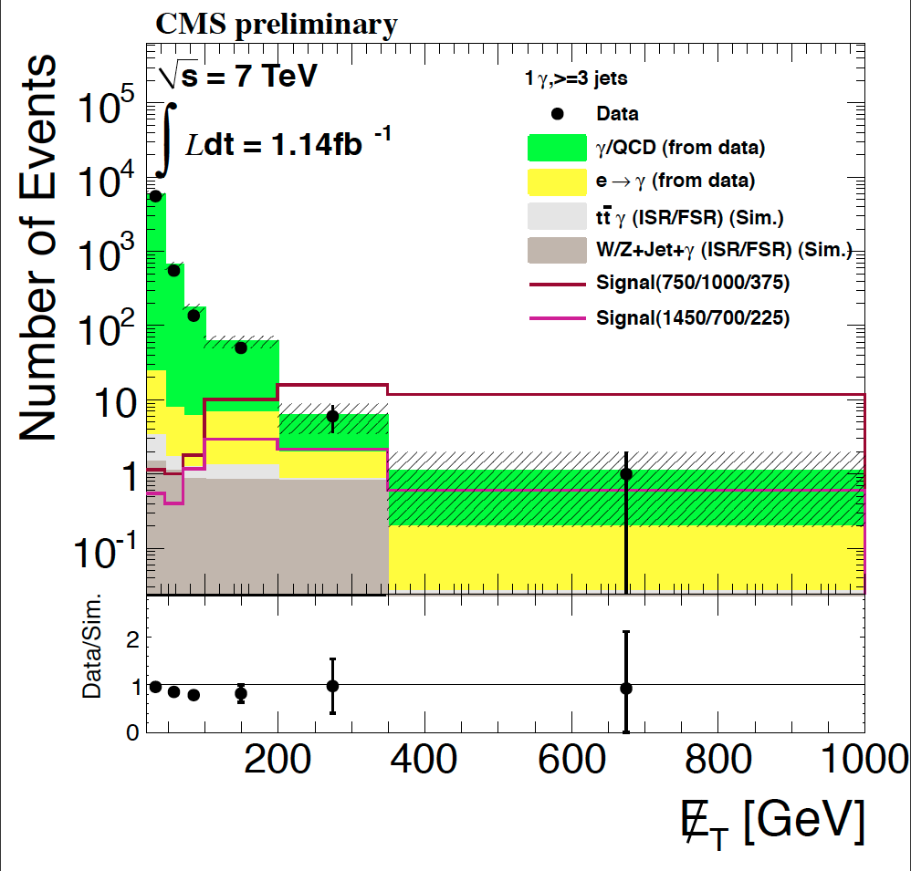
Searches with Single Photons:
Background Determination
Background determination similar to di-photon case
Additional backgrounds: initial state radiation (ISR) and final state radiation (FSR) of photons:
  ISR and FSR in events with electrons in final state covered by EW background prediction from data
  Remaining contributions from SM process are very small – taken from Monte Carlo simulation with a systematic uncertainty of 100%.
No excess observed!
CMS PAS SUS-11-009

Slide 47
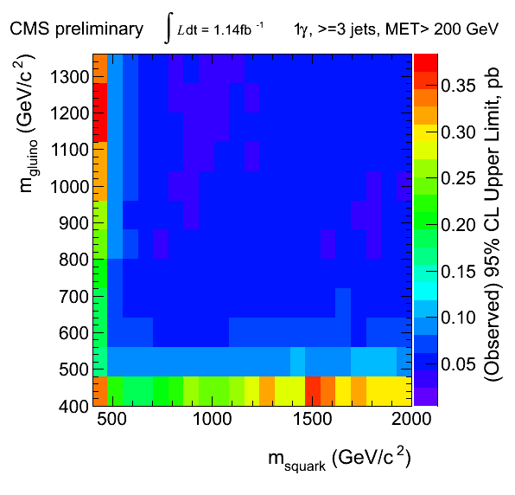
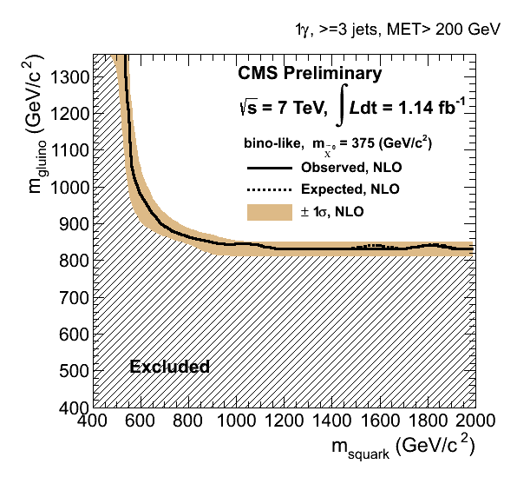
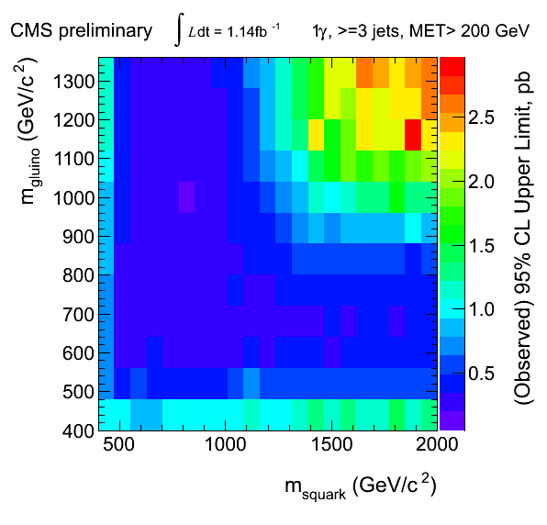
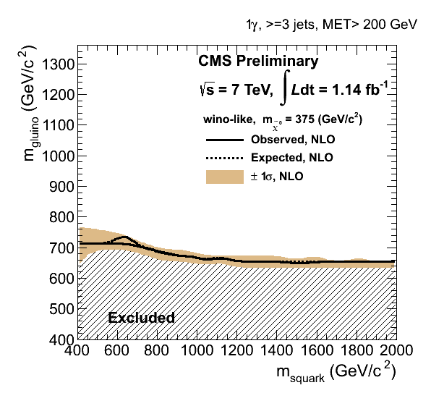
Searches with Single Photons:
Results
95% CL upper limit in gluino-squark mass space
95% CL exclusion contours in gluino-squark mass space
Bino-like
Wino-like
CMS PAS SUS-11-009

Slide 48
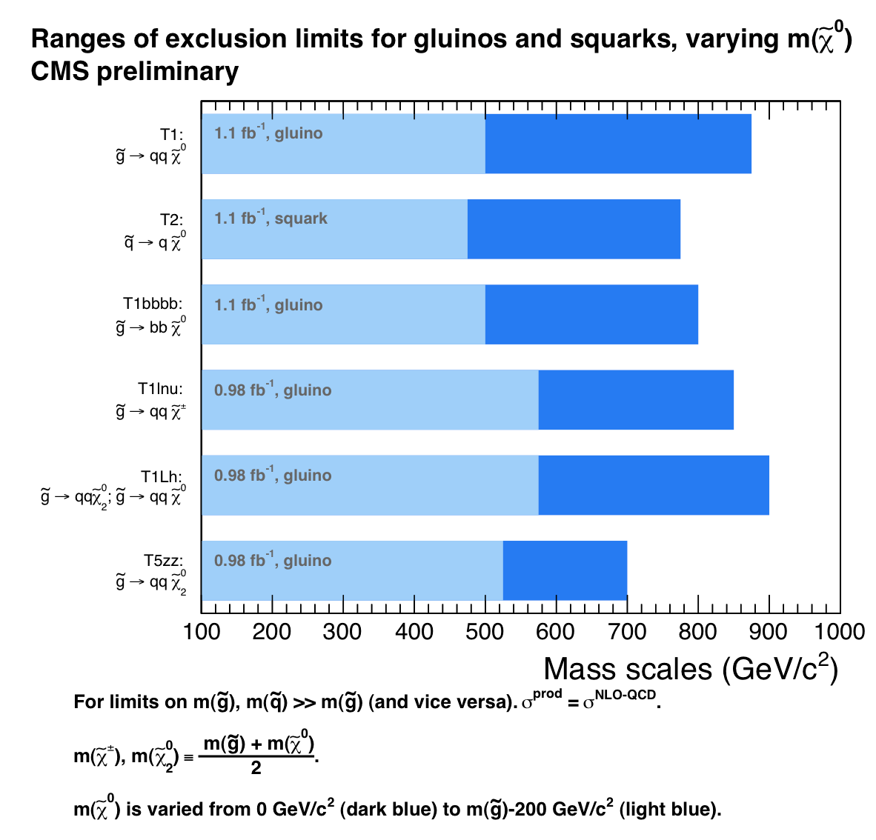
Summary:
Interpretation with Simplified Models
For limits on m(gluino): m(squark)>>m(gluino) and vice verso
m(χ⁰)=m(gluino)-200GeV
(light blue)
m(χ⁰)=0
(dark blue)

Slide 49
Summary and Outlook
Results from many analysis with 1 fb⁻¹ have been presented
None of the analysis have observed any significant deviation from the Standard Model ☹
Exclusion limits have been set
  Using CMSSM
  In simplified models
Much more data
to analyze – stay tuned!

Slide 50
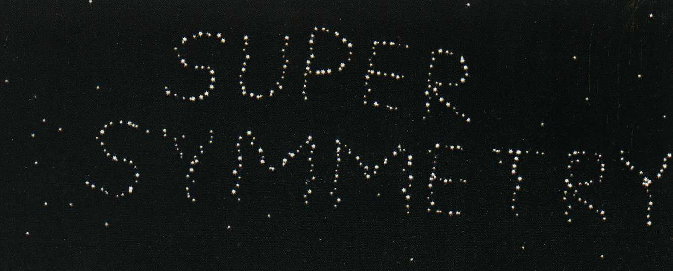
Analyses that are presented in parallel talks
A Search for Supersymmetry Using Events with Photons and Large Missing Transverse Energy at CMS (Rachel Yohay)
A Search for New Physics in Events with Jets and Missing Energy at CMS (Seema Sharma)
Search for Squarks and Gluinos using Kinematic Variables at CMS (Edward Laird)
Search for new physics with same-sign isolated dilepton events with jets and missing transverse energy at CMS (Frank Golf)
Search for supersymmetry in events with multiple isolated leptons at CMS (Richard Carl Gray)
Search for supersymmetry in final states with a lepton, jets and missing energy (Finn O'Neill Rebassoo)
Interpretation of CMS searches for beyond-standard-model phenomena in the supersymmetry framework with simplified models (Mariarosaria D'Alfonso)

Slide 51
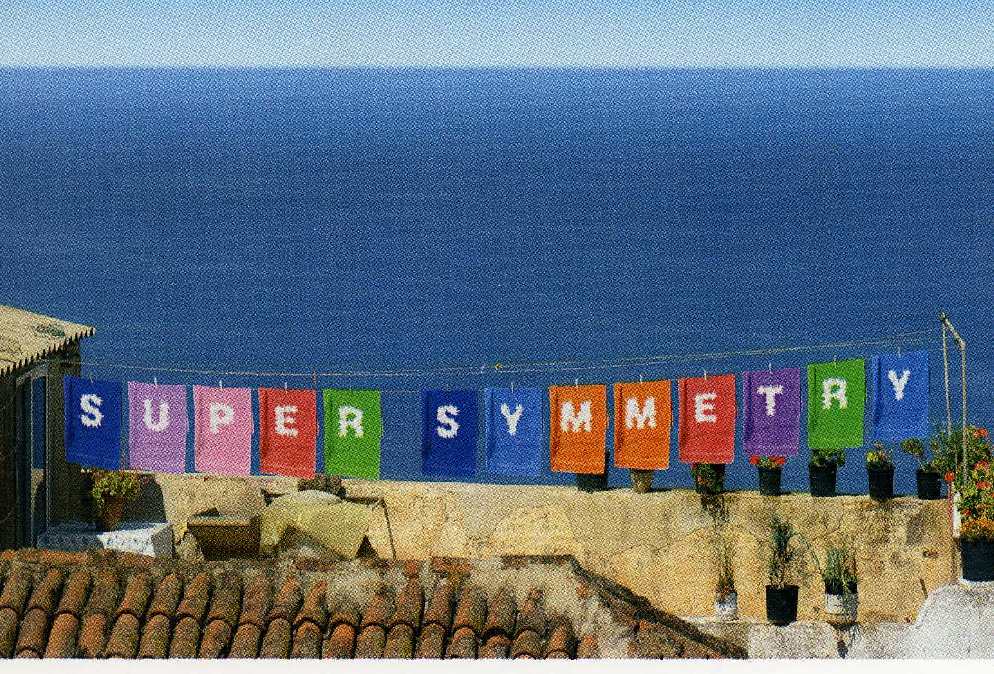
Thank you for listening
Backup slides follow…

Slide 52
All-Hadronic Search with M_{T2} Method:
Background Estimation for QCD
High M_{T2} analysis:
Factorization method with Δφ_{min} (azimuth angle between E_{T}^{miss} vector and closest jet) and M_{T2}
Correlation between Δφ_{min} and M_{T2} is parameterized by
First validated on MC, then measured with data in the region 50 GeV < M_{T2} < 80 GeV
Extrapolation to M_{T2} > 400 GeV gives the number of bg events
Conservative uncertainty of 100% assigned
Low M_{T2} analysis:
Estimated similar as for high M_{T2} analysis on pre-b-tagged sample to have enough statistics
(Ratio of b-tagged/pre-b-tagged sample constant vs. M_{T2})
CMS PAS SUS-11-005

Slide 53
Opposite Sign Di-Leptons:
Results from Counting Experiments

Slide 54
Opposite Sign Di-Leptons:
Results from Counting Experiments

Slide 55
CMSSM
Simplest ansatz: CMSSM – assume universality at high energy scale
  Universal scalar masses: m²=m₀²
  Universal gaugino masses: M_{i}=m_{1/2} (“GUT relation”)
  Universality of soft-breaking trilinear terms:
  Results in five parameters, if possible phases are ignored:
  m₀²,m_{1/2}, A₀, b, μ
  Require correct value of M_{z},
  → |μ|, b given in terms of tan β=v_{u}/v_{d} and sign μ
  ➔ CMSSM parameters:
  m₀²,m_{1/2}, A₀, tan β, sign μ
~

Slide 56
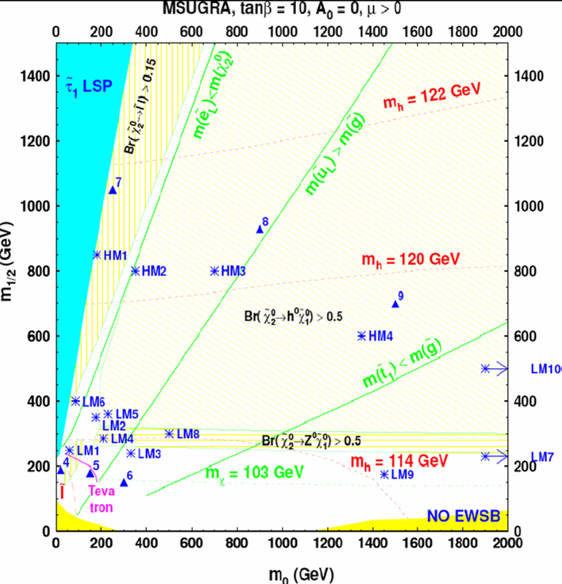
CMS Benchmark Points
Interesting for our nearer future are the Low Mass (LM points)
The High Mass (HM) points are close to the ultimate LHC reach…

Slide 57
CMS Benchmark Point Characteristics
Point LM1 :
  Same as post-WMAP benchmark point B' and near DAQ TDR point 4.
  M(gluino) > M(squark), hence gluino -> squark+quark is dominant
  B(X02 -> slep_R lept) = 11.2%, B(X02 -> stau_1 tau) = 46%, B(X+1 -> sneut_L lept) = 36%
Point LM2 :
  Same as post-WMAP benchmark point I'.
  M(gluino) > M(squark), hence gluino -> squark+quark is dominant (sbot1+b is 25%)
  B(X02 -> stau_1 tau) = 96%, B(X+1 -> stau_1 nu) = 95%
Point LM3 :
  Same as NUHM point gamma and near DAQ TDR point 6.
  M(gluino) < M(squark), hence gluino -> squark+quark is forbidden except B(gluino -> sbot1,2 bot) = 85%
  decays: B(X02 -> lept lept X01) = 3.3%, B(X02 -> tau tau X01) = 2.2%, B(X+1 -> W+ X01) = 100%
Point LM4 :
  Near NUHM point alpha in on-shell Z0 decay region.
  M(gluino) > M(squark), hence gluino -> squark+quark is dominant with B(gluino -> sbot1 bot) = 24%
  decays: B(X02 -> Z0 X01) = 97%, B(X+1 -> W+ X01) = 100%
Point LM5 :
  In h0 decay region, same as NUHM point beta.
  M(gluino) > M(squark), hence gluino -> squark+quark is dominant with B(gluino -> sbot1 bot) = 19.7% and B(gluino -> stop1 top) = 23.4%
  decays: B(X02 -> h0 X01) = 85%, B(X02 -> Z0 X01) = 11.5%, B(X+1 -> W+ X01) = 97%

Slide 58
CMS Benchmark Point Characteristics (2)
Point LM6 :
  Same as post-WMAP benchmark point C'.
  M(gluino) > M(squark), hence gluino -> squark+quark is dominant
  B(X02 -> slepL lept) = 10.8%, B(X02 -> slepR lept) = 1.9%, B(X02 -> stau1 tau) = 14%, B(X+1 -> sneut lept) = 44%
Point LM7 :
  Very heavy squarks, outside reach, but light gluino.
  M(gluino) = 678 GeV, hence gluino -> 3-body is dominant
  B(X02 -> lept lept X01) = 10%, B(X+1 -> lept nu X01) = 33%
  EW chargino-neutralino production cross-section is about 73% of total.
Point LM8 :
  Gluino lighter than squarks, except sbot1 and stop1.
  M(gluino) = 745 GeV, M(stop1) = 548 GeV (A0 = -300), gluino -> stop1+t is dominant
  B(gluino -> stop1+t) = 81%, B(gluino -> sbot1+b) = 14%, B(squarkL -> q+X02) = 26-27%,
  B(X02 -> Z0 X01) = 100%, B(X+1 -> W+ X01) = 100%
Point LM9 :
  Heavy squarks, light gluino. Consistent with EGRET data on diffuse gamma ray spectrum, WMAP results on CDM and MSUGRA (see W. de Boer et al., astro-ph/0408272 v2). Similar to LM7.
  M(gluino) = 507 GeV, hence gluino -> 3-body is dominant
  B(X02 -> lept lept X01) = 6.5%, B(X+1 -> lept nu X01) = 22%
Point LM10 :
  Similar to LM7, but heavier gauginos.
  Very heavy squarks, outside reach, but lighter gluino.
  M(gluino) = 1295 GeV, hence gluino -> 3-body is dominant
  B(gluino> -> t tbar X04) = 11%, B(gluino -> t b X+2) = 27%

Slide 59
Jets

Slide 60
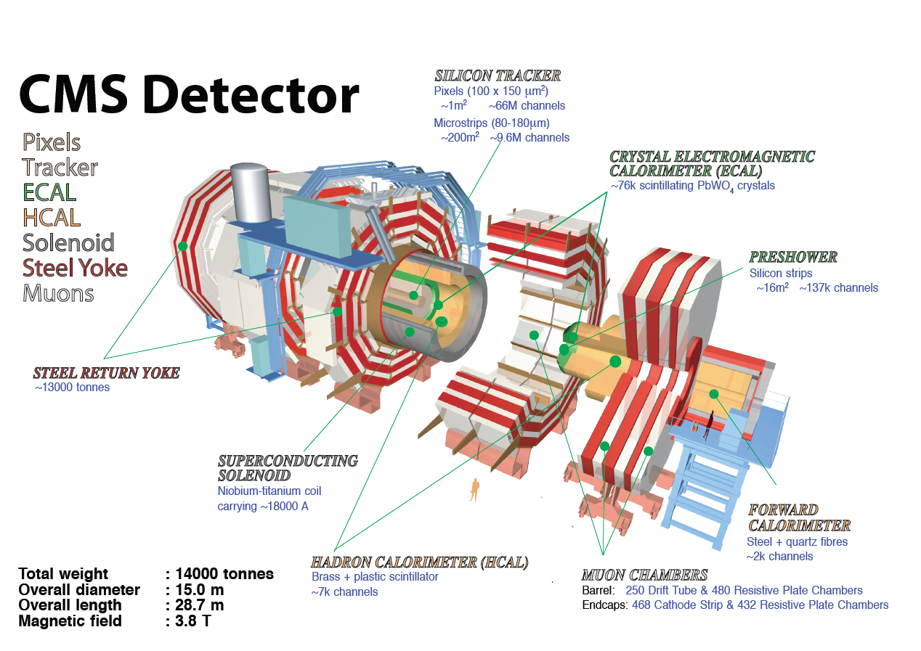
CMS
Compact Muon Solenoid

Slide 61
Inclusive All-Hadronic Search: Background Estimation for Z → νν
Background estimation with γ+jets :
Strategy:
  Declare photon invisible to emulate neutrinos
  Then re-calculate E_{T}^{miss} for this event
  Correct for the photon reconstruction efficiency and neutrino branching ratio
SUSY signals could bias the prediction (depending on
the SUSY scenario, more for Z→μμ+jets (mSUGRA) or
γ+jets (GMSB))
Useful to have background estimations from different processes, preferably Z→μμ+jets:
  Production mechanisms are the same in both processes → E_{T}^{miss} is correctly estimated without having to rely on Monte Carlo simulations
  Drawback: too low statistics, but comparable result in baseline selection
CMS PAS SUS-11-004

Slide 62
Interesting Variables: M_{T}
M_{T} is used for single-leptonic analyses:
Measure of the transverse invariant mass of the lepton and the missing momentum (with ΔΦ: angle between lepton and E_{T}^{miss})
For an event containing a single W → μν decay,
M_{T}² = (p(μ) + p(ν))² = M_{W}²
Single W→μν decays appear as peak with sharp falling edge close to the W mass
If a W decay is the source of both the lepton and the E_{T}^{miss}, the requirement M_{T} > M_{W} would remove most of the SM events
But: this cut also removes a significant fraction of the SUSY events!
Need to combine with another cut…

Slide 63
Background determination for α_{T}:
H_{T} vs |η| of leading Jet
Try to understand the background for α_{T}:
  SUSY signal is expected to be more central and in higher H_{T} region (H_{T} = Σ E_{T}^{jets})
  Background relatively flat in |η| and H_{T}
  Can lower H_{T} region be used to extrapolate background expectation to higher H_{T} values?
  Check behavior for both α_{T} regions (signal and bg region):
SM+SUSY (LM0)
SM only
(signal)
(backgr)
from CMS MC study on 10 TeV 2009

Slide 64
Reconstructed Objects
You can reconstruct so called “physics objects”:
  Photons: no track but energy in el-m (and not in the hadronic) calorimeter
  Electrons: track and energy in el-m (and not in the hadronic) calorimeter
  Muons: track in inner tracker and muon chamber
  Jets: cluster in hadronic calorimeter
  Missing transverse energy (if transverse energy sum is not 0)
Of course reconstruction is not always simple
Different reconstruction algorithms for each object are on the market – need to choose the best one for each analysis
Based on these objects we can select our SUSY events…

Slide 65
Pseudorapidity
Rapidity of a particle of momentum p=(E,0,0,p_{z}) is defined to be
y = ½ log ((E+p_{z})/(E-p_{z}))
Advantage: the rapidity difference is invariant under the longitudinal boost
For massless particles, p_{z} = E cos θ , (θ : polar angle)
y = ½ log((1+cos θ)/(1-cos θ))
= log (cot (θ/2))
= η : pseudo-rapidity

Slide 66
Interesting Observables: E_{T}^{miss}
Missing E_{T}: vector sum of the transverse energy deposited in all calorimeter cells (this combines, ideally, the momenta of all photons, electrons, hadronically decaying taus, and jets) and adding to this the transverse momenta of any muons, whose energy is measured using the muon detection system
The magnitude of the resultant vector is the missing E_{T}:
Attention:
E_{T}^{miss} might be polluted by detector effects!

Slide 67
Interesting Observables: H_{T}^{miss}
Analog to E_{T}^{miss}, but using jets above a certain jet threshold only:
Attention:
You might have a cut on jet momentum of e.g. p_{T}>50 GeV
But there might be several jets below that threshold which could still lead to a considerable amount of ignored momentum in the event!
One idea to control this: add cut on ratio R with
(numbers are just examples)

Slide 68
Interesting Observables: α_{T}
α is a variable developed for 2-jet events:
  Exactly 0.5 for perfectly measured QCD event
  In addition, as the E_{T} of the second energetic jet enters in the numerator, uncertainties introduced through energy mis-measurements partly cancel out in α (if one of the two jet energies is measured wrong by a large amount the order of the two jets will be swapped)
You can also use the transverse mass:
For massless particles (with ΔΦ = difference in azimuthal angle of the jets):
L. Randall and D. Tucker-Smith, arXiv:0806.1049.

Slide 69
Interesting Observables: α_{T} (2)
Now extend α_{T} to n-jet events:
Two pseudo jets are formed which balance each other as good as possible in the “pseudo-jets” H_{T1} = Σ E_{Ti} and H_{T2} = Σ E_{Tj} (E_{Ti} and E_{Tj}: transverse energies of the jets within a pseudo jet)
Assuming massless jets, one can write:

Slide 70
Factorisation (ABCD) Method
Straightforward method, if two variables are uncorrelated:
Estimate number of background events in signal region: D=C·B/A
Attention:
  most variables are correlated
  signal can be spilled into the normalisation region
normalisation
region
signal region
variable 2
B
D
A
C
variable 1
model regions

Slide 71
Prediction from Templates
Collect QCD events with topologies similar to signal events
Fill variable to investigate of QCD event in 2-dim matrix
Then measure the corresponding variables for your signal candidate event, and extract the predicted value for the background from template for this bin
3
t31 | t32 | t33
t21 | t22 | t23
t11 | t12 | t13
variable 2
2
1
1
2
3
variable 1

Slide 72
Example for Prediction from Templates: Artificial E_{T}^{miss}
Missing transverse energy can have several artificial sources:
  Instrumental effects
  Software
  Collision or non-collision backgrounds
  Some effect you haven’t yet thought of…
Predict these effects from data with templates!
Fill measured E_{T}^{miss} of collected QCD events in 2-dim matrix (e.g. with variable1=N_{jet}, variable2=H_{T}, which is expected to be less polluted by artificial effects)
Then measure these variables for your signal candidate event, and extract the E_{T}^{miss} template for this bin
Sounds straight forward, but attention:
  H_{T} of QCD events lower than expected for SUSY
  → need extrapolation
  QCD and signal events might be triggered by different (and differently efficient) triggers

Slide 73
Example for Prediction from Templates: Artificial E_{T}^{miss}(2)
How can we check that it works with early data?
Predict the E_{T}^{miss} for γ+jets events using QCD jets:
→ Prediction quite good, given that:
  Photon sample expected to be polluted by neutral pions
  Jet energy scale for jets less well measured than the photon
  Different triggers used for the two data samples

Slide 74
Jet Smearing – Gaussian Part
Idea: Generate the Gaussian response function either with well measured dijet or with γ+jet events:
In case of γ+jet events (photon well measured):
  Use transverse momentum conservation in γ+jet events to calculate Gaussian response of calorimeters to jets from the distribution of the photon-jet p_{T} balance (with events containing exactly 1 jet):
  Measure this distribution in bins of p_{T}^{γ}

Slide 75
Jet Smearing – Gaussian Part (2)
In case of dijet events:
  Apply jet smearing with the Gaussian jet response on low E_{T}^{miss}, well measured, dijet seed events
  This produces a set of smeared events
  Compare the E_{T}^{miss} distribution of the smeared events with the E_{T}^{miss} distribution of all jet data in the low E_{T}^{miss} region
  Vary the Gaussian parametrisation and repeat the above two steps to find the closest match and therefore the optimal Gaussian fit
  Still need to measure the non-Gaussian part… (see next page)

Slide 76
Jet Smearing – Non-Gaussian Part
Generate the non-Gaussian response function with multi-jet events (preferably Mercedes-like events) where exactly one jet ‘J’ is parallel to the E_{T}^{miss}
  Response of the calorimeter to jet J, if its p_{T} lies in the non-Gaussian tail, can be obtained from:
J

Slide 77
Jet Smearing – Full Jet Response
Construct full jet response by approximately normalising the Gaussian and the non-Gaussian components
Derive the normalisation by comparing the measured non-Gaussian response with the tail of the dijet balance distribution
Use the full response function to 'smear' the four-momenta of jets in events with low E_{T}^{miss}
The smeared jets can now have sufficient E_{T}^{miss} to enter the SUSY signal region and hence provide an estimation of the multijet background in this region

Slide 78
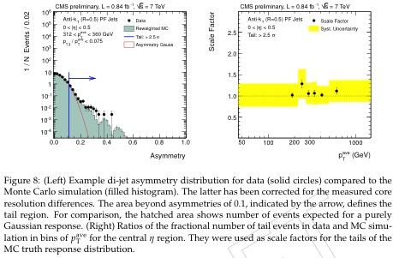
Jet Smearing
From SUS-11-04

Slide 79
Background for prompt Leptons
If SUSY events contain leptons they are prompt!
Different sources of background leptons possible:
  Non-prompt leptons from semileptonic heavy quark decays
For Muons:
  Decay of long living kaons and pions
  Calorimeter punchthrough (to muon chambers)
For Electrons:
  Jets mimicking electrons
  Photon conversions in tracker

Slide 80
Lepton Isolation Predictions
SUSY (and EW) leptons are prompt → should be isolated
Check e.g. the combined relative isolation (with ΔR = √Δη²+Δφ²)
Attention: Sums in Isolation exclude the energy and momentum of the investigated lepton
Expect value close to 0 (essentially <0.1) for isolated leptons
Background mainly >0.3
Try it yourself! These numbers are just examples, and you could also use single isolation for each detector component
But Attention:
EW background (W→lν) is located in SUSY signal region!

Slide 81
Lepton Background Predictions using
Fit and Extrapolation for Isolation
Using the combined relative isolation described before:
  SUSY signal and EW decays are mainly in Isolation<0.15
  Background more or less in region Isolation>0.3
Idea: produce background enhanced sample and fit this in the background region
  Test different fits/fit regions etc. on this sample (e.g. for small E_{T}^{miss})
  Then apply the best fit to data which could contain a signal (e.g. for large E_{T}^{miss})
  From this fit predict the number of background events in signal region
Or use templates:
  Instead of fit use directly a template data sample (extracted by anti-selection)

