Slide 1
Needed Material Property Studies to enable optimization of hydroforming
Thomas R. Bieler
With Chris Compton, Farhang Pourboghrat
Michigan State University
…secondary goal is to identify and verify cost-saving measures via R&D in the areas of Nb tube fabrication and improvement of the forming process
→ Influence 2nd (or is it 3rd?) generation design of hydroforming process path

Slide 2
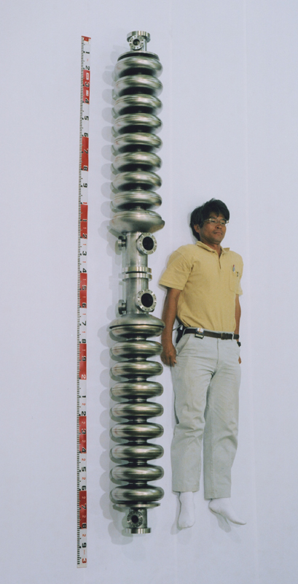

From ingot to cavity, in many steps…
Whether welding or hydroforming, there are many steps needed to get from an ingot to a cavity…
Briefly, good hydroforming requires a good tube:
KEK
So, what happens at each step?
Empirical black box, or
strategically planned?

Slide 3
Singer et al. tried a few different ways to make tube, and some hydroformed better than others…
Back extruded + flow forming
  Not successful – large orientation gradients
Deep drawing + annealing
  partially successful, a stable [111] || ND texture developed while forming
Spinning
Spinning + flow forming
  Textures of latter 3 are similar, weak.
Wah-Chang has developed a tube forming path…
Why are some forming paths better than others?
  Can an optimal tube deformation path be found with computational modeling?

Slide 4
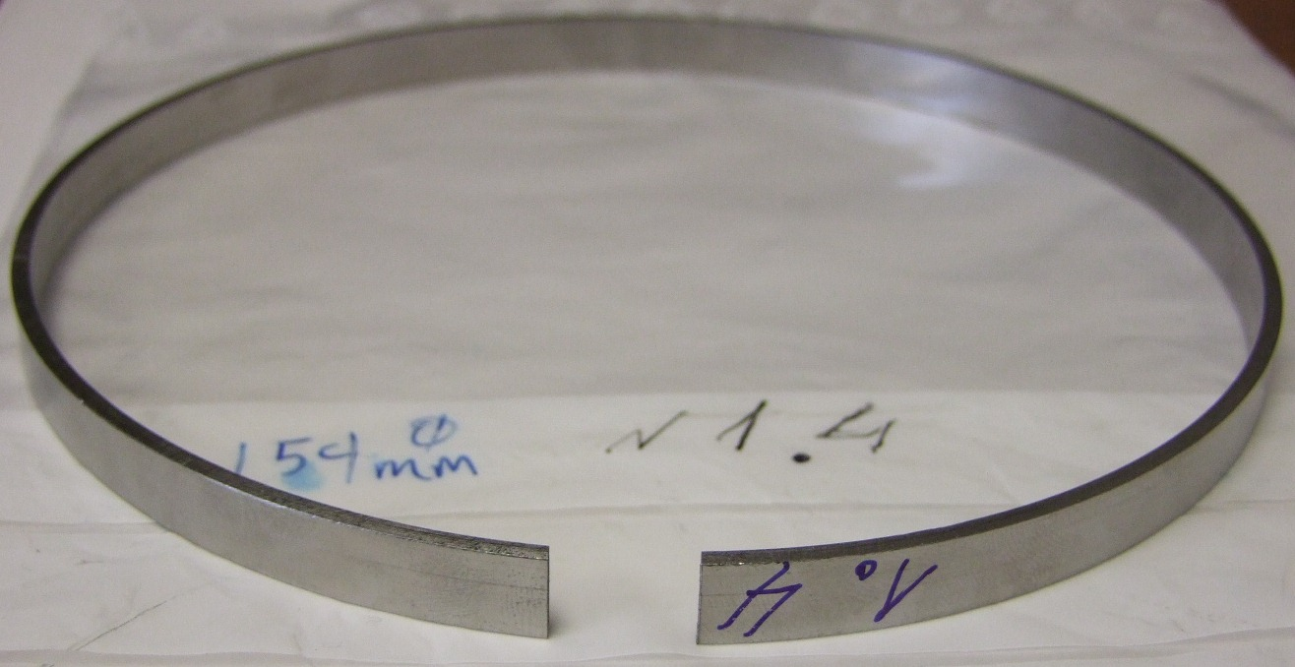
Tube 1.4
Tube was made by deep drawing + 850C 2hr anneal
Clip
Polished surface

Slide 5
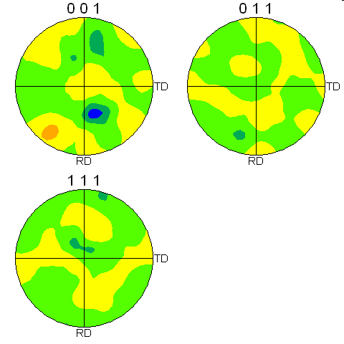
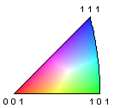
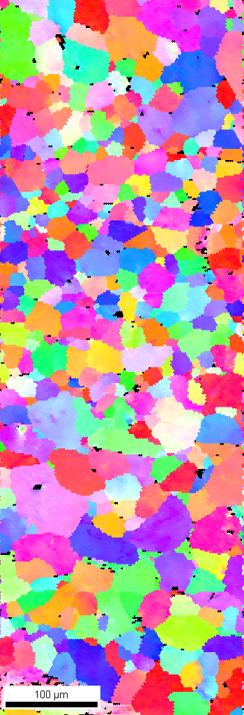
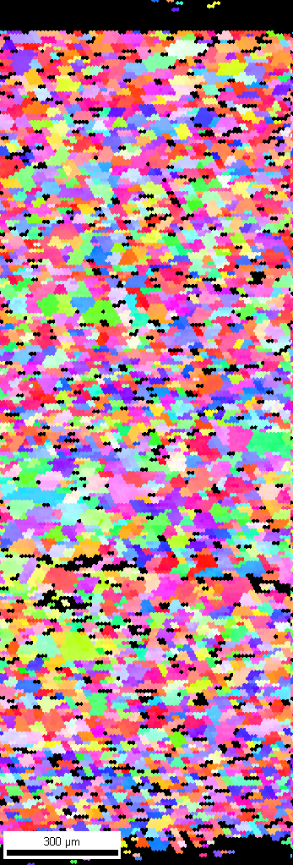
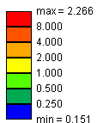
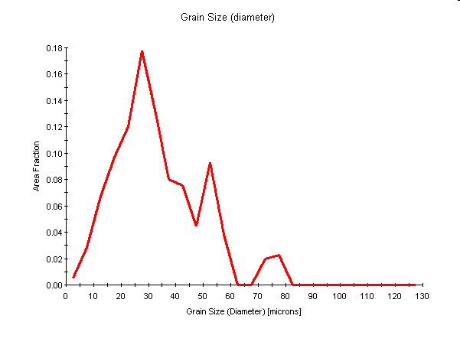
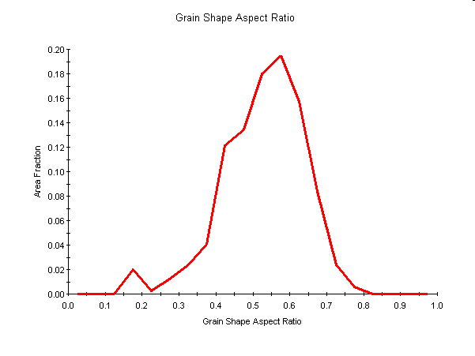
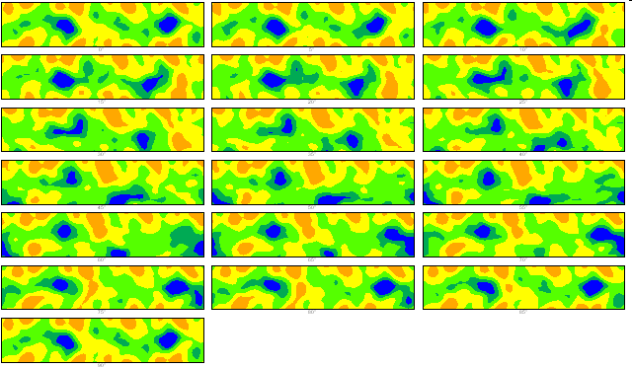
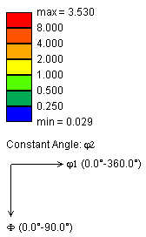
Tube 1.4
420x mag
Full-thickness
2.7 x ran
Deep drawing + 850C 2hr anneal
27.5μm
2 µm step
10 µm step
Colors are parallel to radial direction

Slide 6
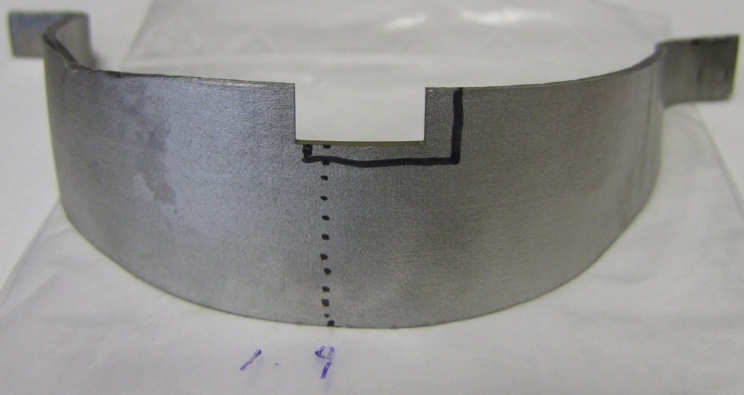
Cavity 1.9 (from tube 1.4)
This cavity was not annealed after forming by deep drawing+anneal. They tried to make double cell, but one broke, (this one)
and the other became very successful single cell. Was the cavity that cracked in a region of the tube with greater deformation?
Clip
Polished Surface
By measuTube thickness, we can find how far from the crack it was

Slide 7
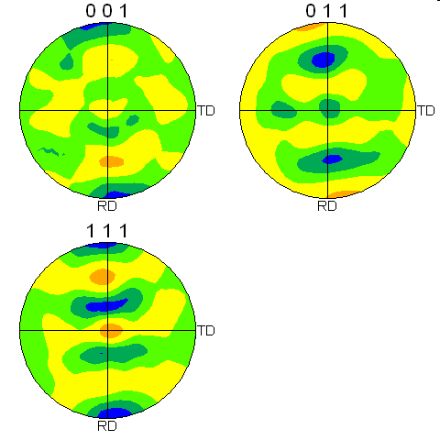
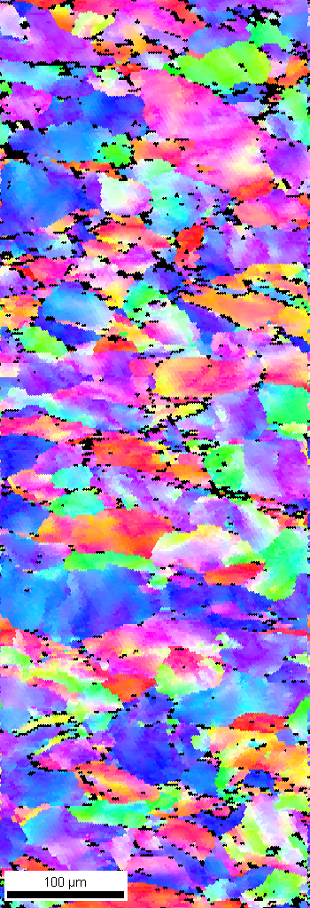
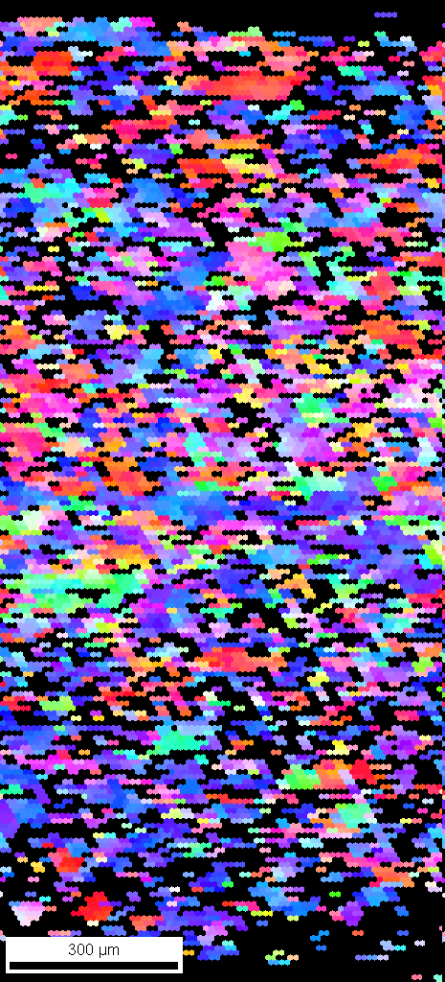

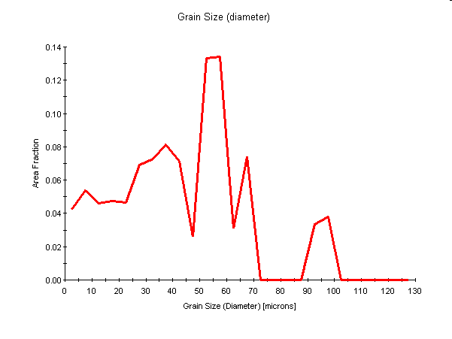
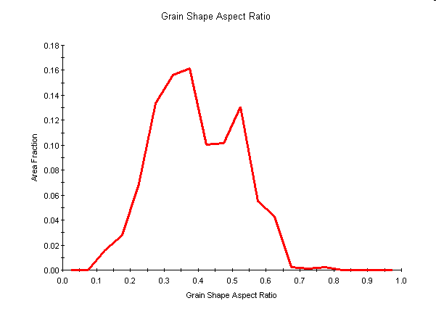
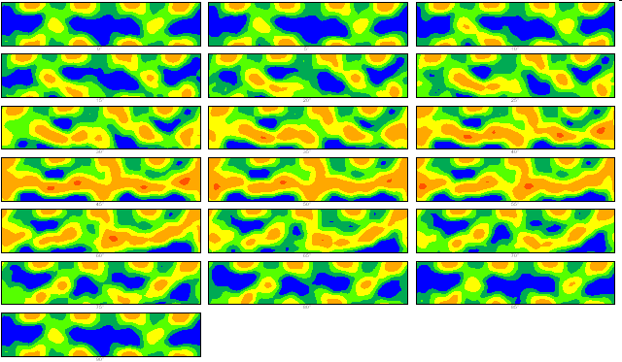

Tube 1.9
420x mag
Full-thickness
Grains have orientation gradients
2.8 x ran
Has appearance of rolling texture, gamma fiber
55μm
2 µm step
10 µm step
Colors are parallel to radial direction
Not annealed, tried to make double cell, one broke, (this one) but the other became successful single cell

Slide 8
Texture and microstructure evolve during tube forming, tube texture and microstructure evolve during hydroforming
Can the process from ingot to cavity be simulated?
Texture evolution can be simulated with success using computational plasticity
  Subtle details related to hardening are harder to capture
Simulating texture changes with recrystallization is more difficult
  depends on knowledge of dislocation arrangement.
  This is a major knowledge gap to overcome to enable simulation of the larger multi-step process
However, recrystallization textures are not as strong, nor change as much from parent texture, as steel…
  so perhaps recrystallization can be ignored in a first pass simulation approach

Slide 9
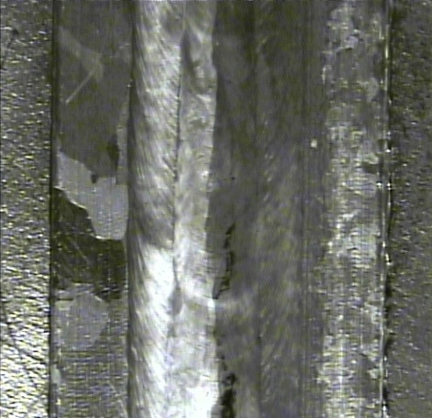
Simulation from single crystal (ingot) to polycrystal (tube) …
Single crystal deformation is very dependent on crystal orientation.
  Some orientations recrystallize more easily with deformation than others.
  Hence, need to know how to deform different large grains of different orientation concurrently to get desired small grain microstructure and texture
  Strategy for initial working of ingot?
    Typically a mixture of science and (proprietary) empiricism in metal working companies
Weld
Rx differs in HAZ
1mm

Slide 10
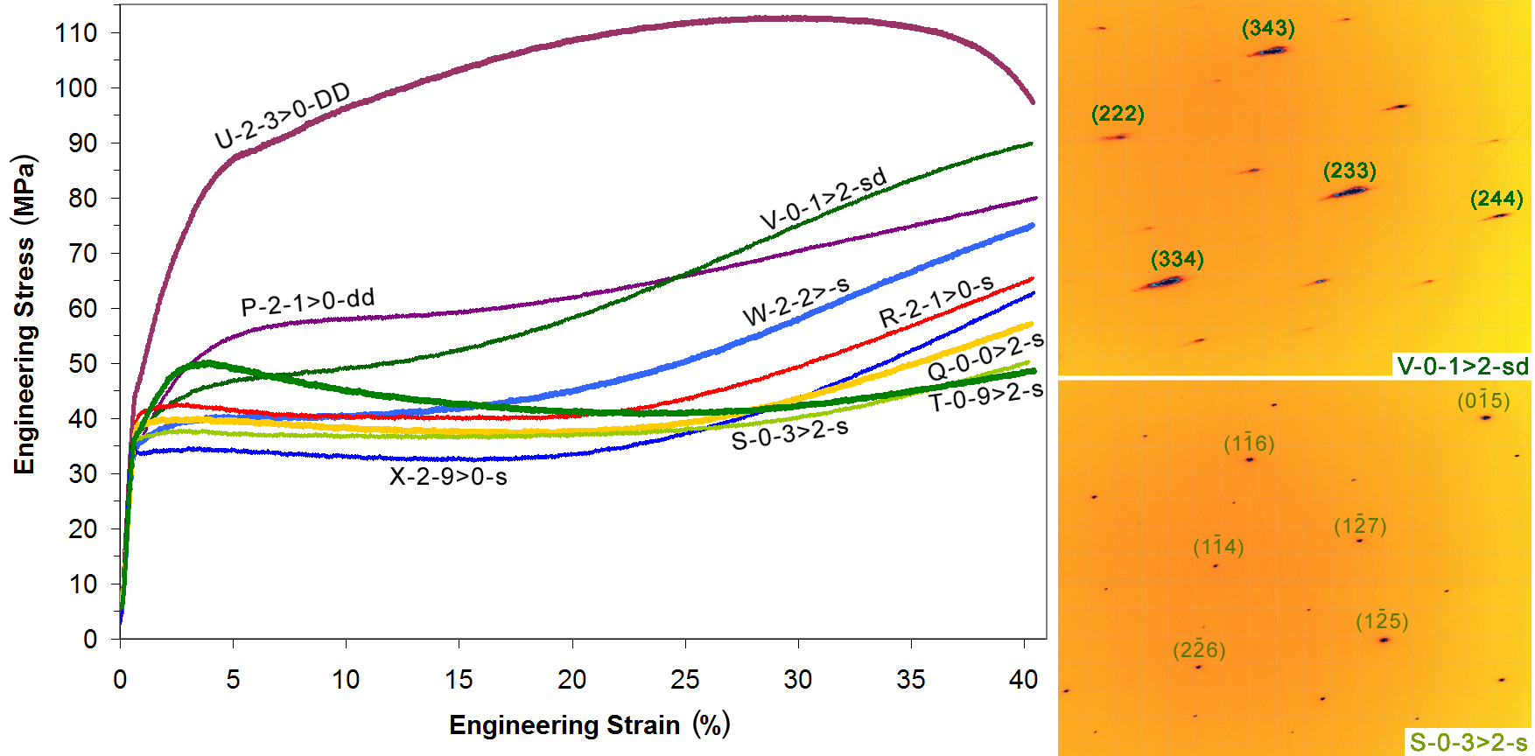
Different single crystal orientations deform differently, depending on single vs. multiple slip directions
Diffraction patterns are typically streaked, indicating large deformation and orientation gradients that affect nucleation of recrystallization → need to change direction of working of ingot
Worse than pxl
Super soft

Slide 11
Each single crystal orientation has an optimal deformation path, what about polycrystal?
Random textures develop into preferred textures with deformation… Rx can alter that…
With an initial texture, can differences in forming path cause better or worse formability?
At least 4 knobs to control:
P
Feed
Rate
Feed
Rate
Feed Rate
Pressure History
Thermal History
Thermal Gradient History
P

Slide 12
Computational Modeling Strategy
Extrusion Grain structure Grain orientation distribution
Circ.
Axial
Experimental Predicted
axial stress-strain curve yield function (anisotropy) Polycrystal model
FEM hydroforming simulations with anisotropic material properties
Plastic flow localization and fracture predictions
1 grain
Ο
Aluminum atoms
Dislocation

Slide 13
Example of Warm Forming Deformation Path Design Optimization
Pourboghrat…

Slide 14
Feedback system to control strain path in instrumented hydroforming facility
In-situ vision based feedback control system needs to be developed and implemented
Radii and strains
F
P
F
0
Controller for
Pressure P
Axial Feed F
Temperature T
Radii of curvature, r1, r2
dF, dP, dT

Slide 15
What foundation is needed?
Crystal Plasticity simulation of deformation and texture evolution
  This is at the microstructure scale
  Need to be able to predict both single and poly crystal evolution correctly
Evolution rules for yield surface based upon metal physics so that property evolution can be made more efficient to simulate deformation at the part (cavity) scale
Experiments designed to assist development and validation of material models
  Heavily instrumented hydroforming facility
Identify rules for Recrystallization

Slide 16
Plans and Progress using Fermi and OHEP funds
Fermi:
  Cryotesting: effects of microstructures and textures on cryogenic deformation of materials in cavities for pressure vessel code compliance
  Hydroforming: Constitutive model development for Nb at crystal plasticity and continuum level simulation
    Experiments and microstructure characterization
    Heavily instrumented hydroforming research facility needs $
OHEP: Continuing identification of physical metallurgy of deformation/recrystallization relationships , and…
    Ingot characterization
    Weld metallurgy
    Microstructure/thermal conductivity relationships
    Support for ECAE and hot hydroforming microstructure/OIM characterization (with some $ help)

