Slide 1
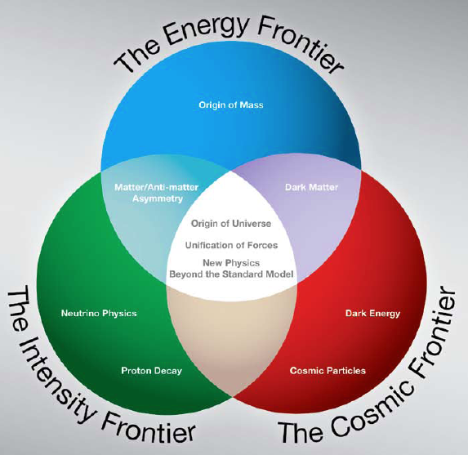
Project-X Muons Synergy with Muon Collider R&D
Steve Geer
Accelerator Physics Center
Fermi National Accelerator Laboratory
μ⁺
μ⁻
ν
MAP Website: http://map.fnal.gov

Slide 2
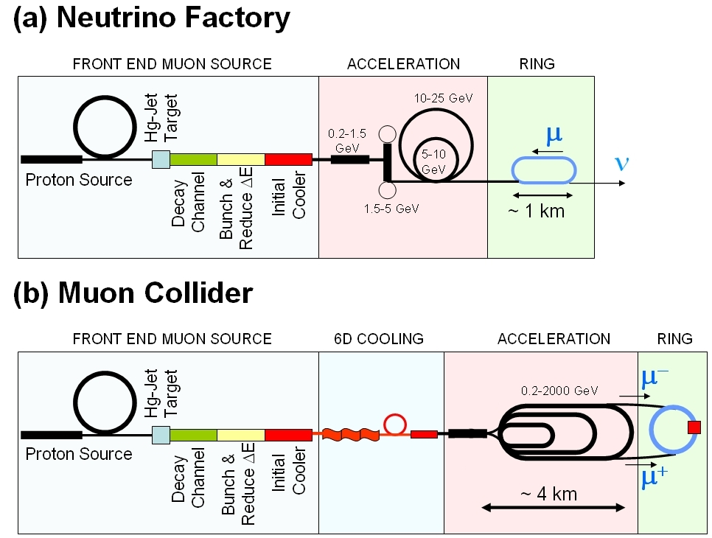
MUON COLLIDER SCHEMATIC
10²¹ muons per year that fit within the acceptance of an accelerator:
ε_{⊥N}=6000 μm
ε_{//N}=25 mm
_{P ~ 220 MeV/c}
_{Δp/p ~ 0.1}
√s = 1.5 TeV
Circumference = 2.75 km
L = 1×10³⁴ cm⁻²s⁻¹
μ/bunch = 2x10¹²
σ(p)/p = 0.1%
ε_{⊥N} = 25 μm
β * = 1cm
Proton source: Upgraded PROJECT X (~4 MW, 2±1 ns long bunches)

Slide 3
Muon Collider cf. Neutrino Factory
NEUTRINO
FACTORY
MUON
COLLIDER
In present MC baseline design, Front End is same as for NF

Slide 4
Possible Impact of MC R&D on
Low Energy Muon Experiments
Concepts
  High Intensity muon beams
  Cold muon beams
Technology Development
  Systems & components to handle very high intensities
  Muon beam phase rotation channel (reduces energy spread)
  Muon beam cooling channel (reduces 6D phase space)
Test Facilities
  Target test/R&D facility ?
  6D cooling test facility ?
  Muon Collider Front-End test facility ?

Slide 5

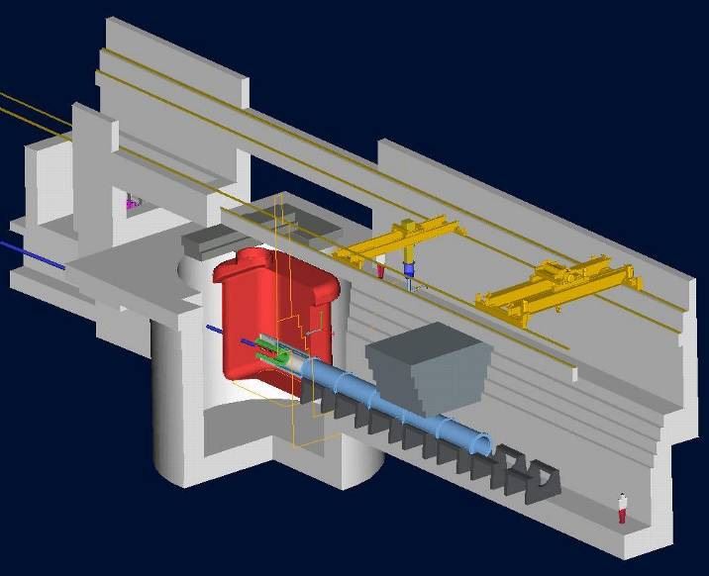
Concepts: Getting more muons
Start with high power proton source
(Proj. X at 4 MW)
Need a viable target concept
  MERIT Experiment at the CERN PS
  demonstrated liquid Hg Jet in 15T
  solenoid … concept good up to ~8MW.
  A 4MW target station design study
  was part of “Neutrino Factory
  Study 1” → ORNL/TM2001/124
  Much more design/development
  needed (e.g. beam dump, thermal
  management, solenoid design, …. )
Need optimized π collection, decay
channel, bunching & phase rotation …
already at an advanced design stage
→ O(0.1 μ⁻ + 0.1 μ⁺) per 8 GeV proton.
1 cm
V. Graves, ORNL
4MW Target Station Design

Slide 6
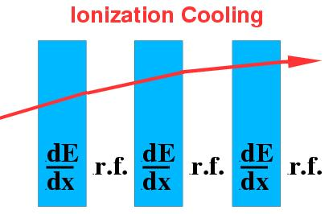
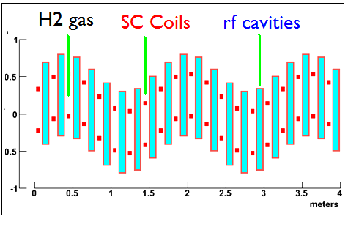
Concepts: Cold Muon Beams
Use Ionization Cooling: reduces transverse
(4D) phase space.
MC designs require the muon beam to be
cooled by ~ O(10⁶) in 6D.
To also cool longitudinal phase space (6D)
must mix degrees of freedom as the cooling proceeds.
This can be accomplished with solenoid coils arranged in a helix, or with solenoid coils tilted.
Alexhin & Fernow
Palmer
Muons Inc.

Slide 7
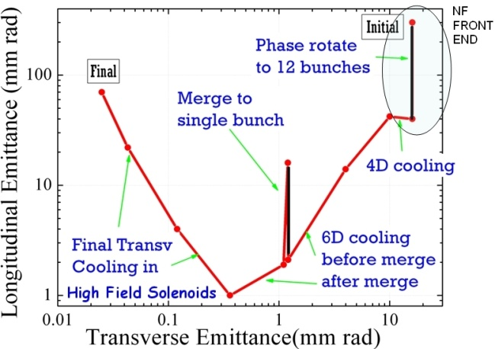
Cold Beams
Palmer

Slide 8
Technology Development:
HTS Solenoids
At the end of cooling channel want very high field solenoids (luminosity ~ field up to ~50T).
On going R&D in TD (with national partners) to explore possibility of very high field HTS solenoids.
FNAL TD test cable. Test degradation of J_{c} in the cabling process

Slide 9
Technology Development:
RF in Magnetic Fields
To bunch, phase rotate, and cool the muons, we want to use
high-gradient NCRF cavities that operate in multi-Tesla axial magnetic fields.
Good News: Since muons are penetrating particles, we can
close the open RF aperture with a thin conducting window … for
a given accelerating gradient on axis, this halves the required peak power (# power sources) .
Bad News: If we use a copper vac. Cavity of this type, we have observed that the max. stable accelerating gradient is significantly reduced in a few Tesla axial magnetic field.
Lots of ideas on how to overcome this … and an active R&D program to find the best solution.

Slide 10
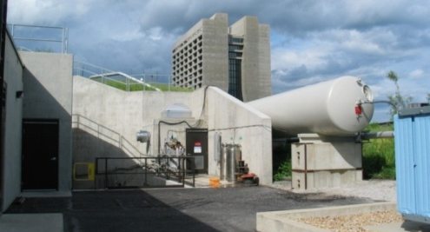
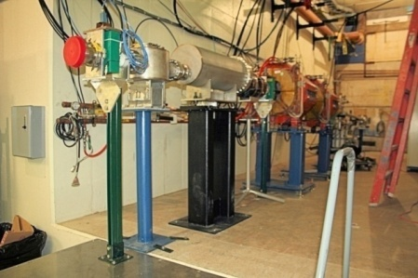
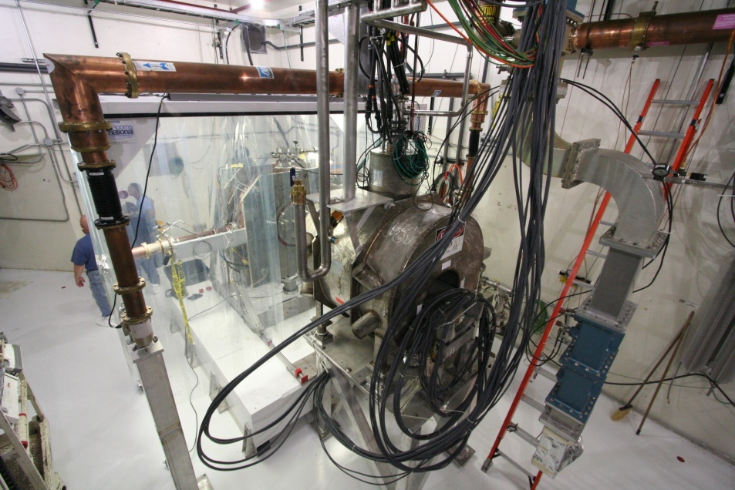
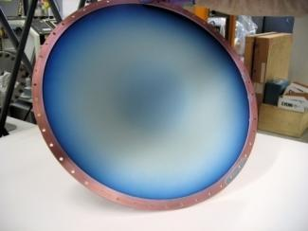
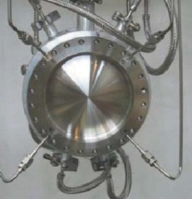
MUCOOL TEST AREA
Developing & bench testing
cooling channel components
MuCool Test Area at end of FNAL linac is a unique facility:
  -Liquid H2 handling
  -RF power at 805 MHz
  -RF power at 201 MHz
  -5T solenoid (805 MHz fits in bore)
  -Beam from linac (soon)
New beamline
MTA
42cm ∅ Be RF window
Liq. H2 absorber

Slide 11
Possible Future Test Facilities:
Target R&D Facility
As proton beam powers increase
to MW(s), target stations will
become more and more
challenging:
  Remote handling
  Thermal management
  Radiation hardness of
  materials & components …
There has already been some
thinking about a multi-purpose
target facility at Proj. X for ADS
& Nuclear physics experiments
A target R&D facility at Proj. X that could take, or be upgraded to take, a 4MW beam would be a great asset for the future high intensity program.
V. Graves, ORNL
4MW Target Station Design

Slide 12
Possible Future Test Facilities:
6D Cooling Experiment
Beyond the MICE experiment at RAL (which demonstrates 4D cooling technology), we will likely need a 6D cooling experiment.
To arrive at an optimal setup, we need to carry out
  Simulations to understand what aspects of the cooling channel performance need to be tested, and to what accuracy. This will include determining the required length of cooling channel, the required beam parameters, and the analysis approach.
  A diagnostics/detector effort to determine how best to measure the muon beam to the required accuracy.
  A design/integration effort to specify, and define a layout for, the experiment (this will be informed by a bench test activity in the MUCOOL Test Area). This will also include finding a suitable location and designing a muon beam line.

Slide 13
Possible Future Test Facilities:
6D Cooling Experiment
Date | Milestone | Designation | Deliverablesa)
FY10 | Study possible minor extensions to MICE | ST10.1 | DR
FY11 | Deliver Spectrometer Solenoids to RAL | ST11.1 | DR
FY12 | Deliver first RFCC module to RAL | ST12.1 | DR, MR
FY13 | Initial specification of 6D cooling bench test | ST13.1 | DR, MR
FY14 | Finalize 6D cooling bench test specification | ST14.1 | DR, MR
FY15 | Initial component specifications for 6D cooling experiment | ST15.1 | MR
FY16 | Install 6D cooling bench test section in MTA | ST16.1 | MR
 | Prepare proposal for 6D cooling experiment | ST16.2 | FR, ER
DR: design report (MAP technical note); ER: external review; FR: formal report;
MR: MAP (internal) review.

Slide 14
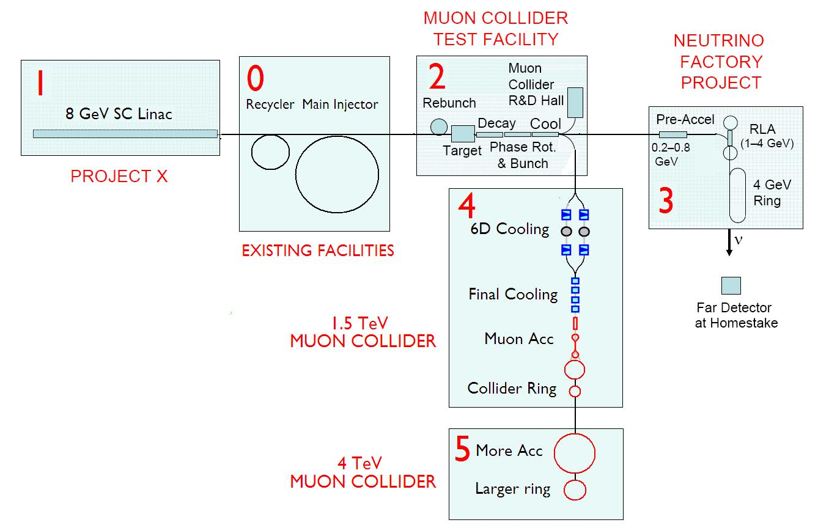
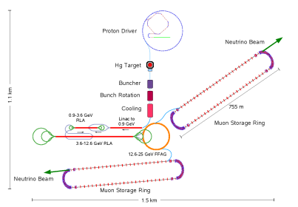
Test Facilities & Staging
4MW multi-GeV
Proton Source
α
4 GeV
NF
Accumulation &
Rebunching
3
25 GeV
NF
β
4

Slide 15
The MAP Initiative in the U.S.
Oct 1, 2009 letter from DOE Assoc. Director of Science for HEP to FNAL Director:
  “Our office believes that it is timely to mount a concerted national R&D program that addresses the technical challenges and feasibility issues relevant to the capabilities needed for future Neutrino Factory and multi-TeV Muon Collider facilities. ...”
Letter requested that FNAL Director put in place a new organization for a national Muon Collider & Neutrino Factory R&D program ⇒ MAP.
Initial MAP participants from 14 institutions:
  ANL, BNL, FNAL, Jlab, LBNL, ORNL, SLAC, Cornell, IIT, Princeton, UCB, UCLA, UCR, U-Miss
MAP R&D proposal submitted by FNAL Director in March, reviewed (favorably) in August.

Slide 16
Anticipated Progress
Timescale: ~6 Years
Deliverables:
  Muon Collider Design Feasibility Report
  Hardware R&D results → technology choices
  MC Cost range
  Contributions to IDS-NF RDR
7
MUON COLLIDER PROPOSAL
6
NOW
5
PROPOSED MC-DFS
4
3
2
1
Ring
6D Cooling
Acceleration
Initial Cooling
Final Cooling
Bunch / Phase
Target & Dump
Pre-Acceleration

Slide 17
Past, Present, Future
First
~10 years
FY07 –
FY09
Now
(FY10)
≥FY11
NFMCC
+
MCTF
Interim
MAP
NFMCC
MAP
~4 M$/y
~9 M$/y
~10 M$/y
~15 M$/y (requested)
NFMCC = Neutrino Factory & Muon Collider Collaboration
MCTF = (Fermilab) Muon Collider Task Force

Slide 18
FINAL REMARKS
Muon accelerator R&D is receiving increased attention in the U.S. (→ MAP). As the R&D progresses we should look to see how future low energy muon experiments might benefit from the developing concepts, technologies, and test facilities.
Beyond the common NF/MC front end, a Muon Collider requires a 6D cooling channel that could provide muon bunches with very small longitudinal emittances :
  - Stop muons in very thin foils
  - Ultimate example (gedanken experiment):
  Suppose we could stop a short O(1ns) long bunch containing O(10¹²) μ⁻ in 1μm³ of material. The muon density would be comparable to the density of atomic electrons … after ejecting the electrons, the resulting density of the material will increase by O(10⁷) … for 2 μs !

Slide 19
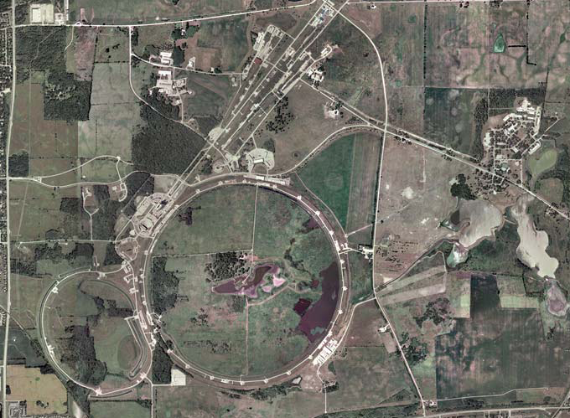
A MUON-BASED VISION
RLA Linac 2
ADDITIONAL SILDES
detector
μμ
Muon Collider
RLA Linac 1
Project X
ν-factory beam
To DUSEL
NF
MCTF
Final Cooling

