Slide 1
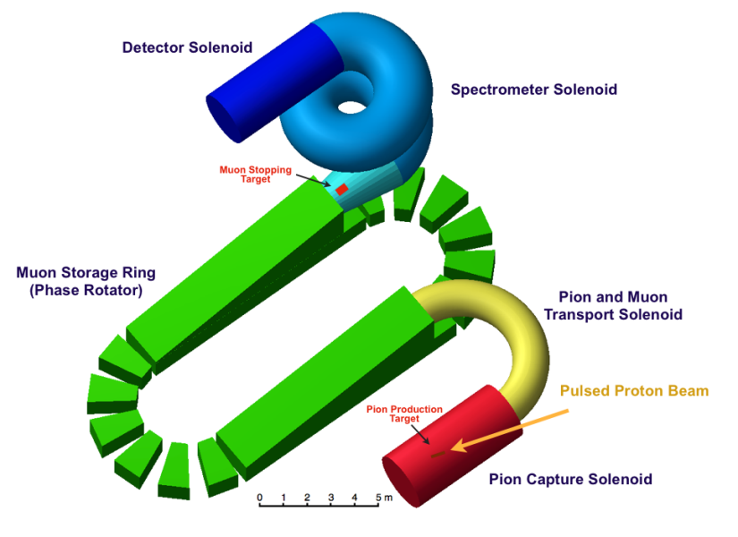
Proton Beam for PRISM
Keith Gollwitzer
Accelerator Division
Fermilab
5th Workshop Project X Physics – Muons
November 8, 2010

Slide 2
Outline
Review of Project X beam
PRISM beam requirements
Changing bunch structure
Issues

Slide 3
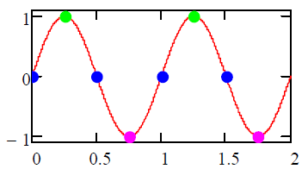
Project X Beam Review
3GeV beam energy out of CW Linac
325MHz bunches (3.1ns spacing)
RF splitter doubles spacing
50ps bunch width
1.9x10⁸ particles/bunch (10mA for < 1μsec)
Linac average beam current 1mA (>1 μsec)
3MW out of Linac possible
H⁻ beam out of Linac
Preference to convert beam to protons before 3 way RF splitter

Slide 4
PRISM Beam Requirements
1MW of proton beam power
Already asking for more beam power
More beam current (towards 4MW)
Increase CW Linac energy
Repetition rate of ~1kHz
Believed to be limit of injection/extraction kickers of muon storage ring
2x10¹² protons every 1ms
Bunch width of 10ns
A narrower width is desirable

Slide 5
Changing Bunch Structure (1)
Need to accumulate beam
Change 162.5MHz beam out of RF splitter to 1kHz beam onto target
Requires H⁻ beam out of RF splitter
Accumulation Ring will have stripping system and dump
To accept unconverted beam (H⁻ and Hº)
Requires programmable Linac front end to populate appropriate Linac bunches such that the appropriate Accumulation Ring RF bunch(s) are filled
Leave kicker gap using barrier RF system
Set initial bunch length before RF manipulations

Slide 6
Change Bunch Structure (2)
Final bunch length requires RF manipulation
After accumulation, beam transferred to second ring: Buncher
Buncher will perform final RF bunch rotation to achieve short bunch length
Linac
H- beam
Proton
Bunch to
Target
RF Splitter
Accumulation
Ring
Buncher
Ring

Slide 7
Issues (1)
Injection/Extraction Kickers
1kHz kickers are the same technological issue as for PRISM Muon Storage Ring
Repetition rate
Rise time or fall time
Beam Dynamics
Space Charge?
Beam size in dipoles at final bunch length
RF
How much required to perform manipulations at required rate?

Slide 8
Issues (2)
H⁻ beam out of RF splitter
Requires lower field in downstream Lambertson to avoid Lorentz stripping of H⁻ beam
Affects layout of switchyard area
Each area will need own stripping system
Stripping system and beam dump
Quantum mechanics of stripping systems
>95% easy but leaves tens of kW beam power

Slide 9
Summary
Project X can provide the amount of proton beam necessary for PRISM
Work will be needed to convert bunch structure

