Slide 1
View from Washington and Germantown
Vincent Dattoria
ESnet Program Manager, Facilities Division, Office of Advanced Scientific Computing Research
February 2nd, 2011

Slide 2
Talk Outline
ASCR Organization
Next-Generation Networks
SBIR/STTR
Upcoming Activities

Slide 3
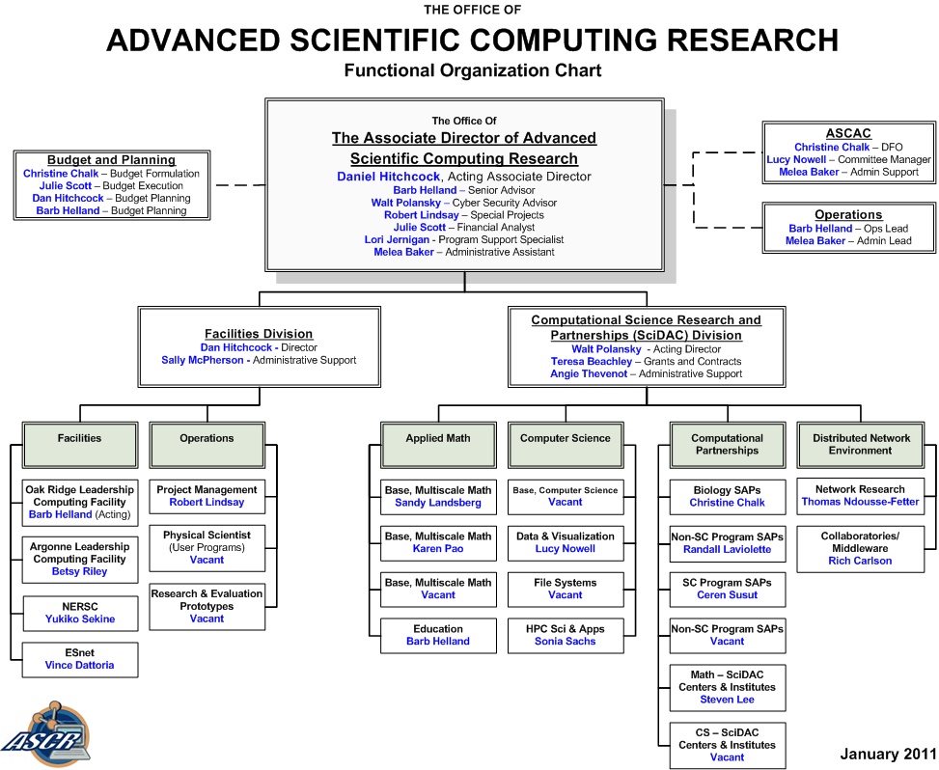

Slide 4
Next-Generation Networks Program
The next-generation networks program supports R&D activities to develop advanced networks to enable distributed high-end science
Program elements:
Network research – core network research
Middleware research – Grid technologies
The program coordinates with ESnet to develop and deploy networks that enable scientists to push the limits of today’s networks
Next-generation network technologies has enabled the efficient and rapid distribution of massive data generated by the LHC experiment and climate modeling
Terabits Networks for Petascale Science

Slide 5
Next-Generation Networking
Upcoming Terabit workshop
February 16-17 in Rockville, MD
Participation by invitation
37 attendees confirmed
https://indico.bnl.gov/confRegistrantsDisplay.py/list?confId=319
New FOA planned for FY11
Magellan-ANI Testbed well underway
Contact members of the Next-Gen team for further information
Thomas Ndousse and Rich Carlson

Slide 6
ASCR Technical Approach for SBIR/STTR
ASCR SBIR focus is now technology-centric, not science-centric.
Engaged people with entrepreneurial and venture capital experience in all stages
Engaged Lab personnel to assist with writing topic descriptions, identify reviewers, and assist with commercialization.
More info at: http://www.science.doe.gov/sbir/
Notes:
6

Slide 7
ASCR SBIR/STTR Proposals
Phase I:
Received 210 proposals
(Note: 32 proposals received in “Other” sub-topic)
16 proposals declined in first-step reviews
194 proposals sent for peer review
>582 reviews
217 reviewers
Review panels scheduled for next week
Rich Carlson is ASCR Portfolio Manager.

Slide 8
Upcoming Activities
NERSC/ASCR requirements workshop: Jan 5-6
Terabit Networking workshop (Rockville): Feb 16-17
ASCAC (Wash, AGU): Mar 22-23
NERSC/NP requirements workshop (Wash): May 26-27
ESnet/FES and NP requirements workshop (Wash): TBD
DOE IPv6 taskforce meeting every two weeks into June 2011

