Slide 1
IPAM and IPv6 at ESnet
R. Kevin Oberman, Sr. Network Engineer
ESnet Site Coordinators Committee IPAM Focus Meeting Clemson University February 2, 2011

Slide 2
IPAM and IPv6: Why it is Important
IPv6 Address Space is BIG
IPv6 addresses are long
2001:400:24b:145c::/64
Got that? You’ll remember it when I’m finished, won’t you?
Subnets should be assigned sparsely to minimize need for re-numbering
Makes it even harder to keep track of without IPAM
A good IPAM make this far easier to handle efficiently
Does your IPAM handle IPv6?

Slide 3
ESnet IPAM
In nine years of production IPv6, ESnet required IPv6 support in our IPAM first specification about a decade ago
We chose Nixu NameSurfer
Fully IPv6 capable
Acts as a DNS master
Uses Solid DB as the back-end
Runs both BIND and a proprietary DNS server to handle zone transfers (and queries)
Runs “hidden”

Slide 4
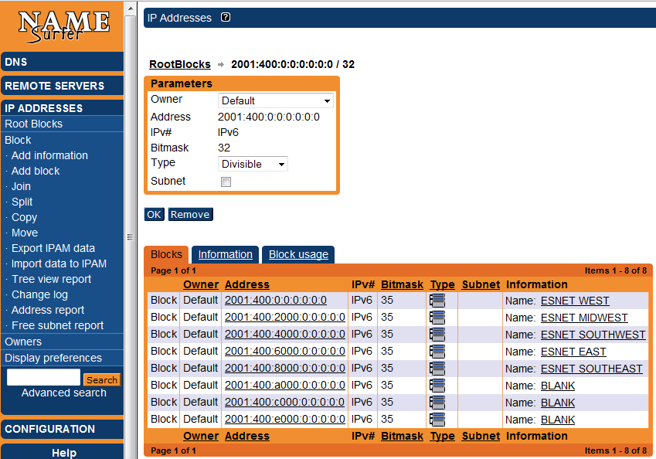
What it looks like

Slide 5
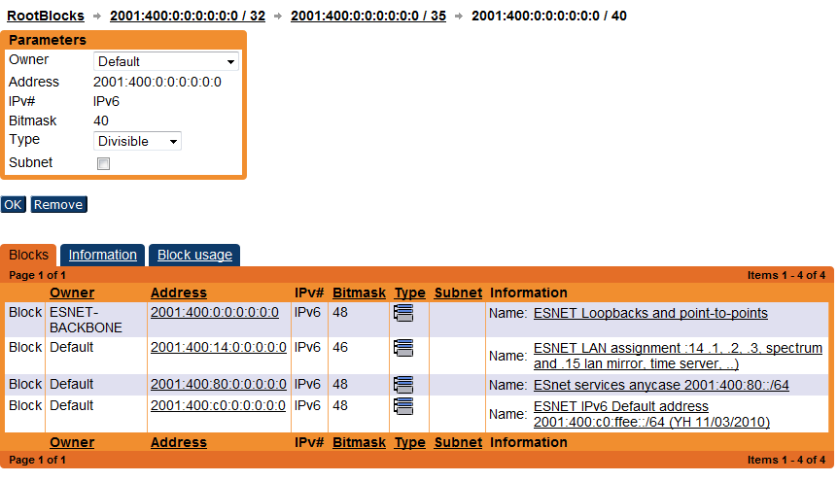
After drilling down

Slide 6
How does it work?
Generally does all that is required
DNS integration assures that reverse DNS is handled
IPv6 capacity has a LOT more bugs than IPv4 component
Typical as IPv6 tools have had far less testing
That is changing, though

