Slide 1

SLAC Project-X RF Power Program
Chris Adolphsen
Outline
  1.3 GHz, 30 kW CW Sources
  650 MHz, 30 kW CW Sources
  Modulators for the 1.3 GHz Pulsed Linac

Slide 2
Introduction
SLAC RF Experience
  Extensive S-band (2.9 GHz) and X-band (11.4 GHz) rf technology development for room temperature linacs
  During past six years, focused on L-band (1.3 GHz) rf technology (Modulators, Klystrons, RF Distribution and Power Couplers) for the ILC program at ~ 6 M$/year
  In 2009-10, started efforts on 1.3 GHz CW rf sources, kickers and the MI rf cavity. Recently funded at 400 k$ for studies of 650 MHz CW rf sources and long-pulse modulators

Slide 3

1.3 GHz, 30 kW CW Sources
Chris Adolphsen and Heinz Schwarz
SLAC

Slide 4
IOTs
Good efficiency (~ 60%) and would take advantage of TV transmitters for lower frequency systems – however 1.3 GHz only recently developed, little reliability data (short cathode-grid spacing), low gain, 2x higher voltage modulator than klystron and needs more development
IOT manufacturers: CPI (30 kW), E2V (16 kW – no longer in catalog), Thales (16 kW) and recently Mitsubishi (built 30 kW prototype for KEK ERL program)
Costs for turn-key systems with 100 k$ CPI 30 kW IOT range from 400 – 900 k$ based on quotes from Bruker, ETM, DTI and Continental for small quantities

Slide 5
Klystrons
Good efficiency (~ 60%) and high gain, but ‘slow’ approach to saturation compared to IOTs
Klystron manufacturers: CPI sells a ‘reliable’ 11 kW tube and has a design for a 30 kW tube (would build one for 440 k$) and Toshiba is developing a 25 kW tube (probably for KEK)
For the 12 GeV upgrade at JLab, they chose klystrons over IOTs for their 1.5 GHz, 13 kW sources. L3 is currently building 24 (out of 84 required) at 45 k$ each. They claim the modulators would also be ~ 50 k$, so using two such tubes (modified to 1.3 GHz) could cost as little as 200 k$ and be industrialized to a large extent

Slide 6
Solid State Transmitters
Reasonable efficiency (~ 50%), high gain, modular design provides high reliability but cost on high side (although may lower over time with advances in cell phone transmitters)
At the 2010 CW rf workshop in Spain, much interest in solid state approach, especially in Europe where the 352 MHz SOLEIL solid state source will be upgraded and the approach will be adopted by ESRF
Bruker makes a 10 kW single rack unit that sell for 162 k$ - combining three for 30 kW would cost around 500 k$. Also seems like there is a lot of Asian companies marketing lower power, lower frequency devices

Slide 7
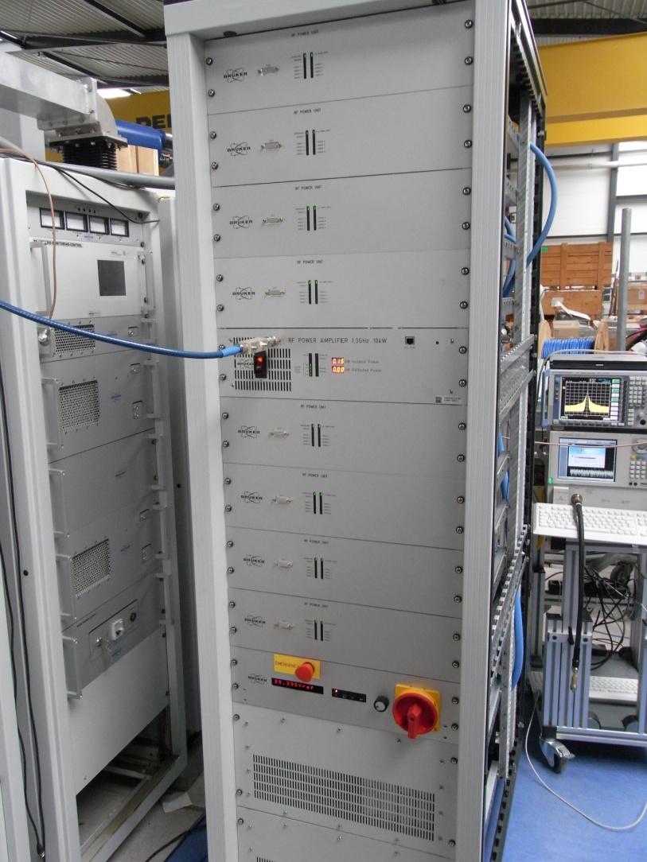
Bruker 10 kW CW Source
Consists of eight 1.25 kW water-cooled modules - each module has eight 160 W, isolated transistor units that are summed in a coaxial combiner – the output of the each module drives a common WR650 waveguide – no solenoid, HV PS, filament PS nor vacuum pump

Slide 8
1.3 GHz Cost Summary
CPI quotes
IOT VKL9130A, 30 kW CW $95k
KLYSTRON VKL7930A, 30 kW CW
Prototype from existing design including NRE $435k
(considered more reliable than IOT by CPI)
Transmitter quotes (30kW CW, IOT based):
Continental Electronics Corp.
Prototype including IOT $850k
ETM Electromatic Inc.
Prototype including IOT $797k
Quantity > 5 $500k
DTI Diversified Technologies Inc.
Prototype including IOT and output Isolator $600k
Quantity 64 $400k
BRUKER (France)
Transmitter without IOT 230 kEuro x 1.4 = $320k

Slide 9
1.3 GHz Cost Summary (cont)
Solid State Power Amplifier s
BRUKER (France)
Single Rack SSPA (3*10kW CW) 3*120kE x 1.4 = $504k
(Commercial Product)
INTEGRA Technologies, Inc. (USA)
Double Rack SSPA (25kW CW) $785k
NRE $415K
Single Sub-Module (2kW CW) $30k
NRE $25k

Slide 10
FY11 SLAC Program
Recently Funded by PX to:
Compare possible 650 MHz, 30 kW sources (IOTs, Klystrons and Solid State) in terms of performance and cost
Evaluate vendors and kW level 650 MHz solid state sources and see where we can collaborate with RRCAT and BARC
Indentify modulator and 1.3 GHz klystron designs for a 5 ms or 25 ms pulsed linac (the ILC sources are designed for 1.6 ms pulses)

Slide 11
650 MHz, 30 kW CW Sources
Chris Adolphsen, Heinz Schwarz and Rosa Ciprian
SLAC

Slide 12
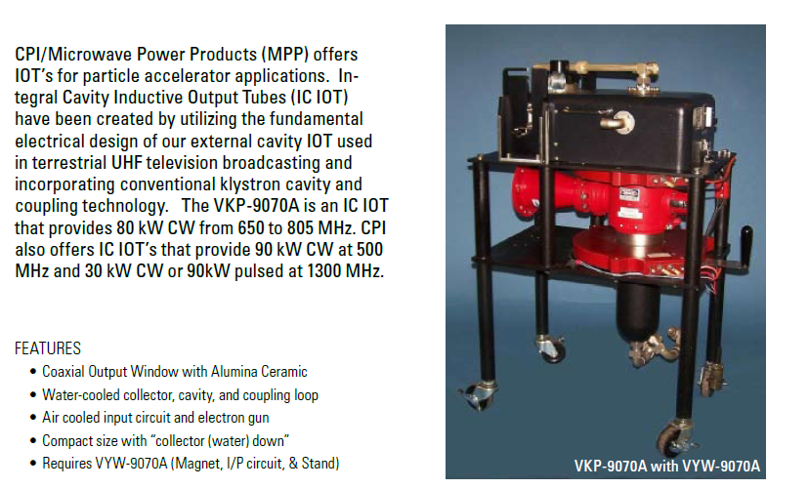
CPI 80 KW, 650 MHz, CW IOT
2/11 Quote for a VKP9070A with Magnet = 128 k$

Slide 13
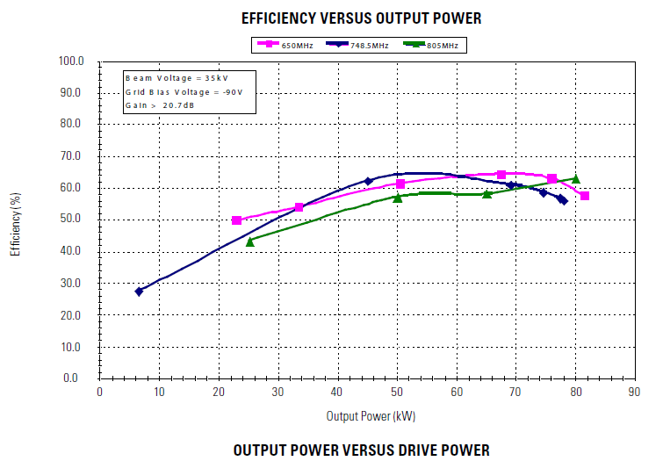
CPI IOT Performance at 30 kW
52% efficiency with 35 kV beam
and 150 W drive power

Slide 14
650 MHz, 30 kW RF Solid State Amplifier Objectives
Achieve 30 kW by combining modules with an output power of 2-2.5 kW.
Ideally each module should include its own power supply and a pre-amp such that the drive power is ~ 0 dBm.
Water cooled with water temperature in the 20-35 degC range.
Distributed power supplies so the system reliability is improved and single point of failure (power supply) is avoided.
Status:
  Working on building and testing a single 1-2 kW module based on RF power FETs. We are buying some RF power FETs, an RF power load (2.5kW) and a 650 MHz phase locked oscillator. SLAC has all other components required to implement this step.
  SLAC is also seeking for companies to manufacture the 650MHz, 2 kW modules, which we can combine, to get to the 30kW requirement.
Rosa Ciprian

Slide 15

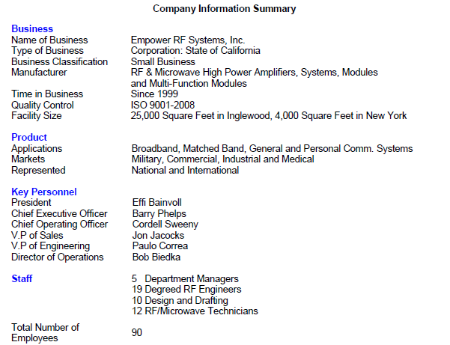
Located in Inglewood, CA

Slide 16
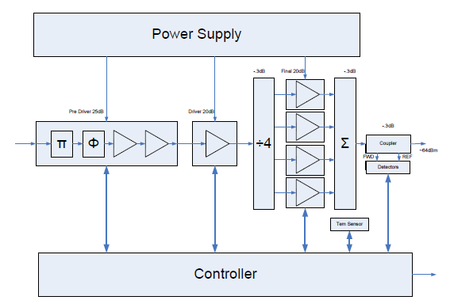
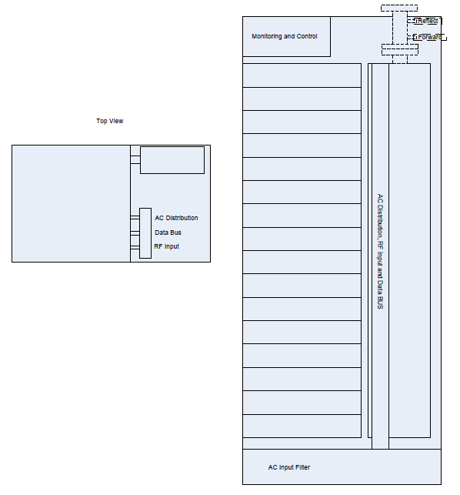
Empower 30 kW, 650 MHz Proposal
One of 16, 2.2 kW Units
Side View of Rack
Top View of Rack

Slide 17
Empower Proposal (cont)
Single 19" rack, 1 m deep for the stand-alone 30 kW system (power supply and combiner included).
16 modules at 2.2kW each
The combiner would be placed in the back of the rack
480 VAC input and filter at the bottom of the rack.
Monitor and control at the top of the rack
About 0.2dB losses in the combiner where the transformation to 50 ohms is made. The combiner material could be aluminum or copper; it is effectively a coax with coderite for spacers (thermally stable).
6¼ inch coax for the output.
Might consider hot swappable units, but it is not a requirement.
Inputs to the system are: AC input, Data bus, and RF driver.
Each module has a microprocessor, which is Ethernet connected to the rest of the system.

Slide 18
Empower Proposal (cont)
Each module contains 4 pallets with 500 W transistors operating at 300W.
Each module contains a temperature sensor in the cold plate.
Same pallet for the driver.
The pre-driver has amplitude and phase control.
Efficiency is in the 50-60% range.
No single point of failure (independent modules)
PS and RF are mounted on the water-cooled cold plate. Cooling water in the 20-30 C.
Pallets are tested at 85 degC on the cold plate.
Shutdown automatic sequence controlled at a higher level.
Isolator at each output of the 2 kW modules or at the input of the combiner, the later is the one preferred by Empower.

Slide 19
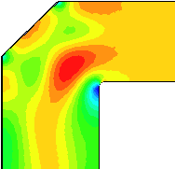
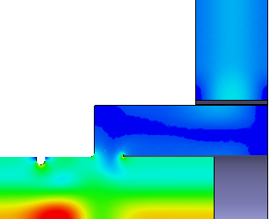
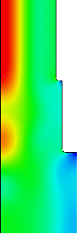
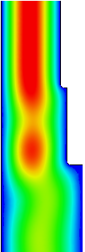

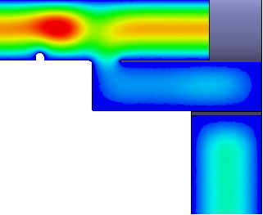
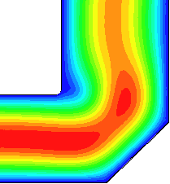
Combining 2 kW RF Sources
Use same vector adder approach as being pursed at SLAC for combining 30, 10 MW 1.3 GHz sources, but use different modes
ILC Low-Loss Klystron Cluster Scheme
5 MW
0.5 m pipe
0.5 m pipe
|H Field|
X+10 MW
X MW
|E Field|
5 MW

Slide 20
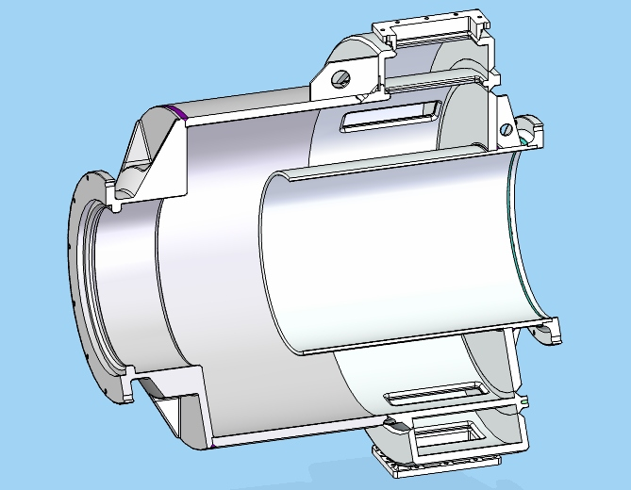
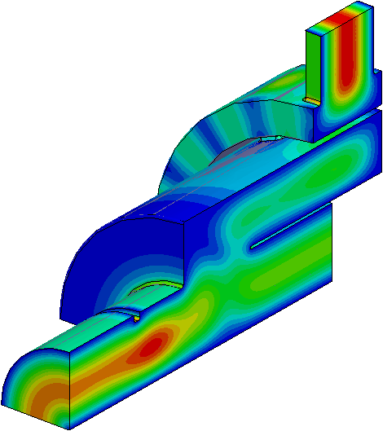
Adjust Coupling as Power Increases
Power Combining:
2
2
2
2
2
…
1
3
3
1
3
1
3
1
3
1
l
-3 dB
-3 dB
-4.8 dB
-6 dB
-7 dB
But instead of using TE01/02 taps as shown below, use a compact planar or coaxial geometry
WR650
WC1375
WC1375
3 dB Tap

Slide 21
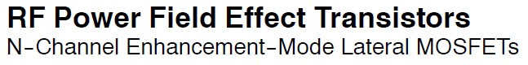
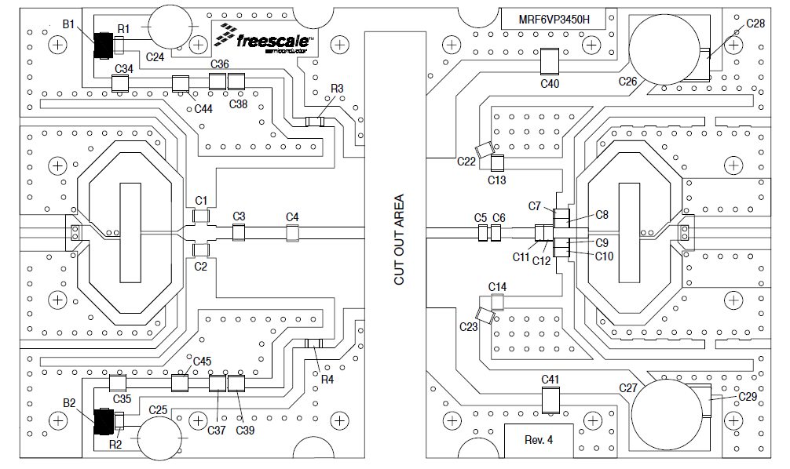
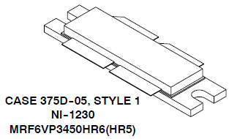

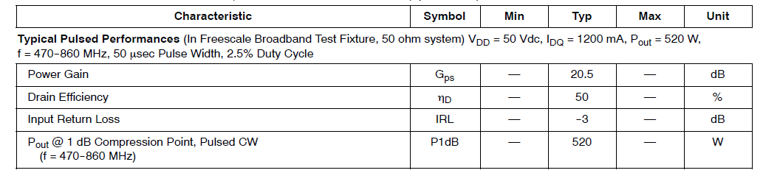
Will Also Test Freescale 500 W, 650 MHz FETs Using Their Evaluation Boards

Slide 22
650 MHz Cost Summary
IOT
CPI VKP9070A, 80 kW max, CW $128k
Solid State Power Amplifiers
EMPOWER RF Systems, Inc.
Single Rack SSPA (30 kW CW) $467k
NRE $53K
Single Sub-Module (2kW CW) $28k
includes Power Supply and Driver
NRE $1.4k
INTEGRA Technologies, Inc. Waiting for a Quote
Freescale Semiconductor
MRF6VP3450H (650MHz/500W) and a test circuit $1.5 k
MRFE6VP61K25H (600MHz/1250W) and test circuit (modify to 650 MHz) $0.9k

Slide 23
Modulators for the 1.3 GHz Pulsed Linac
Mark Kemp, Craig Burkhart and Chris Adolphsen
SLAC

Slide 24
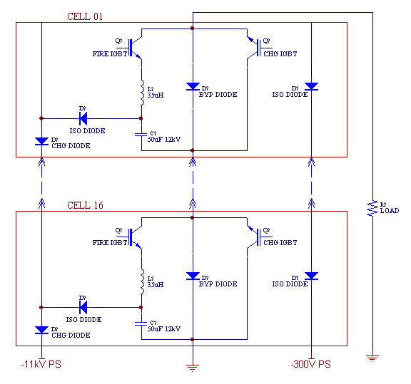
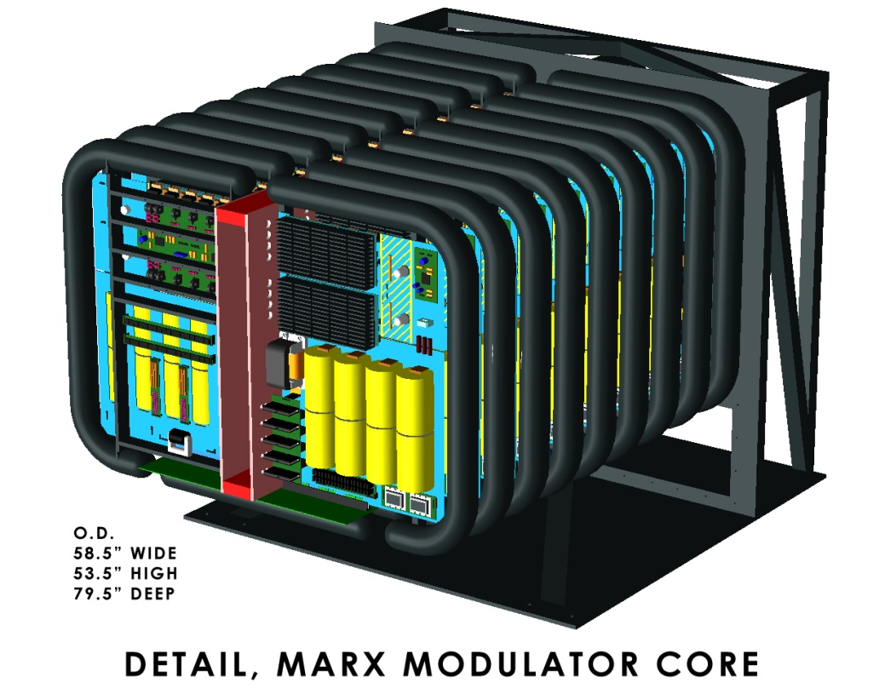
SLAC P1 Marx Modulator for the ILC
(120 kV, 140 A, 1.6 ms, 5Hz)
120 kV Output
16, 11 kV Cells
Vernier Cell for Pulse Flattening
11 kV per cell (11 turn on initially, 5 delayed for coarse droop compensation)
Switching devices per cell: two 3x5 IGBT arrays
Vernier Cell (‘Mini-Marx’) flattens pulse to 1 kV

Slide 25
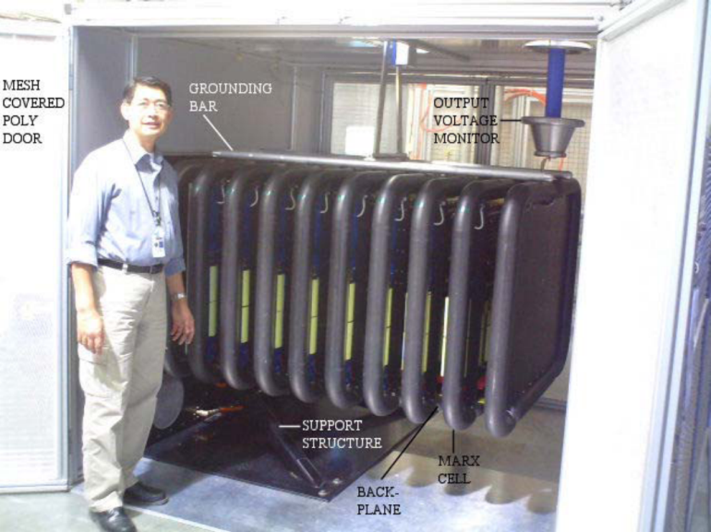
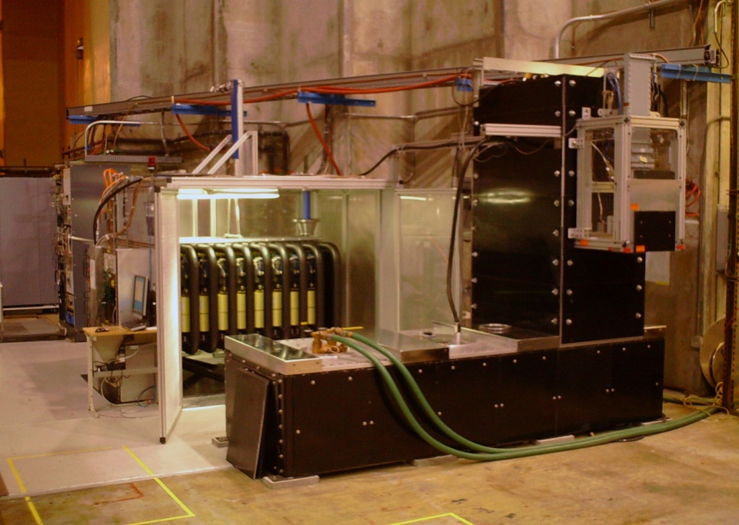
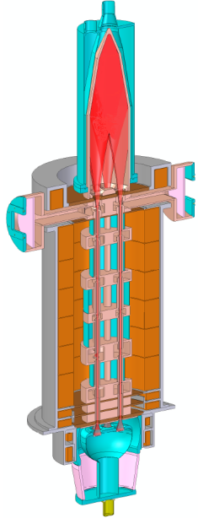
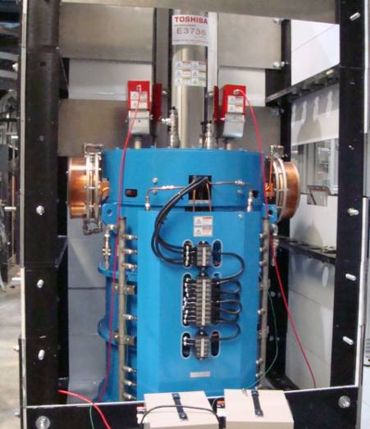
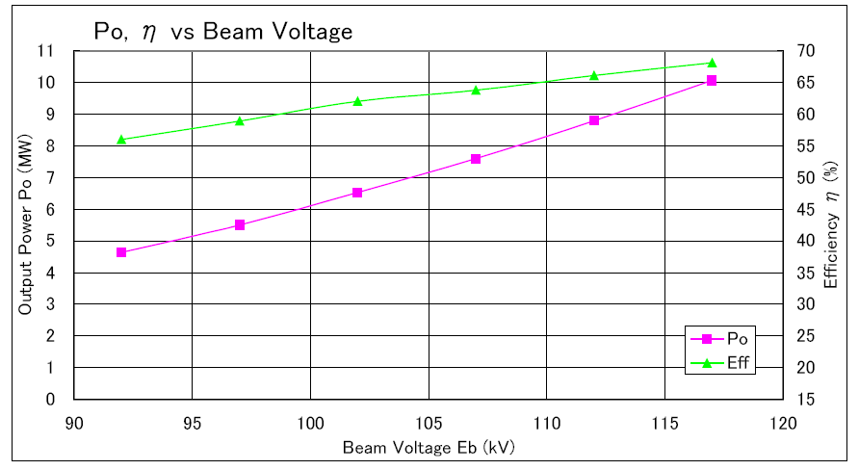
P1 Marx Test Stand at SLAC ESB
RF Controls
P1 Marx
10 MW Klystron
Toshiba MBK Measurements of Efficiency and Output Power -vs- Beam Voltage

Slide 26
Marx Output with Different Levels of Droop Compensation
Current
Blue: no droop compensation
Green: with only delay cells
Red: with delay cells and Vernier – flat with 3% saw-tooth modulation
Voltage

Slide 27
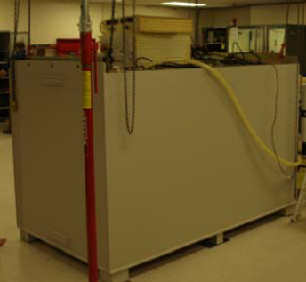
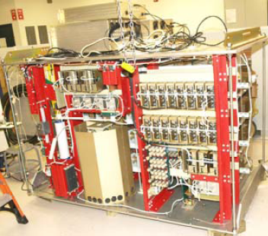
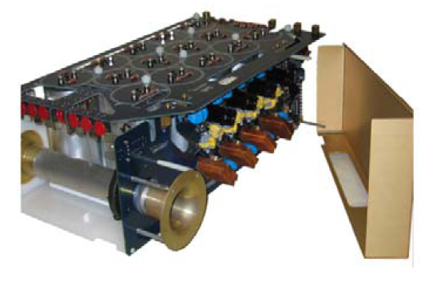
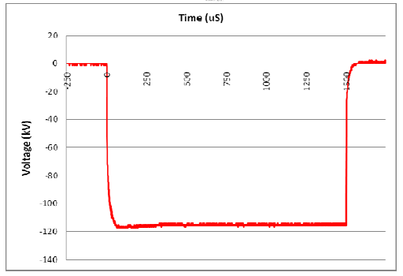
Diversified Technologies Inc. (DTI) Marx Modulator
This Marx was SBIR funded and will be delivered to SLAC after it is modified to improve ease of use. It has 6 kV cells that are immersed in oil, electrolytic capacitors (half the droop) and 900 V vernier cells.
Full Unit
Inside Layout
Measured Voltage Waveform
Marx Cell

Slide 28
Long Pulse Modulator
Initial Scoping
M. Kemp

Slide 29
PX Long-Pulse Modulator Scoping
Initial scoping performed without knowledge of klystron specifications
Several topologies identified as candidates. Focus initially on scaling of SLAC P2 Marx
Scaling parameters of interest include cost, size, and effect on facility mains
After klystron is identified, will further analyze potential modulators and advantages and disadvantages of each

Slide 30
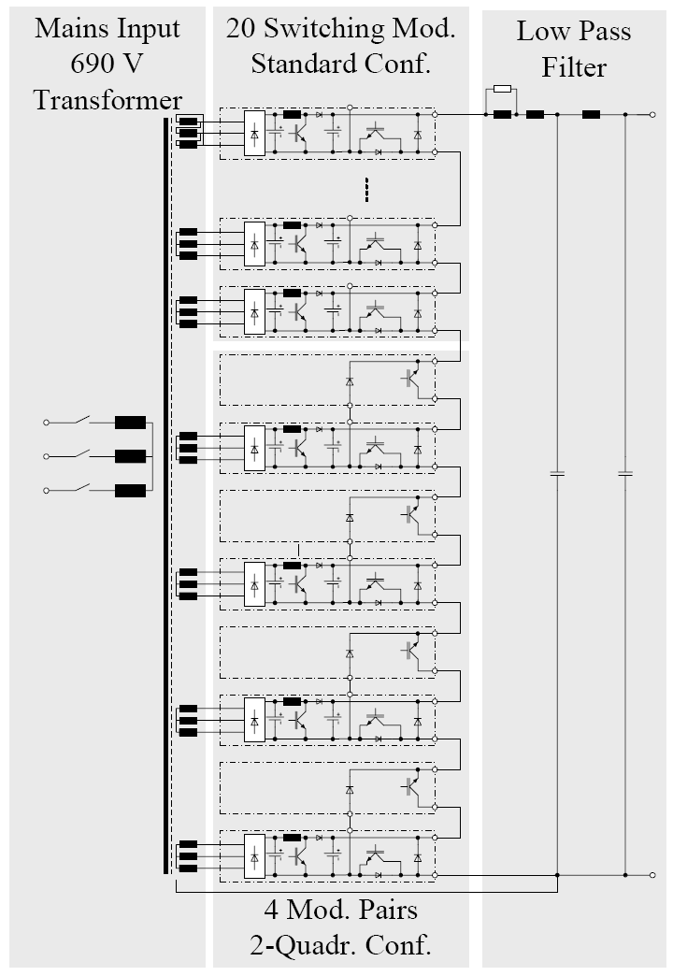
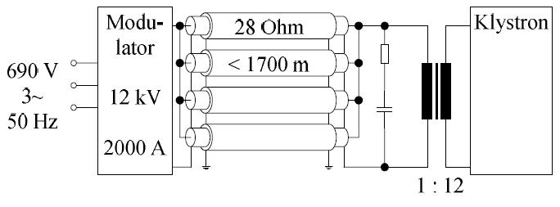
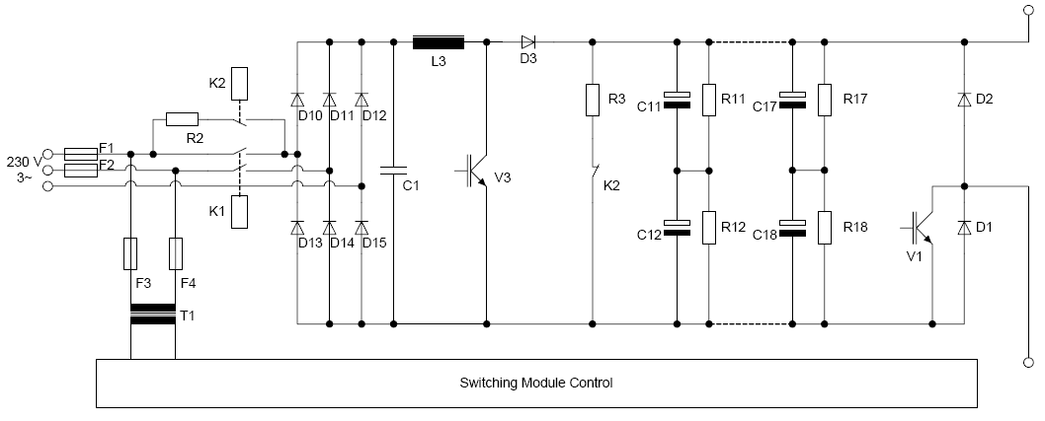
Thompson Modulator for E-XFEL
Large Transformer in Tunnel

Slide 31
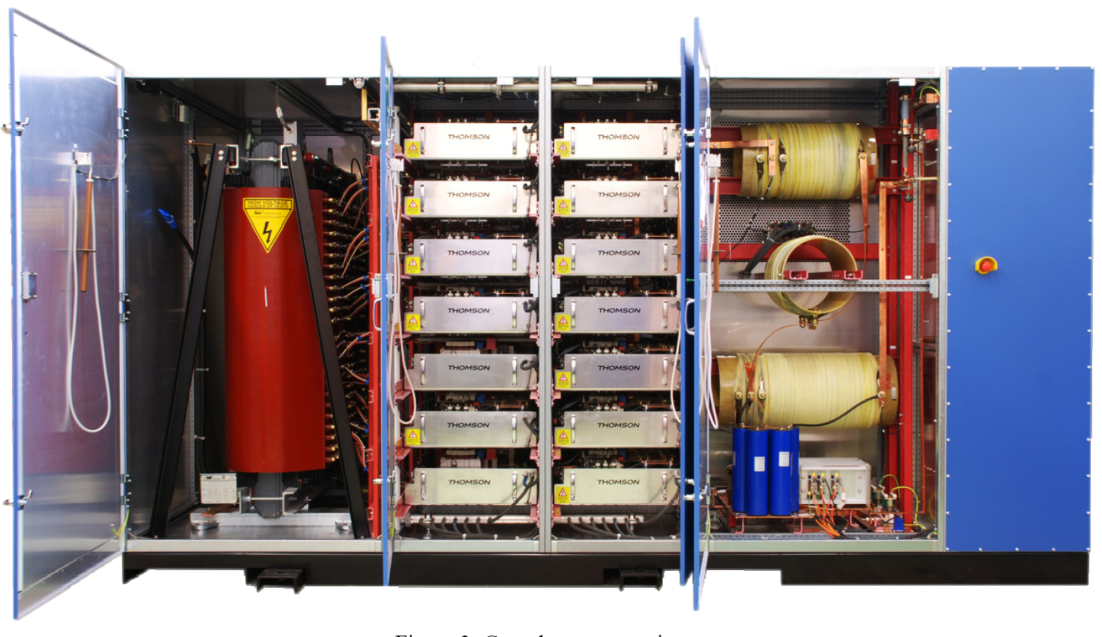
Thompson Modulator 12 kV Pulser

Slide 32
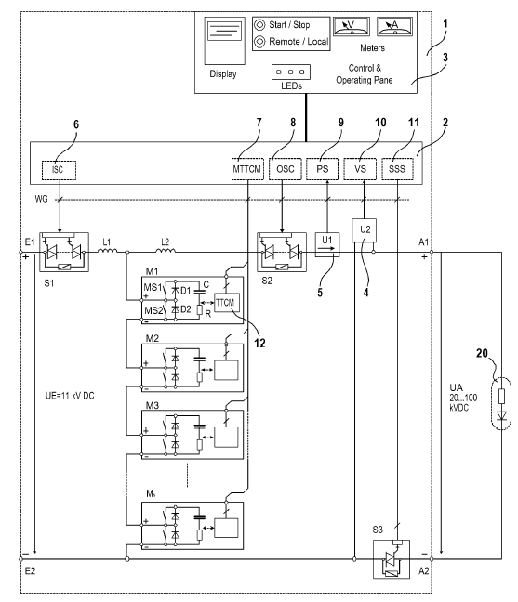
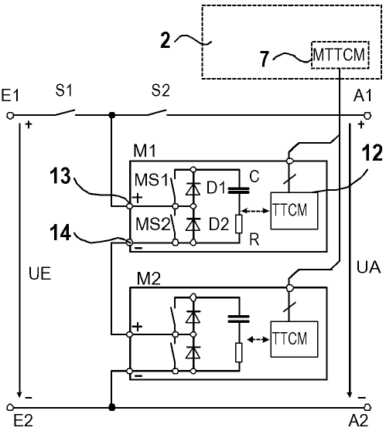
Transtechnik Modulator

Slide 33
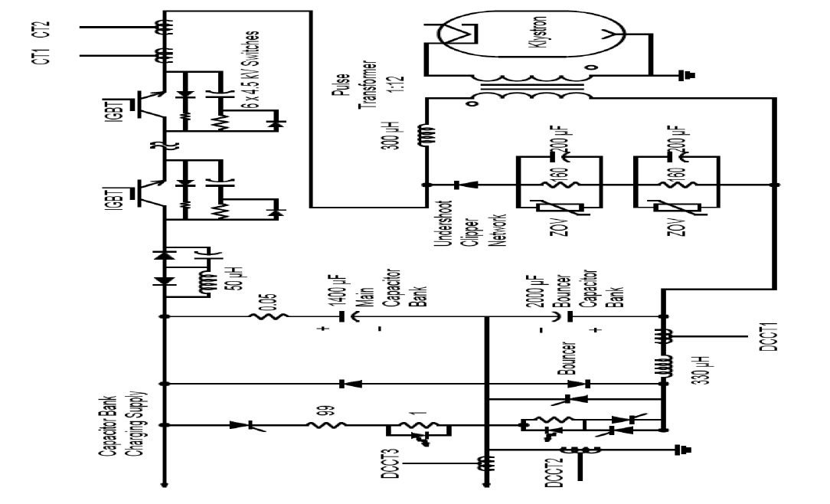
FNAL Bouncer

Slide 34
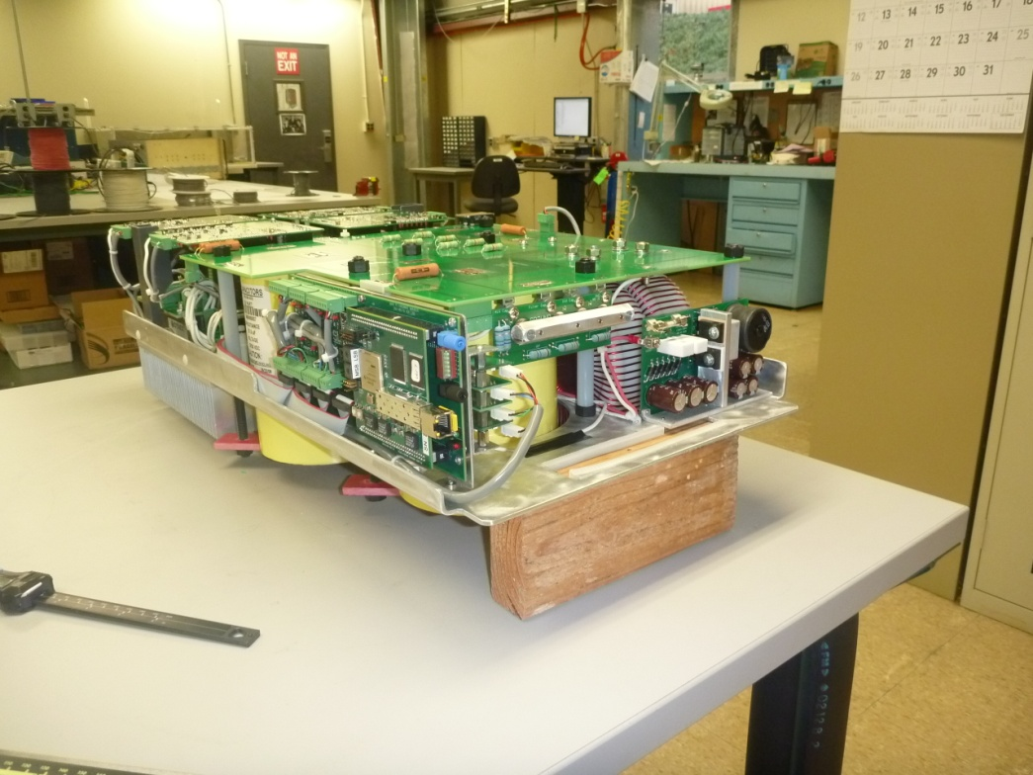
SLAC P2 Marx

Slide 35
Below are assumed parameters for initial scoping (obviously must be refined, but presented here to illustrate issues of interest)
Assume P2 design, and simply adjust energy storage and some components
 | A (ILC, P2) | Short pulse | Long Pulse
Output Voltage | 120 kV | 120kV | 120kV
Output Current | 140 A | 140 A | 140 A
Pulse Width | 1.6 ms | 5 ms | 25 ms
Pulse Repetition Frequency | 5 Hz | 5 Hz | 1 Hz
Average Power | 134kW | 420 kW | 420 kW

Slide 36
Issue 1: Energy storage
  For simplicity, accept P2 energy density and droop as baseline
  ILC/P2
    C1=350 µF/cell
    C2=875 µF/cell
    E_{store,modulator} ~ 0.09 MJ
  PX short pulse
    C1=1.1mF/cell
    C2=3.8mF/cell
    E_{store,modulator} ~ 0.25 MJ (3.1x P2)
  PX long pulse
    C1=5.3mF/cell
    C2=22mF/cell
    E_{store,modulator} ~ 1.2 MJ (15x P2)

Slide 37
Issue 2: Volume
Top view: P2 Marx
Added
capacitors
Cells
Top view: 5-ms Marx
 | Depth | Width
P2 baseline | 4.5’ | 9.5’
P2 topology- 5ms | 6.5’ | 9.5’
P2 topology-25ms | 14’ | 10.5’

Slide 38
Issue 3: Effect on mains
  IEEE 519 sets Total Harmonic Distortion (THD) < 5% with, in general, no harmonic > 3% (in some cases harmonics < 11 can be up to 10%)
  For the P2 Marx topology, the modulator has gaps in DC current draw during the pulse. The DC supply should therefore actively provide an appropriate interface between the mains and the modulator to limit current THD
  A simple figure-of-merit:
    P_{DC,avg} *duty factor/p.r.f => minimum energy for DC supply to absorb from mains during pulse
    P2 Marx => 0.230 kJ
    PX short-pulse => 2.2 kJ
    PX long pulse => 11 kJ
    Thompson modulator topology, PX long pulse => 431 kJ
      (1-D)*P/prf

Slide 39
Issue 4: Cost scaling from P2 Marx
  No volume scaling
  Assume no increased efficiencies
  Assume similar design
P2 M&S
2.3x P2
3.4x P2

Slide 40
Summary
SLAC has rf resources and expertise to contribute significantly to Project X.
Coming up to speed on low power CW rf systems (have built 1.2 MW, 476 MHz CW klystrons for the SLAC B Factory) – also hope to contribute to the NGLS (CW SC linac driven soft X-Ray FEL)
Willing to collaborate on CW efforts, perhaps in the rf combining systems for which we have much experience

