Slide 1
Active Stabilization of the SRF Resonance Frequency FERMILAB Experience
Warren Schappert Yuriy Pischalnikov
FERMILAB

Slide 2
Microphonics and df/dP
Project X plans to use cavities with bandwidths as narrow as 20 Hz
Narrow bandwidth cavities can be detuned by changes in He pressure (df/dP) and by mechanical vibrations (microphonics)
Power required to maintaining the gradient in a detuned cavity proportional to the square of the detuning
Results of detuning can be either or both of
Increased capital and operating costs
Frequent cavity trips
Goal to keep PEAK detuning <= cavity bandwidth
Mitigation strategies
Passive
Reduce pressure variations
Reduce df/dP
Reduce vibration levels
Provide more RF power overhead
Active
Use fast or slow tuner to stabilize dynamically
resonant frequency of cavity
Tremendous progress with passive mitigation
over the past year
Active compensation may still be
required for reliable operation
Section | Number of cavities/ c.modules | Max gain per cavity (MeV) | Minimum bandwidth (Hz) | Beam Power per cavity (kW) | RF Power (kW)
SSR0 | 18/1 | 1 | 35 | 1 | 1
SSR1 | 20/2 | 2.2 | 36 | 2.2 | 5
SSR2 | 44/4 | 3.9 | 24 | 3.9 | 6
LE650 | 42/7 | 11.6 | 21 | 11.6 | 30
HE650 | 152/19 | 17.4 | 24 | 17.3 | 30
Project X meeting, ORNL/SNS, April 12-14, 2011,

Slide 3
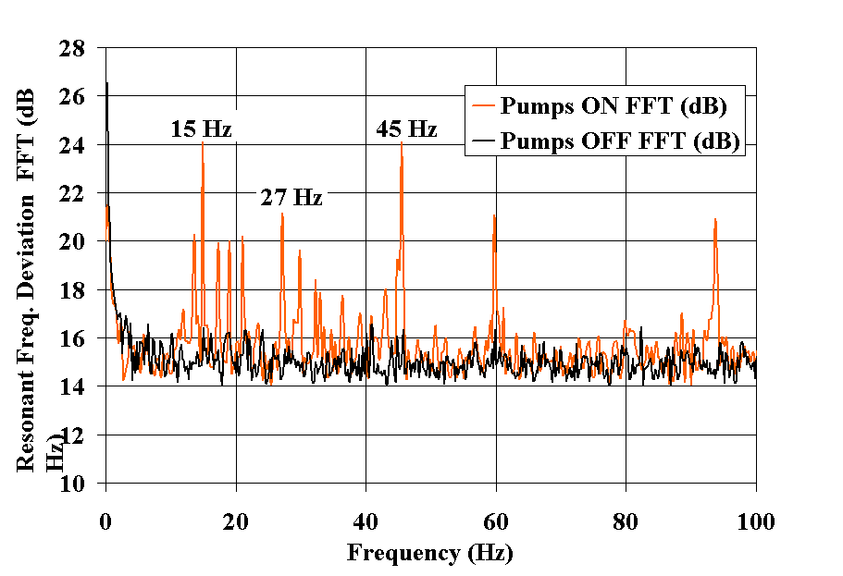
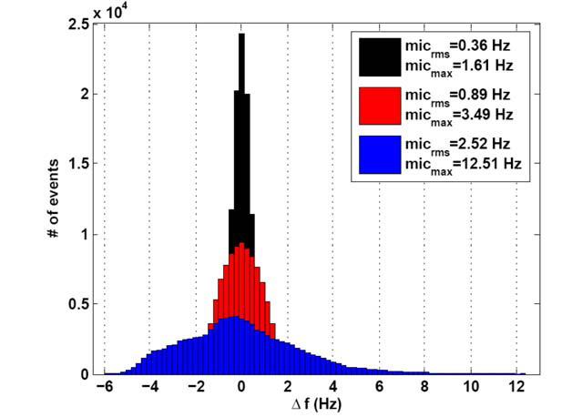
Active Compensation
Piezo actuators used to reduce microphonics in CKM cavities by 20 dB (Carcagno et al. 2003 --FNAL)
Bessy able to limit pressure related detuning in1.3 GHz CW cavities to less than 1 Hz (Axel Neumann Thesis )
Other work by groups at MSU, Cornell, Argonne, JLab, …
Project X meeting, ORNL/SNS, April 12-14, 2011,

Slide 4
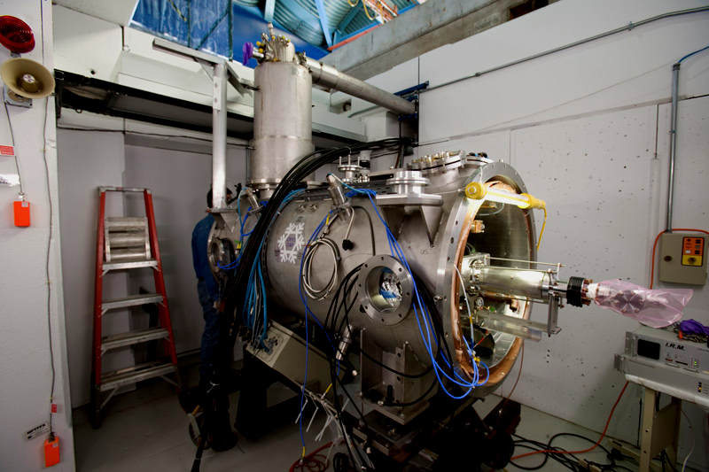
CCII- 1,3GHz Tesla style cavity (our “sand-box” to gain experience in SRF cavity control field… Now is part of photo-injector at NML)
Test hardware and algorithms for NML
Development of LS LFD Algorithms
Development of Microphonics Compensation Algorithms*
*Detail study of Microphonics was never main objectives of CC2 study… microphonics up to 40-50Hz was “good enough for ILC project”
Project X meeting, ORNL/SNS, April 12-14, 2011,

Slide 5
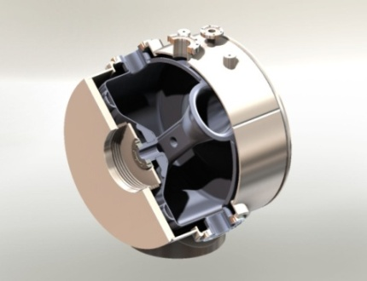
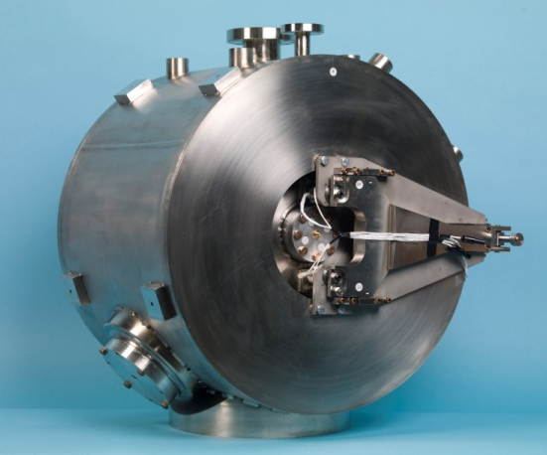
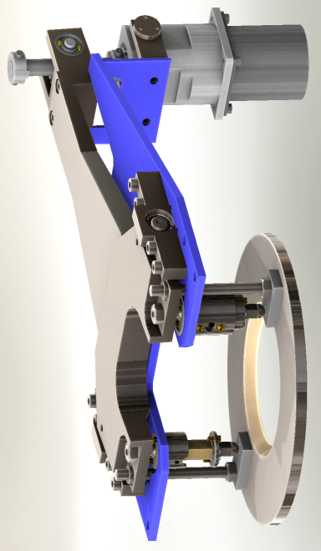
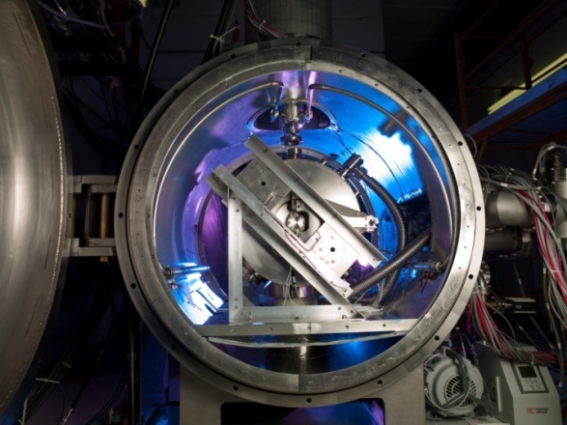
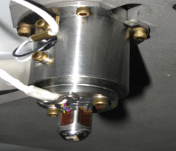
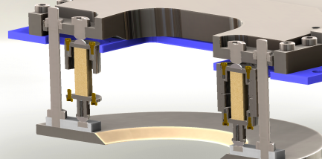
325MHz Single Spoke SRF Resonator
SSR1 –originally designed for HINS.
RF- pulsed operation at 4.5K.
Slow/Fast tuner requirements:
Compact size (in beam-line axis);
250KHz slow tuning range;
Fast Tuner: 4-Piezos
to compensate LFD &
and dF/dP –
frequency fluctuation as a results of large dF/dP =140Hz/torr and 4.5K He bath pressure fluctuation…
Stepper Motor & Harmonics Drive
Encapsulated
Piezo assembly
“Bullet” with SGs
Project X meeting, ORNL/SNS, April 12-14, 2011,

Slide 6
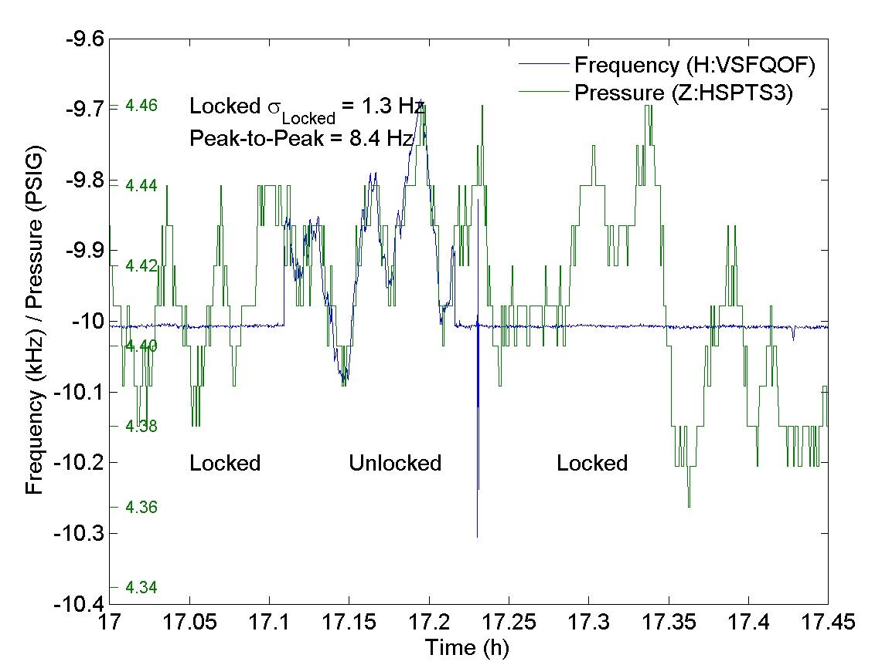
dF/dP compensation SSR1 with Narrow Bandwidth Coupler
Initial cold tests of SSR1 using CW provided an opportunity to gain experience with a very narrow bandwidth cavity
Test Conditions
4.5K
Cavity bandwidth of about 1.5 Hz
df/dP ~= 140 Hz/torr
dP_{PTP}~=5 torr
LLRF tracking resonant frequency of cavity
Detuning control system
100 kHz digitizer measured RF frequency offset from an arbitrary set point
FPGA fed Δf back to fast tuner
Reduced pressure related variations in cavity frequency from several hundreds Hz to
Δf <= 1.3 Hz RMS

Slide 7
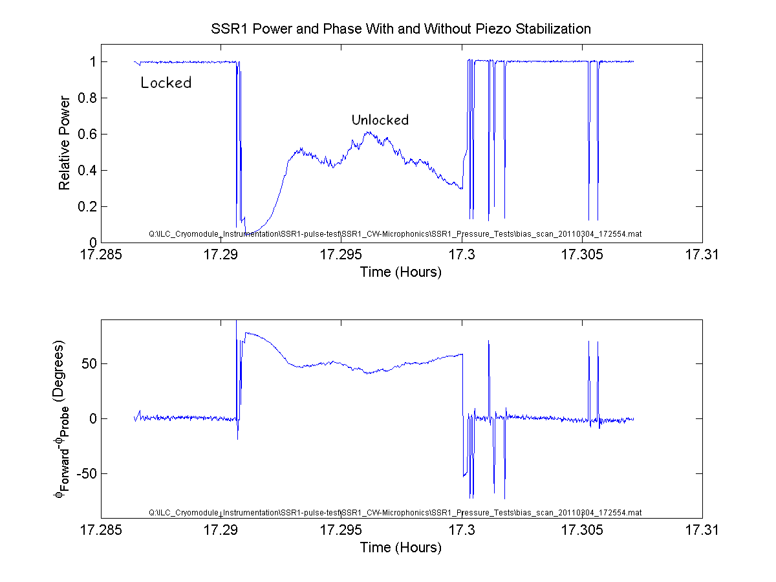
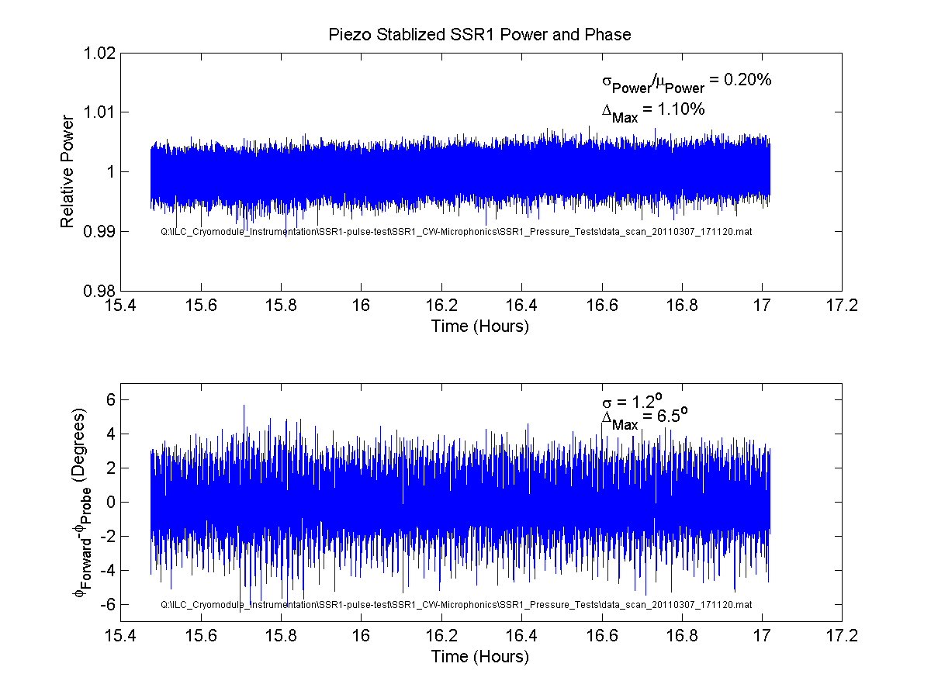
dF/dP compensation SSR1 with Wide Bandwidth Coupler
Second round of CW tests provided an opportunity to gain experience with a wider bandwidth cavity and fixed RF drive frequency
Test Conditions
4.5K
Cavity bandwidth ~100 Hz
RF drive frequency fixed ~325 MHz
Detuning control system
104 MHz digitizer measured RF phase difference between forward and probe signals
CPU fed Δφ back to fast tuner
Able to limit pressure related variations
Gradient <= 0.2% RMS
Phase <= 1.2º RMS
Project X meeting, ORNL/SNS, April 12-14, 2011,

Slide 8
Microphonics CCII experience
Example of successful passive reduction of vibration level at CCII.
Project X meeting, ORNL/SNS, April 12-14, 2011,

Slide 9
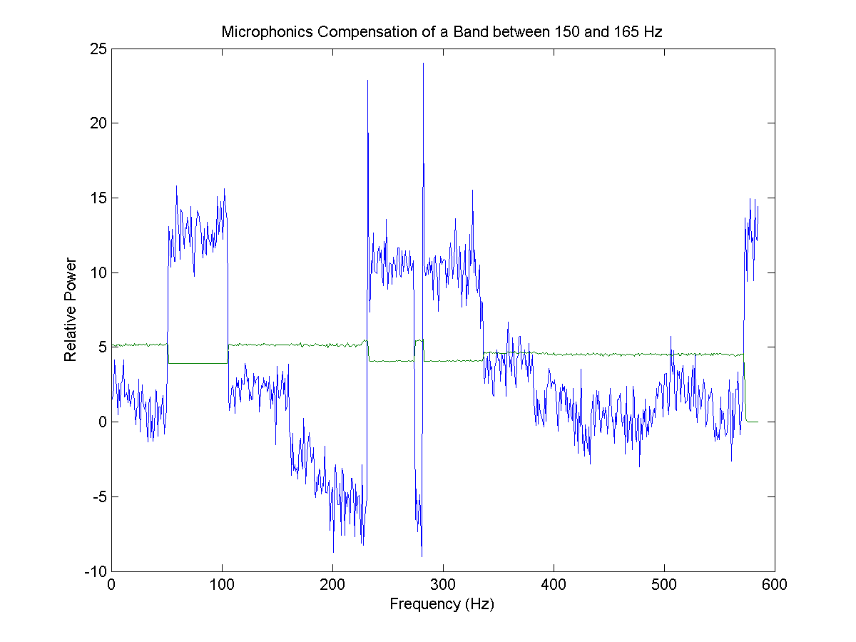
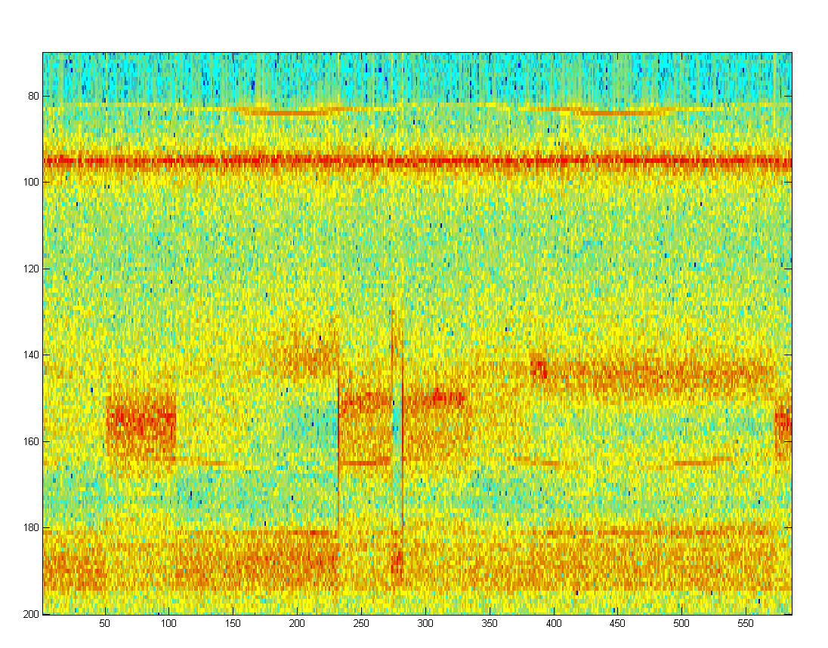
Microphonics Compensation CCII, wide (150-165 Hz) mechanical vibration
The Piezo tuner actively damped vibrations induced by external sources. An IIR filter bank was used to isolate and reverse the phase of the particular spectral line. The phase reversed signal then fed back to the piezo tuner.
Active damping reduces the vibration at this frequency by 15db
Piezo OFF
Piezo ON
Frequency, Hz
Project X meeting, ORNL/SNS, April 12-14, 2011,
Time, sec

Slide 10
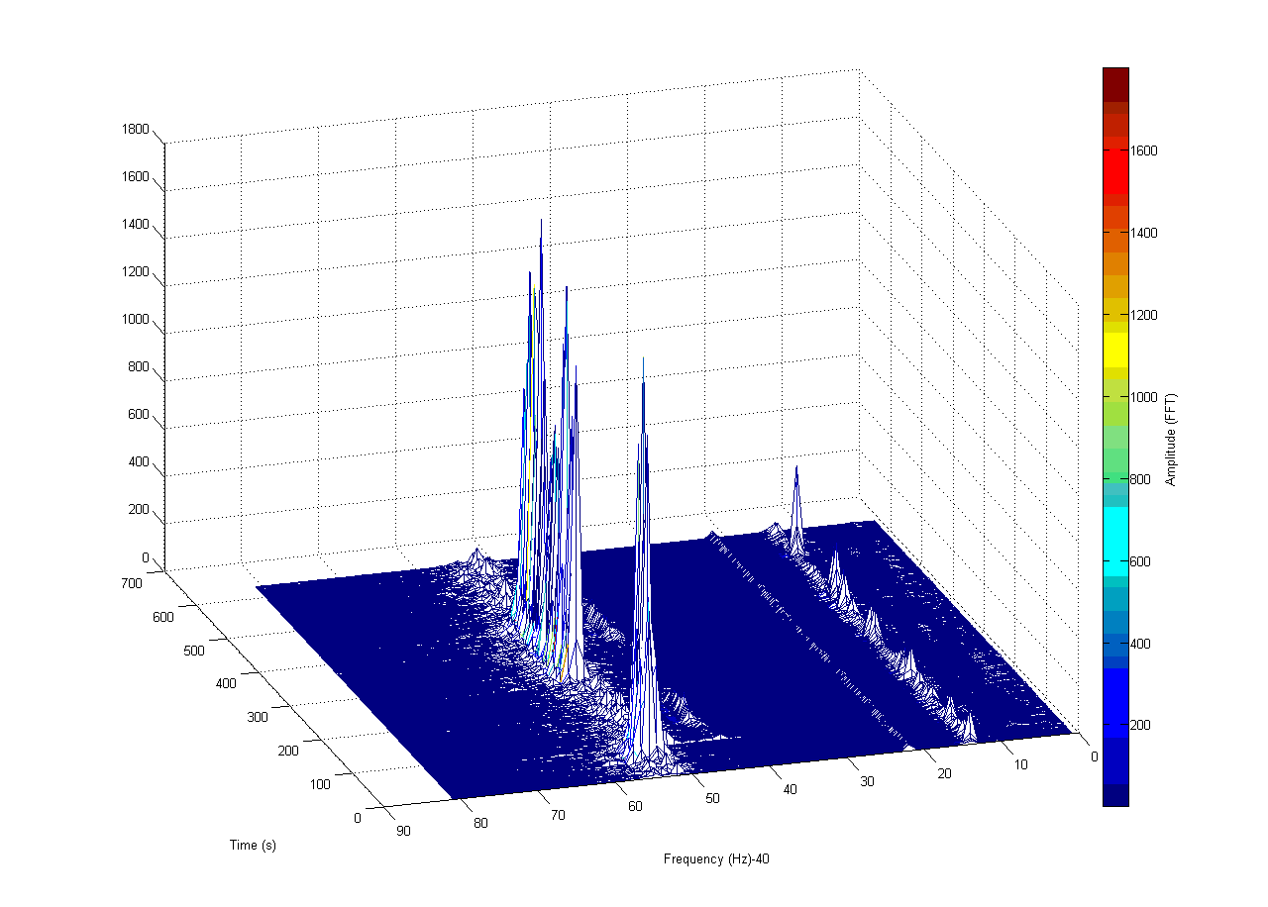
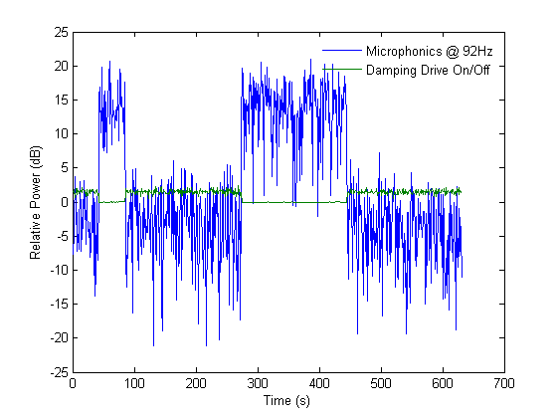
Microphonics Compensation CCII, narrow (92 Hz) mechanical vibration
Active damping reduces the vibration at this frequency
by 15 dB.

Slide 11
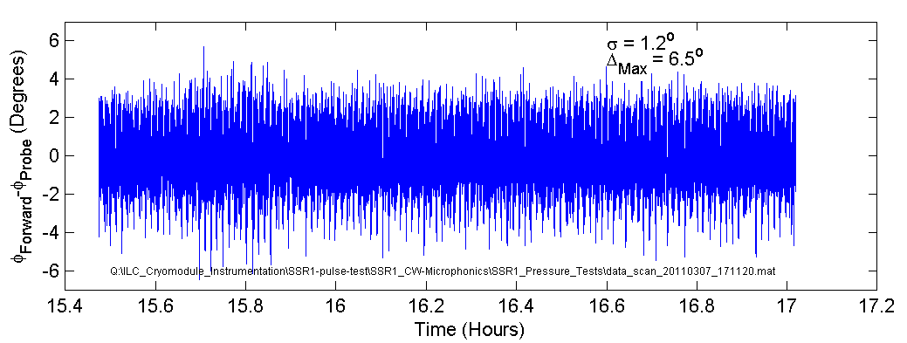
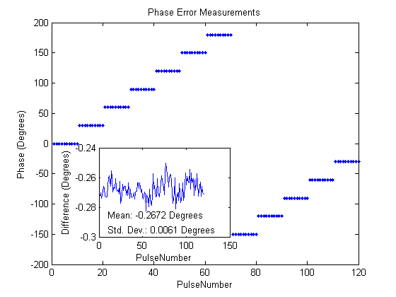
Next Step (short term)
Continue to work with SSR1 and wide bandwidth coupler for immediate future
Repeat measurements with improved controller
Phase Measurement
Currently ~1º/Sample @ 20S/s
0.006º @ 1kHz possible
Use more sophisticated filter
Replace simple integrator with Kalman filter
Improve controller bandwidth
Replace CPU with FPGA
FPGA firmware modifications required
Goal is to understand limits to active control
Reassess plans for SSR1 when performance of improved controller has been evaluated
Project X meeting, ORNL/SNS, April 12-14, 2011,

Slide 12
Application of Adaptive LS LFD algorithm for long RF Pulse (“proof-of concept” test related to 3-8GeV pulsed linac-Project X) (test has been performed at HTS)
Detuning of nine-cell elliptical cavity driven by an 8ms pulse with gradient Eacc=22MV/m.
Cavity detuning without piezo compensation aprox. several kHz.
This was sufficient to drive cavity completely off resonance.
Fill=4ms
FlatTop=4ms
Piezo Stimulus Pulse
10ms
8ms-RFpulse
Start of RF pulse

Slide 13
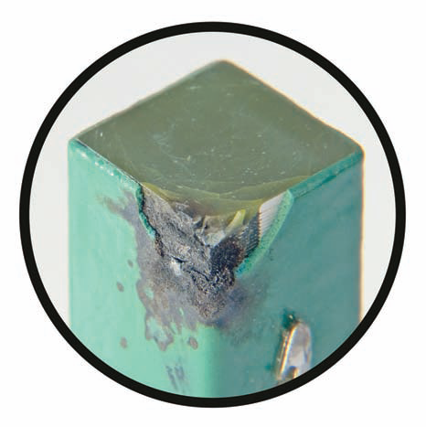
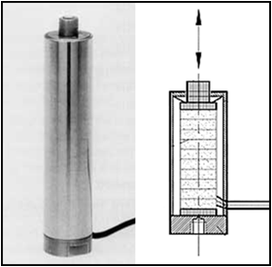
Piezo Actuator Reliability
Repeated questions about reliability of piezo actuators based on experience at SNS
Piezos susceptible to damage by
Shear force
Humidity
High slew rates
Highly reliable if used properly
Diesel fuel injectors
Laptop transformers
Problems at SNS are due to failures of mechanical capsule
Actively seeking information about long term reliability
Project X meeting, ORNL/SNS, April 12-14, 2011,

Slide 14
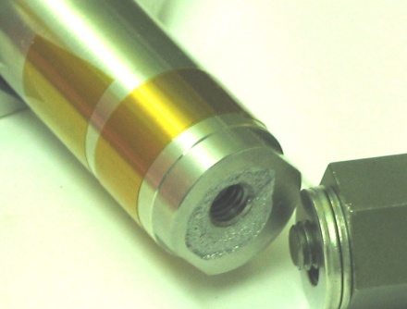
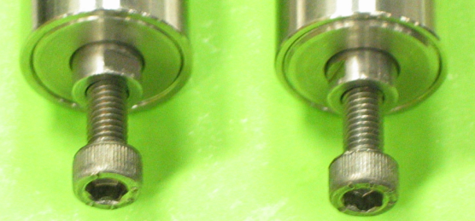
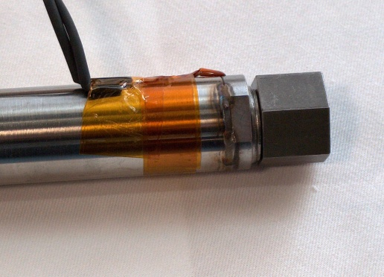
SNS – piezo tuner
Project X meeting, ORNL/SNS, April 12-14, 2011,

Slide 15
Summary
Active detuning control may be required for some or all of the Project X cavities
Possible to stabilize cavity resonant frequency to several Hz or better even at 4.5K using relatively simple closed loop
Substantial performance improvements may be possible using a more sophisticated controller
Plan to use SSR1 to gain experience and more fully understand factors that limit active control
Active compensation of microphonics (detuning of the cavity by external mechanical vibrations) by 15db has been demonstrated (for short period of time). This is just “illustration” rather than prove of stable and reliable operation.
Piezo actuators can be extremely reliable if treated properly
Tuner problems at SNS result of design deficiencies
Work still required to fully assess long term reliability

Slide 16
Additional Slides

Slide 17
