Slide 1
SNS SCL Experiences
Project-X Collaboration Meeting
SNS/ORNL
April 13, 2011
Sang-ho Kim
SNS/ORNL

Slide 2
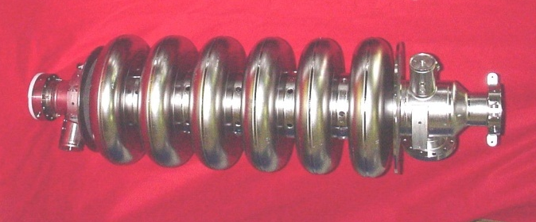
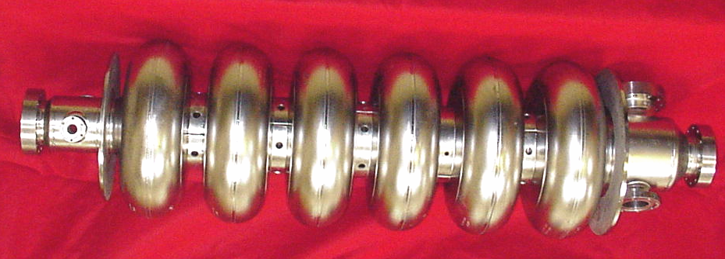
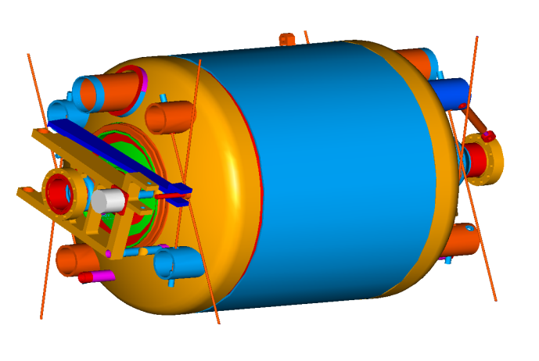
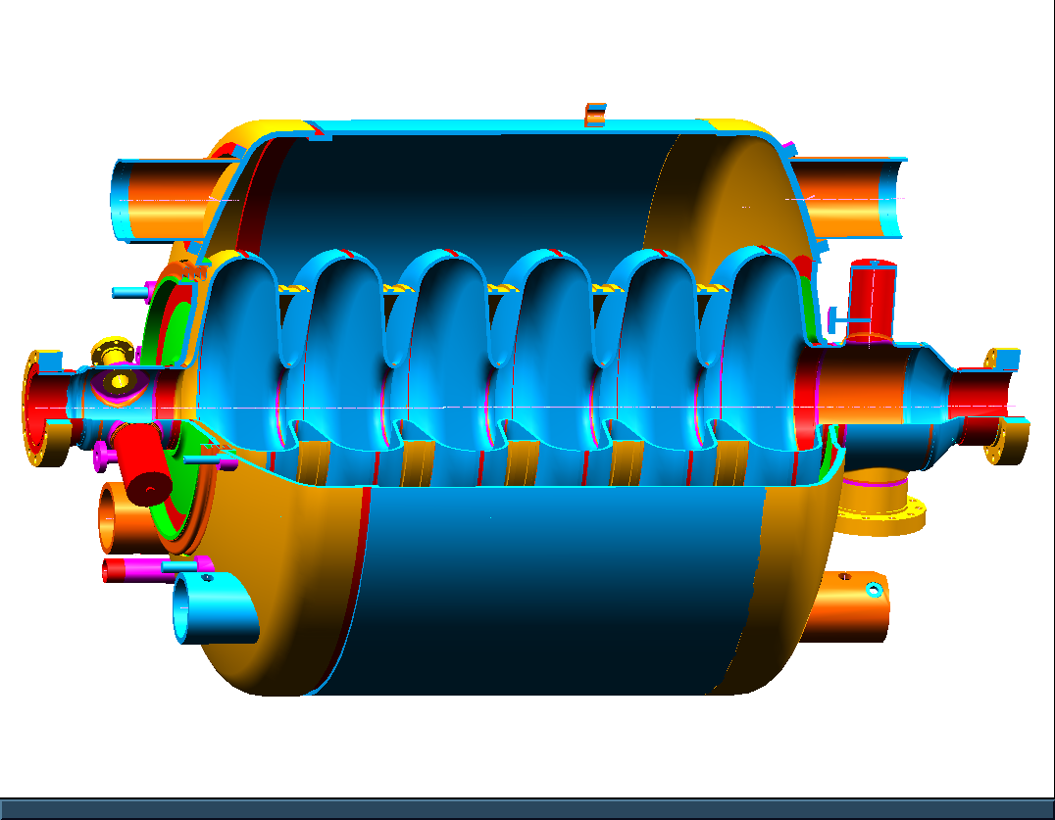
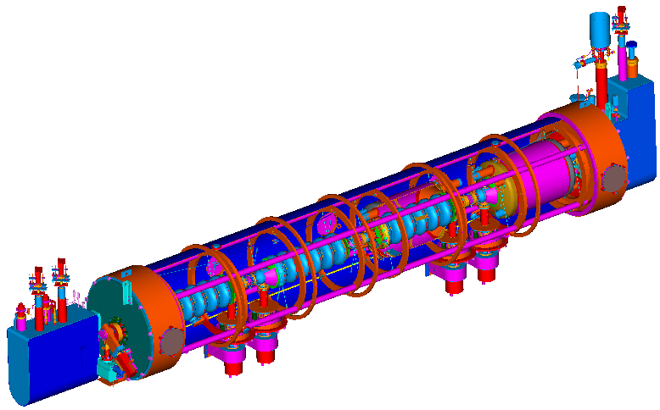
SNS Cavities and Cryomodules look;
β=0.61 Specifications:
E_{a}=10.1 MV/m, Q_{o}> 5E9 at 2.1 K
β=0.81 Specifications:
E_{a}=15.8 MV/m, Q_{o}> 5E9 at 2.1 K
Medium beta (β=0.61) cavity
High beta (β=0.81) cavity
Helium Vessel
Field Probe
HOM Coupler
Fast
Tuner
HOM Coupler
Slow
Tuner
Fundamental Power Coupler
11 CMs
12 CMs

Slide 3
Major Parameters achieved vs. designed
Parameters | Design | Individually achieved | Highest production beam
Beam Energy (GeV) | 1.0 | 1.01 | 0.93
Peak Linac Beam current (mA) | 38 | 42 | 42
Average Linac Beam Current (mA) | 1.56 | 1.1 | 1.1
Beam Pulse Length (μs) | 1000 | 1000 | 825
Repetition Rate (Hz) | 60 | 60 | 60
Beam Power on Target (kW) | 1440 | 1100 | 1100
Linac Beam Duty Factor (%) | 6.0 | 4.8 | 4.8
Beam intensity on Target (protons per pulse) | 1.5 x 10¹⁴ | 1.55x 10¹⁴ | 1.1 x 10¹⁴
SCL Cavities in Service | 81 | 80 | 80

Slide 4
SNS SCL, Operations and Performance
The first high-energy SC linac for protons, and the first pulsed operational machine at a relatively high duty
  Some features of the SNS are R&D objects by itself, like any other large scale accelerators
We have learned a lot in the last 6 years about operation of pulsed SC linacs:
  Operating temperature, Heating by electron loadings (cavity, FPC, beam pipes), Multipacting & Turn-on difficulties, HOM coupler issues, RF Control, Tuner issues, Beam loss, component/equipment, interlocks/MPS, alarms, monitoring,
  Understand ‘System as a whole’ for highly reliable operation

Slide 5
Current Operating Condition
1105 us RF (250 us filling + 855 us flattop) at 60 Hz
  Flattop duty; 5.1 %
Eacc setpoints; about 85~95 % of collective limits
  Average gradient; ~12.6 MV/m
  925 MeV + 10 MeV (energy reserve)
Stable operation; < 1 trip/day (<5 min./day) mainly by errant beam, control noise
16
Eacc (MV/m)
8

Slide 6
Lesson learned
Some of operational limits, difficulties, nuisances are design dependent
  Known/expected issues
  Unknowns from knowns (unexpected degradation/interactions)
But there will be always limits/difficulties/nuisances
  Machine specific, and/or general
  More complex→ more limits/difficulties/nuisances
Design should focus on system operations as a whole
  Simplification
  Reasonably enough margins (too much is OK as long as a project can support)
  Robustness
  Room for expected/unexpected unknowns/failures

Slide 7
SNS experiences;
Some relevant topics with Project-X
Commissioning/turn on
Field emission
Cryo-load
Bandwidth (Qex), RF power, detuning, FPC, Tuner
Machine protection
HOM (next talk, Marc Doleans)

Slide 8
Commissioning/turn-on
First turn on must be closely watched and controlled (possible irreversible damage)
  Initial (the first) powering-up, pushing limits, increasing rep. rate (extreme care, close attention)
    Aggressive MP, burst of FE → possibly damage weak components
    Similar situation after thermal cycle (and after long shut down too) → behavior of the same cavity can be considerably different from run to run
Subsequent turn-ons (after long shut-down) also need close attention: behavior of the same cavity can be considerably different from run to run → gas re-distribution
Cryomodules/strings must be removed and rebuilt if vented/damaged

Slide 9
SNS SRF cavity performance statistics
Electron loadings (mainly field emission)
  Collective effects
  Thermal instability at the end group

Slide 10
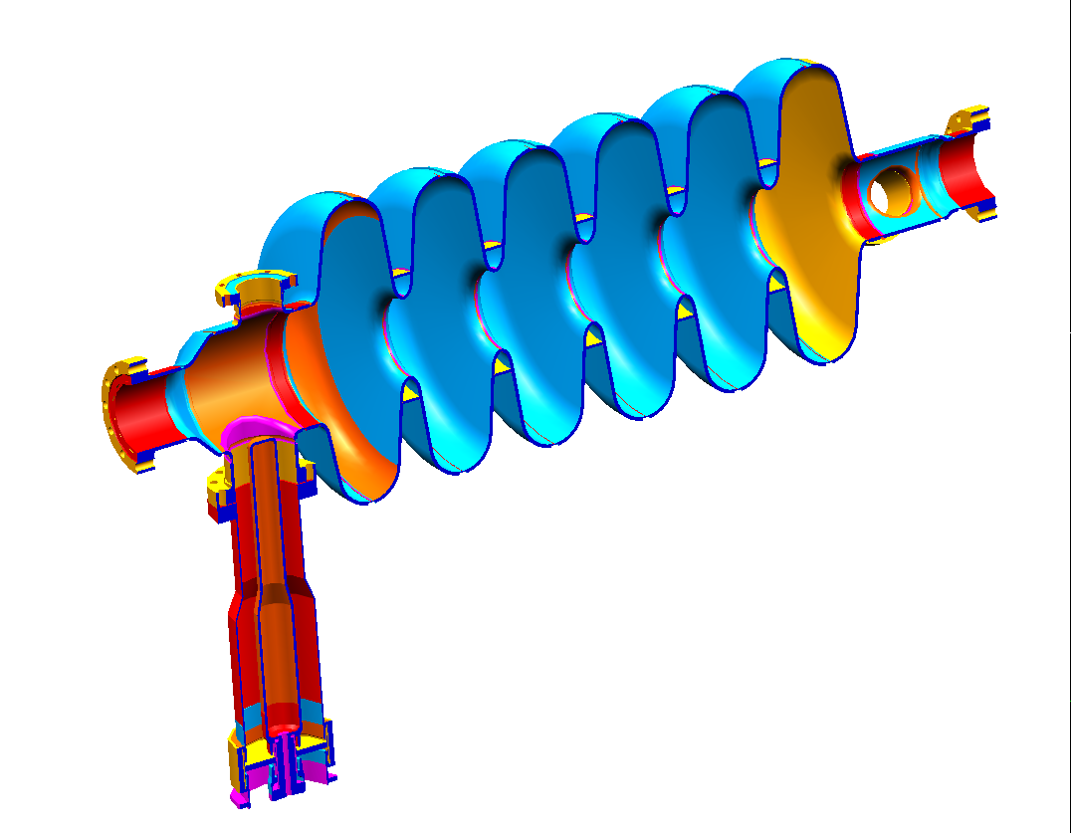
Gradient Limitations from “Collective Effects”
Electrons from Field Emission and Multipacting
  Steady state electron activity (and sudden bursts) affects other cavities
Beam pipe
Temperature
Flange T
Electron impact location depends on relative phase and amplitude of adjacent cavities
Coupler or Outer T
Ex. CM13: individual limits; 19.5, 15, 17, 14.5 MV/m
collective limits; 14.5, 15, 15, 10.5 MV/m
a
b
c
d
Linac 08, Victoria Canada

Slide 11
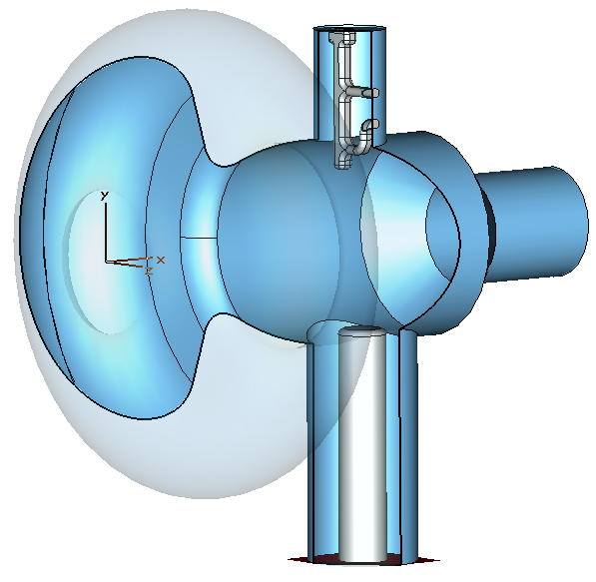
Electron Loading and Heating (Due to Field Emission and Multipacting)
Source of electrons
Field Emission due to high surface electric field
Multipacting; secondary emission
  resonant condition (geometry, RF field)
  At sweeping region; many combinations are possible for MP
    Temporally; filling, decay time
    Spatially; tapered region
    Non-resonant electrons→ accelerated → radiation/heating
  Mild contamination → easily processible
  But poor surface condition → processing is very difficult in an operating cryomodule
Easy to remove with DC biasing
Result
End group heating/beam pipe heating + quenching/gas burst

Slide 12
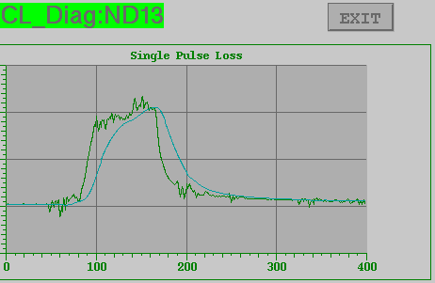
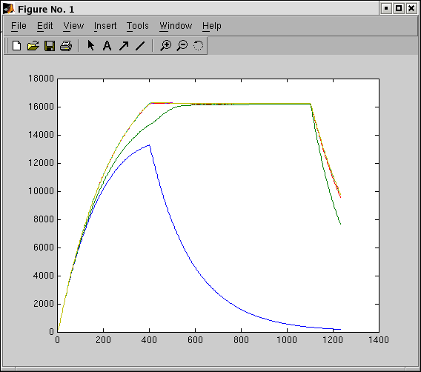
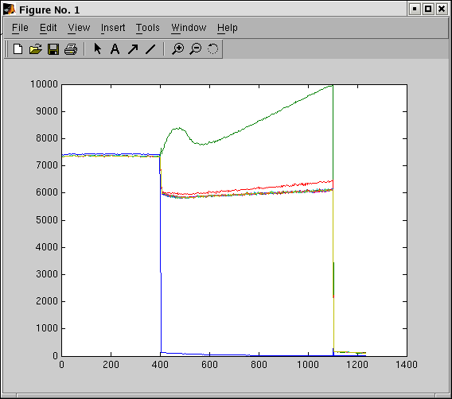
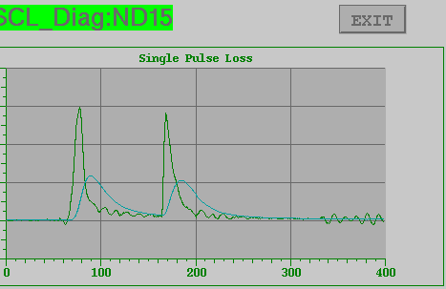
End Group Heating & Partial quench
At partial Quench
Radiation Signals
13a; 14.5 MV/m
13b; 15 MV/m
13c; 15 MV/m
13d; 10.5 MV/m
Radiation (arb. unit)
15a; 19 MV/m
15b; 17 MV/m
15c; 21.5 MV/m
Cavity Field
Forward P
(1 unit=10 us)

Slide 13
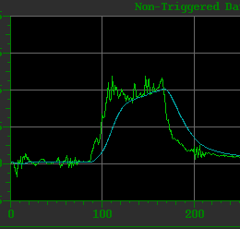

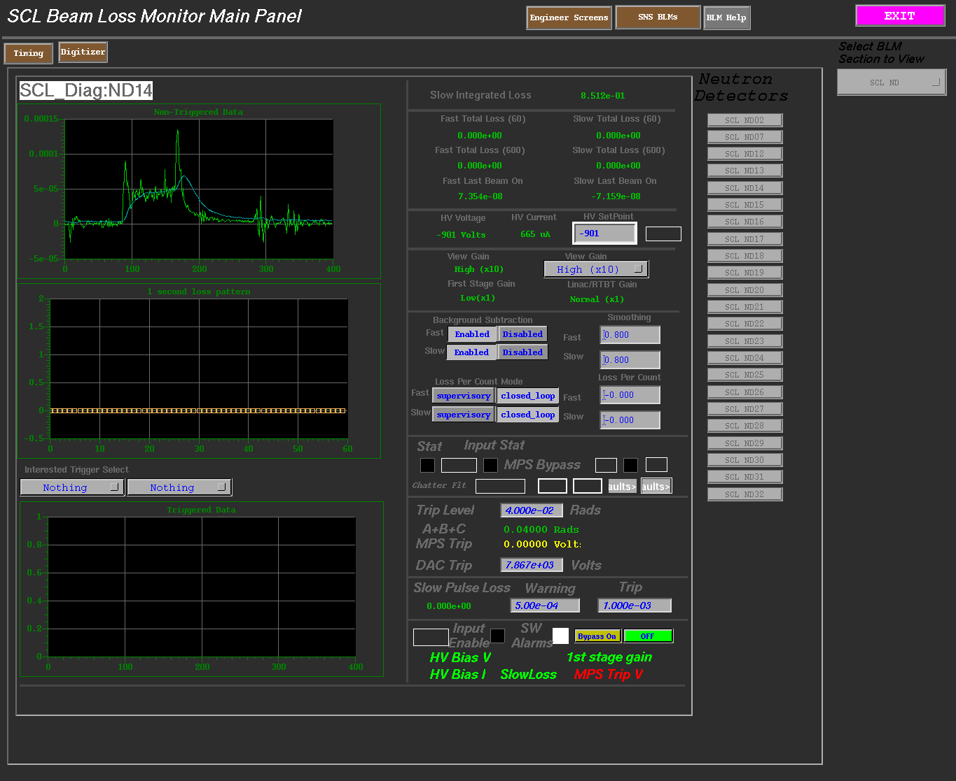
SNS Cavity Operating Regime
We don’t have MP induced radiation
at op. gradient, if any, very small.
Basically running in the field emission regime.
MP
Surface condition
Radiation (in log, arb. Unit)
Radiation
onset
Measurements of Radiation during RF Pulse
FE onset
Eacc
Radiation (arb. Unit)
Time

Slide 14
Back to Cavity performances in VTA test
Typical high beta cavity
MP
FE
More precisely this MP indication is MP induced radiation
We observed MP starting from 3 MV/m in both medium and high beta cavities
In general MP can be processed and does not hurt operation that much

Slide 15
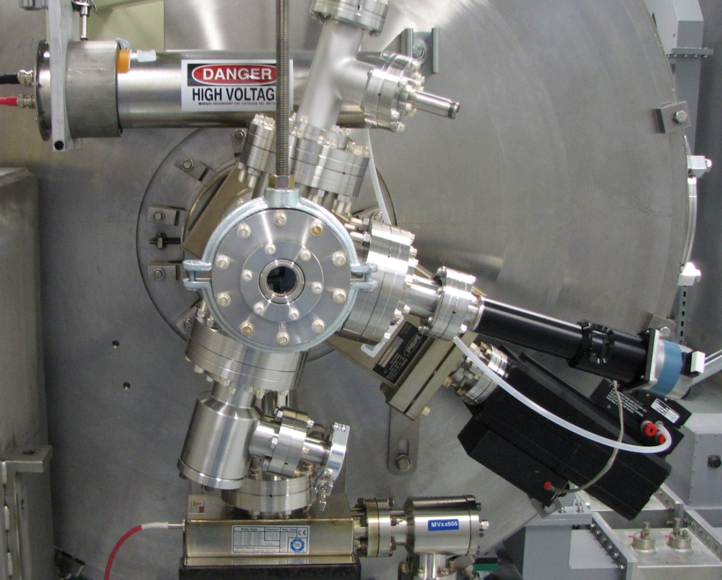
Radiation/electron activity diagnostics
in the Test Cave
IC1
Cavity D
Cavity C
Cavity B
Cavity A
IC2
IC7
IC3
IC4
IC5
IC6
Phosphor Screen
& Faraday Cup
Phosphor Screen
& Faraday Cup
IC0
IC-int
Ionization Chamber
Internal Ionization Chamber
Phosphor Screen, Camera,
Faraday Cup

Slide 16
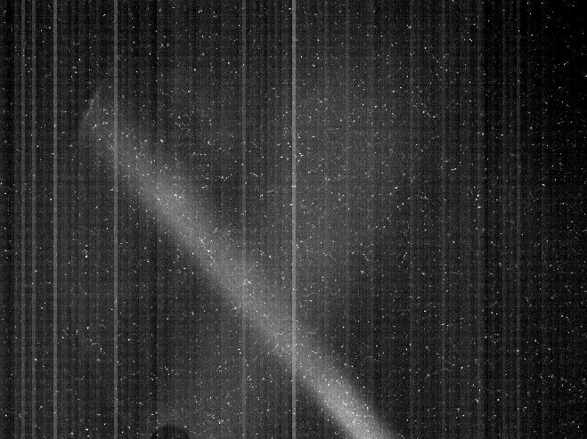
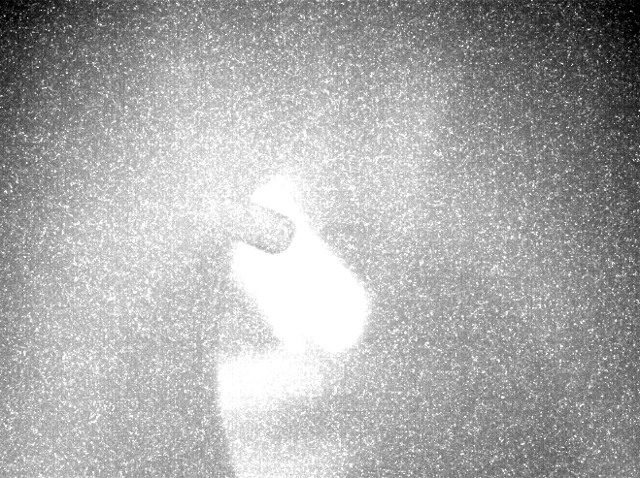
Phosphor screen images
Cavity A 9.3MV/m
Camera exposure; 30 ms
Cavity D 12 MV/m
Camera exposure; 30 ms

Slide 17
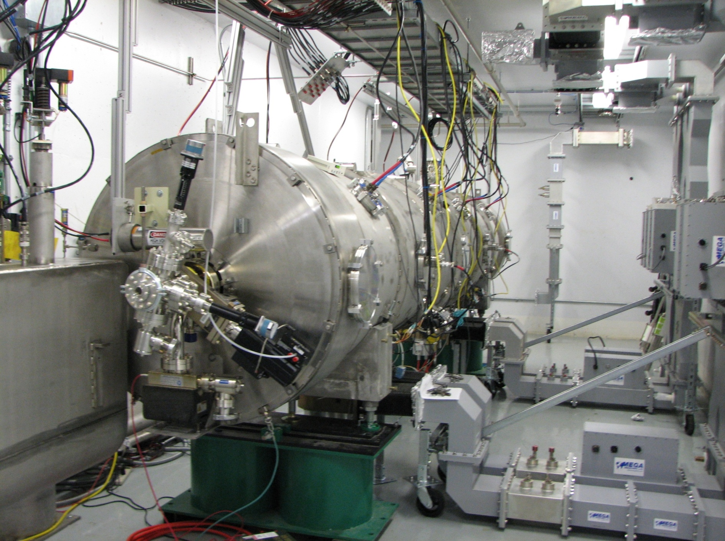
4-way waveguide system in test cave

Slide 18
Cryogenic loads (I)
Dynamic load estimation; provide constant load condition to cryogenic system for reliable 2K operation
Static loss (~20 W/cryomodule)→ total 450~500 W
Thermal radiation from fundamental power coupler
static; without RF
dynamic; with RF
estimation (dynamic) <10 W to 2K circuit at MW beam operation
Cavity surface dynamic loss (design parameter Qo > 5e9 at 2.1 K)
BCS resistance (~6.5 nOhm at 2.1K, 805 MHz)
residual resistance (10 nOhm)
Other heating; FE, MP, pure Q-deacy
Ex. at 6.5% duty at 60 Hz & at design gradient
Pbcs(6.4nOhm)+Pres(10nOhm)=130 W, Pother=210 W → Qo=5e9,
Qo~1.1e10 (MB)
Qo~1.3e10 (HB)

Slide 19
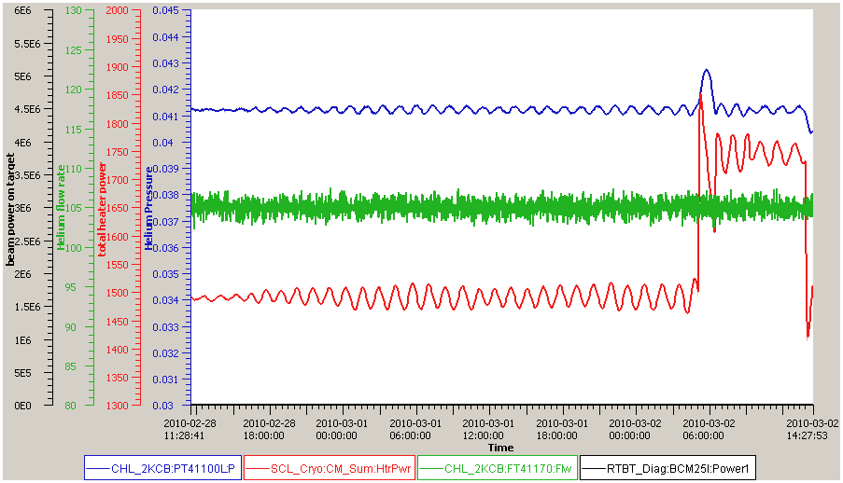
Cryogenic loads at 5.1 % duty (855us flattop)
RF on
RF off
Helium pressure; ~0.04 atm
Δ: errors
(heater
setting)
Total heater power; 1750 W
Helium flow rate; ~105 g/s
~260 W
Total heater power; 1490 W
Turned off
all SRF cavities
260 W at 5.1 % duty→ Overall Qo~4.5e9

Slide 20
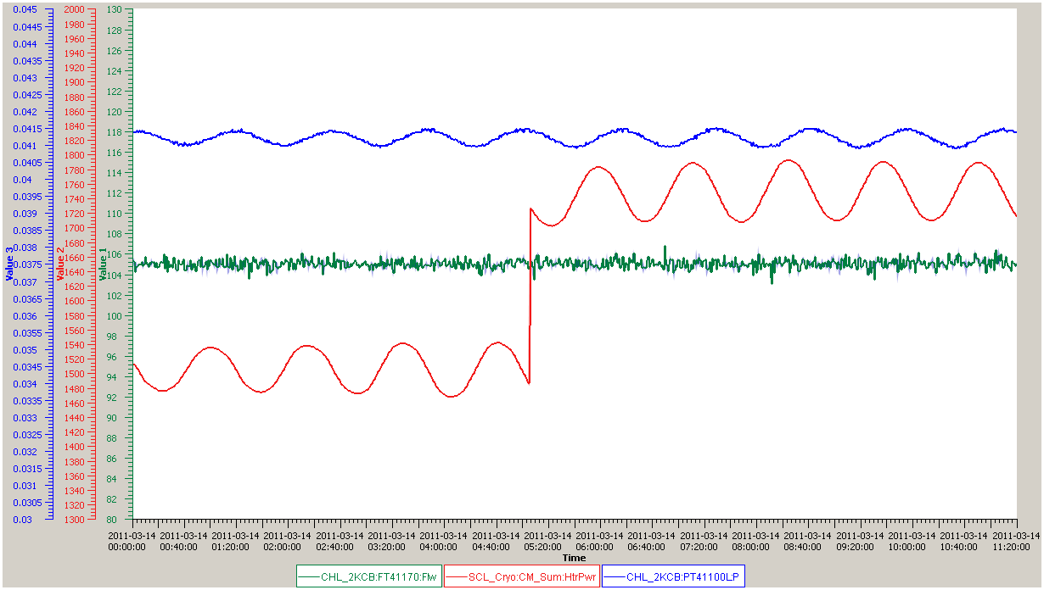
After correction of heater settings
RF on
RF off
Helium pressure; ~0.04 atm
Total heater power; 1750 W
Helium flow rate; ~105 g/s
~245 W
Total heater power; 1505 W
Turned off
all SRF cavities
245 W at 4.5 % duty → Overall Qo~4.5e9

Slide 21
Operational efficiency
w/ existing SNS cryo-plant
~30 Hz operation → very marginal
Duty=
0.08
0.06
Limitation of He flow rate
← Cold box
0.04
0.02
with a cryo-plant to be designed
at the SNS SCL layout
Given the design of the cryogenic plant, the highest overall efficiency is not necessarily achieved
when the nominally optimal thermodynamic conditions are reached.
Since the cryogenic plant has to run at a fixed load no matter what the actual static and
dynamic loads from the cryomodules, a more efficient use of the plant would be
at temperatures different from the designed ones.

Slide 22
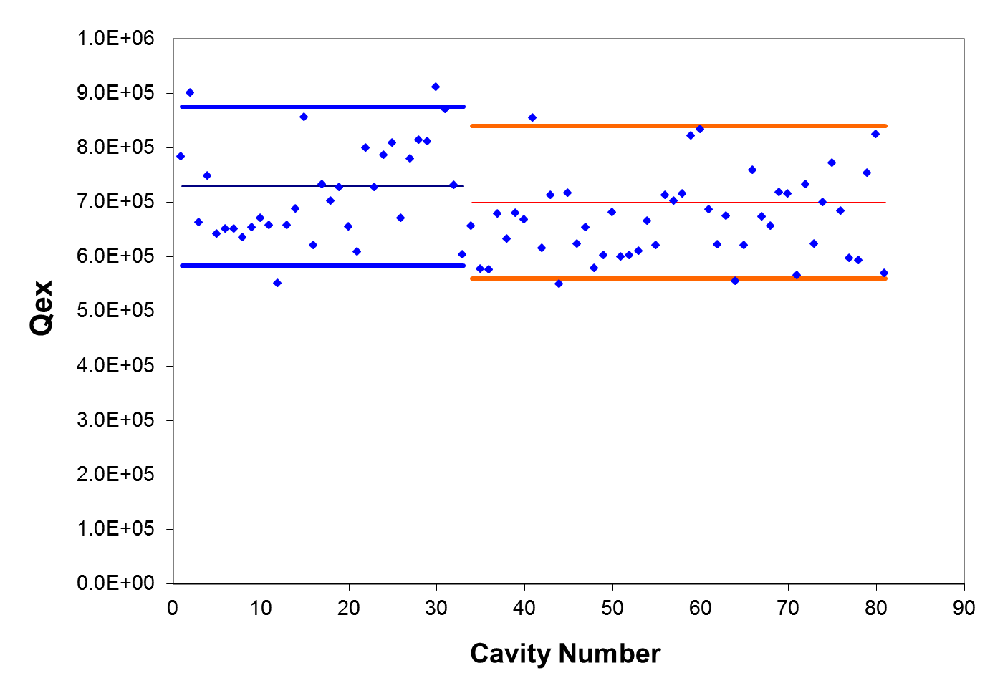
Qex variation
Reference+/-20%
Field tilt, mechanical error, other mismatches (circulator, …)

Slide 23
LFD
Medium beta cavity (installed cavity)
K_{LDyn}: 3~4 Hz/(MV/m)²
High beta cavity (installed cavity)
K_{LDyn}: 1~2 Hz/(MV/m)²
17 MV/m
16.5 MV/m
filling
flattop
filling
flattop

Slide 24
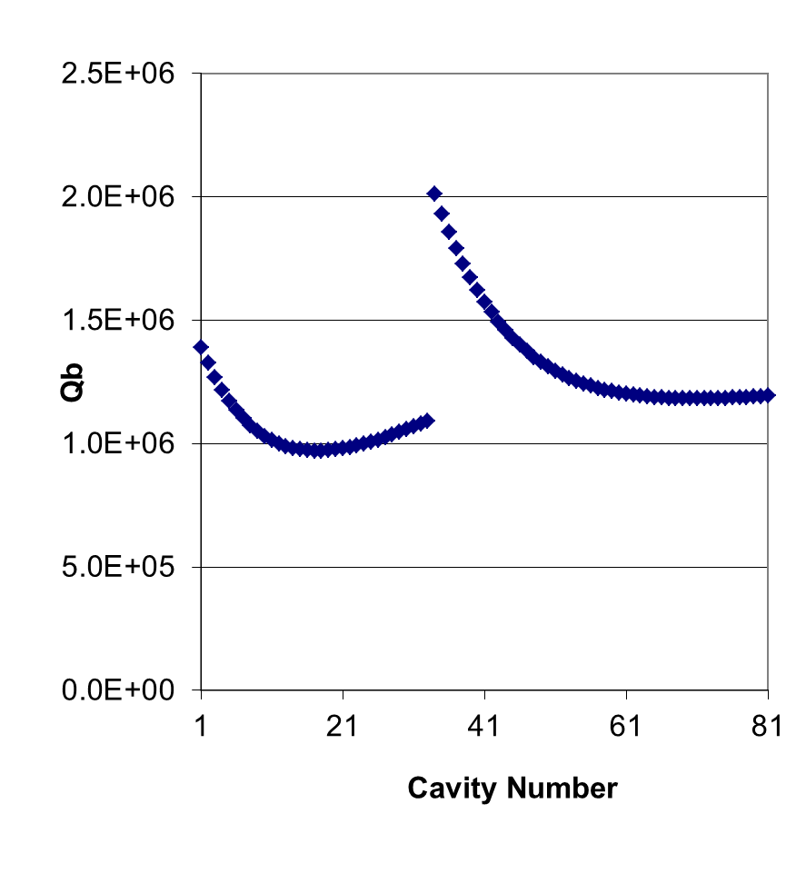
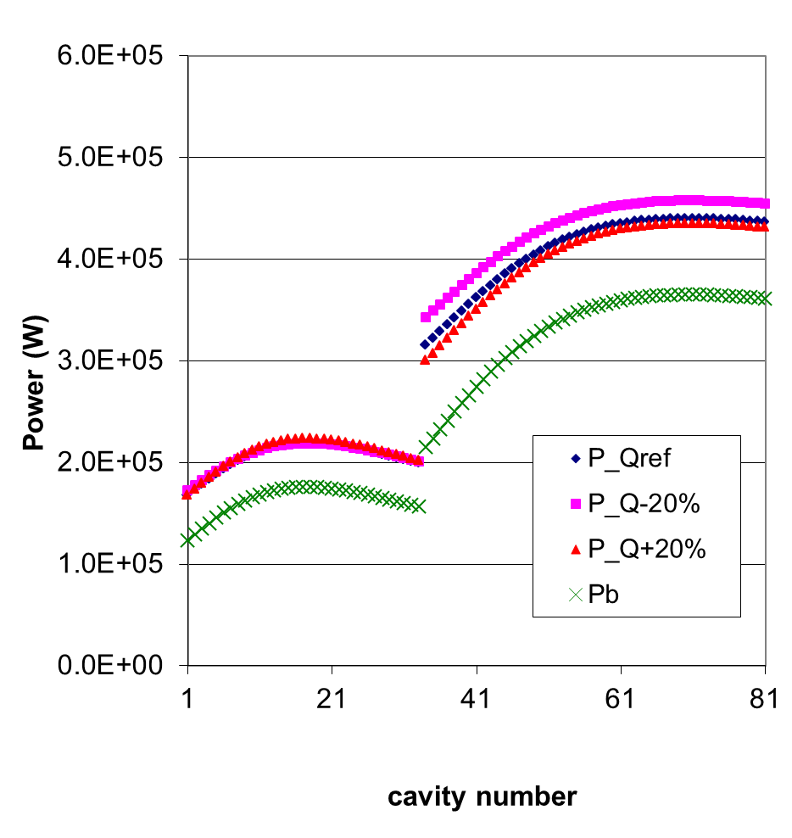
RF margin
Klystron power at saturation
Qref=7.3e5
Qref=7.0e5

Slide 25
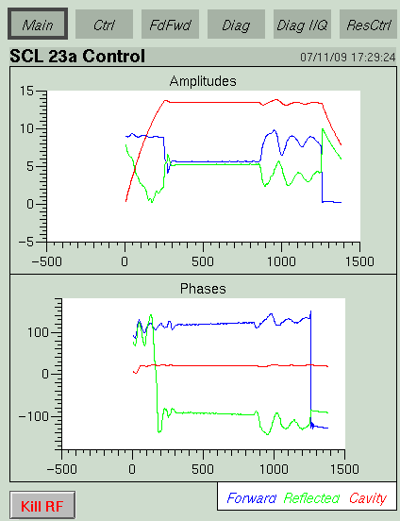
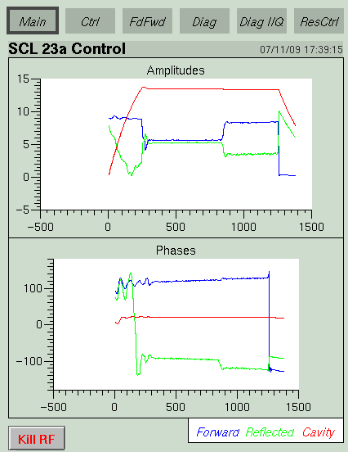
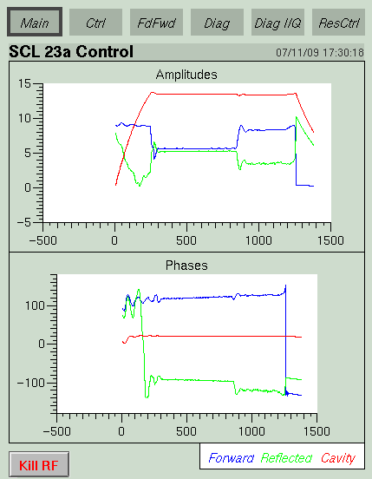
AFF learning
AFF fully learned
At beginning
While learning
Some cavities need ~>25 % more RF at the beginning of AFF

Slide 26
Overall RF gain characteristic
FCM digital output
Amp on FCM board
Solid state amp (transmitter)
Klystron
Cavity forward power
~>20 % RF budget is needed for control margin, other losses, etc.

Slide 27
RF budget
High intensity study in 2007 based on existing configuration
  need >73 kV → have 75 kV now with one additional HVCM
By product
  shortened filling time by 50 us (300us→250us)
Klystron power at saturation at 75 kV

Slide 28
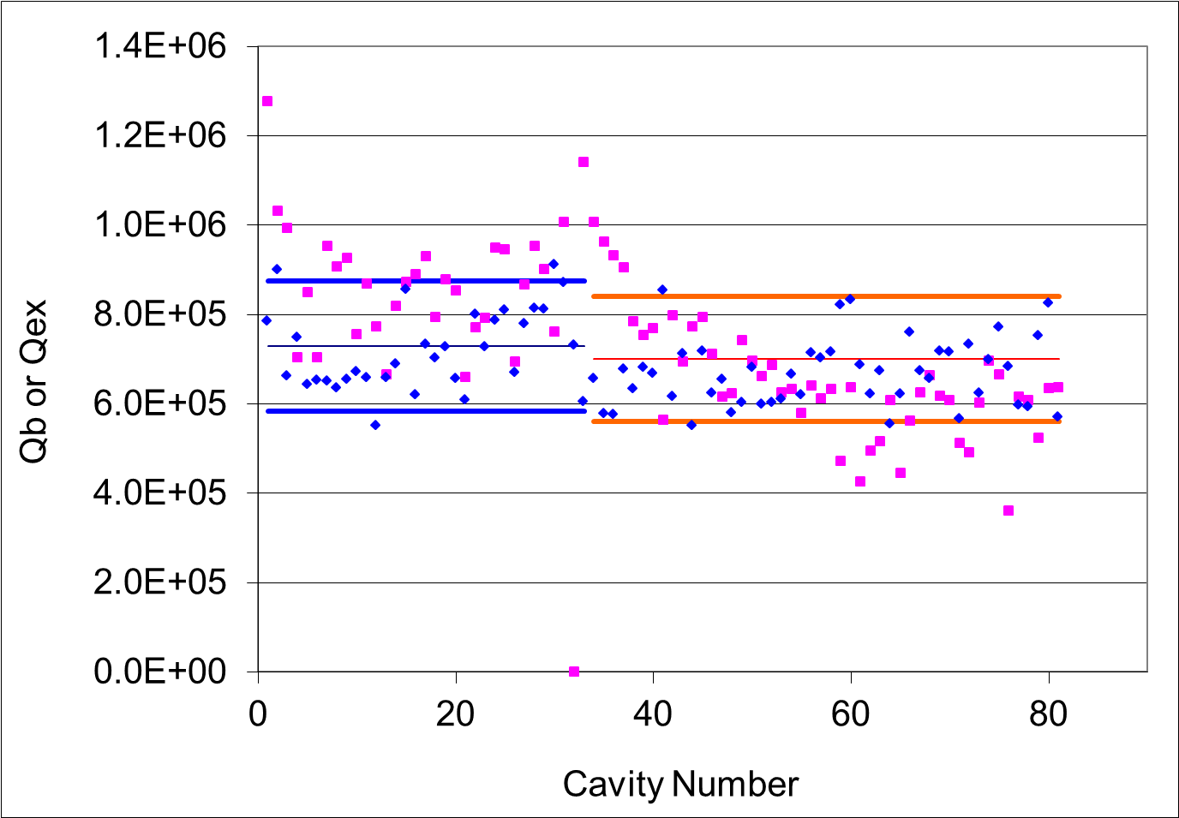
Qs at the present operating condition
Qb
Qex

Slide 29
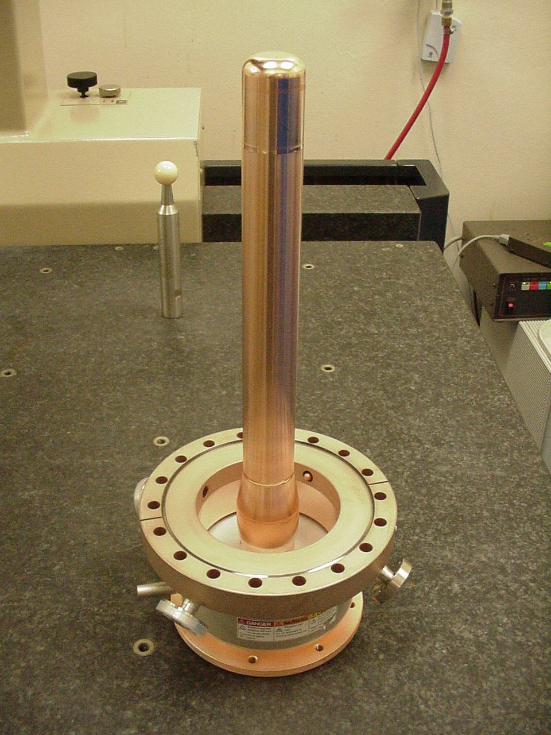
Fundamental Power Coupler Performance
All couplers have been pre-processed at JLab or SNS to nearly 1 MW peak power traveling wave and full reflection to 500 kW.
During testing of cryomodules in the SNS tunnel most couplers has transferred more than 500 kW peak power, in full reflection and with the 2 MW traveling wave peak at the end of the RF pulse.
Relatively cheap & Very robust.
Outer conductor cooling: some have flow balancing issues.

Slide 30
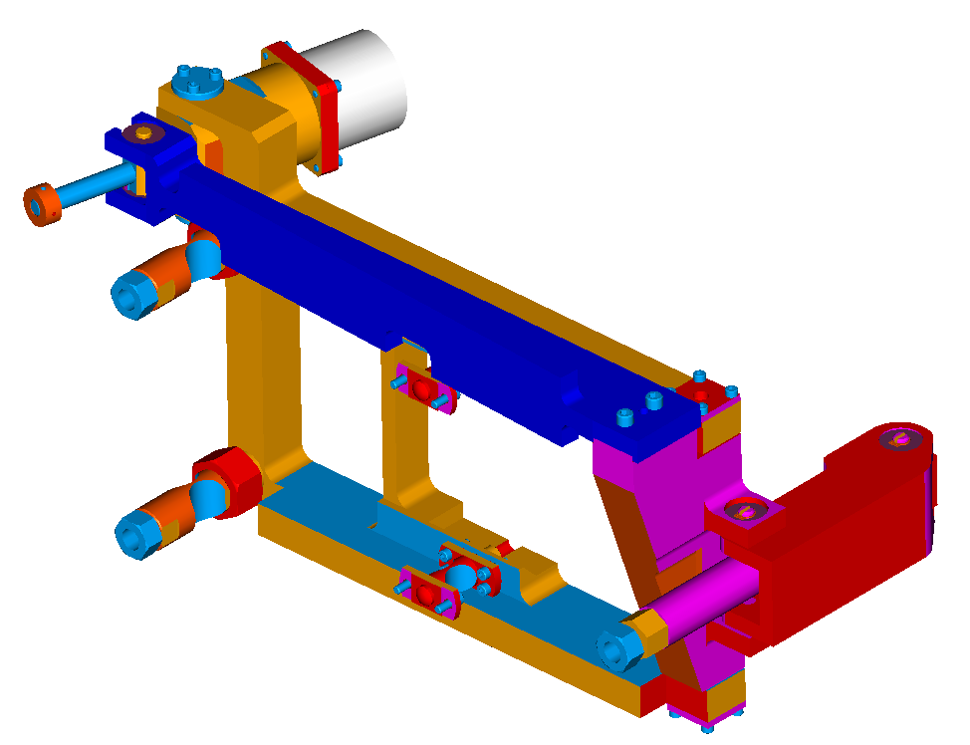
Tuner
Pressure events, 2-4-2K transition, or just short life time→ >10 tuners are replaced.
  Harmonic driver, piezo stack (and/or motor) failure
  Worn out in progress, loosen connection, slips; unstable mechanical boundary; irregular detuning
Motor & Harmonic Drive
Piezo Actuator
(2X) Flexure Connection to Cavity
(2X) Flexure Connection to Helium Vessel
Connection to Helium Vessel

Slide 31
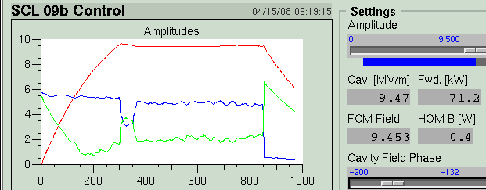
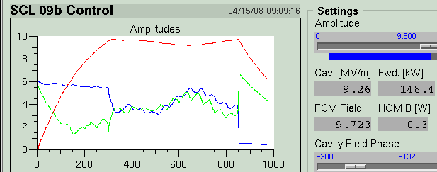
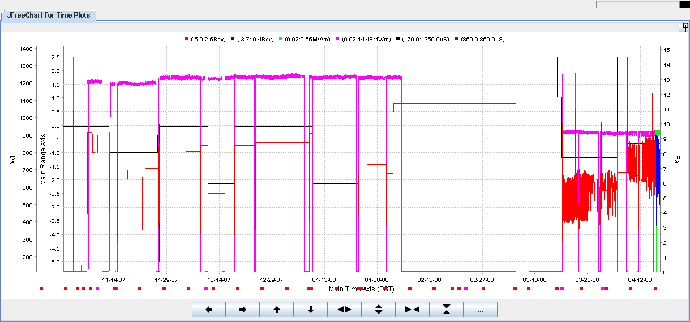
Irregular dynamic detuning (9b)
Eacc (13MV/m)
9.5 MV/m
Tuner motion
5.5 months

Slide 32
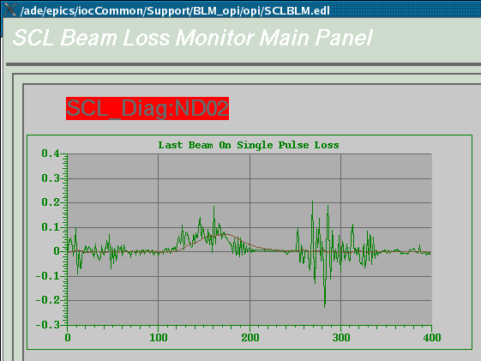
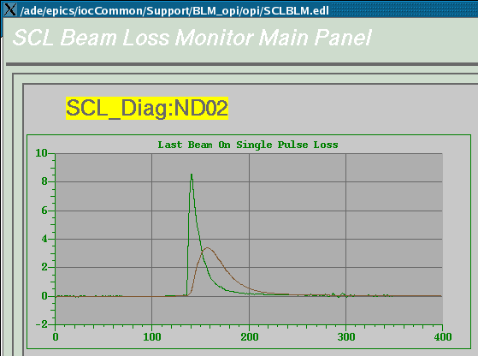
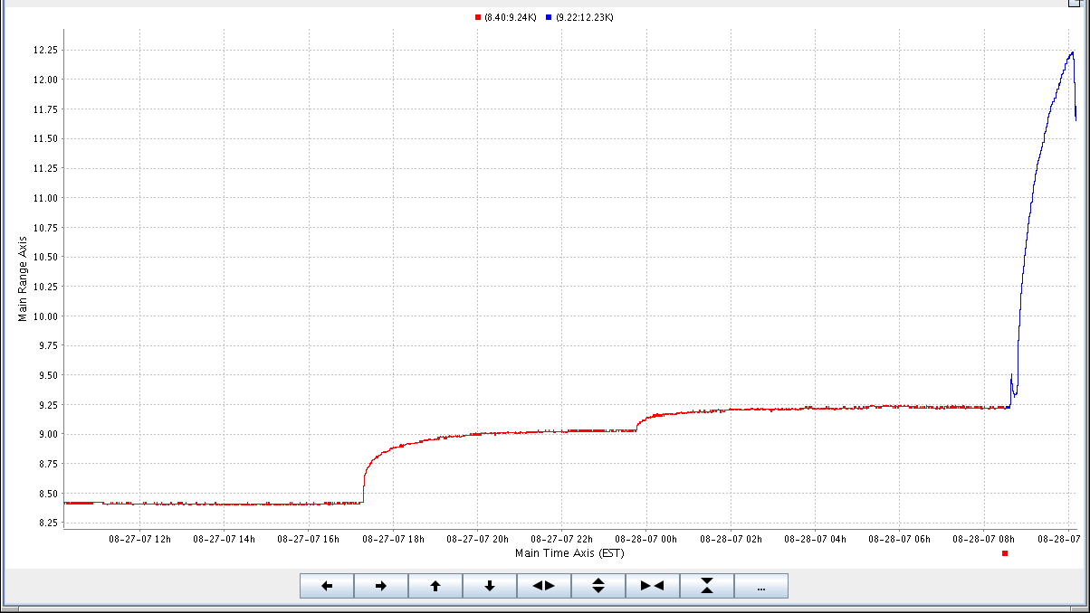
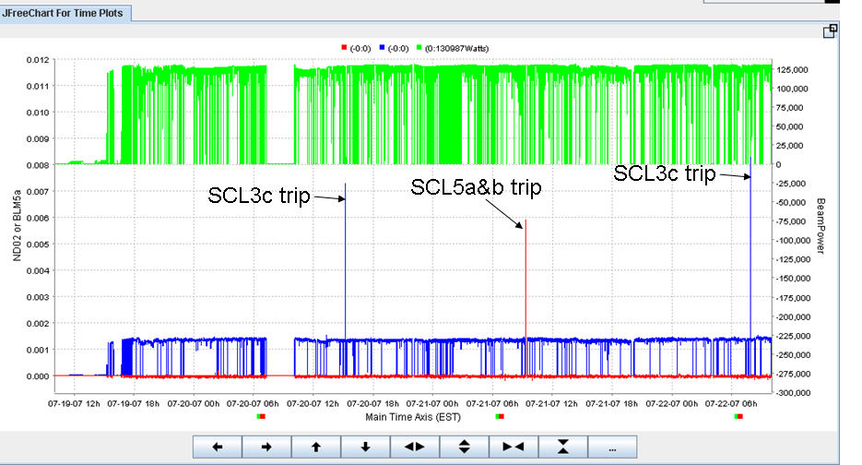
Beam induced trip
At normal beam
At errant beam
Beam pipe temperature
w/o beam
Beam trucation
2. Dark current
1. Errant Beam and RF truncation at upstream

Slide 33
At errant beam condition; MPS
MPS
  If RF field regulation becomes bad, RF/beam truncation
  If BLM signal touches the threshold, beam truncation
  MPS; supposed to be less than 20-30 us
Had performance degradations with 2 cavities → claimed that errant beam is too frequent and MPS delay looks long
Measured all MPS delay in the linac; 50-300 us
  Caps, some open collector circuit

Slide 34
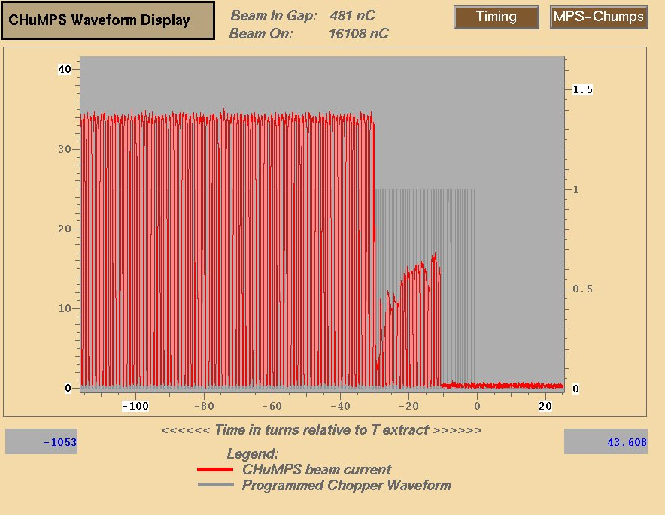
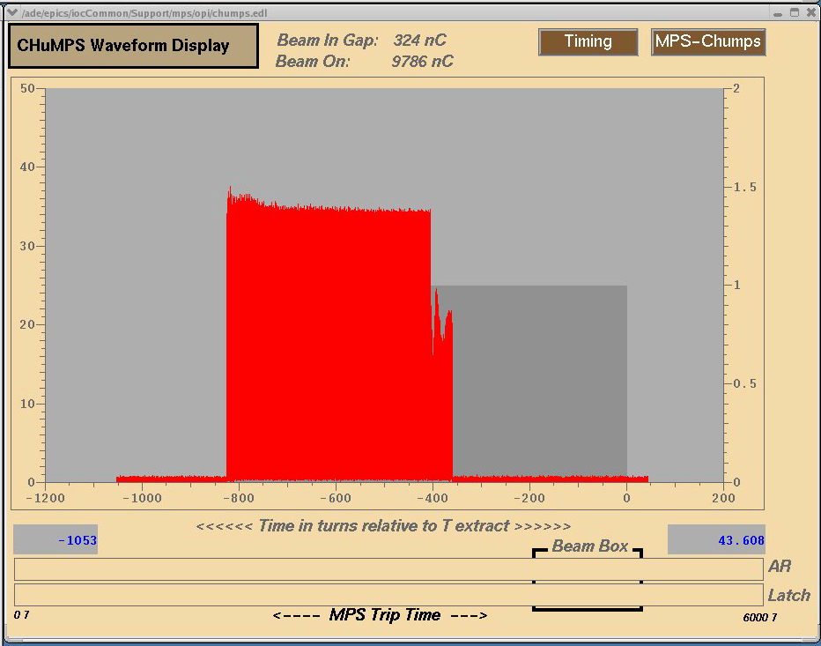
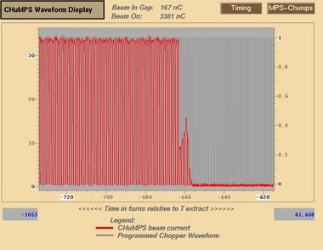
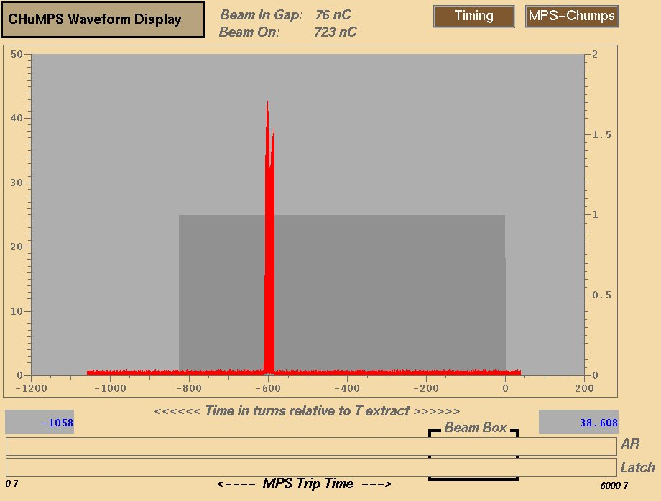
Errant beam from the source
MPS trucation ~20 us

Slide 35
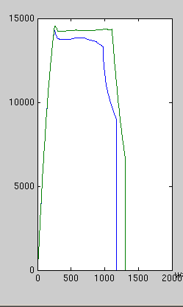
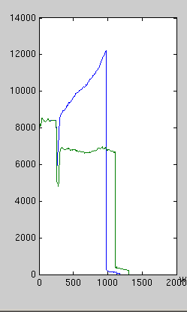
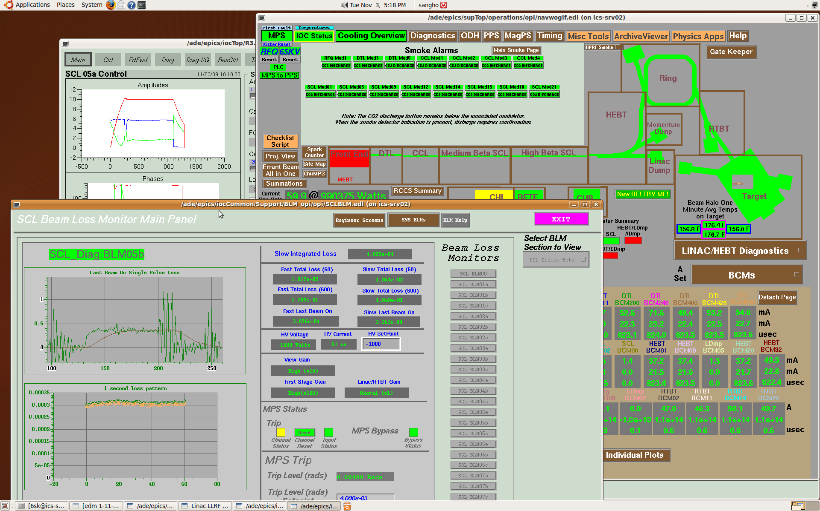
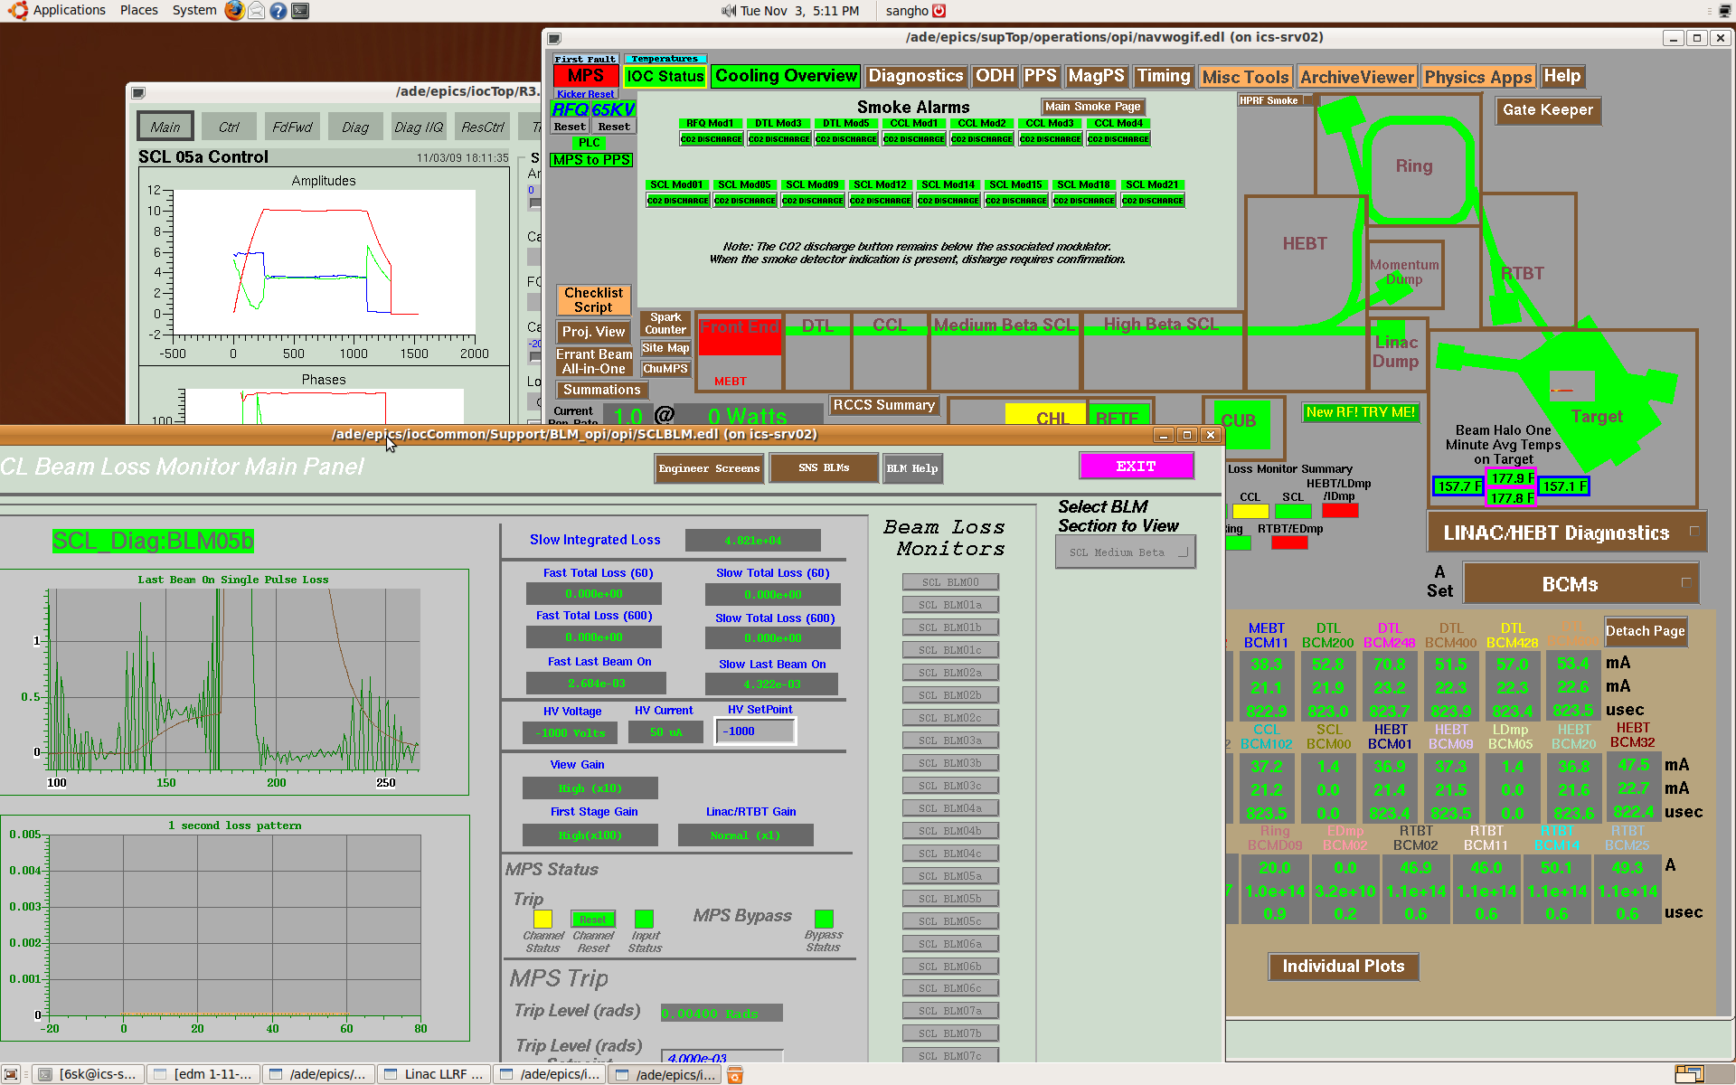
Performance degradation
First time in 4-years operation + commissioning
Limiting gradient of two cavities; 14.5 MV/m → Partial quench at 9 MV/m
Beam between MPS trigger and beam truncation → off-energy beam → much bigger beam loss at further down-stream → gas burst → redistribution of gas/particulate → changes in performance/condition
Random, statistical events; made HOM coupler around FPC worse
Cavity field
Forward power
Partial quench

Slide 36
Thank you for your attention!

Slide 37
Collective effects
FE; heating vs. relative phase and amplitude
b cavity phase → a cavity beam pipe
a cavity phase → a cavity beam pipe
a
b

Slide 38
Individual limits & collective limits
CM19; removed
Design gradient
Large fundamental power through HOM coupler
Average limiting gradient (collective)
Field probe and/or internal cable (control is difficult at rep. rate >30 Hz)
Average limiting gradient (individual)
Operating gradient setting in SNS are based on the limiting gradients achieved
Operational stability is the most important issue

Slide 39
Spare cryomodule
Revisit SNS HB cavity processing
  Vertical test data has traditionally not been a good indicator of module performance due mainly to field emission limiting the collective gradients of all installed cavities
  Field emission on-set point is more relevant criteria
  What else can enhance electron activity, especially FE
Lots of processing/testing for 4 cavities
  Additional BCP made performance worse in many cases
  Random variations of performance/field emission after processing cycle
  Visual inspection tells that end group(reactor grade Nb)/first iris is very rough
  EP seems to be the best option for the exiting SNS cavities
  HOMless cavity achieved highest VTA results; 23MV/m

Slide 40
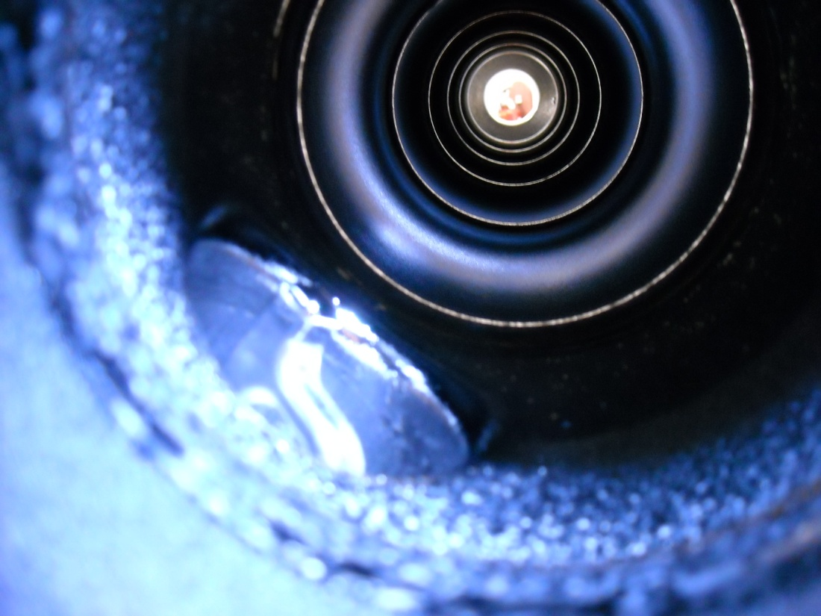
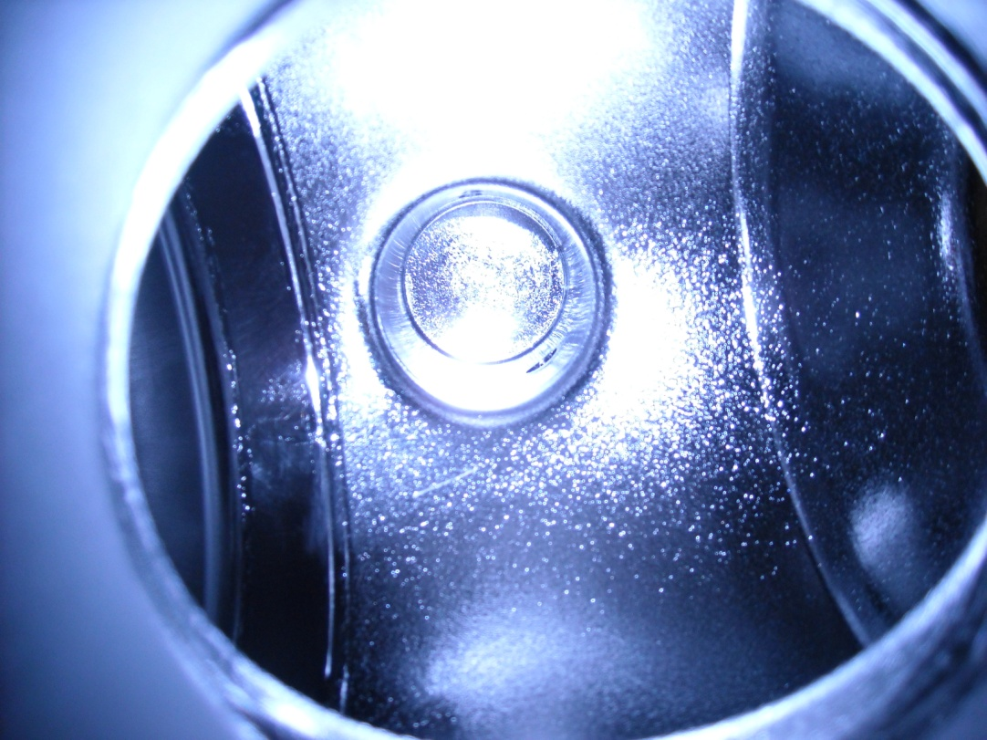
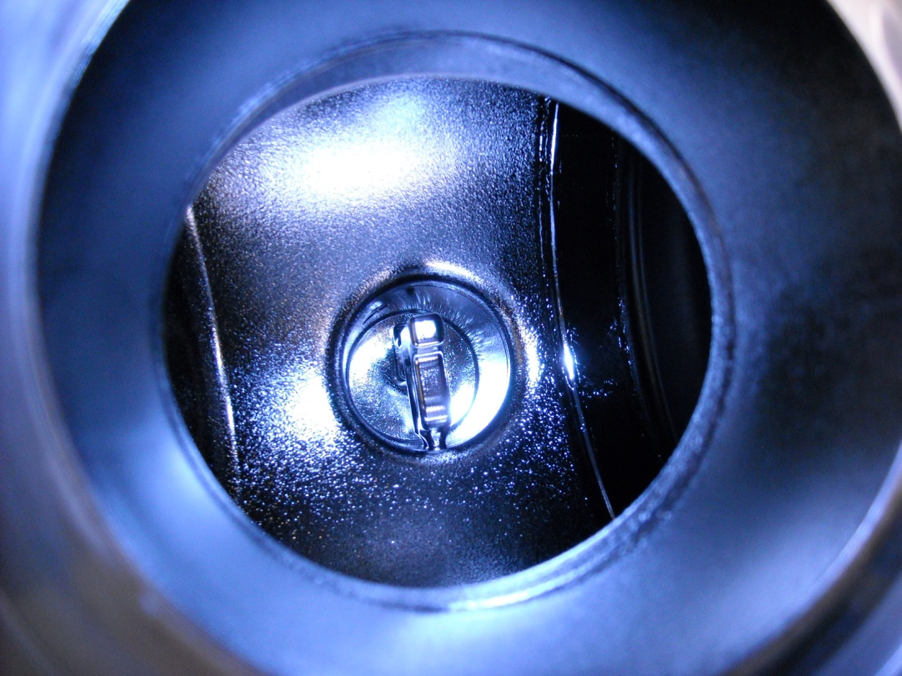
Endgroup Roughness
Cells have normal surface finish
Rough Surface
to the First IRIS

Slide 41
Summary of Cavity VTA Performance:
Cavity Number | Emax (MV/m) | Rad at Emax (mR/hr)
HB53 | 17.6 | 2.0
HB58 | 17.2 | 0.0
HB56 | 17.5 | 408
HB54 | 13.0 | 850
Field Emission
Tunnel Data RF Only
Multipacting
Combination
20 Seconds

Slide 42
Cryogenic loads (II)
Qo~4e9
Qo~2.5e9
Qo~1e10
Set 1; Below FE threshold
average~9 MV/m
Set 2; 80 % of individual limits
averate~13.8 MV/m
Set 3; 88 % of collective limits
average~12.8 MV/m
Set 1
1300us
(300+1000)
30 Hz
Set 2
1300us
(300+1000)
15 Hz
Set 2
1300us
(300+1000)
30 Hz
Set 3
1300us
(300+1000)
30 Hz
Set 3
900us
(300+600)
30 Hz
Total dynamic heat loads due to different sources

Slide 43
Cavity Gradient Limiting Factors (60 Hz Operation)
One does not reach steady state mechanical
vibration
1 cavity is disabled
CM19 removed and repaired
CM12 removed and found vacuum leaks
at 3 HOM feedthroughs (fixed)
-Dominated by Electron Loading (Field Emission & Multipacting)
-~14 cavities are limited by coupler/end-group heating (MP),
but close to the limits by radiation heating
-Operating gradients are around 85~95% of E_{lim}

Slide 44
CW, Pulse (BCS and cooling)
T_{b}=4.2 K, f=805 MHz, niobium thickness=4 mm
(Ti=4.6 K)
150 mT
Reaches film boiling regime (Ts=4.53 K)
130 mT (Ti=4.56 K, Ts=4.5 K)
Pulsed operation at 60 Hz, 4.2 K, 805 MHz
No limitation up to or close to
the critical field
(Rs enhancement at close to
critical field is not concerned)
(due to relative low operating frequency,
pulsed nature)
CW operation at 4.2 K, 805 MHz
Meet film boiling regime (quench)
We tested all cavities at both 2 and 4.5 K
The performances are exactly same

Slide 45
Qex vs. penetration depth
+/- 20 % → +/- 1.5 mm

