Slide 1

Summary of Laser Stripping Mini-Workshop and Implications for Project X
David Johnson
Project X Collaboration Meeting
April 13, 2011

Slide 2
Second Mini-Workshop on Laser Assisted H- Beam Stripping
The primary purpose of this mini-workshop
  will be to assess and update the progress on the theoretical,
  technical, and
  experimental work toward the realization of laser-assisted stripping since the first workshop in 2009 (https://wiki.ornl.gov/events/lahbsa/default.aspx )
We would like to bring together experts in laser-particle beam interactions,
  theory and modeling, and
  experts in high power lasers and laser optics to discuss the current status and remaining R&D to establish a realistic laser-stripping system for use in existing or future high-power proton accelerators.
We had 25 participants from 3 National Labs (SNS,FNAL,LBL) and 7 expert laser and/or optics industrial partners who are actively involved (or interested in becoming involved) with SNS or FNAL laser stripping activities. (There is interest in collaboration from other Labs/personnel who were unable to attend)

Slide 3
Agenda
  08:45 - 11:30 Theory and Facility Plans/Requirements Convener: Slava Danilov (SNS)
    Laser Stripping for SNS and Project X 30' Speakers: Timofey Gorlov, Slava Danilov (SNS)
    SNS Laser Stripping Requirements, Status, and Next Step 30' Speaker: Sasha Aleksandrov (SNS)
    Fermilab Laser Stripping Requirements 30' Speaker: David Johnson (Fermilab)
    Conceptual Design for a Laser Chopper 30' Speaker: Vic Scarpine (Fermilab)
    Laser Optics Development at SNS 30' Speakers: Yun Liu, Chunning Huang (SNS)
  12:30 - 16:00 Technology Convener: Yun Liu (SNS)
    High sustained average power cw and ultrafast Yb:YAG near-diffraction-limited cryogenic solid-state lasers: relevance to laser stripping 30' Speaker: David Brown (Snake Cerrk Lasers)
    Buildup Cavity for Megawatt Peak Pulse Powers 30' Speaker: Mark Notcutt (BPEO)
    Isobar Suppression by Photodetachment 30' Speaker: Yuan Liu (ORNL)
    An H- Stripping Laser using Commercial, Diode Pumped Nd:YAG amplifiers 30' Speaker: Russell Wilcox (LBNL)
    High Energy UV Laser Operated at 400 Mhz Repitition Rate 30' Speaker: Bhabana Pati (QPeak)
    RING Resonator for laser Ion stripping 30' Speaker: Rodion Tikhoplav (Radiabeam)
  16:00 - 17:45 Discussion/Next Steps/Follow-on-work Convener: David Johnson (Fermilab)
All talks are posted on Workshop Website:
  https://indico.fnal.gov/conferenceDisplay.py?ovw=True&confId=4114

Slide 4
Theory Talk
Timofey Gorlov outlined theoretical basis of the 3-step laser stripping process
  Stripping H- in magnetic field
  Interaction of H0 with photons
    Schrodinger Equation (E= B=0) and linear polarized laser field
    Compensation of energy spread of H- on excitation efficiency
      Chirped laser (angular divergence)
      Addition of D’ to produce correlated energy-angle+ chirped laser
    Advanced model :Density matrix (with everything taken into account)
      Stark effect at interaction point
      Spontaneous decay
      Lorentz stripping
    Stripping in High Magnetic Field
      Broad shape resonance

Slide 5
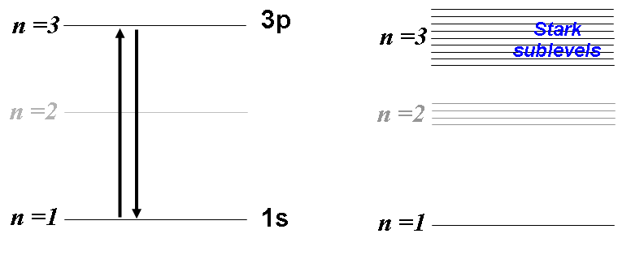
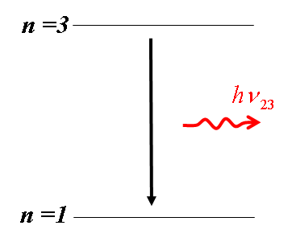

Advanced physical model
Unperturbed atom
Atom in electric field
High-field Dipole Magnet
High-field Dipole Magnet
Spontaneous decay losses
Ground
state
H⁻
H⁰
External field
Stark effect at the interaction point
Spontaneous decay losses
Lorentz stripping of H⁰ excited beam
T. Gorlov
Notes:
In this case we need to do some optimization of parameters and use more complicated model taking into account different phenomena…

Slide 6
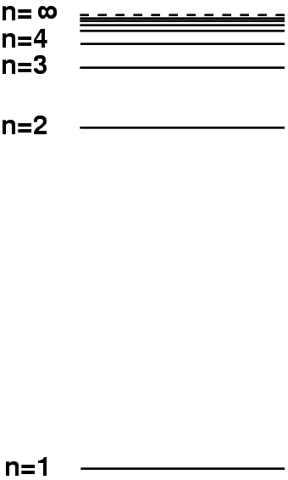

Hydrogen atom in a strong electric field
H⁰
H⁰
H⁰
e
E
e
E
e
No field
Weak field
Strong field
broadening
splitting
Continuous spectrum
T. Gorlov
Notes:
The next way is to change resonant property of atom itself by strong electric field.
Weak field leads to Stark Effect that worsen the resonant excitation because sublevels run away from laser frequency.
Strong field makes wider sublevels itself and improves the resonance excitation.

Slide 7
Laser Assisted Stripping
  Two papers were published in 2010 discussing advances in Laser Stripping
  PRST-AB 13, 050101 (2010) “Laser-assisted H- charge exchange injection in magnetic fields”, T. Gorlov, V. Danilov, A. Shishlo
  They report advances in the physical model of the three step process have been made which allows the calculation of the evolution of an H0 beam taking into account
    Spontaneous emission
    Field ionization
    External electromagnetic fields
  They discuss stripping in zero, weak, and strong magnetic fields
PRST-AB 13, 074002 (210) “Effective calculation of laser stripping via a broad shape resonance”, T. Gorlov, V. Danilov
  Broad shape resonance can fully compensate the Doppler broadening of the laser frequency in realistic beams without applying a laser chirp and increasing laser power.
  Principal Result-> they show “the feasibility of high efficiency laser assisted charge exchange injection via the broadened Stark states” with approximately the same laser power the resonant excitation

Slide 8
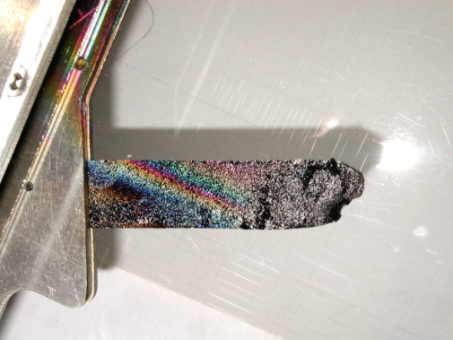
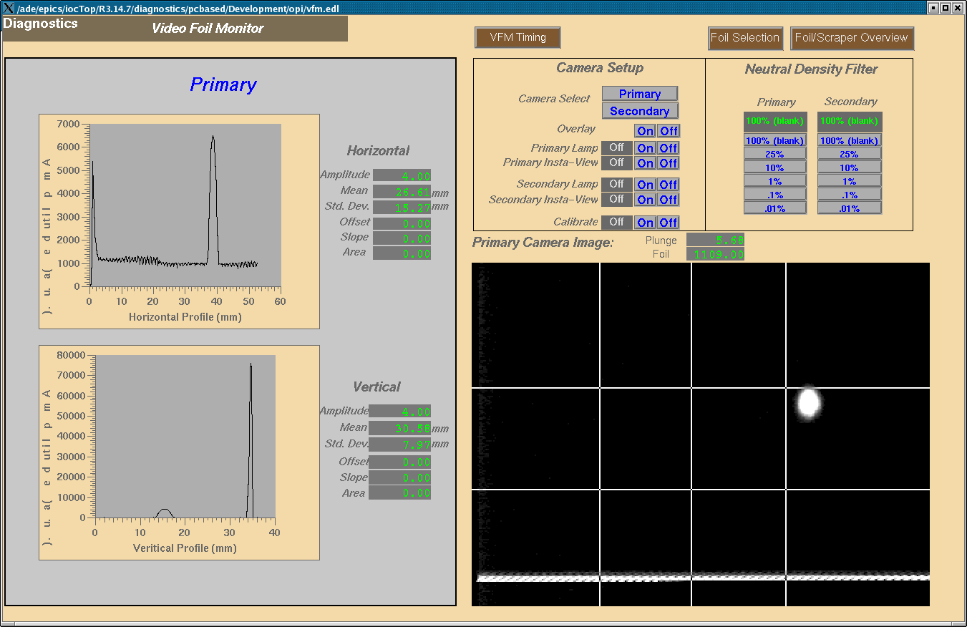
Motivation: Stripping Foil Limitations
The SNS will use 300-400 μg/cm² Carbon or Diamond foils
Two important limitations:
  Foil Lifetime: tests show rapid degradation of carbon foil lifetime above 2500 K, yet we require lifetime > 100 hours
  Uncontrolled beam loss: Each proton captured in the ring passes through foil 6-10 times: leads to uncontrolled loss of protons
  Presently, injection area is the most activated at SNS
Foil lifetime degrades
Damaged PSR Foil
SNS Foil
Glowing
160 kW
From: V. Danilov
Notes:
Slava discussed the motivation for laser stripping and ,

Slide 9
SNS Next Laser Stripping Experiments
Next Step – Proof of Practicality
I. Proof of Principle experiment confirmed good understanding of the process and validity of the models. Our theoretical expectations of ~90% efficiency were met.
II. We stripped few nanosecond beam. Direct scaling to the SNS requirements (60 Hz, 1 ms beam ) is hardly practical:
average laser power required: 10MW*0.06=0.6 MW !!!
III. Next step is to find ways to reduce required laser power and demonstrate feasibility by setting an intermediate stage experiment with beam parameters between the full SNS requirements and PoP experiment:
> 90% stripping efficiency
1 – 10 us pulse width
1 – 10 Hz repetition rate
techniques used should be scalable up to the SNS requirements
From: A. Aleksandrov

Slide 10
Laser Specs Requirement
Energy gap between ground and excited states in hydrogen, beam energy, and the interaction geometry require laser wavelength at UV regime.
Each micro-pulse is required to have a peak power of 1 MW to achieve a sufficient stripping efficiency.
The time structure of the laser system must match the bunch structure of the accelerator with the pulse width of the micro-bunches of ~ 50 ps at a repetition rate of 402.5 MHz.
Such micro-bunches need to hold up to 1 ms duration at a repetition rate of 60 Hz.
From: Yun Liu and Chunning Huang
Notes:
Energy = 2.5*Peak power*bunch length
Aveg power= Energy*freq = 2.5*Peak power*bunch length*freq

Slide 11
Average Power is not Everything!
From proof-of-principle demonstration to the final experiment, we need to verify
Operation of high power, high repetition rate, UV laser
Phase locking between laser and accelerator RF signal
Laser beam spatial profile
Possible laser induced damage on optics, vacuum windows
Radiation effects
Reliability
An intermediate-stage experiment is necessary!
From: Yun Liu and Chunning Huang

Slide 12
SNS Laser Status
Parameters | What we need | What we have | Solutions
Laser wavelength | 355 nm | 355 nm | ○
Micropulse duration | 50 ps | 50 ps | ○
Micropulse energy | 50 μJ | 40-130 μJ | Depending on macropulse width
Micropulse repetition rate | 402.5 MHz | 402.5 MHz | ○
Macropulse duration | 1 ms | 10 μs | Diode pump fiber amp? Optical cavity? Laser array?
Macropulse energy | 20 J | 1 J | Proportional to pulse duration
Macropulse repetition rate | 60 Hz | 10 Hz | Not a serious problem
Average Power | 1200 W | 1.5-3.0 W | Proportional to pulse duration
Temporal Profile | Flat | Flat | ○
Spatial Profile | M²<2 | M²=8 | M² matters when cavity is used
From: Yun Liu and Chunning Huang
Notes:
Macro pulse average power = 20J*60Hz = 1200W
Micro pulse power = 50 uJ*400 Mhz = 20 kW during the 1 ms

Slide 13
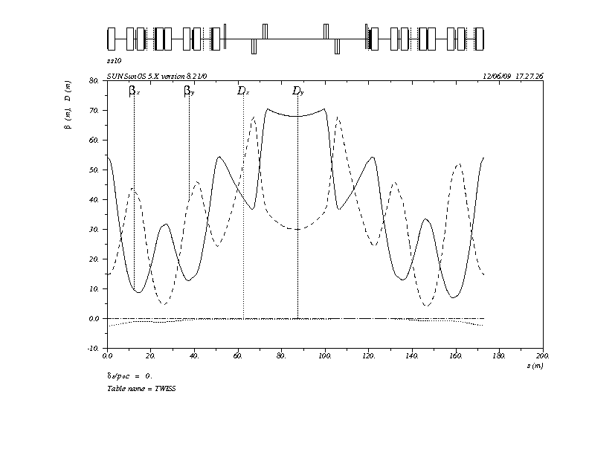
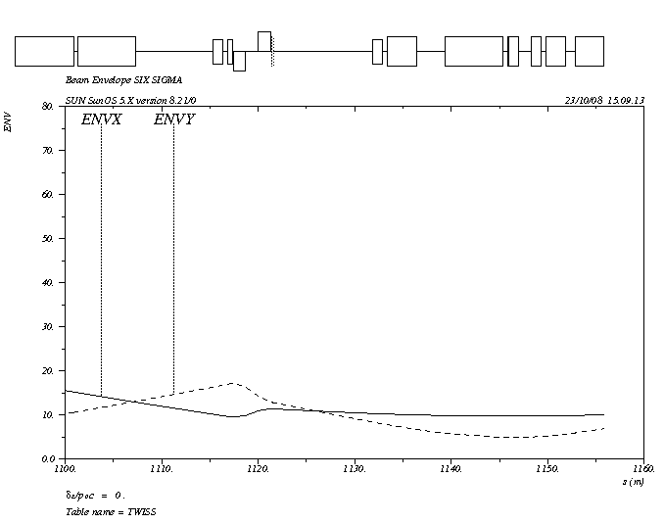
Beam parameters for Recycler/MI Laser Stripping Injection
Linac Beam
  Bunch length corresponds to +/- 12mm (80 ps) with and rms of about 16 ps.
  Assuming phase jitter assume maximum bunch length of +/-20 mm (130 ps) with an rms of 26 ps worst case.
  Best case, if longitudinal tails can be removed, a distribution result from tracking without errors gave a 6ps rms distribution
  For this calculation assume rms bunch length of 20ps.
Transport line parameters
  Beta x 20 - 40 meters -6 sigma truncated gaussian size between 5 and 8 mm
  Beta y 10 – 20 meters – 6 sigma truncated gaussian size between 4 and 5 mm

Slide 14
Excitation Efficiency
Peak power levels of the Laser stripping process using the standard 3 step process in the absence of a magnetic field.
Timofey Gorlov

Slide 15
Laser Power Estimates for 8 GeV laser Assisted Stripping
Required Laser Parameters for 98% stripping Efficiency
*Timofey Gorlov (SNS)
Wavelength [nm] | 1900 | 1064 | 1900 | 1064 | 1900 | 1064
 | elliptical |  | circular |  | Strong Field
Incidence angle [deg] | 49.8 | 94.6 | 49.8 | 94.6 | 49.8 | 94.6
Peak Power, P0 [MW] | 1.1 | 5 | 1.1 | 5.5 | 2.1 | 10
Micropulse energy [mJ] | 0.08 | 0.3 | 0.08 | 0.4 | 0.14 | 0.7
Power at 325 Mhz [kW] | 26 | 100 | 26 | 130 | 47 | 230
Power at 162.5 Mhz [kW] | 13 | 50 | 13 | 65 | 24 | 115
Micropulse duration (rms) [ps] | 29 | 28 | 29 | 28 | 27 | 28
X-rms size [mm] | 4.3 | 5.0 | 2.1 | 2 | 2 | 2
Y-rms size [mm] | 1.9 | 1.9 | 2.1 | 2 | 2 | 2
X’-divergence [mr] | 1.4 | 0.6 | 1.7 | .8 | 0 | 0
Y’-divergence [mr] | 0.9 | 0.6 | 1.7 | .8 | 0 | 0

Slide 16
Investigation on the Feasibility of Using a Laser Chopper for Project X
Why look at this?
Project X has identified a low-energy H⁻ beam chopper as a critical component
  Requirement of a broadband, arbitrary-pattern beam chopper is difficult at 325 MHz and maybe also at 162.5 MHz
    Standard electric-field choppers push limits
    Are there other options?
      Lasers have been used for laser profile monitors; SNS, BNL…
        H⁻ + γ -> Hº + e⁻
      Can laser be used as a broadband chopper?

Slide 17
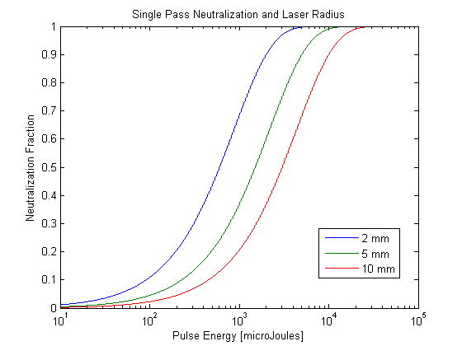
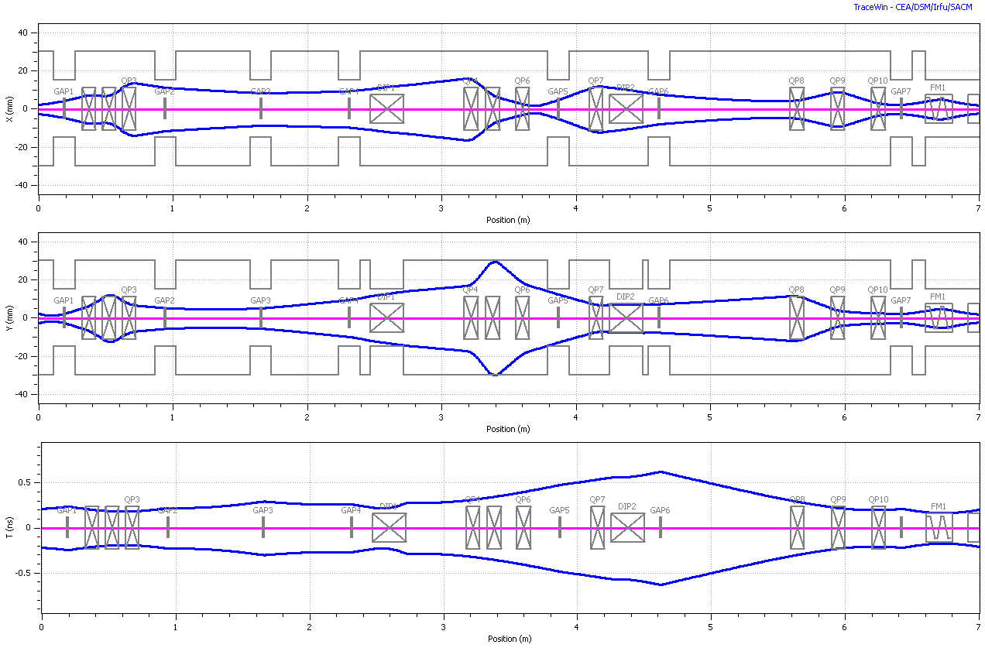
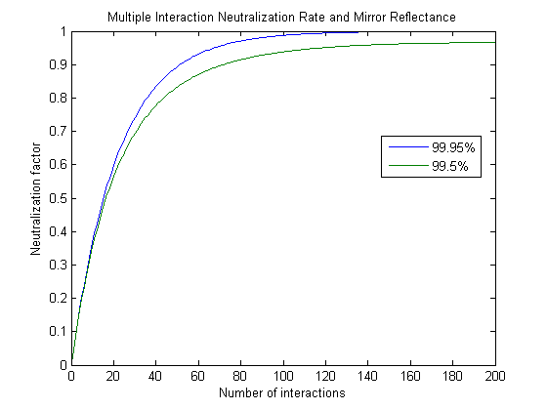
Laser Chopper
Optional H⁺ Leg
RFQ
Laser Cavity
mirror
H0 Dump (.6m offset)
H-
mirror
Input pulse to cavity:
~200uJ, 0.5-1.0 ns, 162.5 Mhz
Match to SSR0
Laser source
22.5 deg Achromat
*Not shown: quads or cavities
SSR0
Length between RFQ & SSR0 ~ 6m
Laser Cavity
Dipoles
Laser input
Dump
Matched into SSR0
Vertical aspect of laser (5mm radius)
*Note: Optics not fully optimized
ε_{x,y}=0.25 π-μm ε_{Z}=0.3 π-μm

Slide 18
Facility formally know as HINS
HINS (High Intensity Neutrino Source) is a unique Linac Injector R&D facility
  Outside of HINS, regular access to high-intensity, low-energy H- beam for R&D is limited
Potential exists to operate HINS as a low-energy, high-intensity H- test facility during Project X R&D phase
  Allows for the development of Fermilab projects as well as a facility for external collaborators
  An accessible test facility is critical for a number of Project-X R&D areas
Potential project areas:
  Beam diagnostics R&D
  Beam dynamics at low-energy
  Beam chopper R&D

Slide 19
Power Buildup Cavity at 355 nm for MegaWatt pulse powers
PI: Mark Notcutt
Boulder Precision Electro-Optics
5733 Central Ave
Boulder CO

Slide 20
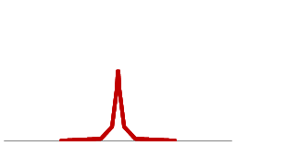
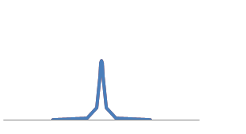
Buildup of circulation Power in a cavity
Spacing between both laser and cavity modes
Equals the repetition rate of the laser 402.5 MHz
The cavity has a wide span of equally separated resonances
(dispersion varies spacing insignificantly over 9 GHz)
The 50 ps laser pulse spans ~9 GHz
Frequency Spectrum
Red – Laser
Blue - Cavity
Df = fsr = rep rate
In the time domain, the cavity round trip time
Is equal to the pulse arrival (rep) rate
50 ps Pulse = 15 mm length, so must match cavity
Length to rep rate to ~ 15 mm

Slide 21
Practical Issues – vacuum quality
In the experiments that are done with buildup cavities, laser damage is an issue when pulse lengths are in the fs range, but this is less prevalent when pulses are > 10 ps.
Mirror losses increase as air is removed from the experiment, below a few Torr. The losses can be reversed by increasing the pressure above this value, or flowing O₂ onto the mirrors.
This effect is seen somewhat at 780 nm (Ti:Sapp) but markedly at 532 nm.
Possible explanations put forward:
  Contamination from outgassed molecules
  Mirror Damage from O₂ stripping
We take the approach of building a super clean cavity with low outgassing materials

Slide 22
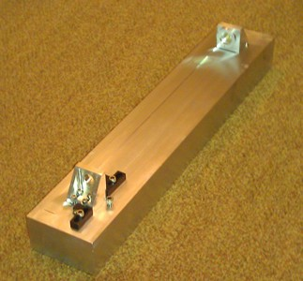
Summary
We have constructed a rigid cavity, from high vacuum materials, from sapphire mirror substrates, with finesse 300, to give 100 x buildup of the incident power.
We have calculated the optimal mirror curvatures, and will use those in future.
We are presently locking the cavity to the laser, using mirrors which are resonant at both 1064 nm and 355 nm.

Slide 23
Isobar Suppression by Photodetachment
Y. Liu, C. C. Havener, J. R. Beene
Holifield Radioactive Ion Beam Facility (HRIBF)
Physics Division, Oak Ridge National Laboratory
April 11, 2011

Slide 24
Isobar Suppression by Photodetachment
Photodetachment:
, hv > electron affinity (EA) of A⁻
Isobar suppression: EA_{isobar} < hv < EA_{RIB}
  D. Berkovits, et al., Nucl. Instr. Meth. A 281 (1989) 663; Nucl. Instr. Meth. B 52 (1990) 378.
There are a number of negative RIBs for which photodetachment can be used to suppress the isobar contaminants:
⁵⁶Ni (⁵⁶Co), ^{17,18}F (^{17,18}O), ^{33,36}Cl (^{33,36}S)
EA(Co) = 0.661 eV EA(O) = 1.43 eV EA(S) = 2.08 eV
EA(Ni) = 1.156 eV EA(F) = 3.41 eV EA(Cl) = 3.62 eV
High photodetachment efficiency is necessary:
e.g., ⁵⁶Ni beam is dominated by 10 times more ⁵⁶Co – more than 100 times reduction of ⁵⁶Co is needed.
Notes:
24

Slide 25
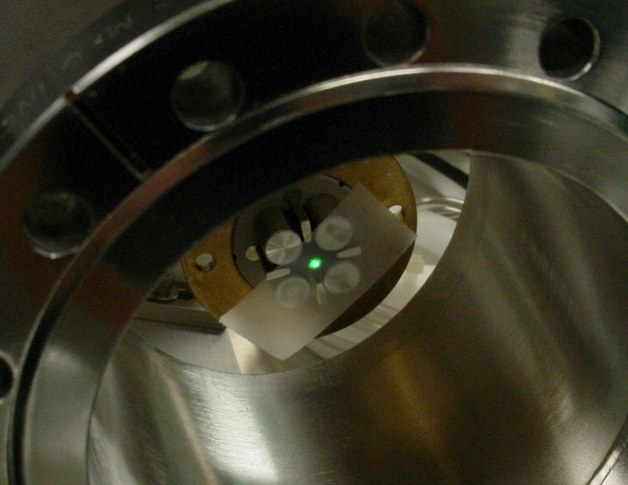
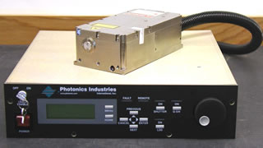
Purify Cl and F RIBs: Remove S and O Isobars
EA(S) = 2.08 eV, EA(Cl) = 3.62 eV
EA(O) = 1.43 eV, EA(F) = 3.41 eV
Nd:YLF laser at 527 nm, photon energy = 2.352 eV
Pulse Nd:YLF laser
Pulse repetition rate: 1 Hz -10 kHz
Average power: 3W maximum
Nominal pulse width @ 1 kHz: 10 - 30 ns
Beam mode: TEM₀₀ with M² < 1.1
Peak Power 100-300 kW
Notes:
25

Slide 26
An H- stripping laser using commercial, diode-pumped Nd:YAG amplifiers
Russell Wilcox
Laser Stripping Workshop, April 11, 2011

Slide 27

This laser scheme was proposed at the last workshop
modelocked
laser
chopper
amplifier
amplifier
buildup cavity
0.5x
100x
4x
120x
average in 1ms
1W
0.5W
50W
200W
24kW
(peak in 10ps)
(250W)
(50kW)
(6MW)
Assume 1 micron operation (high energy H- beams)
  Frequency multiplication could be added
A buildup cavity would be used, with ~120x enhancement
  Peak power goal is 6MW in buildup cavity
SNS reprate and pulse length chosen as an example
  10ps micropulse at 400MHz, 1.2ms macropulse at 2Hz
This work reports success in testing the 1 micron laser
  450W average during 1.2ms pulse (112.5kW peak, ~2x spec)
  Saturation characterized, is the limiting factor for increased power
  Good beam quality, no transient thermal lens
Further testing with a cavity will verify adequacy of the laser

Slide 28
Optical schematic
variable attenuator
diagnostics
E
camera
1mm beam,
2mm rod
amp 2
amp 1
2mm beam,
4mm rod
oscillator
modulator
quarter wave
plate
half wave plate
isolator
Oscillator | 85k
Amp 1 | 25k
Amp 2 | 50k
Other parts | 40k
Total | 200k
2x telescope
Second amp was configured for possible double pass

Slide 29
Conclusions, suggestions
Laser works better than expected, makes >100kW in 10ps
  Try double pass last amp for 1J, 1kW in 1ms, since there’s gain left
  At 162.5MHz, 10ps, 450W average is 277kW peak, requiring only 22x buildup cavity for 6MW peak (not including losses)
We will build a cavity and control system to demonstrate usable peak power
  If this works, it’s a ready solution for 1 micron (PX)
Could be a front end for a higher power system (SNS)
  Assume 10x loss in conversion to UV
  Need 10x 1micron power, or 10J, 10kW
  10J diode-pumped slab amplifier exists
  10kW diode-pumped YAG laser exists
  With 10kW average, 400MHz, 10ps, 10x UV loss, peak power is 250kW
  Only 24x cavity enhancement needed for 6MW
  Enlarge cavity for 4 pulses, maintain finesse 100, etc.

Slide 30
Novel RING Resonator for Laser Ion Stripping
DOE Phase I Results
Rodion Tikhoplav
RadiaBeam Technologies
Santa Monica, CA

Slide 31
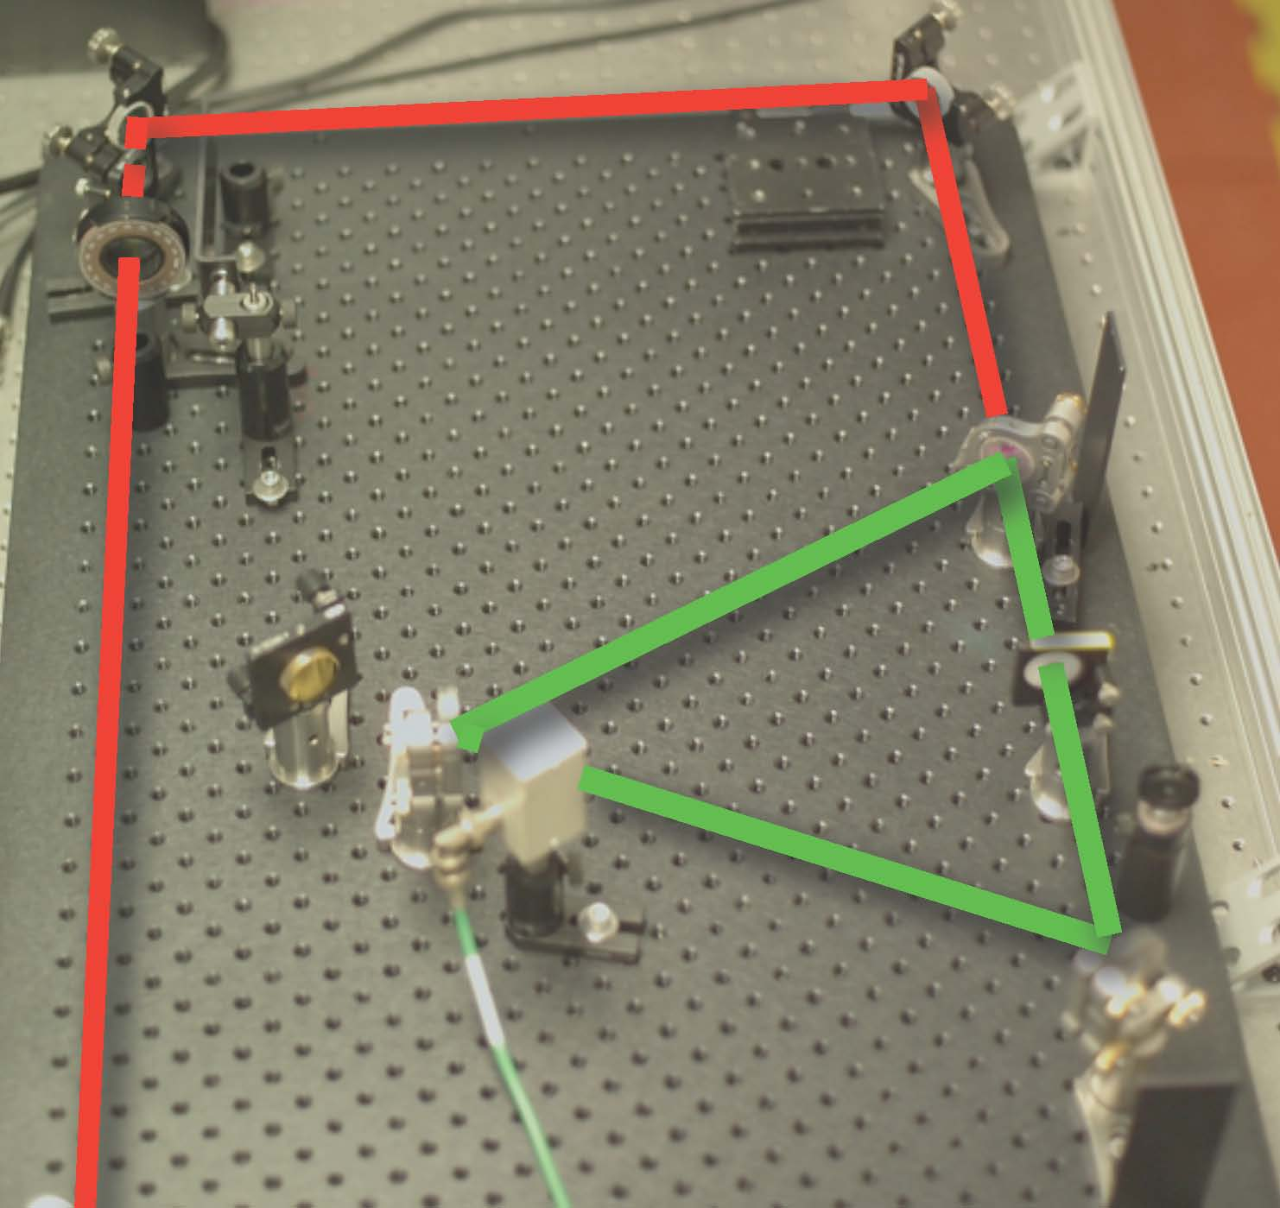
Left: Conceptual diagrams of the proposed RING technique (the case of second harmonic generation regime is shown). Right: A photograph of the actual RING cavity. A frequency converter (FC) is used as a thin optical switch. An IR laser beam (schematically shown as a red line) is entering the RING from the left; the recirculated second harmonic beam (green line) is trapped in the RING resonator .

Slide 32
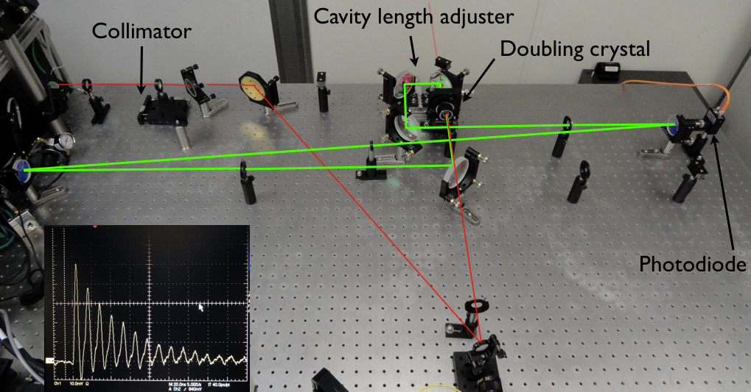
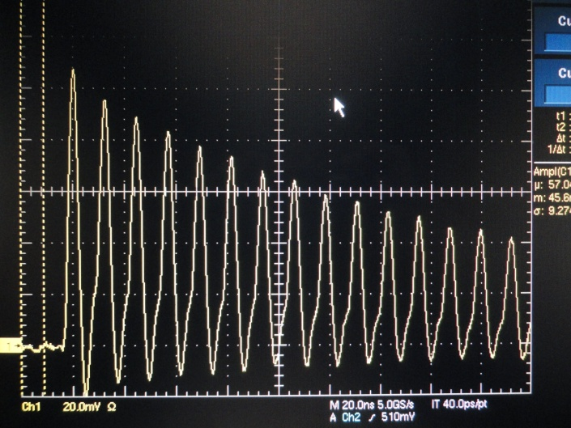
Scaled RING model (second harmonic generation). The beam (1064 nm, in red) comes through the collimator (top left) and enters the cavity through one of the mirrors (middle); after it gets converted to green (532nm) it gets trapped in the cavity. The ring-down (insert) was measured using an amplified photodiode (right) .

Slide 33
UV laser operated at 400 MHz repetition rate
Phase I SBIR, DoE Topic 16d
Ancillary Technologies for Accelerator Facilities
Advanced Laser Systems for Accelerator Applications
Contract no. DE-SC0004386
11 April, 2011
Q-Peak, Inc.
135 South Road
Bedford, MA 01730
Tel: (781) 275-9535
www.qpeak.com

Slide 34
Experimental set up in Phase I
Output laser
Pump
laser
15 -20 kW
Dichroic
mirror
200 W
Seed
source
LMA fiber
amplifier
Free space
Pump coupling
Seed source: Modelocked, 5 ps, 100 MHz, 0.1 W, 1047 nm
Fiber Amp: Yb:silica, 30 μm core, 2 m length, conduction cooled
Pump: Counter propagated and free space coupled
13

Slide 35
Second objective; calculate conversion efficiency to UV
IR
laser
THG
SHG
30 kW
46.6 kW
23.3 kW
66.6 kW
33.3 kW
100 kW
With 30% conversion efficiency,
to generate 30 kW of UV we need 100 kW of IR
18

Slide 36
Q-Peak’s MPS gain module technology
Five pass through the crystal for high gain
Stacked pump diodes allow smaller foot print
24

Slide 37
Summary
We propose a fiber and bulk hybrid approach to the full scale system
  Enhancement cavity with Q of 50
    Fiber amplifier = 7.5 - 10 kW
    MPS gain module = 15 - 20 kW
    Side pumped rod amplifier = 60-100 kW
    UV peak power = 20 - 40 kW

Slide 38
High Sustained Average Power CW and Ultrafast Yb:YAG near-diffraction-limited Cryogenic Solid-state Lasers: relevance to laser stripping
David Brown
Snake Creek Lasers

Slide 39
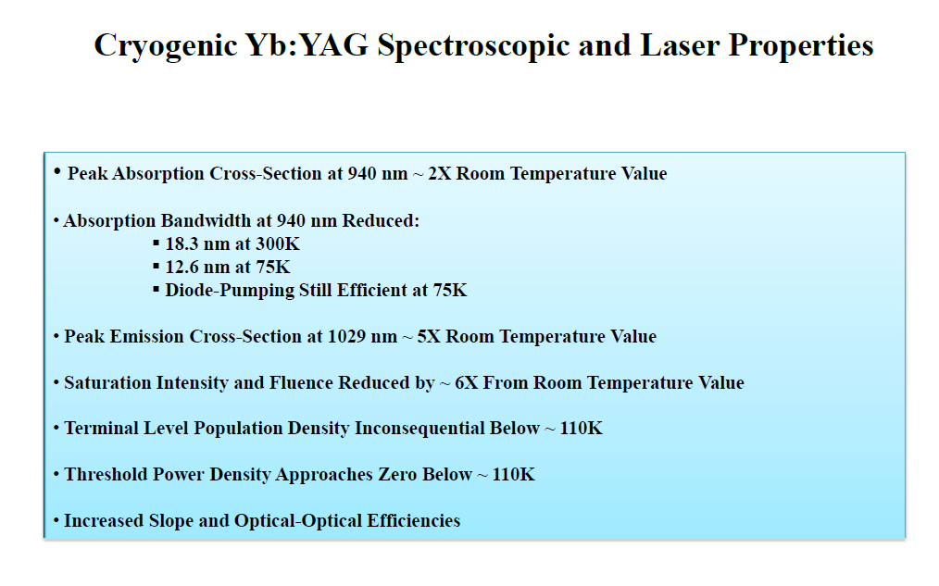

Slide 40
Laser Amplifier Advancement
“High sustained average power CW and ultrafast Yb:YAG near-diffraction-limited cryogenic solid-state laser” David C. Brown*, et.al. Snake Creek Lasers, LLC, Hallstead, PA, 18822 Published in Optics Express, Vol. 18, Iss. 24, pp. 24770-24792
  Produced kW CW output beam power at 1029 nm.
  50 Mhz seed laser with 1-1.5 nJ pulse energy amplified to 15.2 μJ with a FWHM pulse width of 12.4 ps with >700W average power and a peak power of 1.23 MW.
Unique crystal assembly in a distributed
arrangement to minimize heating in any crystal
and minimize any thermal re-population.
Cryo amplifier essentially runs DC

Slide 41
Cryogenically cooled Yb:YAG Amplifier
 | Input | 1-stage amp | 2-stage amp
Rep. Rate | 50 MHz | 50 MHz | 50 MHz
Pulse Energy | 1.1 nJ | 0.91 uJ | 15.2 uJ
Pulse Width | 12 ps | 12 ps | 12.4 ps
Peak power | 92 W | 75.83 KW | 1.23 MW
Average Power | 55 mW | 45.4 W | 758 W
Energy Gain |  | 827 | 16.7
Stage 1 amplifier system: double-pass 7-element cascaded amplifiers
Stage 2 amplifier system: single-pass 8-element cascaded amplifiers

Slide 42
The Field is Very Active
Many techniques such as
  Build up cavities
  Fiber amplification
  Laser re-circulation
  Cryogenic amplification
are being investigated to resolve the many technical issues
  Wavefront distortion (mirror deformation)
  Dielectric coating behavior in vacuum
  Efficient harmonic distortion
  Radiation damage
  Acceptable spatial profile (M²~1)
  Reliability
  High peak powers
  High average powers
  Long macro-pulse length
  High repetition rates
Work being carried out
  at private companies under SBIR program
  National Labs (LBL and SNS and soon FNAL)

Slide 43
Implication for Project X
Utilization for 8 GeV injection to minimize losses due to foil
Estimates were performed for same H- beam parameters except with energy at 6 GeV for 2 wavelengths
  1900 nm – not possible to reach the n=2
  1064 nm (angle 79.25º)
    No magnetic field
      5 MW peak (not significantly different from 8 GeV)
    Strong magnetic field (1.4 T)
      8 MW peak
Looks very encouraging for Project X

Slide 44
Bottom line
Encourage multiple path R&D
Today’s cutting edge technology will be tomorrow’s off-the-shelf standard hardware

