Slide 1
SNS/ProjectX Commissioning/Infrastructure
Willem Blokland
(SNS/RAD)

Slide 2
WorkGroup Controls, Instr.& Protection
What are the requirements for ProjectX?
Identify technical issues for Controls & Instrumentation (and high level applications)
Establish goals and mile stones
Collaboration and R&D

Slide 3
SNS Commissioning Experience
(K. Jones)
Loss tuning and measurement
Flexibility of cavities
Hardware (HVCM) reliability -> Shake out period
Dual Source for reliability -> Risk management
Errant beam control -> Diagnostics performance
Robust Intelligent Control system
What are the (uptime) requirements by the customer?

Slide 4
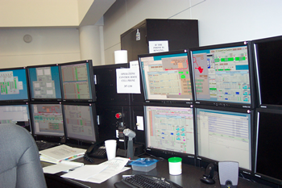
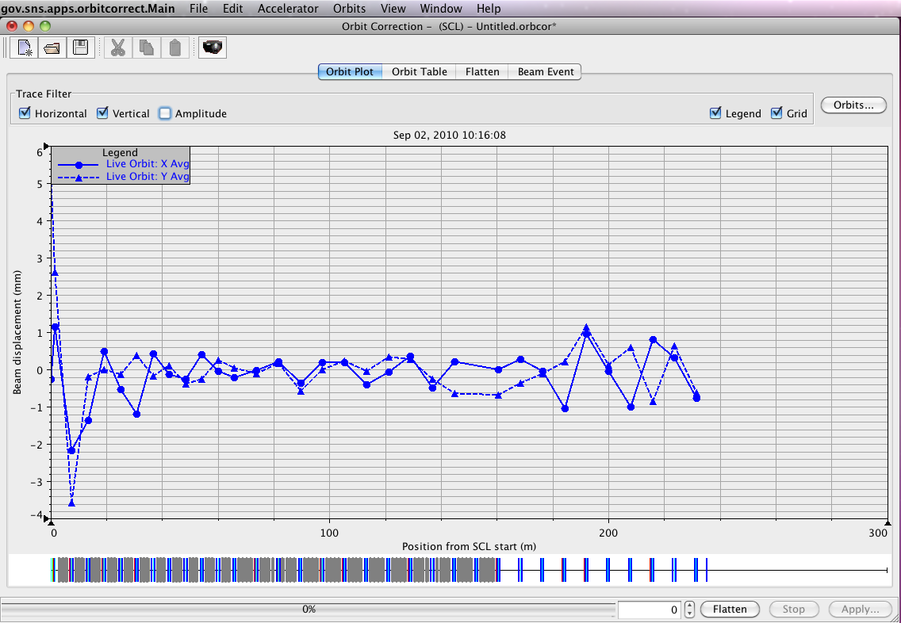
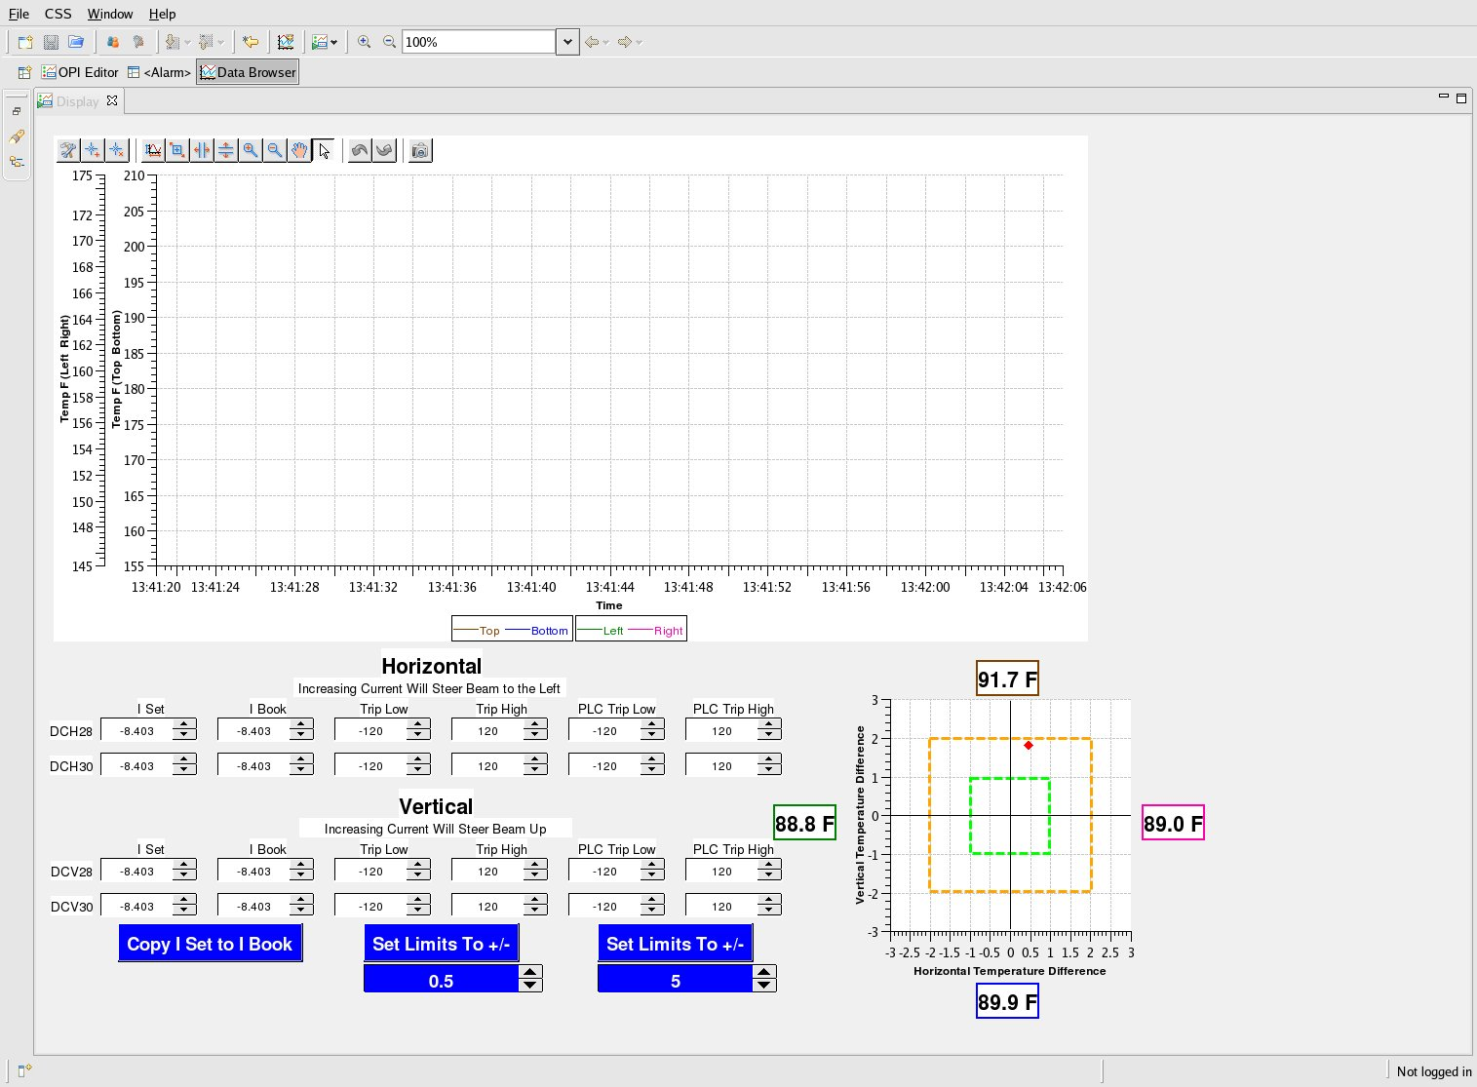
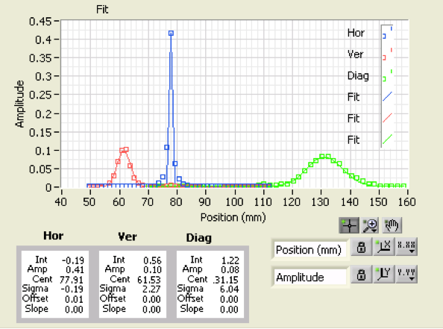
SNS Research Accelerator Division
Operations
Physics
Day to day operations
Console Applications (GUI, Alarm, Tune-up)
Optimizing, setup, theory, design
Accelerator applications (XAL)
Simulations
Real-time/offline models
Responsibilities are separated (to a degree) to avoid priority conflicts
Support and use their own infra-structure on top of Controls’
Controls
Instrumentation
Infra-structure: network, consoles, PLC, PPS, MPS, CSS, Timing….
EPICS, PLC, VME, VxWorks,…
Beam measurements
Detectors, Electronics, Instrumentation Platform
See also previous ProjectX talk on SNS Console Overview, Sept. 2010

Slide 5
Physicist Control System Interface Perspective (SNS)
J. Galambos
Physicists wrote high level programs
Some more, some none
High level programming/script interface
Java, python, matlab, …
Use modern tools for gui, plots, math, …
Simple interface to “physical” quantities
Hide control system connection details
E.g. getAverageHorizontalPosition()

Slide 6
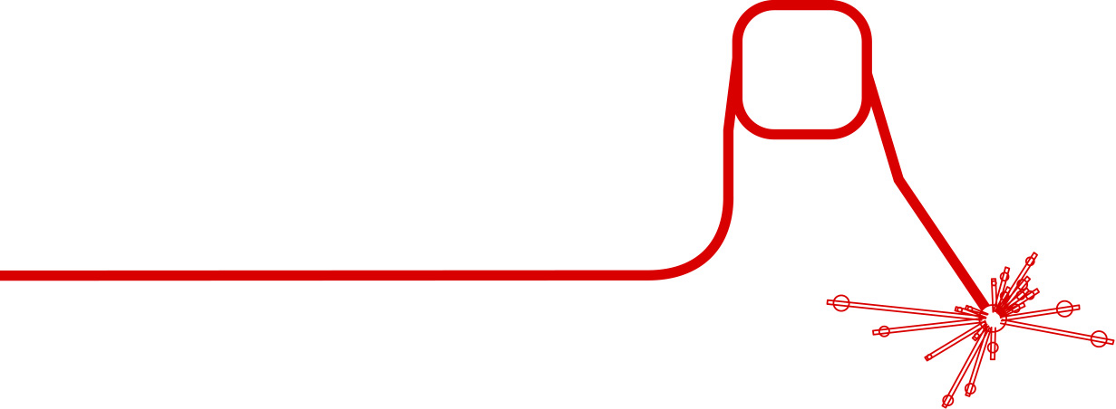
Hierarchical Control System
Management
Planning
Long term planning of the accelerator, e.g.CD4 goal
Run Coordinator
Operations
Execution
Operation of the plant, executing
the plan, e.g run beam to 50mA
Applications
Server
Supervisory
Plant-wide data collection and optimization
Network
Group Control. For Example: Laserwire Transfer line
NAD
Coordination
(Private) Network
NAD
Control
Data-acquisition and processing:
PLCs, NADs
Wires
Sensor/Actuator
Toroids, BMP plates, Harp, etc
Implementation
Accelerator
Examples

Slide 7
ProjectX Infrastructure
What is required for ProjectX from a top-down perspective? If you don’t do a top-down design and rely on a bottom-up approach only, you can end up with a best guess implementation by people who might not fully understand the difference between the old and the new system.
Oh, you wanted wheels with that!
Photo credit: Kevin P. Coughlin

Slide 8
ProjectX Infrastructure
Discussion:
What do you envision for the ProjectX Control Room Environment?
Console screens-> graphics, alarms
Physics applications
programming environment
Rapid development
Who develops in what programming language
What data is needed and at what rates
Archiving and retrieval
Network requirements

