Slide 1
Beam Diagnostics: Requirements (tentative, for discussion)
S.Nagaitsev, V.Lebedev, N.Solyak, M.Wendt, D. Johnson
FNAL

Slide 2
What the Beam Instrumentalist would like to know…
Physical
How many monitors, what kind, and where? (BPMs, BLMs, profile & emittance monitors, bunch profile, phase, halo, tails, etc.)
Space and dimensions, particular long. space including flanges (which type?!) and bellows? Beam pipe diameter?
Operating conditions, i.e. temperature, cleanliness?
Mechanical tolerances(?), alignment?
Machine parameters and operating conditions
Beam parameters, nominal, commissioning, upgrades? Min/ max. beam intensity? Timing of chopped beam, min./max. length of beam-pulses / beam-lets.
Instrument requirements
Dynamic range (beam intensity, displacement, etc.), resolution, accuracy, reproducibility?
Min./max. measurement (integration) time?
Other
Installation conditions (radiation, detector & rack locations, cable length, etc.)?
Timing, trigger LLRF signals, control system and interface, data formats, time stamping, etc.

Slide 3
…well, there are some things we know!
Nominal beam parameters and beam optics
We have an estimate on number and type of beam diagnostics
Beam pickups need to be physical compact (in z-direction)!
A general purpose vacuum tank is foreseen in the MEBT (a la SNS), for flexible installation of various beam detectors and collimators (wires, slits, laser beams, etc.)
No LEBT diagnostics, except for beam intensity.
No or only very little space for most beam detectors!
Only BPM pickup diagnostics inside cryostats
Goal: one BPM pickup (hor. & vert.?) per focusing element)
Comment from SN: not necessarily true. Collimators in SSR section need to be instrumented. Loss monitors may be installed in cryostats
No intercepting beam detectors nearby SC cavities
Definition of “nearby”?
Can we use niobium wires for beam profile monitoring nearby SC cavities?
No electronics in the accelerator tunnel
Except LEBT/MEBT?

Slide 4
Commissioning vs. operations
Instrumentation requirements and beam parameters will be different for commissioning and operations.
The commissioning may proceed by increasing the duty cycle at ~1 mA with beam pulses of several µs.

Slide 7
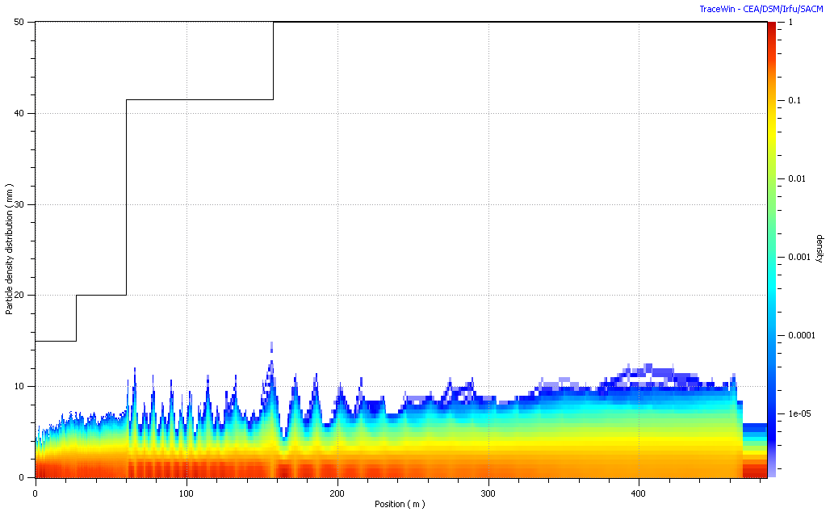
Lattice, beam envelopes and aperture
LE650
HE650
SSR0+SSR1
SSR2
∅100 mm
∅83mm
∅30mm
∅40mm
* SSR0 Cryo-string contains 3 CM; ** SSR1 Cryo-string with 2 CM’s

Slide 8
Table: Component counts for the 3-GeV cw linac
 | SSR0 | SSR1 | SSR2 | LE650 | HE650 | Total
# CM | 1* | 2** | 4 | 7 | 19 | 33
# Cavity | 21 | 20 | 44 | 42 | 152 | 276
#magnet | 18 | 20 | 24 | 14 | 38 | 114
Input energy, MeV | 2.5 | 11.4 | 42.9 | 178.7 | 558.7 | 3060
Period length, m | 0.61 | 0.80 | 1.60 | 4.25/5.95 | 15.40
* SSR0 Cryo-string contains 3 CM’s;
** SSR1 Cryo-string with 2 CM’s

Slide 9
CW Linac Segmentation
MEBT section – Room Temperature
Superconducting Linac
All cryomodules/cryo-strings are separated by RT drift spaces, available for beam diagnostics.
In 325 MHz sections RT space are limited ~200-400 mm available
In 650 MHz sections RT space up to ~1m available for diagnostics

Slide 10
LE Cryomodules
Segmentation in 650 MHz sections, ~1m in RT interconnection is available for beam diagnostics
8878.5
3238
HE Cryomodules
11325
3282
CMs lengths are shown from the first cavity iris to the last cavity iris.

Slide 11
General requirements (Intense Beam and Superconducting environments):
Use minimal longitudinal insertion space for each device
Ultra clean technology for beam diagnostics to prevent cavity contamination.
For interceptive diagnostics: minimize evaporation or disruption of material.
Diagnostics must work with protons as well as with H- ions.
High reliability

Slide 12
Diagnostics
BPM (button type) in each solenoid and doublet.
Located at each solenoid/doublet, 3 coordinates
Absolute Position accuracy <1% of aperture (<0.5 mm in the current range 0.2-1 mA)
Relative accuracy Resolution <0.1% of aperture (<30-100um)
Phase accuracy < 2° of processing freq
Relative phase accuracy Phase resolution < 0.12° of processing freq
Measurement time – 2 μs (required accuracy can be achieved by averaging (less than 30 pulses))
Dynamic range 65 dB
Bandwidth - ??? MHz
Beam Current monitors:
resolution <1.e-4
Absolute accuracy <0.2%
Wire beam profile monitor (@1mA)
Width measurement accuracy 10% of beam size
Beam pulse <100 μs
Laser Beam profile monitors (I am not sure we need them, VL)
Width measurement accuracy 10% of beam size

Slide 13
Possible Cold instrumentations
Slots available for cold instrumentation in SSR1-SSR2
2* 190 mm in SSR0 cryo-string
2 * 270 mm in two SSR1 cryo-strings
Can we place Laser Wire here?

Slide 14
Instrumentation (tentative, for discussion)
 | MEBT | SSR0 | SSR1 | SSR2 | LE650 | HE650 | Total
Current monitor | 2 | 1* | 2** | 4 | 7 | 10 | 26
Emittance (Slit and collector) | 1 | 0 | 0 | 0 | 0 | 1 | 2
Wire Monitor | 4 | ? | ? | 0 | 0 | 0 | 4
Laser Wire | 0 | 2 | 2 | 4 | 4 | 8 | 22
BPM | 11 | 21 | 20 | 24 | 14 | 38 | 128
Loss monitor | 2 | 4 | 4 | 4 | 4 | 12 | 30
Neutron | 4 | 1 | 2 | 2 | 7 | 19 | 35
Halo monitor | 1 |  |  | 1 |  | 1 | 3

Slide 15
RDR Transport Line Layout
3 GeV Experimental (~300m)
3 GeV Linac Dump (~130m)
8 GeV Transfer (~100m)
3 to 8 GeV Transfer (< 1 km)

Slide 16
Transport Line Instrumentation Counts
Line | Beam Power | Quads | Position | Loss* | Profile | Intensity
Match | 3MW | 4 | 4 | 4 | 2 | 1
3G Dump | ~100 kW | 8 | 8 | 8 | 1 | 1
3to8G | 130 kW | 8 | 8 | 8 | 1 | 1
3G Exp | 3 MW | ~28 | ~28 | ~28 | 4 | 2
8G Transport | 345 kW | ~60 | ~60 | ~60 | 4 | 2
totals |  | ~108 | ~108 | ~108 | 12 | 7
*It is assumed that there will be a position monitor and loss monitor
associated with every quad plus additional monitors as needed at
transfer points and collimators.

Slide 17
Transport Line Instrumentation Requirements
Position:
Fundamental measurement and the most powerful diagnostics tool in an accelerator.
Project X transport requires a large number (~100) of new beam position monitors (BPM), thus makes it a complex and expensive measurement system.
BPM pickups need high quality RF cables to transmit their low-power signals to the read-out hardware outside the accelerator tunnel. Specifications yet to be determined.
Measure variable bunch structures (CW to quasi-CW) . Measurement specifications to be determined.
Choice of pick up and electronics technology has not been selected.
Profile monitors:
Required in the transfer line for measuring emittance and matching between the linac and transfer line and the Recycler.
Options include the standard multi-wire monitor and the newer laser profile monitor.
The choice of technology has not been selected.
Beam Loss:
Typical fast ionization chambers with a large dynamic range will be utilized for most loss measurements.
There may be instances where measurements of thermal neutrons or machine activation during cooldown periods are desired which imply dedicated neutron monitors.
The loss monitors will be incorporated in a machine protection system.
Beam current:
An accurate measure of beam current throughout the linac, transfer line, injection straight is required to determine transport and injection efficiency.
The current thought is the utilization of current toroids.

