Slide 1
Project X Collaboration Meeting, April 12-14, 2011 Spallation Neutron Source facility at Oak Ridge National Laboratory
HOM Couplers for Project X: Are they needed?
V. Yakovlev,
on behalf of the FNAL team.

Slide 2
Motivation:
HOM damper is a vulnerable, expensive and complicated part of SC acceleration structure (problems – multipactoring, damage of feed-through, etc; additional hardware – cables, feed-through, connectors, loads);
SNS SC linac experience shows that HOM dampers may limit a cavity performance and reduce operation reliability;
SNS linac experience doesn’t show necessity of the HOM couplers.
The 5-cell 650 MHz cavities are under development and it is necessary to understand necessity of HOM dampers for these cavities.

Slide 3
Effects of HOMs (collective instabilities, cavity heating) depend on the beam current, beam spectrum (chopping!) and cavity HOM spectrum.
“Average” HOM power per cavity (incoherent losses):
P_{av} = k_{loss}Q_{b}I_{av}
 | Project X | SNS | ILC
I_{av}, mA | 1 | 1 | 4.8e-2
Q_{b}, pC | 25.6* | 58 | 3200
k_{loss}, V/pC | 2 | 1.1 | 13.4
P_{av},mW/cavity | 51 | 64 | 2065
The ILC-type 1.3 GHz cavities contain HOM couplers that reduce the loaded Q-factors for transverse and longitudinal HOMs down to 10⁵.
For SNS cavities no measureable HOM signals from beam observed.
*162.5 MHz beam sequence frequency.

Slide 4
In ILC linac HOM dampers are necessary. All the 1.3 GHz ILC cavities are equipped by HOM couplers, which work successfully at DESY. However, some problems with HOM couplers take place. Problem with long-pulse operation: “An insufficient heat conduction of the HOM feedthroughs, even after the alumina window has been replaced with sapphire window, caused heating of the Nb antennae above the T_{c}” – J. Sekutowicz, HOM Workshop, Cornell, 2010. Problem with MP at low gradient (D. Kostin, private communications).
Analysis of the collective effects (BBU and klystron-type) in SNS linac does not show critical influence of the HOMs on the beam dynamics;
Our goal is to understand the HOM influence on the beam dynamics in Project X in order to decide whether we need the HPM dampers in high energy part of the linac and in the low energy part as well.

Slide 5
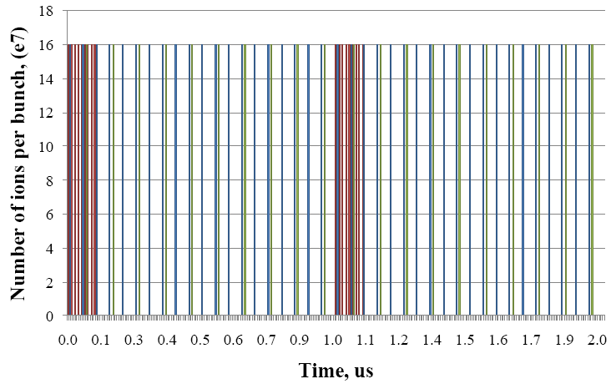
The beam time structure in the Project X CW linac (162.5 MHz front end):
Each bunch contains 1.6•10⁸ of H⁻.
The bunch sequence frequency for the Mu2e is 81.25 MHz, the bunch train width is 100 nsec, the train repetition rate is 1 MHz. The beam power is 700 kW.
The bunch sequence frequency for Kaon experiment is 20.3 MHz, power is 1540 kW.
The beam sequence frequency for nuclear experiment is 10.15 MHz, power is 770 kW.

Slide 6
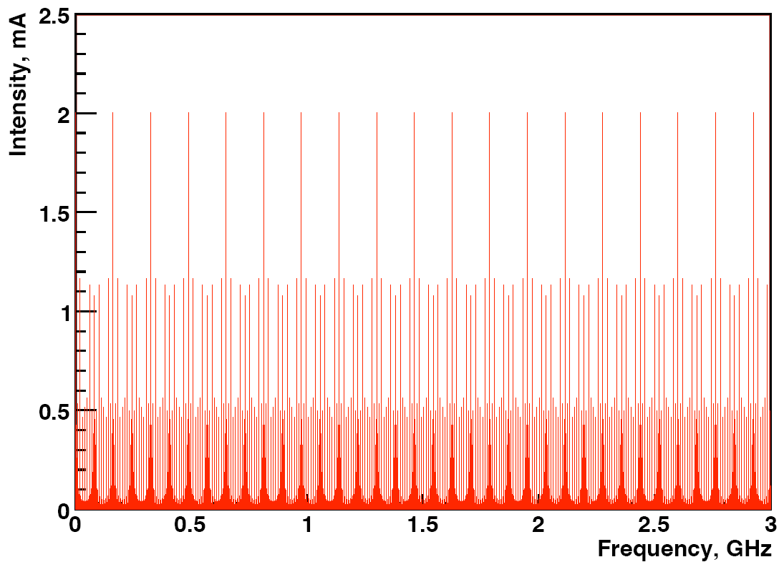
Idealized beam spectrum
The beam current spectrum contains
● harmonics of the bunch sequence frequency of 10.15 MHz and
● sidebands of the harmonics of 81.25 MHz separated by 1 MHz.

Slide 7
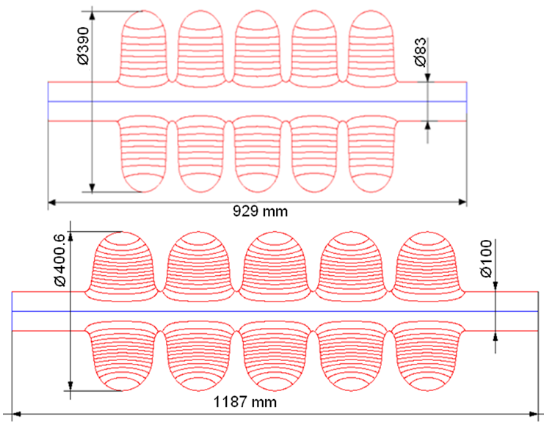
Layout of 650 MHz cavities.
Beta=0.61 (top) and beta=0.9 (bottom).

Slide 8
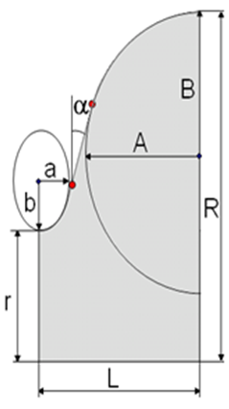
Dimensions of the 650 MHz cavities
Dimension | Beta=0.61 |  | Beta=0.9
 | Regular cell | End cell | Regular cell | End cell
r, mm | 41.5 | 41.5 | 50 | 50
R, mm | 195 | 195 | 200.3 | 200.3
L, mm | 70.3 | 71.4 | 103.8 | 107.0
A, mm | 54 | 54 | 82.5 | 82.5
B, mm | 58 | 58 | 84 | 84.5
a, mm | 14 | 14 | 18 | 20
b, mm | 25 | 25 | 38 | 39.5
α,° | 2 | 2.7 | 5.2 | 7

Slide 9
RF parameters of the 650 MHz cavities
Beta | 0.61 | 0.9
R/Q, Ohm | 378 | 638
G-factor, Ohm | 191 | 255
Max. gain per cavity, MeV(on crest) | 11.7 | 19.3
Gradient, MeV/m | 16.6 | 18.7
Max. Surface electric field, MV/m | 37.5 | 37.3
E_{pk}/E_{acc} | 2.26 | 2
Max surf magnetic field, mT | 70 | 70
B_{pk}/E_{acc} | 4.21 | 3.75
Coupling, % | 0.68 | 0.75

Slide 10
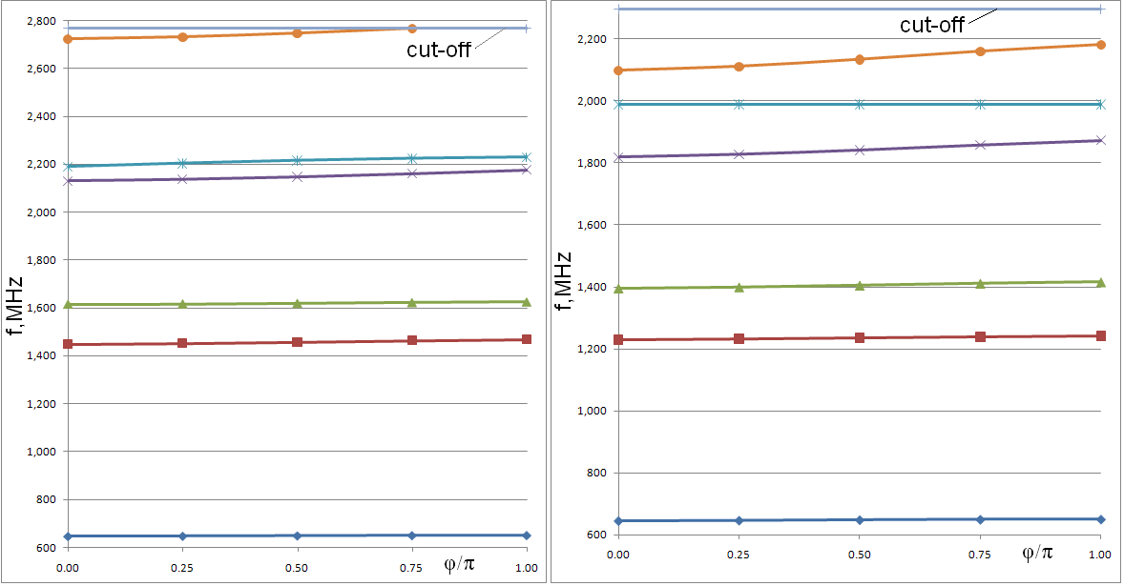
Monopole mode spectrum
β = 0.61 β = 0.9

Slide 11
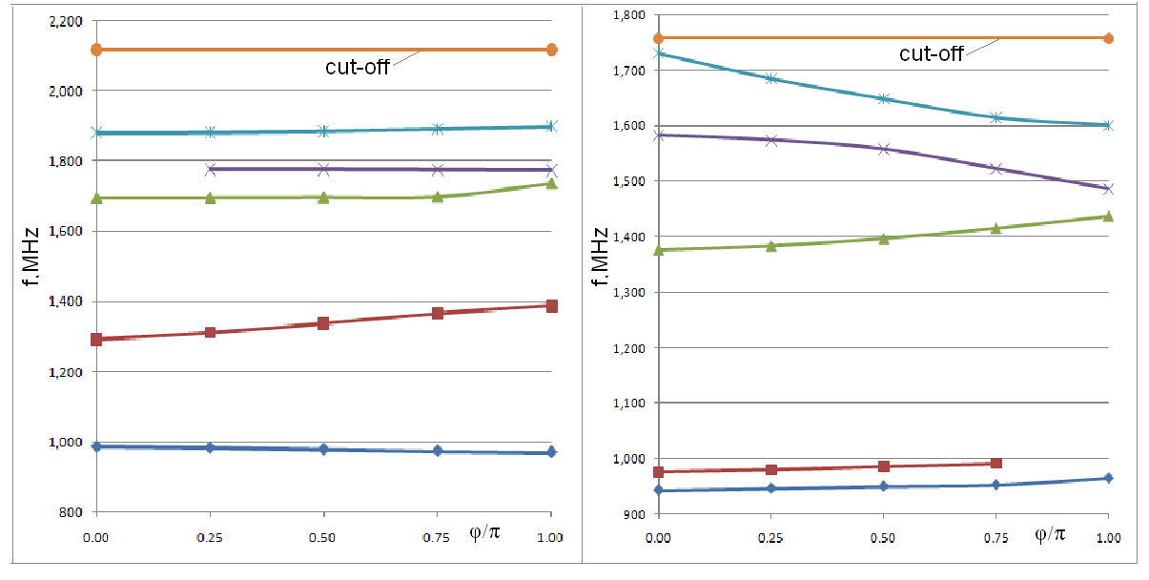
Dipole mode spectrum
β = 0.61 β = 0.9

Slide 12
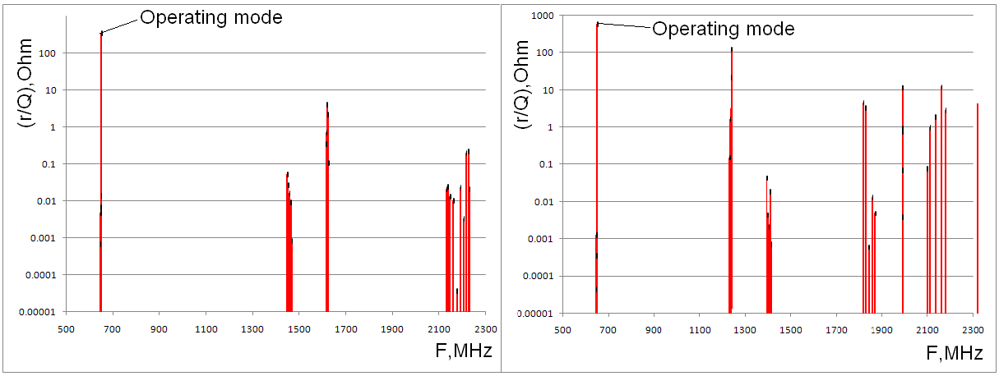
Impedances of monopole modes
β = 0.61 β = 0.9
For β = 0.61: all the modes have (r/Q) below 10 Ohms;
For β = 0.90:
-two modes have (r/Q) =12 Ohm: F=1988 (df=2.2 MHz) and 2159 MHz (df=3.9 MHz),
-one mode has (r/Q) = 22 Ohm: F=1238.6 MHz (df=0.44 MHz) , and
-one mode has (r/Q) = 130 Ohm: F=1241.1 MHz (df=2.0 MHz)
df is the difference between the HOM frequency and nearest main beam spectrum line.

Slide 13
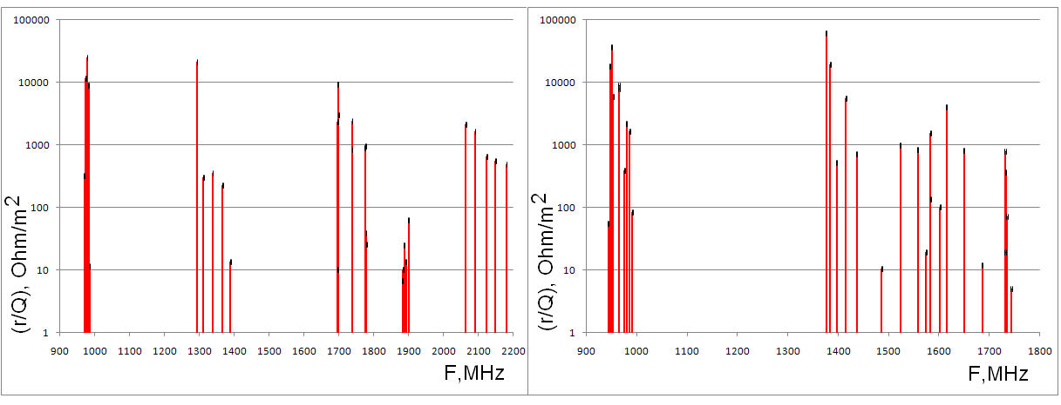
Impedances of dipole modes
β = 0.61 β = 0.9
For β = 0.61 three modes have (r/Q) above 10⁴ Ohm/m²
(F=974, 978.6 and 1293 MHz);
For β = 0.90 four modes have (r/Q) above 10⁴ Ohm/m²
(F=946.6, 950.3, 1376 and 1383 MHz).

Slide 14
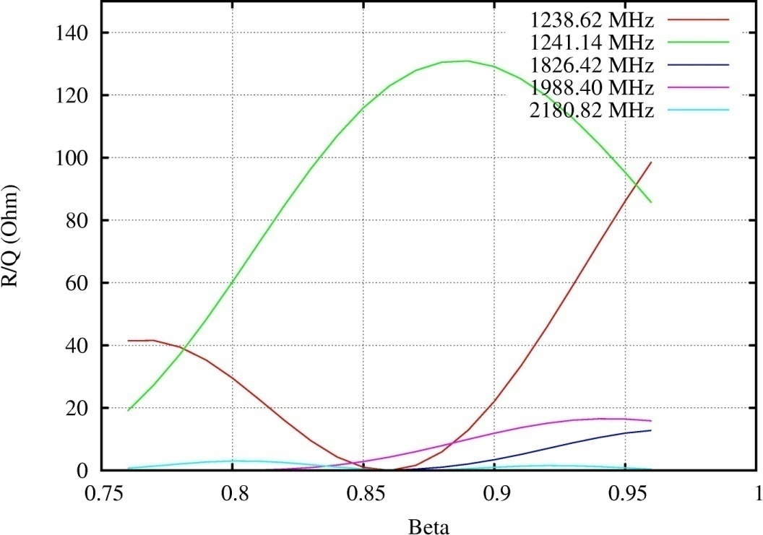
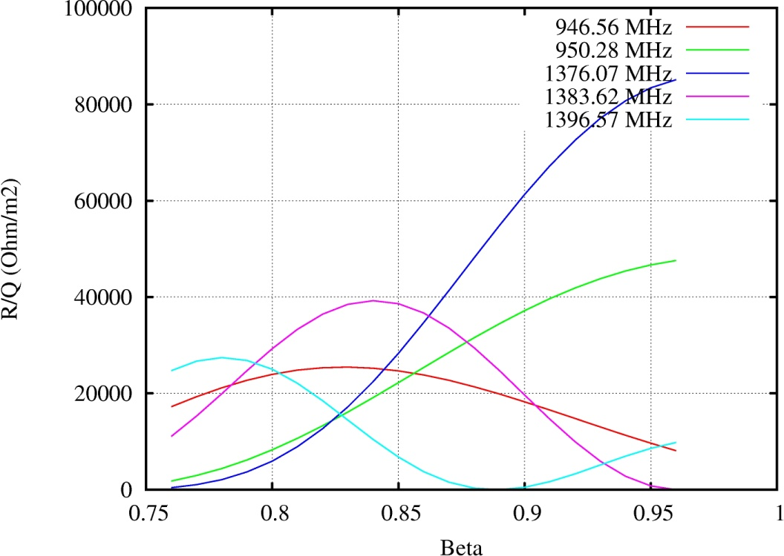
(r/Q) for HOM modes depends on the particle velocity β:
650 MHz, β=0.9 cavity
a) b)
Monopole (a) and dipole (b) impedances of “the most dangerous” modes for beta=0.9 cavity versus accelerated particle velocity.

Slide 15
HOM have frequency spread caused by manufacturing errors.
For ILC cavity r.m.s. spread σ_{f} of the resonance frequencies is 6-9 MHz depending on the pass band, according to DESY measurement statistics: J. Sekutowicz, HOM damping,” ILC Workshop, KEK, November 13-15, 2004. However, in a process of “technology improvement” σ_{f} reduced to ~1 MHz;
Cornell: σ_{f} ≈ 10.9·10⁻⁴×(f_{HOM}-f₀), for PX σ_{f} = 1-2 MHz;
SNS: σ_{f} ≈ (9.6·10⁻⁴ - 13.4·10⁻⁴ )×(f_{HOM}-f₀);
Δf_{max}=|f_{HOM,calculated}-f_{HOM,measured}| ~ σ_{f}

Slide 16
Effect of the HOMs:
Resonance excitation;
Collective effects.
Resonance excitation, monopole modes.
Monopole modes should not increase the beam longitudinal emittance ( = 1.6 keV*nsec):
is average energy gain caused by HOM, is a bunch length. For high-Q resonances
and thus,
is the deference between the HOM frequency and the beam spectrum line frequency ( ). Is a beam spectrum line amplitude.

Slide 17
The worst case: beginning of the high-beta 650 MHz section.
= 7.7e-3 nsec (or 1.8 deg). For = 0.5 mA and (R/Q)= 130 Ohm (HOM with the frequency of 1241 MHz) one has
>> 70 Hz
When the distance between the beam spectrum lines is 5 MHz, and the frequency spread is 1 MHz, the probability that the cavity has the resonant frequency close enough to the beam spectrum line is <1e-4.
The gain caused by the HOM is <300 keV, that is small compared to the operating mode gain, ~20 MeV, and does not contribute to the cryogenic losses
because 1241 MHz mode is TM₀₁₁ mode in a cell, and, thus, it’s surface distribution is “orthogonal” to one of the operating mode. Q₀ ~ 5e9.
If the HOM mode is in resonance, it’s Q_{loaded} << 2e7.
One should take care on the 2d band monopole HOMs in order to avoid resonance accidental excitation!

Slide 18
Resonance excitation, dipole modes.
Dipole modes should not increase the beam transverse emittance
Transverse kick caused by the HOM is:
(k=2π/λ)
Emittance increase may be estimated the following way:
is beta-function near the cavity.
Thus,
is proton rest mass in eV.
For f=1376 MHz, (R/Q)₁=60 kOhm/m² (worst case), proton energy of 500 MeV, β_{f} =15 m and x₀=1 mm one has δf >> 2.5 Hz.
If the HOM is in resonance, Q << 1.4e9.
(ε= 2.5e-7/βγ m).
.5
Does not look to be a problem.

Slide 19
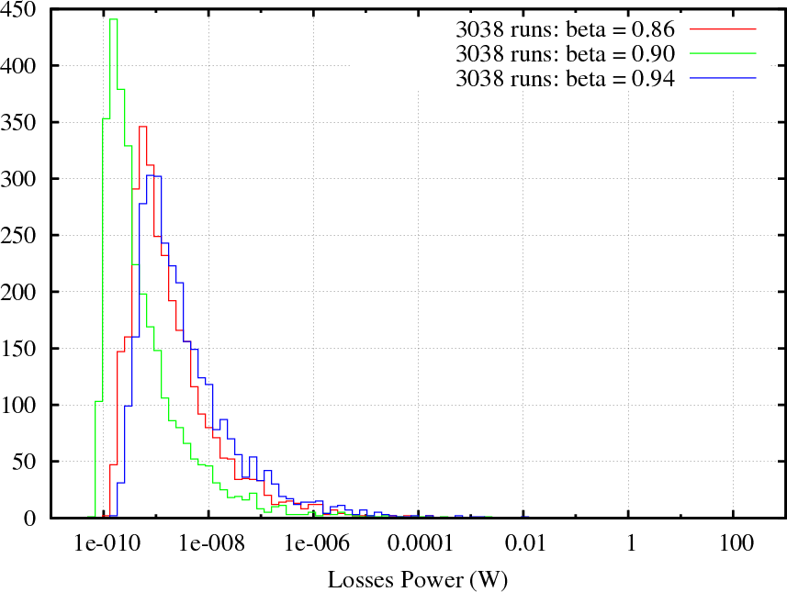
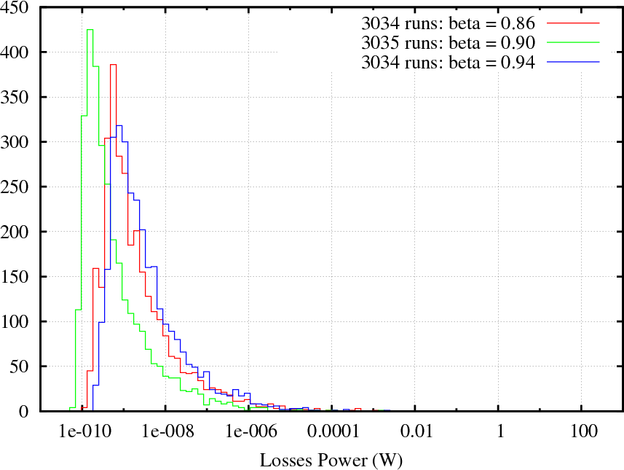
Calculations of the power losses in the HE 650 MHz cavities:
Q=1.e7 Q=1.e10

Slide 20
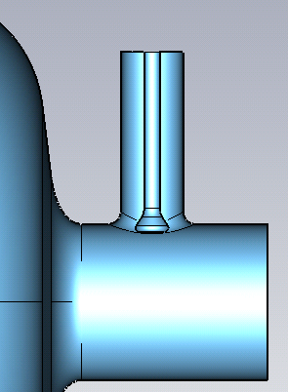
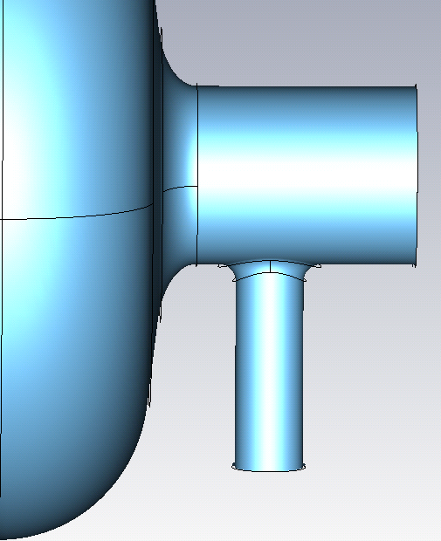
HOM damping through the main coupler.
Main coupler should provide Q_{ext} ~ 2-3e7 for the operating mode.
Da
Dt=100mm
Qext
D=17mm
Dc=40mm
Da

Slide 21
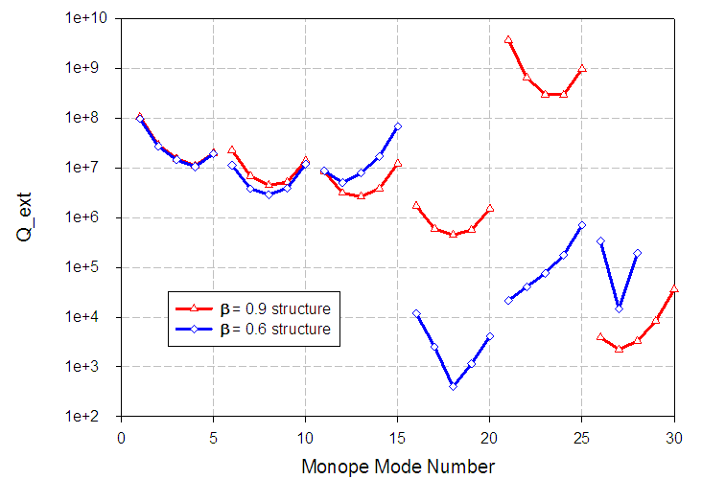
HOM damping through the main coupler (perfect window transmission).
The coupler window is optimized to provide a good transmission for the 2d pass band

Slide 22
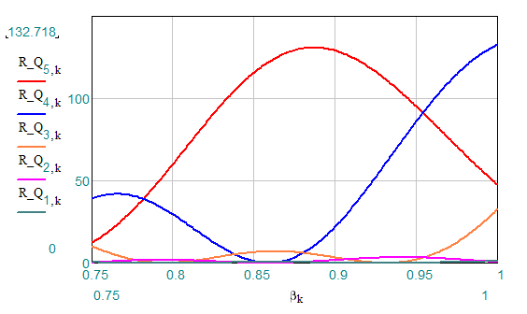
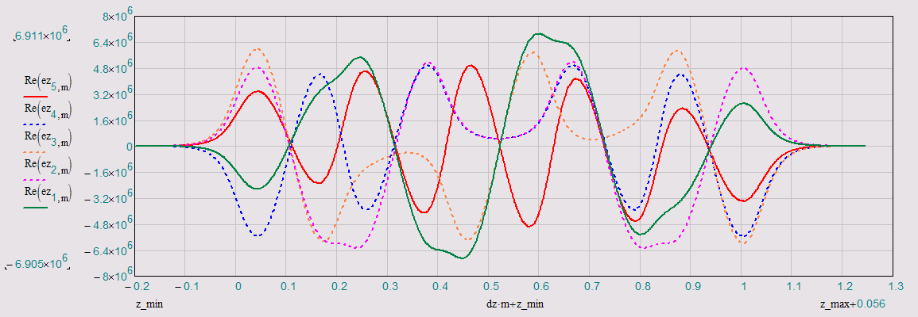
Monopole Band #2
Mode # | Freq [GHz] | Q_ext | R/Q max [Ω] | β max
1/5π | 1.229017 | 2.27E+07 | 1.0 | 1
2/5π | 1.231639 | 6.83E+06 | 3.4 | 0.941
3/5π | 1.235158 | 4.46E+06 | 32.8 | 1
4/5π | 1.238620 | 5.19E+06 | 132.6 | 1
π | 1.241131 | 1.41E+07 | 130.9 | 0.887
R/Q vs β
Ez* on axis

Slide 23
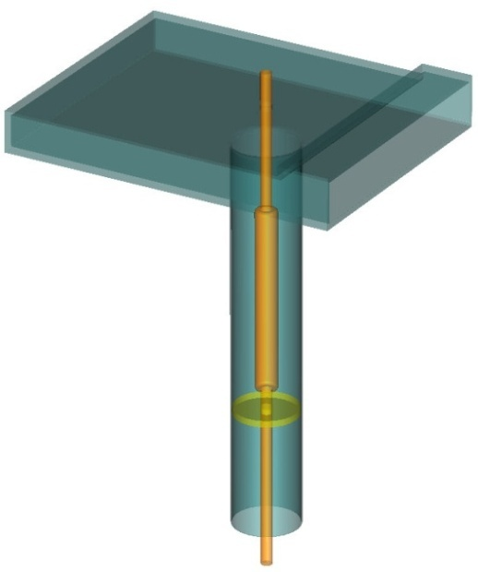
650 MHz coupler , coupler window and WG-coax transition:
1st PB 2d PB 3d PB 4th BP 5th PB
1st and 2d BPs have high (r/Q),
3d and 4th BPs have modest (r/Q) and good damping;
5th BP has modest (r/Q) and poor damping – may need improvement.

Slide 24
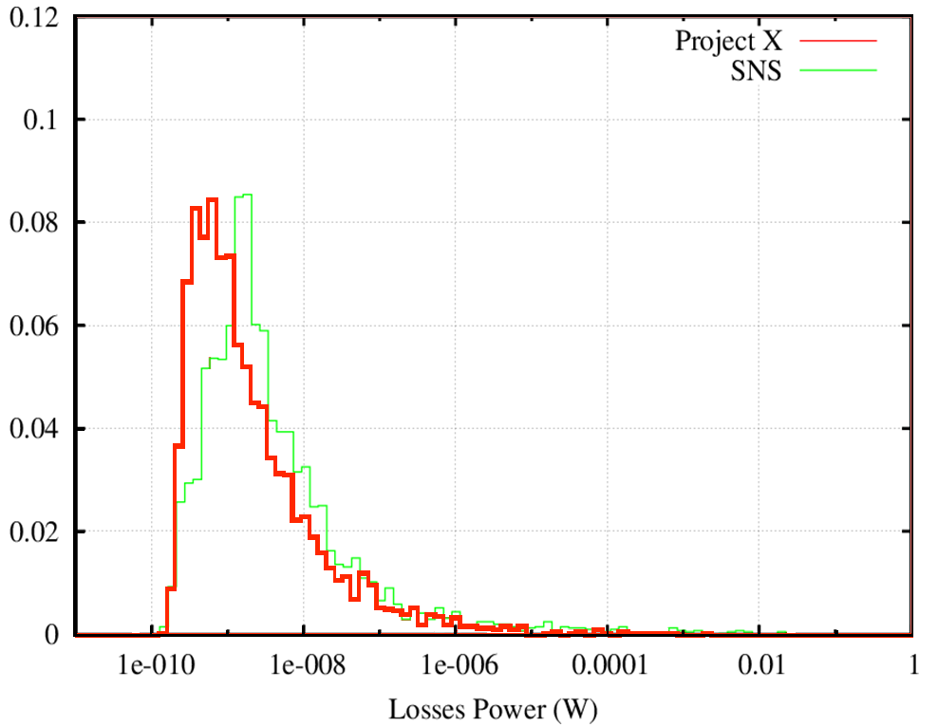
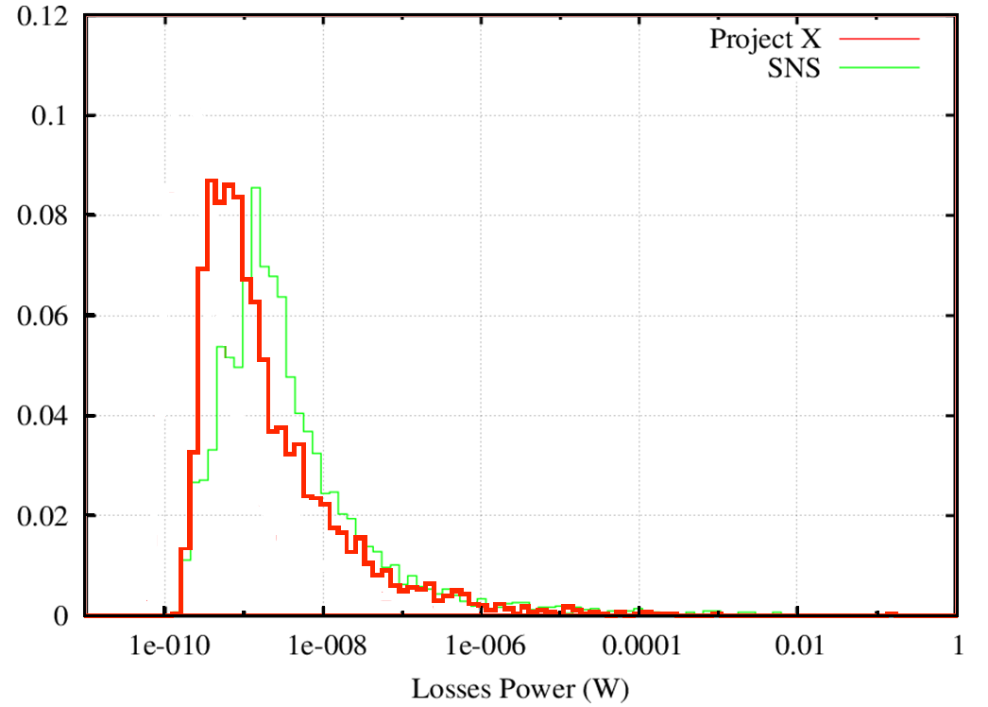
Project X versus SNS (HE parts)
Q=1.e8
Q=1.e9
Power of losses (per cavity) distribution for high energy cavities
for beta=0.9 (PX) and beta=0.81 (SNS) .
SNS: Lorentz detuning and pulse-to-pulse jitter may reduce the losses;
Project X: microphonics may reduce the losses.

Slide 25
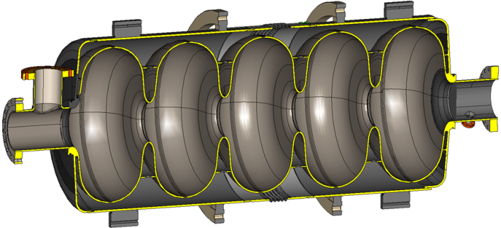
Microphonics for HOMs in HE 650 MHZ cavity of the PX linac.
df/dP in Hz/mbar (blue) for different cavity modes; mode # is in black.
1 | -0.9 | 6 | 58.6 | 11 | 120.0 | 16 | 25.3 | 21 | -93.3 | 26 | 54.6
2 | 4.7 | 7 | 26.6 | 12 | 98.6 | 17 | 46.6 | 22 | -57.3 | 27 | 26.6
3 | 11.6 | 8 | -1.3 | 13 | 96.0 | 18 | 49.3 | 23 | 64.0 | 28 | 50.6
4 | 16.5 | 9 | 5.3 | 14 | 109.3 | 19 | 64.0 | 24 | 77.3 | 29 | 74.6
5 | 5.2 | 10 | 36.0 | 15 | 124.0 | 20 | 89.3 | 25 | 85.3 | 30 | 158.6
The cavity + He vessel are optimized in order to minimize df/dP for the operating mode
#5, but not HOMs.

Slide 26
What to do if the HOM has resonance frequency close to the beam spectrum line*?
f, MHz | Δf, kHz | δf, Hz | Passband
1300 | 90 | 0 | 1Monopole
1600.093 | -218 | 360 | 1Dipole
1604.536 | -215 | 240 | 1Dipole
1607.951 | -214 | 360 | 1Dipole
1612.189 | -210 | 360 | 1Dipole
1621.344 | -211 | 240 | 1Dipole
1625.458 | -208 | 370 | 1Dipole
1830.836 | -185 | 370 | 2Dipople
1859.882 | -36 | 120 | 2Dipople
2298.807 | -278 | 480 | 1Quadrupole
2299.346 | -278 | 490 | 1Quadrupole
2372.333 | -224 | 490 | 2Monopole
2377.333 | -221 | 490 | 2Monopole
2383.575 | -213 | 240 | 2Monopole
2399.289 | -210 | 490 | 2Monopole
Even in the case when it happens, it is possible to move the HOM frequency away from the spectrum line simply detuning the cavity by tens of kHz, and then tune the operating mode back to the resonance.
A special test was made with the 1.3 GHz, 9-cell ILC cavity. The cavity was tested at 2 K.
The operating mode was detuned by Δf=90 kHz, and then was tuned back.
The frequencies of HOMs moved after this procedure by δf=100-500 Hz because of small residual deformation of the cavity.
*Timergali Khabiboulline, this workshop

Slide 27
Collective effects:
Beam break –up (BBU) , transverse.
“Klystron-type” , longitudinal.
Why collective effects may not be an issue:
No feedback as in CEBAF;
Different cavity types with different frequencies and different HOM spectrum are used;
Frequency spread of HOMs in each cavity type, caused by manufacturing errors;
Velocity dependence of the (R/Q);
Small beam current.

Slide 28
Transverse dynamics.
BBU estimations for 650 MHz part of the Project – X linac:
Simple model:
Short bunches;
Current lattice design - N. Solyak, et al;
Two types of the 650 MHz cavities, beta=0.61 and beta=0.9;
Five dipole pass bands are taking into account;
Random transverse misalignment of the cavities;
Beam time structure – S. Nagaitsev (see above)
Model:
(P-W)
Parameters:
Beam current: 1 mA;
RFQ frequency: 325 MHz;
r.m.s cavity off-set: 0.5 mm;

Slide 29
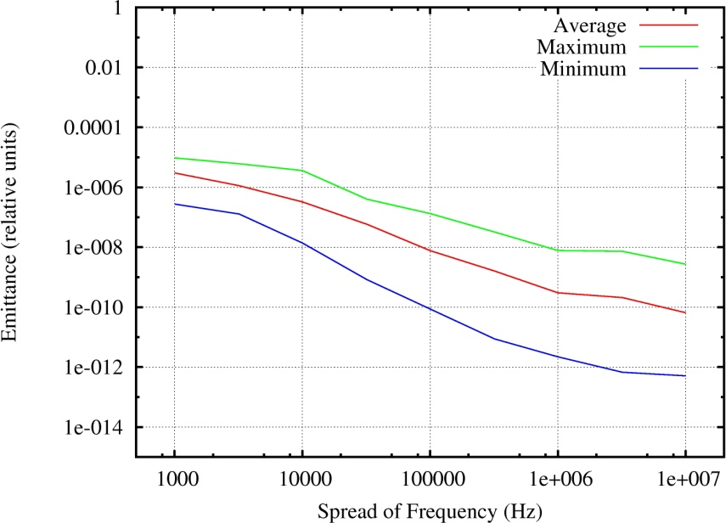
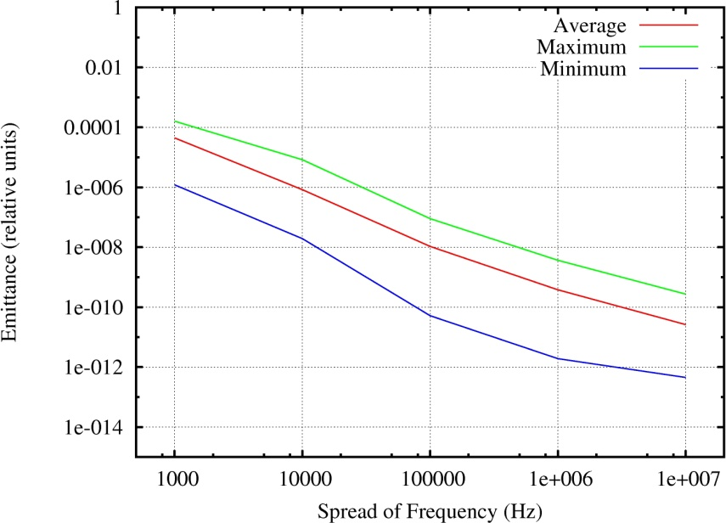
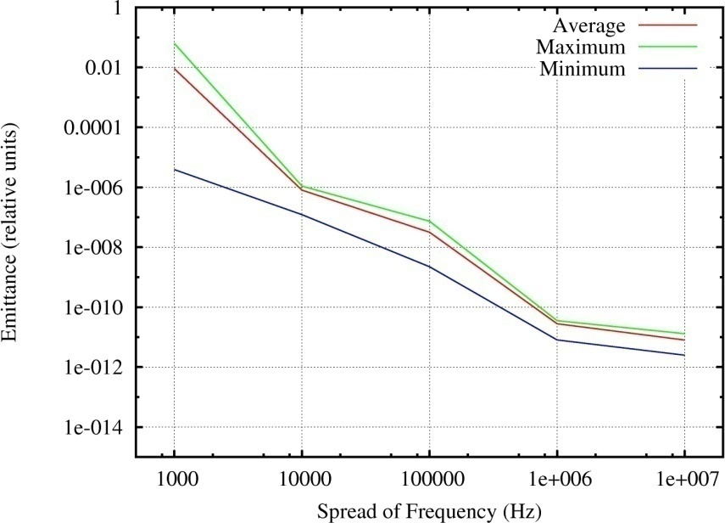
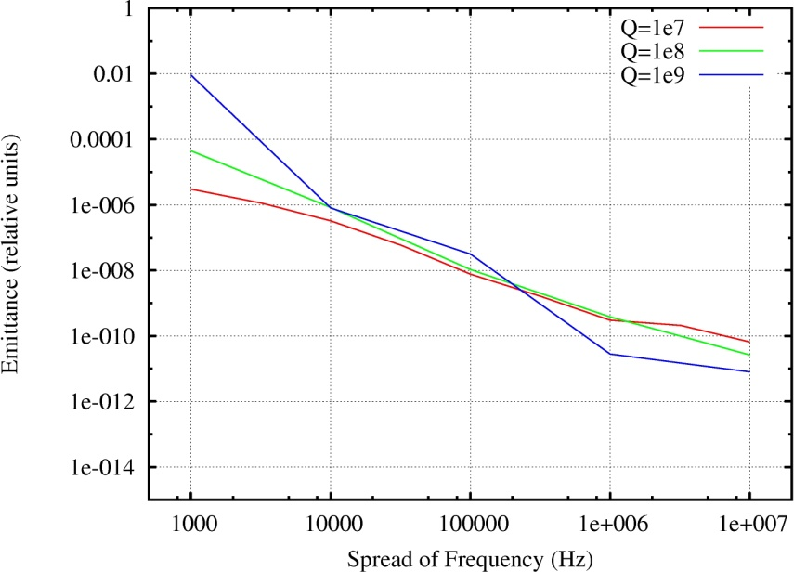
Transverse emittance dilution vs. HOM frequency spread Δf.
Low beta section,
Resonance case,
One HOM only, ( 978.5 MHz, 24 kOHm/m² )
No dependence of (R/Q) on beta.
Δε~Δf⁻²
Q = 10⁷
Q = 10⁸
Q = 10⁹

Slide 30
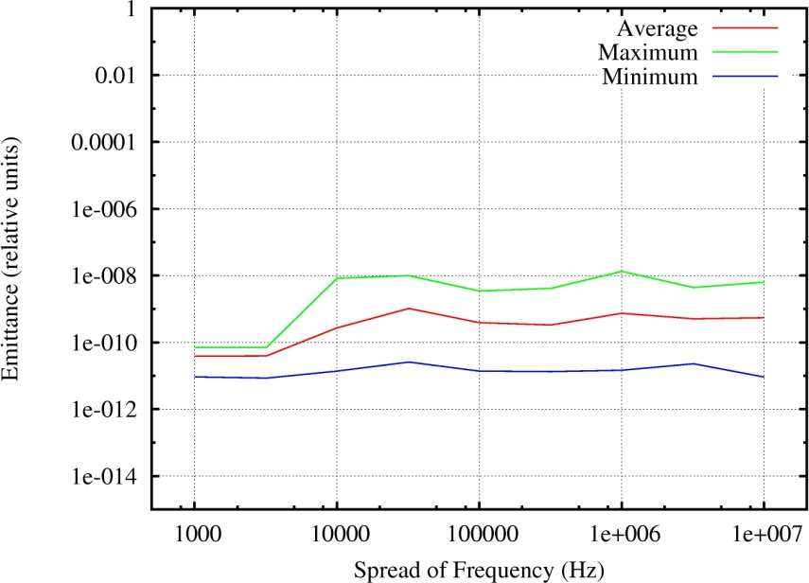
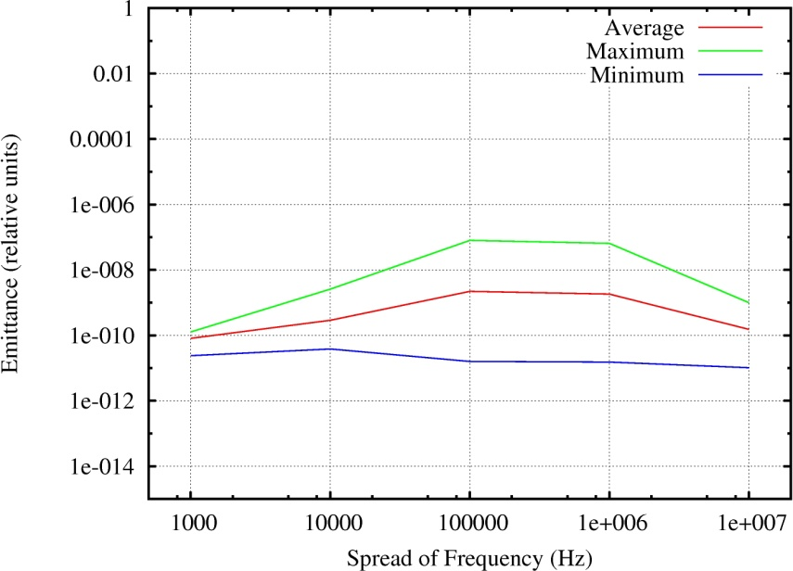
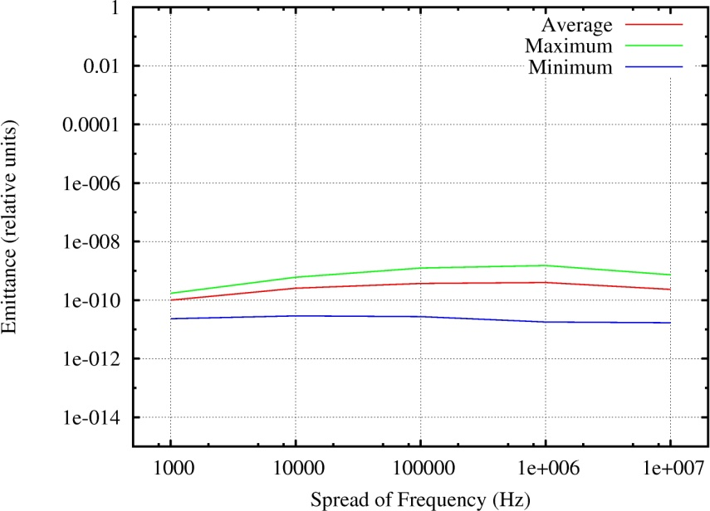
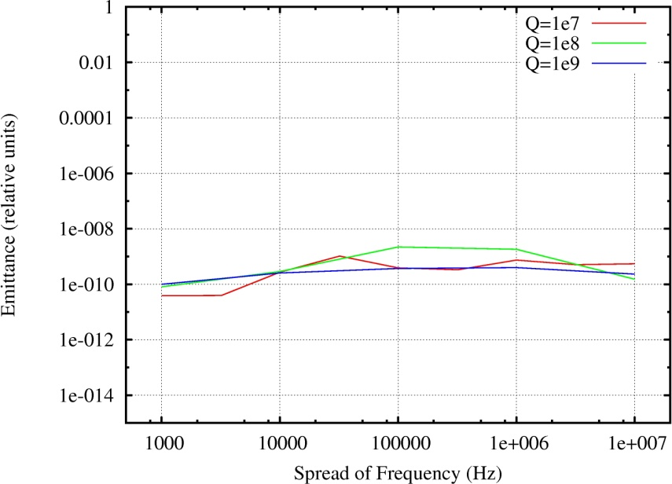
“Realistic” linac. Transverse emittance dilution vs. Δf.
Q = 10⁷
Q = 10⁸
Q = 10⁹
No noticeable effect.

Slide 31
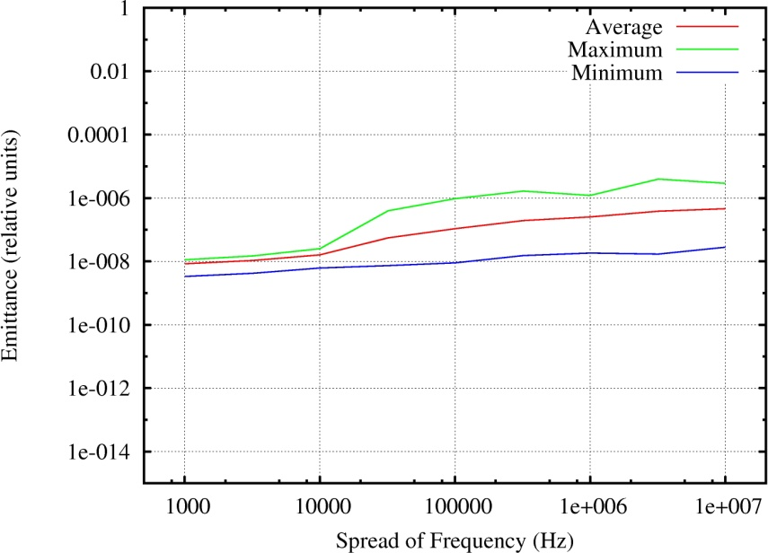
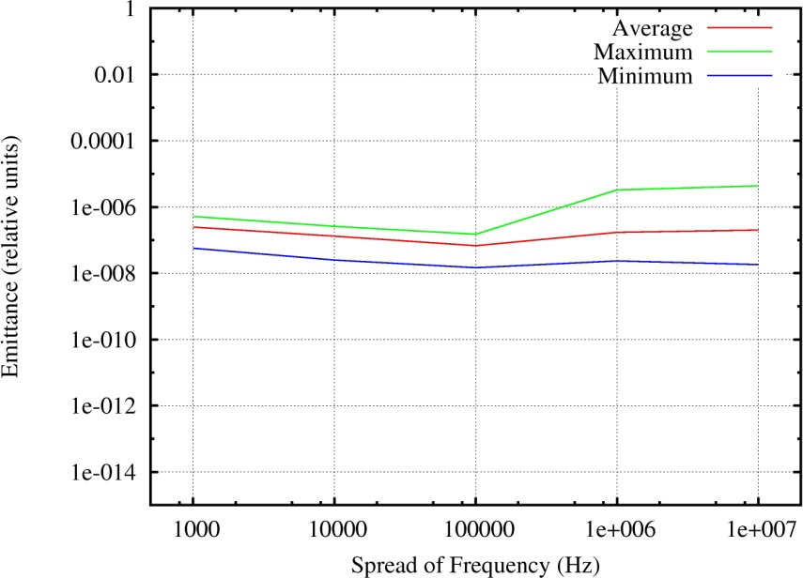
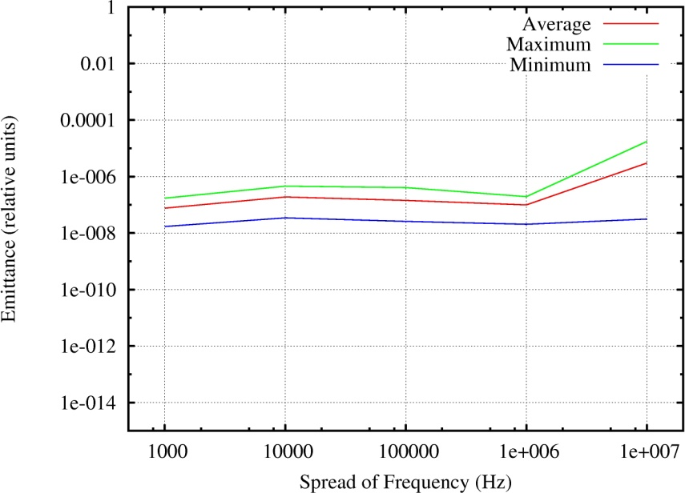
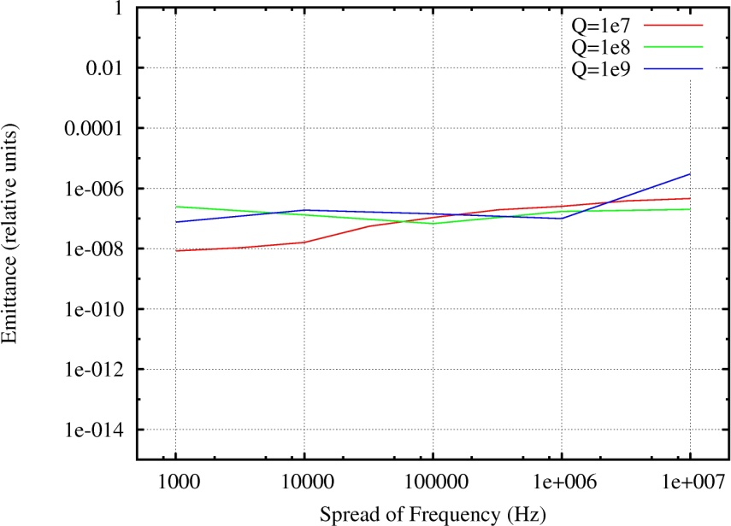
Klystron-type longitudinal instability*,
longitudinal emittance dilution caused by monopole HOMs
Q = 10⁷
Q = 10⁸
Q = 10⁹
J. Tuckmantel, “Do we need HOM dampers on superconducting cavities in proton linacs?”, HOM Workshop, CERN, July 2009

Slide 32
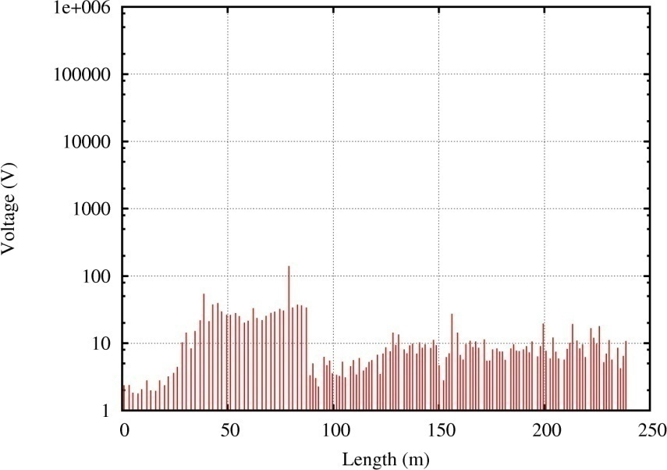
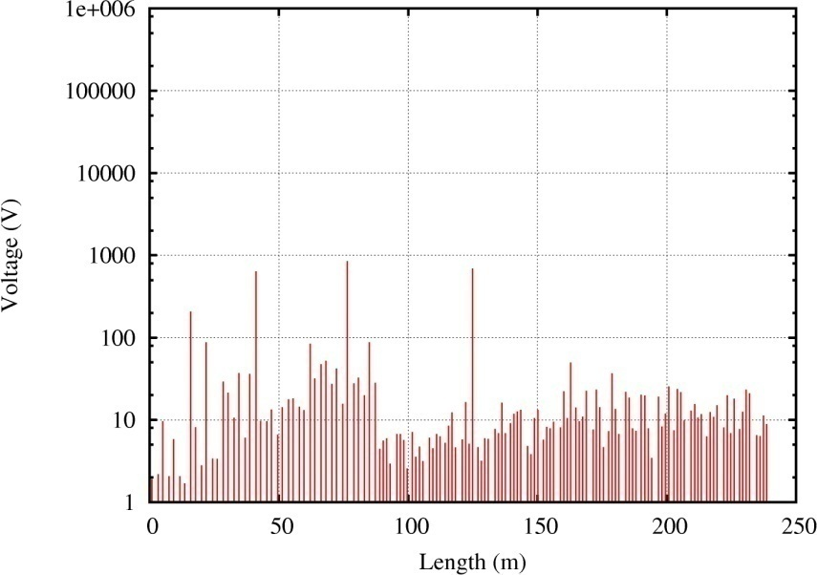
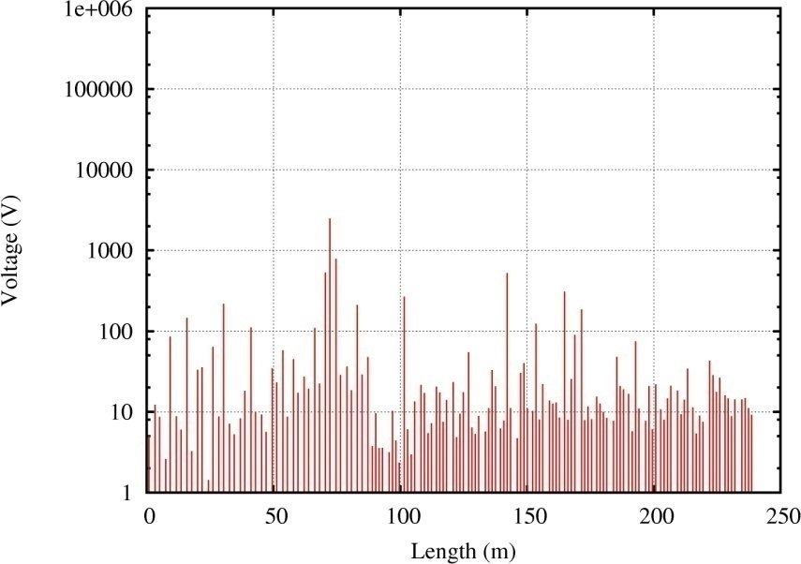
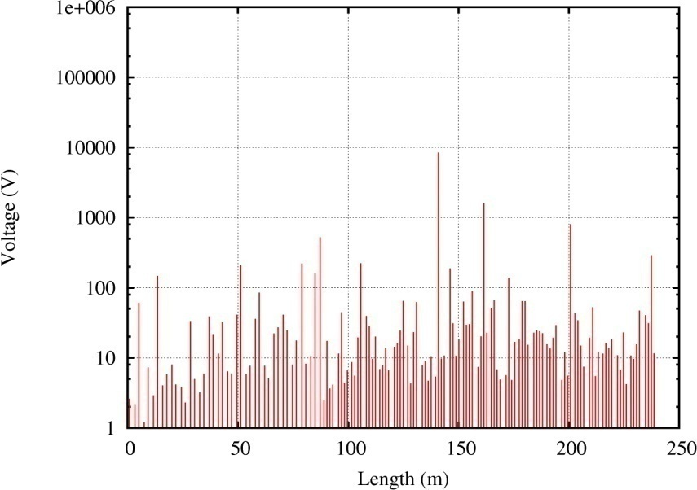
Cavity voltage distribution for different HOM frequency spread
σ_{f} = 10 kHz
σ_{f} = 100 kHz
σ_{f} = 1 MHz
σ_{f} = 10 MHz
No noticeable effect.

Slide 33
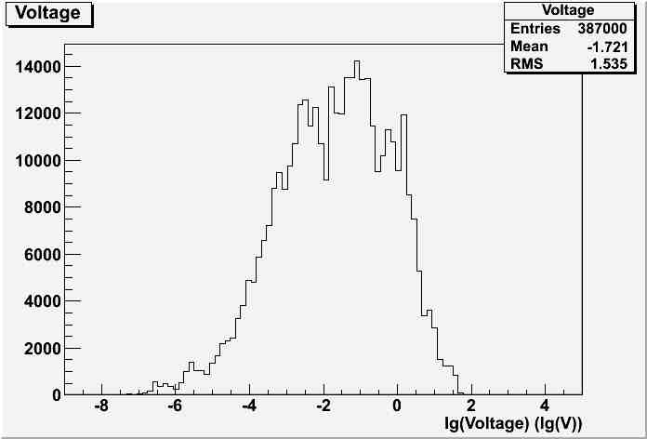
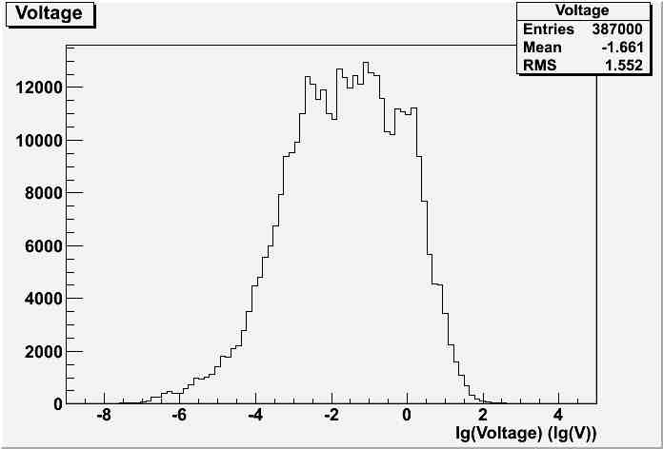
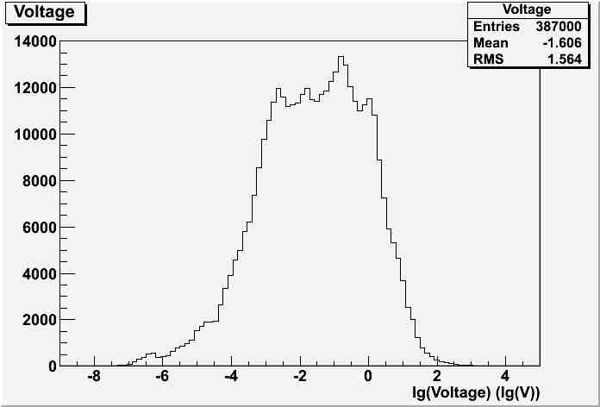
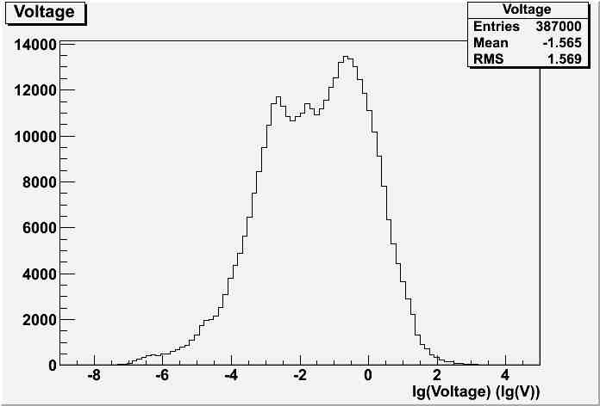
HOM Voltage
σ_{f} = 10 kHz
σ_{f} = 100 kHz
σ_{f} = 1 MHz
σ_{f} = 10 MHz

Slide 34
Summary.
To damp or not to damp?
BBU in 650 MHz section should not be a problem;
“Klystron-type” longitudinal instability does not look to be a problem as well.
Resonance excitation of the dipole modes does not look to be an issue;
Accidental resonance excitation of the 2d monopole band in beta=0.9 section may lead to longitudinal emittance dilution, but probability is small.
However, it may be mitigated by
- properly tuning of the cavities in order to remove the two “dangerous” HOMs from the beam spectrum line (> few hundred of Hz);
tuning-detuning of the operating mode that leads to HOM frequency change caused by residual deformation (needs further tests).
No HOM dampers!

Slide 35
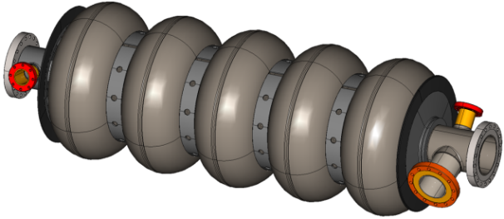
“Safe” option: make flanges (~40 mm)for HOM dampers, seal them and install the dampers in future for possible upgrade if necessary (as they discuss at SPL).
Flange for HOM damper

