Slide 1
Longitudinal dynamic analysis for the 3-8 GeV pulsed LINAC
G. Cancelo, B. Chase, Nikolay Solyak, Yury Eidelman, Sergei Nagaitsev, Julien Branlard

Slide 2
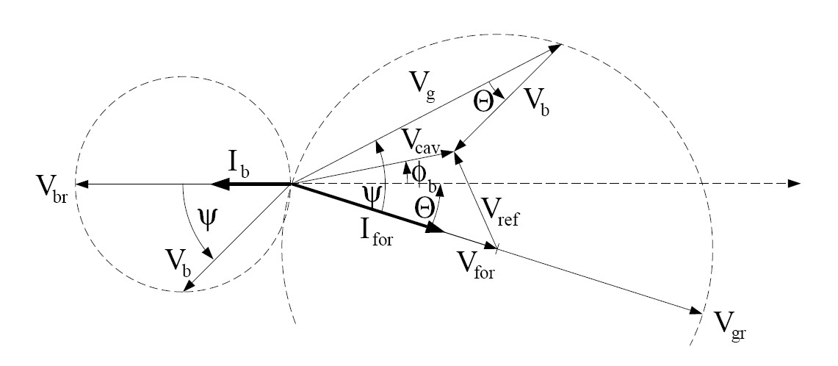
Longitudinal dynamics
An ion/proton LINAC is designed for the synchronous particle which should remain in synchronism with the accelerating fields.
At non relativistic velocities other particles in the bunch will experience phase oscillations around the sync phase.
At 3-8 GeV the β_{b} > 0.97 so oscillations are slow (more on a later slide).
Longitudinal focusing is provided by proper choice of the beam phase relative to the RF field.
E₀
Late particle
Convention: Ib phase =-180˚, RF phase =10˚
Sync particle φ_{s}
Early particle
t

Slide 3
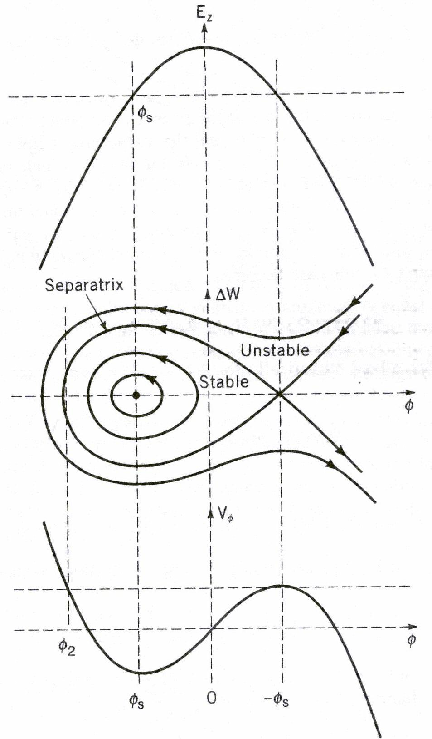
Hamiltonian system
The longitudinal dynamics can be described by a Hamiltonian system in terms of kinetic and potential energy:
Hamiltonian
System H_{φ}
Kinetic
Energy
Potential
Energy
A and B are constants for each particular cavity, but they change cavity to cavity because A is a function of β_{S} and γ_{S}. B is a function of E₀ and TTF.
The bucket has a stable region defined by -φ_{S} and φ₂. φ₂≈ 2φ_{S}.
The maximum ΔW is

Slide 4
Longitudinal dynamics
Liouville theorem applies if we use an adiabatic transformation.
The energy-phase phase space remains constant under acceleration.
ΔW
ΔW
φ
φ

Slide 5
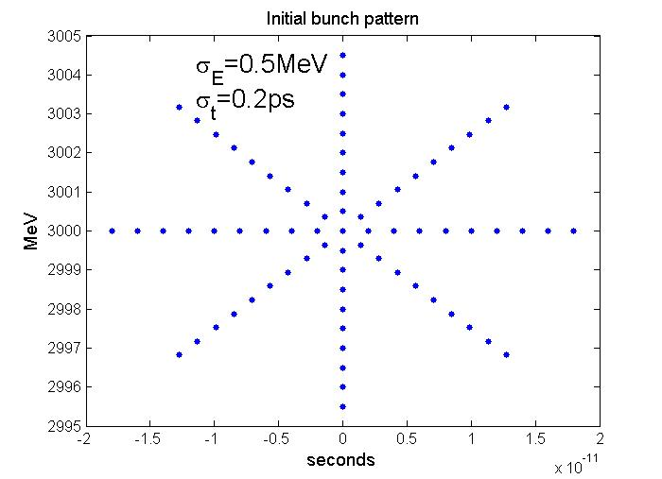
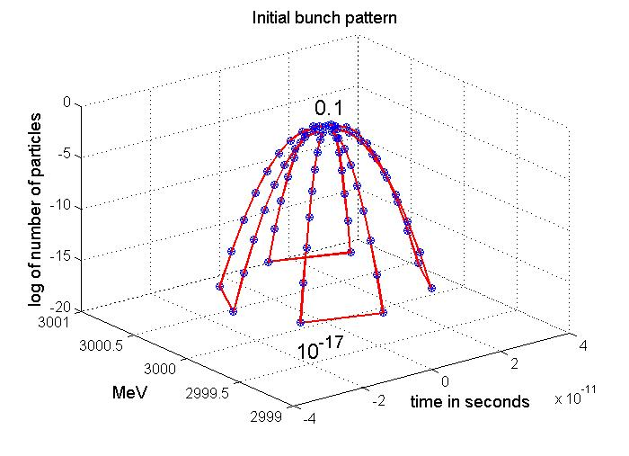
Initial bunch pattern
2ps
73 macroparticles
Total number of particles: 6.24 10¹² per mA of current

Slide 6
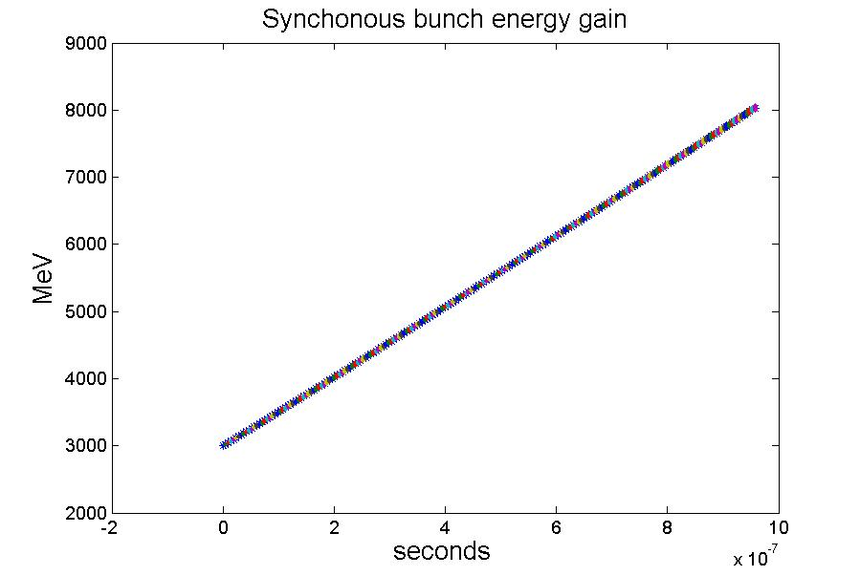
Synchronous bunch simulations
Synchronous bunch energy gain:
For the synchronous particle the energy gain is reduced to:
φ_{S}=π/18
The synchronous bunch is accelerated from 3 to 8 GeV in almost 1us.

Slide 7
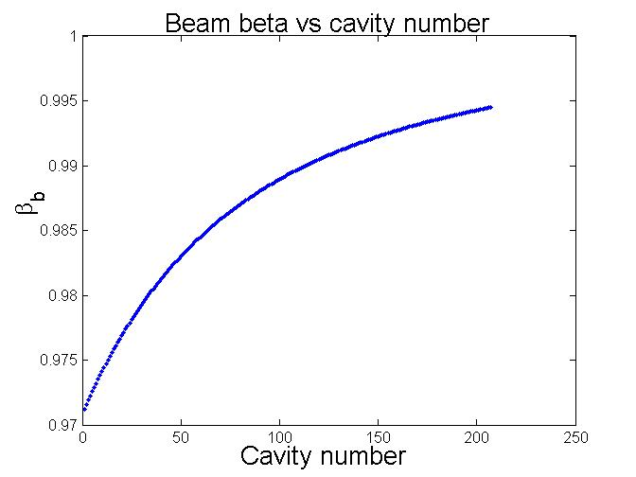
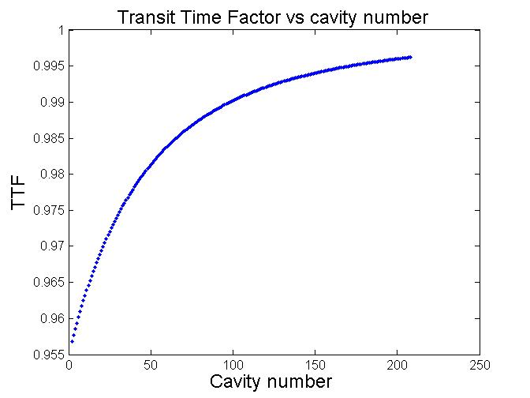
Synchronous bunch simulations
The beta and TTF functions monotonically increase along the LINAC and are close to 1.
This has a small effect in the change of beam loading along the LINAC.

Slide 8
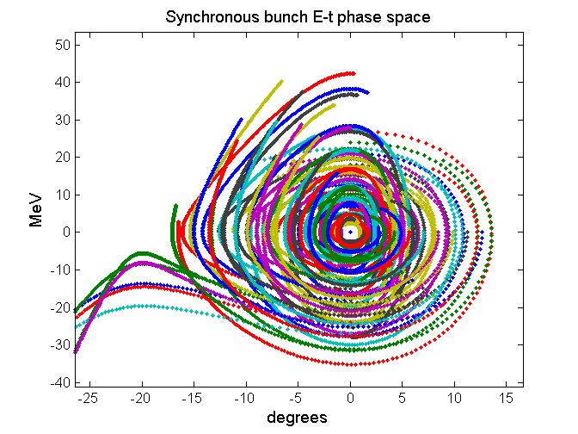
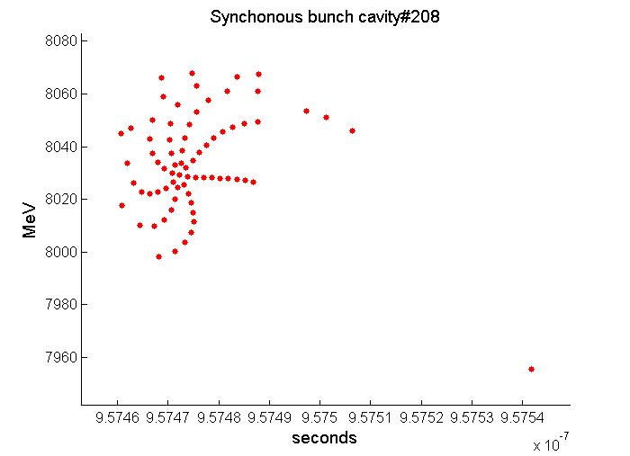
Synchronous bunch simulations
Initial Bunch size at 3GeV: σ_{E}=500 KeV, σ_{t}=2ps.

Slide 9
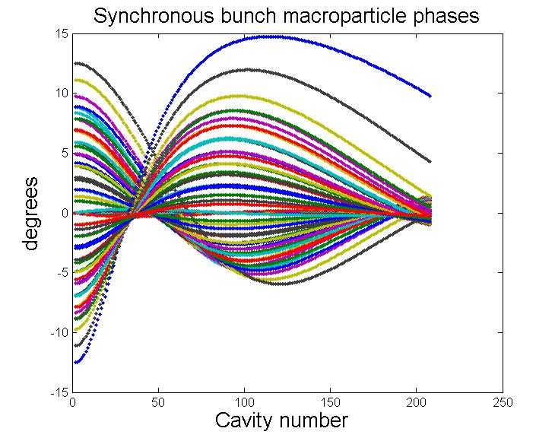
Synchronous bunch simulations
~1µs
At 3 GeV the small amplitude oscillation frequency is 1.24 MHz (i.e. 0.8µs period). The oscillation frequency slows down as energy increases.

Slide 10
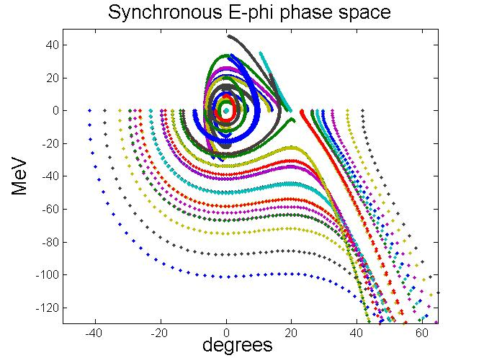
Synchronous bunch simulations
For larger σ_{E}, σ_{t} the beam is unstable

Slide 11
3-8 GeV pulsed LINAC
Requirements:
Gradient amplitude 25 MV/m.
13 RF Stations: 2 cryomodules with 8 cavities/cryomodule for a total of 16 cavities/RF ST.
Total Energy gain ~5 GeV.
Beam current: 1 mA (try also 2 mA).
Beam phase: -10 degrees.
RF pulse: 4.3 ms flattop. (try also 20 or 30 ms).
Fill Time: 4.243 ms.
Qload: max=1e7.
R/Q=1036 Ohm/cav.
16 cavities/kly and 32 cavities/kly.

Slide 12
4.2 ms flattop pulse
The klystron operated in feed forward mode, no feedback loop.
I_{b}=1mA
A Q_{load} of 1e7 implies a half cavity BW of 65 Hz.
At 25MV, I_{b}=1mA and (R/Qo)=1036Ω the Q_{L} for power matching is 2.5e7, but the BW_{1/2} would be too small (26Hz) and it would make it very hard to deal with LFD and u-phonic disturbances.

Slide 13
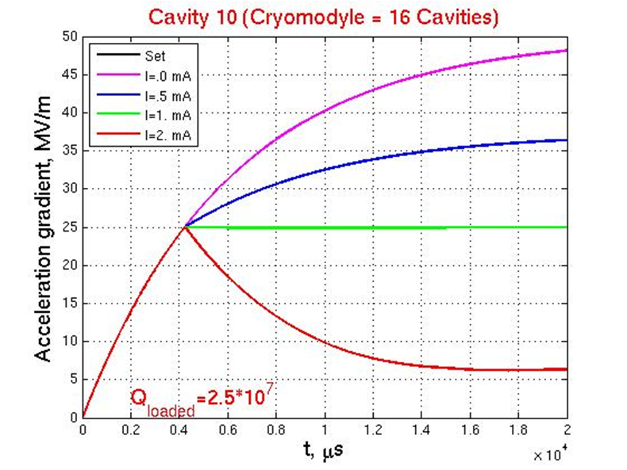
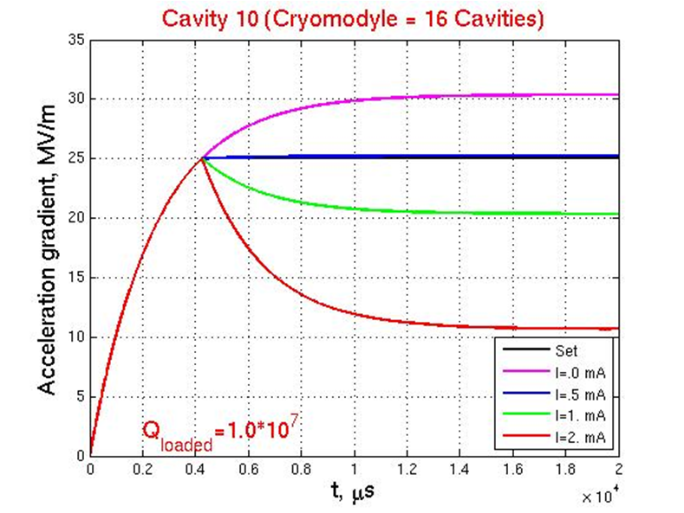
Matched vs. unmatched (no detuning)
If we use 25 KW/cavity constant power during filling and flattop.
Matched power generates a long transient during the flattop.
Other power strategy is required.

Slide 14
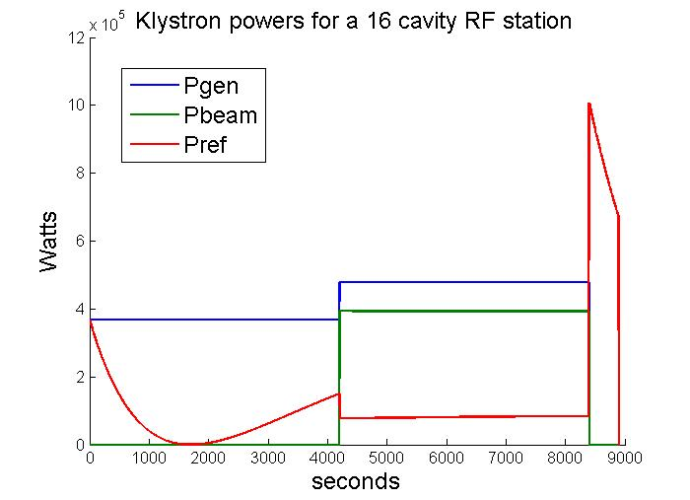
Open loop RF ST powers (no detuning)
P_{gen}: Cavities filled at 23 KW/cavity. P_{gen} power is increased to 30 KW/cav to produce a flattop.
Total P_{ref} of 150 KW at beam injection. 5KW/cavity = 16%

Slide 15
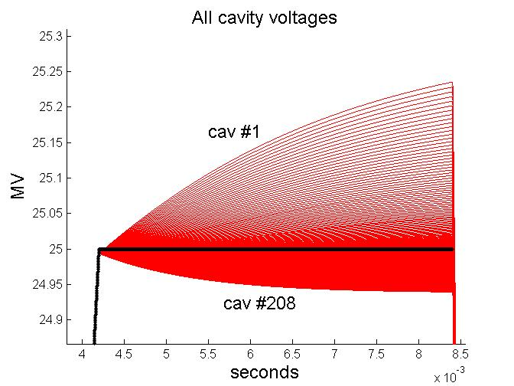
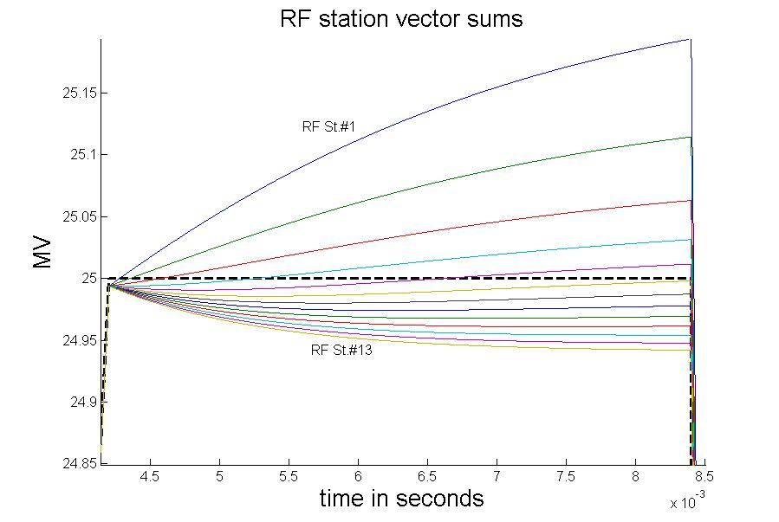
Open loop cavity voltages (no detuning)
Monotonically increasing TTF is responsible for uneven beam loading along the LINAC..
Beam loading monotonically increases with cavity number (i.e. location).
Total Vector sum is kept flat and close to 25MV
TTF effect: 10%

Slide 16
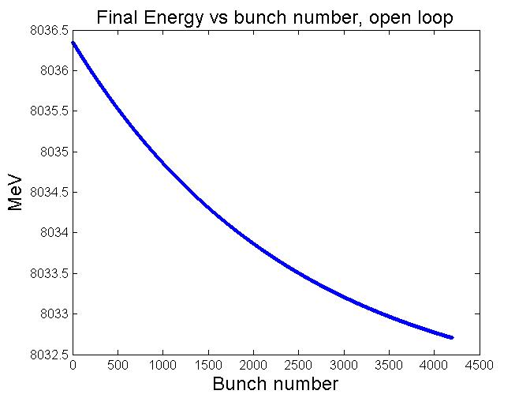
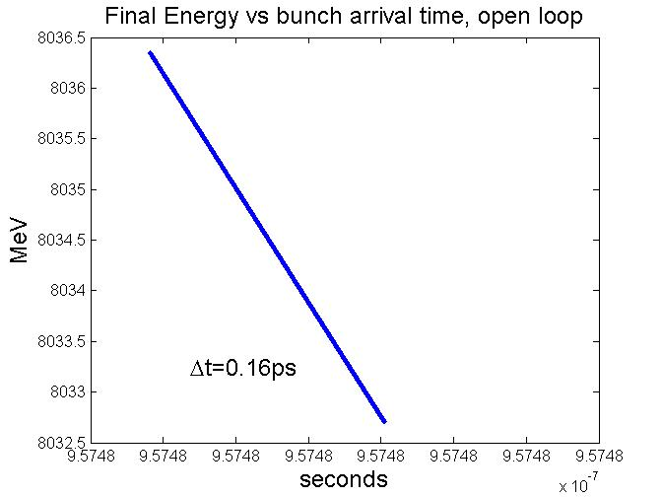
Energy – Time phase space (Open loop, no detuning, no E-t jitter)
E-t fairly linear. Head to tail: ΔE_{FINAL}=3MeV, Δt_{FINAL}=0.16ps.

Slide 17
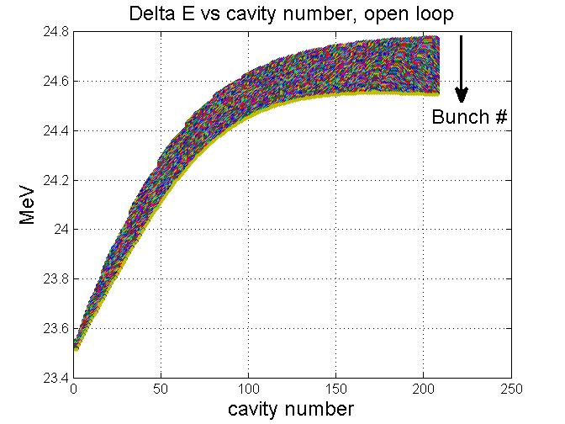
Energy – Time phase space (Open loop, no detuning, no E-t jitter)
Average Energy gain dominated by TTF.
Larger Energy gain spread (0.2MeV) at the end of the LINAC due to gradient spread (beam loading effect).

Slide 18
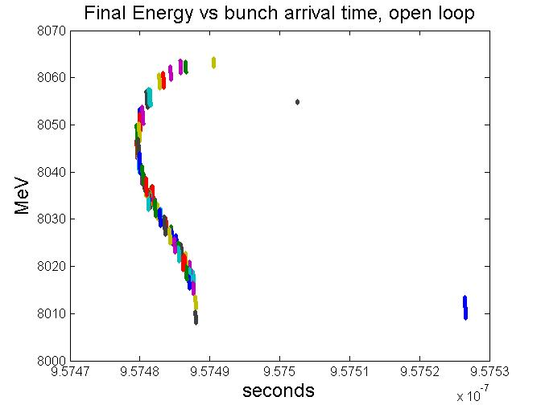

Slide 19
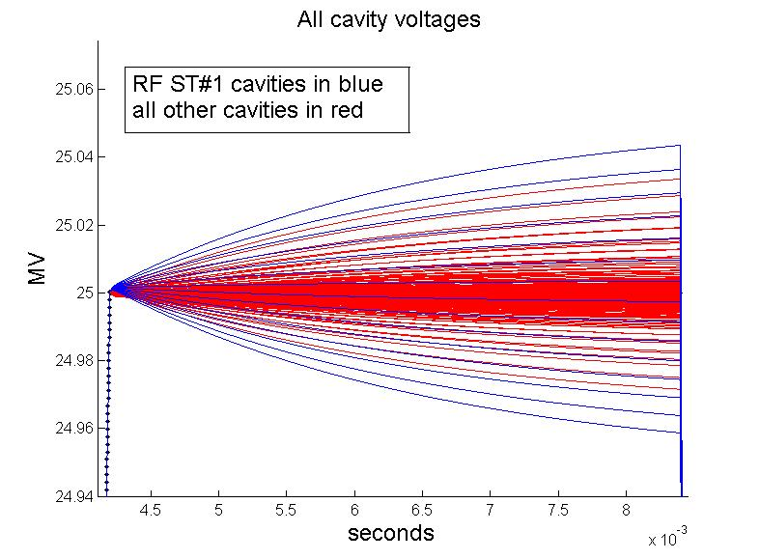
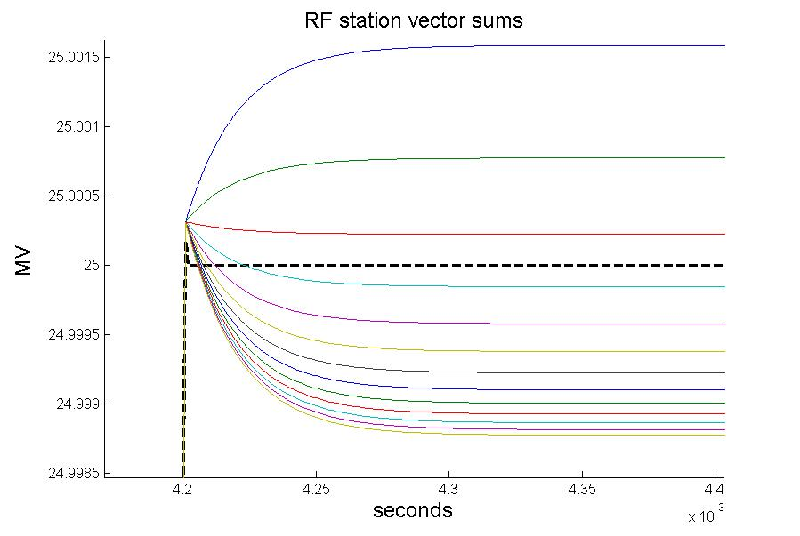
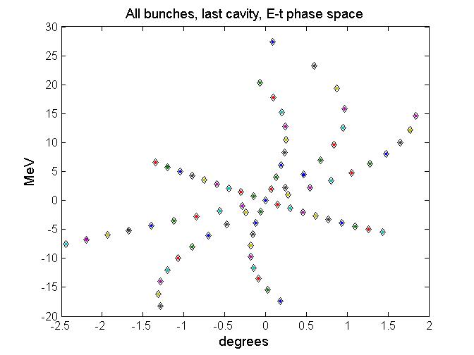
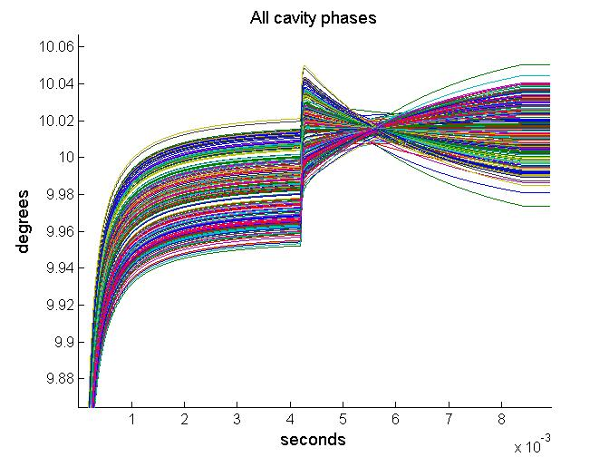
Closed loop cavity voltages (no detuning)
The RF loop redistributes cavity voltages around the vector sum
All vector sums are 1/(K_{P}+1) closer to the set point.
Total Vector sum is kept flat and close to 25MV
±1 KeV
±40KeV

Slide 20
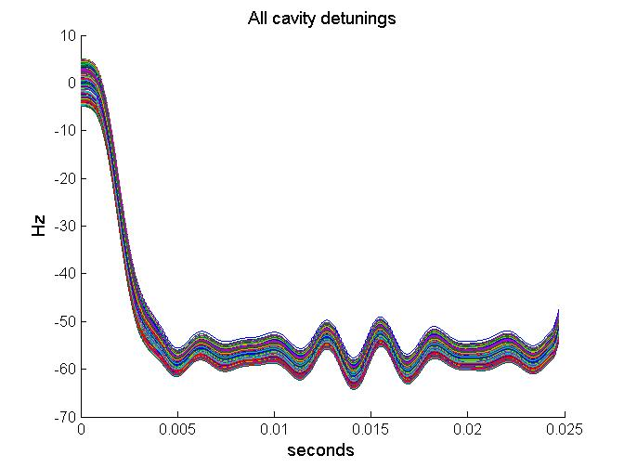
Detuning
ILC type 9-cell niobium cavities detune about 600Hz at 25MV by effect of LFD. This number would prohibitive in terms of RF power required. We assume that LFD can be reduced to 60Hz or better.
In this simulation we assume a cavity to cavity uniform random microphonic detuning of ±5Hz.
The LFD is a function of V².
Longer flattops do not imply worse LFD.
Predetuning the cavities can reduce the LFD during the flattop.
Uniform distributed ±5Hz microphonic added.

Slide 21
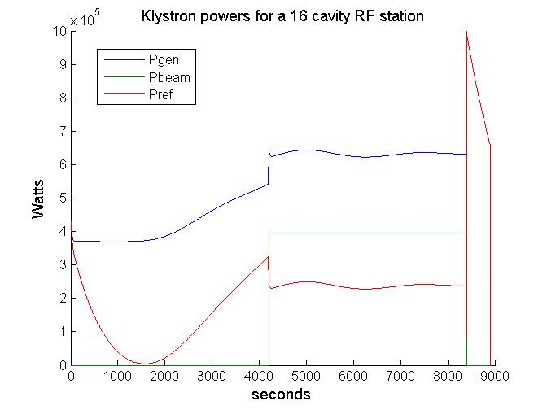
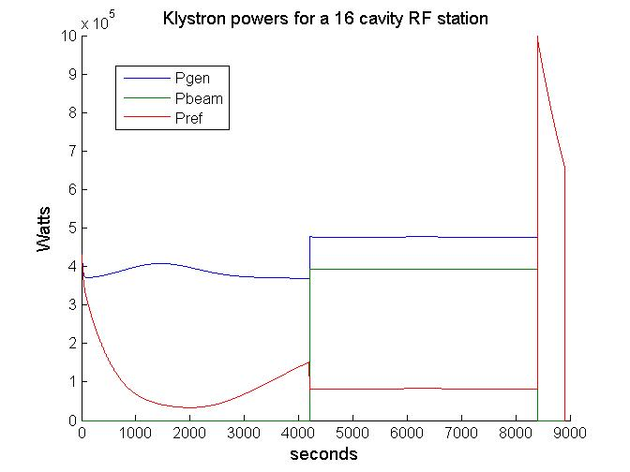
Detuning of ~60Hz at 25MV
Left plot: Largest LFD swing during filling, forward power increases but only 15% because V² is still low.
Right plot: no predetuning. Worst detuning is at the end of the filling. 50% more Forward power is required.
During the flattop 60% more power is required to compensate for detuning.

Slide 22
Other RF issues
ACC6 (MV)
29.77
30.81
28.63
28.18
17.84
18.36
22.45
22.23 Avg=24.8
ACC7
26.56
26.56
27.47
27.47
32.05
32.05
23.81
23.81 Avg=27.5
To the left are the voltages we operate the highest gradient cryomodules at DESY-FLASH. They meet 25MV on average but not in evry single cavities.
Fix RF distribution.
And equal power distribution:
Operate all cavities below the lowest quenching limit of all cavities in the RF station.
Proportional power distribution:
Cavities operated at different gradients to achieve desired VS.
Flattop tilts. They get worse for longer flattops.
Fix couplers.
Can be optimized for a single beam loading condition.
Optimal Q_{L} is a function of several RF parameters. We loose this flexibility.
Cavity tilts.
Cavity tilts and cryomodule misalignment generate transverse kick and large emitance growth.
Beam OFF, beam ON.
Tilt slopes are a function of gradient distribution in the RF station
Fix equal power distribution along with fix couplers imply operating all cavities below the cavity with the lowest quenching limit.

Slide 23
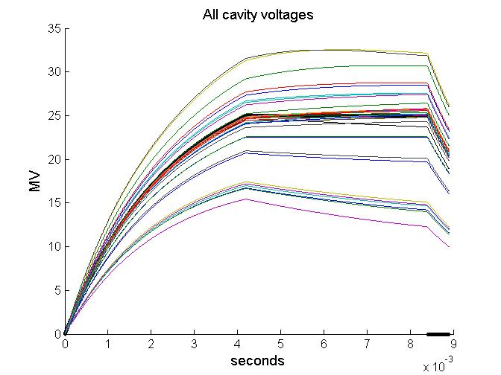
A little bit more realistic simulations
1st RF station is DESY-FLASH ACC6-7
All other 12 RF stations have 2 low gradient cavities at 18MV and 14 cavities at 26MV.
LFD: ~ 60 Hz at 25 MV.
µ-phonics: ±5Hz uniformly distributed.
Beam errors:
Bunch to bunch I_{b} jitter: 3%.
Bunch to bunch Energy jitter: 250KeV.
Bunch to bunch time jitter: 1ps.
I_{b} is 3% lower at the end of a 4.2 ms flattop. (cosine function).
Coupler error: 10% uniformly distributed.
Open loop

Slide 24
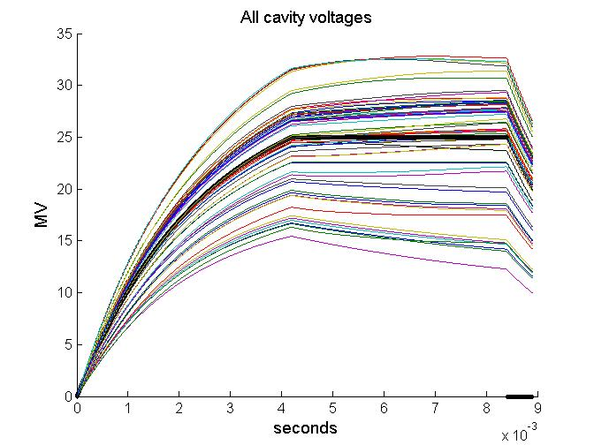
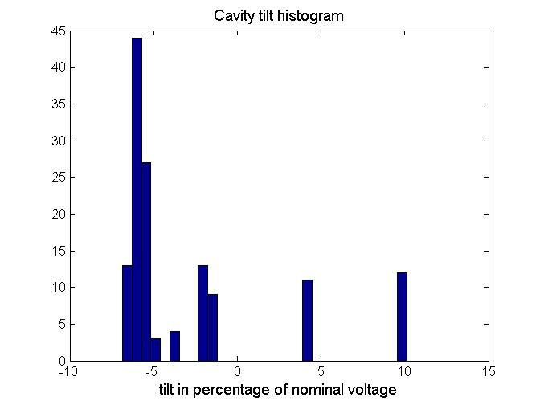
A little bit more realistic simulations
These cavities will probably quench

Slide 25
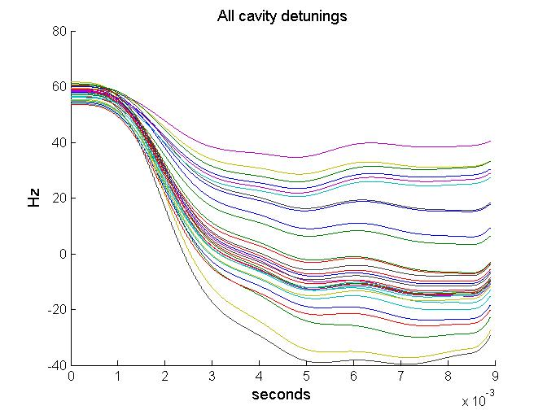
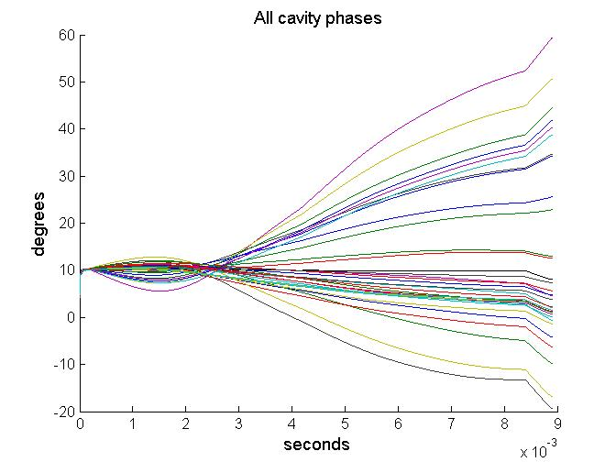
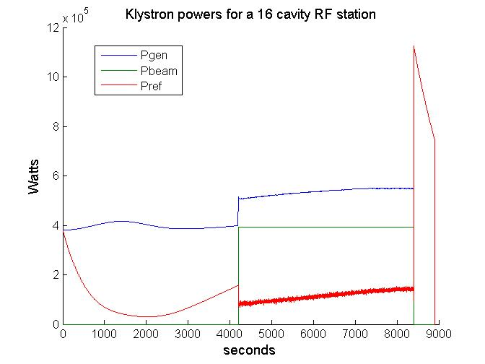
A little bit more realistic simulations
10% more power at end of flattop
With respect to the beginning of flattop.
The closed loop cavity detunings and phases in all directions.

Slide 26
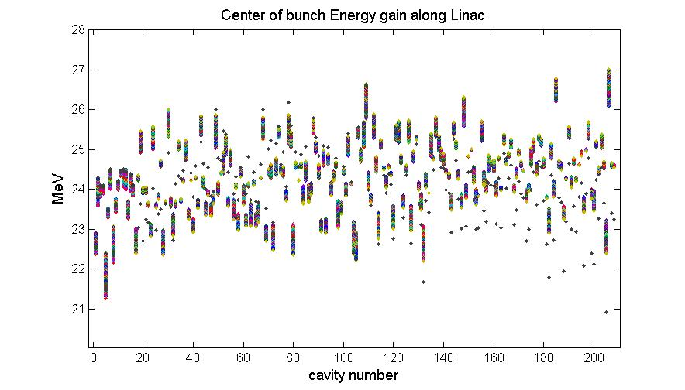
A little bit more realistic simulations
Head of the bunch train
Energy gain
Tail of the bunch train
This plot shows the energy gain spread for the center of the bunch along the LINAC.
The spread is for 4200 bunches.

Slide 27
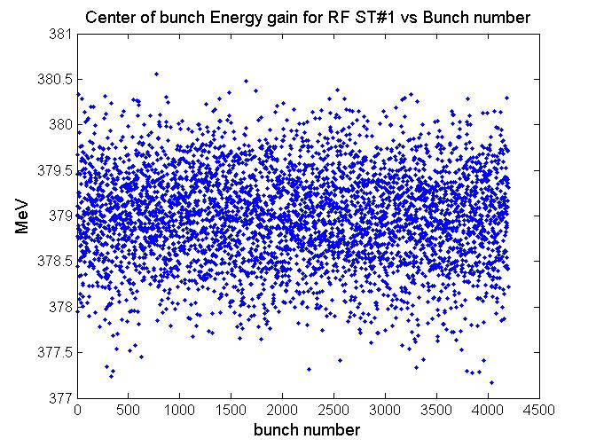
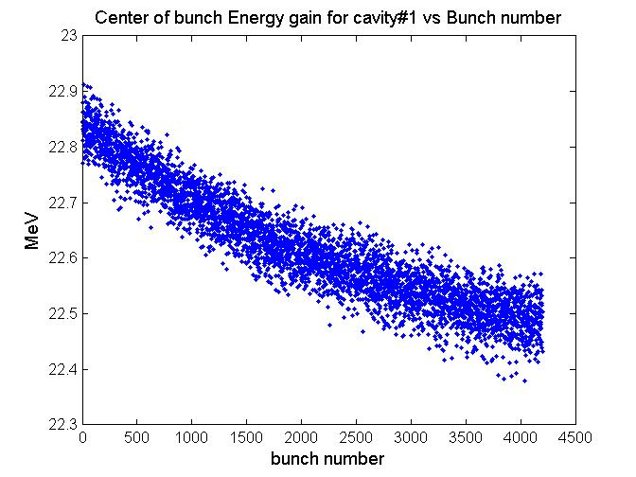
A little bit more realistic simulations
The LLRF controls the vector sum. The energy gain looks OK for a group of 16 cavities.
But each cavity has a large bunch train head to tail spread.

Slide 28
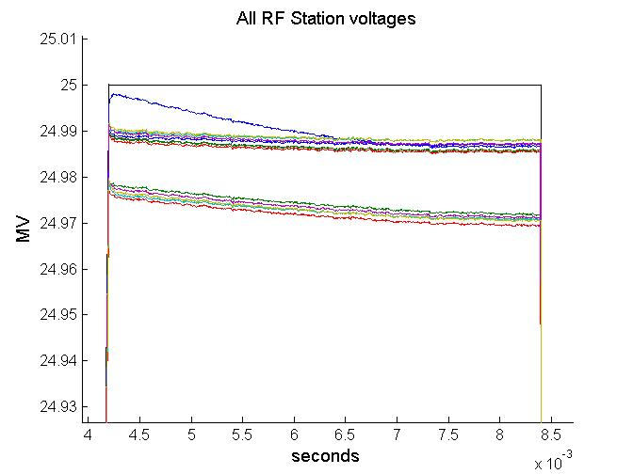
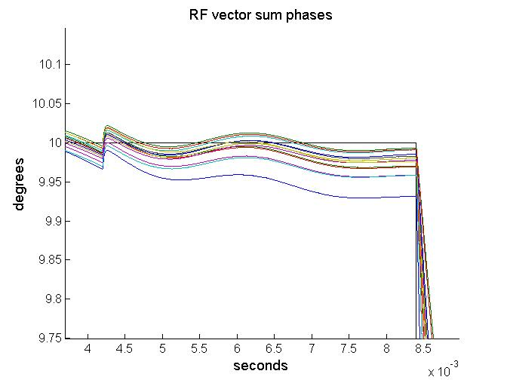
A little bit more realistic simulations

Slide 29
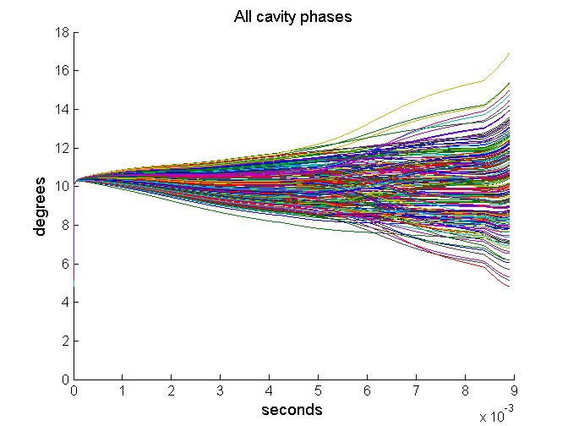
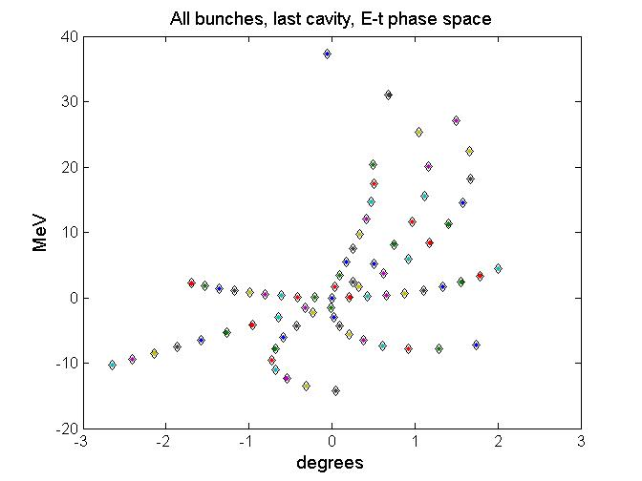
How do we fix it?
Adjust QL’s.
Adjust Pk’s.
Predetune cavities.
Adjust beam injection time.
Do we have methods?

Slide 30
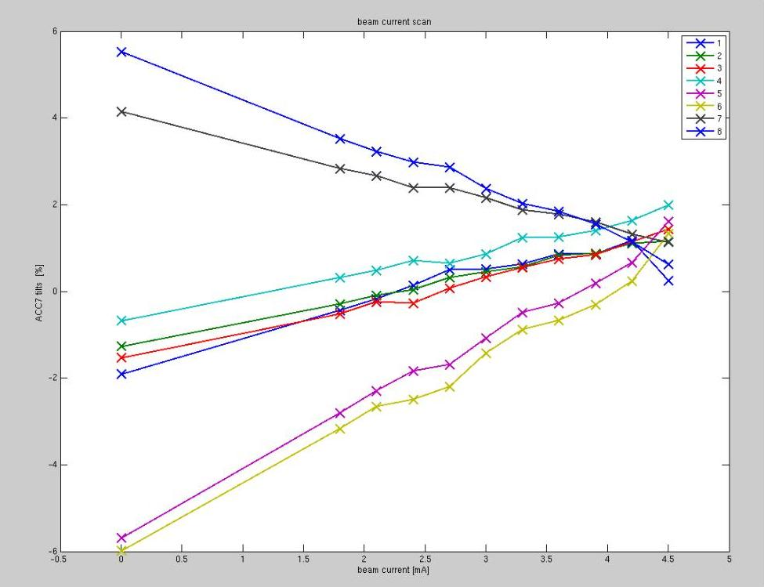
P_{k}-Q_{L} studies at FLASH
At FLASH cryomodules are set for equal Q_{L}’s of 3e6. and gradients to be flat when beam loading is 0.
Beam loading is compensated using feed forward plus adaptive feed forward plus beam feedback compensations.
Only the VS is compensated.
Cavities are operated very close to “on crest”
Beam based VS calibration.
Manual tuning of cavities to reduce LFD. (Piezos operated only occasionally for ILC tests).
ILC 9mA test approach:
Recalculate Q_{L}’s so cavity amplitude and phases are as flat as possible with target beam loading.
3 “free” parameters I_{g} , k and t₀. (i.e. the total forward power, the beam loading compensation and the fill time). However, the free parameters are not so free because are constrained by the RF station energy and allowable Q’s.
tilts
Tilts are linearly proportional to beam loading changes.
Size of tilts are a function of voltage dispersion in the RF ST.
Tilts will become more important for 30 ms pulse.
Tilts should be 0 here
Beam loading

Slide 31
RF loop block diagram
FF
I_{b}
e
+
u
I_{g}
I_{g1}
+
I_{d1}
V_{cav1}
SP
+
K_{P}
+
1/R
α₁
+
P₁
+
-
V_{cav2}
.
.
.
I_{d2}
α₂
P₂
Σ
V_{sum}
I_{b}
.
.
.
+
I_{dN}
V_{cavN}
α_{N}
+
P_{N}

Slide 32
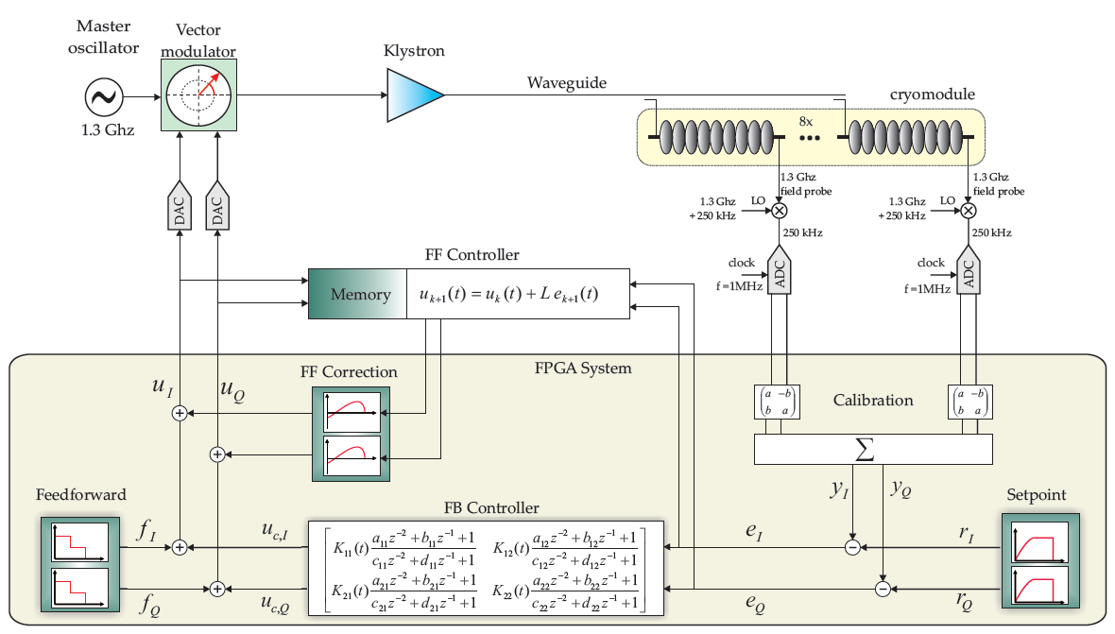
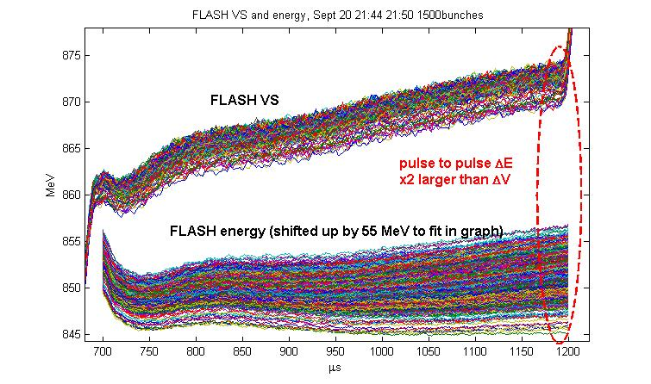
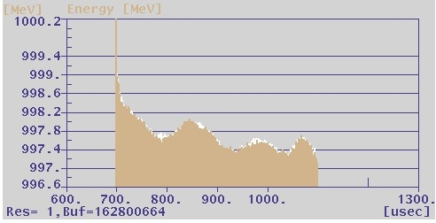
LLRF Control Tables
FLASH Energy, 1500 bunches, Sept. 2009
Operator & LLRF expert
Setpoints: A,ϕ & Parameters: timing, …
FLASH Energy, 800 bunches, Feb. 2011
Beam based
SP correction
Model based
FF & SP tables
ratio
Learning
Feed forward
Bunch
Pattern
≤
Peak to peak 2MeV
RMS<10⁻³
20us 2MeV overshoot
SP_BBF
table
SP_USER
table
SP_CORR
table
SP
table
FF
table
FF_CORR
table
FF_BLC
table
FF_USER
table
≤
≤
≤
≤
Q
MPS
+
+
Q
MPS
Beam signals
-
a b
c d
Rot
FF-total
table
≤
LFF
Field detection
-
Controller
+
Rot
≤
DAC
DAC

Slide 33
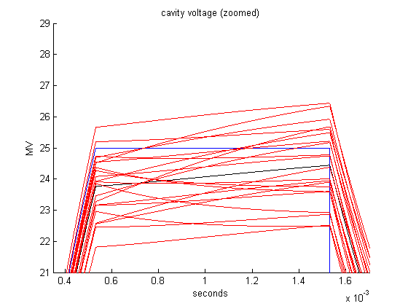
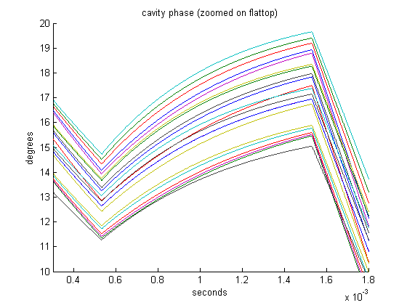
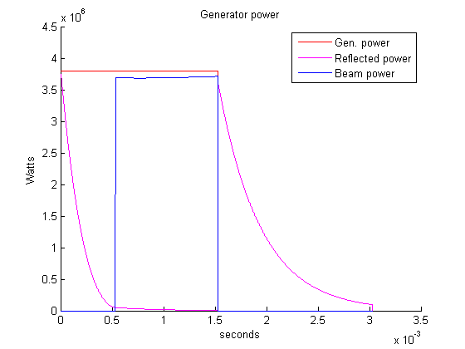
Steady state vs. transient
Adjust QL’s.
Adjust Pk’s.
Predetune cavities.
Adjust beam injection time.
Traditional steady state approach for minimum reflected power does not work because cavities are not matched:
Cavity Number | Beam Beta In | Beam Beta Out | Cavity Phase (degrees) | Cavity voltage (MV/m)
182 | 0.9196 | 0.9208 | -20 | 23.22
183 | 0.9208 | 0.9220 | -20 | 25.62
184 | 0.9220 | 0.9232 | -20 | 24.90
185 | 0.9232 | 0.9243 | -20 | 27.30
186 | 0.9243 | 0.9255 | -20 | 23.46
187 | 0.9255 | 0.9266 | -19 | 26.34
188 | 0.9266 | 0.9277 | -19 | 24.66
189 | 0.9277 | 0.9288 | -19 | 24.18
190 | 0.9288 | 0.9299 | -19 | 26.58
191 | 0.9299 | 0.9309 | -19 | 22.74
192 | 0.9309 | 0.9320 | -18 | 27.54
193 | 0.9320 | 0.9330 | -18 | 25.38
194 | 0.9330 | 0.9340 | -18 | 24.42
195 | 0.9340 | 0.9350 | -18 | 26.82
196 | 0.9350 | 0.9360 | -18 | 25.86
197 | 0.9360 | 0.9370 | -17 | 22.98
198 | 0.9370 | 0.9380 | -17 | 23.94
199 | 0.9380 | 0.9389 | -17 | 25.14
200 | 0.9389 | 0.9398 | -17 | 23.70
201 | 0.9398 | 0.9407 | -17 | 26.10
202 | 0.9407 | 0.9416 | -16 | 27.06

Slide 34
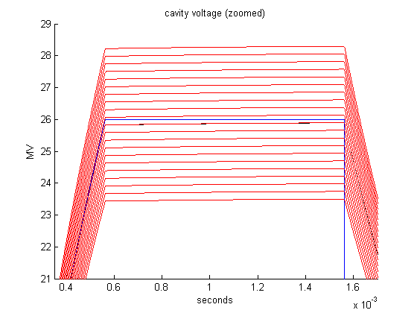
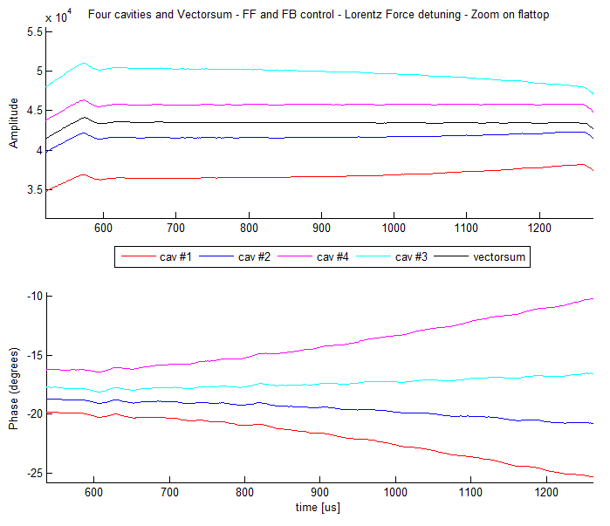
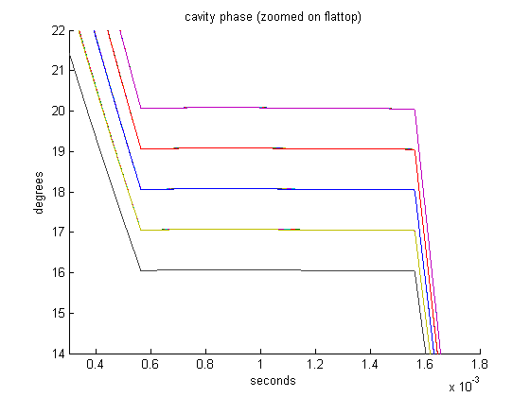
Optimum gradients using the cavity transient response
Closed loop PID response. Cavities include Lorentz force detuning.

Slide 35
Future of simulations
Complete 3 – 8 GeV LINAC simulations.
Use LLRF methods that have not been implemented yet.
Simulate other beam and pulse length situations.
Simulate multipulse.
Simulate the CW LINAC.
Continue comparing simulation results to experimental data.

