Slide 1
Cavity and Cryomodule Progress at RRCAT
Satish Joshi
Raja Ramanna Centre for Advanced Technology, Indore, India

Slide 2
Outline
Prototype 1.3 GHz single Cell cavity
Single cell Nb 1.3 GHz cavity development
Development of Cavity Processing Facility
Design of Cryomodule (1.3 GHz & 650 MHz)

Slide 3
SCRF Cavity Development
1.3 GHz Single cell cavity
  Two 1.3 GHz Single cell cavities in Aluminum & Copper was fabricated with Indian Industry.
  Two 1.3 GHz Single cell Niobium cavities fabricated in collaboration with IUAC, New Delhi.
  Two Nb cavities have been processed & tested at 2 K at FNAL. E_{acc} 21 & 23 MV/m, Q >2E10
  Two more (improved) 1.3 GHz Single cell in Niobium have been taken up.
1.3 GHz Multicell Cavity
  Five cell cavity with simple beam pipe using EBW facility at IUAC is being made.

Slide 4
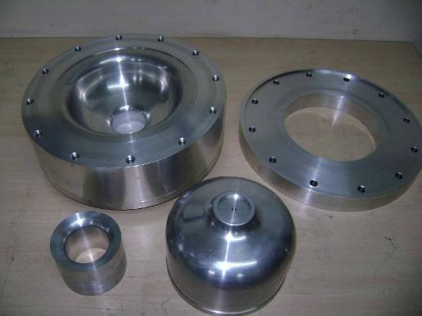
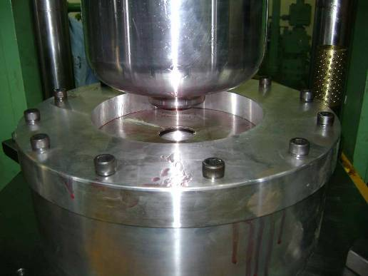
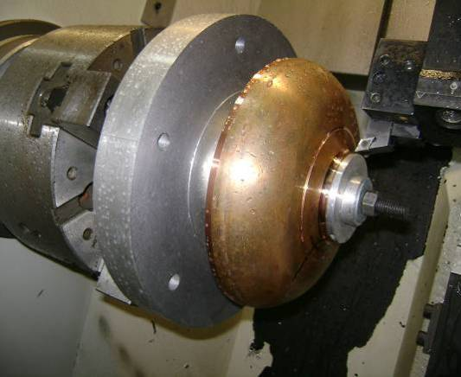
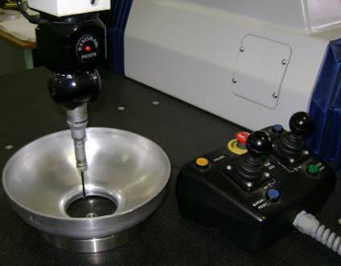
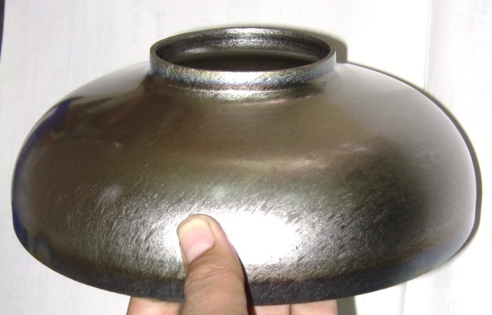
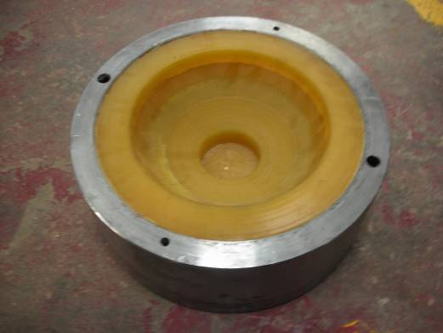
Development of 1.3 GHz SRF cavity forming and machining of half cells 2008-2011
Long End Half Cell Tooling
Forming
Machining
Inspection
Formed Niobium Half cell
Improvement - rubber pad forming tooling completed

Slide 5
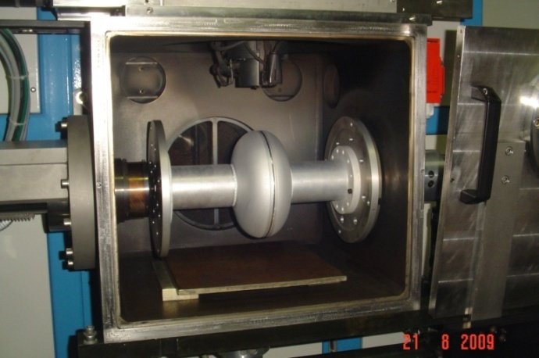
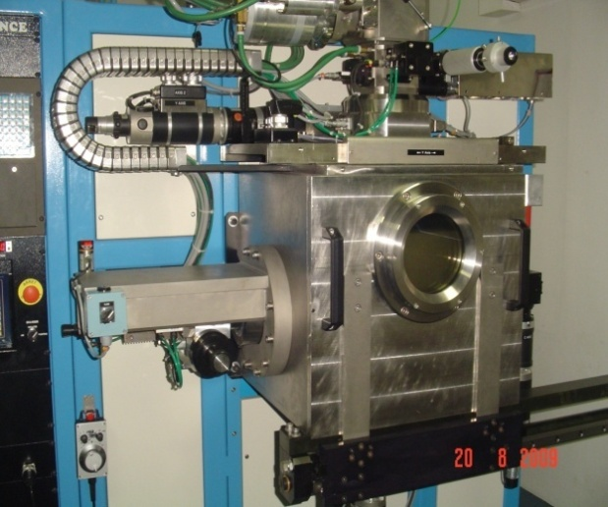
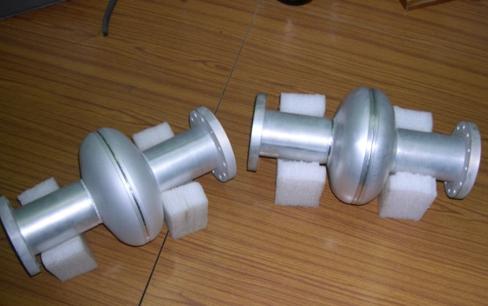
1.3 GHz Prototype Single cell Aluminum cavity with industry
Our technology development efforts started with Aluminum prototype cavities
This has helped us to
  Develop cavity manufacturing process
  Test & qualify the welding fixtures
  Understand various mechanical &
  RF qualification procedure
  Aluminum cavities are now becoming potential candidate for thin film deposition R&D
Single cell cavity welding setup
EBW Machine : 6 KW, 60 kV,
450 x 450 x 500 mm chamber size,
Vacuum < 5 x 10e-05 m-bar
M/s Laxmi Technology &
Engineering Industry Coimbtour
Prototype Aluminum cavities
5

Slide 6
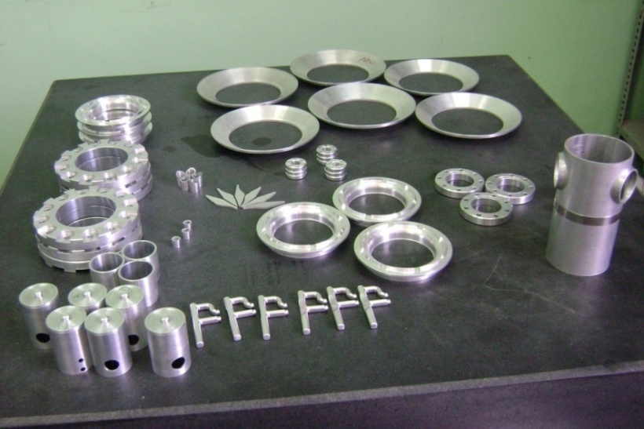
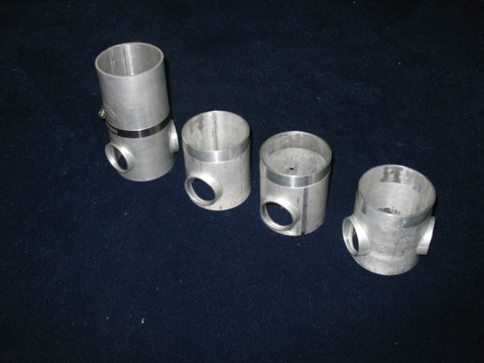
Standard End Group progress
Components for end half cell assembly ( End Group) in Aluminium and side branching for ports

Slide 7
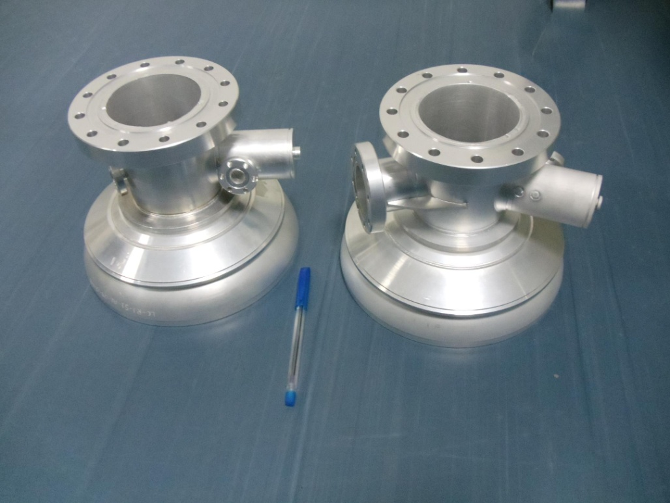
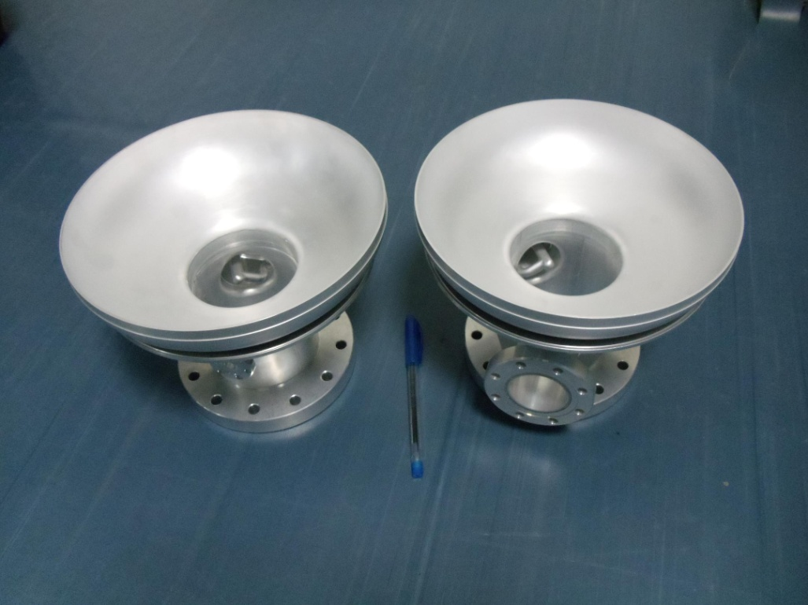
Long & Short End Group in Aluminum
Long – End Group
Short – End Group

Slide 8
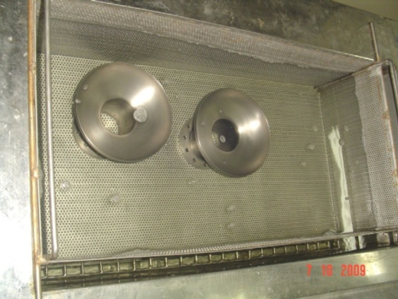
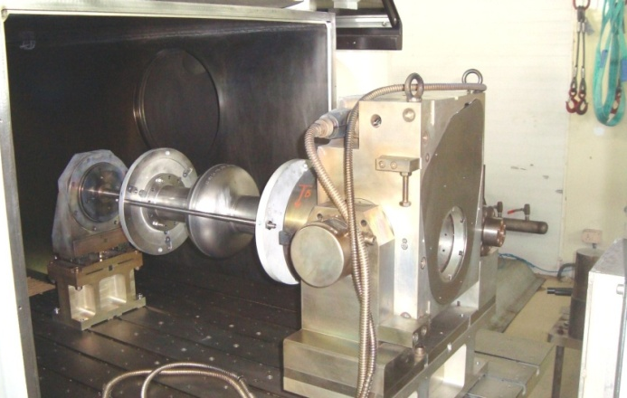
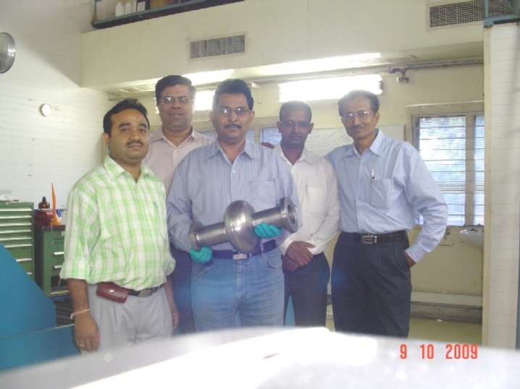
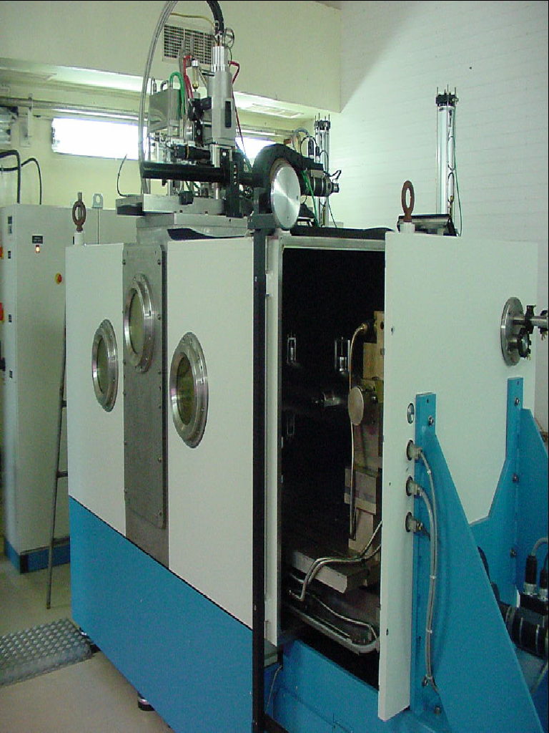
Fabrication of 1.3 GHz Nb Cavity
Pre-weld etching
Ultrasonic Cleaning
Setting for equator welding
EBW Machine @IUAC: 15 KW, 60 kV-250 mA,
chamber size, 2.5 x 1 x 1 m
1st prototype 1.3 GHz Single cell cavity with RRCAT and IUAC team

Slide 9
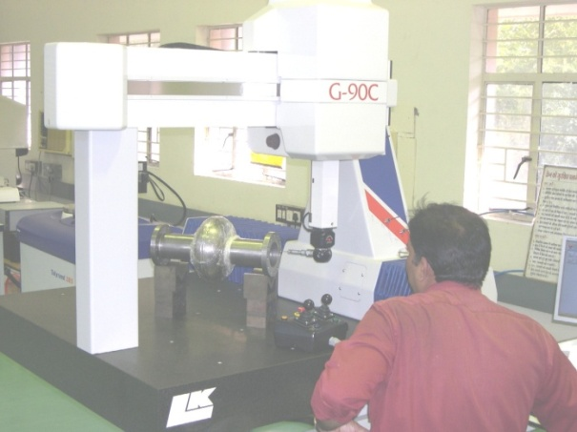
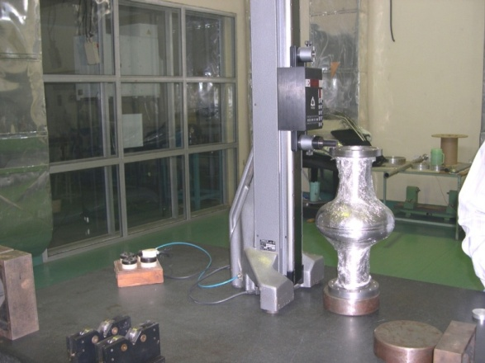
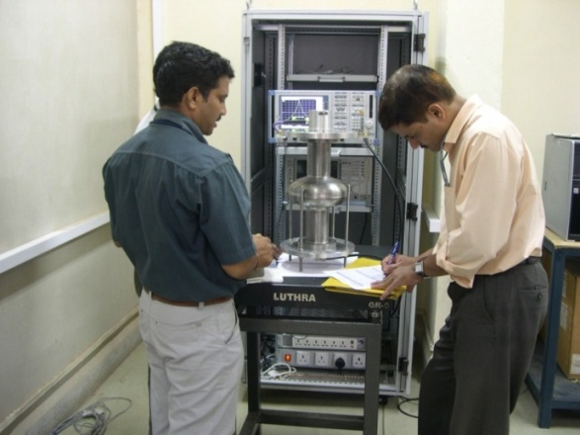
Inspection & testing
The cavities underwent various testing as part of pre-dispatch qualification
Dimensional measurement
Frequency measurement
Niobium cell | Total length (mm) (392 ±1) | Parallelism (mm) | Shrinkage equator (mm) | Frequency (MHz) 300K | Quality factor 300 K
Cell ID # Nb-125 + Nb- 127 TE1CAT001 | 393.52 | 0.10 | 0.47 | 1296.926 | 9076
Cell ID# Nb-138 + Nb-139 TE1CAT002 | 392.97 | 0.14 | 0.42 | 1296.675 | 9328
9

Slide 10
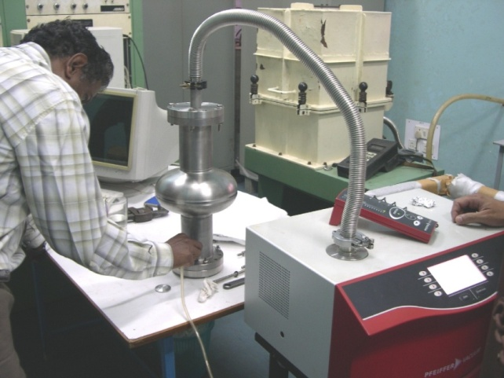
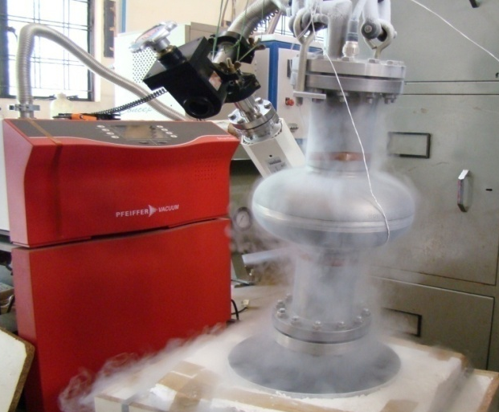
Vacuum leak testing & RF measurement
Leak testing of Single cell cavity at 300 K
Leak testing of Single cell cavity at 77 K
Cavity No. | Vacuum leak rate (mbar l/s) |  | Measured RF Frequency (MHz)
 | At room temp. | At 77 K | At room temp (Vacuum) | At 77 K
TE1CAT001 | < 1 X 10⁻¹² | < 1 X 10⁻¹² | 1297.2666 | 1299.3333
TE1CAT002 | < 1 X 10⁻¹² | < 1 X 10⁻¹² | 1296.73333 | 1298.8666
Estimated frequency
Temperature | 300 K | 77K | 2K
Frequency MHz | 1297.2872 | 1299.8814 | 1300.00
10

Slide 11
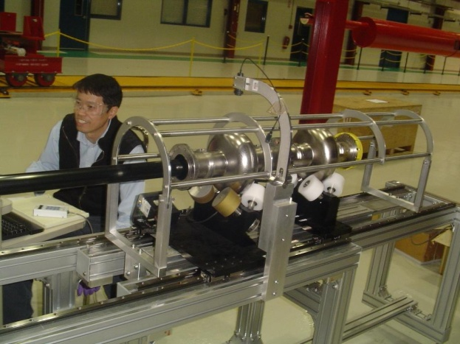
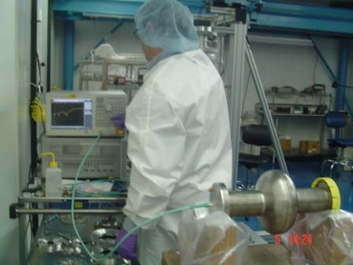
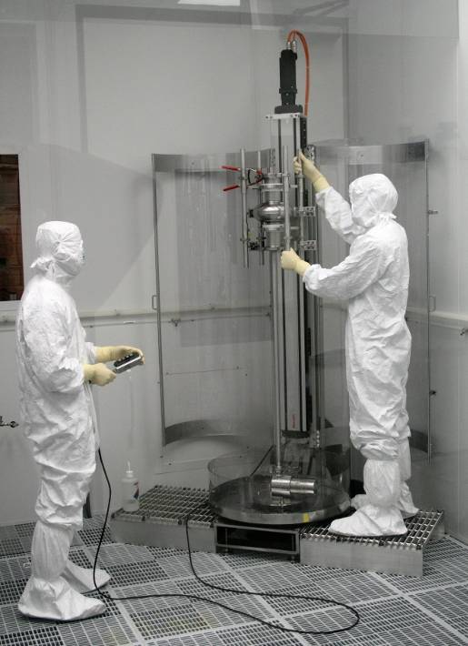
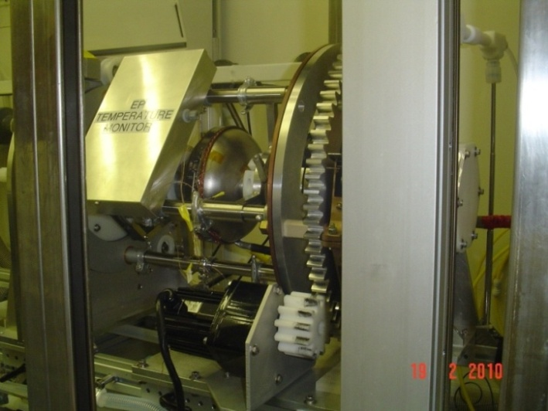
Indian SC Cavity inspection & processing at FNAL
Both the prototype cavities underwent a series of incoming inspection at FNAL
  Visual Inspection
  Internal optical inspection
  RF testing
Processing
  1st set of processing
    Bulk EP ~ 120 µm
    HPR 85 bar for 6 hrs
    Clean room assembly
    Low temperature backing 120 C - 48 hrs
Optical Inspection
RF Measurement
Electro-polishing
High Pressure Rinsing
11

Slide 12
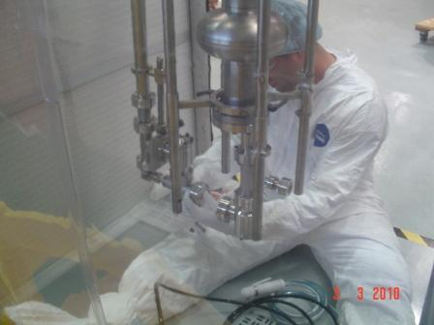
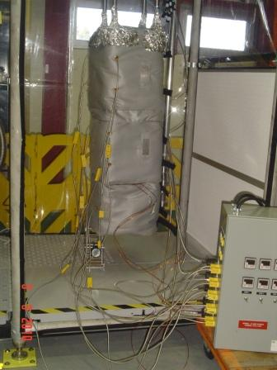
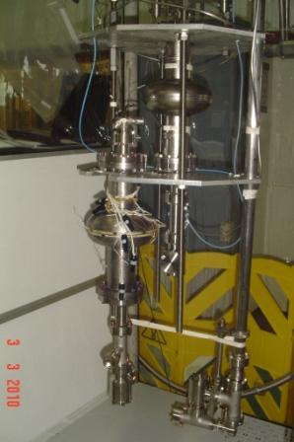
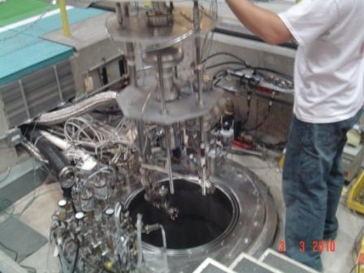
Cavity assembly in to VTS for 2 K testing
Cavity connection vacuum & RF
Low temp bake
120 C - 48 Hrs
Mounted on the VTS
Lowering in to Dewar

Slide 13
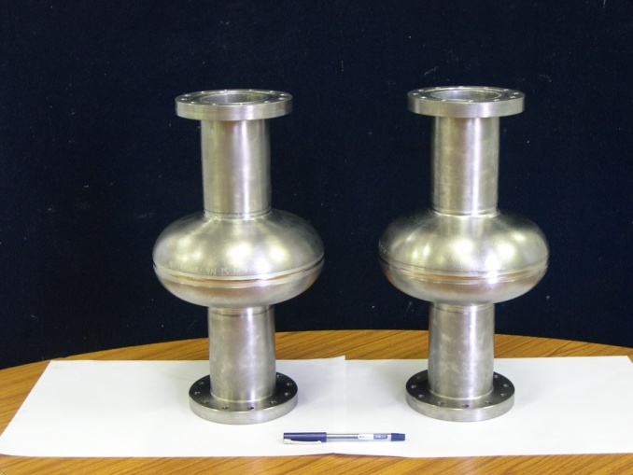
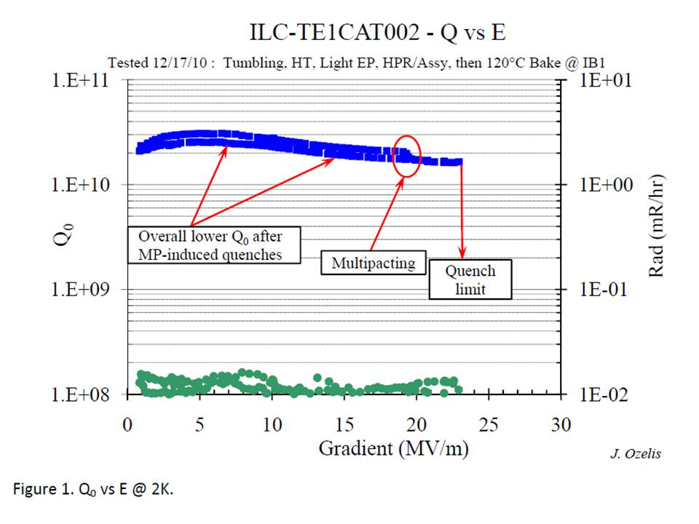
2 K Test results
1.3 GHz Single cell
Prototype cavities
Q vs Eacc plot of second test on Indian SCRF Cavity TE1CAT002 Dec, 2010
(E_{acc}) of 23 MV/m at quality factor (Q) > 1.5E10

Slide 14
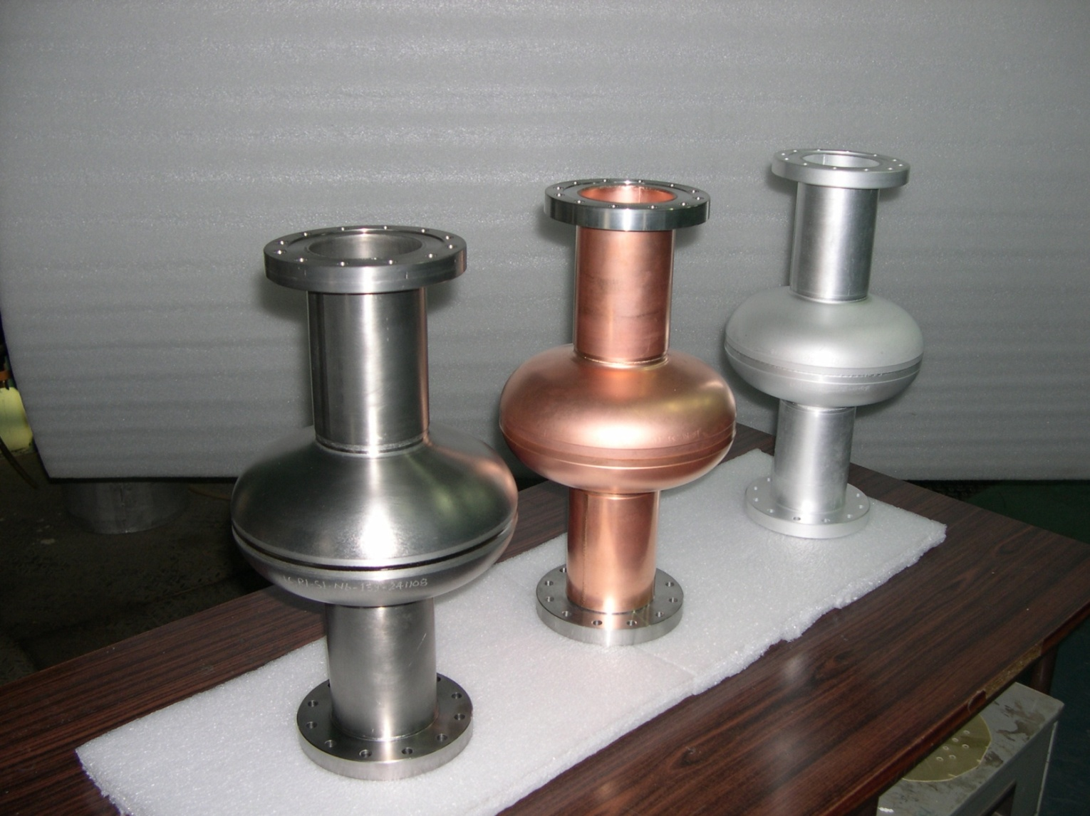
1.3 GHz Single cell R&D
Various prototype 1.3 GHz Single cell cavities developed at RRCAT

Slide 15
Development of beta=0.9, 650 MHz Cavity
650 MHz β=0.9 Single cell cavity
  Design & fabrication of tooling
  Fixtures for trim machining & EBW under progress
650 MHz β=0.9 Five cell cavity
  Design is under process
  Processing of cavity is under discussion with FNAL

Slide 16
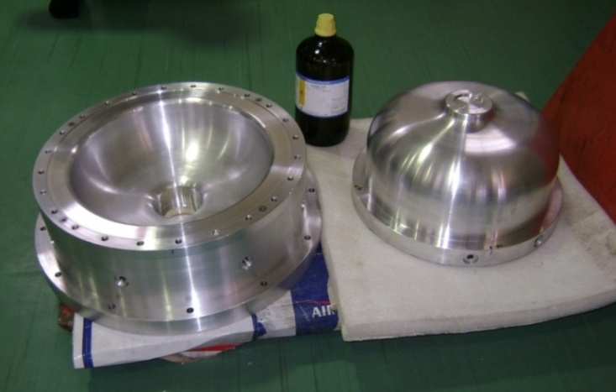
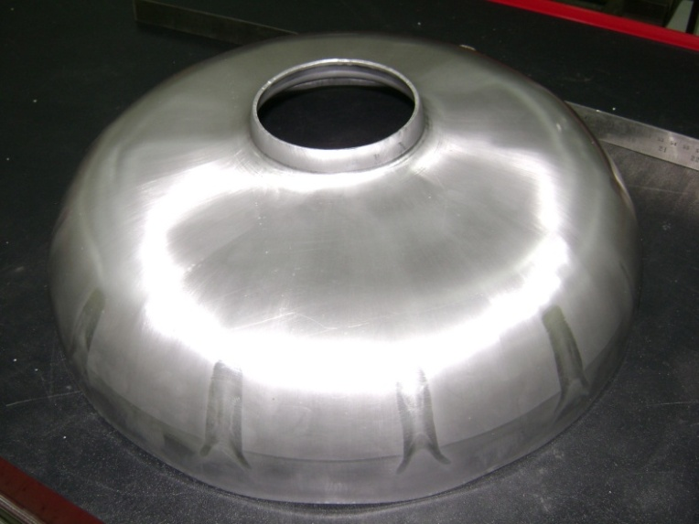
Forming of 650 MHz , beta=0.9 SRF cavity half cells
– October 2010
Design of prototype forming dies, in-house manufacturing, CMM Inspection and forming trials in aluminum were performed.
Problem of buckling of cavity side walls was experienced and profile inspection done.
Forming done using 3.7 mm thick sheet and forming with 4.0 mm under progress.
Profile improvement in progress.
One set of forming tooling with further improvements under fabrication in industry.
650 MHz cavity forming dies
Buckling of cavity cell side walls during first trials

Slide 17
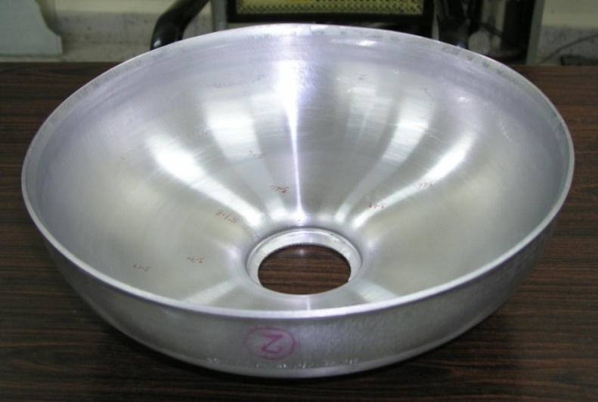
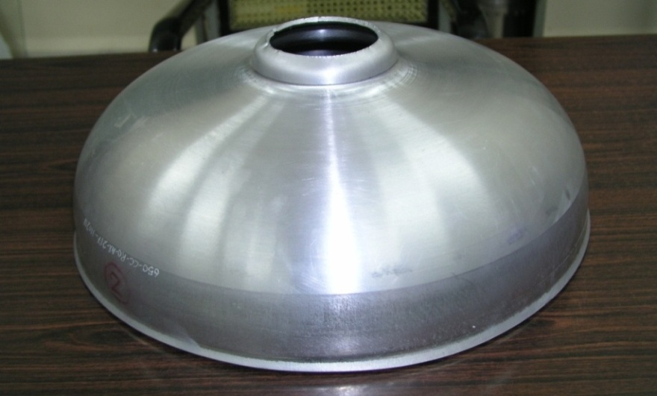
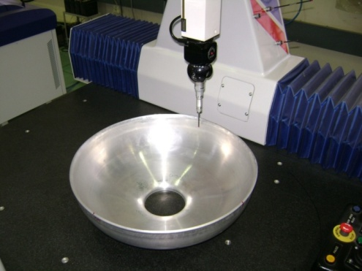
Improved forming results - 650 MHz
– March 2011: work is continuing
Inner view
Outer view
Profile result (thickness of the blank used at this stage was 3.7 mm hence larger deviation is seen)
CMM Inspection

Slide 18
New Facilities Planned at RRCAT
SCRF cavity fabrication Facilities:
120 Ton Hydraulic Press, Nb machining, EBW Machine etc.
Chemical & thermal processing facilities
EP/BCP/CBP, HPR & Annealing Furnaces etc.,
Materials Characterization Facilities
surface conductivity measurement, high field magnetometer, SIMS
Cavity Inspection Facilities
3-D CMM, UTM, Optical inspection bench, 3-D confocal microscope,
Cavity RF Measurement & Tuning Facility
Half Cell, dumbell and multi-cell cavity frequency measurement
Cavity Frequency & field tuning machine
Assembly & testing set up.
Clean-room, 2K Test cryostats, RF sources etc.

Slide 19
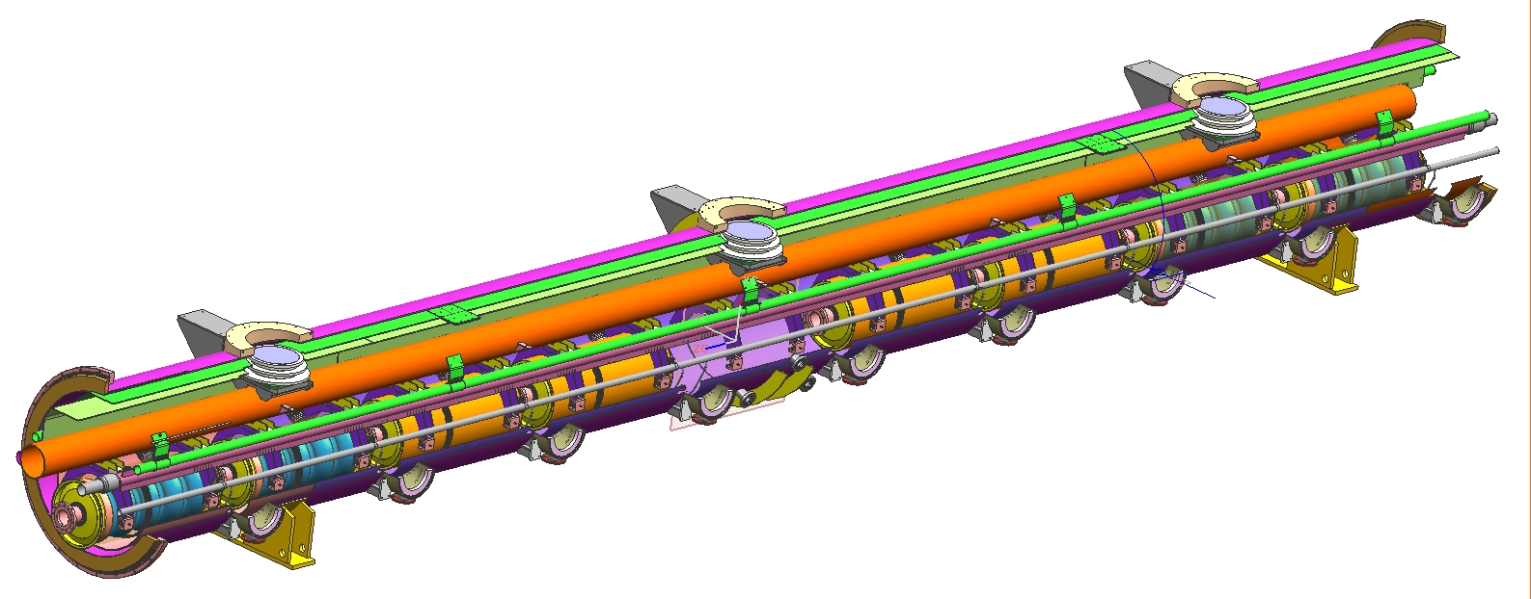
Cryomodule for 650MHz SCRF Cavity
Being designed at RRCAT under IIFC
Cavities : Eight Cavities of 650MHz
Diameter : 1.067 meters
Length : 12 meters
P. Khare, P.K.Kush, S. Gilankar, R. Ghosh, A Laxminarayanan , R.Chaube and A. Jain RRCAT
Tom Peterson ,Yuri Orlov, Camille Ginsburg, Jim Kerby, Fermi Lab

Slide 20

Cryomodule Development Approach
AT FERMILAB
Lattice finalization, Instrumentation, Interconnect region, Cryogen distribution scheme etc.,
PROTOTYPE CRYOMODULE
TESLA DESIGN
WEBEX meeting for technical reviews
Engineering Design of Cryomodule.
e.g Cavity support system, thermal shield, vacuum vessel etc.
AT RRCAT

Slide 21
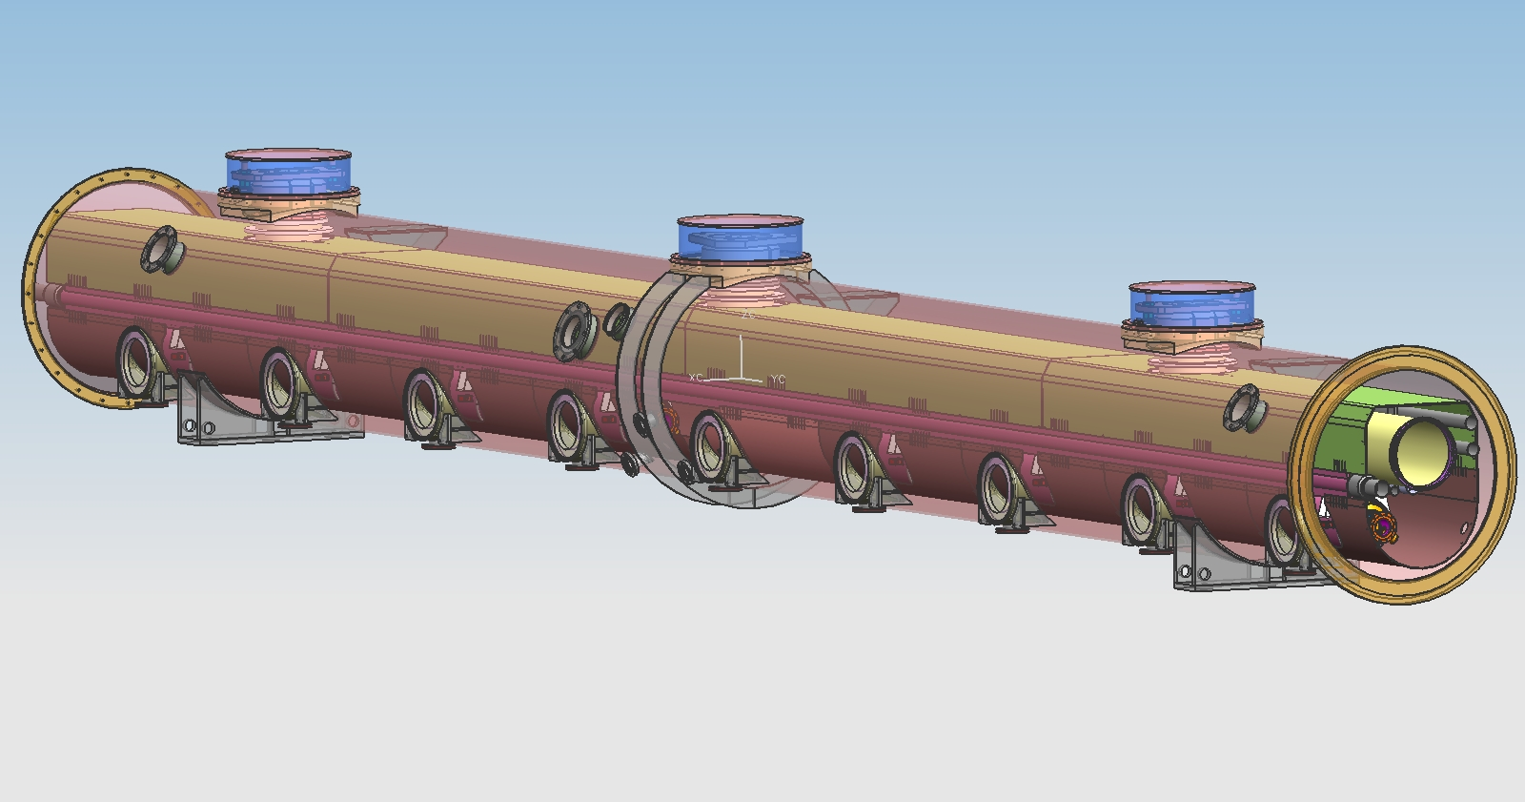
Design of Beta=0.8 Cryomodule
Effort Started In 2008 to Design Beta=0.8 cryomodule for 1.3GHz cavities
Vacuum Vessel engineering Design note prepared
Cavity support system analysis was completed,3-D Model was completed.
In March 2010 ,Project-X decided to go for 650MHz CW cavities
Thermal load 250W/cryomodule . Tesla type 10W at 2K .
Size of cavity (dia.400mm) : ~ 2 times that of 1.3GHzTesla type cavity.
Stand alone cryomodule for ease of accessibility for repairs.
β= 0.8 CRYOMODULE RRCAT - FNAL
21
Notes:
21

Slide 22
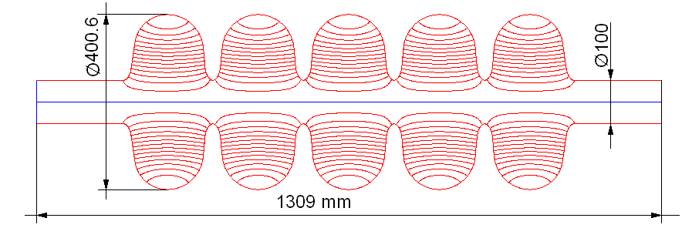
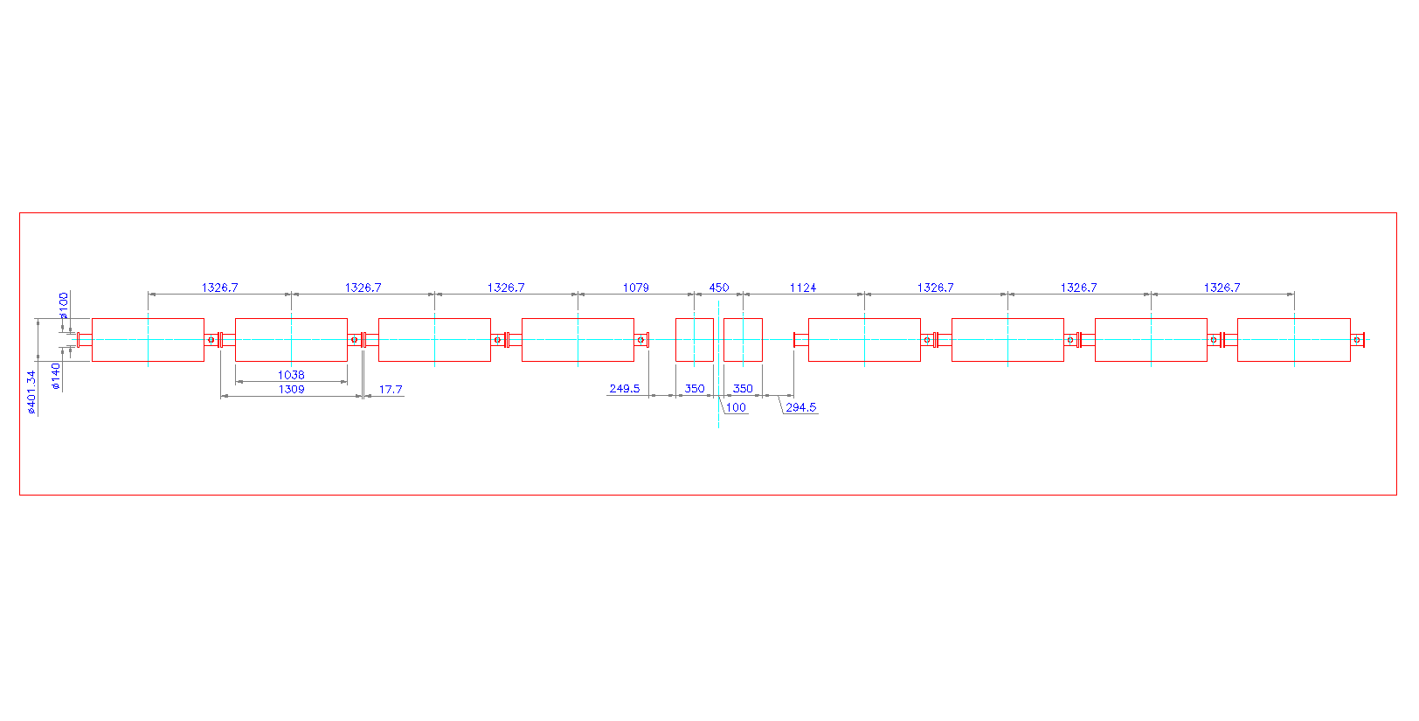
Design of Beta=0.9, 650MHz Cryomodule
A. CAVITY PARAMETERS
Operating frequency | 650 | MHz
β_{G} | 0.9
Cavity length (from iris to iris) | 1038 | mm
Cavity diameter | 400.6 | mm
R/Q | 638 | Ω
G-factor | 255 | Ω
Max. gain per cavity (zero synch. phase) | 19.9 | MeV
Gradient | 19.2 | MeV/m
Maximal surface electric field | 38.4 | MV/m
Maximal surface magnetic field | 72 | mT
 | 650MHz Beta = 0.9 Cryomodule Element | Center Position relative to 1st element (mm) | Effective Length (mm)
1 | Cavity | 0 | 1309.0
2 | Cavity | 1327 | 1309.0
3 | Cavity | 2653 | 1309.0
4 | Cavity | 3980 | 1309.0
5 | Quadrupole | 5059 | 350.0
 | Quadrupole | 5509 | 350.0
6 | Cavity | 6633 | 1309.0
7 | Cavity | 7960 | 1309.0
8 | Cavity | 9287 | 1309.0
9 | Cavity | 10613 | 1309.0
B. CRYOMODULE ELEMENT LOCATION
Data received from FNAL, June 2010

Slide 23
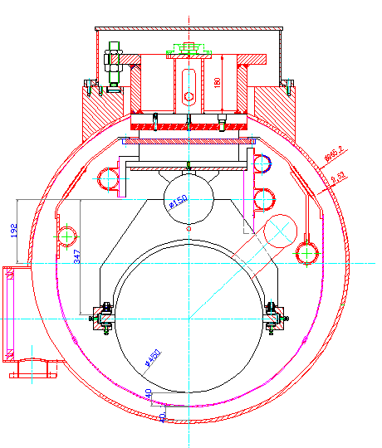
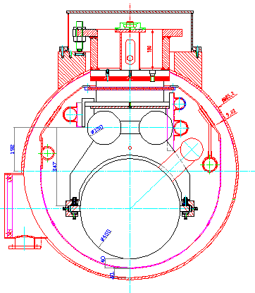
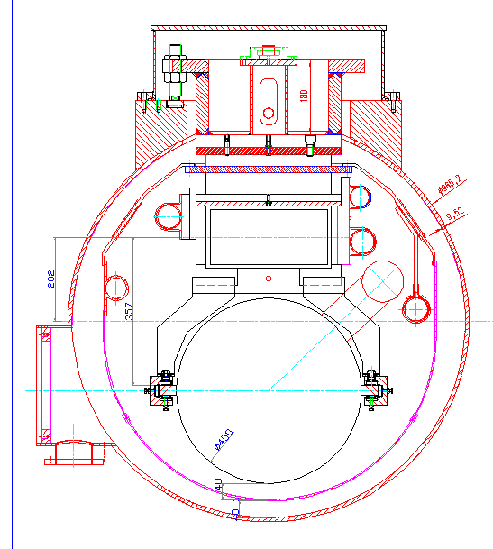
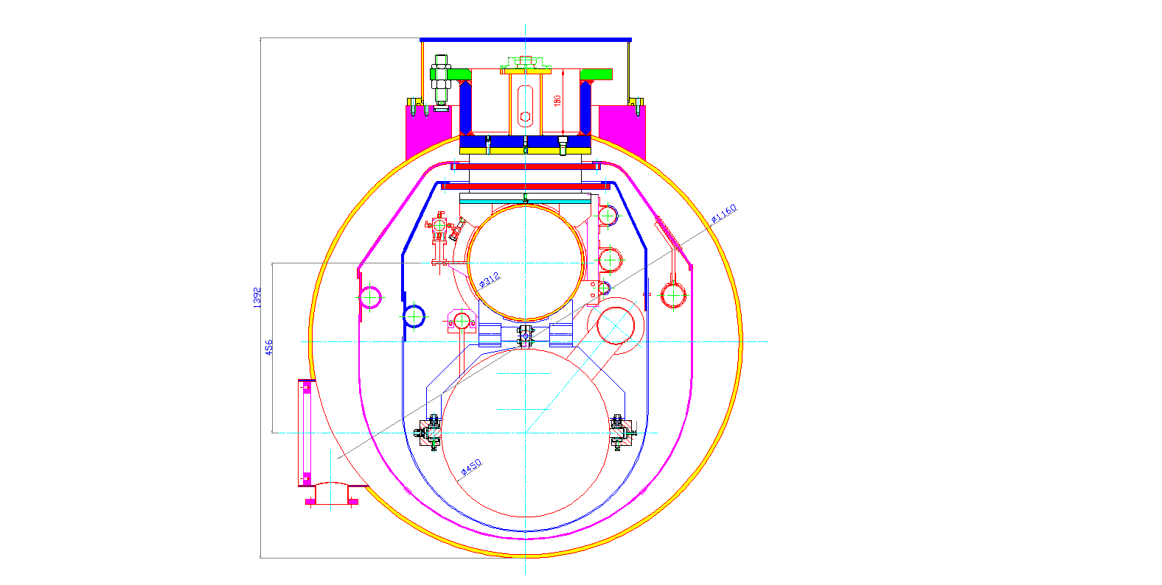
Configuration of 650 MHz Cryomodule (Options proposed by RRCAT)
Possible Options & their evaluation
Goal : Use Popular T4CM Cryomodule design as basic concept
Option A- Single Pipe support
Evaluation Based on:
Static heat leaks (approximations)
Stiffness of the cavity support system
Availability of pipes
General Mech. Engineering issues
Option B- Support on two pipes
Option C- Rectangular Duct support
Option Chosen for Detailed Analysis
Notes:
23

Slide 24
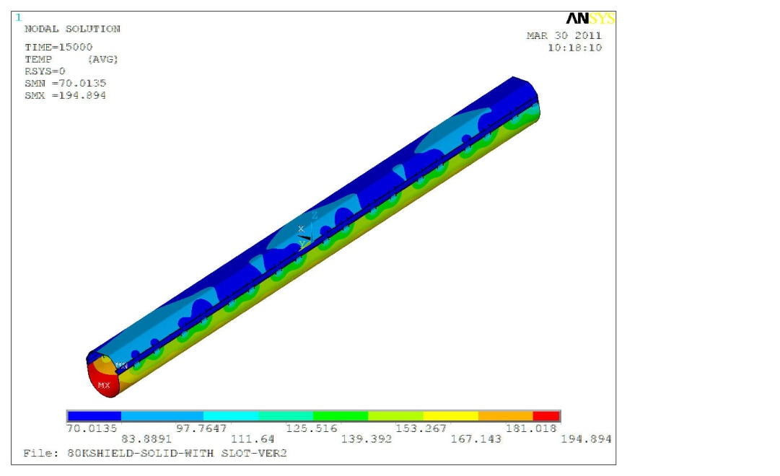
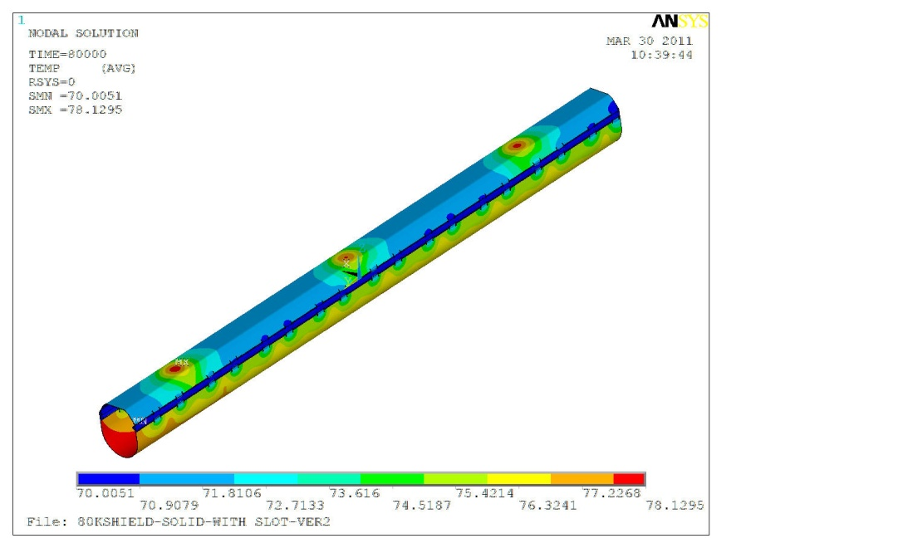
        Glimpses of Design Effort
300 K Vacuum Vessel
Thermal
Radiation
Support Post
Conduction
Res. Gas
Conduction
63.33 | W |  | 29.18 | W | 4.26 | W
92.80 | W
2.45 | W
1.53 | W
80 K Thermal Shield + Support Post
GHe
Support Post
Conduction
Temperature plot after 4.16 hours(15000Sec)
2.56 | W
5 K Support Post
GHe
Thermal
Radiation
Res. Gas
Conduction
Support Post
Conduction
0.40 | W |  | 0.11 | W | 1.03 | W
2 K Cold Mass
2K He
Temperature plot after 22.22 hours(80000Sec)
Thermal Flow without 5 K Shield
Thermal Shield Analysis

Slide 25
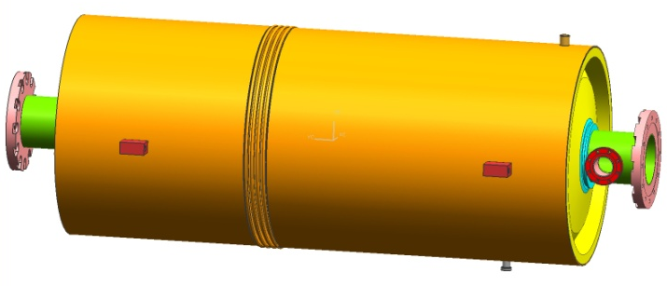
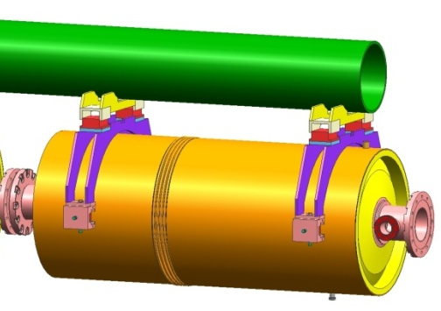





3-D Model of Subsystems Of Cryomodule
SCRF CAVITY
HELIUM VESSEL
CAVITY SUPORT SYSTEM UNDER PROTOTYPING AT RRCAT
3-D Model developed at RRCAT for Project X Cryomodule
CRYOGENIC SUPPORT POST
THERMAL SHIELD
VACUUM VESSEL

Slide 26
Thank You

