Slide 1
Working Group 5
Controls, Instrumentation & Protection
Summary Talk
M. Wendt and W. Blokland
ProjectX Collaboration Meeting April 12-14, 2011

Slide 2
WorkGroup Controls, Instr.& Protection
Charge to working group:
  Collaboration and R&D
  Identify technical issues for Controls & Instrumentation (and high level applications)
  Establish goals and mile stones

Slide 3
WG-5 Agenda
Speaker | Topic
M. Wendt | Kicker R&D for a Broadband Chopper*
C. Burkhart | MOSFET Chopper Driver R&D*
C. Deibele | BPMs as Beam Phase Monitors
Y. Polsky | High Power Fast Faraday Cup R&D
W. Blokland | Electron Beam Scanner R&D
R. Wilcox | Laser Diagnostics R&D
M. Wendt | Cold BLMs
V. Scarpine | Beam Diagnostics & Beam Studies at HINS / MDB
S. Nagaitsev | Project X Beam Instrumentation Requirements
W. Blokland | SNS Experience on Beam Diag., Operations & Controls
 | * WG-1 & WG-5 joint session

Slide 4
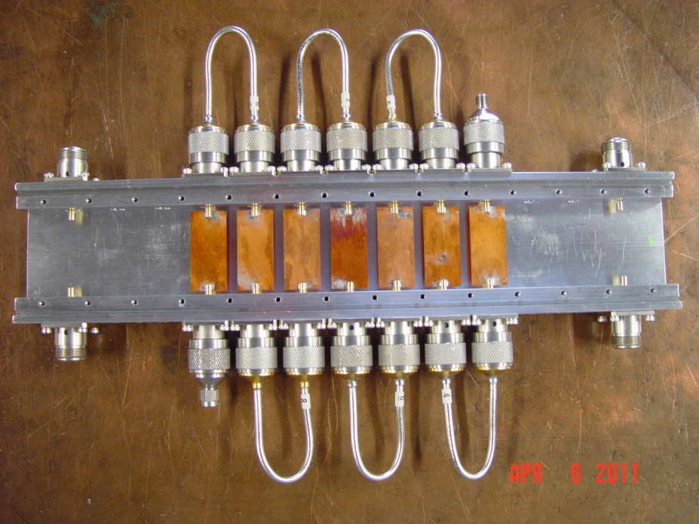
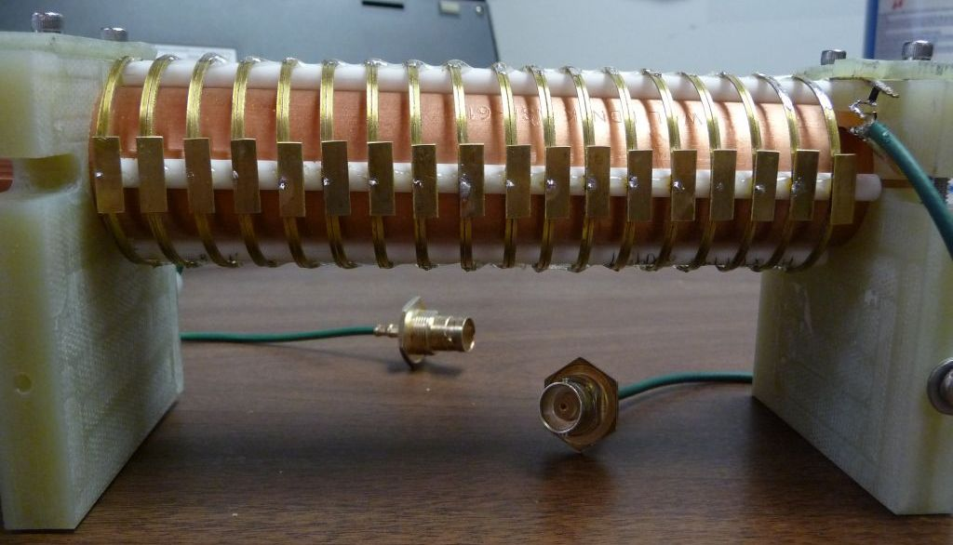
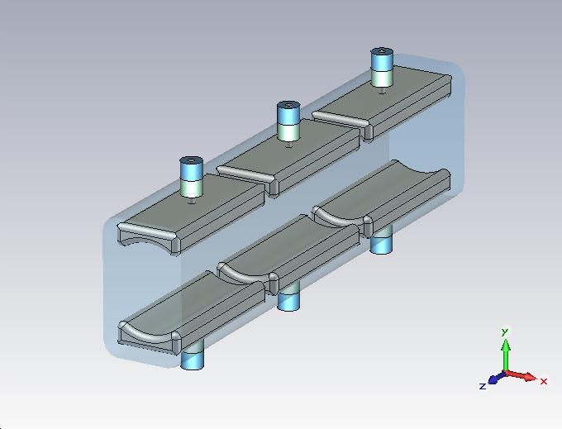
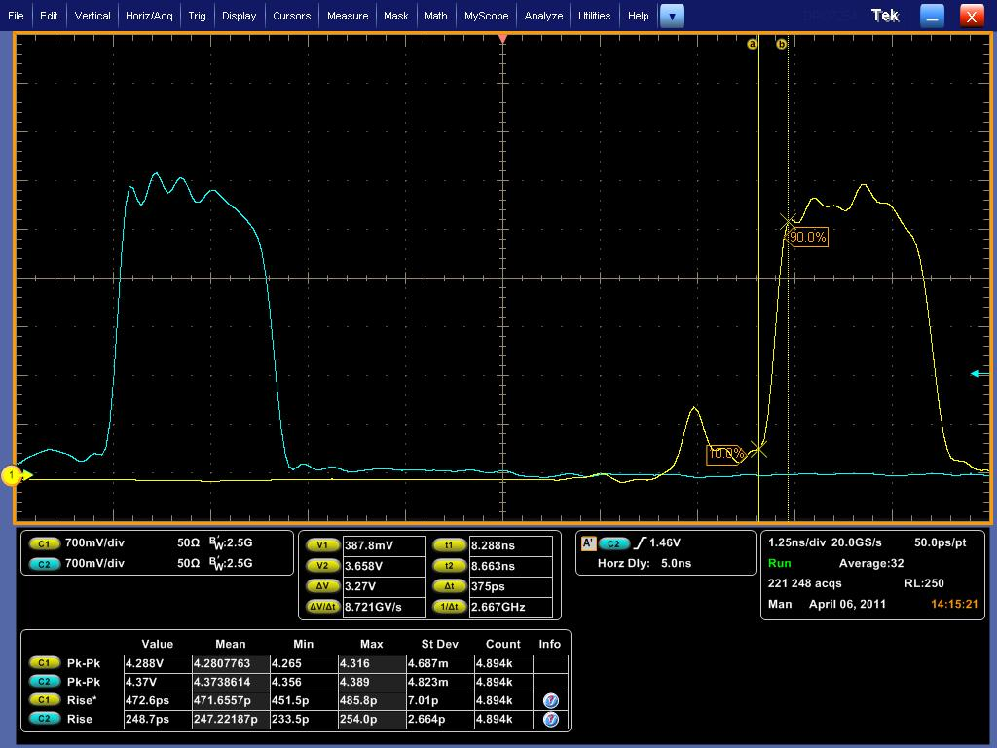
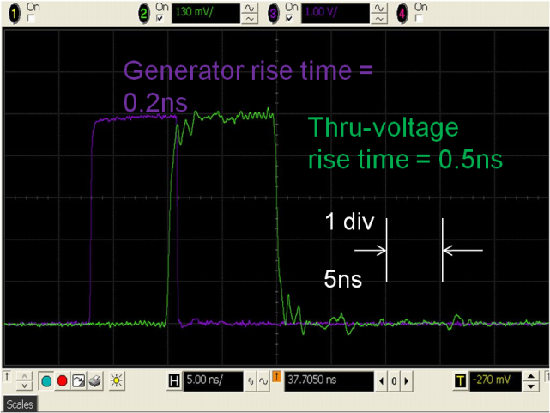
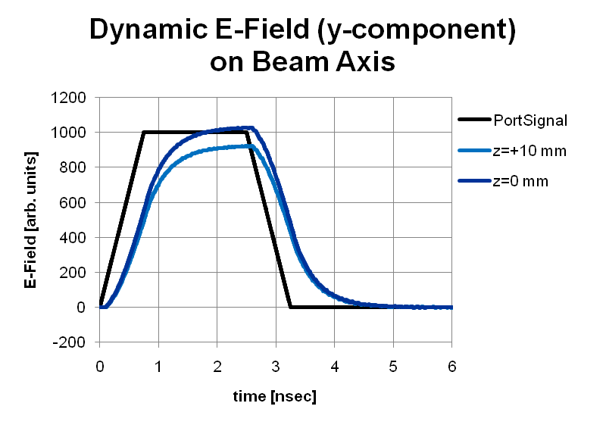
Broadband Chopper R&D
Kicker System Options
  Meander-like travelling wave structure, 50 Ω impedance
  Helical microstrip travelling wave structure, ~200 Ω impedance
  Lumped element electrodes, capacitive, individual powered

Slide 5
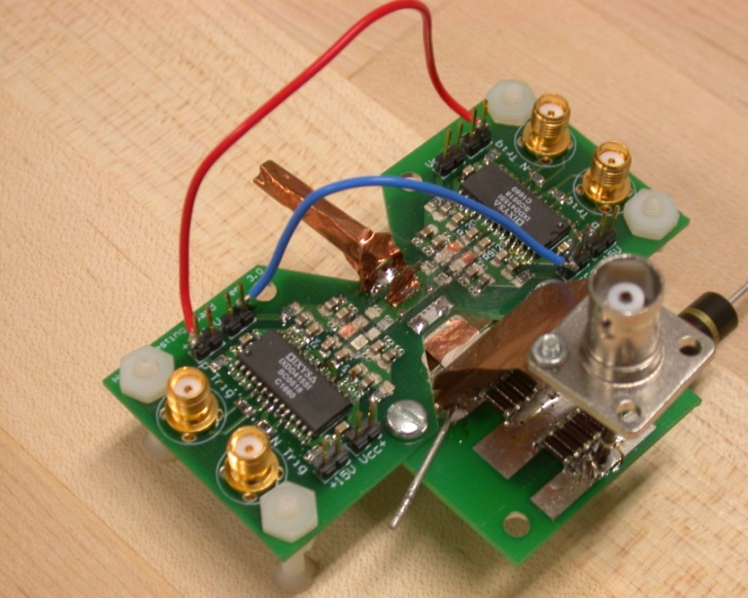
MOSFET Driver for Chopper
Need clear specifications, e.g. voltages, pulse flatness and duration, pulse patterns, jitter, etc.
Hybrid/FET R&D for ILC DR, e.g. 1 nsec, 1200 V, 35 A
  Project X: high rep rate demand -> power losses
  P = 0.5 C_{OSS} V²
MOSFET output capacitance examples
  APT1201R4
    1200 V, 36 A, 310 pF (~150 pF effective)
    P = (0.5) (150 pF) (1 kV)² (80 MHz) = 6 kW
  IRF630N
    200 V, 37 A, 89 pF (~47 pF effective)
    P = (0.5) (47 pF) (0.18 kV)² (80 MHz) = 61 W
Various driver topologies,
e.g. line-type, totem-pole, etc.
Hybrid/MOSFET driver has the switching
speed potential, but minimize switching losses!

Slide 6
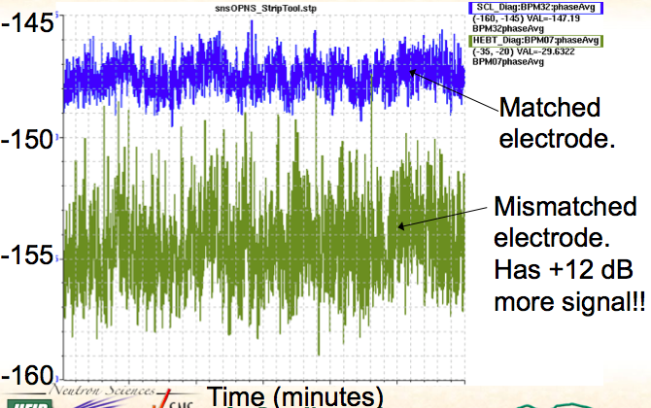
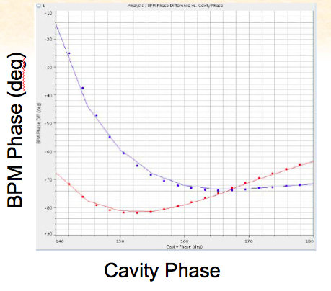
BPM as Phase Monitors
C. Deibele
Calibration in lab
RF Distribution
BPM Cables matched to 2 psec and measured between
On the bench, phase accuracy is demonstrated to 0.05 degrees (2.5 psec)

Slide 7
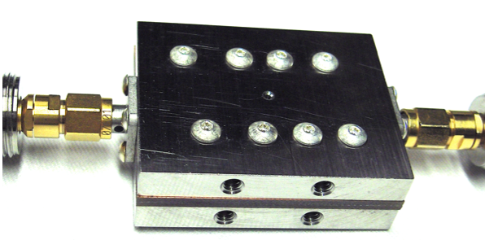
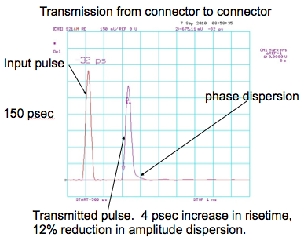
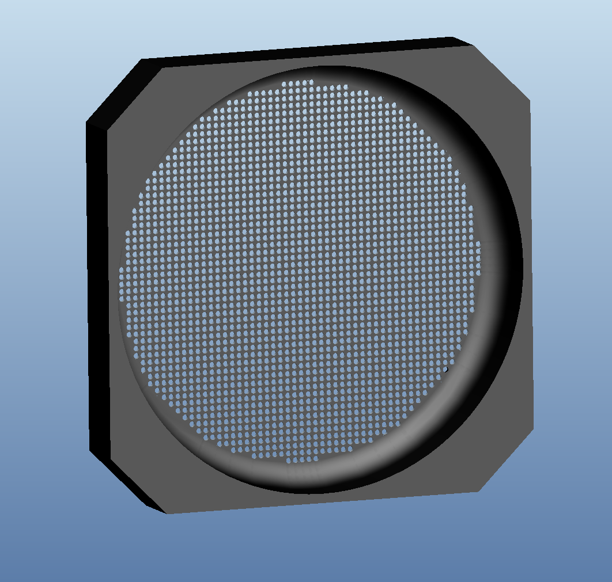
Fast Faraday Cup
Y. Polsky and C. Deibele
Low power FFC delivered and installed but has not yet seen beam.
For higher power options:
  attenuate power
  geometric beam stop design
-> further investigation needed to determine change to transverse profile and if this is acceptable.
aperture
4ps increase in rise time
pyrolitic graphite screens

Slide 8
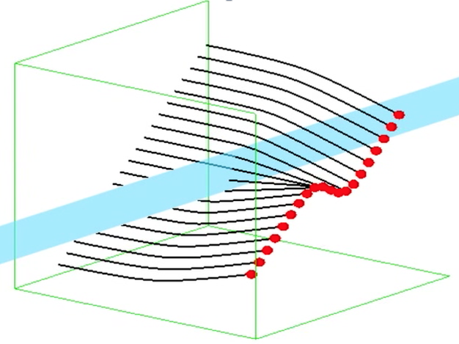
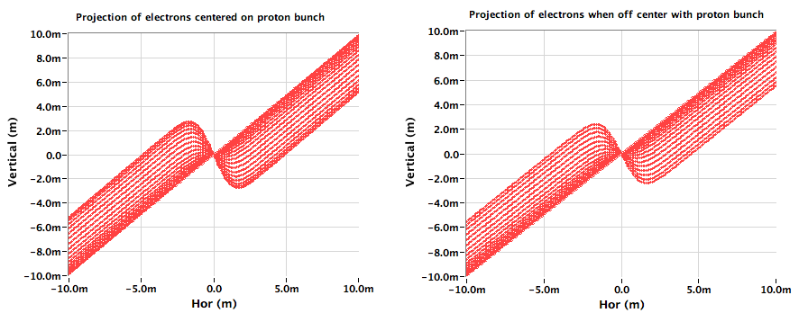
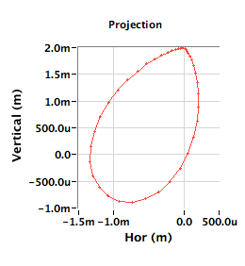
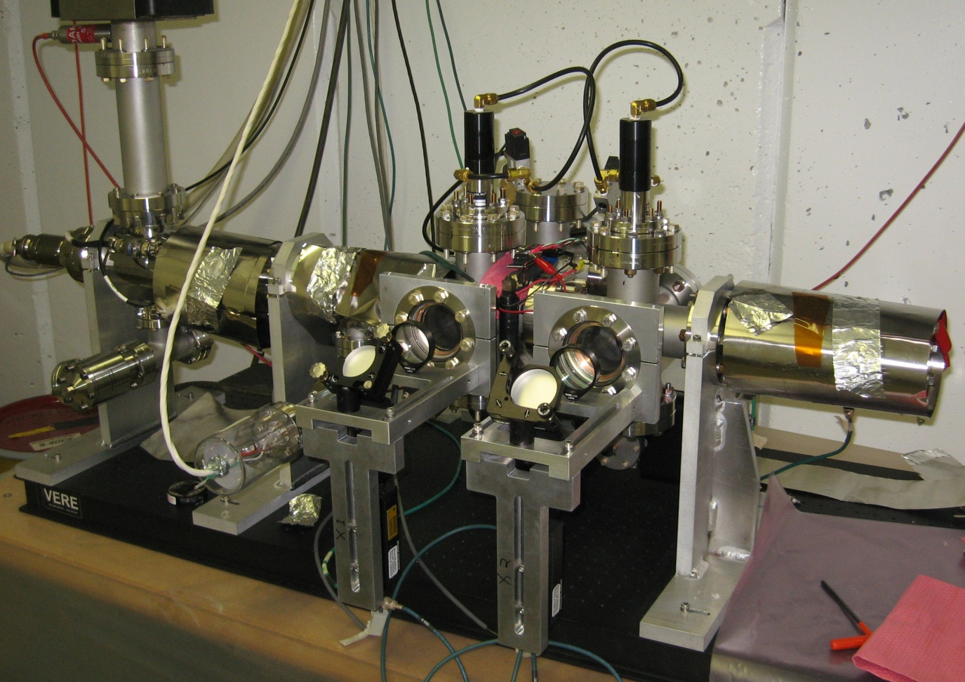
Electron Scanner R&D
T. Gorlov, R. Thurman-Keup, W. Blokland
Main issue in applying SNS style electron scanner is the much shorter proton bunch (700ns <-> 3ns)
  Much faster deflection -> Must be developed
  Ribbon beam -> develop ribbon cathode
  pencil beam being deflected by proton beam
  All options must look at intensifying the image or use multiple exposures
Test setup at Fermilab with commercial gun
  Slow deflector down to 2µs
  Spot size test -> 100µm
SNS style scan
Deflected ribbon
Beam spot measurements
Test stand at Fermilab
Deflected pencil beam

Slide 9
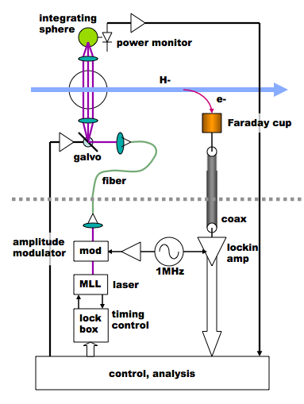
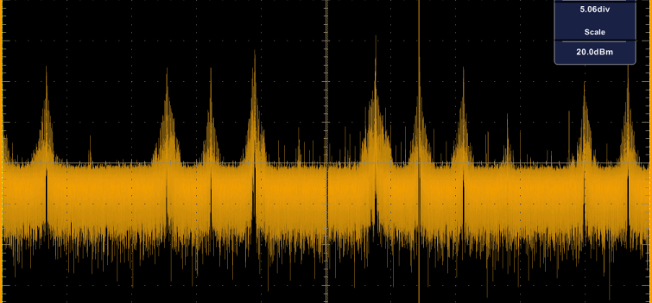
Propagation and noise experiments for a fiber-delivered laser wire
R. Wilcox, J. Byrd, M. Zolotorev, and V. Scarpine
Improve SNR by using narrow band locking amp detecting 1MHz modulated signal
Synchronize laser system with beam
Put modulation between noise signals
Noise measurements at SNS
Fiber will spread pulse: 100m -> 100ps, 30m ->15ps
Beam halo needs many pulse averaging
Mostly commercial components at 1µm wavelength
Configuration

Slide 10
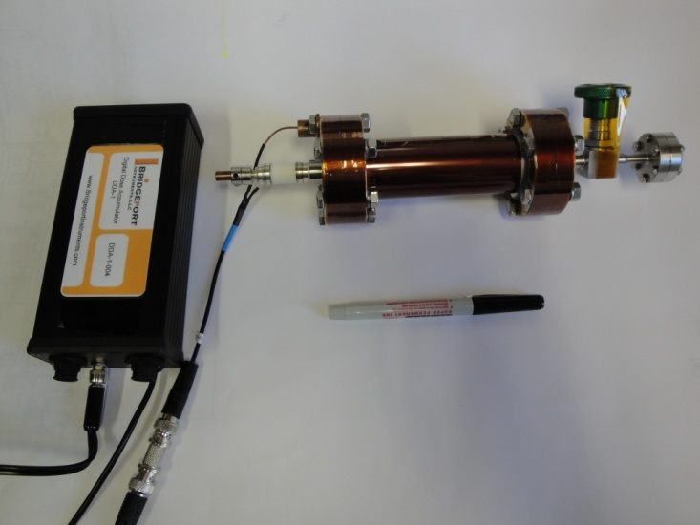
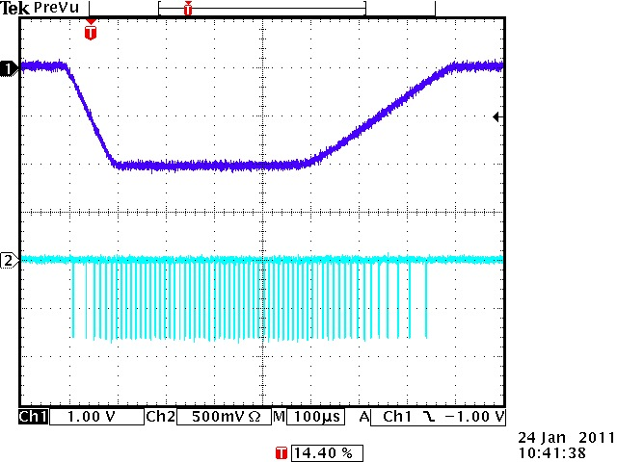
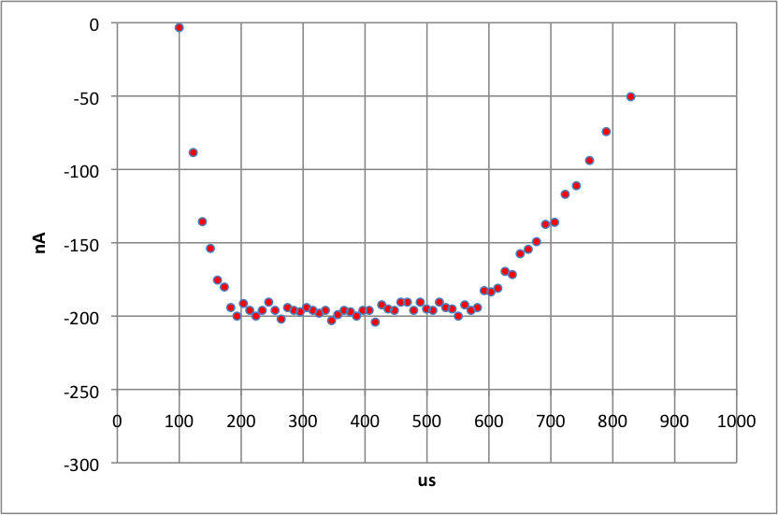
Cold BLM R&D
A. Warden (M. Wendt)
Most of the linac is cold and to make sensible loss measurements, you have to be close to the loss origin.
Technique: convert current to pulse right outside of cryo-module and drive pulse to upstairs electronics -> 1E5 dynamic range
The charge per pulse is 1.63pC or 238µR at 1 atm (room temp) of He.
Helium filled ionization chamber
Bias voltage and electronics
Recovered waveform using FPGA-based time-to-digital converter (TDC) at 10-bit resolution
Bridgeport
Input waveform
pulses

Slide 11
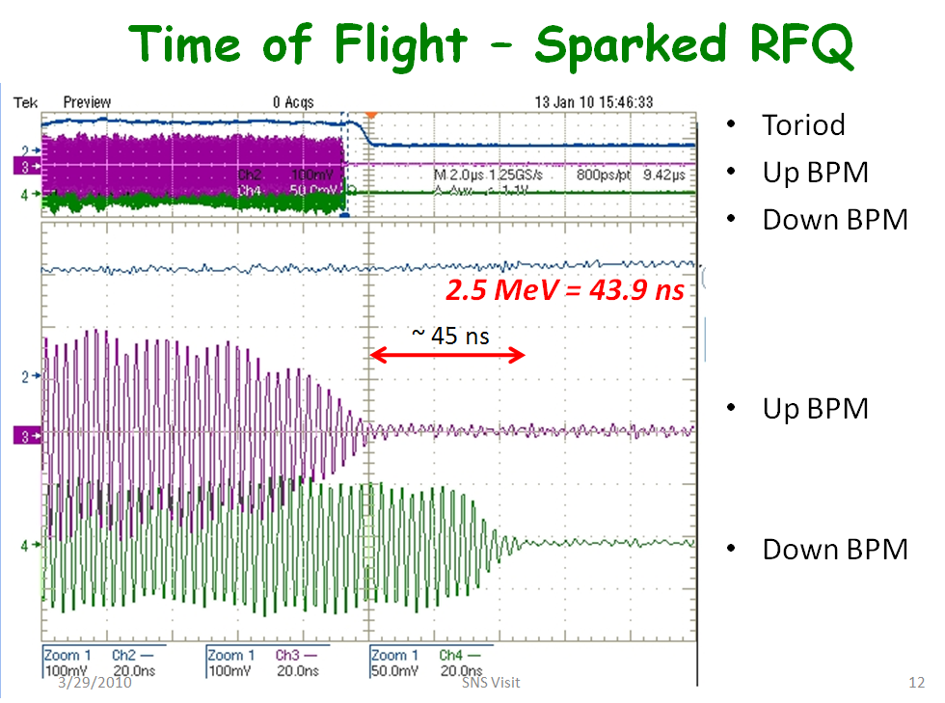
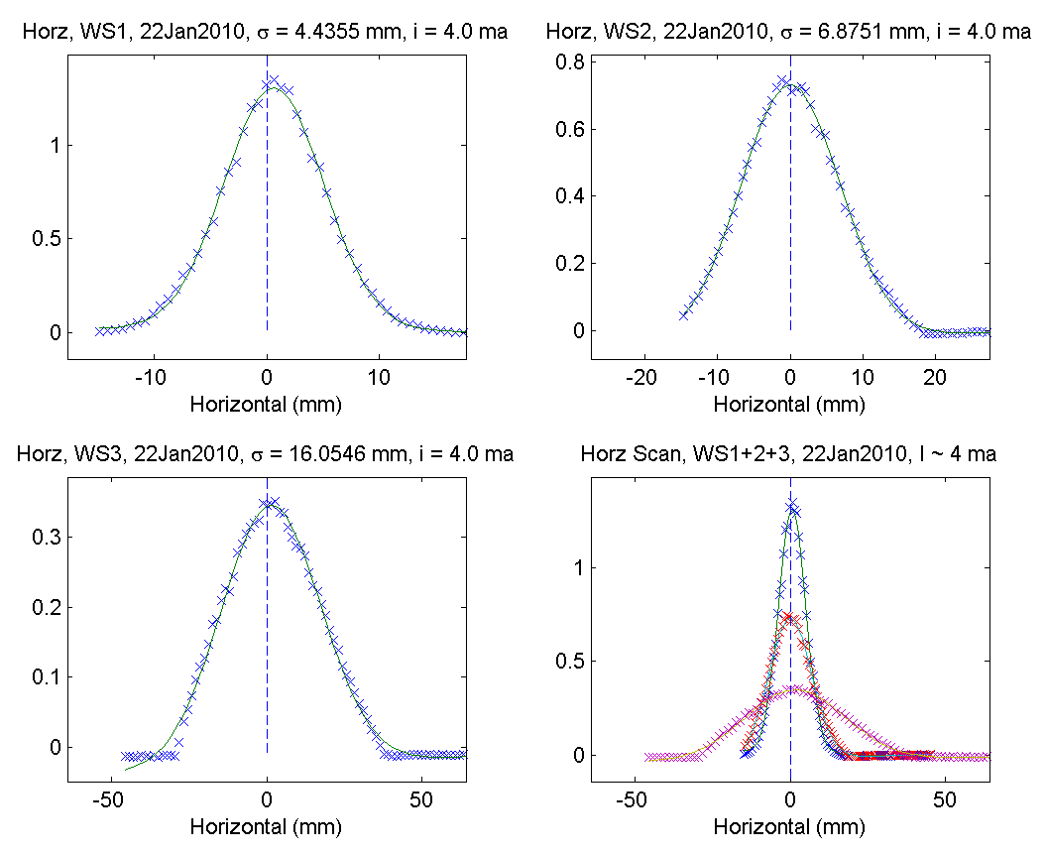
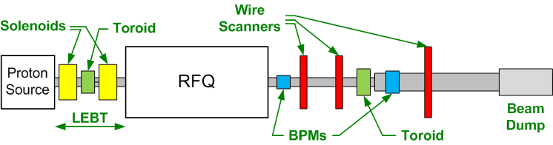
Beam Studies at HINS / MDB
MEBT beam energy: 2.5 MeV
  TOF of the sparked RFQ between two button BPMs
Beam profiles at the
RFQ output
  3 wire scanners
  No focusing
  Beam fills physical aperture

Slide 12
Requirements for PX Beam Diag.
Lots of “unknowns”, few known facts set by lattice, segmentation, etc.
For discussion: Preliminary number and type of beam diagnostics
Discussion on physical space, alignment, resolution, precision, MEBT diagnostics, and comparison with SNS beam diagnostics.
 | MEBT | SSR0 | SSR1 | SSR2 | LE650 | HE650 | Total
Current monitor | 2 | 1* | 2** | 4 | 7 | 10 | 26
Emittance | 1 | 0 | 0 | 0 | 0 | 1 | 2
Wire Monitor | 4 | ? | ? | 0 | 0 | 0 | 4
Laser Wire | 0 | 2 | 2 | 4 | 4 | 8 | 22
BPM | 11 | 21 | 20 | 24 | 14 | 38 | 128
Loss monitor | 2 | 4 | 4 | 4 | 4 | 12 | 30
Neutron | 4 | 1 | 2 | 2 | 7 | 19 | 35
Halo monitor | 1 |  |  | 1 |  | 1 | 3

Slide 13
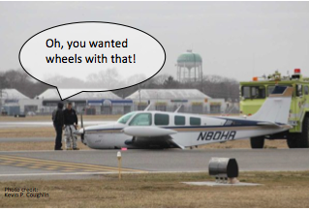
SNS Commissioning Experience
W. Blokland
Experience and setup
  Shake out period
  Created/debugged high level physics application apps during commissioning
  Allow different tools to interface to controls
    Java, python, matlab
Describing control system requirements
  Not very enthusiastic, assumption is that current system is just fine.

