Slide 1
RDR Injection Design Status and Alternate Injection Configuration
David Johnson
Project X Collaboration Meeting
April 13, 2011

Slide 2
Work Group Charge/Points to Consider
Detailed discussion of Reference Design, including specifically targeted technical issues and questions;
Discuss possible alternative implementations and define technical options that require decisions;
Integrate relevant SNS experience into discussions as appropriate;
Establish goals and work assignments for the period through CD-1;
Develop strategies for test facilities, as appropriate;
Identify any issues related to the above that need resolution

Slide 3
WG4 Topics
RDR Injection Configuration
Long pulse (26 ms) injection
Laser Stripping (Laser Workshop summary)
Alternative Foil configuration
Ring RF
Lower MI Energy (6 GeV)

Slide 4
Current RDR Injection Configuration
Current injection into Recycler for accumulation followed by immediate injection into the MI
Carbon Foil Stripping
Linac Beam Structure
1 mA 4.3 ms 6 injections (~26 mA-ms)
Bunch spacing 6.2 ns (162.5 Mhz)
Broadband chopper for abort gap & fit into ring RF
Bunch length ~ 20 ps (rms)
Pulsed linac rep rate 10 Hz
Pulsed Linac final Energy 8 GeV kinetic +/- 10 MeV
Current concept is to utilize carbon foil stripping and transverse phase space painting.

Slide 5
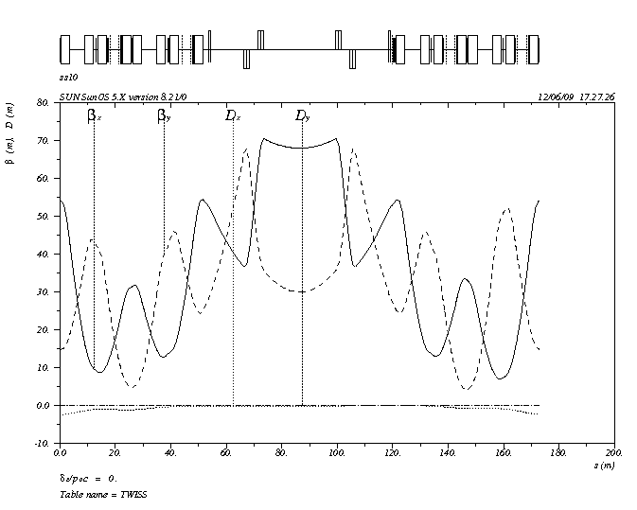
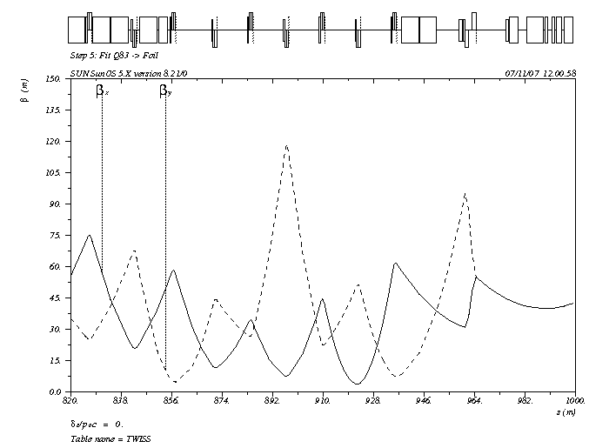
Recycler Injection Straight Section
Linac: emittance(95%) 2.5 π dpop +/- 2 MeV Bunch length 20 mm ( 26 ps rms)
Injected beam β = 40 m for this exercise with 3σ = 4mm
with β adjustable to 10m -> 3σ = 2mm
Recycler ring lattice βx = 70 m βy = 30 m 3σx = 17.2 3σy=10.7
Recycler rev. period 11.13 μs (h=588) beam pulse 10.34 μs (546 53 Mhz bunches/turn)
Injection beam power 34 kW per injection (2.6E13/injection x 6 = 1.54E14)

Slide 6
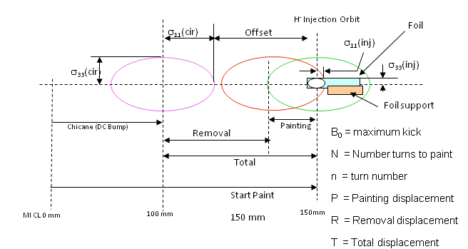
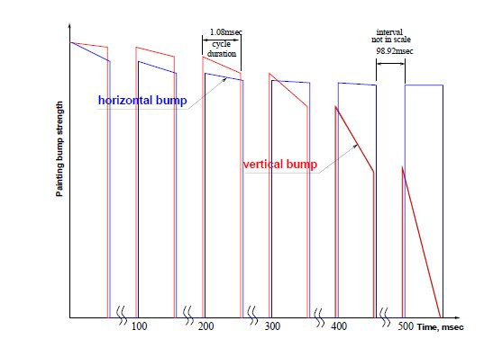
Recycler Injection
Stripping foil
H⁰
Thick foil H⁰->H⁺
HBC1
H⁻
HBC2
HBC3
HBC4
H⁺ to inj. absorber
75 to 100 mm
Circulating protons
8.941 m
0.606 m
1.068 m
+3.5669 kG
-0.4656 kG
-11 kG
11 kG
KEK (anti-correlated) H paint V steer
Foil orientation (corner foil used in present simulation)
Hor. Strip foil (matched to size of beam)
18mm
6-8mm
14mm
12mm

Slide 7
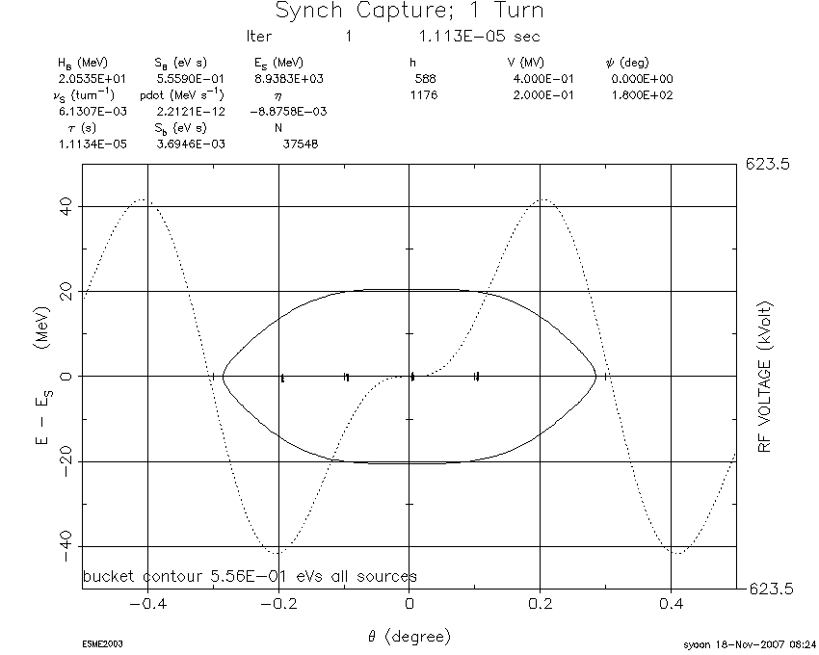
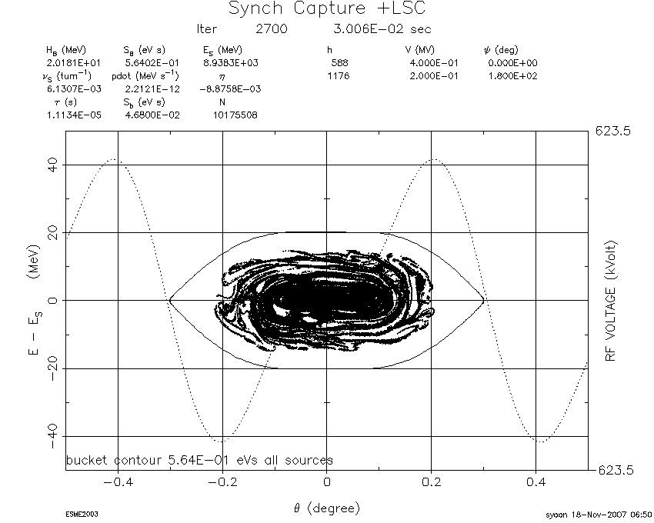
Current RDR Configuration(3)
Longitudinal phase space painting in both phase (fit into central 12 ns of ring RF bucket) and energy considered
Ring RF frequency options (new 53 Mhz cavities from Nova)
Current 53 Mhz (not harmonic) parasitic phase shift during injection process
New cavities with harmonic (3) of 162.5 Mhz (54.166 Mhz)
Second harmonic cavity to flatten RF
2700 turns
BF~2.7
+/- 3 ns
18 ns
ESME Simulation (325Mhz bunches) with space charge but without broadband impedance

Slide 8
Issues to address
More detailed painting simulations
Transverse (ORBIT / STRUCT)
Painting algorithms
Foil interactions
Realistic magnetic fields
Space charge
Wideband impedence
Longitudinal (ESME / ORBIT)
Space charge
Wideband impendence
New bunch structure
Both phase and energy painting
Foil Issues
Temperature
Losses
Electron collection
Dynamic aperture studies (preliminary report show space charge not an issue during injection…. But need to verify with new bunch parameters
Ring collimation (for injection losses) – the need to be addressed in with ORBIT and STRUCT.

Slide 9
Plans to go forward
8 Gev Transport line design and footprint - revise for either 8 GeV or 6 GeV
David Johnson
Injection insertion design (including injection absorber) and optimization
David Johnson
Deepak Raparia (et. al. BNL)
End-to-end tracking RFQ to injection foil,using TRACK, to supply injection phase space for ORBIT /STRUCT/ESME simulations.
Summer student
Recycler lattice modifications, dynamic aperture simulations (including space charge) -> HB2010
Meiqin Xiao - pretty much done (revise as necessary)
Injection Absorber design --- first past done for MI and Recycler need to revisit when design becomes firm
Zhijing Tang
Igor Rakhno
Transverse Phase Space Painting simulations --- on going as configurations change and change and change
Sasha Drozhdin (STRUCT)
Leonid Vorobiev (Orbit)
Igor Rakhno (Foil Temperature calculations )
Longitudinal Phase Space Painting simulations
Leonid Vorobiev (ORBIT)
ESME ( need to revise simulation for new bunch frequency and painting)

Slide 10
Proposed Alternate Configuration
IF pulsed linac can be operated in long pulse mode (26 ms beam pulse):
Inject directly into Main Injector
at either 8 GeV
or 6 GeV (6 GeV MI operation discussed later)
Potential issue at MI-10 with LBNE extraction
Stripping options (will address in next presentations)
Laser assisted stripping
Carbon foil

