Slide 1
Cryomodules
Matthew Howell and Stephen Stewart
Cryomodule Design Team Members

Slide 2
Outline
Spare cryomodule
  Drivers
  Status
Cryomodule design
  Relation to original design
  Complying with pressure code
  Incorporating lessons learned
  What changed
Power Upgrade Project
  Scope
  Facility Needs

Slide 3
SNS LINAC
Twenty-three cryomodules
  11 medium beta cryomodules
  12 high beta cryomodules
  9 empty slots for high beta cryomodules
  Multiple repairs necessary – most done in place in tunnel
  Two cryomodules were removed from tunnel for more complex repairs after beam operations began
Spare cryomodules necessary
  1 high beta spare
  1 medium beta spare

Slide 4
Spare Cryomodule
Allows removal of operating cryomodule for repair
  Maintain same beam energy
  Increase time for conducting complex repairs
  Removes complexity of repairing cryomodules in LINAC tunnel
  Necessity for beam reliability and availability goals for SNS
High beta spare serves as prototype for PUP
  High beta spare is first priority over medium beta spare
  Meets pressure requirements put forth in 10 CFR 851
  Incorporates design upgrades to vacuum vessel and end cans
  Fabrication techniques are being developed
  Alignment methodology is being refined
Medium beta spare to be built as funding is available

Slide 5
High Beta Spare Cryomodule Status
Cold mass complete
  Cavities processed at J-Lab and shipped to SNS
  BCP and vertical EP was processing technique
  String assembly completed at SNS
  Integration of string, shields, and space frame complete at SNS
Vacuum vessel
  Manufactured at Keller Technology Corporation
  Due to arrive at SNS end of this month
End cans
  Supply can (Completion date – May)
    Design complete
    Fabrication under way at ORNL
  Return can (Completion date – July)
    Design is 90%
    Fabrication will start after supply can is complete

Slide 6
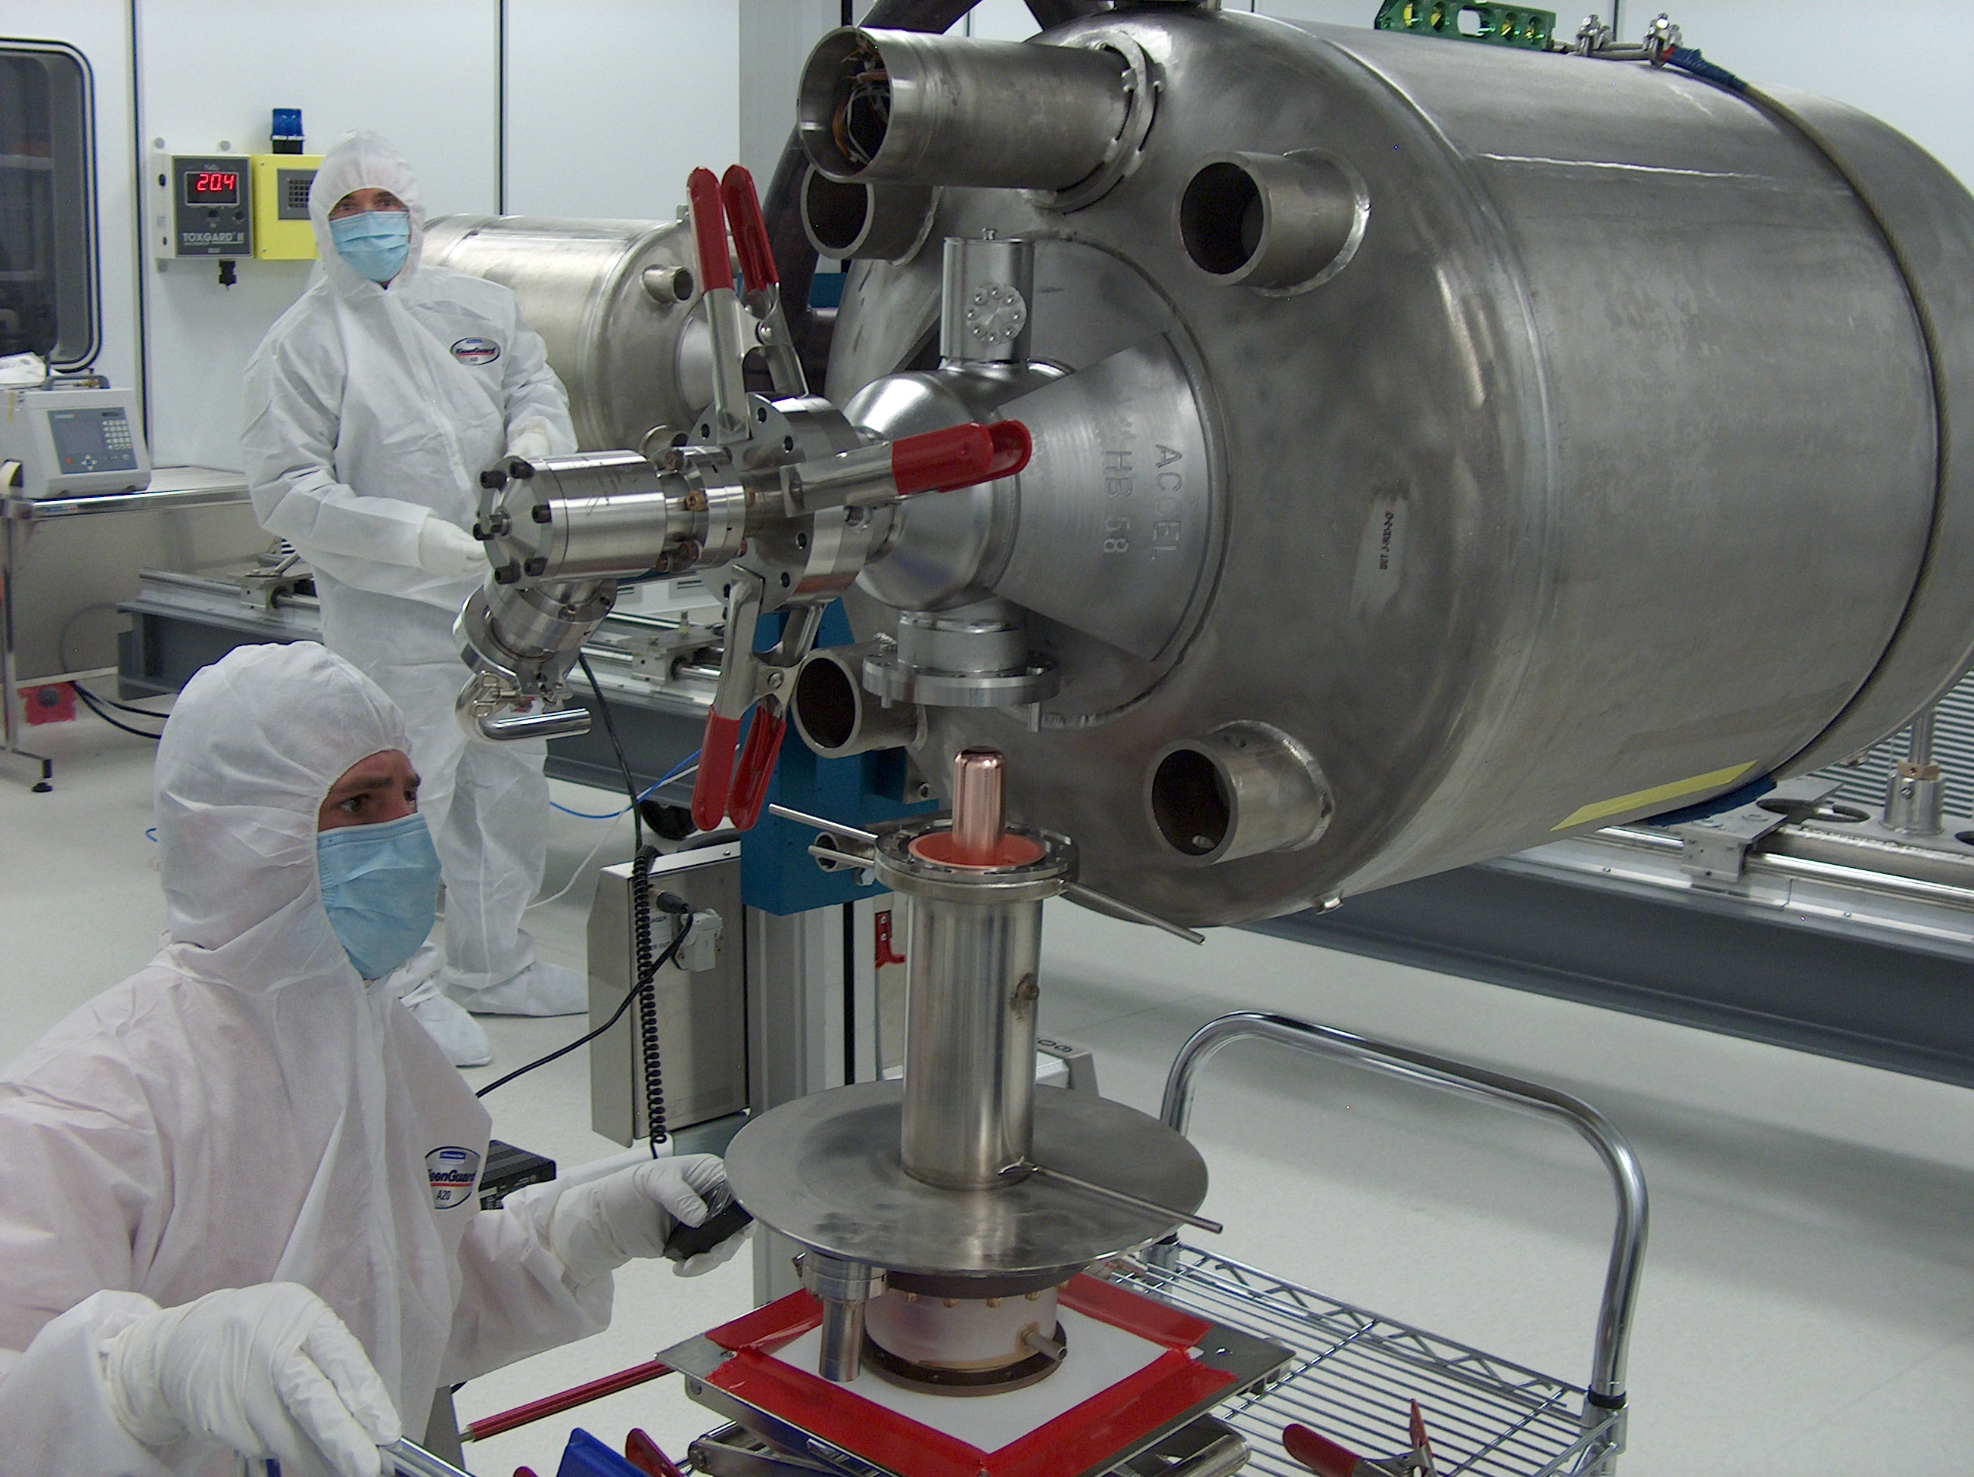
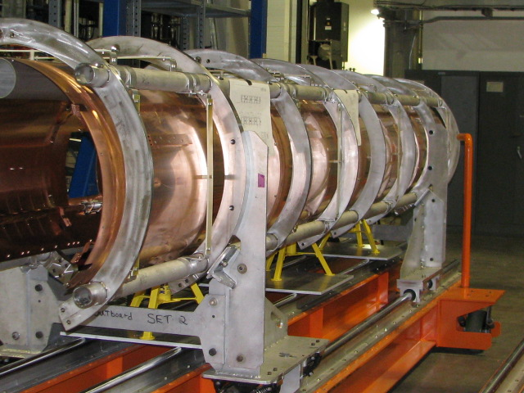
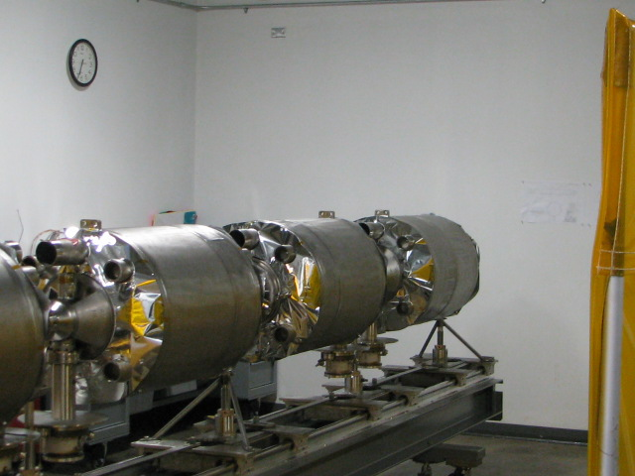
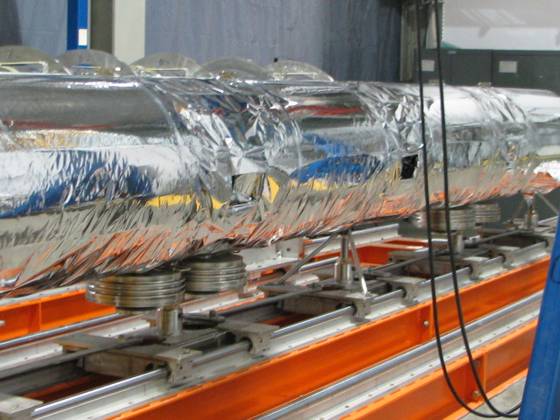
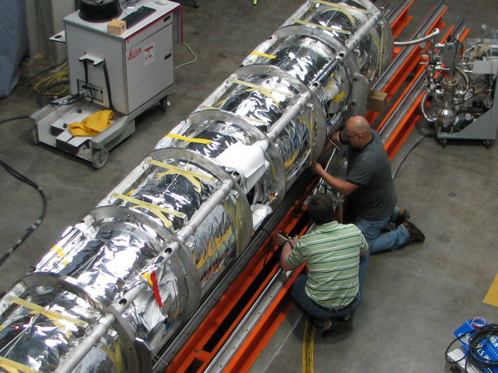
Spare Cryomodule Status

Slide 7
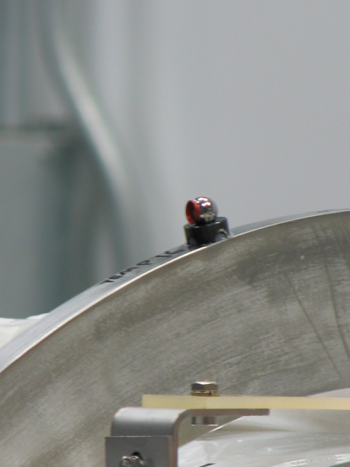
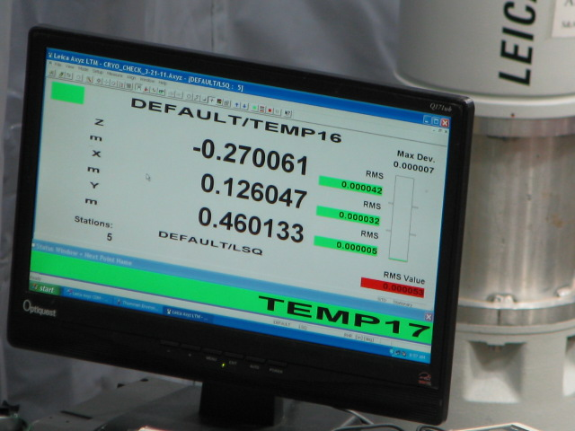
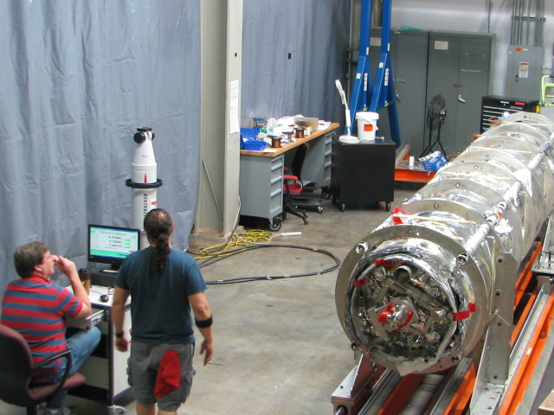
Spare Cryomodule Status

Slide 8
Basis of New Cryomodule Design
Maintain design similar to original SNS high beta cryomodule
  Proven design
  Six years of operating experience
  Interface points same as original
Meet 10 CFR 851 with regards to pressure safety
  New requirement introduced in February 2007
  Vacuum vessel will be code stamped
  End-cans will be code stamped
Reviews conducted
  Internal Reviews – Feb 2009, Feb 2010
  External Reviews – Nov 2009, Feb 2010
  End Can Review – Feb 2011

Slide 9
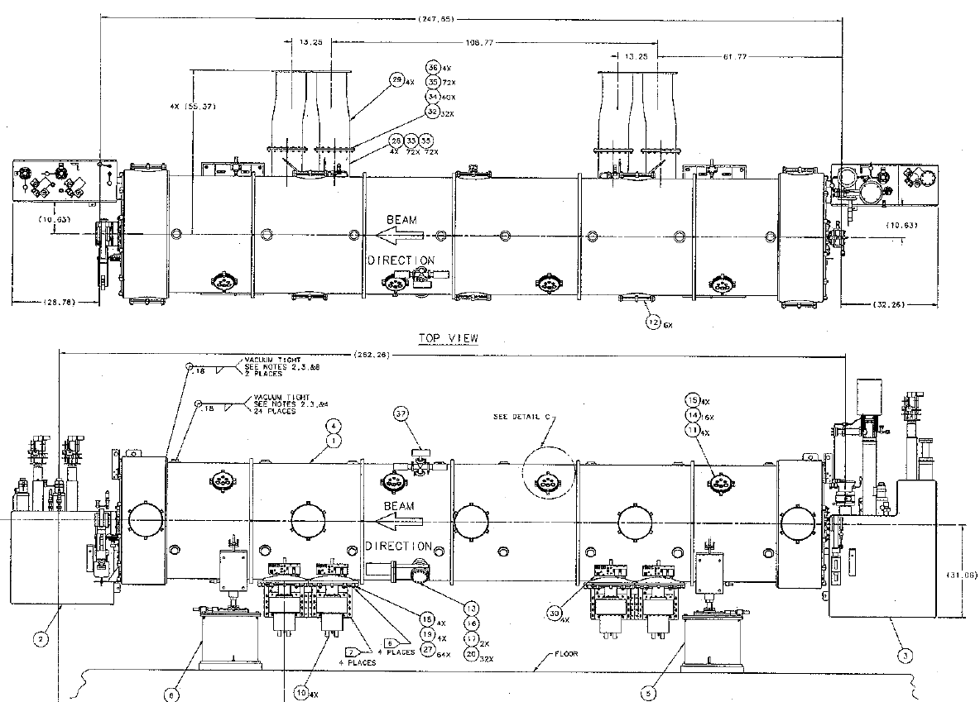
Constraints/Interfaces
Bayonet’s
Cool Down
Bypass
Fixed
“Free”
J-T’s
Pressure Reliefs
OAL
Slot Length
CRM9000000-0001 Sht #1

Slide 10
Redefining the Pressure Boundary!
Defined the pressure boundary as the vacuum vessel and end can envelope
  This was mainly due to the difficulty in applying PV code requirements to cavities and helium circuit materials
    Nb and Titanium are not code listed material at operating temperature therefore an equivalent level of safety comparable to B&PV code must be provided
    It is very difficult to test helium circuit materials at their operating temperature

Slide 11
Moving PV Boundary:
    Benefits:
    Pressure testing of the completed helium circuit is not required
    Code can be applied at 77K. In event of failure, vessel shell never reaches helium temperature.
    Vacuum vessel (SNS case) is stainless steel and is a ASME listed material
    Pressure stamp increases quality assurance and documentation of fabrication/materials
    Internal components are not required to be ASME code stamped
    Challenges:
    Assembly will be more difficult
    Alignment of string to warm valves presents challenges
    End-can will be more difficult to align

Slide 12
Pressures Chosen for the New Design
What Was Chosen
Design Pressure | 3.0 atm absolute
MAWP | 2.5 atm absolute
PRD’s | Some changes to Jlab design
The Design Pressure and the MAWP are different this is not typical but is more conservative
Design pressure chosen was compatible with existing design material although some minor changes would be made to ports for compliance
MAWP allows for reasonably sized PRD’s therefore minimal changes to the original design

Slide 13
Design Requirements
Design criteria
  Design for 3 atma internal pressure and 1atma external pressure (plus the UG-22 loadings)
  Ensure design is compatible with existing constraints
    Slot length
    Bayonet position
    Warm region interface
    Vacuum and particulate control

Slide 14
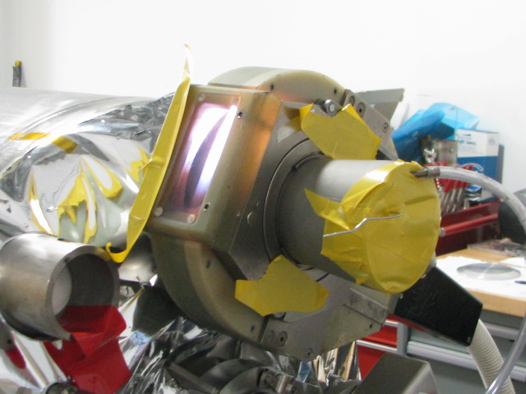
Incorporation of Lessons Learned
Diodes changed from in-process to surface mount
Procedures/travelers
  J-Lab travelers are the basis of our assembly procedure
  Updates to assembly procedure have been made based on spare cryomodule effort
  Staff training has been conducted on spare cryomodule effort
Spare cryomodule
  Recording lessons learned and incorporating them into PUP planning
  Spare is approximately 70% complete
  Learning lessons is ongoing
Notes:
This must be presented at December review and at CD-2 review in March. Is not required for Cost and Schedule Reviews.

Slide 15
Incorporation of Lessons Learned
Spare cryomodule
  Alignment presents some challenges
    Removed flexibility of adjusting warm valves
    Adjustable design while meeting code is complicated
    New techniques will be developed in clocking bayonets to beam line
  Some alignment techniques have been developed/improved
    Real time feedback while adjusting string with laser tracking
    Tolerance improvement of warm alignment
Notes:
This must be presented at December review and at CD-2 review in March. Is not required for Cost and Schedule Reviews.

Slide 16
Design Changes to Cryomodule
Vacuum vessel
  Some major and some minor changes were made to allow for independent pressure testing of vacuum vessel
  Major changes:
    Vacuum vessel length increased
    End flanges were added and bridging rings removed
    Added end can ports with flange connection
  Minor changes:
    Lockdown studs enlarged for bolt pattern
    Nozzles redesigned for code compliance
  PRD’s – adding additional burst disk

Slide 17
Design Changes to Cryomodule
End Cans
  Major Changes Supply End Can
    Cryo piping routed in flanged bridging pipe to vacuum vessel
    Moved JT valves to vacuum vessel
    End plate now part of vacuum vessel
    Changed piping runs
    Assembly sequence – new technique to clock bayonets in relation to beam line
  Major Changes Return End Can
    End plate now part of vacuum vessel
    Added and moved piping flex lines
    Changed piping runs
    Assembly sequence

Slide 18
Design Changes to Cryomodule
Minor String Changes
  Warm to cold transition redesigned for new end can design
  Cooling block added to each end of cold cavity string
  Changes to magnetic shielding, 50k shielding and MLI have been designed
  Pump drop on beam-line redesigned / improved
  Added second burst disk port
  Assembly of warm to cold transition areas has been outlined
    Expect an iterative process
    Flexibility of aligning warm valve with internal beam line removed

Slide 19
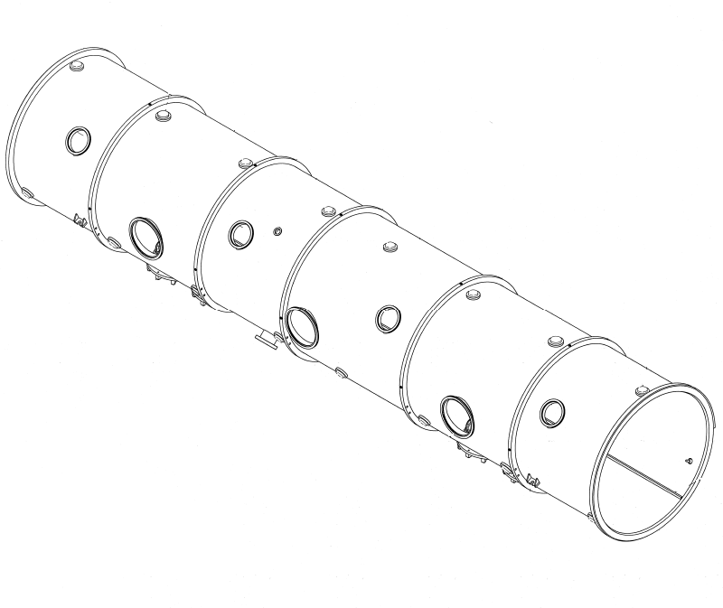
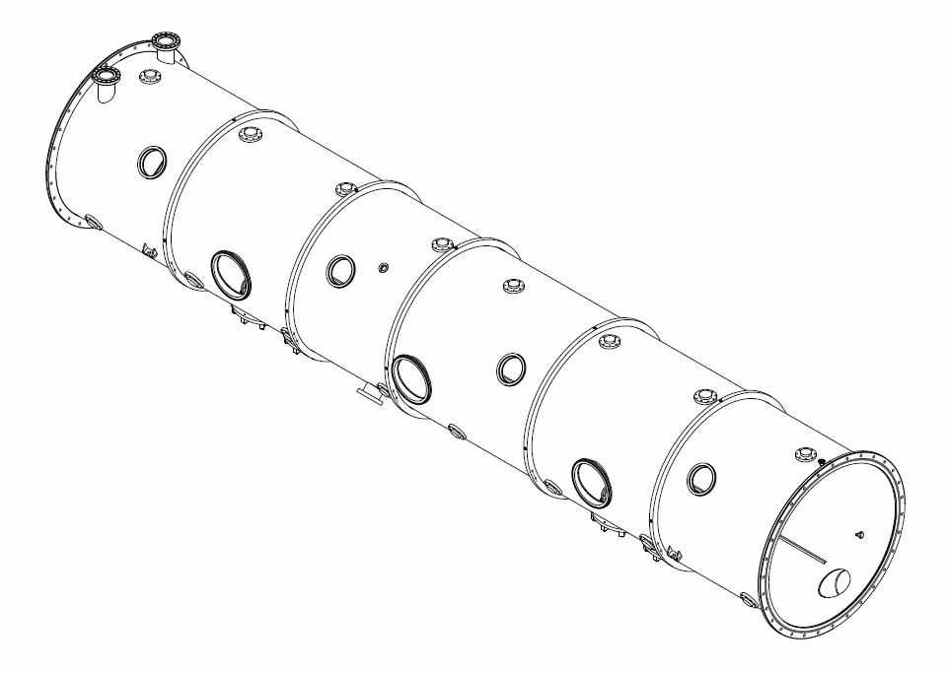
Vacuum Vessel Changes
Removed Weld Ring and Added a Flange to the end of the Vacuum Vessel
Increased the length of the Vacuum Vessel
Flange
Weld Ring
Existing Design High Beta Spare Design

Slide 20
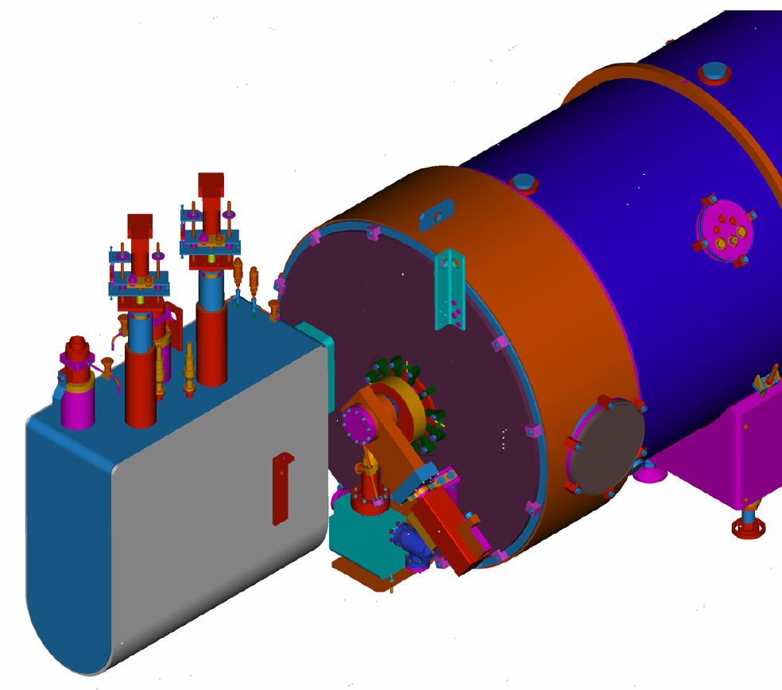
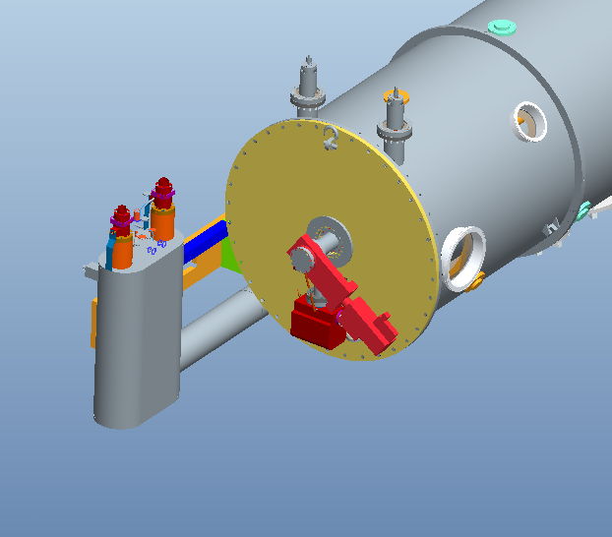
Vacuum Vessel Changes
Removed Bridging Ring
Bridging Ring
Flat Head
Existing Design High Beta Spare Design

Slide 21
Vacuum Vessel Changes
Moved J-T Valves from the Supply End-Can to the Vacuum Vessel
J-T Valves
J-T Valves
Existing Design High Beta Spare Design

Slide 22
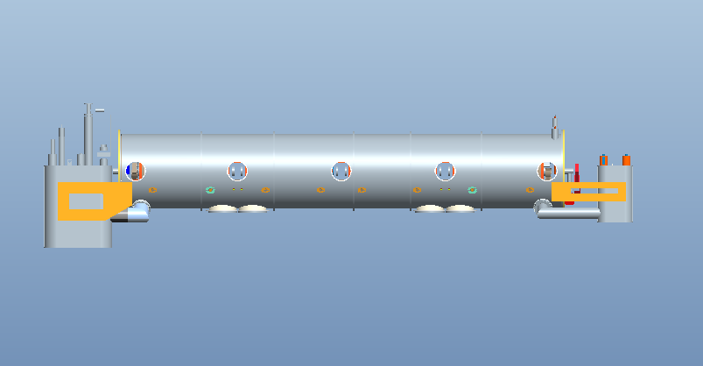
Vacuum Vessel Changes
Added End-Can ports
End Can Supports
Bridging Pipe
End-Can ports in the vacuum vessel
Bridging Pipe

Slide 23
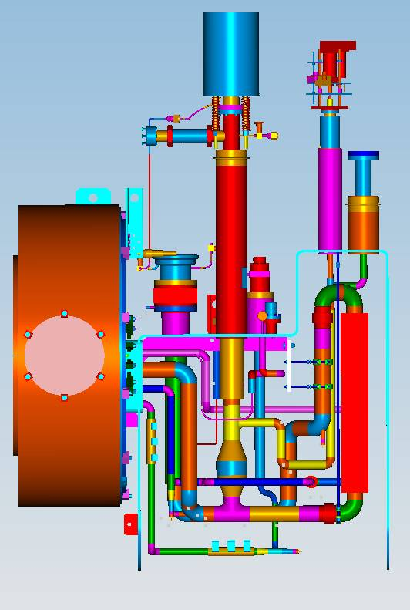
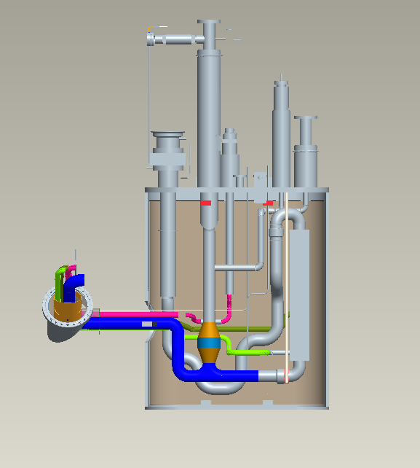
Return End-Can Changes
Simplified piping in the return end-can
Old Design New Design

Slide 24
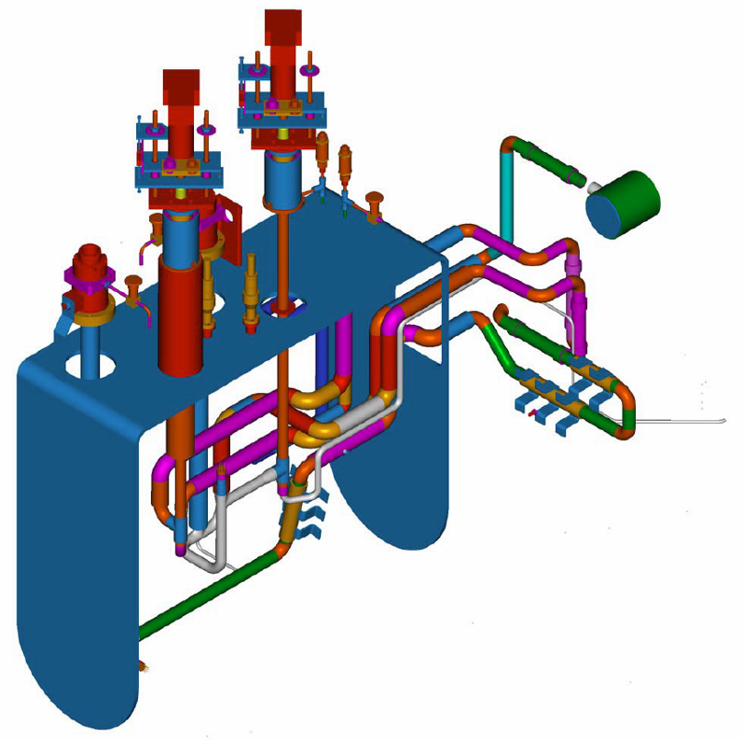
Supply End-Can Changes
Simplified piping in the supply end-can
Existing Design High Beta Spare Design

Slide 25
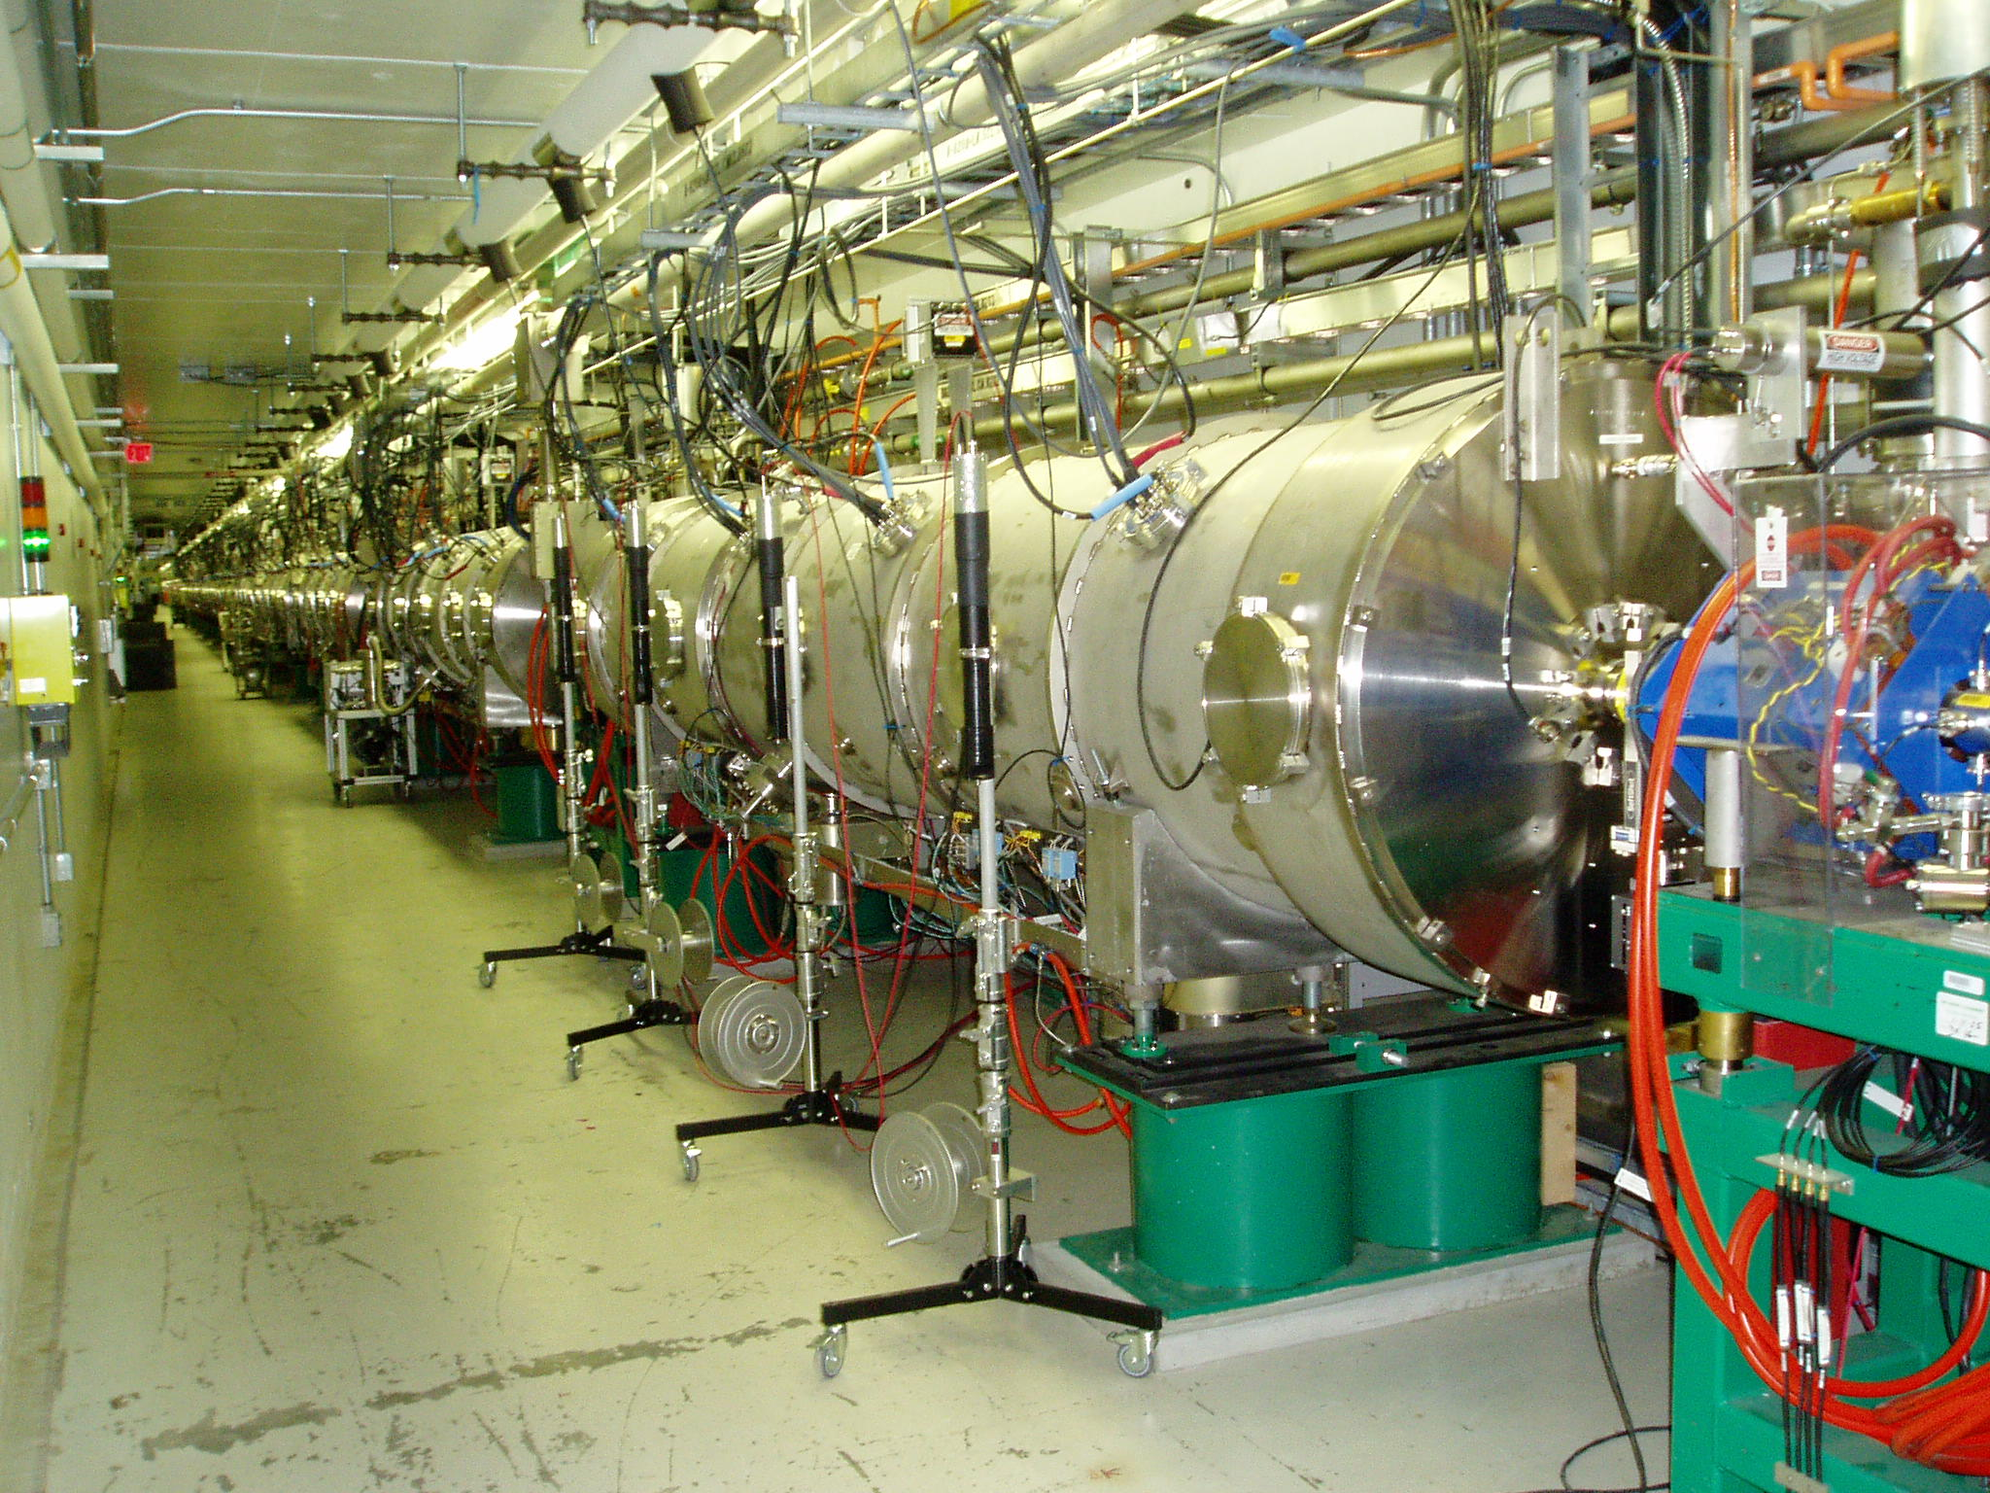
PUP SCL Scope
Increase beam energy from 1.0 to 1.3 GeV
Procure, fabricate, install and commission nine high beta cryomodules for SCL

Slide 26
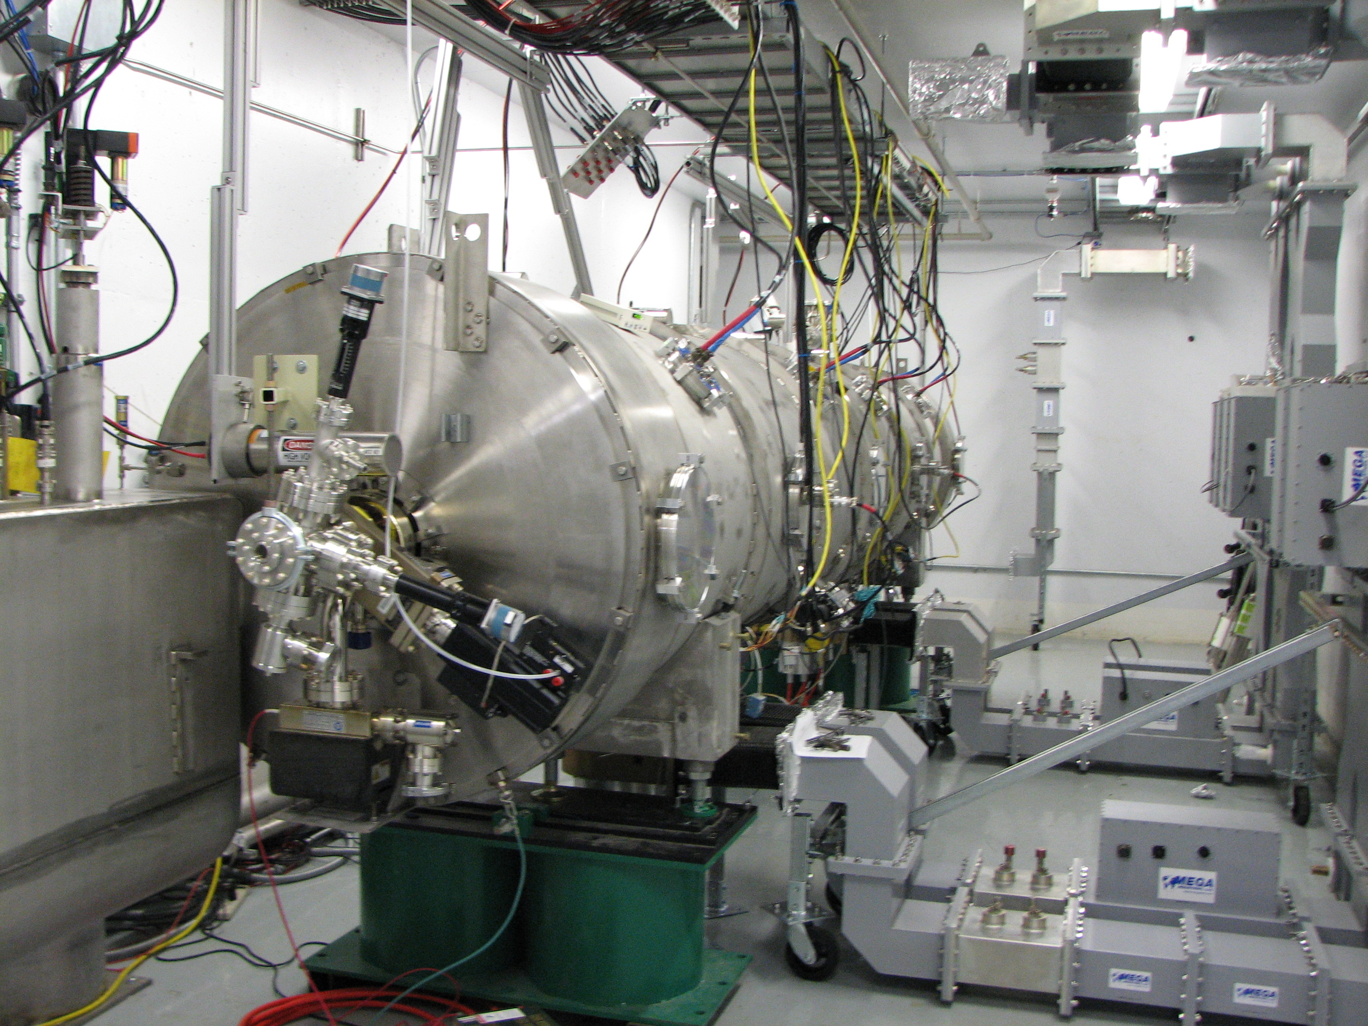
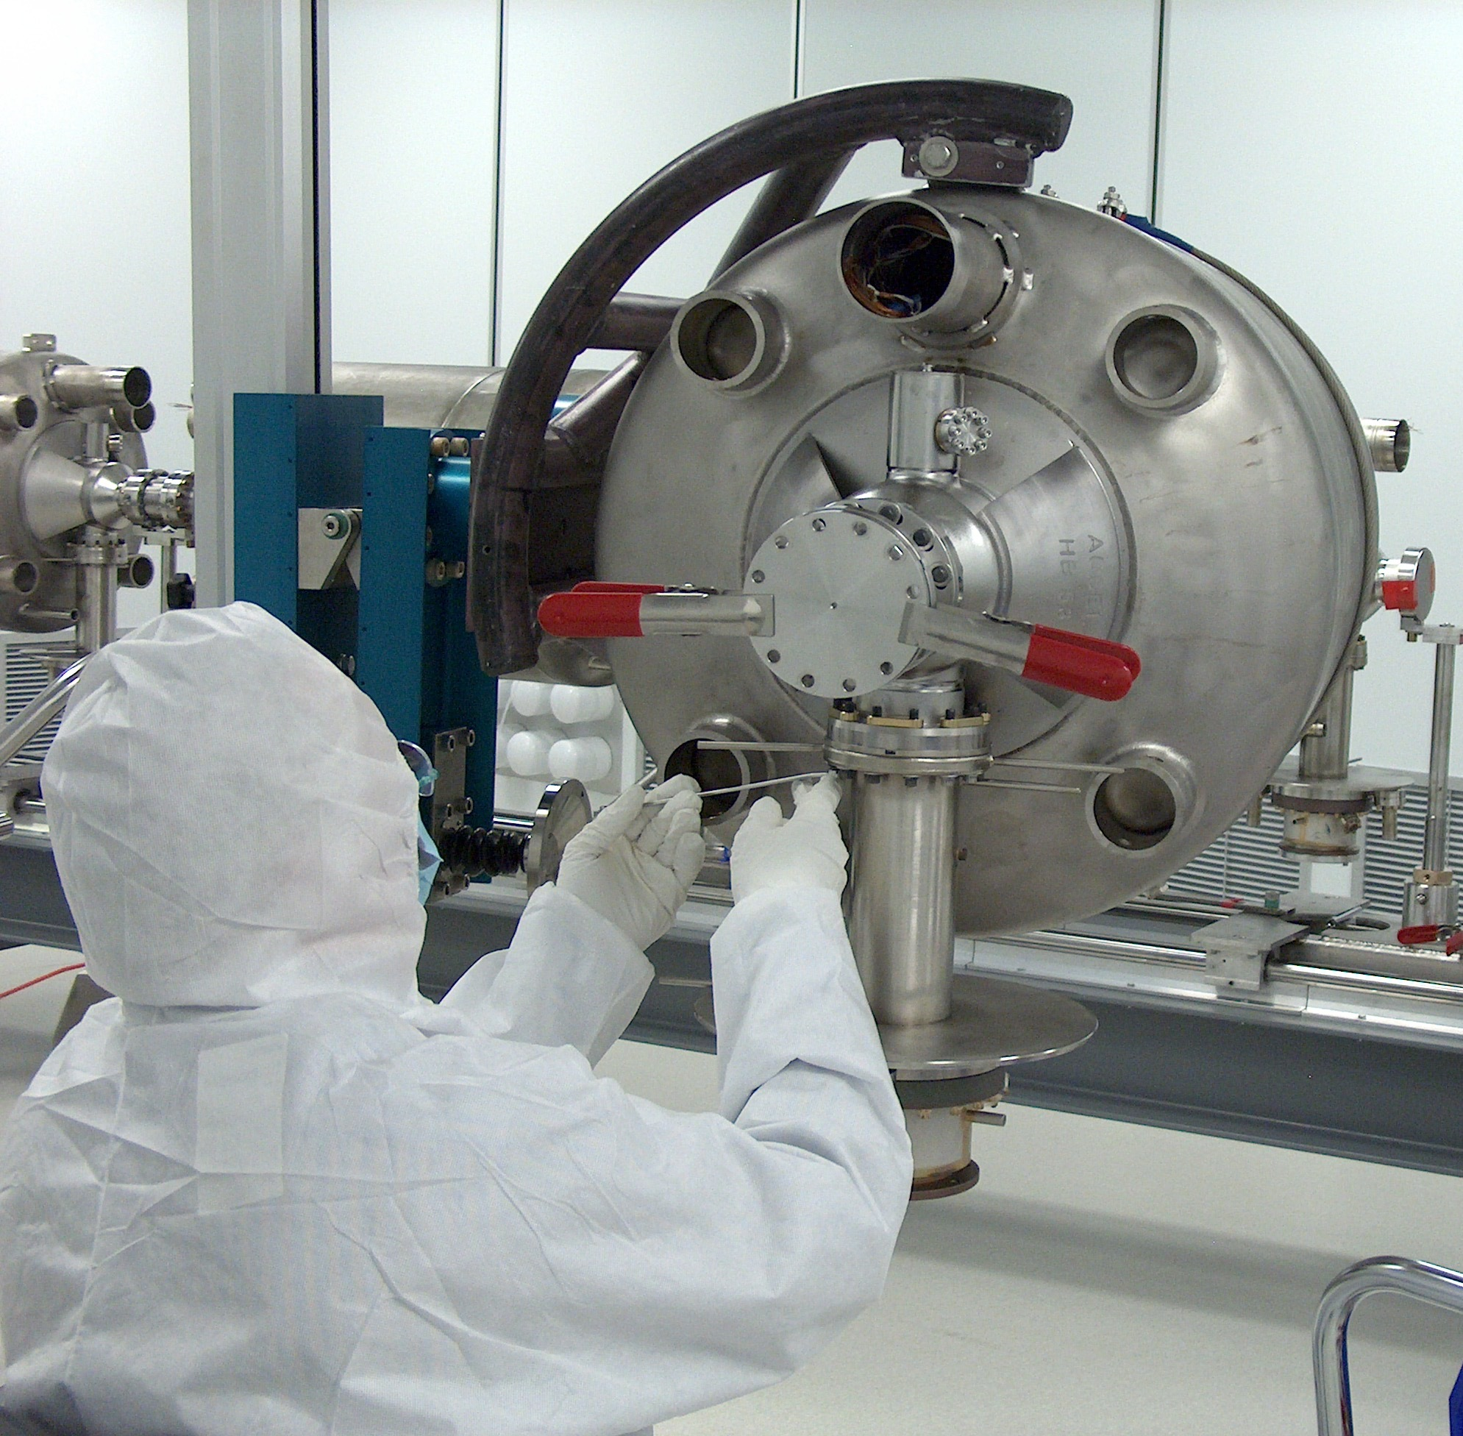
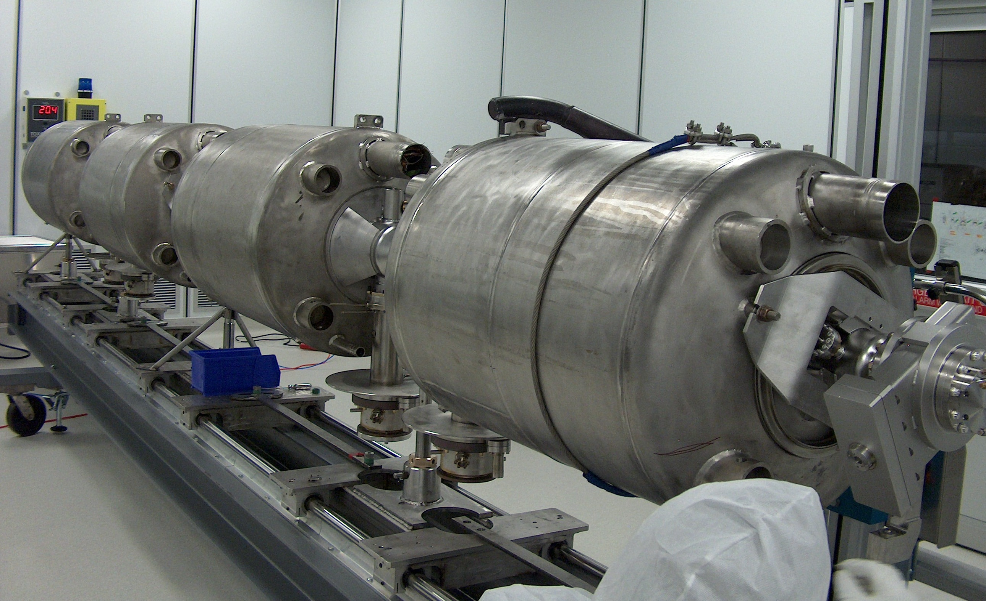
Facilities
Substantial infrastructure in place
  RF Test Facility building
  CM string and cold mass assembly tooling
  Cavity tuning bench
  Clean room
  Test Cave

Slide 27
Facilities- Continued
Work outside the scope of PUP
  Complete AIP for VTA, high pressure rinse, and UHP water systems
    Funding available
    UHP water is complete
    VTA civil construction due to start this month
  Complete AIP for CTF refrigerator
  Future plans for facilities
    Chemistry System
      Closed cabinet chemistry
      Small parts chemistry
      Waste neutralization
    HTA completion

Slide 28
Detailing the Scope
Fabricate 9 new high beta cryomodules
  Procure/qualify new cavities
    Procure cavities from industrial vendor
    Process/Qualify with SNS facilities
  Procure/qualify new couplers
    Prototype couplers ordered
  Use procedures developed during spare cryomodule effort
    String assembly
    Cold mass
    Vacuum Vessel and End Cans
  Qualify completed cryomodules in our test facility
    Protocol developed during previous cryomodule repair efforts

Slide 29
Summary
Spare cryomodule effort provides confidence in design and assembly methodology
Cryomodule is based on original design while complying with 10 CFR 851
Design has been reviewed internally and externally
Proceeding with spare cryomodule effort as a model for PUP cryomodule manufacturing
Notes:
This must be presented at December review. Is not required for Cost and Schedule Reviews.

