Slide 1
Reliability of SNS Superconducting Linac
April 12, 2011
Jeff Saunders
SNS/ORNL

Slide 2
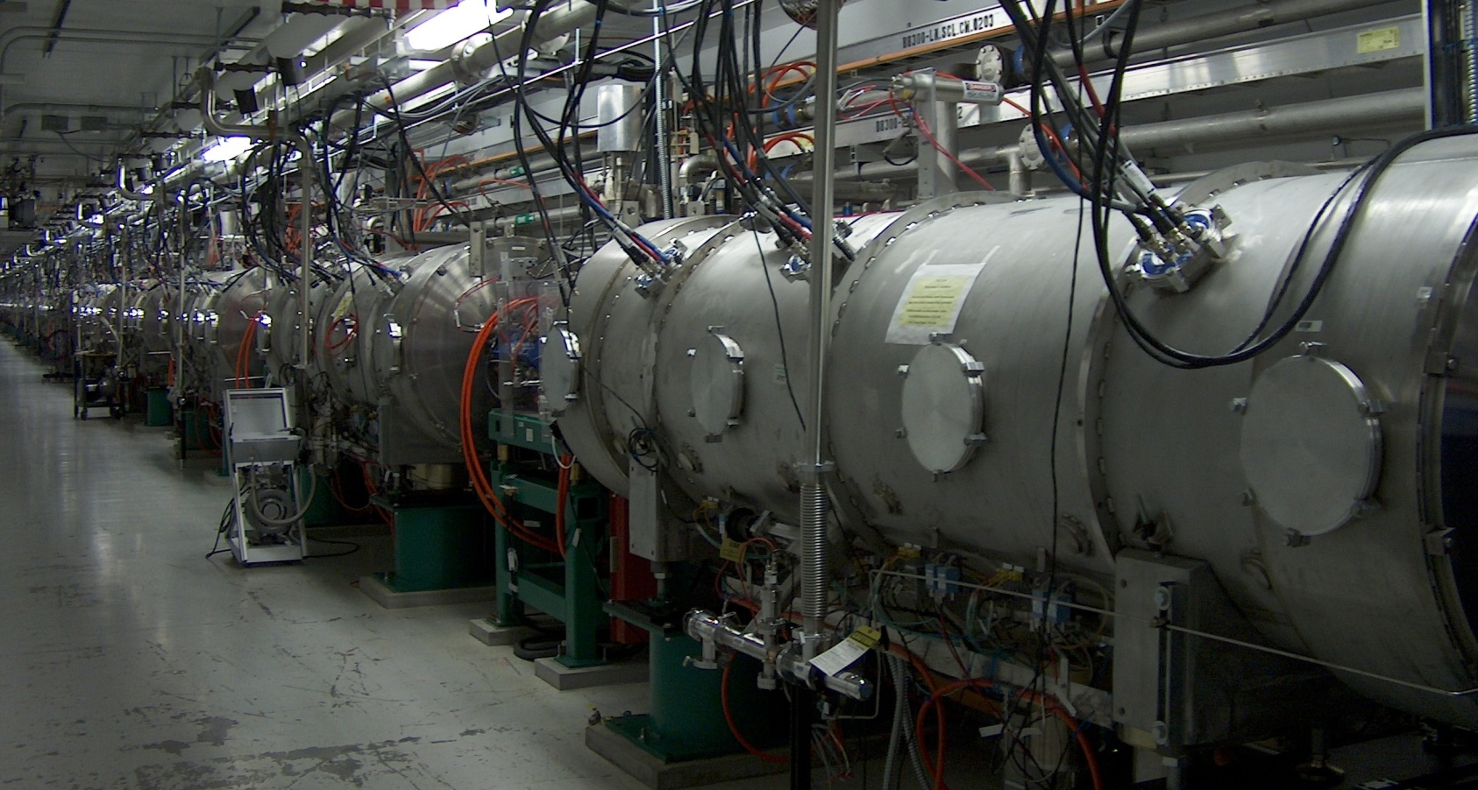
SNS LINAC
Twenty-three cryomodules
11 medium beta cryomodules
12 high beta cryomodules
9 empty slots for high beta cryomodules

Slide 3
Machine Availability Optimization
Strategy is to minimize downtime by recognizing nuisance failures and permitting continued operations
Many component failures create no downtime due to redundancy or operational strategy
Machine interlocks allow bypassing non-critical failed components and controlling operations via redundant components until repairable during scheduled maintenance period
Proactive maintenance program repairs or replaces weak components prior to failure minimizing impact on reliability

Slide 4
Most Frequent Maintenance / Repair Activities
Pressure Transducers
Cold Cathode Gages
Tuner – Piezo / Harmonic Drive
HOM Issues
Helium Circuit / Beam line Vacuum Leaks
Loose RF Cable

Slide 6
Pressure Transducers
Multiple incidents of PT failures (35 – 40)
PT’s are located on surge tank and return piping
Component electronics failures due to radiation damage
Failure is considered a nuisance failure and not a reliability issue
Replacement transducers have had much better service life.

Slide 7
Cold Cathode Gages
Two types of CCG on the existing CM. They are located on the Insulating Vacuum and on the Fundamental Power Coupler (FPC)
CCG failure in the insulating vacuum are considered a nuisance failure and does not affect machine reliability
FPC cold cathode gauges, provide interlock signals for window protection, proved to be troublesome and unreliable in operation, often with an erratic signal character.
Operational input is being transitioned from CCG to electron probe interlock for RF window protection

Slide 8
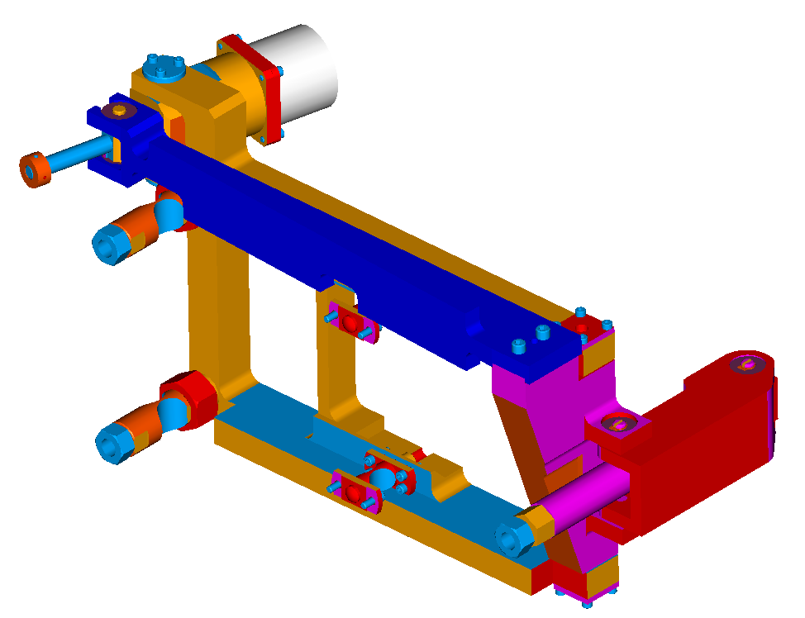
Tuner
Pressure fluctuations, 2-4-2K transition, component installation issues, and component manufacturing issues→ about 14 tuners have been repaired.
Harmonic driver, piezo stack and/or motor failure
Worn out in progress, loosen connection, slips; unstable mechanical boundary; irregular detuning
Motor & Harmonic Drive
Piezo Actuator
(2X) Flexure Connection to Cavity
(2X) Flexure Connection to Helium Vessel
Connection to Helium Vessel

Slide 9
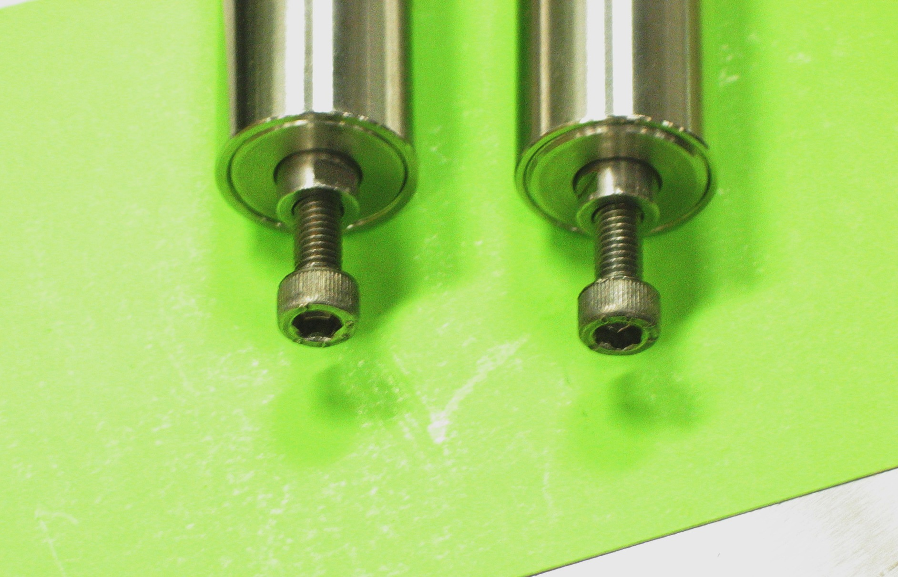
Failed piezo at tuner end

Slide 10
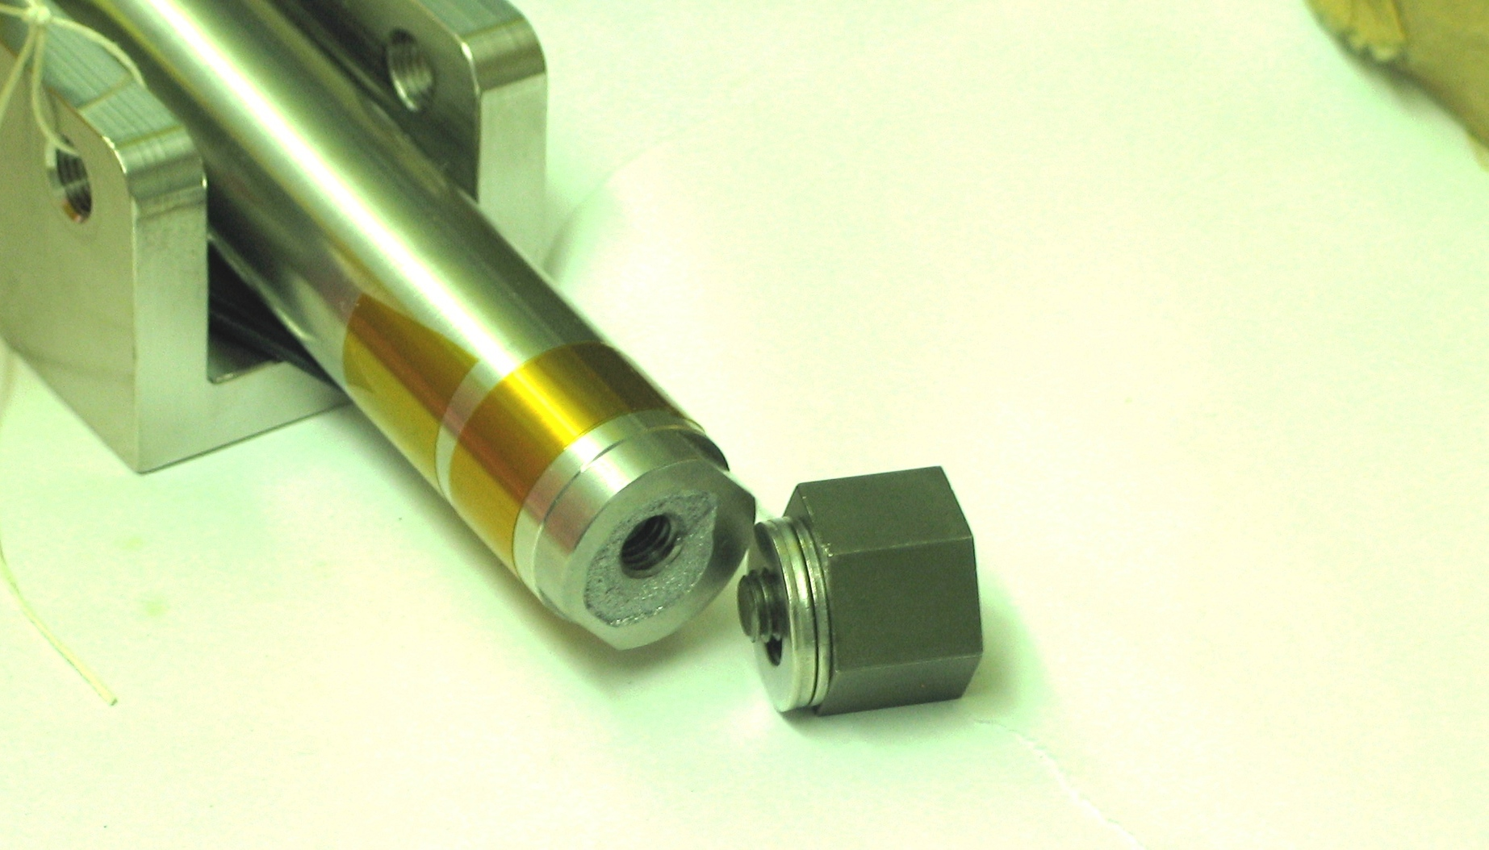
Failed piezo base

Slide 11
Harmonic Drive Components

Slide 12
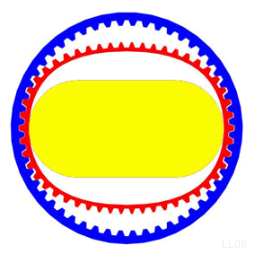
Harmonic Drive operating principle

Slide 13
Harmonic Drive Operating Principle

Slide 14
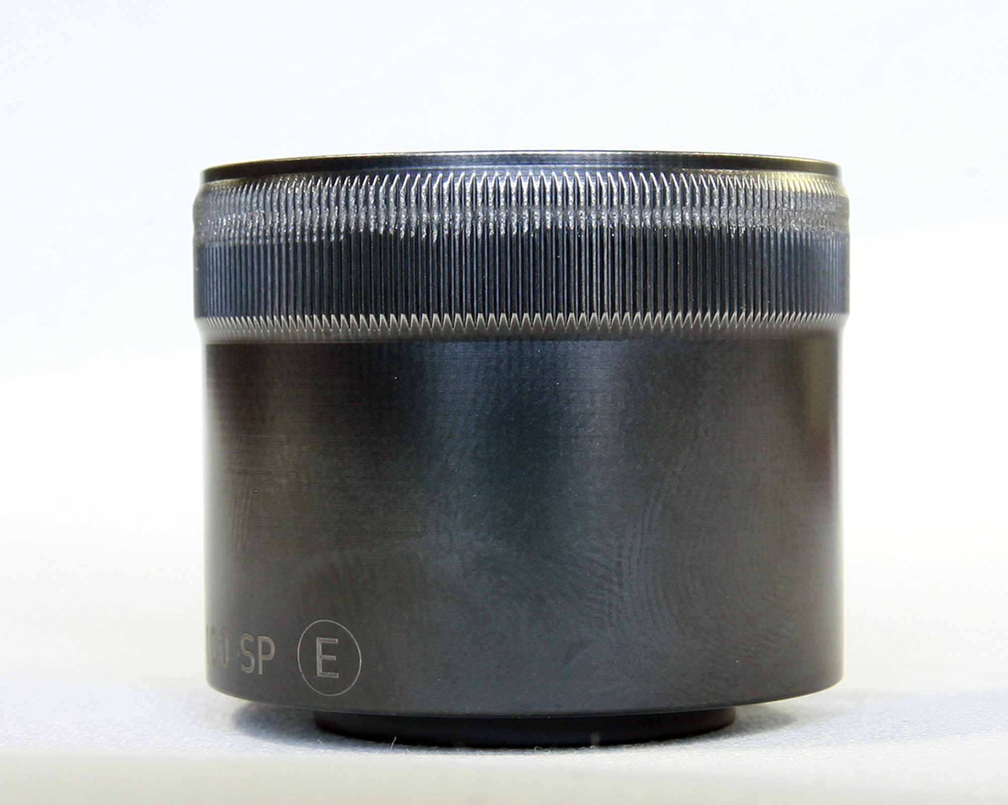

Slide 15
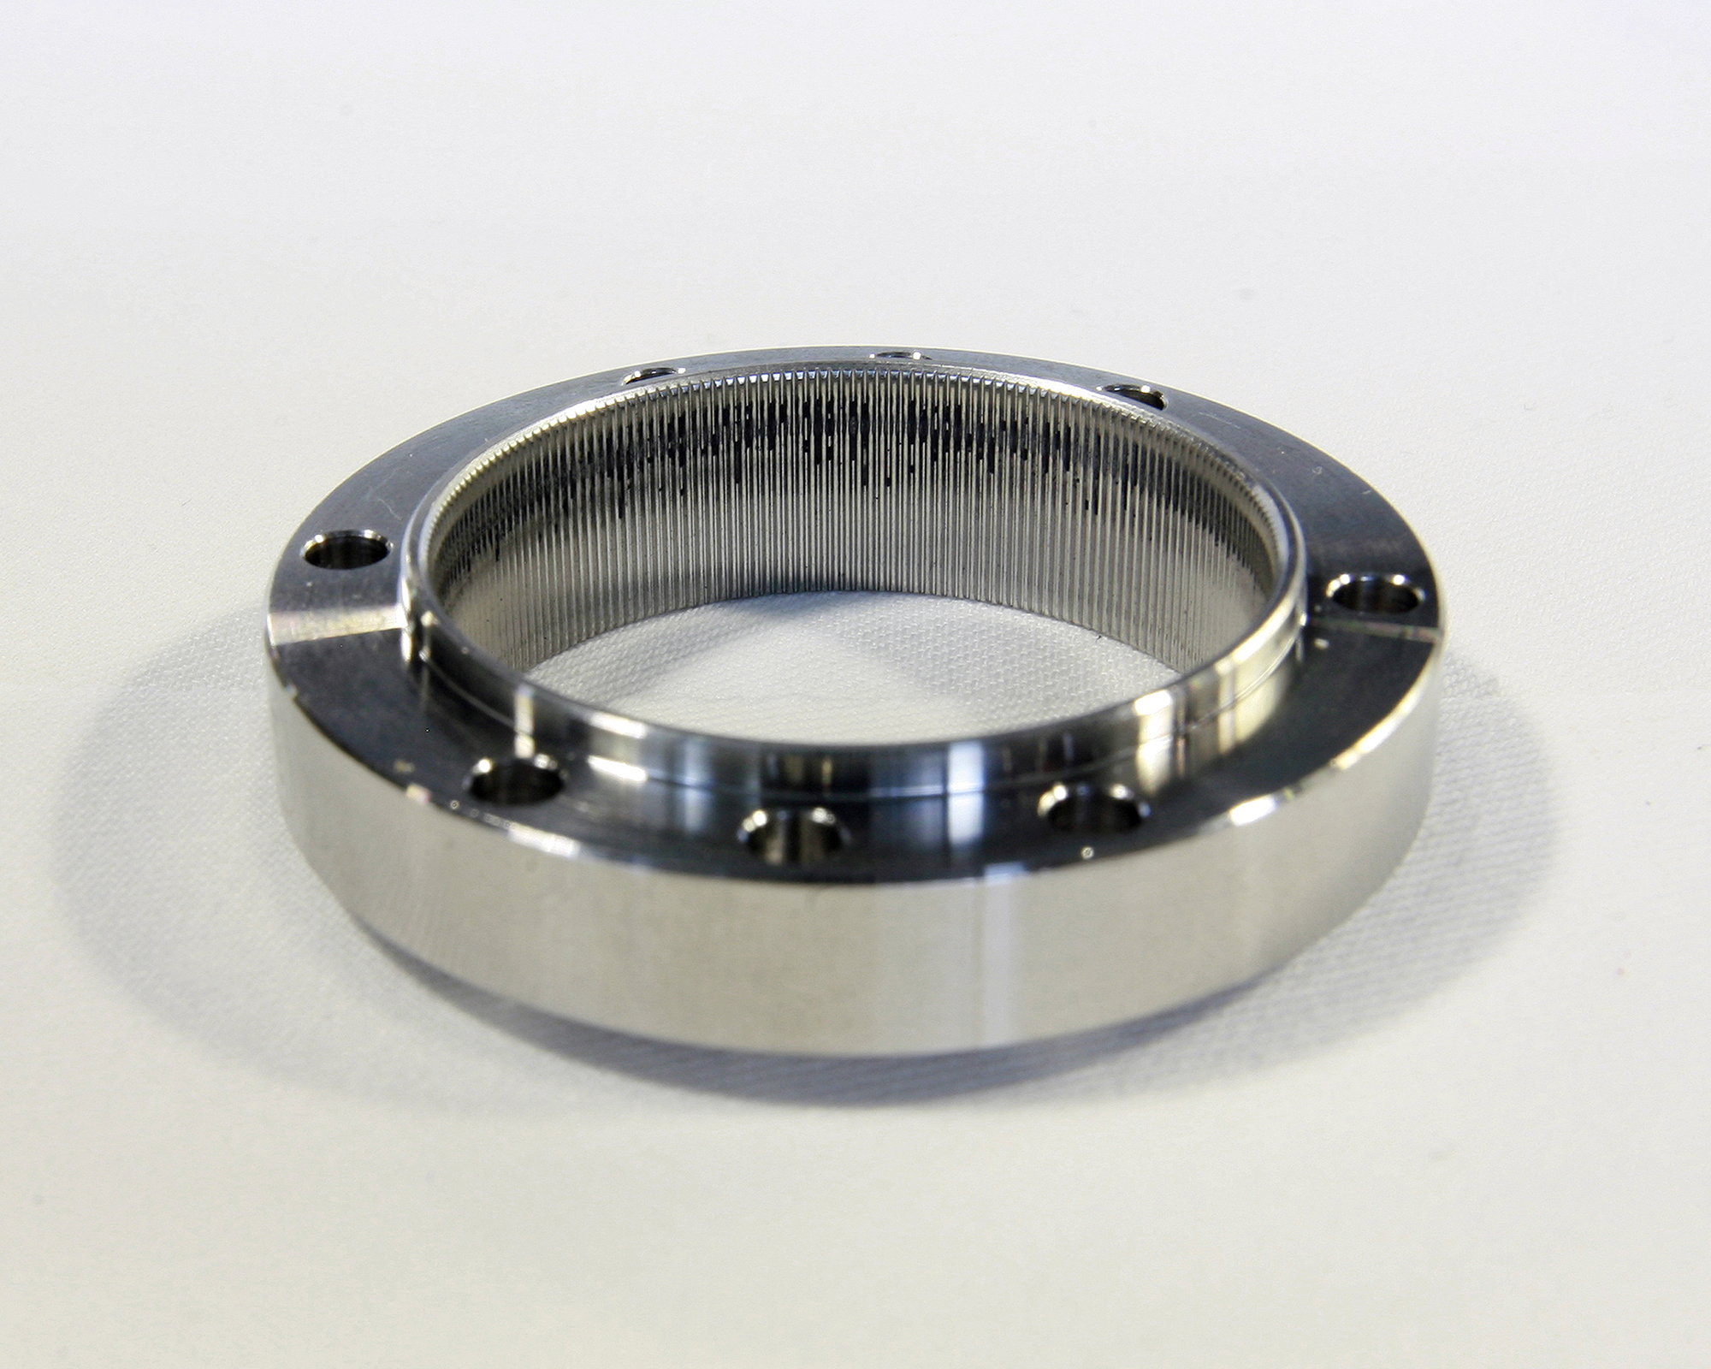

Slide 16
HOM coupler issues
– Introduced to avoid beam break-up and cavity heating from high order mode (very small probability)
– Some cases showed excessive fundamental power coupling and attenuator damage
– 6 HOMs feed throughs have been removed from 2 CM

Slide 17
HOM in SNS
SNS HOM history
Beam breakup & instability; no issue
HOM power is the main reason for SNS to have HOM coupler (but chance is very small)
More realistic analysis with actual frequency distributions measured.
Probabilities for hitting dangerous beam spectral lines are much less.
Future concerns
HOM feedthroughs will be taken out as needed
Spare cryomodule
Does not have HOM feedthroughs for cavities
PUP cryomodule
Will not have HOM couplers for new cavities

Slide 18
Helium Circuit and Beamline Leaks
Predominately ceramic feed throughs in end cans
Multiple have been replaced
Spare and PUP CM end cans will not use these ceramic feedthroughs
HOM ceramic feed throughs have also been an issue
Spare and PUP CMs eliminate the HOM ceramic feedthrough
Also experienced one end dish to helium tank weld leak

Slide 19
CM23 Repair
Leak in the weld between the NbTi end dish and the Ti Helium vessel.
Was repaired in the Front End building by SNS personnel.

Slide 20
Loose RF Cable
Two incidences of loose RF cable impacting operations
Cryomodule warm-up procedure now includes step verifying cable tightness

Slide 21
SNS SCL, Operations and Performance
We have learned a lot in the last 6 years about operation of pulsed SC linacs:
Operating temperature, Heating by electron loadings (cavity, FPC, beam pipes), Multipacting & Turn-on difficulties, HOM coupler issues, RF Control, Tuner issues, Beam loss, interlocks/MPS, alarms, monitoring, …
Current operating parameters are providing very stable and reliable SCL operation
Less than one trip of the SCL per day mainly by errant beam or control noise
Proactive maintenance strategy (fix annoyances/problems before they limit performance)
Several cryomodules were successfully repaired without disassembly
Multiple beam-line repairs were successfully performed

Slide 22
Thank you for your attention!

