Slide 1
Status of the Kicker R&D for a Broadband Chopper
Greg Saewert
Ding Sun
Manfred Wendt

Slide 2
Broadband Chopper R&D
Kicker System
  Ding Sun, Valeri Lebedev:
  Meander-like travelling wave structure, 50 Ω impedance
  Greg Saewert, Brian Chase:
  Helical microstrip travelling wave structure, ~200 Ω impedance
  Manfred Wendt:
  Lumped element electrodes, capacitive, individual powered
Broadband pulser system
  Collaboration with SLAC (Tao Tang, Craig Burkhart)
  MOSFET driver R&D
Other option:
Laser-based broadband chopper (photo-detachment)

Slide 3
162.5 MHz Beam Structure
σ_{z} = 3.5 mm, σ_{t} = 160 psec (~9⁰) ?!
v_{beam} = 21.84 mm/nsec
t_{bunch-to-bunch} = 6.15 nsec
z_{bunch-to-bunch} = 134.3 mm

Slide 4
Broadband Chopper
134.3 mm
v_{beam} = 21.84 mm/nsec
20…25 mm
v_{E-field} = 21.84 mm/nsec
Broadband chopper:
  Travelling wave structure v_{E-field} = v_{beam}
  High E_{tr}-field, ideal: 3.0 nsec rectangular pulse
  Kick angle = ≈
  Basically only the E-field is used for the beam kick
E_{tr} ℓ_{ki}
E_{tr} ℓ_{ki}
E₀ γ β²
5 MV

Slide 5
Chopper Technologies
Pulse Delay Network
Lumped element chopper
Travelling wave chopper
Requires many low-power pulsers
  Low cost homebrew (SLAC)
  Driver output-stage physically close to high-impedance electrode
Digital delay driver network
Short lumped, capacitive electrodes
  dimensions << wavelength
  control of parasitic elements
Requires only one, but high-power pulser
Meander, helical or similar transmission-line
Pulse shape degradation
  Long transmission-line with dispersion effects
  Reflection effects for some structures, e.g. meander
Only a small part of the travelling field energy is used to kick the beam

Slide 6
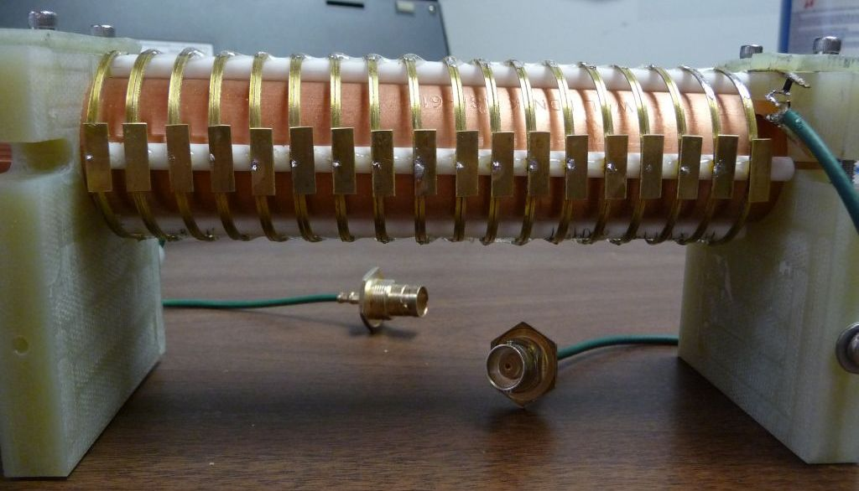
Helical Kicker R&D
.18 x .50 in. Electrodes are attached
High characteristic impedance (~200 Ω)
Lower power drive signal

Slide 7
Helical Stripline Dimensions
W
P
H
Ground
(Cu tube )
characteristic impedance | 205 ± 20 Ω (measured)
brass conductors dimensions | 0.091 x 0.02 inch (W x t)
pitch | 0.333 inch (P)
height (suspended on four ceramic rods) | 0.187 inch (H)
outer diameter | 1.47 inches
ground tube diameter | 0.875 inches
total length | 6 inches (18 turns)

Slide 8
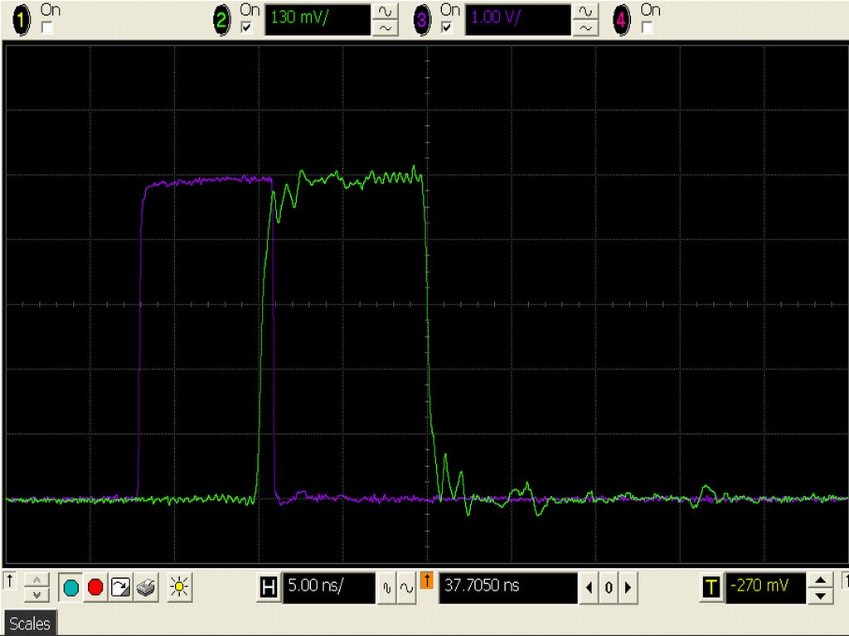
Transfer Response (TD)
Generator rise time = 0.2ns
Thru-voltage
rise time = 0.5ns
Notes:
205 Ohm microstrip line is resistively matched to 50 Ohms, in and out.
.18 x .50 in. Electrodes are attached.
1 div
5ns

Slide 9
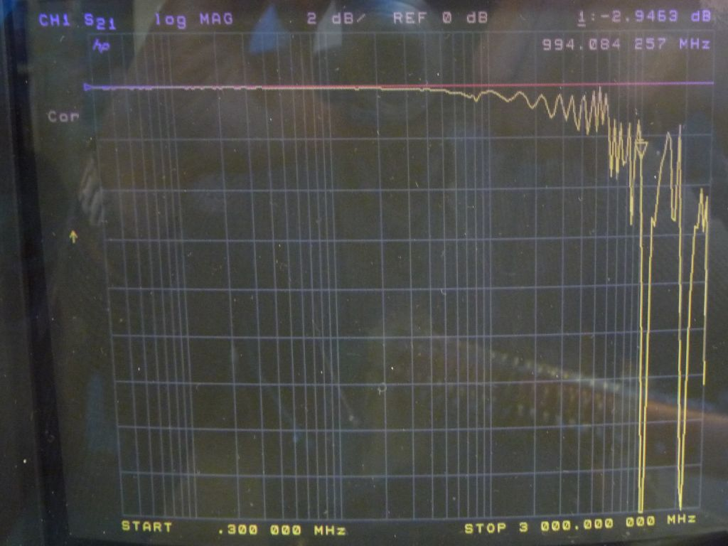
FD Characteristic (S21 magn.)
Sweep range: .30MHz – 3GHz
Vertical scale: 2dB/div
Response remains below 3dB above 900 MHz
Fixture, including the matching resistive matching network,
is calibrated out of the measurement

Slide 10
Comments to Helical R&D
Objective was to construct and analyze 200 Ohm helical microstrip line
Dimensional variations caused inconsistent impedance along the length resulting in internal reflections and observable ripple in both time and frequency domains
  Strip width varies 12% along the length
  Pitch varies +/-10% turn-to-turn
Measurements were made before and after attachment of electrodes
  Electrodes will maximize E-field efficiency of hi-Z strip line
  Electrical effects of electrodes were observed only above 700 MHz
Both copper and brass strip material were evaluated for rigidity
  Copper is preferred for conductivity, rather than brass
  .025 in. copper seems to be rigid enough with these narrow strip widths
  Although brass used in this construction, copper will be used in the future
The next prototype currently under construction will be more tightly controlled dimensionally

Slide 11
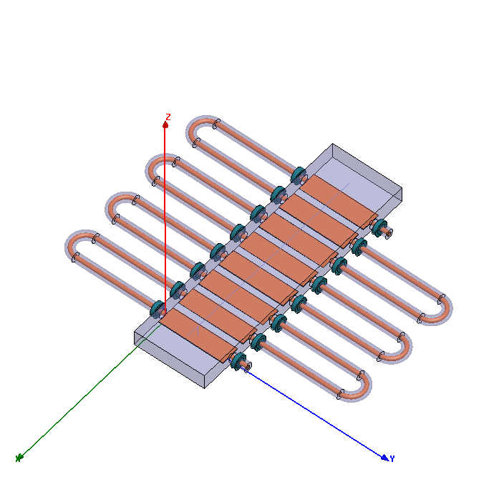
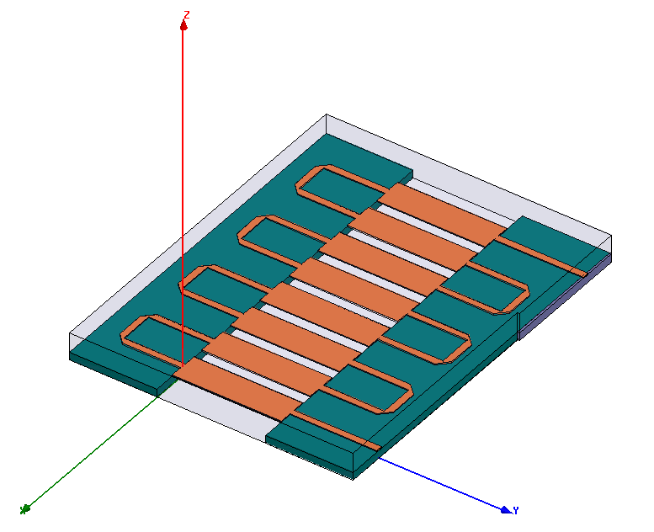
Meander Kicker R&D
Basic idea: reduce coupling between lines, therefore: reduce dispersion
Lines are not on Al₂O₃ substrate, so they can be wider
Keep kicking portion short
Use coaxial line, or stripe-line, or microstrip-line as delay portion,
so there is no coupling between delay lines

Slide 12
Develop a Practical Design Tool…
Hybrid Simulation
  3D simulation (HFSS, frequency domain) for single transition (such as coax – stripline, stripline – microstrip, bends, steps etc.) → create s-parameter files
  Combine the s-parameter files periodically with the multi-coupled lines model in ADS and do analytical modeling in frequency and time domain.

Slide 13
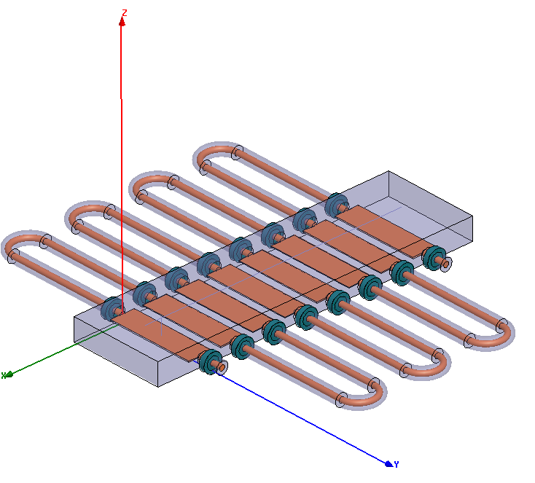
HFSS 16 Striplines (FD)

Slide 14
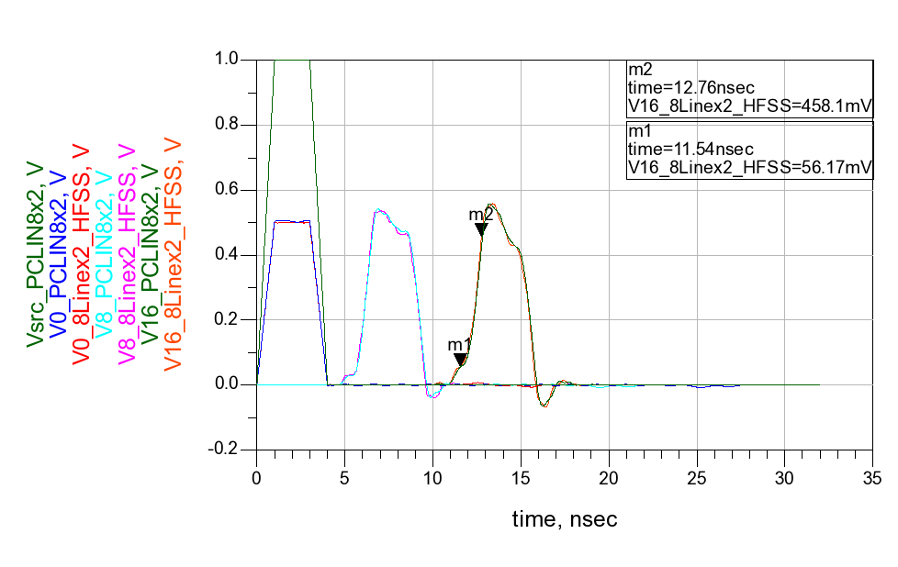
ADS/HFSS 16 Striplines (TD)
16 Striplines, 4 ns pulse / 1 ns rise time
1.2 ns total rise time
~ 0.66 ns device rise time

Slide 15
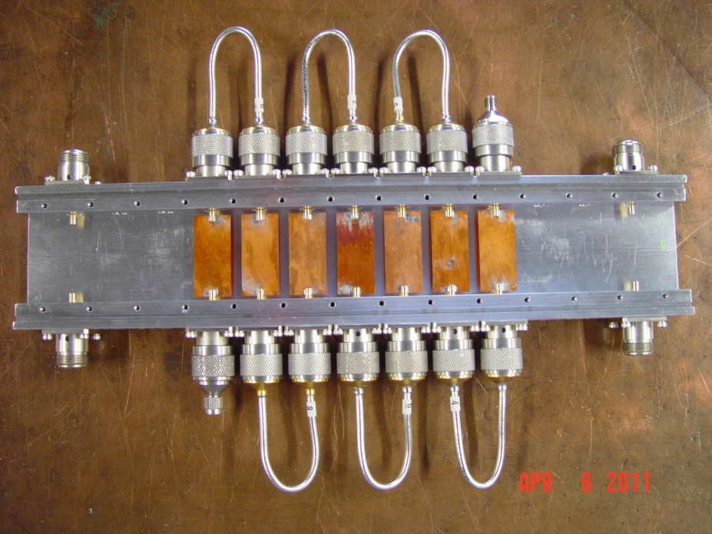
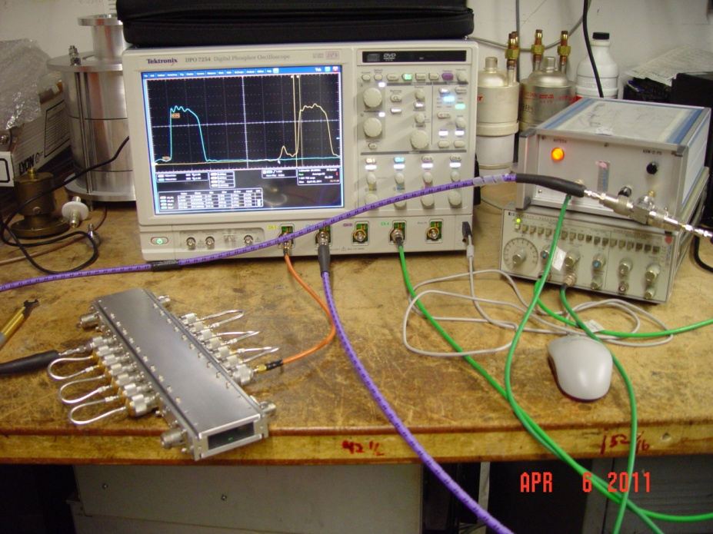
Prototype
We are building the prototype by adding lines (1,3,5,7…) to study
the effect of coupling on rise time.
Part (7 lines) of a 11 lines (25 cm long) structure
Measured with a fast pulse generator

Slide 16
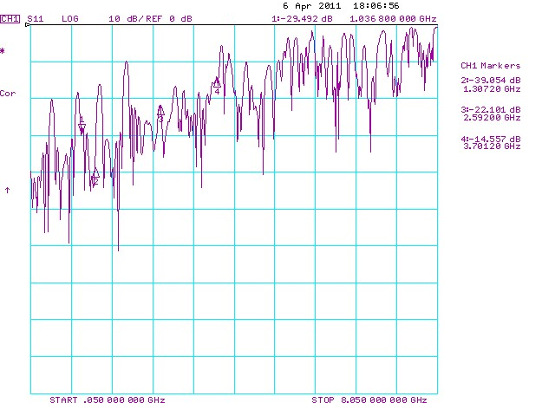
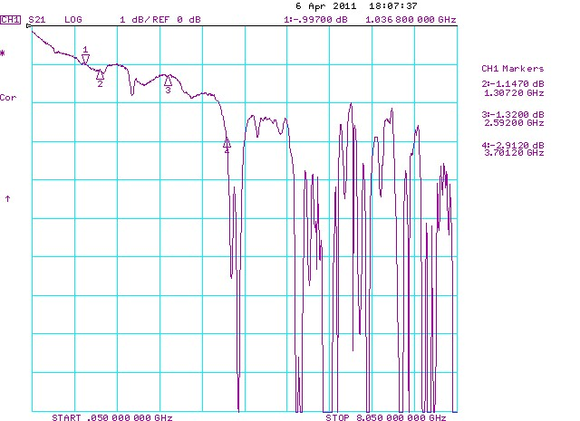
Frequency Domain Measurement
S11 of the 7-line-Structure
S21 of the 7-line-structure

Slide 17
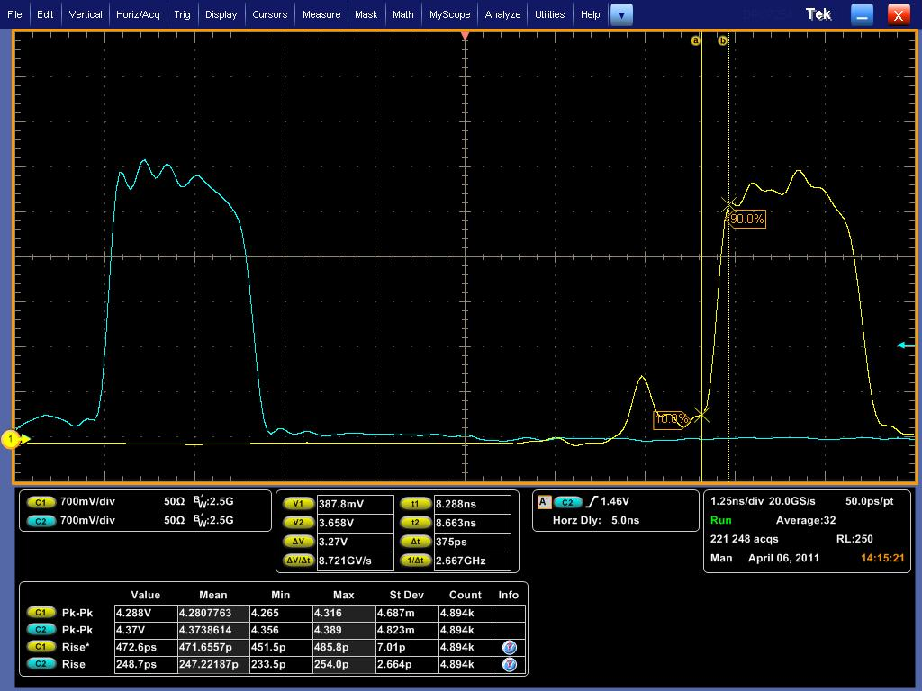
Time Domain Measurement
Blue: pulse before the 7-line-structure (rise time: 245 ps)
Yellow: pulse after the 7-line-structure (rise time 375 ps)
Rise time of the structure: 280 ps

Slide 18
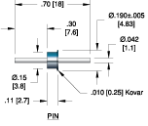
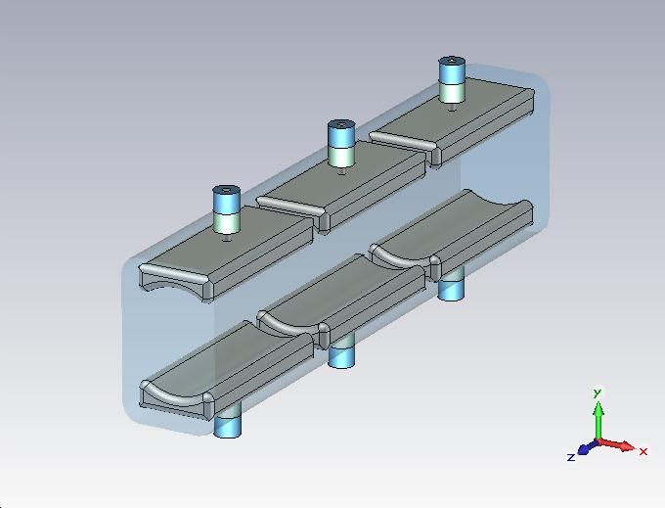
Lumped Element Kicker R&D
Copper electrodes
  11 x 27.5 mm (w x l)
  13.1 pF
30 mm pitch
Ceramtec feedtrough
~15 mm aperture
± 500 V differential supply
Very preliminary!!!

Slide 19
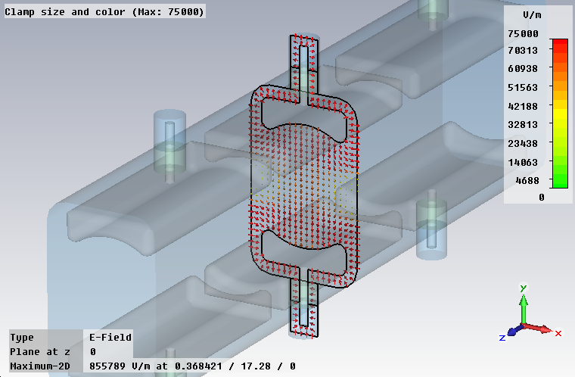
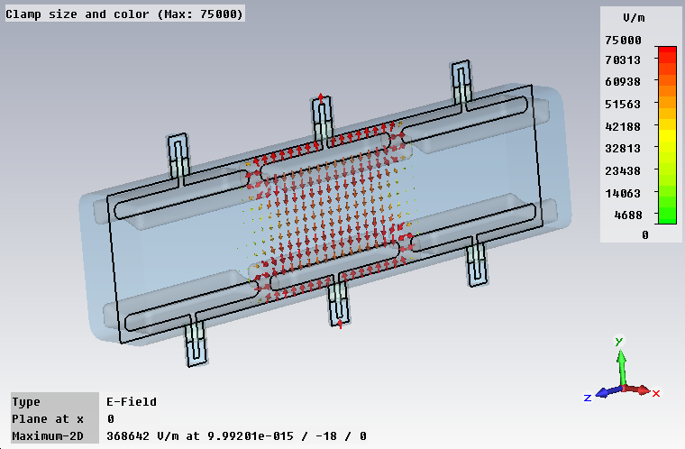
Electrostatic Results
E-field ~60 kV/m (@ ± 500 V)
  for ~20 mm range
  varies 55…62 kV/m
kicker parameters
  effective length: 500 mm
  (fill factor 60...70 %)
  kick angle: 6 mrad

Slide 20
Dynamics Results
CST MWS transient simulation
  10 GHz BW
  E-field probes on beam axis
  (at z = 0 mm & 10 mm)
  Stimulus only to one port
  Structure: 3+3 electrodes
Two different stimulus signals
  6 nsec total simulation time
  2.9 nsec flat-top,
  0.1 nsec rise/fall times
  1.75 nsec flat-top,
  0.75 nsec rise/fall times

Slide 21
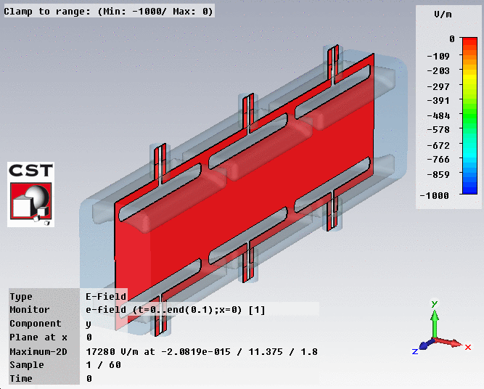
E-Field Animation

Slide 22
S11 Characteristic
Frequency Range: 0-1000MHz
Equivalent capacitance: 13.1 pF
Next steps
  Beam simulation (PIC)
    Better understanding of the deflection variation
  RF model
    Build a copper model,
    single and multi electrode
    Wire on beam axis to proof the field build-up time

