Slide 1

650 MHz Beta = 0.61 Cavity Design, Fabrication and Testing
R. Rimmer for F. Marhauser
Jefferson Lab, Newport News, Virginia 23606, USA
Project-X Collaboration Meeting
12-14. April 2012

Slide 2
Statement of Work (August 30, 2010)
- Objective and Work Plan -
  Objectives:
  Understand the issues relevant to 650 MHz cavity cryomodule designs for Project-X
  and develop an optimized approach. JLAB will closely work with Fermilab and its collaborators to
  help establish a unified effort
  Work Plan:
  Cell shape optimization for a balance of high current, good efficiency, low impact energy
  and low halo interception
  Prototype the 650 MHz 1-cell cavities for beta = 0.6. JLab has some die material on hand
  to get a jump-start on prototypes
  Study the concept of an SNS-type cryomodule for 650MHz. A conceptual level analysis of the suitibility
  of the space-frame concept and cryogenic scheme for this application is worthwhile. The segmentation
  and compatibility with the proposed spacing of the magnetic elements of the linac should be examined

Slide 3
Statement of Work (August 30, 2010)
- Deliverables and Schedule -
  Deliverables and Schedule:
  Cell shape optimization report detailing JLabs approach to the 650 MHz cavity design and the comparison o the JLAB design to the FNAL design
due January 2011, finalized prior time in October 2010
cf. JLAB-TN-10-043 “A Medium Beta 650 MHz Design For Project-X”
  Two fabricated, processed and tested 650 MHz single-cell cavities
1st cavity due May 2011, 2 cavities have already been fabricated in March 2011 and are currently
post-processed prior VTA-testing (prevalent procurement delays are prolonging project artificially)
  Cryomodule comparison report detailing advantages of each of the two concepts, specifically with respect to machine availability and required spacing in the optice design
report was due January 2011, however activities just started due to unavailable resources
  Completion of this work is expected prior to September 2011
Early completion possible depending on staff availability.

Slide 4
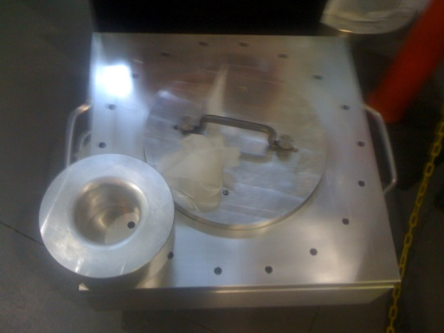
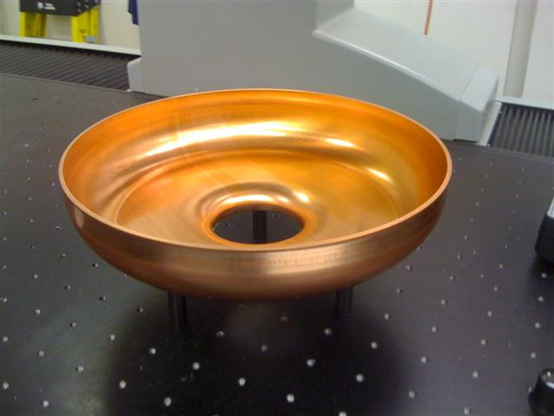
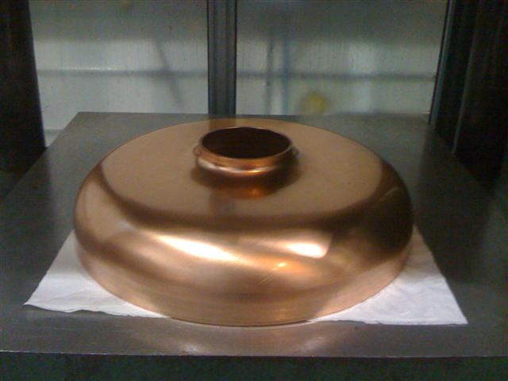
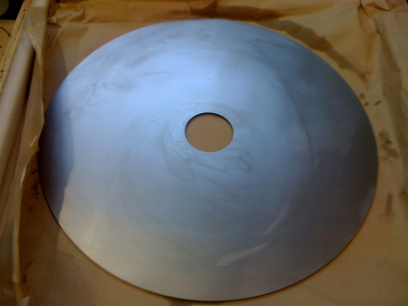
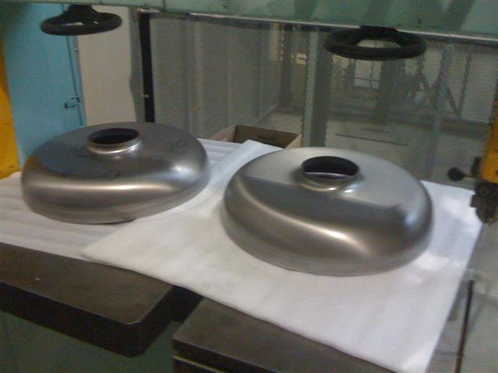
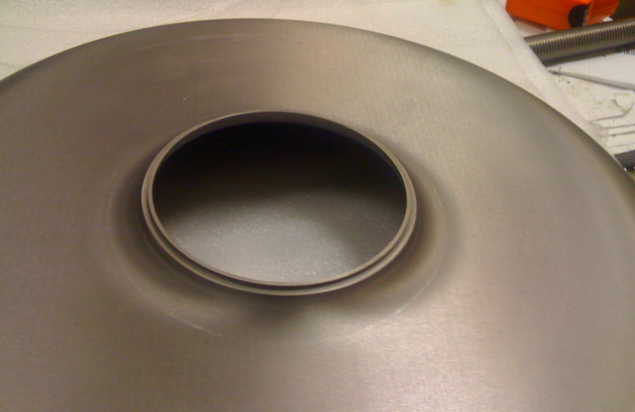
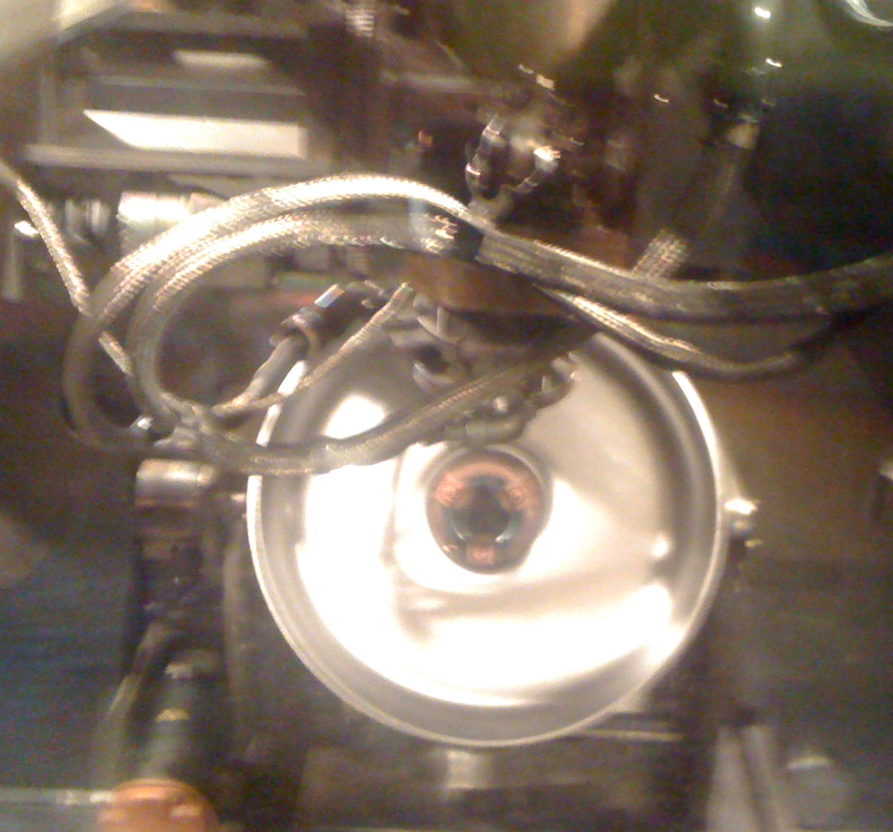
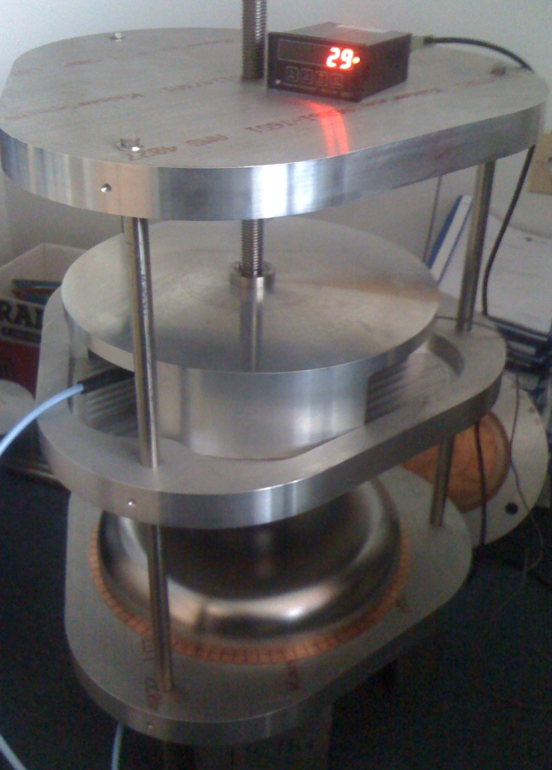
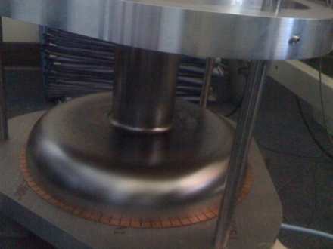
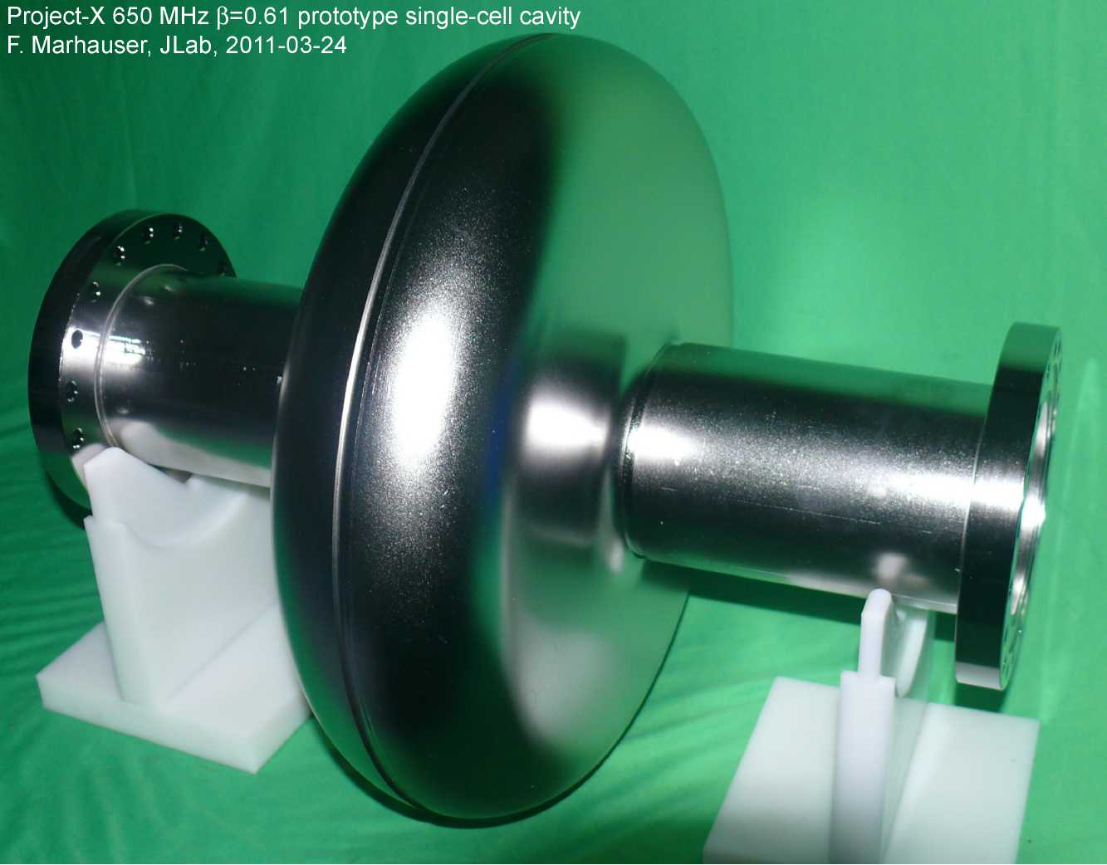
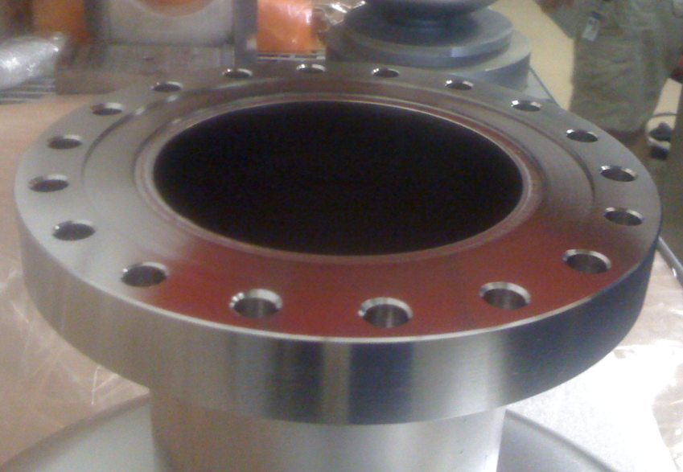
Cavity Fabrication
- Process Timeline and Milestones -
  December 2010: Completion of drawings for cavity cell and beam tube dies
  January 2011:
  - Dies manufactured and received incl. trimming fixture
  - High RRR and reactor grade Nb sheets (for tubes)
  available at JLAB stock for cavity #1
  - Nb and Cu (test) discs wire EDM-ed for deep-drawing
  - JLAB in-house 450 ton press re-activated, two copper cells pressed for prototyping
  - 10 Hexagonal Al beam tube seals received from FNAL
  - NbTi flange material received from FNAL
  - Drawings for rf tuning fixture finalized
  February 2011:
  - JLAB cavity drawings for single-cell completed
  - 2 Nb cells pressed for cavity #1 with JLAB material
  - 4 beam tubes manufactured with JLAB material
  - 4 NbTi flanges manufactures with JLAB material
  - high RRR material received from FNAL for cavity #2
  - cavity #1: cells irises prepared for EBW
  - cavity #1: tubes welded to cells
  - RF tuning fixture fabricated
  March 2011:
  - FNAL sheets wire EDM-ed
  - 2 Nb cells pressed for cavity #2 with FNAL material
  - cavity #1: half cells RF measued , equators trimmed
  - cavity #1: NbTi flanges welded to tubes
  - cavity #1: completed 2011-03-24 (cavity halves welded)
  - cavity #2: cells irises prepared for EBW
  - cavity #2: tubes welded to cells
  - cavity #2: half cells RF measued, equators trimmed
  - cavity #2: NbTi flanges welded to tubes
  - cavity #2: completed 2011-03-30 (cavity halves welded)

Slide 5
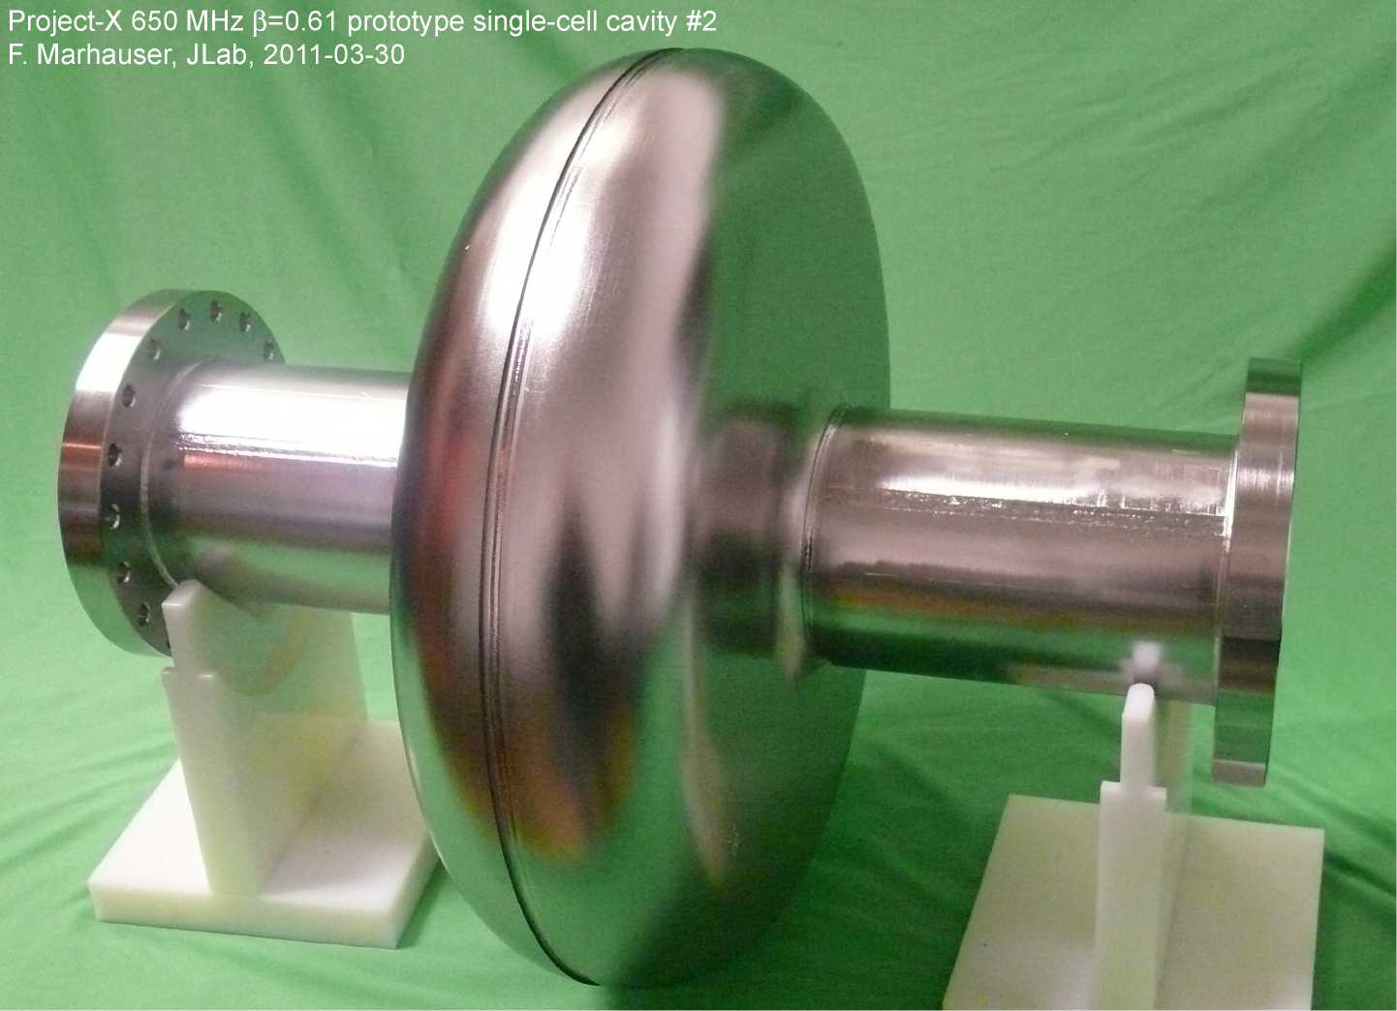
Deliverables
cavity #1: JLAB cell material
cavity #2: FNAL cell material

Slide 6
Post-processing started April 2011
  bulk BCP (200 um)
  2) ultrasonic wall thickness measurement after BCP (data before existing)
  3) frequency measurement
  4) Heat-treatment in vacuum furnace 600deg. for 10 hours
  5) frequency measurement
  6) Qext/antenna calibration
  7) degrease
  8) light BCP (~30 um)
  9) HPR
  10) 1st assembly
  11) HPR
  12) assembly/ evacuation in test stand
  (critical: leak-tight sealing of hexagonal Al beam tube gaskets)
  13) Leak check/test
  14) low temperature bake (120 deg. C for 12 hours)
  15) frequency measurement (warm)
  16) VTA test
17?) …Electropolishing/Retest

