Slide 1
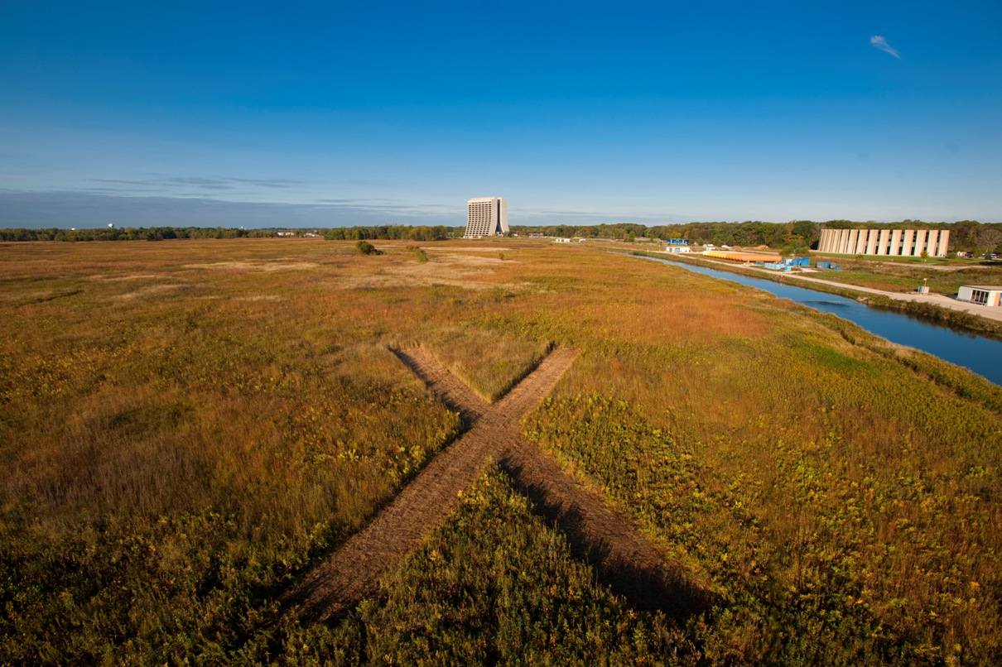
WG1: Front End
Summary
Sergei Nagaitsev
Apr 14, 2011

Slide 2
Ion source
Commercial source procured
Tests an TRIUMF in May 2011
Preparing for tests at LBNL
  Optimize for Project X: 5mA, 20 kV
  Measure emittance, life time
We welcome SNS and LBNL R&D on external rf antennas

Slide 3
LEBT
Concept: 2 sources with a Y dipole magnet
Neutralized beam transport
Introduced LEBT chopper
  Need for commissioning – start with a pulsed beam, then increase duty factor
  May support 1 MHz pulsing
Will study experimentally at LBNL
  Excellent progress in preparation

Slide 4
RFQ
Excellent progress on 162.5 MHz design
Low longitudinal emittance
Low power density
Need to establish output energy: 2.1 or 2.5 MeV
Ready for rf and mechanical engineering design studies:
  Potential to use ANL experience
Keep power under 200 kW
  Thales has an RF source

Slide 5
MEBT
Several configurations presented
  Excellent progress in defining beam dynamics
Chopper
  Several slow-wave structures discussed
  2.1 MeV preferred
  Excellent potential to use SLAC experience in kicker drivers
MEBT beam absorber
  Thermal management
  Serious material study needed

Slide 6
FE summary
Excellent progress overall
  Many thanks to the LBNL team
  Much interest and support from ANL and SLAC teams
Ready to move beyond beam dynamics toward engineering requirements

