Slide 1
Electron Scanner Collaboration
W. Blokland & T. Gorlov. SNS
R. Thurman-Keup. Fermilab
ProjectX/SNS
ProjectX Collaboration Meeting April 12-14, 2011

Slide 2
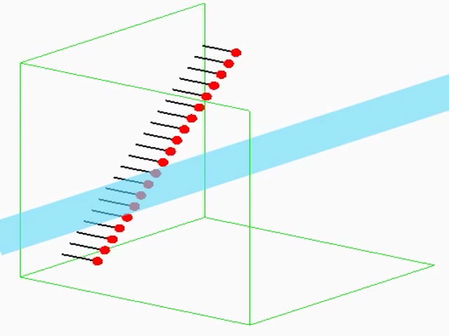
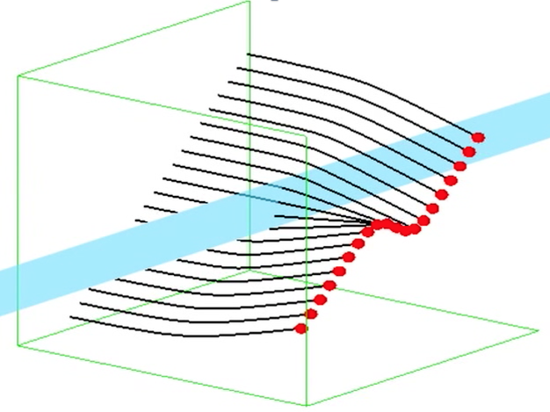
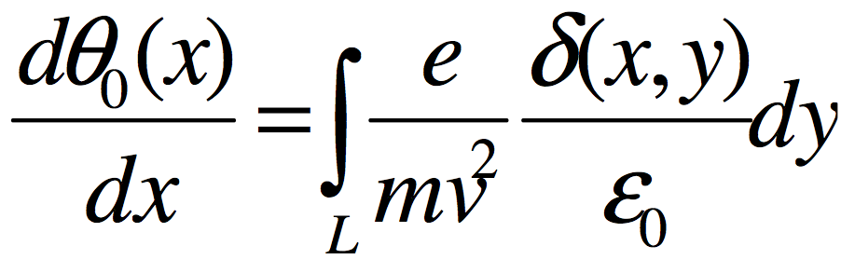
Electron Scanner Collaboration
Non-intrusive profile measurement of high intensity beam
  Help with design of ProjectX electron scanner
  Evaluate measurement techniques for available electron gun
  Setup simulation
Look at the deflected projection of a tilted sheet of electrons due to the proton beam charge ^{[1,2,3]}
  Neglect magnetic field (small displacement of projection)
  Assume path of electrons is straight (they are almost straight)
  Assume net electron energy change is zero (if symmetric)
  Proton bunch length >> electron scan
  i.e. take the derivative to get the profile

Slide 3
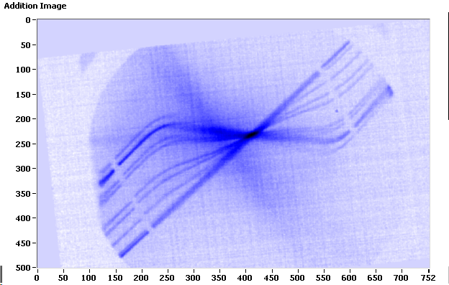
SNS & ProjectX parameters
 | SNS | ProjectX
Proton bunch length | 670 ns | 2-4 ns (18.8n spacing)
Proton bunch transverse size | 10-20 mm | 1-3 mm
Proton bunch intensity | 10^14 | 10^11
#bunches | 1 | 1-many
Cycle time | 1 µs | 11 µs
Energy | 1 GeV | 120-150 GeV
ProjectX has a much shorter bunch length
Options for electron scanner setup:
  Electron scan << proton bunch longitudinal length
  Electron scan ≈ proton bunch longitudinal length
  Electron scan >> proton bunch longitudinal length

Slide 4
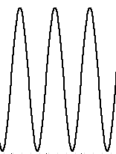
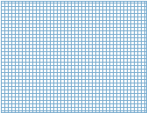

ProjectX ELS
Slanted Scan (duration E<P)
Same as SNS but must shorten electron scan from 20ns to ~100ps
  Scan at 10GHz (RF sync?), scrapers leave only about 20-30% of beam
  Gate pulsed to let only one
  Deal with >100x less electrons -> MCP or very sensitive camera with multiple exposures
5-10 GHz
protons
electrons
dθ
dx
Gate
Y
Cathode
Deflectors
Scrapers
S
X

Slide 5
ProjectX ELS
Ribbon beam (duration E<P or E≈P)
Same as SNS but must shorten electron scan from 20ns to ~100ps
  Use quads to create a stretched beam (density distribution??)
  Gate pulsed to let only short burst of electrons
  Cathode shape a line
  Deal with >100x less electrons -> MCP??
X
X
protons
Gate
electrons
dθ
dx
X
X
Y
S
Cathode
X
Quadrupole(s)
Scrapers

Slide 6
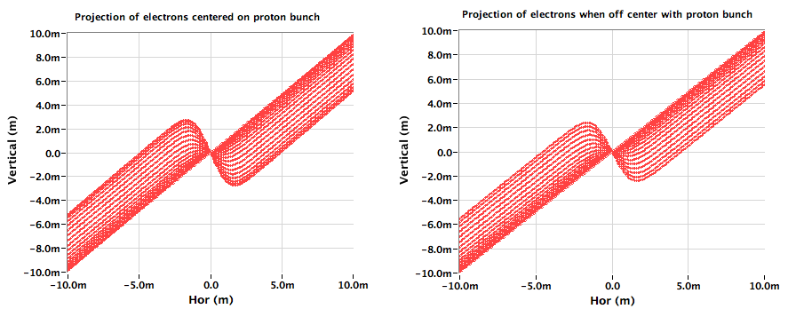
ProjectX ELS
Ribbon beam (duration E≈P)
Density of max deflection line depends on relative timing of electron scan and Proton bunch
The projections of the electron scan with a 10nsec electron spread and 3ns long proton bunch (no magnetic field).

Slide 7
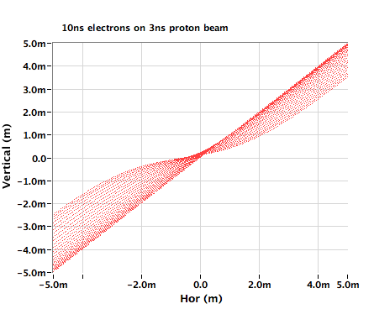
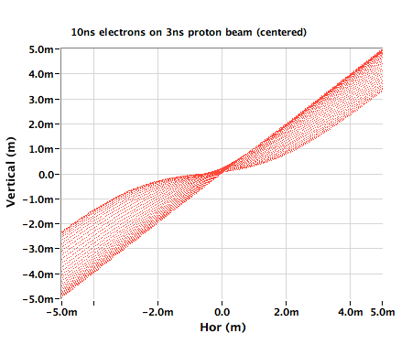
ProjectX ELS
Ribbon beam (duration E≈P)
Most electrons hit outside of center
Electron sheet and Proton Bunch Centered
The projections of the electron scan with a 10nsec electron spread and 3ns long proton bunch (magnetic field on).

Slide 8
ProjectX ELS
Slanted Scan (duration E≈P)
If scan length ≅ bunch length -> edges will be deflected less (if scan centered)
Shorten scan by only factor of 5
Need sensitive camera and fluorescent screen (still be possible)
Gating of camera at nsec level is very expensive (EMCCD?)
protons
electrons
dθ
dx
Y
S
X

Slide 9
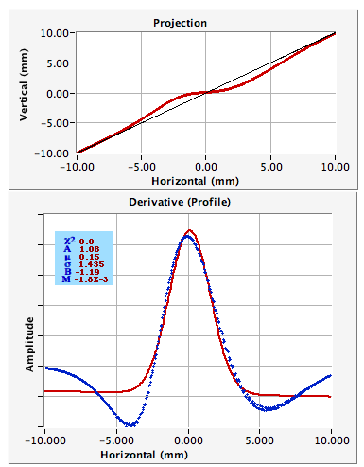
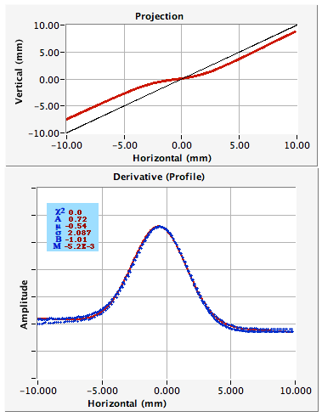
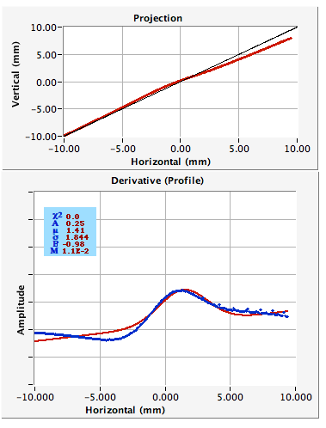
ProjectX ELS
Slanted Scan (duration E≈P)
  Gaussian shaped proton beam: 3ns long, 2mm transverse width
  Electron scan: square pulse (FWHM = 2.35*sigma)
20 nsec long deflected scan
3 nsec long deflected scan
Off-center, 7ns long scan

Slide 10
ProjectX ELS
Repeated pencil beams
Hold pencil beam electrons in same spot while bunch fly by and look at projection extremes of electron bunch
Repeat for different locations
Reconstruct profile from extreme positions
Need enough electrons to make extremes visible
t=0
Protons at t=0
electrons
t=t₁
Protons at t=t₁
Y
S
X

Slide 11
ProjectX ELS
Repeated pencil beams
Hold pencil beam electrons in same spot while bunch fly by and look at projection extremes of electron bunch
Repeat for different locations
Reconstruct profile from extreme positions
Need enough electrons to make extremes visible
t=0
Protons at t=0
electrons
t=t₁
Protons at t=t₁
Y
S
X

Slide 12
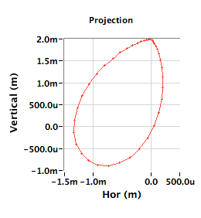
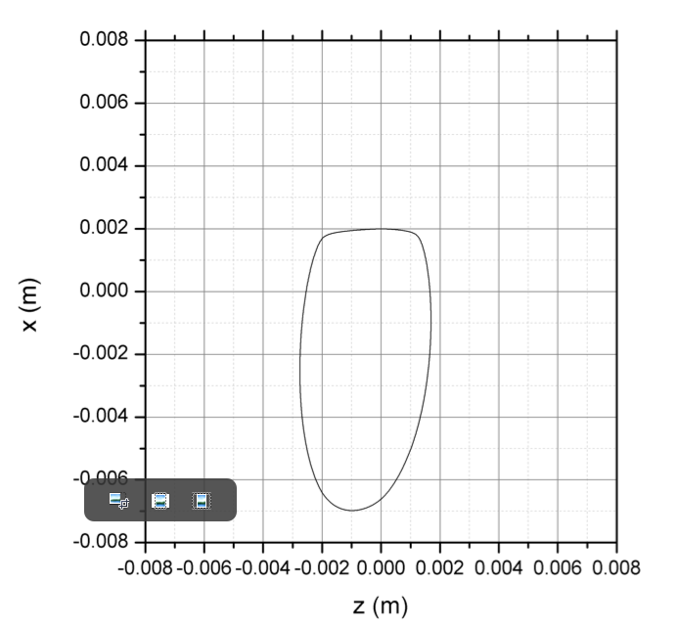
ProjectX ELS
Repeated pencil beams
  Proton beam passing by continuous electron beam
Elliptical Proton beam with 3 ns half-length and 2*10^11 particles. Offset pencil beam 2mm
Gaussian shaped proton beam 1ns long, 2mm transverse sigma, 2*10^11 particles. Offset pencil beam 2mm.

Slide 13
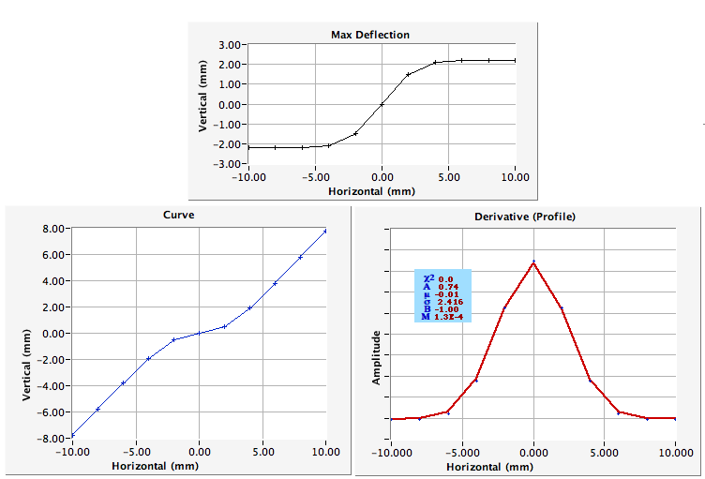
ProjectX ELS
Repeated pencil beams
- Sequence of pencil beam at different offsets
Preliminary results of repeated pencil beams

Slide 14
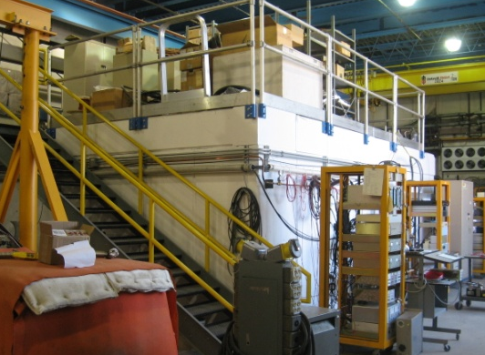
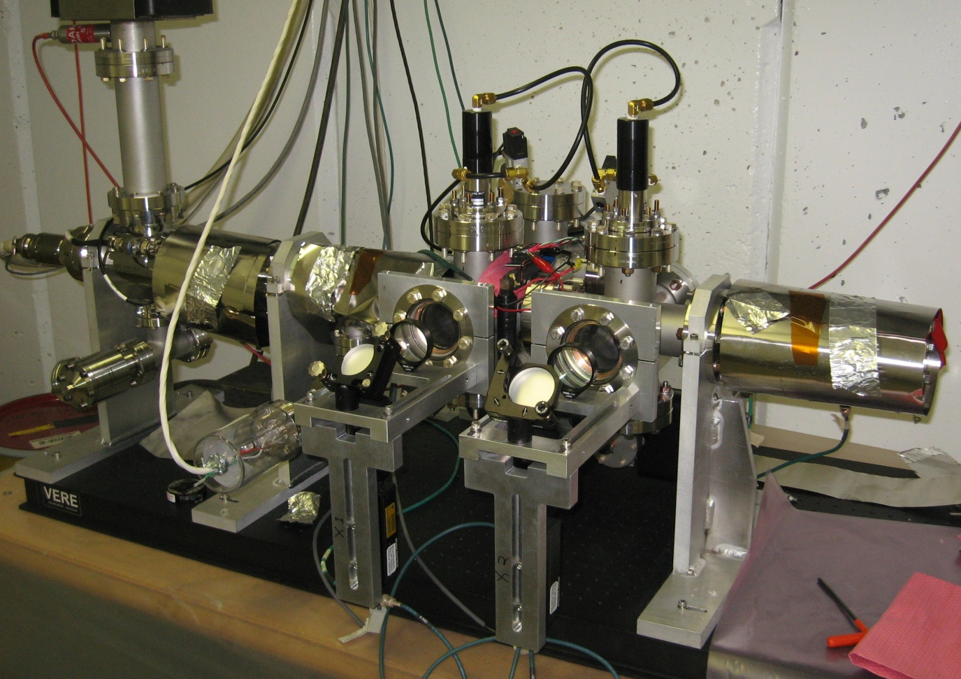
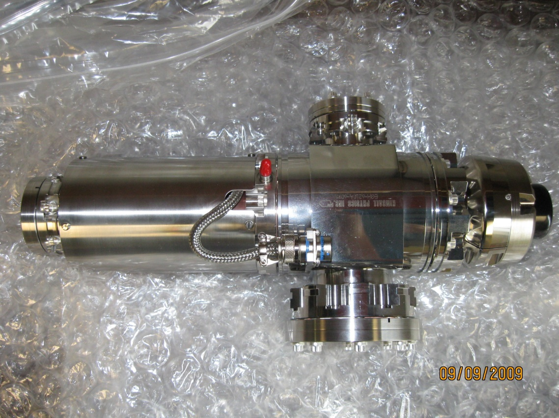
Test Setup at NWA (R. Thurman-Keup. Fermilab)
Actuators
Electron Gun
EGH-6210
Gun Solenoid
Cave at NWA
X1
X2
Gun Parameters
Energy: 1 – 60 keV
Current: 10 μA – 6 mA
Spot size: 50 μm – 10 mm
Gateable: 2 μs – DC; 5 kHz max rate
Firewire Cameras
Faraday Cup / Dump

Slide 15
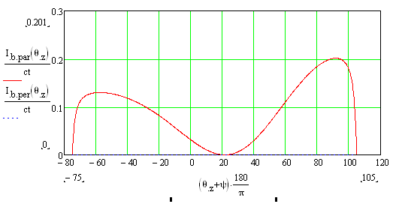
Spot Size Measurements
Determine beam size at “detector” with e beam waist at proton beam
Measure profiles using two screens with 60 KeV beam (200 mm btwn screens)
  First set of measurements was Ce:YAG powder scintillator on Al substrate
    Beam was 40 μs pulse of 1 μA
    Screens oriented at 45 deg from beam direction
  Second set of measurements was OTR from 1 mm thick polished stainless steel
    Beam was train of 80 pulses each 40 μs long and 1000 μA (except below right)
    Screens oriented at 15-18 deg from beam direction (below left)
OTR angular distribution
from 60 KeV electrons
Early OTR attempts with 1 mA beam 2 ms long
Damaged stainless steel
Camera
Aperture
Light intensity
during pulse
(Blackbody)

Slide 16
Spot Size Measurements
Gun has internal solenoid
  Scanned beam through waist
  at screen X1
Scanned beam sizes from Ce:YAG screens (1 μA beam)
Scanned beam sizes from OTR screens
(1 mA beam)
X2 minimum is smaller than X1??
Possibly due to not being quite in focus.

Slide 17
Next Step(s)
Simulate proton beam with stretched wires
  Test static deflection first
HINS???
  Dramatically different beam
  But, possibly study slow sweep behavior
Develop fast deflector (100ps?… see next bullet)
Consider systematics of Main Injector measurement
  For given proton beam sizes, just how good is the resolution given the measured parameters of this gun?
  How fast does the sweep need to be to achieve a given resolution?
  Longitudinal proton distribution not necessarily gaussian-like
    Variation of charge density over a fast sweep distorts the sweep pattern

Slide 18
ProjectX ELS
Summary
When using the deflection of electrons mechanism, the duration of the scan must be smaller than the duration of the bunch.
Ribbon beam approach seems possible but brightness of image needs to be verified.
Pencil beam is promising but better simulation is needed (e.g. include beampipe)
Electron scan duration << proton bunch duration is best option but requires development of fast scan hardware and sensitive imager

Slide 19
ProjectX ELS
Direction
Hardware Options :
  Apply existing electron gun at Fermi using pencil beam
  Develop fast scan mechanism
  Develop sensitive imager (MCP, repeated exposures)
Software Options:
  Further develop simulations

